Slide 1
Exploiting the New Frontier of Gravitational-Wave Astronomy
Fred Raab, for the LIGO Scientific Collaboration and the Virgo Collaboration
Fred Raab, for the LIGO Scientific Collaboration and the Virgo Collaboration

Slide 2
Basics of Gravitational-Waves

Slide 3
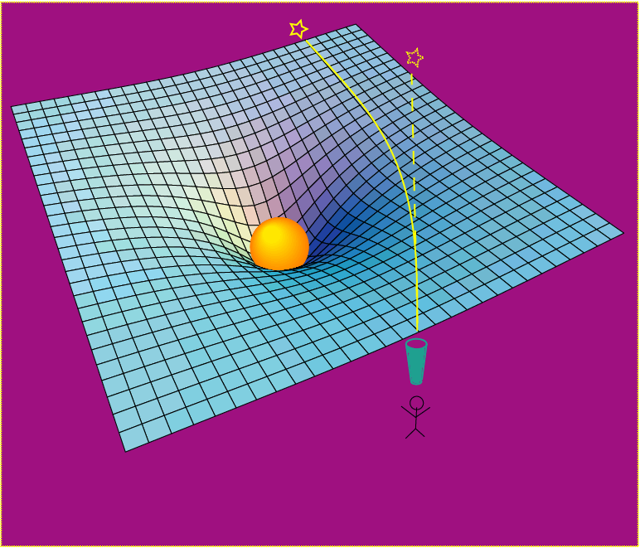
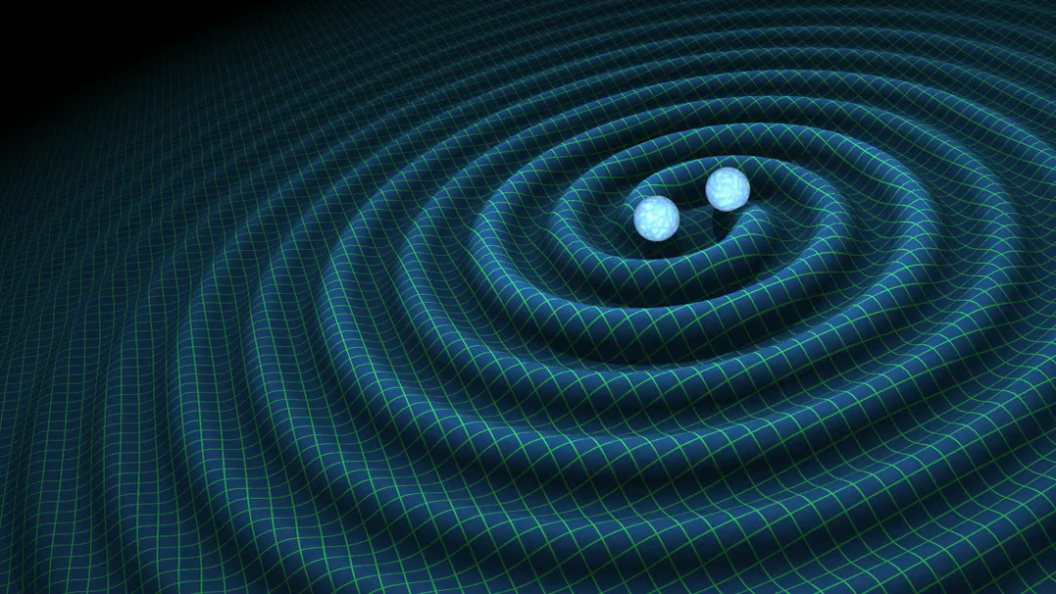
Einstein’s General Relativity:
gravity is a manifestation of space-time curvature
curved spacetime can bend light, too!
dynamic deformation of spacetime
Credit: R. Hurt - Caltech / JPL:
A massive object shifts apparent position of a star
Space has a shape, a stiffness and a maximum speed for information transfer.

Slide 4
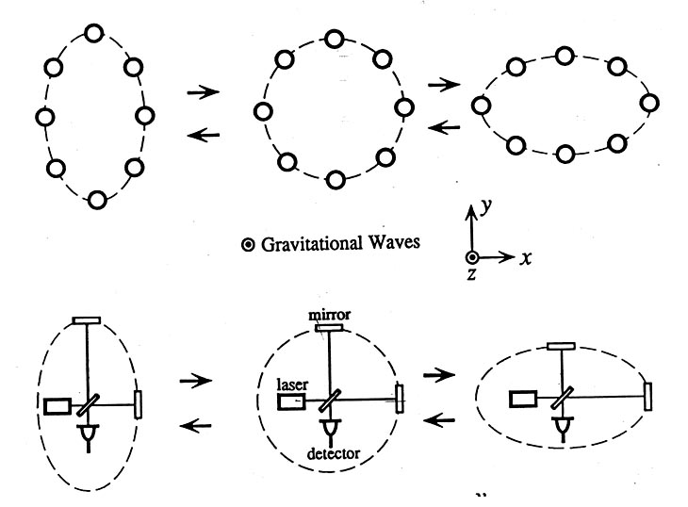
Basic idea for detection is simple
GW amplitude h = (R_{x}-R_{y})/R
Spatial asymmetry induces relative phase shifts on light in arms

Slide 5
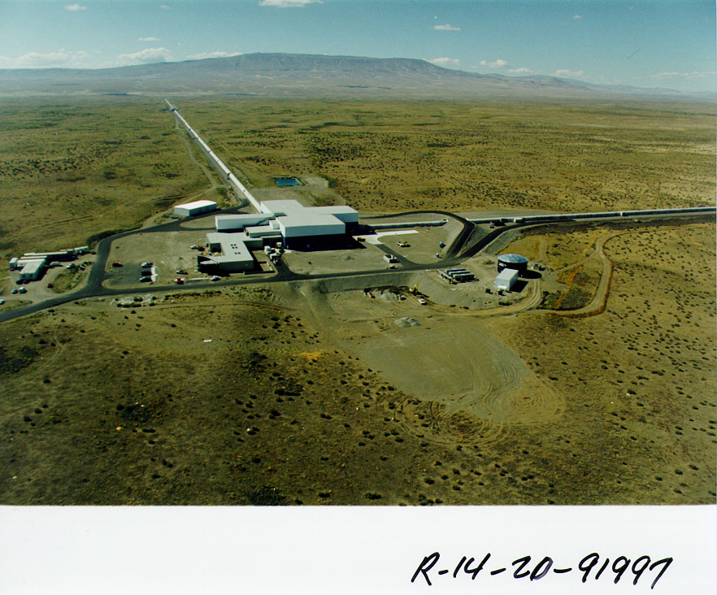
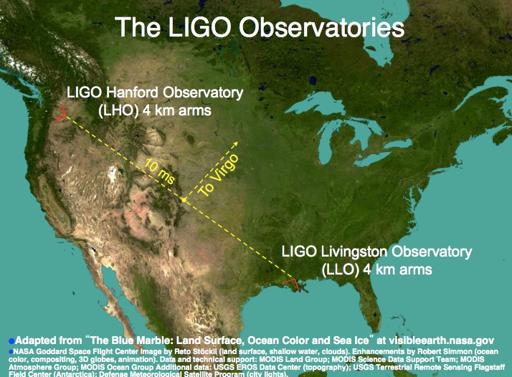

The Laser Interferometer Gravitational-wave Observatory
LHO
LLO
Livingston, LA

Slide 6
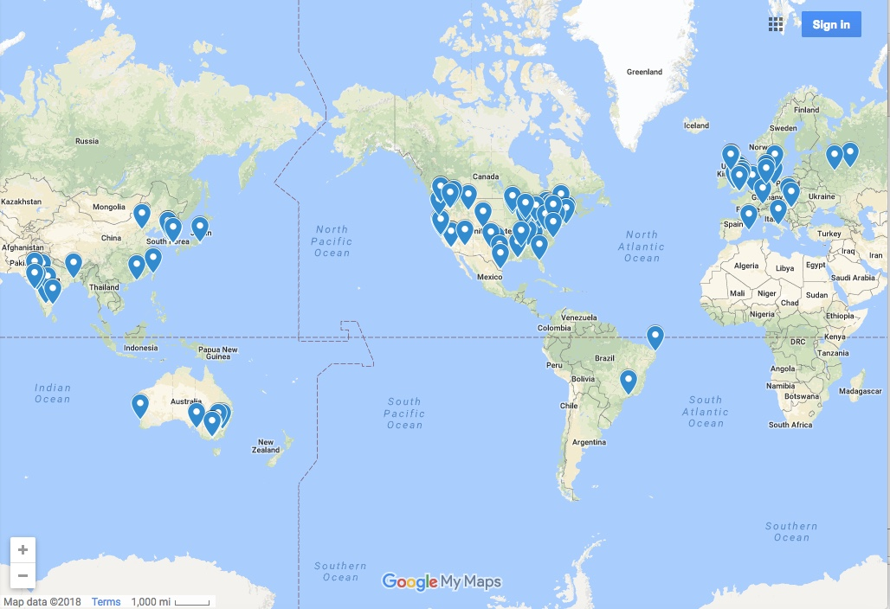
The Laser Interferometer Gravitational-wave Observatory
LHO
LSC Institutions
LLO
Livingston, LA

Slide 7
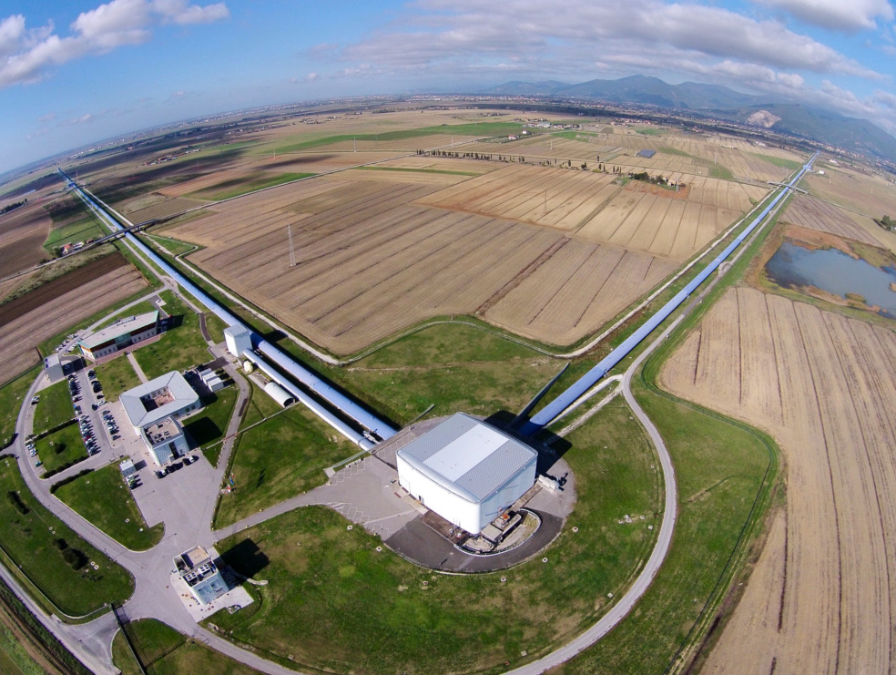
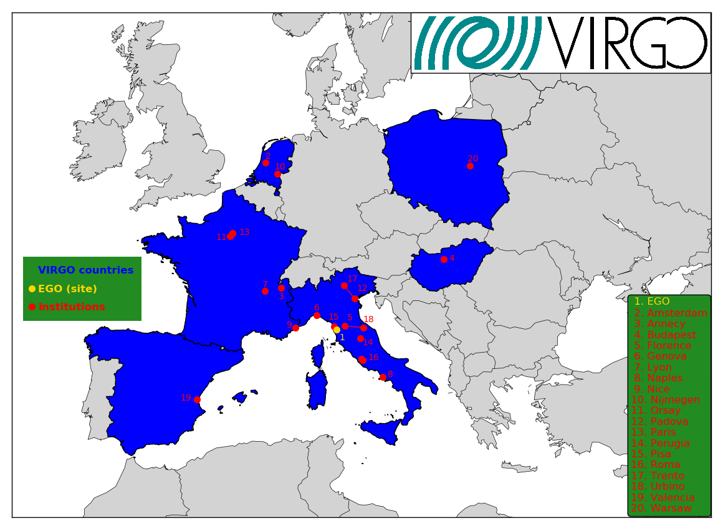

VIRGO
A collaboration made up of 20 laboratories in 6 european countries,
involving more than 280 physicists and engineers
Cascina (Pisa), Italy

Slide 8
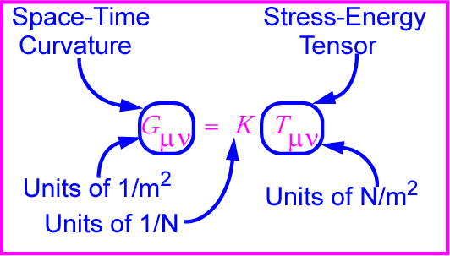
Gravitational waves: hard to find because space-time is stiff!
Following I.R. Kenyon, General Relativity
K~[G/c⁴] is combination of G and c with units of 1/N
K ~ 10⁻⁴⁴ N⁻¹
⇒ Wave can carry huge energy with miniscule amplitude!

Slide 9

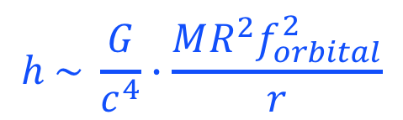
Expected strength
Sense of scale: strain from a binary neutron star pair
  M = 1.4 M,
  r = 10²³ m (15 Mpc, Virgo),
  R = 20 km
  f_{orb} = 400 Hz
$$h \sim \frac{G}{c^{4}}∙\frac{MR^{2}f_{orbital}^{2}}{r}$$
$$h\sim {10}^{−21}$$

Slide 10
Breakthroughs

Slide 11
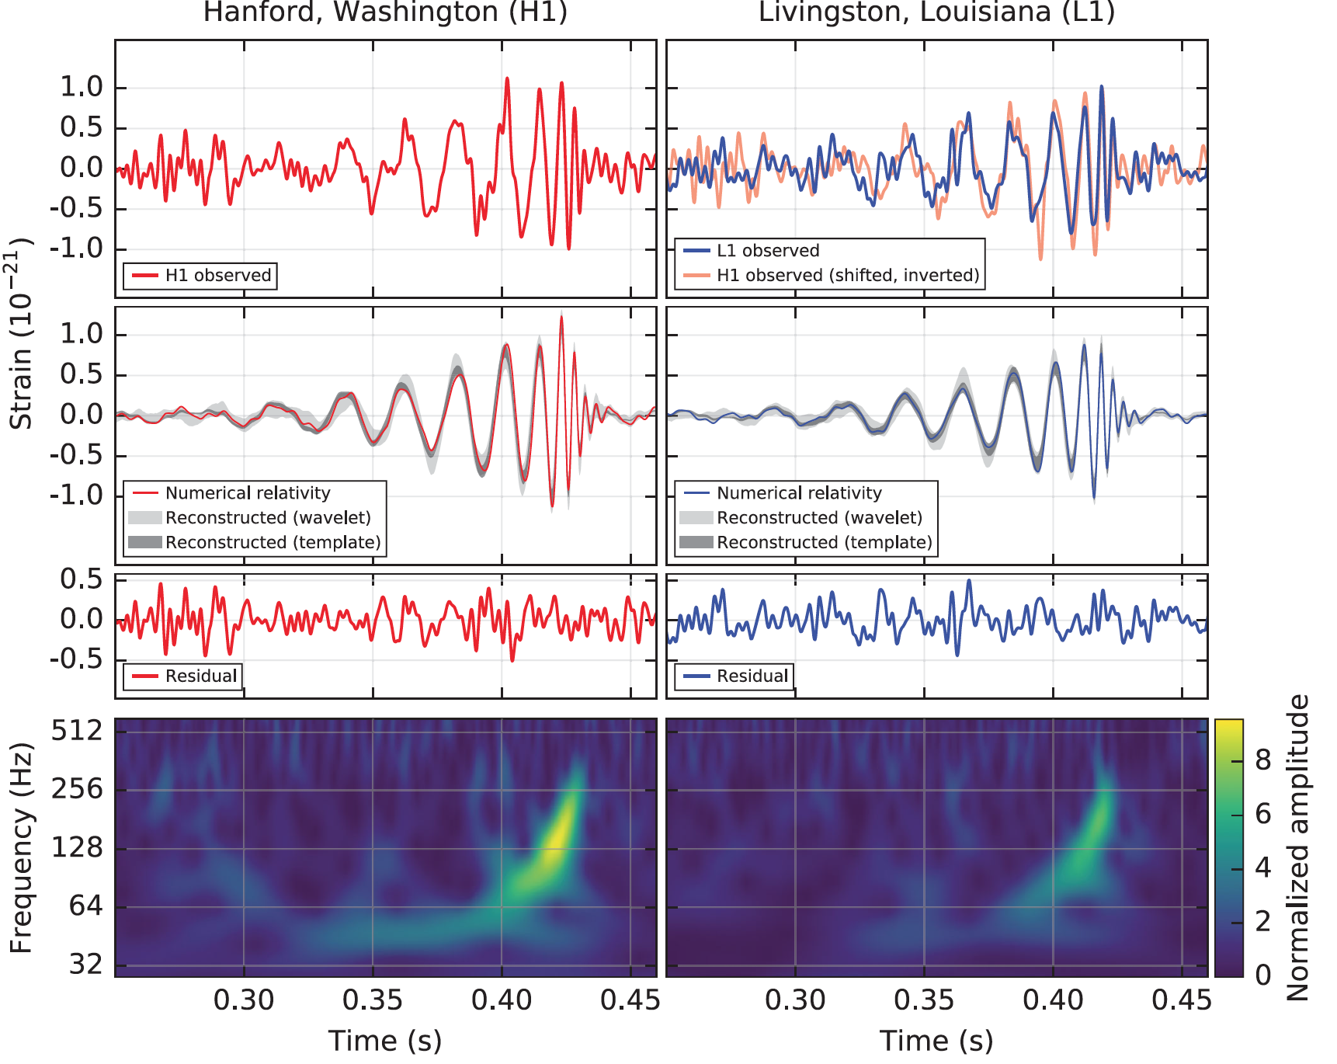
B. P. Abbott et al. (LIGO Scientific Collaboration and Virgo Collaboration), Observation of Gravitational Waves from a Binary Black Hole Merger, Phys. Rev. Lett. 116, 061102 (2016)
Notes:
The spectrum pointed immediately to large black holes.

Slide 12
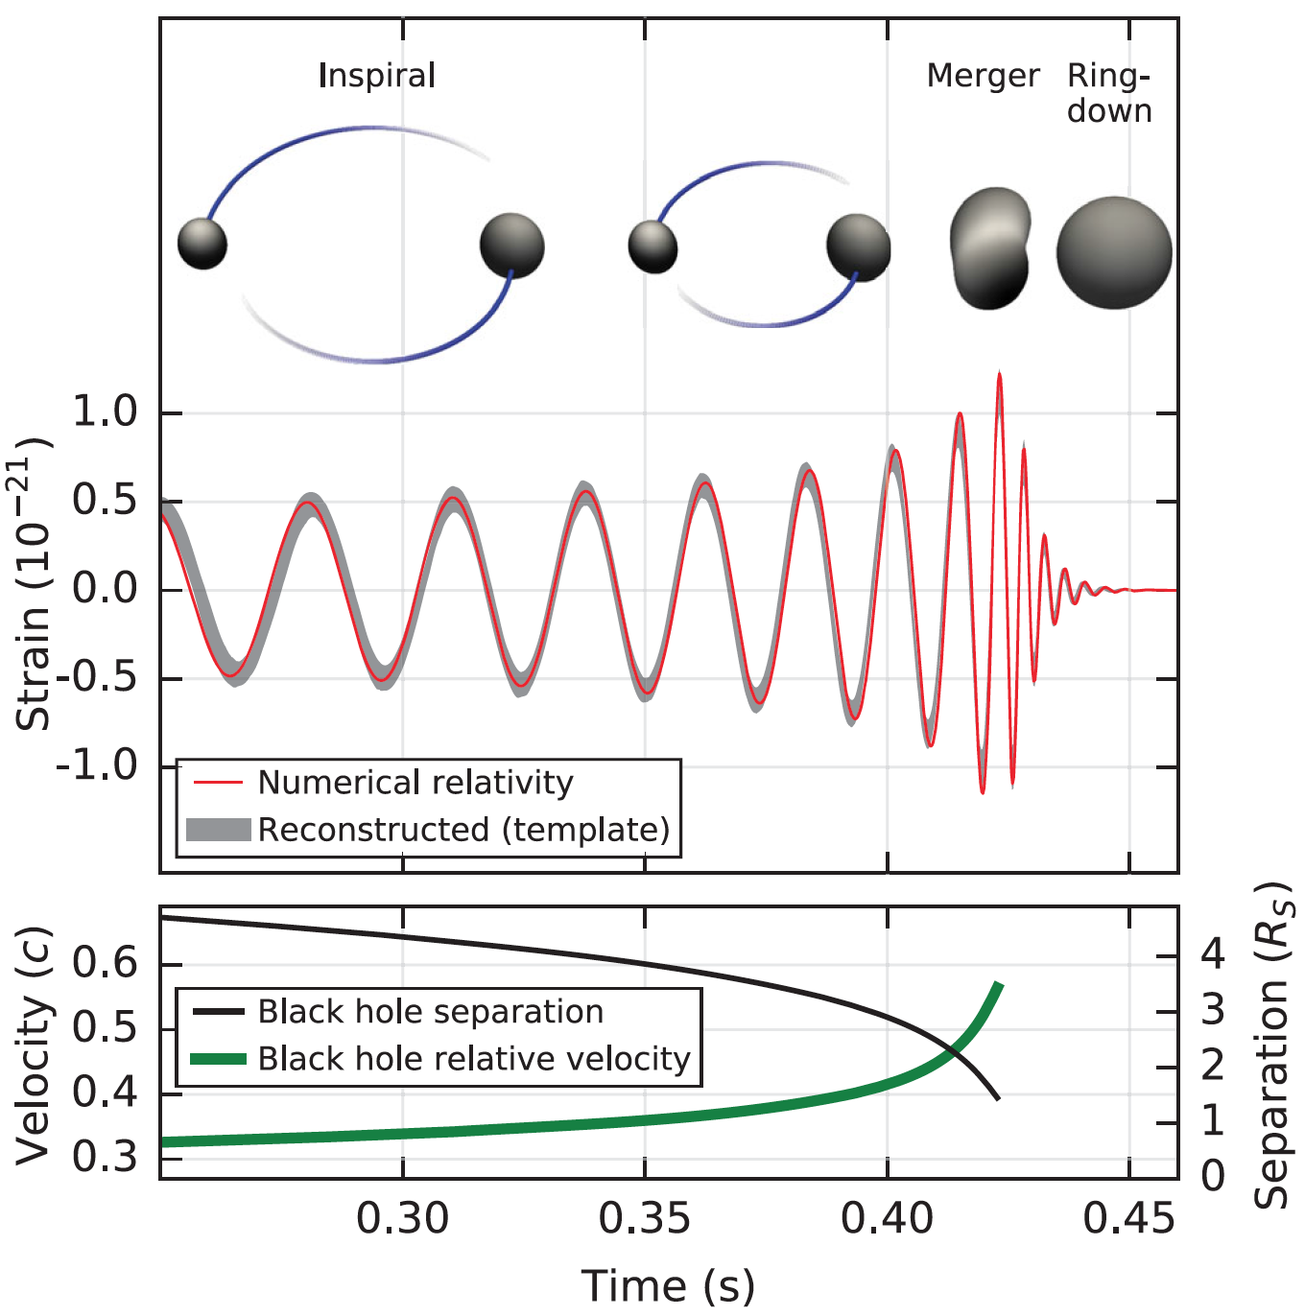
What can we learn from h(t)?
Phase evolution gives chirp mass and aligned components of spin
Amplitude scale factor gives luminosity distance (standard siren)
B. P. Abbott et al. (LIGO Scientific Collaboration and Virgo Collaboration), Observation of Gravitational Waves from a Binary Black Hole Merger, Phys. Rev. Lett. 116, 061102 (2016)
Ringdown frequency and Q
give mass and spin
of final black hole
Modulation of amplitude gives nonaligned spin components
Highest frequency gives sizes of objects just before merger.

Slide 13
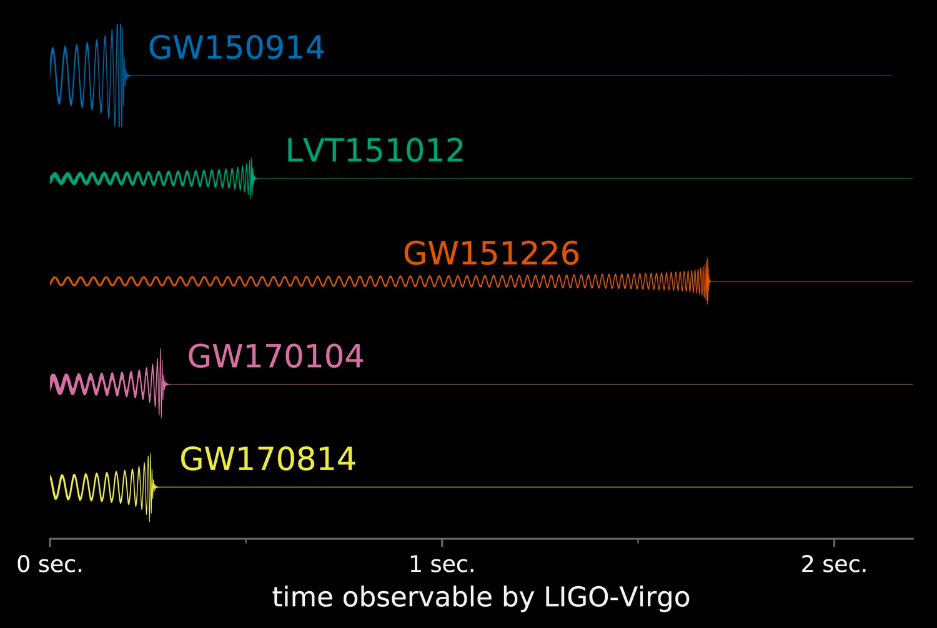
Comparison of GW Waveforms from BBHs (Sep 2017)
LIGO/Caltech/MIT/LSC

Slide 14
These first observations of dynamic extreme spacetimes with BBHs show us that GR is reasonably accurate in this regime and can be used as a tool for examining and interpreting extreme states of matter.
There are a rich collection of sources still to be examined!

Slide 15
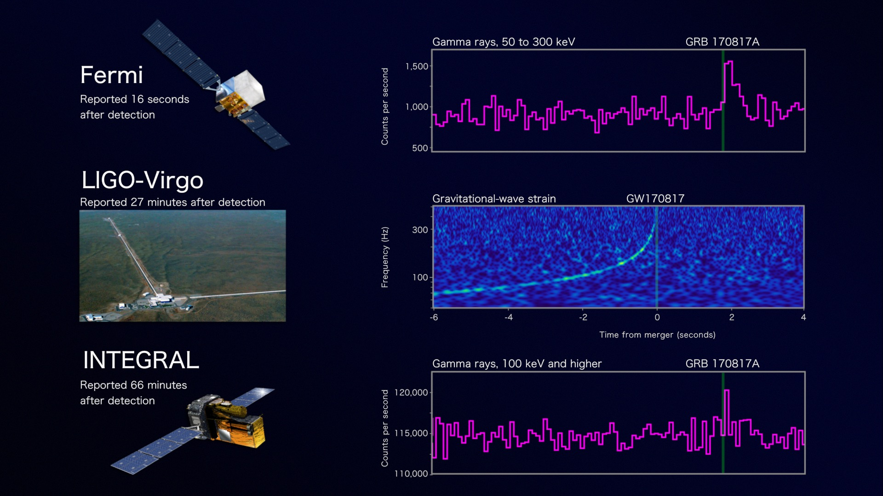
Onto the study of the most extreme states of matter
Credit: NASA's Goddard Space Flight Center, Caltech/MIT/LIGO Lab and ESA

Slide 16
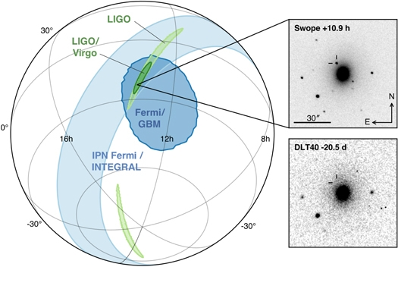
LIGO-Virgo network localization enables discovery of optical counterpart
Figure 1 from Multi-messenger Observations of a Binary Neutron Star Merger
B. P. Abbott et al. 2017 ApJL 848 L12 doi:10.3847/2041-8213/aa91c9

Slide 17
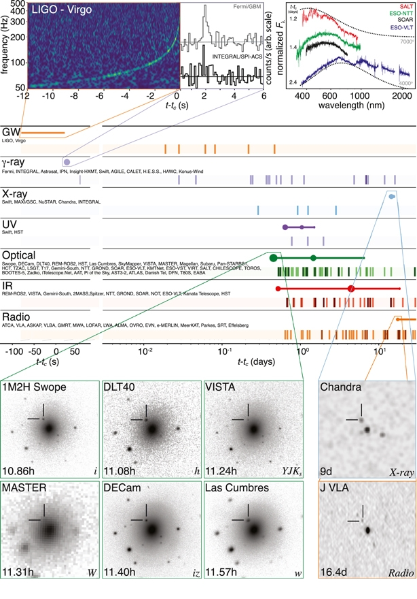
Figure 2 from Multi-messenger Observations of a Binary Neutron Star Merger
B. P. Abbott et al. 2017 ApJL 848 L12 doi:10.3847/2041-8213/aa91c9

Slide 18
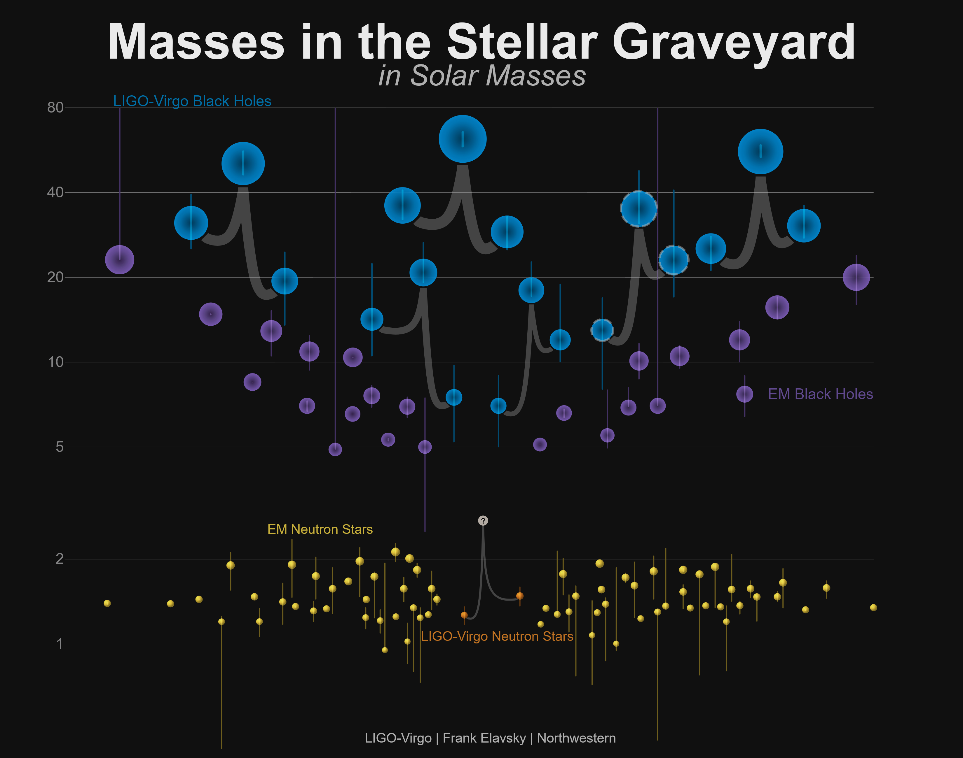
Known Masses of Stellar Remnants – Dec 2017
Non-LIGO Data Sources: Neutron Stars: http://xtreme.as.arizona.edu/NeutronStars/data/pulsar_masses.dat
Black Holes: https://stellarcollapse.org/sites/default/files/table.pdf |
LIGO-Virgo Data: https://losc.ligo.org/events/

Slide 19
The full range of expected sources

Slide 20

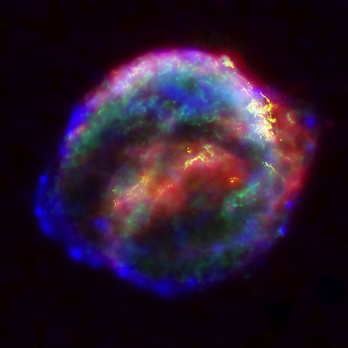

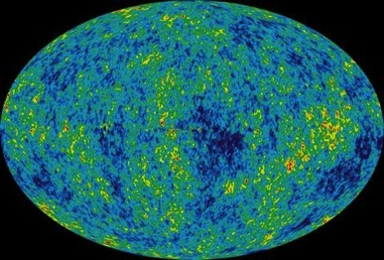
Astrophysical Sources of Gravitational Waves
Coalescing Compact Binary Systems:
Neutron Star-NS, Black Hole-NS, BH-BH
- Strong emitters, well-modeled,
- (effectively) transient
Asymmetric Core Collapse Supernovae
- Weak emitters, not well-modeled (‘bursts’), transient
✓
✓
Credit: Chandra X-ray Observatory
Credit: AEI, CCT, LSU
Cosmic Gravitational-wave Background
- Residue of the Big Bang
- Long duration, stochastic background
Spinning neutron stars
- (nearly) monotonic waveform
- Long duration
NASA/WMAP Science Team
Casey Reed, Penn State
Notes:
LIGO is designed to be an observatory, not a one-off proof that GWs exist. What do we look for?
There are number of predicted astrophysical sources of gravitational radiation, and most of them involve cataclysmic events.
Binary systems – NSs and BHs, most likely source, theoretically well understood with known waveforms
Bursts – GW emissions that are not well modeled or understood. These include asymmetrically core collapse supernova, cosmic strings, and perhaps unknown sources
The residual GW background
Continuously emitting sources such as spinning neutron stars, which have a pure monotone emission.

Slide 21
Frequency-Time
Characteristics of GW Sources
time
Ringdowns
Broadband Background
Bursts
frequency
CW (quasi-periodic)
Chirps
Earth’s orbit
Earth’s rotation
frequency
frequency
time
time

Slide 22
Building Out the Terrestrial Gravitational-Wave Network

Slide 23
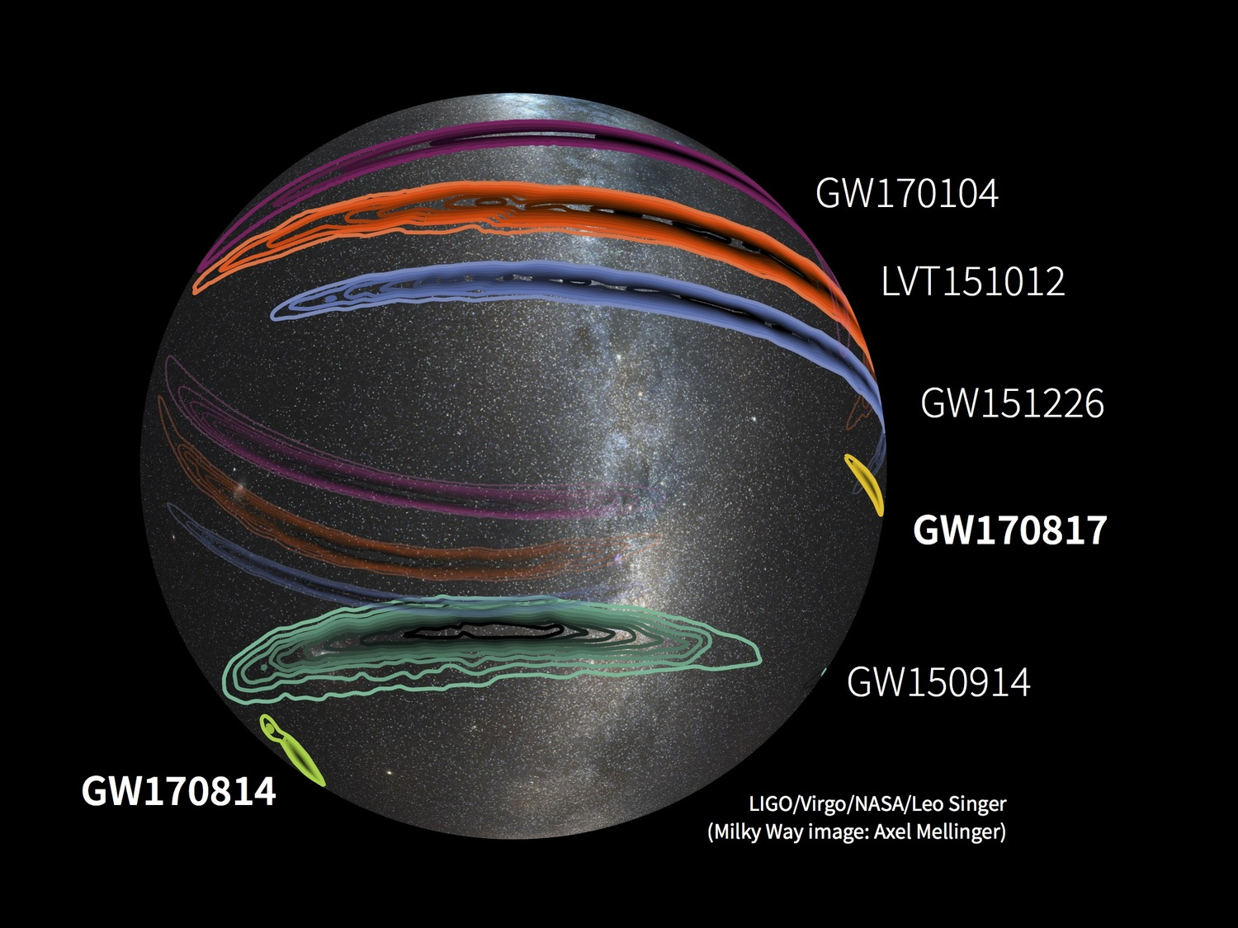
Localization for events - Oct 2017

Slide 24


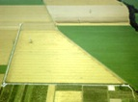

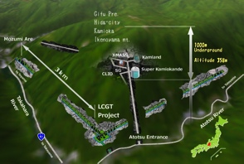



The advanced GW detector network:
2015-2025
Advanced LIGO
Hanford
2015
GEO600 (HF)
2011
KAGRA
2020
Advanced LIGO
Livingston
2015
Advanced
Virgo
2017
LIGO-India
2025
24
24

Slide 25
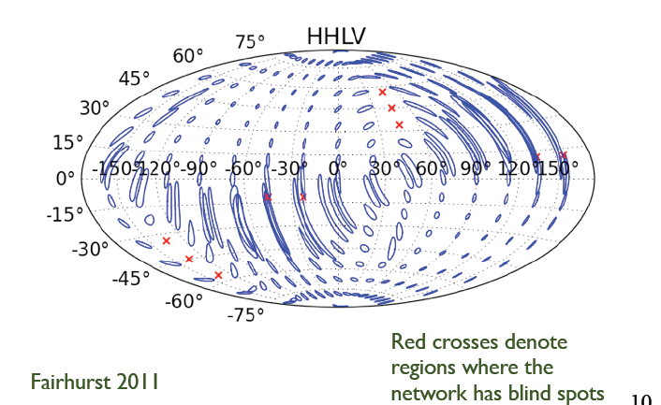
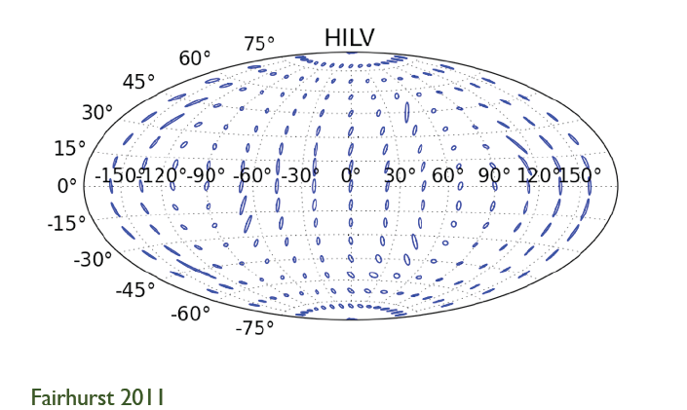
Effect of Adding LIGO-India to the LIGO+Virgo Network
LIGO+Virgo only
With LIGO-India
GW170817 Landed in a Good Region of Sky When 3 Detectors Were Up

Slide 26
Detection rate improves as sensitivity cubed

Slide 27
Sensitivity of Detectors is Determined by Noise and Background
The key to improving detectors is sensitivity which is improved by reducing noise and background.
Range is proportional to sensitivity.
Event rate is proportional to volume, which is proportional to range cubed.
Thus a factor of 2 in sensitivity gives a factor of 8 in event rate (nearly an order of magnitude).

Slide 28
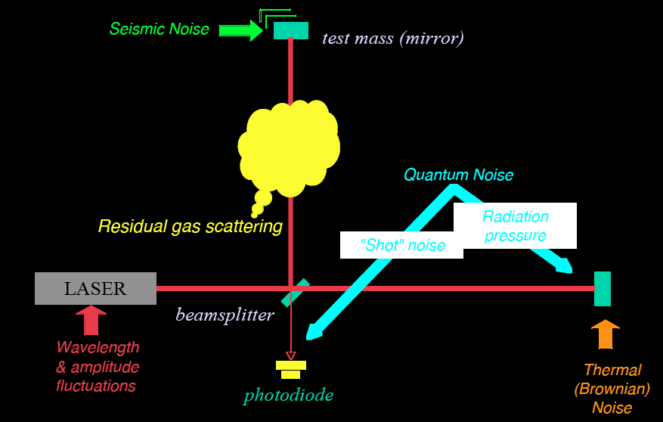
Noise and background cartoon
R. Adhikari
Notes:
Call out seismic/suspension achievements from UW gravity group (Krishna, Jens, Michael Ross) and Detchar/Burst Bayeswave group (Joey Key). Classical back-action effects (John Sidles)

Slide 29

Optical configuration
Complete detector description in Class. Quantum Grav. 32 (2015) 074001
Notes:
Complexity: 15,000 drawings, more than 10^5 data channels, a million named parts.

Slide 30
The next step: O3

Slide 31
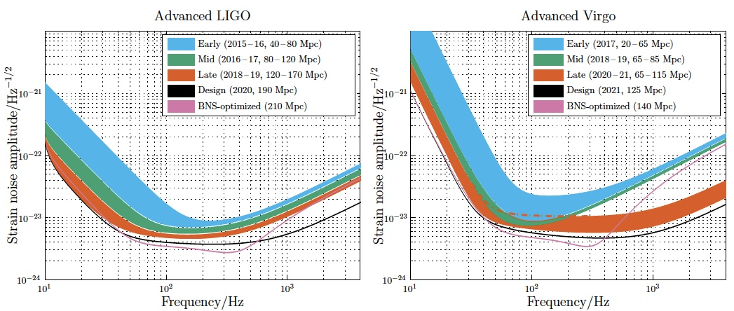
LIGO-Virgo Observing Scenario (arXiv:1304.0670)
Journal reference: Living Reviews in Relativity; 21:3; 2018
DOI: 10.1007/s41114-018-0012-9

Slide 32
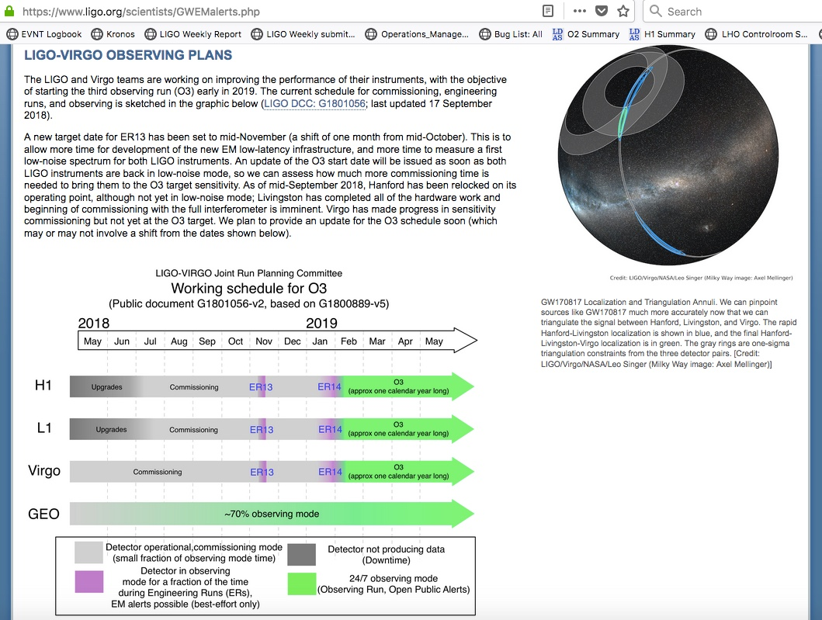
Working schedule for next observing run (O3)

Slide 33
Open Public Alerts (OPAs) begin in O3
Starting with O3 the LIGO and Virgo Collaborations will release open public alerts (OPAs) for all transient event candidates in which we have reasonable confidence and we consider likely to be real
For compact binary coalescences we aim an overall astrophysical purity of 90% which will translate to a false alarm rate threshold of 1/month – 1/year. For unmodeled transient events, this threshold will probably be in the 1/10years – 1/100years range
We aim to have preliminary, fully automated alerts (not vetted by humans) sent out within 5min from data collection via GCN Notices
Human vetting is expected to take place within 4 hours from data collection, following which another GCN Notice and Circular will be issued; depending on the human vetting, such GCN Notice/Circular may be a retraction one
Event profile/information will be very much like the one during O2: search and source type (unmodeled, BNS, NSBH, BBH), significance (false alarm rate), 3D localization (with added error ellipses and multi-resolution option), “EM bright” classification, p_astro estimation

Slide 34
The longer term

Slide 35
Science drives Requirements
Stellar Evolution at High Red-Shift: Black Holes from the first stars (Population III)
  Reach z > ~10
  At least moderate GW luminosity distance precision
Independent Cosmology and the Dark Energy Equation of State
  Needs precision GW luminosity distance and localization for EM follow-ups (for redshift)
Checking GR in extreme regime
  High SNR needed
  GW luminosity distance and localization not essential

Slide 36
Advanced LIGO upgrade path
Advanced LIGO is limited by
quantum noise & coating thermal noise
Squeezed vacuum can reduce quantum noise
Options for thermal noise:
  Better coatings
  Cryogenic operation
  Longer arms (new facility)

Slide 37
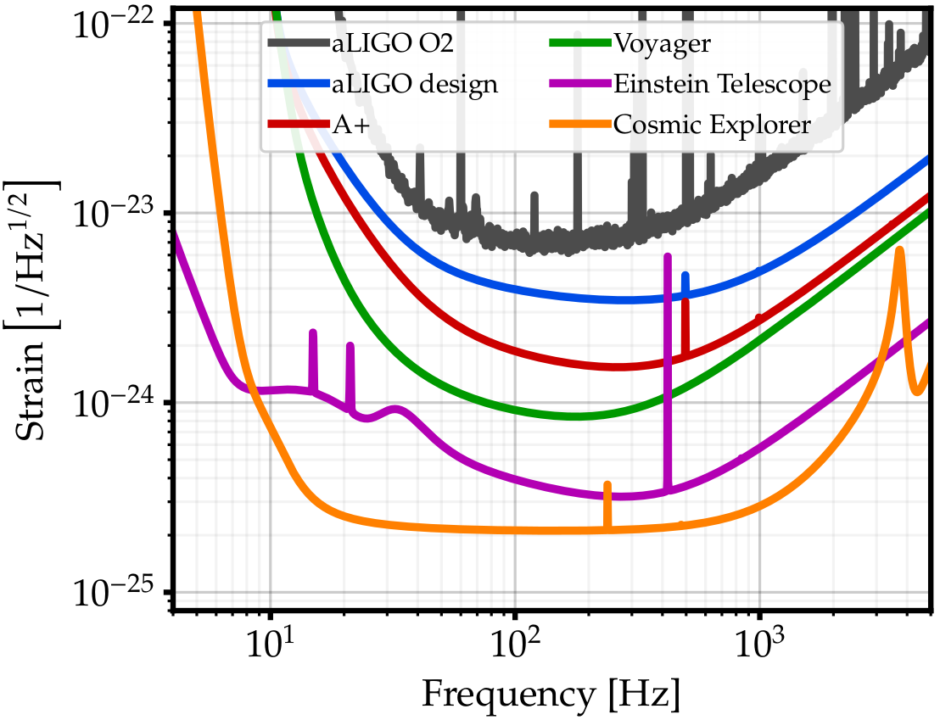
Upgrade possibilities
Exploring the sensitivity of next generation gravitational wave detectors (2017) CQG 34, 044001; www.et-gw.eu
Notes:
Adapted from Lisa Barsotti’s DAWN-IV presentation.

Slide 38
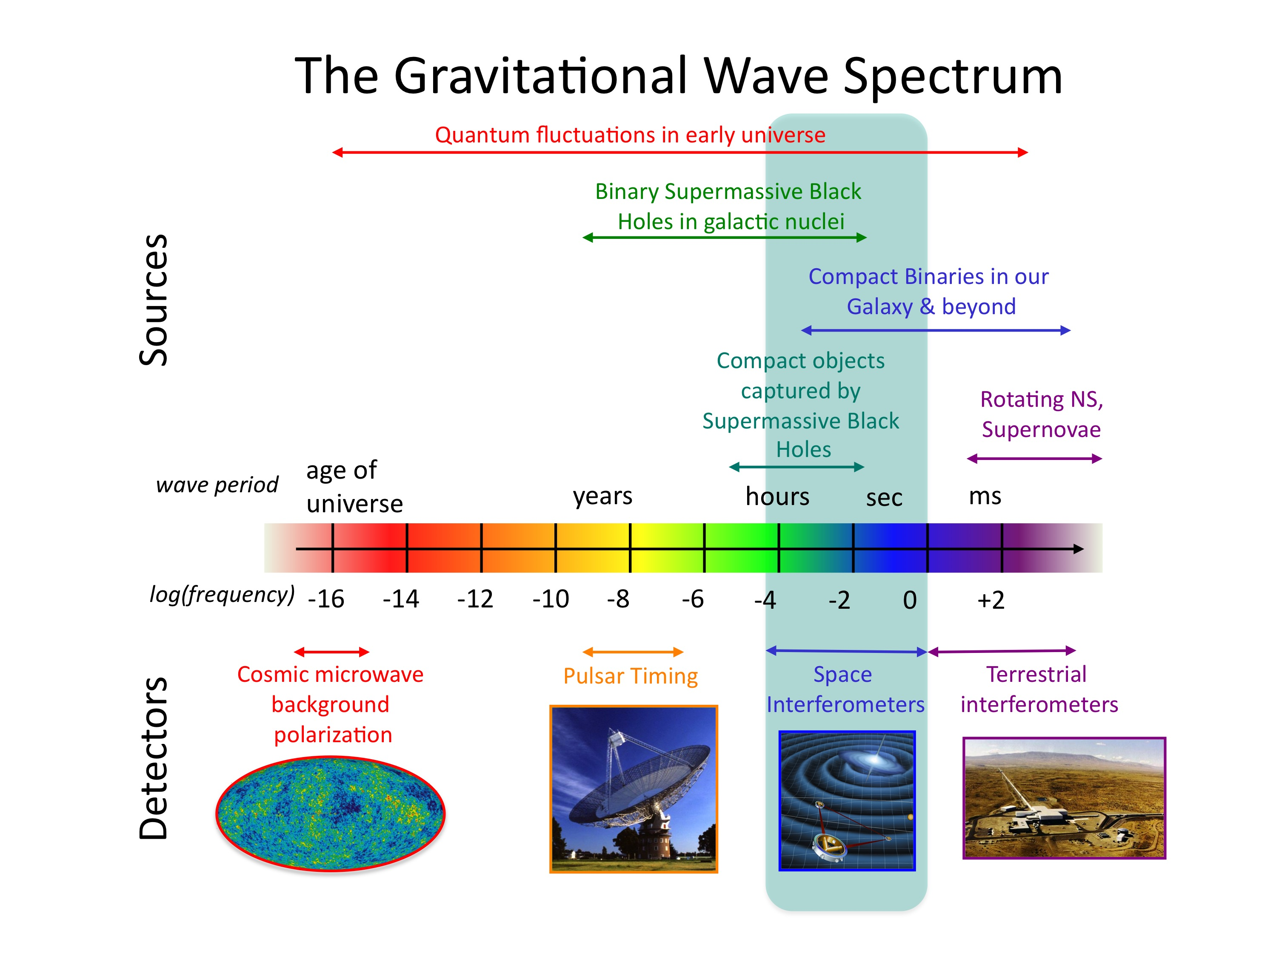
Credit: NASA

