Slide 1

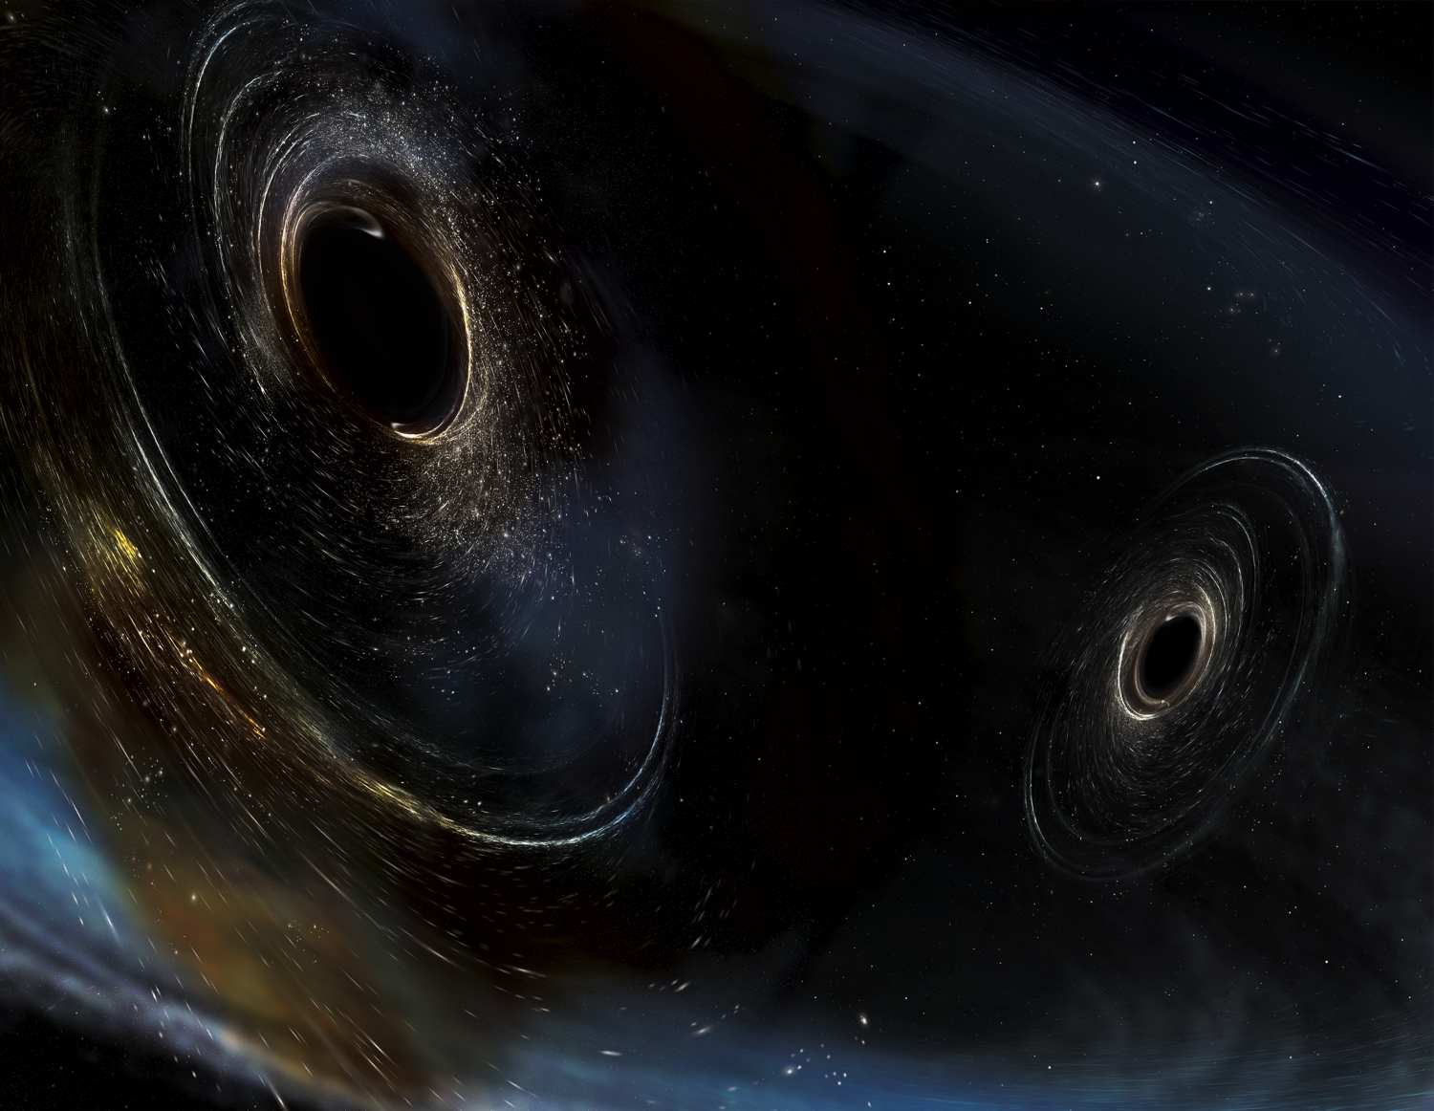




The LIGO 4km Vacuum System: Design, Construction, Features & Faults
Image Credit: Aurore Simmonet/SSU
Mike Zucker, LIGO Caltech & MIT
NSF Workshop on Large UHV Systems for Frontier Scientific Research LIGO Livingston Observatory
29-31 January, 2019
LIGO-G1900137

Slide 2
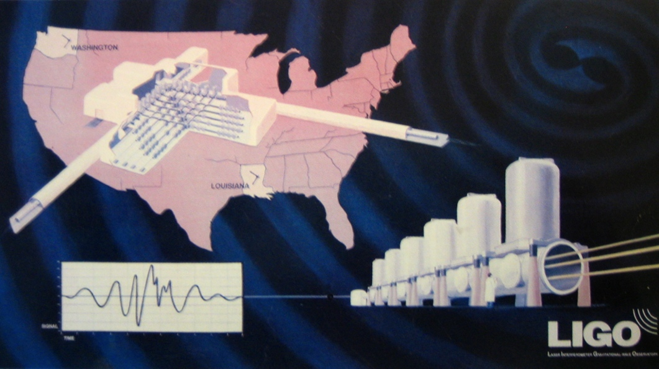
30 years ago…

Slide 3
Topics
Vacuum Equipment vs. Beamtubes
VE construction
Tube construction & Bakeout
Performance
Gotchas & Lessons Learned

Slide 4
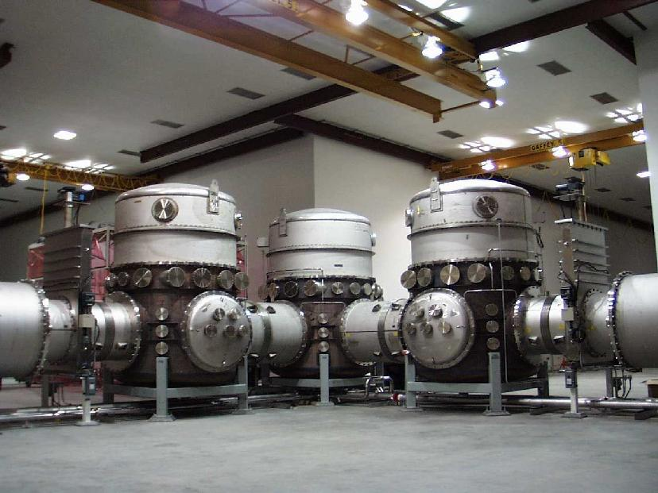

LIGO is Really Two Vacuum Systems (at each site)
Vacuum Equipment
Chambers, pumps, instruments-
“Vacuum Equipment”
  Houses detector apparatus
  Isolation (valves), access (doors)
  Electrical, mechanical, optical penetrations/interfaces
  Pumping & instrumentation
  Somewhat “conventional”
  F:A ~ 10⁻² ls⁻¹cm⁻²
Beam tubes
  Just a long hole in the air;
      Never to be vented
  Highly “unconventional”
    10 million liters (per site)
    300 million cm² (per site)
    200 l/s char. conductance
  F:A ~ 10⁻⁵ ls⁻¹cm⁻²

Slide 5
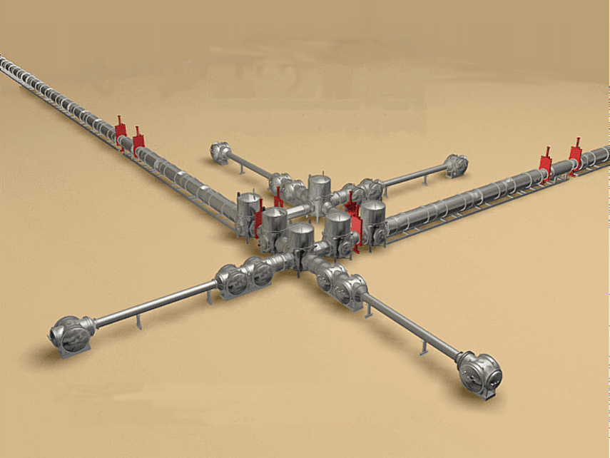
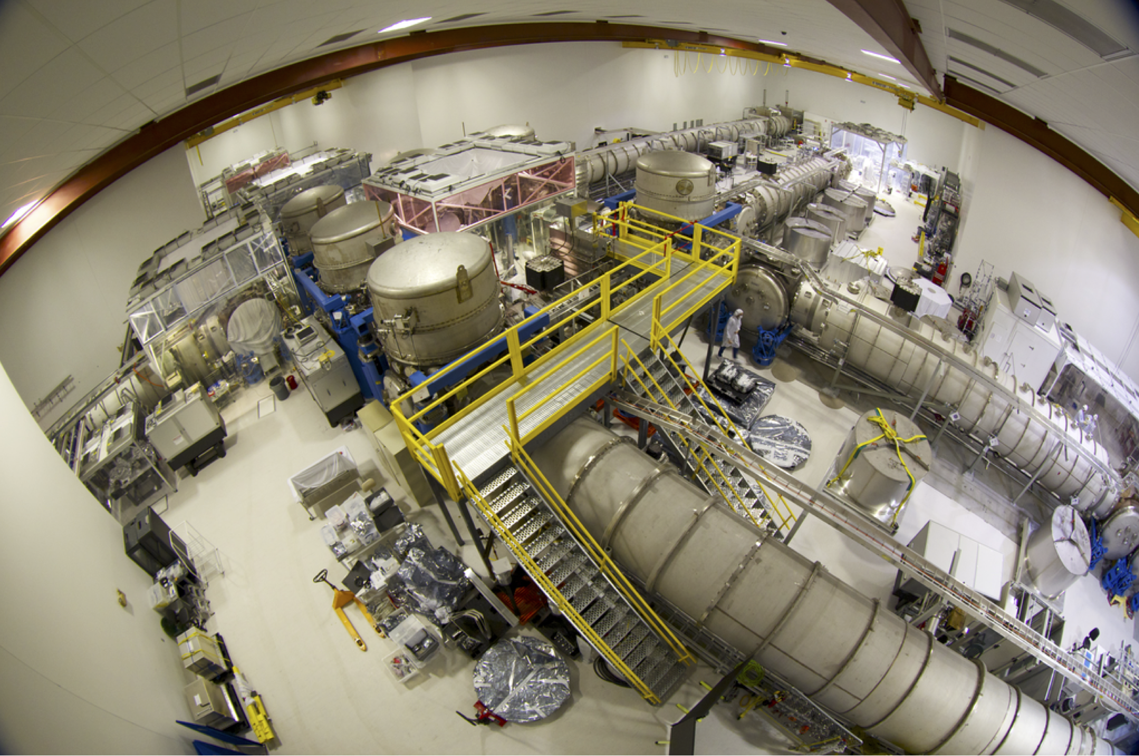
LIGO Vacuum Equipment, LHO Corner Station

Slide 6
Modular Vacuum Equipment Design
Corner station (Hanford)
50 m
50 m

Slide 7
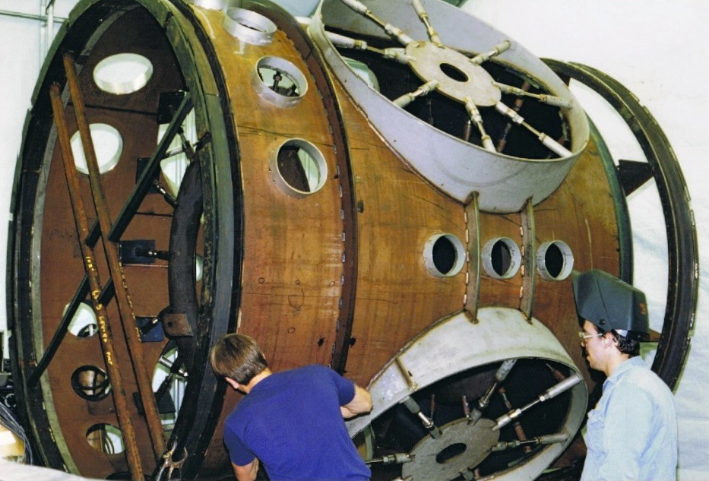
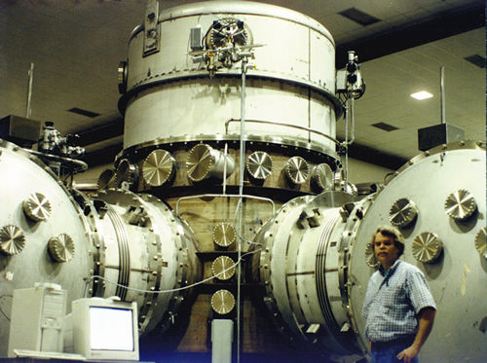
BSC chamber
(Boring Symmetric Chamber)
2.8m Ø x 5.5m h
Upper third removable dome
Thin (10-15mm) 304L SS shell with welded stiffeners, F&D heads
Combination of GTAW and plasma welding
Ports < 35cm Ø: ConFlatTM
Ports > 35cm Ø: Dual O-ring
  Treated Viton elastomer
  Isolated pumped annulus between inner and outer seal
  Permeation and damage tolerant

Slide 8
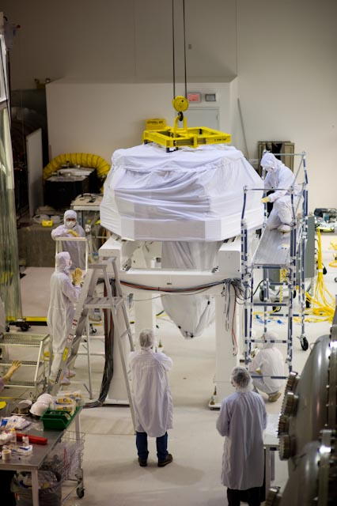
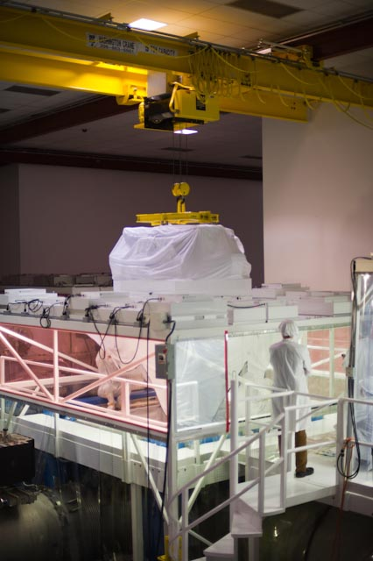
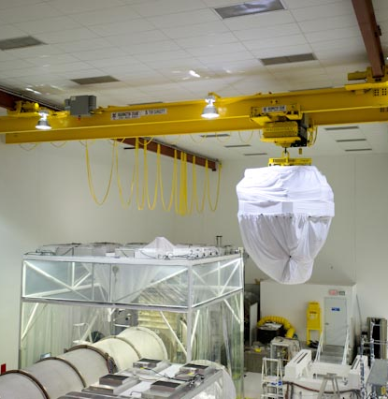
BSC Equipment Installation

Slide 9
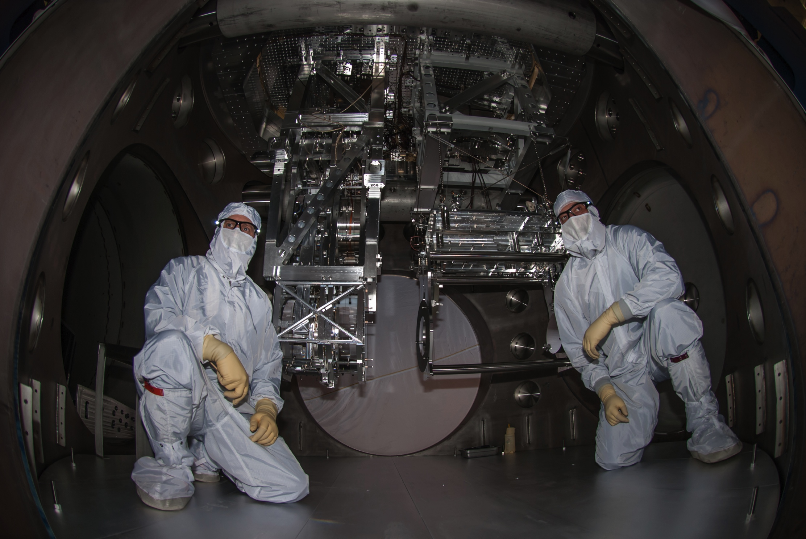
Livingston ETM Y BSC “Cartridge” Installation
21 Feb ‘14

Slide 10
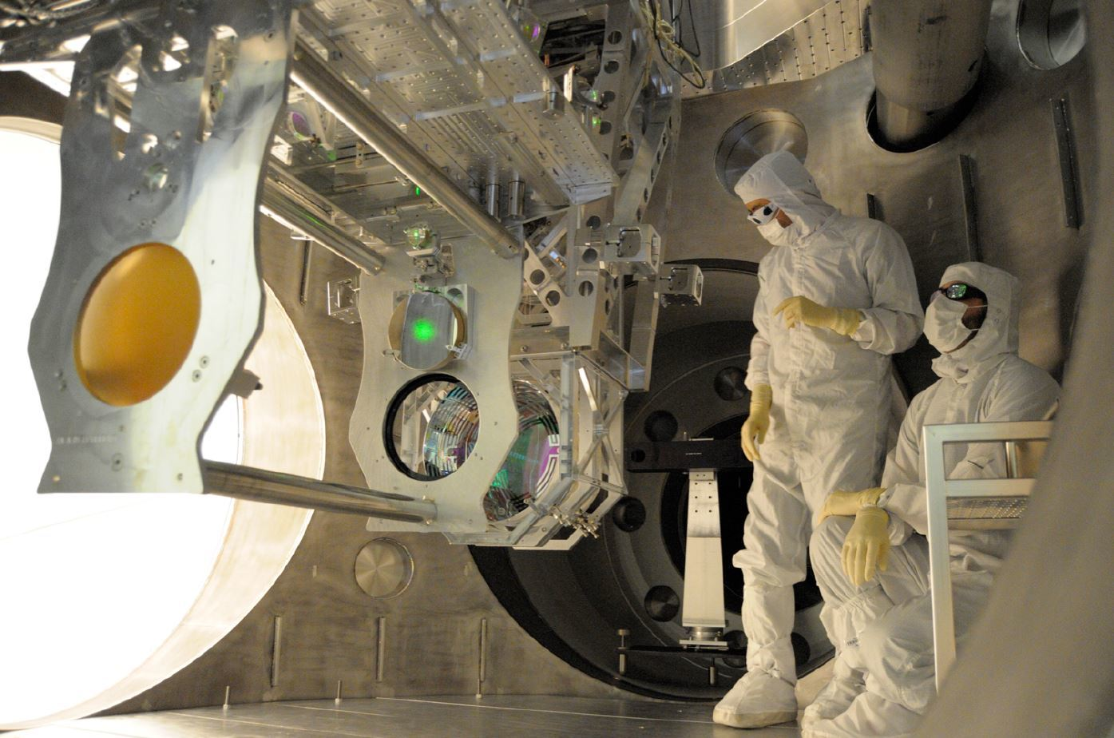

Slide 11
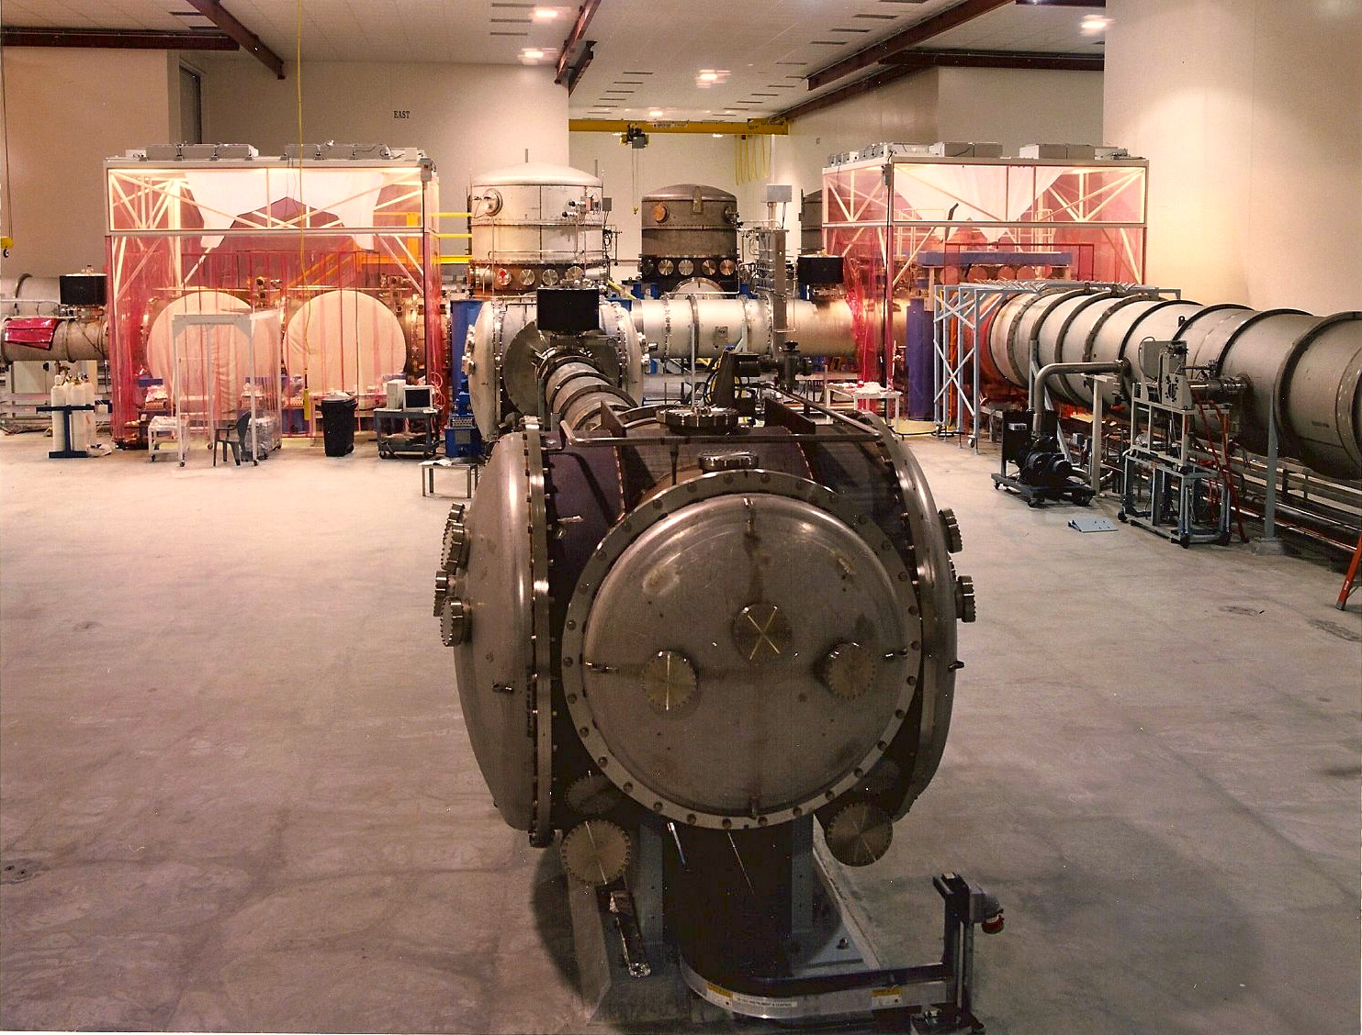
HAM chamber
(Horizontal -Axis Module)
House complex input/output optics
2.1m Ø x 2m w
More than 70% of area is removable access doors

Slide 12
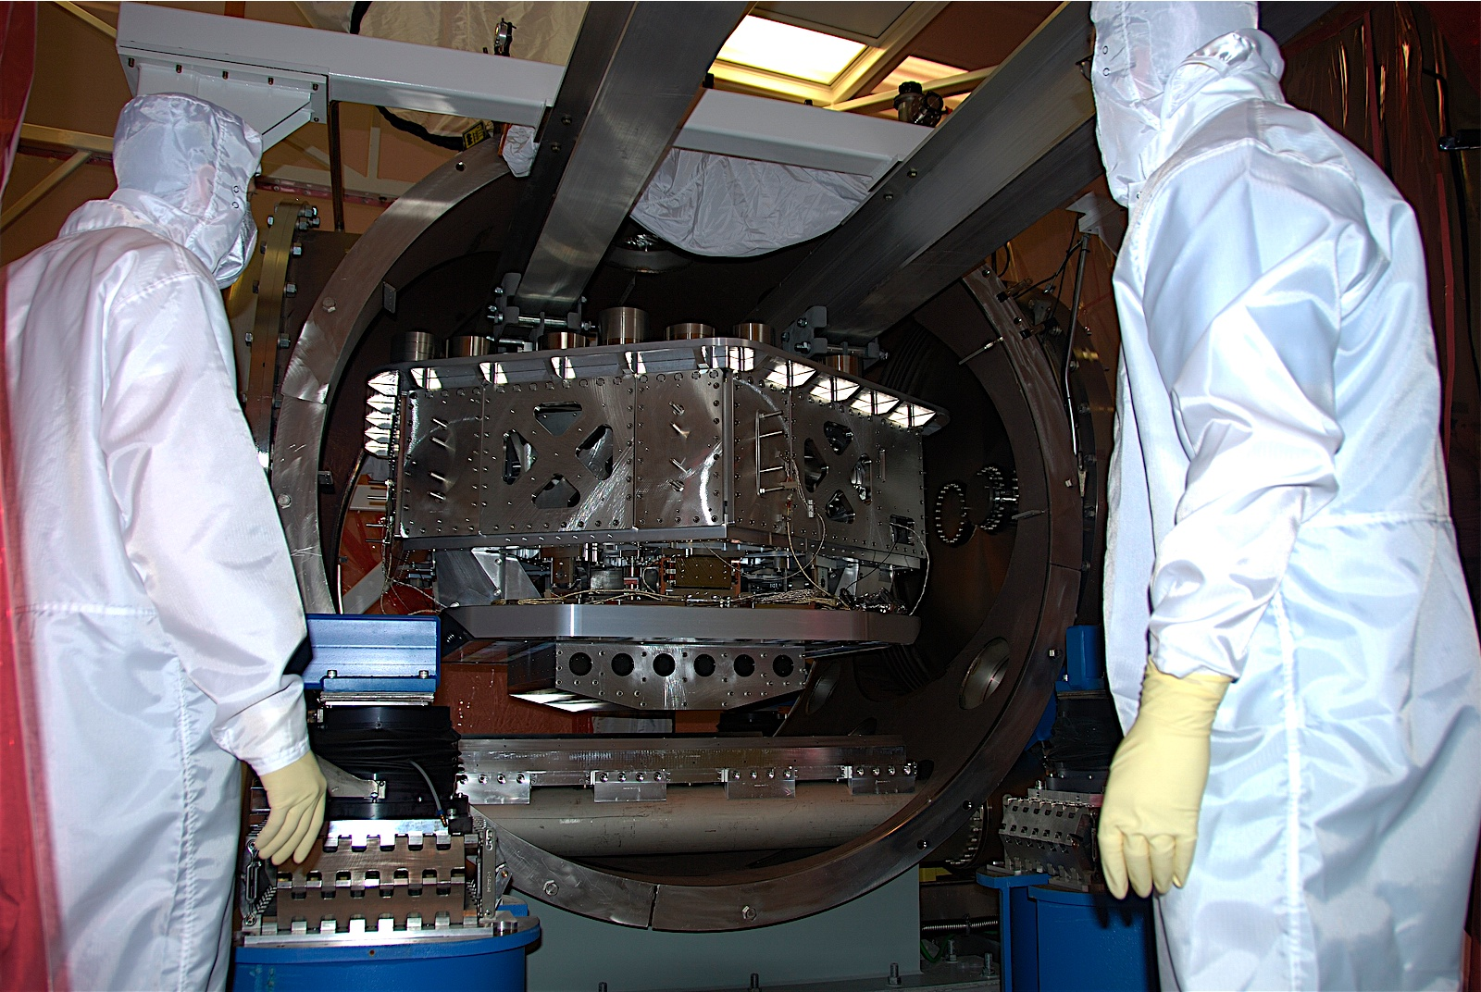
L1 ISI 1/31/08
Notes:
HAM ISI insertion in HAM6 at Livingston with guidance from Jeff Kissel (LSU, left) and Brian O’Reilly (LLO, right). March 2008.

Slide 13
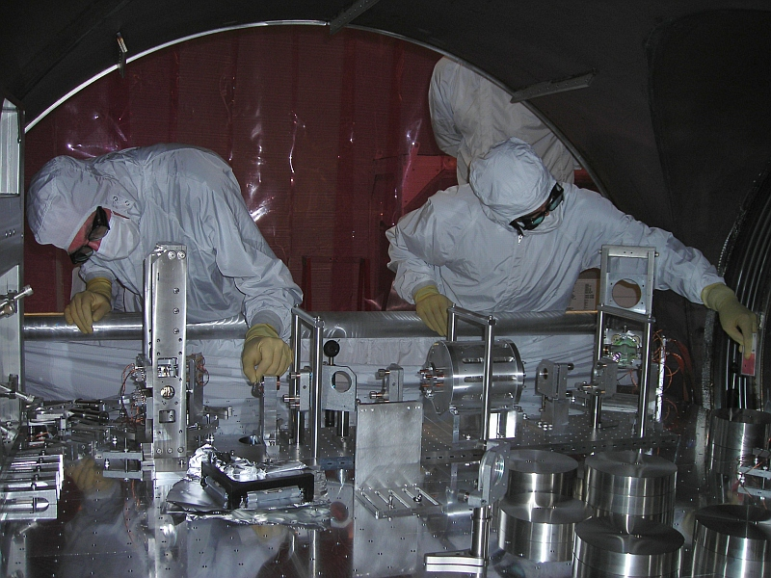

Slide 14
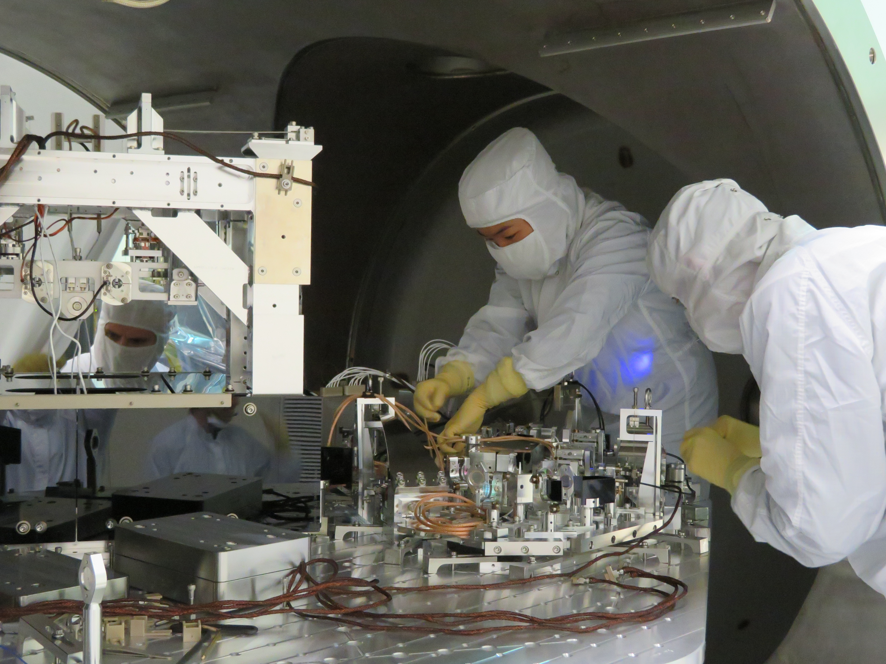

Slide 15
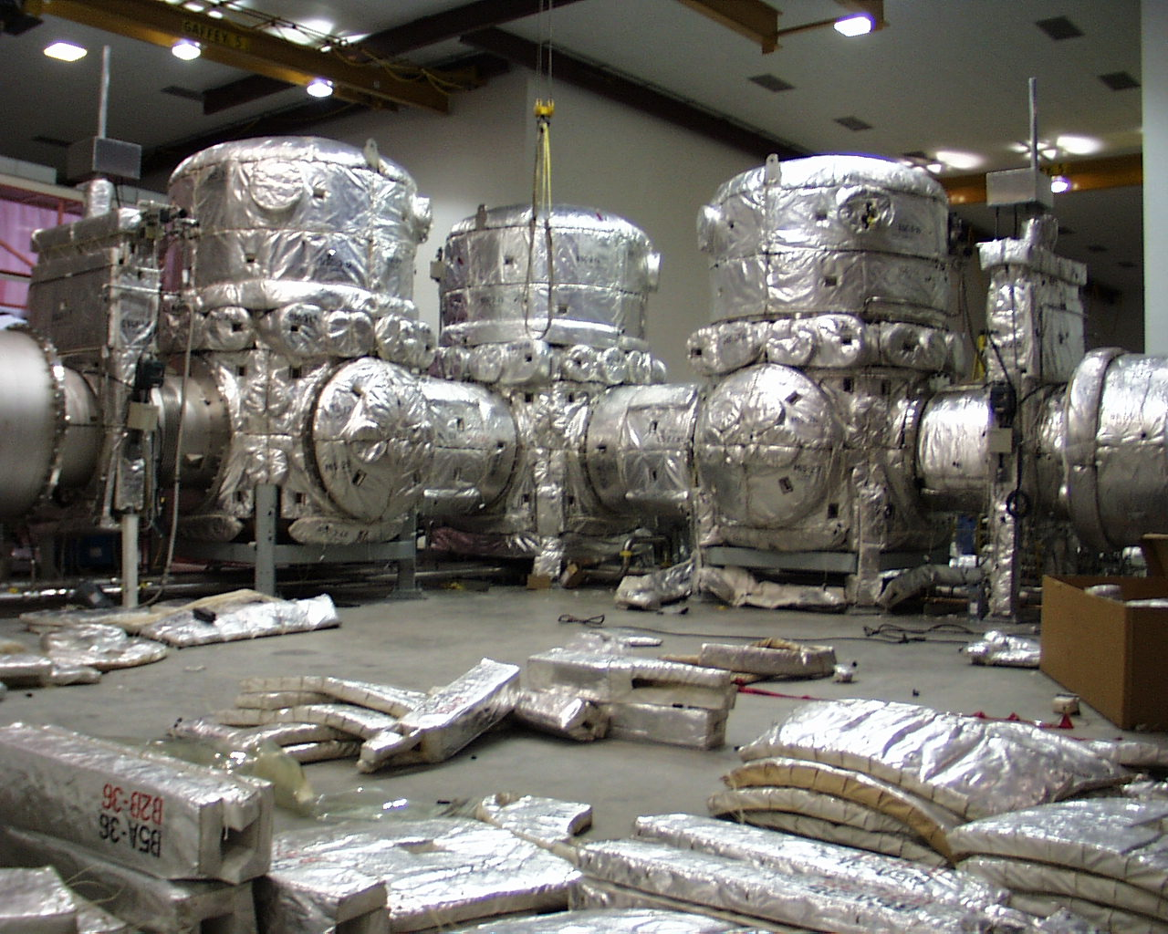
In Situ Chamber Bakeout

Slide 16
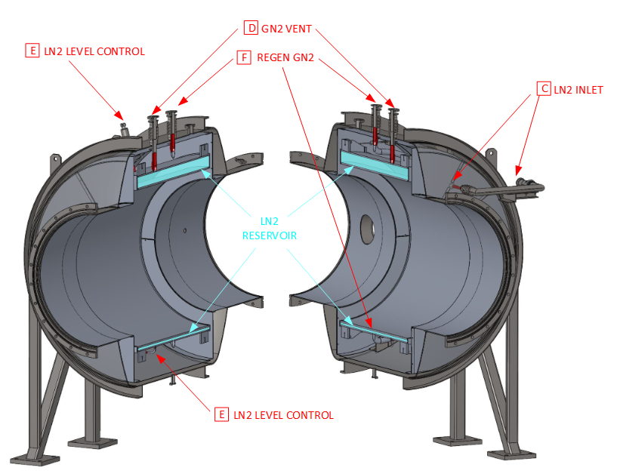
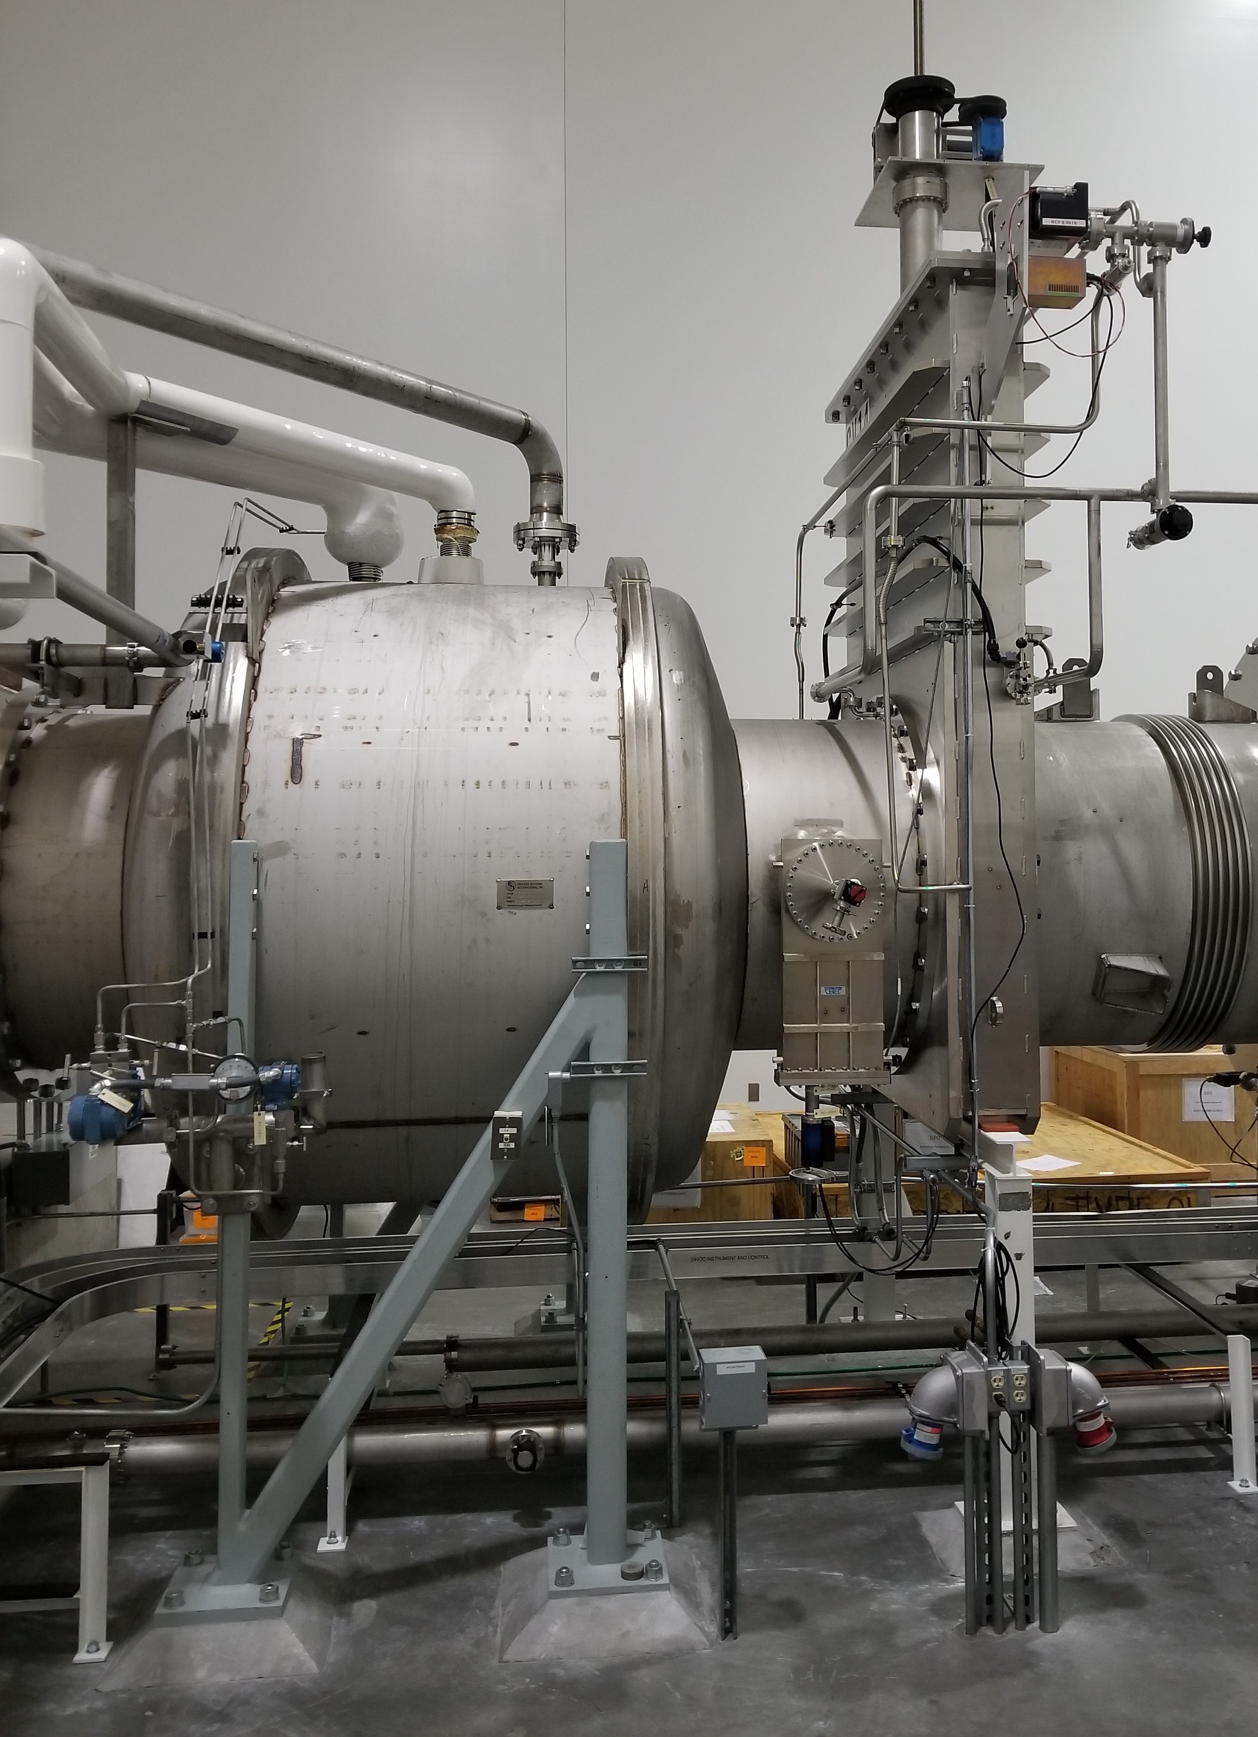
Passive 80K cryotraps pump water vapor released by detector components
3D model
E. Sanchez
photo
G. Moreno

Slide 17
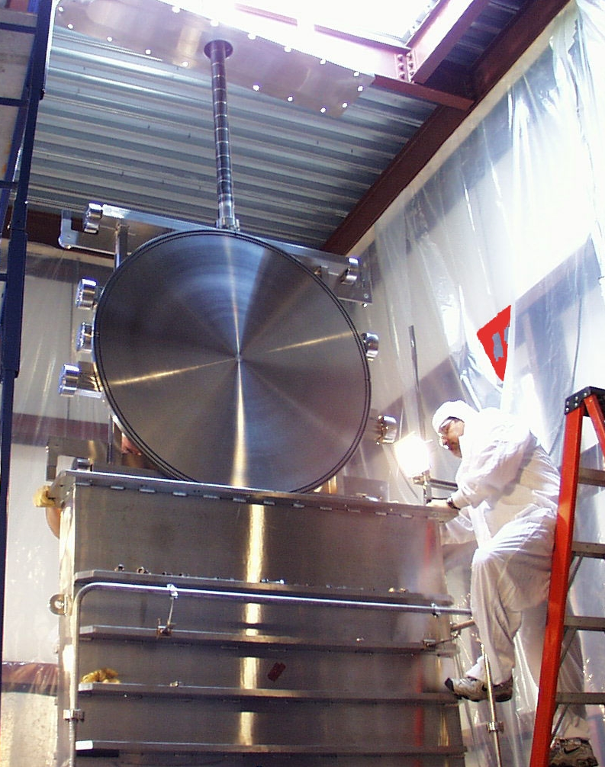
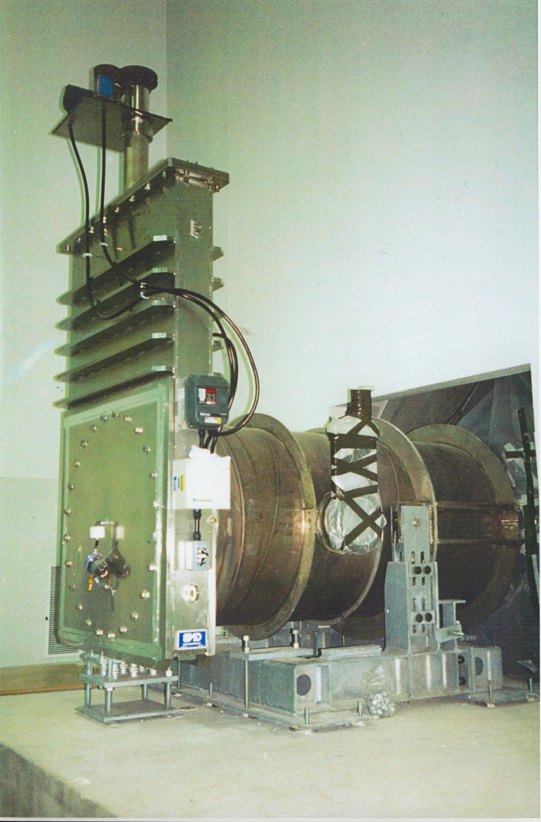
Gate Valves
40” & 44” ID
valves isolate
beamtubes from instrumentation

Slide 19
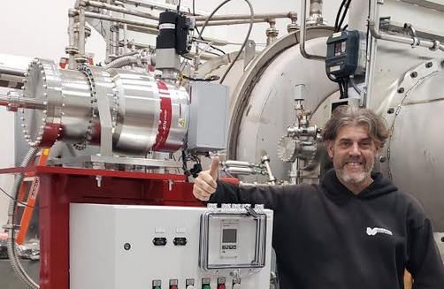
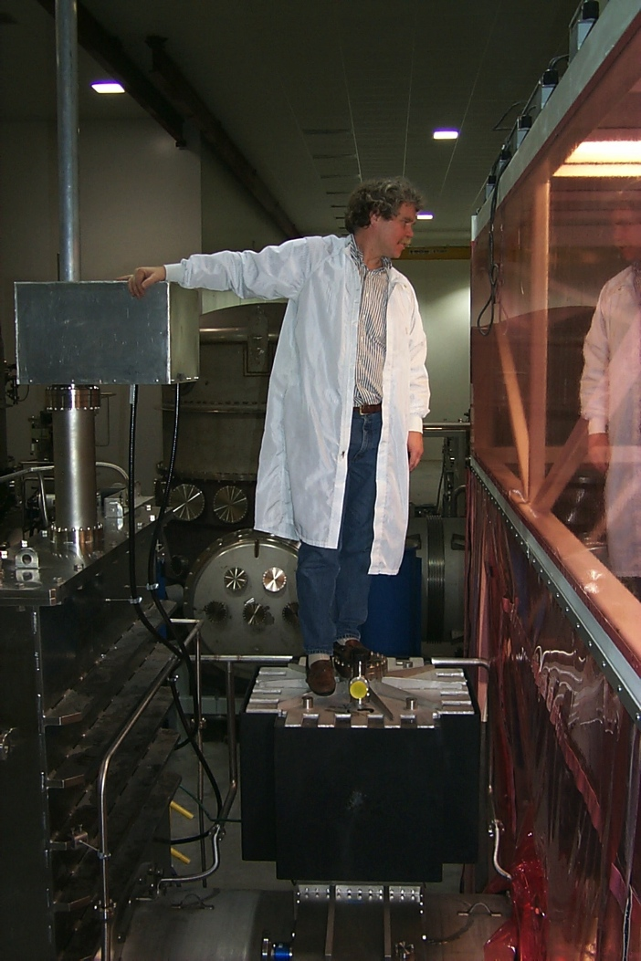
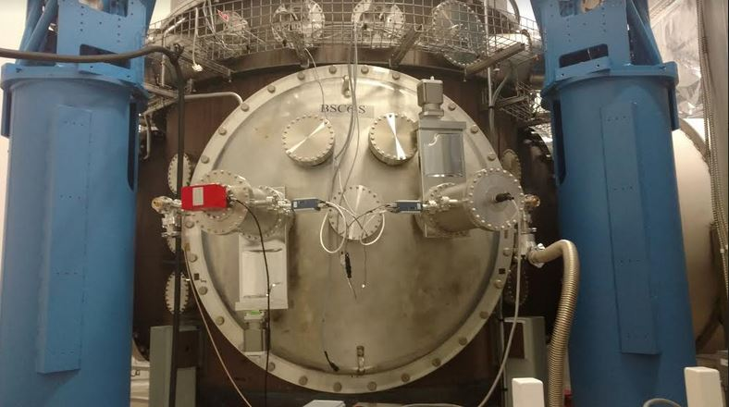
Pumping for Non-condensibles
Maglev turbos for initial evacuation only
Ion pumps assisted by NEGs in normal operation
NO rotating or vibrating machinery allowed during interferometer operation

Slide 20
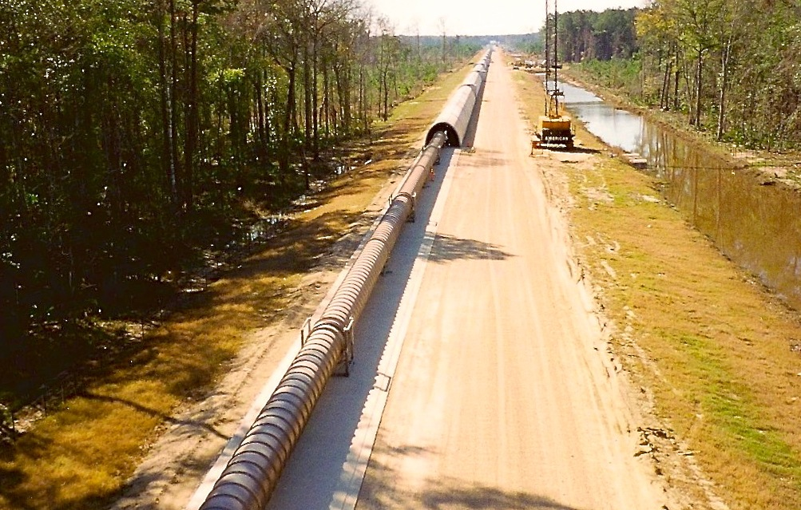
LIGO Beamtube
  9000 m³ volume/site
  30000 m² area/site
  50 km of spiral welds
  ~10⁻⁹ torr
  budget ~ $40M (1997)
    $2500/m
    $50/lb

Slide 21
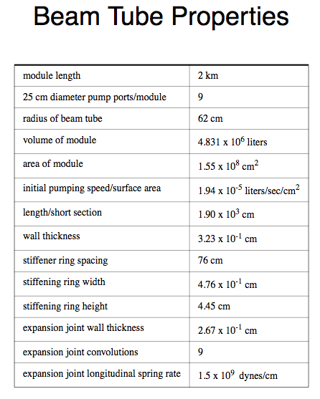

Slide 22
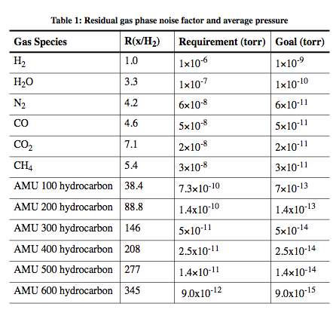

Residual Gas Pressure Limits in Beam Tubes

Slide 23
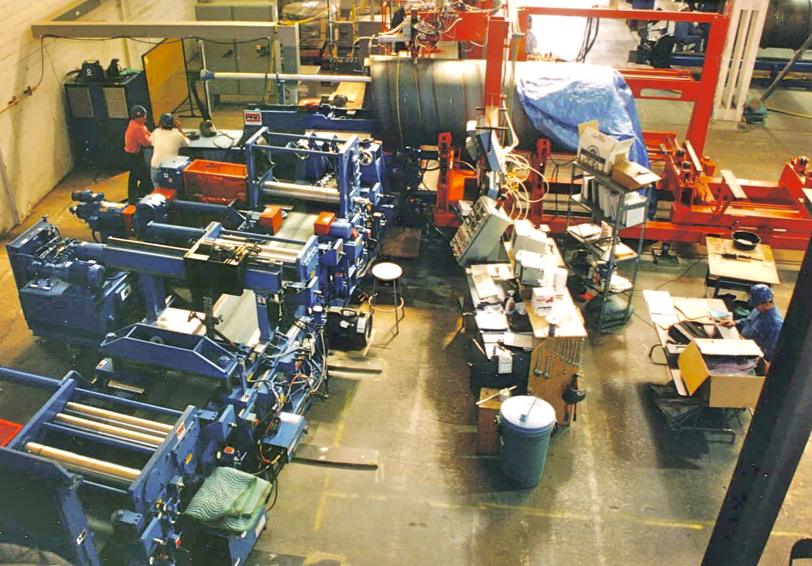
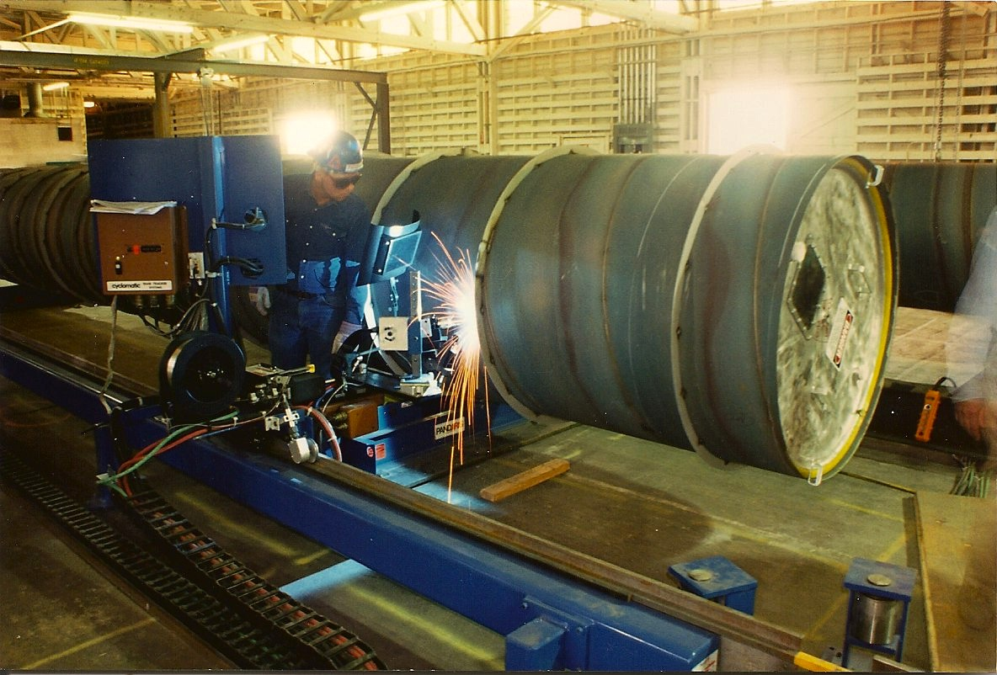
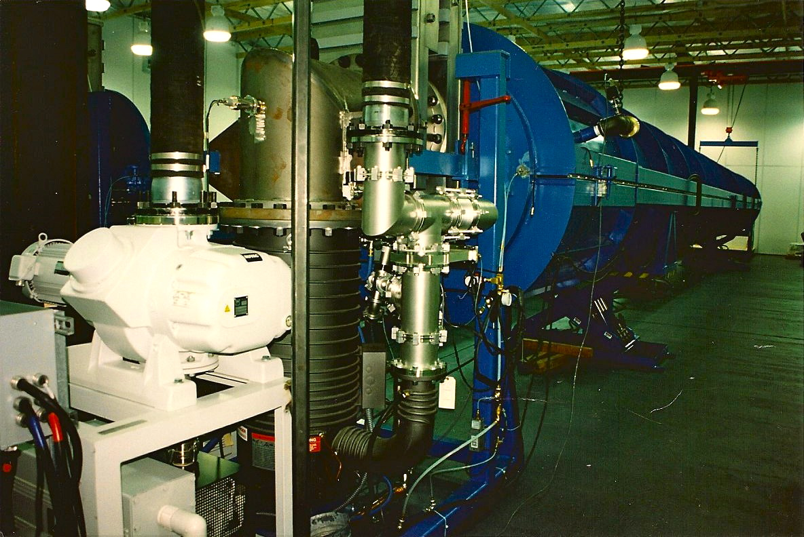
Beam Tubes
304L SS
3.2 mm thick with external stiffeners
Raw stock air baked 36h @ 455C
  Final J_{H2} < 1e-13 Tl/s/cm²
coil spiral-welded into 1.2m tube 16m long
  method adapted from sewer pipe industry
16m sections cleaned, leak checked
FTIR analysis to confirm HC-free
sections field butt-welded together in travelling clean room
Over 50 linear km of weld

Slide 24
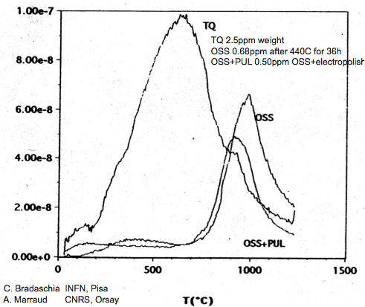
Depleting Hydrogen from raw SS before tube fabrication:
An economical alternative to high T vacuum bakeout
SS sheet from mill is baked in air 36 hours at 455 ºC
(Hotter treatment deemed inadvisable due to carbide formation)
Total dissolved hydrogen is reduced ~ 3x
Remaining H is tightly bound, high activation T
Care is required in welding to avoid re-introduction of H
Raw SS
H₂ Flux (A.U.)
After
Airbake
data courtesy of Virgo
Sample Temperature (ºC)

Slide 25
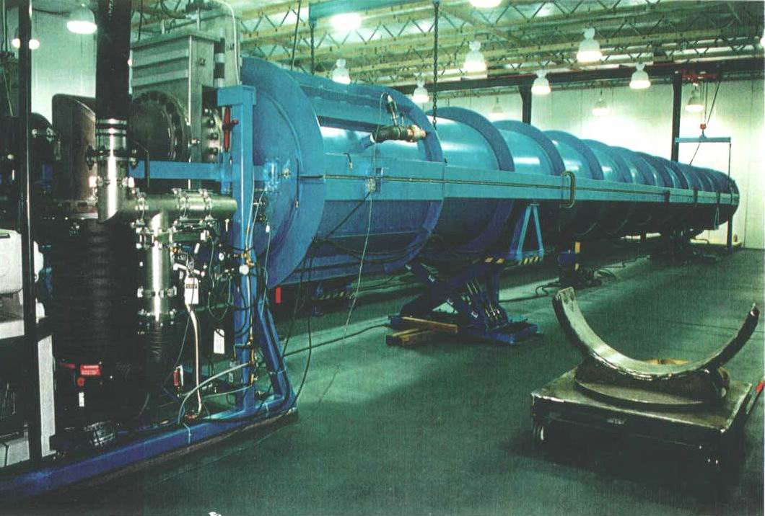
Leak Test “Coffin”

Slide 26
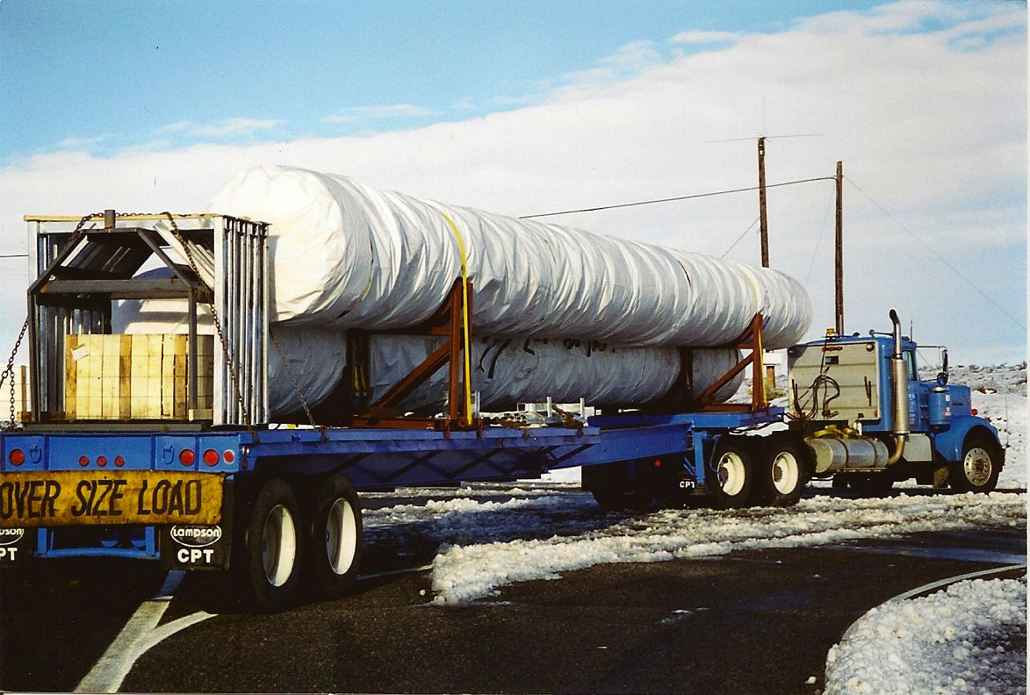
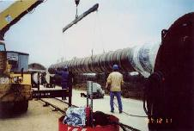
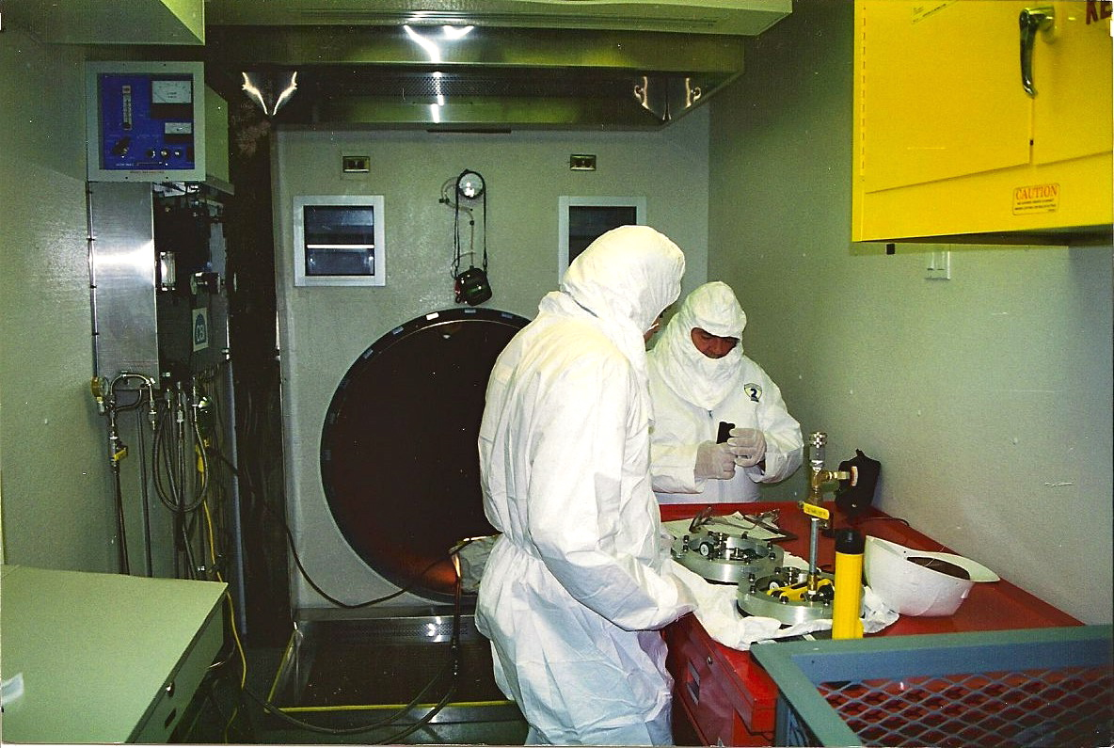
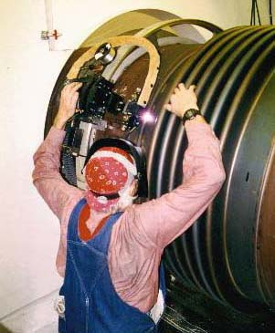
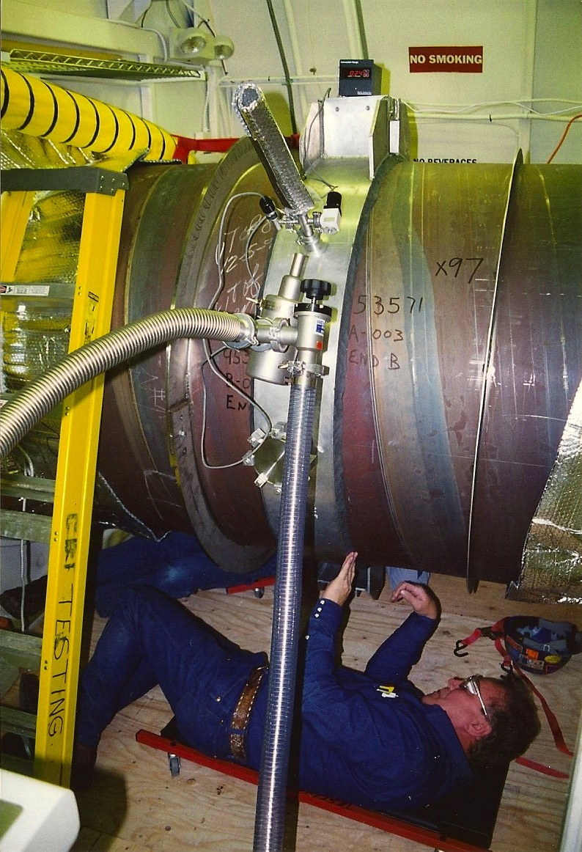
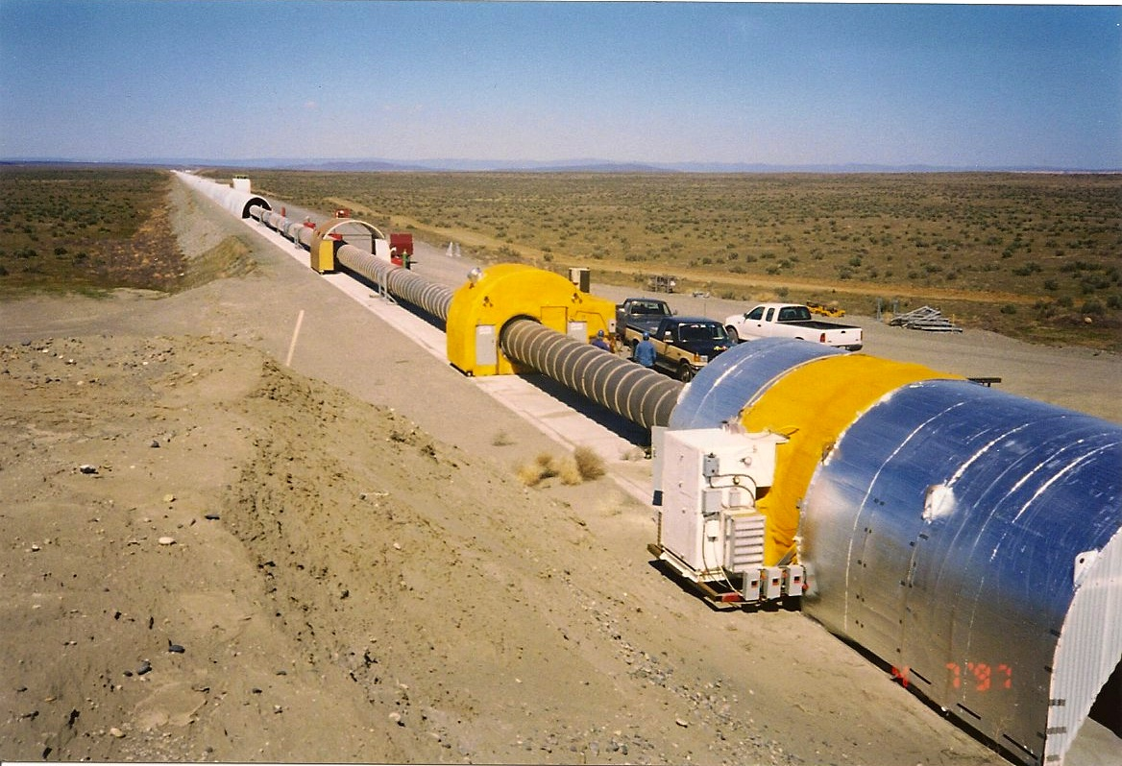
Beamtube Field Assembly
transport
position
field fitup
butt weld
leak check
next section

Slide 27
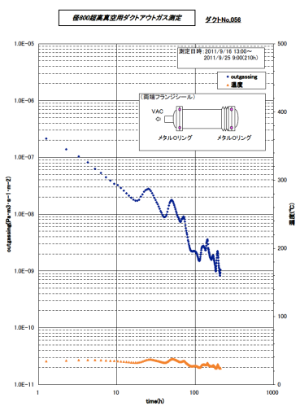
Unbaked Water Outgassing
(norm. to 1000 hours)
Weiss et al, T970111
LHO beamtube
J(H₂O) ~ 8 x 10⁻¹² T l s⁻¹ cm⁻² x (1000 h)/t
Li and Dylla (1993)
Electropolished 304L
10 ppm water content air re-exposure
J(H₂O) ~ 4 x 10⁻¹² T l s⁻¹ cm⁻² x (1000 h)/t
Saito et al (KAGRA, 2011)
ECB 304L, 200C conditioning bake
-40C dewpoint (127 ppm) re-exposure
J(H₂O) ~ 2 x 10⁻¹³ T l s⁻¹ cm⁻² x (1000 h)/t
Tolerable pressure for H₂O ~ 1/10 that for H₂
Passive 1/t desorption with time too weak
Low-temperature bakeout was required
  LIGO used 1-shot bakeout to save cost
  Tubes can never be re-exposed to atmosphere
Weiss et al, T940090
BTD at CB&I
J(H₂O) ~ 3 x 10⁻¹² T l s⁻¹ cm⁻² x (1000 h)/t
(~ 10⁻¹⁶ T l s⁻¹ cm⁻² post-bake)

Slide 28
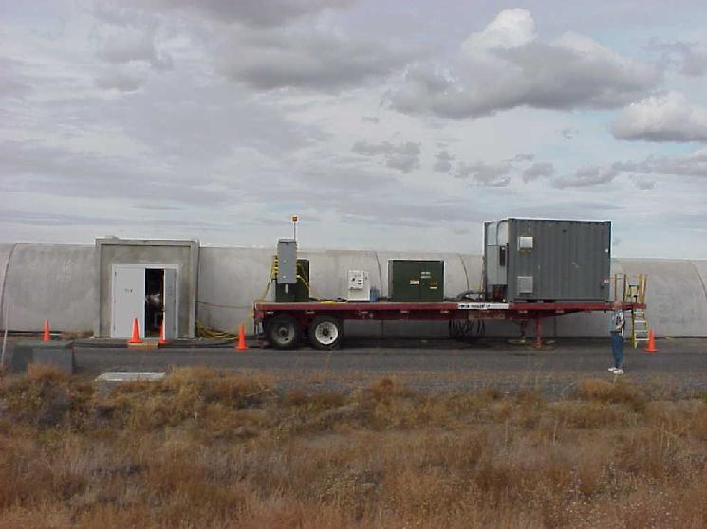
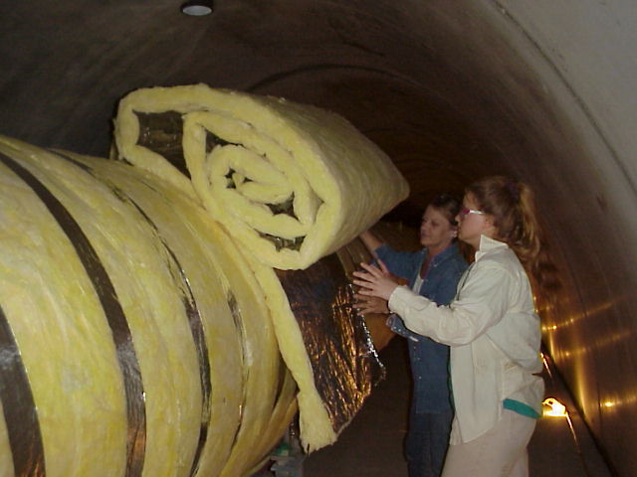
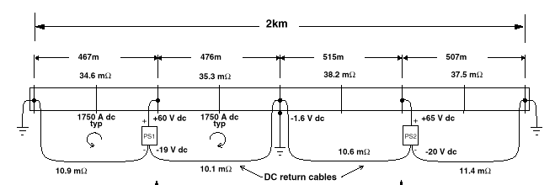
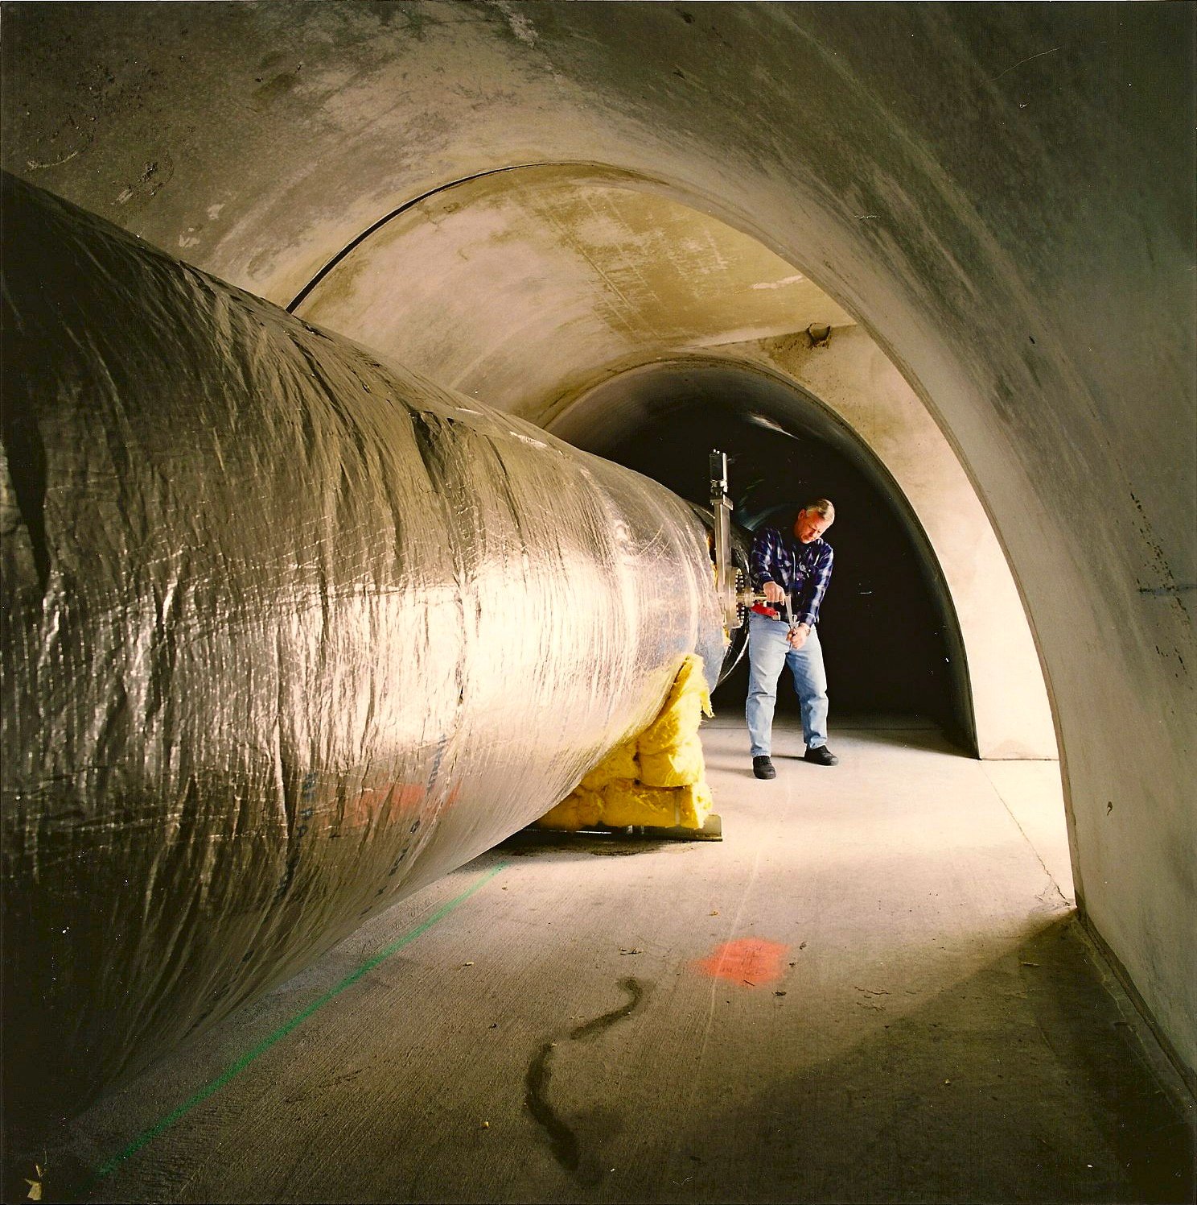
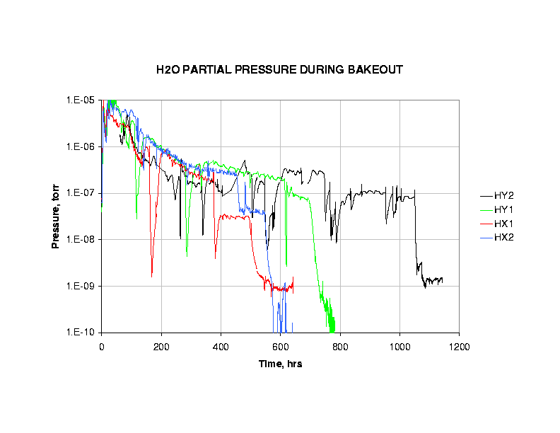
I²R Bakeout to Desorb Water
I_{DC} = 2,000 A
3 weeks @ 160ºC
Final J_{H20} < 2e-17 Tl/s/cm²

Slide 29
Bakeout Results (Hanford)

Slide 30
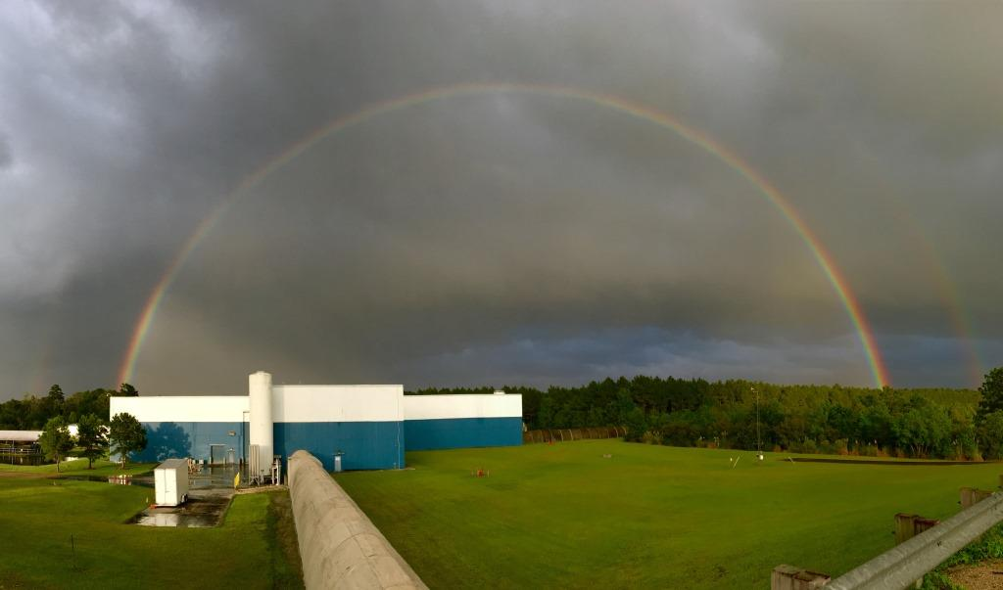
Sounds great- but
WHAT WOULD WE DO DIFFERENTLY?
Photo credit: Hurricane Harvey and Richard Oram

Slide 31
20:20 Hindsight–
What Worked Well for LIGO
Low-hydrogen steel airbake process
Spiral-welded tube construction (with aggressive QA)
I²R bakeout heating
Modular chamber & spool concept
Soft-wall modular cleanrooms for installation
Dual differentially-pumped O-rings on large flanges
Passive LN₂ cryotraps
Ion pumps
Two highly proficient and cooperative subcontractors
  Chicago Bridge and Iron (beamtubes)
  Process Systems International (vacuum equipment)

Slide 32
20:20 Hindsight—
Not so much…
Large gate valves
  Have had two develop bizarre leakage through stem
  Serious and increasing concerns about fragility of the mechanism
Microbial-induced corrosion
  Leaks caused by SS-eating bacteria in Louisiana
  Tube environment was not climate-controlled
  Vermin and moisture “disease vectors”
But our biggest regret of all is…

Slide 33
20:20 Hindsight–
If I could turn back time…
Budget constraints left us no standing provision to vent, re-evacuate and re-bake beamtubes in case of future contingency

Slide 34
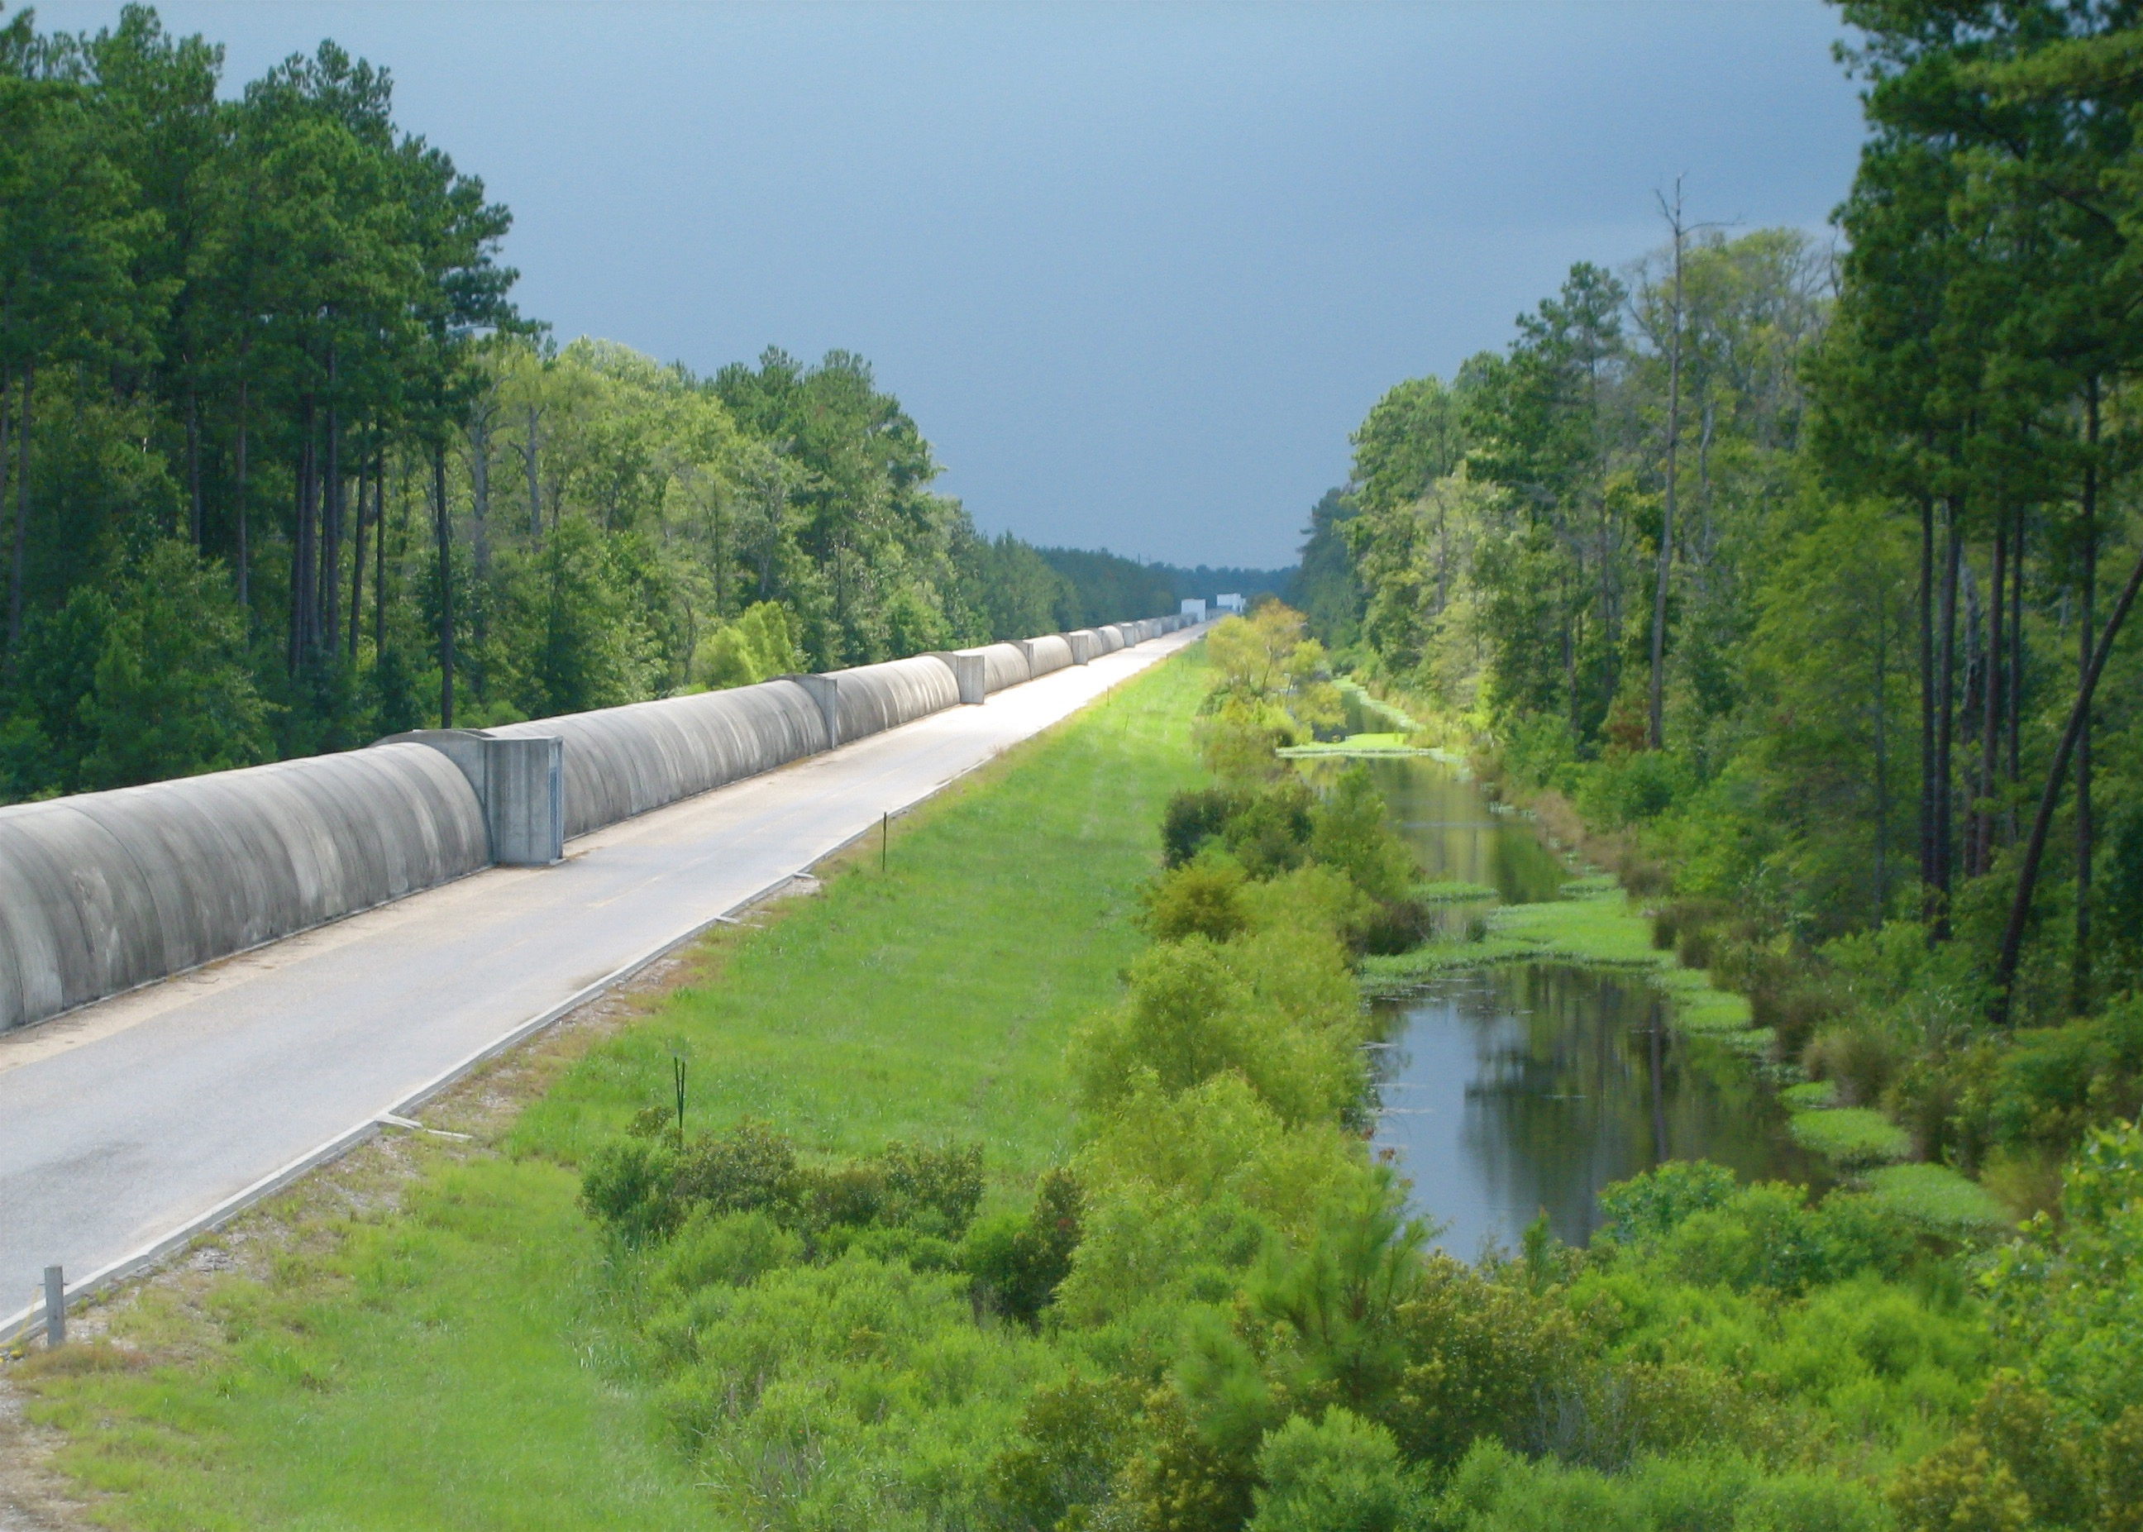
Thanks for your attention

Slide 35
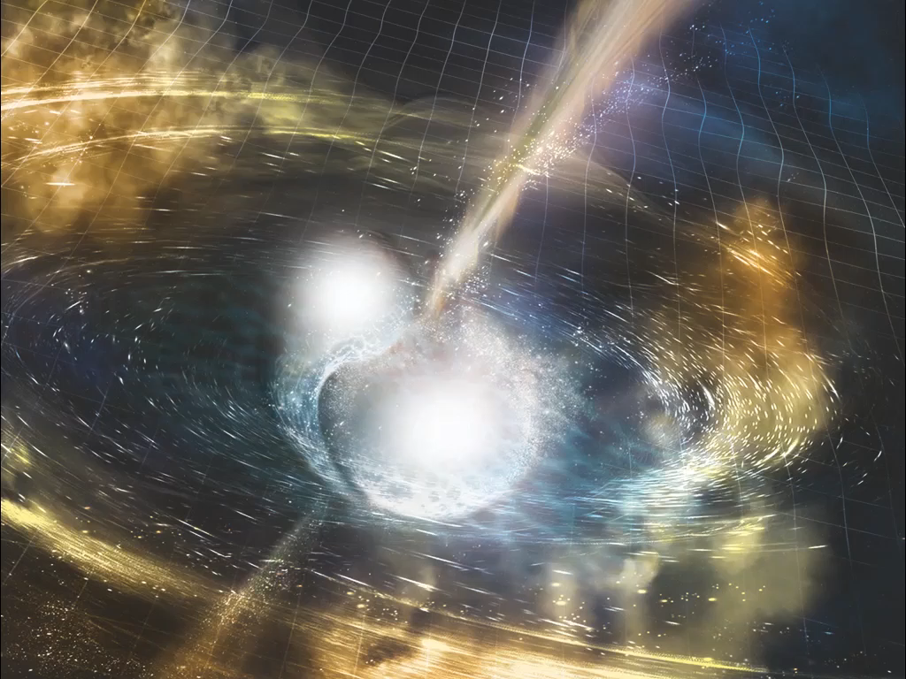
REFERENCE SLIDES

Slide 36
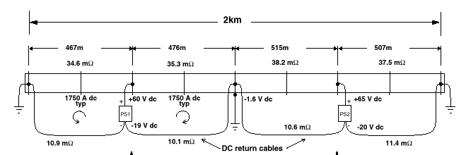
I²R Bakeout to Desorb Water (cont’d)

Slide 37
“Dubinin-Radeschevich Isotherm” desorption model
Weiss et al, LIGO-T970111

Slide 38
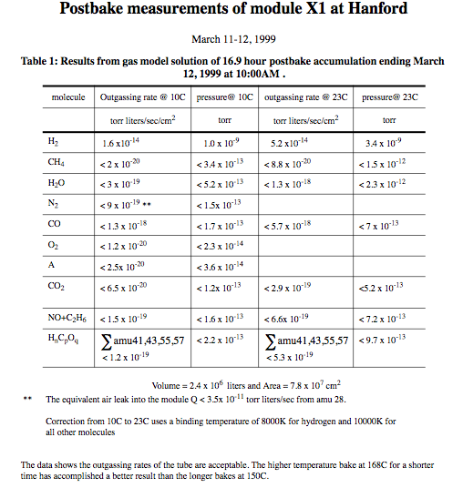

Slide 39
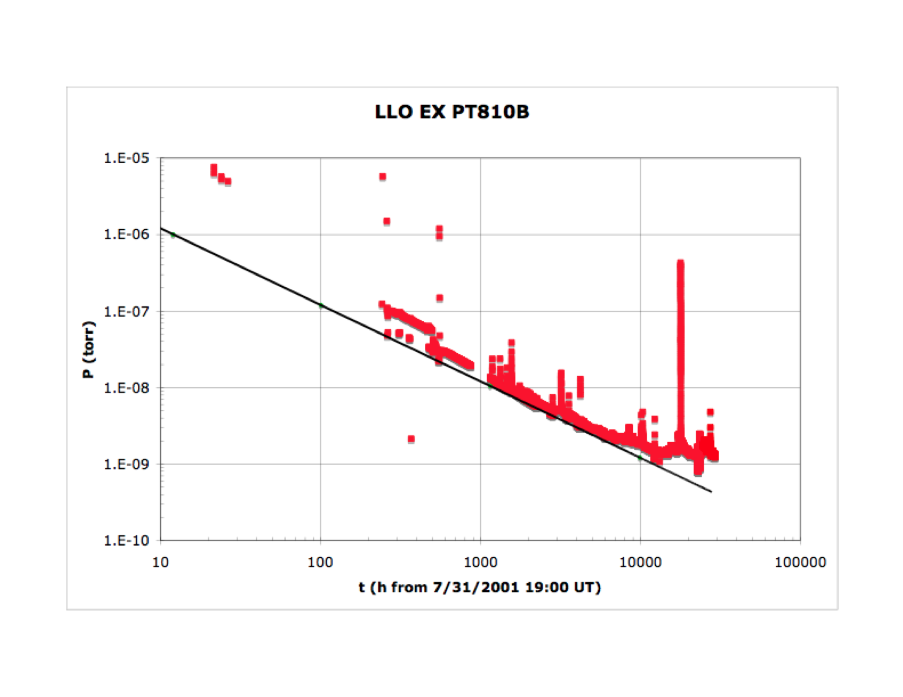
End Station Pressure Evolution after Backfill

Slide 40
Effects of Pump Distribution on Required J(H₂O)
Consider 4km aLIGO arm (1.2m ID) with 2 or 15 distributed pumps + cryotraps at ends
Assign S_{h}^{1/2}(H₂0) < 0.1 x min aL curve¹
➔S_{h}^{1/2} (H₂0) < 2.6 x 10⁻²⁵ Hz^{-1/2}
Then², for 2 pumps
J(H₂O)_{2p} < 2.0 x 10⁻¹⁵ T l s⁻¹ cm⁻²
and for 15 pumps
J(H₂O)_{15p} < 4.3 x 10⁻¹⁵ T l s⁻¹ cm⁻²
(no leaks, just autogenous water; F_{i} = 534 l/s)
2 pumps
15 pumps
¹ T1400177, Fig. 3, “BNS Optimized 125W”
² T1500202
NB: 1 T l s⁻¹ cm⁻² = 1.33 x 10³ W m⁻²

Slide 41


Slide 42


