Slide 1
LIGO
Laser Power Calibration Standards
Richard Savage
for
Yannick (Niko) Lecoeuche
LIGO Hanford Observatory
March 15, 2019
GW Metrology Workshop , NIST, Boulder, CO

Slide 2
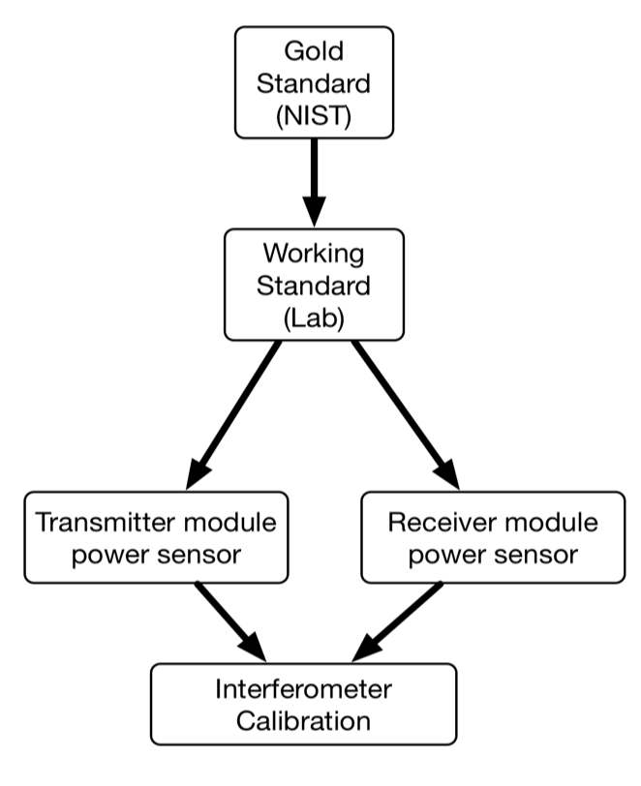
Power Calibration Standards
Transfer power calibration from NIST to GW interferometers
  Establish relative (and absolute) calibration of detectors in network.

Slide 3
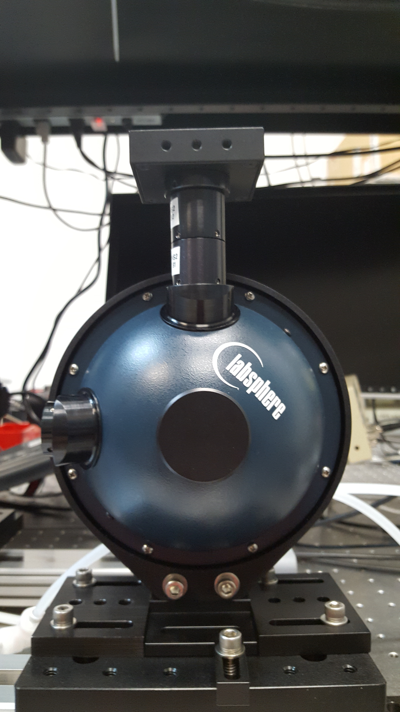
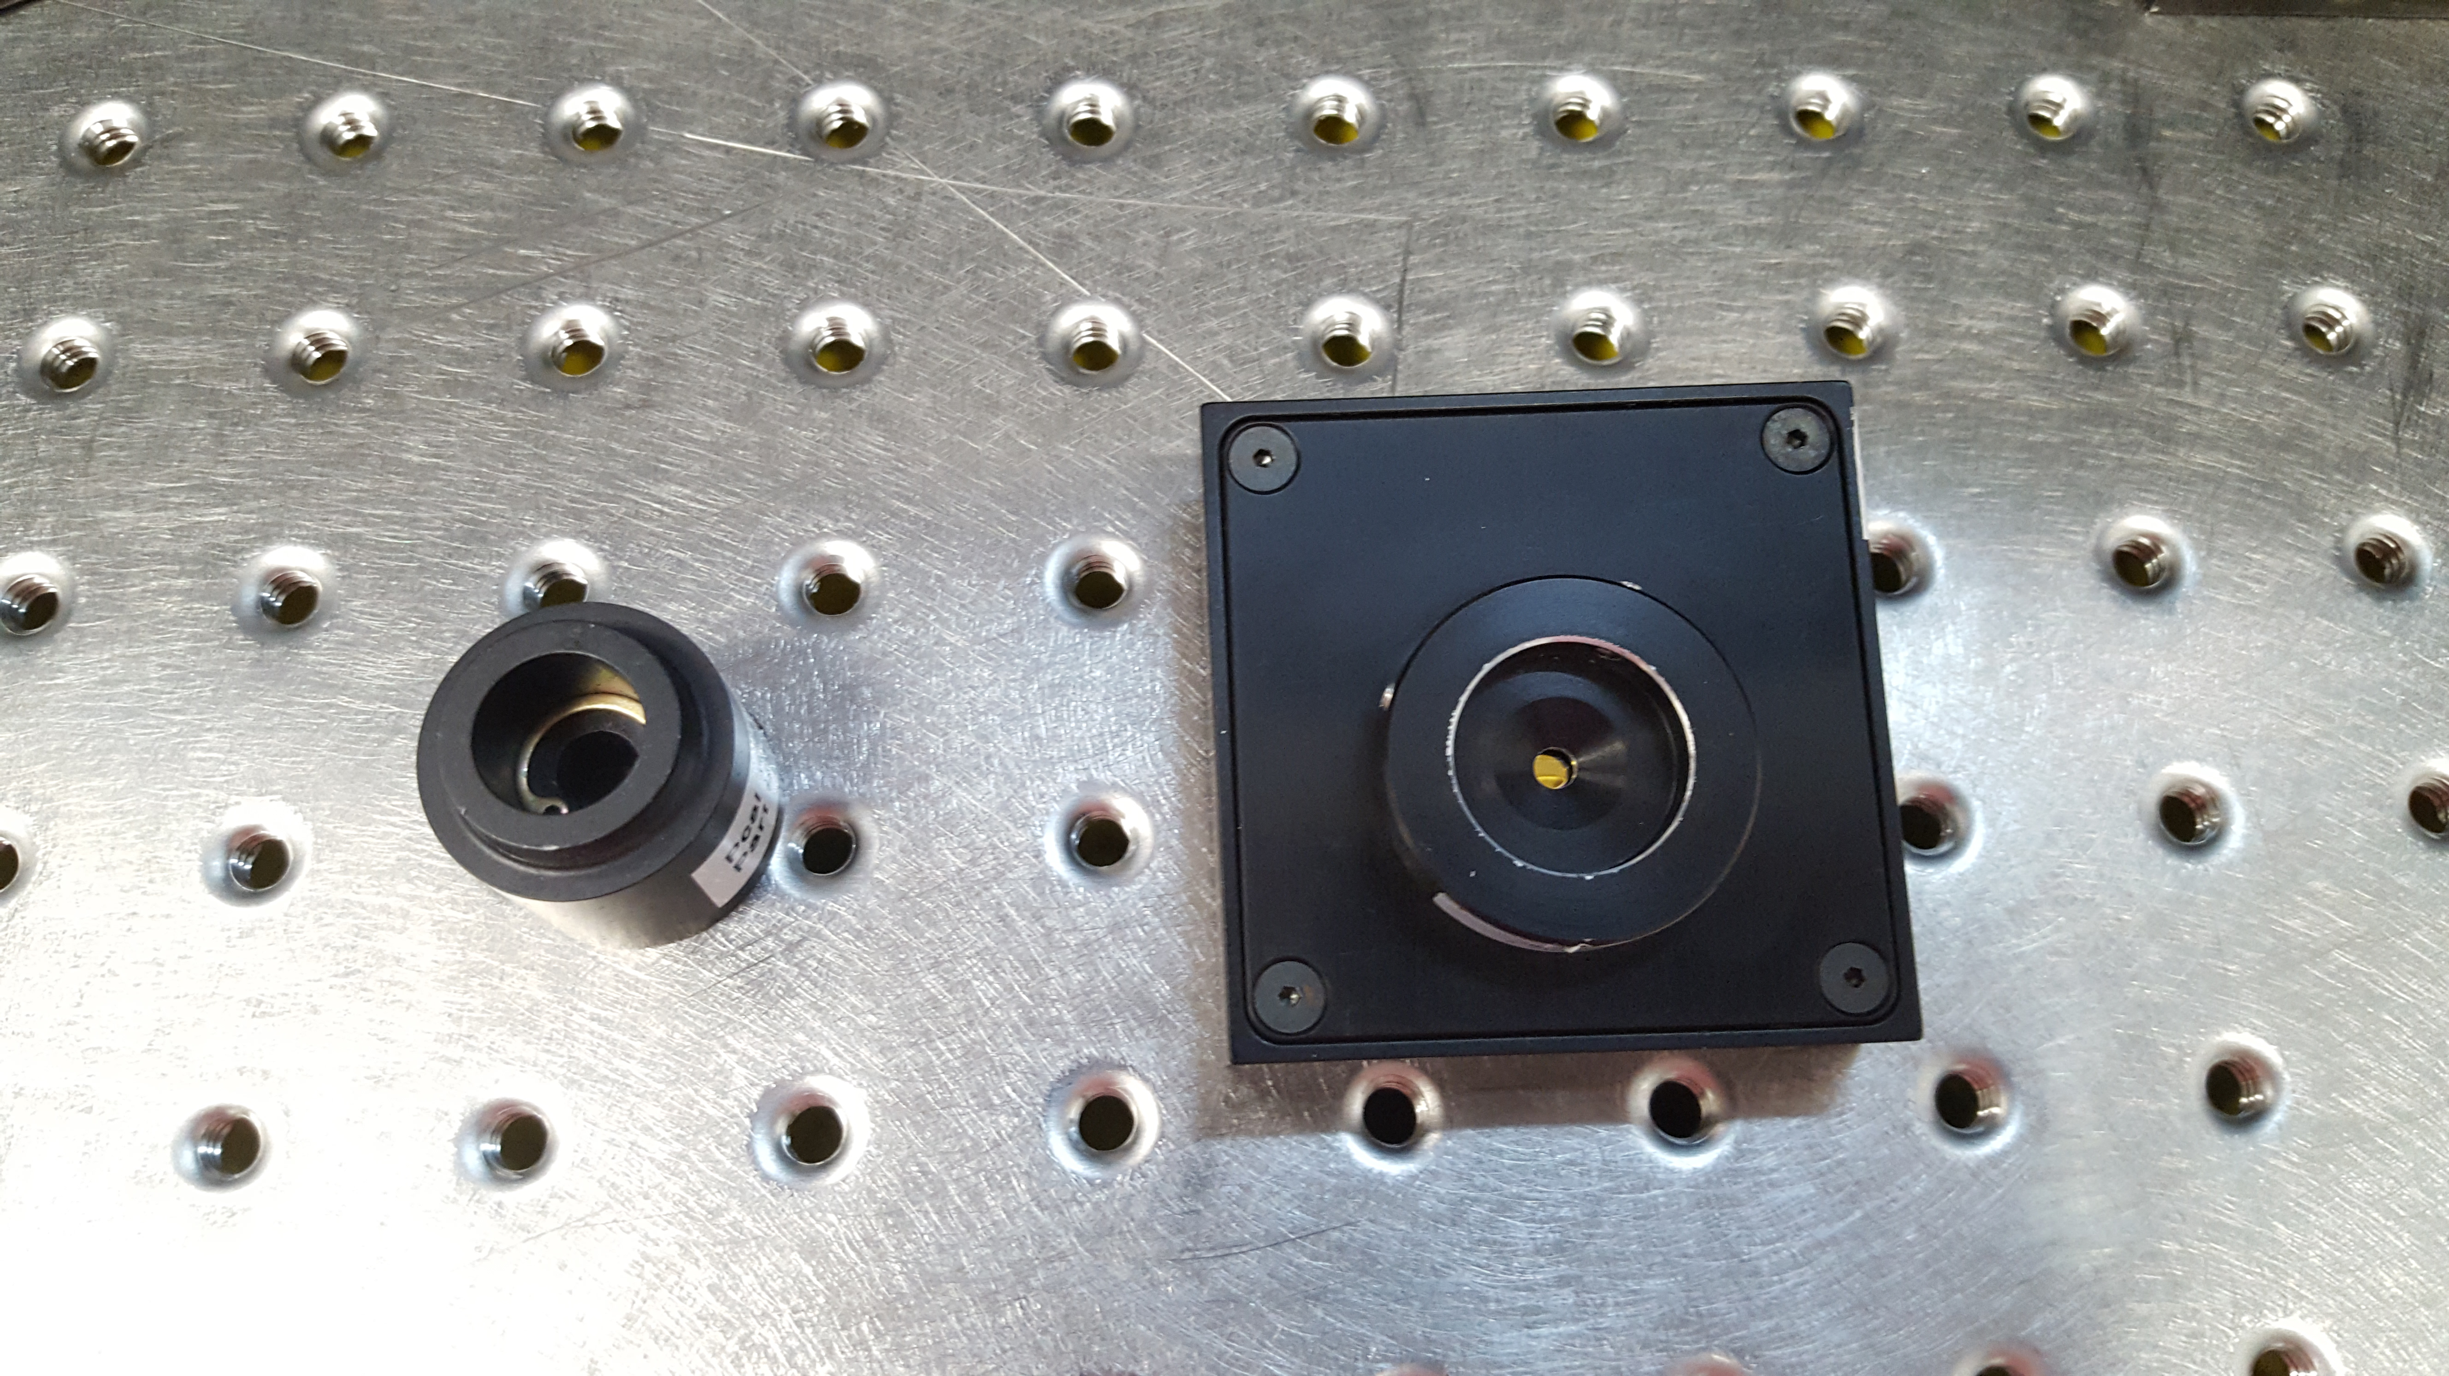
Earlier Power Sensor Configuration
Two spacers with apertures between integrating sphere and photodetector.
  Less sensitive to radial position.
  Increased laser speckle amplitude.
  Less robust mechanically

Slide 4
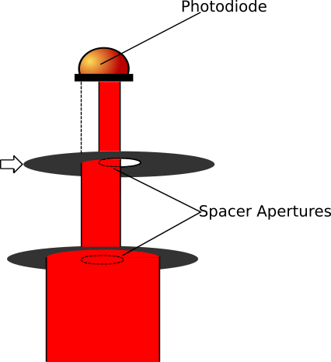
Mechanical Robustness
Radial dependence
  No spacers: 4 %/mm
  One spacer: 1 %/mm
Lateral dependence
  1 % per 16 μm offset
Measurement with
M. Szczepanczyk

Slide 5
Laser Speckle
Increases with decreasing viewing area
  Less detector spacers better

Slide 6
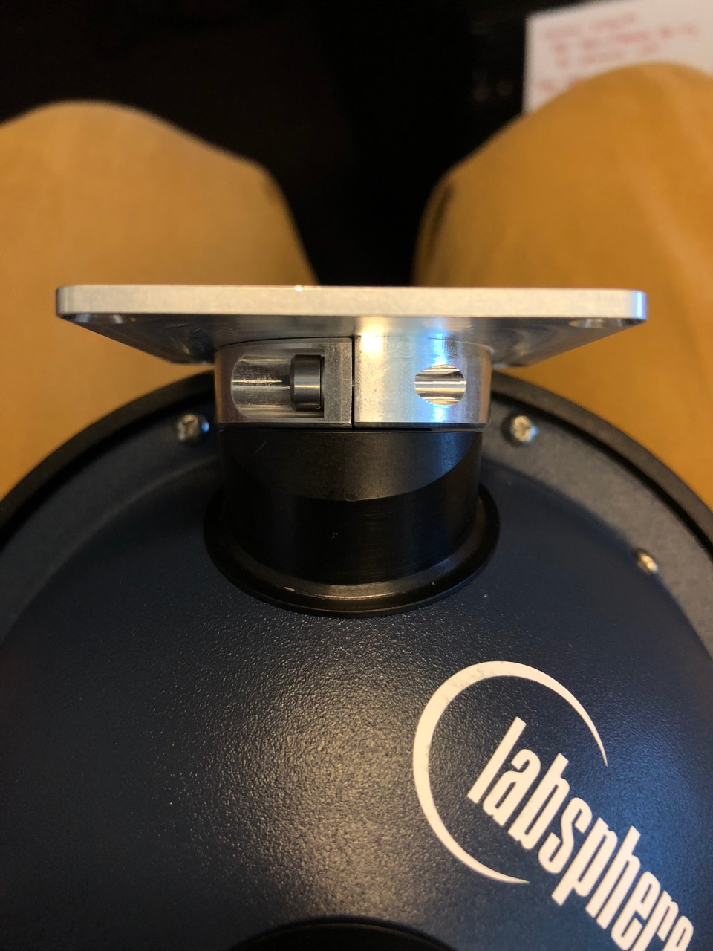
Photodetector mounting
Monolithic photodetector housing front plate
Two-piece assembly draws PD assembly against sphere port.

Slide 7
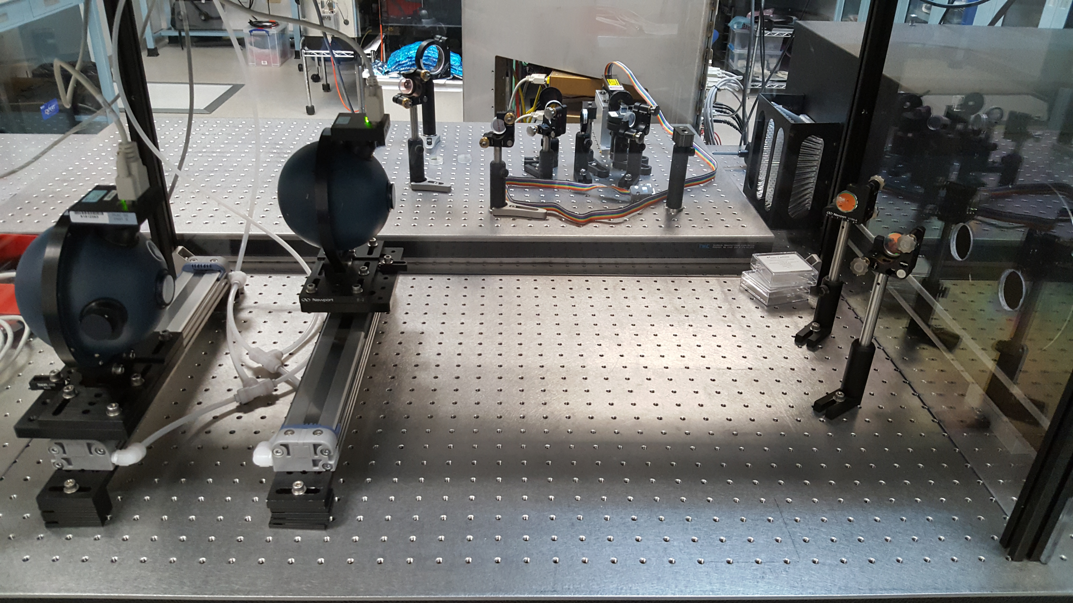
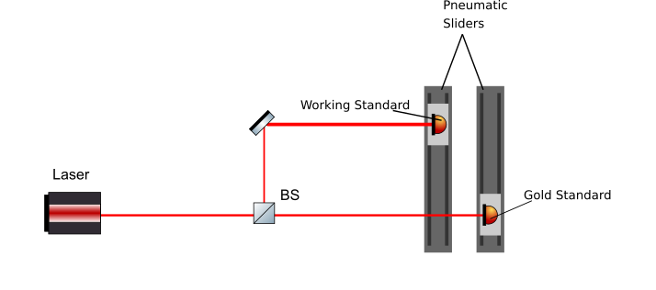
Pneumatic Sliders for Automated Measurements
(Thanks M. Spidell)

Slide 8
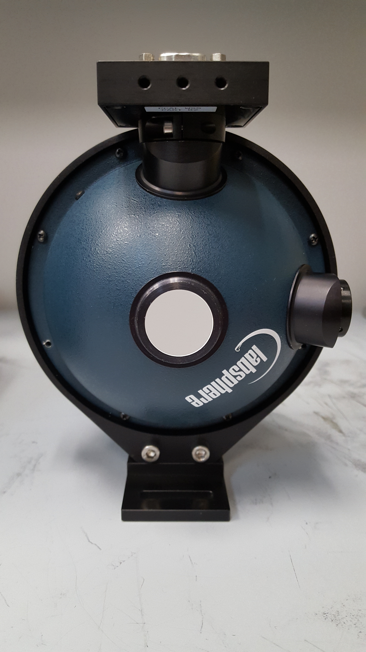
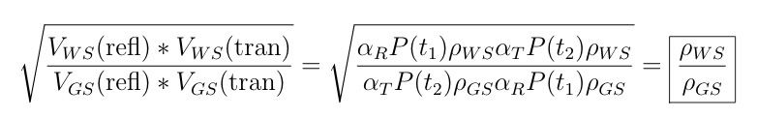
Working Standard Calibration Procedure
WS/GS calibrations use:
  Simultaneous measurements eliminate laser power variations
  Swapping positions eliminates beamsplitter variations

Slide 9
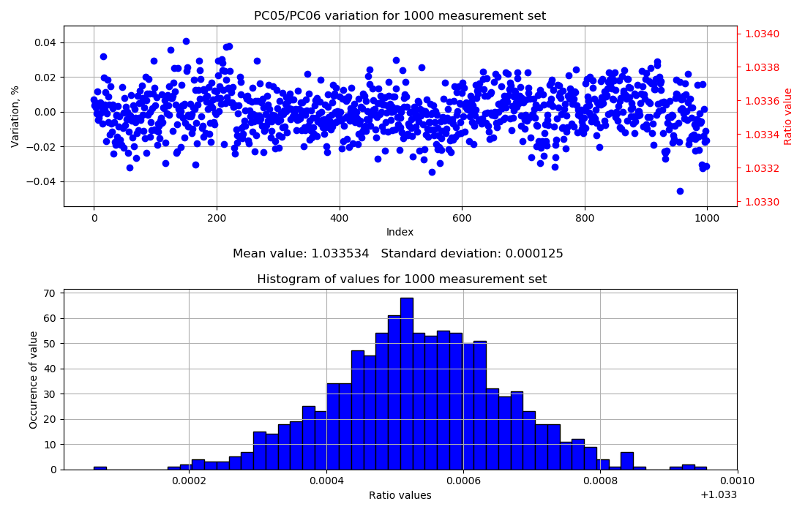
Responsivity ratio measurements
100-second samples; 1000 measurements over weekend

Slide 10
Temperature Dependence
Heat one WS to 35 ºC in oven
Measure resp. ratio as temp. relaxes
Temp. dependence ~ 0.07 % / ºC.

Slide 11
Gold Standard Stability
Before/After NIST Calibration
Finally,

Slide 12
EXTRA SLIDES

Slide 13
Gold Standard Stability
Before/After NIST Calibration

Slide 14
Temperature Dependence of Photodiodes
Installed temperature sensors by photodiodes to investigate trends
Thermalized WS at 35ºC, measured against WS at ~20ºC
Ratio changes by ~0.07%/ºC difference in WS temperature.

Slide 15
Responsivity ratio measurements
Believed to have stable enough measurements to see laser speckle in timeseries ratios

