Slide 1


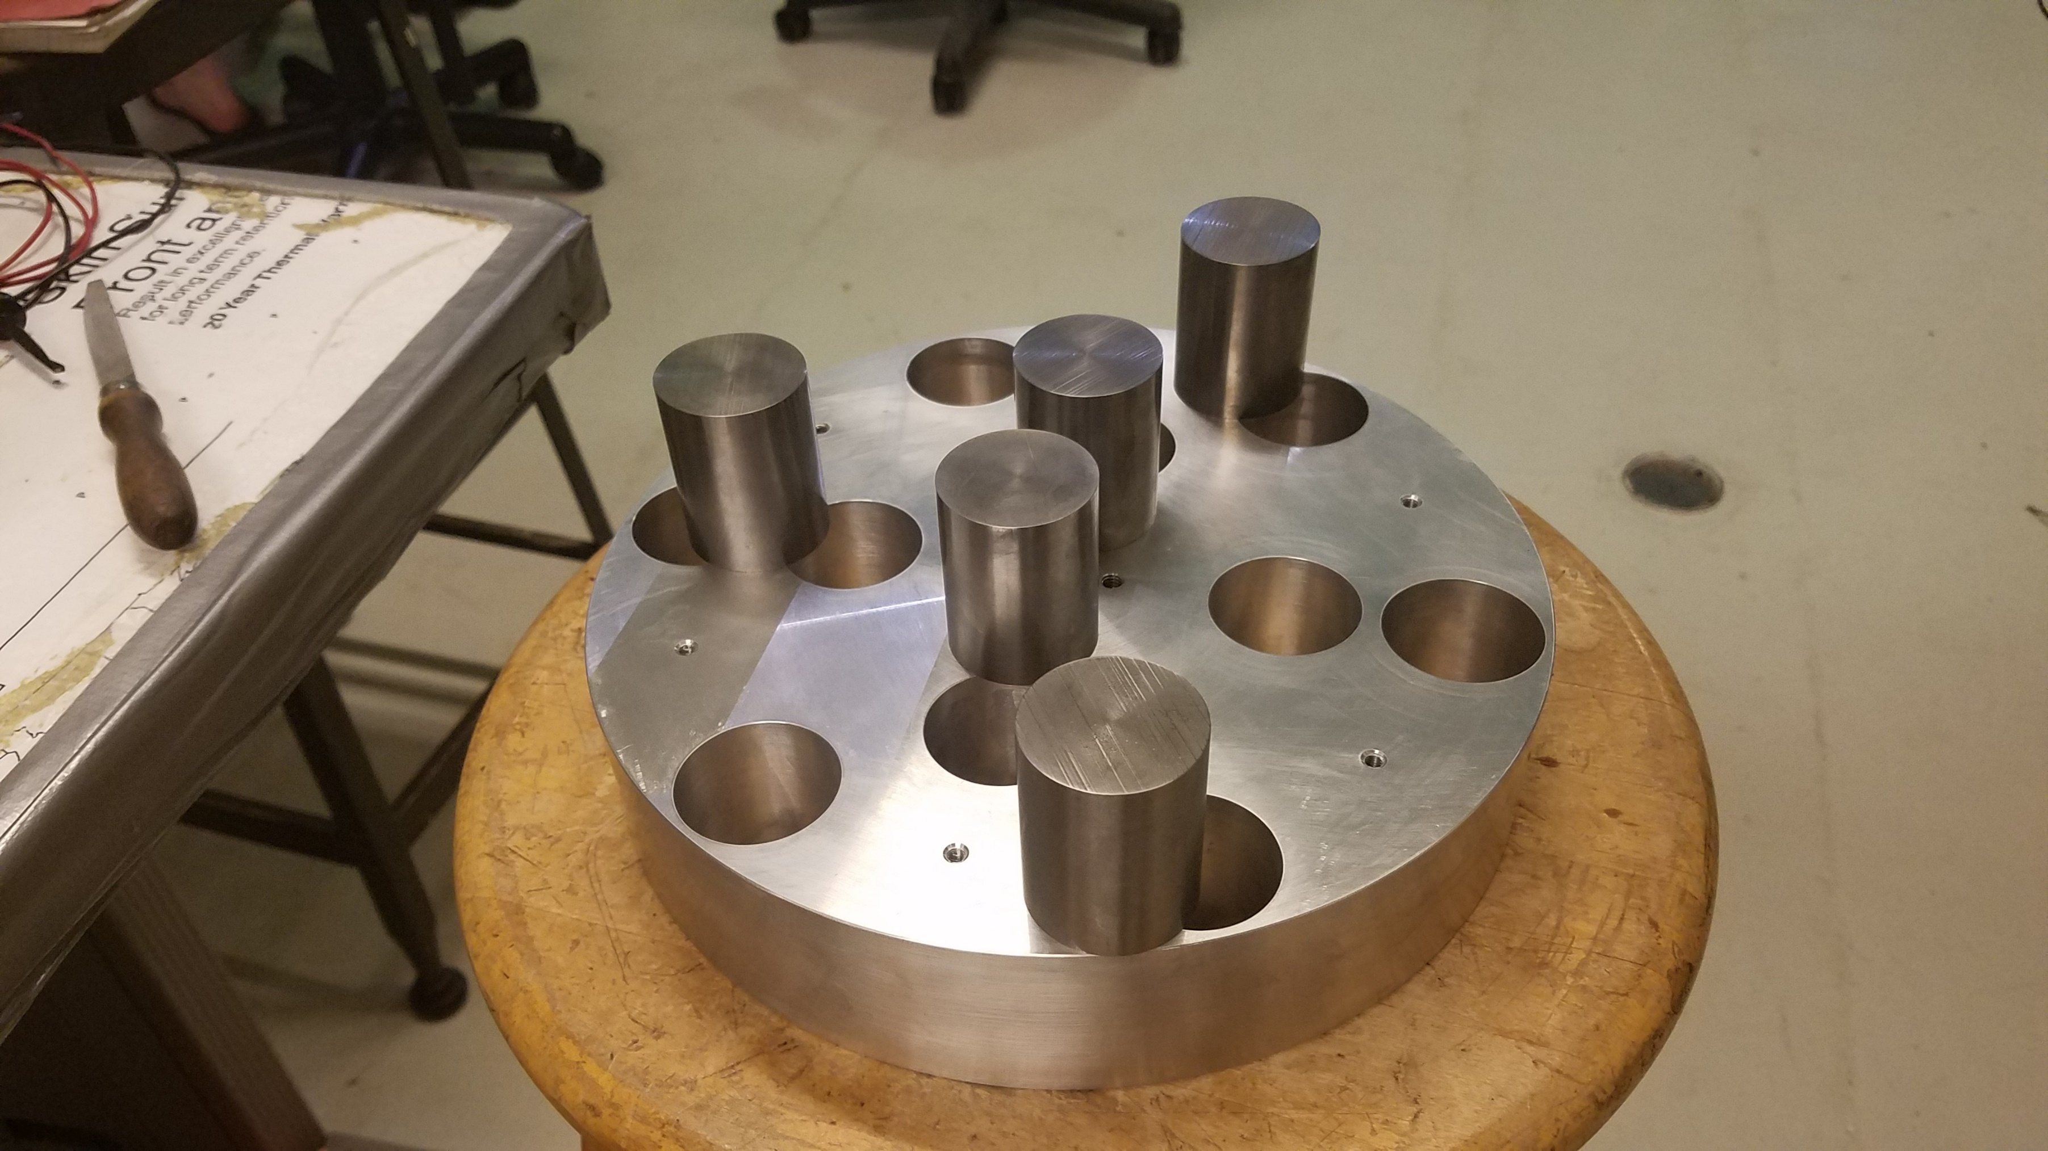
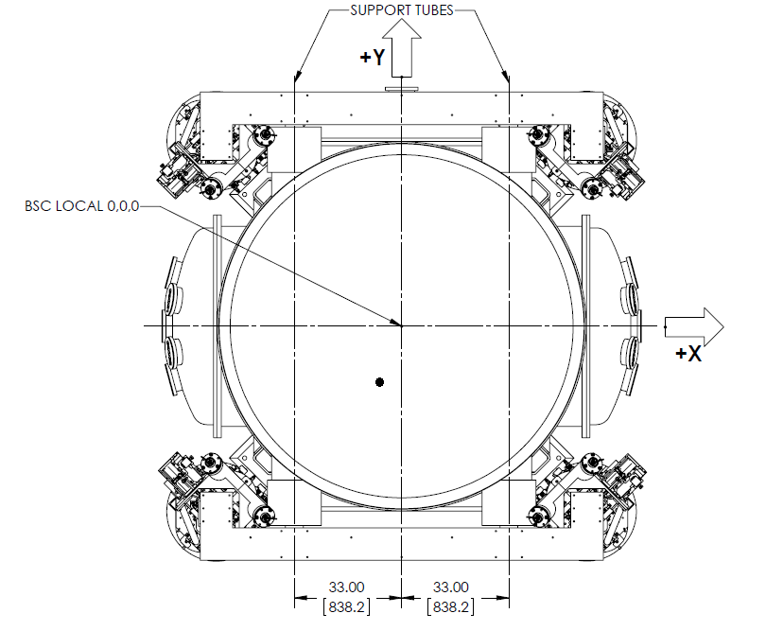
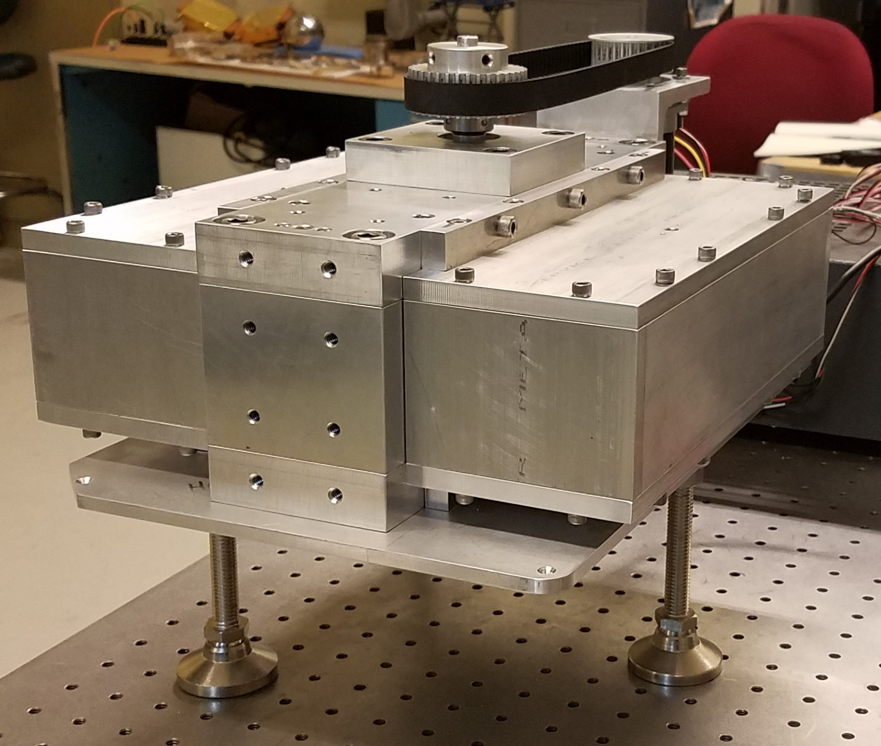

Gravitational Calibrator for LIGO
Jeff Kissel¹, Kavic Raman Kumar², Michael Ross², Jens Gundlach², Krishna Venkateswara²
1 LIGO Hanford Observatory
2 University of Washington
To calibrate LIGO’s strain measurement, a known force is applied to the test mass using photon pressure. Current limitation comes from systematic uncertainties at the few percent level. A local gravitational actuation could also be used to provide additional calibration information, potentially lowering the overall calibration uncertainties¹. KAGRA and VIRGO teams have proposed and tested such Gravitational calibrators.^{2,3}
We are building a gravitational calibrator for LIGO , as shown in the schematic to the left, which builds on these previous ideas. It consists of an aluminum rotor disc with holes, in to which Tungsten cylinders are placed in a hexapole and quadrupole configuration. When spun at high speeds, between 5 and 30 Hz, near a LIGO test mass it will produce a precisely calculable gravitational force at the second and third harmonic of the rotor frequency. The combination of the two signals will be used to minimize the distance-based systematic error. Other important systematic uncertainties might arise from vibrational, acoustic and magnetic couplings, along with readout cross-couplings from angular motion.
d
Aluminum rotor with holes machined by wire-Electrode Discharge Machining to minimize positioning errors. On top, the 1.056 kg Tungsten (alloy) cylinders are shown which will be the active masses in the calibrator. They were matched in weight to better than 0.1%.
Planned location of the calibrator (shown as a black rectangle) relative to the test mass (shown as a bold dot). The signal amplitude is not affected significantly by being at a large angle relative to the laser beam, since the actual induced test motion is elliptical (with low e). As the quadrupole and hexapole signals fall off as 1/d⁴ and 1/d⁵ respectively, being close to the test mass is crucial The plot to the right shows the strain signals at 90 Hz (third harmonic) computed by a custom FEM calculation. Expected signal amplitude is ~ $1.5×{10}^{−21}$.
Status: The calibrator has been built at UW and can be spun up to speeds of 30 Hz with about 40W total Power dissipation. A robust control system using Beckhoff parts is being developed currently and will be delivered to LHO in the next few months. The calibrator will likely only be used periodically to calibrate PCal and is not expected to be active during GW Observation.
1: https://dcc.ligo.org/LIGO-G1900379 2: Inoue et al., Phys. Rev. D 98, 022005 3: Estevez et. al., arXiv:1806.06572

