Slide 1
Detectors and observations in O3
Lisa Barsotti, Nicolas Leroy,
Keita Kawabe, Brian O’Reilly, Alessio Rocchi
for the LIGO-VIRGO Joint Run Planning Committee

Slide 2
ER14 and Instrument Status
First half of ER14 (Started Mon Mar. 4 2019)
  Better sensitivity than O2 for all 3 instruments.
  As planned, almost fully commissioning (no OBSERVING) for H1 but there are low noise segments.
  Large periods of commissioning for Virgo.
  No triple coincidence OBSERVING so far. But 3-IFO coincident running segments.
  Minimal L-V coincidence so far.
  Expect this to go up in the next couple of weeks.
  Ironing out bugs as we go.

Slide 3
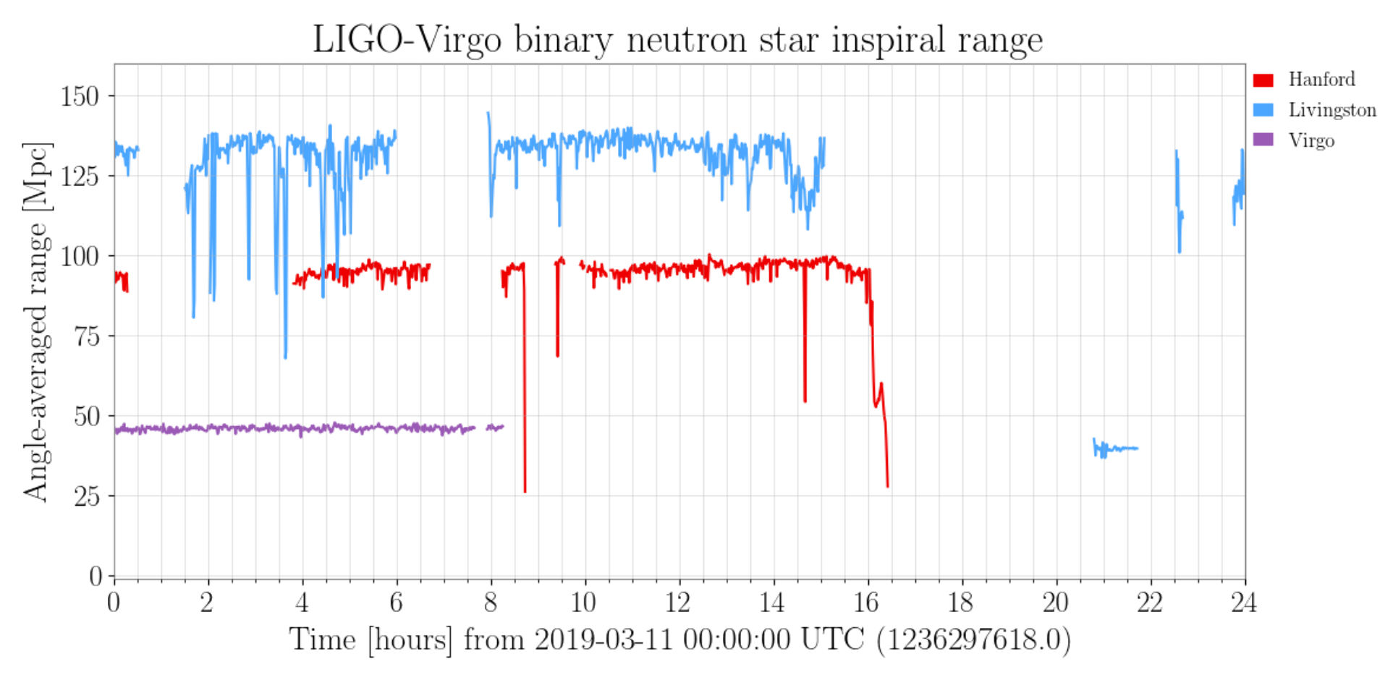
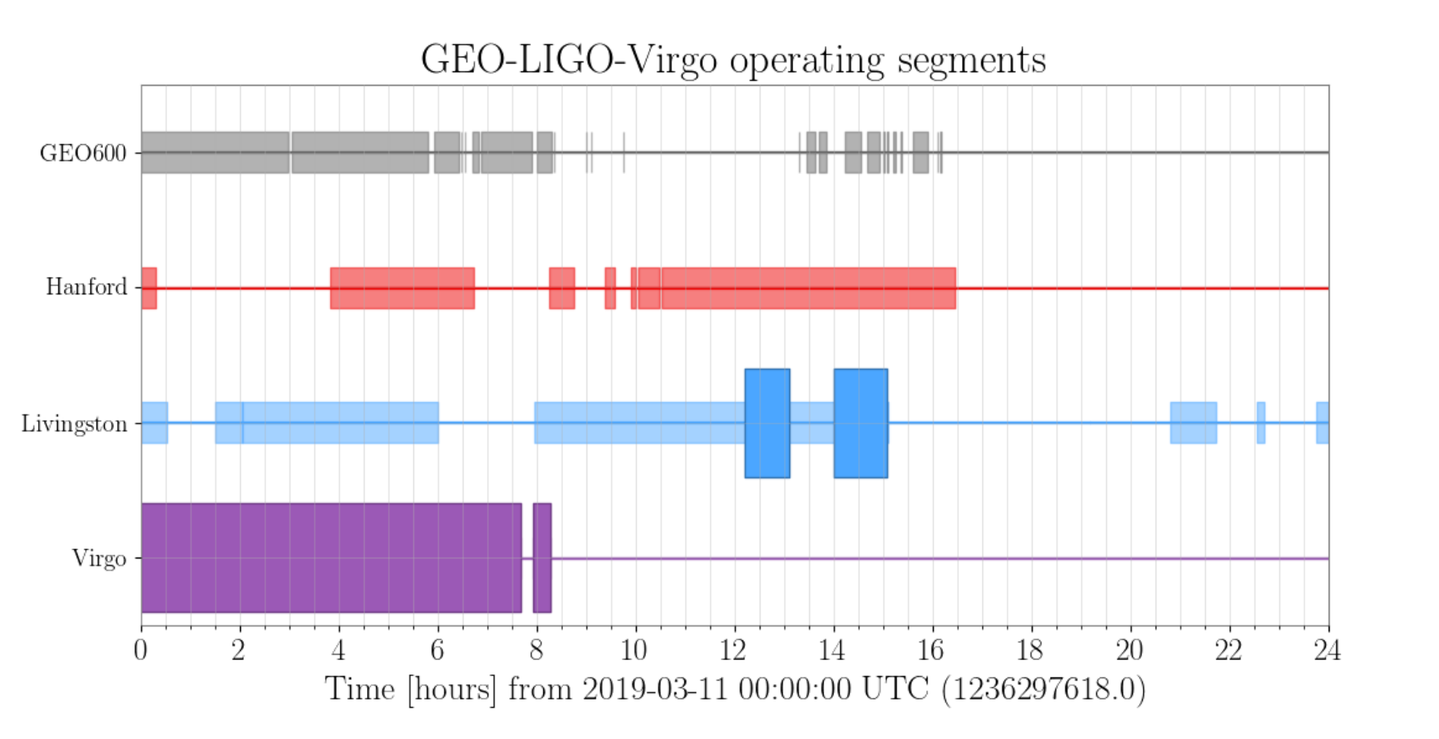
Example: Mar/11, no coincident OBSERVATION but some HLVG coincident running.

Slide 4
ER14 and Instrument Status
Second half (Starting Mon Mar. 18 2019)
  H1 will start going into OBSERVING whenever possible
  Finalizing calibration for all instruments. Significant calibration time for H1.
  Some work to be done for all IFOs, but will transition more and more toward 24/7 until O3.

Slide 5
O3
Apr/01/2019, 15:00 UTC (Tentative, no change in the plan).
Coordination between the sites for planned downtime to maximize triple coincidence.
Planned downtime: maintenance and commissioning
  L1 maintenance Tue. 14:00-18:00 (or 15:00-19:00) UTC.
  H1 maintenance Tue. 15:00-19:00 (or 16:00-20:00) UTC.
  V1 maintenance Tue. 07:00 – 11:00 UTC
We WILL spend time on problems that need immediate attention, or if we think we can make significant improvement in short period.

Slide 6
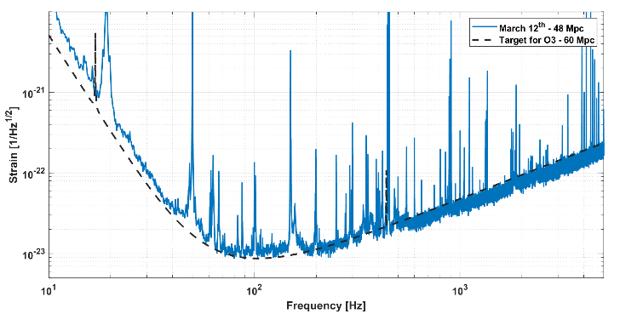
Current detector performance: V1
Currently alternating commissioning and calibrations during daytime and observing mode in the nights;
Good (>85%) duty cycle in science mode (“night time”)
Same scheme will be kept in place in the next weeks, with commissioning activities fading away as O3 approaches;

Slide 7
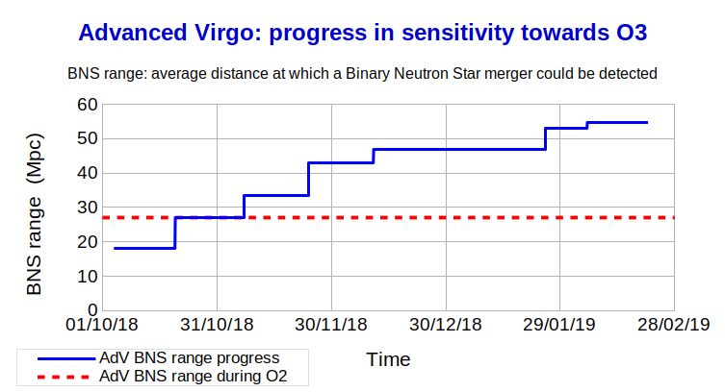
Current detector performance: V1
Best range observed so far close to 55 Mpc for BNS, usually fluctuating between 45 Mpc and 50 Mpc → work in progress to stabilize the sensitivity;

Slide 8
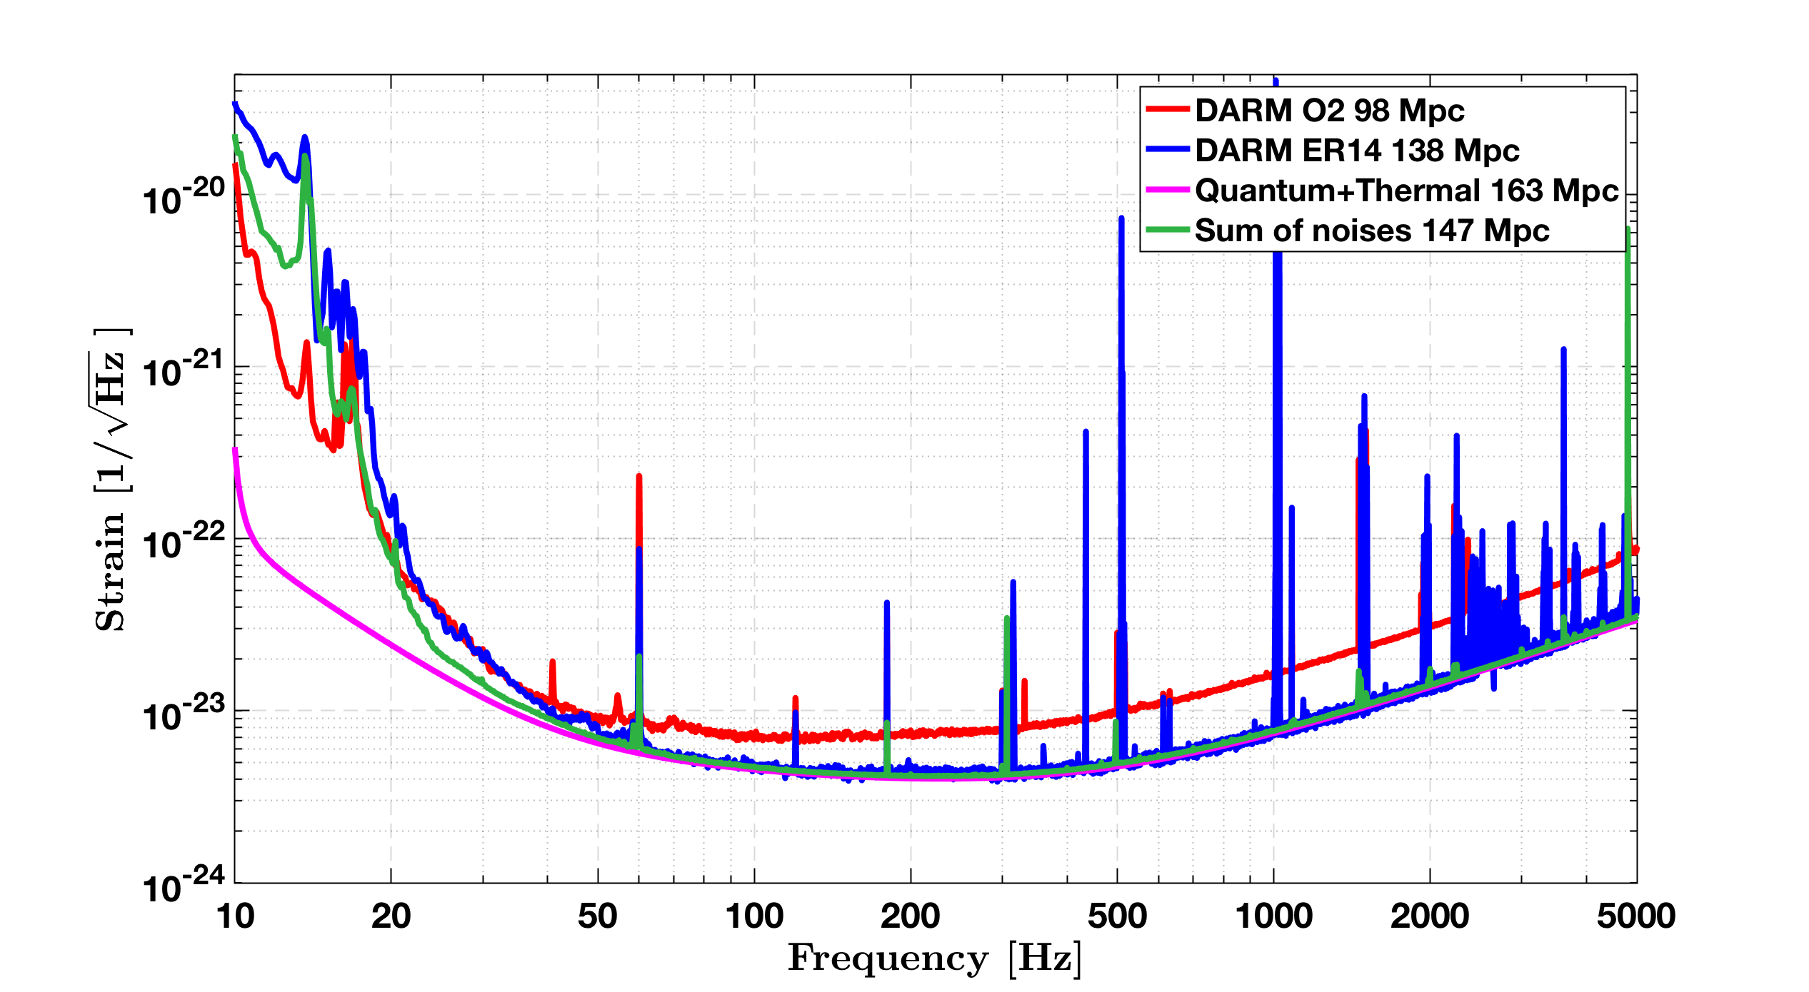
Current detector performance: L1
Squeezing + Higher Laser Power

Slide 9
Current detector performance: L1
Recent improvement in sensitivity from finding alignment on test mass that avoids point absorbers.
Squeezing as high as 3.0 dB observed. Input power as high as 50W but plan to run with 40W during O3 for stability/robustness.
ER14 –
  Commissioning work continues
  Tracking down noise sources.
  Improving lock sequence and stability.
  Calibration, Hardware injection tests etc.

Slide 10
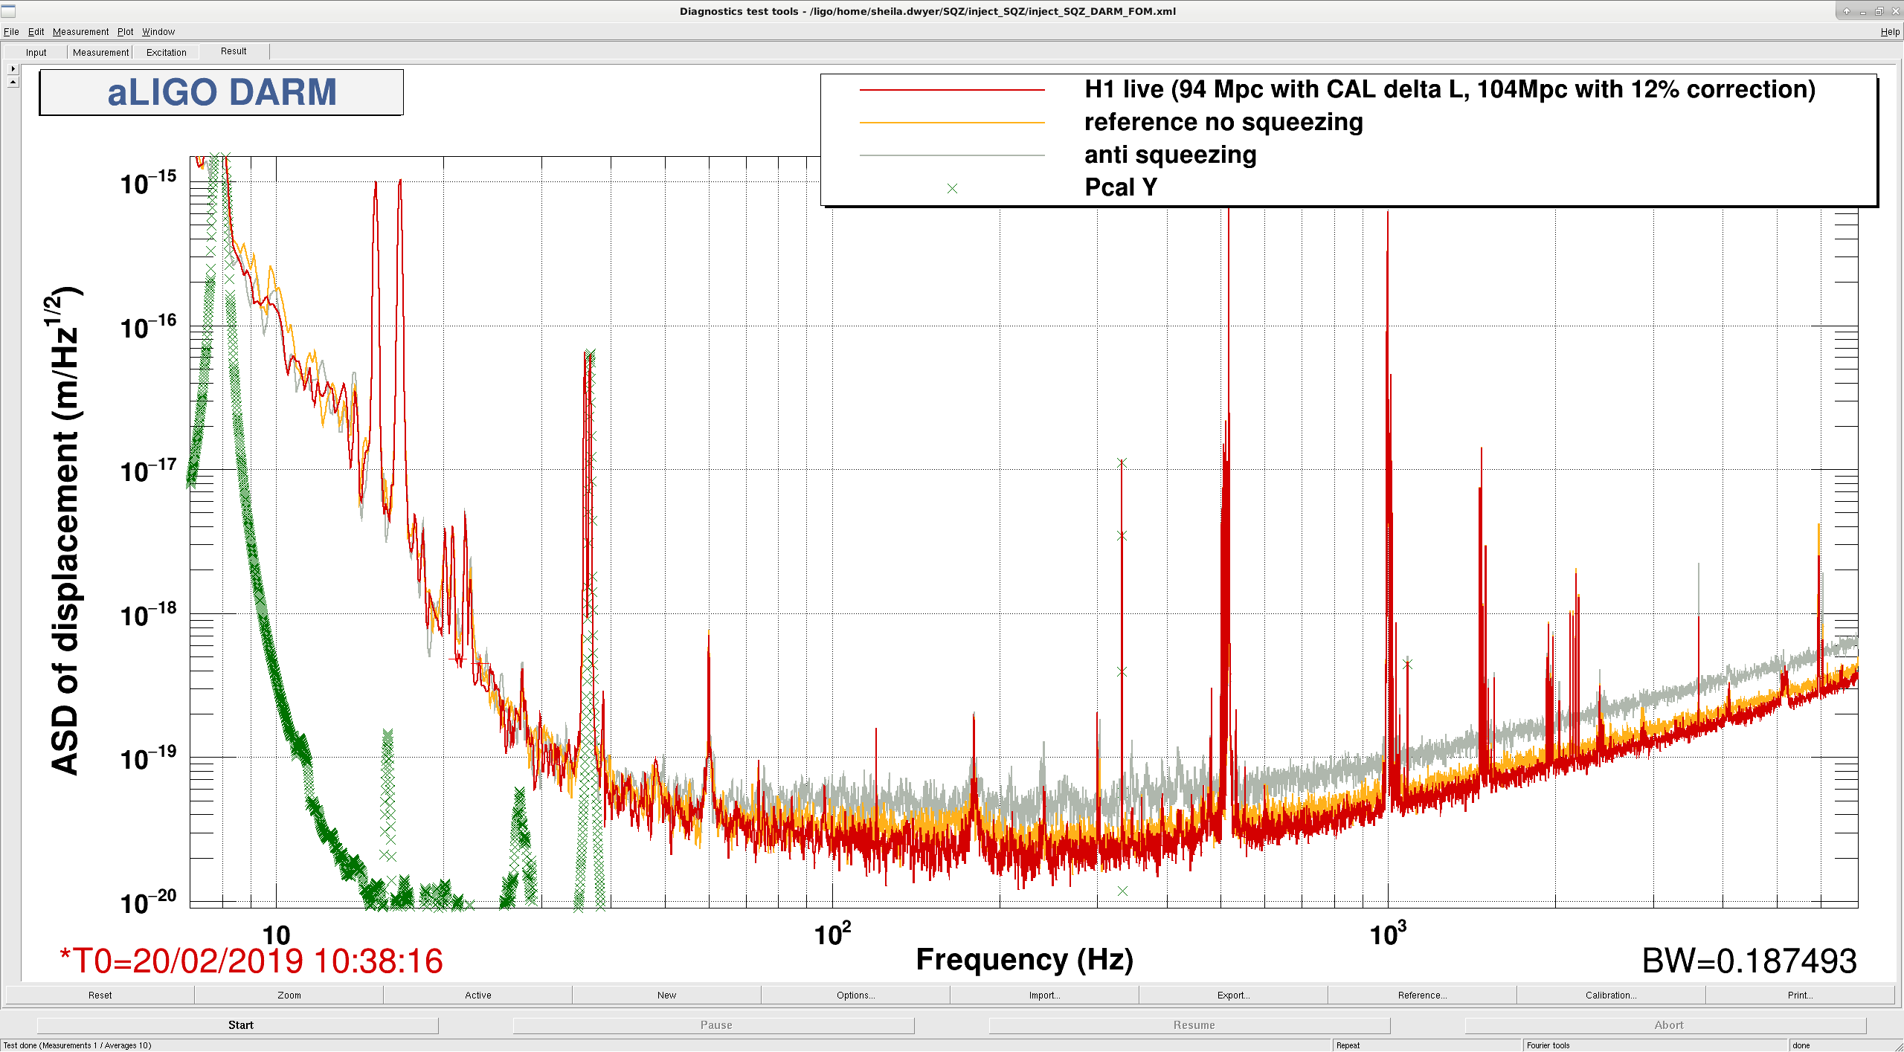
Current detector performance: H1
~100Mpc with 30W, ~2dB squeezing
Preliminary data with calibration correction at the time of measurement.

Slide 11
Current detector performance: H1
Benefit from avoiding high absorption spot on one of the mirrors.
Benefit from squeezing.
Operation reliable once it acquires lock (but acquisition is still slow).
Later half of ER14
  Calibration.
  Environmental noise Injection.
(Site closure days during ER14 due to snow.)

Slide 12
LIGO-G1801056

