Slide 1
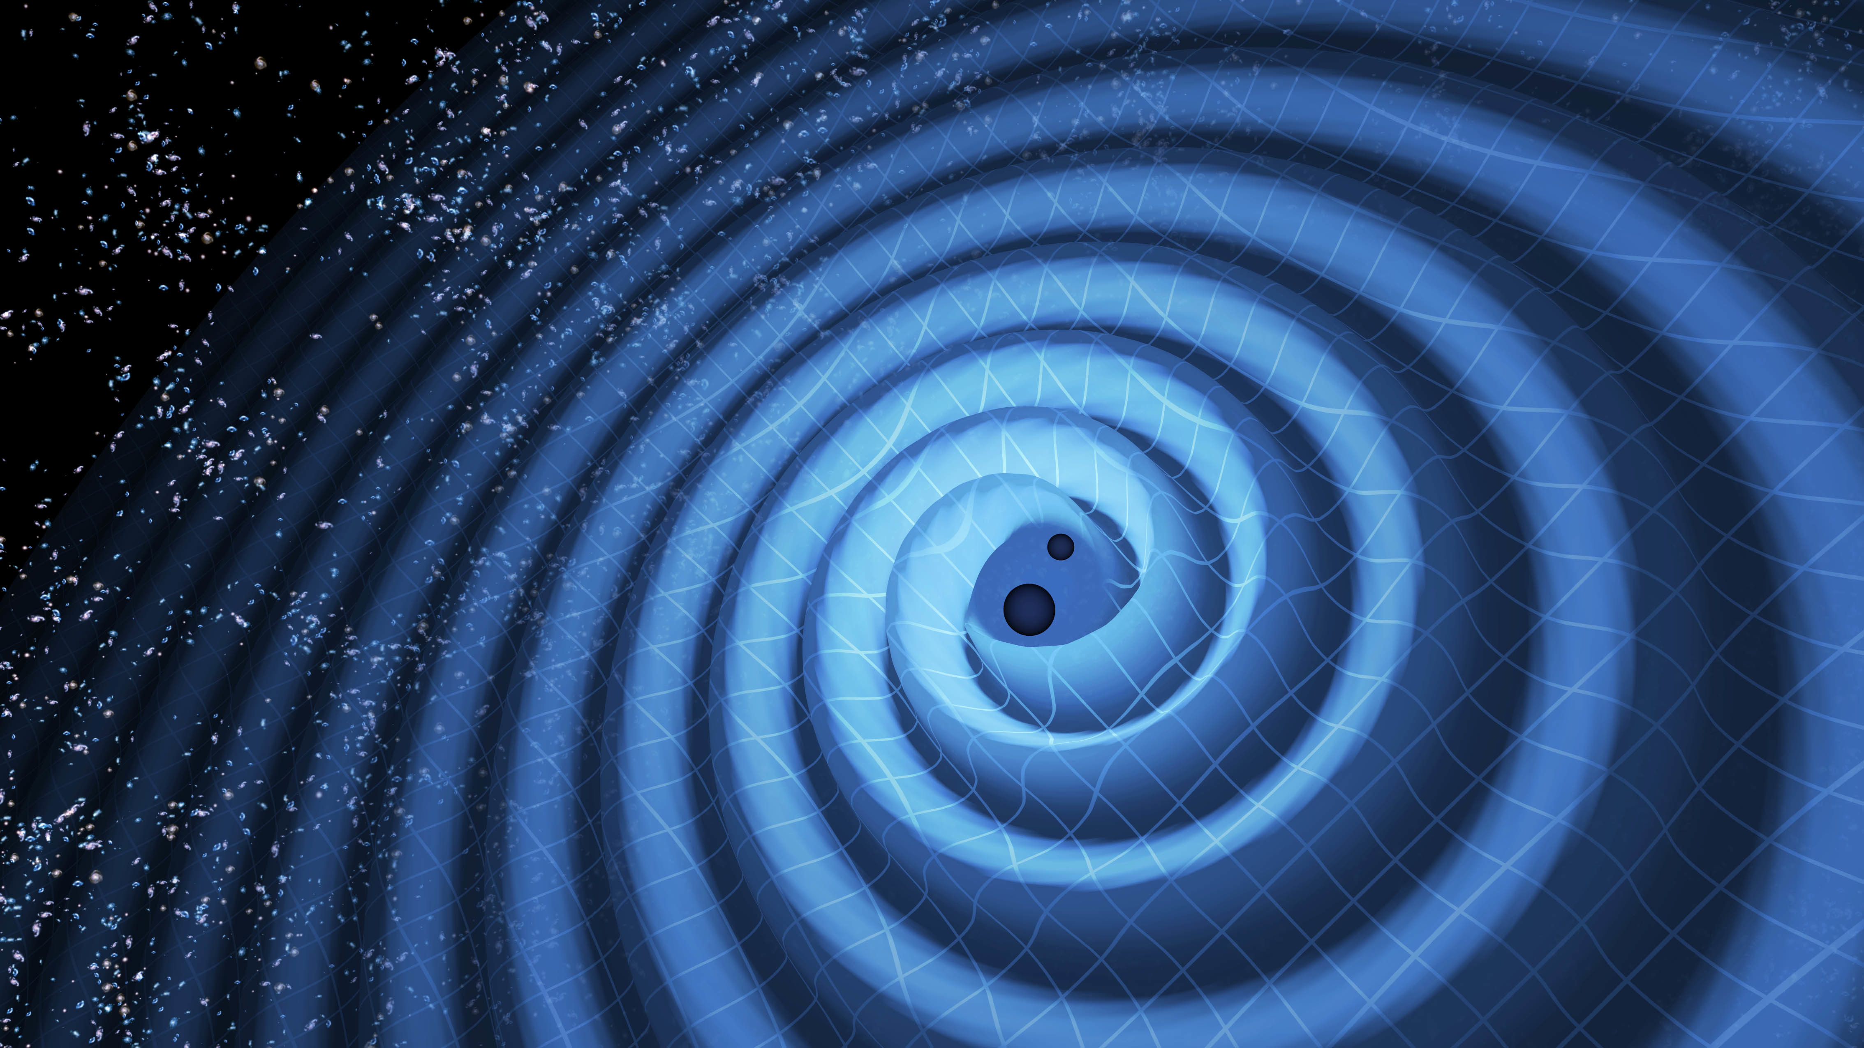
Accessing and using Gravitational Wave open data
Agata Trovato for the LIGO/Virgo collaboration
APC, CNRS/IN2P3, Univ. Paris Diderot

Slide 2
Outline
What are LIGO/Virgo data?
Available data sets
Timelines and working with segment lists
How to find tutorials and software

Slide 3
GWOSC
https://www.gw-openscience.org/
A. Trovato, GW-ODW2, 8th Apr 2019

Slide 4
LIGO/Virgo data
LIGO/Virgo data: strain, data quality and hardware injections
LIGO/Virgo data are arranged in files provided in different formats:
HDF5: easily readable in python, MATLAB, C/C++, and IDL
Frame format (.gwf)
Text file
Reminder: strain
A. Trovato, GW-ODW2, 8th Apr 2019

Slide 5
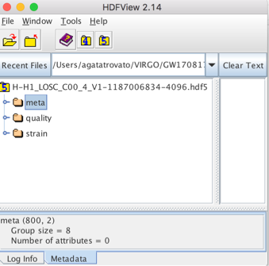
LIGO/Virgo data
LIGO/Virgo data: strain, data quality and hardware injections
LIGO/Virgo data are arranged in files provided in different formats:
HDF5: easily readable in python, MATLAB, C/C++, and IDL
Frame format (.gwf)
Text file
Reminder: strain
Meta-data for the file. This is basic information such as the GPS times covered, which instrument, etc.
You can use HDFView to quickly see what is inside the file
Refers to data quality. The main item here is a 1 Hz time series describing the data quality for each second of data.
Strain data from the interferometer. In some sense, this is "the data", the main measurement performed by LIGO/Virgo.
A. Trovato, GW-ODW2, 8th Apr 2019

Slide 6
Simple python script
The content of the files can be easily read with a simple python script
#----------------------
# Import needed modules
#----------------------
import numpy as np
import matplotlib.pyplot as plt
import h5py
#-------------------------
# Open the File
#-------------------------
fileName = 'H-H1_LOSC_C00_4_V1-1187006834-4096.hdf5'
dataFile = h5py.File(fileName, 'r')
#----------------------
# Explore the file
#-----------------------
for key in list(dataFile.keys()):
print(key)
https://www.gw-openscience.org/s/sample_code/plot_strain.py
If you execute this code the output will be:
meta
quality
strain
A. Trovato, GW-ODW2, 8th Apr 2019

Slide 7
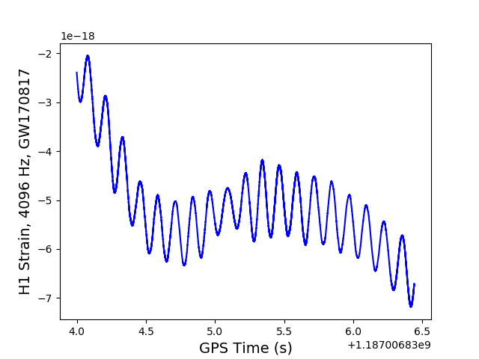
Simple python script
The content of the files can be easily read with a simple python script
#----------------------
# Import needed modules
#----------------------
import numpy as np
import matplotlib.pyplot as plt
import h5py
#-------------------------
# Open the File
#-------------------------
fileName = 'H-H1_LOSC_C00_4_V1-1187006834-4096.hdf5'
dataFile = h5py.File(fileName, 'r')
#----------------------
# Explore the file
#-----------------------
for key in list(dataFileC00.keys()):
print(key)
https://www.gw-openscience.org/s/sample_code/plot_strain.py
#---------------------------
# Create a time vector for
#---------------------------
meta = dataFile['meta']
gpsStart = meta['GPSstart'].value
duration = meta['Duration'].value
gpsEnd = gpsStart + duration
strain = dataFile['strain']['Strain'].value
ts = dataFile['strain']['Strain'].attrs['Xspacing']
time = np.arange(gpsStart, gpsEnd, ts)
#----------------------
# Plot the time series
#----------------------
numSamples = 10000
plt.plot(time[0:numSamples], strainC00[0:numSamples],color='b')
plt.xlabel('GPS Time (s)’)
plt.ylabel('H1 Strain, 4096 Hz, GW170817')
plt.show()
How many seconds of data this plot should contain?
This file was sampled at 4096 Hz (every second you have 4096 strain measurements). We are plotting the first 10000 samples so the length in time will be 10000/4096 = 2.44 s
A. Trovato, GW-ODW2, 8th Apr 2019

Slide 8
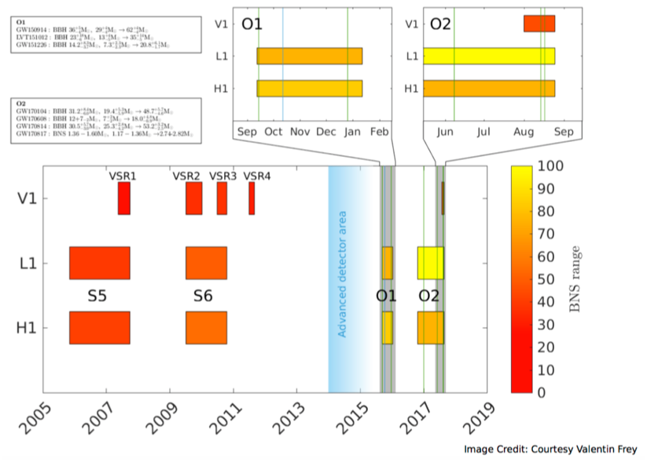
Science runs
A. Trovato, GW-ODW2, 8th Apr 2019

Slide 9
Available data sets
Open data can be found at https://www.gw-openscience.org
Two different types of data release:
Gravitational wave data surrounding discoveries
Confident detections available at the moment:
Data taken during a whole observation run
Runs available:
S5 (Nov 2005 - Oct 2007)
S6 (Jul 2009 - Oct 2010)
O1 (Sep 2015 - Jan 2016)
O2 (Nov 2016 - Aug 2017)
Name | Detector | Type | Run
GW150914 | LIGO | BBH | O1
GW151012 | LIGO | BBH | O1
GW151226 | LIGO | BBH | O1
GW170104 | LIGO | BBH | O2
GW170608 | LIGO | BBH | O2
GW170729 | LIGO + Virgo | BBH | O2
GW170809 | LIGO + Virgo | BBH | O2
GW170814 | LIGO + Virgo | BBH | O2
GW170817 | LIGO + Virgo | BNS | O2
GW170818 | LIGO + Virgo | BBH | O2
GW170823 | LIGO | BBH | O2
BBH = Binary Black Hole
BNS = Binary Neutron Star

Slide 10
GWOSC Catalogs
https://www.gw-openscience.org/catalog/
A. Trovato, GW-ODW2, 8th Apr 2019

Slide 11
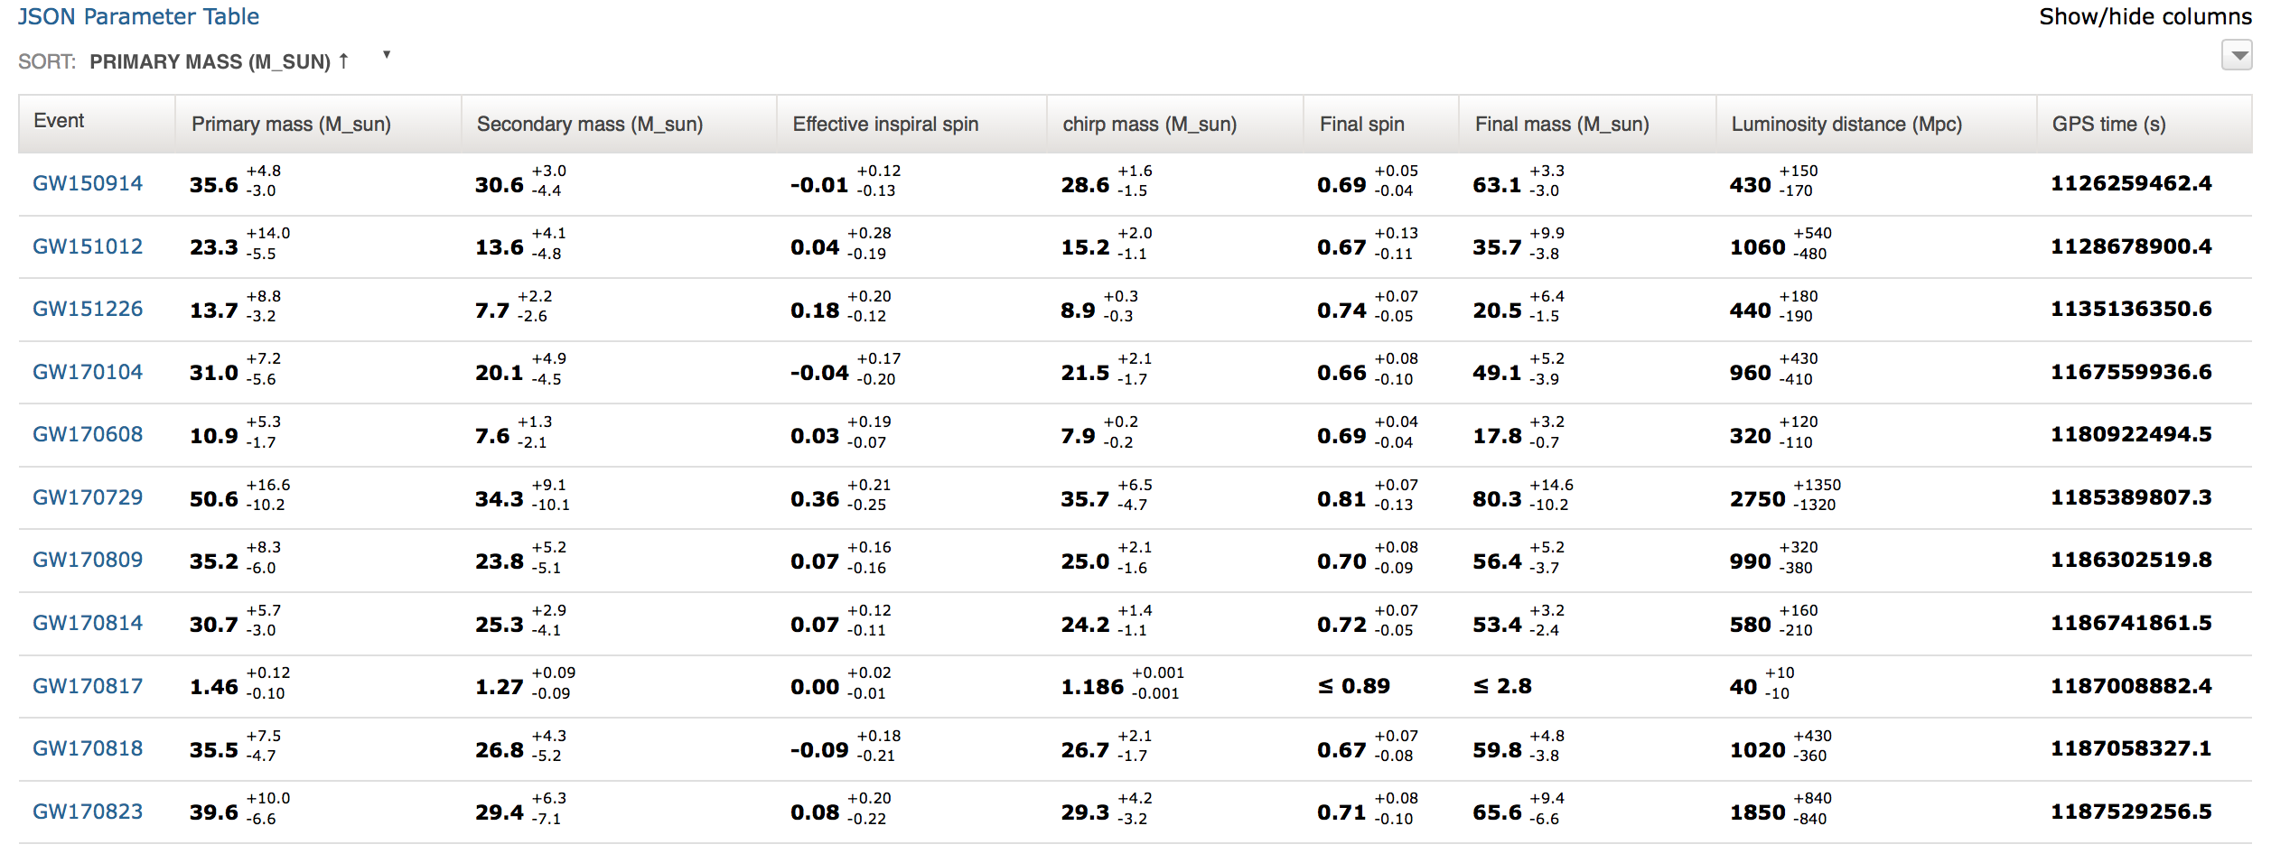
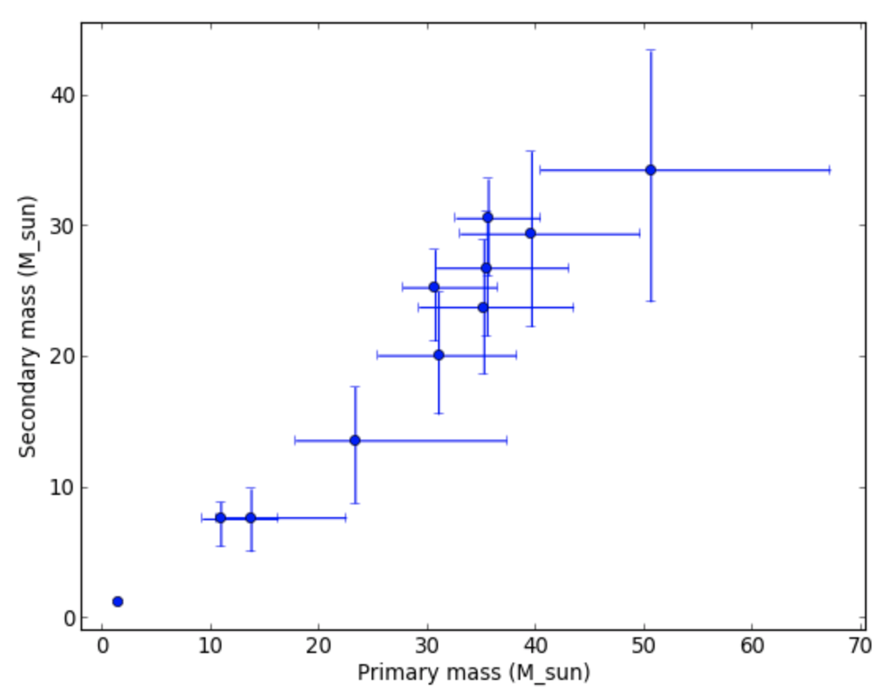
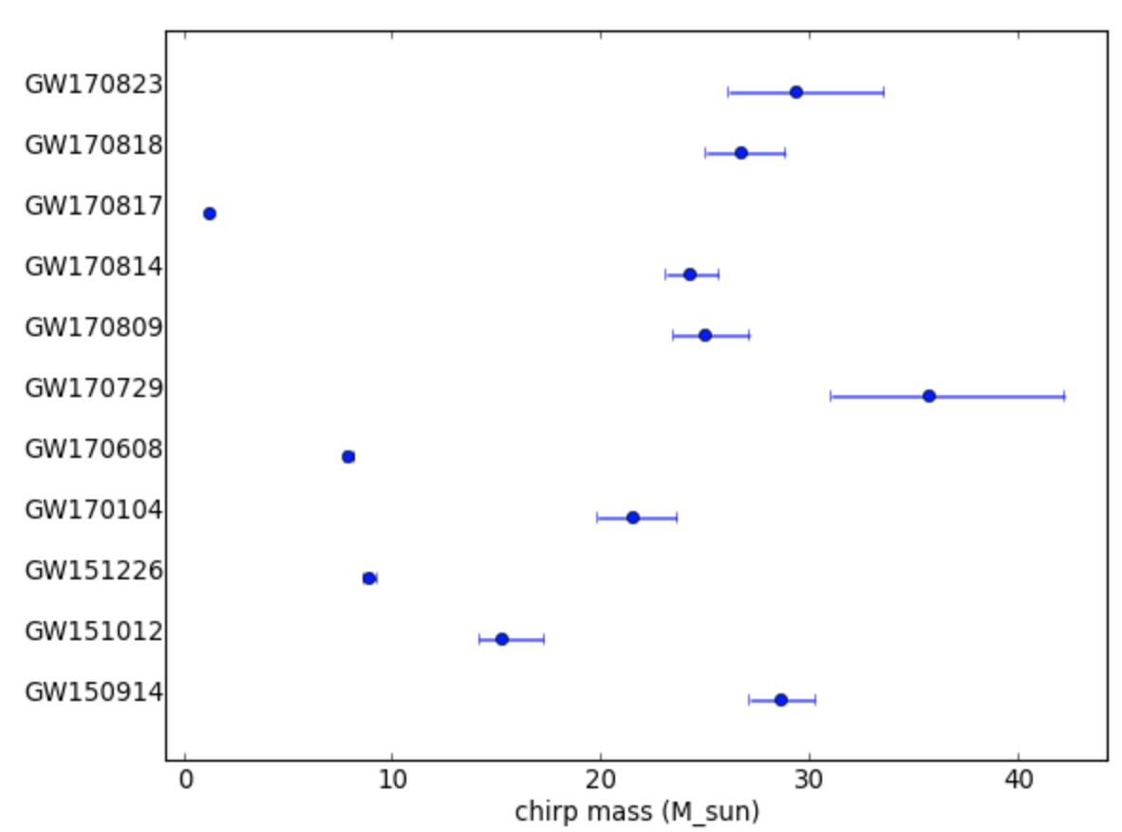
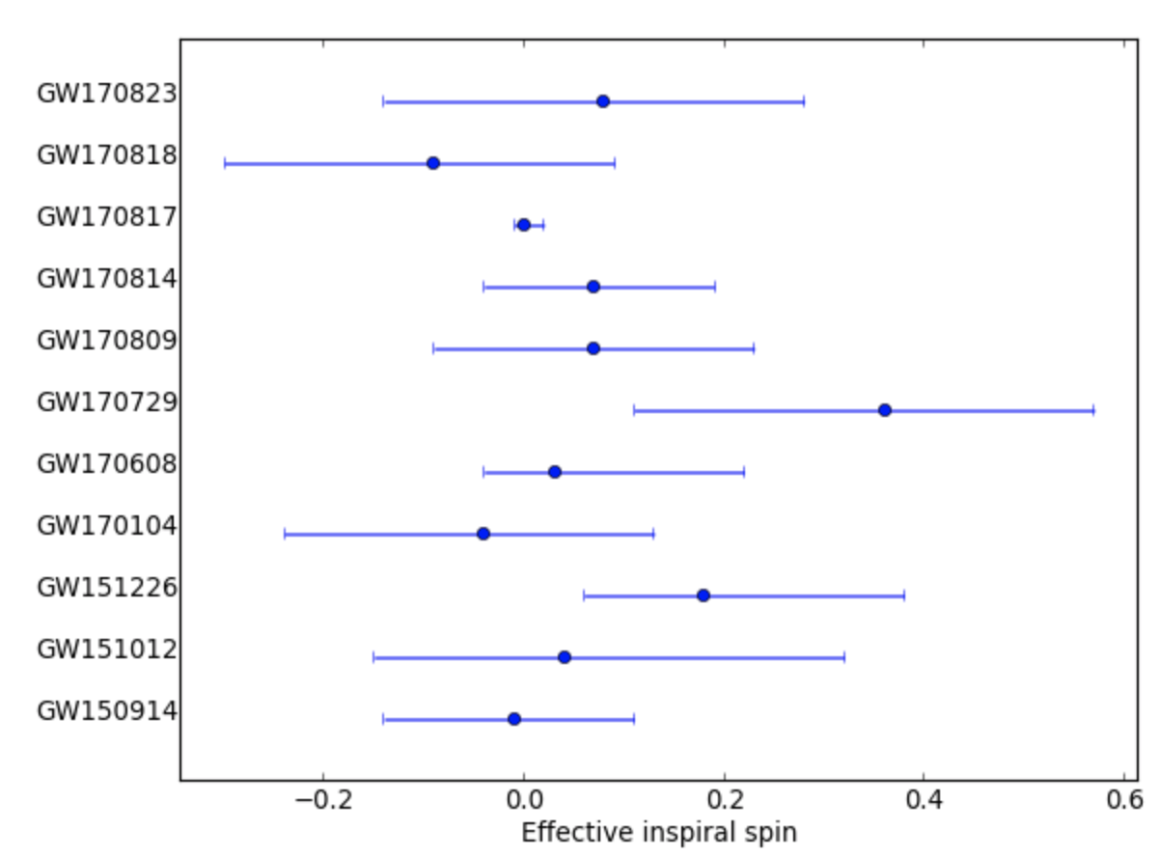
GWTC-1 Confident
A. Trovato, GW-ODW2, 8th Apr 2019

Slide 12
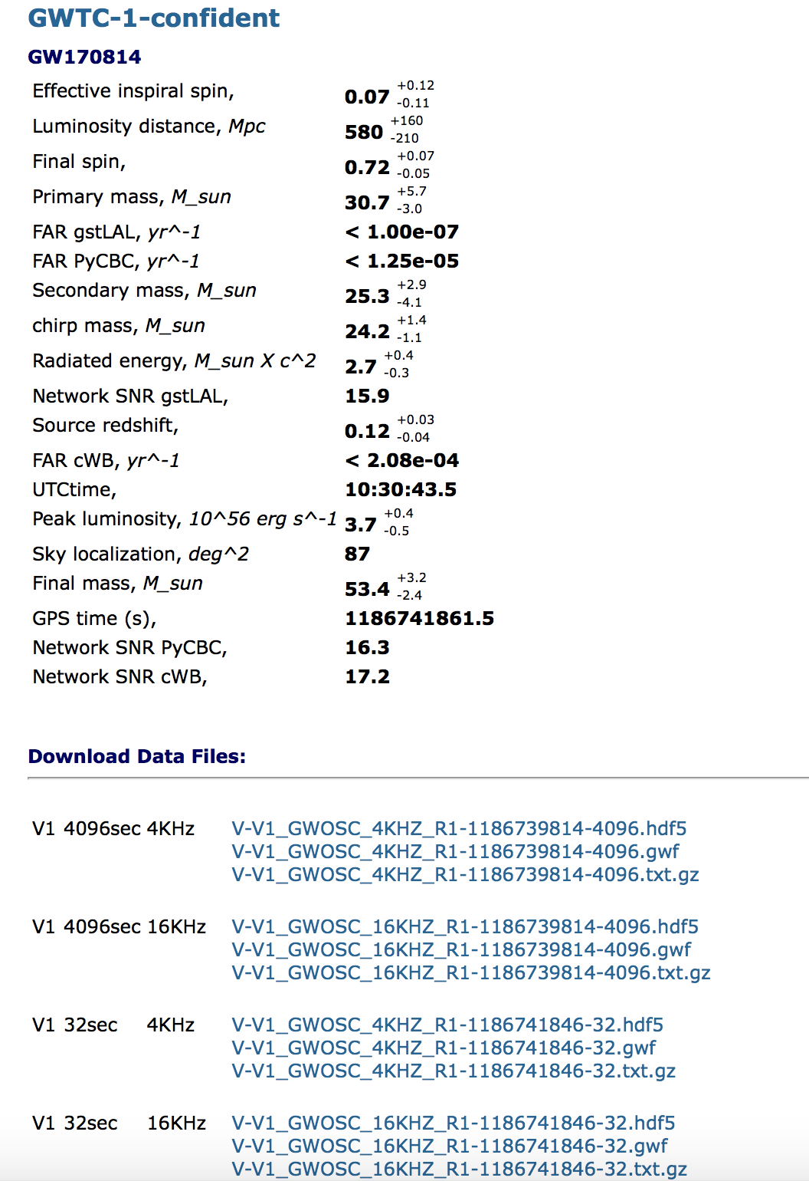
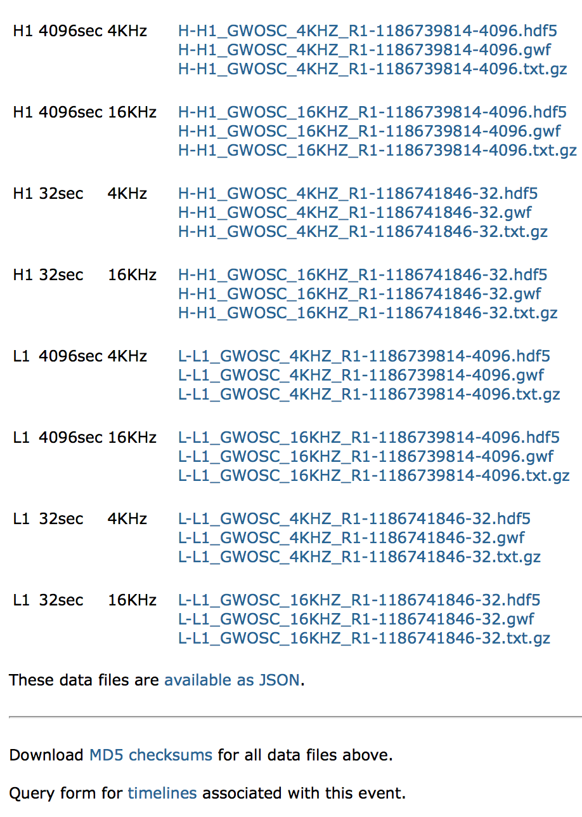
GWTC-1 event example
A. Trovato, GW-ODW2, 8th Apr 2019

Slide 13
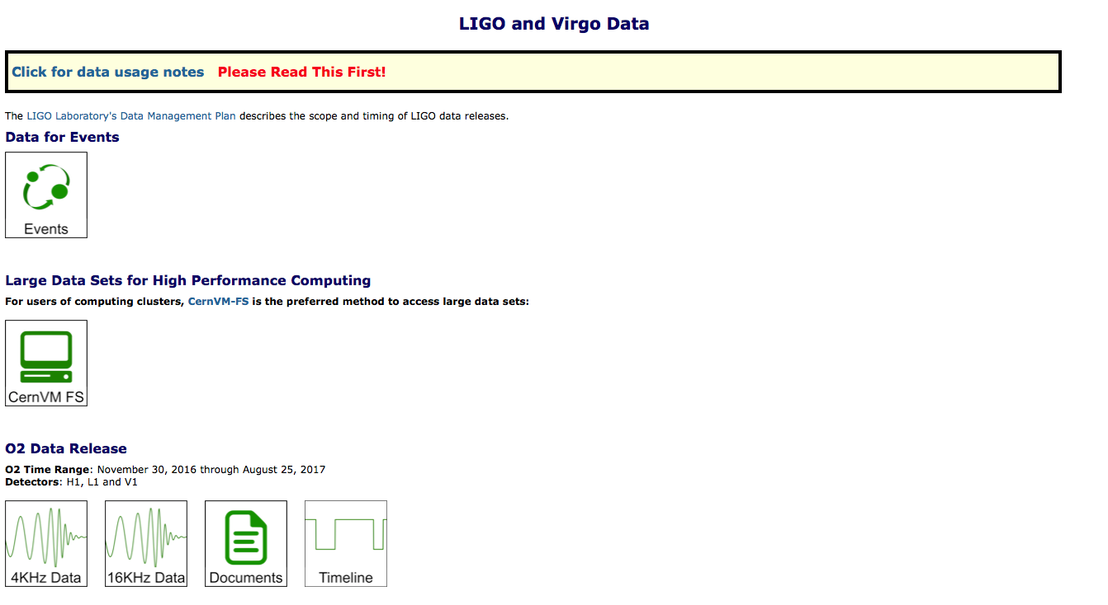
GWOSC bulk data
https://www.gw-openscience.org/data/
Distributed filesystem that will allow you to mount the data local to your computer
-> Once you have installed and configured CernVM-FS client, you will be able to access data from these observation runs as files in subdirectories on your computer
Scrolling down you get the data for O1, S5 and S6
A. Trovato, GW-ODW2, 8th Apr 2019

Slide 14
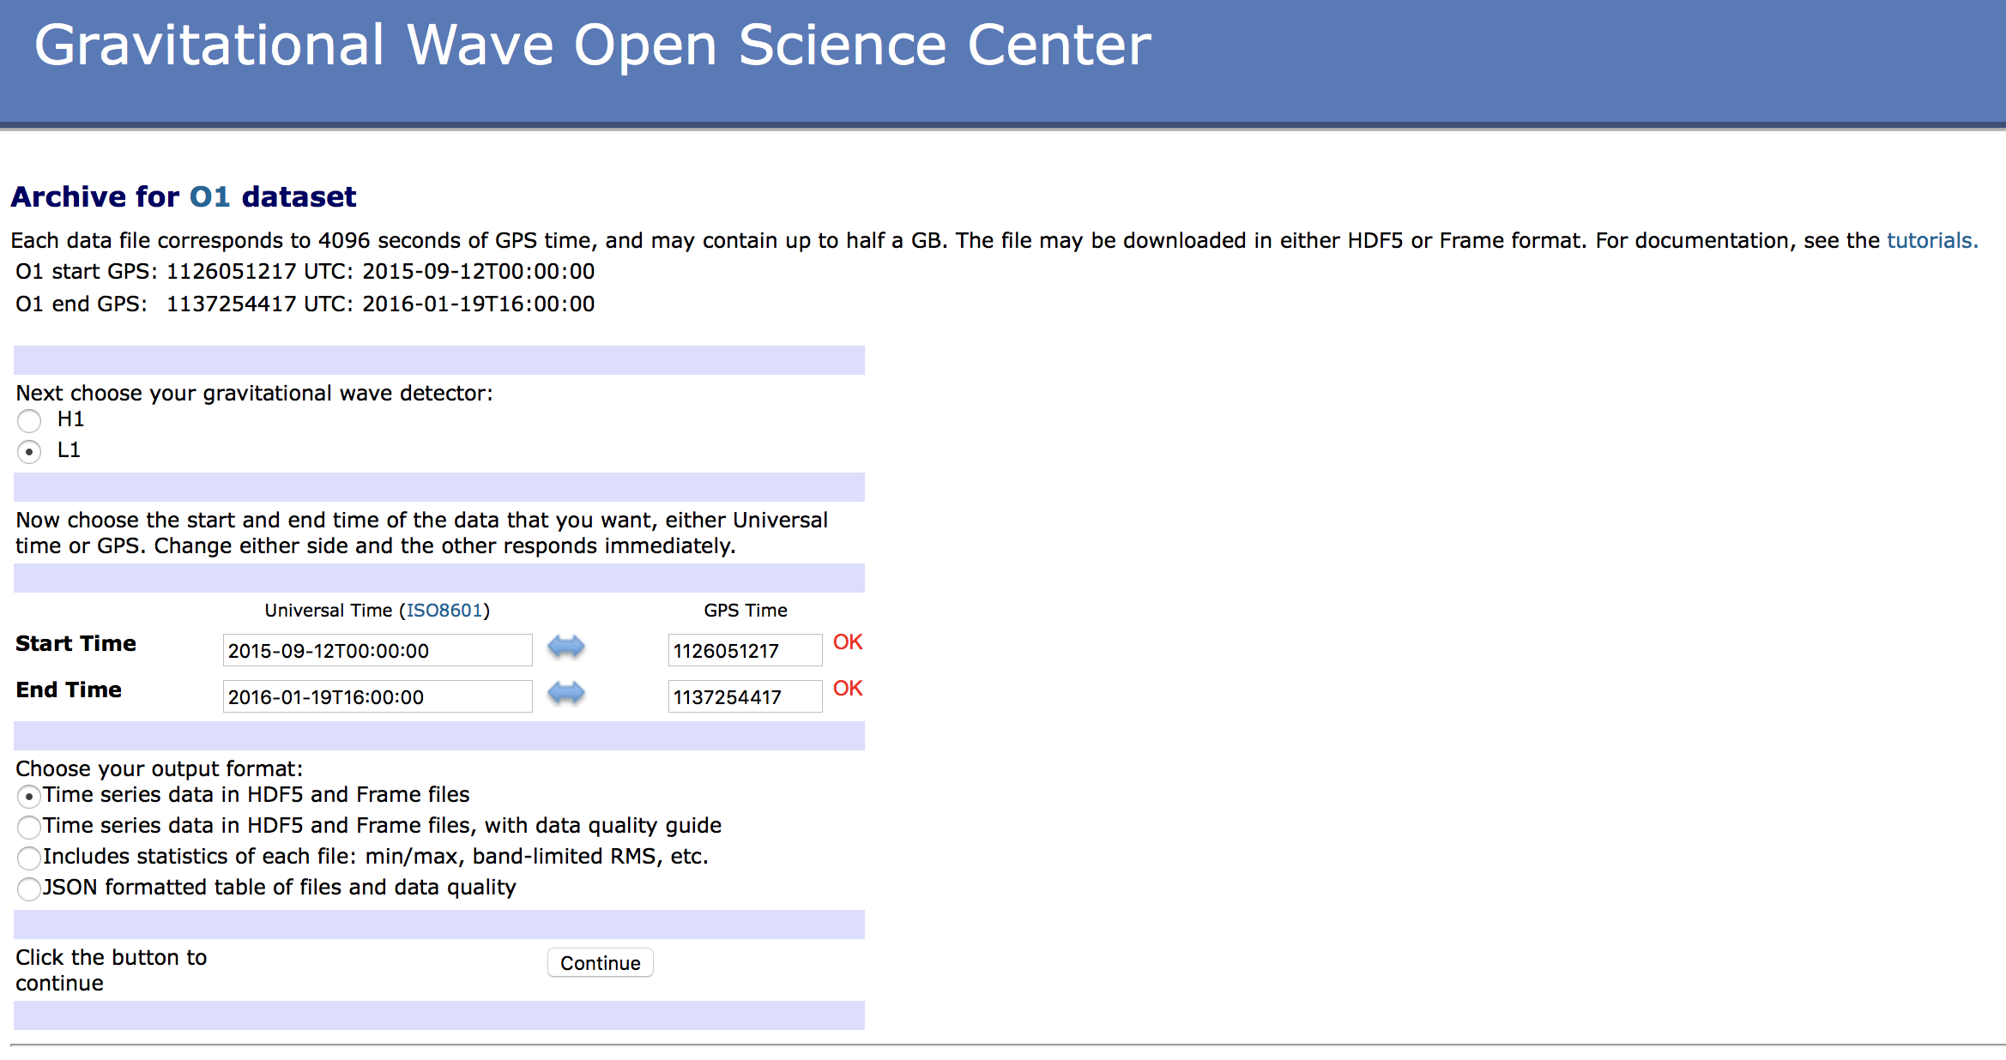
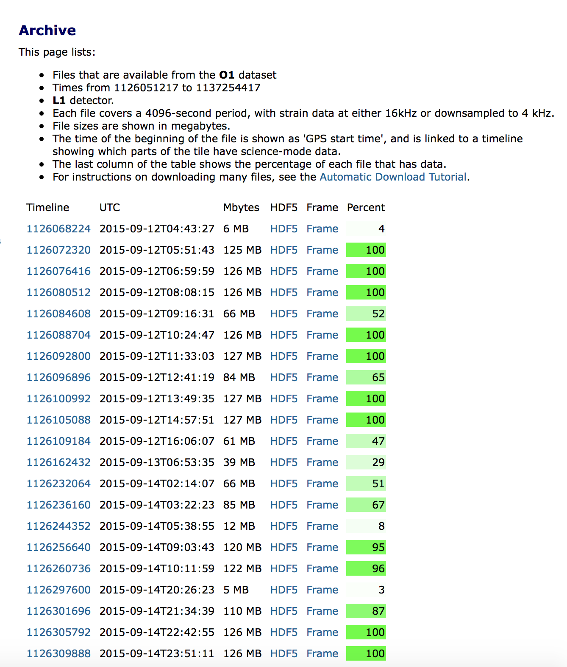
Example: O1 page
https://www.gw-openscience.org/archive/O1/
A. Trovato, GW-ODW2, 8th Apr 2019

Slide 15
Segment Lists
LIGO/Virgo data are not always 'on' (in science mode)
Data quality may not meet basic requirements
Consequence : GW data analysis is applied to data segments (different in each detector)

Slide 16
Segment Lists
LIGO/Virgo data are not always 'on' (in science mode)
Data quality may not meet basic requirements
Consequence : GW data analysis is applied to data segments (different in each detector)
The “Timeline” tool of the GWOSC website allows you to select segments that fulfill specific data quality checks in a time period that can be selected specifying GPS time and duration
6 segments

Slide 17
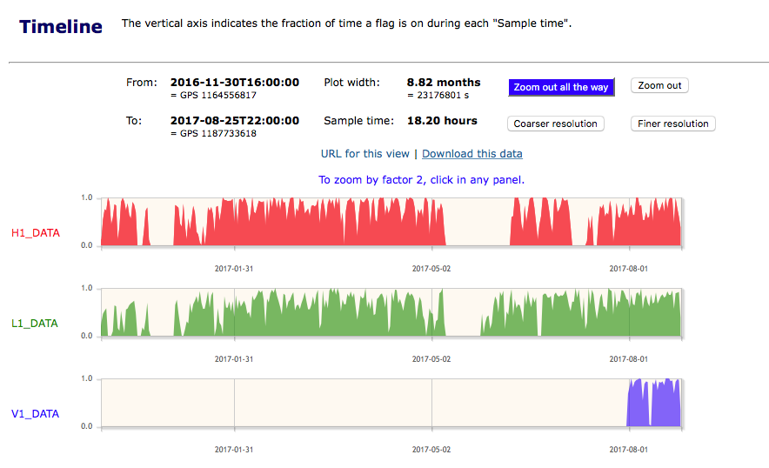
O2 timelines
A. Trovato, GW-ODW2, 8th Apr 2019

Slide 18
Timeline page
A. Trovato, GW-ODW2, 8th Apr 2019

Slide 19
Segments via readligo
On the GWOSC page you can find a lot of examples and tutorials
The website contains also an example API readligo.py that easily allow you to handle HDF5 files (it has to be in the same directory of the files)
To use the methods you have to add in the header of your program:
import readligo as rl
To load a single file you can use the method loaddata
strain, time, chan_dict = rl.loaddata(‘H-H1_LOSC…hdf5’, ‘H1’)
To get segments of data (assuming you downloaded the hdf5 files in the same folder)
segList = rl.getsegs(start, stop, 'H1', flag='BURST_CAT2')
Strain time series
dictionary of all of the data quality flags in the file
GPS time series
GPS time
Detector
data quality flag
List of GPS time of the segments fulfilling the requested criteria

Slide 20
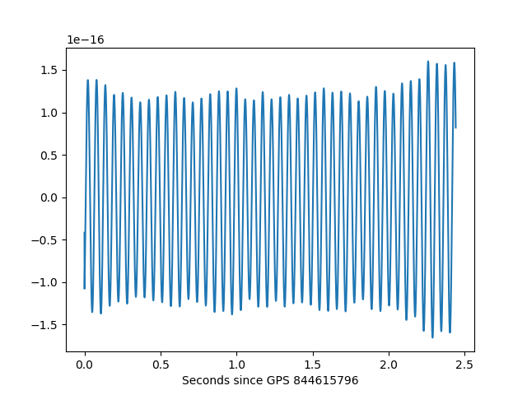
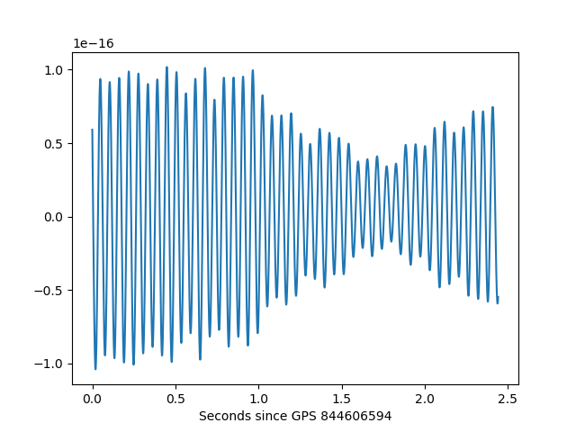
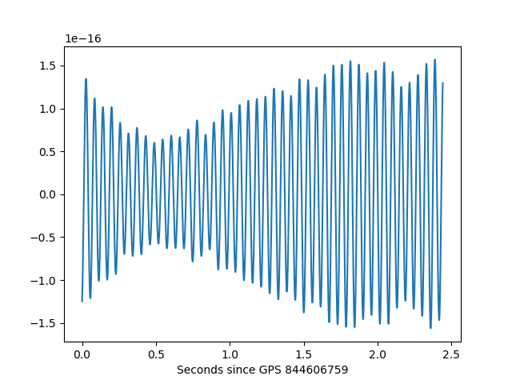
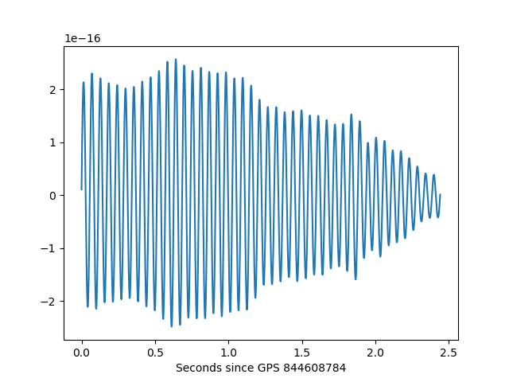
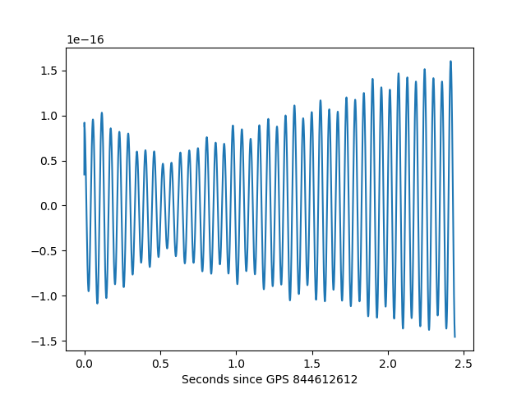
Segments: example code
import numpy as np
import matplotlib.pyplot as plt
import readligo as rl
start = 844605900
stop = 844615900
segList = rl.getsegs(start, stop, 'H1', flag='BURST_CAT2')
print (segList)
#-------------------------------------------
# Plot a few seconds of each "good" segment
#-------------------------------------------
N = 10000
for (begin, end) in segList:
# -- Use the getstrain() method to load the data
strain, meta, dq = rl.getstrain(begin, end, 'H1')
# -- Make a plot
plt.figure()
ts = meta['dt']
rel_time = np.arange(0, end-begin, meta['dt'])
plt.plot(rel_time[0:N], strain[0:N])
plt.xlabel('Seconds since GPS ' + str(begin) )
plt.show()
https://www.gw-openscience.org/s/sample_code/use_readligo.py
Output:
SegmentList( [(844605900, 844606294), (844606594, 844606649), (844606759, 844607779), (844608784, 844609581), (844612612, 844615722), (844615796, 844615900)] )
A. Trovato, GW-ODW2, 8th Apr 2019

Slide 21
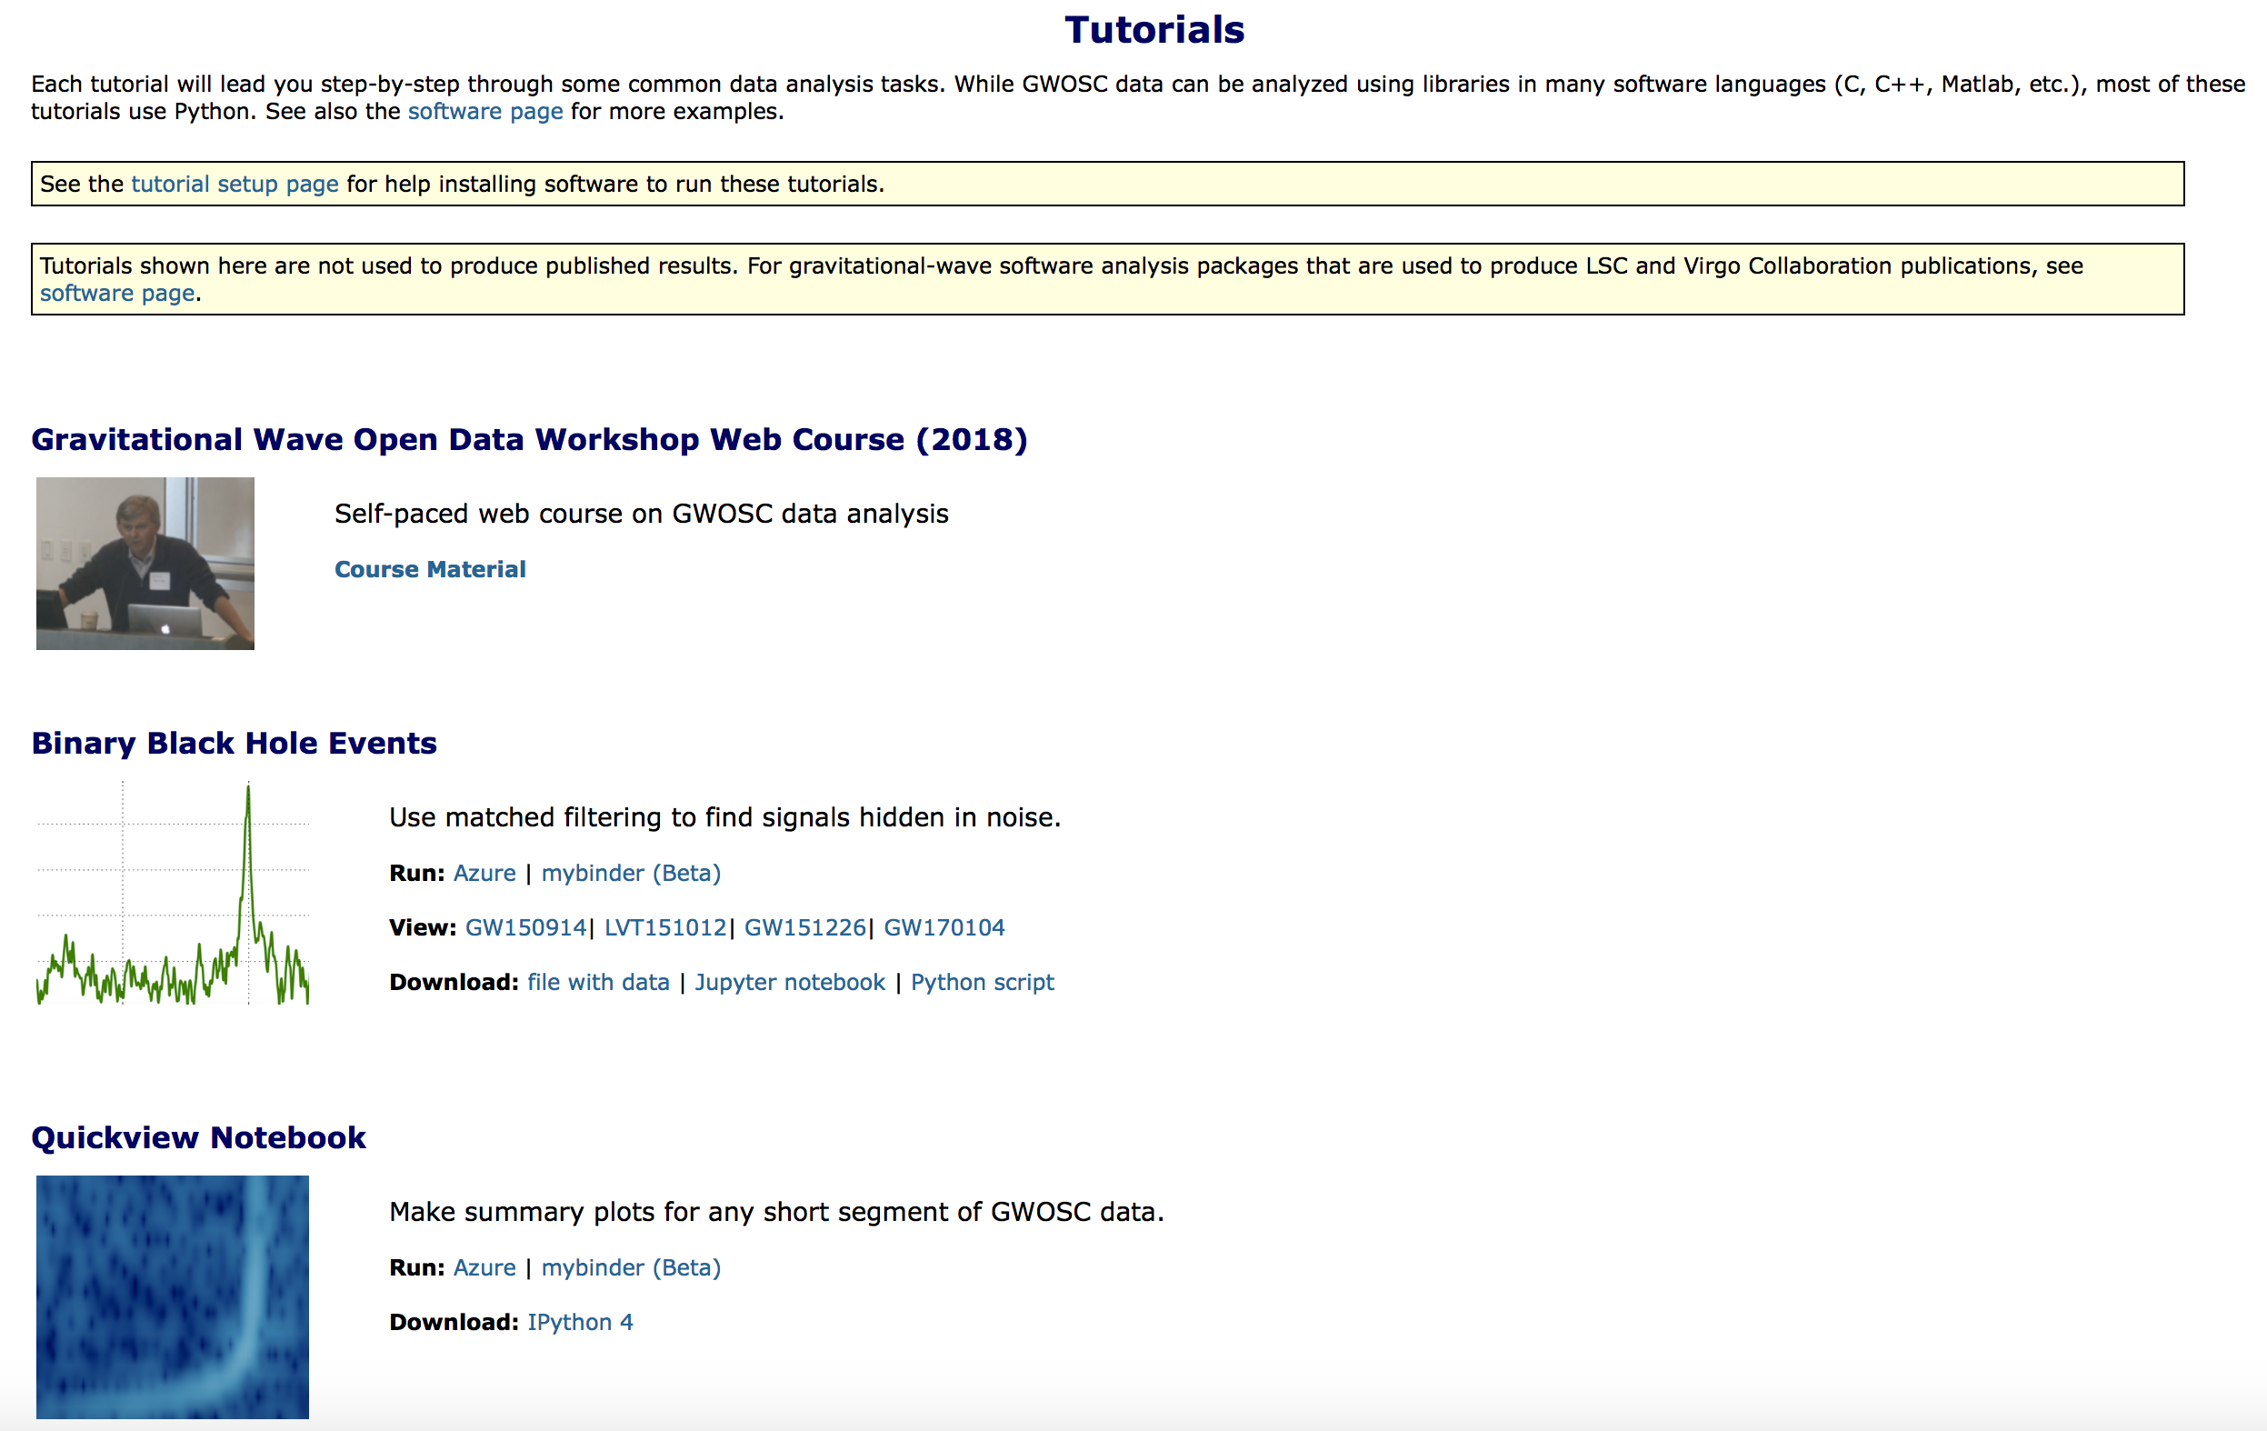
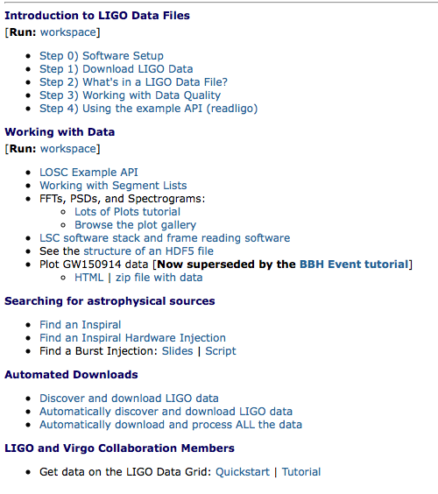
GWOSC Tutorials
The scripts I’ve shown are part of GWOSC tutorials that you can find at:
https://www.gw-openscience.org/tutorials/
This Open Data Workshop:
Materials will be made available on GWOSC shortly after workshop
First Open Data Workshop:
slides + videos of the presentations + Jupiter notebook for hands-on sessions
Short tutorials about the basics of data analysis applied to the some detected events
More specific tutorials on the data structure and how to read them

Slide 22
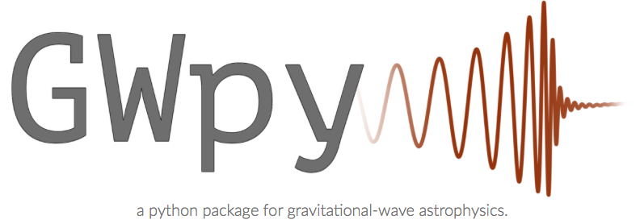
Software for GW data
Software for working with Gravitational Wave Data available to the public: https://www.gw-openscience.org/software/
Part of the software developed by LIGO/Virgo and open-source

Slide 23
Thank you!
Questions?

