Slide 1
The Beauty of Hindsight: Advanced LIGO
24 May 2019
David Shoemaker
MIT

Slide 2
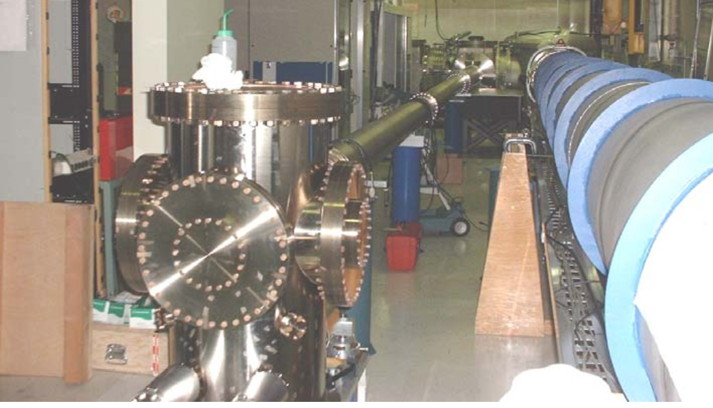
A Short History of aLIGO
1990’s: Many table-top and small-scale experiments in
Laser systems
Interferometer topologies
Mirror coating materials science
Extremely low-loss mechanical systems
Many degree-of-freedom servo control systems
1999: White paper, based on these ‘small science’ successes
Early 2000s: LIGO Scientific Collaboration is born, refines design, shows strong scientific consensus and unity on the path forward
2003: Proposal to the NSF from the LIGO Laboratory
Mid-2000’s: Advanced LIGO design refinement, hard choices, ‘Projectification’

Slide 3
The Project
2008: Project Start
$205M from the NSF, complemented by $15M UK, $15M Germany, $5M Australia (or so)
Scope:
(design was separate from the Project, and done before/in parallel)
Remove and dispose of three old interferometers
Build three new interferometers
Install three interferometers
Turned into install two, store one
Pay all staff time
Keep to schedule, and don’t ask for more money
2015: Project End
What could possibly go wrong?

Slide 4
(design was done in parallel)
Bad idea: try to do design on some subsystems while others are cutting metal
Led to rework, subsystems waiting for parts, thrash to keep ‘new, better ideas’ from being introduced
Not too much stuff thrown away
Auxiliary optics is the poster child here

Slide 5
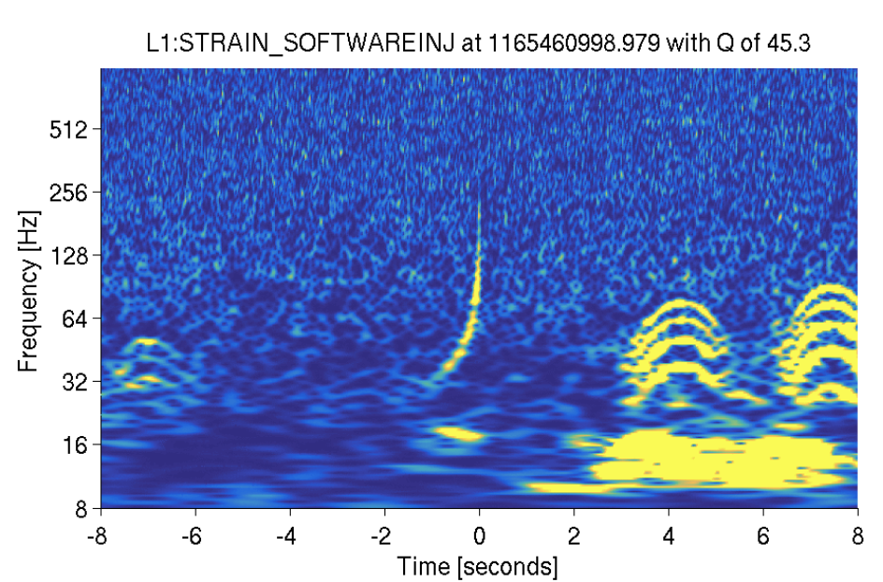
Auxiliary optics ‘subsystem’
Lumped together a bunch of stuff as we had in initial LIGO
1 transport of interferometer output beams,
2 stray light control,
3 thermal compensation (including diagnostic wave front sensing),
4 optical levers for alignment reference,
5 initial alignment procedure and equipment, and
6 the photon calibration/excitation system.
Underscoped cost and labor by about a factor of 6
Moral: make it 3-4 subsystems
Starved of early design and planning
Still working on stray light control today

Slide 6
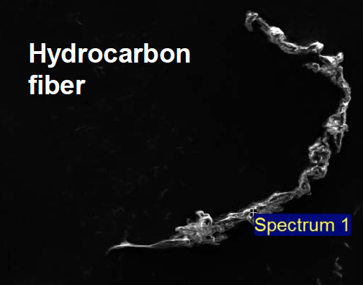
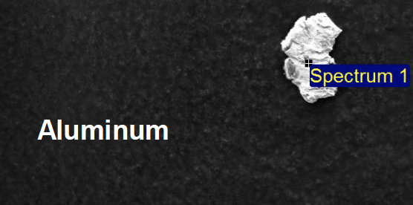
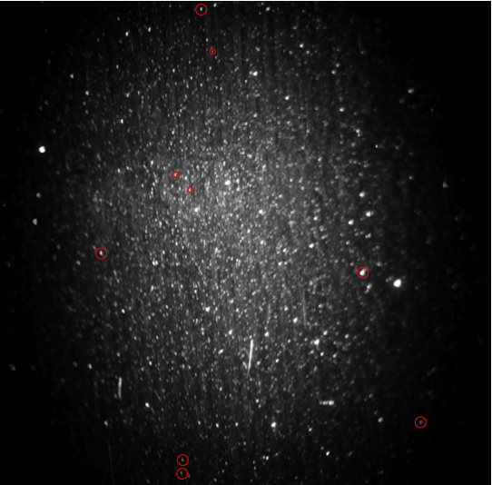
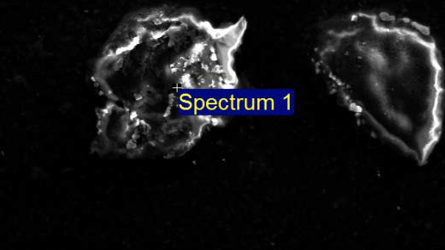
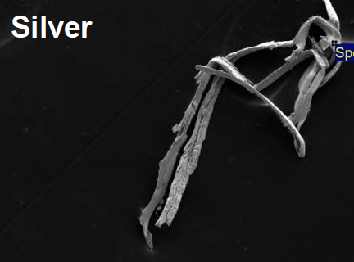
Particulate Contamination
Still learning how critical cleanliness is
…point absorbers…
Knew we needed to scrub the interior of all the chambers
Did not know how much dirt we dragged in as humans
Tiger Team (Thanks Calum) attacked this problem
Changed garb requirements, glove manufacturers, etc.
Much much better now
…still not good enough.
iLIGO Test Mass Scattered
1064 nm Light

Slide 7
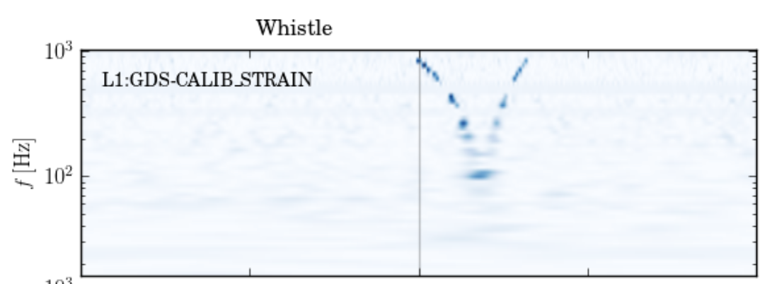
RF Electronics
Many radio-frequency oscillators
Some of them slewing to track interferometer lengths
Too much RF radiated and carried in grounds
Enough nonlinearities to mix everything in sight

Slide 8
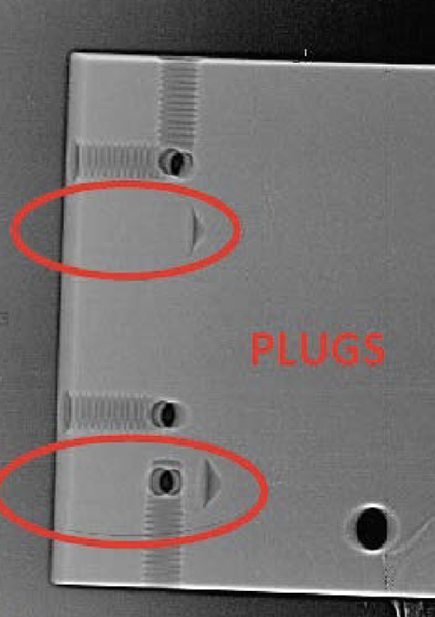
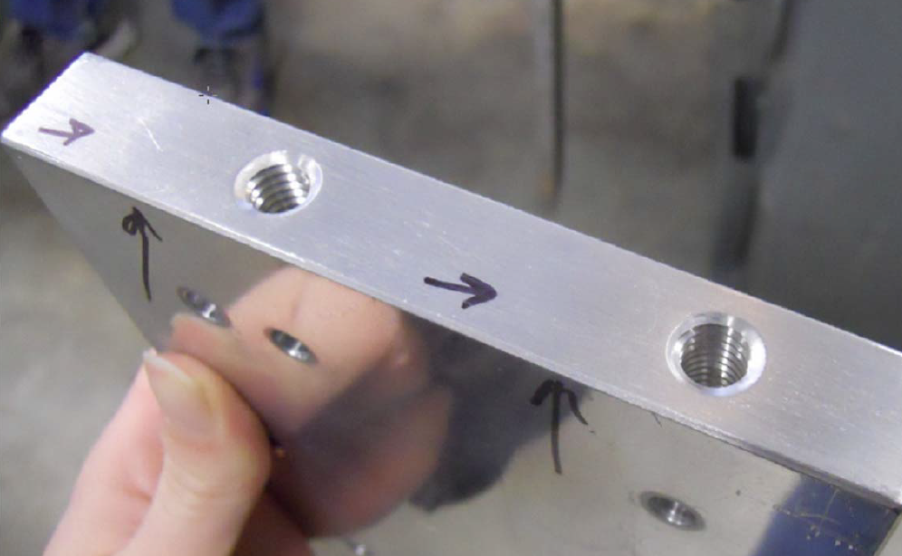
Subcontractor monitoring
QA/QC was invented and executed in house, with a light touch
Production in the Lab worked out ok
Had some dramatic problems with subcontractors
Holes drilled in wrong places, filled with plugs, and intentionally hidden
…found after assembly of seismic isolation systems
Disassembly, new fab, clean, reassemble
Time = money; this cost time AND money
Next time: heavier touch on QA/QC

Slide 9
Labor estimates
Asked subsystem leaders with experience in initial LIGO to estimate labor and its uncertainty
Followed with lead system engineers, in general increasing estimates and uncertainty
Followed with a MonteCarlo study (Thanks, Carol) to estimate a roll-up of costs covering a range of uncertainties
And…
Underestimated Labor by something like a factor of 2 – a huge cost for aLIGO (all labor was paid by the Project).
How did we survive?
Estimates from fab houses collected in dot.com years – all high
aLIGO contracts let after dot.com bubble burst – fab costs were lower than expected.
We got lucky – fab money could pay for people

Slide 10
Project Management
Project management infrastructure and software
Required by the NSF to do ‘earned value tracking’ and to report voluminously on spending
Also needed to be agile for changes – late mirror coatings, LIGO-India shift, etc.
Basic incompatibility for the tools we used (Primavera, Prism)
Also: software needed experts for input, and to interpret output
Many project controls people required ($$$)
Technical leaders felt disconnected from process
Project management communication
Because it felt imposed, and project controls people were not savvy on our technology, little buy-in from tech staff
Subsystem leaders did not want to spend time on it and in fact did not have the time – ‘Do you want the paperwork or the subsystem?’
→ Project management did not feel like a tool to the team but instead like a burden
(but absolutely necessary)

Slide 11
Geographically dispersed subsystem teams
Initial LIGO had suffered from having people in a given team at the 4 Lab sites (Caltech, MIT, LLO, LHO)
Disconnects, miscommunication, duplicated effort, travel costs…
We swore never to do it again…
…we did it again.
No choice: the experts were spread around.
aLIGO could profit from iLIGO – people either had already worked distributed, or had been at e.g., MIT then moved so already ‘a team’
(there are also advantages – cross-checking, more breadth in background, teams at observatories had ownership and were not shipped black boxes)

Slide 12
Documentation
Much much better than in iLIGO
But still too little too late
Spent the last 6 months scrambling to get basic documentation in place
But lacking a critical scope: running and debugging
Also need to maintain and refine documentation during running
Extra site burden – needs documentation staff to shadow commissioners
Very, very hard to do real detailed detector characterization if not at a site, limiting severely the number of people who can help
aLOG is very useful, but could consider a system which also builds and corrects documentation as aLOGs are made using a collection of keywords

Slide 13
Delaying decisions
aLIGO had very valuable external committees
LIGO PAC
aLIGO PAP
They told us again and again:
Make decisions early on imperfect knowledge – take risk
Spend money early to save time (and thus money) later
We did a little of it but not anywhere near as much as we should have
Would have had the resources to fix most of the persistent problems if we had.
But despite all that…

Slide 14
Happy Ending
Completed
within budget
on schedule
Detections were made
We are eager to do it again
…and make new mistakes

