Slide 1
LLO locklosses
O3 Status
Arnaud Pele for the LLO commissioning team

Slide 2
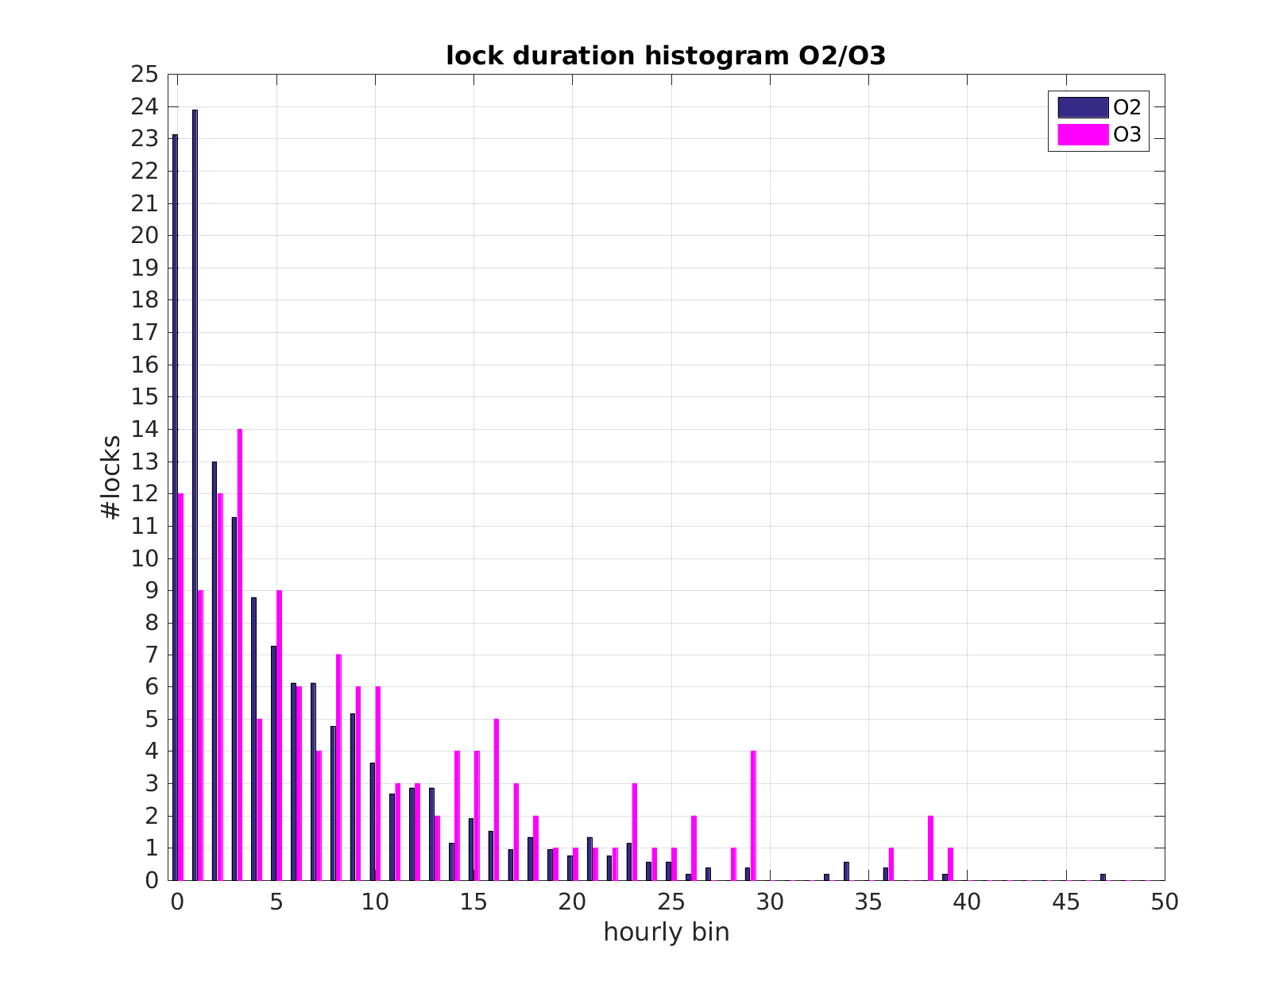
Some statistics
Counted locklosses and lock durations for O2 / O3 with change of ISC_LOCK guardian state
Total O2 locklosses = 717/240 days ~ 3/day Total O3 locklosses = 137/74 days < 2/day
Main differences could be from :
ESD DAC filtering (35230, 35262,T1700428)
BRS (43874)
Increase of locklosses from anthropogenic noise
100+ hour lock

Slide 3
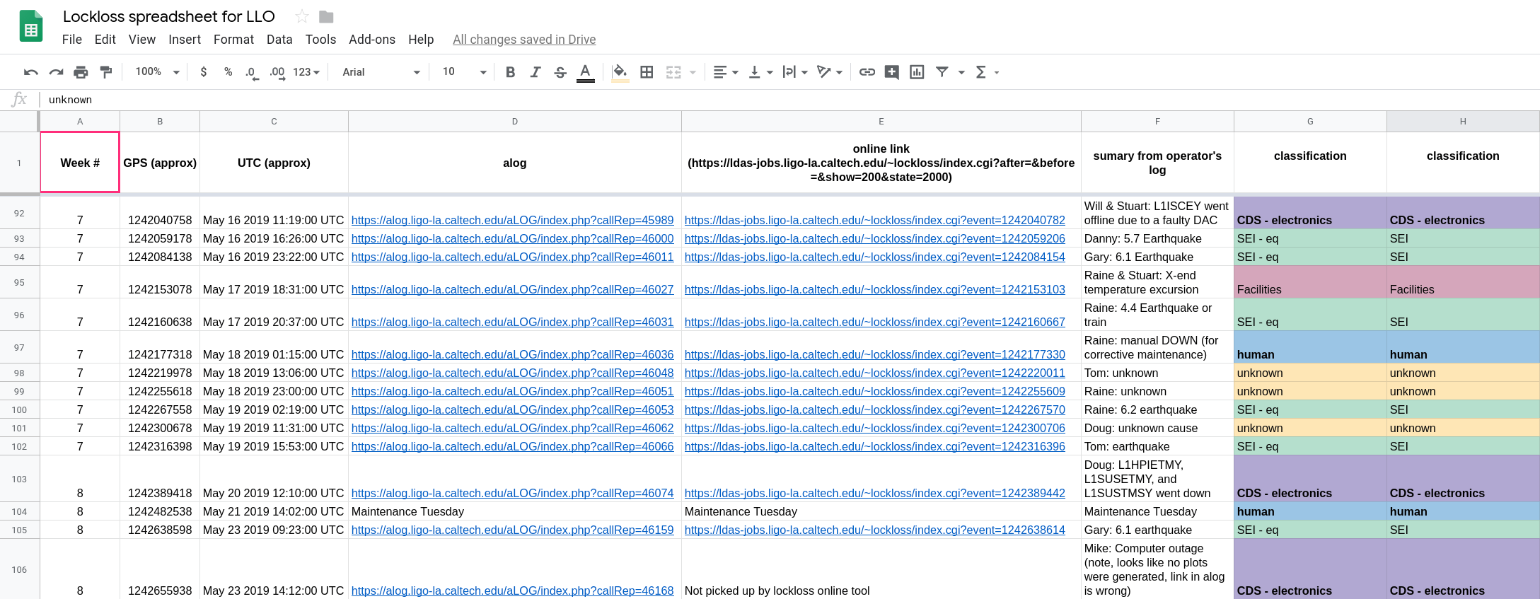
Lockloss classification from operator notes
Link to LLO lockloss spreadsheet

Slide 4
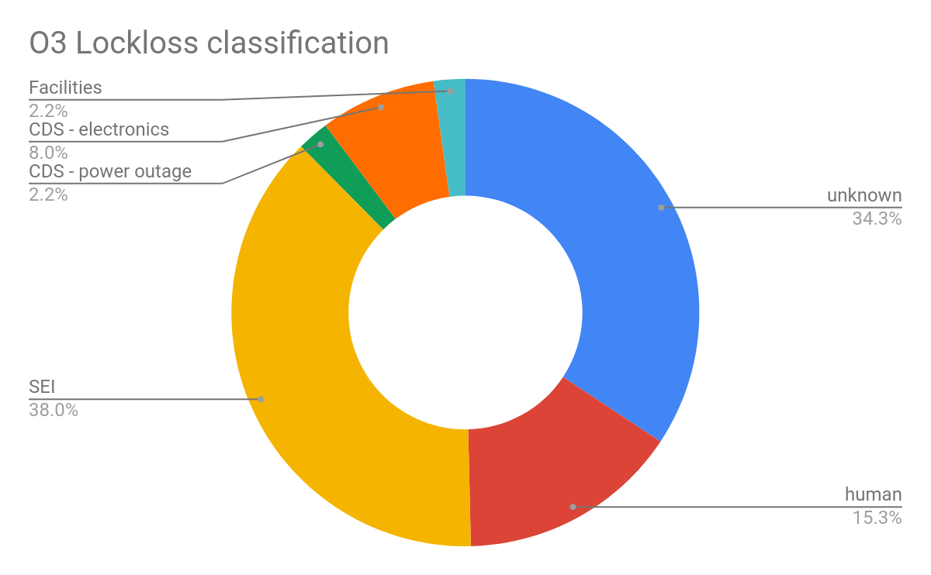
Lockloss classification
-SEI 38% [earthquakes (24.1%), wind (2.2%), trains/ anthropogenic noise (8%), useism (3.6%)]
-Unknown 34.3%
-Human 15.3% (tuesday maintenance, error, commissioning)
-CDS 10.2% (power outage 2.2%, electronics failure/computer lock-up 8%]
-Facilities 2.2% [temperature issue]
data from LLO lockloss spreadsheet

Slide 5
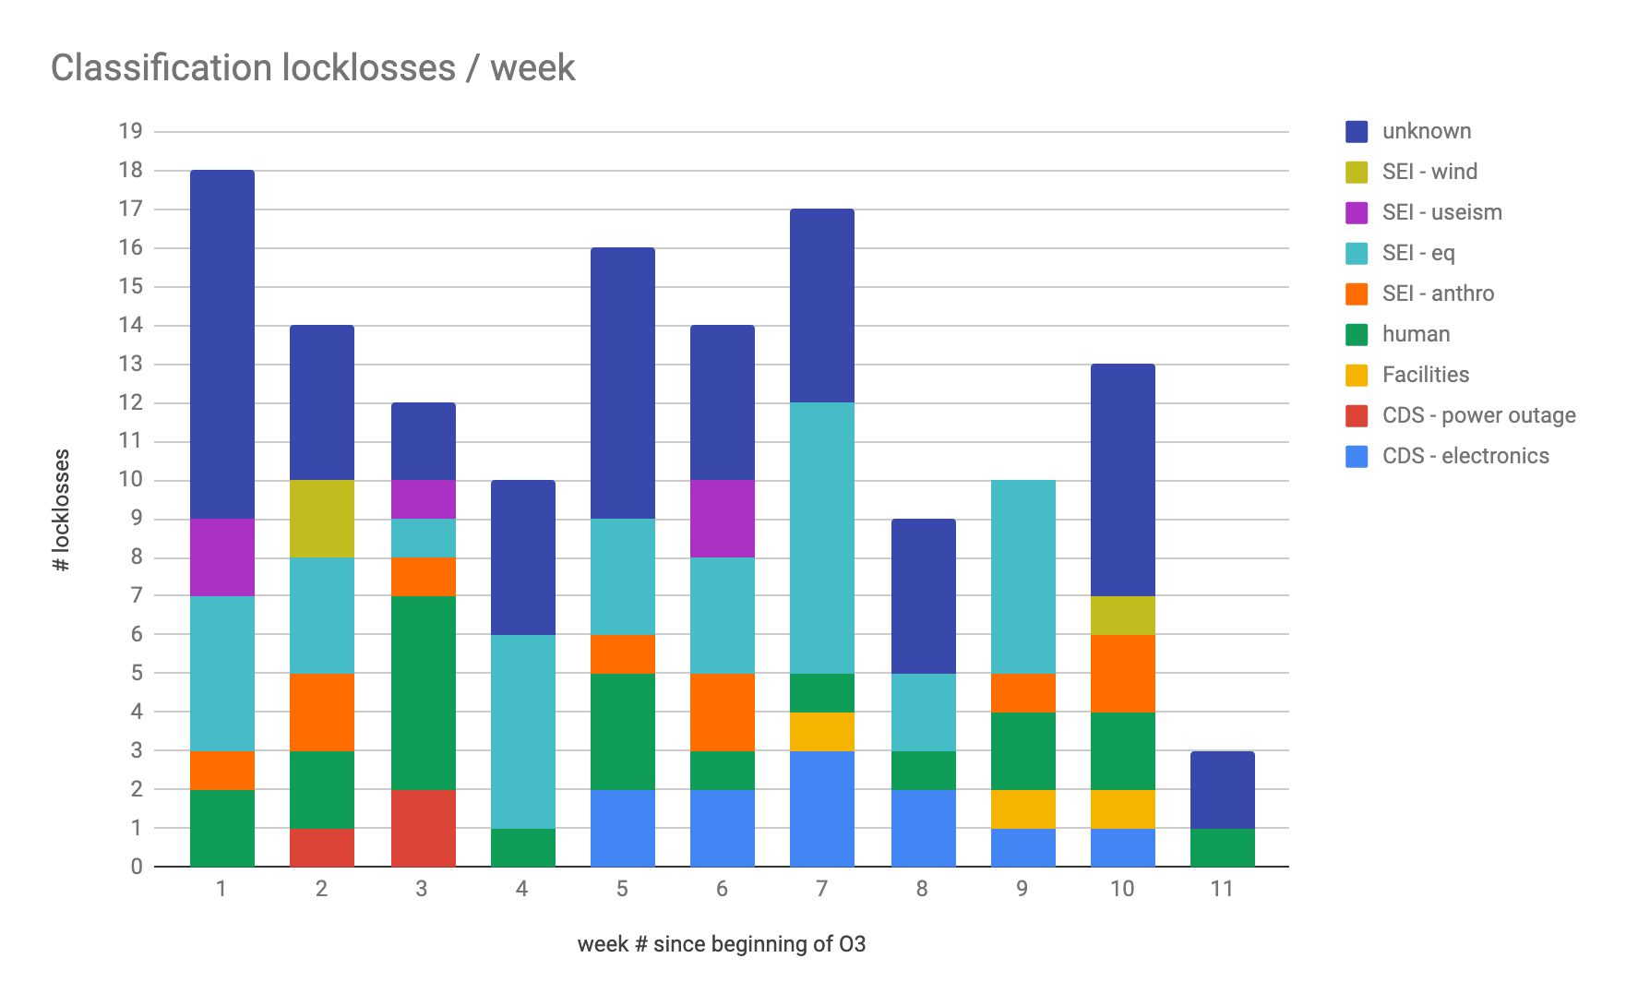
Lockloss classification

Slide 6
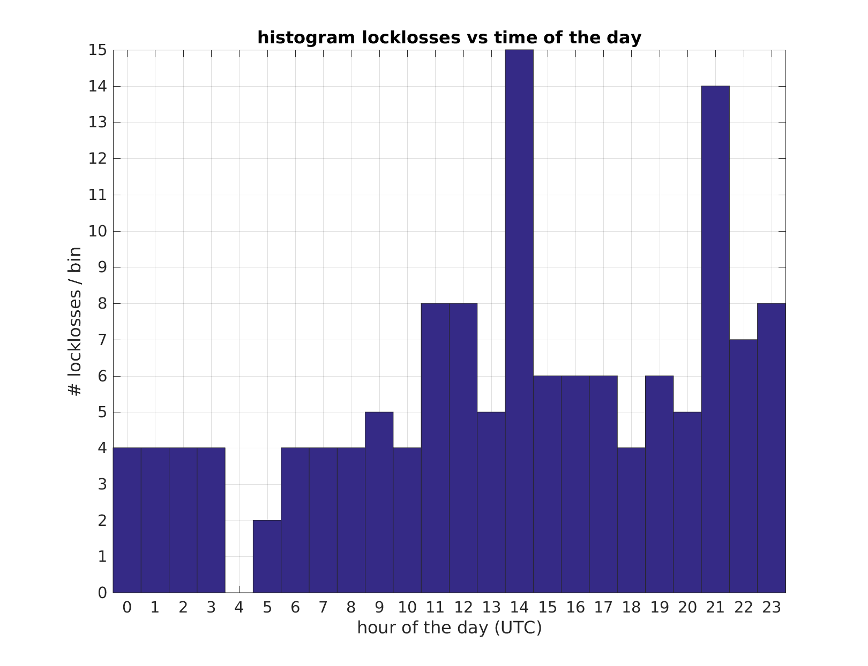
Lockloss time histogram
Tuesday maintenance time

Slide 7
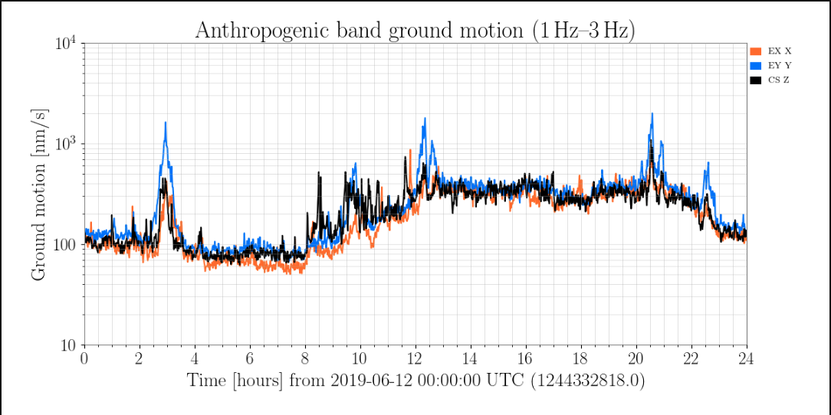
Lockloss time histogram
Tuesday maintenance time
trains?
Daytime noise?

Slide 8
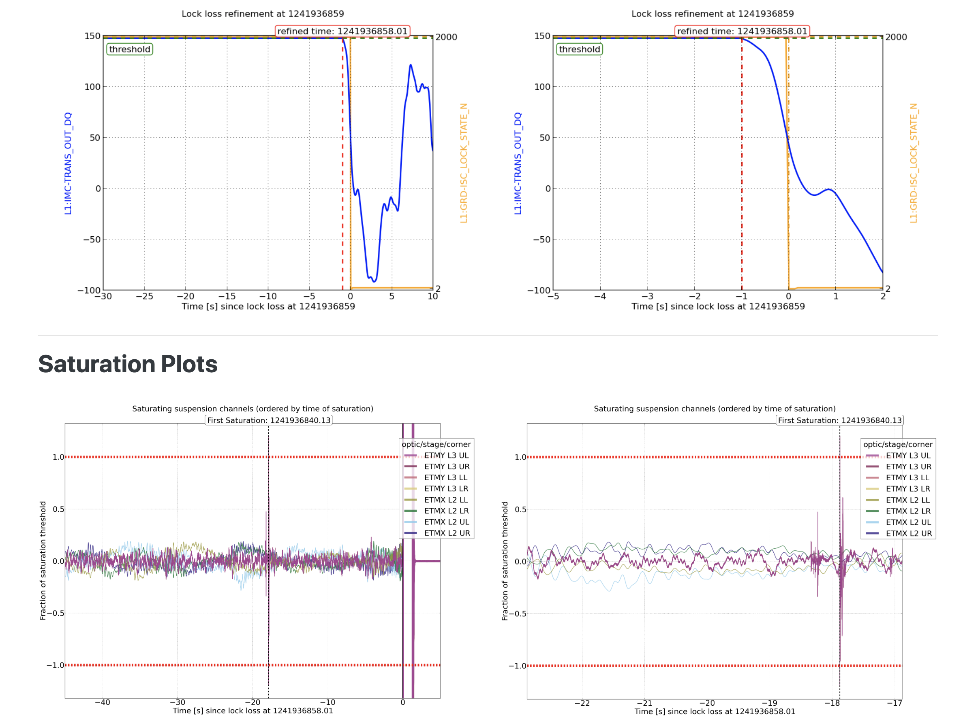
Identification process and fixes
Why do we loose lock ? non-linear signal in feedback loop
Saturation of actuator
Saturation of sensor/electronics chain
Other ?
Online tool: https://ldas-jobs.ligo-la.caltech.edu/~lockloss/
Helpful to identify suspension actuators saturations precursor to locklosses

Slide 9
Identification process and fixes
online tool
Saturation precursor ?
Which suspension/stage ?
What dof dominates ? DHARD ? CHARD ? ...
What frequency ?
L, P or Y?
Yes
Fixed!
Can we increase the range ?
Yes
Fixed!
Noise budget to try identify noise source
Can we limit at the source ?
No
Keep searching!
No

Slide 10
Identification examples
SRCL FF (alog 45241)
-Lockloss tool identified EX saturation -Correlated with increase of ground motion in corner -Drive RMS from L drive @ 2.6Hz -SRCL FF coupling to DARM. Notch in FF filter @ 2.6Hz

Slide 11
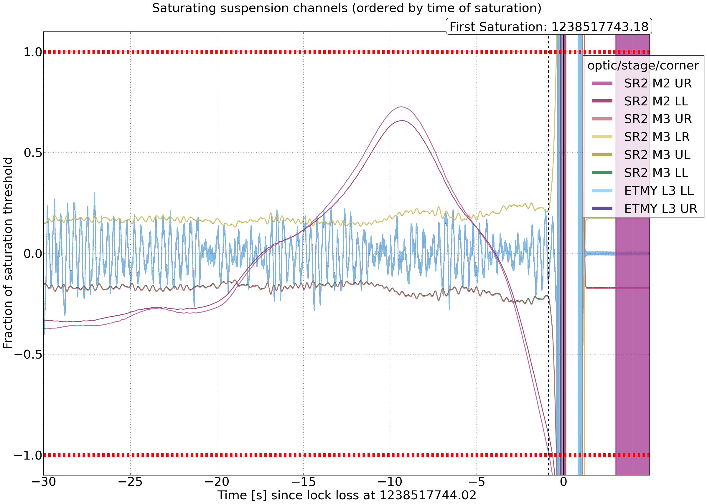
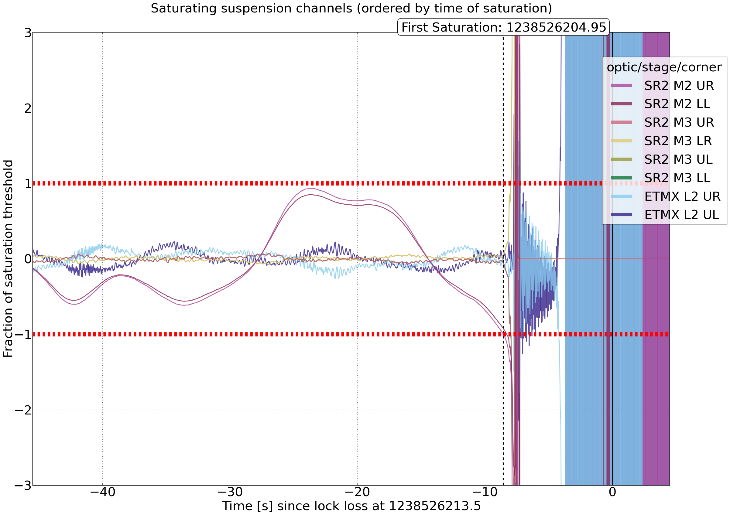
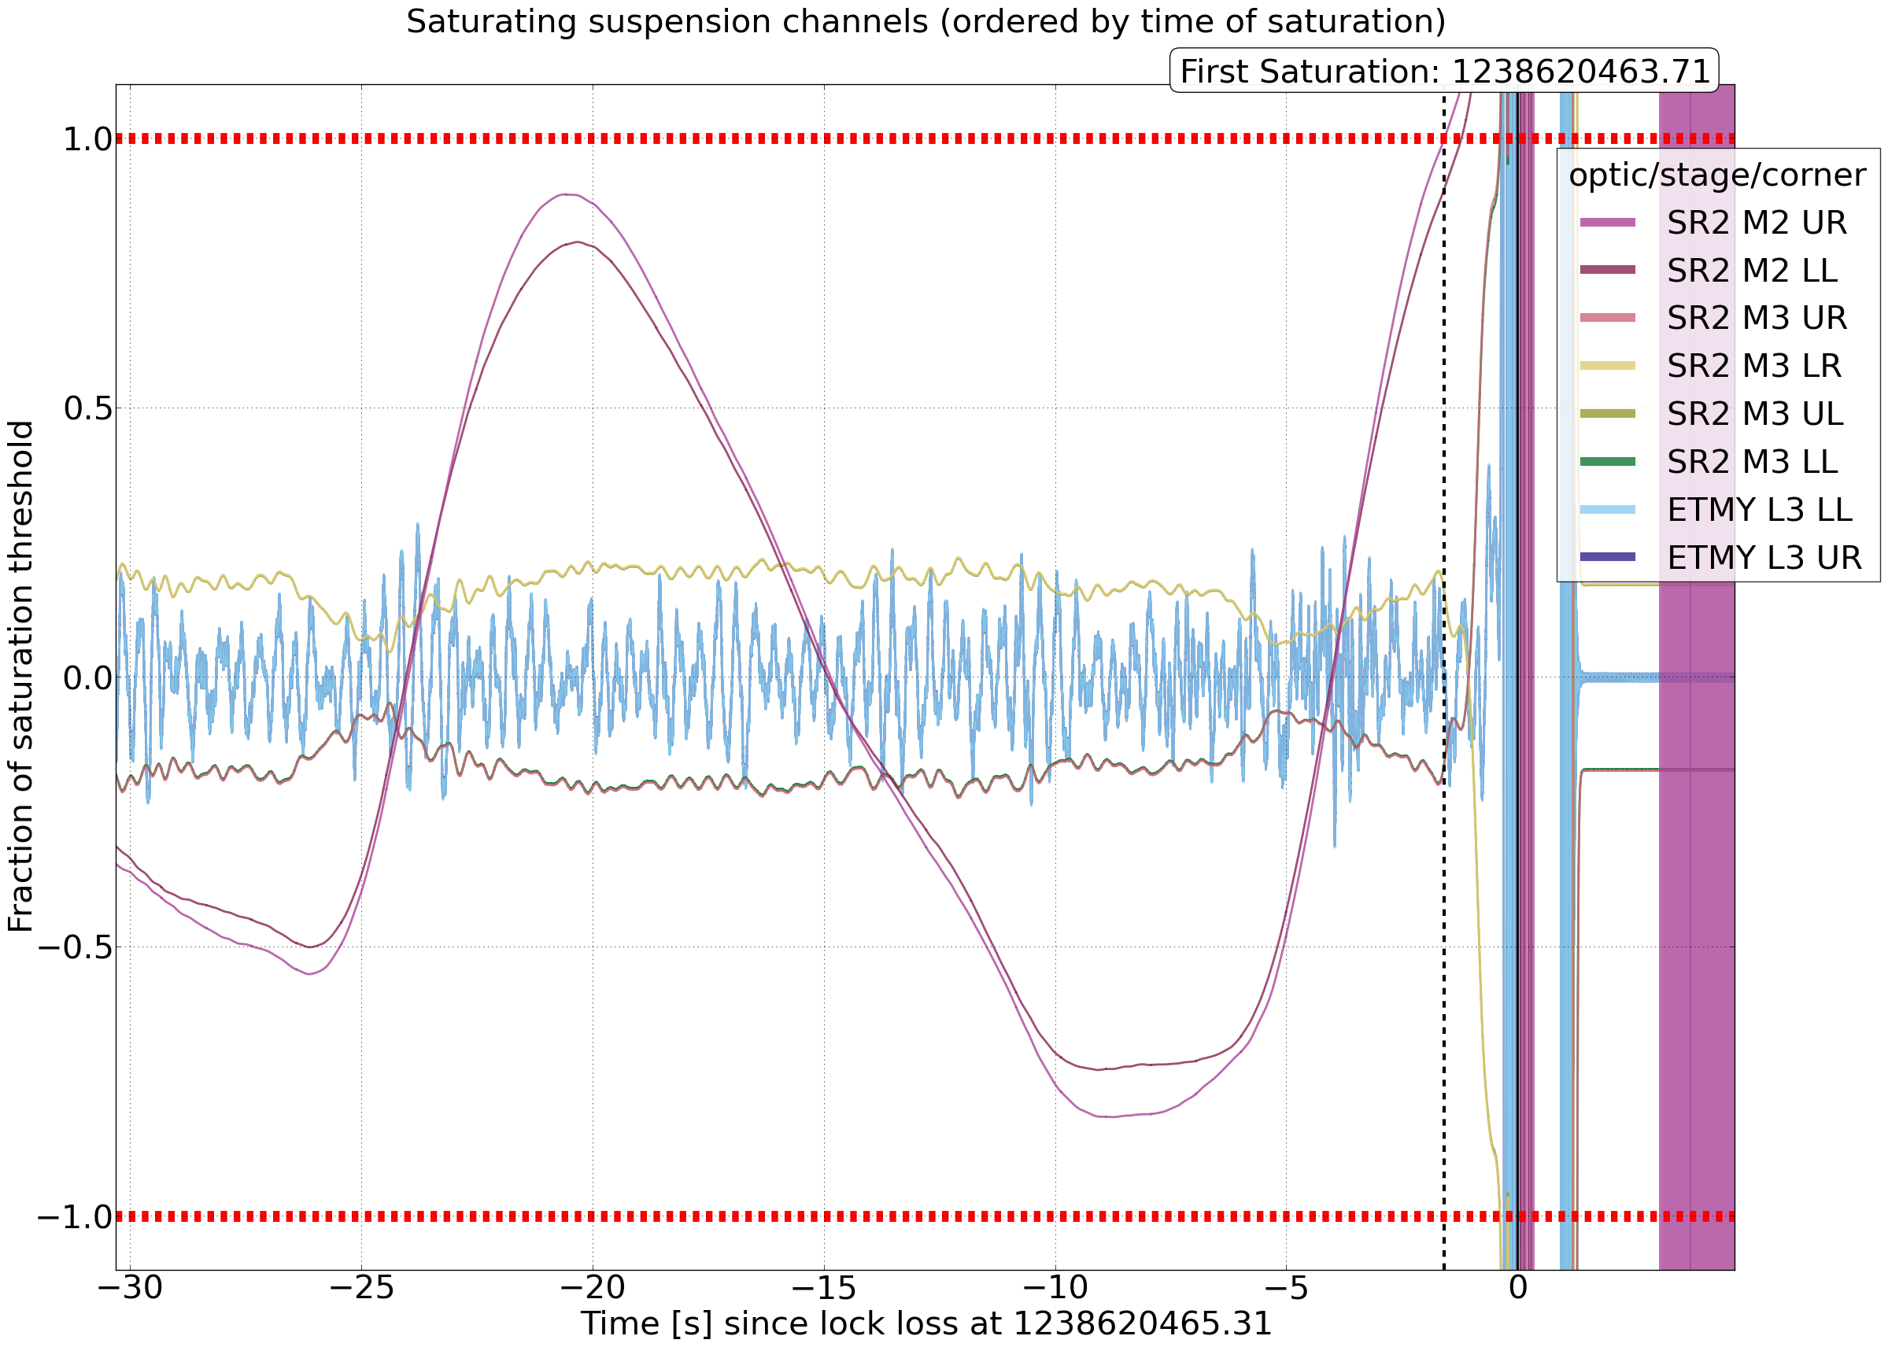
Identification examples
SR2 cross-over (alog 44997, 45034)
-Identified behavior during earthquakes 1st week of O3 : SR2 M2 saturations from length drive -Increased M1 control authority in eq band

Slide 12
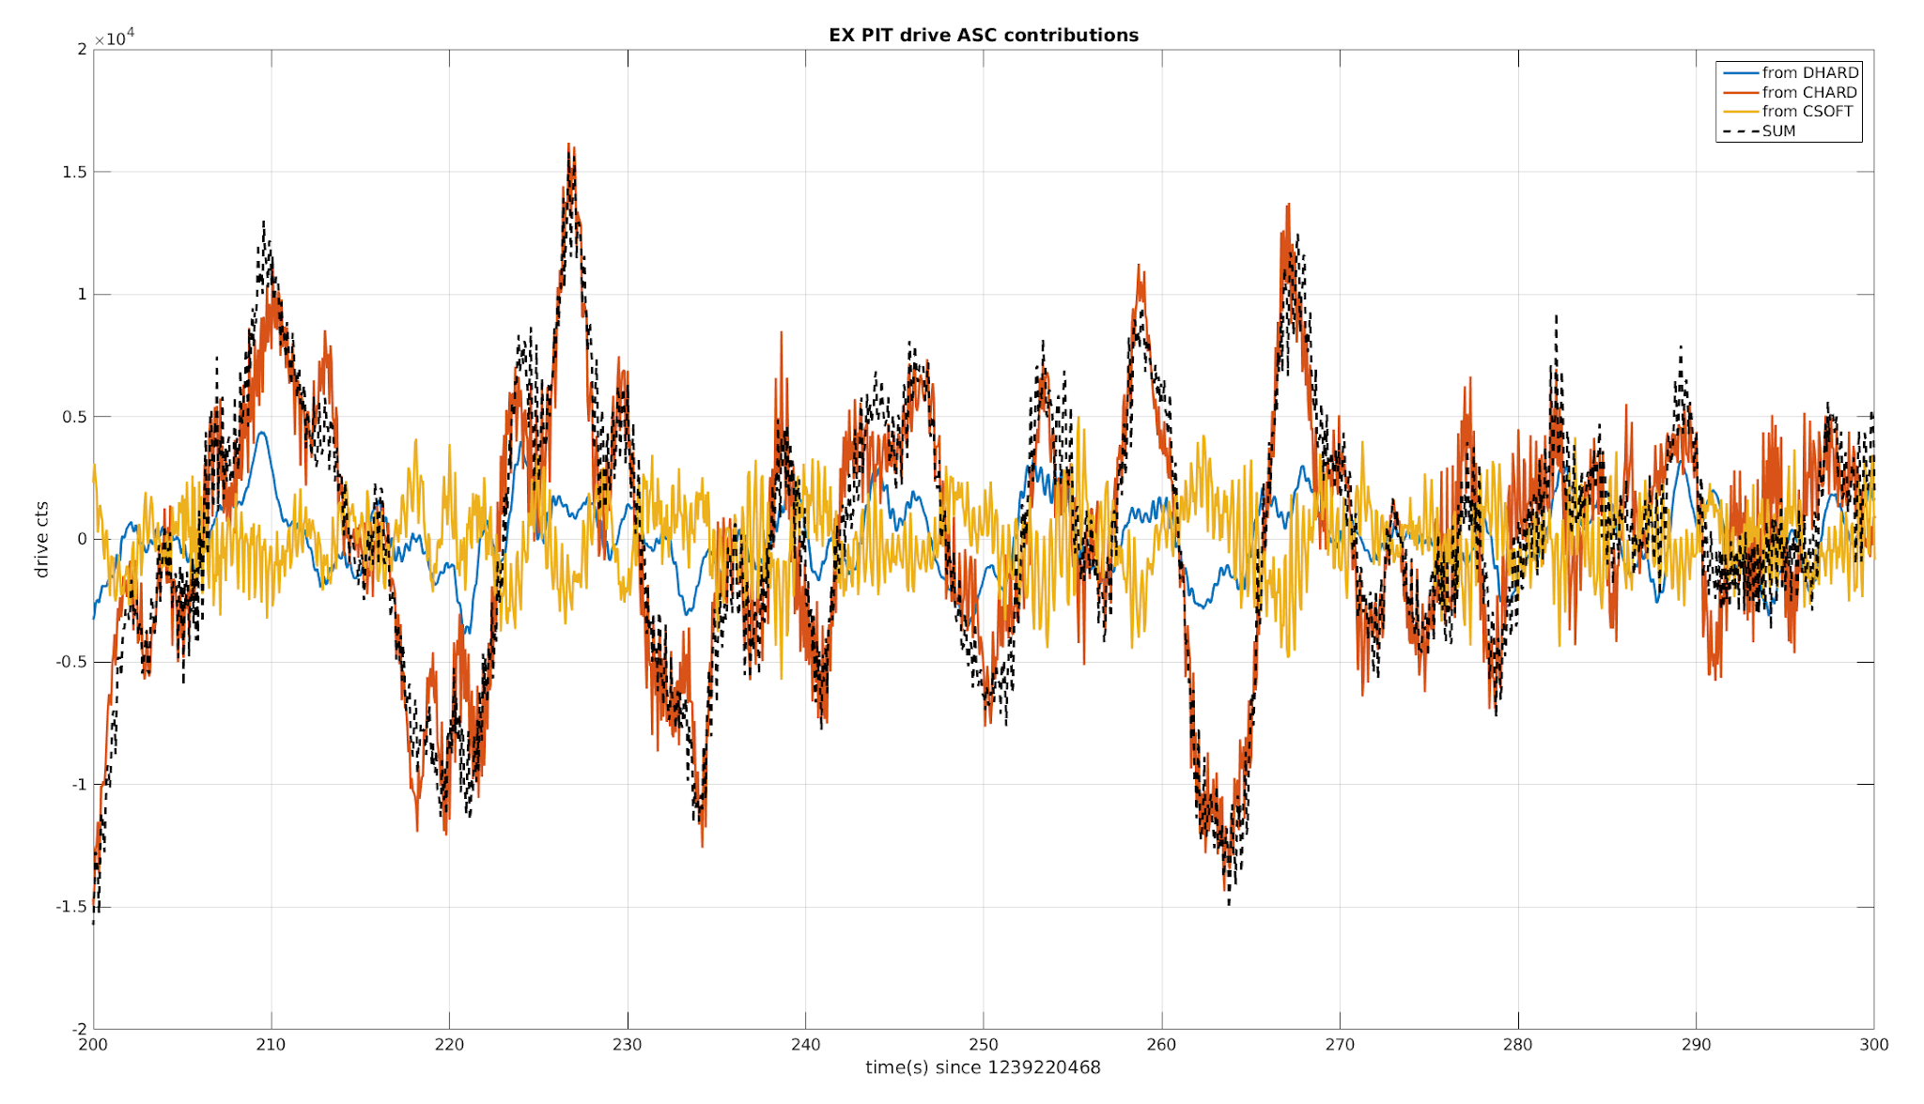
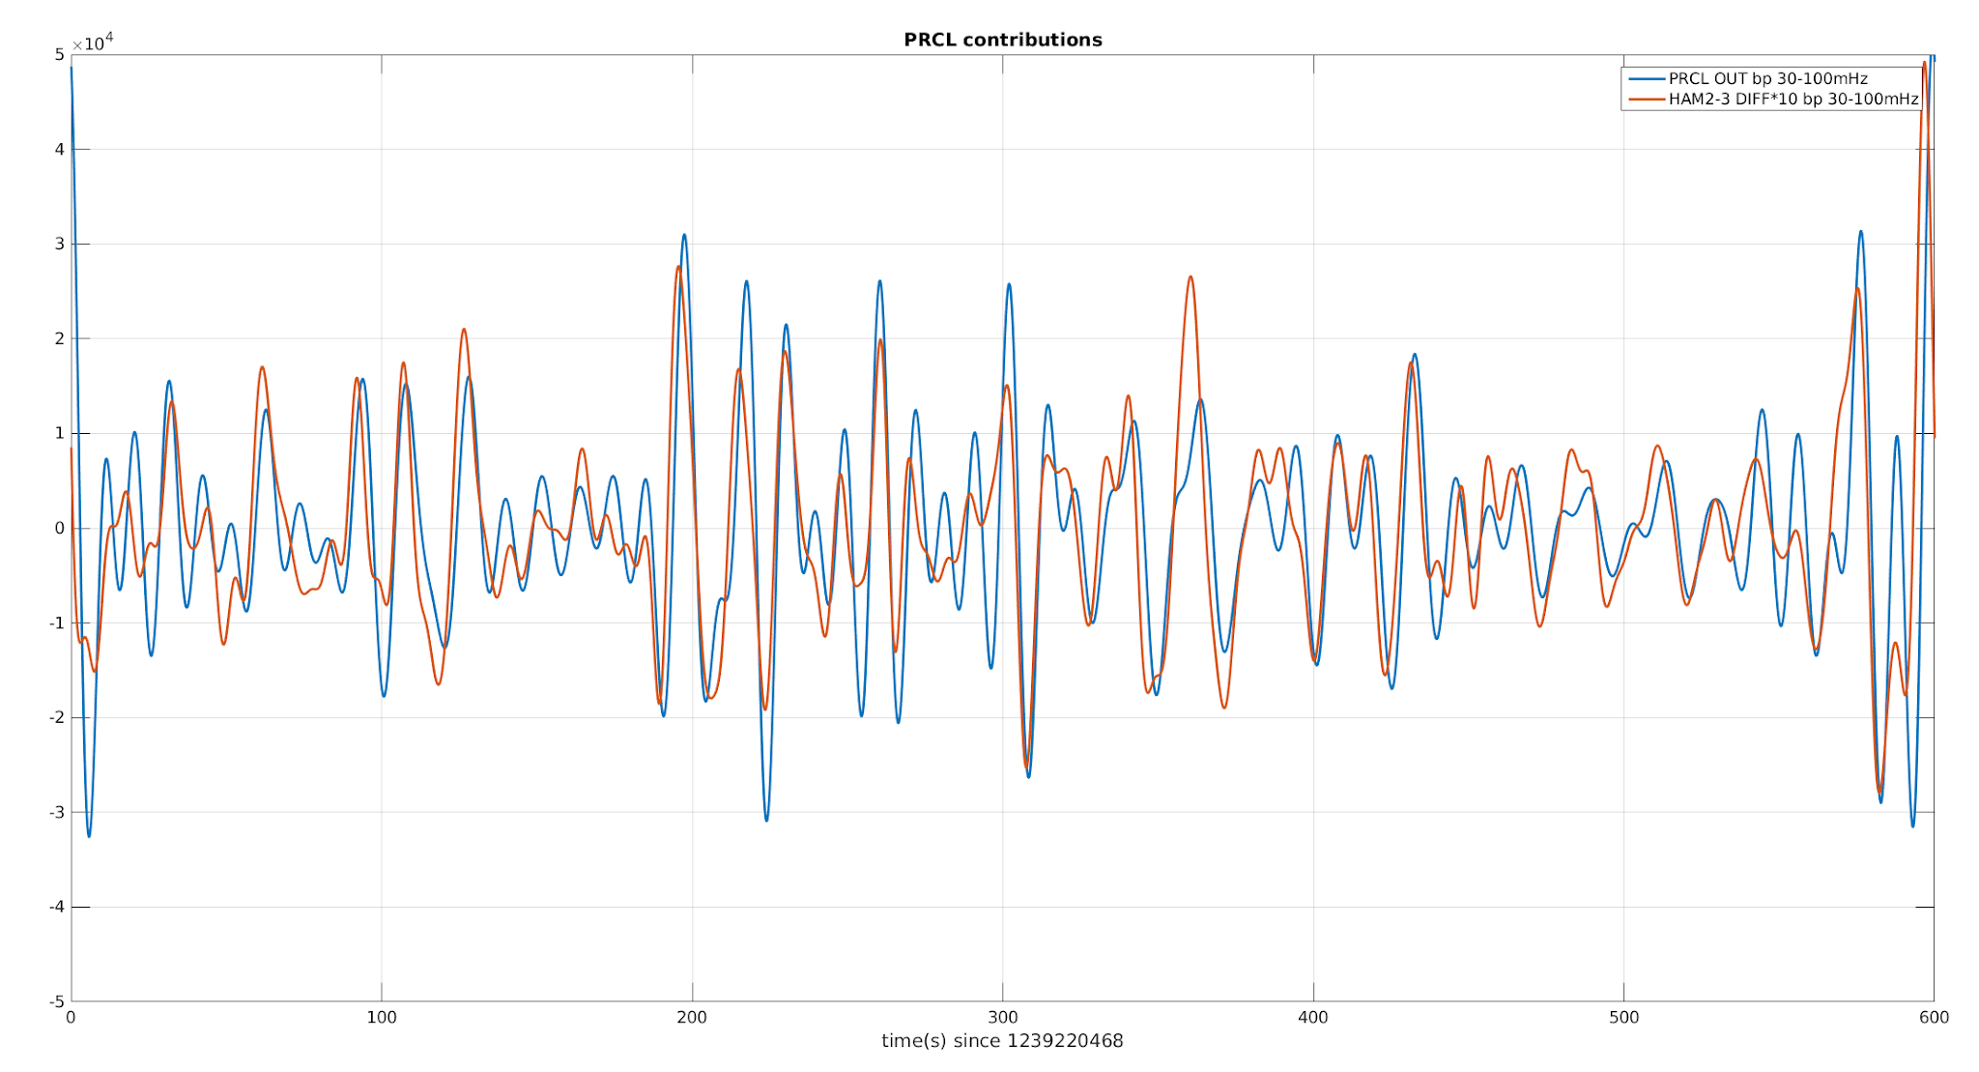
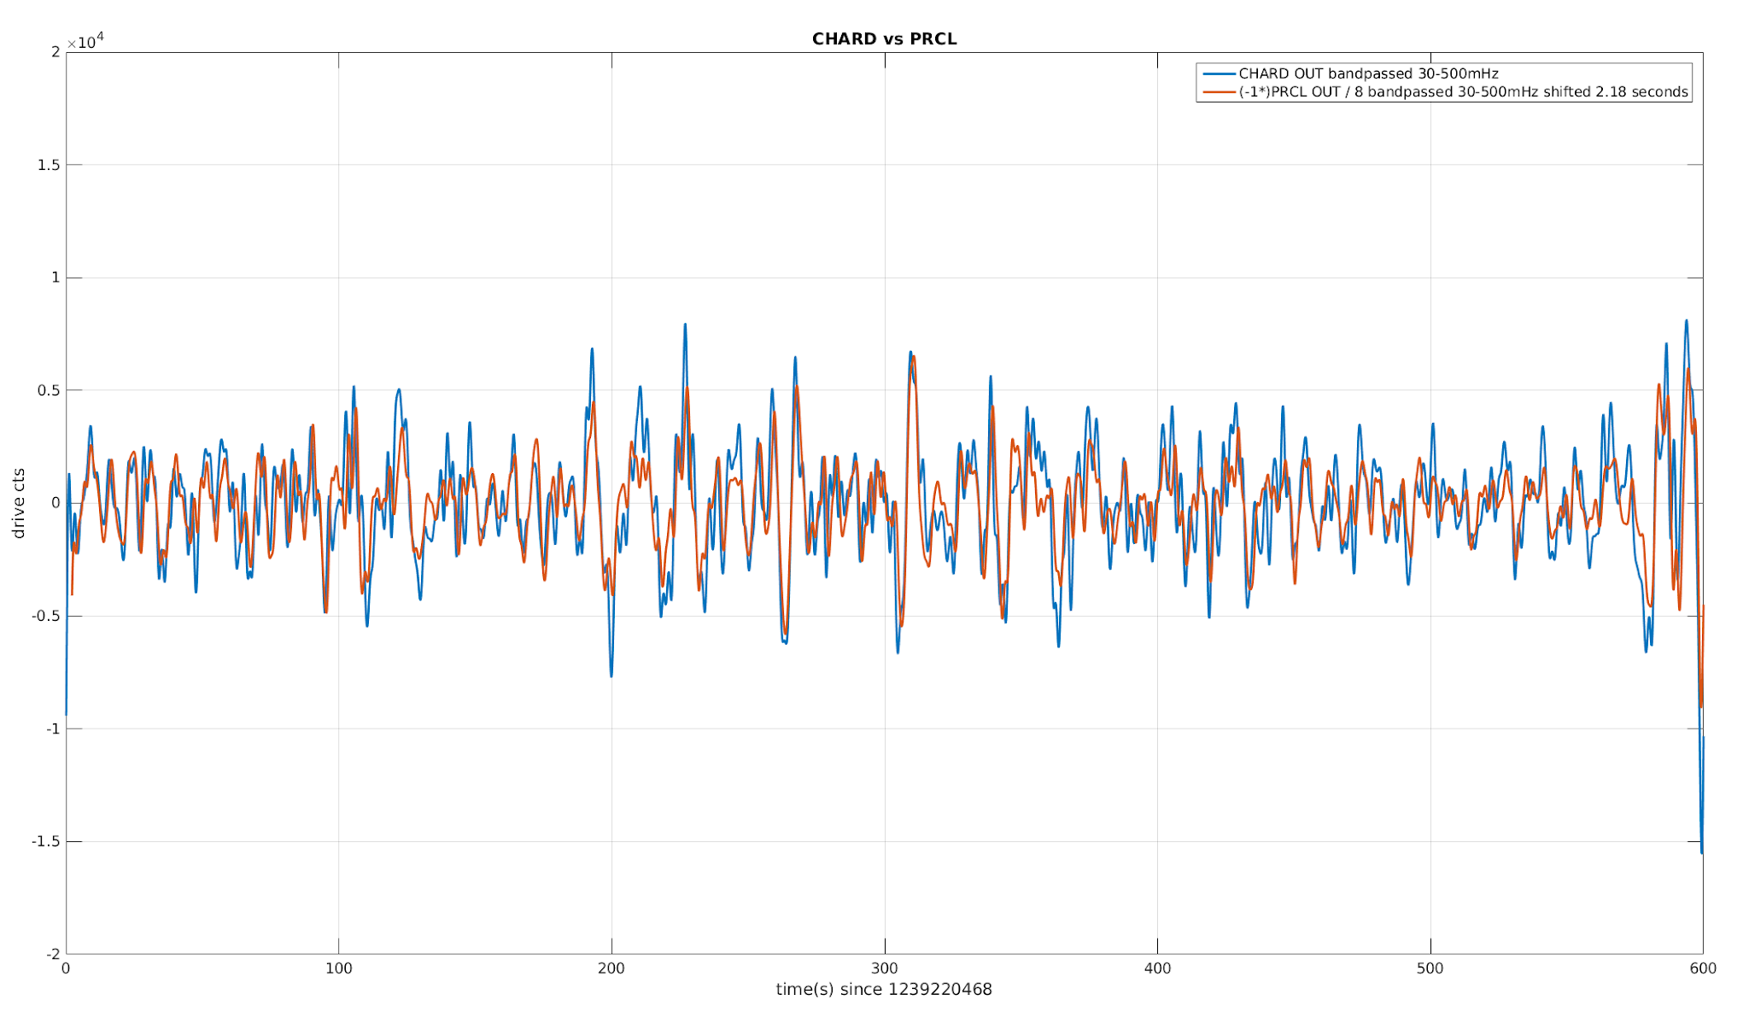
Identification examples
CHARD from HAM2-3 diff motion ? (alog 45237), unresolved

Slide 13
Ideas, to-do list
-If no saturation precursor, more complicated, develop new search process (43113,sei 1445)
-Try to limit SEI locklosses + unknown (=70% of locklosses)
- Some trains are correlated with locklosses, need to understand how (46590)
-Improve the automated process by :
-Classifying locklosses automatically from known triggers (correlation with ground motion for example)
-Allowing manual tagging of events online (commissioning, human error, or others)
→ would help to build statistics and recognize patterns

Slide 14
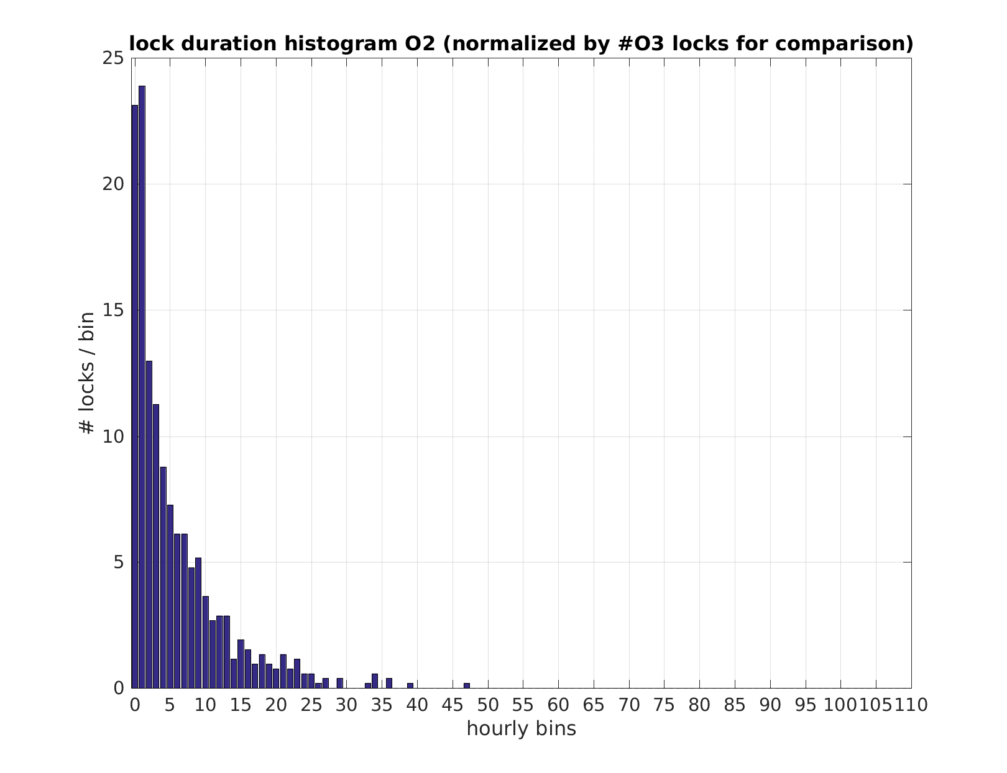
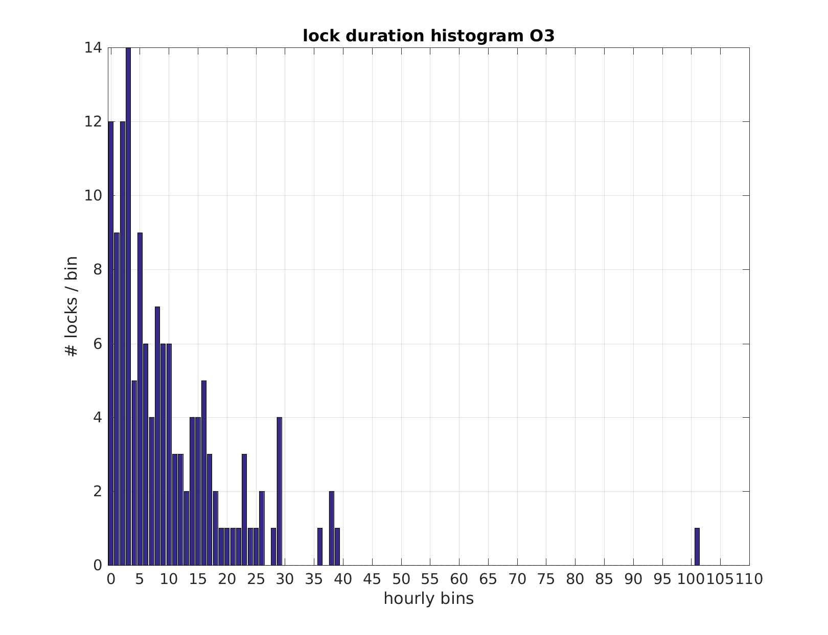
Extra slides

Slide 15
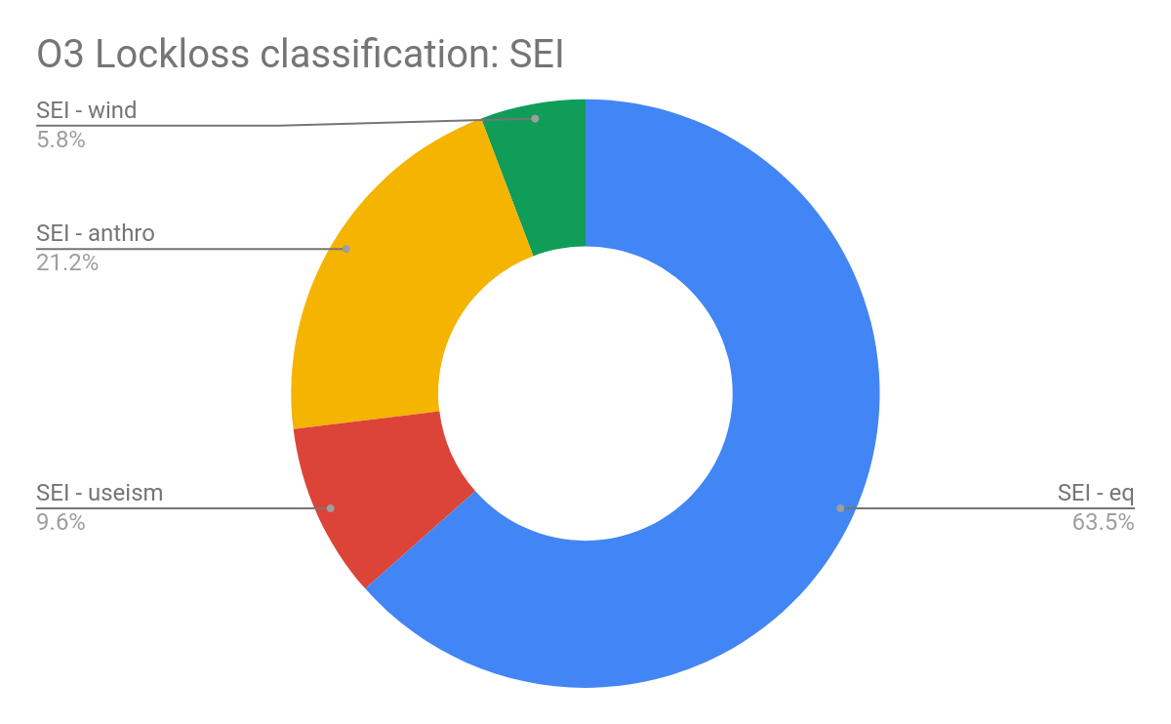
Breakdown of SEI locklosses
Breakdown of locklosses correlated with increase of ground motion :
Wind = [30mHz-100mHz] Eq = earthquakes = [30mHz-100mHz] Useism = [0.1-1Hz] Anthro = trains, human activity = [1-10Hz]
Most SEI locklosses from earthquakes (63% ) and anthropogenic noise (21%)
data from LLO lockloss spreadsheet

