Slide 1
O3 LIGO-Virgo (and KAGRA) update, June 20 2019
Lisa Barsotti, Keita Kawabe, Nicolas Leroy, Shinji Miyoki, Brian O’Reilly, Alessio Rocchi, David Shoemaker

Slide 2
Summary
Since last meeting (May 23), two public alerts, one was retracted.
Duty factor: 82 % with at least 2 interferometers, only 2.2 % of time without any interferometer.
  Improvement over the last month’s report where 2+ IFO duty factor was 78%.
Potential ~1 month commissioning break.
  Thanks for your input about our schedule.
  At the moment things are still in flux, but we’re likely to do this, and if we do it’ll be late September or early October. The end date of O3 may be shifted.
  We will give you a definitive update as soon as it becomes available before or at the next meeting.
KAGRA is planning to join later this year, no firm date yet.

Slide 3
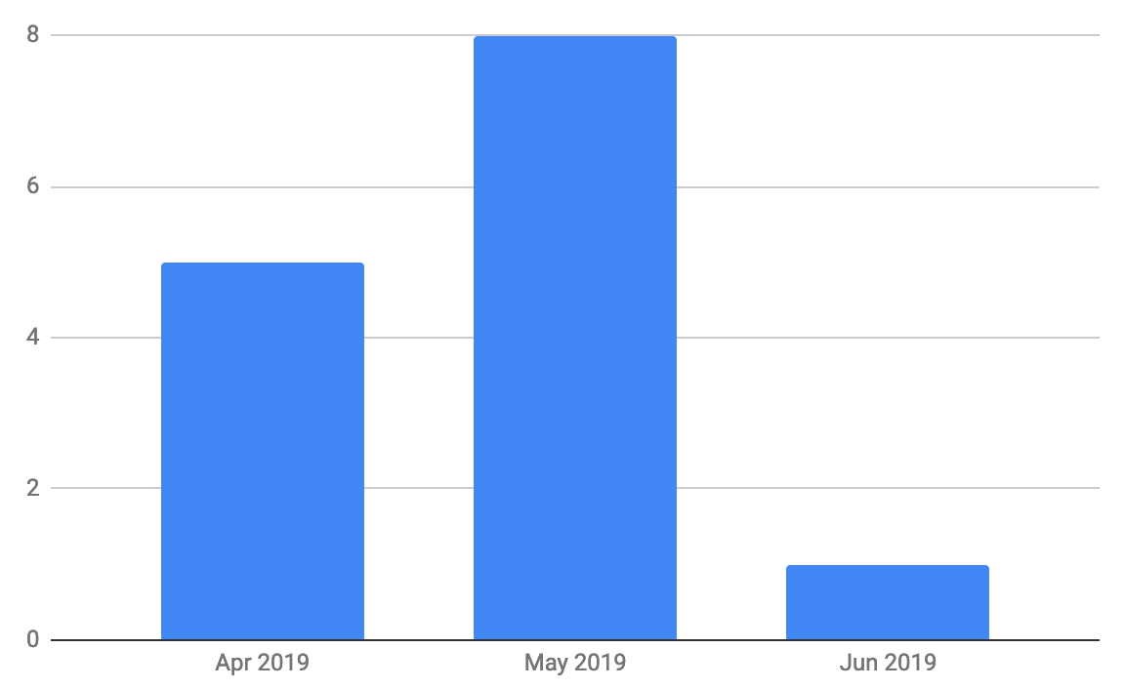
Not much update since May 23
S190524q (retracted due to non-stationary noise in the highest sensitivity detector L1)
S190602aq, a potential BBH
# of alerts (not retracted)

Slide 4
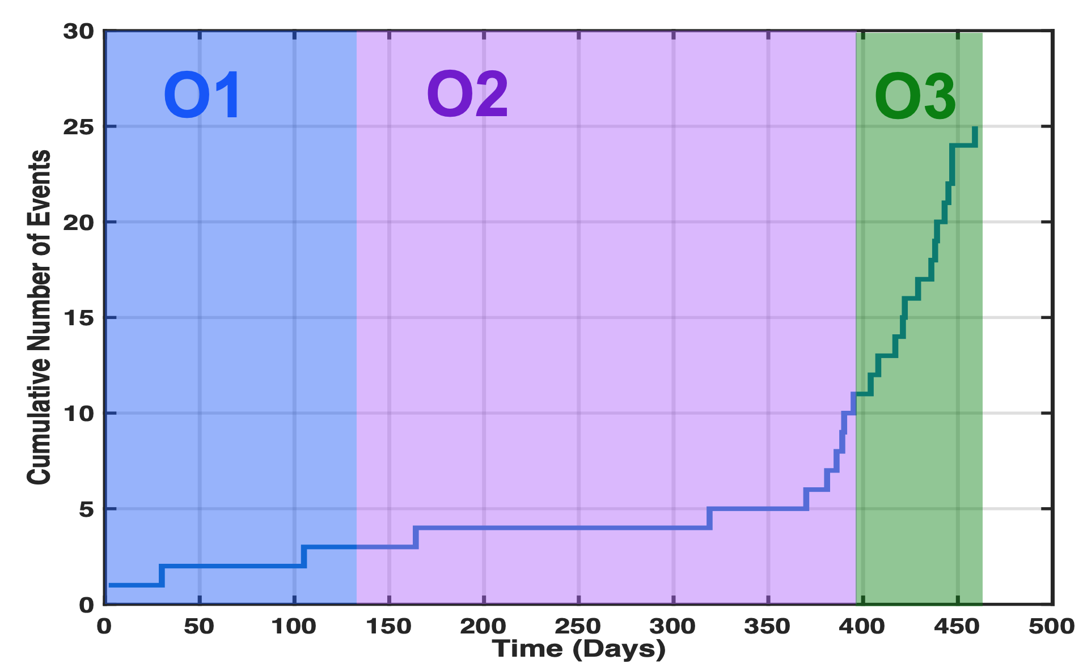
# of O3 candidates and O2+O1 detections VS run time

Slide 5
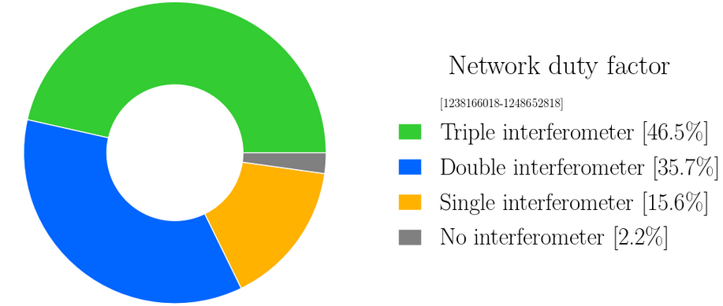
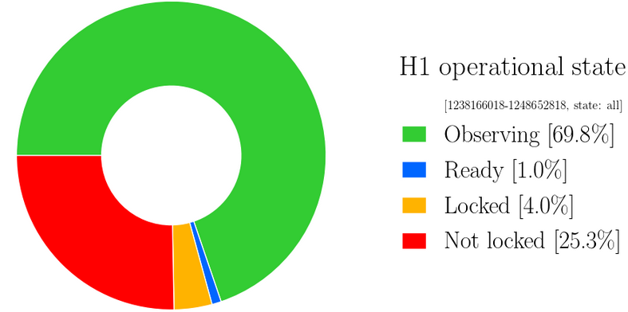
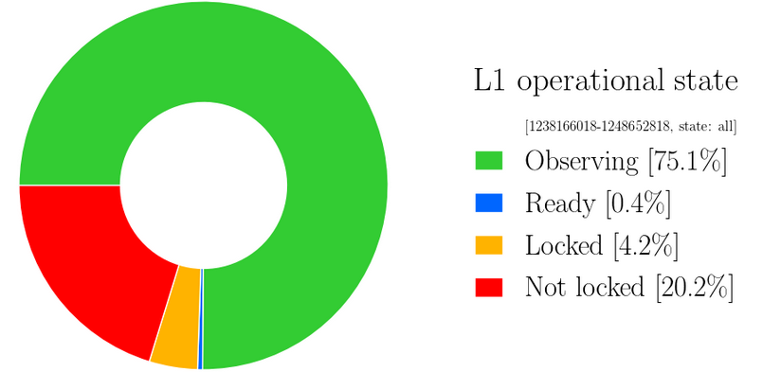
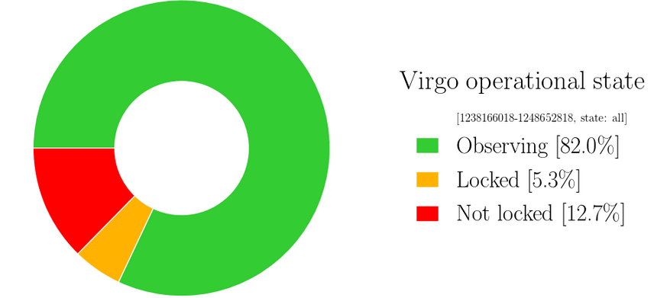
Detector Performance: O3 Cumulative Duty Factor
46.5% Triple IFOs
82.2% at Double or Triple
2.2% zero IFO coverage
(Downtime includes everything including but not limited to maintenance)

Slide 6
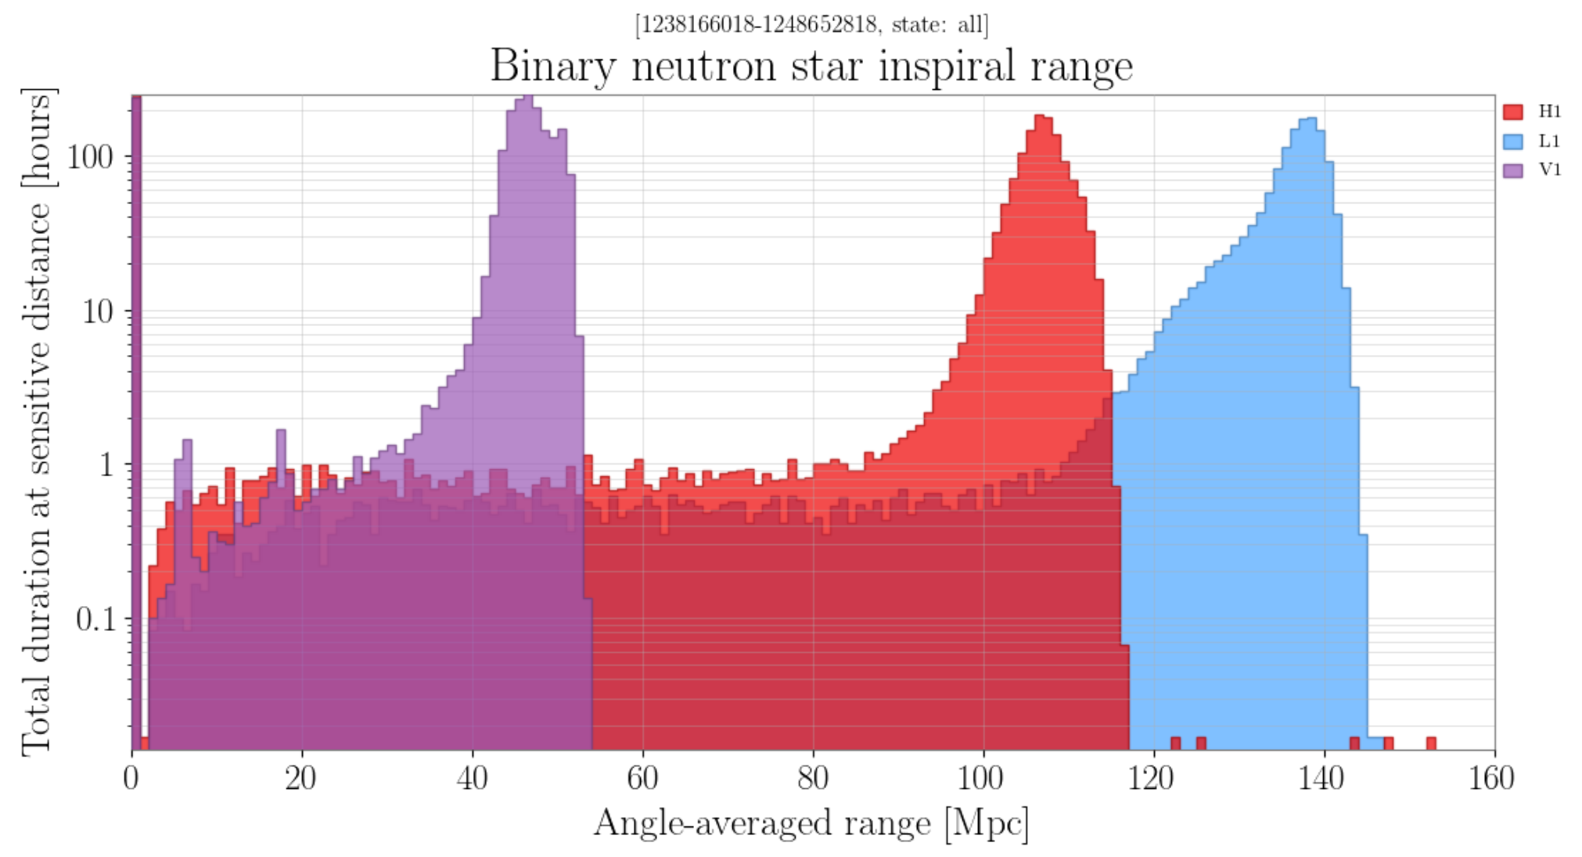
Detector Performance: BNS range

Slide 7
(Potential) Commissioning Break of ~1 month
IF we do it, it will be late September to early October.
  Proposal is yet to be approved by LIGO and Virgo upper management.
  We may shift the O3 end date by ~1 month.
  One way or the other, we’ll have a firm update before the next meeting, we’ll let you know as soon as it becomes available.
H1: Fiber feedthrough replacement for squeezer (SQZ improvement), septum window replacement (scattering mitigation), wind fence (environment noise mitigation).
L1: Septum window replacement, X arm accumulation test (vacuum), end station scattering mitigation.
V1: no installations foreseen, possibly modification of the locking configuration to improve knowledge of noise couplings and to test control strategy for O4.

Slide 8
KAGRA
Commissioning the corner station interferometer now.
  Successful lock of DRMI on Wed. this week(!!!)
Engineering run on June 08, next one July 13.
Plan to join O3 toward the end of this year. No firm date yet.

