Slide 1


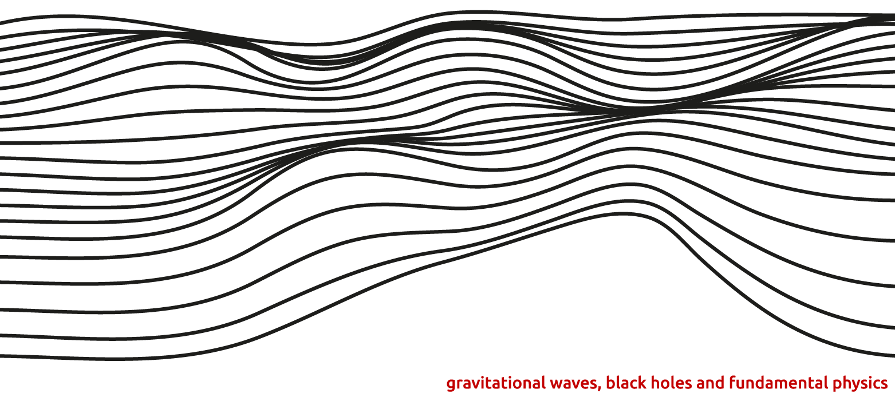
Higher-Order Modes of Gravitational Waves
Credit: GWverse
Mahlet Shiferaw Dr. Alan Weinstein, Liting Xiao
Notes:
Hi everyone, my name is Mahlet Shiferaw and this summer I worked on studying HOMs of GWs with Alan Weinstein and Liting Xiao.

Slide 2
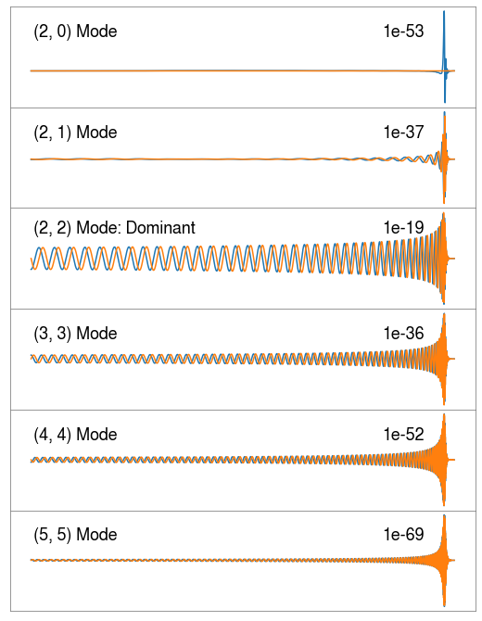
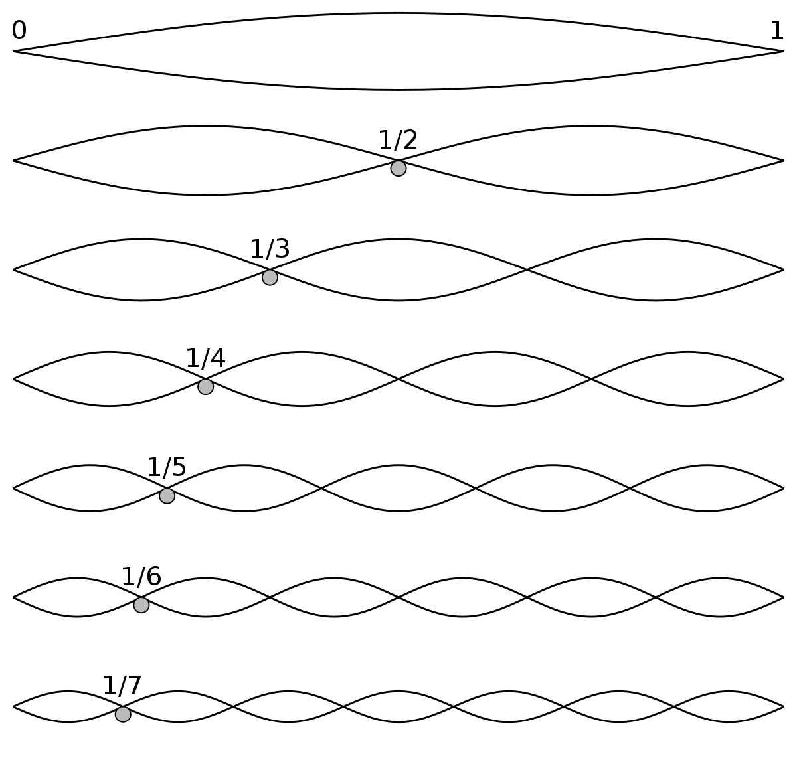
Credit: Wikipedia
Notes:
So what are higher order modes? They are different l,m’s from spherical harmonics, and for gravitational waves the dominant mode is the (2,2) mode, which you can see clearly from the amplitude, as it is many orders of magnitude higher than the other (l,m) modes. So clearly, HOMs can be very hard to detect, if I plotted them with the same normalization you wouldn’t even be able to see some of the HOMs.
So here I’ve plotted the strain in the time domain, so you have the inspiral, the merger, and finally the ringdown. I’ll show a plot that makes this clearer, but you can see even with these plots that each mode has its own frequency. And remember, for each l,m there’s also these harmonic overtones, pictured on the right, where you have a fundamental mode, and then a first, second, third harmonic overtone, and so on. These harmonic overtones are also included in a GW waveform.

Slide 3
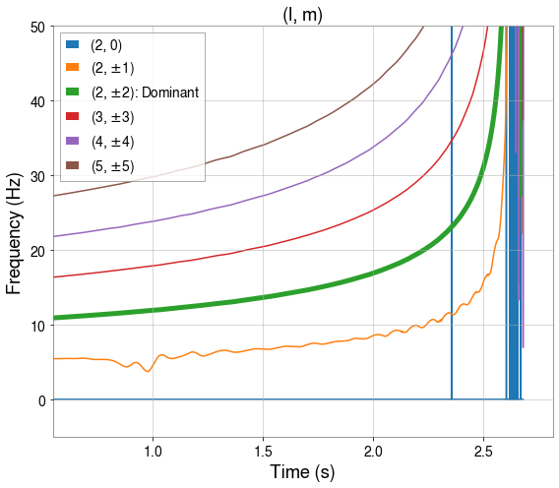
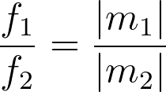
Visualizing HOMs
Instantaneous frequency scales with m
Notes:
So here is a nice way to visualize the different frequencies for these higher order modes. Here I’ve plotted instantaneous frequency for different modes, including the dominant (2,2) mode. It’s easy to see that the frequencies of different HOMs are multiples of each other, and in fact they are multiples depending on the m in (l,m). Which means for example the (4,4) mode is twice the frequency of the dominant mode, and (3,2) has the same frequency. You should note that HOMs can also be at lower frequencies than the dominant mode, for example with the (2,1) and the (2,0), which doesn’t oscillate at all. And in fact none of the m=0 modes oscillate until the very end of inspiral, when they begin to merge and the orbit becomes non-circular.. This end of inspiral, beginning of merger is where HOMs truly emerge, because the system is as non-quadrupolar as possible. In the absence of inspiral, there is radiation but it’s at one frequency. The merger is what is making the HOMs because it departs from circular motion. During inspiral it is quasicircular. By merger it’s completely departed from circular motion so there’s a lot of non quadrupolar motion. Circular orbit has ended and the BBHs are moving in towards eachother.

Slide 4

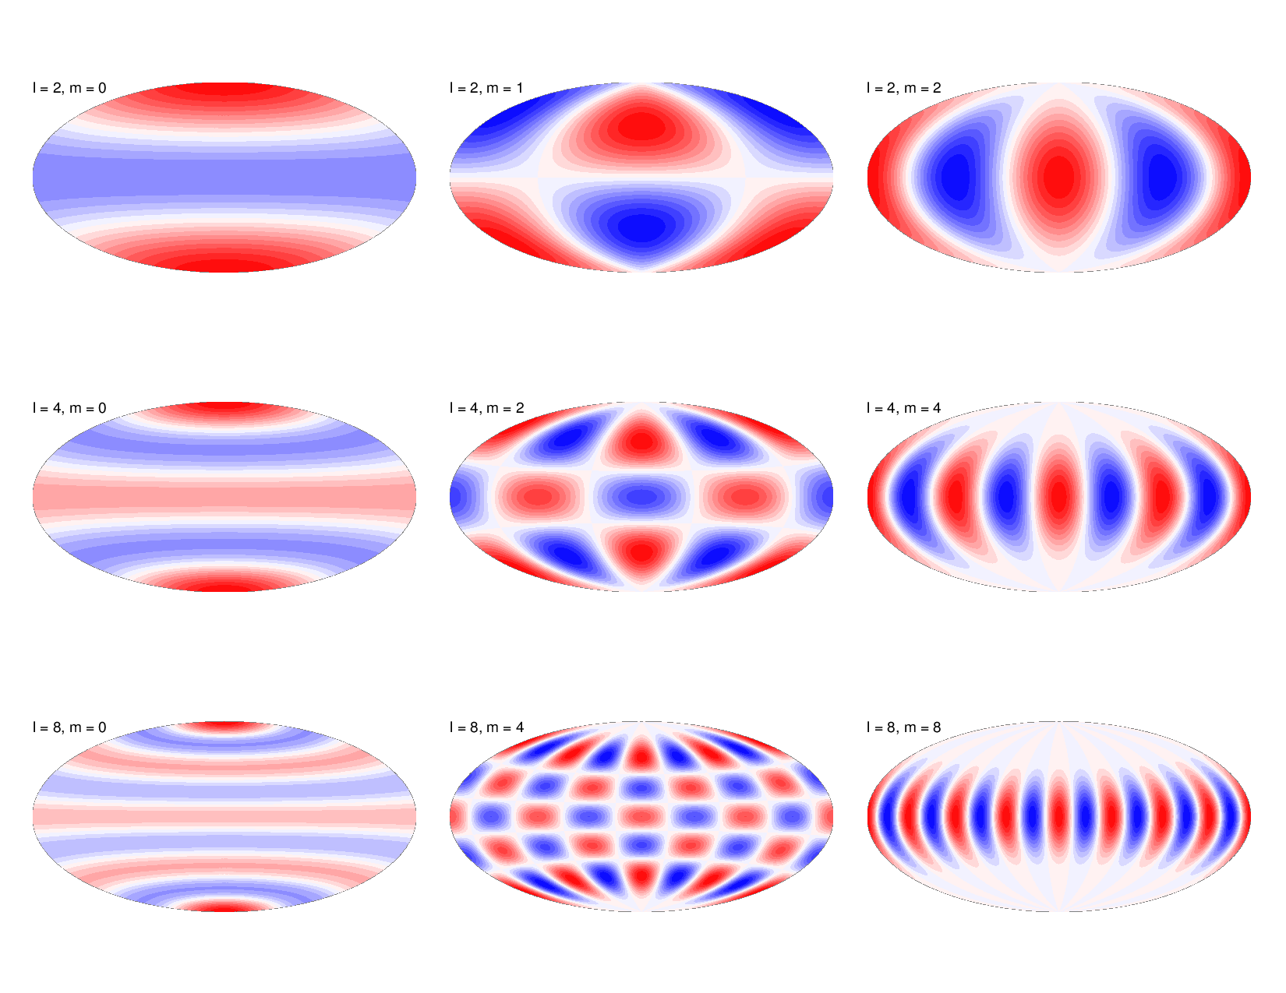
Visualizing HOMs
Spin-Weighted Spherical Harmonics: s=-2
Dominant Quadrupole Mode: l=2, m=2
Credit: Thorsten W. Becker at UT Austin
Notes:
So here is another way to think about HOMs. These are the emission patterns of different modes in spherical harmonics, which you might remember from a quantum mechanics course. In the top right is the dominant mode, and the way you read these plots is wherever there is white, that is a null mode. Meaning at that specific viewing angle, an observer will not be able to see any HOMs. So here is the orbital plane, and this is theta=pi, face on, and theta=pi/2, edge on.
Now, the emission patterns for HOMs of GWs are a little more complicated. The equation at the top helps give a little more insight. This is the strain of a GW as a function of radius, time, inclination angle, and azimuthal angle. So it falls off as 1/r, and is summed for all (l,m) modes. And here is the portion which gives you the GW modes, produced using numerical relativity, and tells you that the (2,2) mode is the dominant mode, is the strongest or loudest component. And here is Yl,m, but spin-weighted. So in contrast to the hydrogen atom, for example, the spin weight is -2, rather than 0, which is what’s plotted here. So I hope from these first initial slides you have a little more intuition and understanding of these HOMs. They come from spin-weighted spherical harmonics, and the dominant mode for gravitational waves is the (2,2) mode because it is quadrupolar. And the strength of the strain depends on the observer’s position, or alternatively the location of the merger in the sky.
Tensor gravitational waves
Mention that I’m ignoring phi and only looking at theta inclination angle
Observer sees it at inclination angle but there’s also phi dependence. But we’re only going to focus on inlination angle

Slide 5
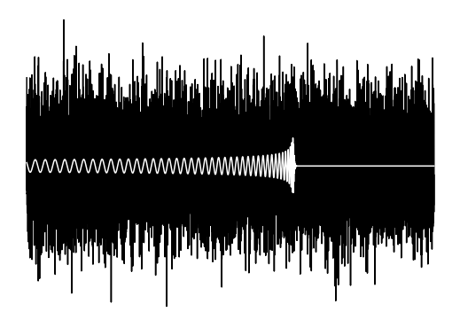
Why do they matter?
In detecting a gravitational wave, template banks used for matched filtering are restricted to just the dominant mode, rather than including the sum of all modes.
Notes:
So, now we have a little more intuition for HOMs. Why do we care about them at all? As many of us know, in detecting a gravitational wave, data is optimally searched using a technique called matched filtering, for a waveform model in a template bank. If the data matches one of these models, a detection is declared. But, the waveforms used in these template banks are restricted to just the dominant mode, and don’t include the sum of all modes, as written in the equation earlier.
There are practical reasons for this, namely that we don’t know where the merger is in the sky before we detect it. Remember, template banks are predetermined points in parameter space, for example mass ratio and total mass. So, we would have to include as an extra parameter, inclination and azimuthal angle, making a high dimensional problem even more complicated. This would expand parameter space by maybe 3 orders of magnitude, making matched filtering an extremely computationally intensive process, especially given the fact that we would be searching through, say 6 months worth of data for 2 seconds of signal. To keep up with the data as it comes in, it’s better not to include overly complicated waveforms in matched filtering.
Now, I will say we’re still not using waveforms with HOMs in the search pipeline, but within the last year we’ve started to use them in parameter estimation, which is a much more feasible endeavor when we’re only dealing with 2 seconds of data.
Vs parameter estimation is random walk in parameter space that returns point

Slide 6
Including HOMs…
Will make parameter estimation more precise, furthering our understanding of GW sources.
Increases similarities between the data and the template, thus boosting aLIGO's detection confidence during matched filtering.
Can act as a powerful new test of General Relativity in the strong-field, highly-dynamical regime.
Notes:
So, we believe that including HOMs in matched filtering, barring the practical complications, would have many scientific benefits. First, it would make the parameter estimation process more precise, giving us a better understanding of GW sources. Second, it would naturally increase the similarities between the data and the template, thus boosting LIGO’s detection confidence during matched filtering. And finally, and most importantly, this would act as a poweruful new test of GR in the strong-field, highly dynamical regime. This is because we have not yet found significant evidence for HOMs or harmonics of dominant mode, so when this finally does happen, this would be very interesting for theory.

Slide 7
Research Question:
What range of parameters for a source BBH merger optimizes the likelihood that aLIGO will be able to detect the statistically significant presence of HOMs?
Notes:
So this leads me to my research question for this summer: given that HOMs are so difficult to detect, since they are much weaker than the dominant mode, and depend on where they are in the sky, among many other factors, what range of parameters for a source BBH merger optimizes the likelihood that LIGO can detect the presence of these HOMs.

Slide 8
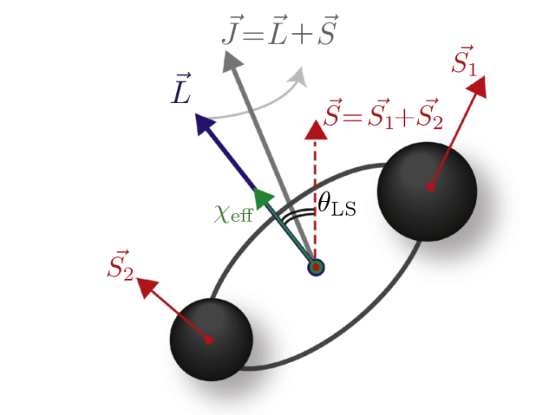
Four Parameters:
Total Mass, M
Mass Ratio, q
Aligned Spin, χ_{1z}
Inclination, θ
Credit: Carl Rodriguez at MIT
Notes:
And there are four parameters we are looking at in particular: total mass, which is just m1+m2. Mass ratio, which we define as M1/M2. The aligned spin component of the larger mass, which we define as M1, so chi_1z, which you can see in this plot here. These are the two black holes, this is the orbital plane, and here are the spins of each black hole. The aligned spin component is the portion of the spin that is parallel to the orbital angular momentum L. And in this image, the BBH system is precessing about the total angular momentum, J. But for our purposes, in order to reduce the parameter space to just four dimensions, we are ignoring precession and only looking at systems with aligned spin. Which means we’re only varying chi1z and setting chi2z to 0.
And the last parameter is the inclination angle, theta, which is simply the polar angle with respect to the orbital angular momentum of the observer. As we saw from the emission patterns that I showed earlier, there is also a phi dependence, on the azimuthal angle, but for the same reason of reducing parameter space, we are ignoring it and holding it to 0, which by design is an angle at which all the HOMs exist.
Theta is quasi constant due to graviational radiation

Slide 9
Research Procedure
Generate a waveform using numerical relativity.
Calculate the observed strain according to the Hanford detector’s antenna pattern.
Compute the overlap integral between the full waveform with HOMs and the dominant mode waveform, according to aLIGO’s total noise curve.
Compute the maximum luminosity distance at which ΔSNR ≥ 1, the detection threshold.
Notes:
So, I am going to outline quickly the broad steps I took to begin answering this question, and I will go more in depth in the following slides. So first, we needed to generate a waveform using numerical relativity. Then, we calculated the observed strain according to the Hanford detector’s antenna pattern. And with this, we can begin addressing the research question by computing the overlap integral between the full waveform with HOMs and the dominant mode waveform, according to LIGO’s total noise curve. And the last calculation is for the maximum luminosity distance at which the change in SNR is at least1, which we are making our detection threshold.
If overlap<1 we have potential to detect presence of HOMs. =1 means no hope

Slide 10
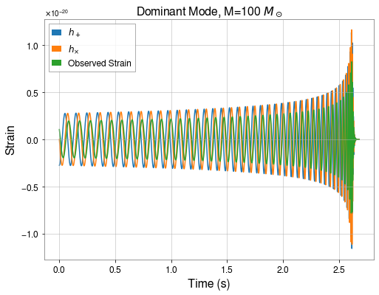
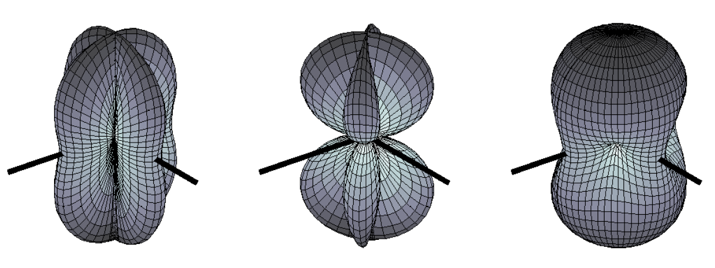
Polarization:
+
x
Credit: The LIGO Scientific Collaboration
Notes:
So, we generate a waveform using numerical relativity and obtain h plus and h cross, plotted here in orange and blue. But, we need to take into account the antenna pattern of the detector, which is essentially the angular response of the detector to gravitational waves with a specific polarization, showing how well the detector responds. F is the antenna pattern, and it goes from -1 to 1, as you can see here. Like the emission patterns of the HOMs, some places are null depending on the direction of the waves. So here, strain as a function of time depends on f+, which is for plus polarization, and fx for cross polarization, which are each functions of RA, dec, polarization, and time. Because we ultimately want to compare the waveforms with and without HOMs, we can arbitrarily choose values for these parameters since we’re just doing a relative comparison.

Slide 11
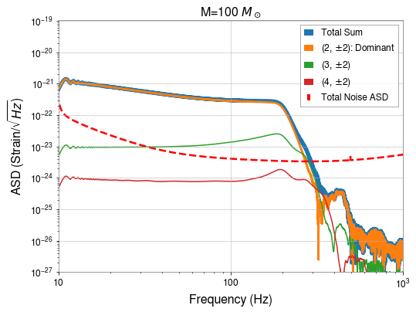

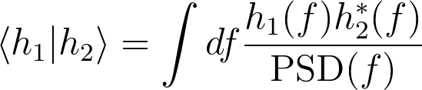
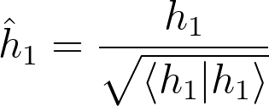
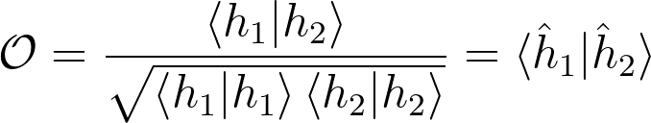
Calculating the Overlap Integral
Notes:
So now we have the strain for the dominant waveform and the full waveform, and can calculate the overlap integral. This is a value between 0 and 1, which for a certain amplitude spectral density plot, tells us how similar the waveforms are from eachother. A value of 1 means that they are identical and there is no hope of distinguishing HOMs from the dominant mode, while a value of 0 means they have absolutely nothing in common. So we use the LIGO Noise Curve as the ASD, and compute the inner product between h1 and h_2, which are the full and dominant waveforms respectively, and integrates over the PSD; this is essentially like a dot product. Then we think in abstract dimension space and say that hhat is the normalized unit vector of the waveform. So the Overlap integral, written down here, is really taking the inner product of h1 hat and h2 hat.; you can think of it as the angle between the two unit vectors in data space
And plotted on the right is a visualization of this in the frequency domain, where the dashed red line is the total noise ASD, and the orange is the dominant mode, the blue is the total sum, and the other curvesare other HOMs. This is just the fourier transform of the time domain plots you saw earlier, and you can see we’ve set the bounds of integration from 10 to 1000 Hz. So this flat bit here is the inspiral, then comes the merger, which is like a Lorentzian resonance frequency curve, and then there’s the peak and ringdown. Over here is just numerical noise associated with the fourier transform of a discontinuous, abruptly starting wavefunction, known as Gibbs noise. I used a tapering function to mitigate this effect, but there is still work to be done, clearly.
65,000 parameter space- you’ll see the effect of HOms in the sum

Slide 12
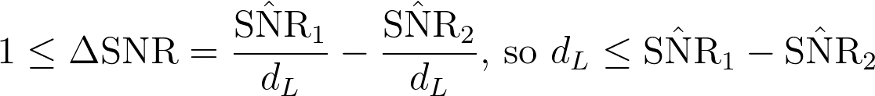
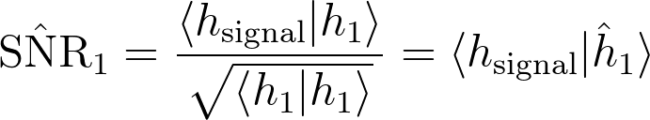
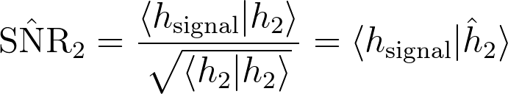
Calculating the Signal-to-Noise Ratio
h₁: Full Waveform
h₂: Dominant Mode
h_{signal}=h₁
Notes:
Now, the overlap integral is normalized such that it does not take into account the distance to the source, which scales inversely with the SNR; the strength of the signal has been normalized away. This means that the overlap integral is theoretical, while SNR takes into account distance and therefore detectability. We define this detectability threshold as a difference in SNR between using a template with and without HOMs of at least 1. So in order to get the full picture, we want to calculate the maximum luminosity distance at which this inequality is true. So SNR 1 is the template with HOMs, and SNR2 is using just thedominant mode. So SNR 1 is the inner product of the signal with the unit vector of full waveform, and SNR2 is the inner product of the signal with the unit vector of the dominant mode. And of course, the signal is equivalent to h1, the full waveform.
Now we get to ask this question bc we have new research (waveforms with HOMs)
SNR is at fixed distance of 1 Mpc so d is units of 1 Mpc

Slide 13
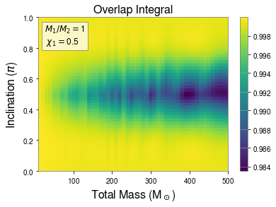
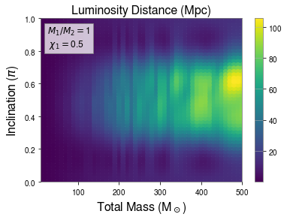
Results
Fixed parameters: d=1 Mpc, χ_{2z}=0, φ=0, q=1, χ_{1z}=0.5
Notes:
So, here are our results! Here we’ve looped over 2500 different numerical relativity waveforms, varying inclination angle and total mass, while keeping distance, spin, phi, and the mass ratio constant. Looking at the left plot for the overlap integral, we see that the darker areas are where the overlap integral is smallest, meaning we are more likely to be able to distinguish HOMs. We see this happens at about an incination angle of pi/2. on the right hand side, we’ve plotted the luminosity distance. And this time, we’re looking for the brighter spots, which means that at a larger distance away, we are still able to distinguish HOMs because we maintain that threshold delta SNR of 1. And we see that happens also for high masses, and for about pi/2 inclination.
We were expecting plots to be smoother and symmetric. Not sure why,under investigation

Slide 14
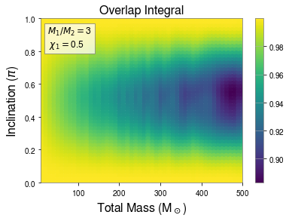
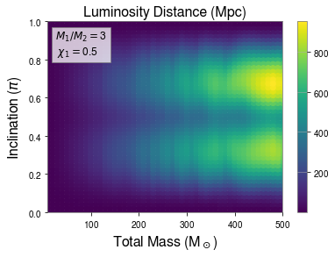
Results
Fixed parameters: d=1 Mpc, χ_{2z}=0, φ=0, q=3, χ_{1z}=0.5
Notes:
Repeating this for a higher mass ratio, so before it was an equal mass system and now it is a mass ratio of three, we see that the inclination angle is still optimal at pi/2 for the overlap integral, but the opposite is true for the luminosity distance. And we think this is true because changing the mass ratio changes the mix HOMs that are emitted, thus altering the dependence of the viewing angle. So essentially, we are getting some nulls based on the inclination angle.

Slide 15
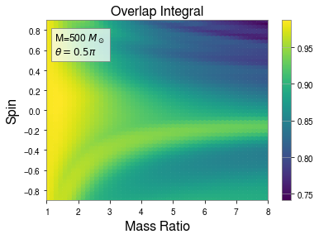
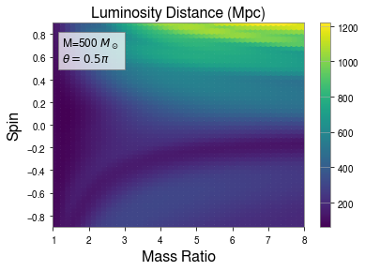
Results
Fixed parameters: d=1 Mpc, χ_{2z}=0, φ=0, M=500 M☉, θ=0.5π
Notes:
Now in this plot, we are varying mass ratio and spin, and instead fixing total mass and inclination angle. And we find that for both the overlap integral and the luminosity distance, we want a high mass ratio and a high positive spin, rather than negative. It’s important to remember that this is just a slice of data at this mass, inclinaton angle, etc, so this is simply a way that we canreduce the high dimensional parameter space and draw conclusions off of that.

Slide 16
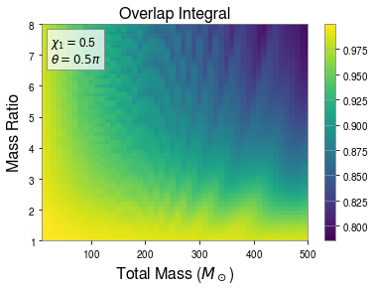
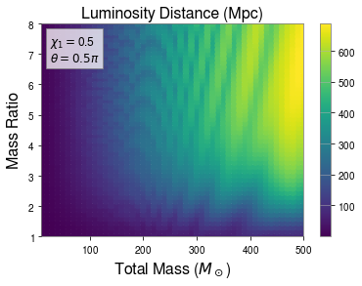
Results
Fixed parameters: d=1 Mpc, χ_{2z}=0, φ=0, χ_{1z}=0.5, θ=0.5π
Notes:
Lastly, here we vary total mass and mass ratio, and fix chi1 and the inclination angle. This reiterates what we found earlier, namely that the overlap integral is minimized for large masses and mass ratios, while the luminosity distance is maximized for these same values.

Slide 17
Summary
Total Mass, M | As high as possible.
Mass Ratio, q | As high as possible.
Aligned Spin, χ_{1z} | As high (and positive) as possible.
Inclination, θ | Depends on which HOMs are most dominant at a certain mass ratio.
Notes:
So to summarize, we find that we want the total mass and mass ratio to be as high as possible, and the aligned spin component of the larger BH to be as high and positive as possible. We find that the dependence on inclination angle is nontrivial, and varies depending on which HOMs are most dominant at a certain mass ratio.

Slide 18
Further Questions for the Future
When do the overlap integral and luminosity distance begin to decrease for extremely high mass systems?
How do precessing systems with non-aligned spin behave?
What parameters does the optimal inclination angle depend upon, and why?
What results would we see with a more detailed study using full Bayesian model selection analysis?
Notes:
But, these results immediately beg further questions for the future. Namely, when do the overlap integral and luminosity distance begin to decrease for extremely high mass systems? We know this has to happen eventually, because as the mass increases, the starting frequency decreases, and eventually the waveform will fall off the noise curve and the signal will be undetectable, as you can see from this plot. So we know this should happen, but it is a matter of determining at exactly which point quantitatively.
Second, we would like to know how precessing systems with non-aligned spin behave. As I mentioned earlier, in order to reduce parameter space we fixed chi2z and only looked at aligned spin, non-precessing systems. So we have no idea how our results would change if we added that dimension. Second, we need to study and understand better inclination angle dependence, because from this study it seems that it has a nontrivial dependence on the mass ratio, for example. Lastly, this was a fairly quick study that aimed to reduce parameter space as much as possible. We would like to conduct a more detailed study using full bayesian model selection analysis to identify the presence of HOMs.
Bayesian inference: model selection (fwf and rwf) and parameter estimation (15 parameters, posterior distribution)
Calculate bayesian odds ratio for fwf and rwf (model vs model 2) → whichever is bigger

Slide 19
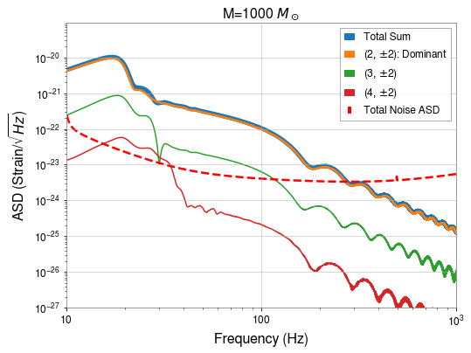
Falling off the Total Noise ASD Curve

Slide 20
Acknowledgements
To: Dr. Alan Weinstein, Liting Xiao, Dr. Vijay Varma, Caltech LIGO SURF, LIGO Laboratory, NSF, Rouse Family, Dr. Tom Callister, fellow SURF students...
Thank you!
Notes:
Alright, that’s it. I want to thank the following individuals and groups for helping me throughout the summer. Thank you, and I’ll take any questions.

