Slide 1
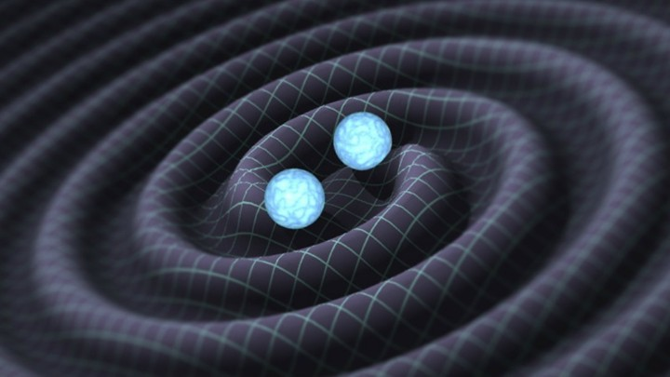
Discovering the Underlying Distributions
of Black Hole Populations
Phoebe McClincy¹
Mentors: Alan Weinstein², Jonah Kanner², Liting Xiao²
¹Department of Astronomy and Astrophysics, Pennsylvania State University
²LIGO Laboratory, California Institute of Technology
Caltech / LIGO

Slide 2
Overview
Introduction to rates and populations
Motivations
Proposed mass distributions
Recovering the mass distributions
Conclusions/future work

Slide 3
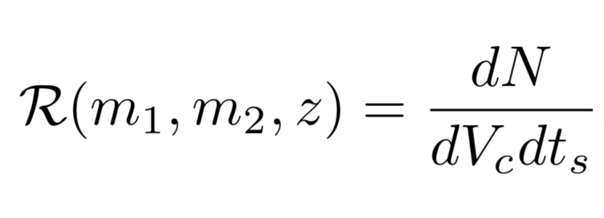
Introduction to rates and populations
Detector sensitivity ↑, distance we can hear GWs from compact binary mergers ↑
# of events detected will dramatically increase in the near future
We expect tens, hundreds, or thousands of events
Measure event rate density (in units of mergers/time/volume) as a function of mass, spin, and redshift (ignore spin for now)
Now is the optimal time to develop tools to use for this

Slide 4
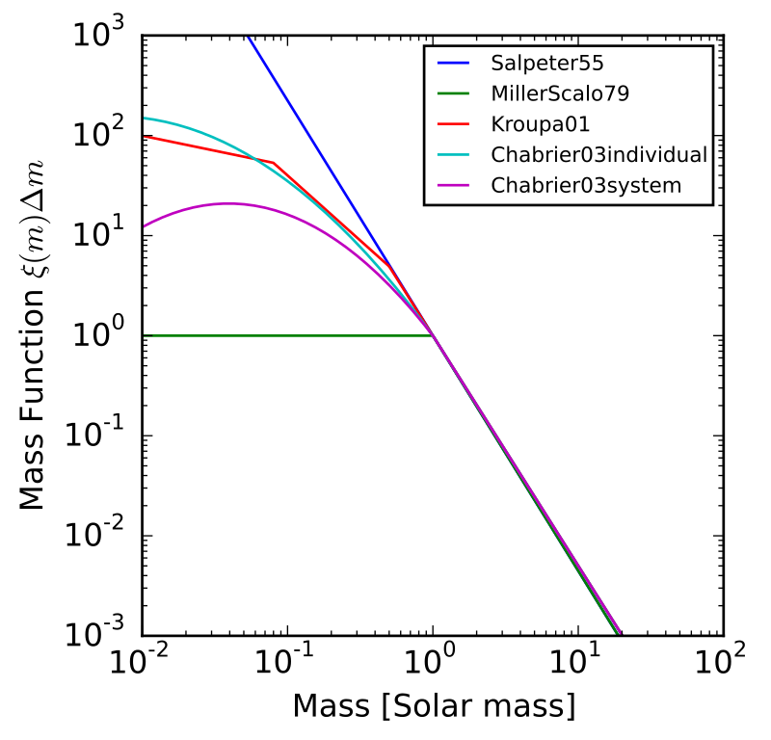
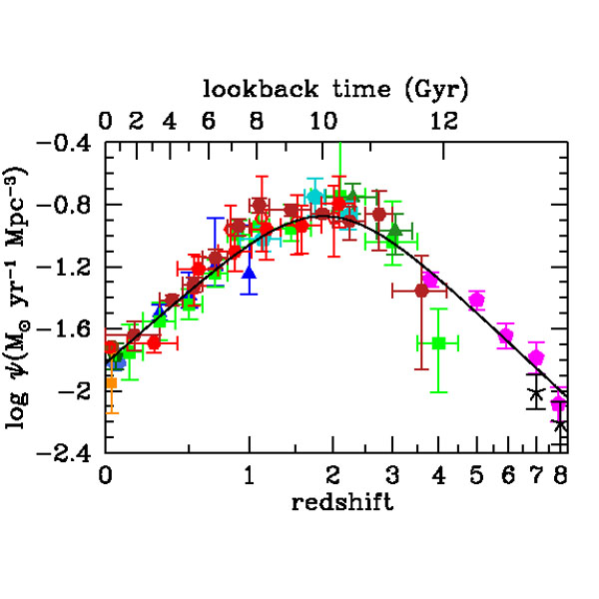
Models of R (m₁, m₂, z) for Single Stars
Salpeter IMF, shown in dark blue, on a log scale. Describes the initial mass distribution for a stellar population. It appears linearly as its true nature is a power law.
(Johannes Buchner. “Initial Mass Function,” Wikipedia.)
Madau-Dickinson star formation rate density (SFR/unit volume) as a function of redshift. The data points come from many other bodies of work. This distribution will be shifted left for BHs.
(Piero Madau, Mark Dickinson. Cosmic Star
Formation History. 2014)
Notes:
Has been done for stars, we want to connect this to BHs

Slide 5
Connecting Single Stars to BBHs
Single
Stars
Binary
Stars
BBHs

Slide 6
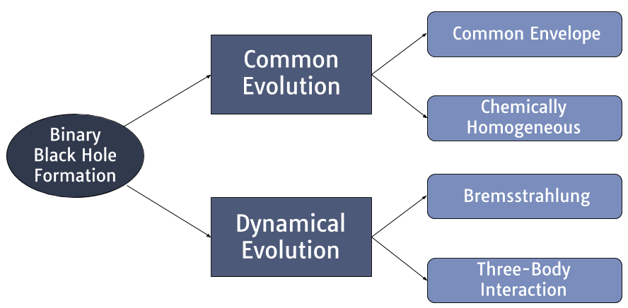
Channels of BBH Formation
Notes:
Distinguish channels of form., tell which is more prominent in nature

Slide 7
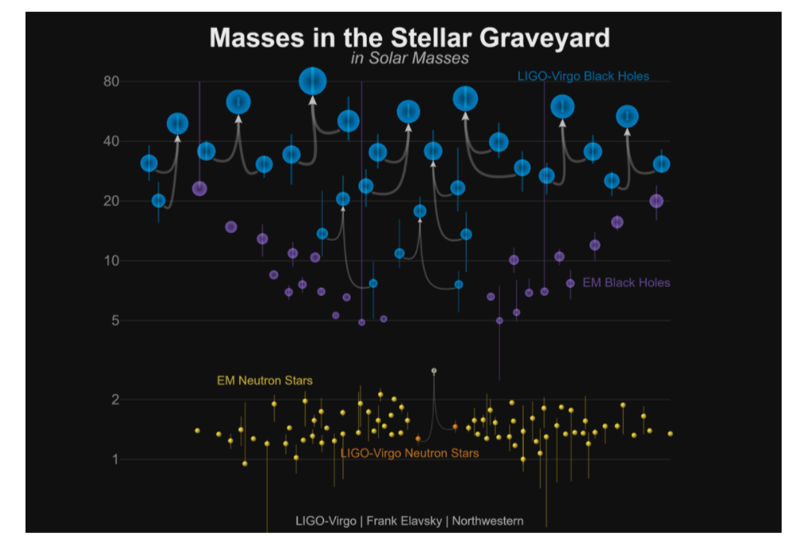
Populations, Mass Distributions, and Mass Gaps
~50-150M☉: Pulsational pair-instability supernovae (blows away significant portion of mass)
~2-5M☉: Possible disparity between NS and BH masses
< 1M☉: Small likelihood that traditional stellar collapse would form BHs
Notes:
Explain the plot!! Be informed about the nature of mass gaps / if they are truly mass gaps

Slide 8
Mathematical Process
.
Naturally-occurring event rate as a function of θ = m₁, m₂, z,
λ = α, β, γ
(1)
(2)
Naturally-occurring, true number of events
(3)
Observed number of events
(4)
Probability of true # of events given detected # of events
Notes:
cosmological evolution of volume, time-dilated time, time at detector (can get many waveforms bc of our many detectors). N is the expression on slide 3 so we multiply by Vc and t

Slide 9
Mathematical Process
.
Naturally-occurring event rate as a function of θ = m₁, m₂, z,
λ = α, β, γ
(4)
(3)
Naturally-occurring, true number of events
(2)
Observed number of events
(1)
Probability of true # of events given detected # of events

Slide 10
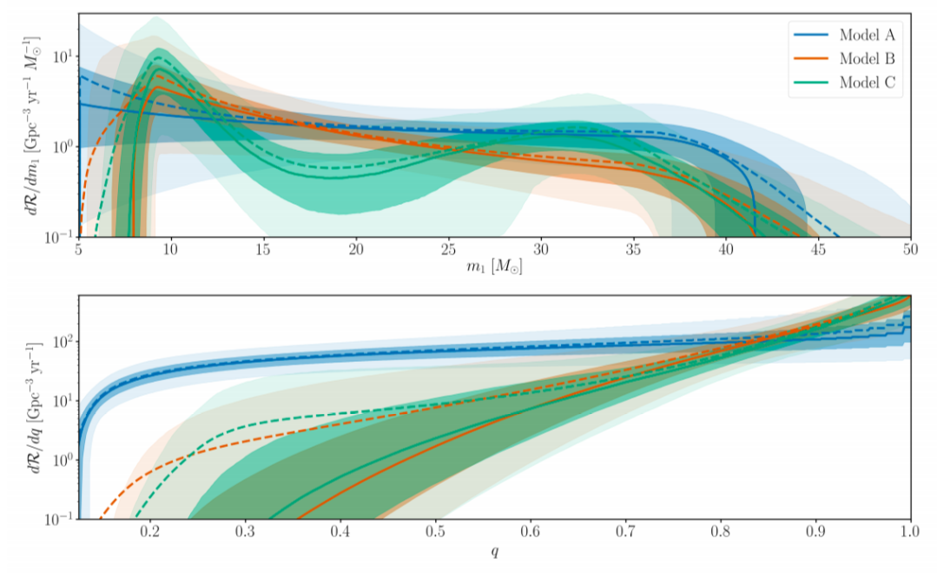
Primary Mass Distribution
Power law
component
Abbott, B. P., Abbott, R., Abbott, T. D., Abraham, S., Acernese, F., Ackley, K., ... & Agathos, M. (2019). Binary Black Hole Population Properties Inferred from the First and Second Observing Runs of Advanced LIGO and Advanced Virgo. arXiv preprint arXiv:1811.12940.
Notes:
Explain all the parts of Model C (mmin/max, turn-on fn, pl, and gaussian)

Slide 11
Analysis Process
Generate optimal waveforms based on mass distributions in my model
Retrieve the optimal SNR from each waveform, evaluate SNR threshold
Parameter estimation on the retrieved mass distributions to recover the hyperparameters
α, β, γ

Slide 12
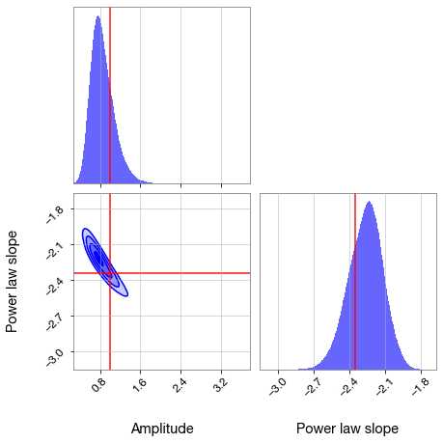
Initial Parameter Estimation: Salpeter IMF
Well-recovered!

Slide 13
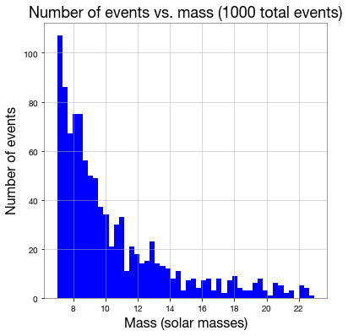
Model C Power Law Component
Parameter estimation
to follow soon…

Slide 14
Conclusions / Future Work
The known hyperparameters for the initial power law testing were well-recovered
In the future, we will likely be able to conduct a similar parameter estimation on real populations of BBHs, and will be able to recover the underlying distribution
Finishing Model C analysis / other more complex models
Incorporating efficiency of detection
Errors in the values of mass

Slide 15
Acknowledgements
Alan Weinstein
Jonah Kanner
Liting Xiao
Tom Callister
Shreya Anand
Ryan Magee

Slide 16
Other Slides

Slide 17
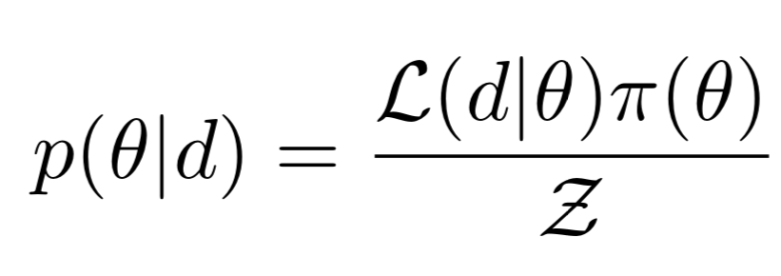
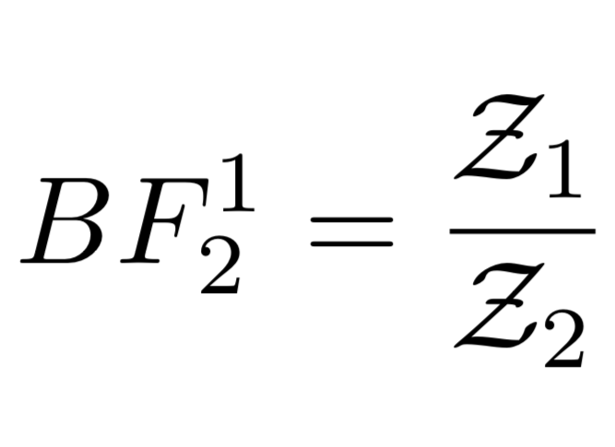
Bayesian Inference
Bayes’ Theorem
Evidence
Bayes Factor

Slide 18
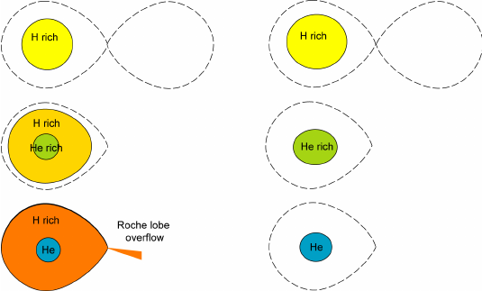
Common Envelope vs. Chemically Homogeneous
(de Mink, 2008)

Slide 19
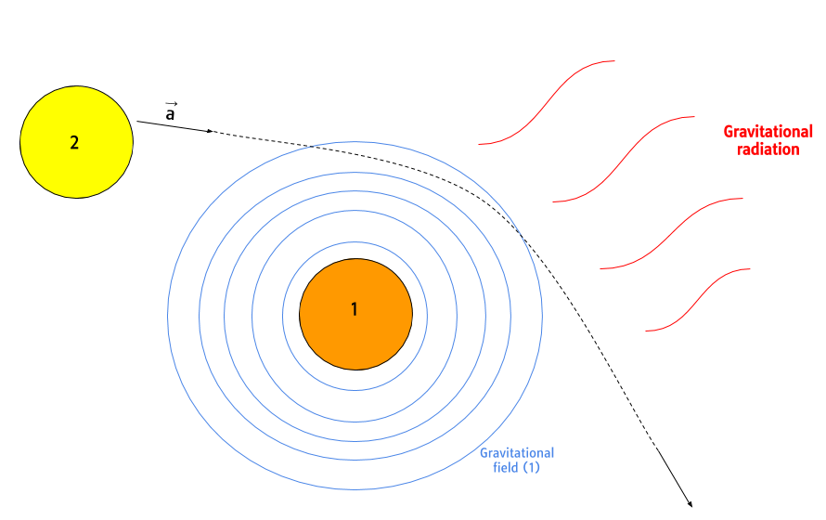
Bremsstrahlung

Slide 20
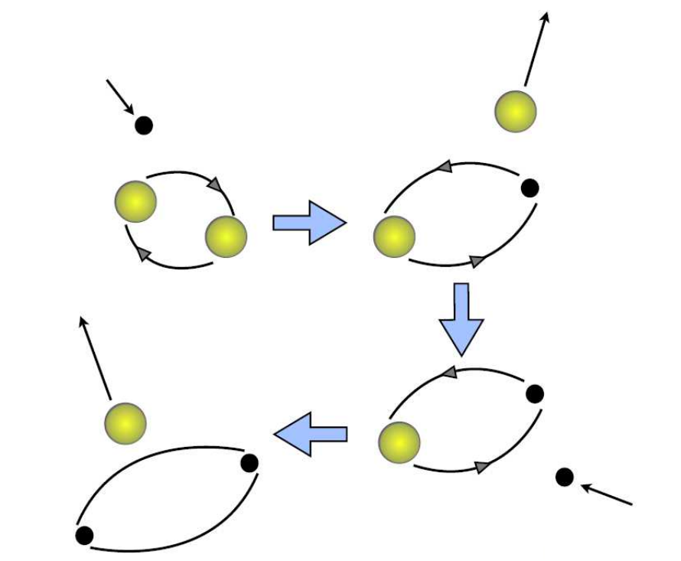
Three-Body Interaction
(Banerjee, 2016)

