Slide 1
Radio Frequency Noise Reduction in the LIGO Hanford Observatory
Matthew Withers
2019 Caltech SURF Program
Mentors: Dick Gustafson and Keita Kawabe
LIGO-T1900364-v5

Slide 2
Overview
RF Distribution System Overview
Investigation: Mapping RF Cable Noise to DARM
Intro to RF Cable Shield Noise
Mapping Methodology
Experiment #1: Cable Characterization
Experiment #2: RF Noise Injections
Experiment #3: Cable Noise Profile Collection
Further Improvements
Adjusting Mapping Equation for Non-Flat Transfer Function
Future Work
LIGO-T1900364-v5

Slide 3
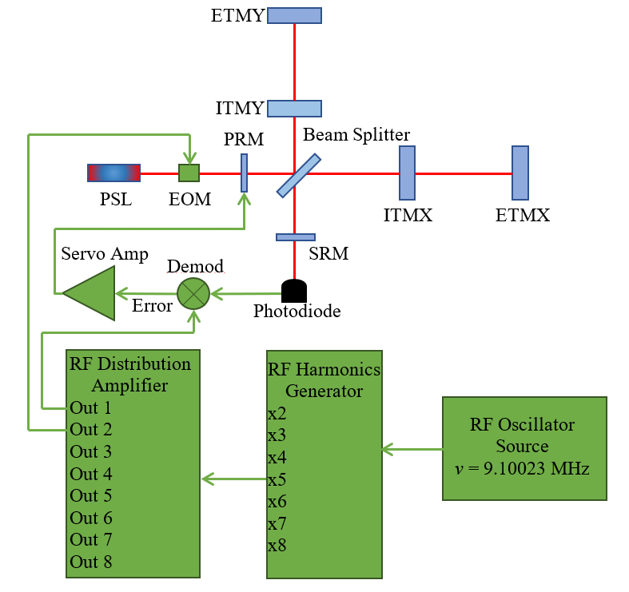
RF Distribution System Overview
RF Signal Generation for Servo Control Loop
PSL = Pre-Stabilized Laser
EOM = Electro Optic Modulator
PRM = Power Recycling Mirror
SRM = Signal Recycling Mirror
ITMX = Input Test Mass X
ETMX = End Test Mass X
ITMY = Input Test Mass Y
ETMY = End Test Mass Y
LIGO-T1900364-v5

Slide 4
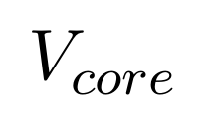
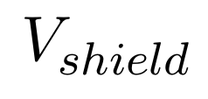
Mapping Cable Noise to DARM
Shield Noise Overview
Shield Noise = Any unwanted RF signal (V_{shield}) on the shield of a transmission cable
LIGO-T1900364-v5

Slide 5
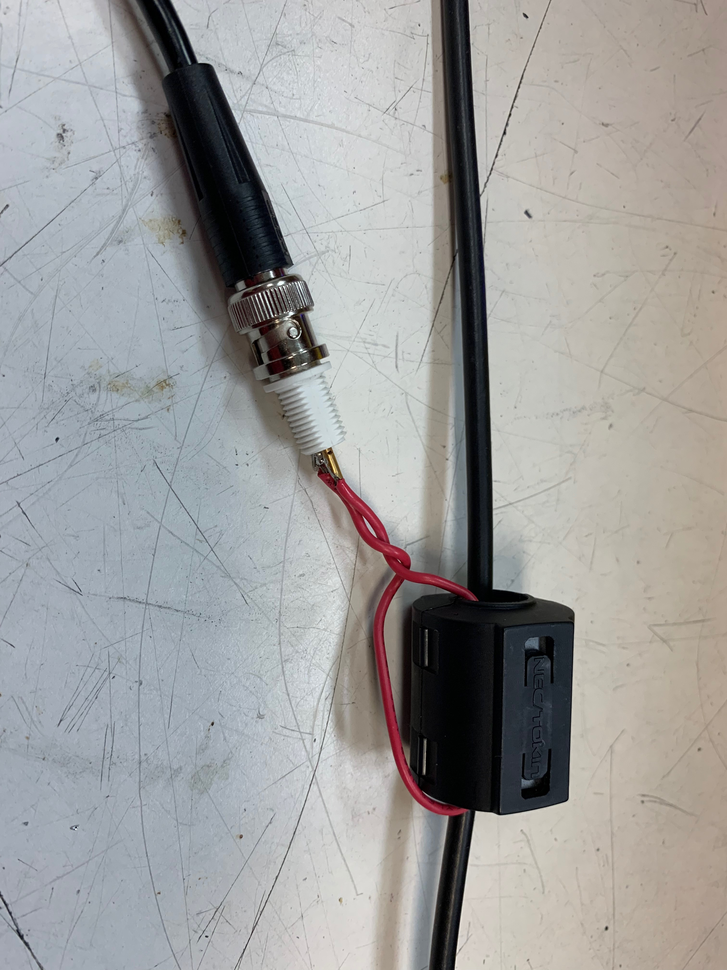
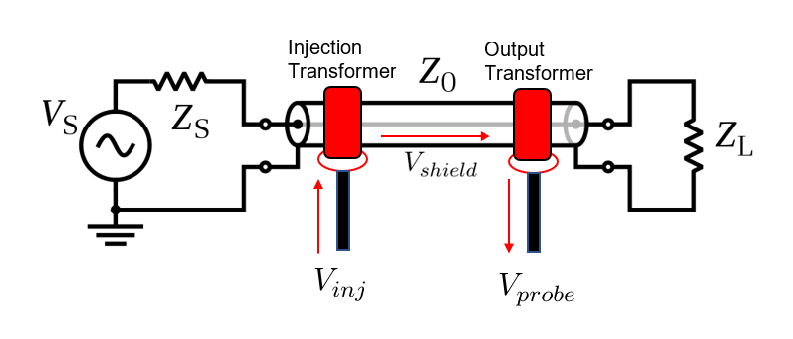
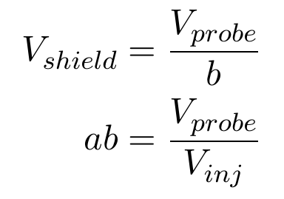
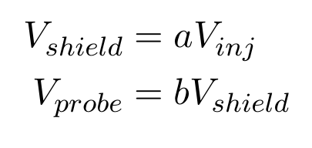
Mapping Cable Noise to DARM
Measuring and Exciting Shield Noise
LIGO-T1900364-v5

Slide 6
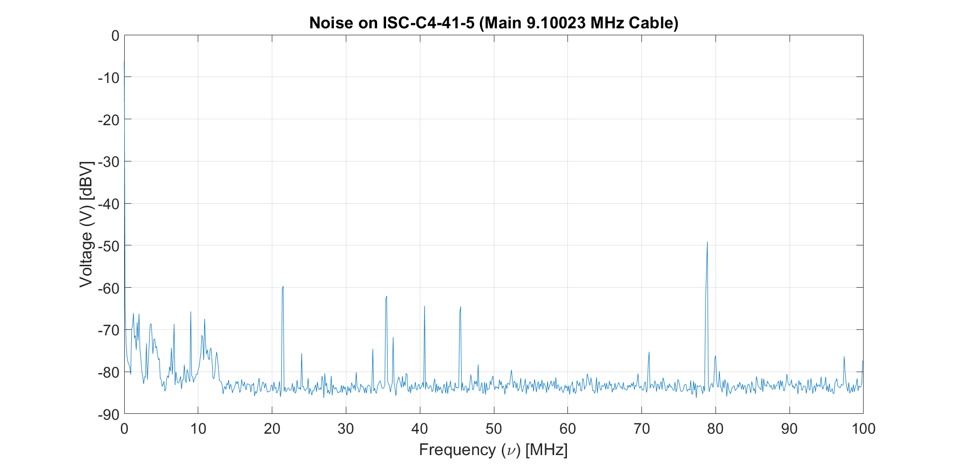
Mapping Cable Noise to DARM
Sample Shield Noise Profile
LIGO-T1900364-v5

Slide 7
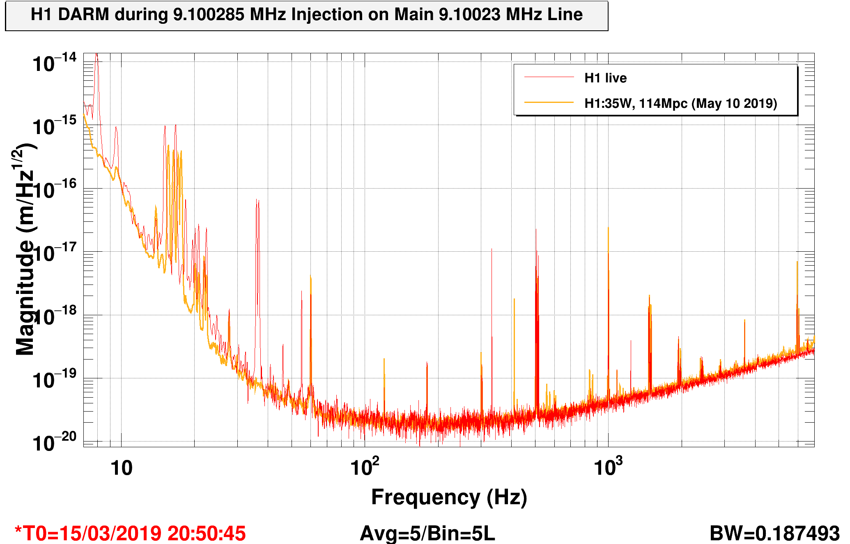
Mapping Cable Noise to DARM
DARM Response of March 2019 RF Signal Injection
Injection Line (55 Hz)
LIGO-T1900364-v5

Slide 8
Mapping Cable Noise to DARM
Mapping Methodology:
Experiment #1: Cable Characterization
Experiment #2: RF Noise Injection
Experiment #3: RF Noise Profile Collection
LIGO-T1900364-v5

Slide 9
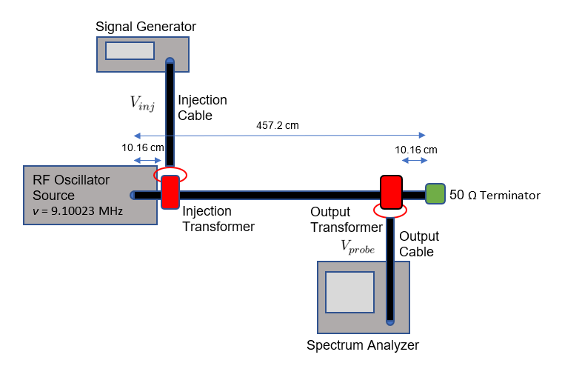
Mapping Cable Noise to DARM
Experiment #1: Cable Characterization - Setup
LIGO-T1900364-v5

Slide 10
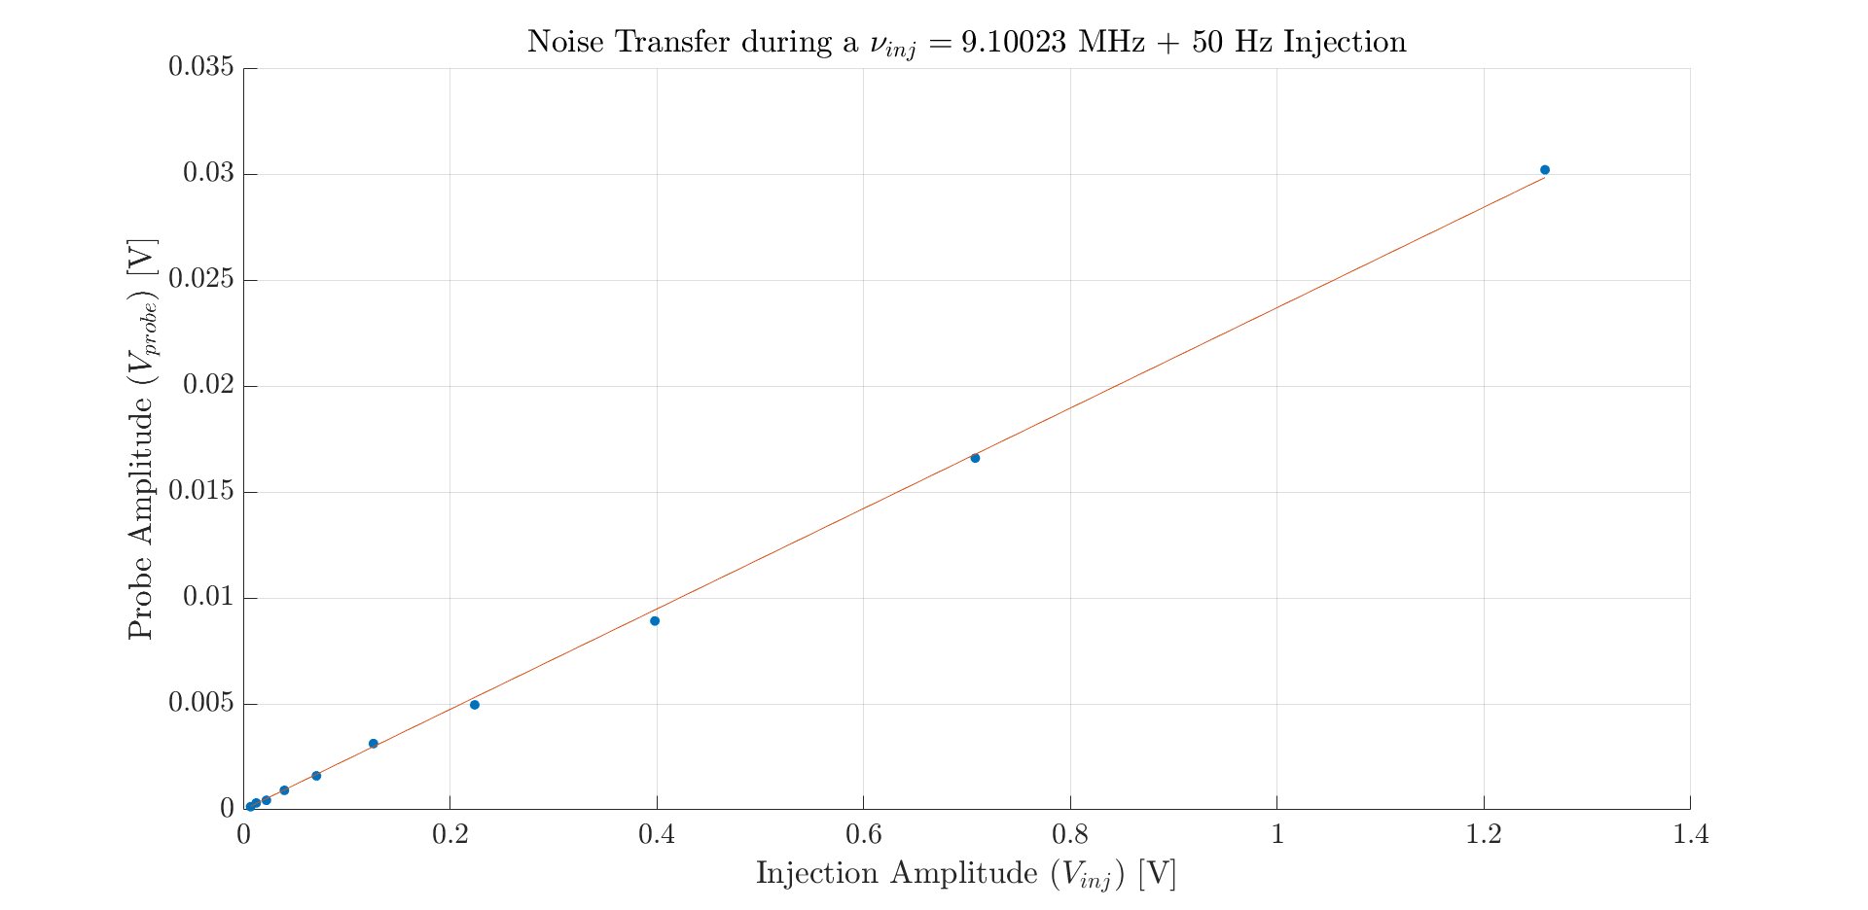
Mapping Cable Noise to DARM
Experiment #1: Cable Characterization - Results
LIGO-T1900364-v5

Slide 11
Mapping Cable Noise to DARM
Mapping Methodology:
Experiment #1: Cable Characterization
Experiment #2: RF Noise Injection
Experiment #3: RF Noise Profile Collection
LIGO-T1900364-v5

Slide 12
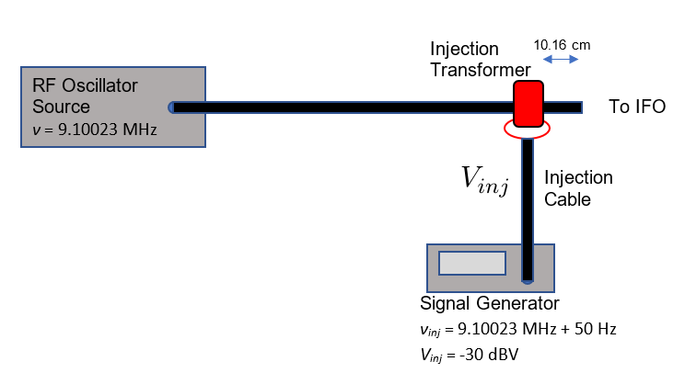
Mapping Cable Noise to DARM
Experiment #2: Noise Injections - Setup
LIGO-T1900364-v5

Slide 13
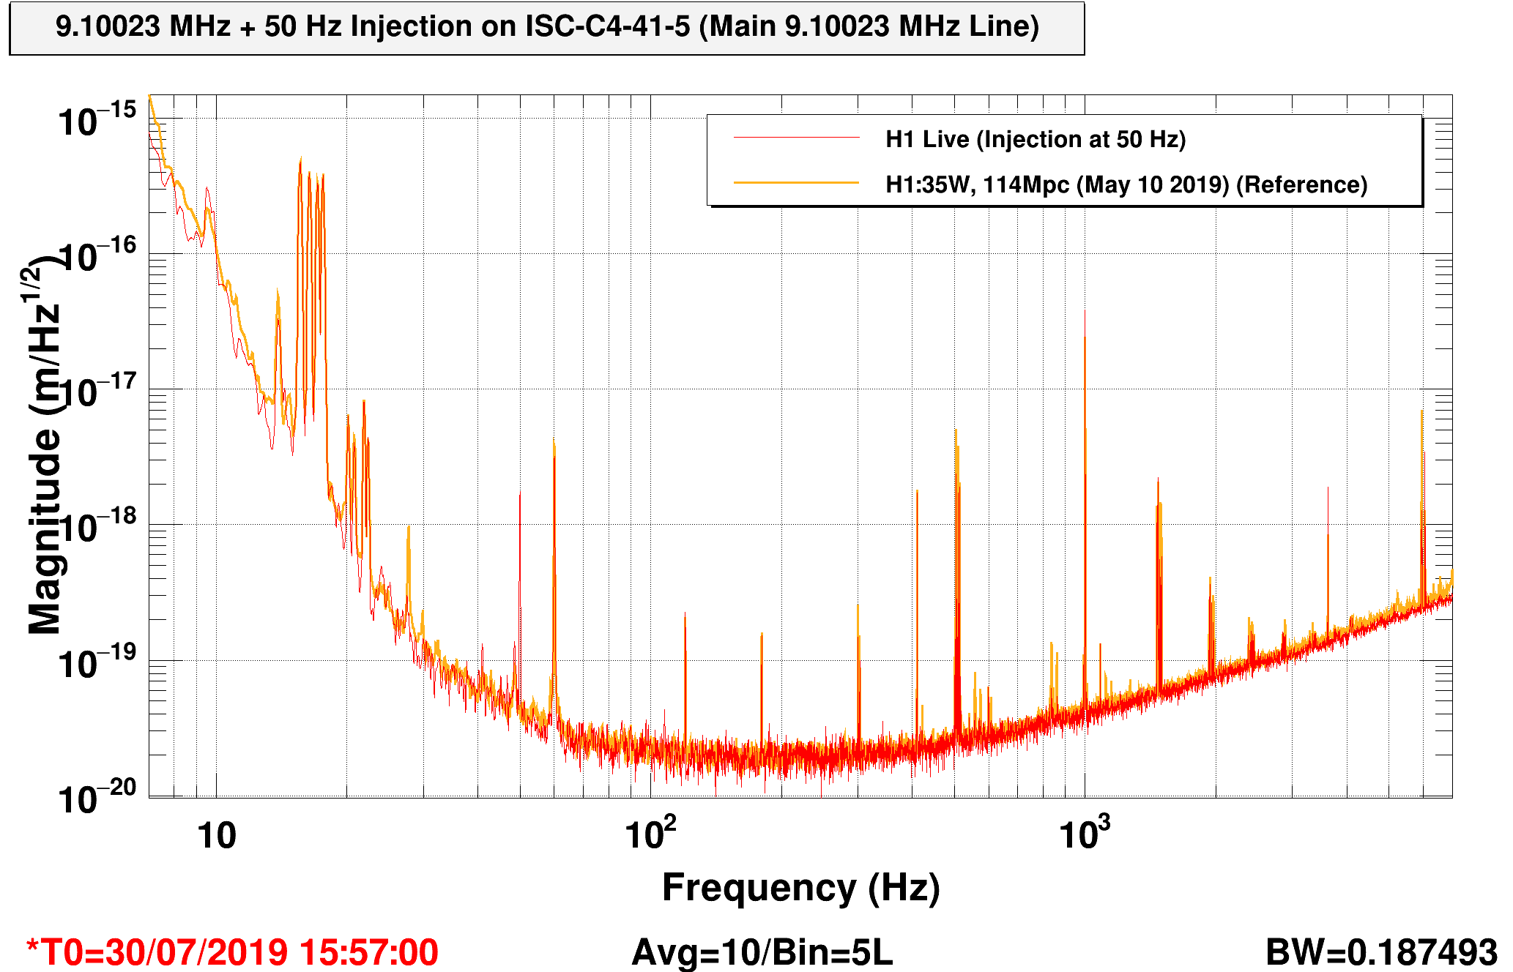
Mapping Cable Noise to DARM
Experiment #2: Noise Injections - Results
Injection Line (50 Hz)
LIGO-T1900364-v5

Slide 14
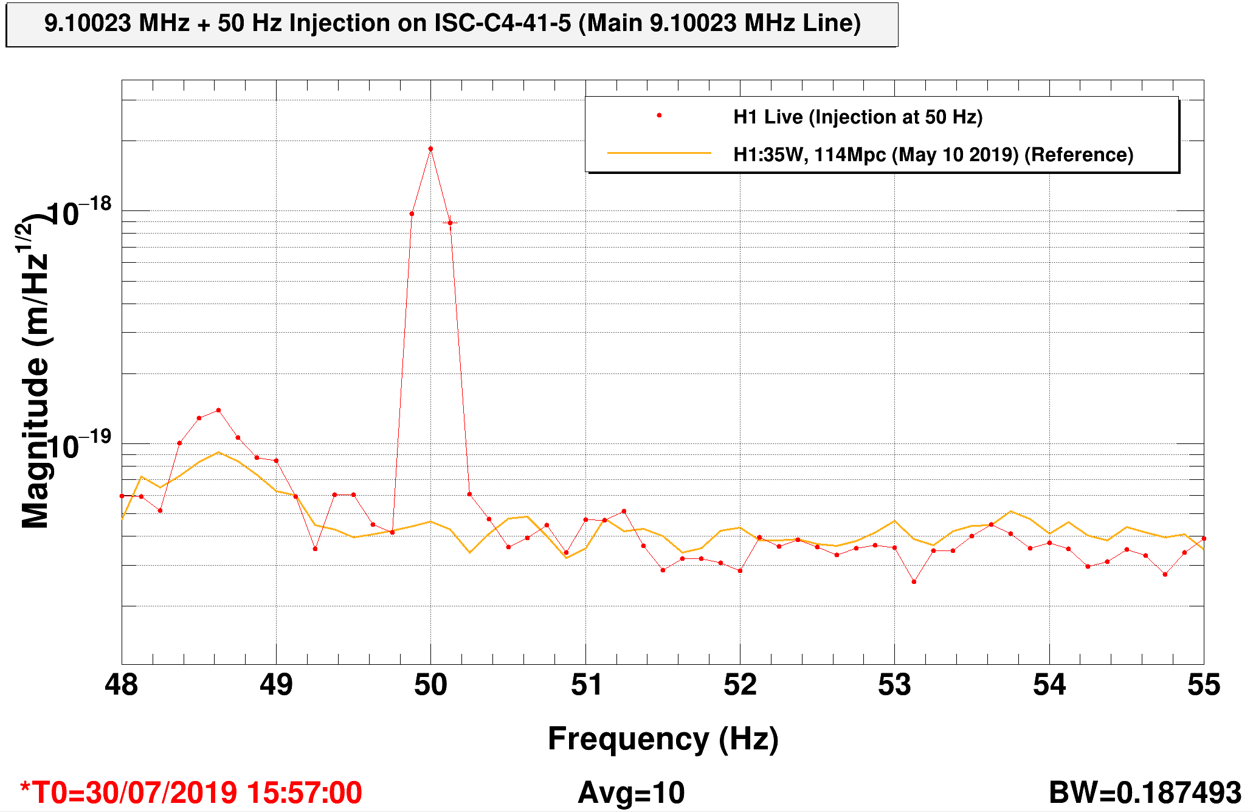
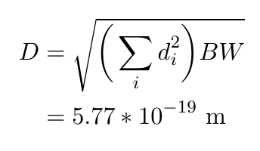
Mapping Cable Noise to DARM
Experiment #2: Noise Injections - Results
LIGO-T1900364-v5

Slide 15
Mapping Cable Noise to DARM
Mapping Methodology:
Experiment #1: Cable Characterization
Experiment #2: RF Noise Injection
Experiment #3: RF Noise Profile Collection
LIGO-T1900364-v5

Slide 16
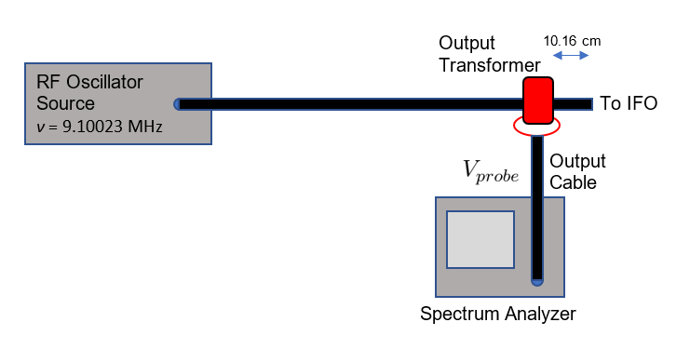
Mapping Cable Noise to DARM
Experiment #3: RF Noise Profile Collection - Setup
LIGO-T1900364-v5

Slide 17
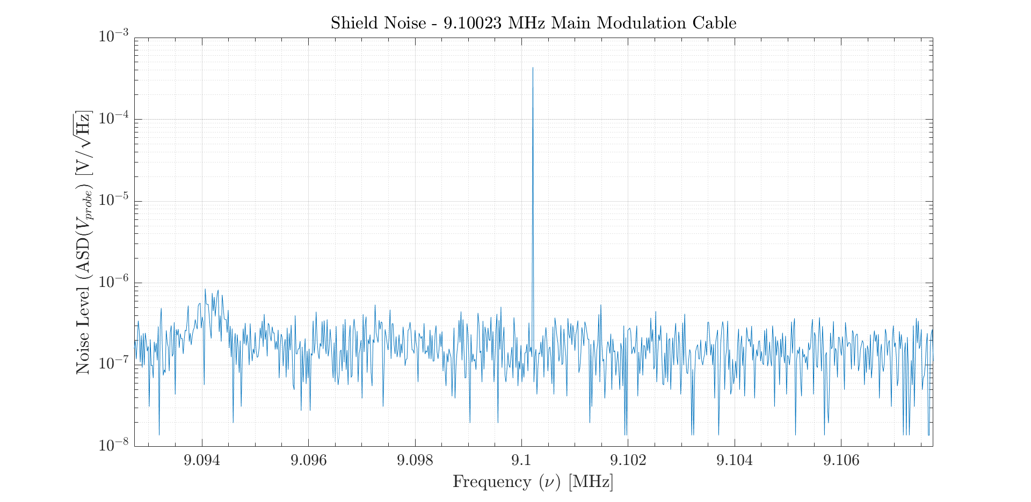
Mapping Cable Noise to DARM
Experiment #3: RF Noise Profile Collection – Data Prep
LIGO-T1900364-v5

Slide 18
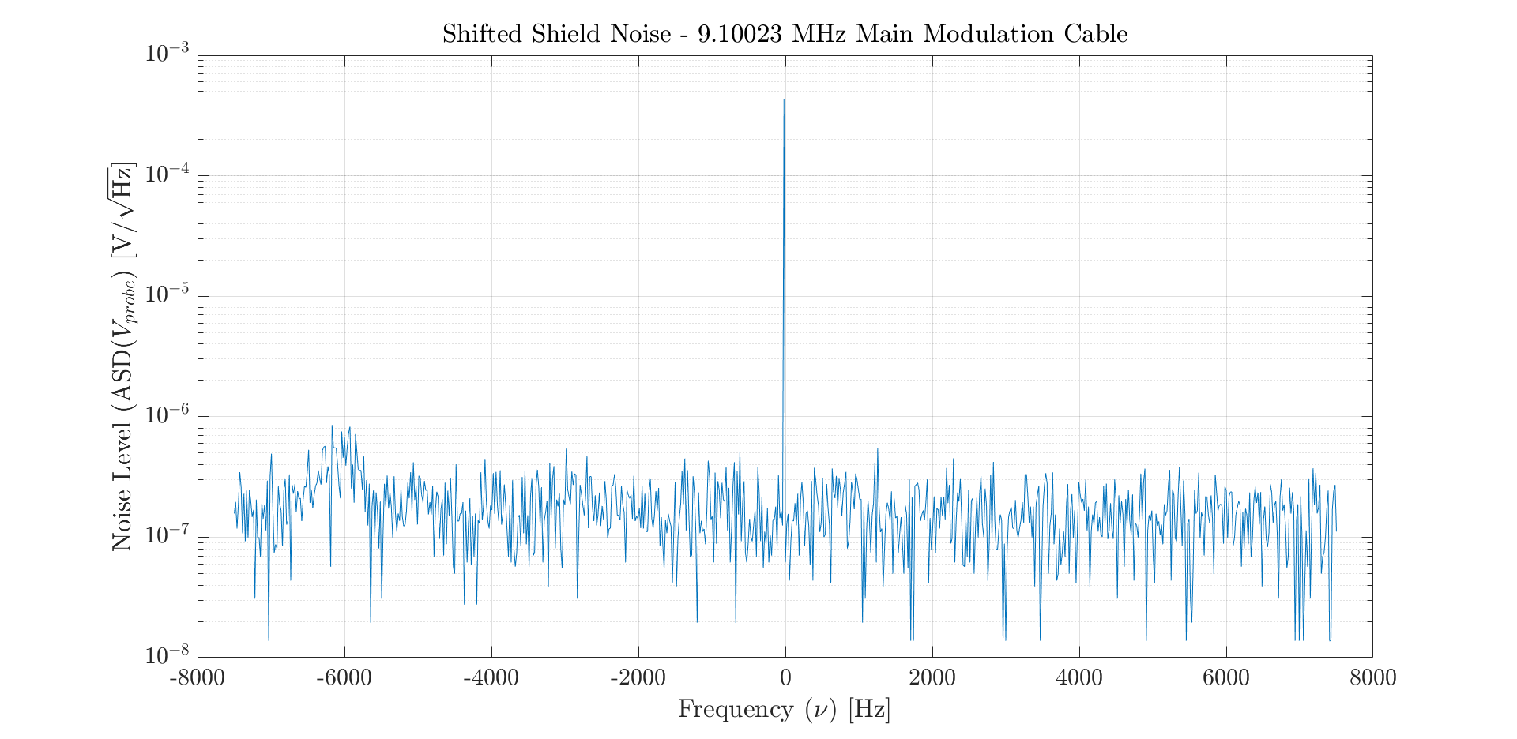
Mapping Cable Noise to DARM
Experiment #3: RF Noise Profile Collection – Data Prep
LIGO-T1900364-v5

Slide 19
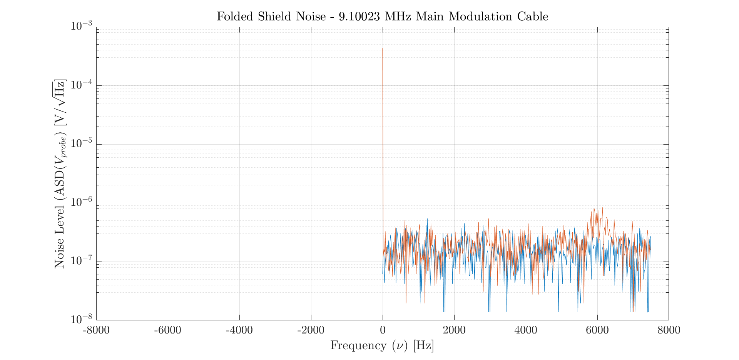
Mapping Cable Noise to DARM
Experiment #3: RF Noise Profile Collection – Data Prep
LIGO-T1900364-v5

Slide 20
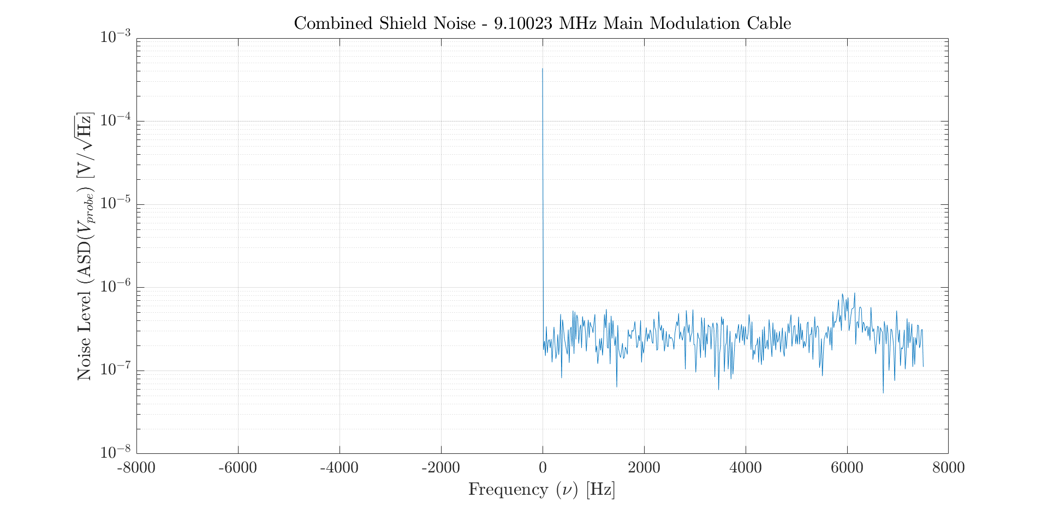
Mapping Cable Noise to DARM
Experiment #3: RF Noise Profile Collection - Results
LIGO-T1900364-v5

Slide 21
Mapping Cable Noise to DARM
Experiment #1: Cable Characterization
Experiment #2: RF Noise Injection
Experiment #3: RF Noise Profile Collection
LIGO-T1900364-v5

Slide 22
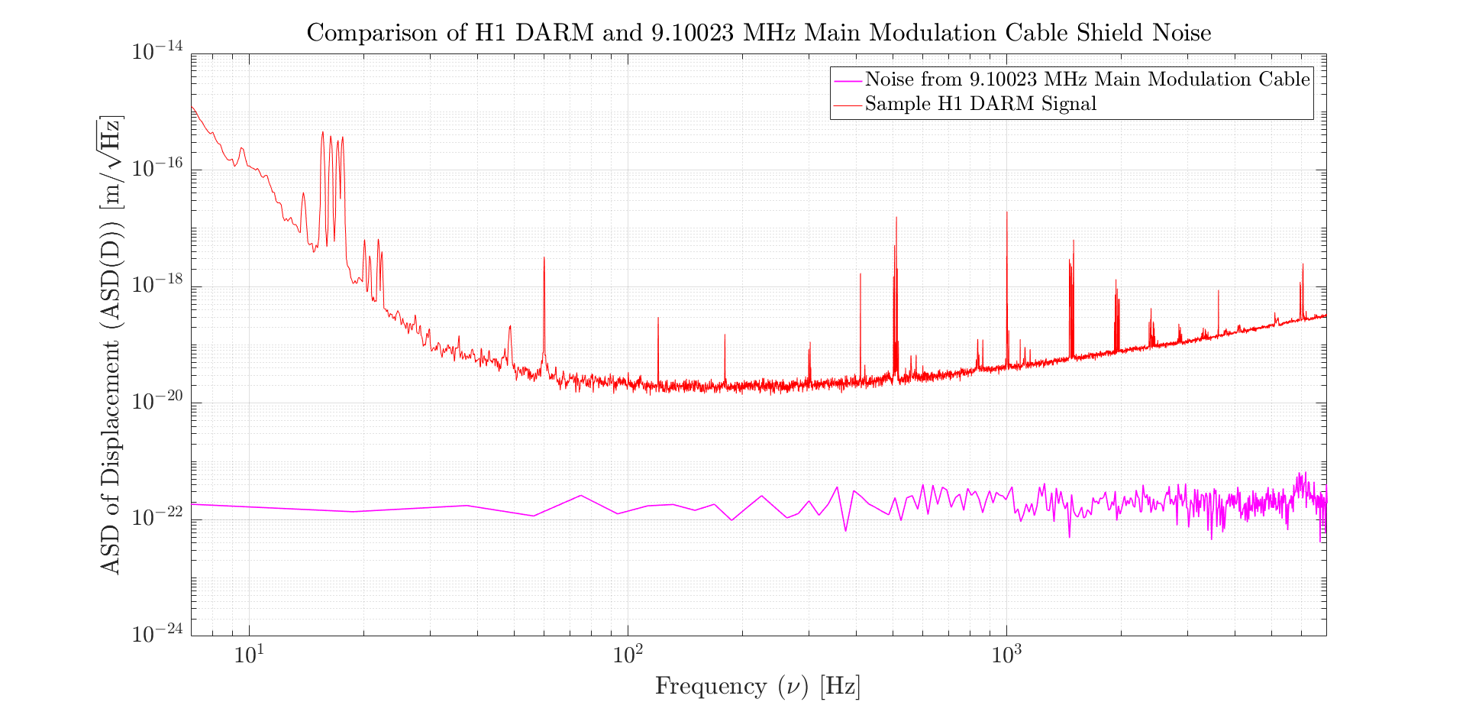
Mapping Cable Noise to DARM
Final Results: 9.10023 MHz Main Modulation Cable
LIGO-T1900364-v5

Slide 23
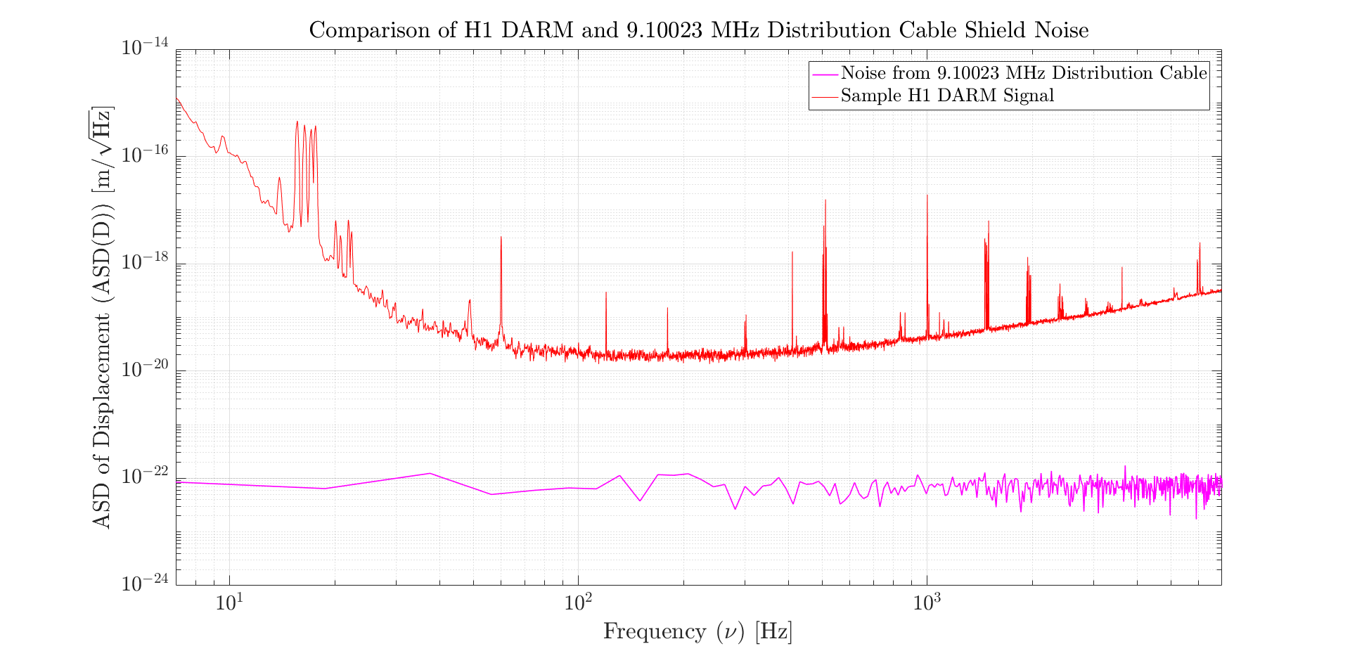
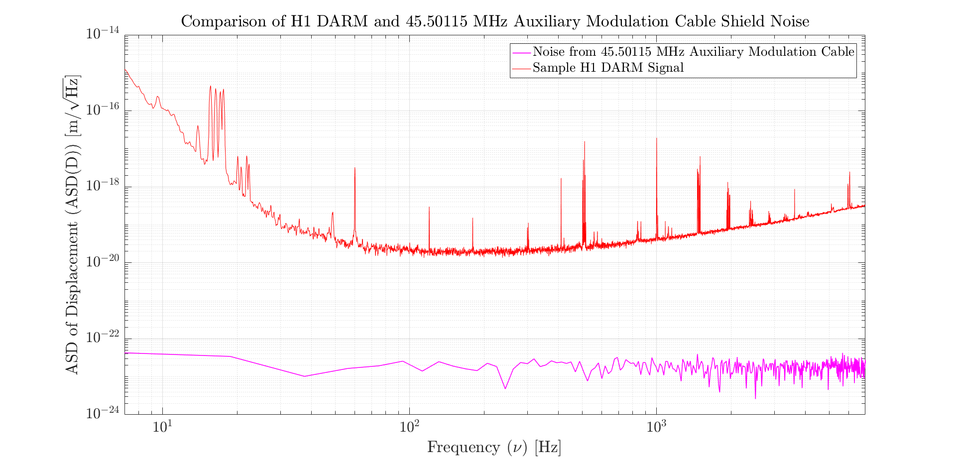
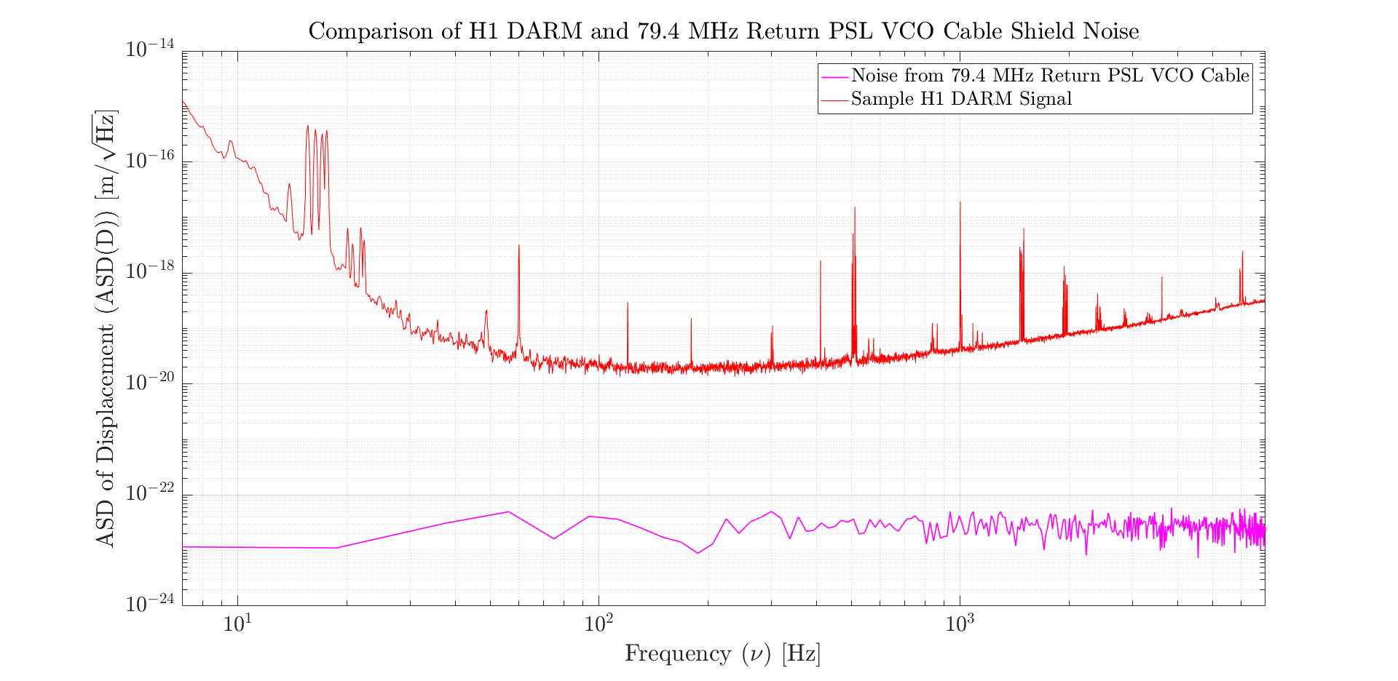
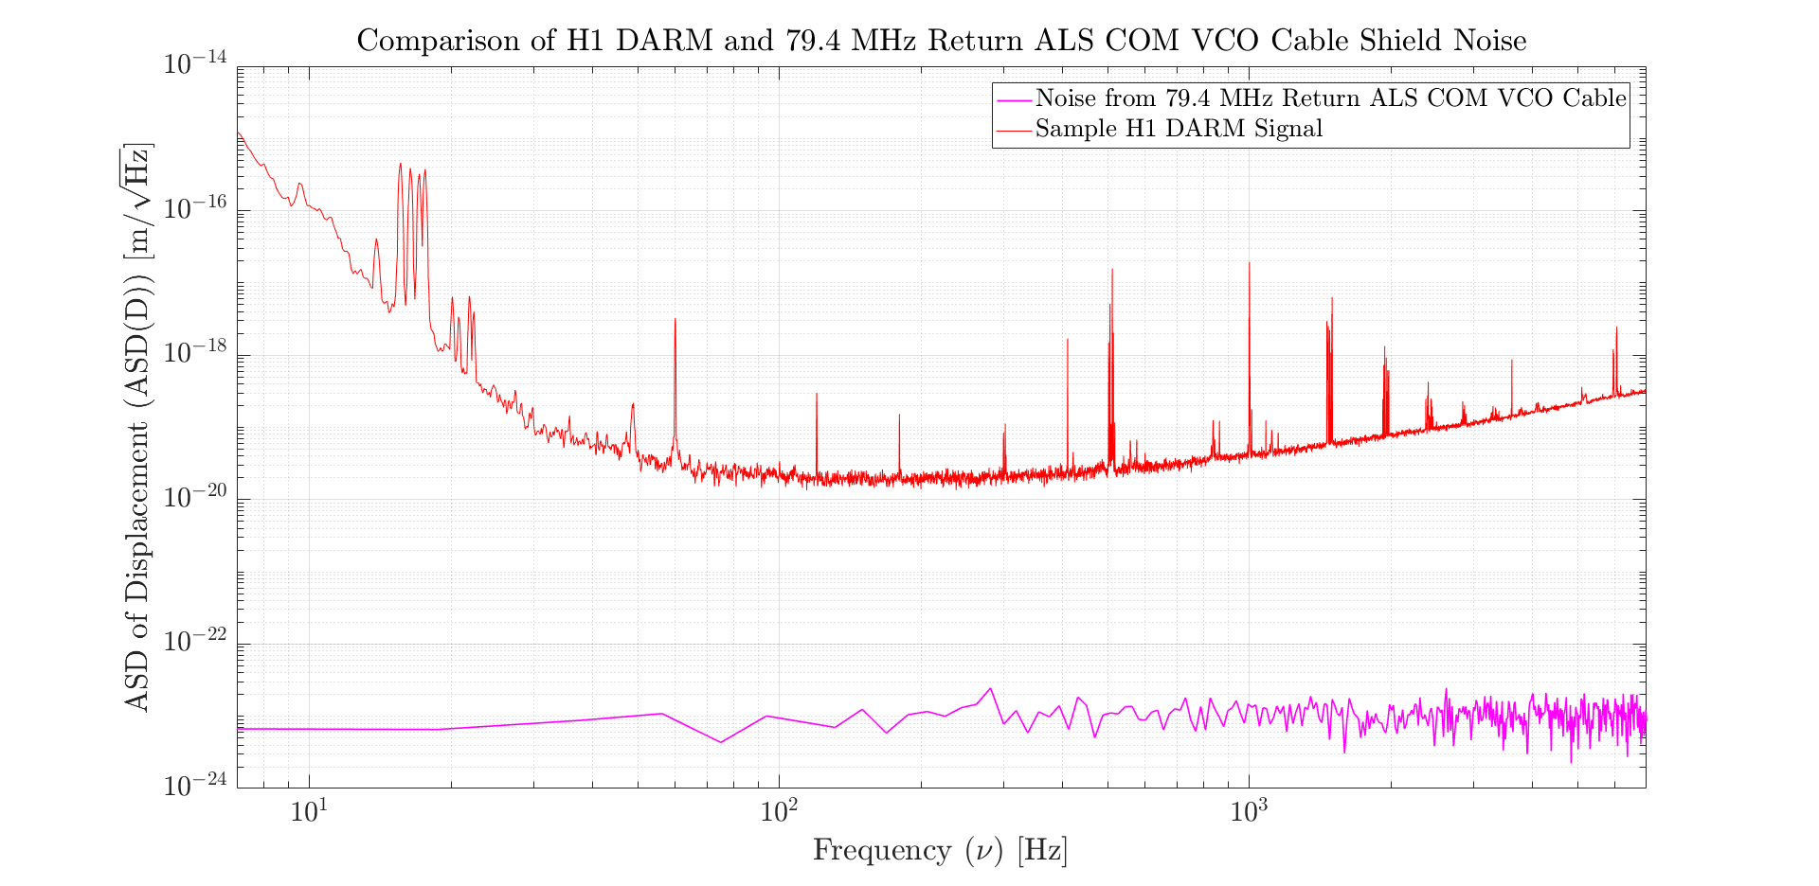
Mapping Cable Noise to DARM
Final Results: Other Cables
LIGO-T1900364-v5

Slide 24
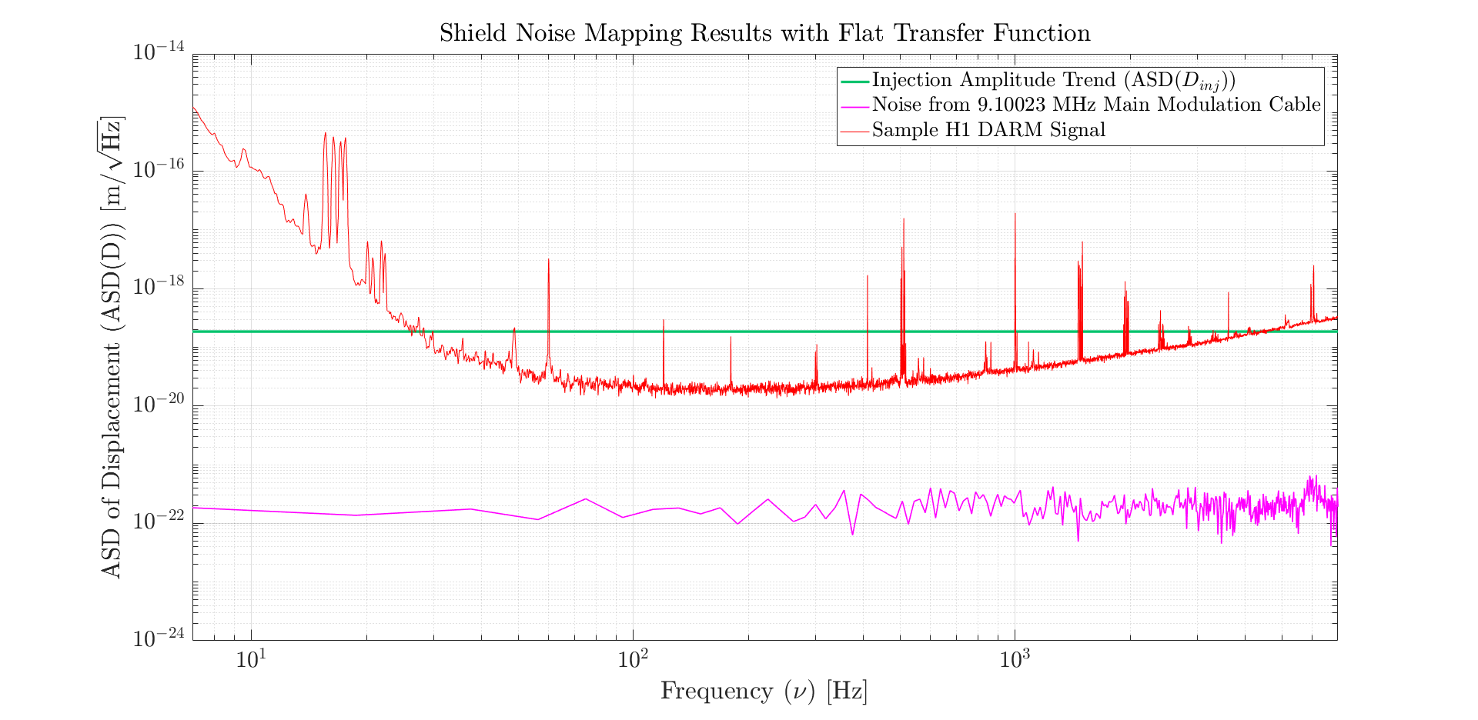
Further Improvements
Original Equation Assumes Flat Transfer Function between Cable Noise and DARM Noise
LIGO-T1900364-v5

Slide 25
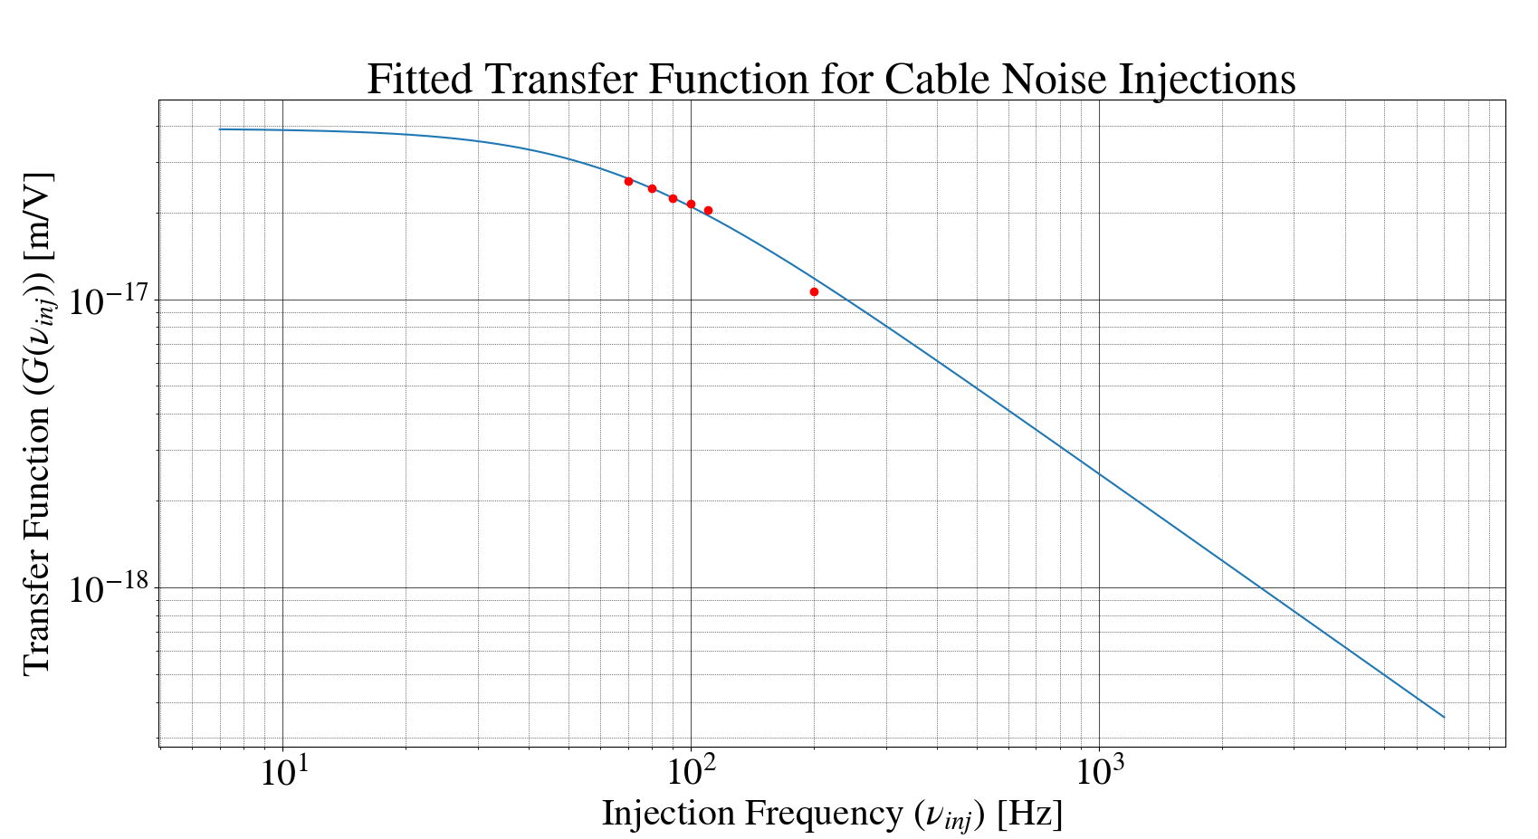
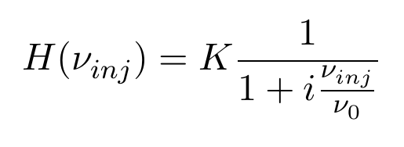
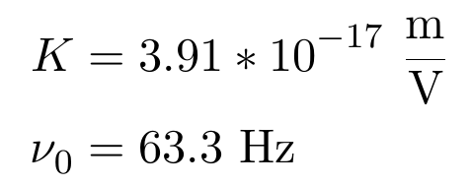
Further Improvements
Recently Acquired Data Suggests a Non-Flat Transfer Function -> Try 1-pole Transfer Function
LIGO-T1900364-v5

Slide 26
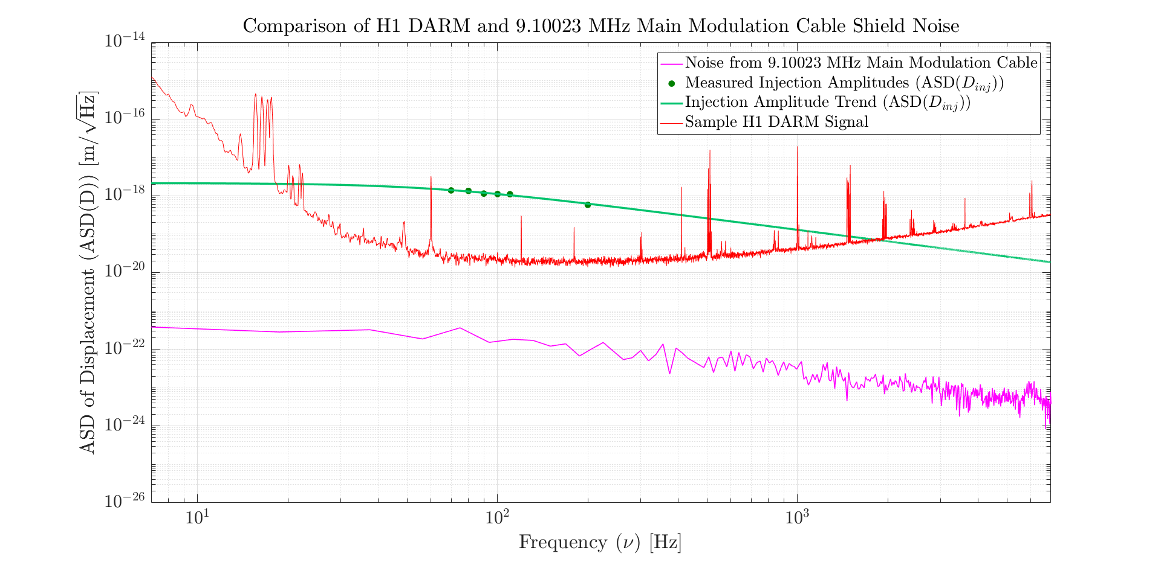
Further Improvements
Mapping Equation with Single Pole Transfer Function
LIGO-T1900364-v5

Slide 27
Future Work
Perform more injections across the aLIGO DARM frequency band to verify our choice of a 1-pole transfer function
Improve fit values or select new transfer function template as necessary
Use new mapping equation to model noise on 45.50115 MHz and 79.4 MHz cables
LIGO-T1900364-v5

Slide 28
Acknowledgements
Special Thanks Goes to the Following Individuals for their Contributions to the Project
Mentors: Dick Gustafson and Keita Kawabe
EE Lab Staff: Marc Pirello and Filiberto Clara
National Science Foundation and the Caltech SURF Program
LIGO-T1900364-v5

