Slide 1
Analisys of the correlations between the non stationary noise and the auxiliary channels in LIGO
Luca D’Onofrio¹
Gabriele Vajente²
¹Università di Napoli “Federico II,” Complesso Universitario di Monte S.Angelo, Napoli, Italy
²LIGO, California Institute of Technology, Pasadena, USA
‹#›

Slide 2
Overview
Band-Limited Root Mean Square (BLRMS)
Auxiliary channels
Standard Linear Regression - Overfitting problems
Simulated data - LASSO regression
Results (O3 data)
‹#›

Slide 3
Band-Limited RMS
Noise is NOT stationary. We need a way to quantify the time evolution of the noise.
Amplitude Spectral Density 04/22/2019 [1]
Square root of the integral of the Power Spectral Density (PSD) in a frequency band
Time evolution of the noise floor: NO lines in PSD, NO glitches in BLRMS evolution
[1] G. Vajente, "Compute band-limited RMS for LIGO O3 data", https://git.ligo.org/gabriele-vajente/blrms
‹#›

Slide 4
Auxiliary channels
Thousands of sensors to monitor instrumental and environmental conditions
Minute trends (without glitches)
Mean trend and standard deviation trend for each channel
‹#›

Slide 5
Linear Regression
i-th BLRMS value
k = # channels
i = time index
Ɛ_{i} = additive noise
Sum of squared error
^
Estimate β values on the training set
Compare predictions on the test set
‹#›

Slide 6
Overfitting Problems
47-49 Hz
33 hours
‘AlignmentSensingControl’ subsystem
resample
splitting in training and test set
scaling
standard linear regression
LHO
Training set
Test set
‹#›

Slide 7
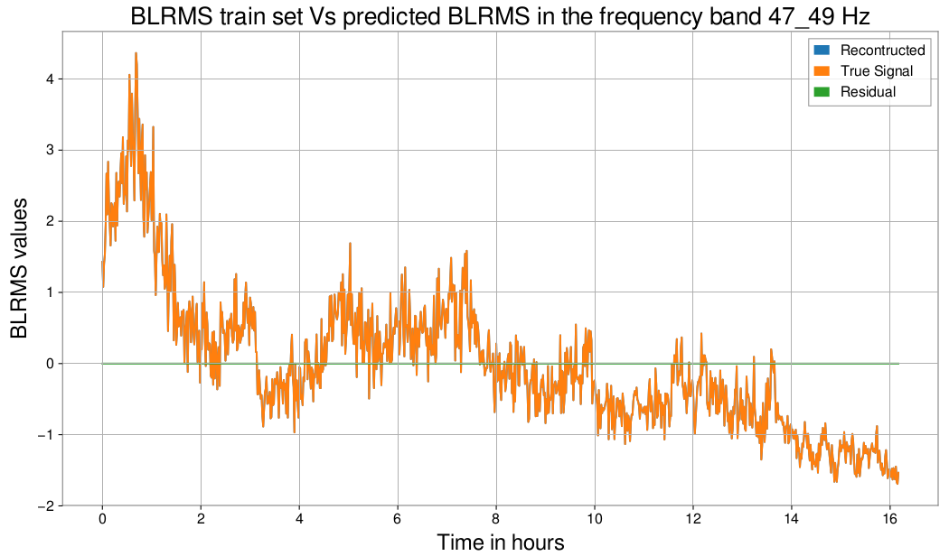
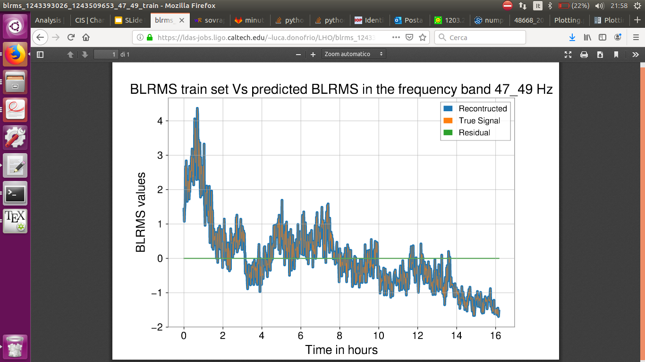
Overfitting problems
Perfect prediction for the training set !
‹#›

Slide 8
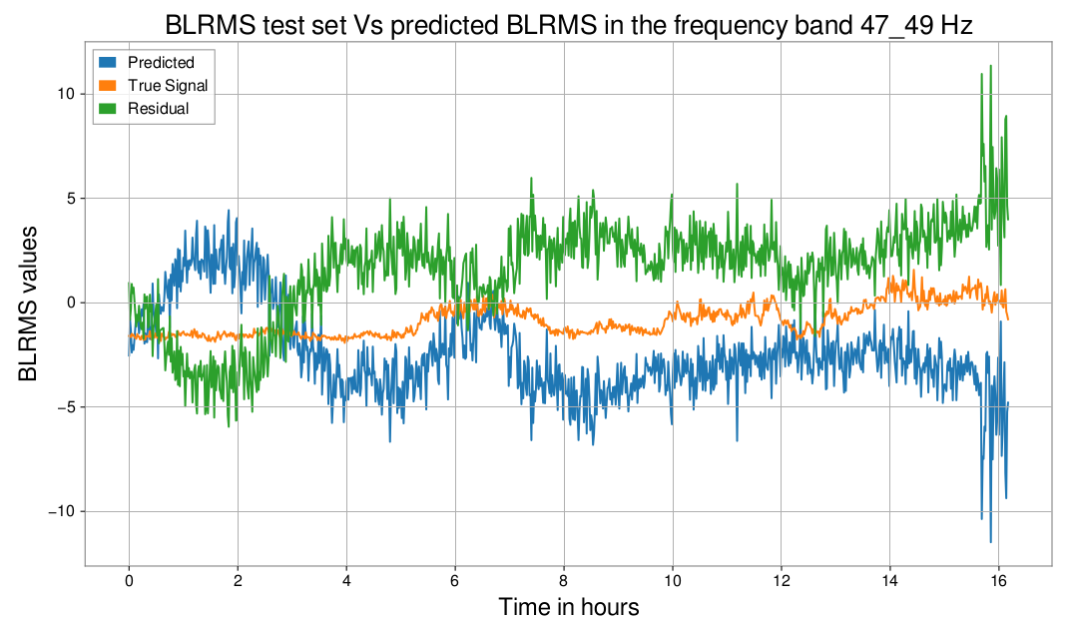
Overfitting problems
The model fails to generalize to unseen data.
‹#›

Slide 9
Simulated data
To test possible solutions
WHY SIMULATED DATA?
Known coefficients to estimate
20000 random time series (Input signals x_{j} ), 3600 points to simulate auxiliary channels time serie
Combine first 20 input signals with known coefficients
‹#›

Slide 10
LASSO Regressor
Least Absolute Shrinkage and Selection Operator
This term shrinks many components of the solution to zero.
The number of selected features is controlled by the regularization parameter α.
α →0 : Standard Linear regression
Increasing α values, we expect that the number of coefficients different from zero decreases
‹#›

Slide 11
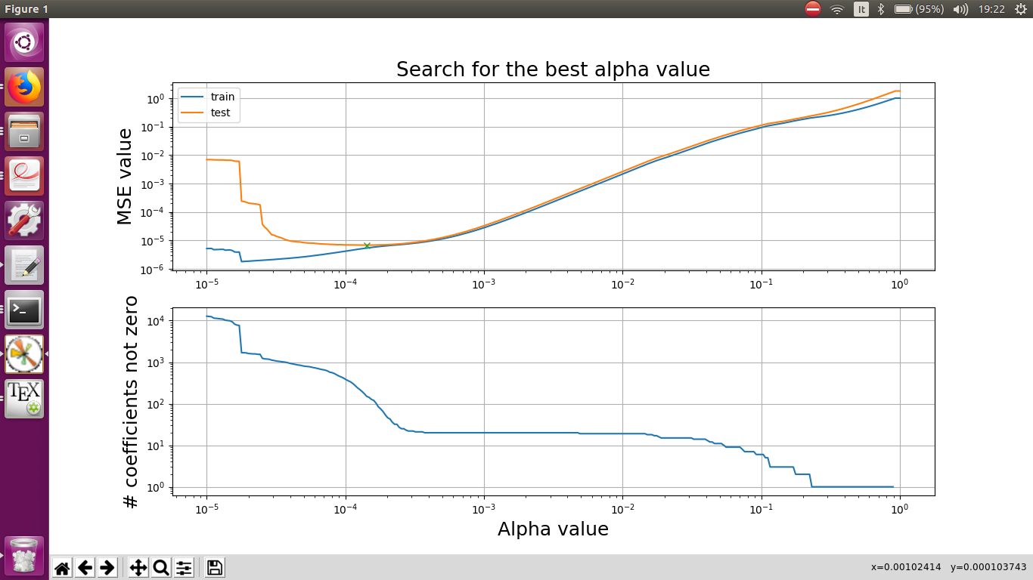
LASSO: results
Mean Squared Error:
Best α : 0.00014
# of coefficients different from zero for Best α : 149
‹#›
‹#›

Slide 12
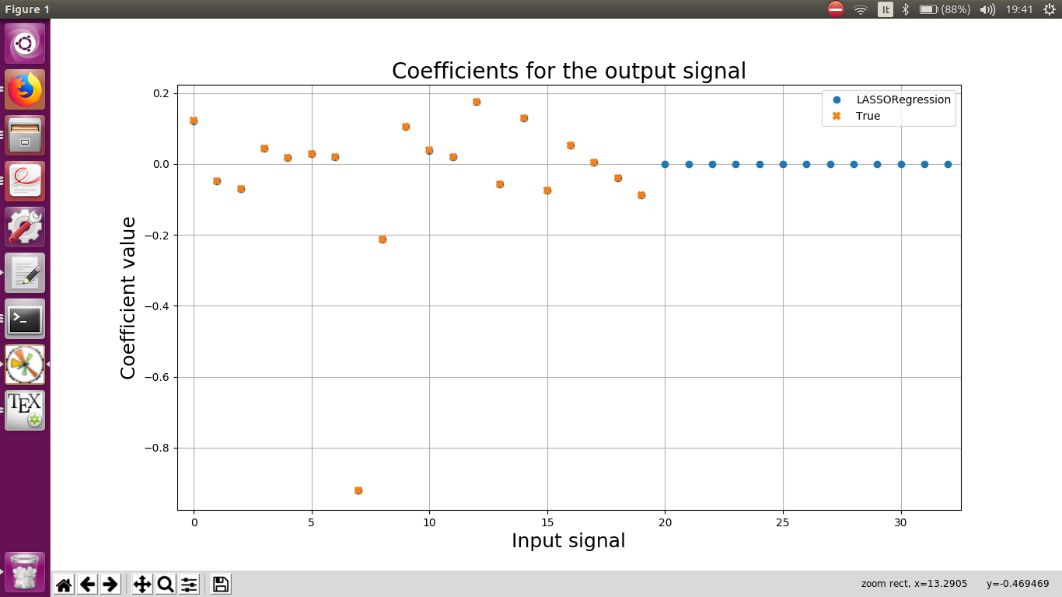
LASSO: results
i-th IS
0 | 0.990
1 | 0.998
2 | 0.995
... | ...
7 | 0.078
8 | 0.980
... | ...
14999 | 1.000
19826 | 1.000
‹#›

Slide 13
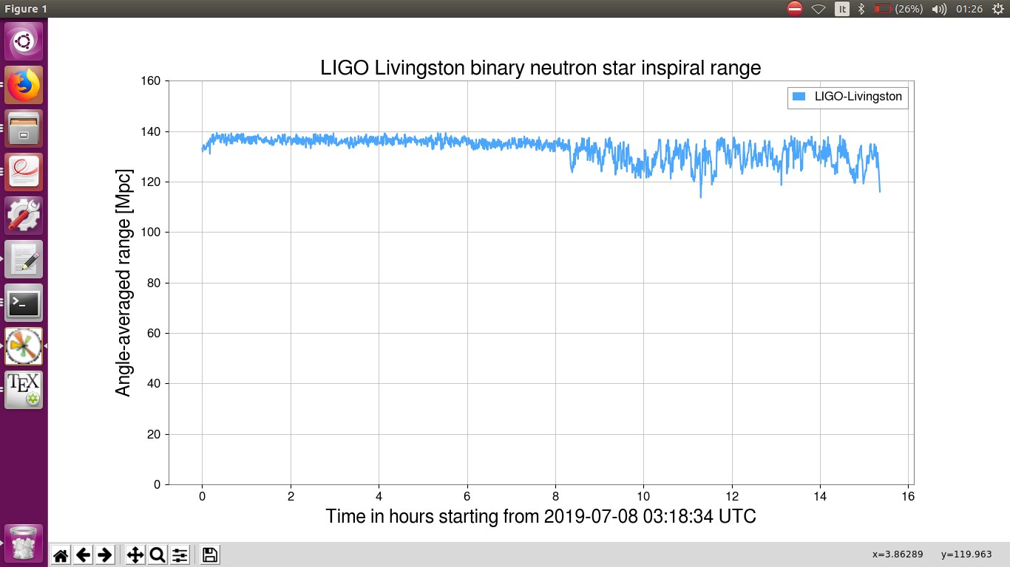
O3 data
How to split BLRMS segment in training and test set?
‹#›
LLO
‹#›

Slide 14
LLO 65-76 Hz
L1:PEM-CS_ACC_HAM6_OMC_X_MON.std
𝜀 score : 0.84
L1:HPI-HAM6_BLND_L4C_VP_INMON.std
𝜀 score: 0.91
+16
04/26
L1:HPI-HAM6_BLND_L4C_VP_INMON.std.
𝜀 score : 0.64
L1:PEM-CS_ACC_HAM6_OMC_X_MON.std𝜀 score: 0.80
+15
05/25
‹#›
Time in hours

Slide 15
LLO 65-76 Hz
L1:PEM-EX_SEIS_VEA_FLOOR_Z_BLRMS_1HZ3
𝜀 score : 0.90
L1:SUS-ITMY_R0_DAMP_R_INMON.mean
𝜀 score: 0.92
+14
06/14 - 06/15
L1:PEM-CS_ACC_HAM6_OMC_X_MON.std
𝜀 score : 0.92
L1:HPI-HAM6_BLND_L4C_VP_INMON.std
𝜀 score: 0.95
+21
07/22 - 07/23
‹#›
Time in hours

Slide 16
LLO 65-76 Hz
06/14 - 06/15
Reconstructed signal : Standard Linear Regression using only 2 channels,
L1:PEM-CS_ACC_HAM6_OMC_X_MON.std
L1:HPI-HAM6_BLND_L4C_VP_INMON.std
‹#›

Slide 17
Summary
Using BLRMS time series, we can select particular frequency bands to reconstruct the time evolution of the noise. We used LASSO to solve overfitting problems. We defined a way to quantify the “importance” of each channel (𝜀-score)
In the frequency band 65-76 Hz for LLO, we identified 2 channels correlated to time evolution of the BLRMS.
Other interesting results for LHO in the frequency band 1120-1400 Hz.
FUTURE WORK :
- why does not LASSO explain all the bumps in 65 - 76 Hz band?
- systematic search in all the bands for LLO and LHO
‹#›

Slide 18
Thank you !
I am grateful to my mentor Gabriele Vajente for the support in these weeks.
I would also like to thank to National Science Foundation and Instituto Nazionale di Fisica Nucleare that supported this research.

Slide 19
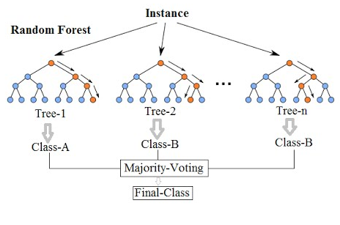
Random Forest
Split :
(feature, threshold) that minimizes the impurity function
In the case of regression, trees predict a continuous value and the final prediction is the avarage
Mean Squared Error:
‹#›

Slide 20
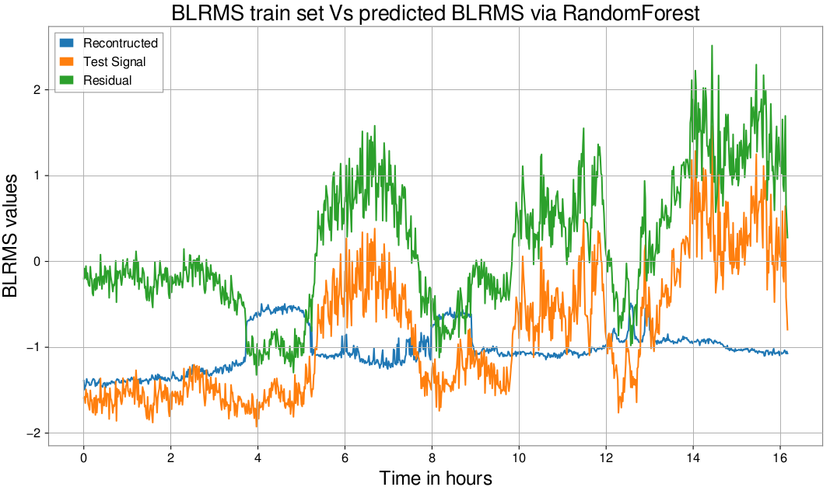
Random Forest

Slide 21
04/26
L1:PEM-CS_ACC_HAM6_OMC_X_MON.std
L1:HPI-HAM6_BLND_L4C_VP_INMON.std

Slide 22
05/25
L1:PEM-CS_ACC_HAM6_OMC_X_MON.std
L1:HPI-HAM6_BLND_L4C_VP_INMON.std

Slide 23
LHO 1120-1400 Hz
H1:IMC-REFL_A_DEMOD_RFMON.std
𝜀 score : 0.94
H1:PSL-FSS_PC_MON_OUTPUT.std
𝜀 score: 0.95
+11
06/29
H1:PSL-FSS_PC_MON_OUTPUT.mean
𝜀 score : 0.42
H1:PSL-FSS_PC_MON_OUTPUT.std
𝜀 score: 0.58
H1:PSL-FSS_PC_PP.std
𝜀 score: 0.77
H1:PSL-PMC_OSCILLATION_MON.std
𝜀 score: 0.86
08/05

