Slide 1
A+ HAM7 ISC OPTICAL PATH LAYOUT
Related Documents: D1800092
Authors: Don Griffith

Slide 2
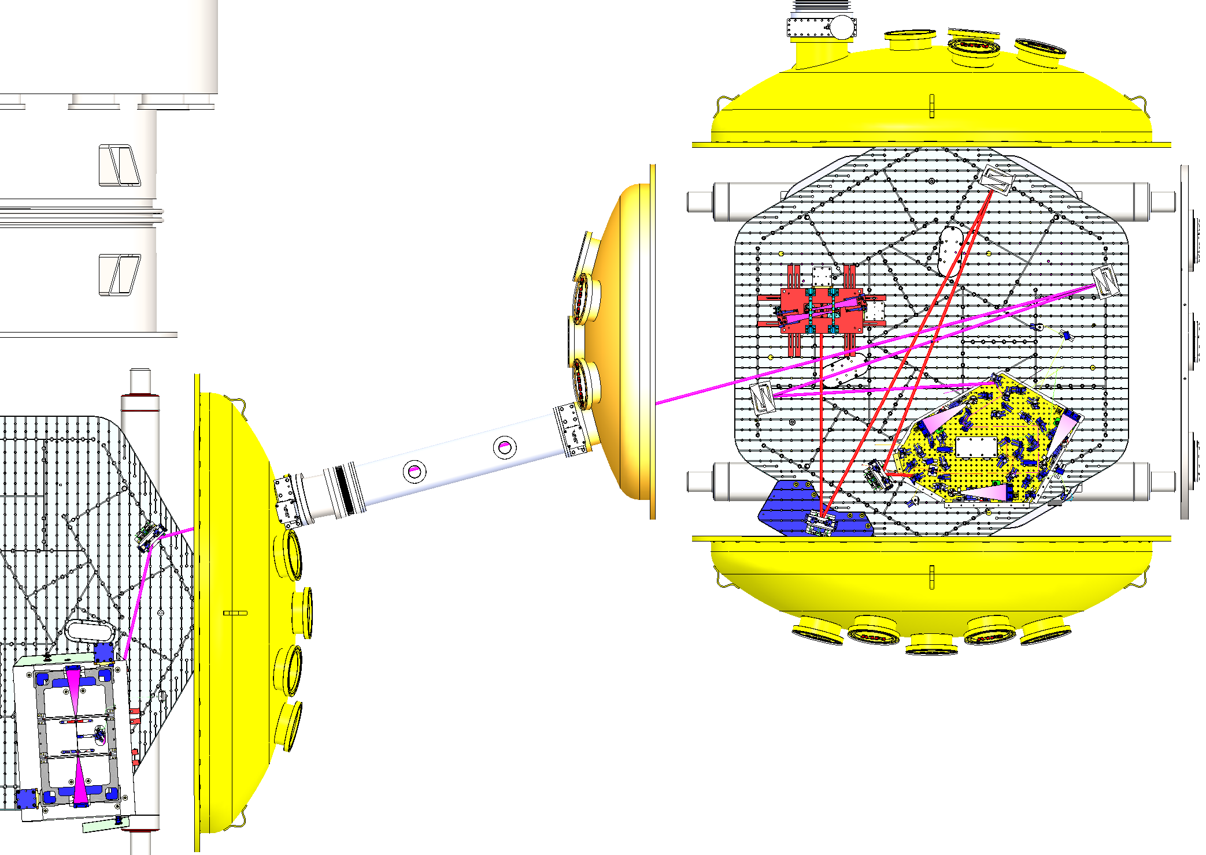
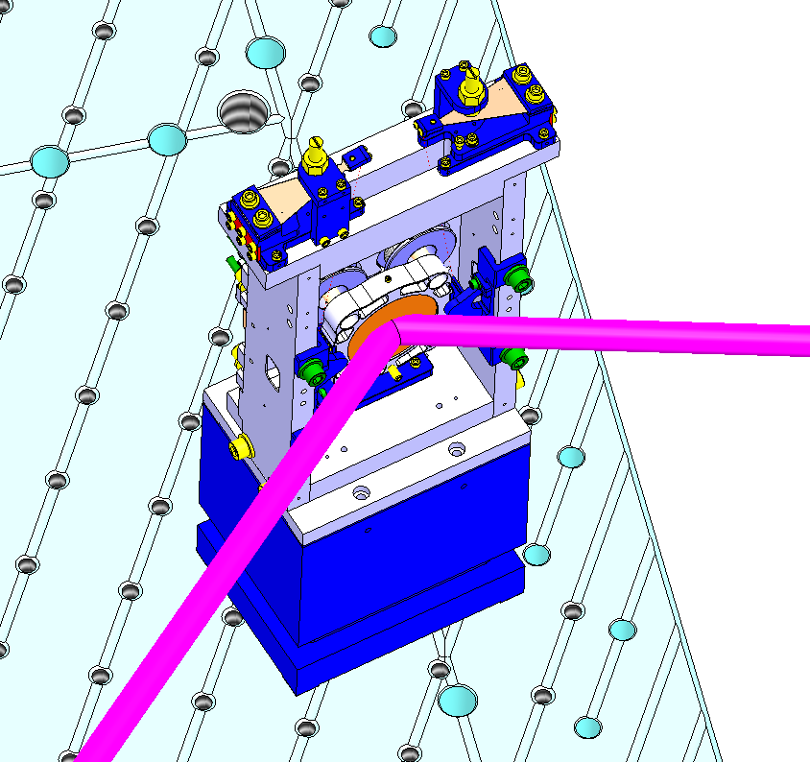
+Y
ZM5
BEAM PATH FROM HAM5 TO HAM7
+X
ZM6
TIP-TILT WITH ECD BRACKETS P/N D1800092
HAM7
(SEE NEXT PAGE FOR DETAILS)
15mm BEAM DIAMETER
HAM5
118 DEGREES

Slide 3
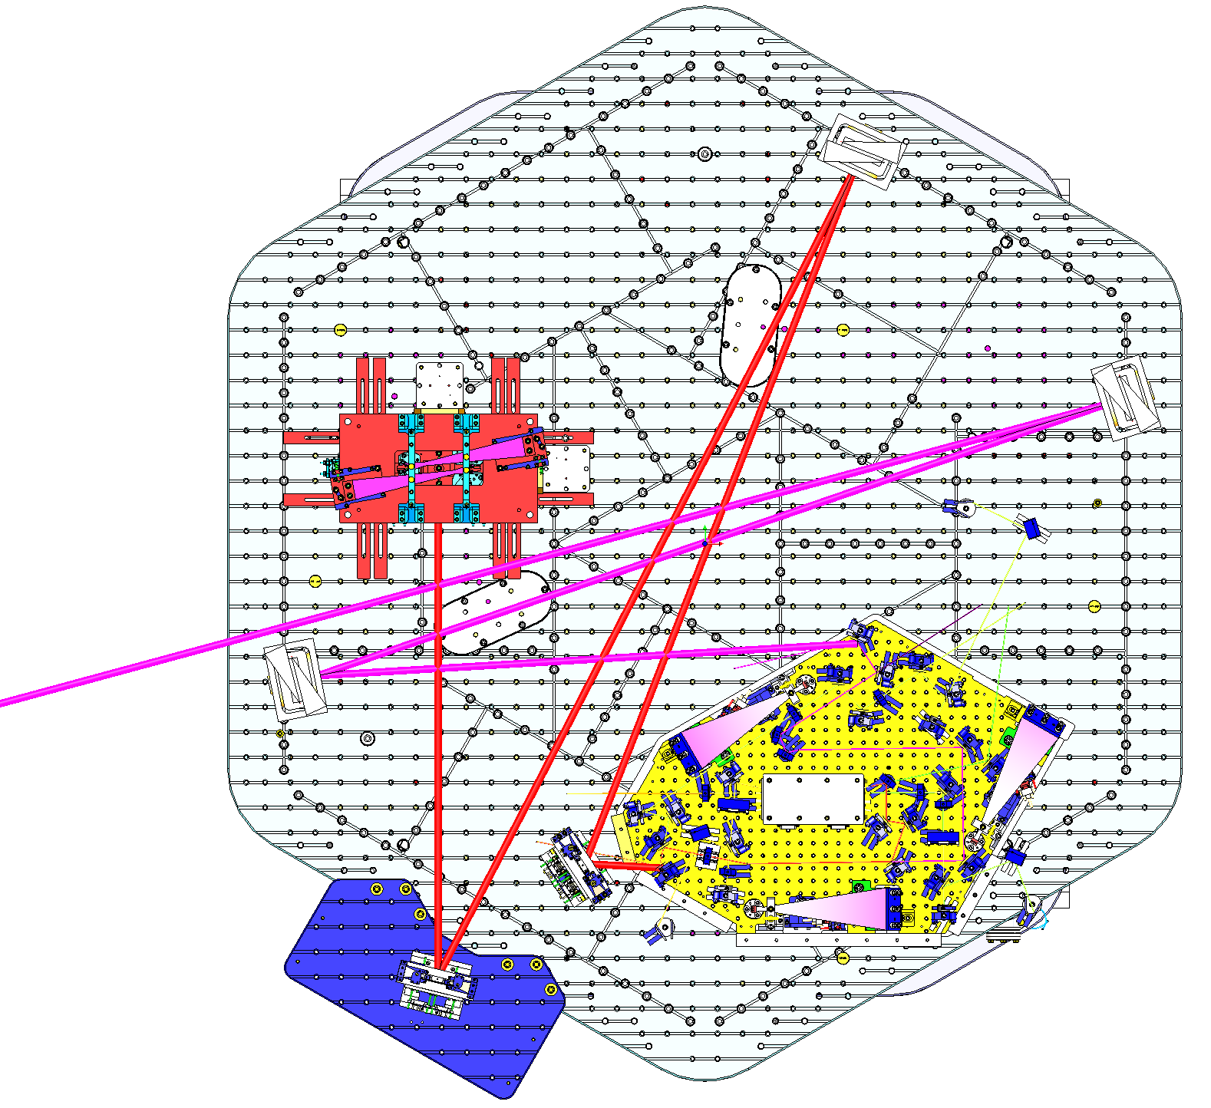
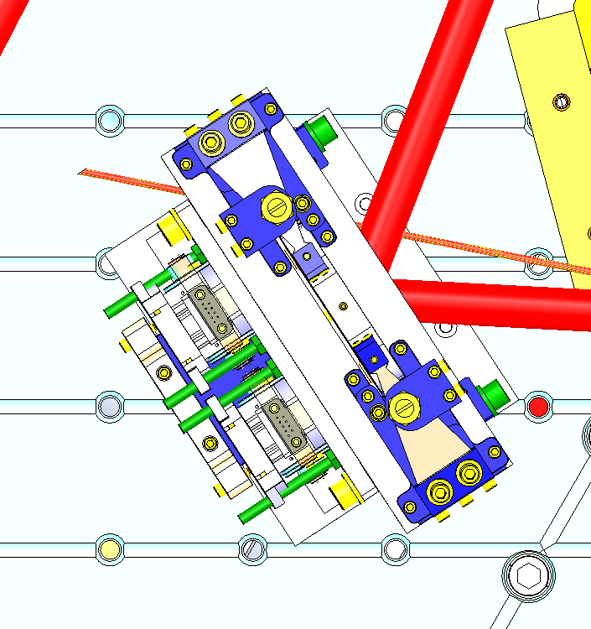
PARTS
ZM1: TIP-TILT, SQUEEZER
ZM2: HDS + SAMS
ZM3: TIP-TILT, SQUEEZER
ZM4: HDS + SAMS
ZM5: HDS + SAMS
ZM6 (HAM5): TIP-TILT, SQUEEZER
FC1: HSTS
+Y
HAM7
ZM2
BEAM PATH LENGTH
FC1* to ZM3 = 39.0”
ZM3 to ZM2 = 72.0”
ZM2 to ZM1 = 59.0”
ZM1 to VOPO = 6.23”
ZM6 (HAM5) to ZM5 = 188.3”
ZM5 to ZM4 = 66.19”
ZM4 to VOPO = 43.04”
ZM5
FC1
+X
TOTAL LENGTH FROM
FC1* to ZM3 to ZM2 = 111.0”
* FROM REAR SURFACE OF HSTS OPTICS
TO ZM6 (HAM5)
ZM4
VOPO
TIP-TILT WITH ECD BRACKETS P/N D1800092
ZM1
ZM3

