Slide 1
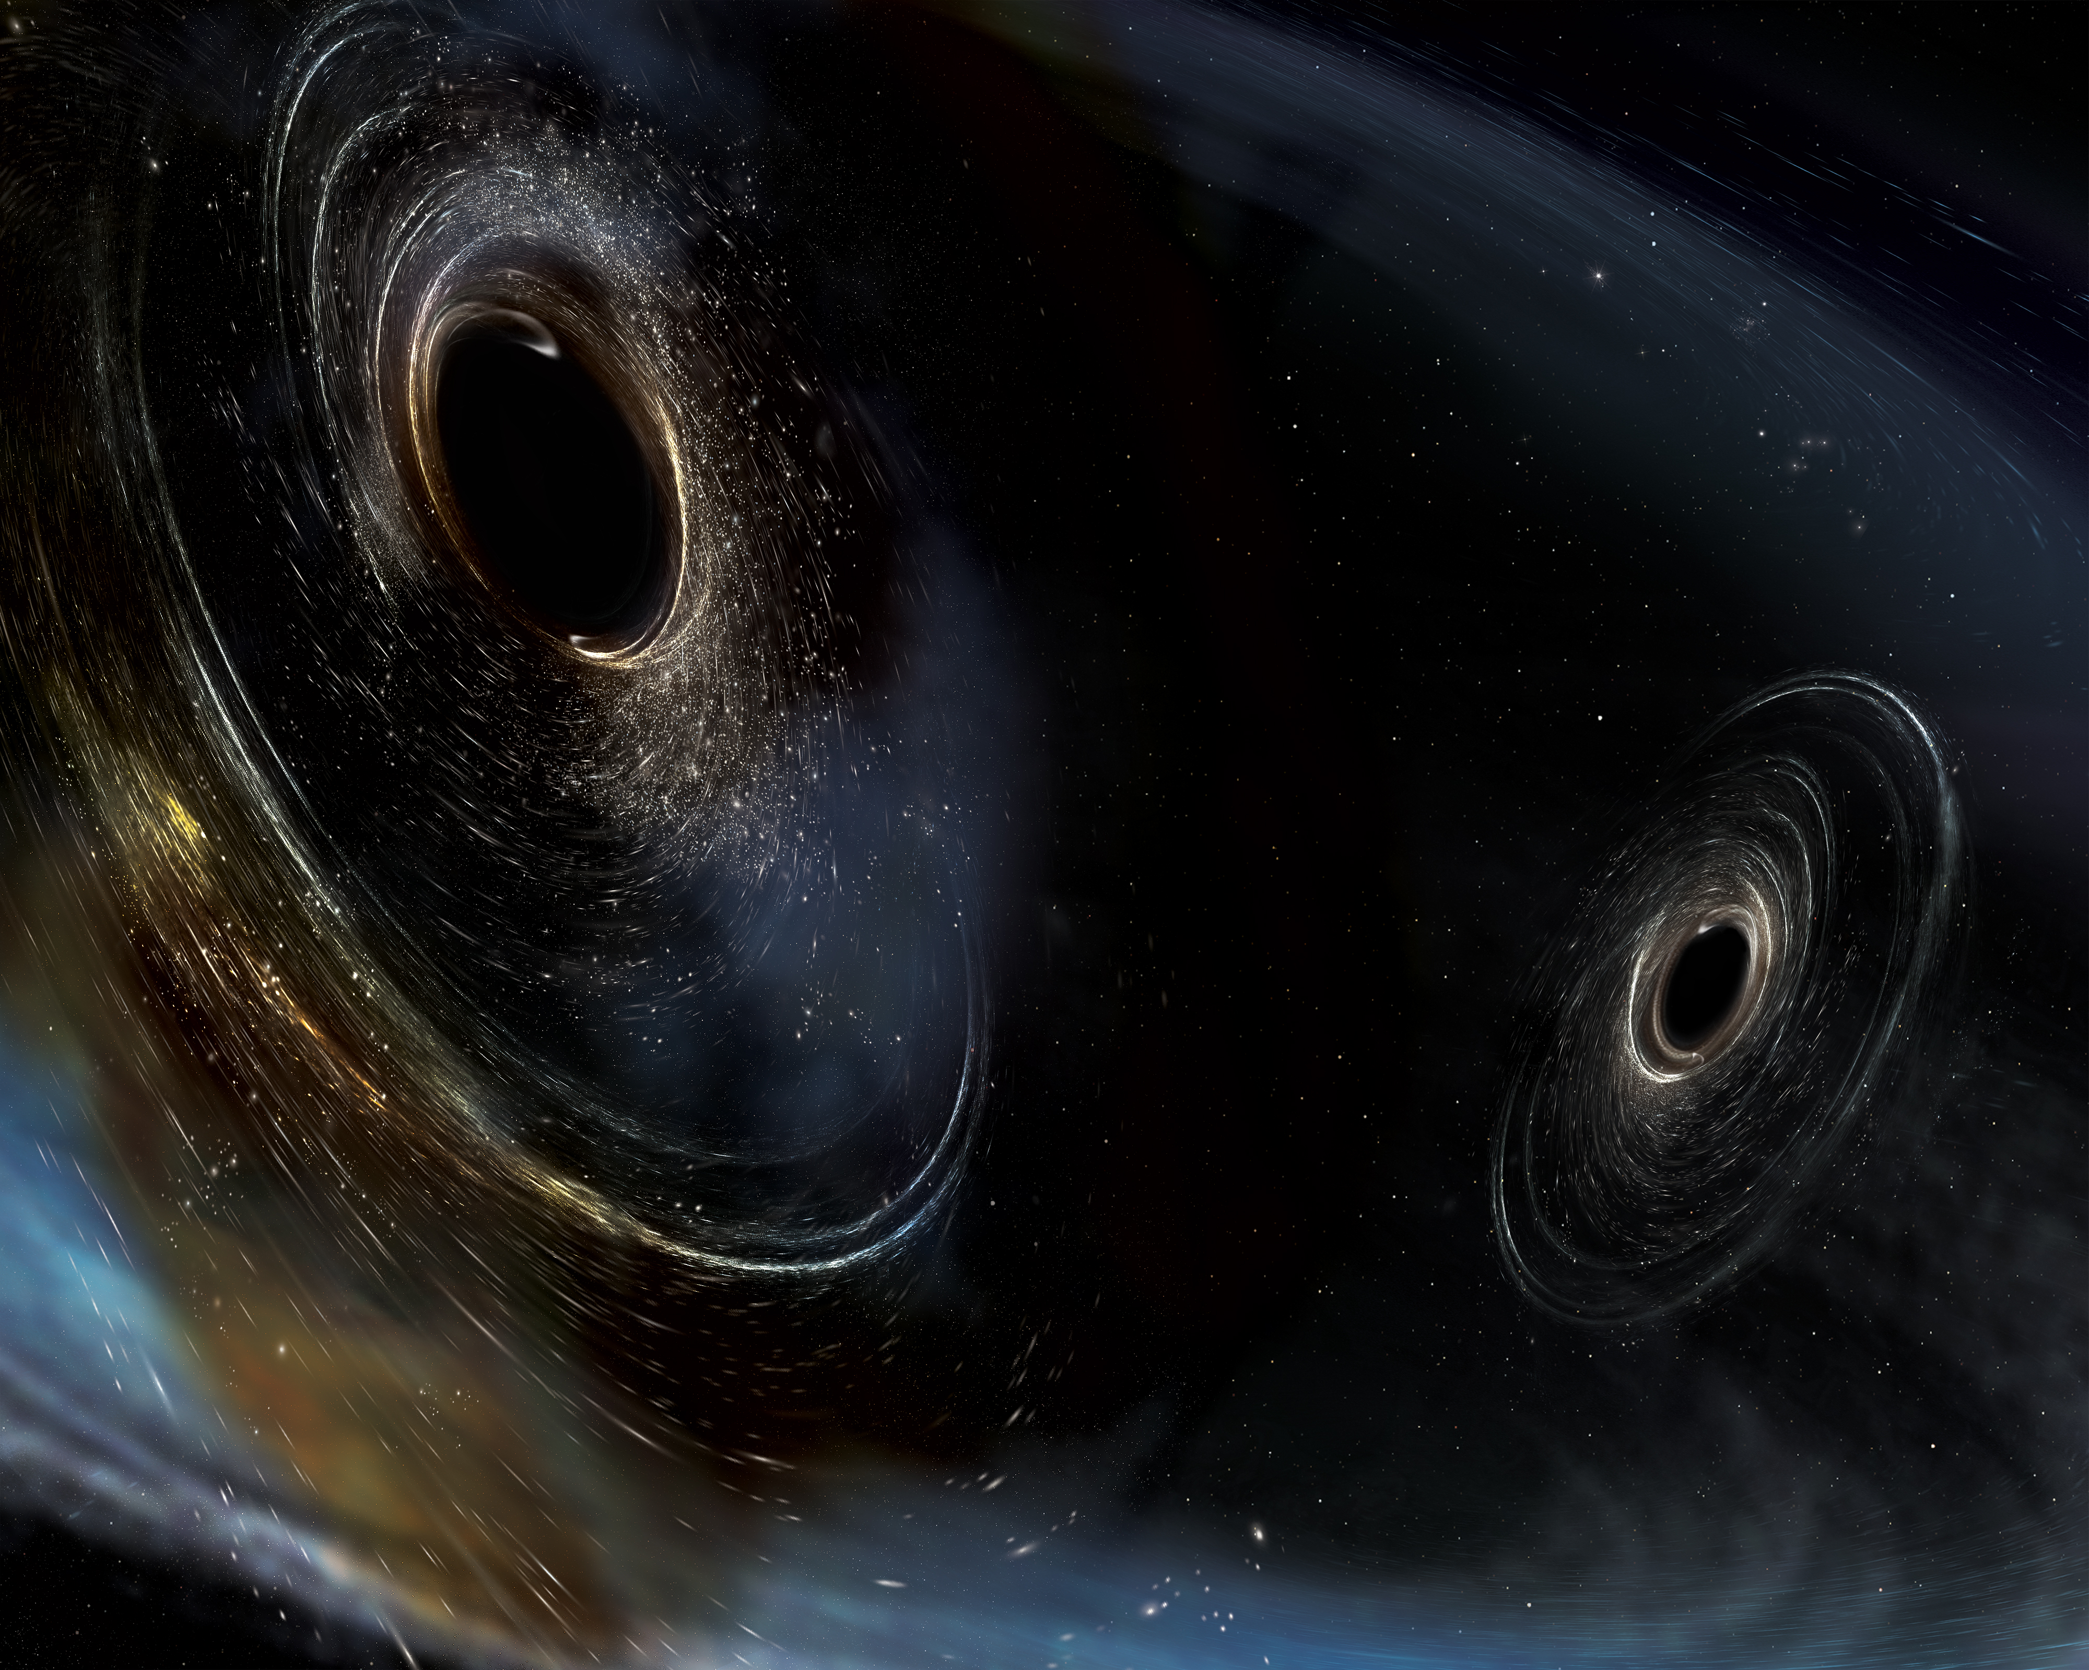
Third Time’s a Charm:
A Status Report from the The LIGO Detectors during their 3rd Observation Run
J. Kissel, for the LIGO, VIRGO, and KAGRA Scientific Collaboration

Slide 2
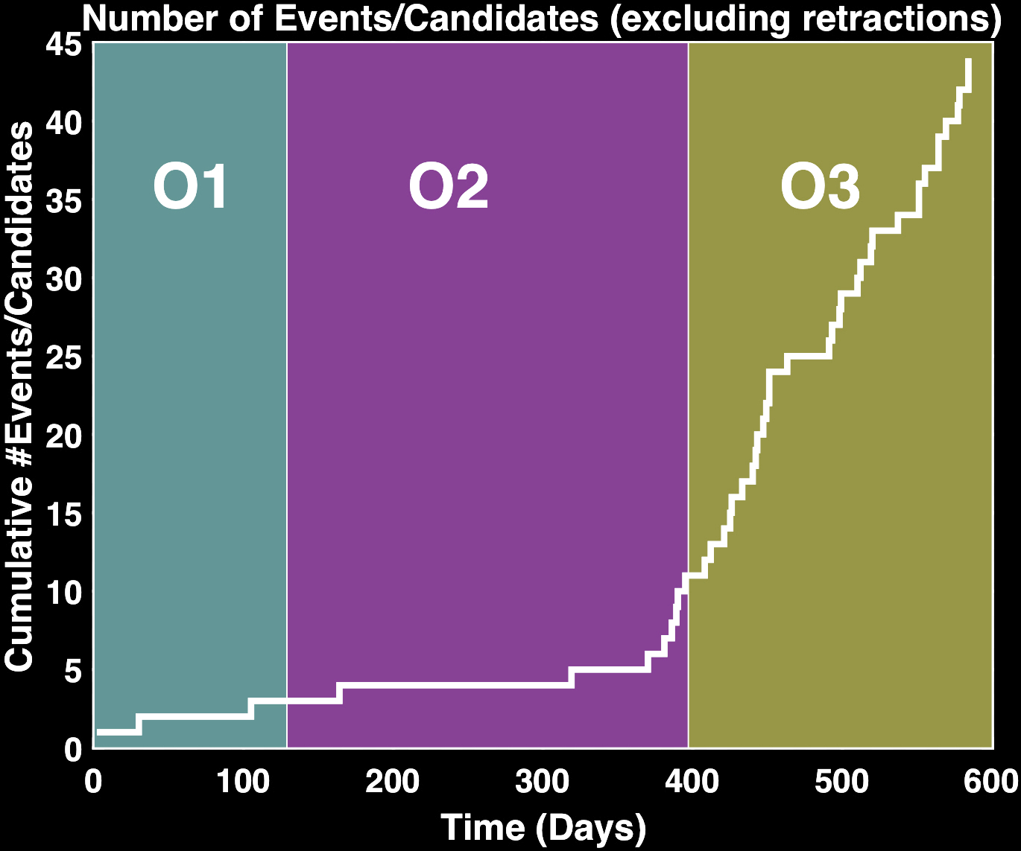
We are now an observatory
44 confident detections
A

Slide 3
Improved between O2 and O3 at LIGO
“Downgraded” noisy 180 W laser to quieter 70W laser (only using 35-40W anyways)
Replaced some test masses
Now using quantum mechanical tricks to improve phase noise – aka Squeezed Light
Improved mitigation of “stray light”

Slide 4
The O3 Interferometer

Slide 5
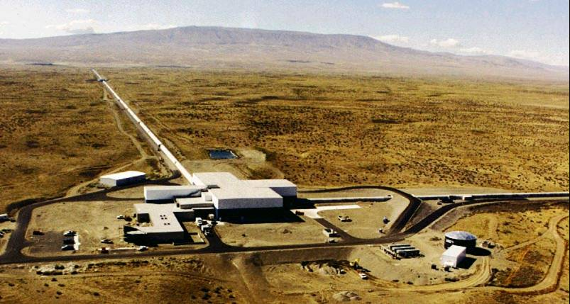
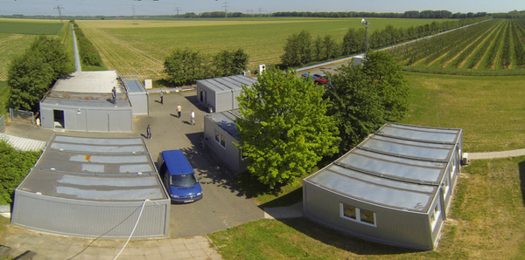
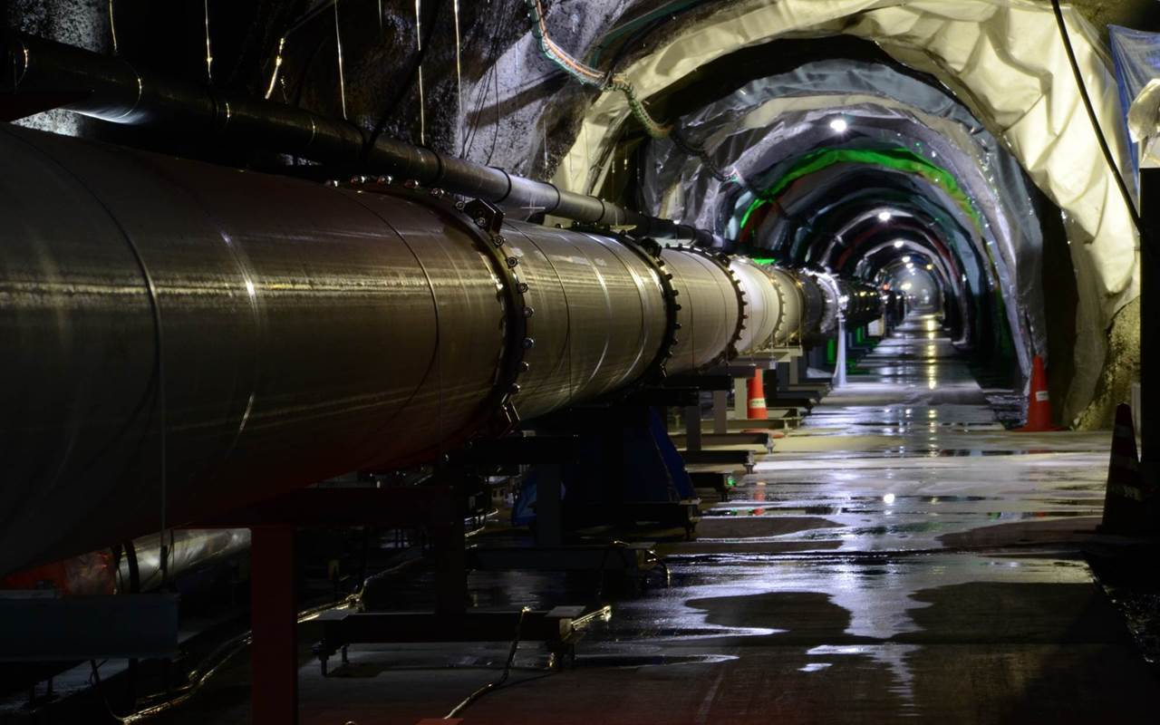

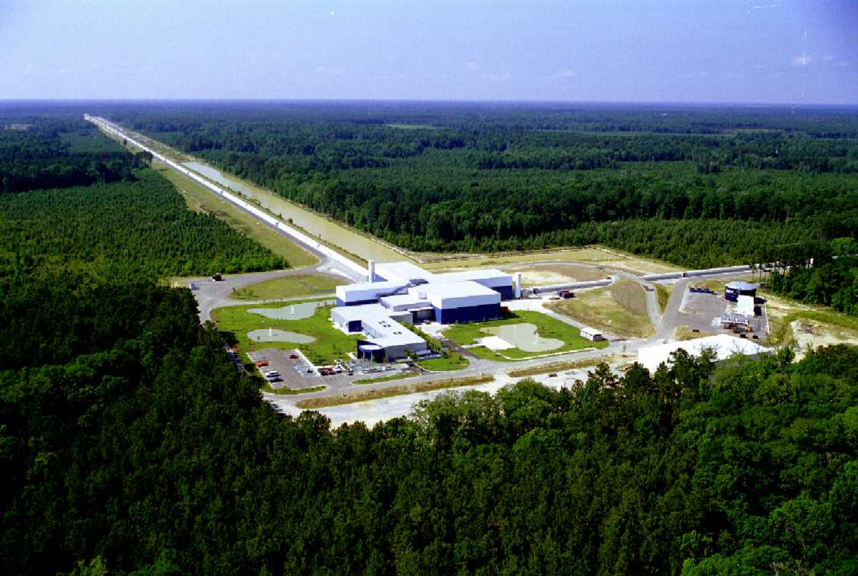
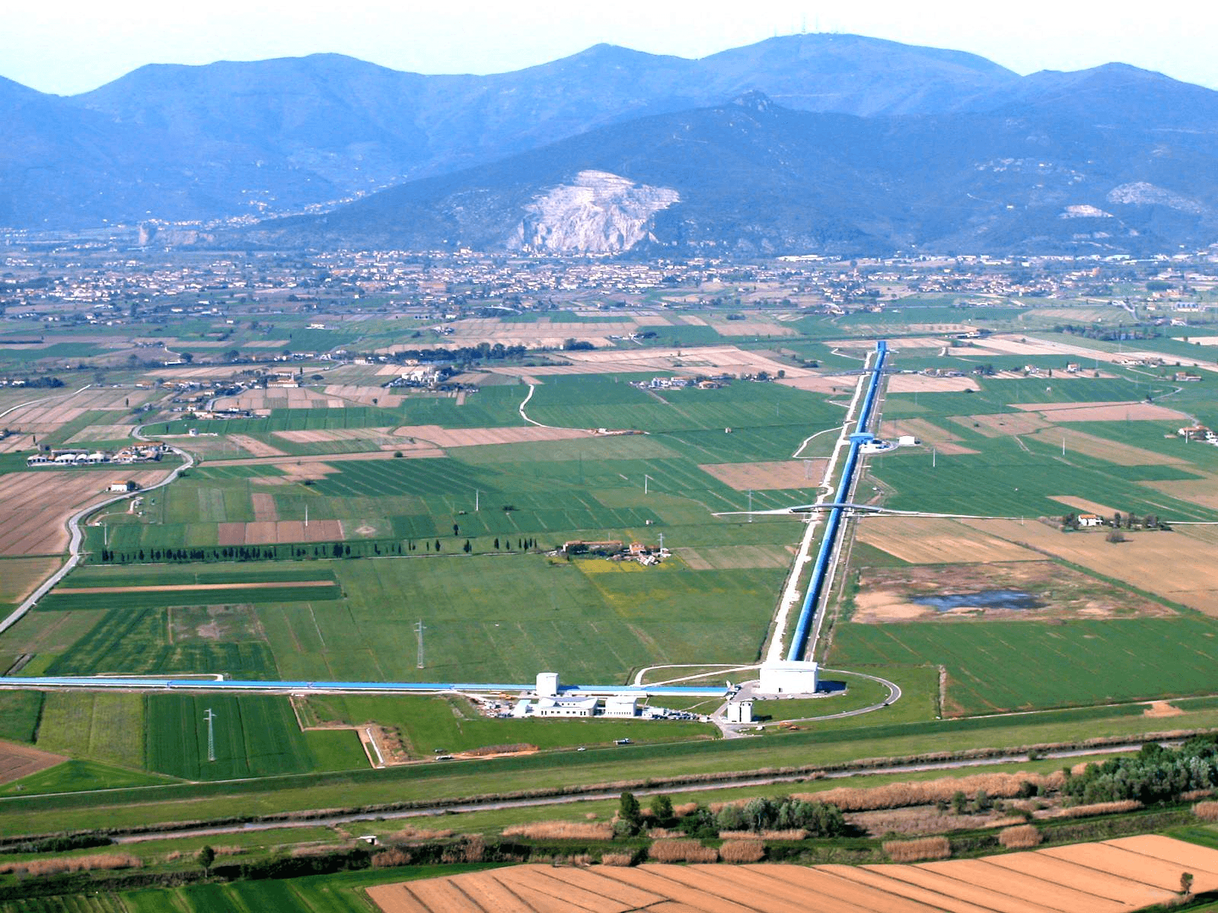
LIGO’s Global Partners
LIGO
Hanford
GEO600
LIGO
Livingston
KAGRA
VIRGO
LIGO India
With a network, you gain directional sensitivity!

Slide 6
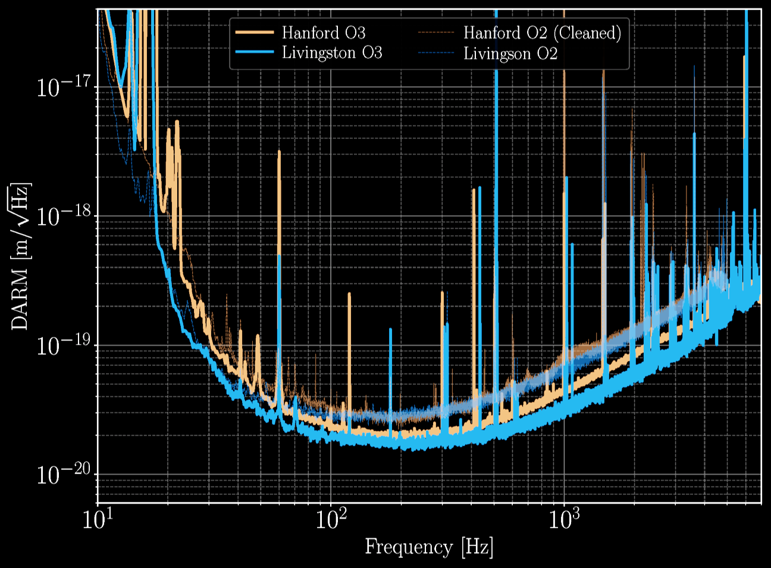
Displacement Sensitivity
Displacement Sensitivity (m/Hz^{1/2})
Frequency (Hz)

Slide 7
First 6 Months of O3
3 detector network:
LIGO Hanford, LIGO Livingston, VIRGO
Apr 1 2019 to Oct 1 2019 (183 days)
3.2% total “dark” time
Typical BNS Reach: (see next slide)
41 GW-only event candidates announced to the public in low latency
33 candidates still considered viable!

Slide 8
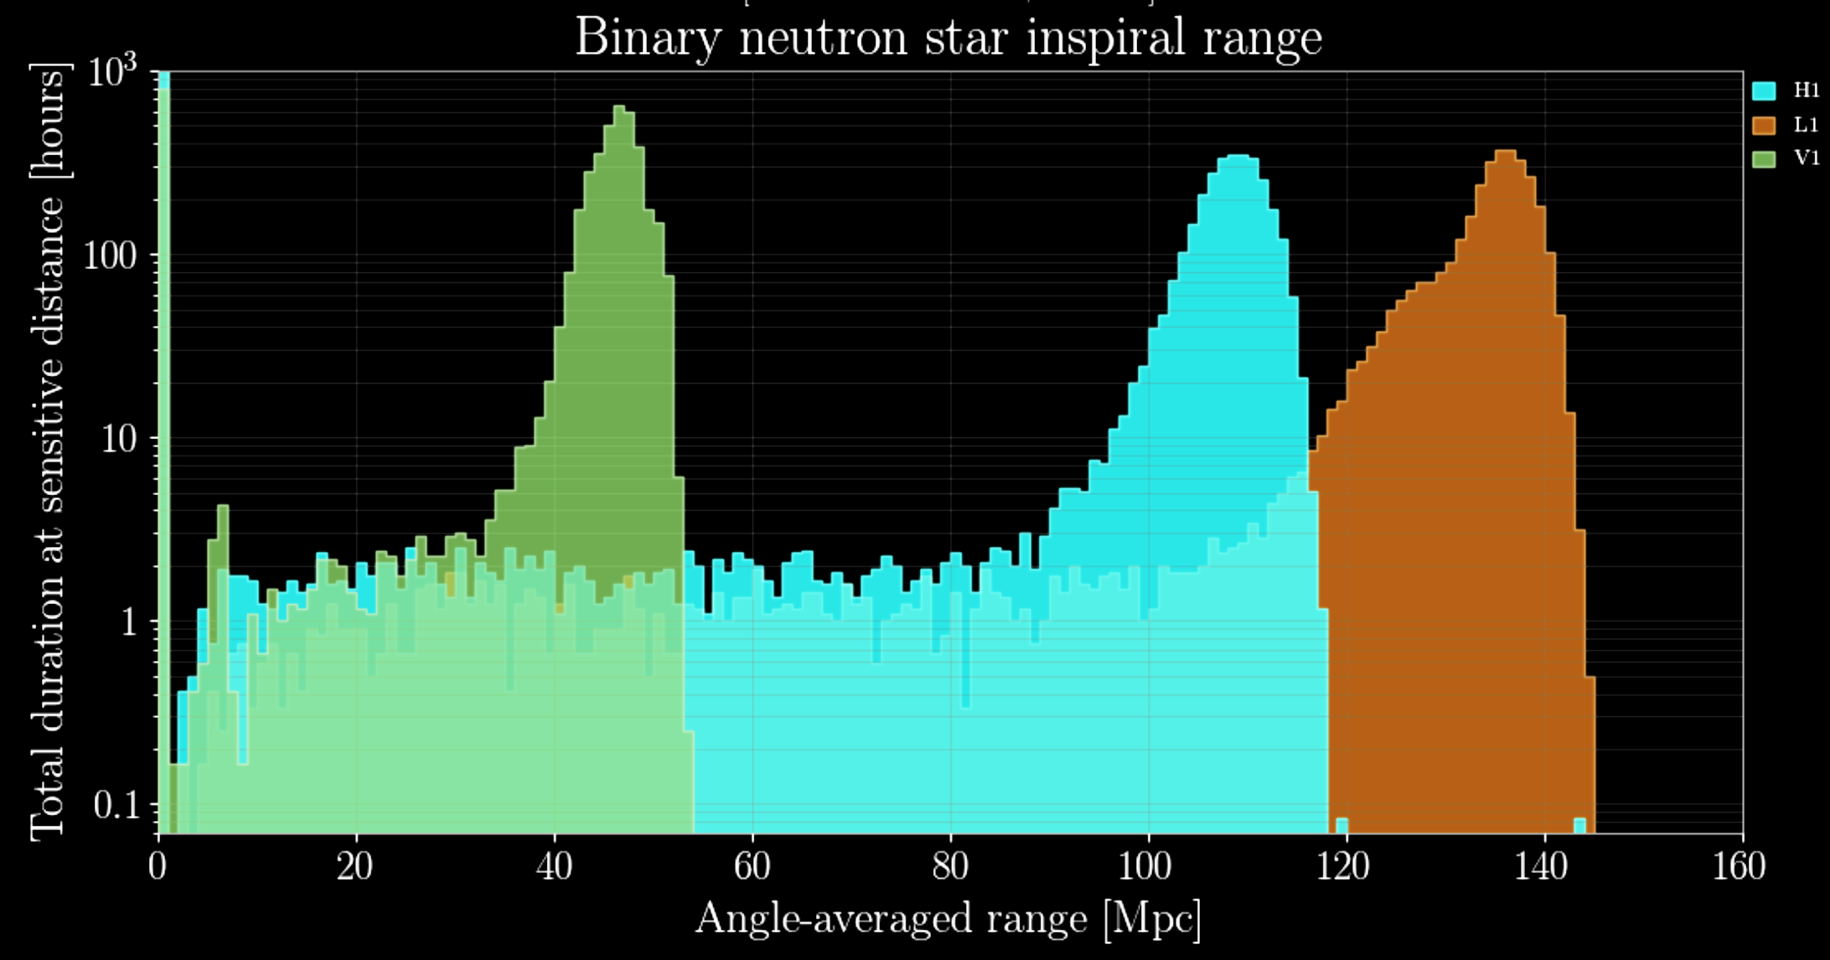
Binary Neutron Star Sensitivity
V1
H1
L1

Slide 9
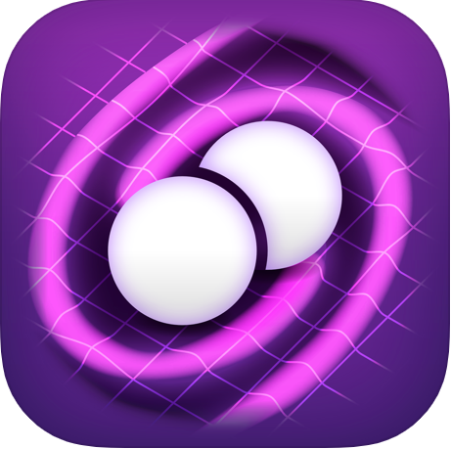
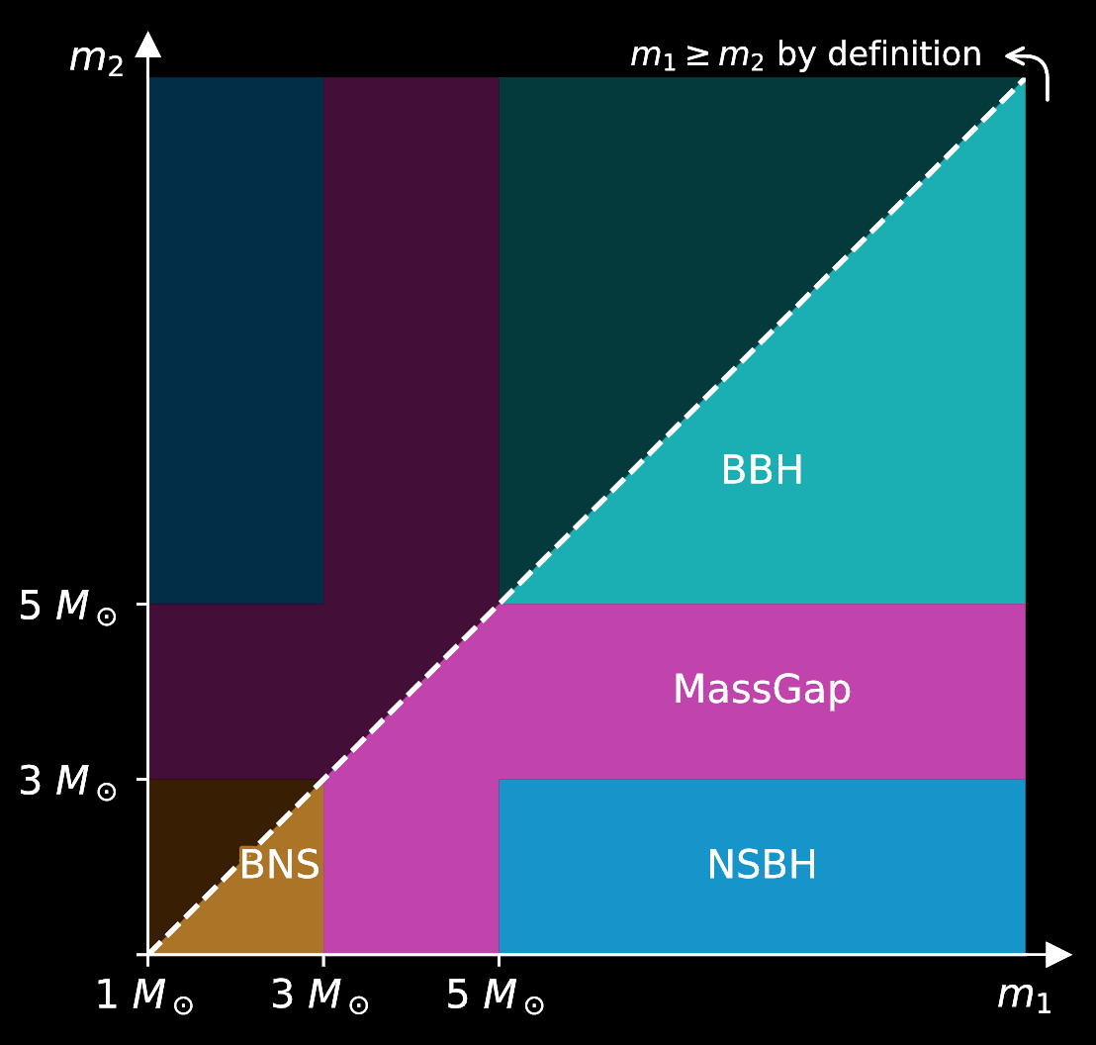
Astrophysical Results
“Chirp” gravitational wave app
Available for iPhone and Android!
http://chirp.sr.bham.ac.uk/alerts
I wish I could tell you more!
Papers coming in April 2020

Slide 10
Binary Neutron Star Sensitivity
V1
H1
L1

Slide 11
What is a point absorber?
Localized small (~ 100μm),
highly absorbing (> 1E4 ppm)
on test mass HR surface
Resulting thermal lens/surface deformation
(example)
Test Mass
AR
HR
34 cm
Arm cavity (≈ 200kW)
Example change in temperature
α = 100%, diameter = 100μm
Then ΔT = 800K
0.01cm

Slide 12
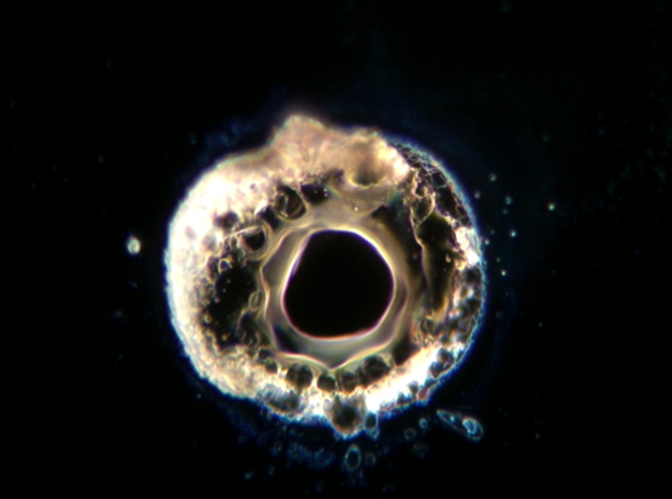
Absorber: 155 µm across bright center
Forensics on one of H1’s Input Test Mass; replaced between O2 and O3
Image credit: G. Billingsley et al.

Slide 13


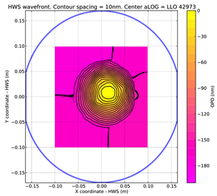
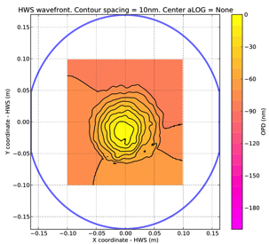
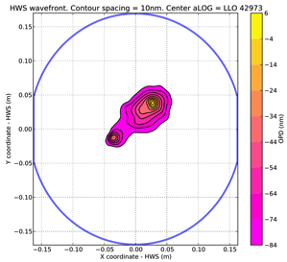
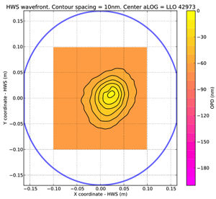

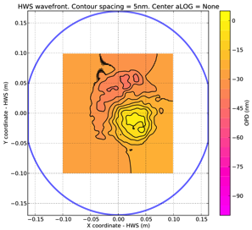
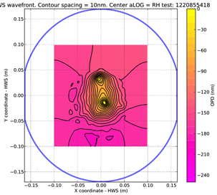
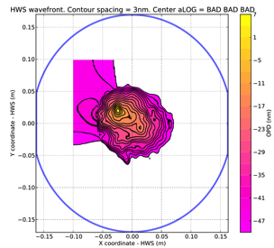
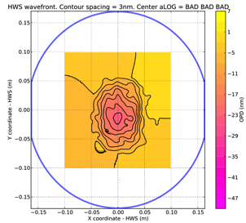
Summary Test Masses at the end of O3a
L1
H1

Slide 14
O3 Commissioning Break
Oct 2019 – Nov 2019
Vacuum system repair & maintenance
More scattered light improvement
Test Mass cleaning at L1
Repair squeezed light system at H1
Wind Fence Install at H1

Slide 15
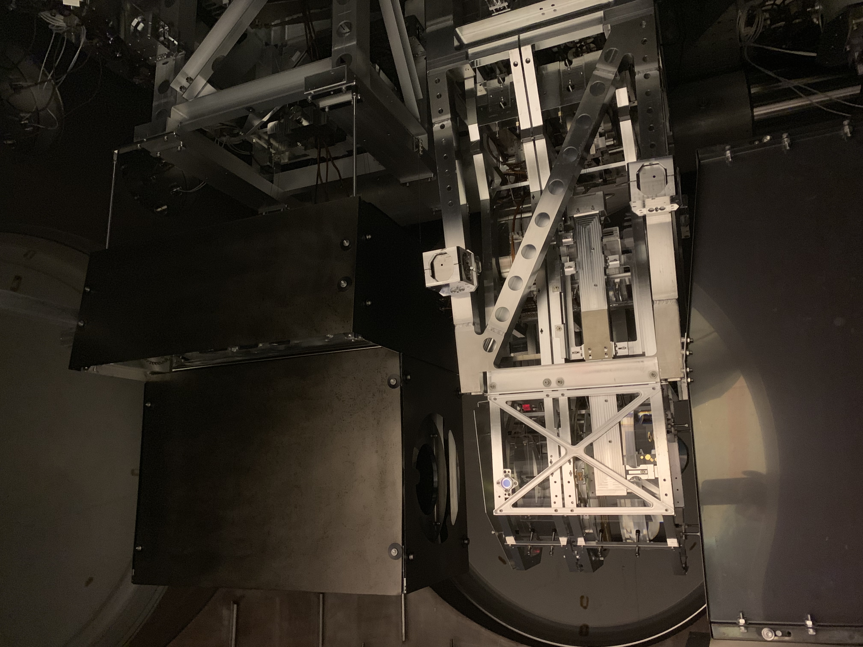
O3 Break, L1: New Shrouds

Slide 16
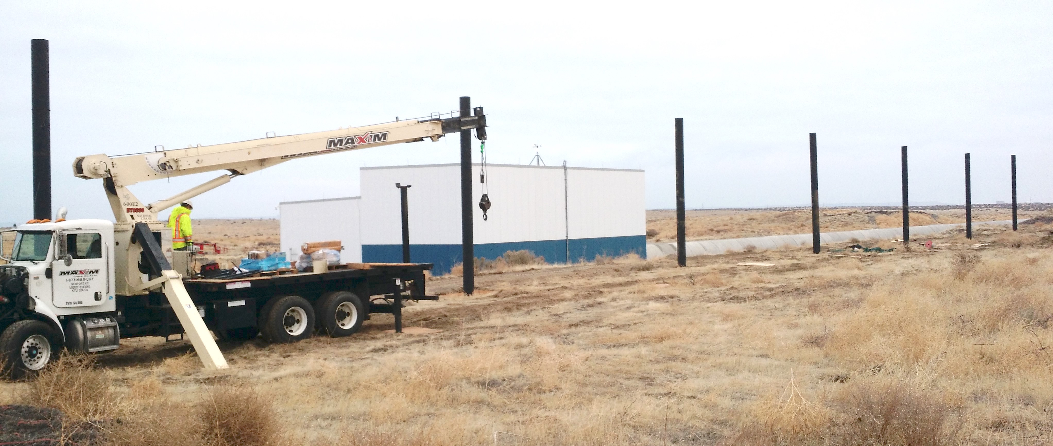
O3 Break, H1: Wind Fence
Nov 13th Picture of End-X
(Installation not yet finished!)

Slide 17
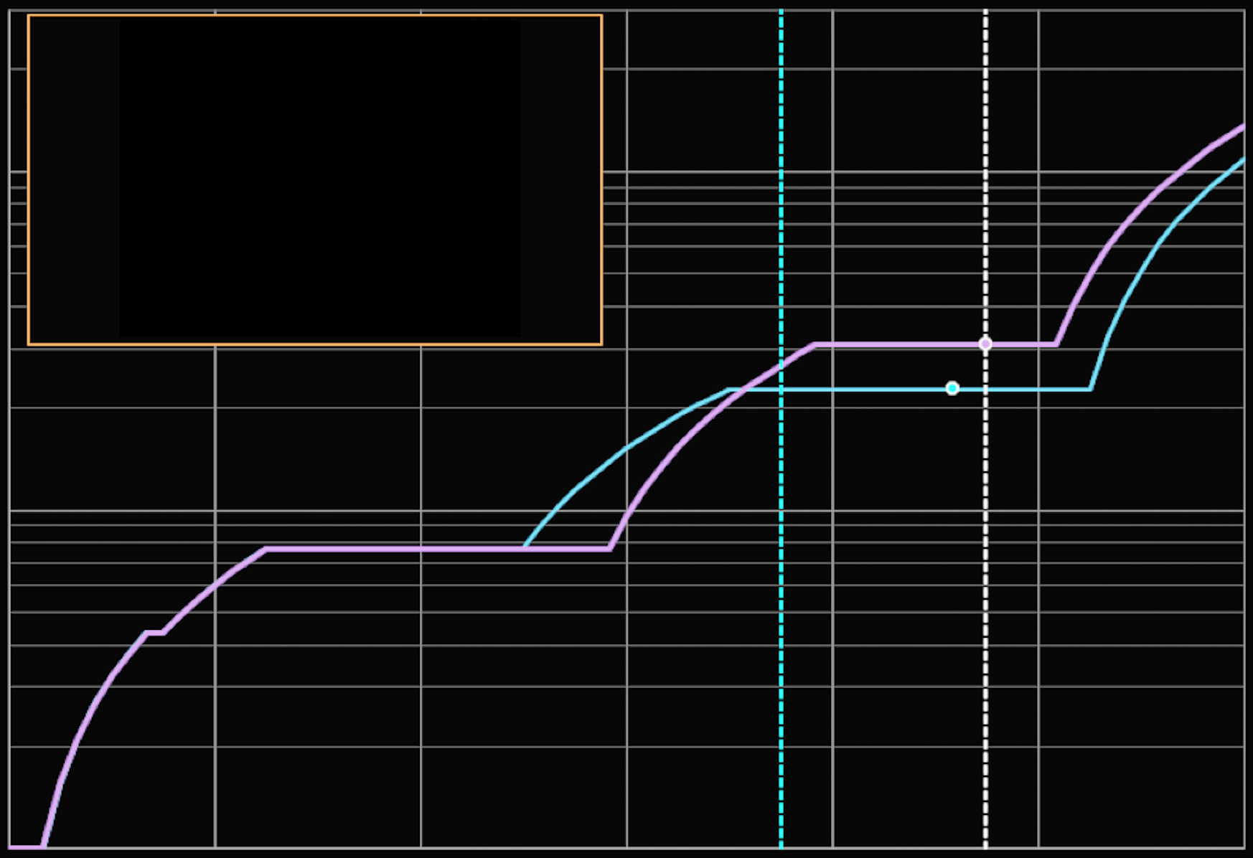
What we’re already thinking about…
Fallback Plan
100
O5
Baseline Plan
O4
Network Improvement beyond O2
(Volume * Time)
10
O3
Next
Funding
Cycle
LSST
1
2020
2021
2022
2023
2024
Calendar Year

Slide 18
Conclusions
O3 is already a wild success, tripling the number of detections
The detectors are better, but there’s still plenty to do
O3 has resumed (2 events already in 2 weeks!)
The detectors are already thinking about what they can do next!

