Slide 1
O3 LIGO-Virgo-KAGRA update,
January 2020
Nicolas Arnaud, Keita Kawabe, Nicolas Leroy, Shinji Miyoki,
Brian O’Reilly, Alessio Rocchi, David Shoemaker, Matteo Tacca

Slide 2
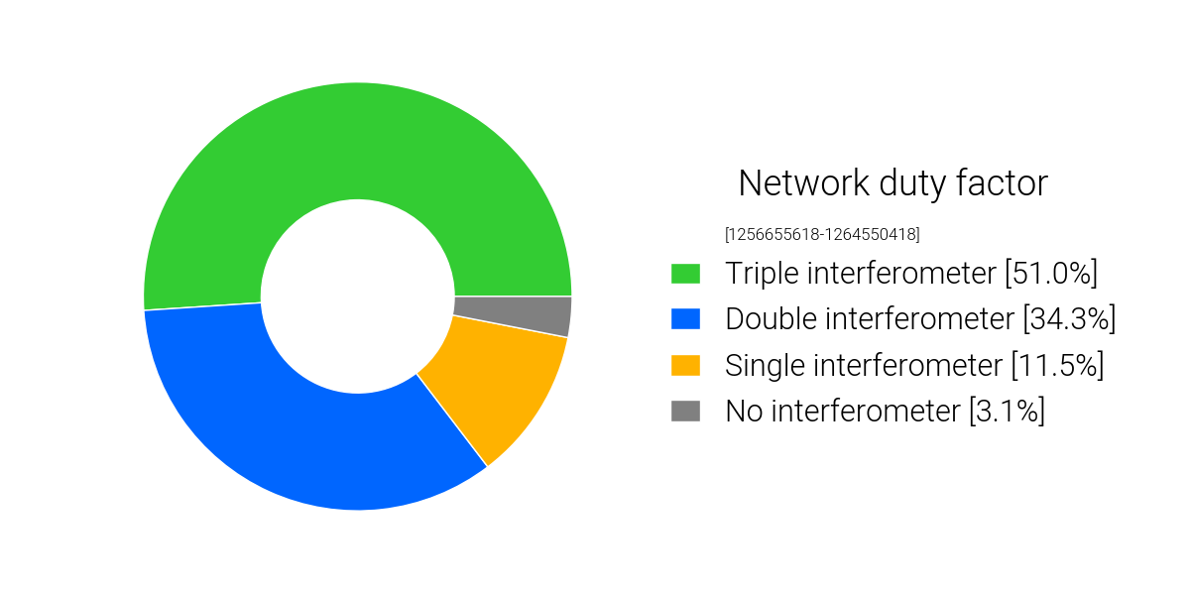
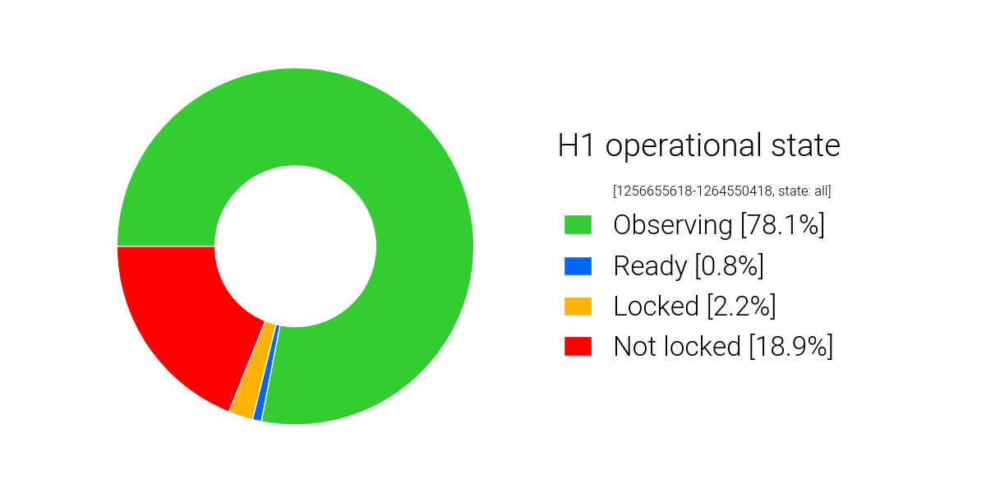
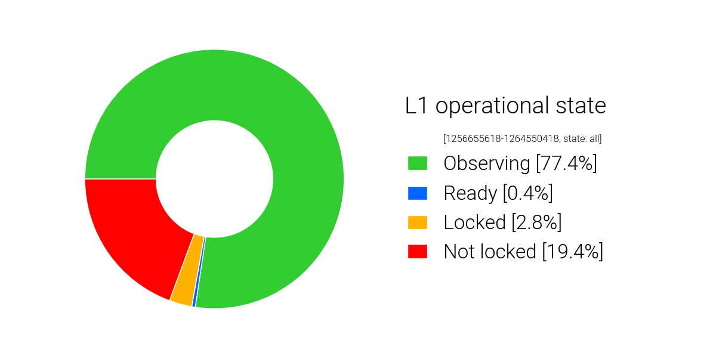
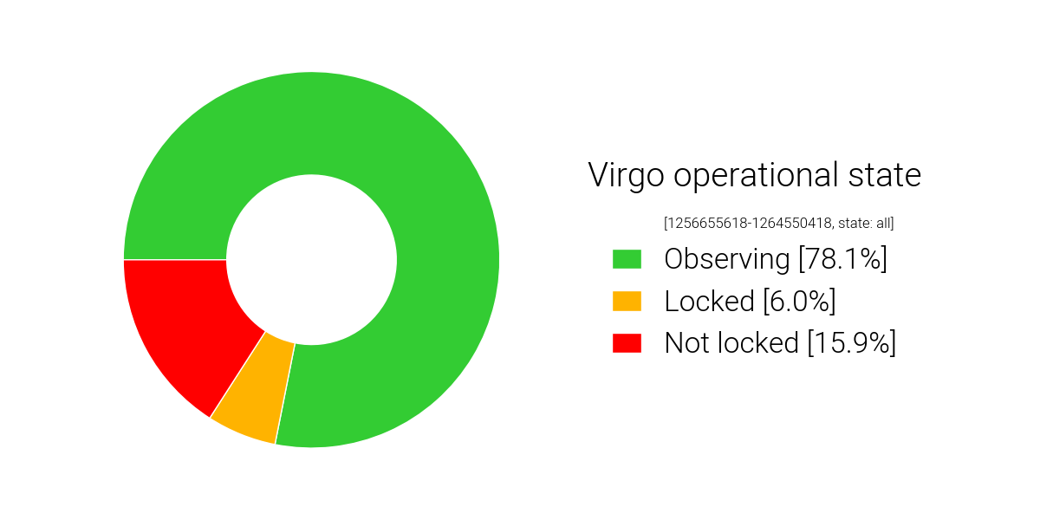
10th week into O3b: So far so good.
51% Triple IFOs (VS 44.5% in O3a)
85.3% Double or Triple (VS 81.9%)
3.1% zero IFO (VS 3.2%)
(Downtime includes everything including but not limited to maintenance)
78.1% VS 71.2 in O3a
77.4% VS 75.8
78.1% VS 76.3

Slide 3
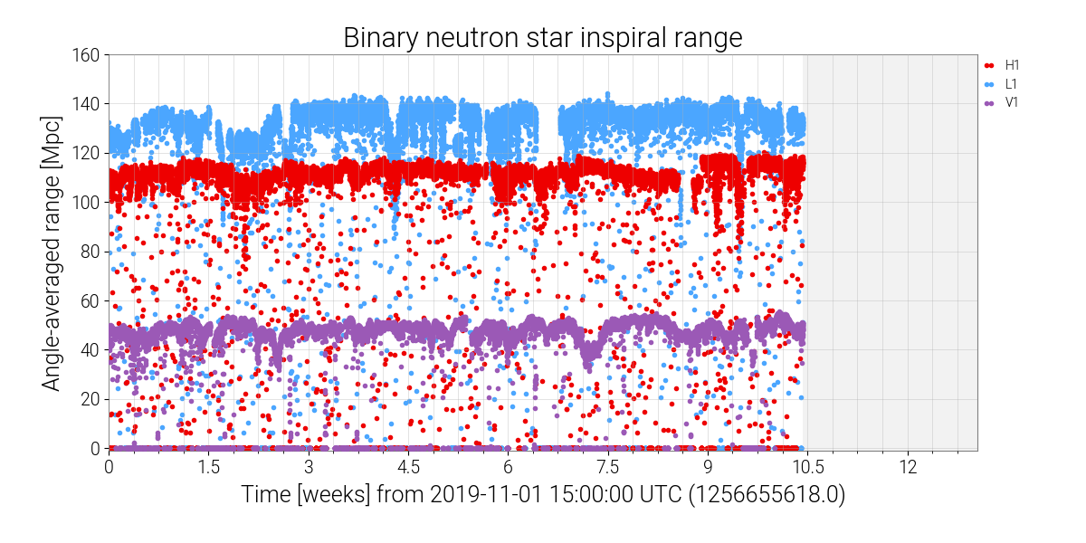
Holidays

Slide 4
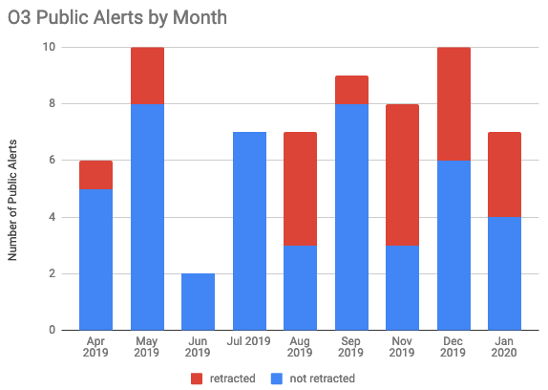
Some stats. 19 alerts including 8 retractions since the last OpenLVEM telecon on Nov/21/2019.
https://dcc.ligo.org/LIGO-G1901322/public

Slide 5
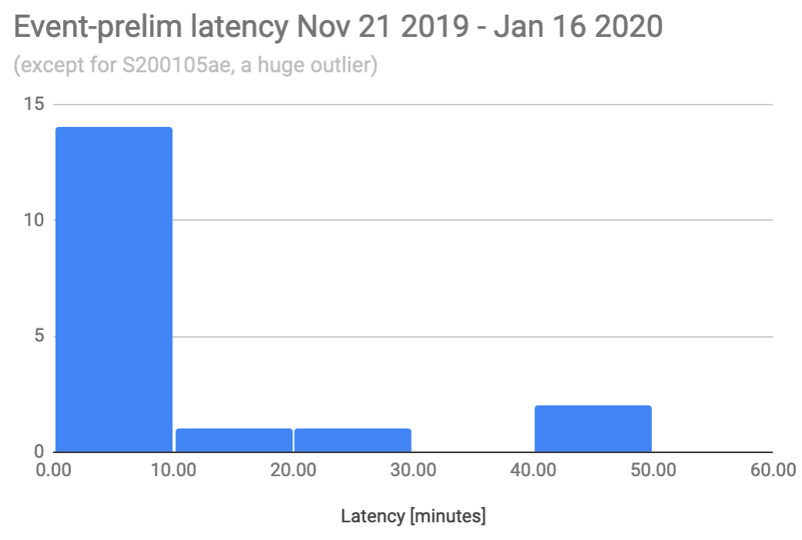
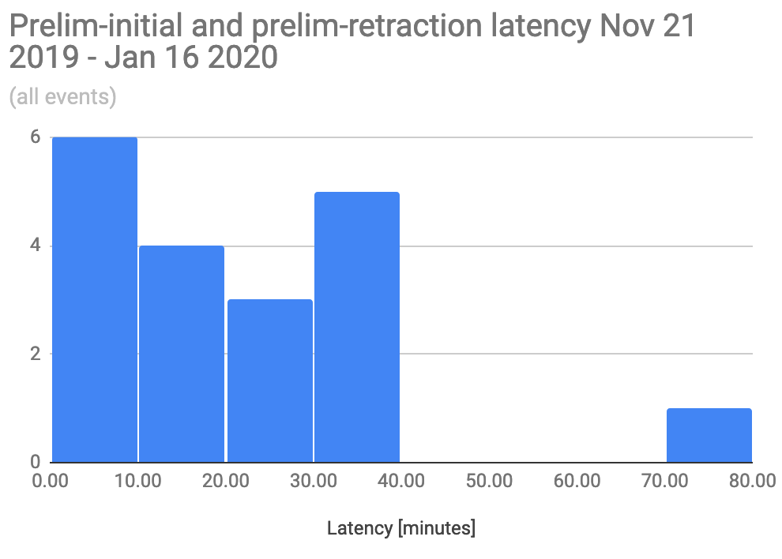
Preliminary alerts got faster with lesser outliers, thanks to the efforts of low latency software developers at multiple fronts.
  We plan to implement incremental improvements like these till the end of O3.
Initial alert (and Retraction) latency after the Preliminary is sent is human-dependent, ~20min on average for both Initial and Retraction.
Retractions cannot be entirely eliminated. However, 2 out of 8 retractions in this period could have been programmatically caught before sending Preliminary. Fix is in place.

Slide 6
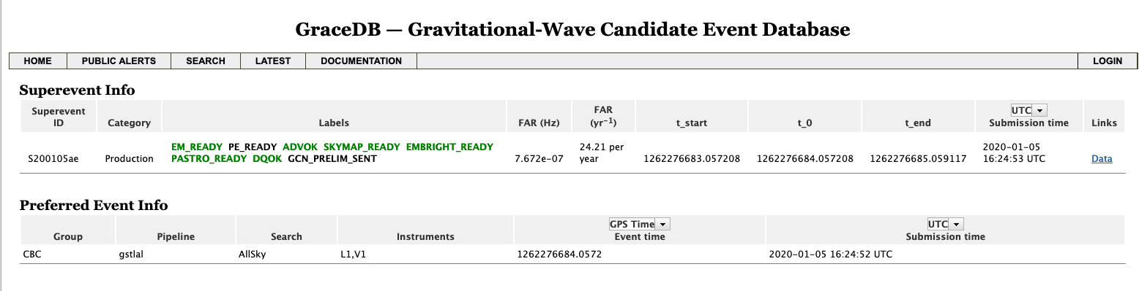
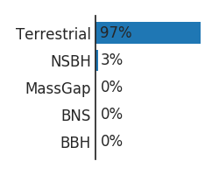
Event to explain: S200105ae, a subthreshold LV event candidate.
Subthreshold FAR (24 per year), large p_terrestrial (97%), why did we bother?

Slide 7
S200105ae: What we said in GCNs
GCN 26657: “Preliminary human vetting of this candidate indicates a chirp structure in the L1 time-frequency plane with no indication of contamination by instrumental artifacts.”
GCN 26688: “our examination of the data indicates that the signal has greater significance than what was calculated in real-time processing (and is still contained in the GCN Notice), sufficient to warrant a public alert.”
What do these mean?

Slide 8
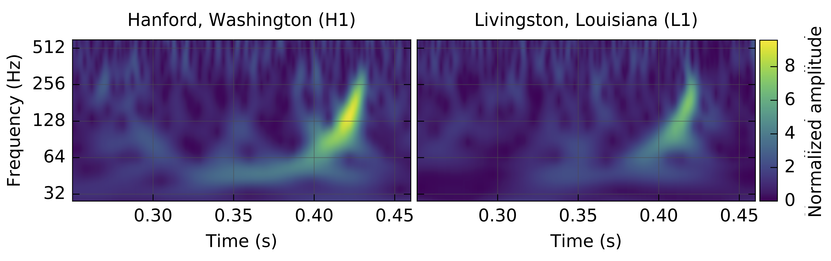
“Preliminary human vetting” (= all sorts of things, but anyway…)
One of them is manual inspection of the “omega scan”, a tool for time-frequency analysis.
Example of the omega scan of IFO strain for GW150914 (note that this is NOT for S200105ae!!)
We do this systematically for all useful channels, not just strain, for all candidates.
In S200105ae, clear chirp in L1 omega scan but not in any of L1 witness channels. Thus a suspicion that this is more real than FAR~24/year.

Slide 9
Why low significance?
Basically L1-only as far as online FAR is concerned though V1 was running at the time.
Single-detector events are heavily penalized in the production code, estimating FAR larger than we believe in this case.
Better code is being developed.
We don’t have a revised significance, but we sent PE-based update for localization as well as classification assuming that this is of astrophysical origin. HasNS~98%, HasRemnant<1%.

Slide 10
Future of O3
Planned end date of O3: Still April 30 2020.
As always, incremental improvements are to be made for instruments as we go, reducing noise as well as increasing stability.
  We’d like to see the excellent duty factor of O3b continue till the end.
KAGRA will join.

Slide 11
Future: KAGRA
Finally successfully locked in Power Recycled FPMI (PRFPMI) configuration though only for a short time!
Output Mode Cleaner (OMC), which we believe is necessary for noise and sensitivity improvement in PRFPMI configuration, was installed.
Optimization and noise hunting continues.
For now we’re planning to start observing some time in mid-February.
  Infrastructure to fold KAGRA members into event-vetting RRT is in place.
Notes:
This slide shows outline of 2019 schedules. Upper panel shows schedule plan presented in the last PAB. Lower panel shows the current plan. I like to explain important difference between them.
This slide shows the schedule outline based on the Gantt chart.
Installation works, such as ...
ETMX WAB means installation of baffles in Xend. During this periods, we can not use ETMX. Major installation works complete in the next March.
We start beam alignment works for Xarm commissioning from September. The Xarm commissioning continues early December. From the end of November, we start beam alignment works for Yarm and DRMI commissioning. When ETMX is ready, we start commissioning of full interferometer. In this periods the full interferometer is FPMI.
After FPMI, we will proceed DRFPMI or FPMI.
In the case of DRFPMI, we start commissioning with low laser power. After then we construct alignment sensing control system with laser power increase. Then we do post commissioning and installation of baffles. I will explain later.
In the case of FPMI, we construct ASC system and then we do post com and baffle installation.

Slide 12
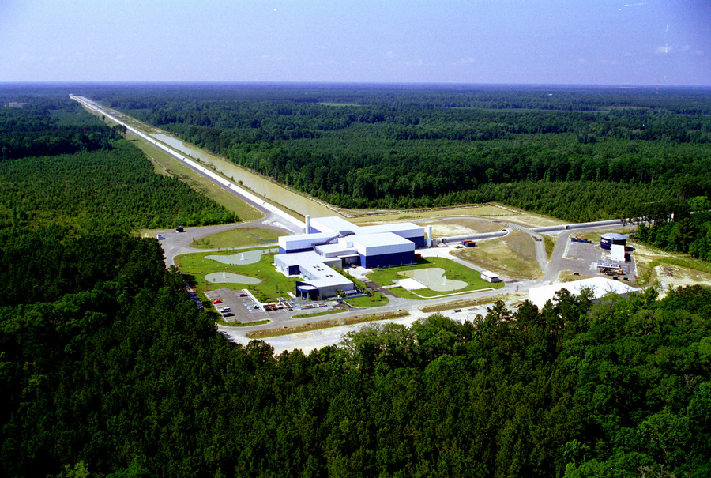
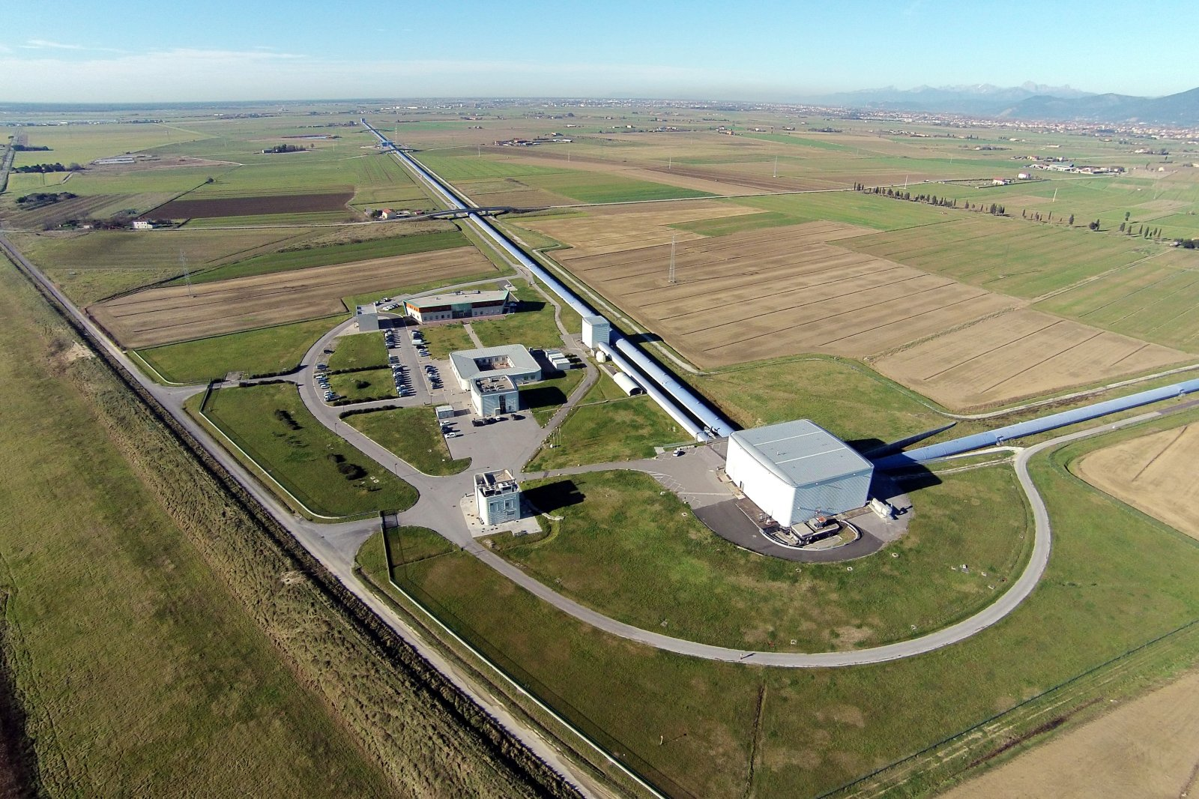
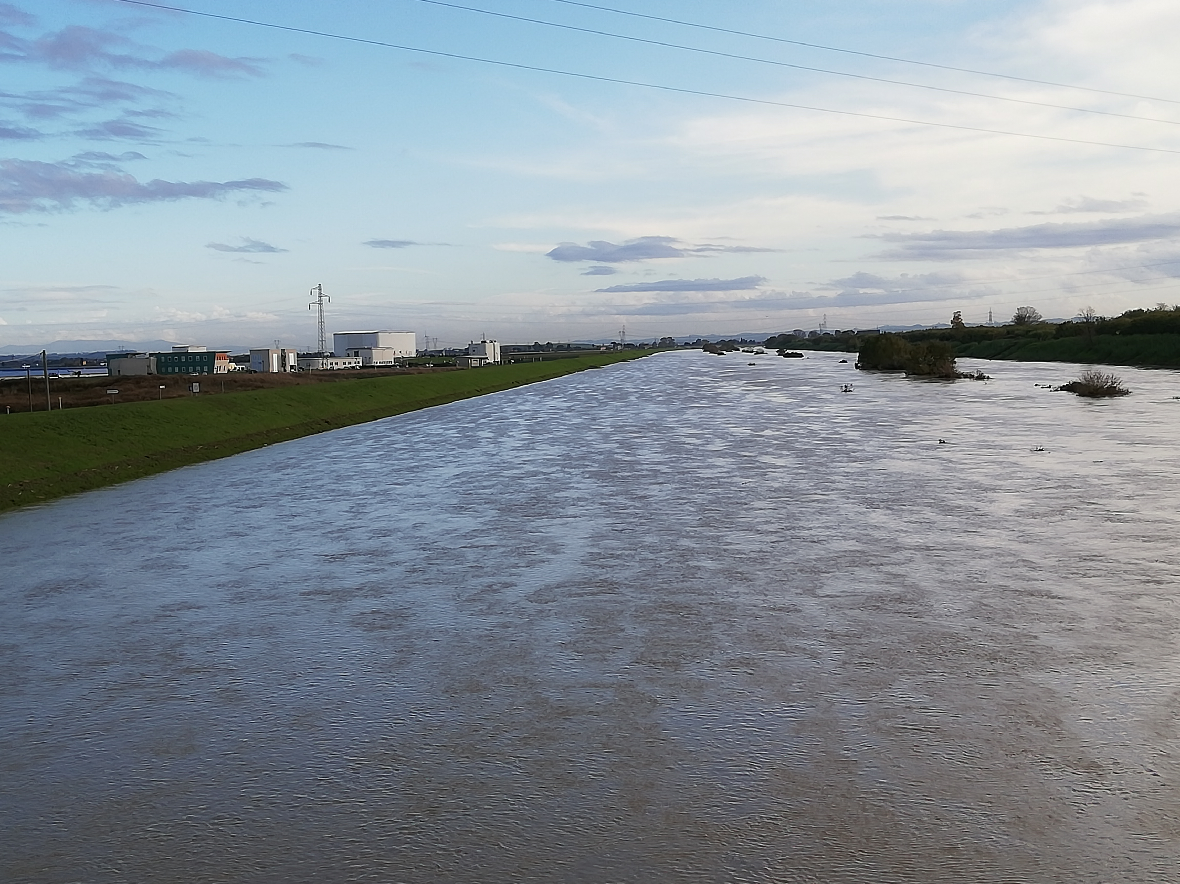
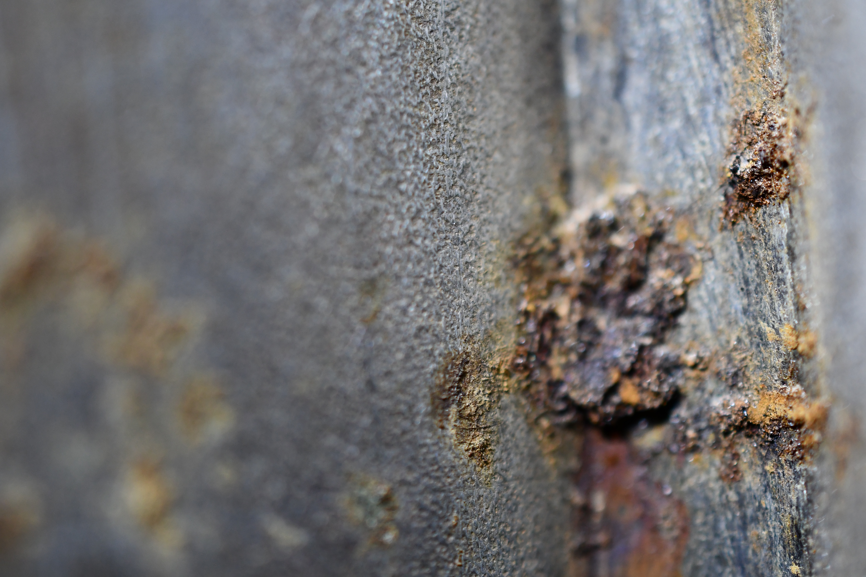
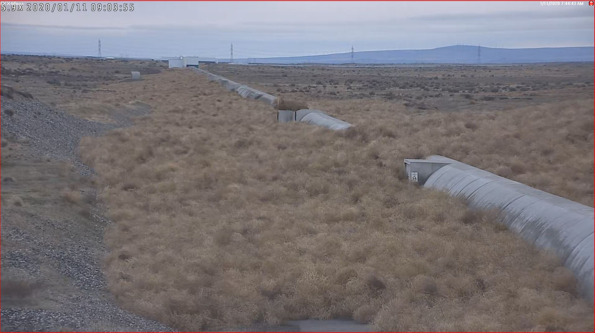
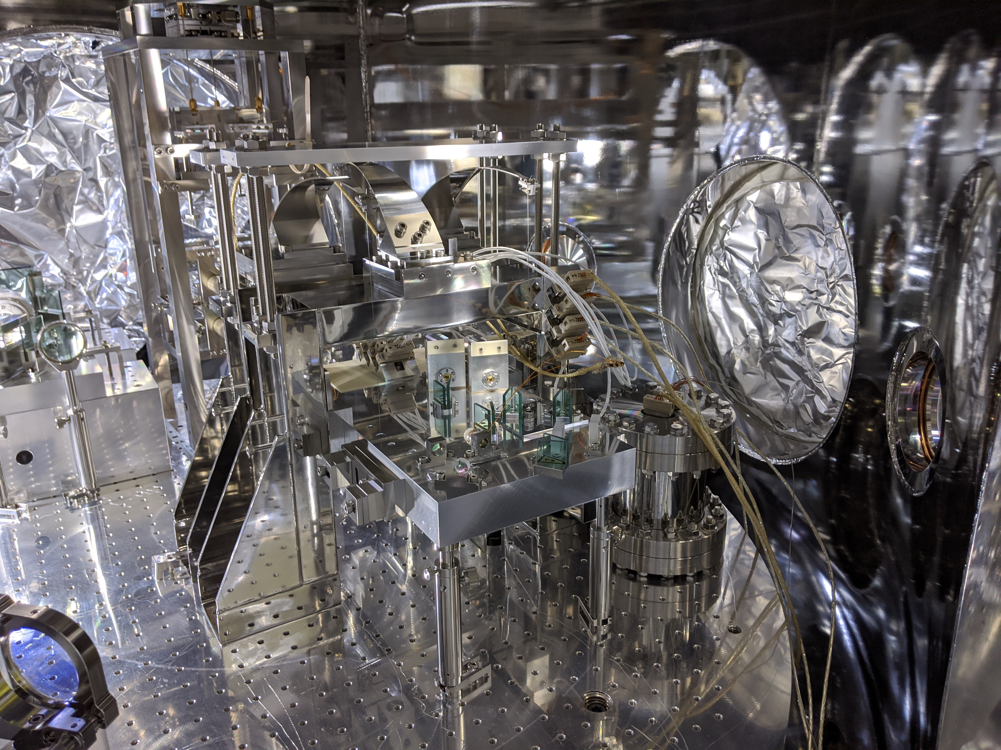
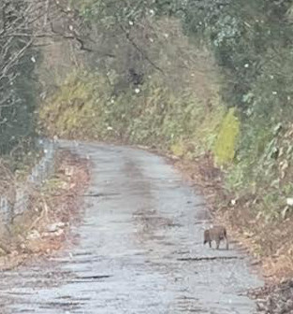
Example of vacuum leak spot found at LLO. Mitigation/patching continues.
It can happen that the risk of flood increases at the Virgo site (last November)
KAGRA boar
Wind also means overabundance of tumbleweed at LHO.
Pitchforking etc. continues.
KAGRA OMC

