Slide 1
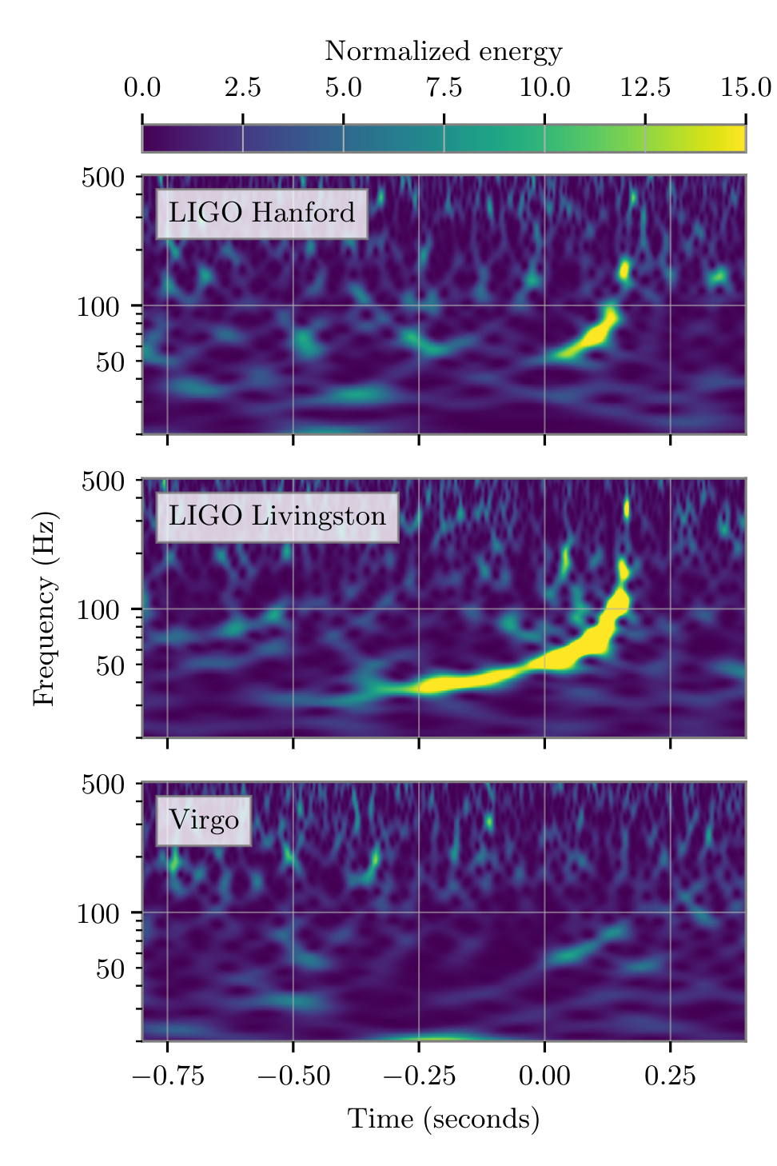
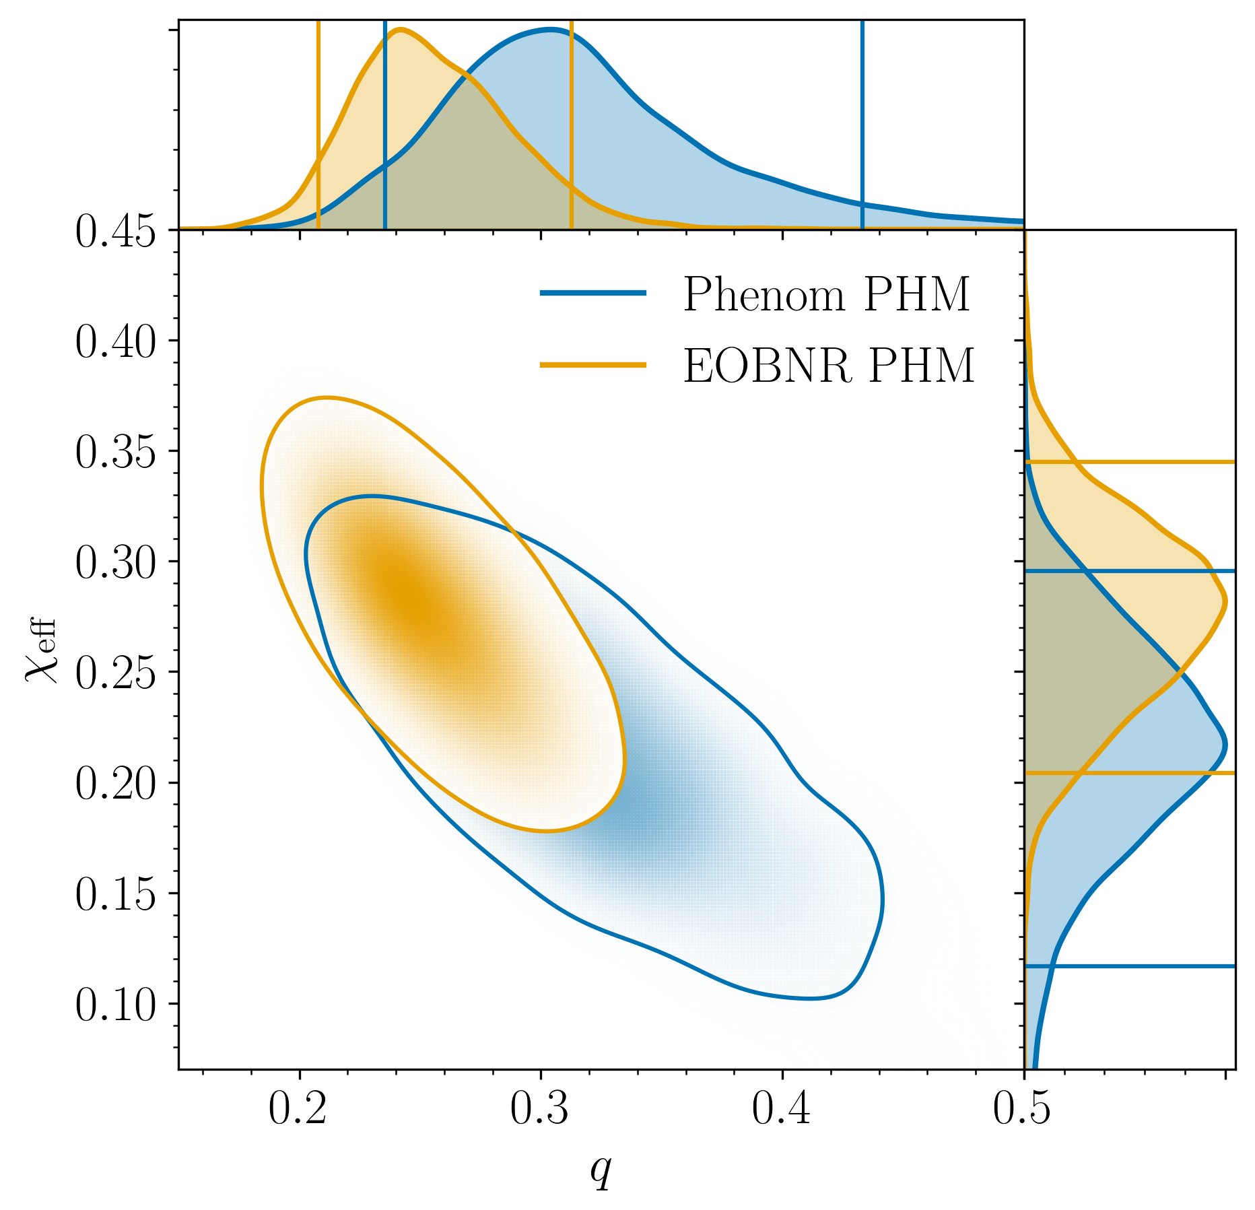
GW190412 FACTSHEET
FIRST DETECTED EVENT WITH STRONG EVIDENCE FOR AN UNEQUAL
MASS RATIO AND HIGHER GRAVITATIONAL WAVE MODES PRESENT
Observed by | LIGO Hanford and Livingston, Virgo | Mass of final BH | 33.1 to 41.1 M☉
Source type | Binary black hole merger | Spin magnitude of final BH | 0.60 to 0.72
Event time | 5:30:44 UTC, April 12, 2019 | Initial astronomer alert latency (referenced to time of merger) | 60 minutes
Network signal to noise ratio | 19.1 | Sky area of 90% credible region | 156 deg²
Distance | 1.83 to 2.84 billion light years
Redshift | 0.12 to 0.18
Primary BH mass | 24.4 to 34.7 M☉
Secondary BH mass | 7.4 to 10.1 M☉
Ratio of secondary to primary BH mass | 0.21 to 0.41
Effective inspiral spin parameter | 0.14 to 0.34
Effective precession spin parameter | 0.15 to 0.49
Images: Mass ratio and spin (left) – from the properties of the signal, it was possible to estimate the mass ratio (q) and the effective spin (χ_{eff}) of the binary BHs. The blue and orange contours represent 90% credible estimates on the values of these quantities from two different models.
GW spectrograms (above) – time-frequency representation of the GW signal data from all three detectors.
GW = gravitational wave, BH = black hole, M☉=1 solar mass=2x10³⁰ kg
Parameter ranges are 90% credible intervals from combining two models

