Slide 1
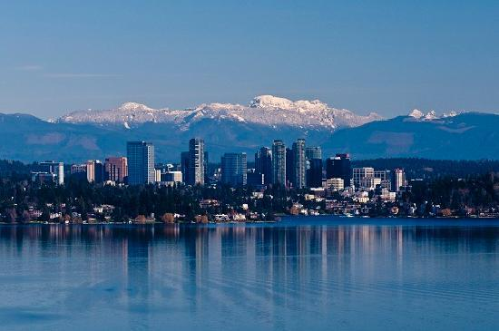
Bellevue College LIGO Group
Gwynne Crowder, Yi Ting Huang
LIGO-G2000994

Slide 2
Bellevue College
Primarily associate degree-granting four-year institution of higher learning
Public, open-access, community-based
~33,000 student annually
Diverse student body
Physics department
Enrolls ~950 students per year in entry-level courses
Offers all calculus-based sequence classes every term

Slide 3
BC LIGO Activities: Stochastic
Study of how intermittent signals from transients might affect measurements of stochastic background
Intermittent signals might arise from environmental, instrumental, and astrophysical sources
Simulate software signals characteristic of transients (e.g. combs, Gravity Spy glitches), and analyze with stochastic search pipeline
Will inform interpretation of signal

Slide 4
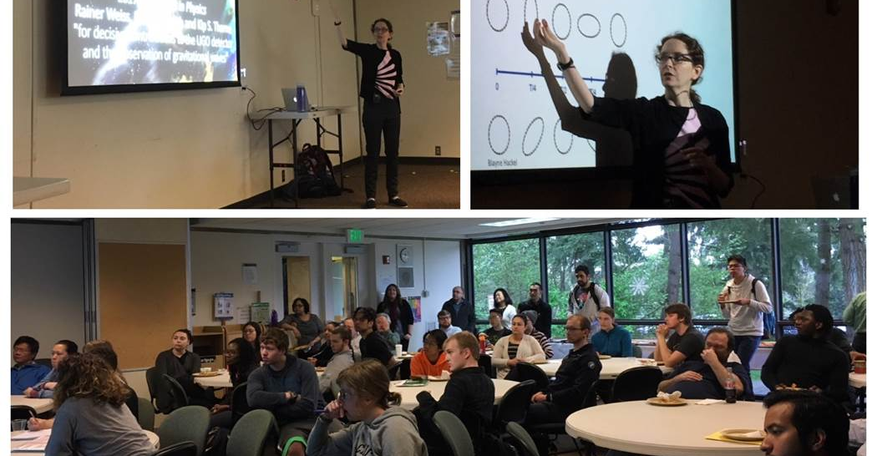
BC LIGO Activities: EPO
Students present research to campus community
Talks to students about gravitational waves and LIGO
Updates to FAQ at ligo.org (Yi Ting Huang)

Slide 5
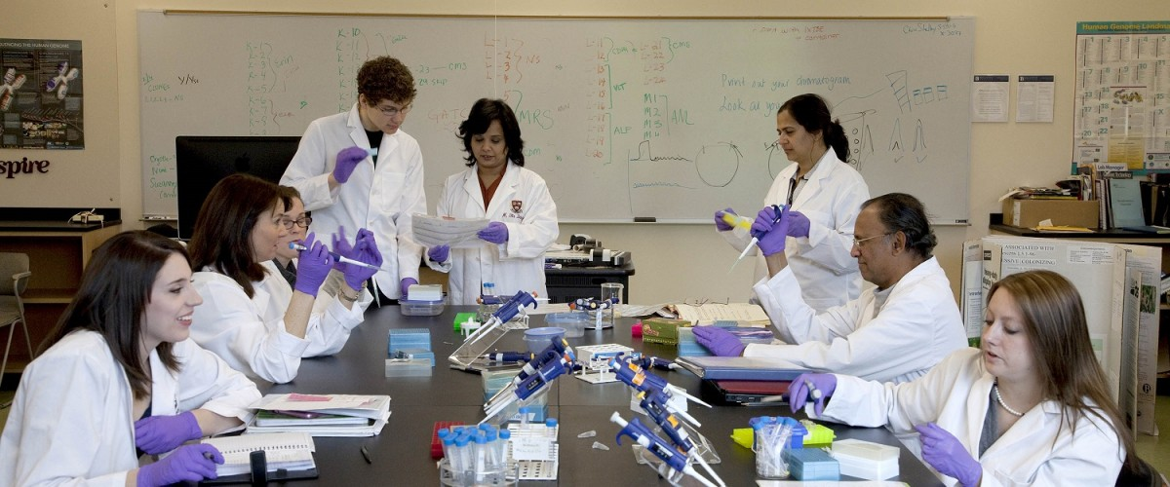
Additional interests
Studies show early research opportunities help retain students in STEM fields
BC RISE Learning Institute has central aim of helping faculty develop research learning opportunities for students
RISE houses locally-developed ComGen course
Classroom-based undergraduate genomics research
Please contact Gwynne if interested in discussing classroom-based LIGO research!

Slide 6
Future
Continuing and expanding investigations into how intermittent transient signals might affect future stochastic gravitational-wave searches
Develop classroom-based undergraduate research capitalizing on the interest and excitement around gravitational waves
Interested in collaborations!
Contributing to STEM Exploration Center

