Slide 1
ETM Profiling to mitigate cavity loss due to point absorbers
G2001160, G2001530
LLO data
LIGO-P2000122 PRD accepted 2020
Model prediction of arm power loss due to point absorber and coating absorption

Slide 2
Addition on November 14, 2020 optimized polishing may not be necessary
RTL using optimized surface shape vs using coating thickness nonuniformity
O3 ETM map
Latest coating nonuniformity
100 cases with #PA = 0~4, random location, random power

Slide 3
polishing design to realize idealistic mirror surface
A is idealistic mirror surface
Ap is A – power term to simplify the RoC specification
B is the latest coating shape
Bp is to make the polishing easier
Polishing [A-B],[Ap-B],[Ap-Bp] are various options of mirror surface polishing

Slide 4
Effect of new coating is close to that of optimal shape
Power and RTL(ppm) with different ETM surface
sph+B : no special polishing, A-B : optimal polishing
H1X H1Y L1X L1Y
power RTL power RTL power RTL. power RTL
sphere 262, 62.1 277, 65.4 266, 53.9 266, 55.5
sph+B 262, 63.6 277, 63.8 266, 56.5 266, 57.2
A-B 262, 65.2 277. 65.4 266, 57.8 266, 58.4
A-Bp 262, 70.7 277, 71.0 266, 60.8 266, 61.1
Ap-B 262, 65.6 277, 65.6 266, 57.7 266, 58.4
Ap-Bp 262, 70.5 277, 70.6 266, 60.3 266, 60.7
sphere 257, 211 272, 183 261, 185 261, 195
sph+B 261, 113 275 107 265 99.5 265, 94.9
A-B 261, 98.9 276, 97.2 265, 89.3 265, 86.8
A-Bp 261, 108 275, 107 265, 95.5 265, 92.5
Ap-B 261, 102 276, 98.9 265, 90.5 265, 87.7
Ap-Bp 261, 109 275 107 265, 95.5 265, 92.4
No point absorber
One point absorber
at 2cm with 30mW

Slide 5
new coating shape is closer to optimal shape than O3 ETM
O3 map vs new LMA and optimal

Slide 6
Performance with multiple PAs
Power (W)
RTL(ppm)
w_{ITM},w_{ETM}(cm)
# point absorbers | 0 | 1 | 2 | 3 | 4 | all
Sph - Sph | 264 55.9 5.26, 6.14 | 263 99.3 5.26, 6.13 | 262 121 5.25, 6.12 | 262 110 5.25, 6.12 | 257 271 5.22, 6.10 | 262 126 5.25, 6.12
ITM - Sph | 264 58.4 5.26, 6.14 | 262 109 5.25, 6.12 | 262 131 5.25, 6.12 | 262 121 5.24, 6.12 | 257 282 5.22, 6.09 | 262 136 5.25, 6.12
As built O3 ETM maps | 264 57.7 5.23, 6.12 | 263 88.0 5.22, 6.11 | 263 100 5.21, 6.10 | 263 94.0 5.21, 6.10 | 260 179 5.19, 6.08 | 263 102 5.21, 6.10
Latest coating map (B) | 264 60.2 5.25, 6.12 | 264 77.6 5.24, 6.11 | 263 87.8 5.23, 6.11 | 263 82.3 5.23, 6.11 | 261 142 5.21, 6.08 | 263 88.5 5.23, 6.11
Optimal mirror shape (A) | 264 61.7 5.23, 6.09 | 264 74.6 5.23, 6.08 | 263 83.1 5.22, 60.8 | 263 78.0 5.22, 6.07 | 262 124 5.20, 6.05 | 263 83.2 5.22, 6.08

Slide 7
Performance with multiple PAs
200 cases with #PA = 0~4, random location, random power, generated in 4 aLIGO arms
RTL(#PA=3) > RTL(#PA=2) is because the production rate of relevant HOM is less with #PA=3 than #PA=2 in the analyzed case
Sph-sph : ITM is spherical, all other cases use as measured phasemap
Beam size variation is 2%
Polished surface maps are used when real ITM or ETM maps are NOT used

Slide 8
Mode analysis
Random PA sources in aLIGO arms
The optical gains (3rd column), cavity power (2nd column) / production of modes by ETM (1st column), are independent on the number of point absorbers.
The ordering of HOM powers in the arm (colored lines in 2nd col) is the same as the ordering of production rates.
RTL is determined by the 7th HOM population, so smaller 7th mode in the arm means smaller RTL.
Less production of 7th mode with #PA=3 than #PA=2 is the cause of RTL(#PA=3) < RTL(#PA=2).

Slide 9
Addition on October 6th
100 cases of point absorbers are analyzed
11 FP cases, different map combinations, studied
RoC variations among 4 arms are small
ITM coatings with and without LMA coating masks do make difference
Optical gain vs map combinations
  No surprise
RTL vs map combinations
  No surprise

Slide 10
11 FP map combinations for 4 arms
I, E means coated maps of ITM and ETM
Ix, Ex means the maps of uncoated maps (very uniform out to the edge) are used with RoC of the coated surface. This is used to make a surface with specified fall off shape.
Corr(a,b) is the fall off correction
Differences among four arms for case 1 and 11 are RoC’s of coated surfaces
100 sets of point absorbers are generated, and RTL and cavity powers are calculated for 4 arms with these mirror maps.
Following are average of events.
Plots with and without RH give uncertainty due to RoC correction
Ix - Ex
I - Ex
I - E
I - Ex*corr(0.1,15)
I - Ex*corr(0.1,20)
I - Ex*corr(0.1,25)
I - Ex*corr(0.1,30)
I - Ex*corr(0.1,35)
I - Ex*corr(0.1,40)
I - Ex*corr(0.1,30,2e4)
Ix *corr(0.1,15) -
Ex*corr(0.1,15)

Slide 11
Optical gain
1:no fall off vs 11:both fall off

Slide 12
Optical gains of 6,7,8th modes shapes of different #PAs are close

Slide 13
RTL vs FP maps average of all events

Slide 14
RTL for difference #PAs
Without RH
With RH

Slide 15
Addition on October 4tn
“Spherical surface” is based on polished surface map with spherical shape using the RoC of coated surface
Comparison of H1 and L1 with the current ITM masks
  ITM coating mask affects some
Optical gain of 7th mode
  Fall off improve for all cases
Small difference affects small
  Fall off affects in a similar way for all arms
  Ring heater correction does not change the main effects
  Different point absorbers cause different effects
More analysis coming with more case studies
  Different correction shapes

Slide 16
RTL : for A+
ITM with existing mask
ETM : sphere vs fall off
This fall off helps to reduce RTL

Slide 17
In the future,
When both ITM and ETM are polished both are spherical vs with fall off
The difference among 4 cases are caused by RoCs of mirrors
Effects of fall off on optical gain and RTL are the same
Gains and loss can be different from case by case, depending on PA populations

Slide 18
Cause and effect of point absorbers on test masses
Mirror
  Point absorption on mirror surface causes thermal distortion of the surface and substrate
  Many HOMs are induced on reflection
FP cavity
  aLIGO arm is close to resonance of TEMnm, n+m=7, and this mode is amplified in the cavity,
  HOM has long power tail and induces large RTL
aLIGO IFO, DRFPM
  Large RTL reduces PRG
  Curvature mismatch of fields
  from two arms reduces PRG
    RTL of FP
    PRG of full DRFPM
(A)
(A)
Point abs
coating abs
(B)
(B)
(C)
(D)
(D)
(C)
7th mode 15%

Slide 19
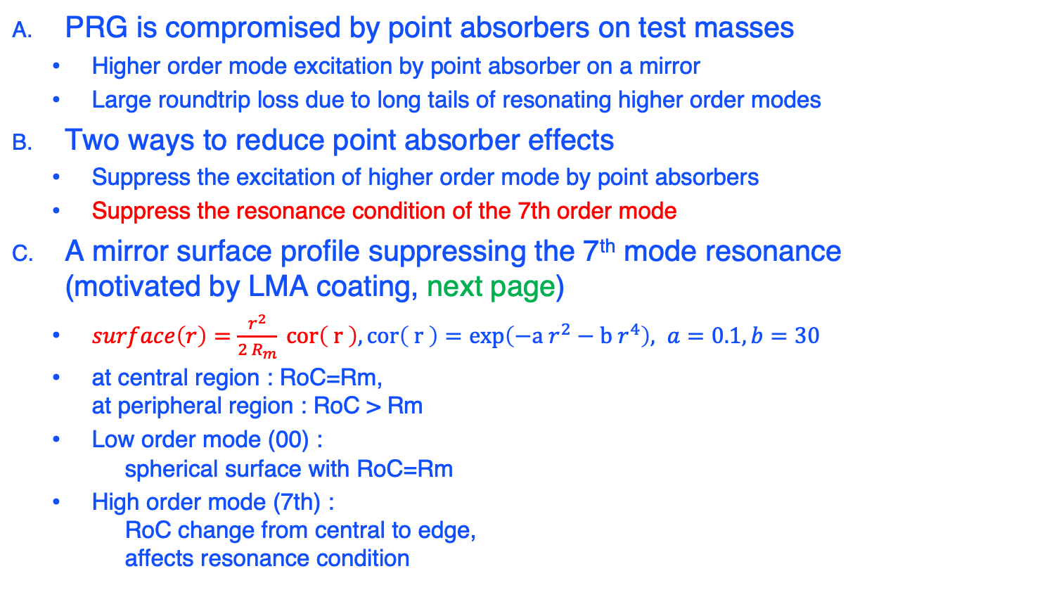

Test Mass surface profiling to suppress higher order modes
PRG is compromised by point absorbers on test masses
  Higher order mode excitation by point absorber on a mirror
  Large roundtrip loss due to long tails of resonating higher order modes
Two ways to reduce point absorber effects
  Suppress the excitation of higher order mode by point absorbers
  Suppress the resonance condition of the 7th order mode
A mirror surface profile suppressing the 7th mode resonance
(motivated by LMA coating, next page)
  $surface\left(r\right)=\frac{r^{2}}{2 R_{m}} cor\left( r \right), cor\left( r \right)=exp\left(−a r^{2}−b r^{4}\right), a=0.1,b=30$
  at central region : RoC=Rm,
  at peripheral region : RoC > Rm
  Low order mode (00) :
  spherical surface with RoC=Rm
  High order mode (7th) :
  RoC change from central to edge,
  affects resonance condition
$$field amp \sqrt{w/m^{2}}$$

Slide 20
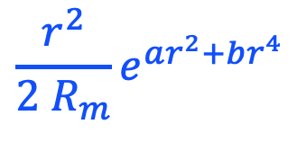
Map specifications and performance
$$\frac{r^{2}}{2 R_{m}}e^{ar^{2}+br^{4}}$$
Functional form motivated by
“Diffraction losses of a Fabry-Perot cavity with nonidentical non-spherical mirrors"
by Poplavskiy, Matsko, Yamamoto, Vyatchanin
Article reference: JOPT-107582.R1

Slide 21
What are studied
Does this shape suppress 7th mode efficiently
Performance when there is no point absorber
Performance when there is coating absorption
Performance when beam is tilted to reduce the point absorber effect
Requirement on polishing and coating

Slide 22
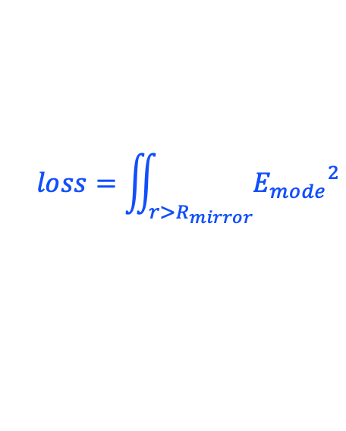
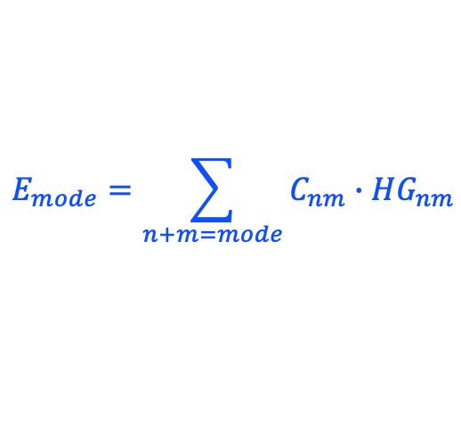
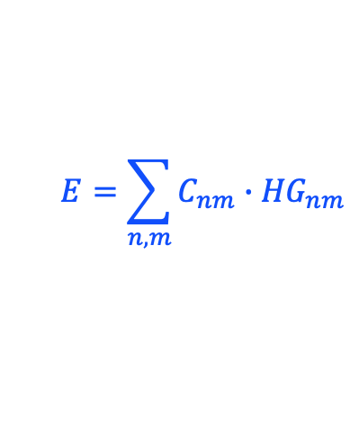
* Stationary field by FFT
* Field is mode-expanded using standard HG or LG
FFT simulation
ITM
standard HG or LG
E
ETM
$$E=\sum_{n,m}{C_{nm}{∙HG}_{nm}}$$
$$E_{mode}=\sum_{n+m=mode}{C_{nm}{∙HG}_{nm}}$$
$$loss=\iint_{r>R_{mirror}}{{E_{mode}}^{2}}$$

Slide 23
Optical gain
7th mode gain is suppressed but …
Does this shape suppress 7th mode efficiently
Clipping loss

Slide 24
Optical gain with various
ETM surface profile

Slide 25
RTL = gain x clipping loss
clipping loss (%),
absolute loss (ppm)
15%,30ppm
6%,4ppm
39%,4ppm
15%,5ppm
27%,1ppm

Slide 26
Dependence on mirror maps
Does this shape suppress 7th mode efficiently
RTL with one PA on ETM (2cm, 30mW)
Fit : a=0.1, b=30
00 loss = 1 - 00 power on ETM with PA / without PA
 | ITM and ETM maps | ITM map ETM no map | ITM map ETM cor (0.1,30) | ITM no map ETM cor(0.1,30) | TEM00 gain loss
 | Current performance (PA / no PA) | Larger loss w/o ETM map | Performance with new ETM maps (O4) | Smooth ITM (O5) with new ETM maps (O4) | Loss of the signal (fit / as is)pp
H1 X arm ITM07-ETM13 | 148 / 58 | 195 | 95 | 91 | 0.5% / 1.3%
H1 Y arm ITM11-ETM16 | 140 / 59 | 190 | 96 | 90 | 0.5% / 1.2%
L1 X arm ITM04-ETM10 | 137 / 57 | 180 | 88 | 91 | 0.5% / 1.1%
L1 Y arm ITM08-ETM15 | 120 / 58 | 193 | 87 | 90 | 0.5% / 0.9%

Slide 27
one vs two PAs dE = E-TEM00
dRTL = RTL – RTL0, RTL0 = RTL(without map and absorber) = 48ppm
dEE
±3cm
one absorber 10mW
at x=2cm, y=0
No mirror maps
dRTL=10ppm
one absorber 10mW
at x=2cm, y=0
L1 x arm maps
dRTL= 17ppm
two absorbers 10mW
at 2cm & -2cm
L1 x arm maps
dRTL= 11ppm
dEI
±20cm

Slide 28

Multiple point absorbers
Random locations and powers
Does this shape suppress 7th mode efficiently
$corr\left(a,b,c\right)=\frac{r^{2}}{2 R_{m}}exp⁡(−\text{a} r^{2}$-b $r^{4}$- c $r^{8}$)
#PAs : 0~4 poisson (ave=2)
Locations(x,y) : normal (sig=3cm)
Power( r ) = normal( 30mW)*exp(-2r²/w^2)
LLO Y arm
ITM:phase map
ETM:uncoated map
+correction

Slide 29
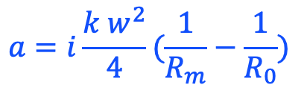
Effect of edge fall off shape when there is no PA but with coating absorption
Performance when there is no point absorber
ITM : phasemap as is
ETM : uncoated map + fall off shape exp(-a r² –b r⁴)
 | LHO X | LHO Y | LLO X | LLOY
No thermal (power/RTL) | 262 / 62 262 / 65 | 277 / 63 277 / 65 | 266 / 54 266 / 57 | 266 / 55 266 / 58, 266 / 58
Coating abs No RH | 261 / 57 260 / 64 | 276 / 57 275 / 66 | 265 / 54 264 / 60 | 265 / 55 264 / 60, 264 / 59
Coating abs RH corr | 262 / 61 262 / 69 | 277 / 62 277 / 71 | 266 / 55 266 / 58 | 266 / 56 266 / 59, 266 / 60
Poorman’s ring heater
Arm power (W) / RTL (ppm) without fall off
Arm power (W) / RTL (ppm) with fall off
Arm power (W) / RTL (ppm) with ETM15 map
$$a=i\frac{k w^{2}}{4}(\frac{1}{R_{m}}−\frac{1}{R_{0}})$$

Slide 30
Point absorber (2cm,30mW) on ETM,
Coating absorption(700kW,0.5ppm),
Ring heater (HR RoC)
Performance when there is coating absorption
Thermal aberration by coating absorption by Hello-Vinet
Ring heater nullifies LG(1,0) excitation by HR RoC change
LLO PRG : without RH 30.3, with RH 28.5
Coating thermal
RH correction
Edge shape

Slide 31
Thermal effect in DRFPM
When or how to use RH
Performance when there is coating absorption
LLO : ITM coated map, ETM uncoated map + corr(0.1,30)
case | Coating abs | PA on EY | Correction ETM | RH (ITM,ETMX) | RH (ETMY) | PRG
1 | 0 | 0 | no | no | no | 53
2 vs 4 | 0 | 30mW | no | no | no | 27
3 vs 5~7 | 0.35W | 30mW | no | no | no | 33
4 | 0 | 30mW | 0.1,30 | no | no | 44
5 | 0.35W | 30mW | 0.1,30 | no | no | 33
6 | 0.35W | 30mW | 0.1,30 | yes | no | 27
7 | 0.35W | 30mW | 0.1,30 | yes | yes | 23

Slide 32
Beam offset on ETM
Performance when beam is tilted to reduce the point absorber effect
ITM : ITM08 coated phase map
ETM : ETM15 uncoated phase map with correction (0.1,30)
Coating absorption on ITM and ETM, 0.35W each
Point absorber on ETM at -20mm from center (power=30mW exp(-2 r² / 6.2cm²))
Tilt ETM to make the resonating beam position on ETM to have offset, 0~40mm (opposite to point absorber), keeping the beam on ITM to be centered
RH correction calculated with beam at the center of ETM
Input beam is tilted to make proper mode matching between the input and the resonating cavity mode
Mode expansion using the cavity axis
8 cases compared
  Coating absorption off / on
  Point absorber off / on
  shape correction off / on

Slide 33
Power and RTL vs offset
Performance when beam is tilted to reduce the point absorber effect
solid : flat map,
dashed : fall off
red and purple : no coating abs
blue and cyan : with coating abs
red and blue : no point abs
purple and cyan : with point abs

Slide 34
Extra factors
Polishing spec = idealistic surface – all possible deformations
Coating stress effect on RoC (T970176, T050057)
  Waiting for LMA report
Intrinsic coating non uniformity (T2000398)
  Waiting for LMA report
Deformation by gravity (T050184)
  Negligible
Polishing requirement
  In radius > 8cm, height variation less 10%
Anything else?

Slide 35
Summary
The surface shape correction of test mass to reduce the thickness at the edge by O(1%) works OK
The effect by a single absorber seems to be improved by a factor
When the thermal deformations by coating absorption and point absorber mix badly, a careful ring heater correction will be necessary and this shape does not help, nor does it harm.
Nominal ring heater to restore the central region curvature adds to much curvature at the edge. Another ring heater to handle the edge may be necessary.

Slide 36
Answer to recommendations
For this case, what is the eigenfrequency for the 6th & 7th order modes (delta_f from the TEM00 mode)?
  df is not all to determine the mode gain
  loss or width or coupling to
  other modes matter
Analytic df for 6th mode
This matches with analytic calculation for the 7th mode

Slide 37
Answer to recommendations
G2001747-v3, slide 32, upper right plot. Is there any understanding why the RTL for the solid purple curve is lower than for the solid red curve for offsets greater than 2.5 cm ?
A : there was a bug to setup a FP cavity with offset. Needs to be redone.
Also why is the RTL for the dashed cyan curve higher than for the solid cyan at zero offset?
A : see the answer in the last page. The thermal bump by the coating absorption distorts the field and the edge fall off does not work as is naively expected.
As the beam is moved, does the absorbed power stay the same, or decrease as it’s moved away from the PA?
A : Power changes as exp(-2 d² / w²) where d is the distance between the beam and the point absorber.

Slide 38
Answer to recommendations
Can you comment on the benefit of retaining or removing the slight spherical aberration, induced by the coating, using a custom polish?
  Simply filling the central dip harms => larger 6th mode gain
  RTL(flat) is 10% larger than RTL(B)
Curvature correction
flattening

Slide 39
Answer to recommendations
From G2001747-v3 page 32 - Are labels swapped? Cyan with corr is worse than without at center alignment.
A: labels are not swapped.
These are plots of ITM and ETM surfaces
with 0.35W coating absorption. Bump at the
center by the absorption affects the cavity
mode a lot.
Also plots on slide 2 - are the axes labels swapped?
A : Yes, axes are swapped

Slide 40
Cases studied
100 events generated, up to 4 point absorbers on ETM, at random locations with random power Prand, each PA absorbs Prand*exp(-2r²/w²) (r is distance between the beam at center and the individual PA).
ITM (measured map and measured RoC) + ETM sphere (polished surface + measured RoC of the arm)
ITM + ETM as measured map and measured RoC
ITM + ETM sphere + coating thickness B
ITM + ETM sphere + B + 200mW coating absorption
ITM + ETM sphere + B + 200mW + ring heater RoC correction

Slide 41
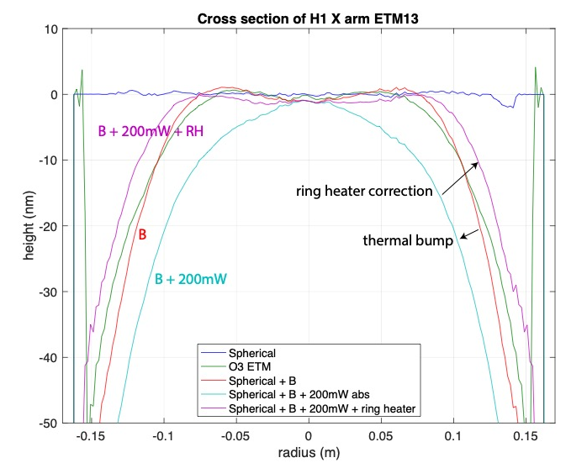
ETM surfaces

Slide 42
Beam size measured beam size / modal model value - 1
#PA = 1
#PA = 2
#PA = 0
#PA = 3
#PA = 4

Slide 43
RTL, #PAs and effect of B

Slide 44
More on
RTL vs shape
RTL(#PA=0)
RTL(#PA=2)-RTL(0)
RTL(#PA=1)-RTL(#PA=0)
RTL(#PA=3)-RTL(0)
RTL(#PA=4)-RTL(0)

Slide 45
Optical Gains vs Modes
HOM gains are weakly depends on #PAs

Slide 46
Mode gain vs shape (#PA=1)

Slide 47
Offset dependence
PA absorption of 30mW x exp(-2r²/w²) is placed at -2cm, where r is the distance between the PA and the beam center
Beam center is moved away from the PA
The center of the 200mW thermal bump by coating is the location of the beam on EM
Mode is calculated using the cavity axis as z axis

Slide 48
RTL vs offset
0cm
4cm
0cm vs 4cm

