Slide 1
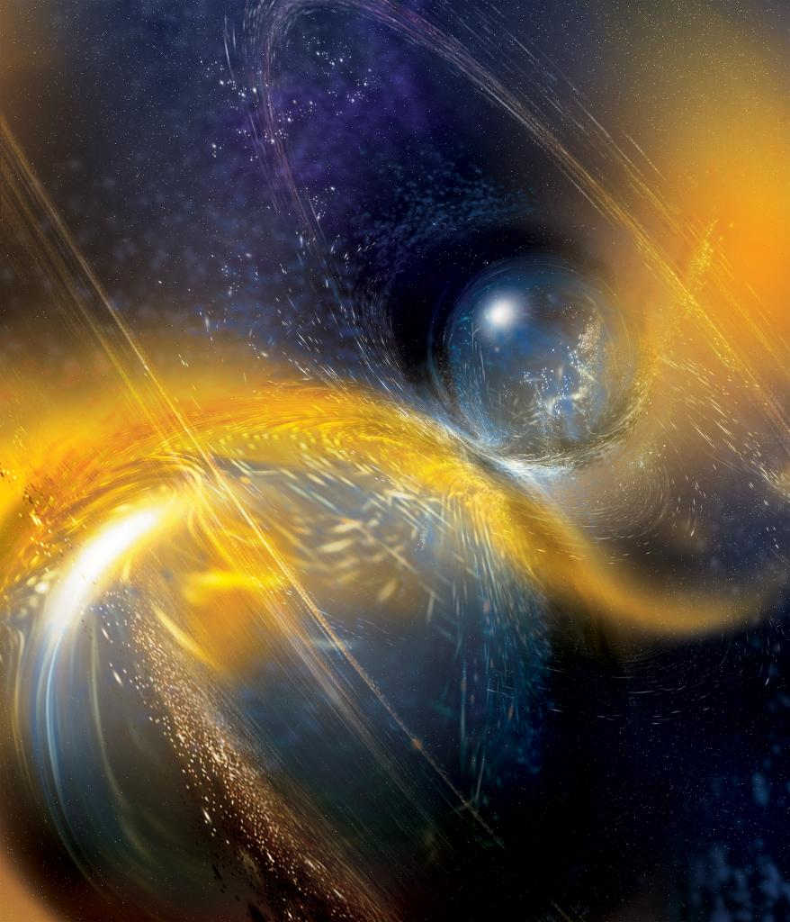
Available Data Products from LIGO-Virgo Gravitational-Wave Searches Peter S. Shawhan University of Maryland and Joint Space-Science Institute (JSI) for the LIGO Scientific Collaboration and Virgo Collaboration
APS Mid-Atlantic Section Meeting
December 6, 2020
LIGO-G2001894-v2
National Science Foundation/LIGO/Sonoma State Univ./A. Simonnet

Slide 2
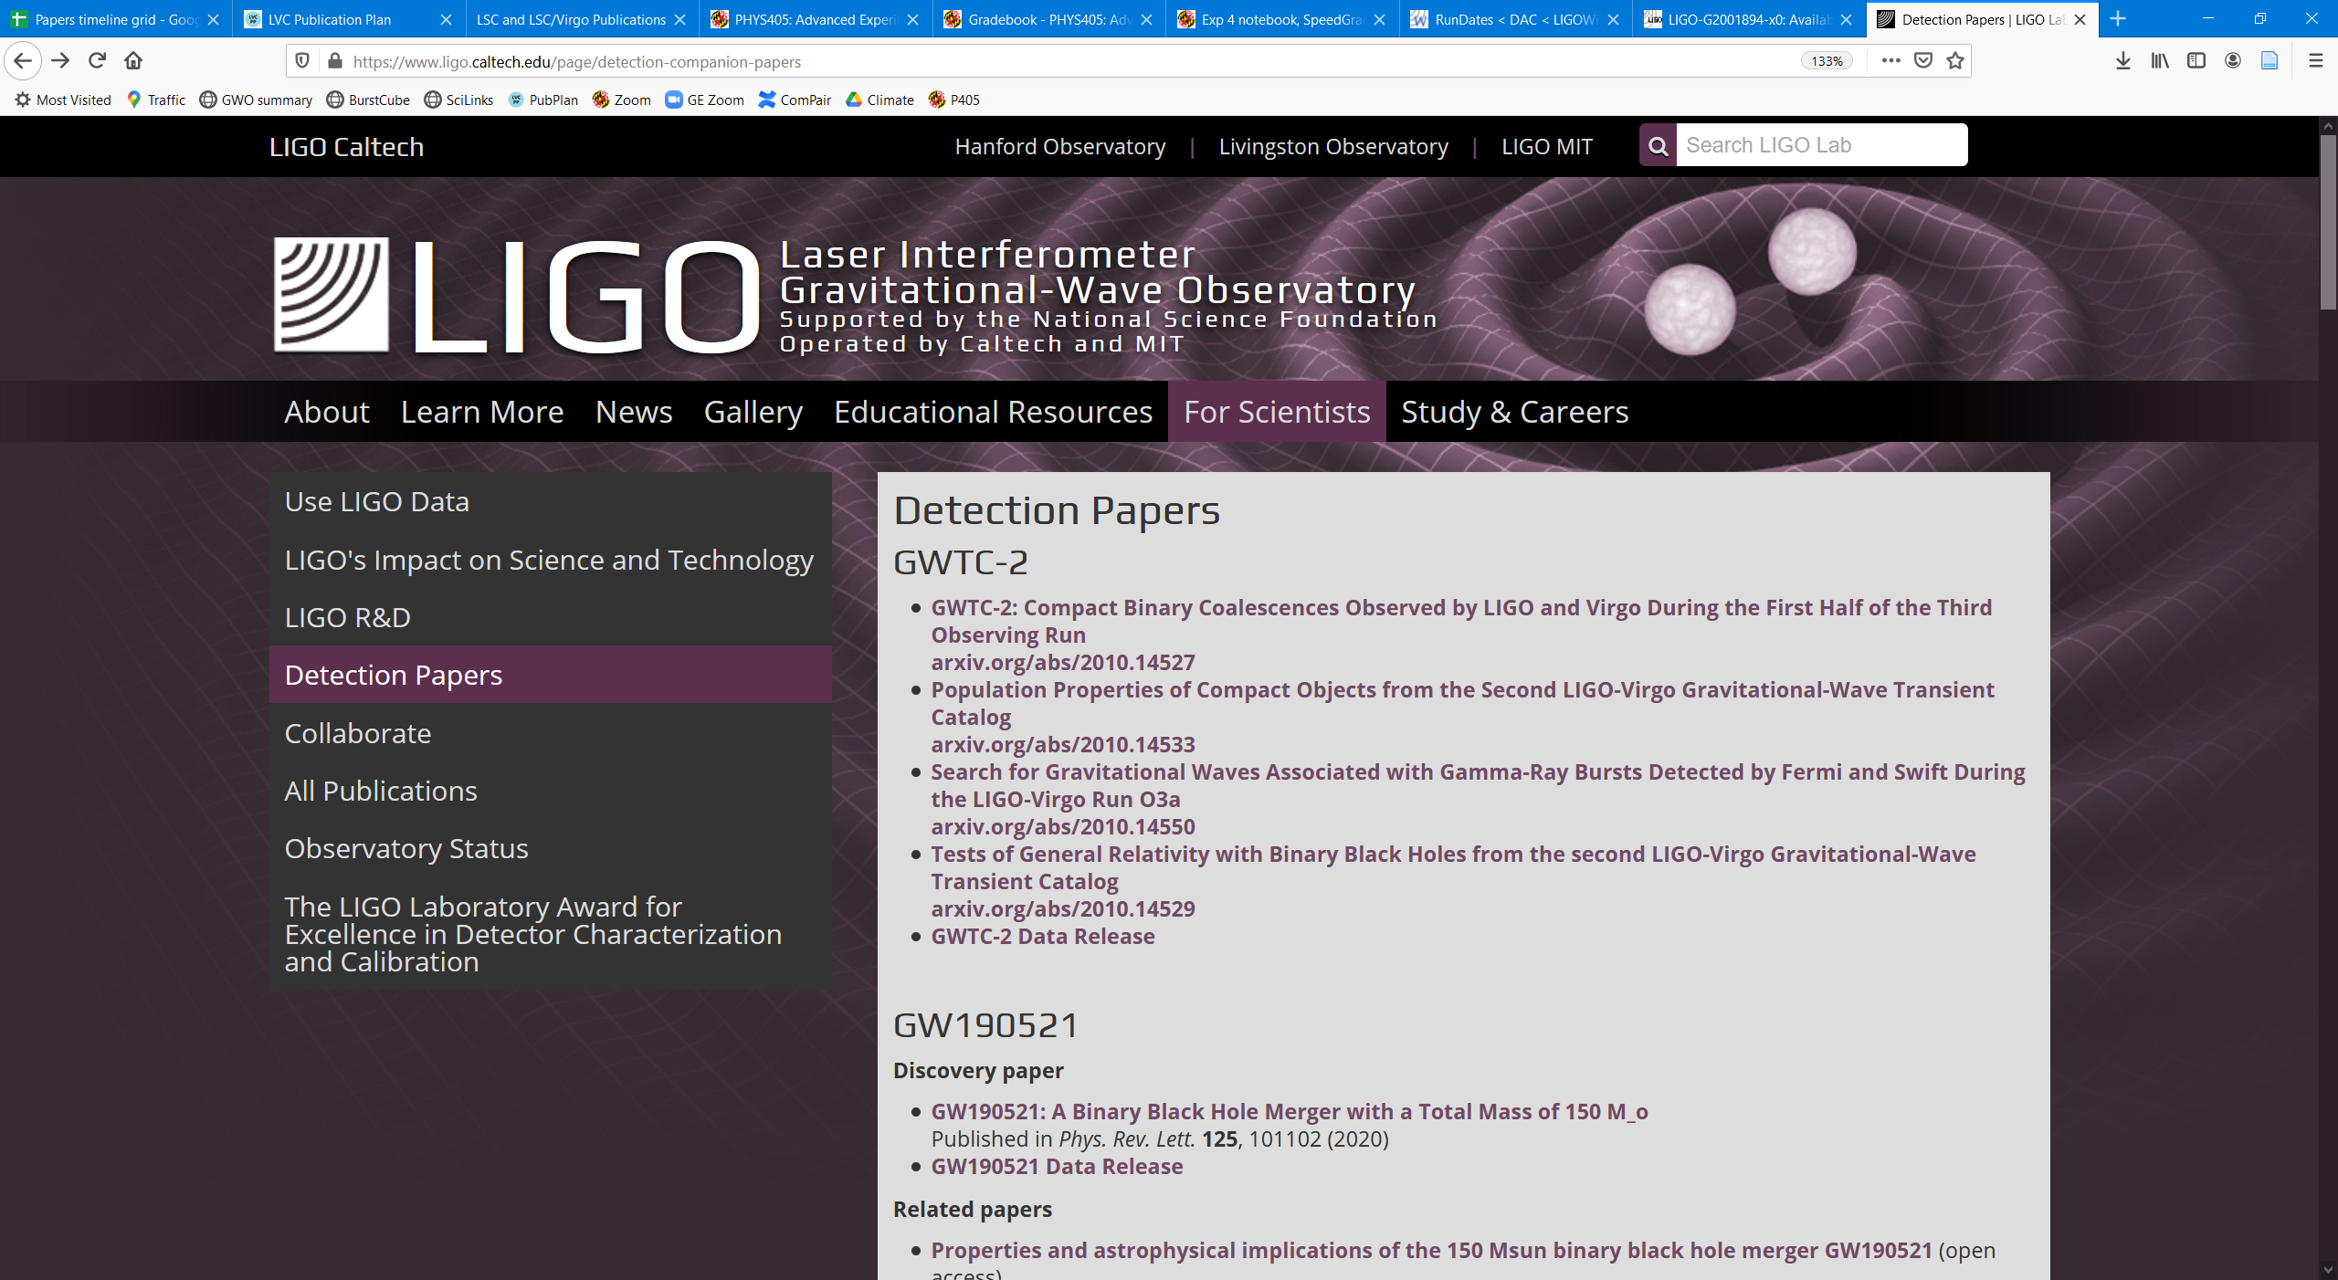
Detection Papers: papers.ligo.org

Slide 3
www.gw-openscience.org

Slide 4
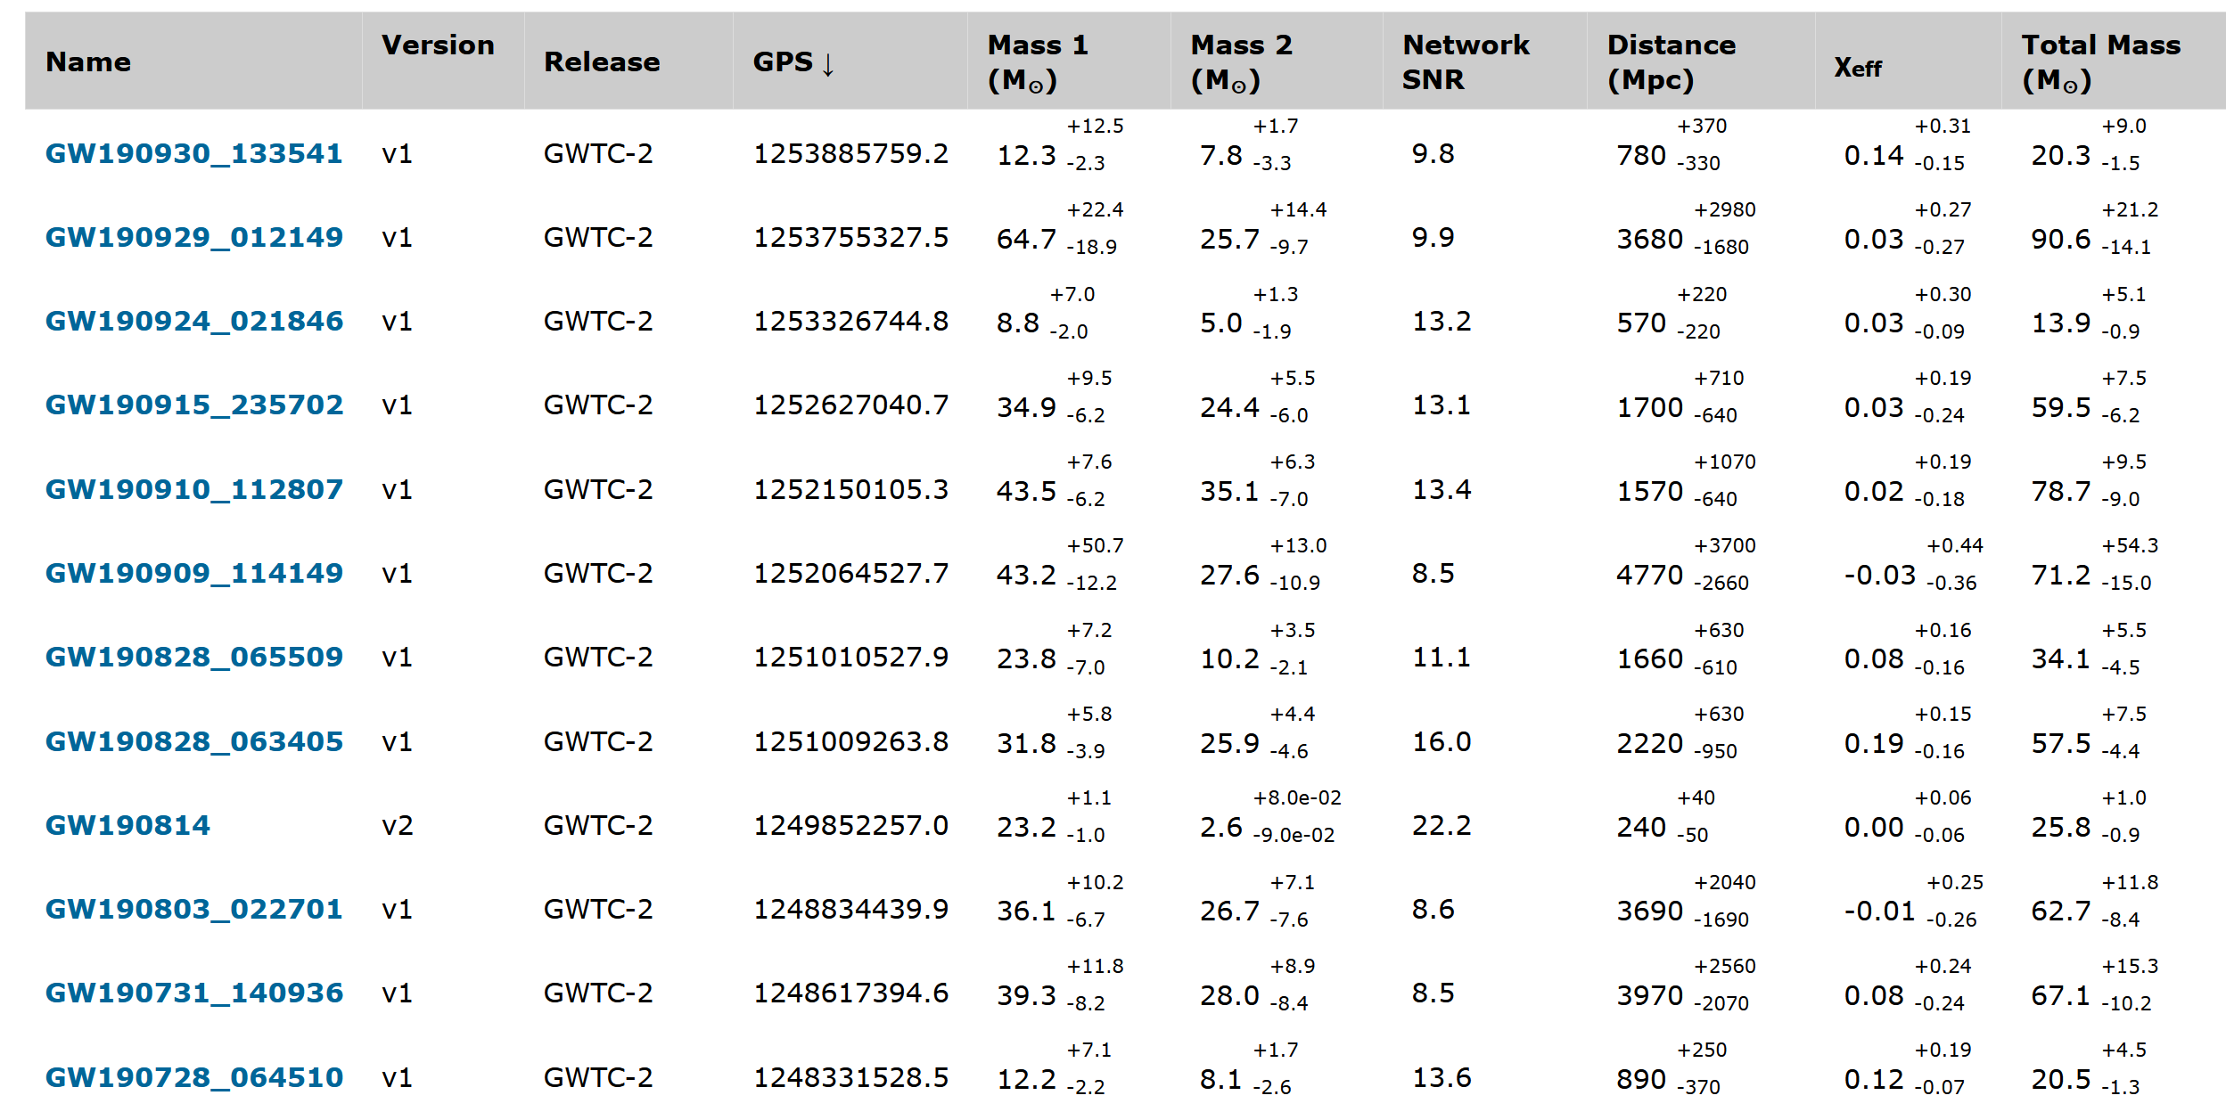
Event List

Slide 5
Available Data (varies somewhat with the event)
GW strain data — also known as $h(t)$
Downloadable files for each published event
Bulk data releases from past observing runs
Files downloadable from the web site
Remote filesystem using CernVM-FS
Also available on gw-openscience.org : tutorials and recorded workshops showing ways to display and analyze strain data, etc.
Summary properties of each event
Masses, distance, spin parameters, etc.
Signal-to-noise ratios
Skymap (probabilistic localization)
As FITS file containing HEALPix
Posterior samples from parameter estimation (PE) analyses

Slide 6
Bayesian Parameter Estimation
Repeatedly adjust the various physical parameters of the waveform model to see what fits the data from all detectors well – i.e., explore the parameter space
Illustration by N. Cornish and T. Littenberg

Slide 7
Bayesian Parameter Estimation
With a suitable algorithm for using the calculated likelihood to control “jumps” to different points in parameter space, we accumulate a collection of “samples” distributed in proportion to the Bayesian probability density in the parameter space, given the data
Each “posterior sample” is a vector of parameter values, plus calculated log-likelihood
from pesummary.io import read
...
data = read(file_name)
samples_dict = data.samples_dict
posterior_samples = samples_dict['PrecessingSpinIMRHM']
parameters = sorted(list(posterior_samples.keys()))
print(parameters)
['Npts', 'a_1', 'a_2', 'chi_eff', 'chi_p', 'chirp_mass', 'chirp_mass_source', 'comoving_distance', 'cos_iota', 'cos_theta_jn', 'cos_tilt_1', 'cos_tilt_2', 'dec', 'final_mass', 'final_mass_non_evolved', 'final_mass_source', 'final_mass_source_non_evolved', 'final_spin', 'final_spin_non_evolved', 'geocent_time', 'inverted_mass_ratio', 'iota', 'log_likelihood', 'luminosity_distance', 'mass_1', 'mass_1_source', 'mass_2', 'mass_2_source', 'mass_ratio', 'neff', 'p', 'peak_luminosity', 'peak_luminosity_non_evolved', 'phase', 'phi_1', 'phi_12', 'phi_2', 'phi_jl', 'ps', 'psi', 'psiJ', 'ra', 'radiated_energy', 'radiated_energy_non_evolved', 'redshift', 'spin_1x', 'spin_1y', 'spin_1z', 'spin_2x', 'spin_2y', 'spin_2z', 'symmetric_mass_ratio', 'theta_jn', 'tilt_1', 'tilt_2', 'total_mass', 'total_mass_source']
Example code snippet adapted from https://dcc.ligo.org/LIGO-P2000223/public

Slide 8
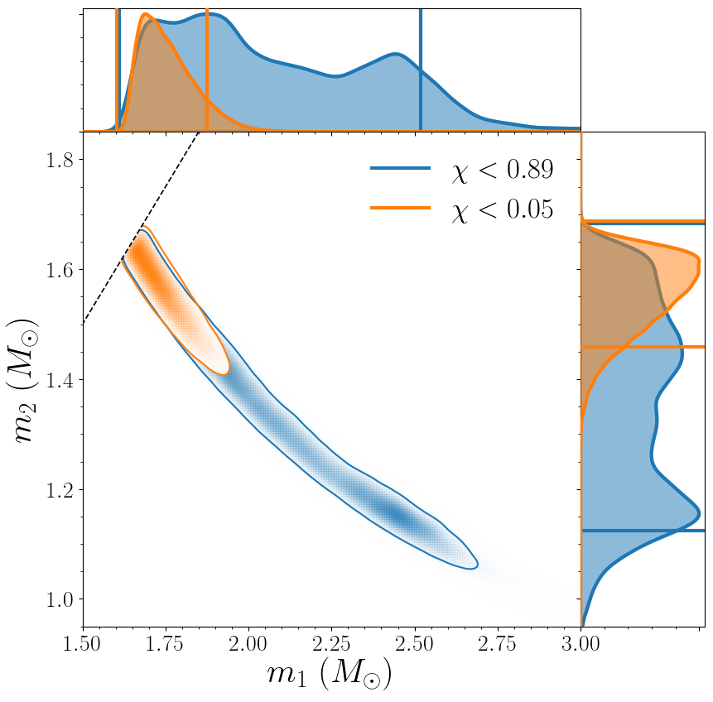
Why Posterior Samples Can Be Useful
The parameters are all varied simultaneously, so you can investigate correlations and conditional distributions, as well as apply different priors
Example from GW190425:
$m_{1}$ versus $m_{2}$ with different priors on the neutron star spins
Abbott et al., ApJL 892, L3 https://arxiv.org/abs/2001.01761

Slide 9
But wait, there’s more!
Besides the event-focused data products in the GW Open Science Center, we generally provide other data products specific to each published paper in the LIGO Document Control Center (DCC)
dcc.ligo.org
However, the best way to find all the LIGO-Virgo result papers is via either papers.ligo.org or www.ligo.org

Slide 10
papers.ligo.org
www.ligo.org

Slide 11
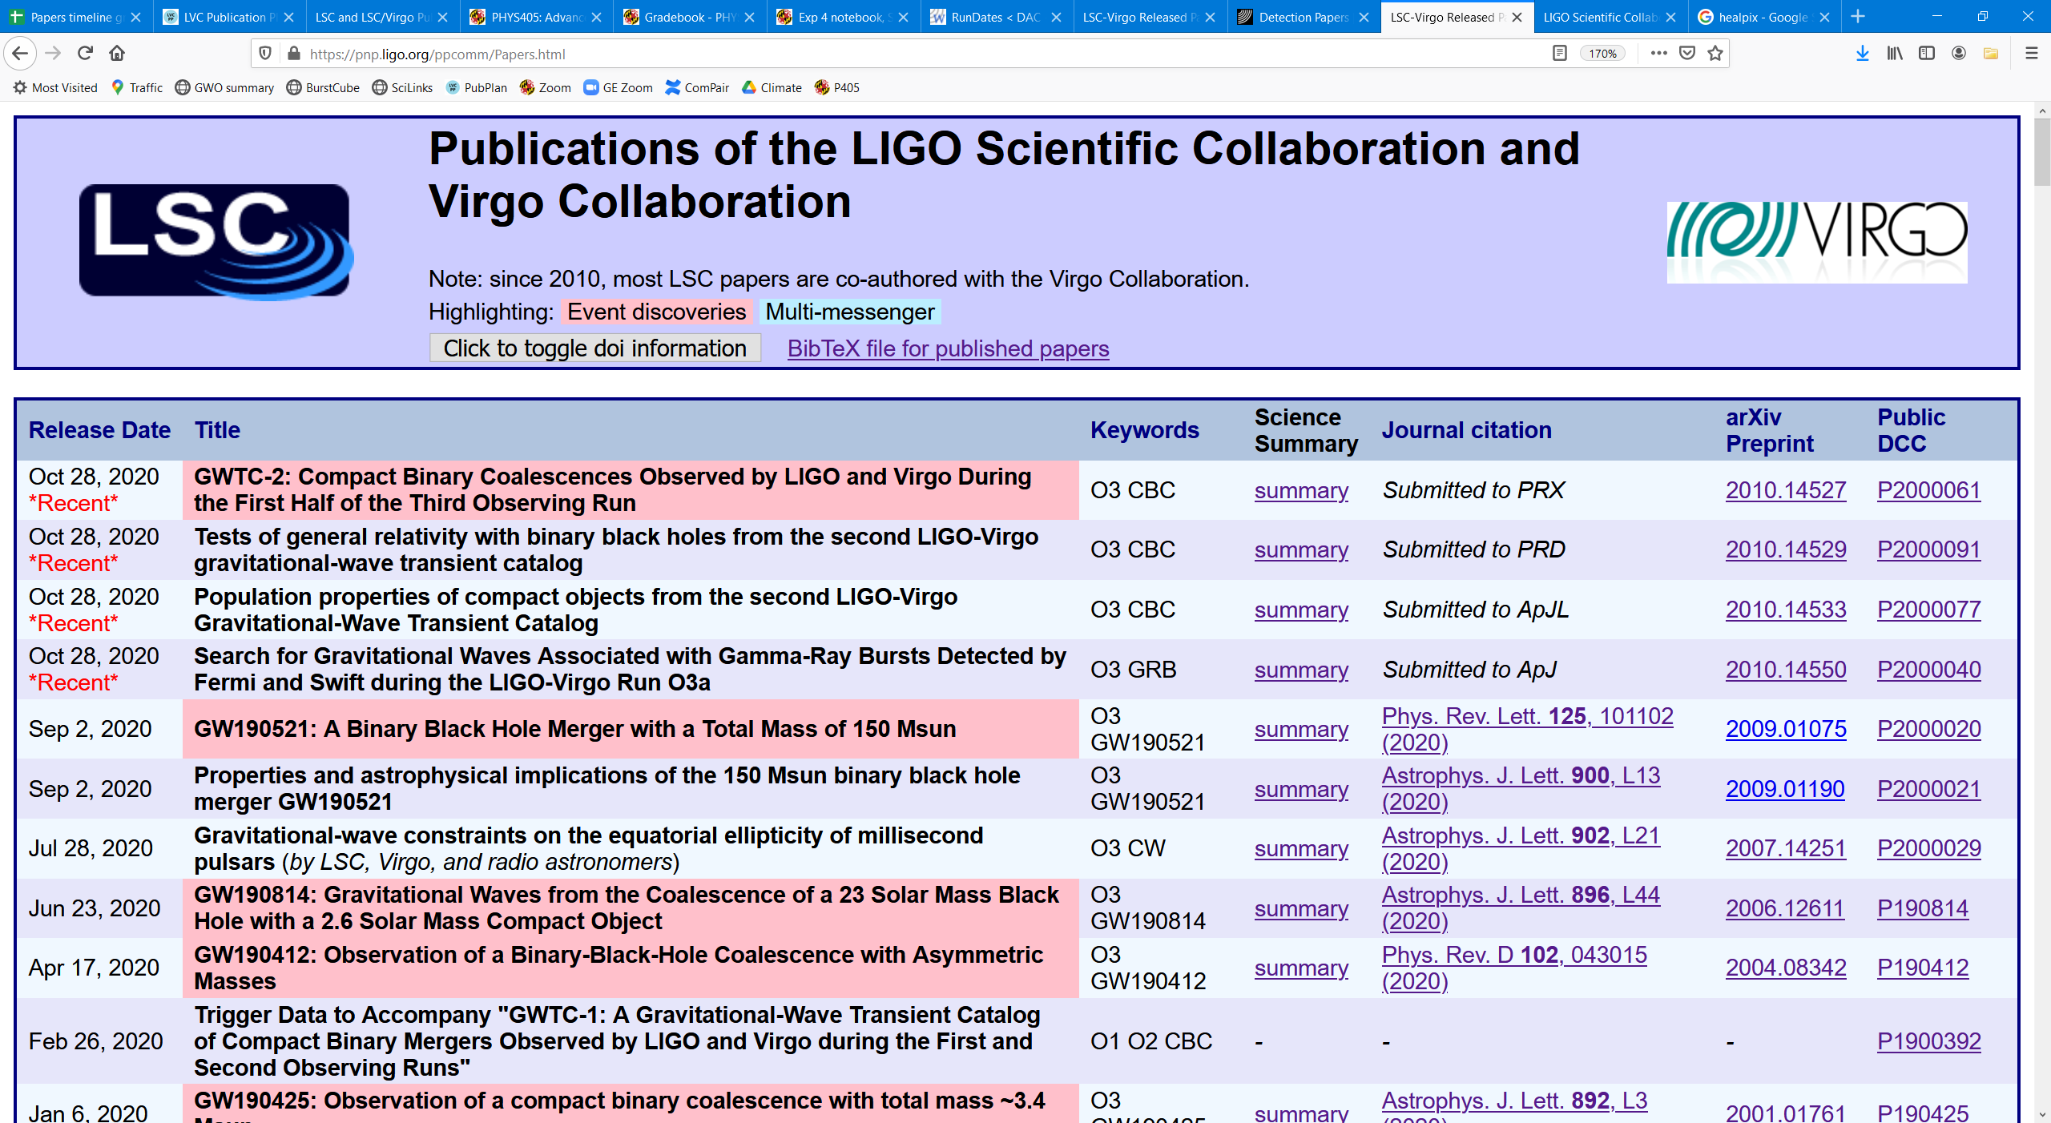
The DCC records generally include paper-specific data products

Slide 12
Example 1
Sometimes, the “data behind the figures and tables” is attached as additional files

Slide 13
Example 2
Other times, there is a separate, related DCC entry containing data products

Slide 14
Acknowledgements
These scientific results have been produced by the many members of the LIGO Scientific Collaboration (LSC) and the Virgo Collaboration
PSS thanks the National Science Foundation for support through grant PHY-1710286
The Gravitational Wave Open Science Center is a service of the LIGO Laboratory, the LIGO Scientific Collaboration and the Virgo Collaboration. LIGO Laboratory and Advanced LIGO are funded by the United States National Science Foundation (NSF) as well as the Science and Technology Facilities Council (STFC) of the United Kingdom, the Max-Planck-Society (MPS), and the State of Niedersachsen/Germany for support of the construction of Advanced LIGO and construction and operation of the GEO600 detector. Additional support for Advanced LIGO was provided by the Australian Research Council. Virgo is funded, through the European Gravitational Observatory (EGO), by the French Centre National de Recherche Scientifique (CNRS), the Italian Istituto Nazionale della Fisica Nucleare (INFN) and the Dutch Nikhef, with contributions by institutions from Belgium, Germany, Greece, Hungary, Ireland, Japan, Monaco, Poland, Portugal, Spain.

