Slide 1
GraviTational Wave Astronomy
History in the making!
J. Kissel, for the LIGO, Virgo, and KAGRA Scientific Collaborations

Slide 2
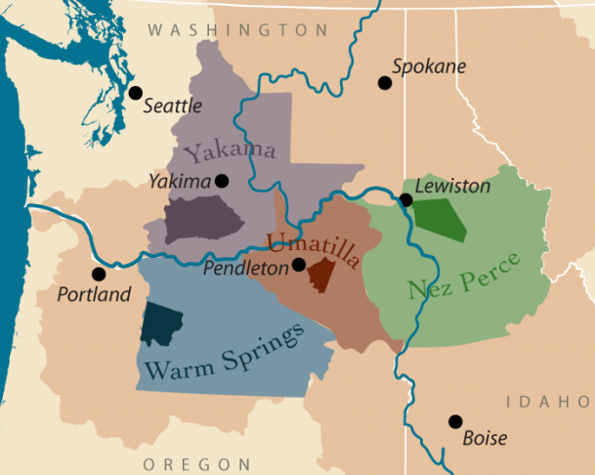
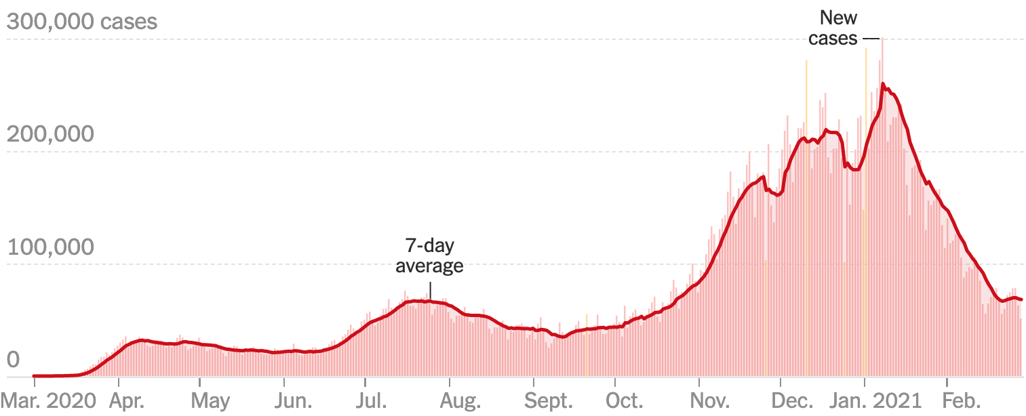

Before we Start
Confederated Tribes of Cayuse and Umatilla
ctuir.org
fpg.unc.edu/
https://github.com/nytimes/covid-19-data
vote.org/

Slide 3
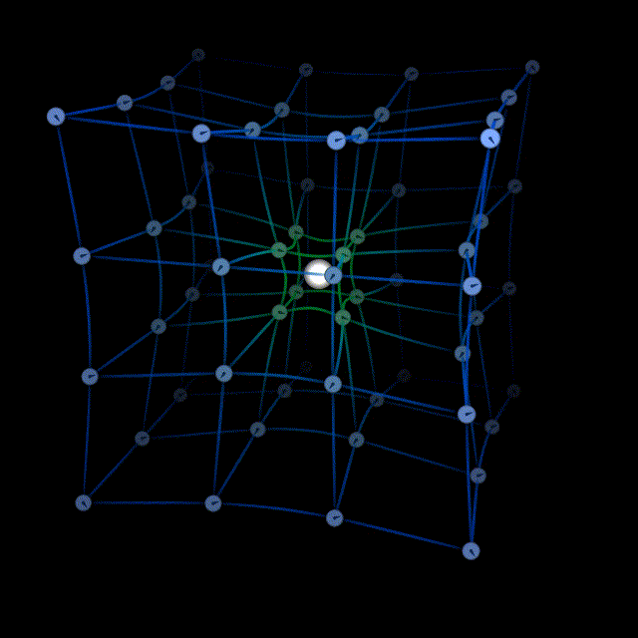
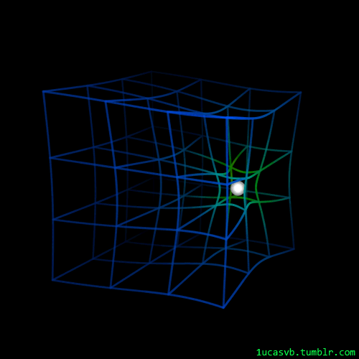
Geometry
Matter tells space-time how to curve…
Space-time tells matter how to move.

Slide 4
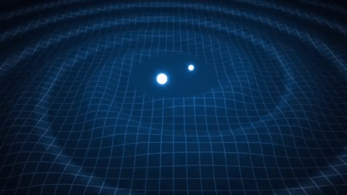
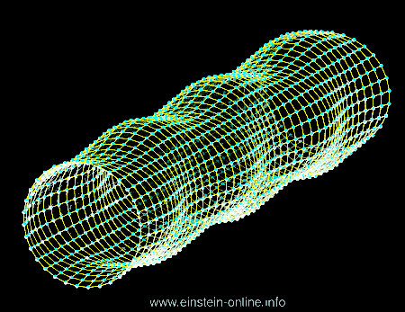
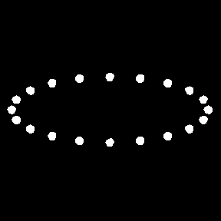
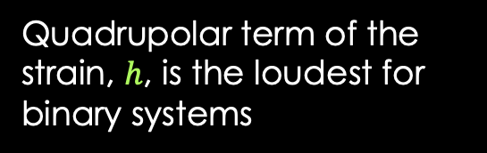


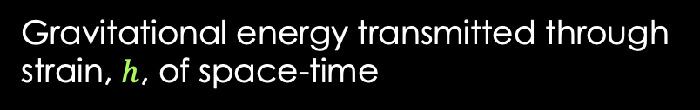
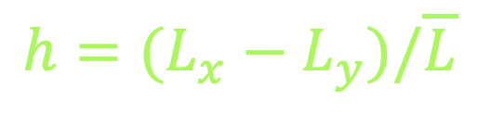

The Gravitational wave (GW)
Gravitational energy transmitted through
strain, $h$, of space-time
Quadrupolar term of the
strain, $h$, is the loudest for binary systems
Space-time is very stiff
Strain from astrophysical sources on earth is
$h≈$10⁻²¹
$$L_{x}$$
$$L_{y}$$
$${h=(L}_{x}−L_{y})/\overline{L}$$

Slide 5
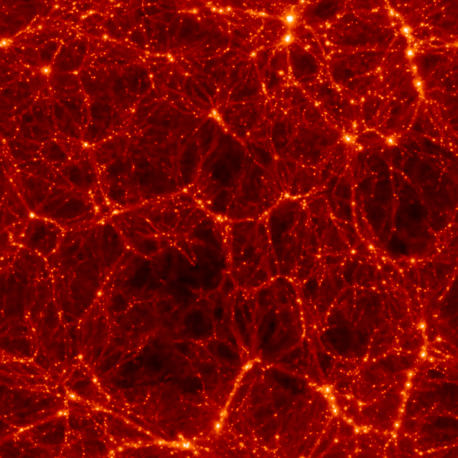
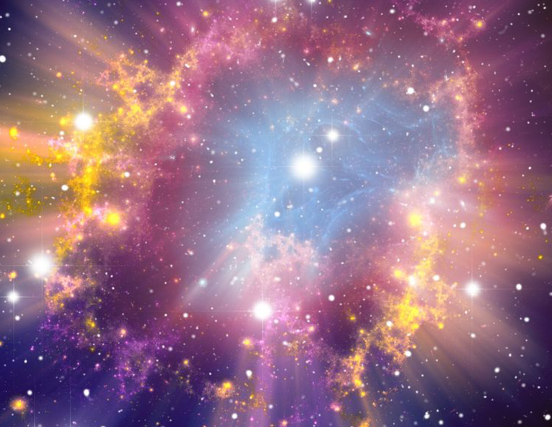
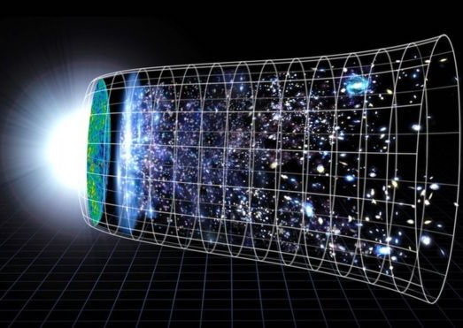
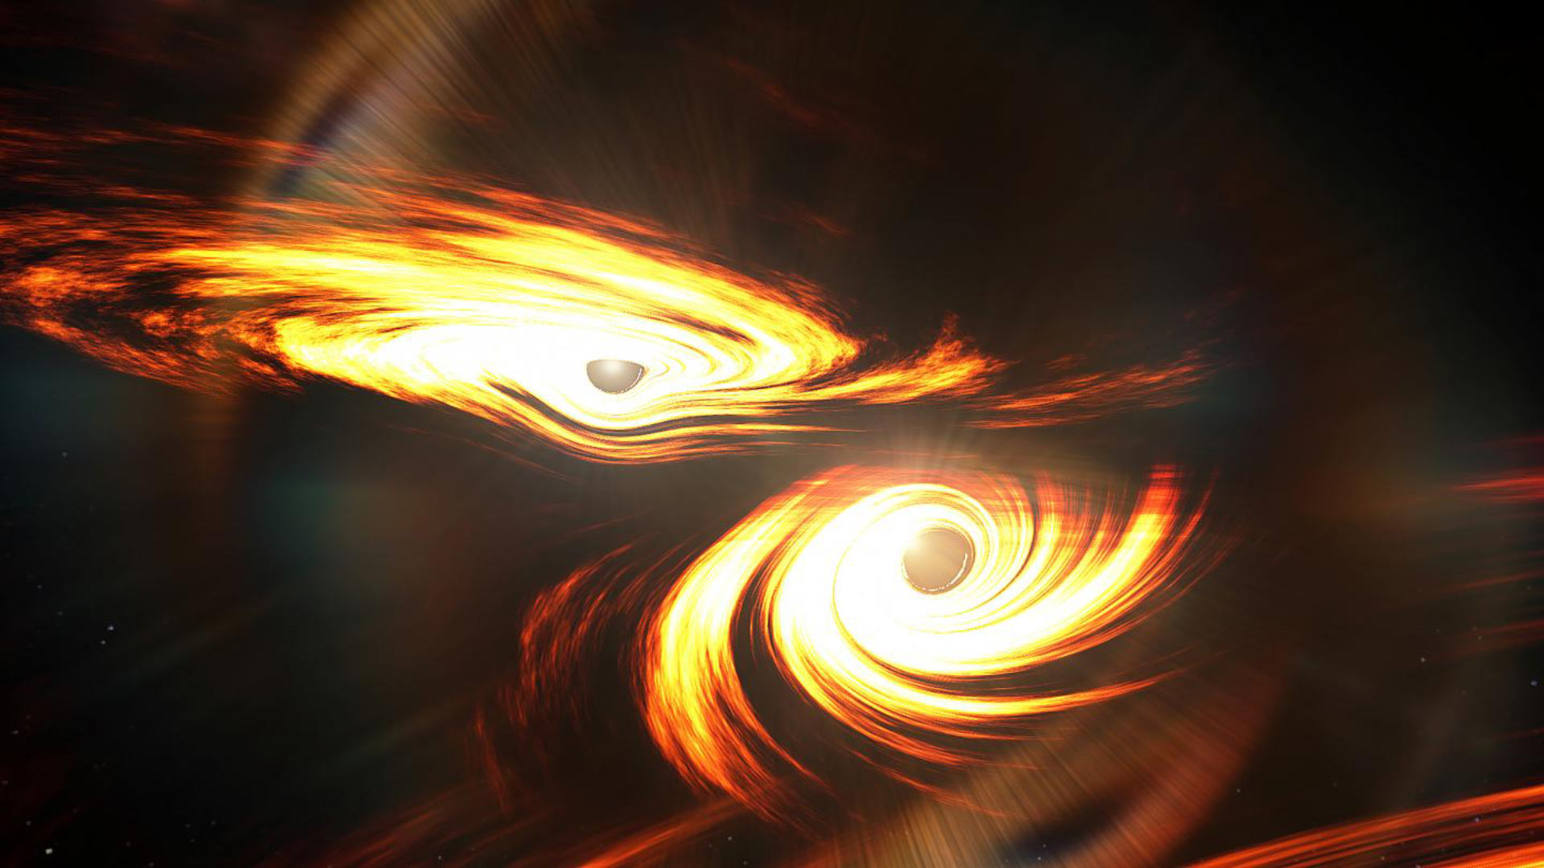
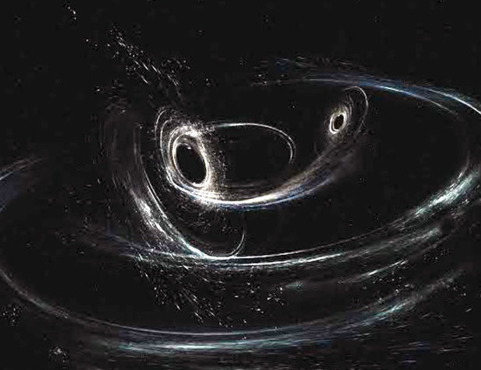
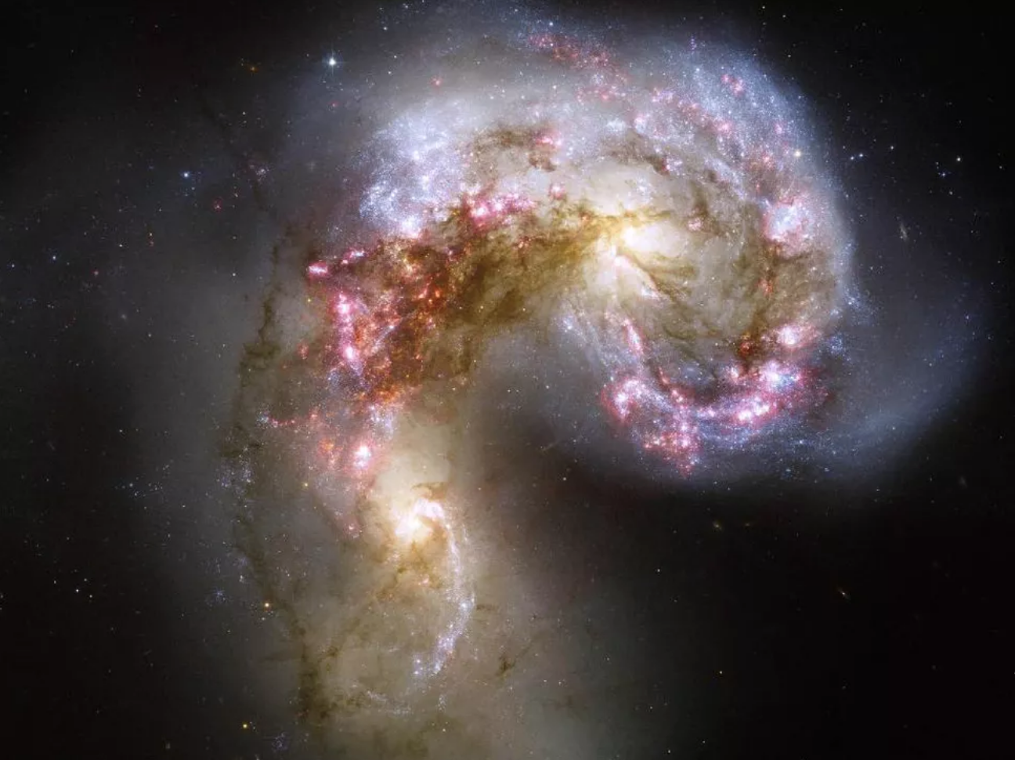
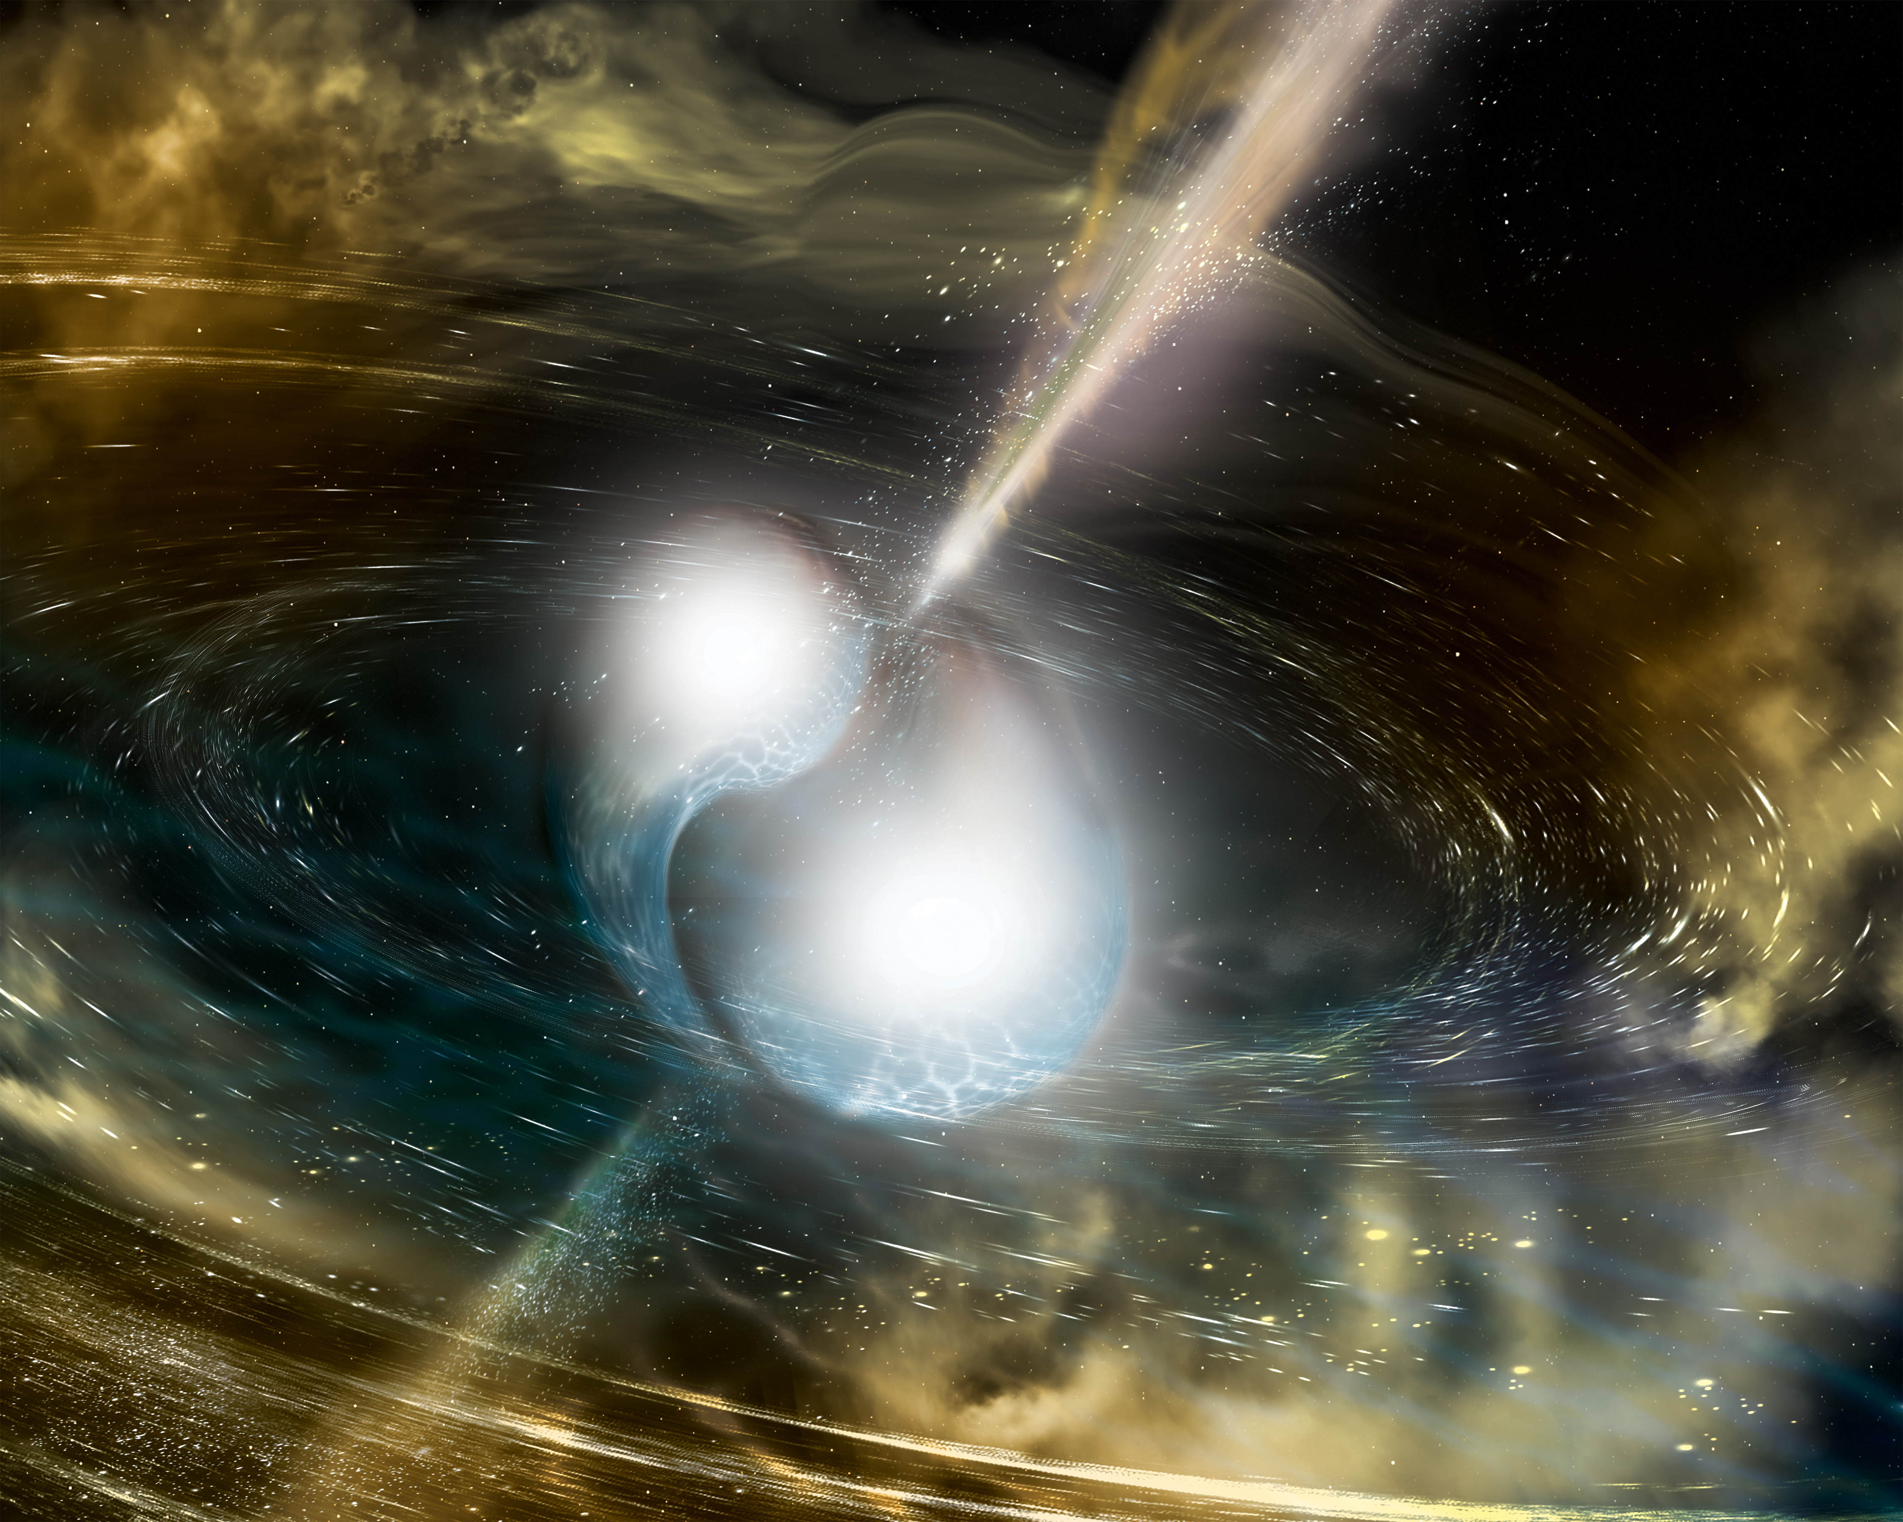
Mass defines a GW spectrum
Mass
Period:
Billions
of Years
Decades
Years
Days
Minutes
Seconds
Fractions of seconds
Wavelength
scale:
Universe
Galaxies
Star Systems
Planets
Countries
Kilometers
Frequency:
10⁻¹⁸ Hz
10⁻⁹ Hz
10⁻³ Hz
1 Hz
10 Hz
100 Hz
1000 Hz
Universe’s Dark Matter
Large Scale Structure
Stellar Mass
Supernovae
The Big Bang and
the Entire Universe
Intermediate
mass
Supermassive
Neutron Star
Collisions
Black Hole Collisions

Slide 6
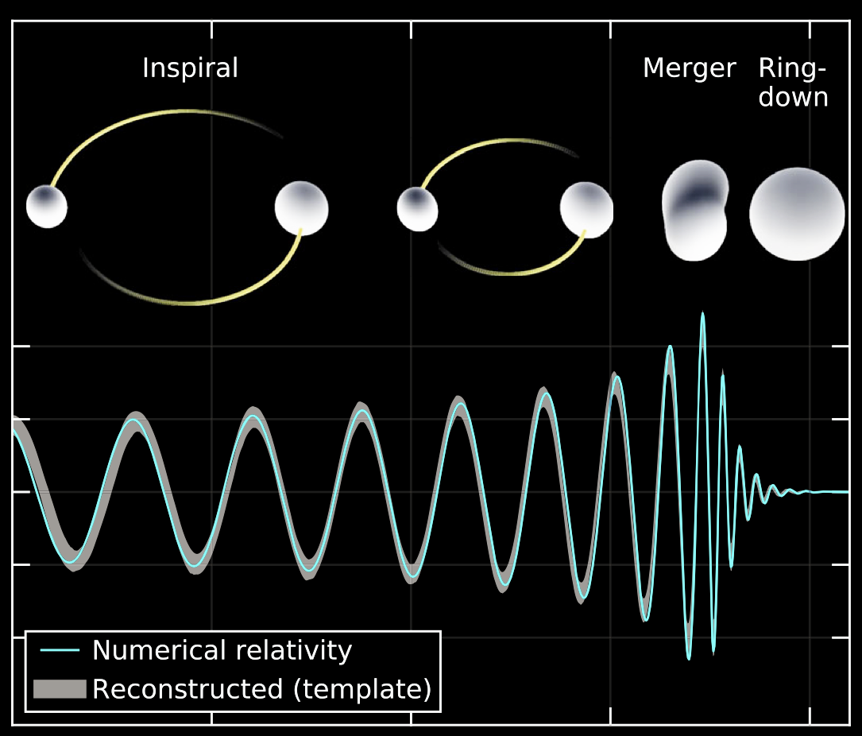
the flagship G-Wave
Amplitude
Time

Slide 7

BLACK HOLES Collide
1-D
Cross Section
Time
1-D Amplitude
Time
Predicted Gravitational Waveform
Tim Dietrich
/ AEI
/ BAM Collaboration
https://youtu.be/YnCccVDpmrw

Slide 8
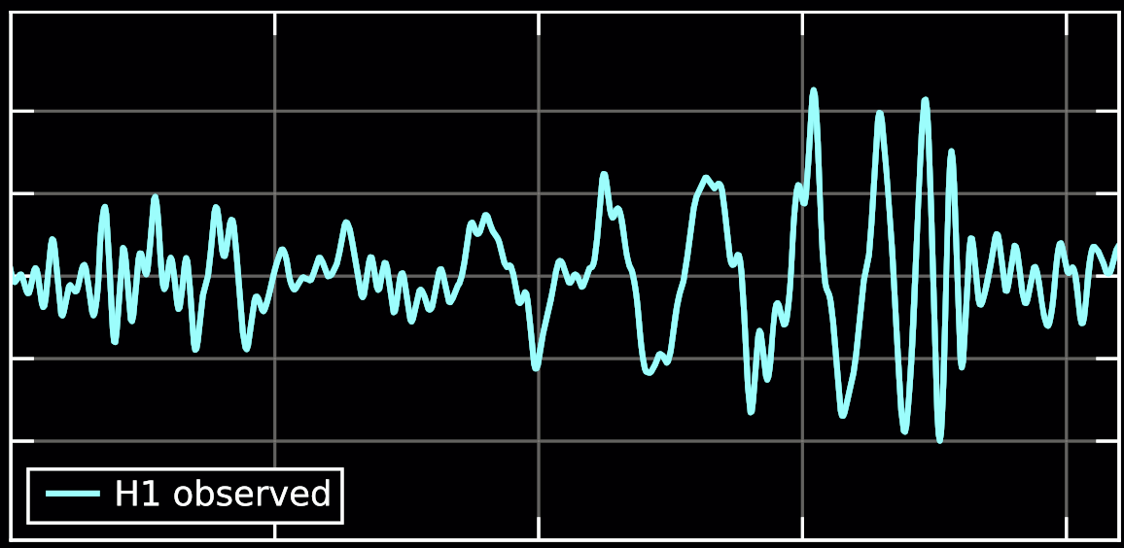
The MODERN Interferometers
Michelson
Fabry Perot Arm Cavities
Power Recycling Cavity
Signal Extraction Cavity
Interference of fields from two perpendicular arm cavities, with optics that are “free of forces.”
GW space-time distortion causes change in light travel time along the arms which changes interference pattern.
Interference pattern measured with photodiodes at the “dark” port of the beam splitter, converted to electrical signal with amplitude and phase.

Slide 9
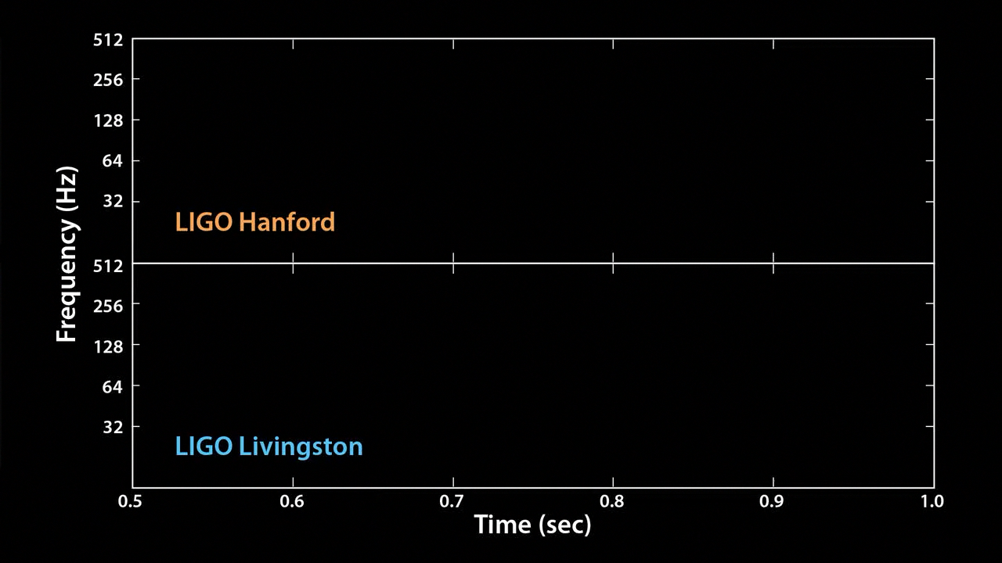
detection
In this sense, we’re now LISTENING to the SOUNDS of the universe!

Slide 10
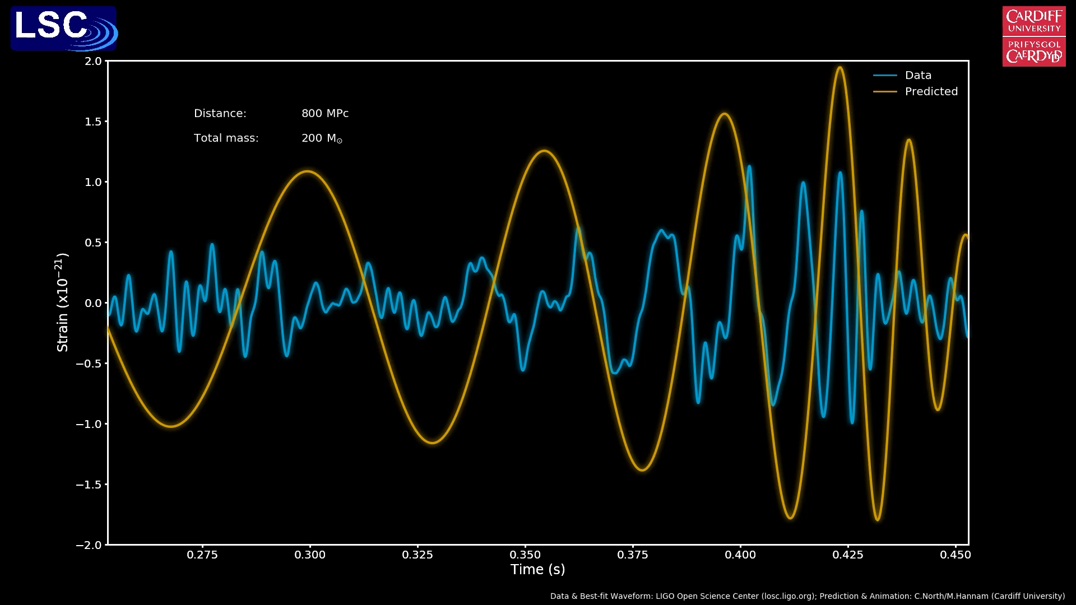
GW Encodes Source Parameters
Total Mass of the binary system
Distance to the binary system
But measurement near the limit of “Noisy” Detectors

Slide 11
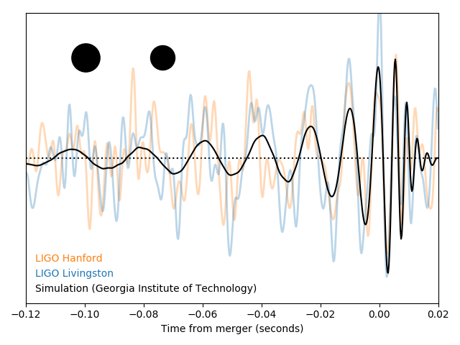
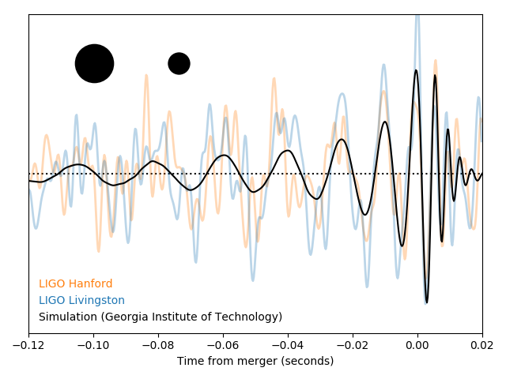
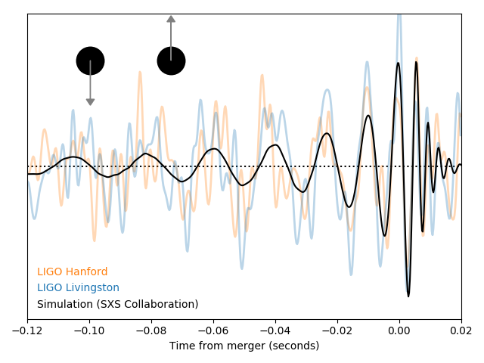
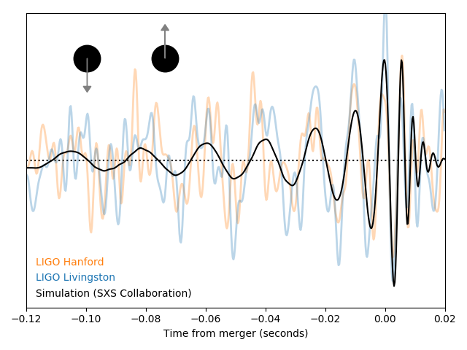
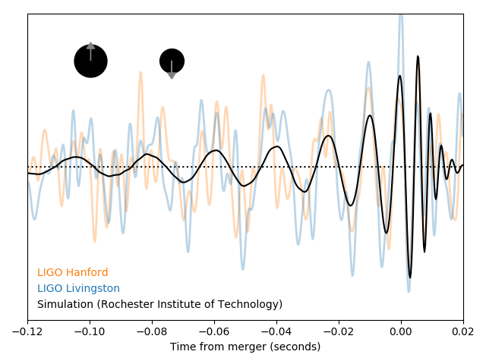
GW Encodes Source Parameters
Mass Ratio of the binary system
Spin of components of the binary system

Slide 12
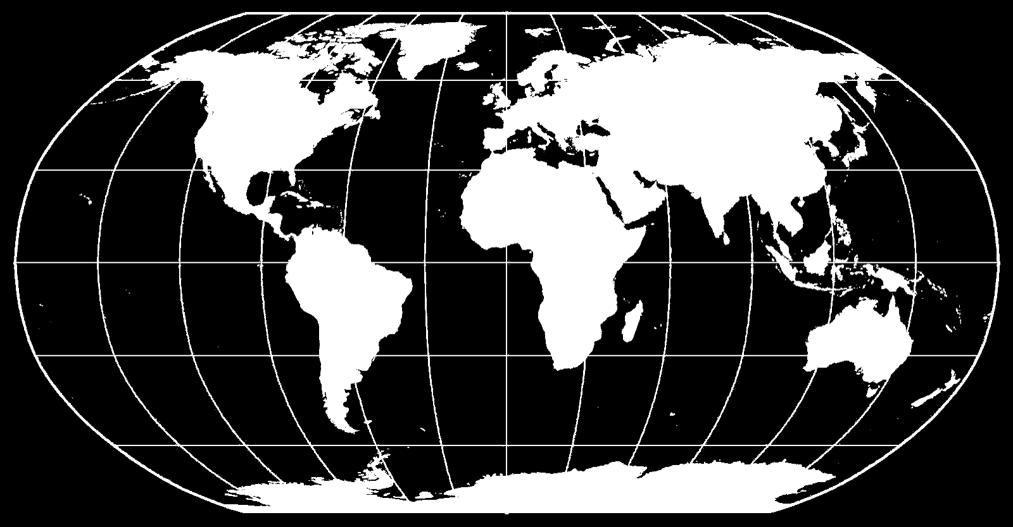
The GW Detector Network
With a network of detectors and depending on their sensitivity,
one can begin to determine
sky location, orbital inclination, polarization, tidal deformation…
GEO-HF
LIGO
Hanford
LIGO
Livingston
VIRGO
KAGRA
LIGO
India
Operational
Under Construction

Slide 13
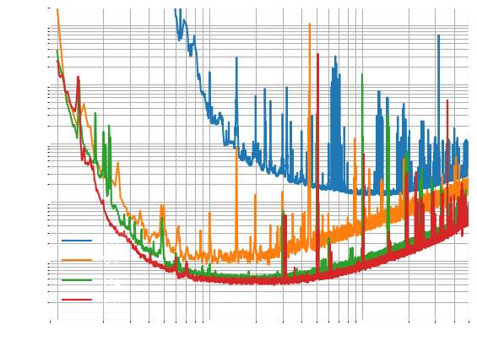
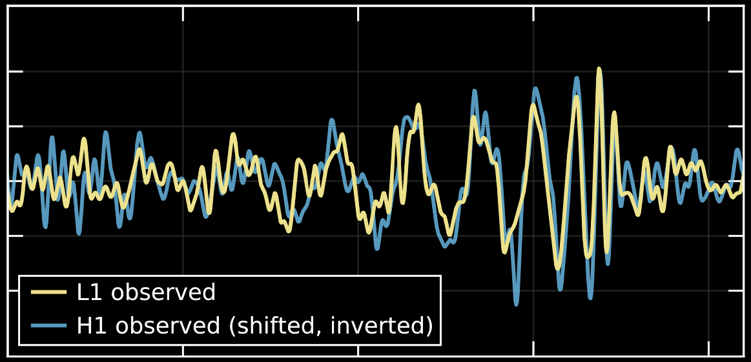

GW Network Sensitivity
$${h=(L}_{x}−L_{y})/\overline{L}$$
Dimensionless Strain [ (m/m) / Hz^{1/2} ]
inspiral
merger
ringdown
Frequency (Hz)

Slide 14
GW Network Timeline
The number of detections is proportional to
the time spent observing and
the volume (defined by spherical radius) observed
1 Mpc = 3.3e6 ly
Today
time (years)

Slide 15
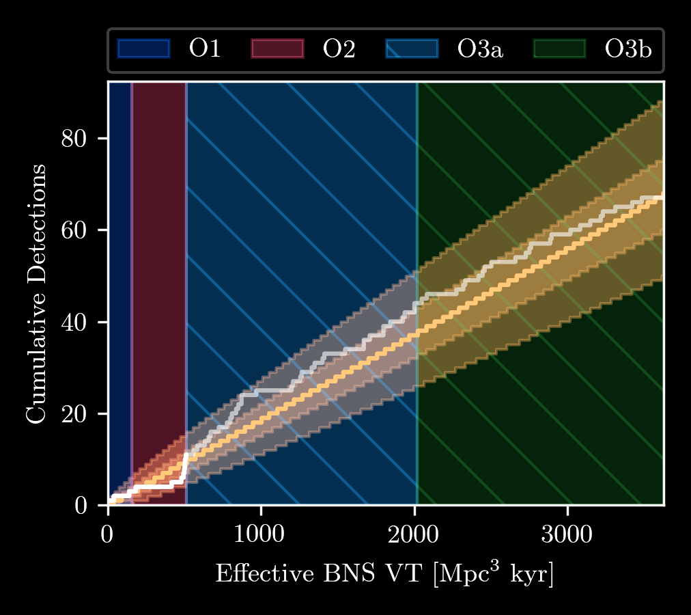
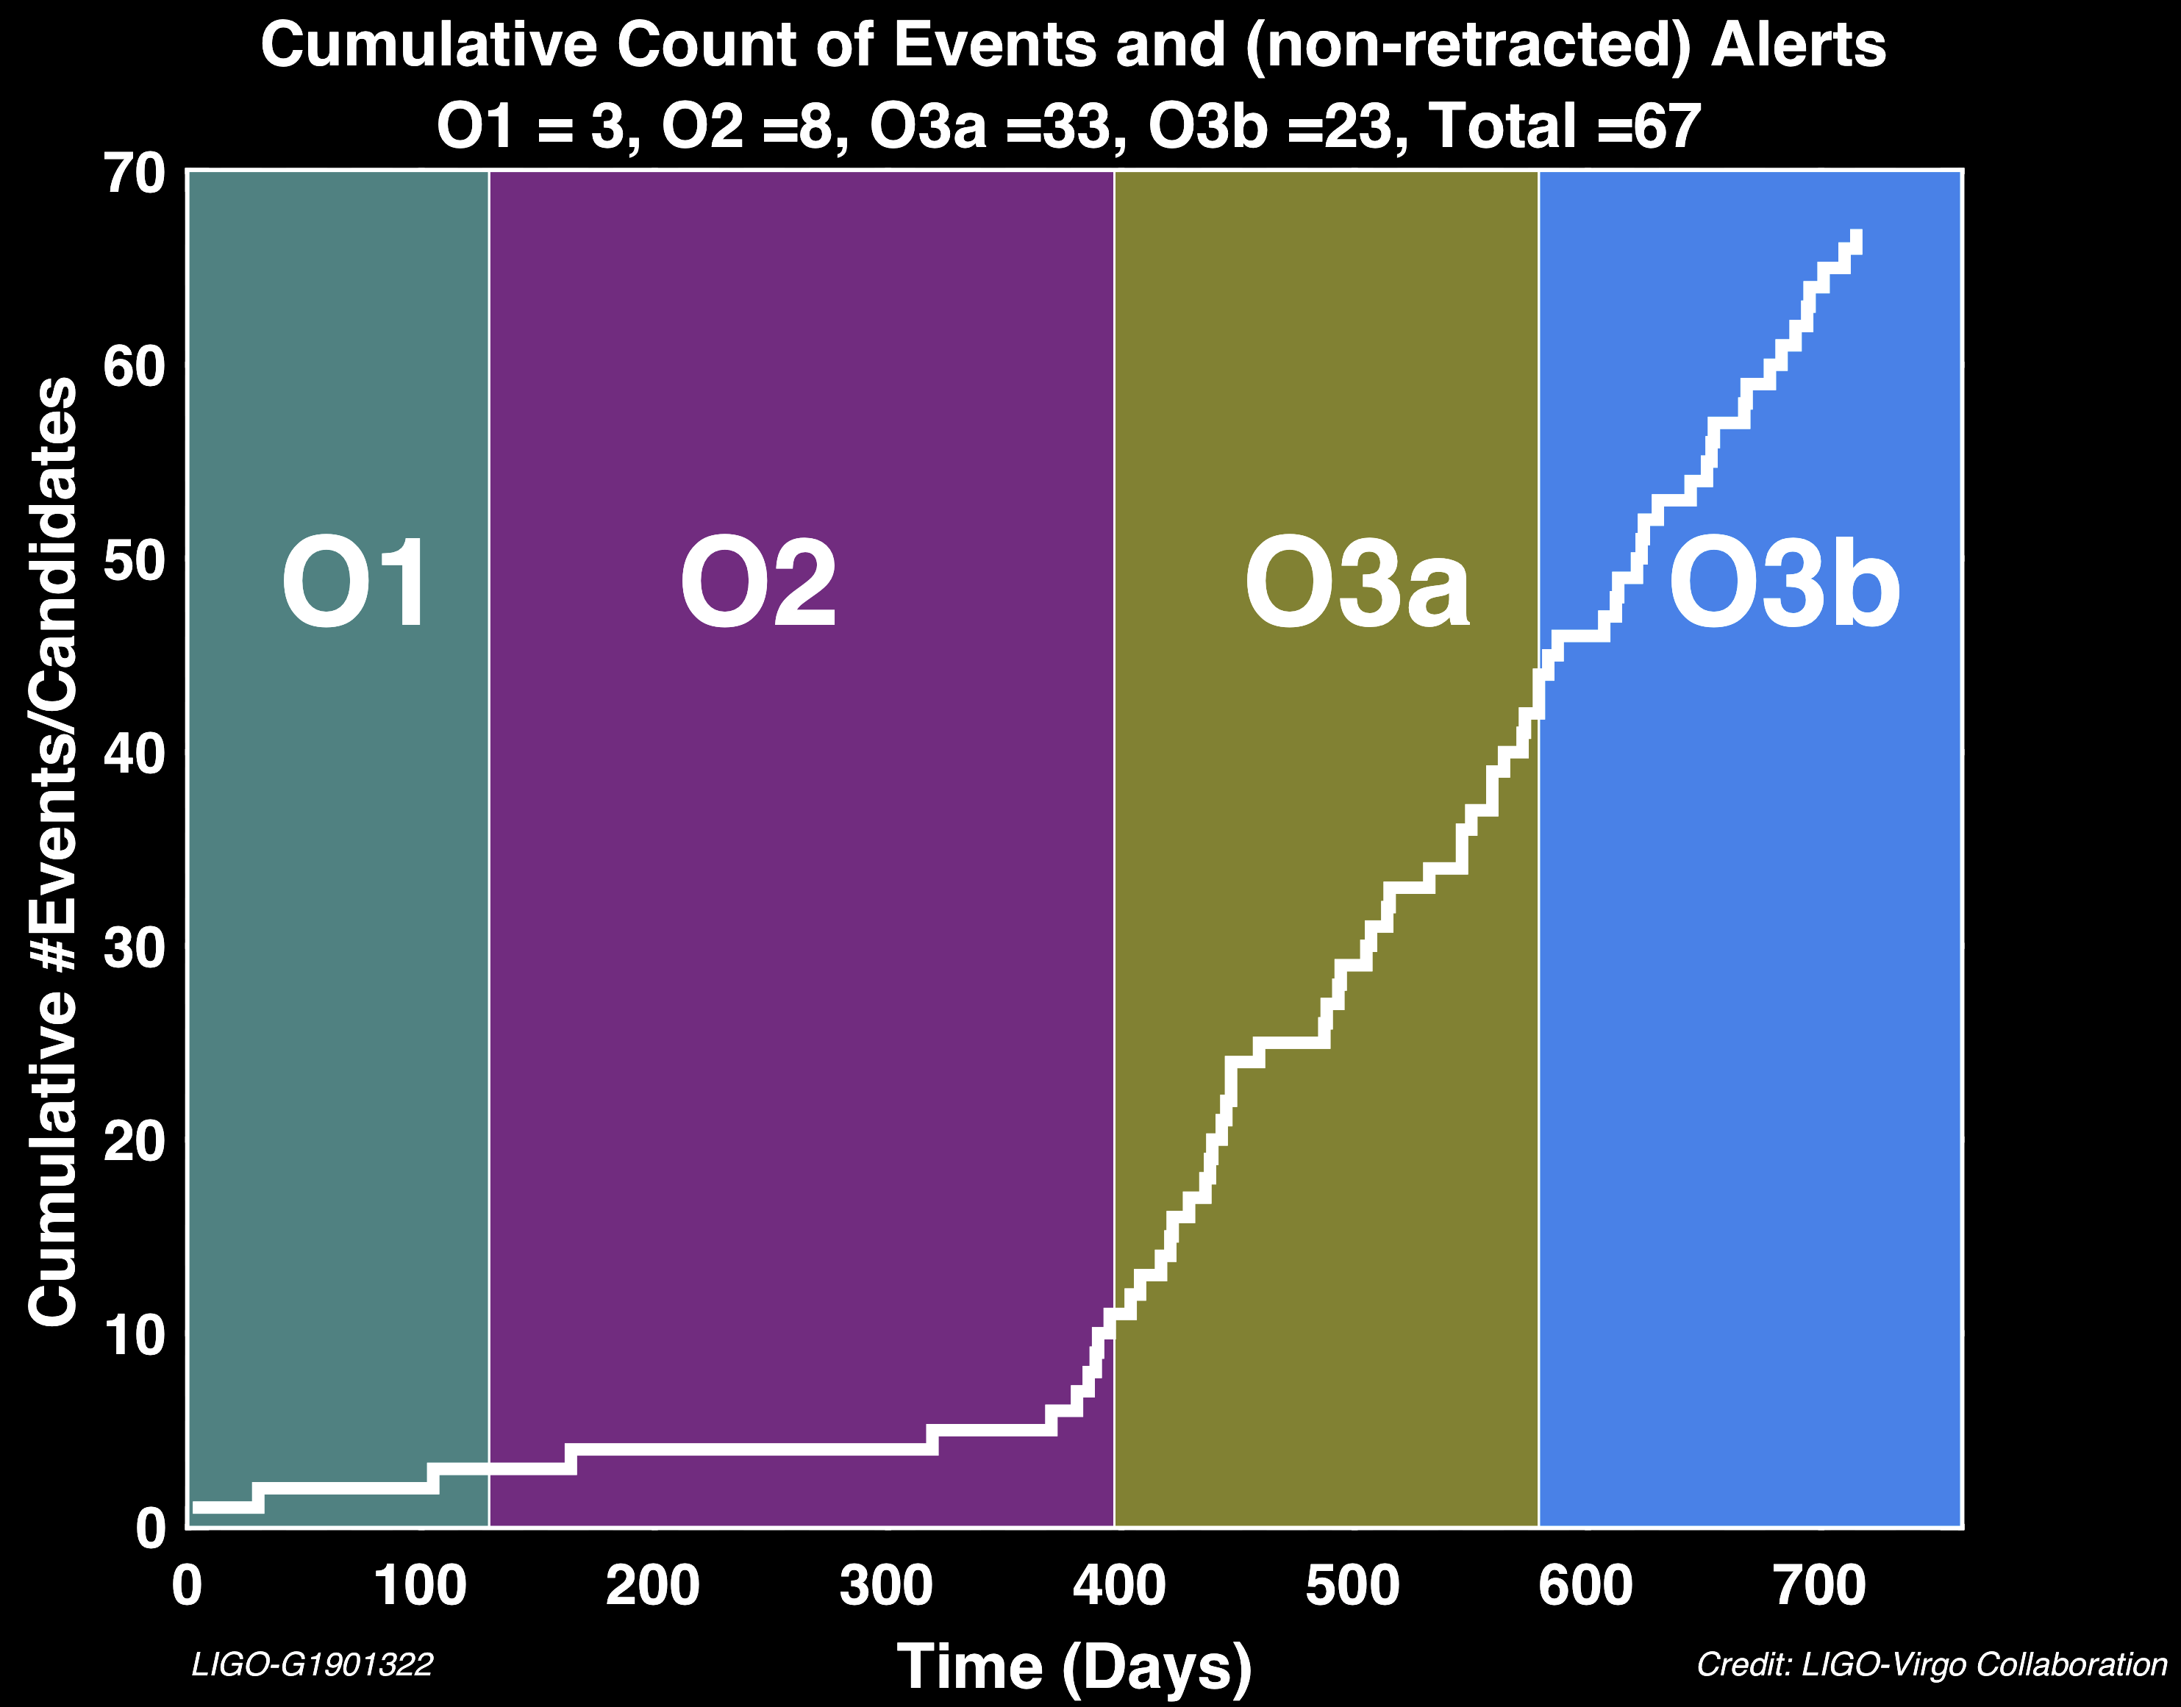
GW Network detections
Now hard to discuss all individual event detections in one talk.
Even too many “exceptional” events for one talk.
We begin to talk about populations of event properties.
We are astronomers.
Target Release: Summer ‘21
Published:
Oct ‘20
Published:
Nov ‘18
Final O3
detection
count not yet
confirmed
PRX 9.3 (2019): 031040
arXiv:2010.14527 (2020)

Slide 16
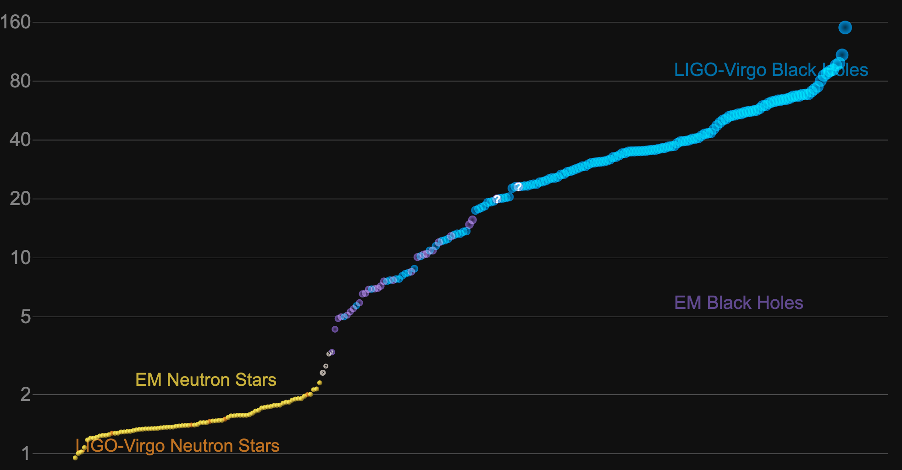
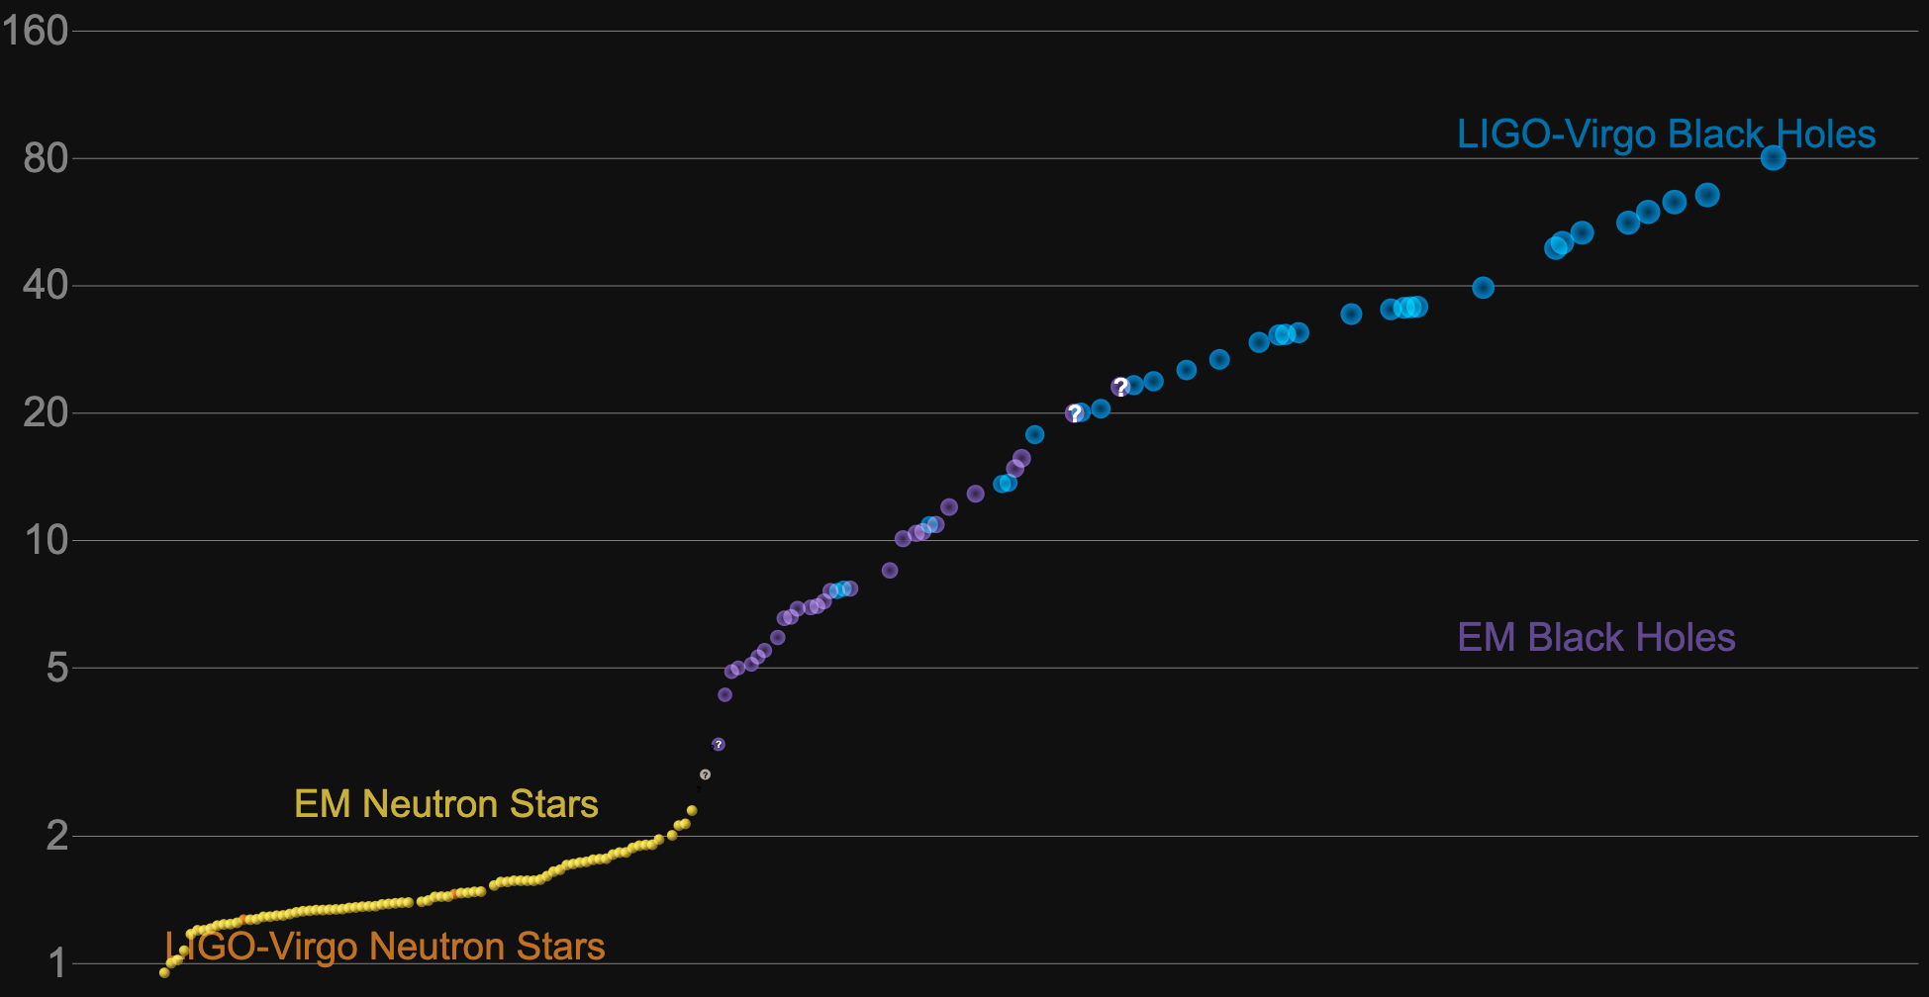
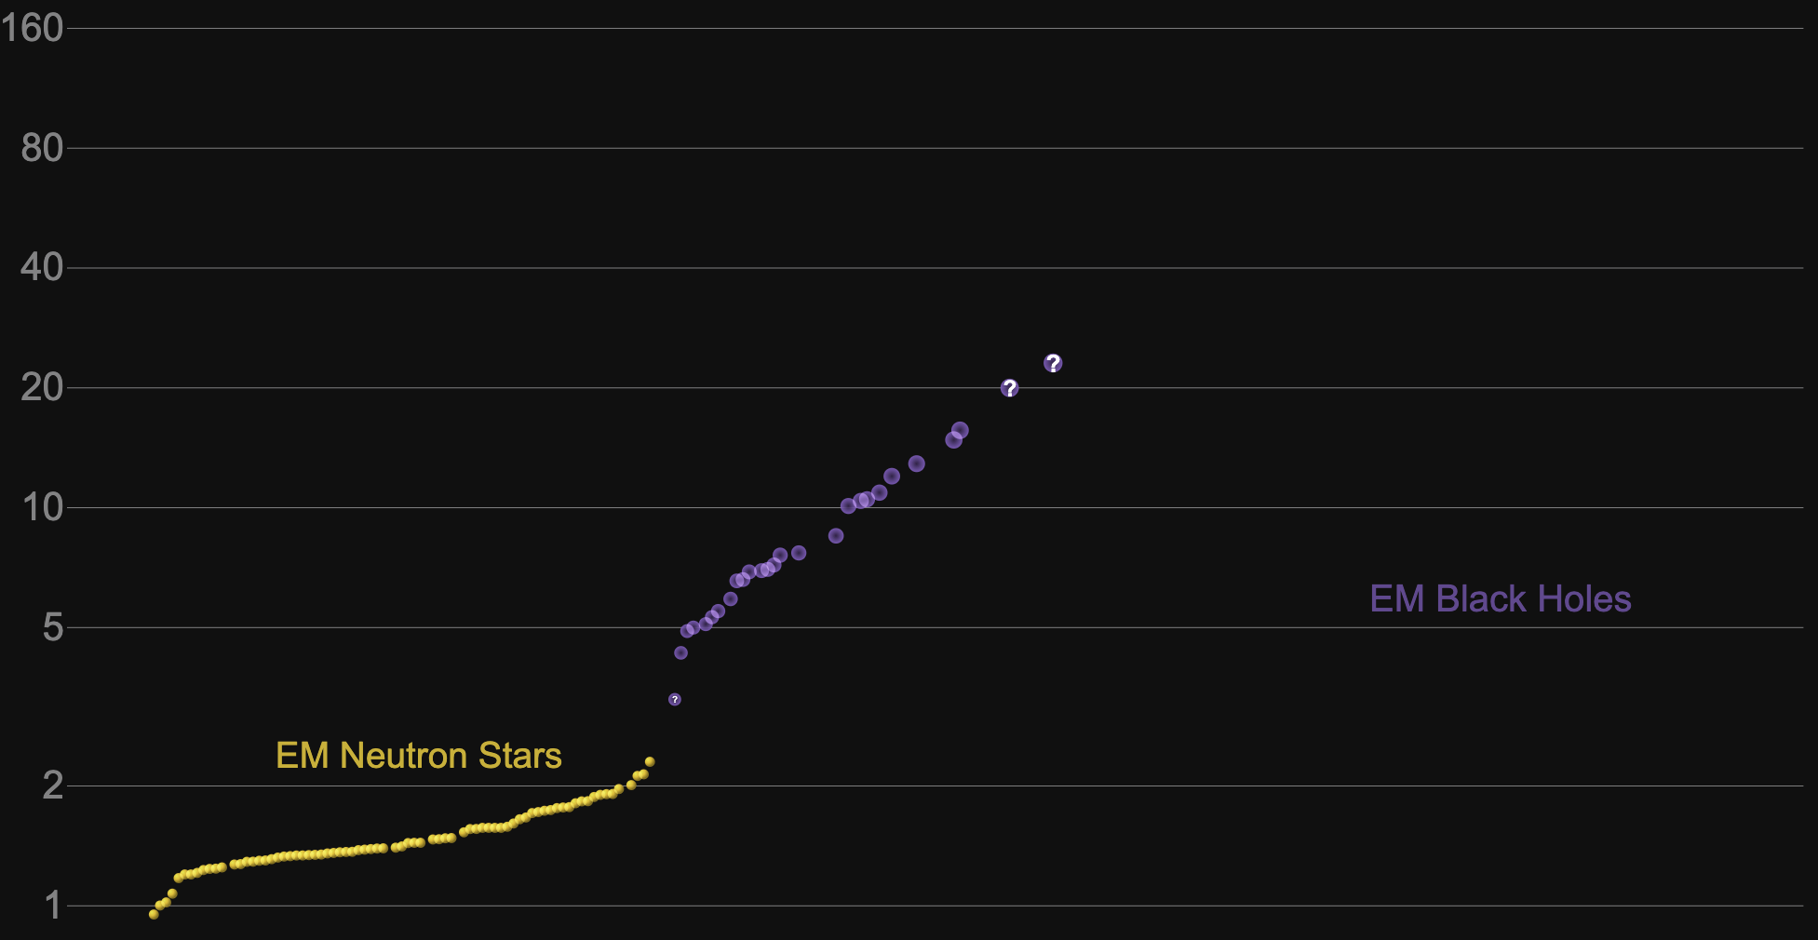
Filling in the “EM” GAPs
Intermediate Mass
Black Holes
Pair Instability MASS GAP?
Object Mass [Solar Masses]
Stellar Mass
Black Holes
Equation of State MASS GAP?
Equation of State
Neutron Stars
GWTC-1 = O1 & O2
GWTC-2 = O3a
PRX 9.3 (2019): 031040
arXiv:2010.14527 (2020)

Slide 17
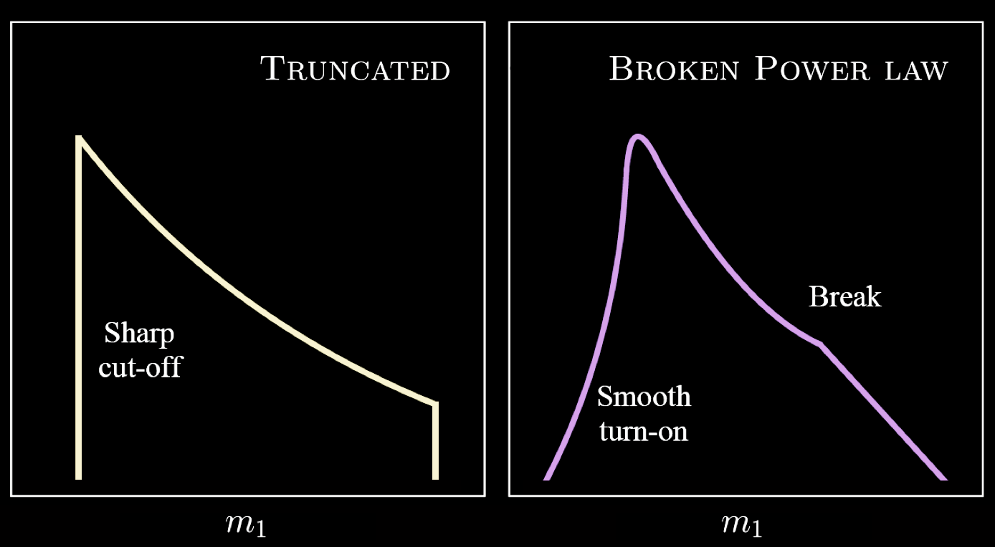
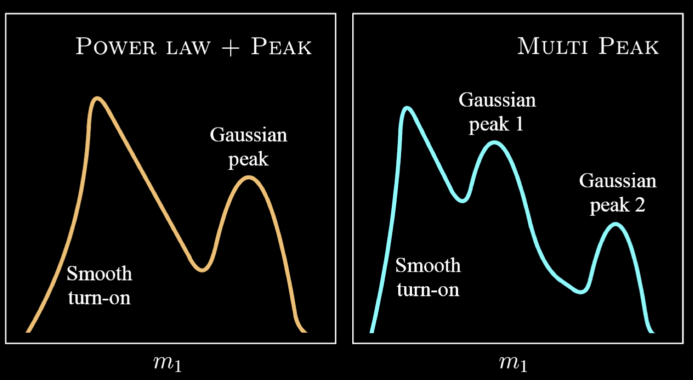
BLAcK HOLE Mass Functions
Remember:
Models based on observations may have bias proportional to
the time spent observing,
the volume observed, and
the mass involved in the merger.
Rate or Probability
of Occurrence
Black Hole Mass
arXiv:2010.14533 (2020)

Slide 18
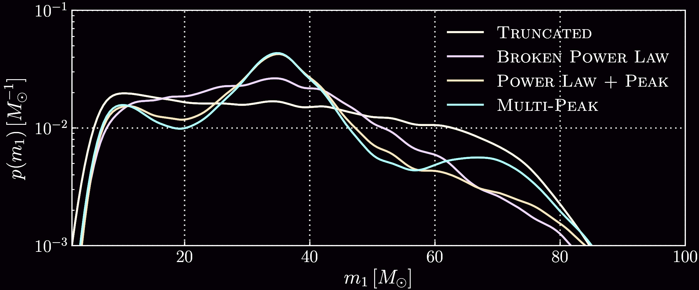
Observed Mass FunctiON
Using all GW detections through O3a,
we can concoct a probability distribution of observed
mass function assuming different model types…
Probability
of Occurrence
observation bias
at high mass
observation bias
at low mass
Black Hole Mass [Solar Masses]
New data from O3a (high mass detections) demands function models that favor a more sophisticated mass function model that “just” truncated power law used for O1&O2!
arXiv:2010.14533 (2020)

Slide 19
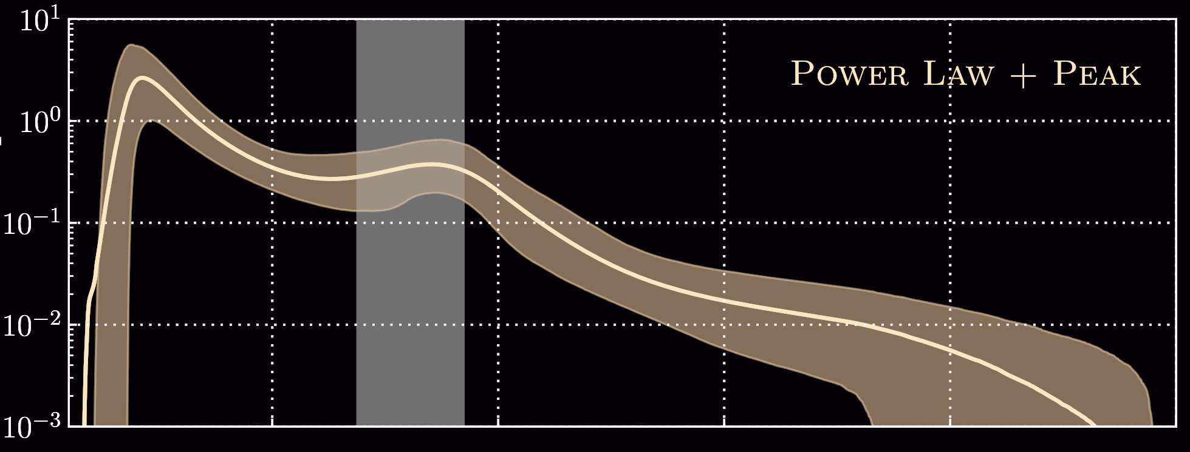
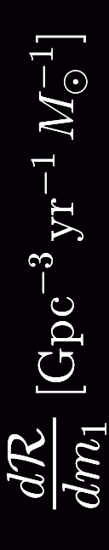
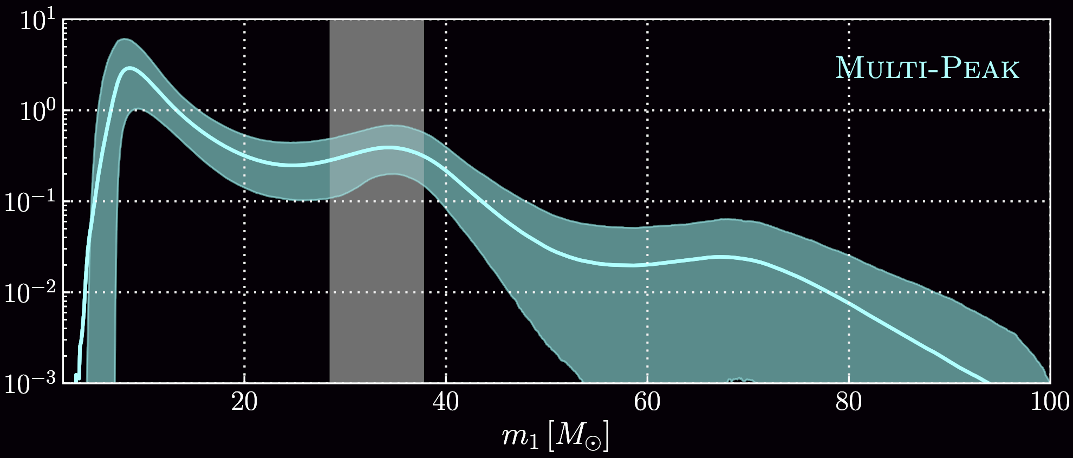
Predicted Mass Functions
Astrophysical Occurrence Rate
[Volume, per year, per mass bin]
Can/should no longer “just” tell you the rate “of all binary black hole collisions!”
arXiv:2010.14533 (2020)

Slide 20
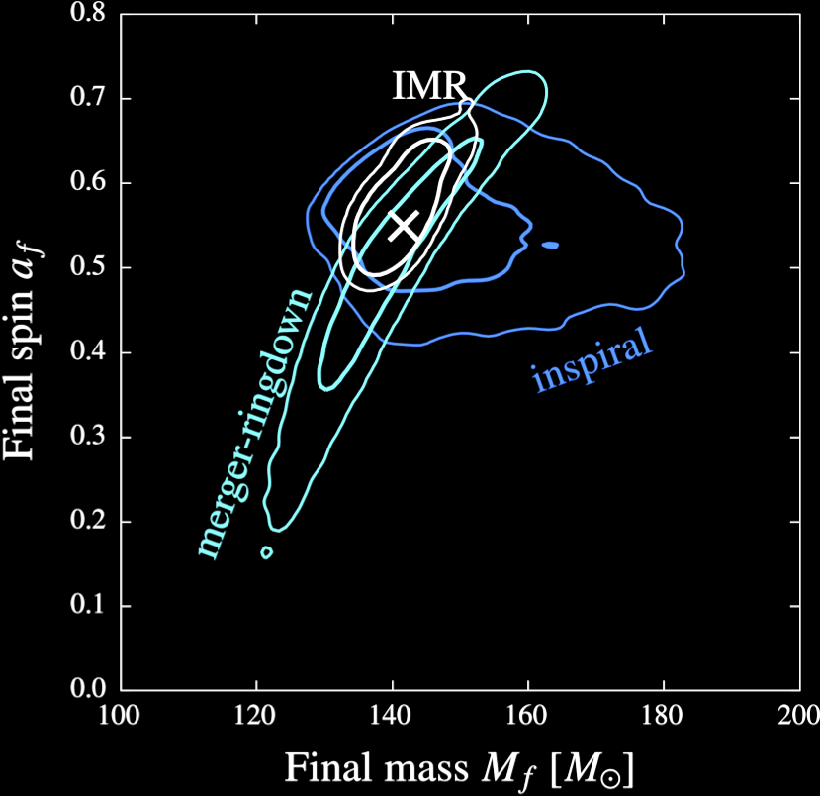
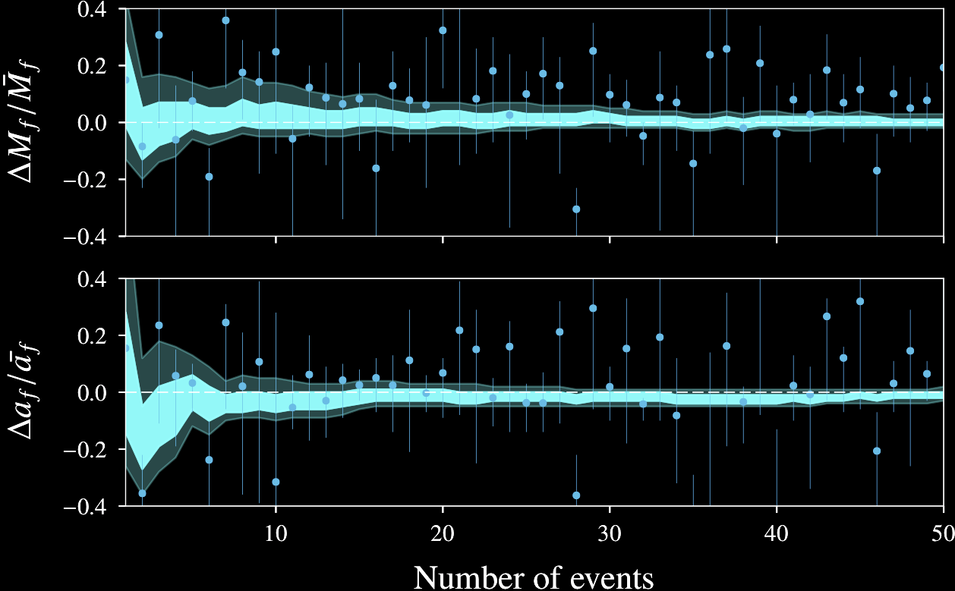
General Relativity
Compare mass and spin of final black hole predicted by
inspiral wave prior to merger (Newtonian Expansion)
ring-down after merger (Perturbation Theory)
numerical relativity (IMR)
95% ci
68% ci
CQG 35.1 (2017): 014002

Slide 21
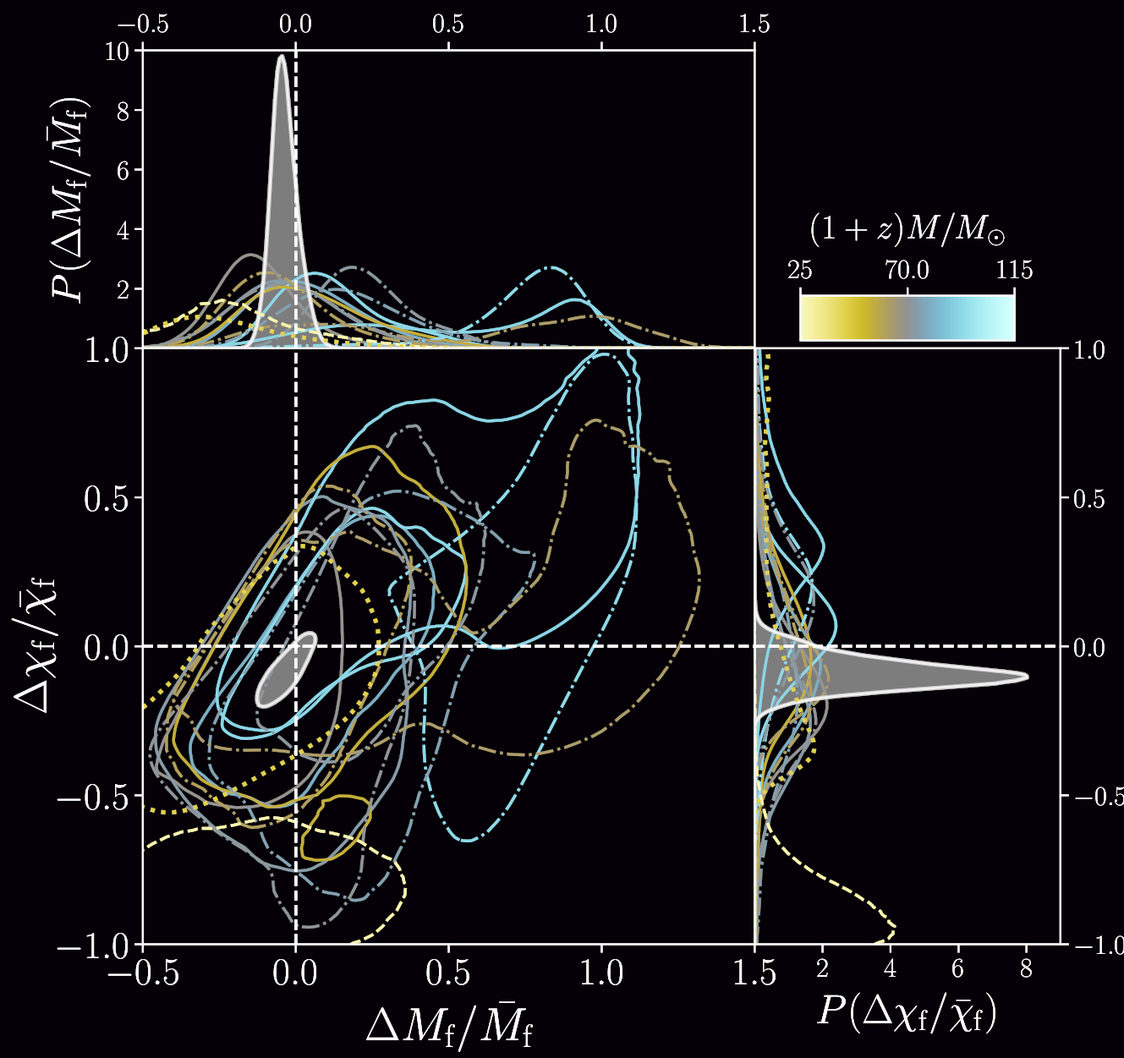
General Relativity
General Relativity continues to explain GW detections well!
90% ci’s for final mass and spin of
High mass systems
Low mass systems
Product
Solid = GWTC-2 events
Dash-dot = GWTC-1 events
arxiv:2010.14529 (2020)

Slide 22
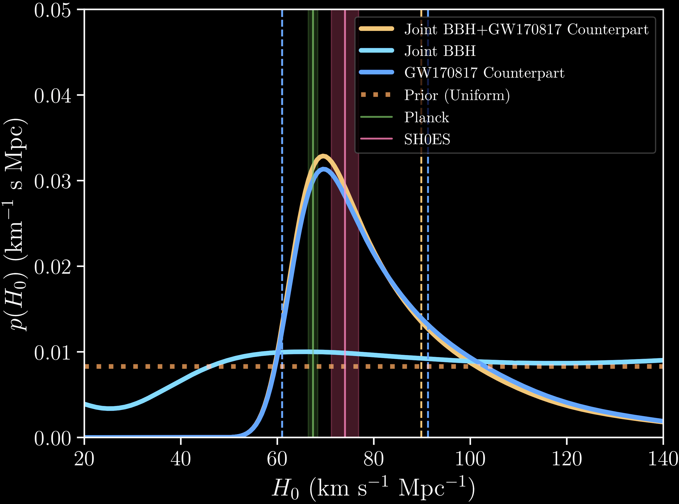
COSMOLOGY
Cosmic Microwaves
Supernovae
Probability Density
Five GW-detected Binary Black Hole Collisions
from O1/O2
One GW-detected Binary Neutron Star Collison (GW170817)
Completely Independent estimate from GWs!
arxiv:1908.06060

Slide 23
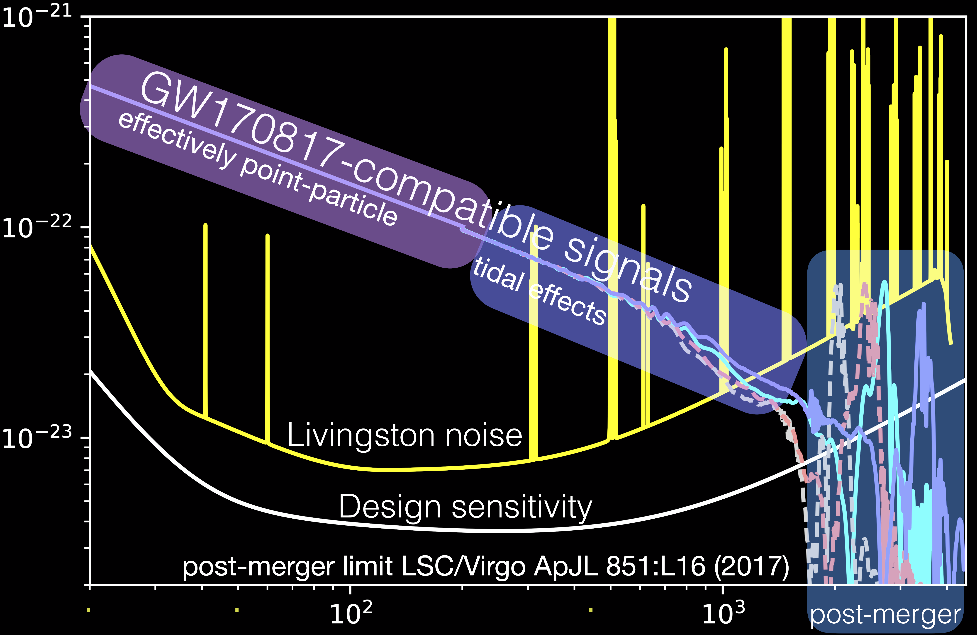
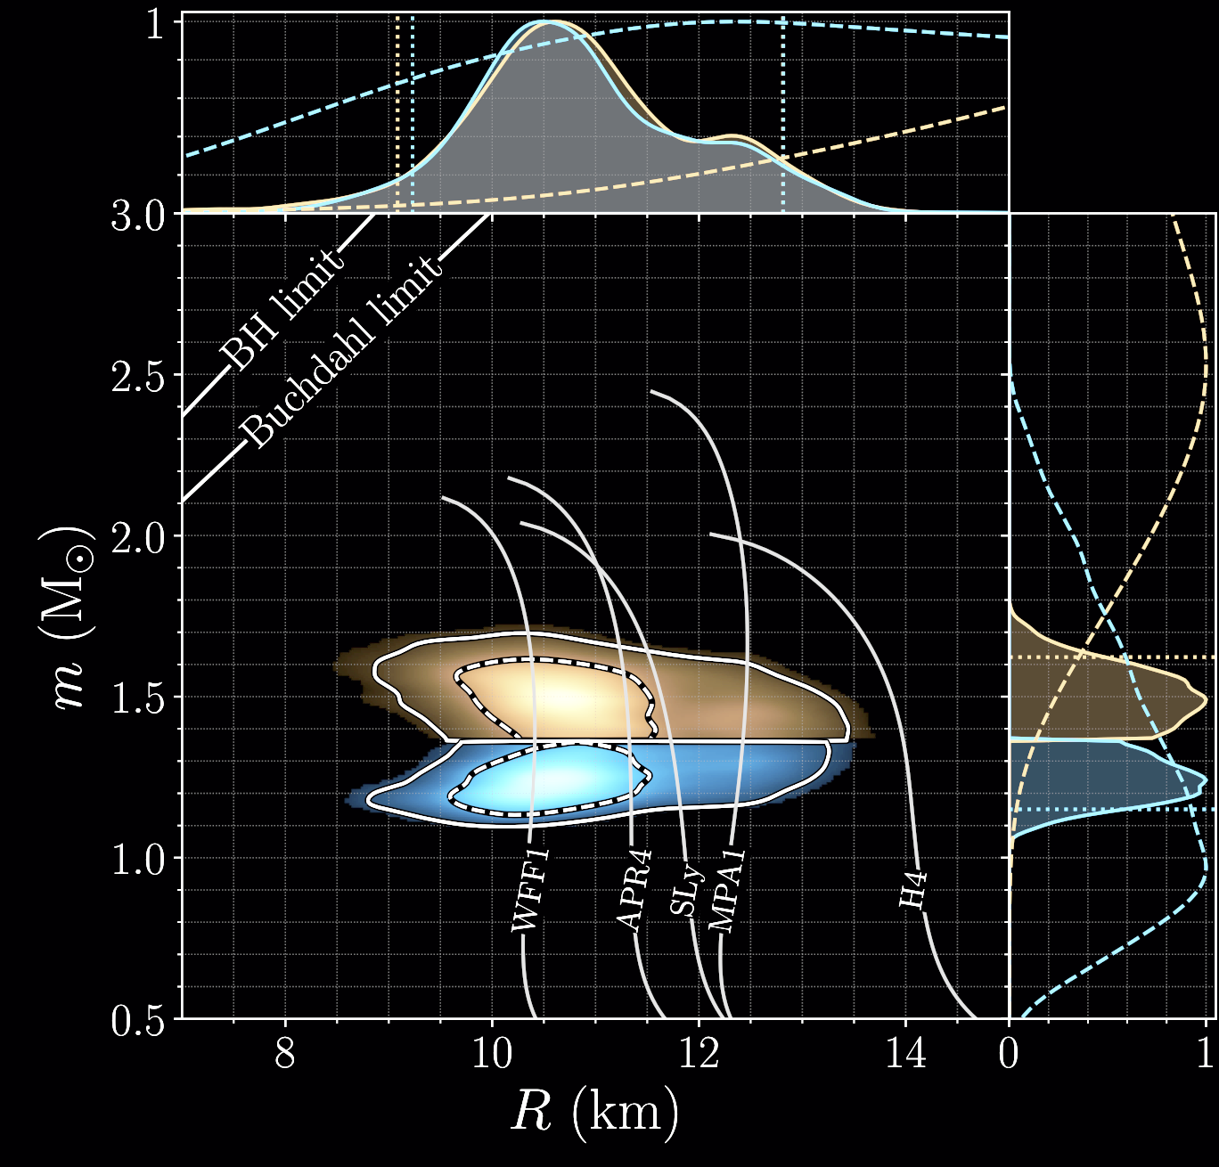
NS Equation of State
GW170817 – a nearby binary neutron star collision with MANY electromagnetic counterparts -- was amazing for so many reasons. Here’s another one.
Various models GWs each using different neutron star equations of state
Dimensionless Strain [ (m/m) / Hz^{1/2} ]
With just one detection, we rule out exotic models for the extreme matter inside neutron stars.
Frequency (Hz)
PRL 121.16 (2018): 161101

Slide 24
the future is loud!
Gravitational waves have “broken the sound barrier:” we can now “listen” to the universe
Individual results are ground-breaking in so many different ways
Study of event populations are becoming competitive
Cracking all sorts of mysteries in all corners of astrophysics
Stay tuned: many more exciting results to come this year!
Thank you!

