Slide 1
Prospects for the future of gravitational-wave observation
Réunion Groupement de Recherche "Ondes Gravitationnelles"
April Fool’s day, 2021
David Shoemaker
MIT LIGO/LISA

Slide 2

Thanks to…
The LIGO Lab – MIT, Caltech, Hanford and Livingston Observatories
The LIGO Scientific Collaboration; Virgo and KAGRA
NASA, and the LISA Consortium
Pulsar Timing Array Collaborations
GWIC – Gravitational-Wave International Committee
The US National Science Foundation for extraordinary support and perseverance for LIGO

Slide 3
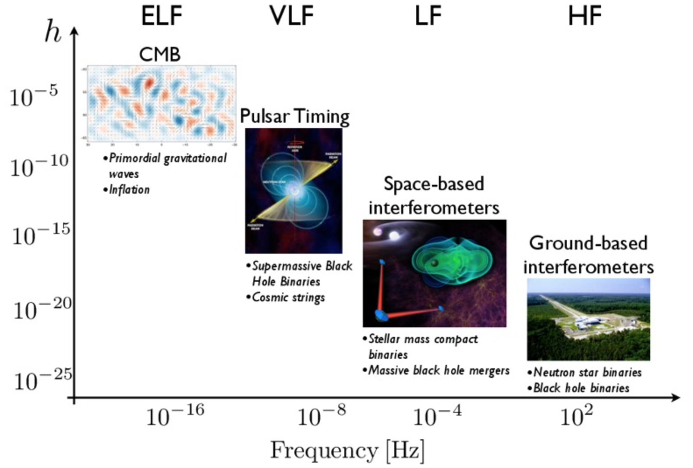
Detection methods, Projects
Nanograv

Slide 4
Detection methods, Projects

Slide 5
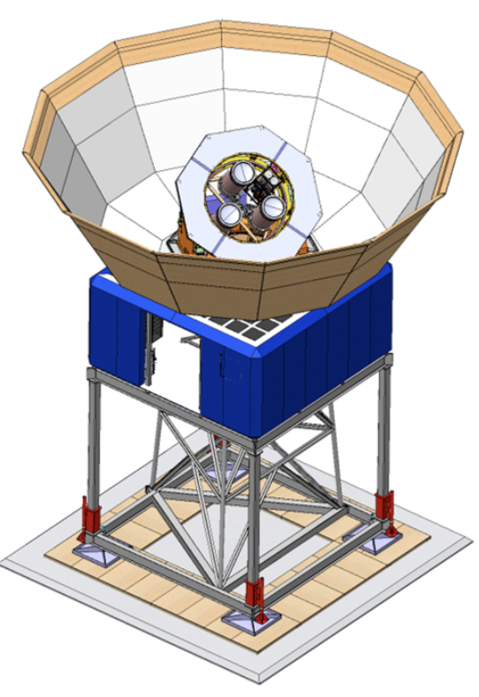
Primordial Stochastic Background search in the CMB
Primordial gravitational waves are a prediction of cosmological inflation
Leads to so-called B-mode polarization – a unique imprint on the CMB
For the foreseeable future, precise measurements of CMB B-modes are our most likely way to detect these primordial gravitational waves
In analogy to the Hulse-Taylor demonstration of GW emission, this search does not give the time series of h(t) but rather an indirect indication
CMB-S4 is the next-generation ground-based
cosmic microwave background experiment;
could make a factor 100 improvement in the
measurement of the amplitude of tensor perturbations
A total of 18 small aperture telescopes will measure
odd-parity B-mode polarization fluctuations at degree scales
Results from CMB-S4 anticipated in the late 2020’s
  No guarantee of positive detections
  Very interesting target!
https://arxiv.org/abs/2008.12619, https://cmb-s4.org

Slide 6
Broad spectrum of GW sources

Slide 7
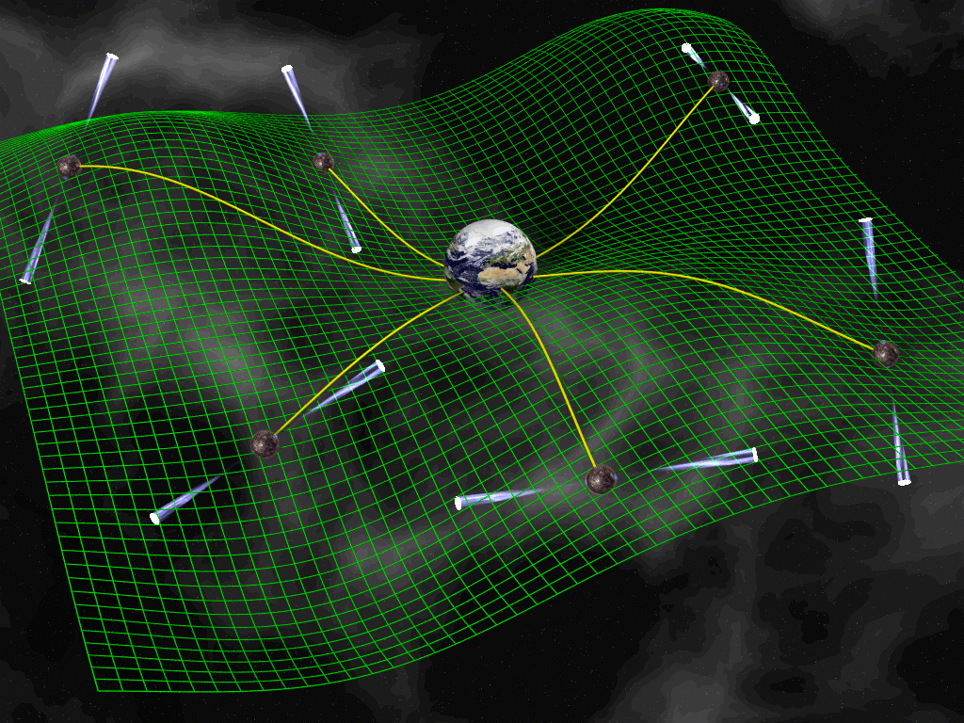
Pulsar Timing Arrays
Pulsars: spinning Neutron Stars; magnetic fields lead to beamed EM emission
  Pulsars are extremely stable clocks, and are ‘free test masses’
Significant number have their ‘beacons’ pointing at Earth, received by an international array of radio telescopes – and team of researchers
If a GW passes between us and
the pulsar, the time-of-arrival
of the clock pulse will be shifted
Looking at a collection of
pulsars scattered in space,
unique signal corresponding
to GWs can be inferred
Sensitive to very massive BH
  ~10⁷ - 10¹⁰ M⦿
Astrophysical stochastic
background best candidate
Some indication of a signal!
  arXiv:2005.06490
  Measurements continuing…
David J Champion

Slide 8
Broad spectrum of GW sources

Slide 9
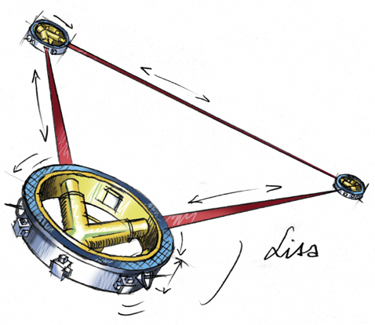
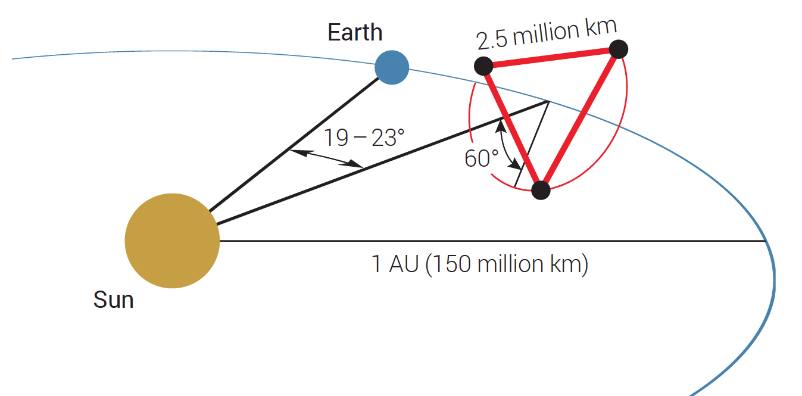
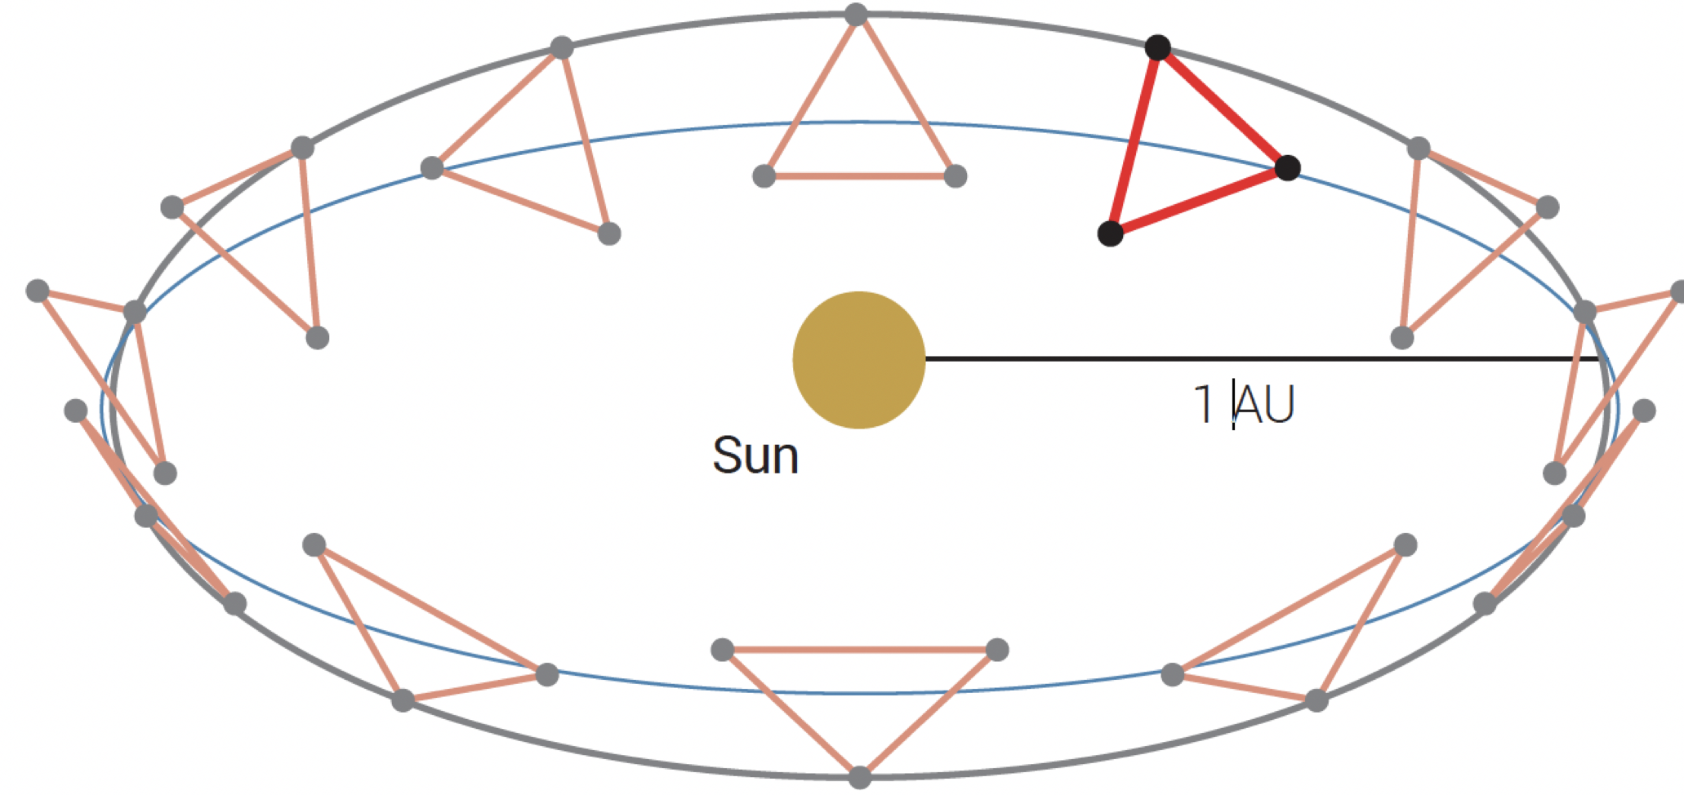
LISA, targeting super-massive Black Holes
Place free masses in space; use interferometry to sense path length changes due to passing GW
2.5x10⁶ km arms: best sensitivity 0.01 Hz,
target masses to 10⁶ solar masses
‘Servo’ the shield satellites to follow the test masses, protecting against solar wind etc.
Orbit scans sky; sources last years, viewed from 2AU baseline
LISA L3 Mission Concept Proposal

Slide 10
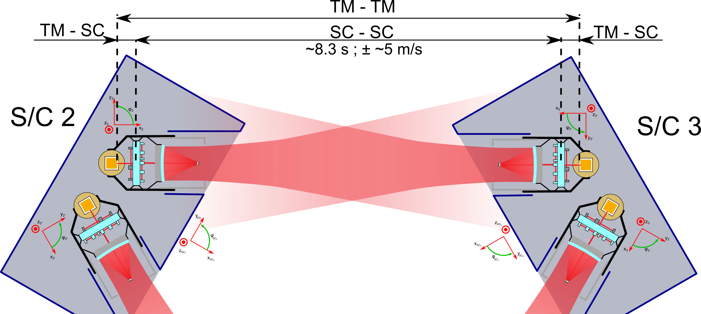
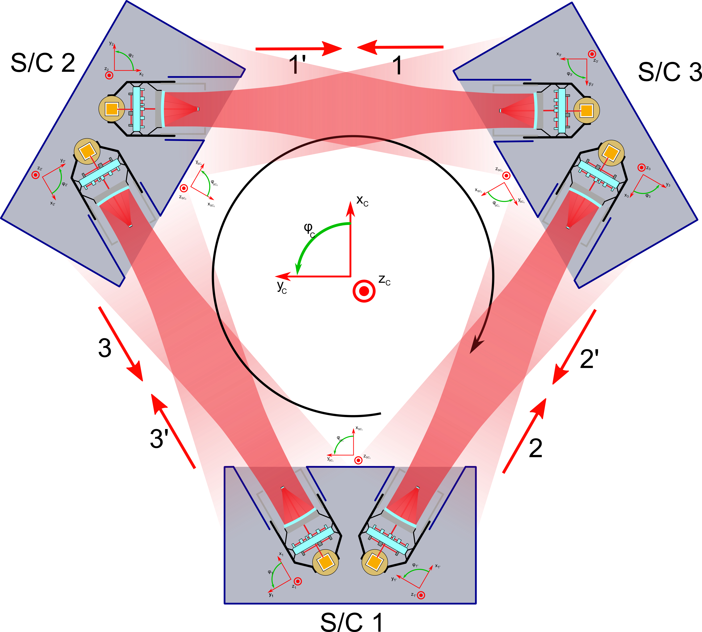
The measurement concept
Test-mass to test-mass
measurement is
synthesized from:
test-mass to spacecraft
→spacecraft to spacecraft
→→spacecraft to test-mass
2 W broadcast, 10⁻¹⁰ W received
  Not LIGO-style interferometry!
  6 independent lengths
Combine 6 links on ground
‘Time Delay Interferometry’ to
reconstruct GW waveform,
suppress technical noise

Slide 11
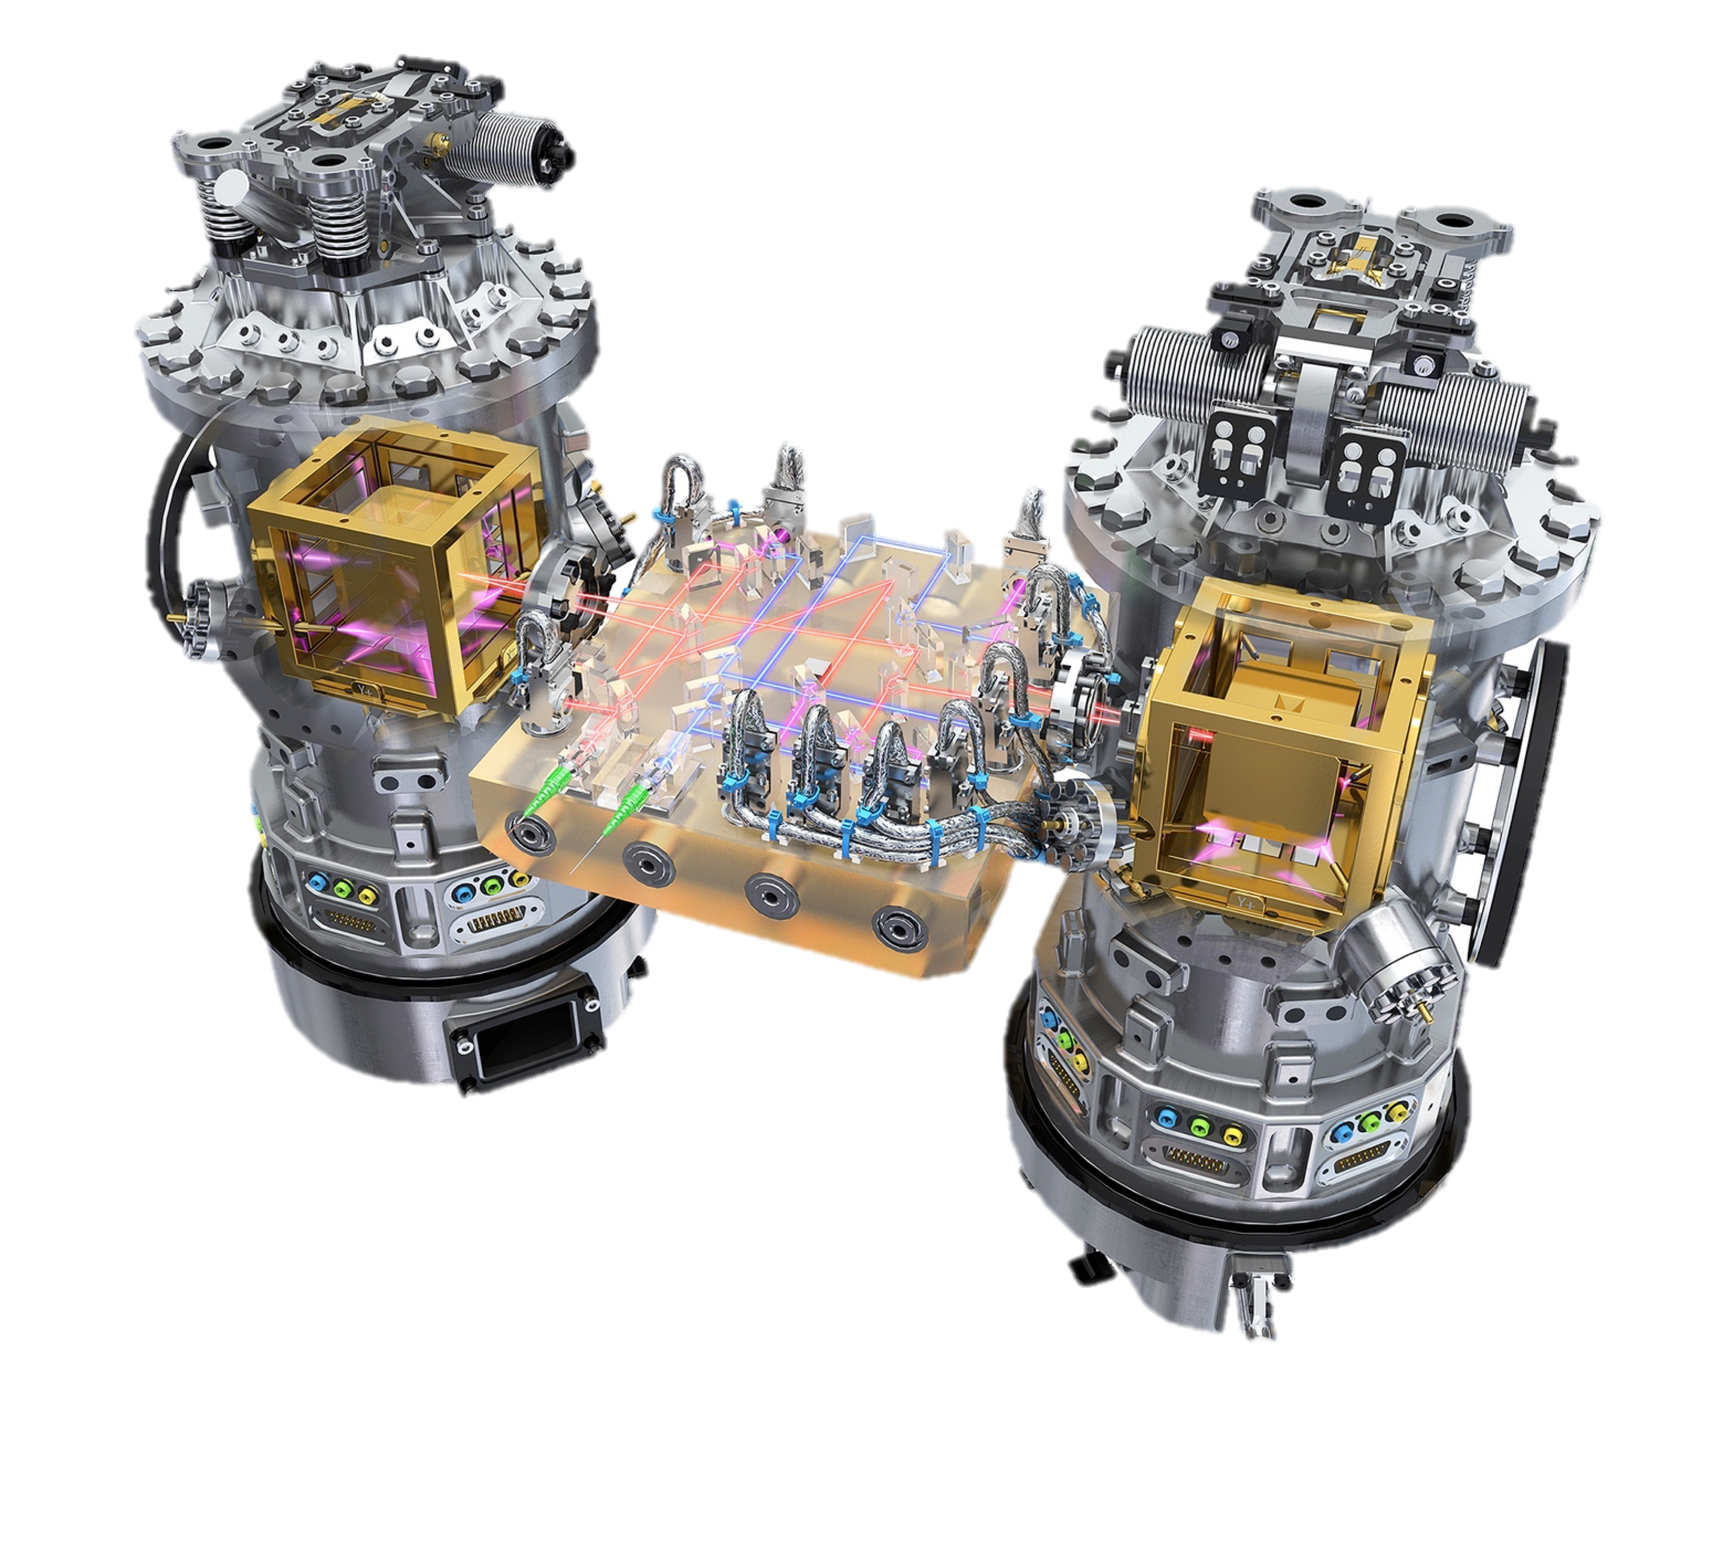
LISA PathFinder
LPF was two test masses, separated by and optical bench of some tens of cm; LISA uses the same test mass setup
Sensors measure distance from test mass to the cage
Low-force thrusters push on spacecraft to keep the cage equidistant from the test mass
Initial balancing is critical!
The ‘gravitational attraction’*
of the test mass to a paperclip
would be fatal, causing the
spacecraft to chase the paperclip
to oblivion…
*‘gravitational attraction’ =
warpage of spacetime

Slide 12
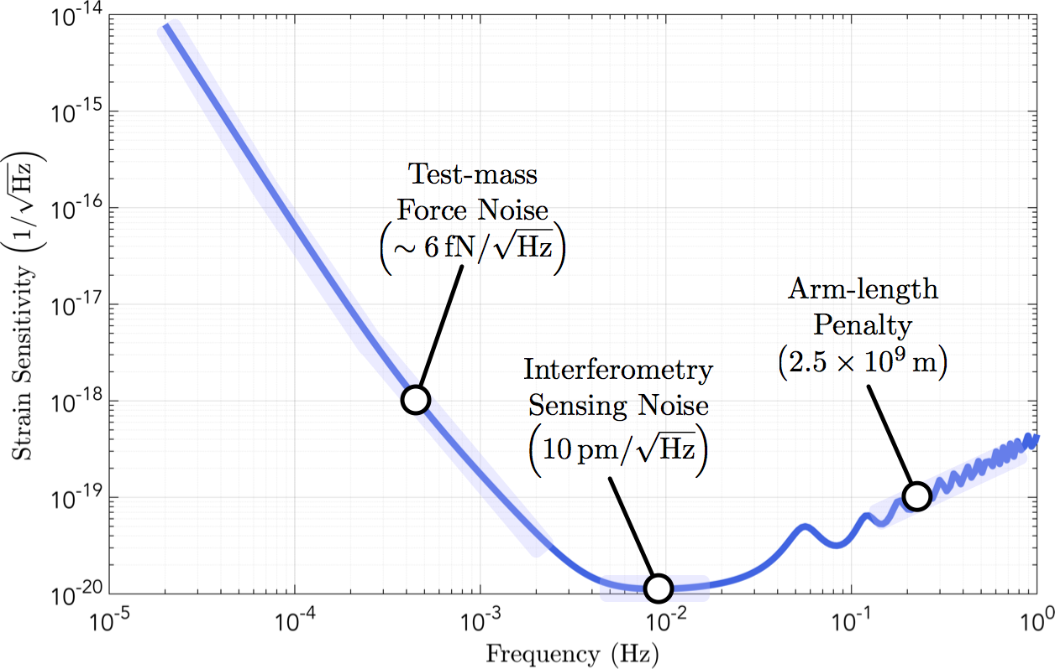
LISA Sensitivity curve
Stray forces at low frequencies, shot noise at high frequency
See the effect of GW wavelengths shorter than arms at HF

Slide 13
LISA Astrophysics
Credit: LISA L3 Mission Concept Proposal

Slide 14
LISA Status
Approved ESA project; NASA also a partner in the mission
LISA Consortium:
  Key expert group for observatory formulation and implementation
  Coordinating deliverables from ESA member nations
  Coordinating the development of scientific analysis of data
Very active design and prototyping activity
ESA funding competing studies for two possible prime contractors to lead the fabrication phase of the mission
Production of 3 satellites, each with two transponders, a big production challenge
Launch in mid-2030’s; cruise to orbit ~18 months, commissioning ~6-12 months
6-year mission at 75% availability; extension to 10 years likely
…seems far away, but there is lots of near-term exciting work to do that is pacing launch!

Slide 15
Detection methods, Projects

Slide 16
Ground-based Detector evolution
Ground-based detectors to date are best-effort technically
  Where were optical or radio telescopes, X-ray satellites, etc. 5 years after their first successful operation? That’s where GW detectors are!
  Seeking observational science enabled with what can be built now
  Parallel development of future science-driven observatories/detectors
Can now envision a science-driven design
  Know infinitely more about rates and signals from (at least) binaries
  Advances in theory offer more specific targets of value
  Instrument science advancing to enable ‘designer sensitivity’
Two phases under consideration:
  ‘Post-O5’ – how far can we get with the current 3-4 km Observatories?
    How will the Network grow in the later 2020’s?
  Next Generation Observatories – what new facilities are needed?

Slide 17




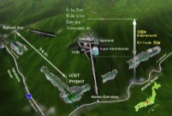
The advanced GW detector network
Advanced
Virgo
2016
Advanced
LIGO
Hanford,
Livingston
2015
KAGRA
2019
LIGO-India
2025
17
17

Slide 18
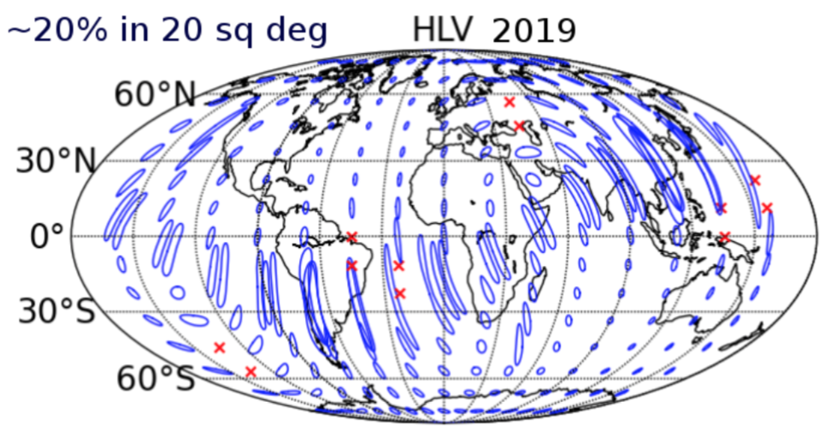
2018-19 Sensitivity/configuration:
3 detectors
~1 signal per week
Notes:
P0900125-v8

Slide 19
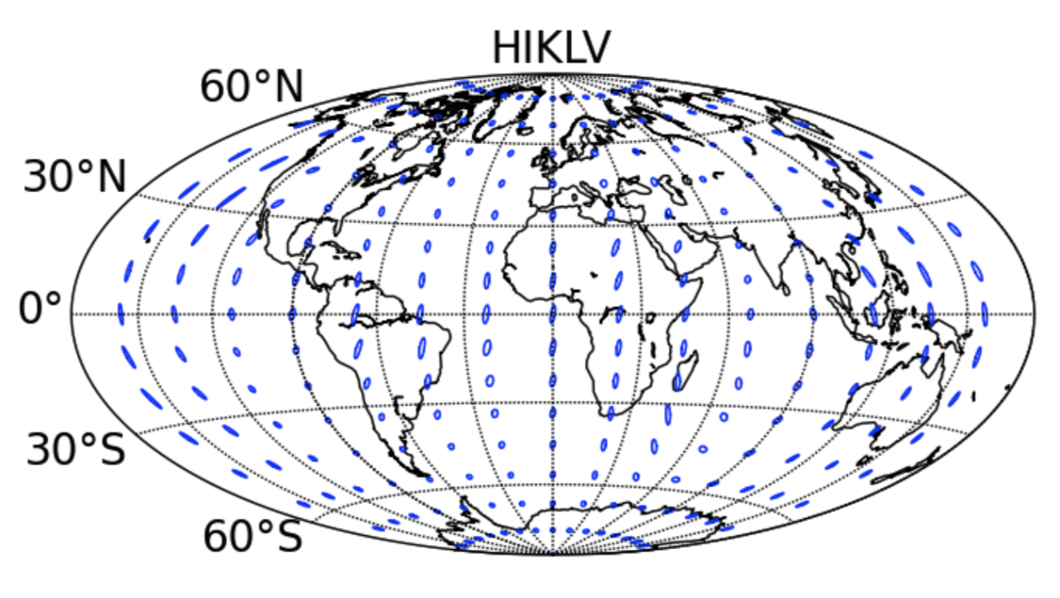
~2025 Sensitivity/configuration:
5 detectors (add India and Japan)
far improved source localization
~60% in 10 sq deg
2024
Notes:
P0900125-v8

Slide 20
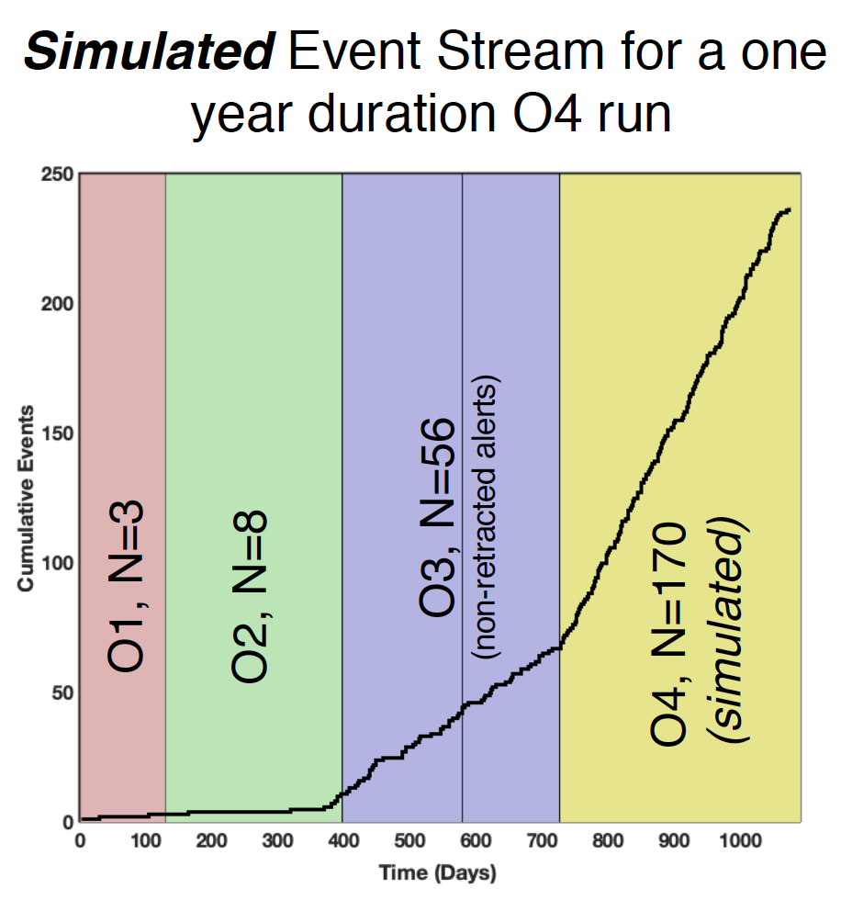
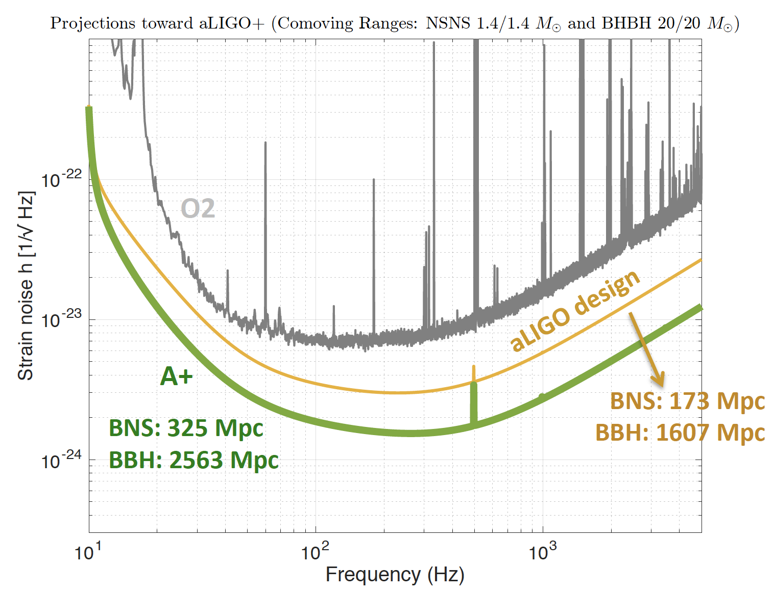
Sensitivity improvements are very well rewarded
LIGO ‘A+’ – Incremental changes to the
Advanced LIGO design
  Similar changes planned for Virgo
Rough doubling of reach
  2³ = 8 greater volume
  8x higher rate
  17-300 BBH/month
  1-13 BNS/month
  2-11 BNS x SGRB
  coincidences/year
Population studies
Hubble Constant
…higher SNR for e.g.,
tests of GR
Plan to be observing
~2024 (plus pandemic delay)

Slide 21
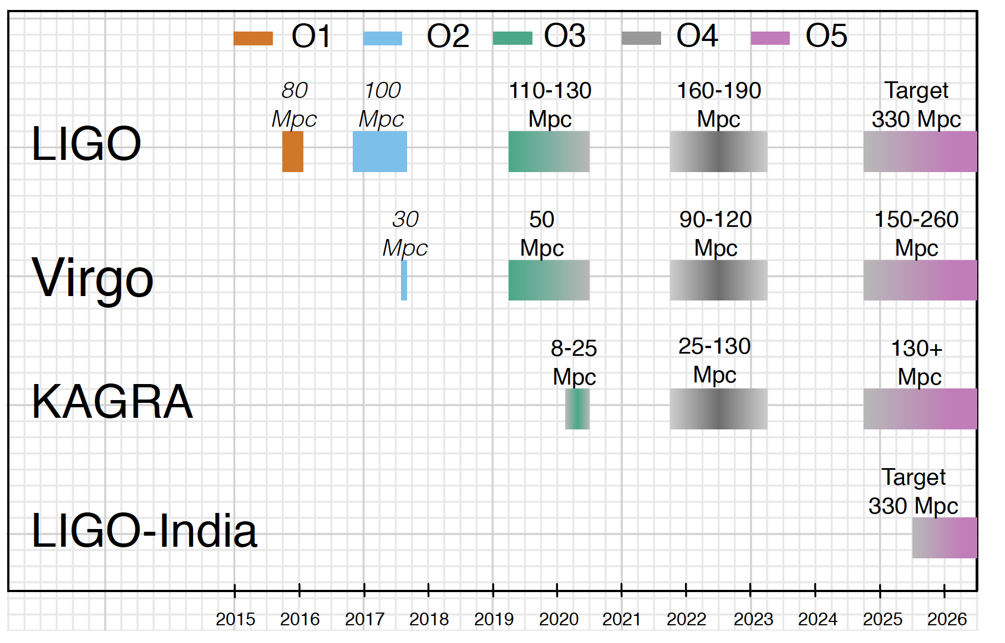
Planned Observing Timeline
O4 start no earlier than June 2022 – pandemic delays
Binary Neutron Star Range

Slide 22
Planned Observing Timeline
Binary Neutron Star Range
O5 dates TBD; currently early 2025

Slide 23
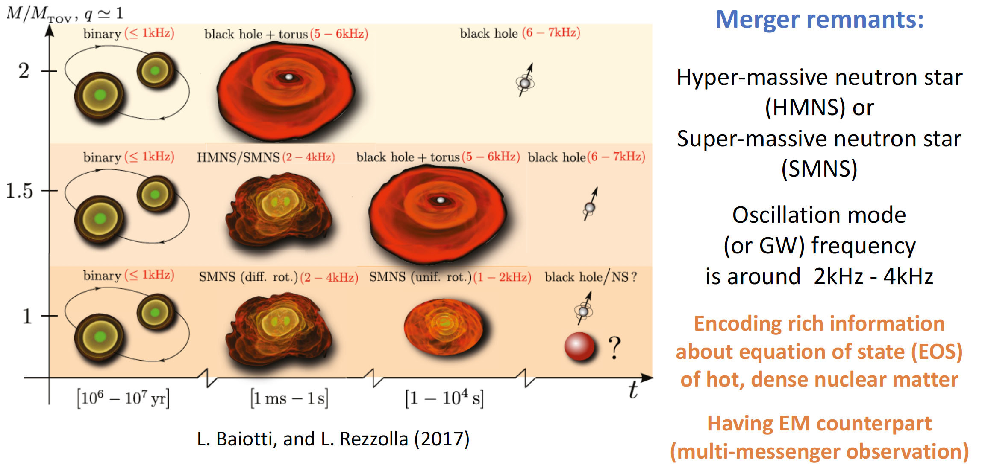
Designing instruments for Astrophysical goals
Suppose we want to focus on the nuclear physics of Neutron Stars –
Denis Martynov

Slide 24
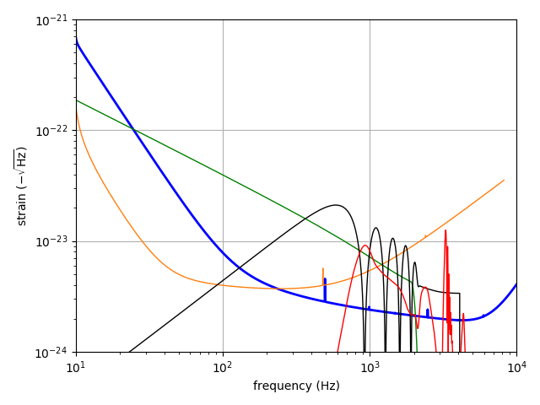
NEMO: A ‘Neutron Star Explorer’ – Possible evolution path for 3-4km
Target the 1-5 kHz range
Modest length requirements –
3-4 km
Stressful on the optical design (high circulating power)
…easy on the 1/f ^{n} noise sources
Australian
future detector working group
BNS
aLIGO
Post-
Merger
High-
Freq
Detector
BNS-BH
‘Voyager’ another interesting path for the current infrastructures
  Mild cryogenics, high laser power, aggressive ‘squeezing’

Slide 25
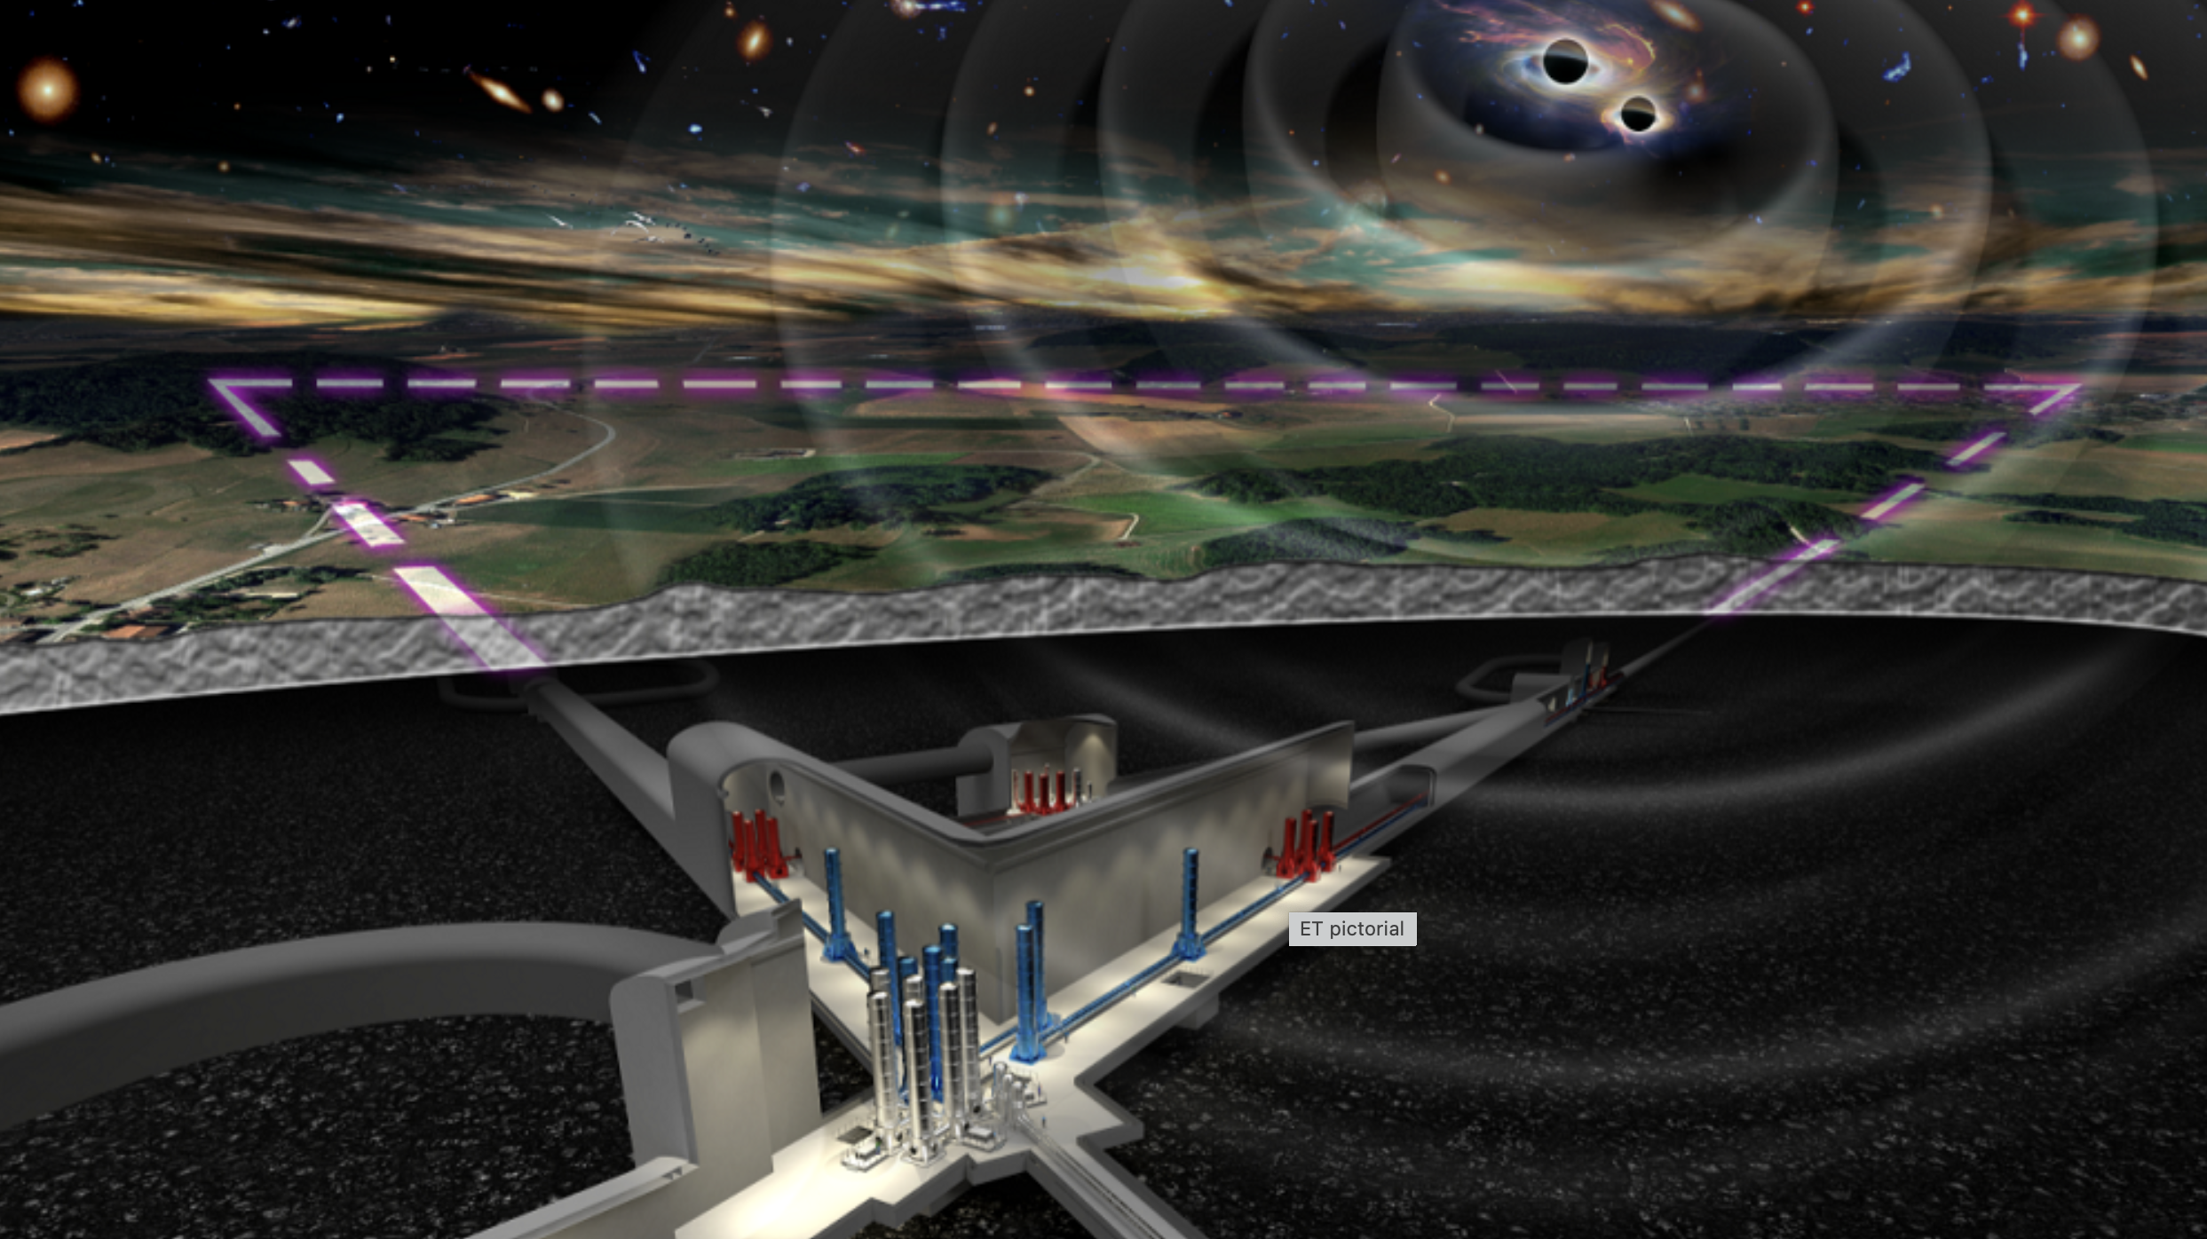
Next Generation Observatories: Einstein Telescope

Slide 26
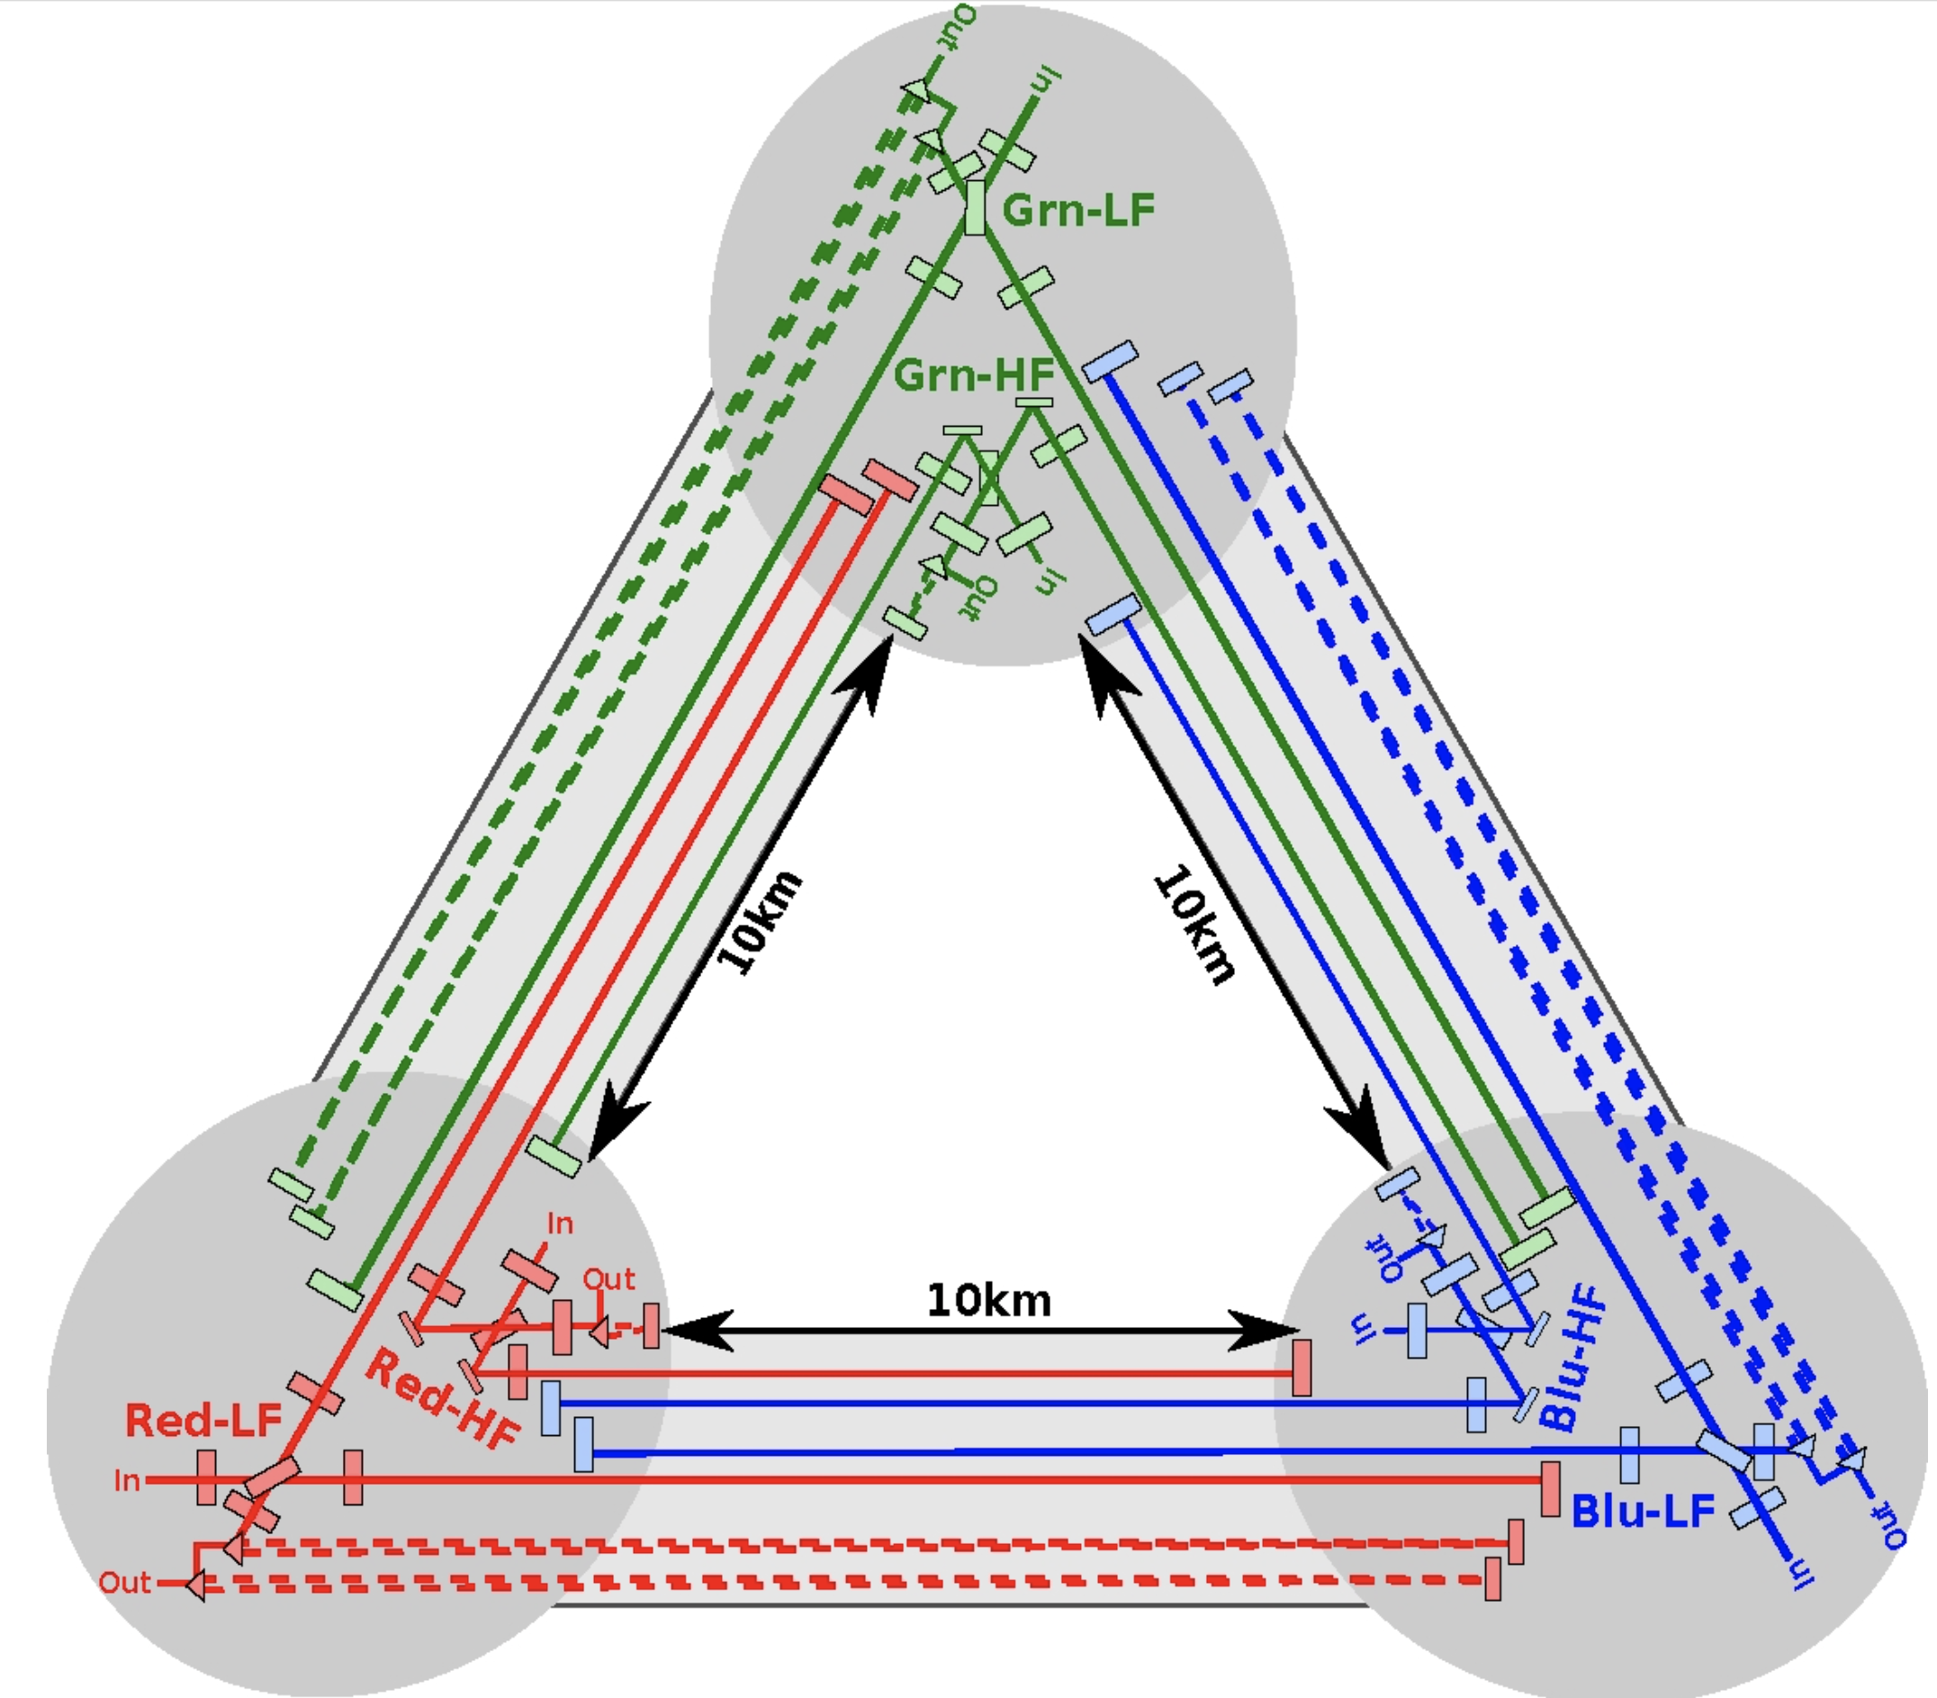
Einstein Telescope: Underground multi-ifo Triangle
10km arms – philosophy is to stretch technologies to reduce external and internal test-mass motions
Underground to reduce seismic and
Newtonian noise
  Also helps with site in Europe
Triangular to give 2 polarizations,
‘null stream’
High- and low-frequency detectors
  High-power for NSNS signals
  Cryogenic low-frequency
  for BHBH
→ Ed Porter’s talk

Slide 27
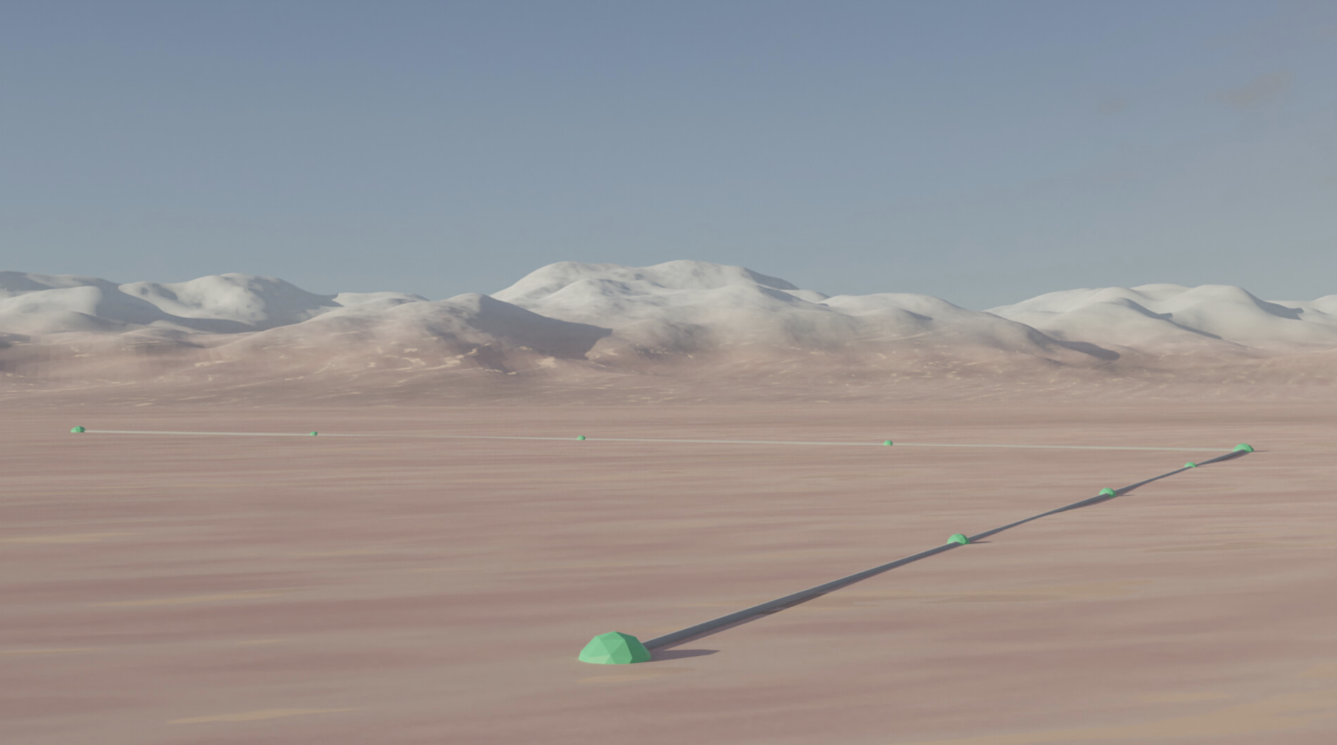
Next Generation Observatories: Cosmic Explorer

Slide 28

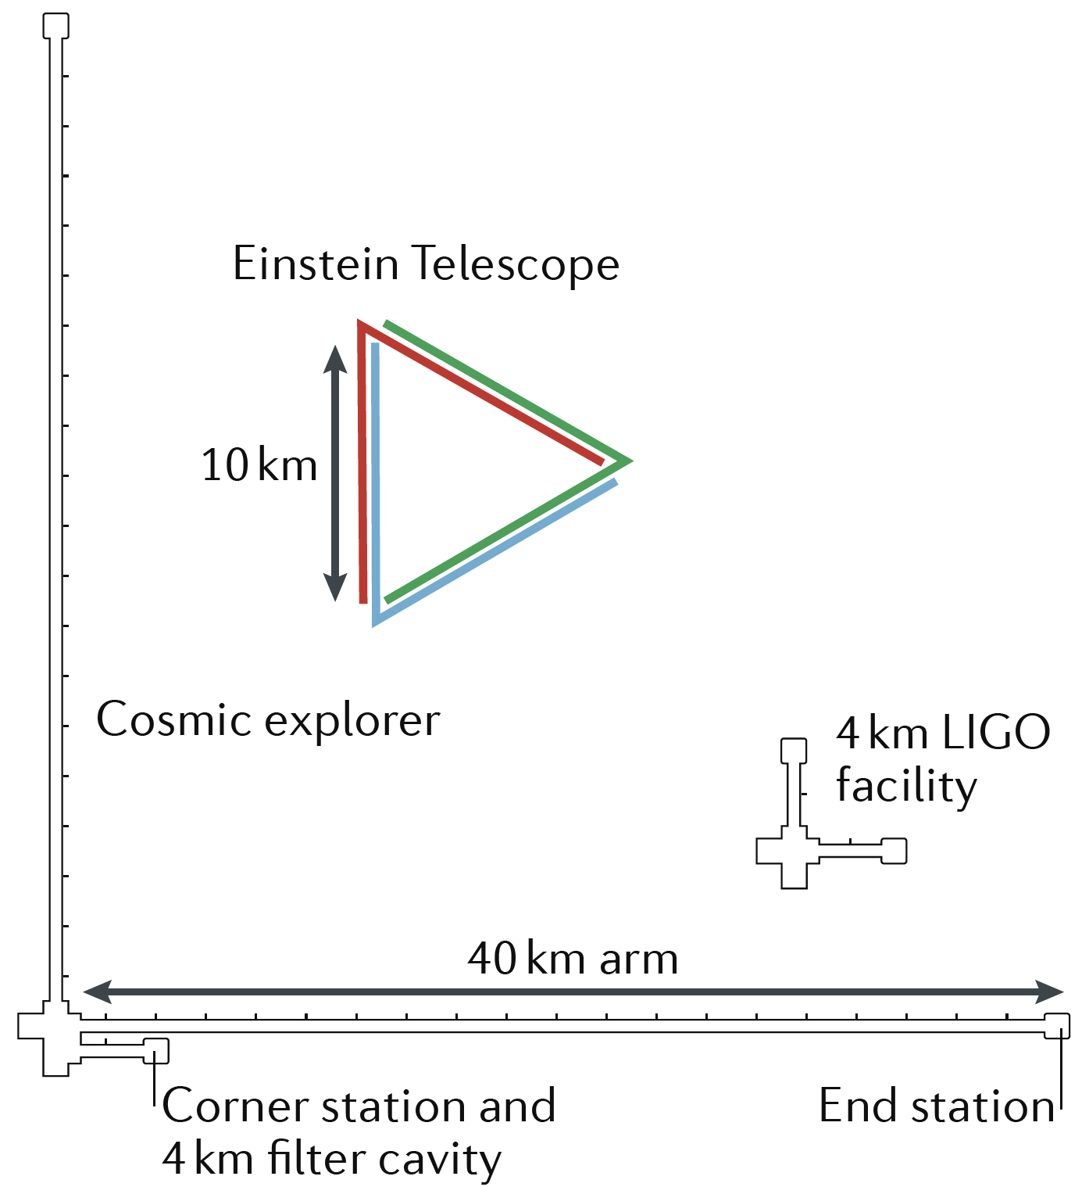
Cosmic Explorer:
Make arms 10x longer
Philosophy is the stretch the arms, and start with known technologies
Signal grows with length – not most noise sources
  Thermal noise, radiation pressure, seismic, Newtonian unchanged
  Coating thermal noise improves faster than linearly with length
Concept offers sensitivity without new measurement challenges;
start at room temperature, modest laser power, etc.
  Will install more challenging technologies
  when timely – Low initial risk is key
  Transfers challenges to vacuum, earthmoving
Baseline of two detectors:
  40km arms: maximize reach for cosmology
  20km arms: focused on NSNS
Have identified many possible sites
  Sagitta is 31 meters…
  Find ‘bowls’ which are in fact flat
    US; elsewhere, e.g., Australia

Slide 29
Cosmic Explorer
Currently undertaking an initial ‘Horizon Study’ with NSF funding
  What science is targeted?
  What design does that dictate?
    Looking at the possibility of a 40km for cosmology,
    and 20km for NS physics
  What technologies to use?
    Looking at an initial ‘A+ on steroids’ design, followed by more challenging technologies (cryogenics? Push fused silica to limits?)
  How to make affordable?
    Nobel-prize winning vacuum tube design…
  How to raise consciousness of broad community?
    Starting to plan a Dawn meeting in the Fall
Completion of report in 2021 – Will be shared with the community for feedback
Path forward in discussion with US National Science Foundation
Maybe a review ‘mid-decadal study’ ~2025 for a detailed engineering study
Timeline, governance, funding all fuzzy at present
  hope to see a real start in the late 2020’s

Slide 30
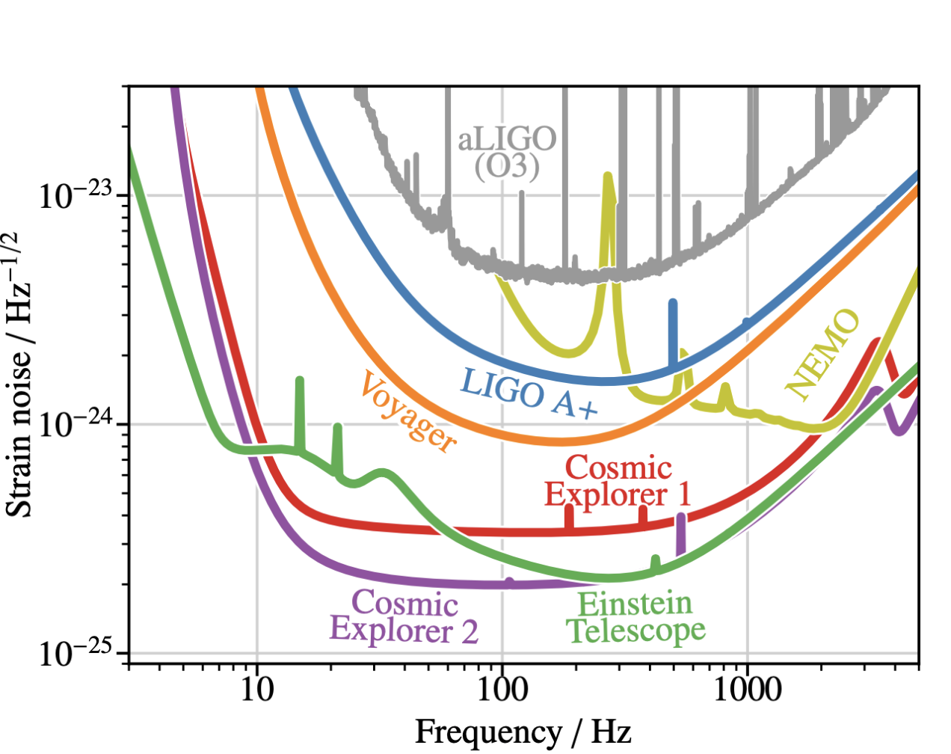
Sensitivity of ground-based detectors

Slide 31
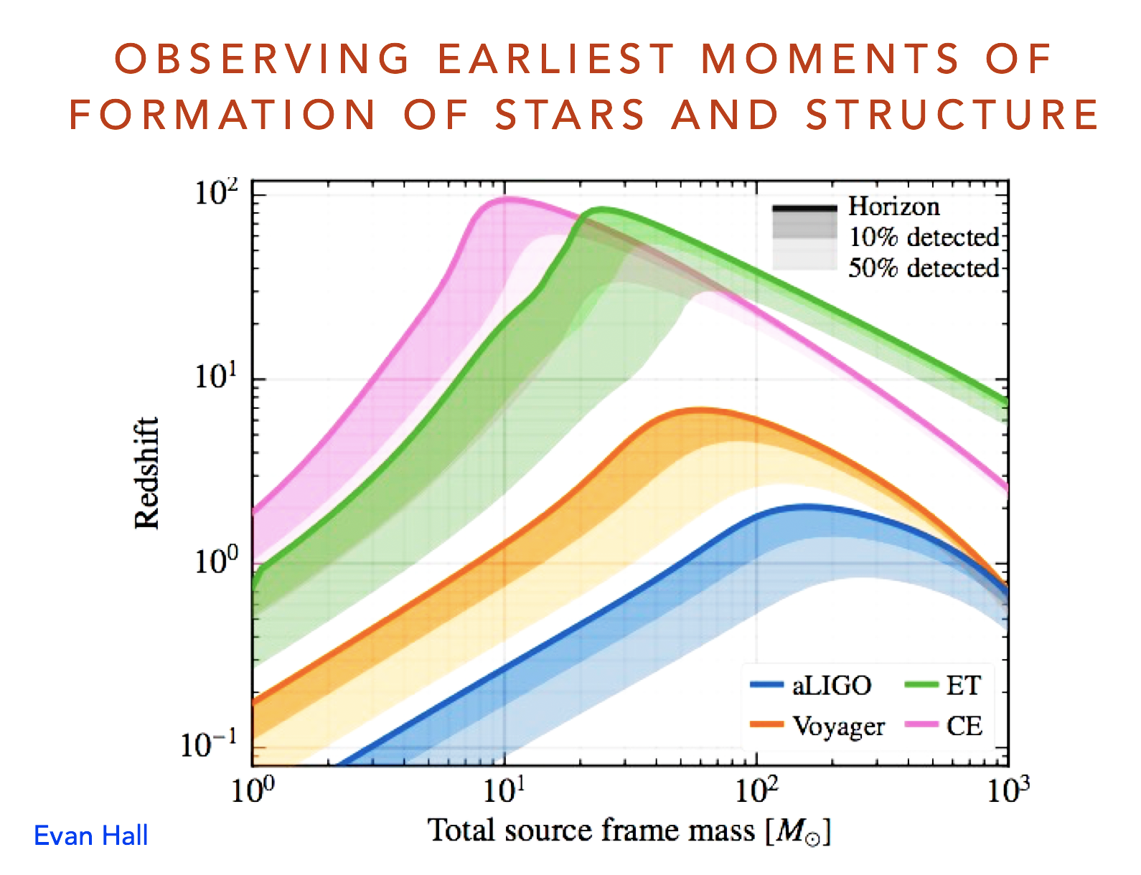
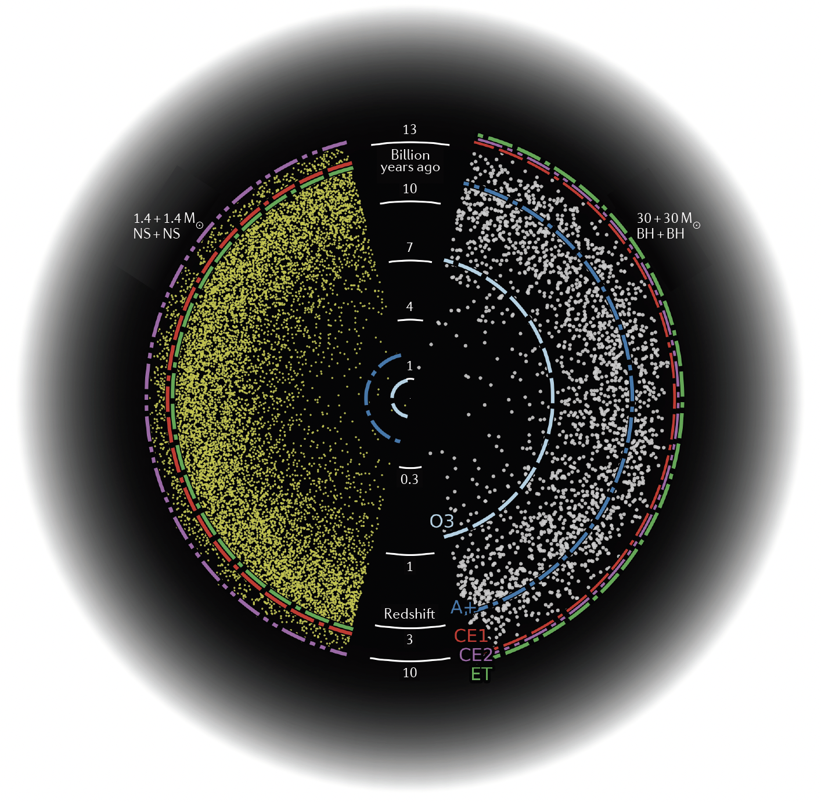
Reach of Next Gen Observatories:
All binaries in universe from 1-1000 M⦿
wq
E. Hall, S. Vitale

Slide 32
Next Generation Observatories
When could this new wave of ground instruments come into play?
Appears 15 years from t=0 is a feasible baseline
  Initial LIGO: 1989 proposal, and at design sensitivity 2005
  Advanced LIGO: 1999 White Paper, GW150914 in 2015
Modulo funding, can envision 2030’s
Should hope – and strive and plan – to have great instruments ready to ‘catch’ the end phase of binaries seen in space-based LISA
Worldwide community working together on concepts and the best observatory configuration for the science targets, e.g.,
  GWIC https://gwic.ligo.org/3Gsubcomm/documents.shtml
Planning starting for a ‘Dawn’ meeting to discuss the path
  likely with the focus on CE – less developed than ET at this time
  Fall, and maybe even in person!

Slide 33
Two critical points
Crucial for all these endeavors: to expand the scientific community planning on exploiting these instruments far beyond the GR/GW enclave
  Costs are like TMT/GMT/ELT – needs a comparable audience
  The initial detection by LIGO was seen as ‘cool science’
  GW170817 was seen as key to realizing the science of thousands of researchers; localization
  The network is critical to serving a big enough community
First Collaborations, now meta-collaborations: ‘The LVK’ – KAGRA, Virgo, and LIGO Scientific Collaborations all sharing data
  The science that is possible is qualitatively greater
  The sociology of a (mostly) non-competitive environment nurturing
LISA and Pulsar Timing also in collaborations/consortia
Now perhaps 3000 persons worldwide – and still short of hands to keep up with the current technology, data, and observational science flow
With a continuing globally collaborative effort, the field will succeed

Slide 34
This meeting shows…
Observational gravitational-wave detection is really a new messenger
The (incredibly short) 5-year history of observations already enough to launch a new field
Demonstrated by the richness of this meeting
Ever-growing network of detectors, with ever-growing sensitivity, promises to deliver new surprises in quantity and character
We are Experiencing
– and you are responsible for –
the birth of a new field
 | GR | Physics | Astro | MMA
Theory | ✅ | ✅ | ✅ | ✅
Modeling | ✅ | ✅ | ✅ | ✅
Observation | ✅ | ✅ | ✅ | ✅
Analysis | ✅ | ✅ | ✅ | ✅

Slide 35
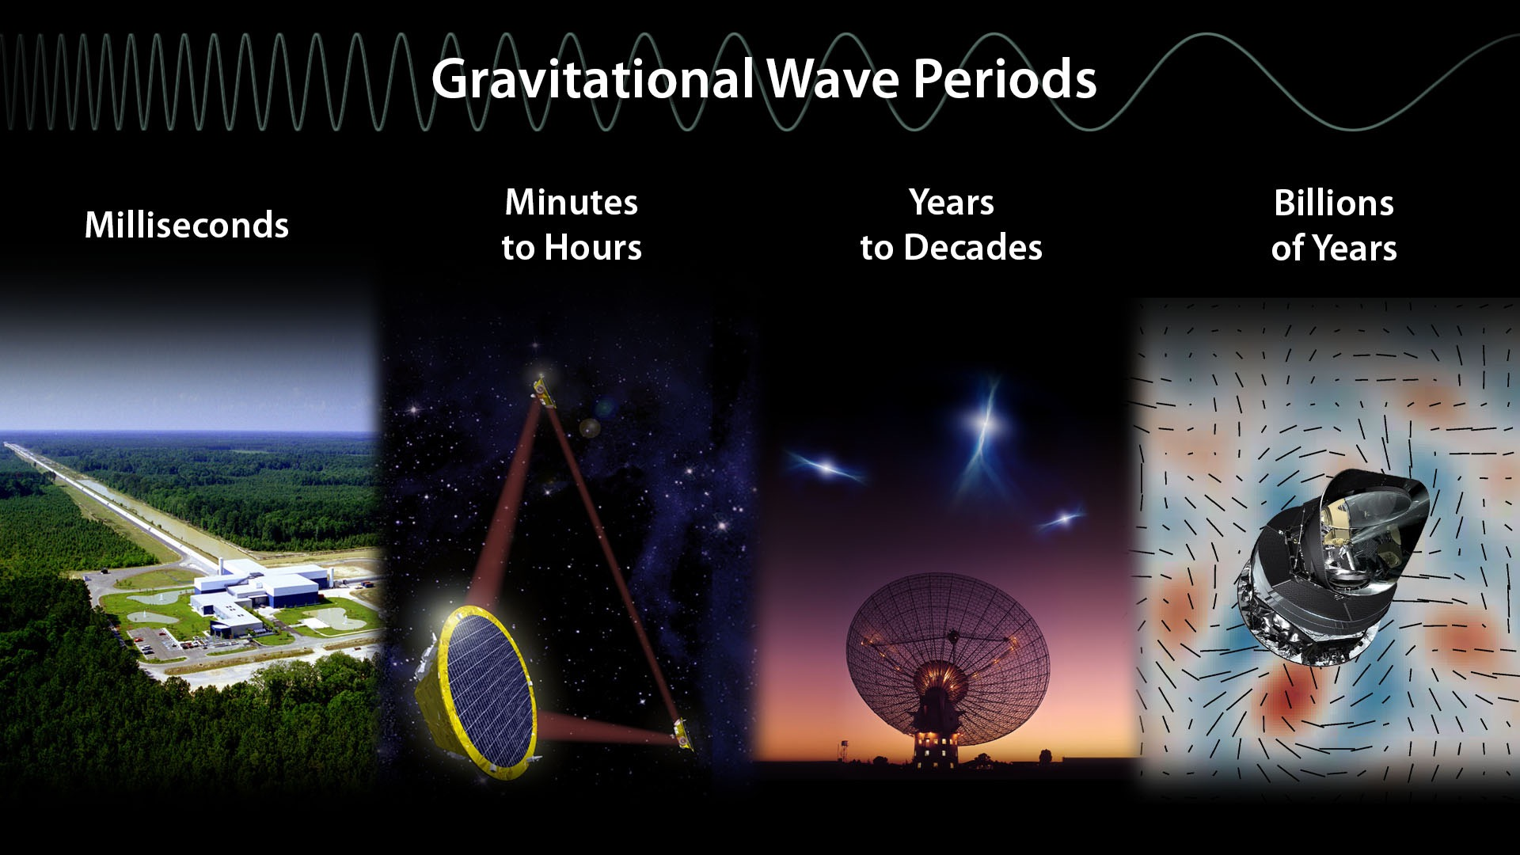
New instruments, New discoveries, New synergies
LIGO/Virgo
LISA
Pulsar Timing Array
Cosmology Probes

Slide 37
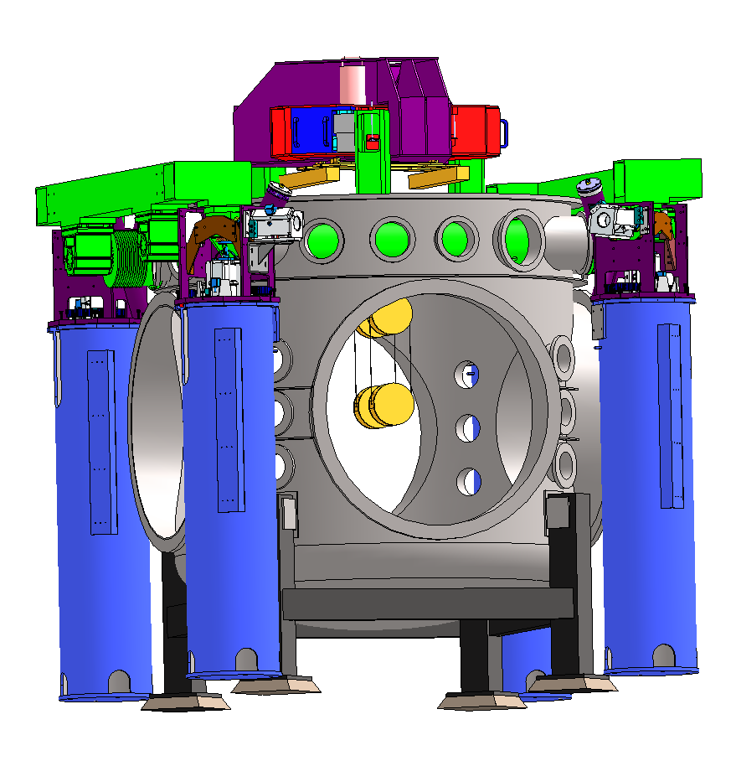
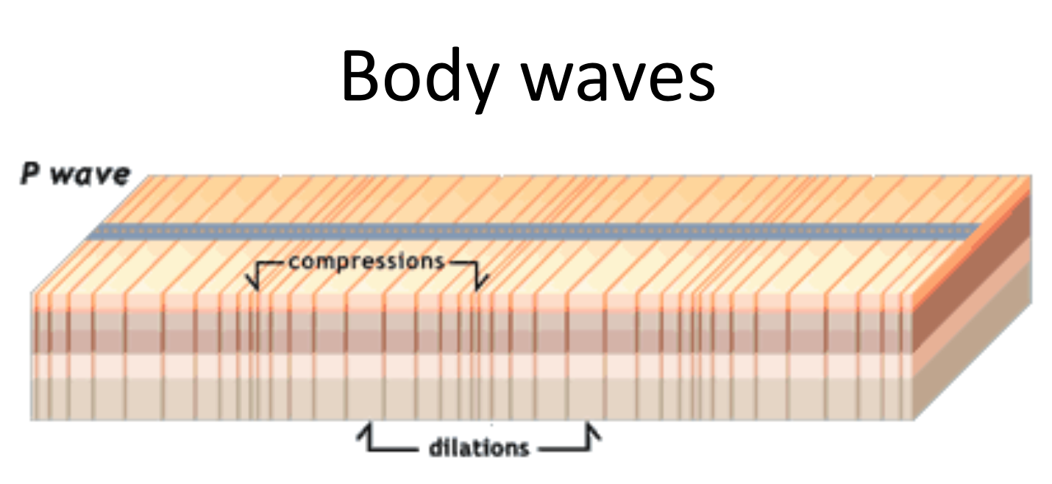
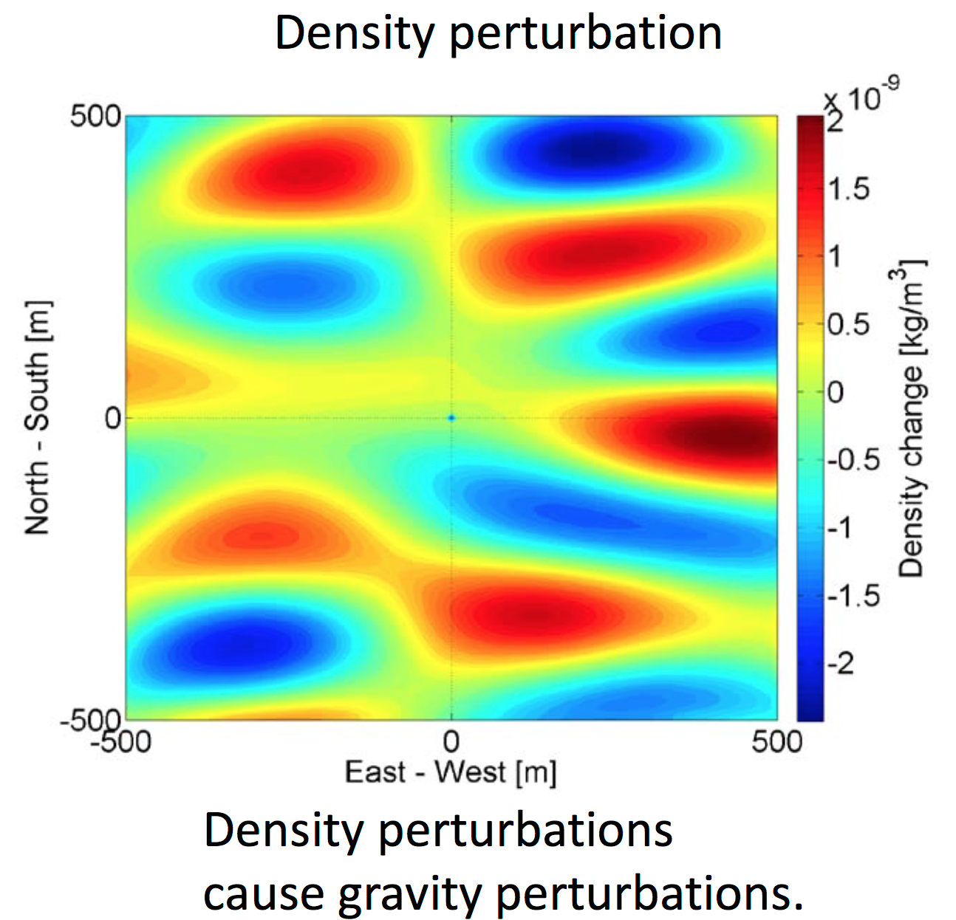
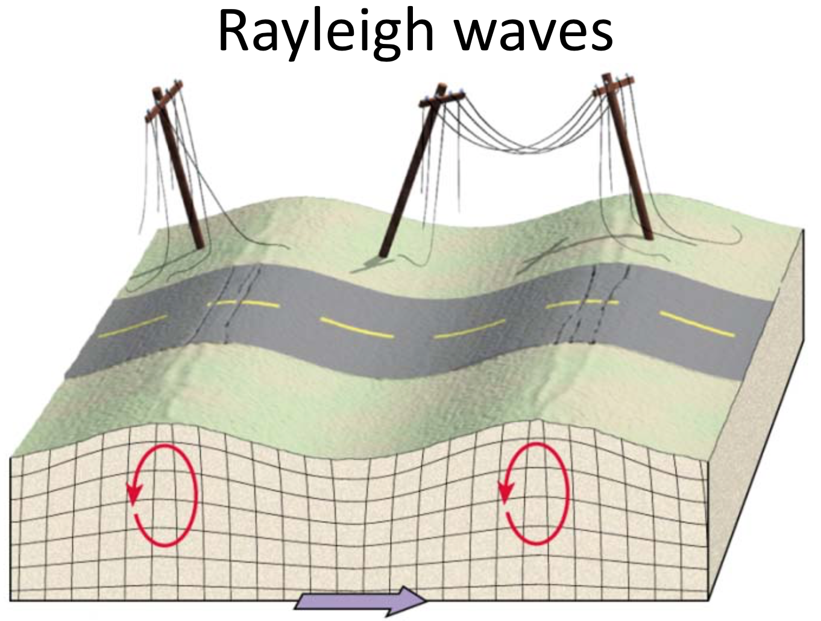
Measuring ΔL= 4x10⁻¹⁸ m
Forces on test mass
Ultimate limit on the lowest frequency detectors
on- or under-ground:
Newtownian background – wandering net gravity vector;
Forbiddingly large for ~3Hz and lower
Images: J. Harms

Slide 38
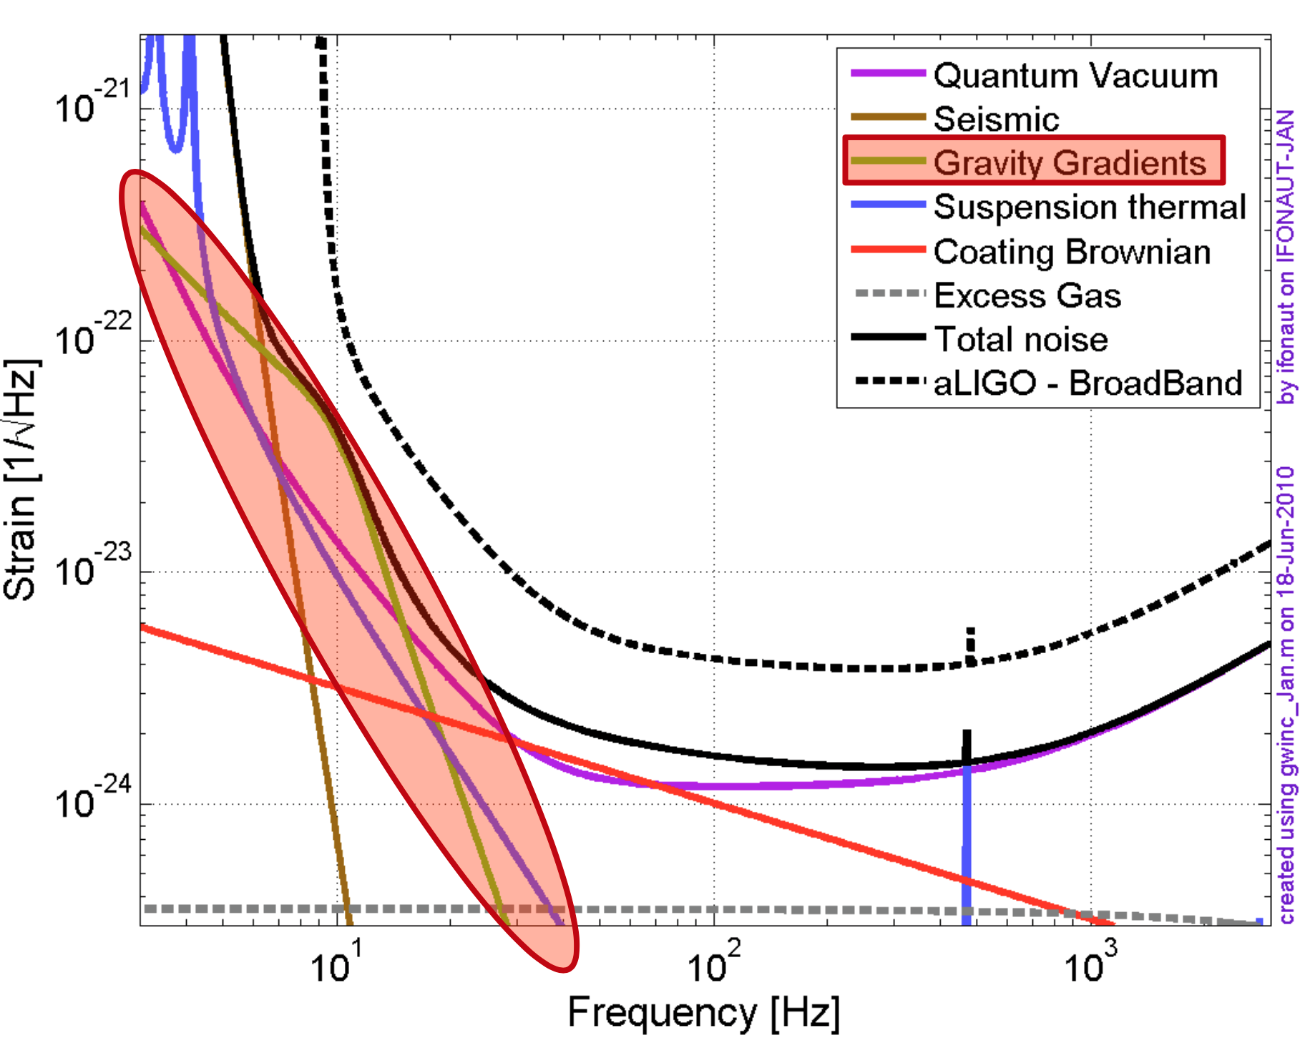
Measuring ΔL= 4x10⁻¹⁸ m
Forces on test mass
Advanced LIGO (and Virgo) expect to be limited by this noise source –
  After all technical noise sources beaten down
  At low optical power (no radiation pressure noise)
  In the 10-30 Hz range
We would love to be limited only by this noise source!
Want to go a bit lower?
Go underground.
Want to go much lower?
Go to space.
Images: J. Harms

Slide 39
Frequency Dependent Squeezing
RADIATION PRESSURE NOISE
gets better
SHOT NOISE
gets better by a factor of 2
Thermal noise in optical coatings
High frequency improvement, + 25% BNS-BNS range (200 → 250 Mpc)

Slide 40
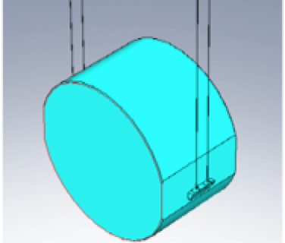
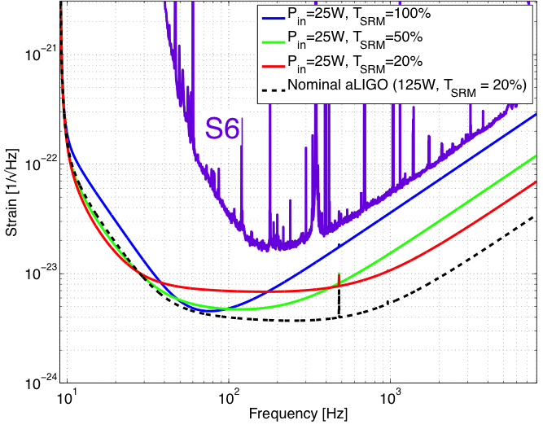
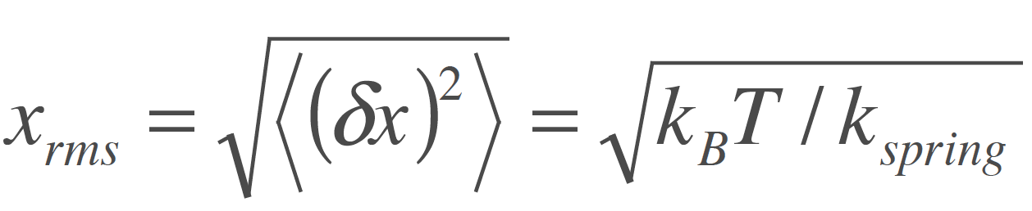

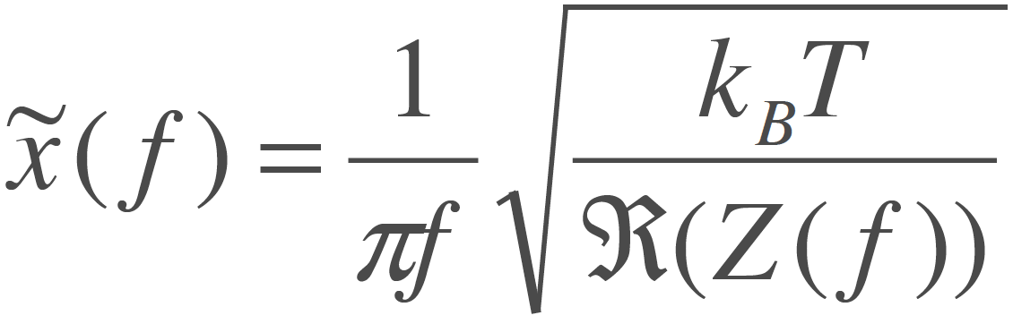
Measuring ΔL= 4x10⁻¹⁸ m
Internal motion
Thermal noise – kT of energy
per mechanical mode
Über die von der molekularkinetischen Theorie
der Wärmegeforderte Bewegung
von in ruhenden Flüssigkeiten suspendierten Teilchen,
A. Einstein, 1905
Simple Harmonic Oscillator:
Distributed in frequency according to real part of impedance
Low-loss materials, monolithic construction

Slide 41
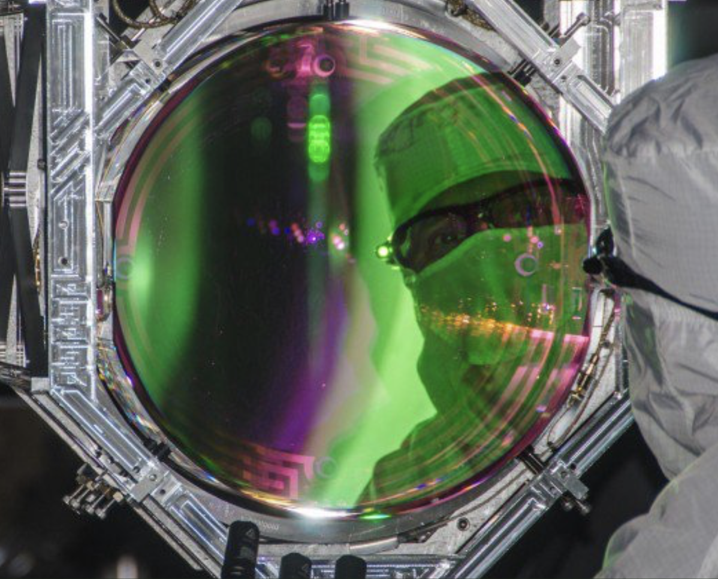
Measuring ΔL= 4x10⁻¹⁸ m
Internal motion
In Advanced LIGO, the dielectric optical coating has a rather large loss tangent
  Some 10⁻⁴ , compared to
  10⁻⁸ for fused silica
The Fluctuation-Dissipation theorem says this is where the greatest motion is found
And: the coating is the surface that is sensed by the laser
This is the dominant limit in the critical 50-200 Hz band

Slide 42
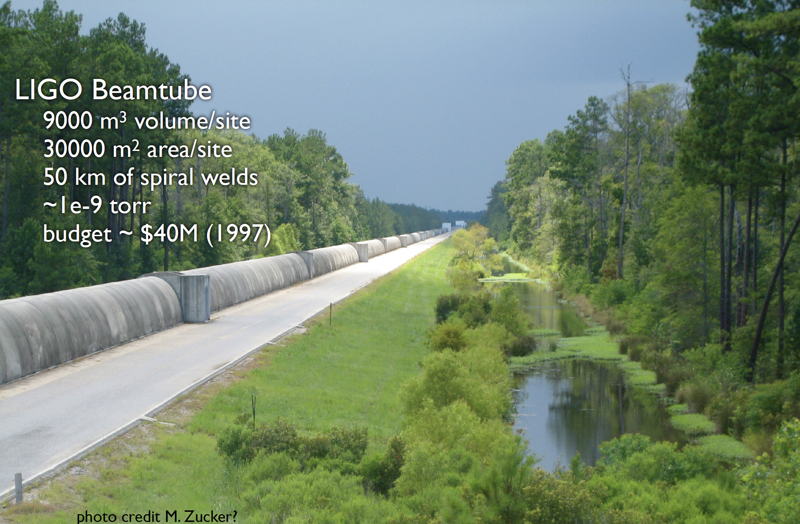
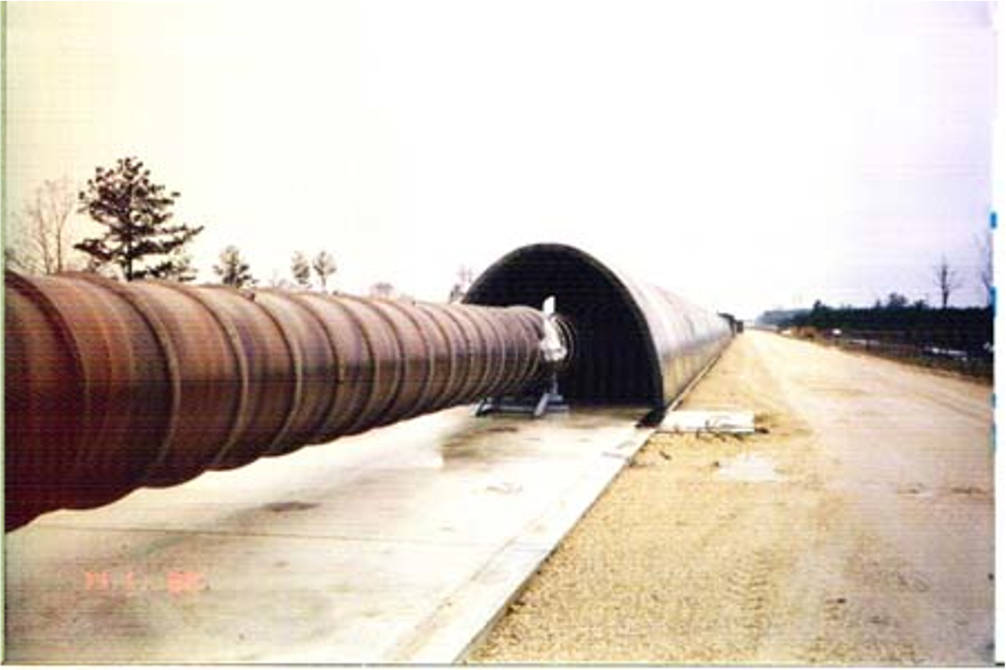
Civil Construction:
Beam Tube cover, foundation, earthmoving

