Slide 1
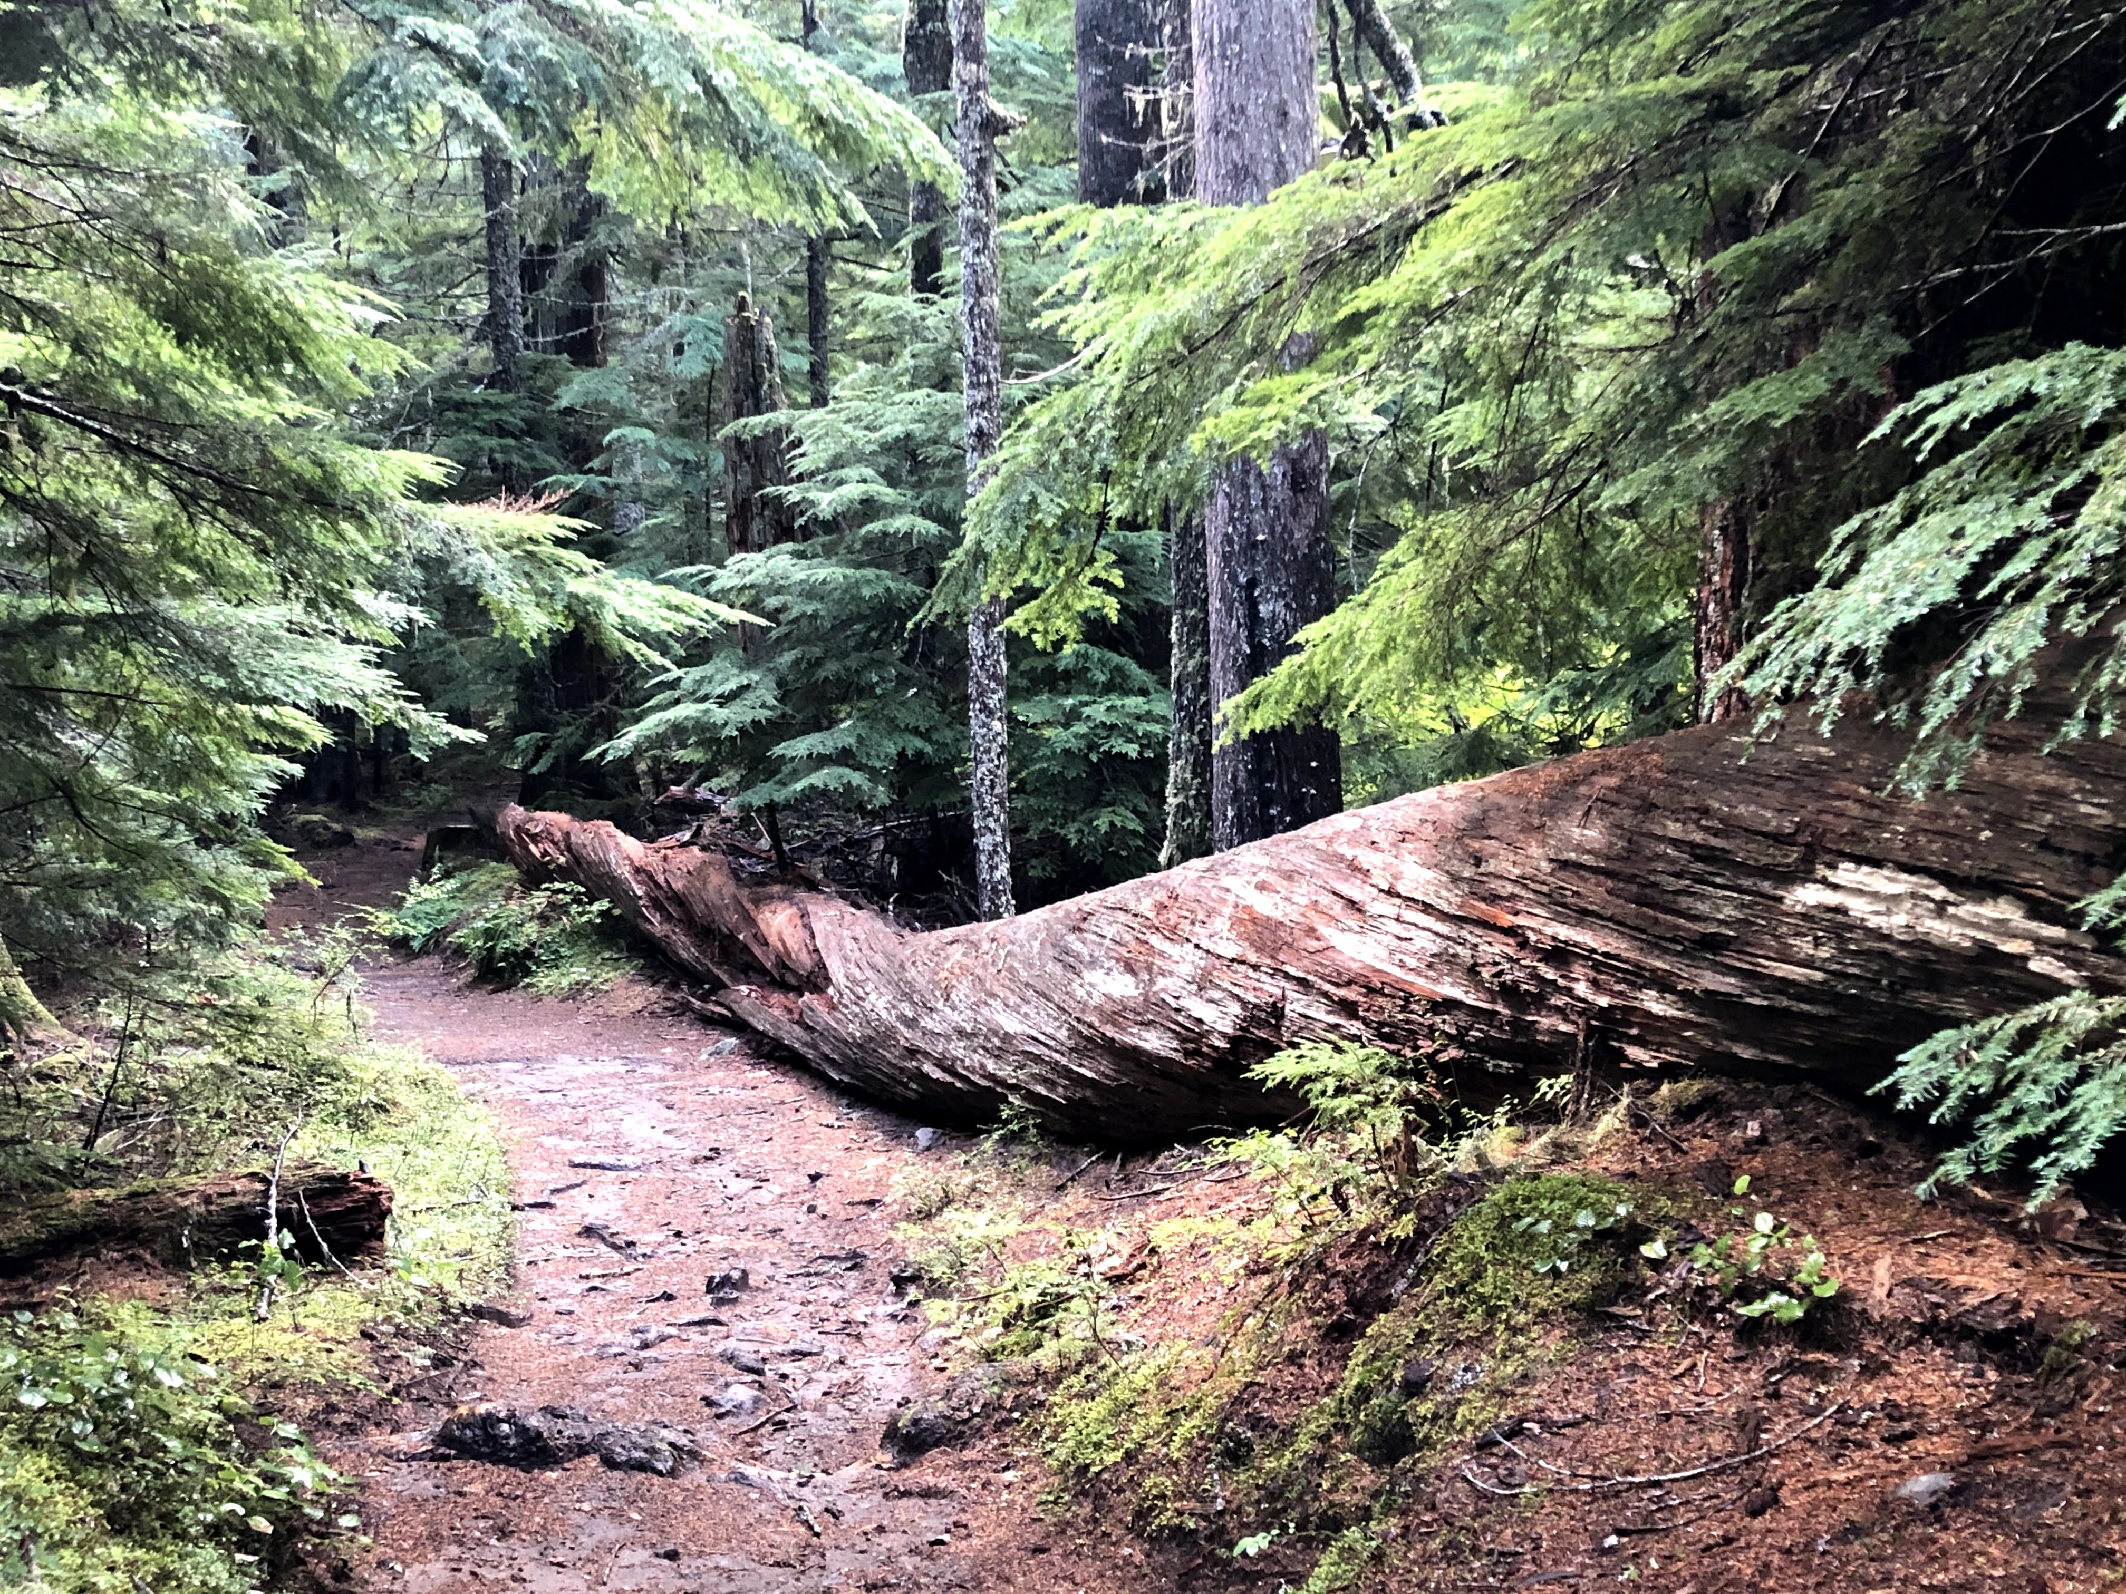
Gravitational Wave Astronomy North-West 4th Annual GWANW Day 2: Jun 29 2021

Slide 2
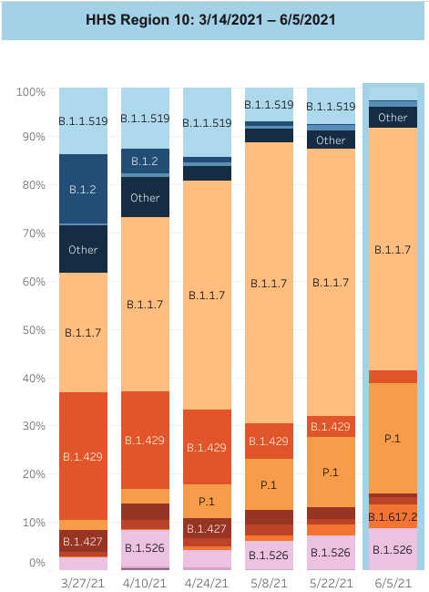
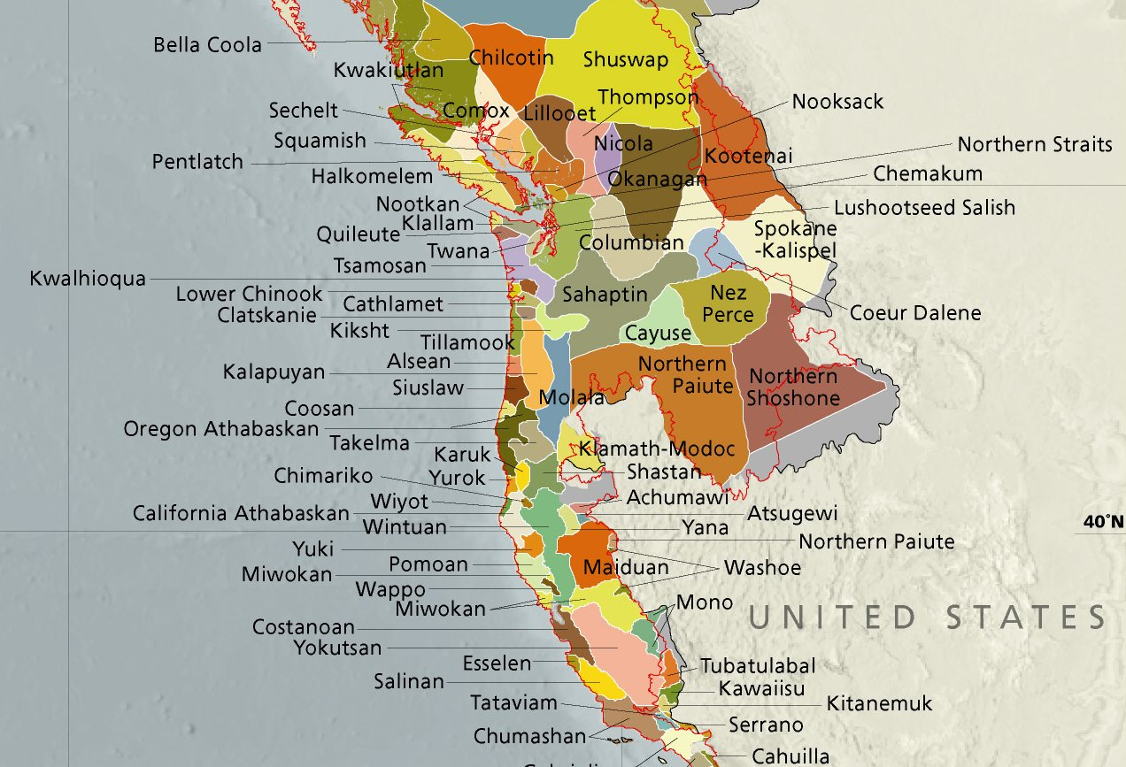
This meeting in context…
Structural
www.instituteforhealingandjustice.org
US Pacific Northwest
https://covid.cdc.gov/
Institutional
Combat
Racism
in as many
ways as you
have influence
Internalized
vote.org/
Interpersonal
Cultural
Support
the
diversity
of
your
local
indigenous
community
Please: get vaccinated,
if you can and
haven’t already.
Love is Love,
every month.
llmap.org/

Slide 3
This is a safe space.
Take your time.
Be patient.
Listen.
Take a break.
Do whatever you need to do.
Today, we set aside the world for a moment to look (and “listen”) up.
Welcome.

Slide 4
😢

Slide 5
GWANW 2021: Essential Links
https://sites.uw.edu/joeykey/gwanw21/
https://dcc.ligo.org/cgi-bin/private/DocDB/DisplayMeeting?conferenceid=1108
https://washington.zoom.us/j/4056700799

Slide 6
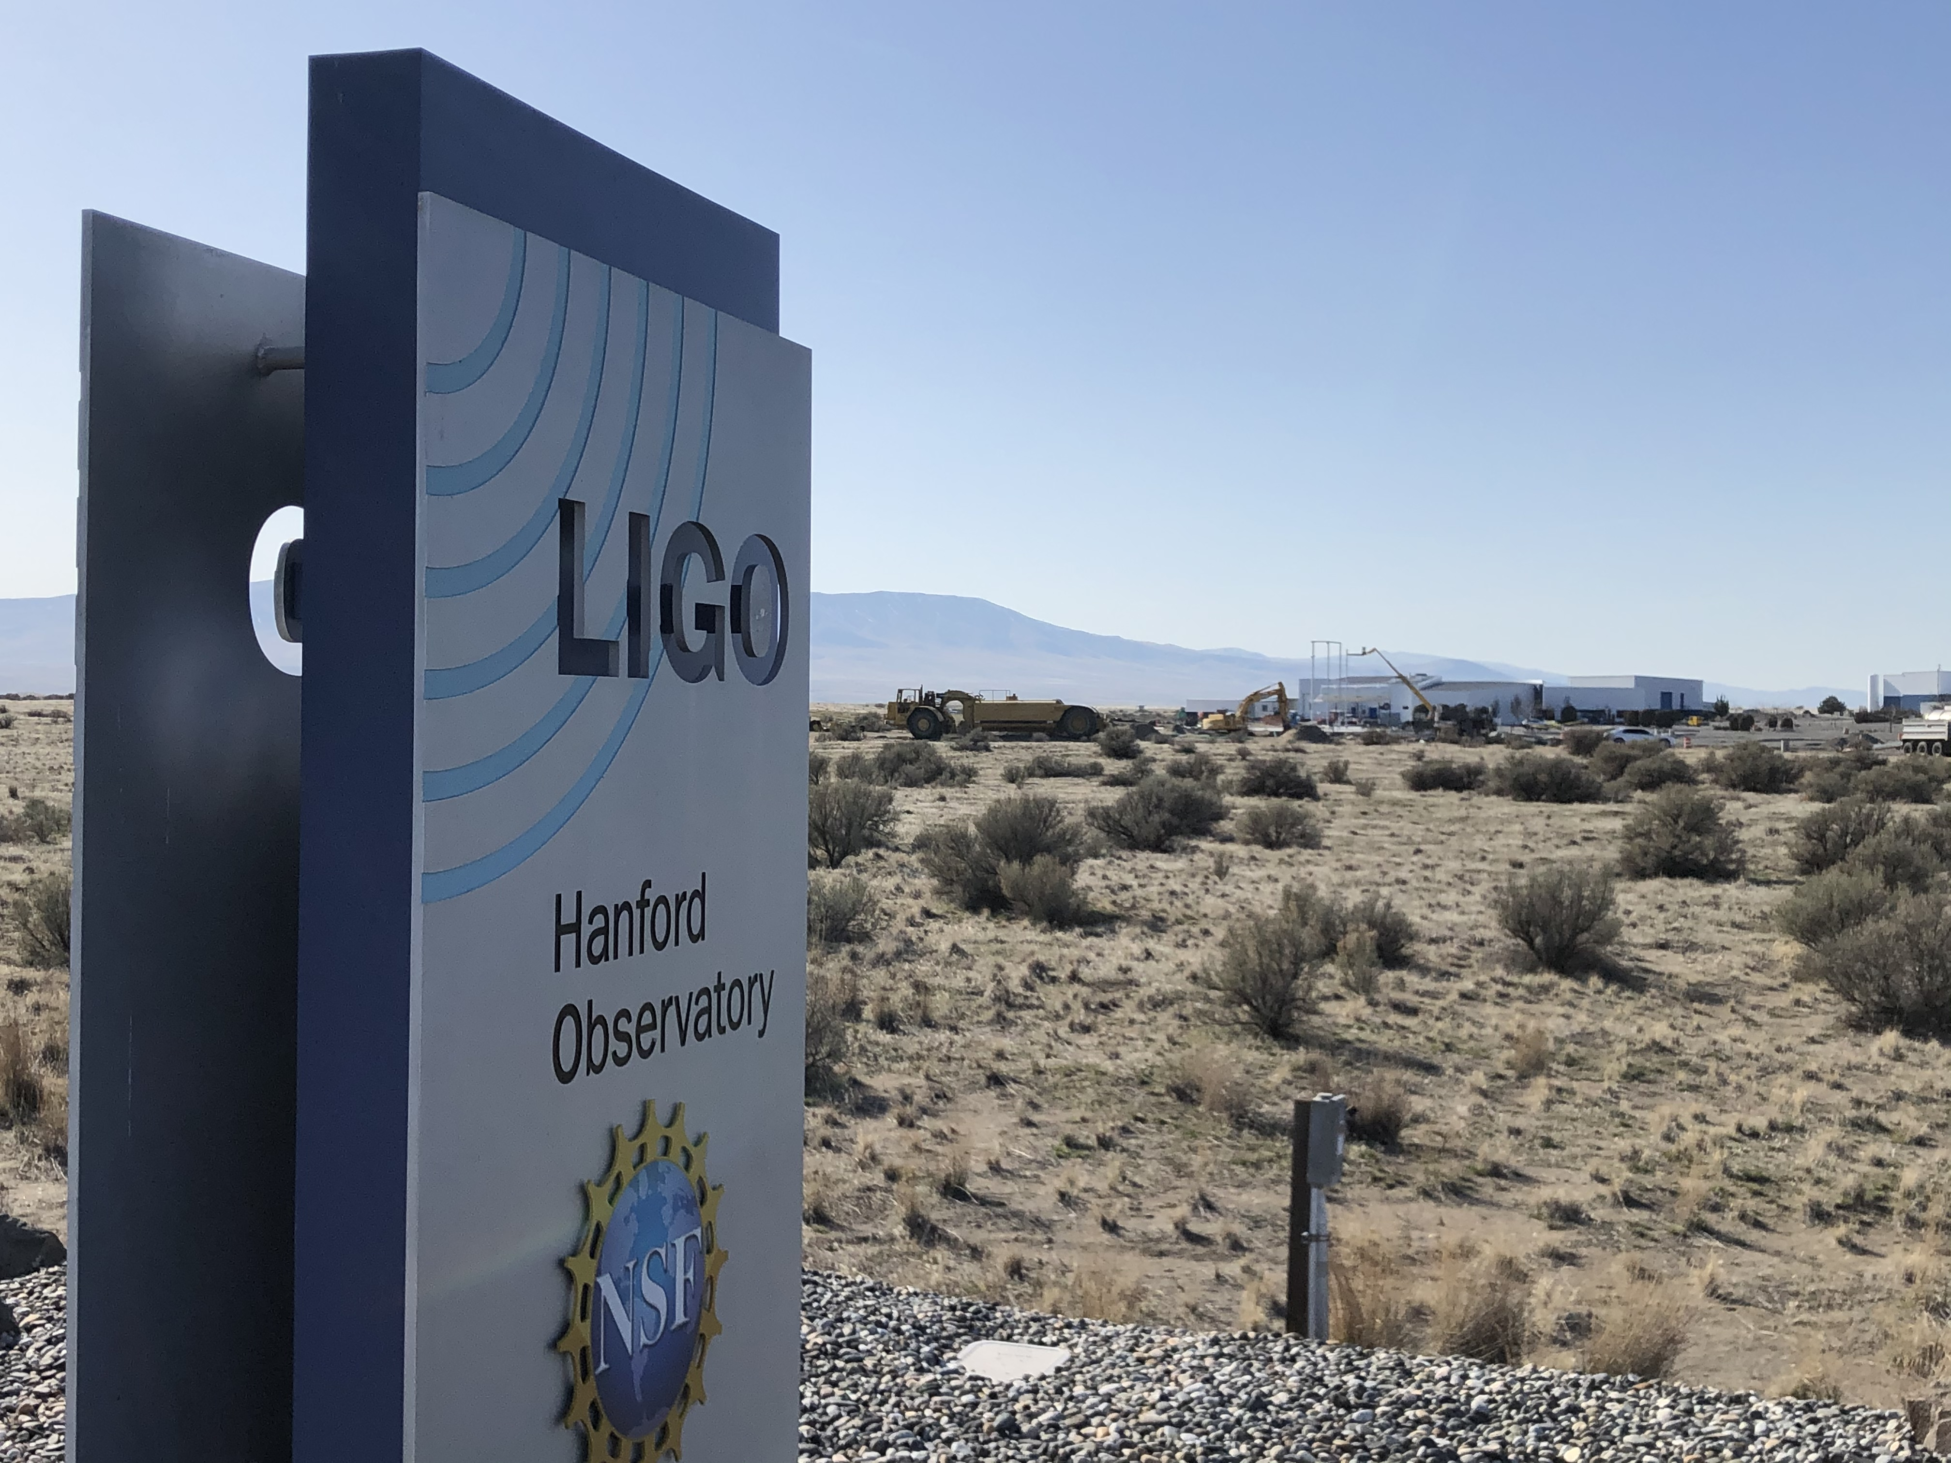
GWANW 2021: Day 2
Yesterday: GWA, LIGO, LISA, and PTA Workshops
Today
9:10 GW Observatory Status Talks
10:10 Quick bio break
10:15 GWANW Group Projects and Challenges
12:30 Lunch Break
13:30 LHO Virtual Tour
14:15 LSC Students and Fellows Talks
15:30 Coffee Break
16:30 Outreach Topics
Let’s get started!

