Slide 1
Introduction to LIGO data with GWpy
Adrian Helmling-Cornell
GWANW 2021

Slide 2
This Session’s Goal
Grab freely-available GW data
Using GWpy, process the data to find the gravitational wave
Represent the GW several different ways with GWpy plotting routines

Slide 3
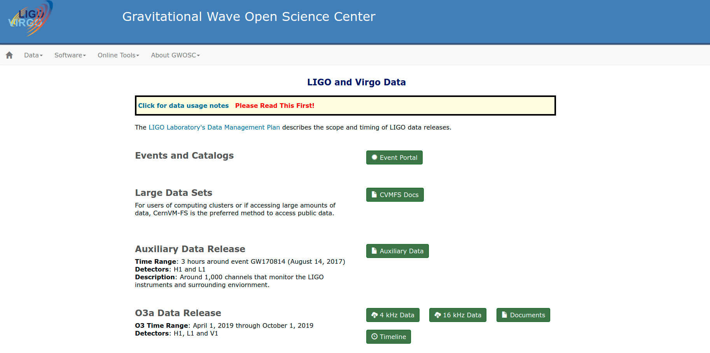
GW Data - Getting open data
Data from around each reported GW from O1-O3a is available for anyone to access
How can I get LIGO data to use in my research?
2 options:
GWOSC (Gravitational Wave Open Science Center)
GWpy
Available data on GWOSC. https://www.gw-openscience.org/data/.

Slide 4
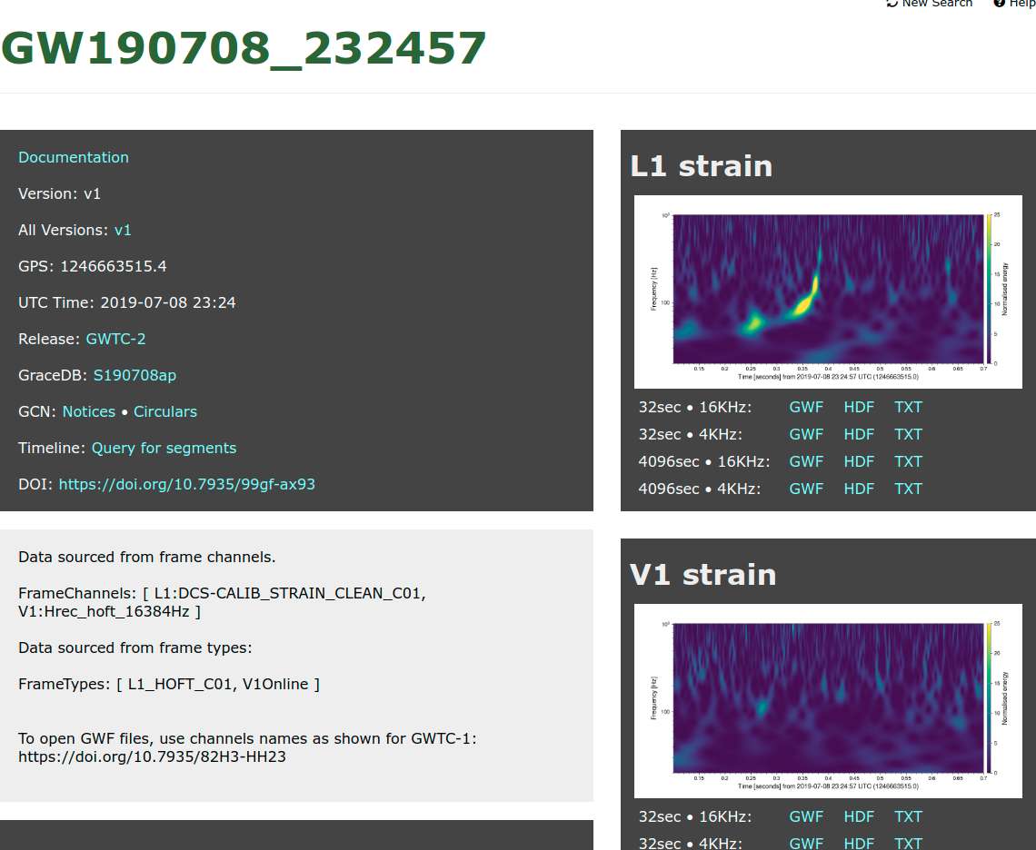
GW Data - Getting open data
GWOSC advantages:
Easy to navigate UI
No specific programming knowledge needed to download data
GWOSC disadvantages
Slow for multiple data pulls
O4 event rate: ~1/day
Data available in .gwf, .hdf5, .txt formats
GWOSC data for a GW event. From https://www.gw-openscience.org/eventapi/html/GWTC-2/GW190708_232457/v1/.

Slide 5
GW Data - Getting open data
GWOSC alternative: GWpy
GWpy is a Python package that integrates LIGO data-fetching routines with common astronomy, numerical and graphical demands
Also works with LALSuite (LIGO Algorithm Library) code
C code wrapped with Python using SWIG
More information
https://gwpy.github.io/docs/stable/index.html

Slide 6
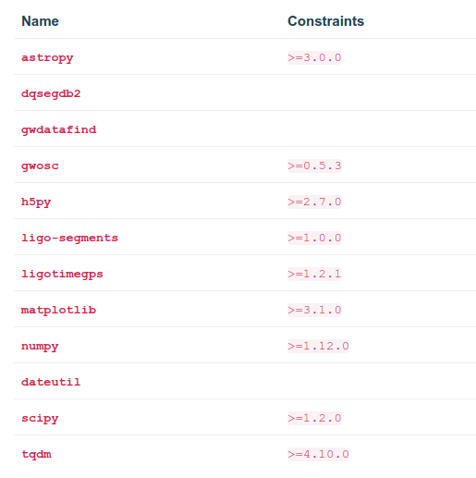
GW Data - Getting open data
Even if you aren’t familiar with Python, it’s simple to pull GW data with GWpy
Get GWpy: for Python version 3.6+
Conda install -c conda-forge gwpy
Python -m pip install gwpy
Additional constraints:
GWpy required auxiliary packages. From https://gwpy.github.io/docs/stable/install/index.html.

Slide 7
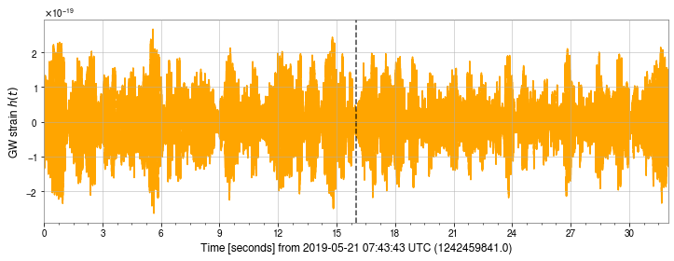
GW Data - Getting open data
Using GWpy 2.0.3 for in the LIGO igwn-py36 environment
Retrieve data for GWTC-2 event GW190521_074359
32 seconds of publicly available H1 GW strain data centered on the approximate time of GW190521_0743359.

Slide 8
GW Data - Getting open data
What is produced by the fetch_open_data() method?
Strain data
DeltaL/L
Metadata
Channel name
Time/frequency information
Observatory
Data quality information
For each catalog event, GWOSC/GWpy provides 4096 seconds of 16384 & 4096 Hz data centered on the event time
Calibration lines and known environmental noise in the data are removed
Not useful below 10 Hz

Slide 9
GW Data - Frequency domain GW data
We’re also interested in the frequency-domain content of the signal
Reminder: a function can be rewritten as a combinations of sines and cosines
Fourier series:

Slide 10
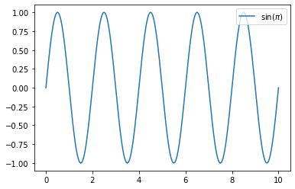
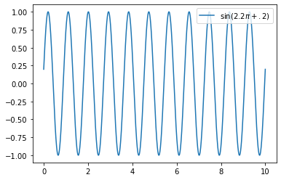
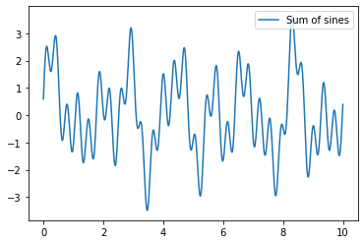
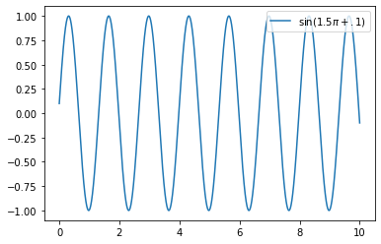
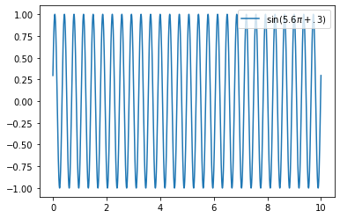
GW Data - Frequency domain GW data
+
=
Adding sine waves to produce some function.

Slide 11
GW Data - Frequency domain GW data
For a given time-domain signal, we can determine both the frequencies of the sinusoids used to “construct” it as well as their amplitudes
We can write this prescription for the time domain function as a function of frequency

Slide 12
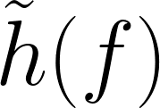
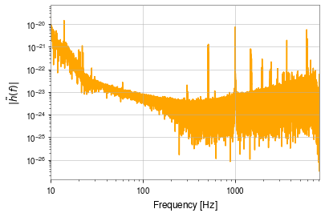
GW Data - Frequency domain GW data
We can take (fast) Fourier transform of the time-domain signal to see
FFT of the H1 timeseries data.

Slide 13
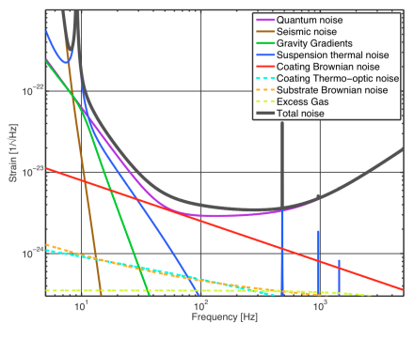
GW Data - Frequency domain GW data
We can take (fast) Fourier transform of the time-domain signal to see
Theoretical aLIGO noise budget. From LIGO DCC T1400316-v5
FFT of the H1 timeseries data.

Slide 14
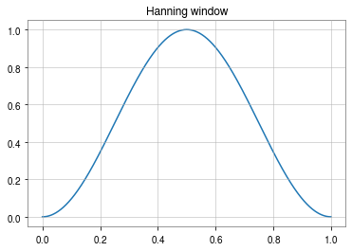
GW Data - Frequency domain GW data
Discrepancy between our plot and LIGO sensitivity due to an underlying assumption of the FT process
FFTs assume the data is periodic
Endpoints of the signal introduce large discontinuities - “spectral leakage”
We can limit the errors introduced by “windowing” the data
Combine the signal with a function that privileges information far from the endpoints of the data
Hanning window - the window function of choice.

Slide 15
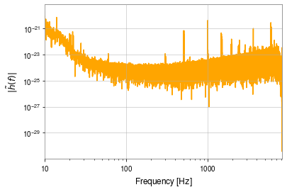
GW Data - Frequency domain GW data
Theoretical aLIGO noise budget. From LIGO DCC T1400316-v5
Windowed FFT of the H1 timeseries data.

Slide 16
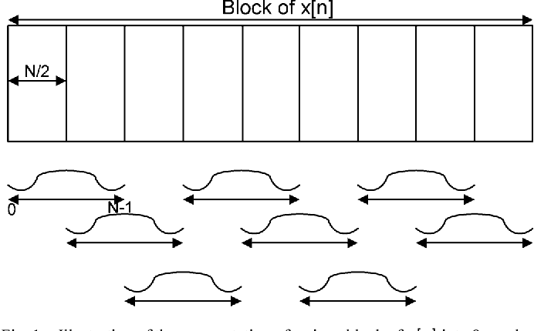
GW Data - Frequency domain GW data
The spectrum produced by the FFT is nice, but is highly variable
Instrument glitches
Environmental noise
Preferable to average several shorter FFTs together to make spectra
Welch’s method
Split the signal into overlapping chunks
Multiply each chunk’s signal by a window function
Perform an FFT on each chunk
Average the amplitude reported in each frequency bin across each FFT
Schematic of the chunking & windowing process of Welch’s method. From https://doi.org/10.1109/TCSI.2013.2264711.

Slide 17
GW Data - Frequency domain GW data
Result - amplitude spectral density of the GW data
Signal amplitude in frequency bin per sqrt(Hz)
Square root of the power spectral density
Power in frequency bin per Hz

Slide 18
GW Data - Frequency domain GW data
Why couldn’t we see the GW in the timeseries beforehand?
Compare amplitude at low frequencies to amplitude at “detection-band” frequencies
We can use GWpy to suppress the response at low frequencies via whitening
Windowed FFT of whitened H1 timeseries data.

Slide 19
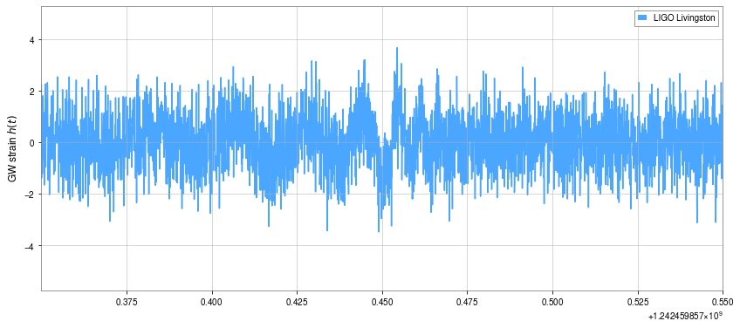
GW Data - Frequency domain GW data
Clear inspiral present in Livingston data

Slide 20
GW Data - Spectrograms, PSDs and Q-transforms
We can use ASDs to produce other powerful visualization tools
A spectrogram combines a series of ASDs on a chunk of data
Shows frequency-domain evolution over time
Time-frequency-amplitude plots
At each time, the spectrogram plots the amplitude in a certain frequency bin
Changing signal characteristics appear as changing colors on the spectrogram

Slide 21
GW Data - Spectrograms, PSDs and Q-transforms
GWpy provides two methods or computing spectrograms
spectrogram() shows an averaged ASD for each time slice
spectrogram2() computes only FFT per time slice
spectrogram() is preferable for long periods of data
spectrogram2() sensitive to short noise bursts - no averaging to smooth each time slice

Slide 22
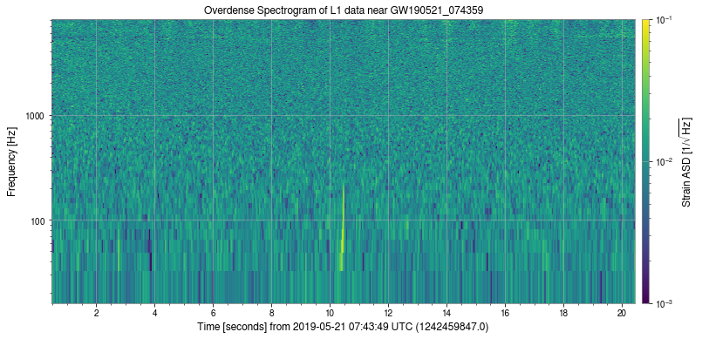
GW Data - Spectrograms, PSDs and Q-transforms
These provide us another way to see a GW signal
Highly overlapping FFTs used to make more features in the data apparent

Slide 23
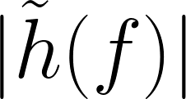
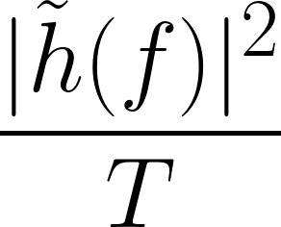
GW Data - Spectrograms, PSDs and Q-transforms
Our code for the spectrogram has a square root in it
GWpy makes spectrograms with power spectral densities rather than amplitude spectral densities
When we calculated our GW ASD, we found ~
is the energy spectral density divided by the time, or the PSD
Units: power in frequency bin per Hz

Slide 24
GW Data - Spectrograms, PSDs and Q-transforms
Q-transform similar to an FFT
Analysis window inversely proportional to frequency
Q-transform is the IFFT of some FFTed data plus a frequency shift times a windowing function
Useful for describing evolution of time-frequency features that happens over short timescales (like a GW)

Slide 25
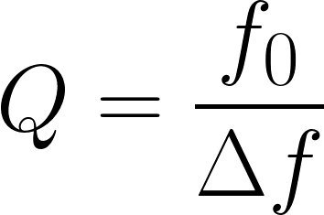
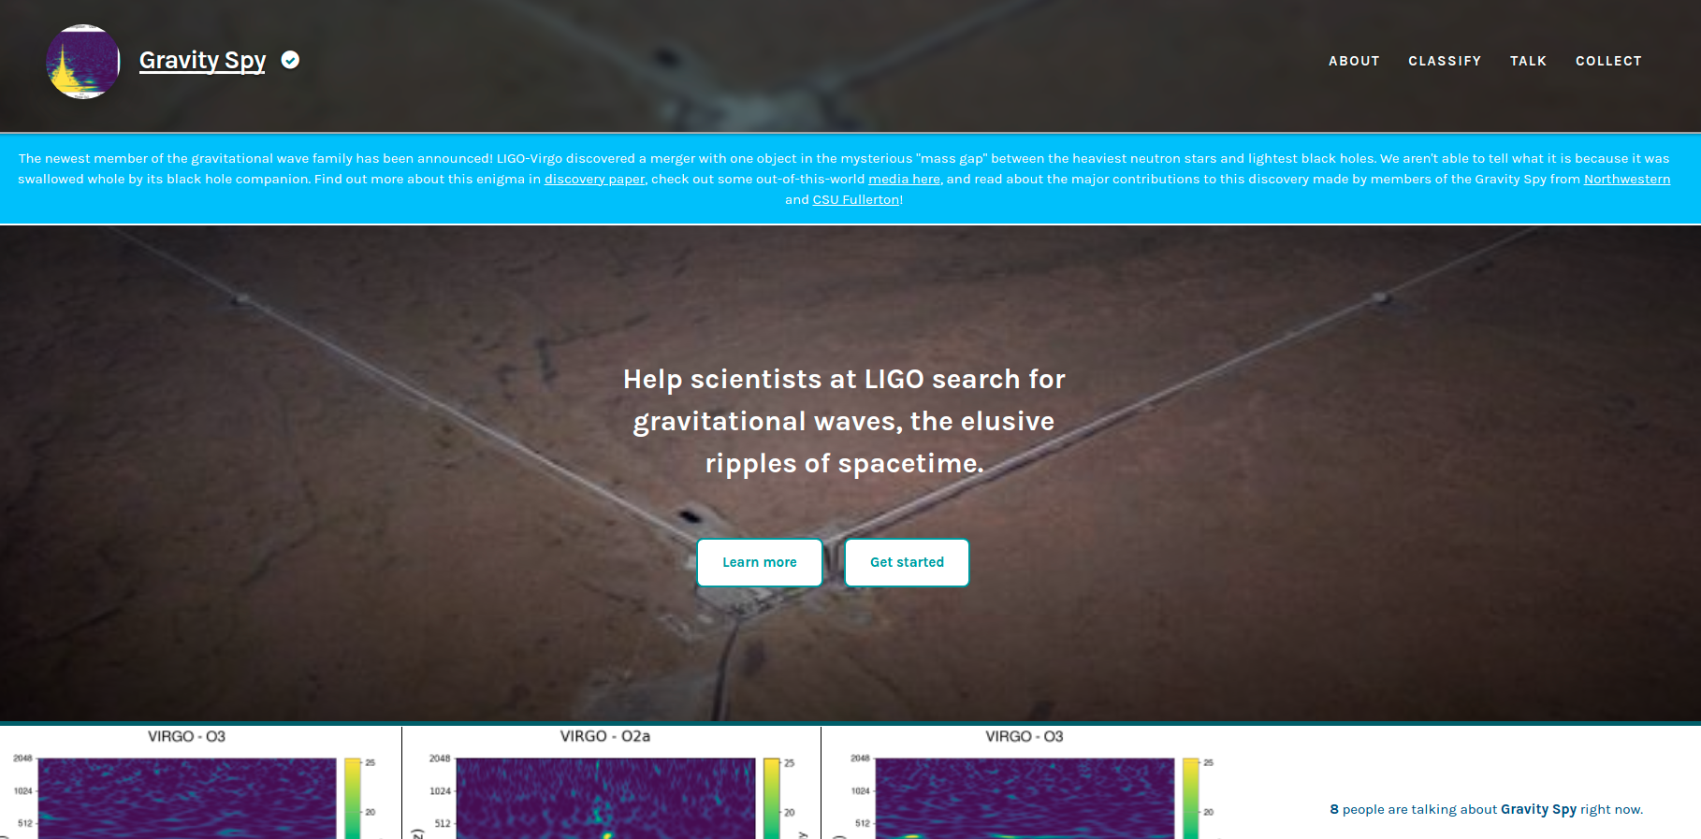
GW Data - Spectrograms, PSDs and Q-transforms
The “Q” in Q-transform comes from the quality factor
Logarithmically spaced frequency bins - closer to how humans perceive frequency/amplitude differences
Gravity Spy Zooniverse page. https://www.zooniverse.org/projects/zooniverse/gravity-spy.

Slide 26
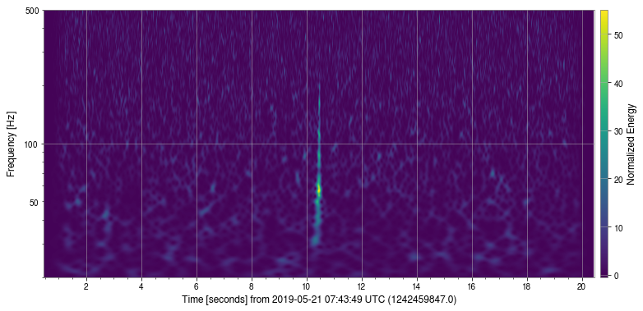
GW Data - Spectrograms, PSDs and Q-transforms
Livingston GW signal

Slide 27
Some things we can work on:
Installing & configuring GWpy
Comparing GW events and noise features between interferometers and epochs
Reviewing this information by going through the GWOSC tutorials

