Slide 1
University of Washington Seattle Eöt-Wash Group Overview
GWANW 2021
Michael Ross

Slide 2
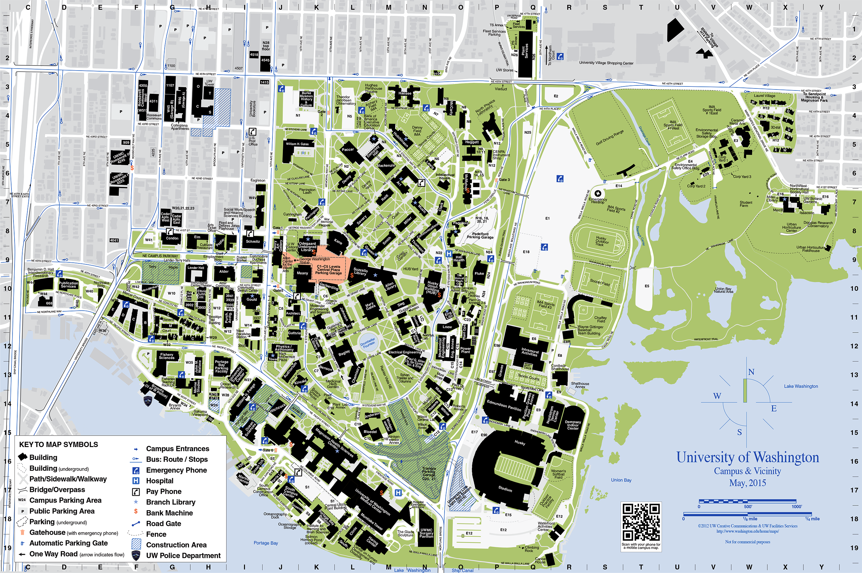
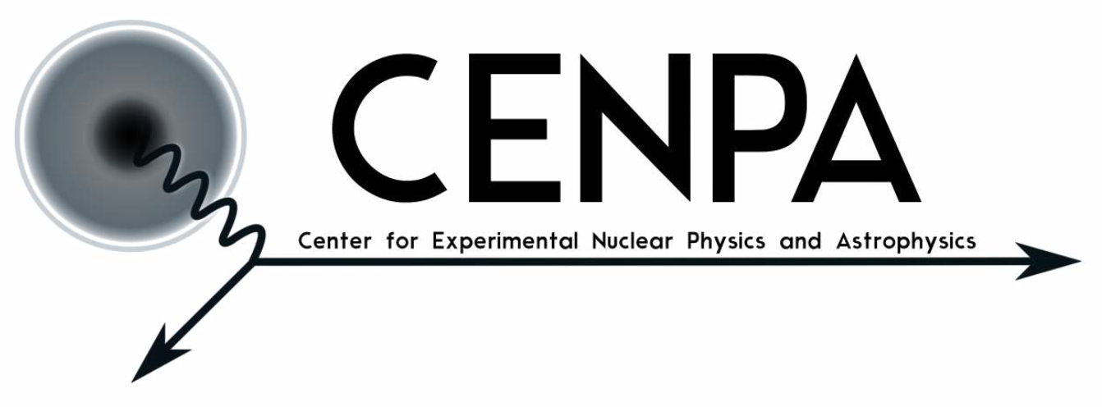
CENPA – Center for Experimental Nuclear Physics and Astrophysics

Slide 3
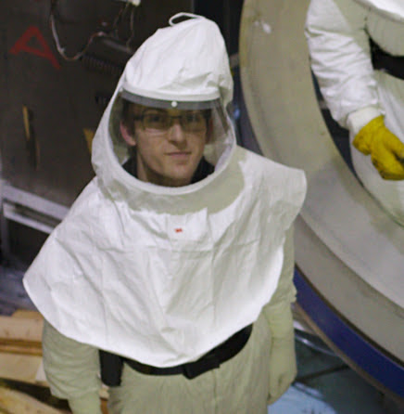
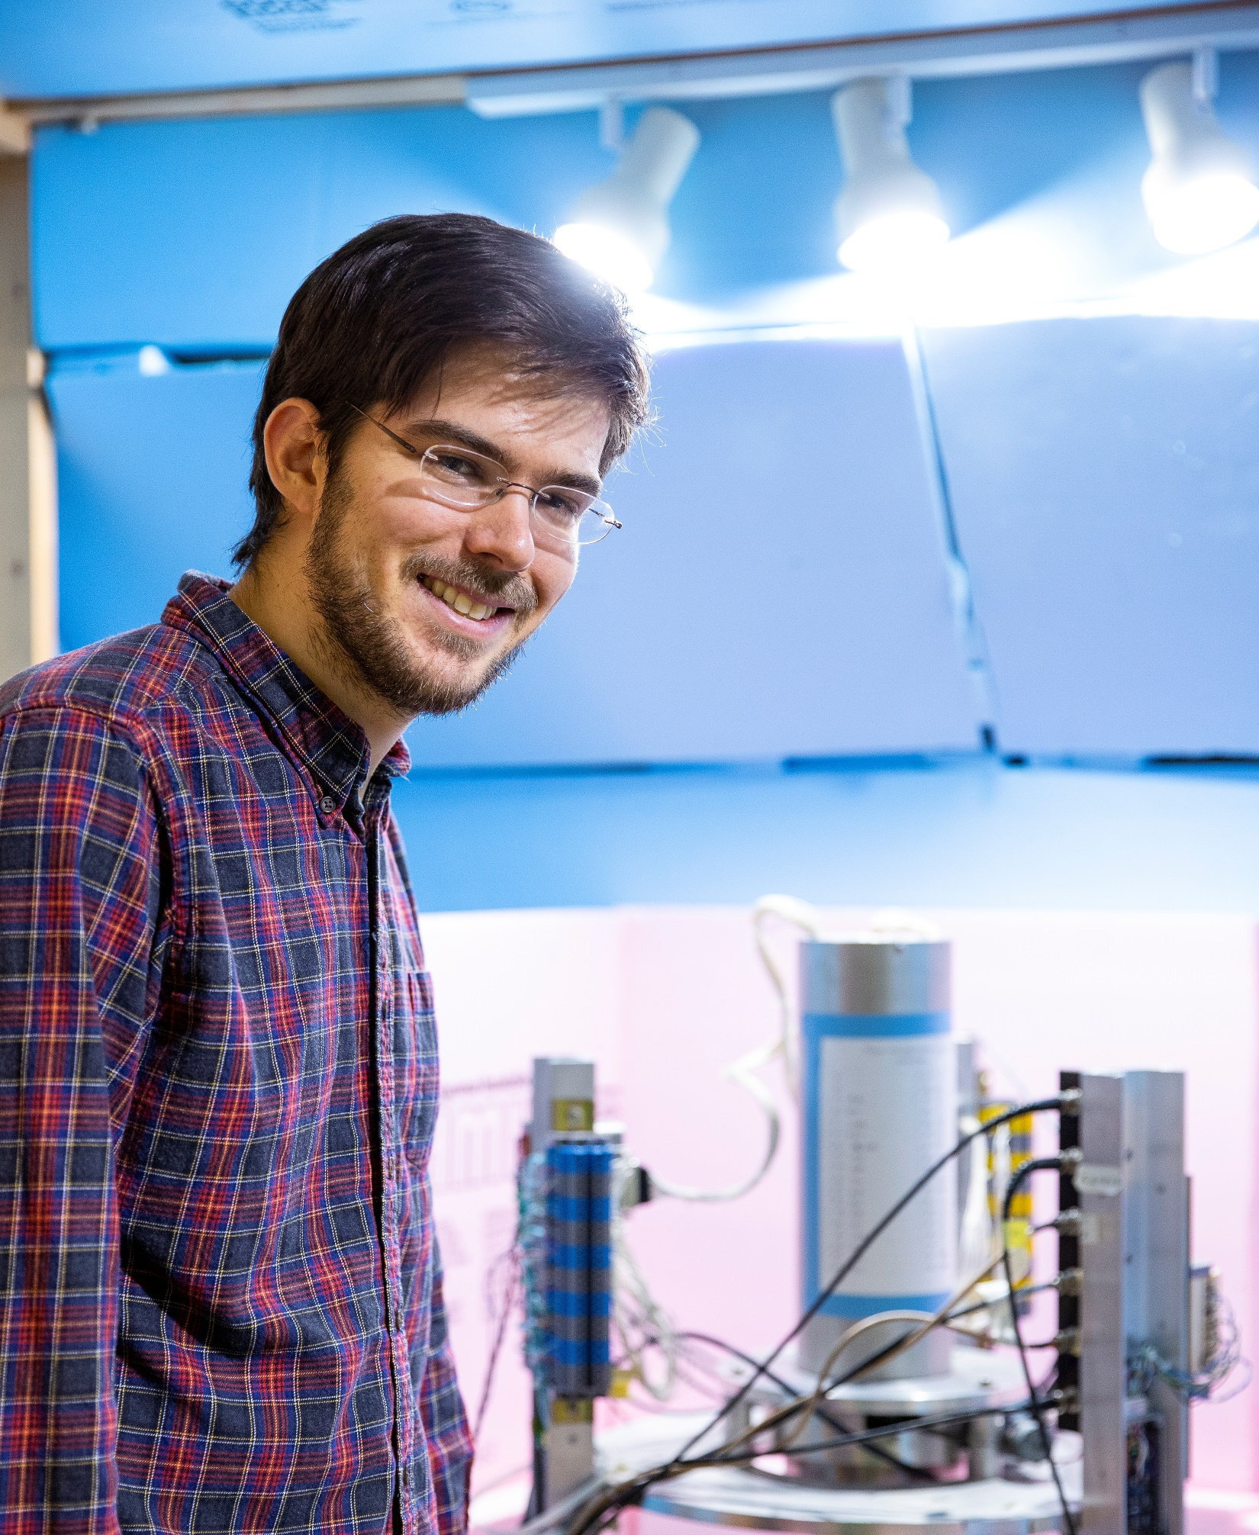
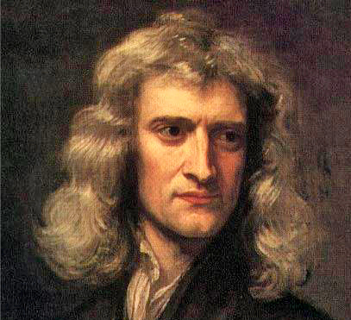
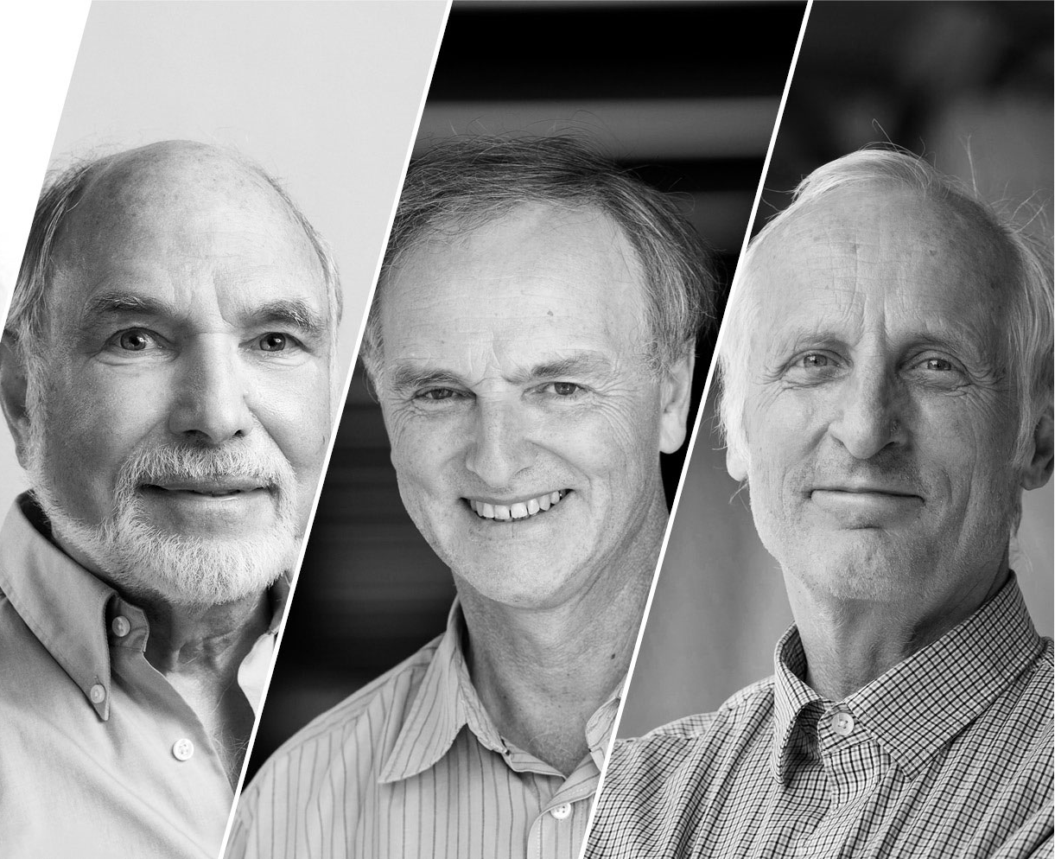
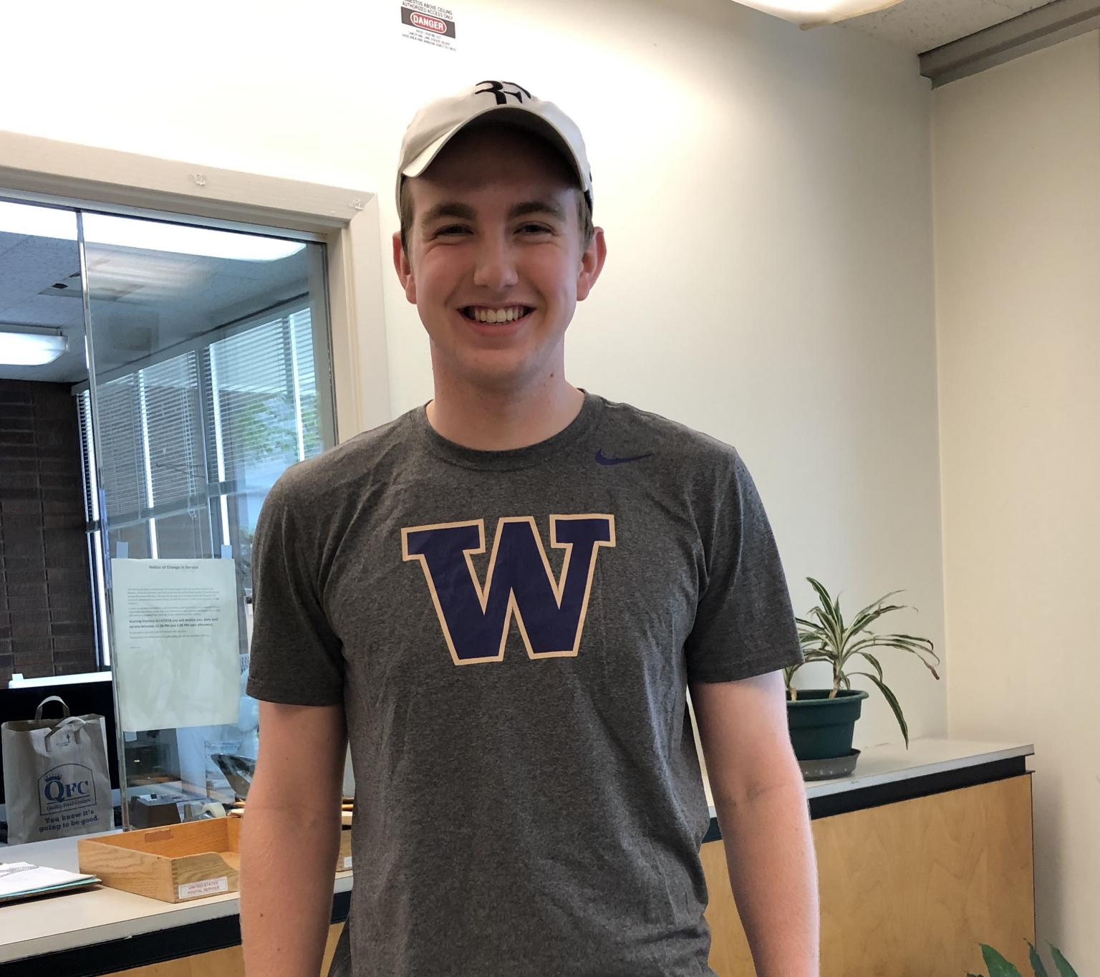
Eöt-Wash Group
Professors
Michael Ross
(Postdoc)
Erik Shaw (Grad. Student)
Conner Gettings
(Postdoc)
Eric Adelberger
Jens Gundlach (PI)
Blayne Heckel
Colin Weller
(Undergrad. RA)
John Waldroup
(Postgrad RA)
Jade Cox
(Undergrad. RA)
Hopefully more students soon!

Slide 4
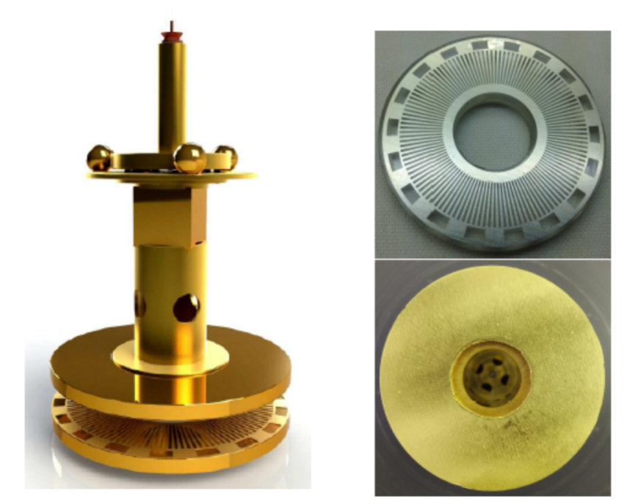
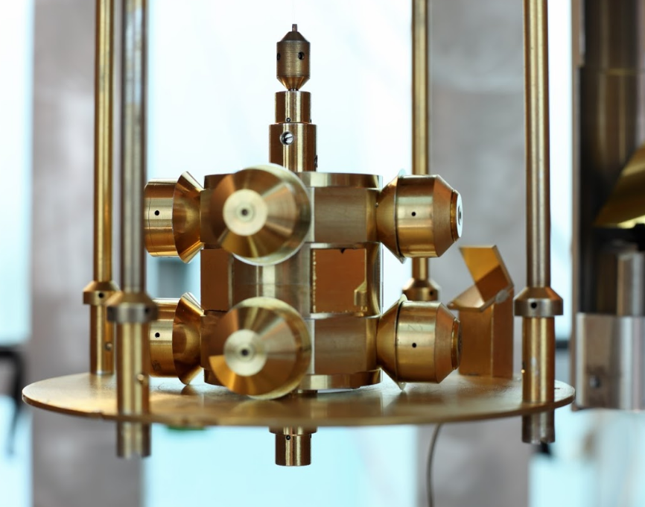
Torsion Balance Experiments
Testing gravity since the 1980s
We use torsion balances to:
Test gravity’s short-range behavior
Verify the equivalence principle (EP)
Search for ultra-light dark matter
Measure gravitational constant, G
Recent short-range results reached separations of 52 μm: arxiv.org/abs/2002.11761
On-going experiments:
Search for atto-eV (${10}^{−18})$ mass dark matter
Upgraded EP test
Test of EP for superconductors
$$V\left(r\right)=−\frac{G m_{1}m_{2}}{r}\left(1+α e^{−r/λ}\right)$$

Slide 5
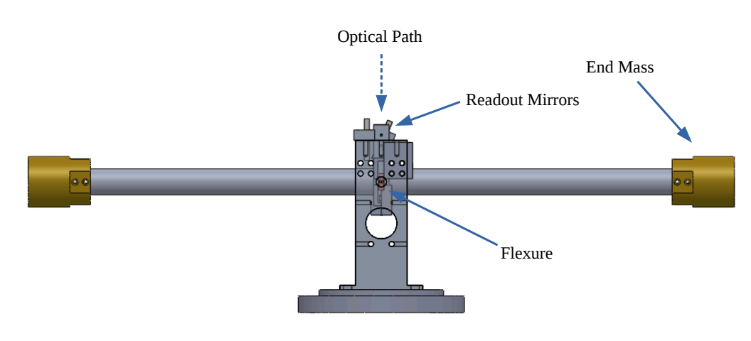
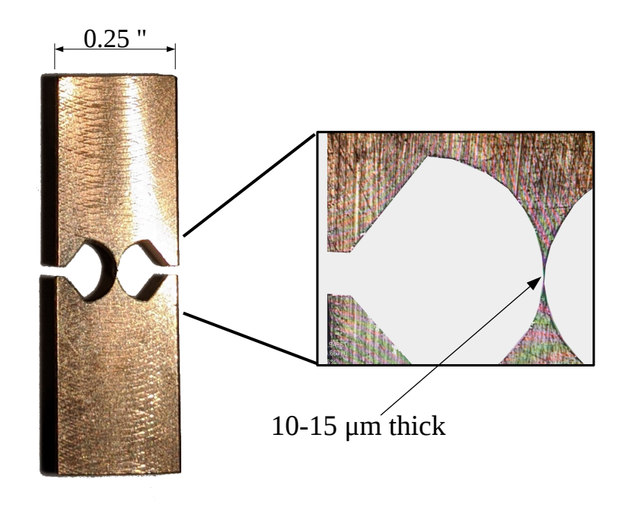
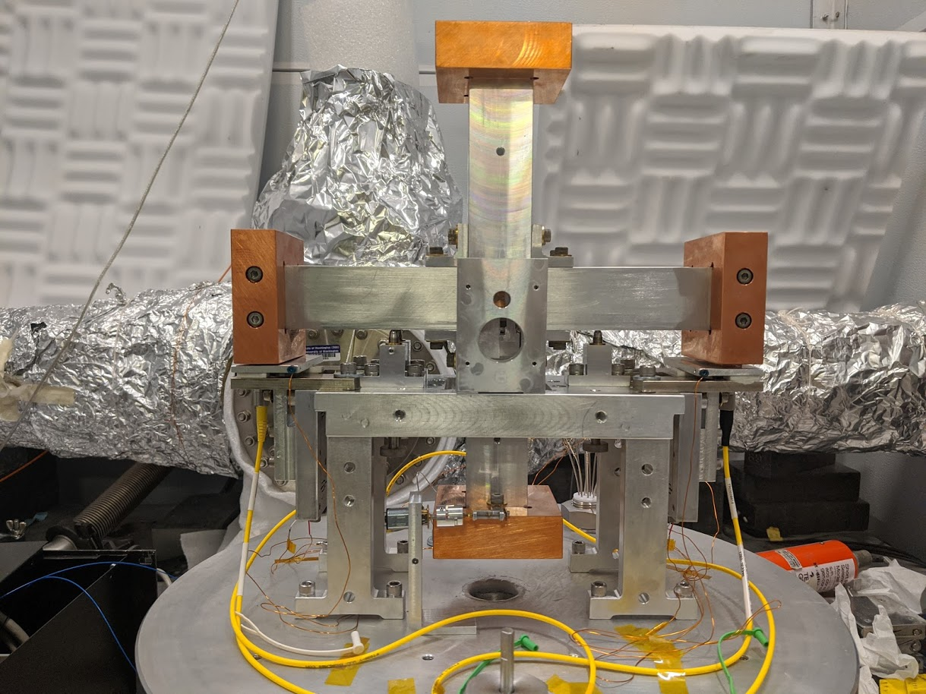
Rotation Sensors
Developed beam-balance based rotation sensors (rotational seismometers)
Proof-mass suspended from 10-15 μm thick Be-Cu flexures forms rotational spring-mass system
Three versions:
Beam Rotation Sensors (BRS): 1-m long beam, used to sense ground rotation for seismic isolation systems, 6 deployed at LIGO (LHO: 2, LLO: 4)
compact Beam Rotation Sensor (cBRS): 30-cm wide cross, deployed for Newtonian noise test at LHO
Cylindrical Rotation Sensor (CRS): In development, 30-cm diam. cylinder, HoQI readouts, to be installed on ISI
BRS
cBRS
CRS

Slide 6
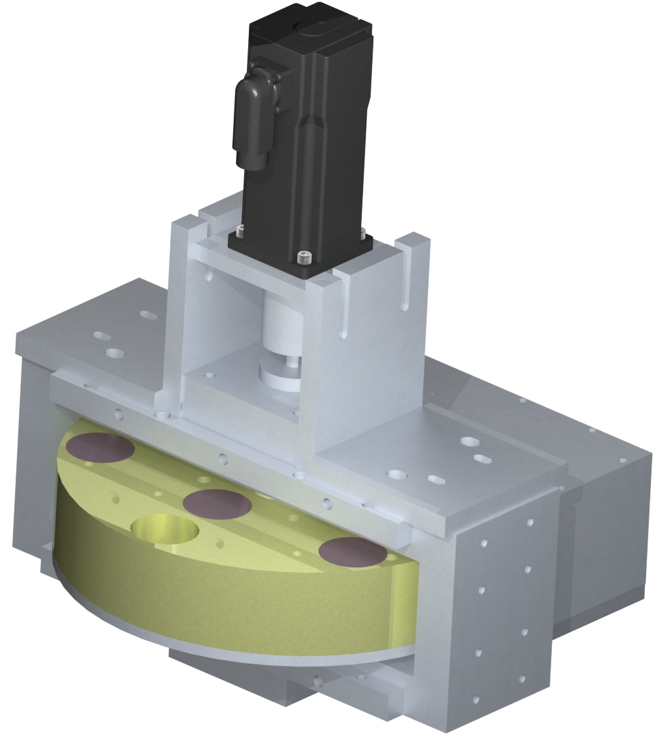
Newtonian Calibrator
“New” way to calibrate LIGO
Injects forces on the test mass with gravity instead of photon pressure
Aluminum rotor with tungsten slugs inserted into it injects at two times and three times the rotation rate
Successfully injected forces during LIGO’s third observing run
Initial Results Paper (to be submitted tomorrow): P1900244

Slide 7
GW Detection with GRACE Follow-On
Even though GRACE Follow-On only has one arm, it can still detect GWs
Should be able to detect IMBH mergers within the Milky Way
Set limits on stochastic GWs comparable with limits due to seismology
Feasibility Paper: arxiv.org/abs/2002.02044
Although unlikely, it’s worth searching for events since GRACE-FO is already operational
Very early stage of data analysis pipeline in progress

Slide 8
Thanks

