Slide 1
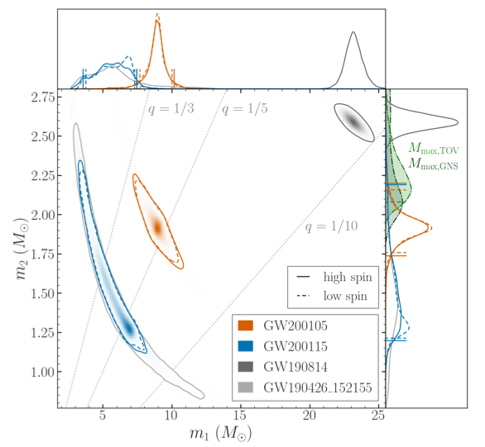
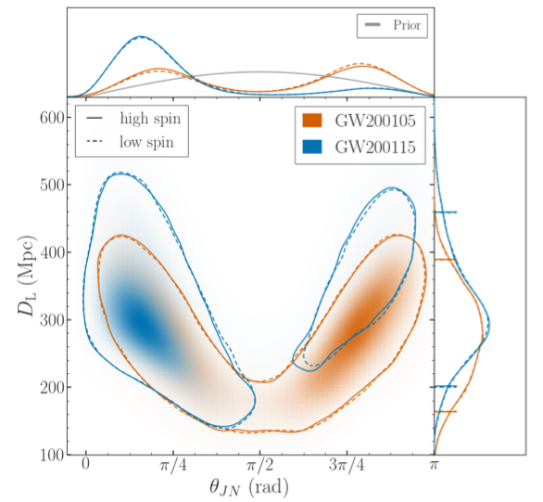
Fact Sheet
GW200105 GW200115
First observation of neutron star-black hole (NSBH) binaries
All parameter ranges correspond to 90% credible bounds. Quoted values are for high spin (<0.99) neutron-star priors
 | GW200105 | GW200115
observed by | LIGO Livingston and Virgo | LIGO Livingston & Hanford and Virgo
date, time | 5 Jan 2020, 16:24:26 UTC | 15 Jan 2020, 04:23:10 UTC
likely distance source redshift | 170 to 390 Mpc 0.04 to 0.08 | 200 to 450 Mpc 0.05 to 0.10
signal-to-noise ratio | 13.9 | 11.6
false alarm rate | < 1 in 2.8 yr | < 1 in 100,000 yr
Source masses (M⊙) total mass primary (BH) secondary (NS) | 9.7 to 12.0 7.4 to 10.1 1.7 to 2.2 | 5.7 to 8.6 3.6 to 7.5 1.2 to 2.2
mass ratio | 0.18 to 0.30 | 0.16 to 0.61
BH spin | 0.00 to 0.30 | 0.04 to 0.81
effective inspiral spin | −0.16 to 0.10 . | −0.54 to 0.04 .
effective precession spin | 0.02 to 0.23 | 0.04 to 0.51
Inferred merger rate density of NSBH systems*: 12 to 120 yr⁻¹ Gpc⁻³
* Assuming GW200105 and GW200115 are representative of the NSBH population
Images: companion masses (left), distance vs inclination (right), both with low (<0.05) and high (<0.99) spin priors for the neutron stars
Credits: B.S. Sathyaprakash, Penn State and Cardiff University

