Slide 1
The Path Forward for Gravitational-wave Astrophysics
Damour Fest
13 October 2021
David Shoemaker
MIT
G2102164

Slide 2
Plans and dreams for the future of detecting/exploiting
FemtoHz: CMB B-mode primordial stochastic background
NanoHz: signals via Pulsar test masses
MilliHz: signals via inter-satellite timing
HectoHz: signals via ground interferometry
GWIC Roadmap in Nature for more detail

Slide 3
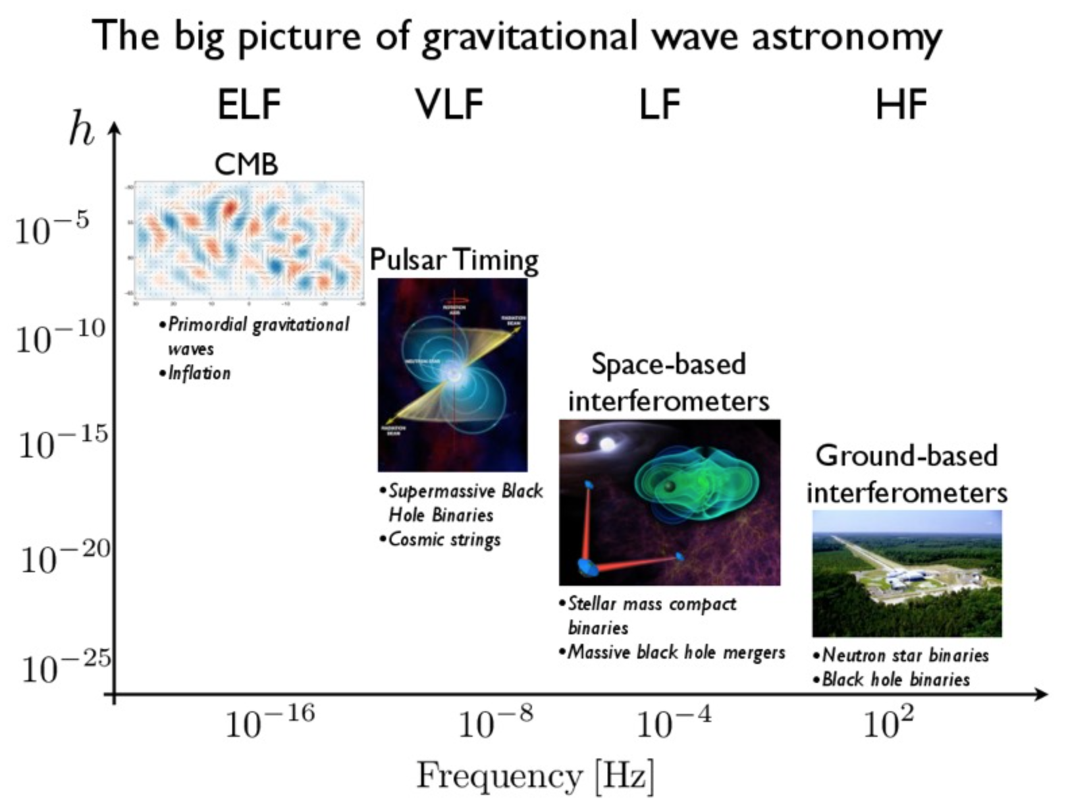
Nanograv

Slide 4
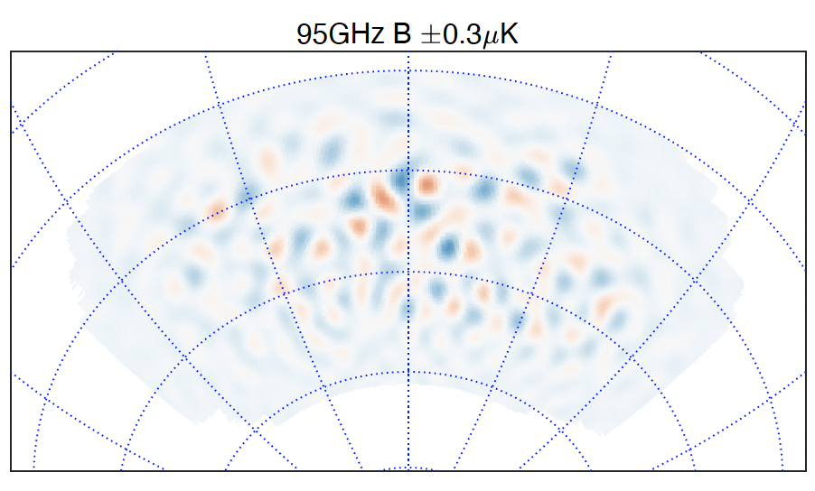
CMB B-mode
The signal of gravitational waves from inflation is the holy grail of cosmology
Measuring primordial CMB B-modes is likely our best opportunity for indirectly observing gravity operating on a quantum scale
Current limit: tensor to scalar ratio r < 0.036 (BICEP/Keck+WMAP/Planck, PRL 127, 151301)
…no detection to date – foreground of galactic dust is challenging
r = (E/3.3*10¹⁶ GeV)⁴ where E is the energy s scale of inflation
E, 10¹⁶ GeV | r
3.3 | 0.1
1 | 0.01
0.6 | 0.001
Hazumi&Lee; Page

Slide 5
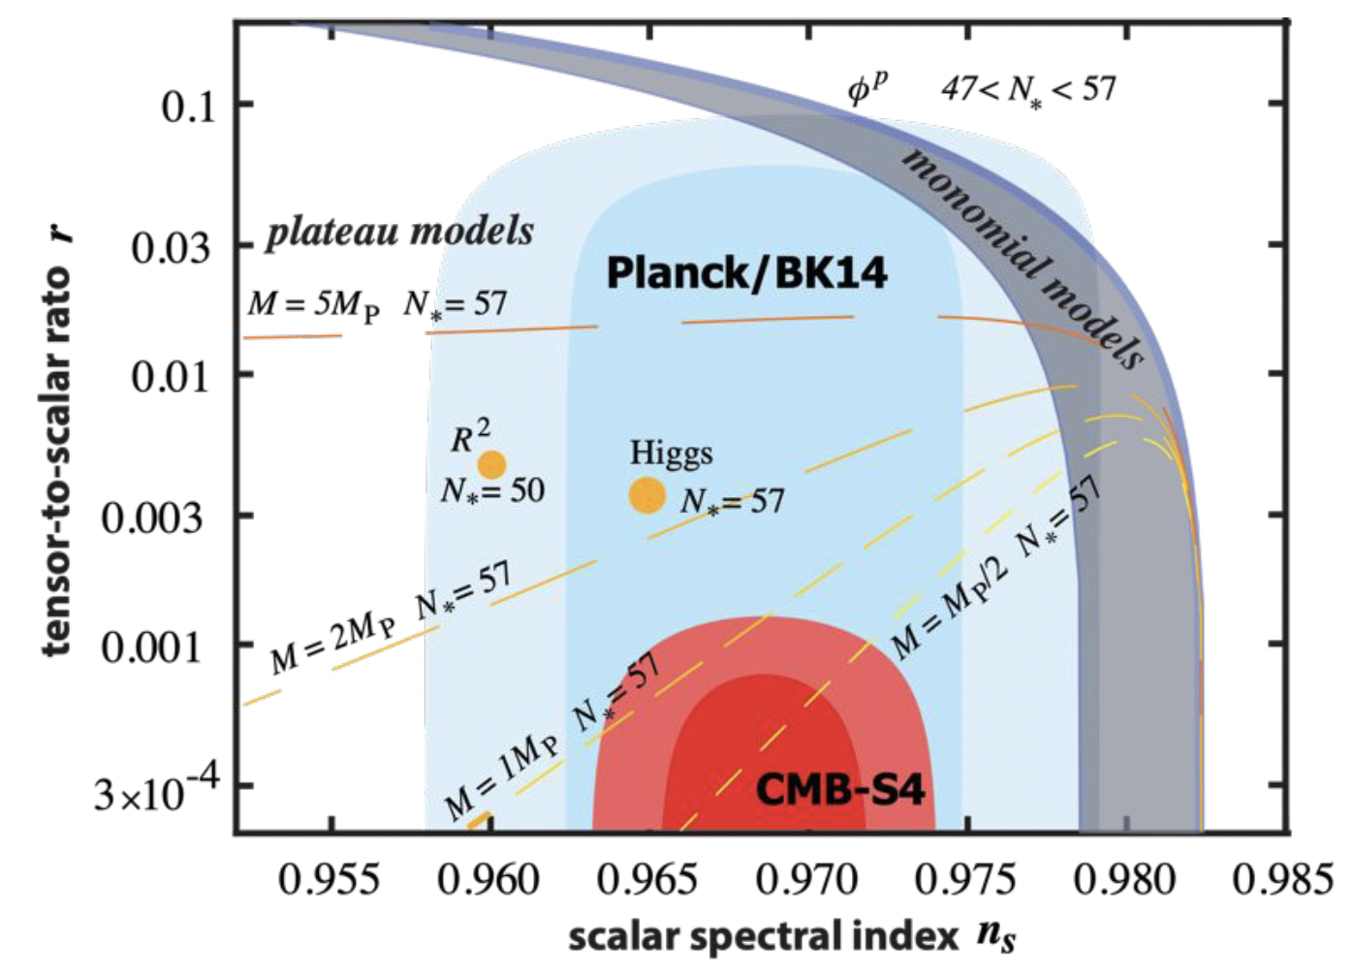
The Future: CMB-S4
CMB-S4 is the next-generation ground-based cosmic microwave background experiment.
21 telescopes at the South Pole and in the Chilean Atacama desert
Multi-band detectors to be able to remove contamination from galactic foregrounds
DOE + NSF joint construction project
Commissioning in the late 2020s
7 years of operations through 2030s
>10x improvement in sensitivity
CMB-S4 sensitivity ensures that a non-detection of r would rule out the leading inflationary models, and motivate alternate models for the origin of the universe
CMB-S4 Science Requirement 1.0:
If r > 0.003: measure at 5𝝈
If r = 0: set r ≤ 0.001 at 2𝝈

Slide 6
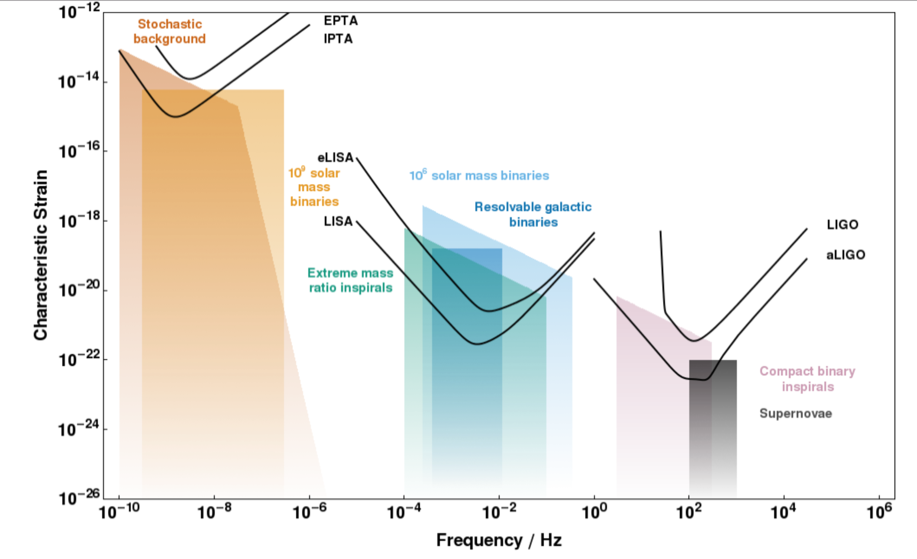
A spectrum of GW Sources and Sensors (trimming off CMB B-modes)
CQG, 32 (2015) 015014

Slide 7
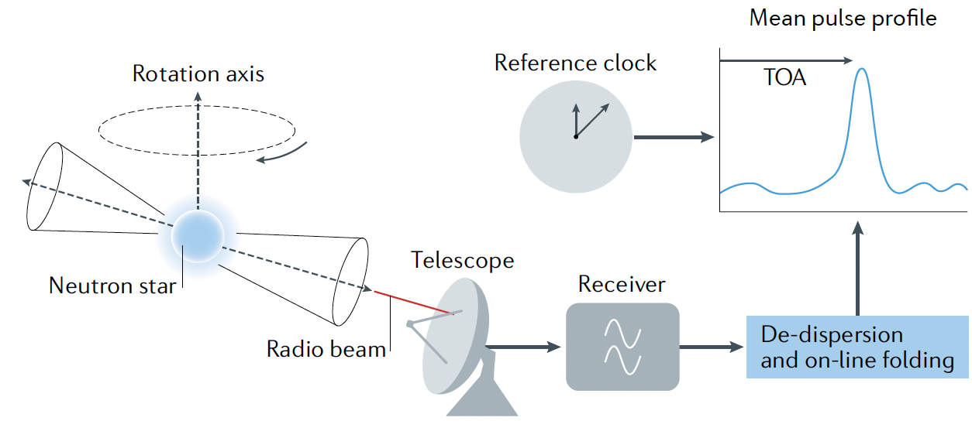
Pulsar Timing Array GW Detectors
Prime target: the stochastic background signal from the cosmological population of gravitationally bound supermassive black hole binaries
May also be able to see some SMBHB inspirals as individual sources
Technique: observe well-characterized msec pulsars, infer distortions of space-time from coherent shifts in timing
Uses an array of ground-based Radio Antennas
Requires search for, and deep understanding of, very stable pulsars

Slide 8
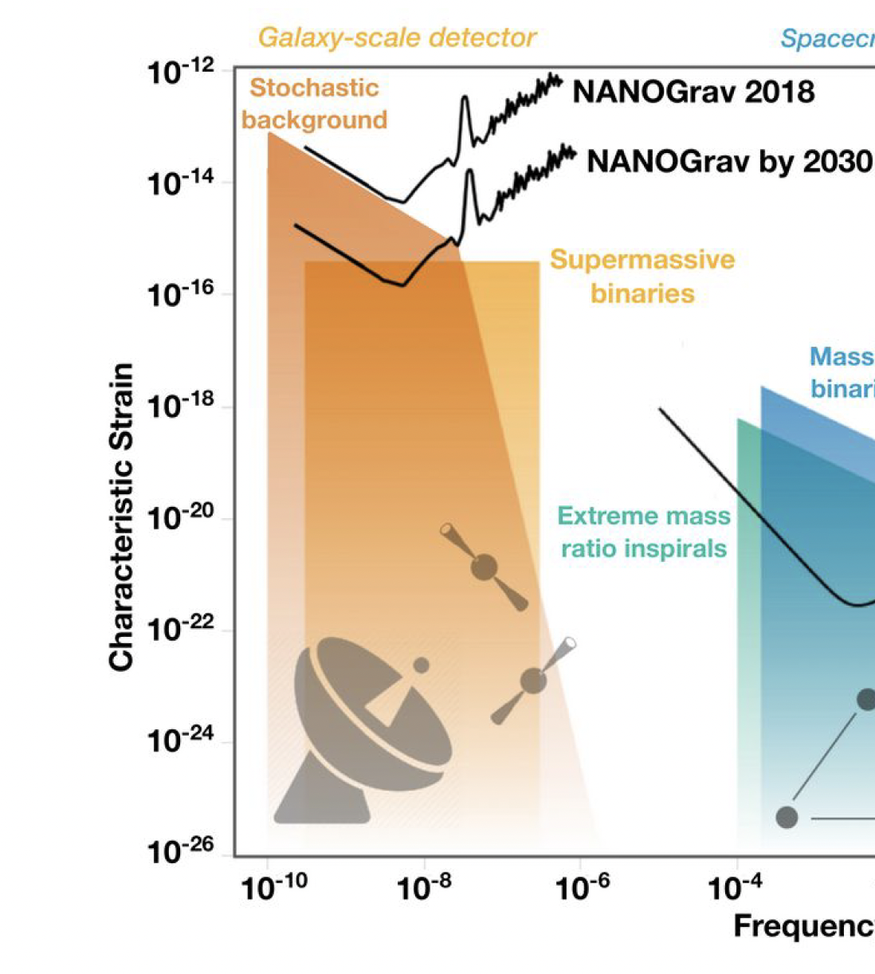
PTA: Projection going forward
The most recent PTA results are from NANOGrav’s analysis of 12.5 years of precision timing data from 47 pulsars
Strong evidence for uncorrelated common red noise process
(GW would show a spatial correlation)
Already constraining Galaxy Formation
Loss of Arecibo…gain of Tianyan, Chime
Foresee ~factor 10 improvement in ~10 years
Nihan Pol (arXiv:2010.11950)
S. Taylor, C. Mingarelli

Slide 9
A spectrum of GW Sources and Sensors
CQG, 32 (2015) 015014

Slide 10
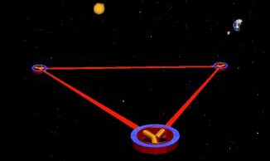
LISA
Notion of a space-based interferometric detector dates from 1974
Rai Weiss and Peter Bender; napkin
Basically a timing measurement between test masses in space
Take advantage of vacuum in space: make very long arms
ΔL = h · L; L can be ~10⁹ m, making ΔL ~10⁻¹¹ m workable (not LIGO’s 10⁻¹⁹)
Best sensitivity to milliHz sources – targets 10³ – 10⁹ M⦿
Triangular configuration
Sums and differences around the triangle
Allows both polarizations of the gravitational waves to be measured
Provides signals to remove laser frequency noise
Earth-trailing orbit provides scan of the sky, provides sky localization

Slide 11
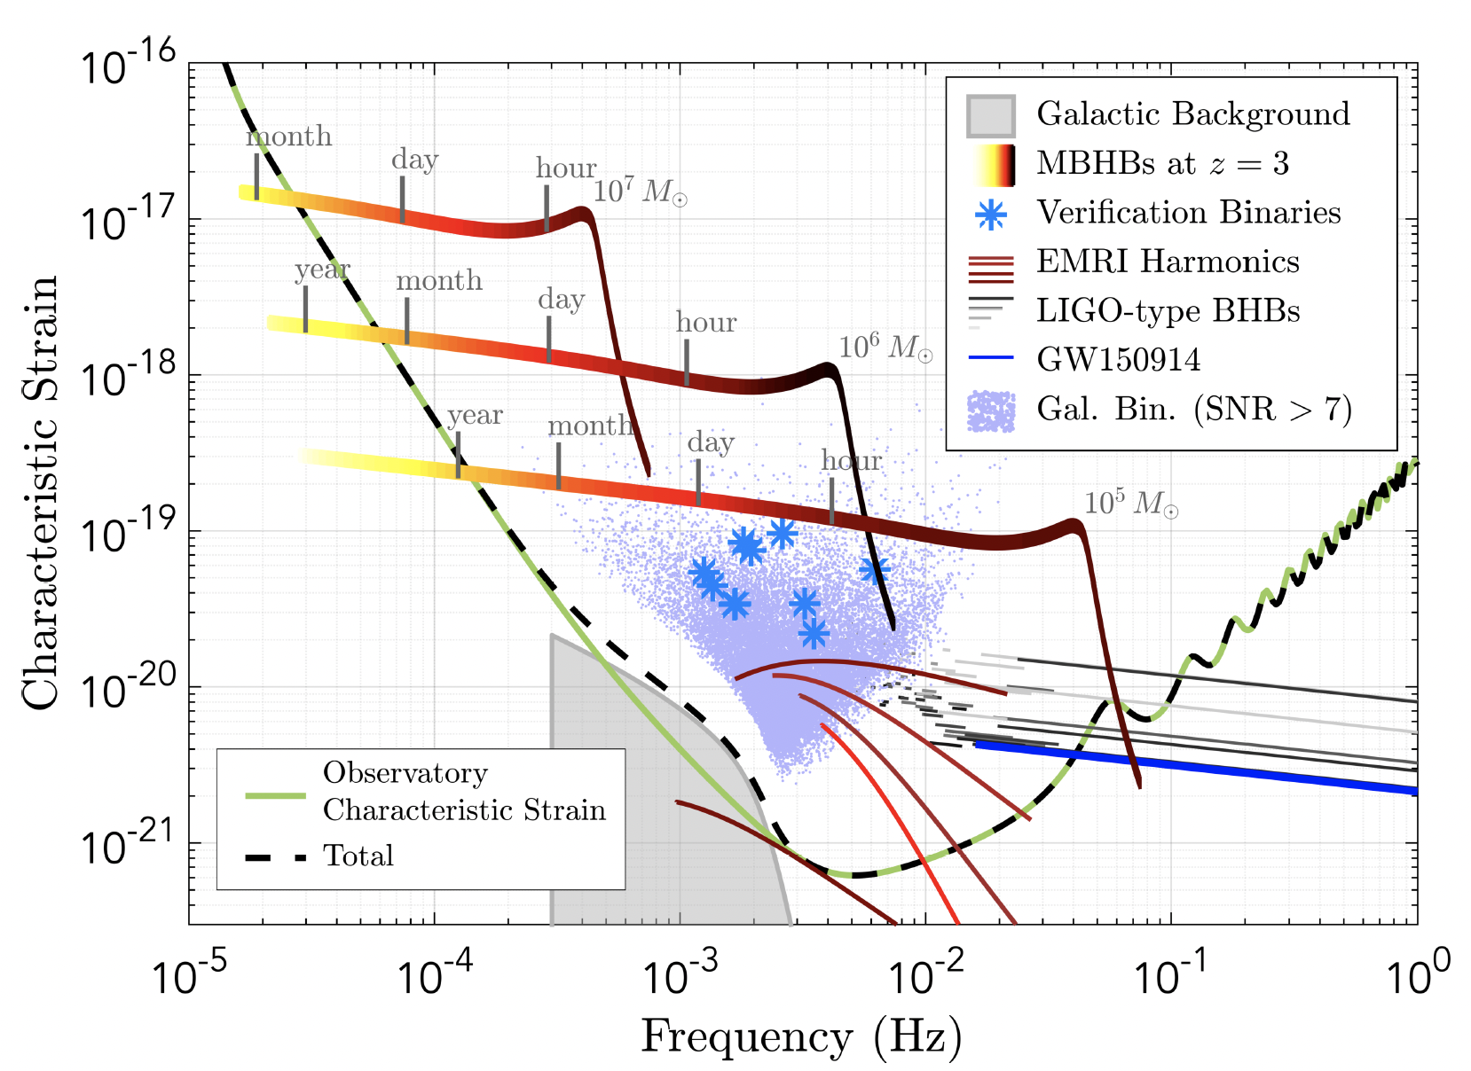
LISA Status
LISA’s Projected science capabilities are breathtaking – mapping of SMBH by IMBH test particles, understanding galaxy formation, unprecedented tests of GR via Thibault’s waveforms…
Key ‘free-fall’ technology beautifully demonstrated by LISA Pathfinder
Telescope is the principal untested instrument element
Systems challenges – alignment, cross-couplings
Mostly just making it robust, redundant, and making 3 satellites, 6 transponders, in time for launch
ESA ‘L’ mission, broad European member-state participation, NASA a junior partner
Mission Formulation Review underway; on track for
2025 adoption
Mid-2030’s launch
4 year mission, 10-year consumables

Slide 12
A spectrum of GW Sources and Sensors
CQG, 32 (2015) 015014

Slide 13
Ground-based instruments
3 Epochs relevant for this ‘future’ discussion:
Building out the network of current ‘Advanced Detectors’
Full exploitation of the present observatories
3rd generation instruments in New Observatories
I’ll just use binaries to indicate sensitivities
Obviously a wide range of GR, astrophysics, and cosmology can be explored
…Building out the network:

Slide 14
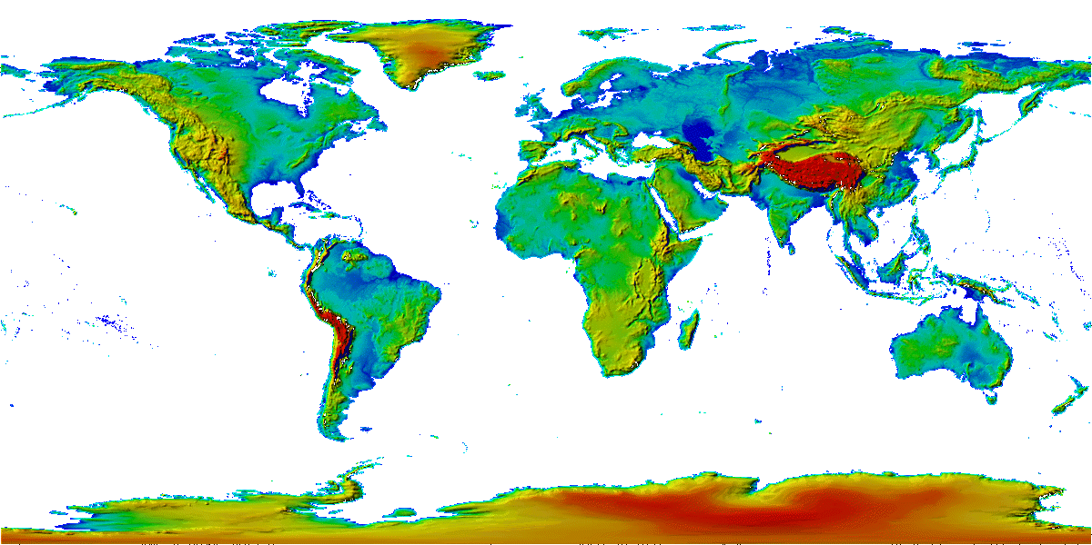
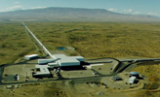
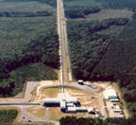
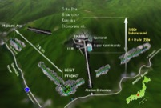
The advanced GW detector network
Advanced
Virgo
2016
Advanced
LIGO
Hanford,
Livingston
2015
KAGRA
2018
LIGO-India
2025
14
14

Slide 15
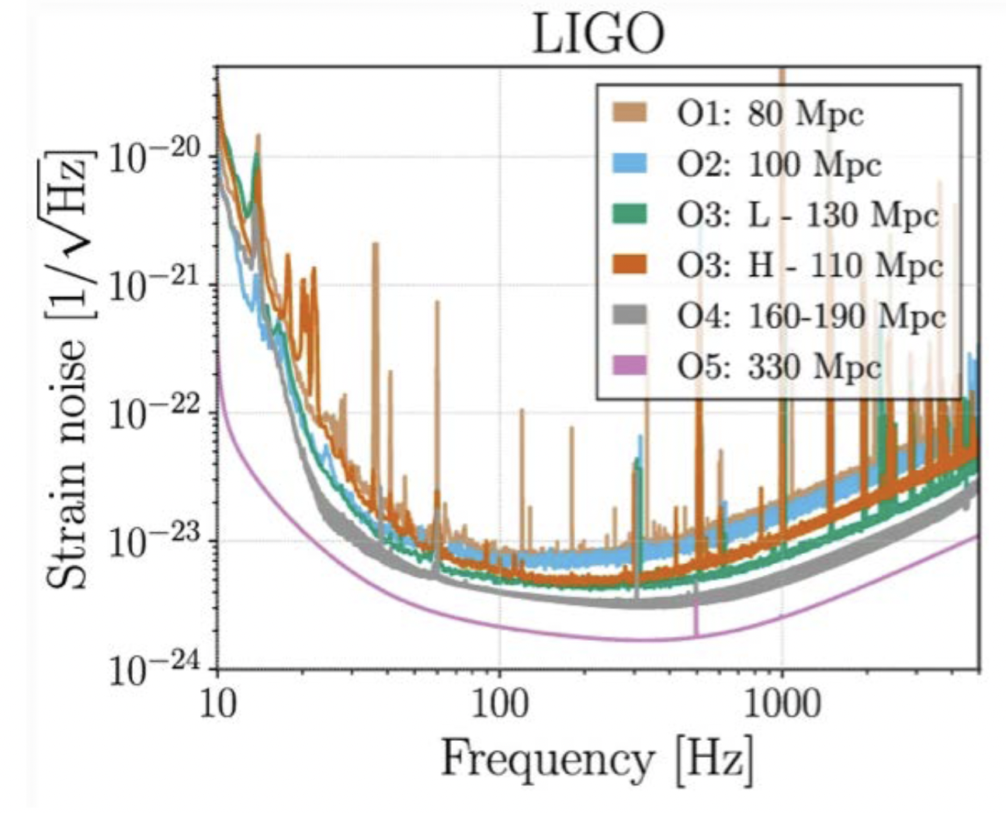
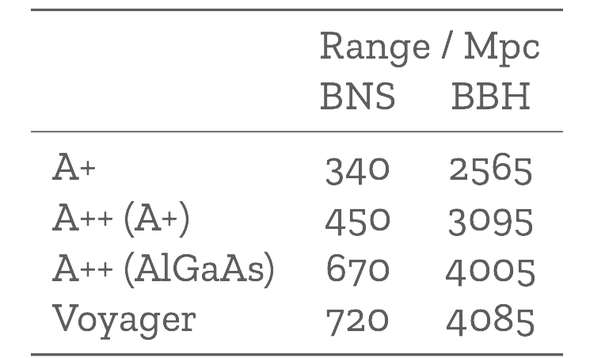
What can we do in a 4km infrastructure?
LIGO, Virgo, and KAGRA will continue to interleave observing and improving sensitivity until the next generation of detectors is in place
…or beyond if there is a good scientific reason
LIGO as example….Near term (to ~2028): well-defined program, leading to ~20x greater event rate, ~2.75x better SNR for given event
Longer term, in 4km infrastructure: Just starting to think about what’s possible, with improvements of another factor 2 in sensitivity, 8 in rate
Kevin Kuns

Slide 16
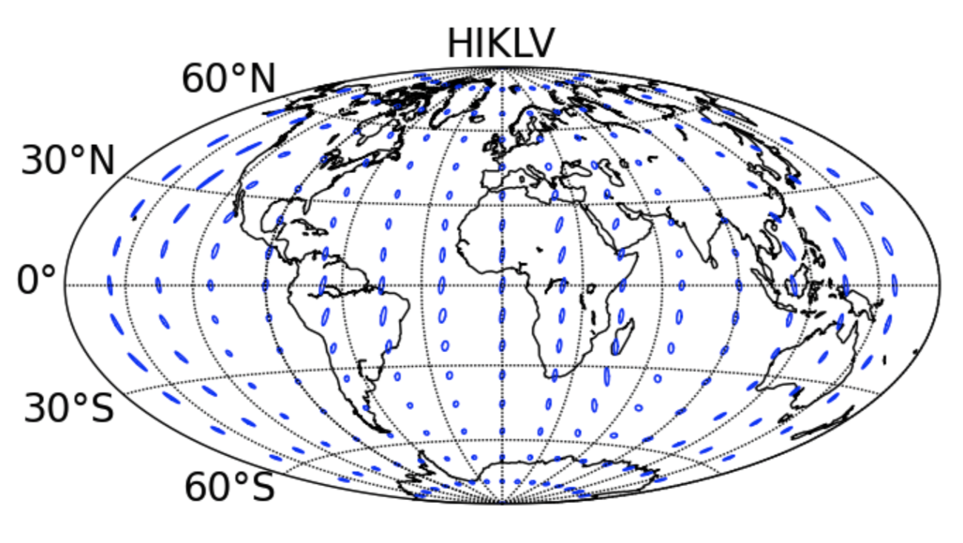
Ability to localize sources
with 5 detectors
~60% in 10 sq deg
Notes:
P0900125-v8

Slide 17
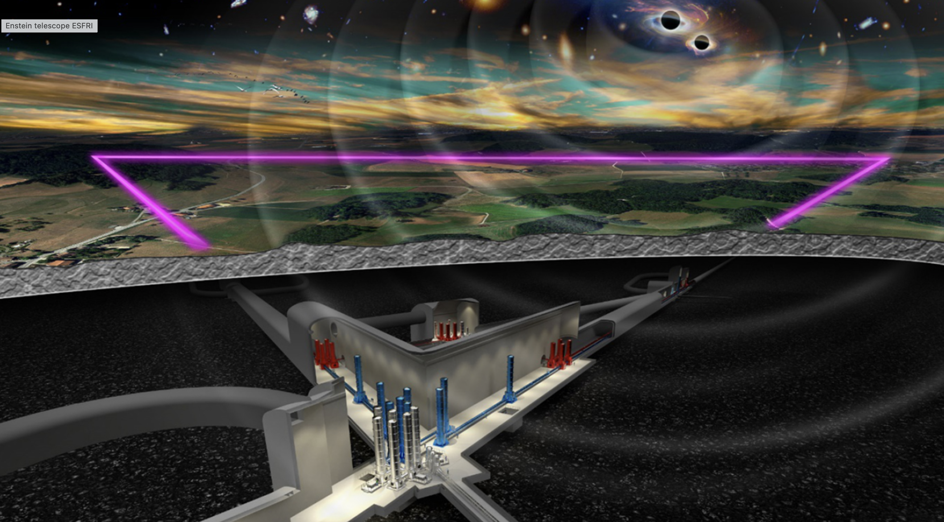
Further Future Improvements: Next Generation Observatories
European Concept: Einstein Telescope
Significant design study undertaken for both Facility and Instruments
Underground construction proposed to reduce Newtonian Background
(and be compatible with densely-populated Europe)
Triangle – LISA-like – with 10km arms; one-site polarization measurement
Multiple instruments in a ‘Xylophone’ configuration
Allows technical challenges for low- and high-frequency to be separated
Designed to accommodate a range of detector topologies and mechanical realizations
Including squeezing and cryogenics
News: placed on the ESFRI Roadmap; Significant step forward!

Slide 19
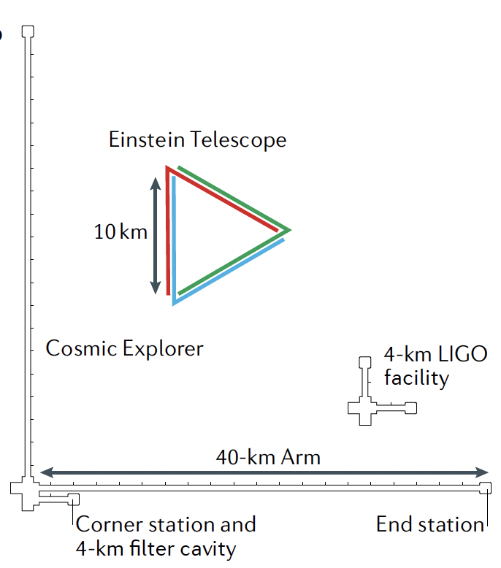
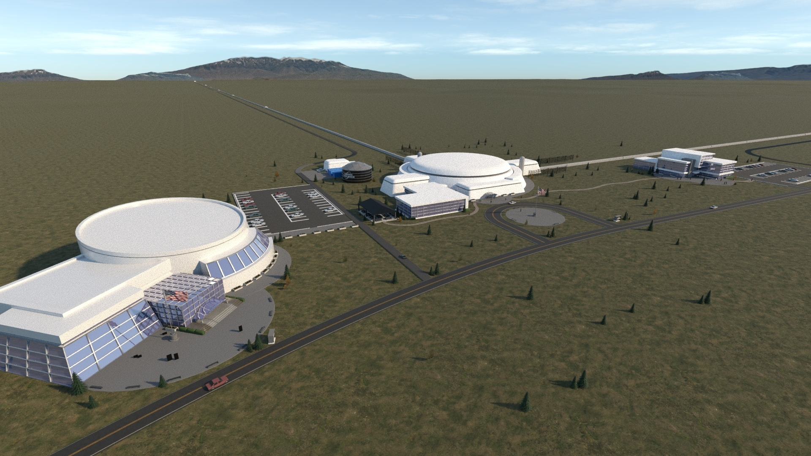
US Concept: Cosmic Explorer
Make Advanced LIGO 10x longer, 10x more sensitive
Thermal noise, radiation pressure, seismic, Newtonian unchanged
Signal grows with length – ΔL = h · L – For wavelengths shorter than the arms; 20km ideal for NS-NS tidal signal detection
Two sites, 40km and 20km; on earth’s surface (needs some earthmoving)
40km ideal for BH-BH horizon
Concept offers sensitivity without new measurement challenges; could start at room temperature, modest laser power, etc
Recently completed ‘Cosmic Explorer Horizon Study’
Eager to catch up with Einstein Telescope
Eddie Anaya, Cal State Fullerton Undergraduate

Slide 20
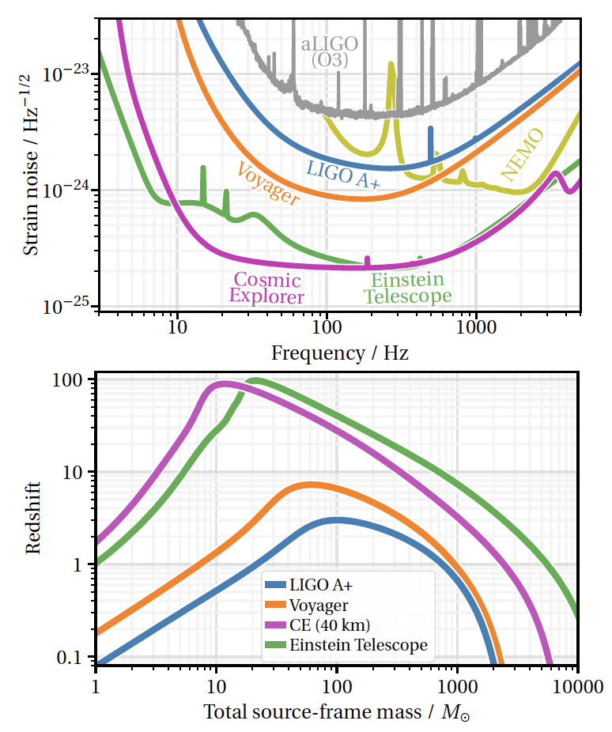
Reach of ET and CE

Slide 21
Next Generation Observatories
When could this new wave of ground instruments come into play?
Appears 15 years from t=0 is a feasible baseline
Initial LIGO: 1989 proposal, and at design sensitivity 2005
Advanced LIGO: 1999 White Paper, GW150914 in 2015
Modulo funding, could envision…
Einstein Telescope in the early 2030’s
Cosmic Explorer in the mid-2030s
Should hope – and strive and plan – to have great instruments ready to ‘catch’ the end phase of binaries seen in LISA (ref. Sesana)
Crucial for all these endeavors: to grow the scientific community planning on exploiting these instruments far beyond the GR/GW enclave
Costs are like TMT – needs a comparable audience

Slide 22
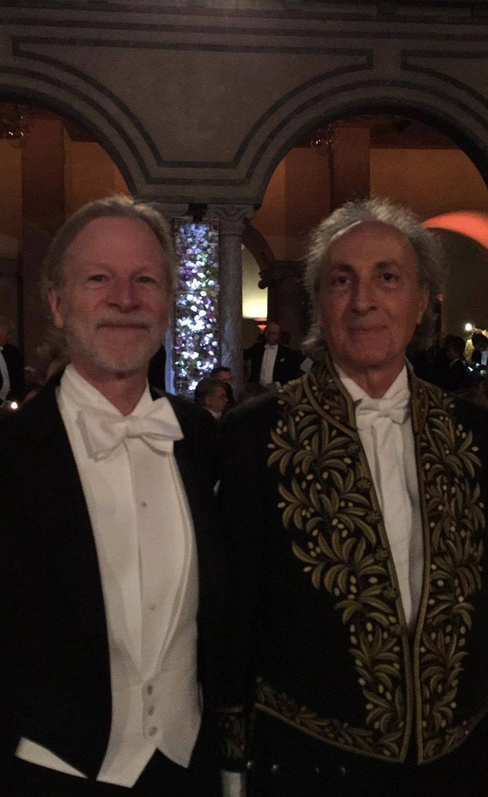
Onward!
Wonderful GW science opportunities within the reach of technology
Let’s hope – and conspire – to cause our funding agencies to support these initiatives
…and thanks to Thibault for contributing in so many ways!
Nanograv

