Slide 1
AS Port Wavefront Sensing
SRM/BS Signals
Daniel Sigg
Work by: Hang Yu
Simulations supported by: Dan Brown and A Freise
3/4/2022
G2200297-v1

Slide 2
What’s the Issue?
WFS36 at the AS port is not a good wavefront sensor
  Signal for SRM is basically an RF optical lever
  SRM signal changes significantly with thermal heating/ifo power
  Signal is dominated by BS (different RF phase but still very large)
First idea: centering is affected by carrier junk light
Second idea: 9MHz RF sidebands are very small and susceptible to thermal heating
  Near dark fringe and non resonant in SRM
  45 MHz RF sidebands are “stabilized” by SRM because they are resonant

Slide 3
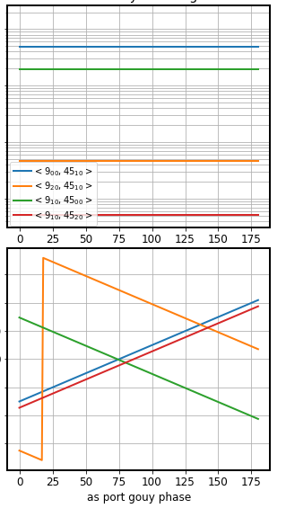
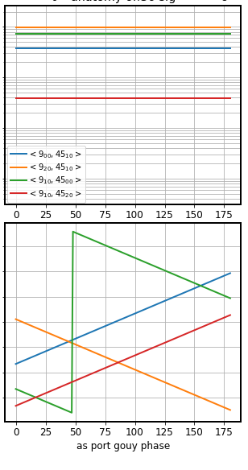
Different fields’ contribution
Nominal
Extra 100 km ITMX lens
ITM lensing generates
large signals contributing to the 36MHz beat
Point absorbers will generate additional HOM contributions
amplitude
+150
0
-150
RF phase

Slide 4
Solution
Pick a higher frequency RF sideband
  Further away from the dark fringe
  More power transferred to the AS port
  Less susceptible to heating (because there is more TEM00)
We chose 13th harmonics at 117 MHz (more like 118.3 MHz)
Demodulate between 5th and 13th: 8th order at 72 MHz
Make sure SRC gouy phase is at least 20°.

Slide 5
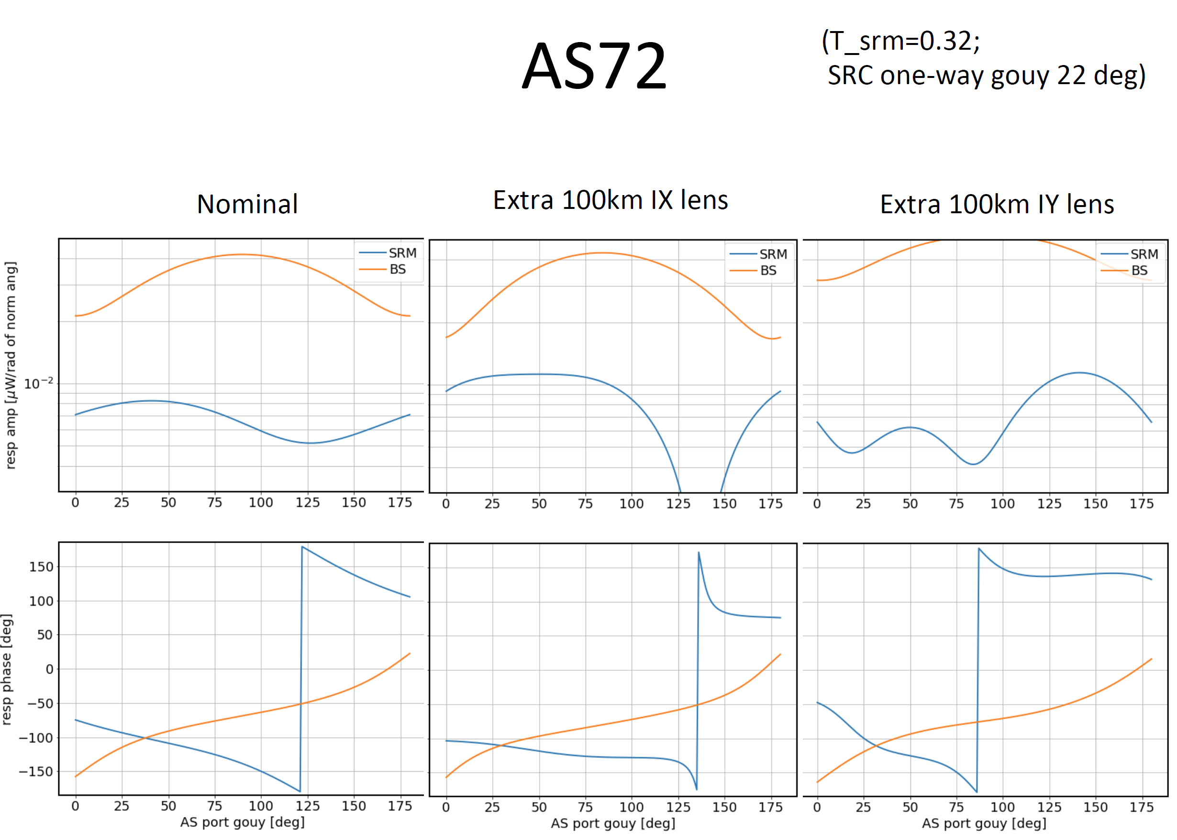

Slide 6
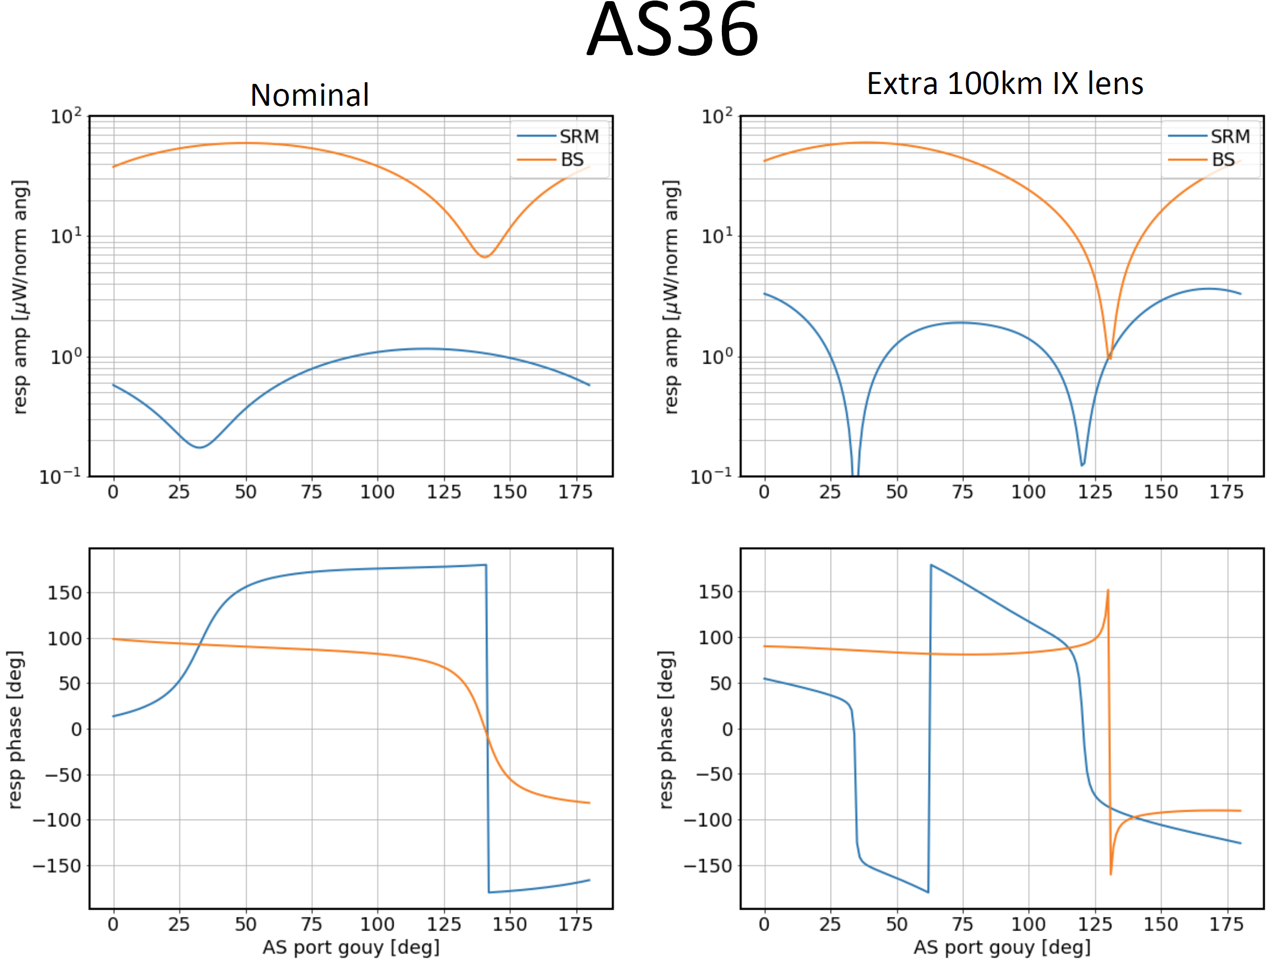

Slide 7
References:
T1700215-v3: Alignment sensing in the signal recycling cavity using a new 118.3 MHz sideband scheme
https://dcc.ligo.org/LIGO-T1700215
T1700324-v2: Implementing the 118 MHz wave front sensors
https://dcc.ligo.org/LIGO-T1700324
G1700603-v5: Differential Lensing vs. SRM Sensing
https://dcc.ligo.org/LIGO-G1700603
G1800719-v1: AS72 for SRM/BS alignment sensing
https://dcc.ligo.org/LIGO-G1800719

