Slide 1
Point Absorber Update
NSF Review June 2022
Ananyeva, S. Appert,
G. Billingsley,
A. Brooks, P. Fritschel, S. Gras, M. Kasprzack, K. Kuns, L. Zhang

Slide 2
Addressing Charge 2.D
2. Commissioning and interferometer performance enhancements
d. Review and comment on progress to develop low
absorption coatings and to mitigate challenges of operating
at higher laser power during Observing Run 4.

Slide 3
Absorber Summary
Installed ETM - 4 of 4 installed have point absorbers
      1 or 2 at LLO to be replaced this quarter
      No replacement planned at LHO
Installed ITM - 1 of 4 installed have point absorbers
      New absorbers since original scan - did we cause?
Reworked ETM - 4 of 4 have been re-coated
      1 of 4 characterized so far
        found 2 point absorbers, these are small enough the part is useable

Slide 4
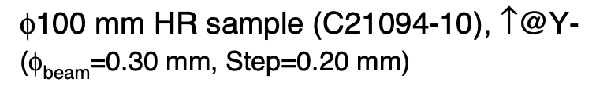

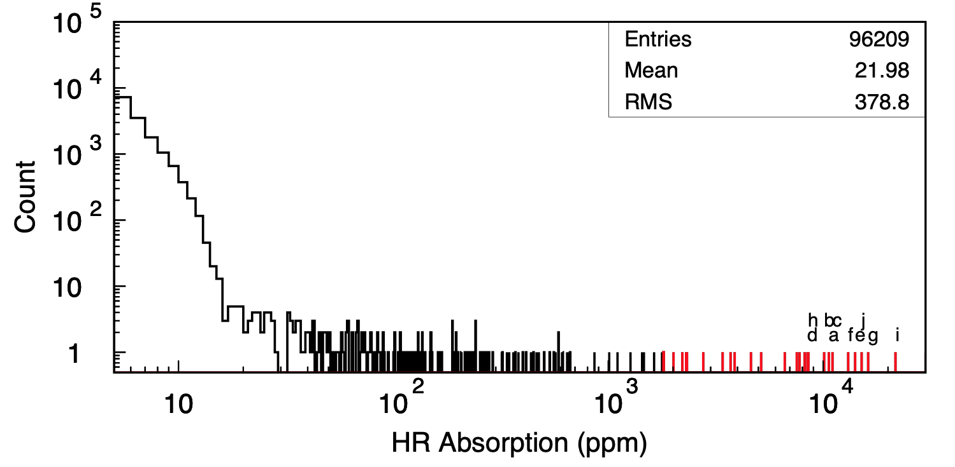
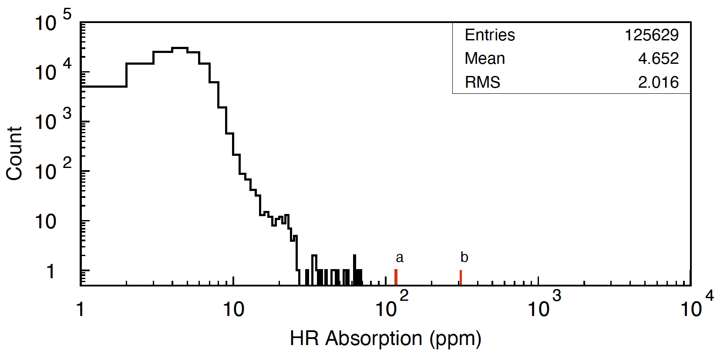
A noticeable improvement in the chamber
Foil covering sandblasted surfaces
No sandblasted surfaces

Slide 5
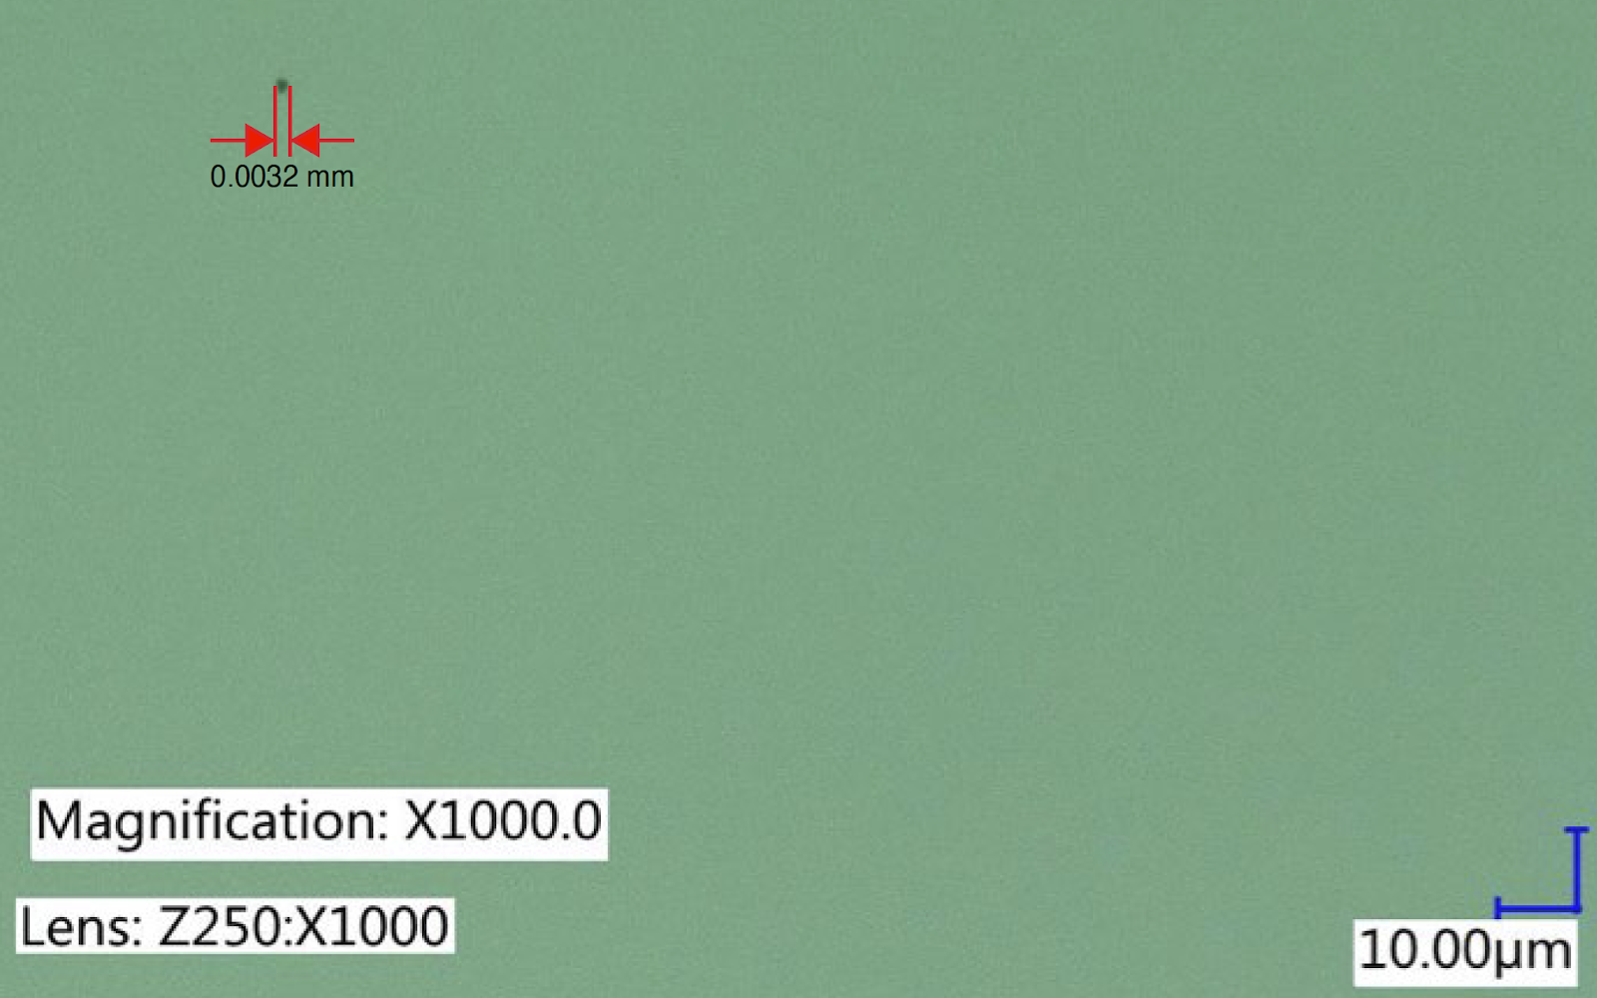
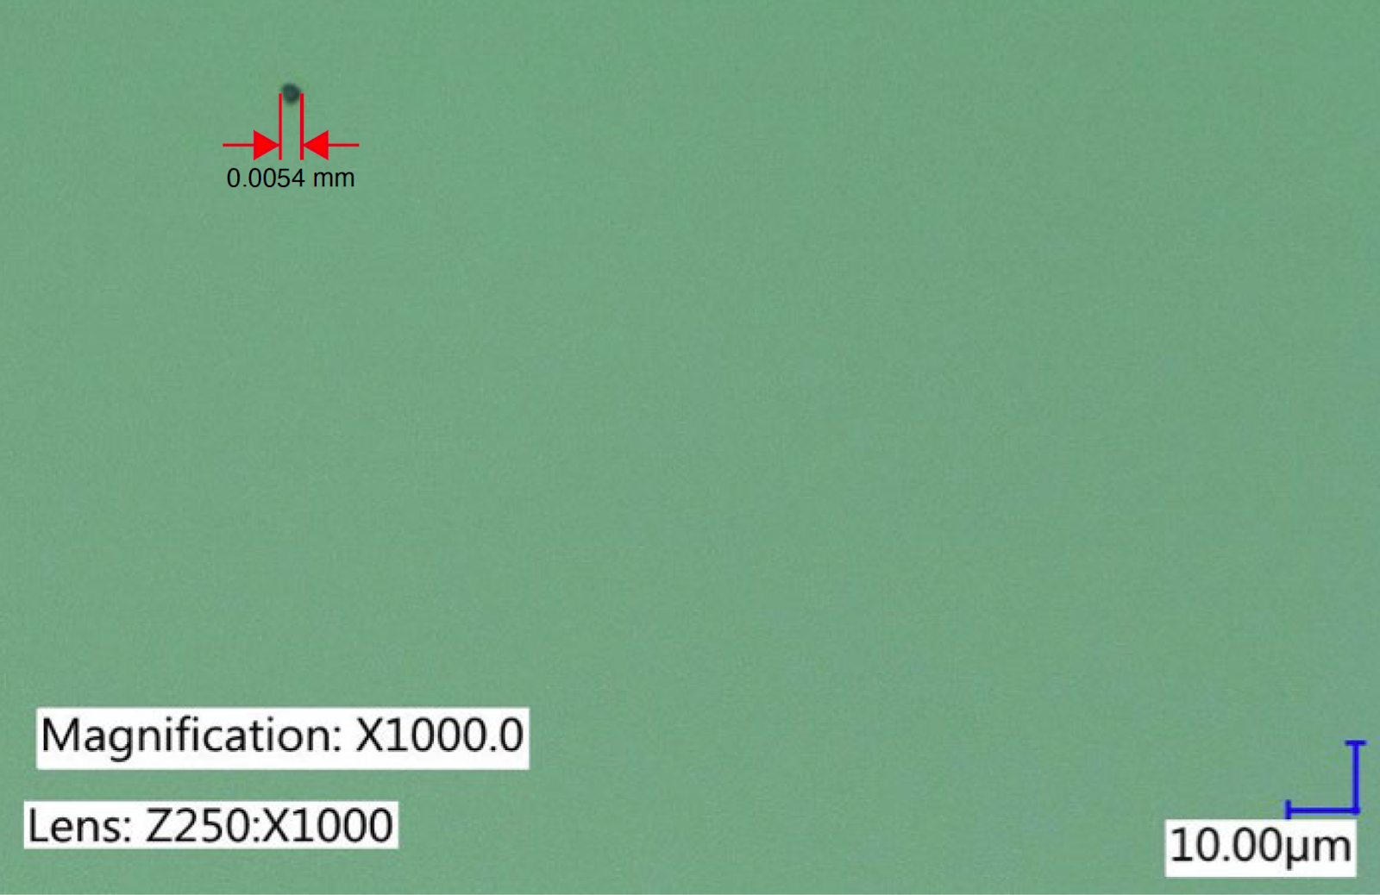
First Result is “good enough” – ETM08
2 PA found on RTS using gentle absorption on 80 mm ø
  ⌀ 3.2 µm, r = 24 mm
  ⌀ 5.4 µm, r = 25 mm
Max allowed ”equivalent diameter” 12.6 µm
  Assumes 100% absorption by defect
* An 80 mm diameter scan takes 11 days
Notes:
120 mm = 24 days
160 mm = 44 days

Slide 6
Causes
During coating
  Coating chamber panels are sandblasted and difficult to clean, may shed during coating T2200351
  Possible Re-sputtering from the coating chamber optic mount, coating mask or shutter
In situ
  First contact fragments from cleaning T2000526
  Exploding dust - we suspect this is minimal E1400010

Slide 7
Identification
Photo-thermal Common-path Interferometry (PCI) absorption tests - Zhang, Catalog at T2000055, E2000079
  Use “gentle absorption” technique, high noise floor, but no risk of damage
  Very sensitive, absolute calibration is unknown for point absorbers
  11 days to scan 80 mm diameter
Hartmann Wavefront Sensor (HWS) - Brooks G2200064
  Deployed at the observatories to monitor change in radius of curvature due to background absorption
  Commissioning a dedicated HWS at Caltech for incoming point detection inspection
Material imaging and ID - Appert/Kuns/Gras/Gomez/Kasprzak, Catalog at T2000733

Slide 8
Mitigation
Prevention
  Chamber cleaning - Ananyeva T2100351
  Masking parts near the optic with clean or new material each run
Ablation
  Demonstrated removal of defects by ablation - Fritschel G2001414 T2100216
    Residual absorption caused by ablation on clean coatings can be mitigated by annealing in air at 300 C° E2000107
    Remaining residual absorption of ablated or partially ablated points, improving with annealing, work is ongoing E2100395
Mirror surface profile change
  Altered from spherical to increase loss for high order modes G2001920 and G2001747

Slide 9
Eliminating PA sources at the Coater
T2000055 Catalog of witness samples measured
Early focus was on elimination of re-sputtering sources near the optic
  Change mask and shutter material from Aluminum to Titanium
  Change optic holder to Titanium, or add Fused Silica shield
Sandblasted panels and tooling found as a significant source of particulate
  All sandblasted material removed, deep clean of the chamber, electropolish mask and optic holder to remove deposited coating materials.
Even with extensive cleaning the surfaces are friable.

Slide 10
Reference Slides

Slide 11
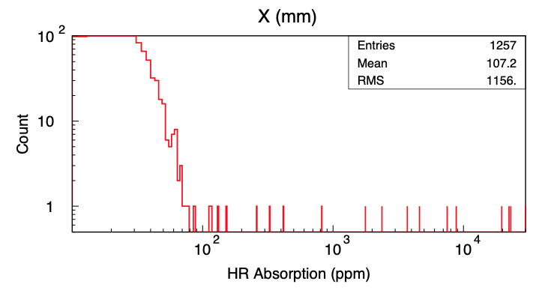
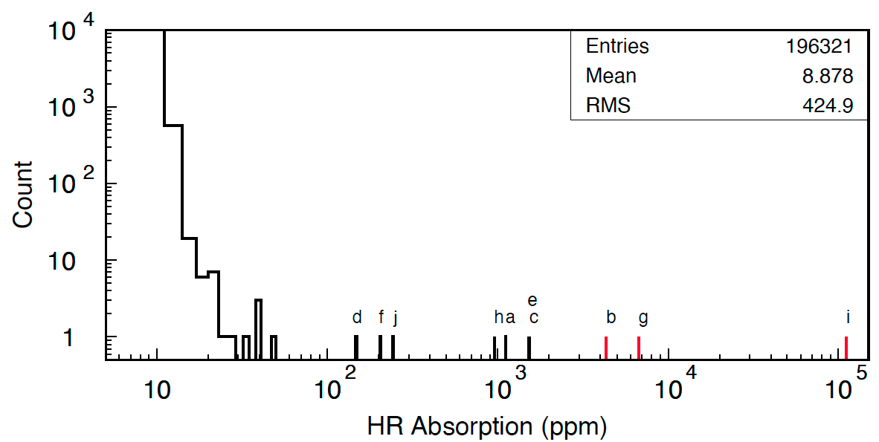
Compare Known Problem Absorbers to New Coating
ITM03 removed from LHO
ITM11 removed from LHO
New ETM08 coating

Slide 12
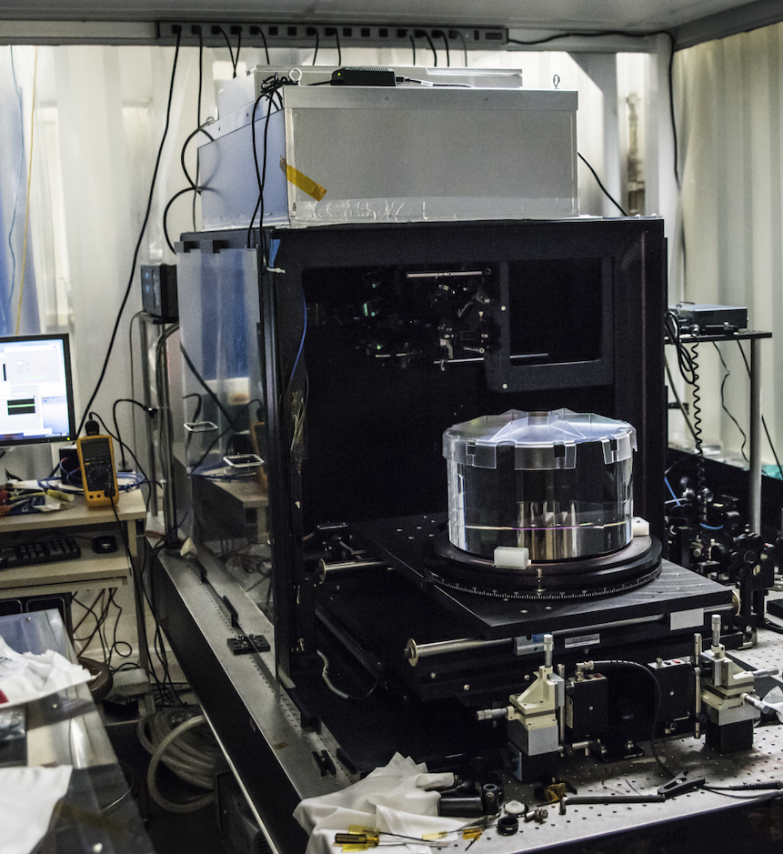
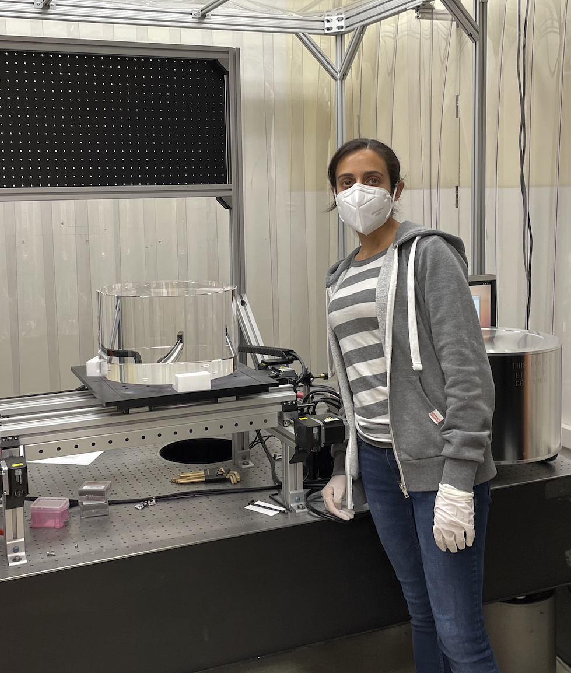
“RTS” Scanner
Reflection Transmission Scatter Absorption
Hartmann Scanner
Point absorbers
Screening
Schedule pressure on RTS, New scanner to add capacity and cross check results

Slide 13
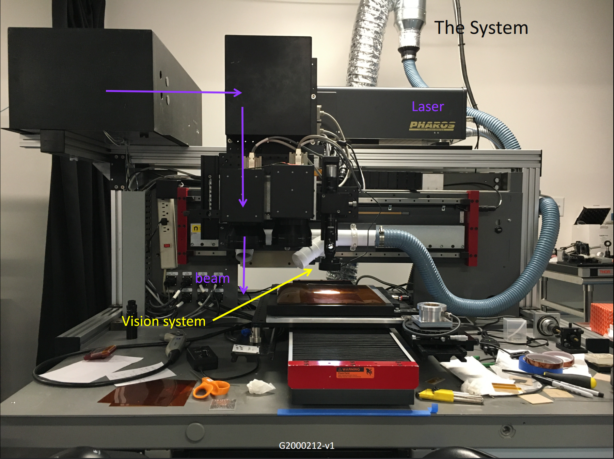
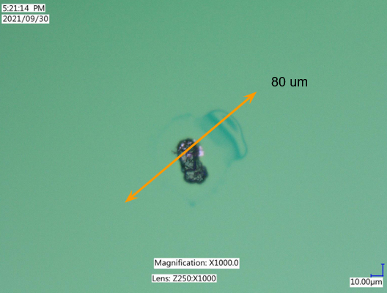
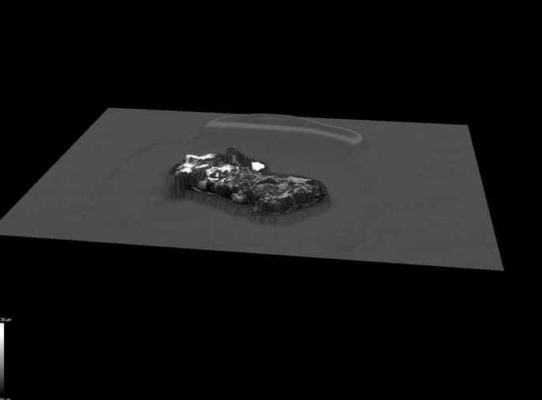
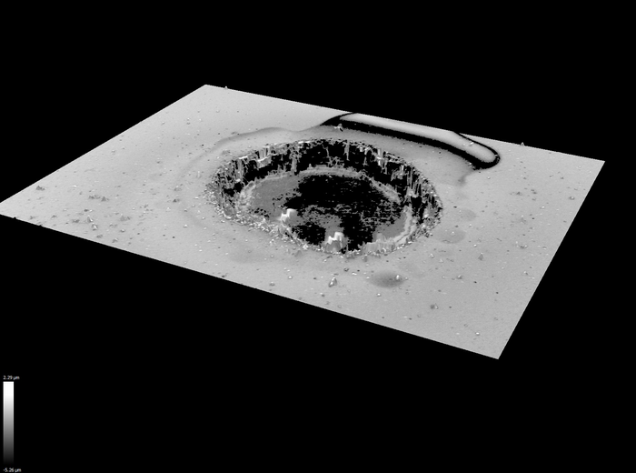
Ablation
MIT collaboration with vendor specializing in laser micro-machining (top right).
  Ablation of ~10 features across 3 visits
  Most recent effort (November 2021):
    7 ablated features on 2 optics
    All features remained absorptive afterwards
      more pulses should do the trick in the future
Image from G2000212-v1, credit Fritschel et. al.
CIT Feature ID and Location
3D Mapping Before Ablation
3D Mapping After Ablation
Images from E2100466 –v2, credit Fritschel et. al.

Slide 14
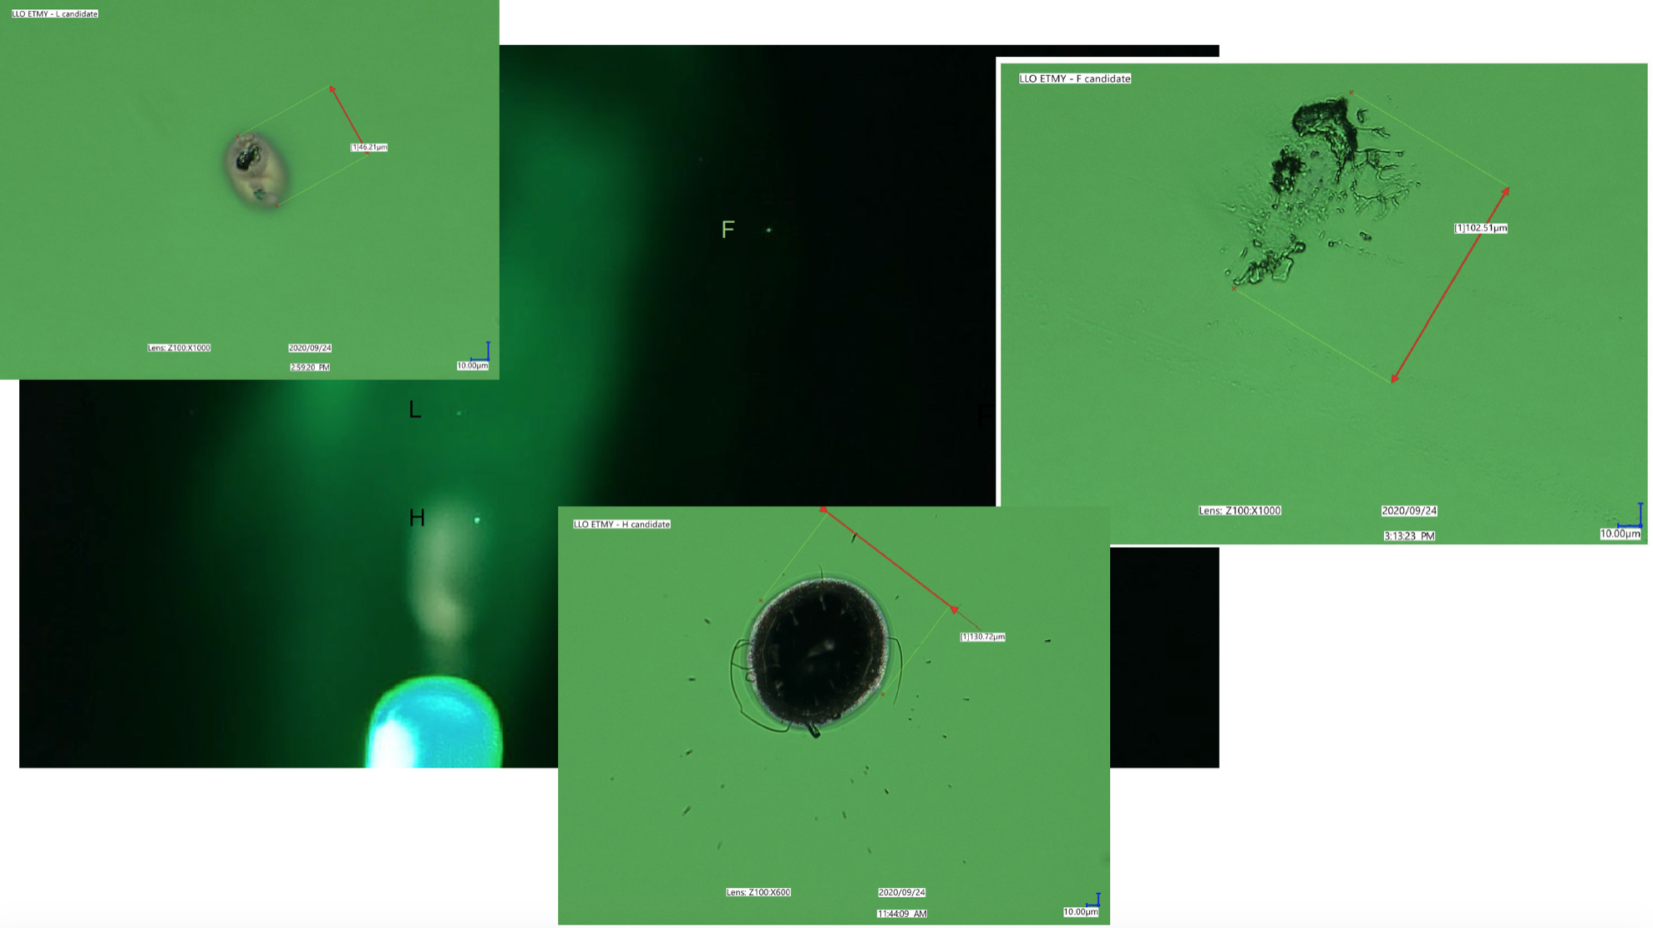
Livingston ETM In-Chamber Inspection
Not present at Oct ‘19 inspection 46 µm
Not seen on any previously installed/removed ETMs
Not present at
Oct ‘19 inspection
102 µm
Cleaned during Oct ‘20 inspection – suspect incomplete removal of First Contact in previous clean
L1 ETMy Alog Source
Original LLO End-y absorber candidate found Oct ‘19 130µm

Slide 15
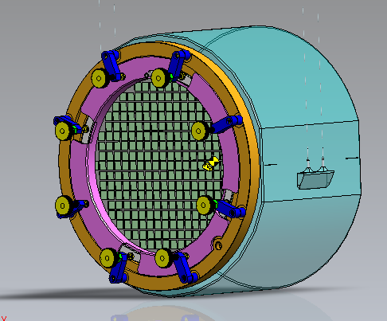
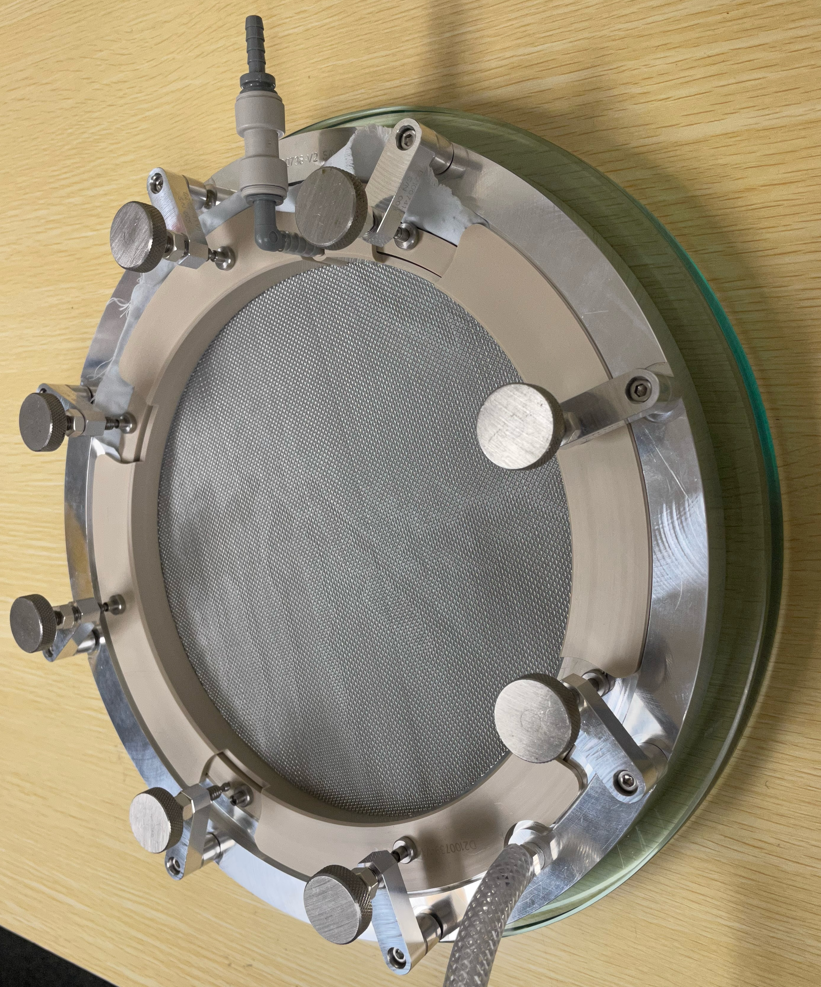
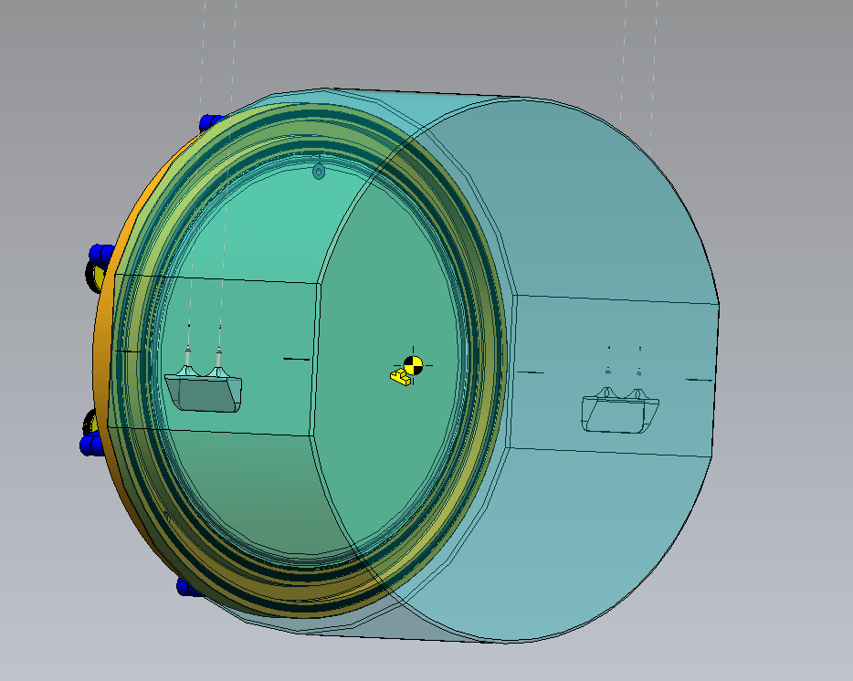
Improved cleaning
Vertical pour of First Contact
Thicker layer = better cleaning
Better layer removal

Slide 16
ETM Inventory – 14 total including A+
4 re-worked ETMs coated
Zygo is under contract to polish
  2 more on OPS funding
  4 more ETMs for A+ on UK funding
  2 more ETMs for A+ on US funding
We hold 2 optics for India (ETM11/ETM14) that have point absorbers found with RTS

Slide 17
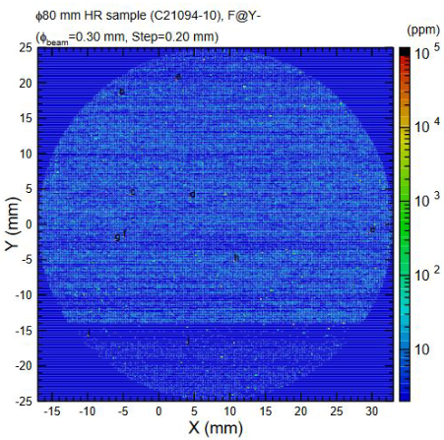
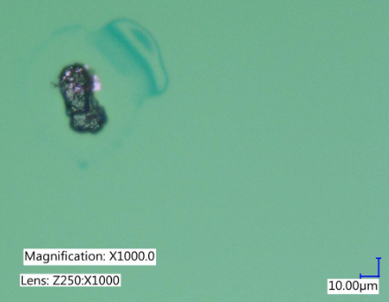
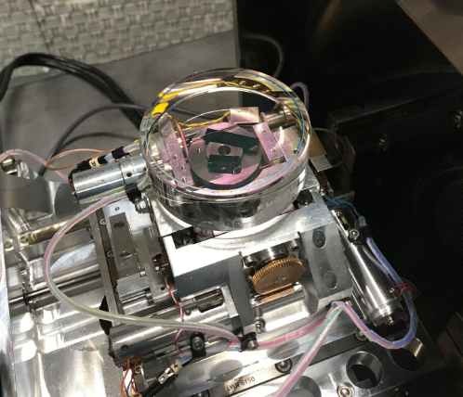
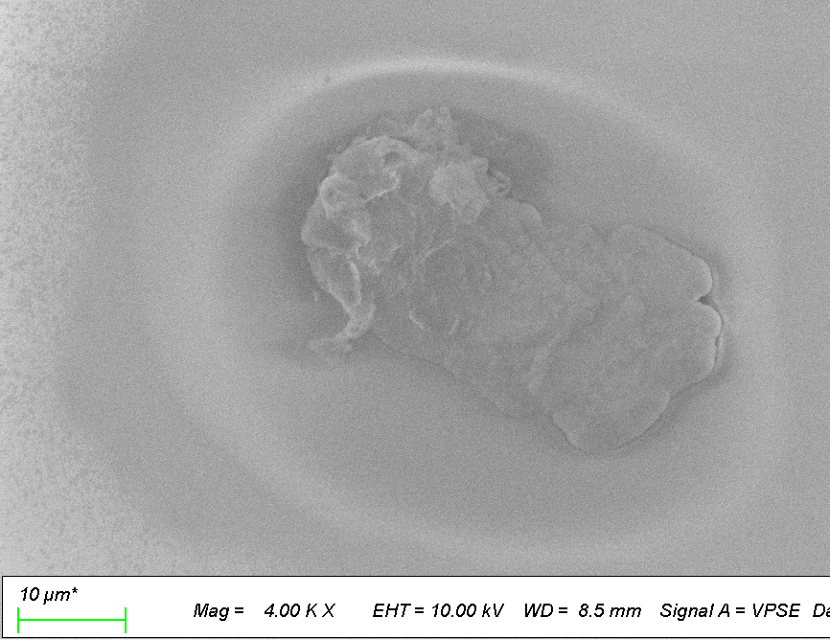
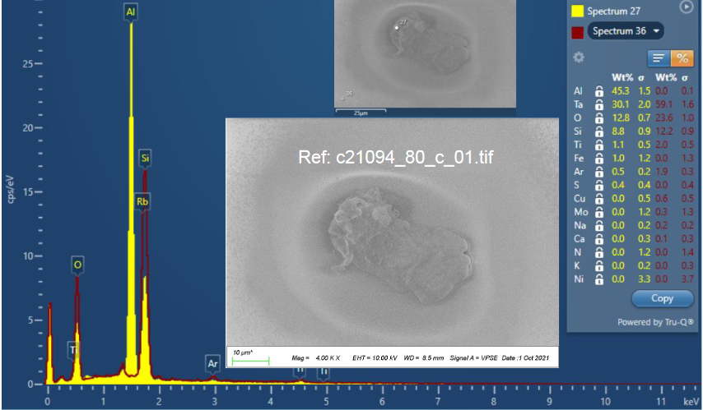
Investigating the Composition of Absorbers: Workflow
Composition investigations have been a primary focus of CIT and MIT Lab efforts since 2020.
  COC cataloged witness samples, traceable to LIGO coating runs.
  CIT absorption measurements locate absorbing features (top right).
    >30 aLIGO witness samples, >100 samples total – more statistics at T1900340
  Energy Dispersive Spectroscopy (EDS) used to conduct elemental analysis (bottom right).
    Scanning Electron Microscope (SEM) facilities at MIT and CIT.
    MIT has used FIB to section some features, a technique with the highest certainty.
Images from E2100395-v1,
credit Zhang et. al.

Slide 18
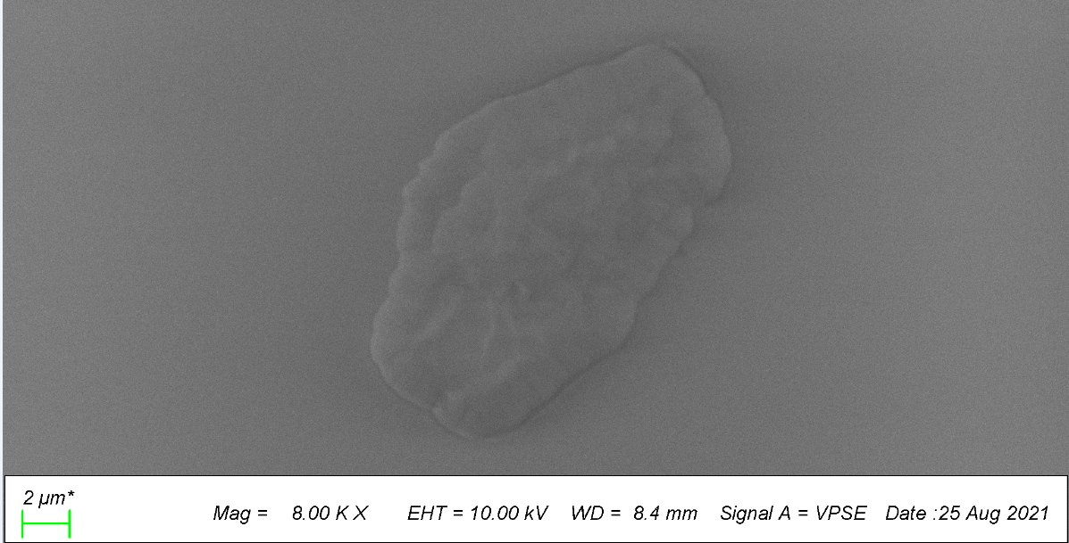
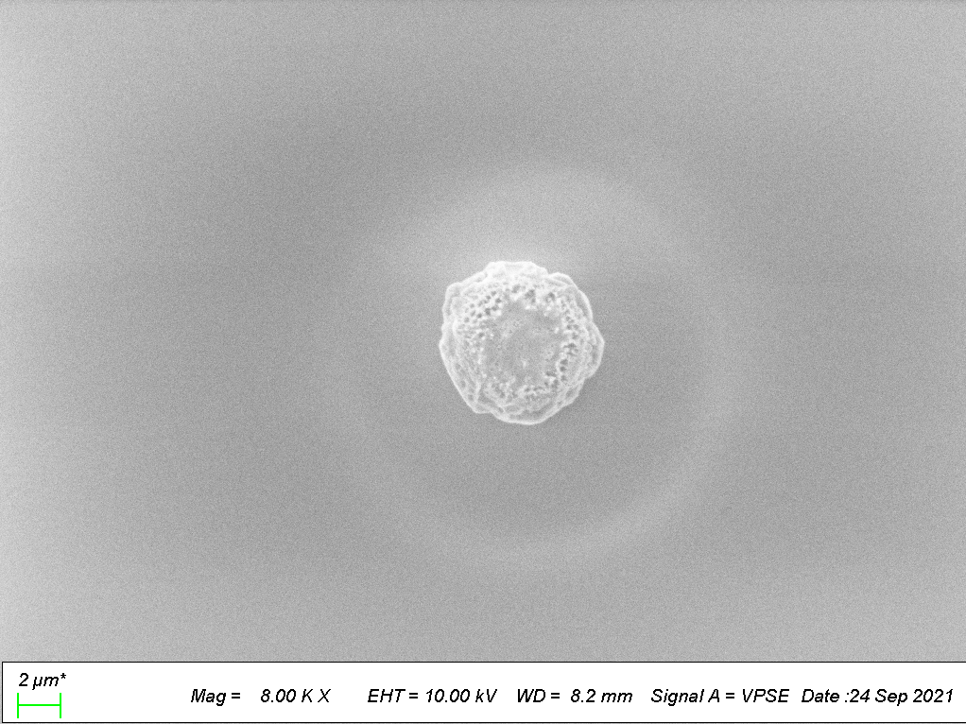
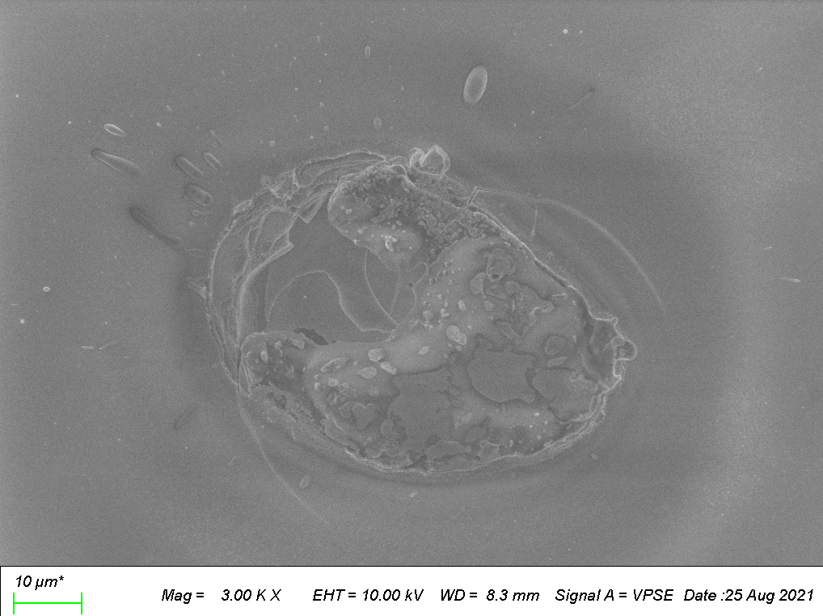
Composition
Composition has been investigated for features on 15+ optics from a wide range of coating runs.
  Cataloged at T2000733
Many absorbers are Aluminum, many have Carbon, and we have also seen Titanium, Copper, Iron, Nickel.
Many absorbers appear to have compositions similar to coating layers.
Coating – C21091_a
Fe, Ni – C21094_f
Fe, Cu – C21091_e
Images from T2000733, credit Appert

