Slide 1
Binary Black Hole Mergers
Zoe Ko
Mentors: Simona Miller and Katerina Chatziioannou
LIGO-T2200185-v1

Slide 2
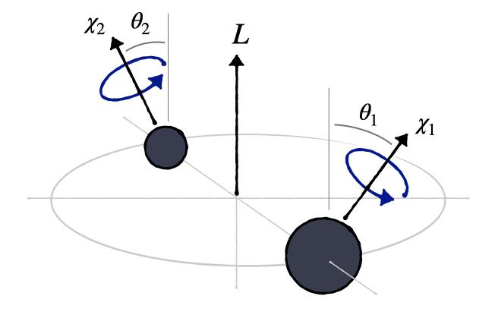

Slide 3
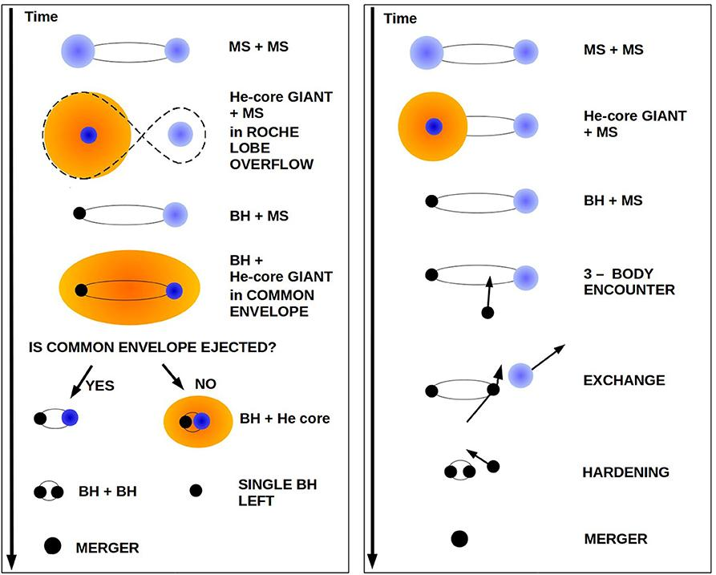
How do BBHs form?

Slide 4
First research Question:
If we simulate different populations of BBH mergers with the same effective spin distribution but different component spin distributions, will we be able to measure that they are different populations?

Slide 5
Second Research Question:
If we choose a poor model to fit our data, can we tell that it is a poor model without knowing the true underlying distribution?

Slide 6
Procedure
Generate and inject artificial BBH merger events into LIGO data
Run parameter estimation for the individual events
Conduct hierarchical inference for the entire population using various models
Can we recover the injected parameter distributions?

Slide 7
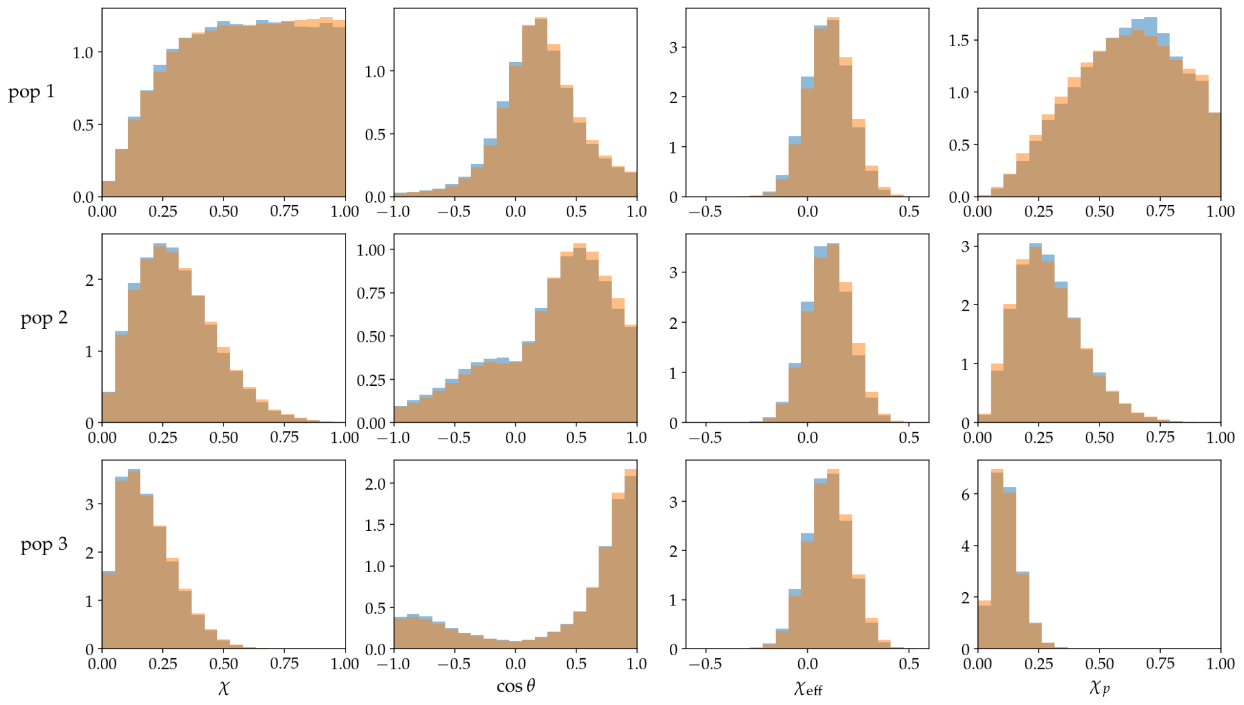

Slide 8
Bayesian Inference
likelihood
prior
posterior
evidence

Slide 9
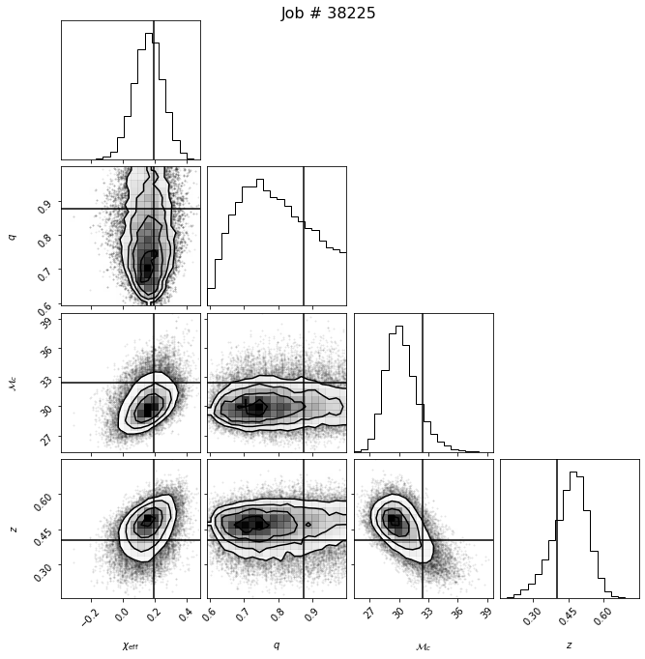

Slide 10
Hierarchical Bayesian Inference
likelihood
prior
posterior
evidence

Slide 12
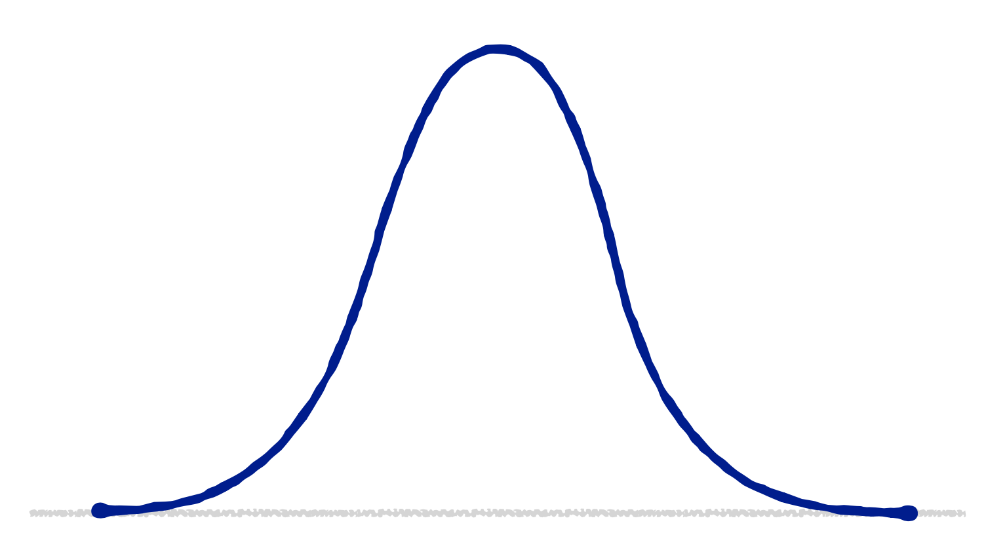
Gaussian Model

Slide 13
Beta plus Mixture
Model

Slide 14
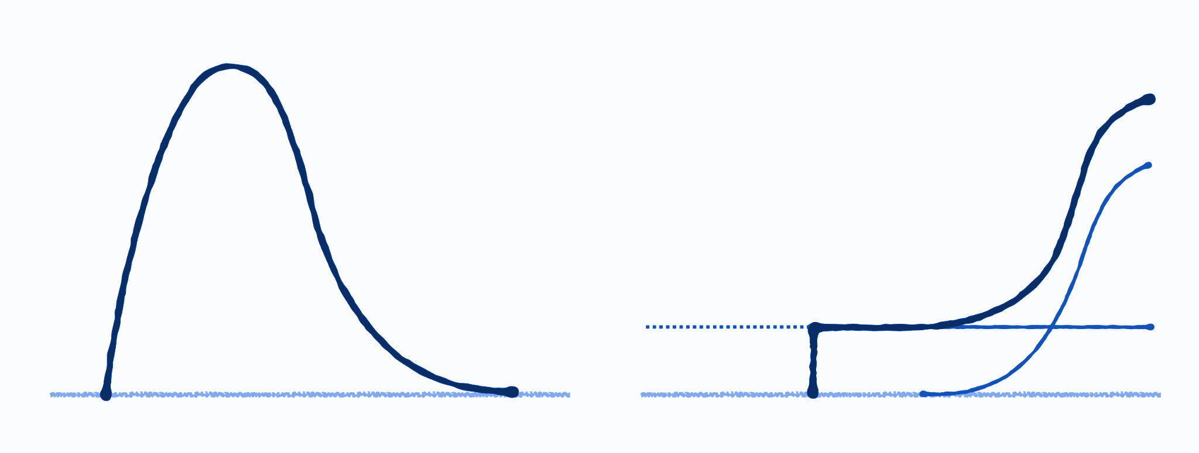
Beta plus Truncated Mixture Model

Slide 15
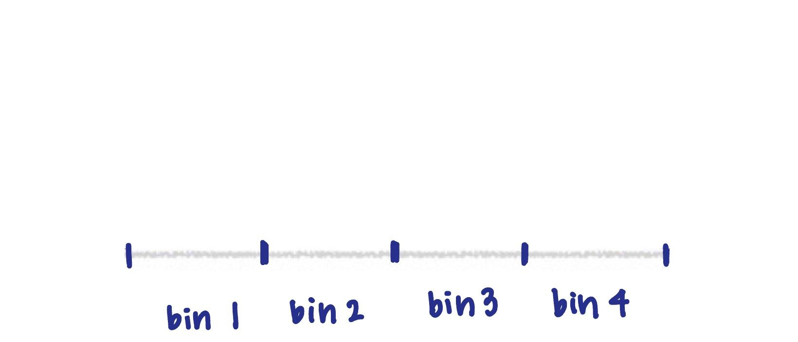
Binned Model

Slide 16
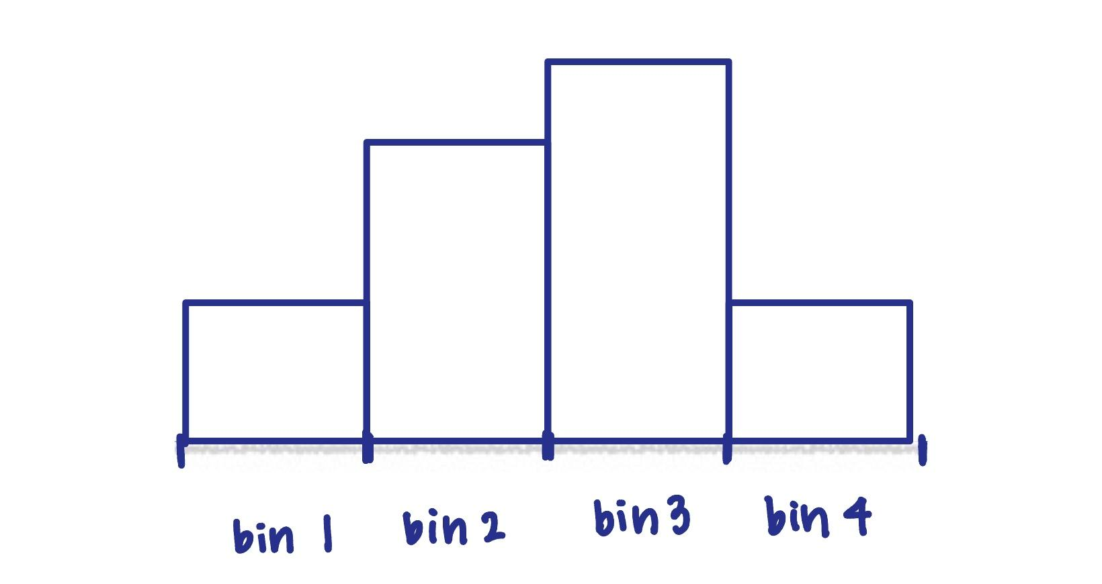
Binned Model

Slide 17
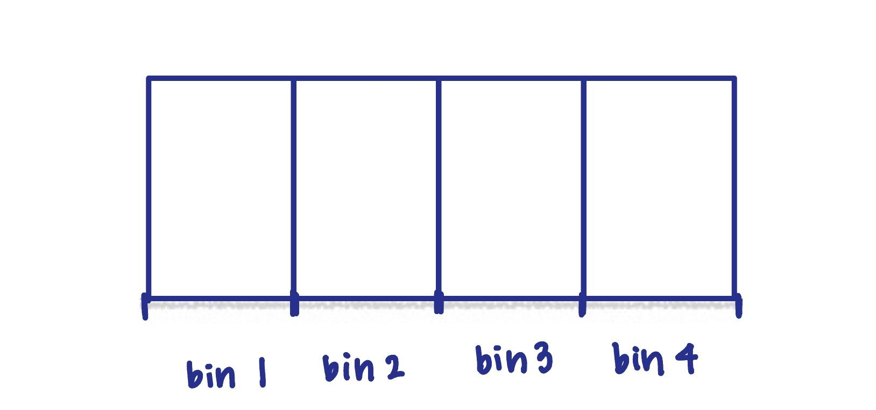
Binned Model

Slide 18
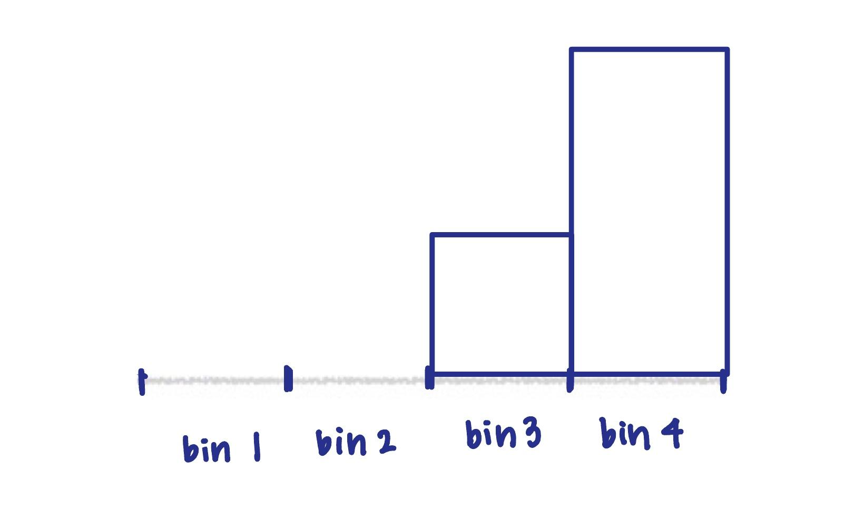
Binned Model

Slide 19
Sanity Check

Slide 20
Beta plus Truncated Mixture Model

Slide 22
Results

Slide 23
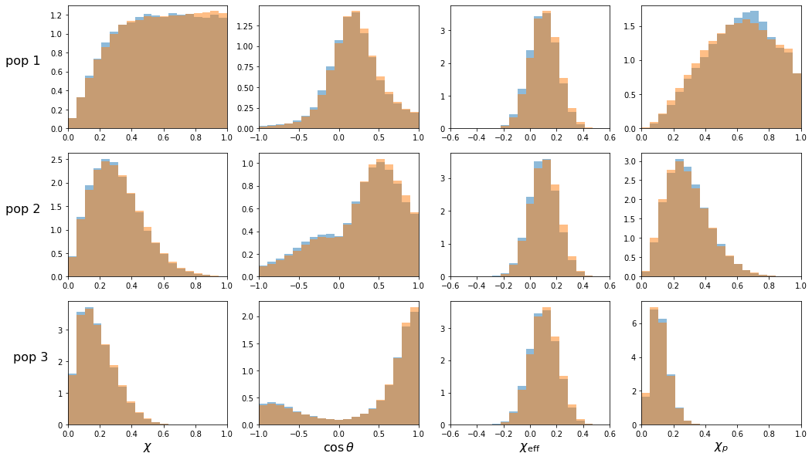

Slide 24
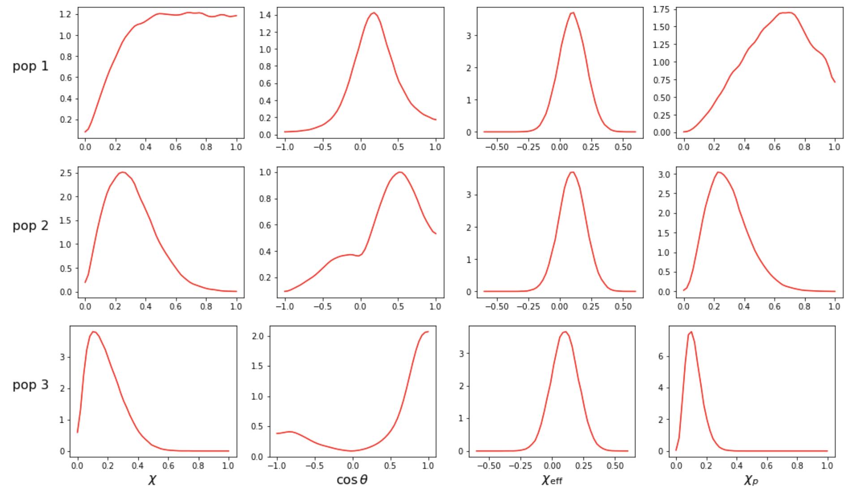

Slide 25
Results: Gaussian Model

Slide 26
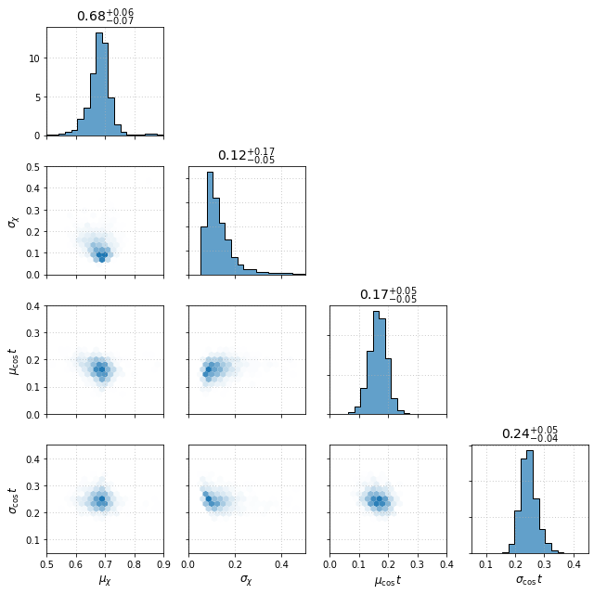

Slide 30
Binned Model

Slide 31
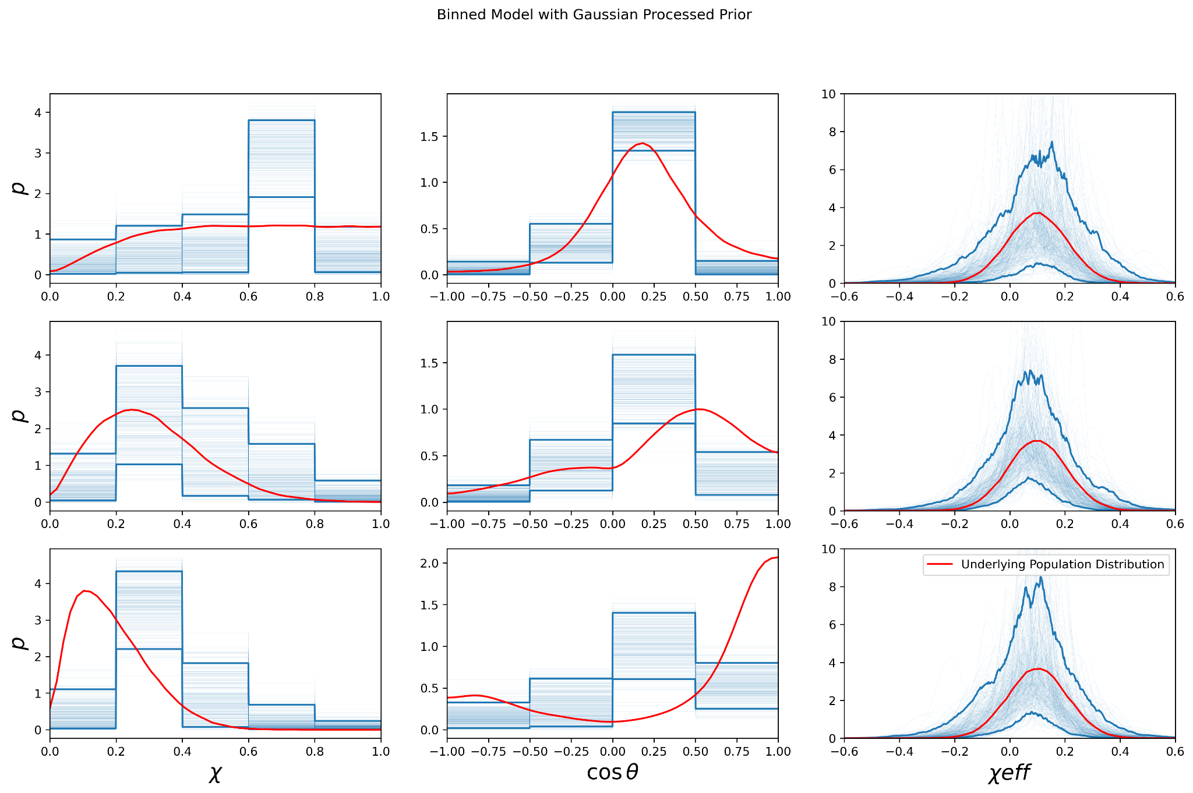

Slide 32
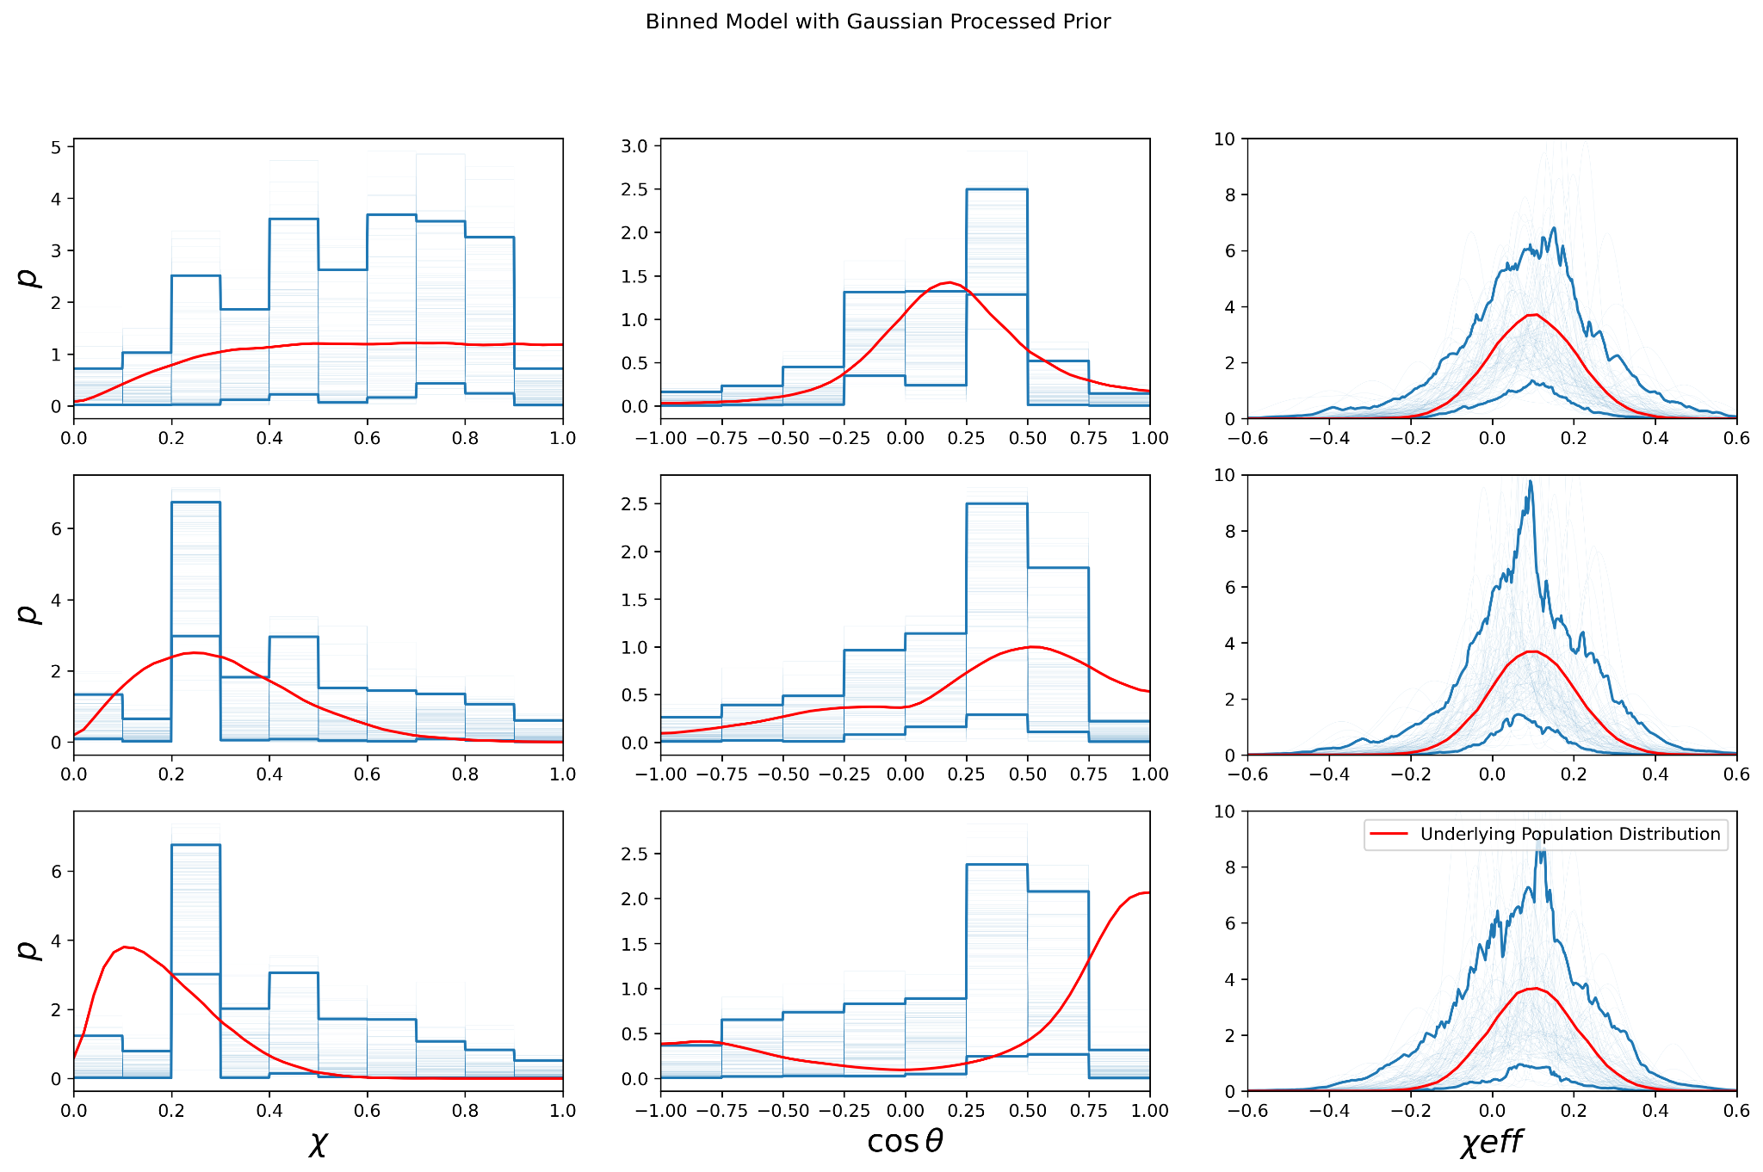

Slide 35
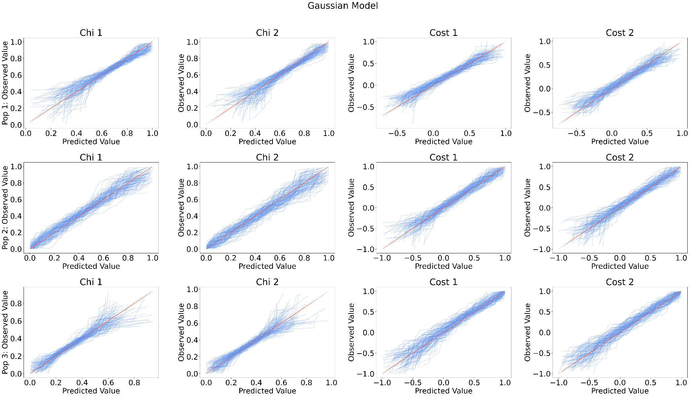

Slide 36
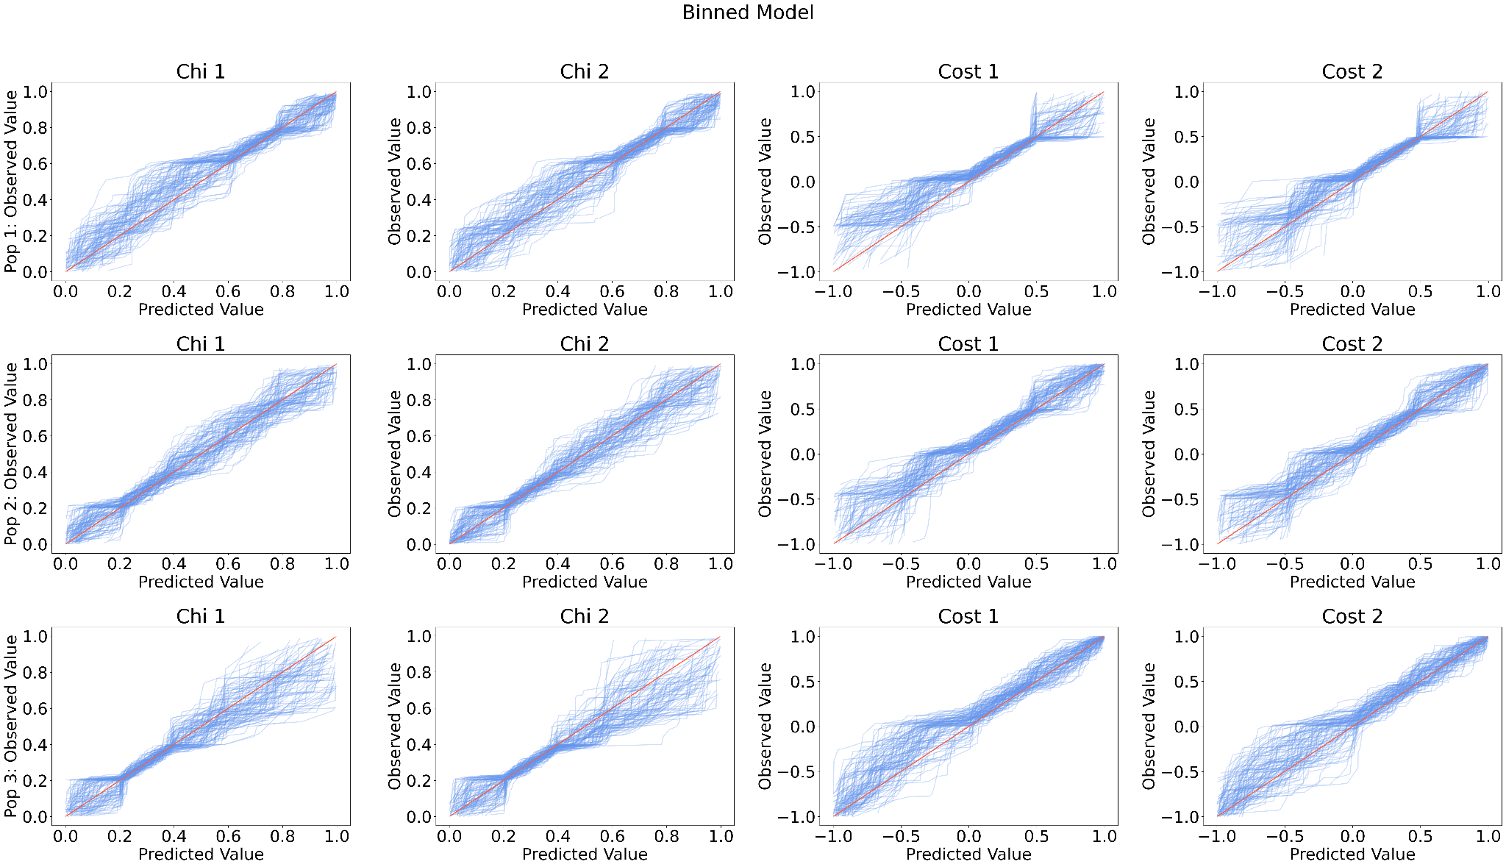

Slide 37
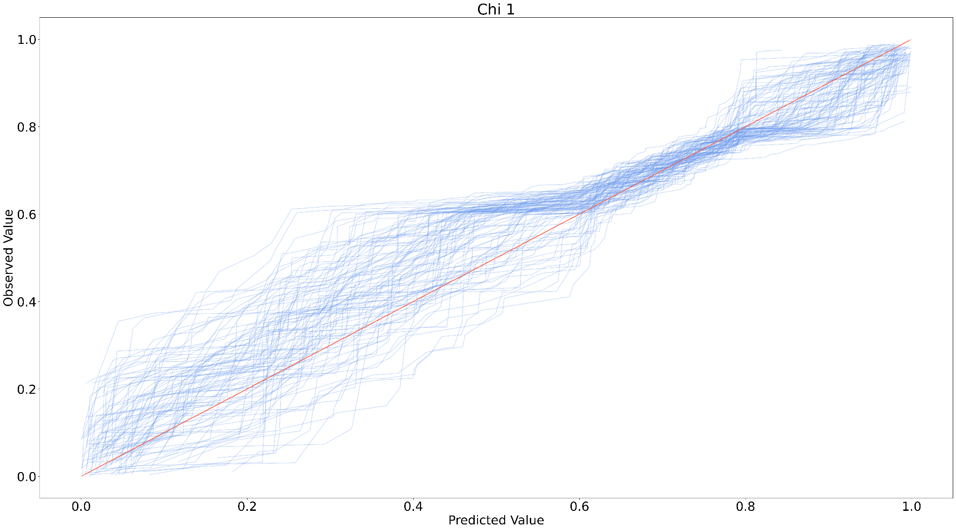

Slide 38
First research Question:
If we simulate different populations of BBH mergers with the same effective spin distribution but different component spin distributions, will we be able to measure that they are different populations?

Slide 41
Second Research Question:
If we choose a poor model to fit our data, can we tell that it is a poor model without knowing the true underlying distribution?

Slide 43
Future Work
Improve the binned model: increasing bin sizes, experiment with Gaussian processed priors
Analyze posterior predictive plots
Update selection effects terms to better represent population sensitivity
Answer our research questions!

Slide 44
Acknowledgements
Thank you to my mentors Simona Miller and Professor Katerina Chatziioannou, and the entire LIGO SURF team!
And thank you to NSF for making this project possible.

Slide 45
References

Slide 46
Thank you! Any questions?

