Slide 1
Improving the Q factor of silicon cantilevers
Ojo Akinwale, Experimental Group
Mentors- Aaron Markowitz, Christopher Wipf, Rana Adhikari

Slide 2
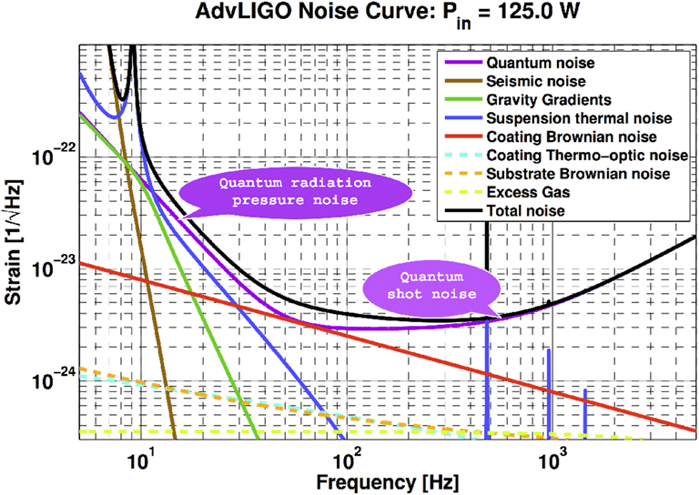
LIGO Noise Distribution

Slide 3
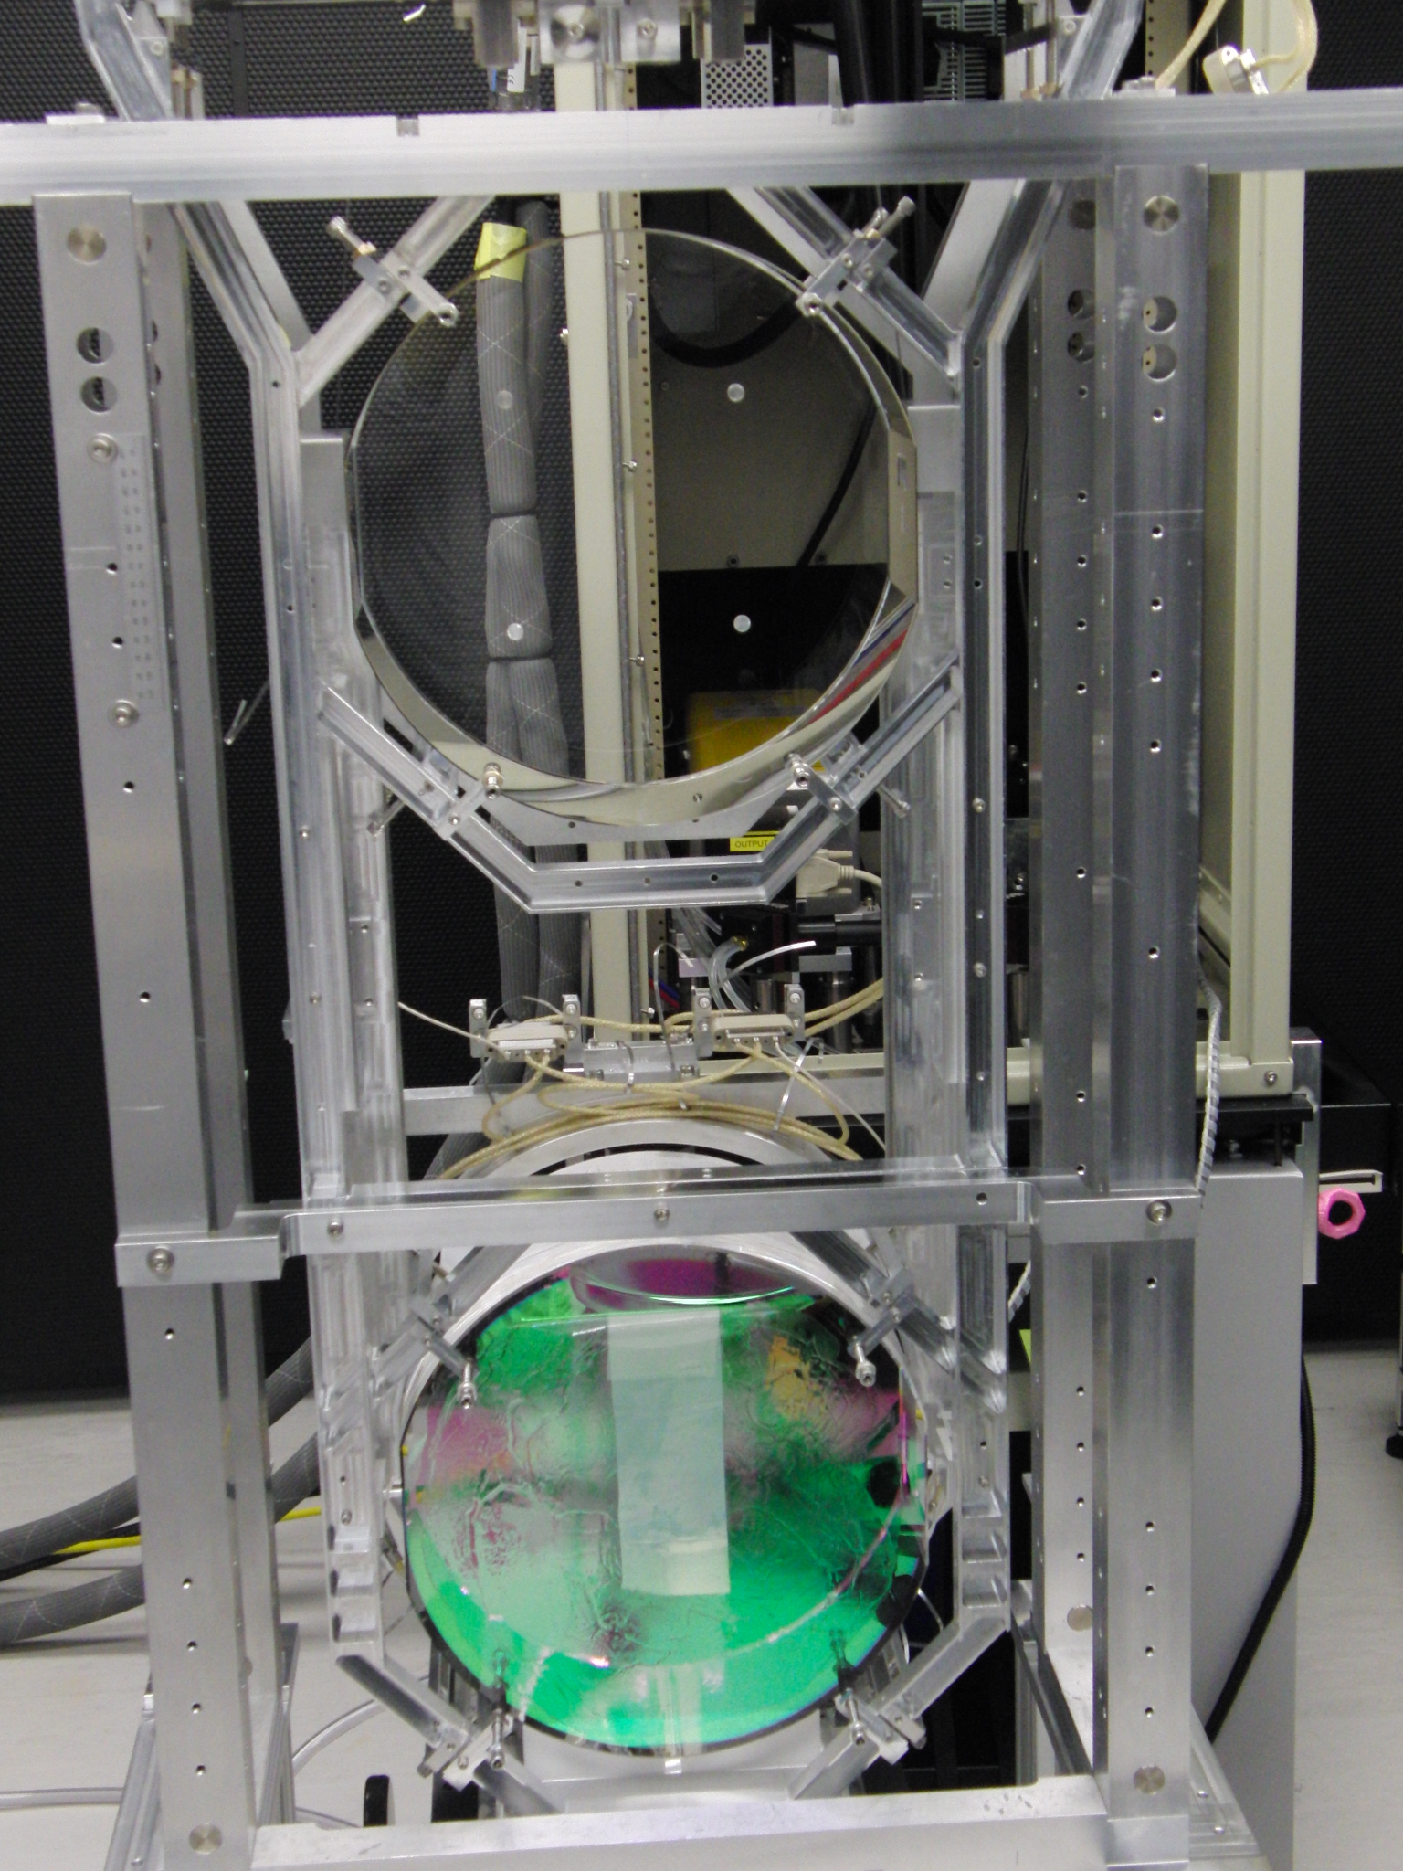
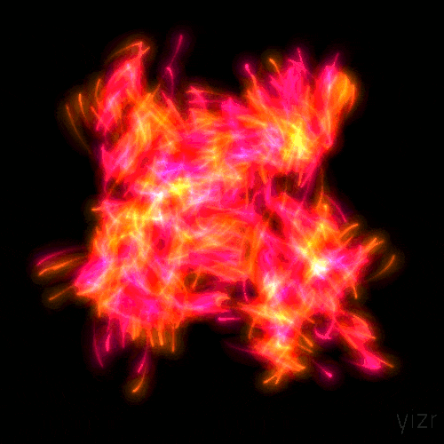
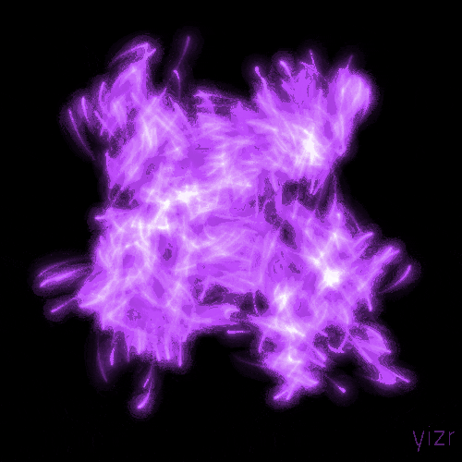
Thermal Noise
What is thermal noise? How is it related to mechanical dissipation?
​​
Thermal Fluctuations in mirrors

Slide 4
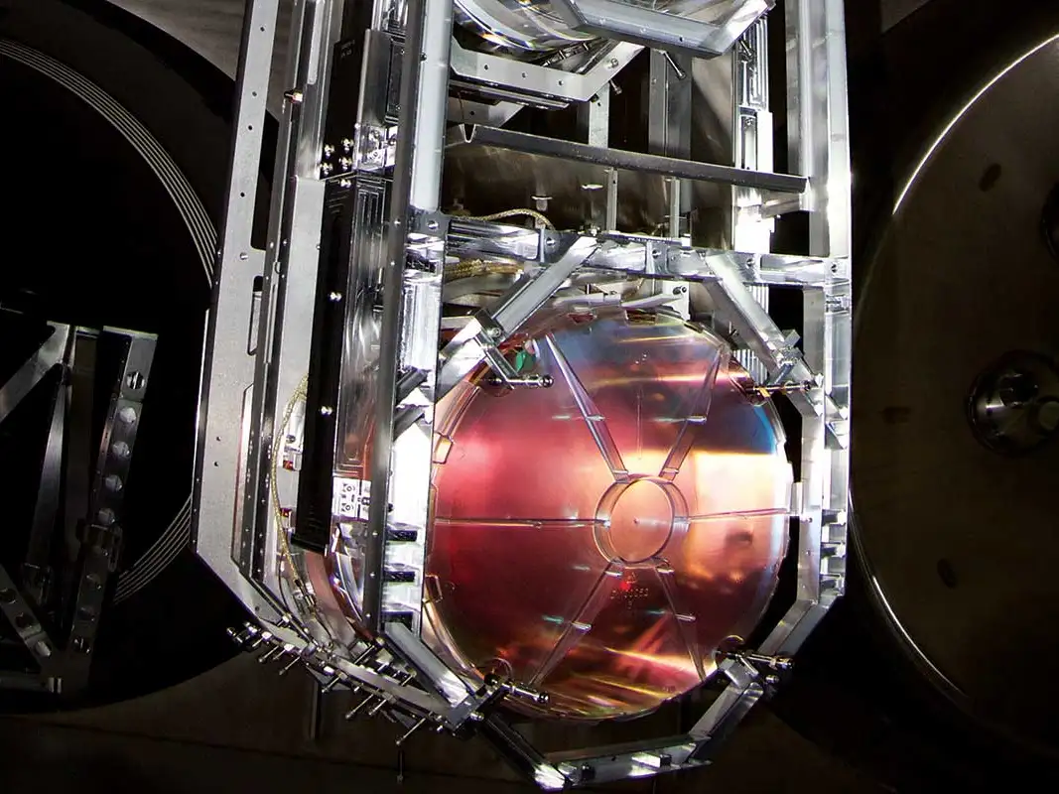
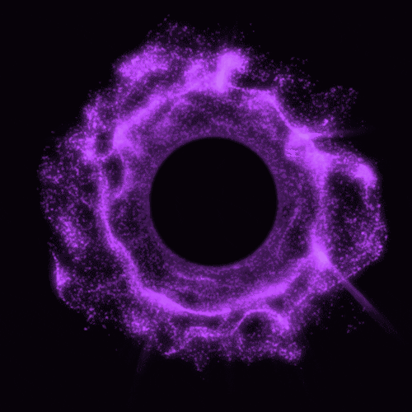
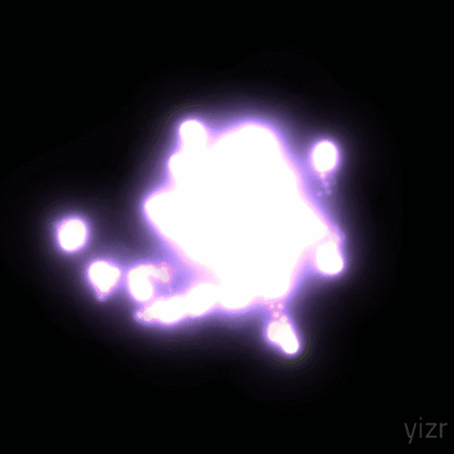
Brownian Motion
LIGO Test Mass (Quantum Scale)
Brownian motion is the random motion of particles suspended in a medium.

Slide 5
The Fluctuation- Dissipation Theorem
Derived from statistical physics and relates noise to mechanical impedance.
SF (ω) = 4kBT Re{Z(ω)}
SF (ω)- force noise power spectral density
Z(ω) ≡ F(ω) v(ω)- mechanical impedance of the system.
Process Reverse Process
Drag- Brownian Noise-
Kinetic Energy → Thermal Energy Thermal→ Kinetic Energy
Resistance- Johnson Noise-
Electricity→Thermal Energy Thermal Energy→ Electricity

Slide 6
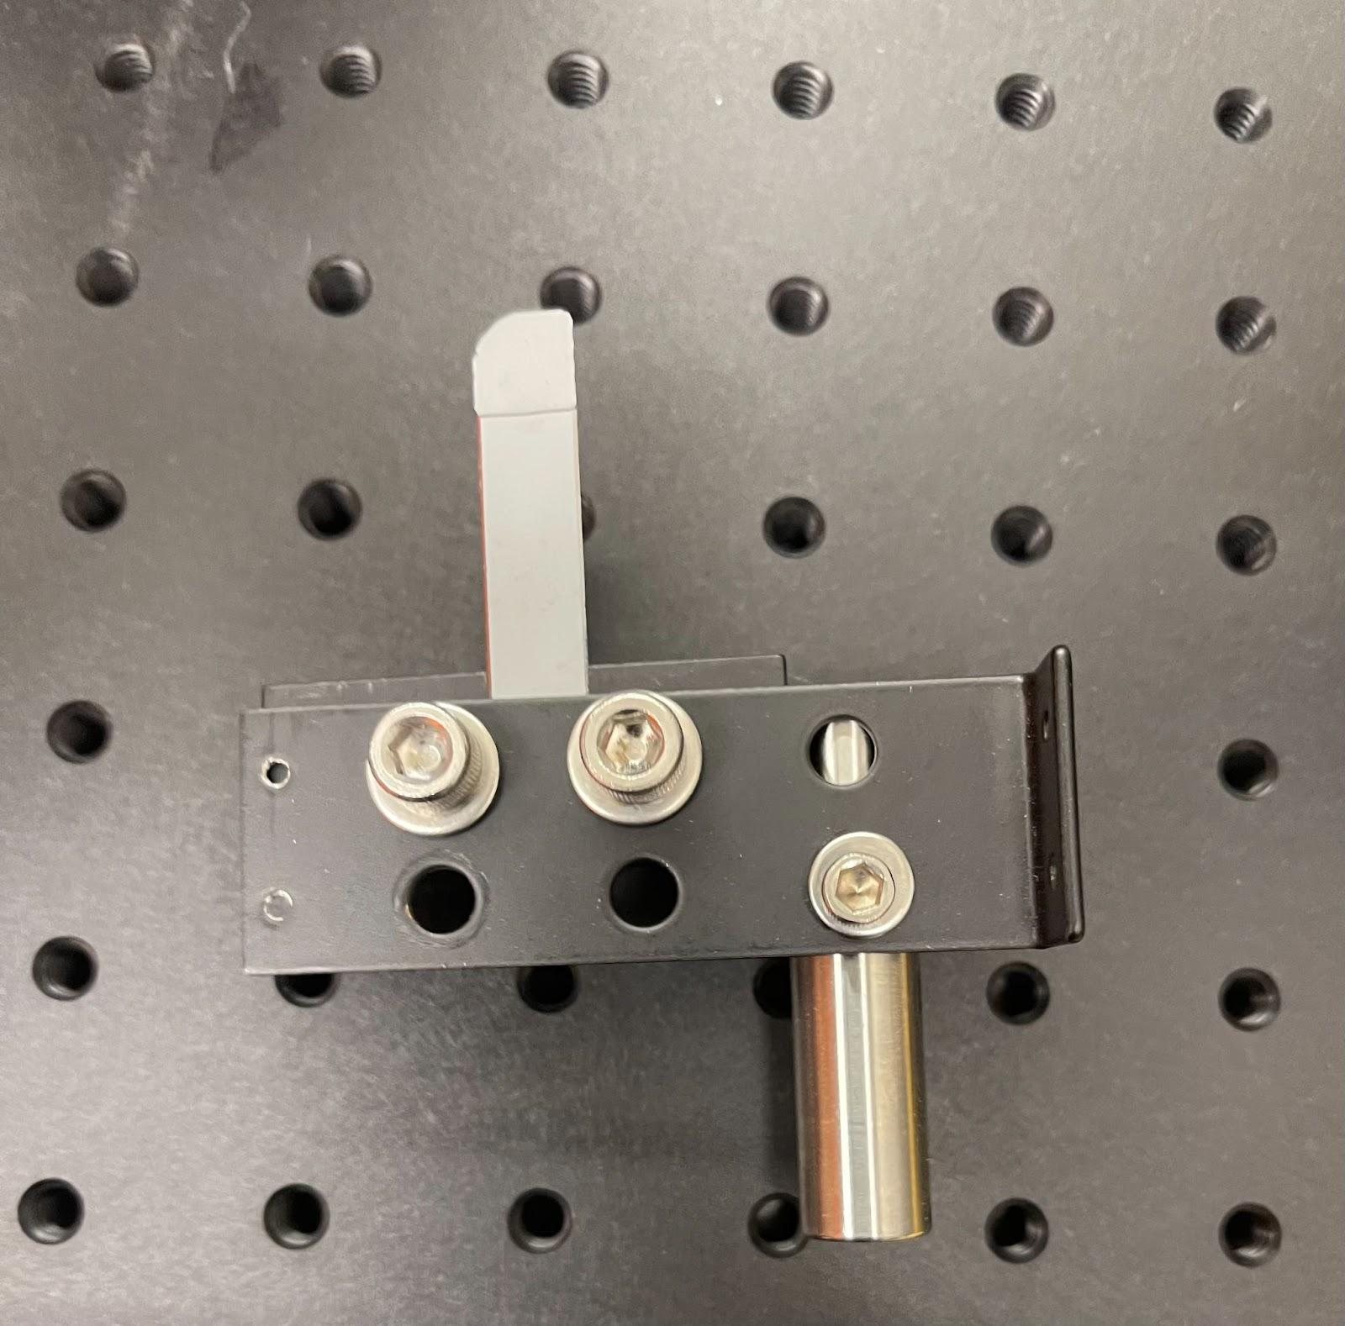
Silicon Cantilevers
We can investigate the loss of the surface of the mirrors with a small cantilever blade.

Slide 7
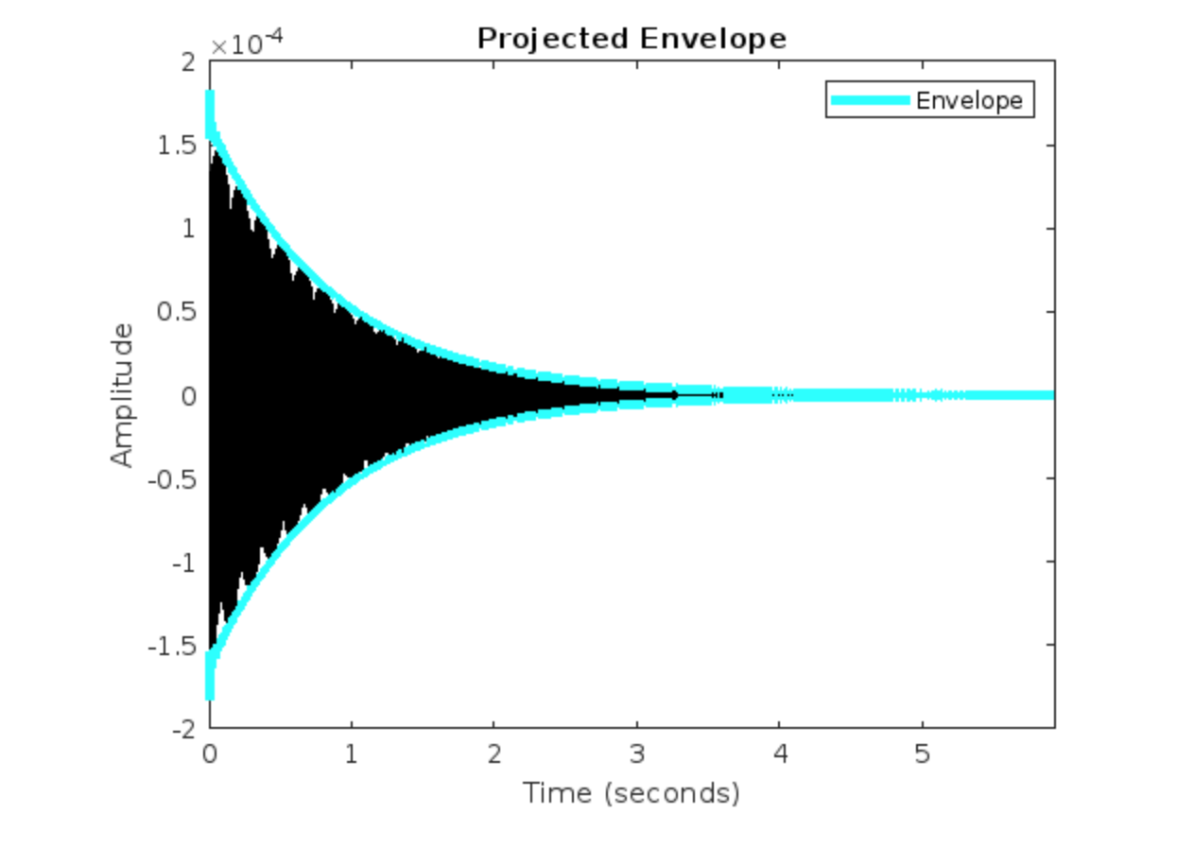
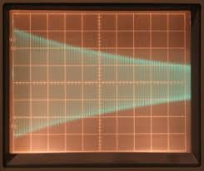
Quality Factor
The quality factor describes how much loss of energy there is for an oscillator or resonator in a given cycle of oscillation.
A(t) = A0.exp(-t/τ). Q = π.f0.τ
A(t) = Acos(2𝝿⍵t+ɸ)*exp(-t/τ)+D
General Equation
Q Formula
Fit equation

Slide 8
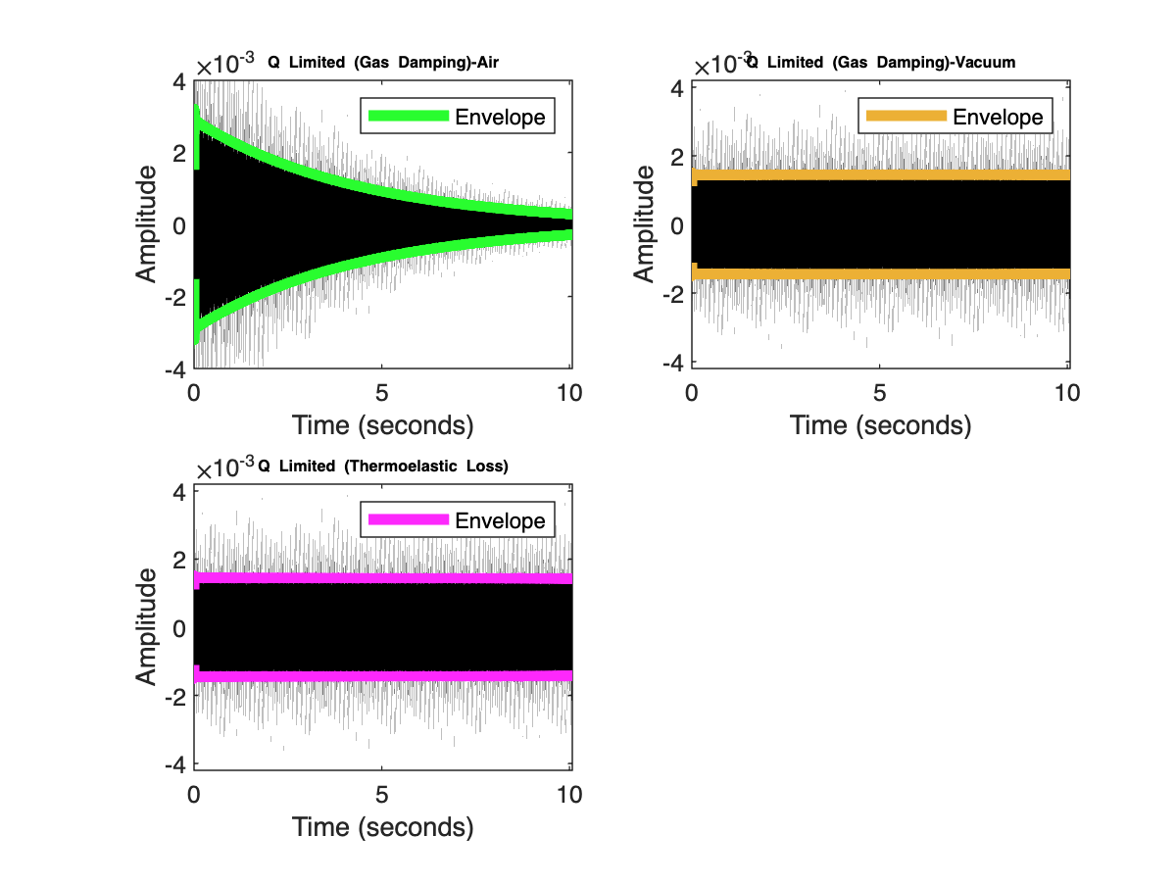
Sources of Mechanical Loss
Intrinsic Sources
Phonon-Phonon Loss
Surface Loss
Thermoelastic Losses- 10^5
Extrinsic Sources
Clamping Losses
Gas Damping- 10^7

Slide 9
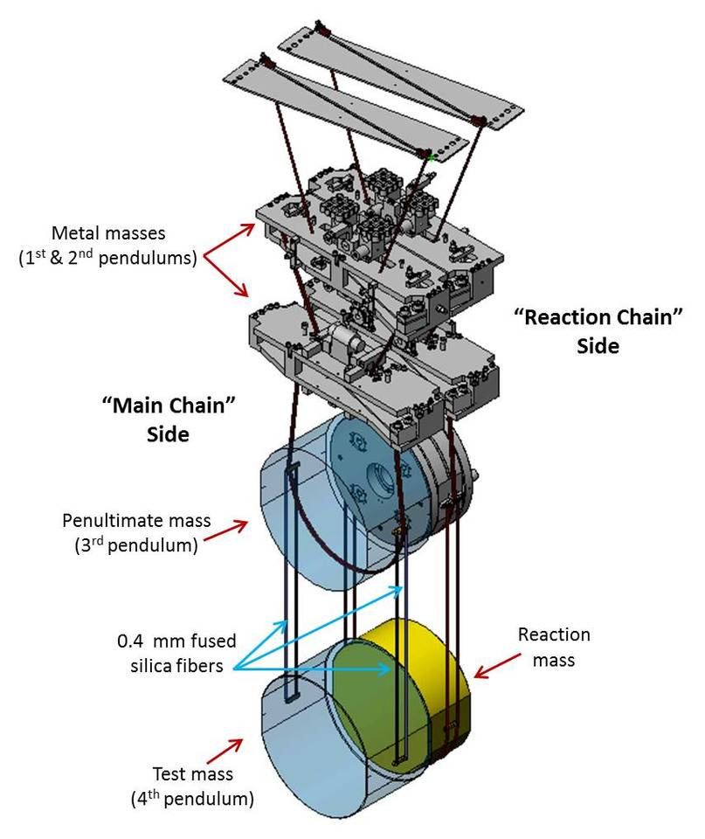
Clamping Losses
Resonator
Acoustic Wave Impedance
Clamp

Slide 10
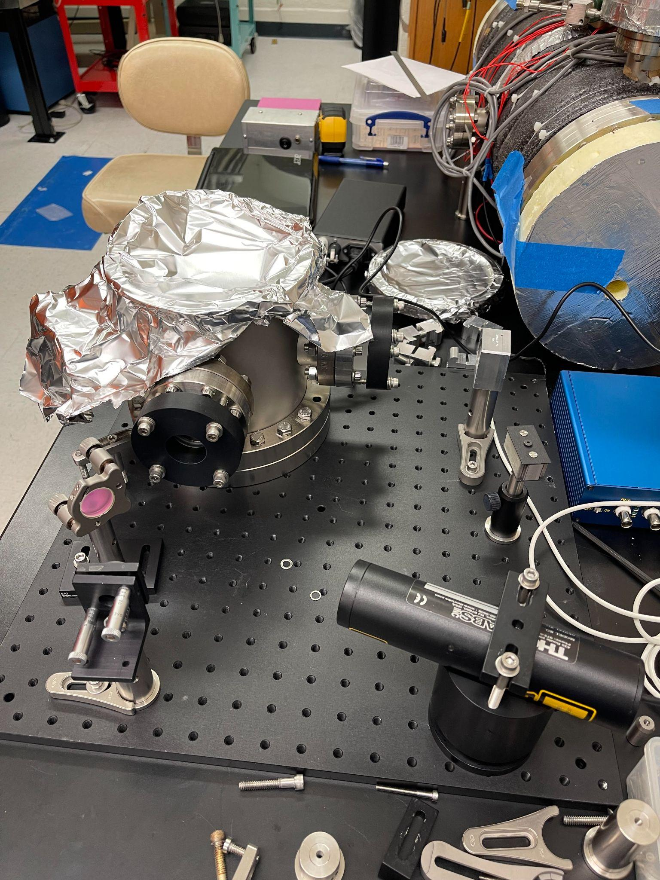
Optical Lever Setup
Vacuum Chamber
Quadrant Photodiode (QPD)
QPD (Closeup)
Helium-Neon Laser with projected laser beam path

Slide 11
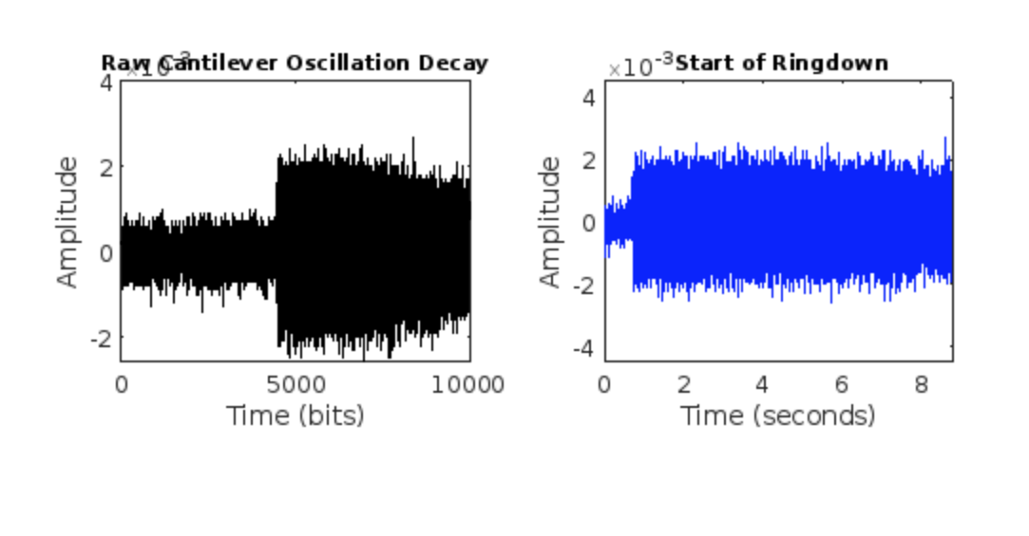
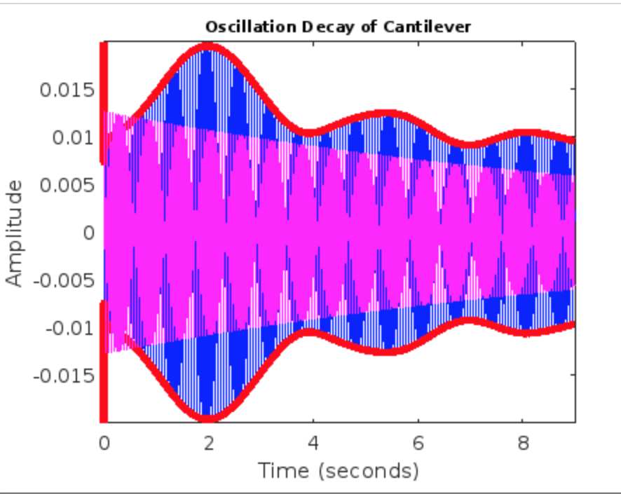
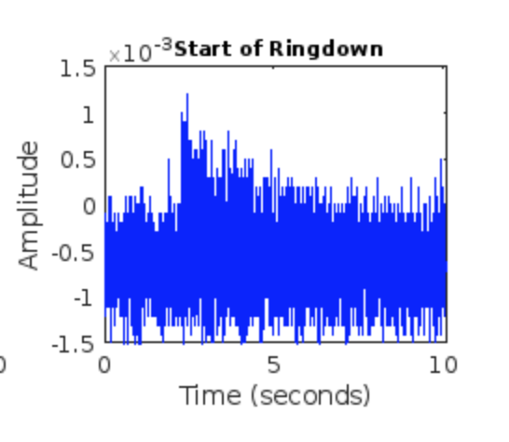
Oscillation Data Collection
Good Data Sample
Data from 1st stage
Data from 2nd stage
Poor Data Samples

Slide 12
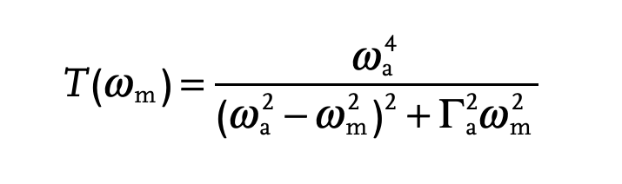

Optical Contacting
Power Transfer function
Scales with:
Resonator
Optically Contacted Layers
Acoustic Wave Isolation
Clamp

Slide 13
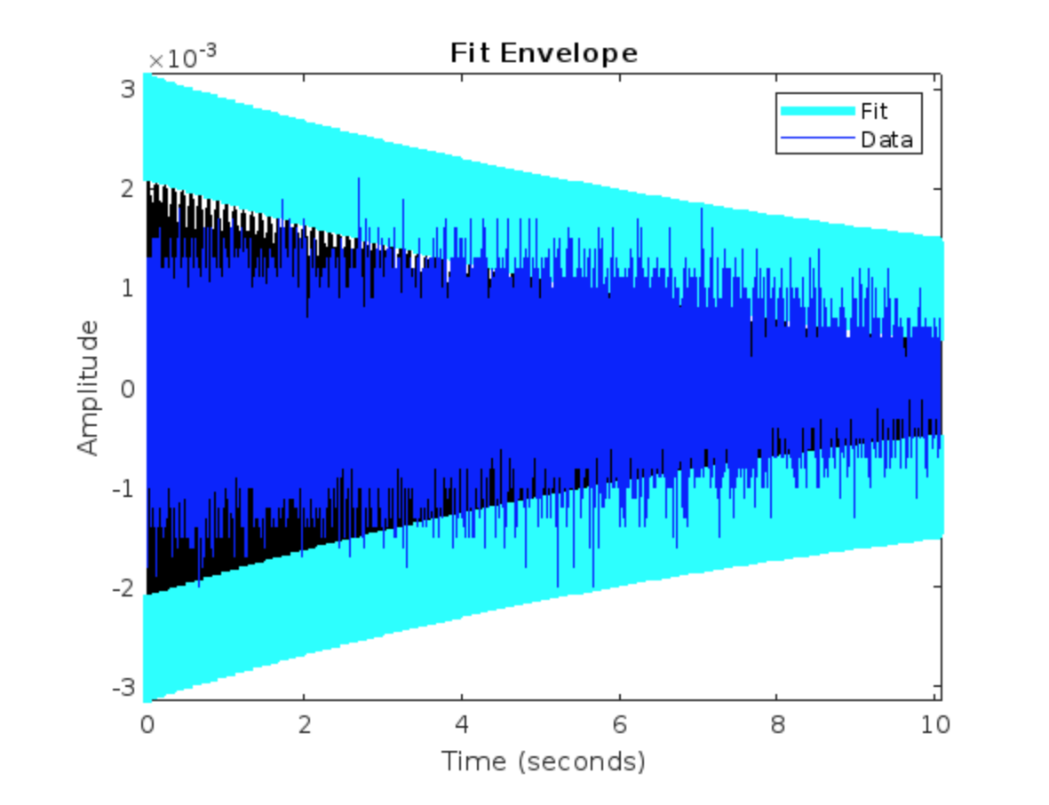
Ringdown Q Factor Calculations
1st Cantilever mean Q Value- 500
2nd Cantilever mean Q Value- 4594
Optical Contacted Cantilever mean Q value- 4623

Slide 14
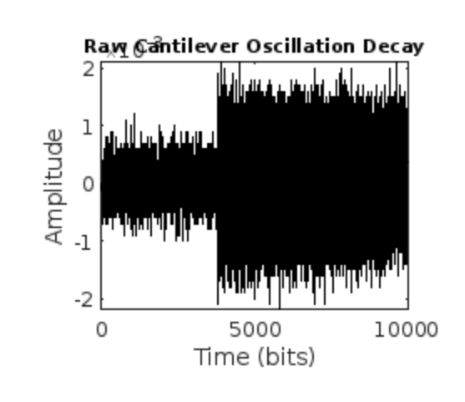
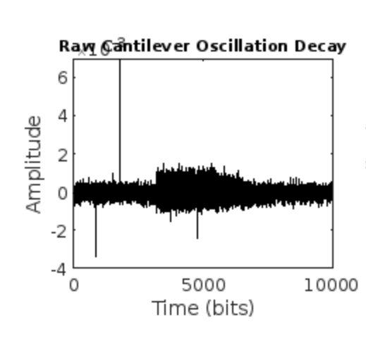
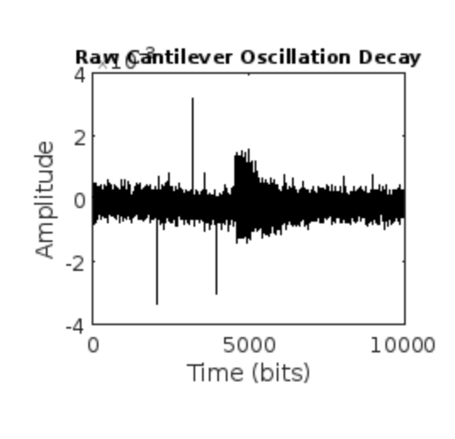
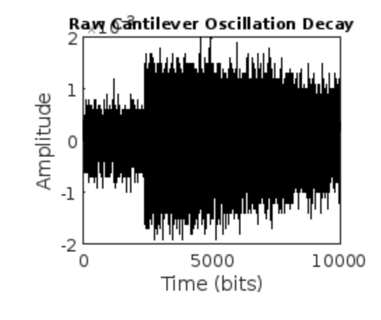
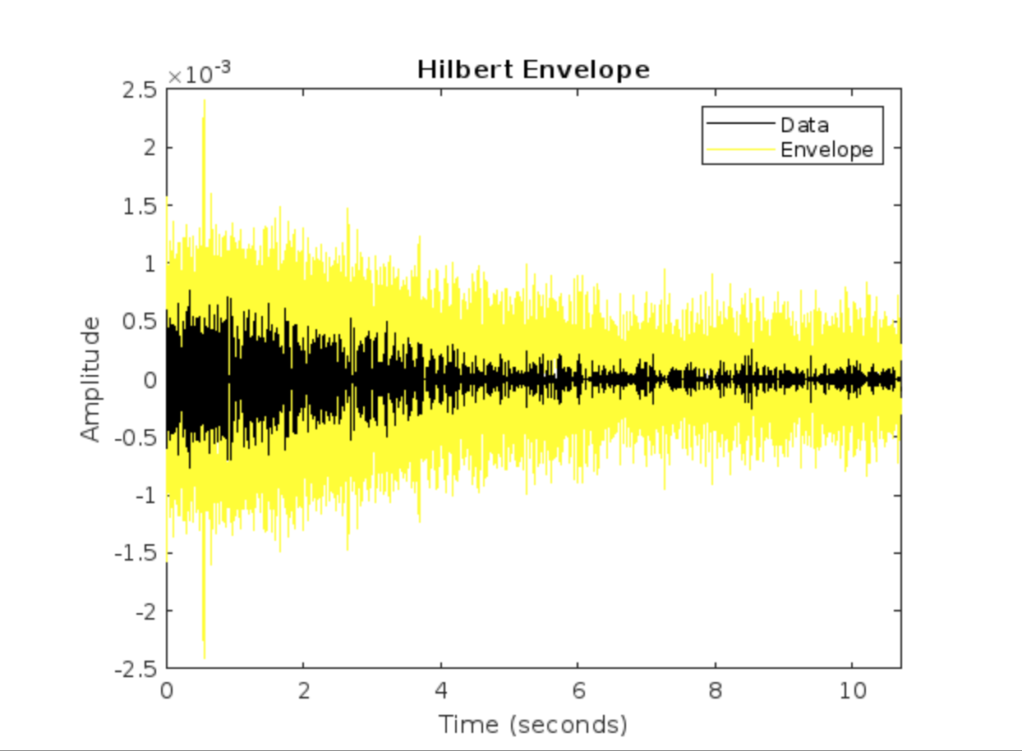
Ringdown Comparison
Regular Cantilever Data
Optically Contacted Cantilever Data

Slide 15
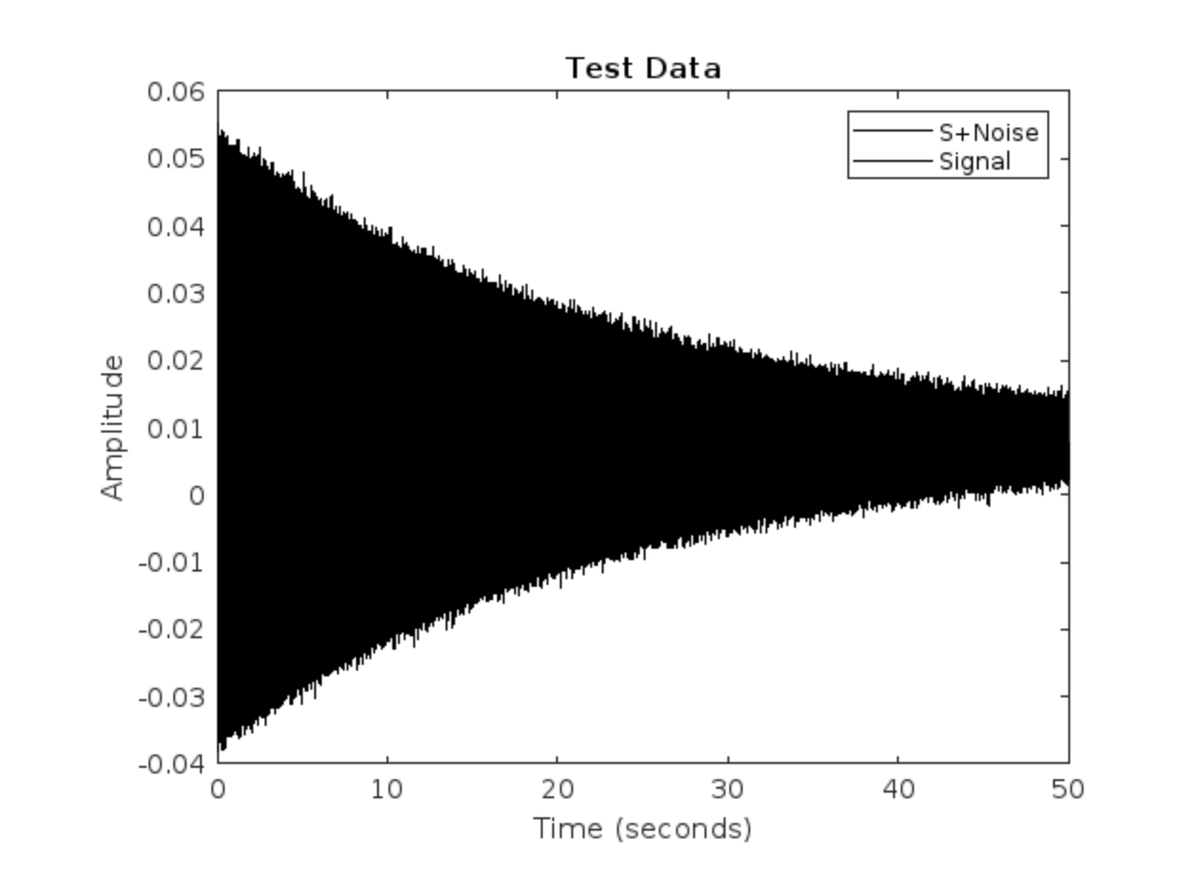
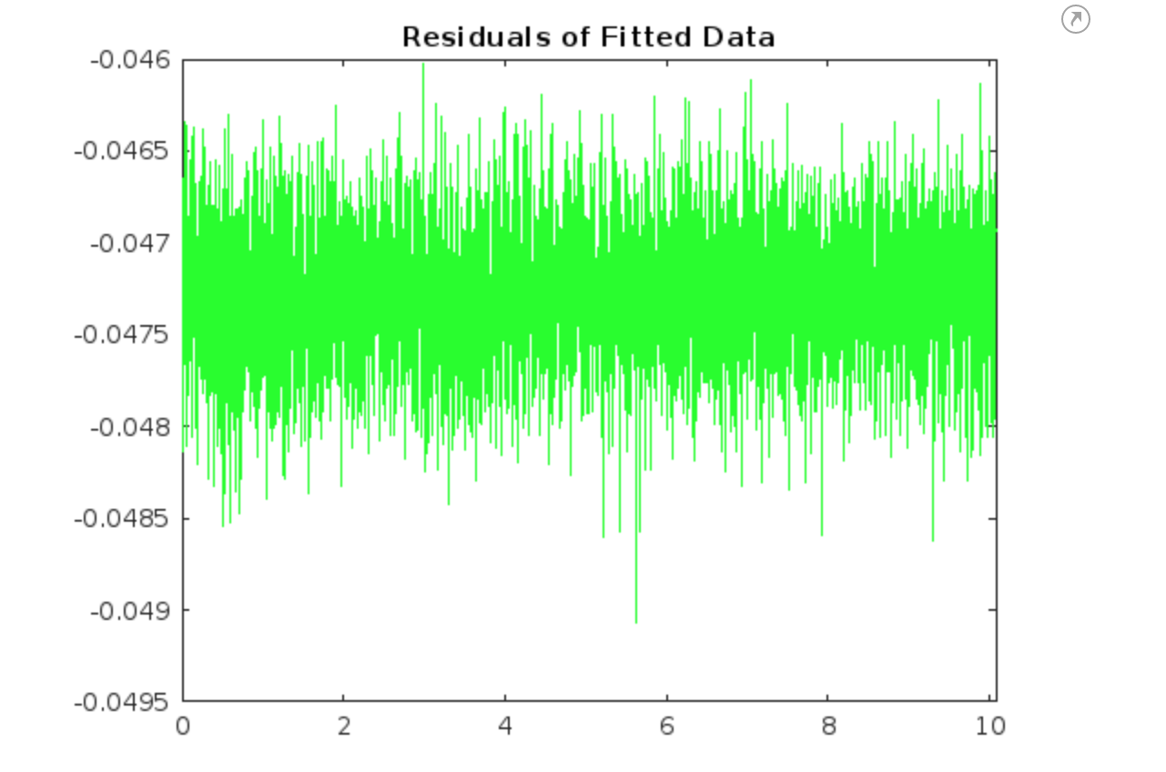
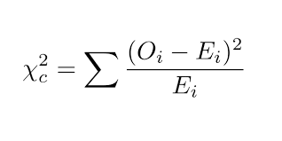
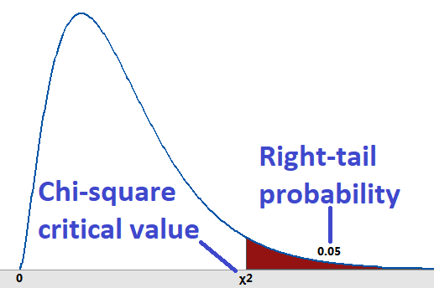
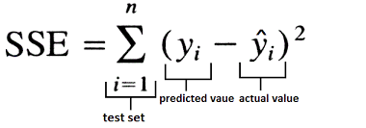
Error Analysis
Test Data
Residuals
Chi-Square Test
Sum of Squares Error

Slide 16
References
[1] Author, Huang-Wei Pan, Ling-Chi Kuo, Lin-An Chang, Shiuh Chao, Iain William Martin,
Jessica Steinlechner, and Mark Fletcher Silicon nitride and silica quarter-wave stacks
for low-thermal-noise mirror coatings. Phys. Rev. D 98, 102001 , 2018.
[2] Author, Brett Shapiro, Rana X. Adhikari, Odylio Aguiar, Edgard Bonilla, Danyang Fan,
Litawn Gan, Ian Gomez, Sanditi Khandelwal, Brian Lantz, Tim MacDonald, Dakota
page 6
LIGO-T11XXXXX–vX
Madden-Fong Cryogenically cooled ultra low vibration silicon mirrors for gravitational
wave observatories. Cryogenics, Volume 81, 2017,
[3] Author, Peter Eastman Introduction to Statistical Mechanics. Stanford University, Available
at: https://web.stanford.edu/ peastman/statmech/index.html, 2015.
[4] Author, Manoj Pandey Analysis of entrainment and clamping loss in an optically actuated
MEMS. Dissertation, Cornell University, 2008.
[5] Author, Yegishe Tsaturyan Ultracoherent soft-clamped mechanical resonators for quantum
cavity optomechanics. PHD thesis, Danish Center for Quantum Optics, Available at:
https://nbi.ku.dk/english/theses/phd-theses/yeghishe-tsaturyan/Yeghishe2.pdf, 2019.
[6] Author, F. R. Blom, S. Bouwstra, M. Elwenspoek, and J .H. J. Fluitman Dependence
of the quality factor of micromachined silicon beam resonators on pressure and geometry.
J. Vac. Sci. Technol. B, 10:19–26, 1992.
[7] Author, Mohammad. J. Bereyhi, Alberto Beccari, Sergey A. Fedorov, Amir H. Ghadimi,
Ryan Schilling, Dalziel J. Wilson, Nils J. Engelsen, and Tobias J. Kippenberg Clamp-
Tapering Increases the Quality Factor of Stressed Nanobeams. Nano Lett. 2019,

Slide 17




Acknowledgements
I would like give heartfelt thank you to my mentors and all those who made this internship possible.

