Slide 1
Note on power measured at
OFI s-pol rejected light monitor
LIGO-G2201296
August 19, 2022
Yuta Michimura
LIGO Laboratory, California Institute of Technology
yuta@caltech.edu
RESCEU, University of Tokyo
michimura@phys.s.u-tokyo.ac.jp
with Masayuki Nakano

Slide 2
Scope
s/p ratio was measured to be ~2% at LLO with full lock
This document summarizes the measurements and discussions to reveal the cause of excess s-pol, and discusses possible additional measurements

Slide 3
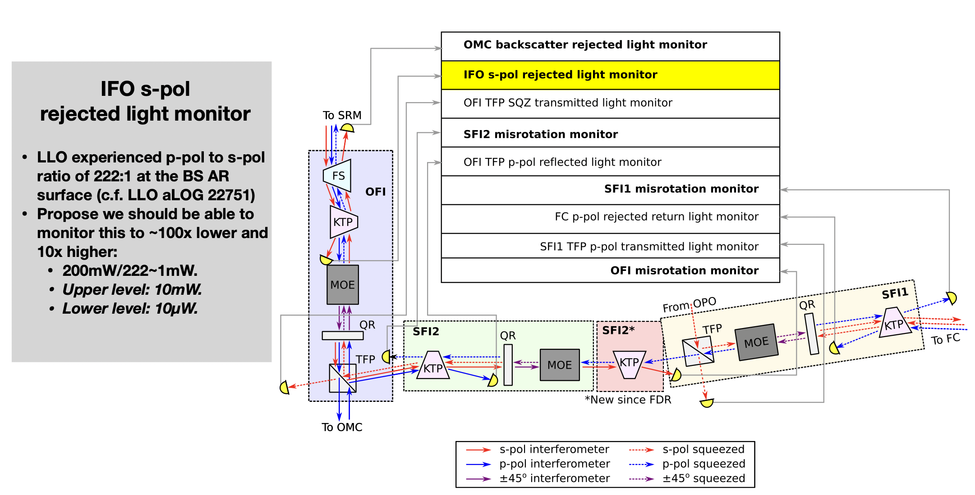
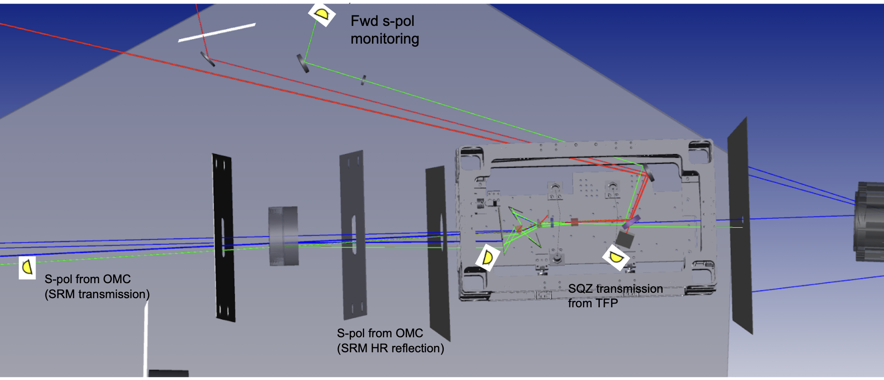
IFO s-pol rejected light monitor
Named OFI_B in HAM5
LIGO-G2000723
L1:IOO-OFI_PD_B in CDS
(currently sampled at 16 Hz)
(LLO alog #59076)
LIGO-T2200018

Slide 4
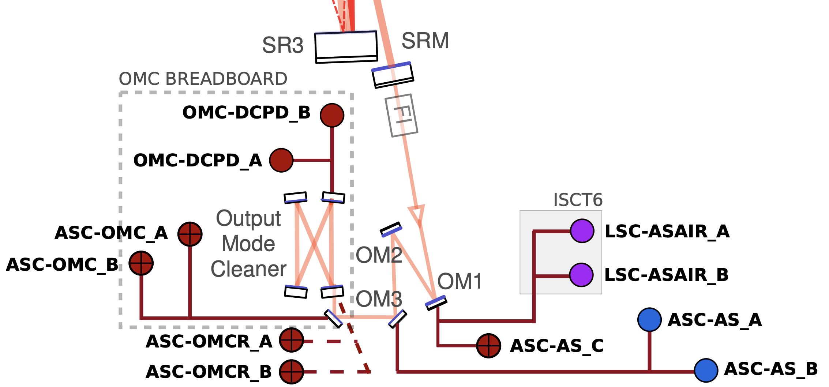
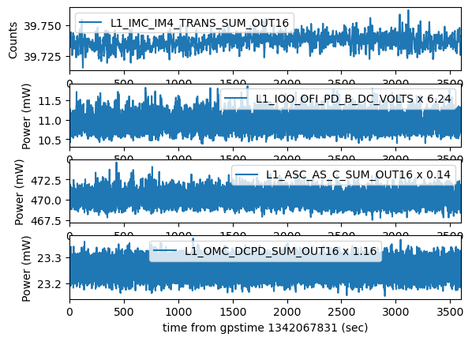
Power at AS port with Full Lock
Estimated from LLO, ~40W at PRM (GPS time: 1342067831)
L1:IOO-OFI_PD_B_DC_VOLTS = 1.75
L1:IOO-OFI_PD_B_DC_GAIN = 1 (0 dB)
-> 11 mW (total s-pol from SRM to OFI)
Using 36.5 uW / (0.0185V*10**(-10/20)) = 6.24 mW/V @ 0 dB (LLO alog #60856, #59266)
LIGO-G1601619
OM1 T=800ppm
OM3 T=1.5%
OMC QPD pickoff=0.7%
OMC MM = 93.2%
OMC loss = 4%
QE = 99%
L1:ASC-AS_C_SUM_OUT_DQ = 3350cnts
L1:ASC-AS_A_SUM_OUT_DQ = 36200cnts
-> 470 mW or 485 mW before OM1 (total OFI transmission (p-pol))
Using 149.8/21 cnts/mW for AS_C, 1568/21 cnts/mW for AS_A
(LLO alog #55225)
L1:OMC-DCPD_SUM_OUT_DQ= 20 mA
-> 23 mW at OMC transmission in total (p-pol carrier TEM00)
Using 0.86 A/W (LLO alog #60885)

Slide 5
Estimating s/p Ratio
s/p ratio of light going to OFI can be estimated using OFI_B and AS_C_SUM
- L1:IOO-OFI_PD_B_DC_VOLTS * 6.24 gives mW when gain is 0 dB. (It was 10 dB before June 22 (around 1339924767))
- L1:ASC-AS_C_SUM_OUT_DQ * 0.14 gives mW
OFI_B / ITM input
- L1:IMC-IM4_TRANS_SUM_OUT gives input power in W
- PRM transmission: 3.1% (PhysRevD.102.062003)
- SRM transmission: 32.4 % (PhysRevD.102.062003)
- BS is 50:50 for p-pol (~80:~20 for s-pol)
- Power recycling gain: 44 (LLO alog 60702)

Slide 6
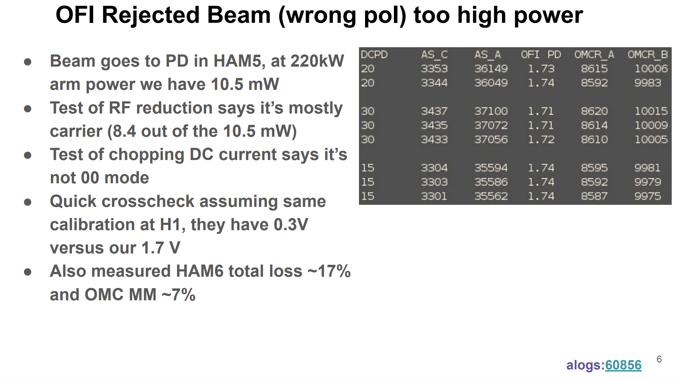
Mode Content with Full Lock
In OFI_B, 8.4 mW out of 10.5 mW is carrier
(We cannot conclude that it is not 00 mode from DC chopping test; see following slides)
s/p ratio is about 2%
LIGO-G2201281, LLO alog #60883, LLO alog #60878

Slide 7
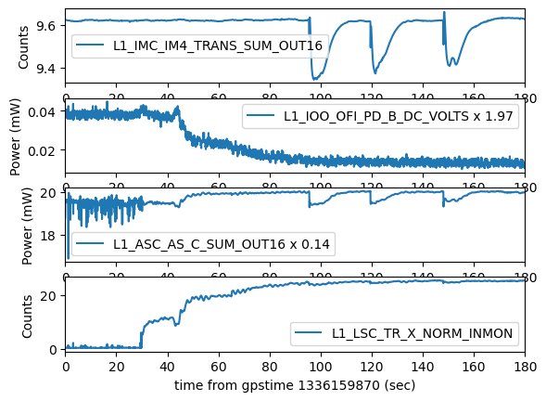
Single X-arm Lock
s/p ratio reduced with Xarm locked, compared with ITMX single bounce (0.2% -> 0.07%)
Suggests non-uniform
ITMX birefringence is
causing this; see Section IV
in LIGO-T2200272
Corrected ratio for BS unbalance
 | IM4_TRANS | OFI_B | AS_C_SUM | s/p ratio
ITMX single bounce | 9.6 W to IFO ~150 mW to ITM | 0.019 @ 10 dB (0.038 mW) | 138 (19.4 mW) | 0.20% (AS) 0.14 mW / 120 mW = 0.12 % (ITM refl)
Xarm locked | 9.6 W to IFO ~150 mW to ITM | 0.0061 @ 10 dB (0.013 mW) | 142 (19.9 mW) | 0.065% (AS) 0.050 mW / 120 mW = 0.041 % (ITM refl)
Full lock | 39.7 W to IFO ~870 W to ITM | 1.74 @ 0 dB (10.8 mW) | 3350 (470 mW) | 2.3% (AS) * Note that p-pol is RF sideband dominated

Slide 8
Lawrence Effect: ITM Substrate
Lawrence effect (conjugation effect; mode healing) also works for birefringence
See Table I in LIGO-T2200272
HOMs are suppressed
Inside the cavity
2 for double pass
1 for HOM, as it will be single pass
s-pol TEM00 remains, HOM suppressed to O(φ(x,y)^2)

Slide 9
Lawrence Effect: ITM Coating
Not perfectly for ITM coating, as penetration length is not equal to coating thickness
See Table I in LIGO-T2200272
HOMs are suppressed
Inside the cavity
2 for double pass
l<1 for penetration length
Enhanced by cavity
s-pol TEM00 enhanced by cavity, HOM not suppressed completely

Slide 10
S-pol from Arm is 90 deg Off
s-pol generated in arm reflection is always 90 deg out of phase from p-pol in small birefringence limit
This is always the case, arm locked/unlocked or with small arm detuning
DARM offset will change MICH fringe and amount of s-pol carrier TEM00 in AS port, but AS port could be bright for s-pol, depending on axis orientation of both arms
If we consider arm cavity as a waveplate which makes small phase shift δ<<1, and its axis is rotated by θ from input polarization, reflected light is
Input pol
Orthogonal polarization have i, which means its phase is off by 90 deg
(+90 or -90, depending on axis orientation)
Resonant condition of arm cavity will change the amount of δ and θ, and thus amplitude of orthogonal polarization, but it will not change the phase of orthogonal polarization

Slide 11
BS Messes Up s-pol
BS is ~80:~20 for s-pol, and phase in reflection/transmission is different from p-pol by O(10) mrad (LIGO-G1501374), which makes MICH reflection/transmission phase difference by ~100 mrad
This is enough to shift s-pol resonance away from p-pol resonance, and MICH fringe away from bright/dark fringe
PRC linewidth is 2*pi/Finesse ~ 50 mrad
With zero DARM/CARM offsets and no PRM/SRM, electric field of AS beam and REFL beam will be
Different for s-pol from BS effects
x-y = -76 mrad for AS and REFL
(x+y)/2 = -184 mrad for AS
(x+y)/2-φ = -146 mrad - 22 mrad = -168 mrad for REFL
DIFF and COMM mixed in PRC

Slide 12
Discussion
Why DARM offset didn’t change power in OFI_B much?
- It is possible because contrast of s-pol is probably worse than that of p-pol, and MICH fringe is different for s-pol (AS port can be dark or bright for s-pol, depending on axis orientations of both arms, and shifted from perfect dark or bright from additional phase in BS). For example, if ITMX birefringence is very large compared with ITMY, DARM offset does not change s-pol power at AS.
Why s-pol is carrier dominant?
- Resonant condition in PRC/SRC is different for s-pol because of BS, and RFSB (and carrier TEM00) are suppressed?
- ITM non-uniform coating birefringence can create carrier HOMs in s-pol (ITM substrate birefringence cannot make much due to Lawrence effect; See previous slides and Table I in LIGO-T2200272), but it also makes more carrier 00 mode when the arm is locked than unlocked.
- Can be also explained if uniform coating birefringence is small
- It could also be that birefringence in the coating mainly on substrate side (because of stress from mirror-coating boundary?)
Why s/p ratio increased to 2%, compared with single arm lock?
- With full lock RFSB dominates p-pol, but for single arm, carrier dominates p-pol
- Also, higher power creates larger birefringence (LLO alog #61099)
- Additionally, some HOM s-pol might be resonating in PRC/SRC?

Slide 13
Possible Additional Measurements
PRXarm/SRXarm locked and unlocked
- Gives the effect of PR and SR
Single arm detuned, RF modulation depth scanned
- To see mode content for single arm lock
FPMI and single arm
- To check if s-pol generated is common or not
ITM/ETM ring heater on/off
- To confirm if the effect is from ITM, and if ETM contributes
Power high/low
- To check power dependence on ITM birefringence
Arm/PRC/SRC cavity scan
- to see mode content in OFI_B (better to have fast ADC synced with other channels)
Use other in-air ports? (POP? HWS port?)
TRX/Y gives polarization modes in the arm (assuming ETM substrate birefringence is small)

Slide 14
Details

Slide 15
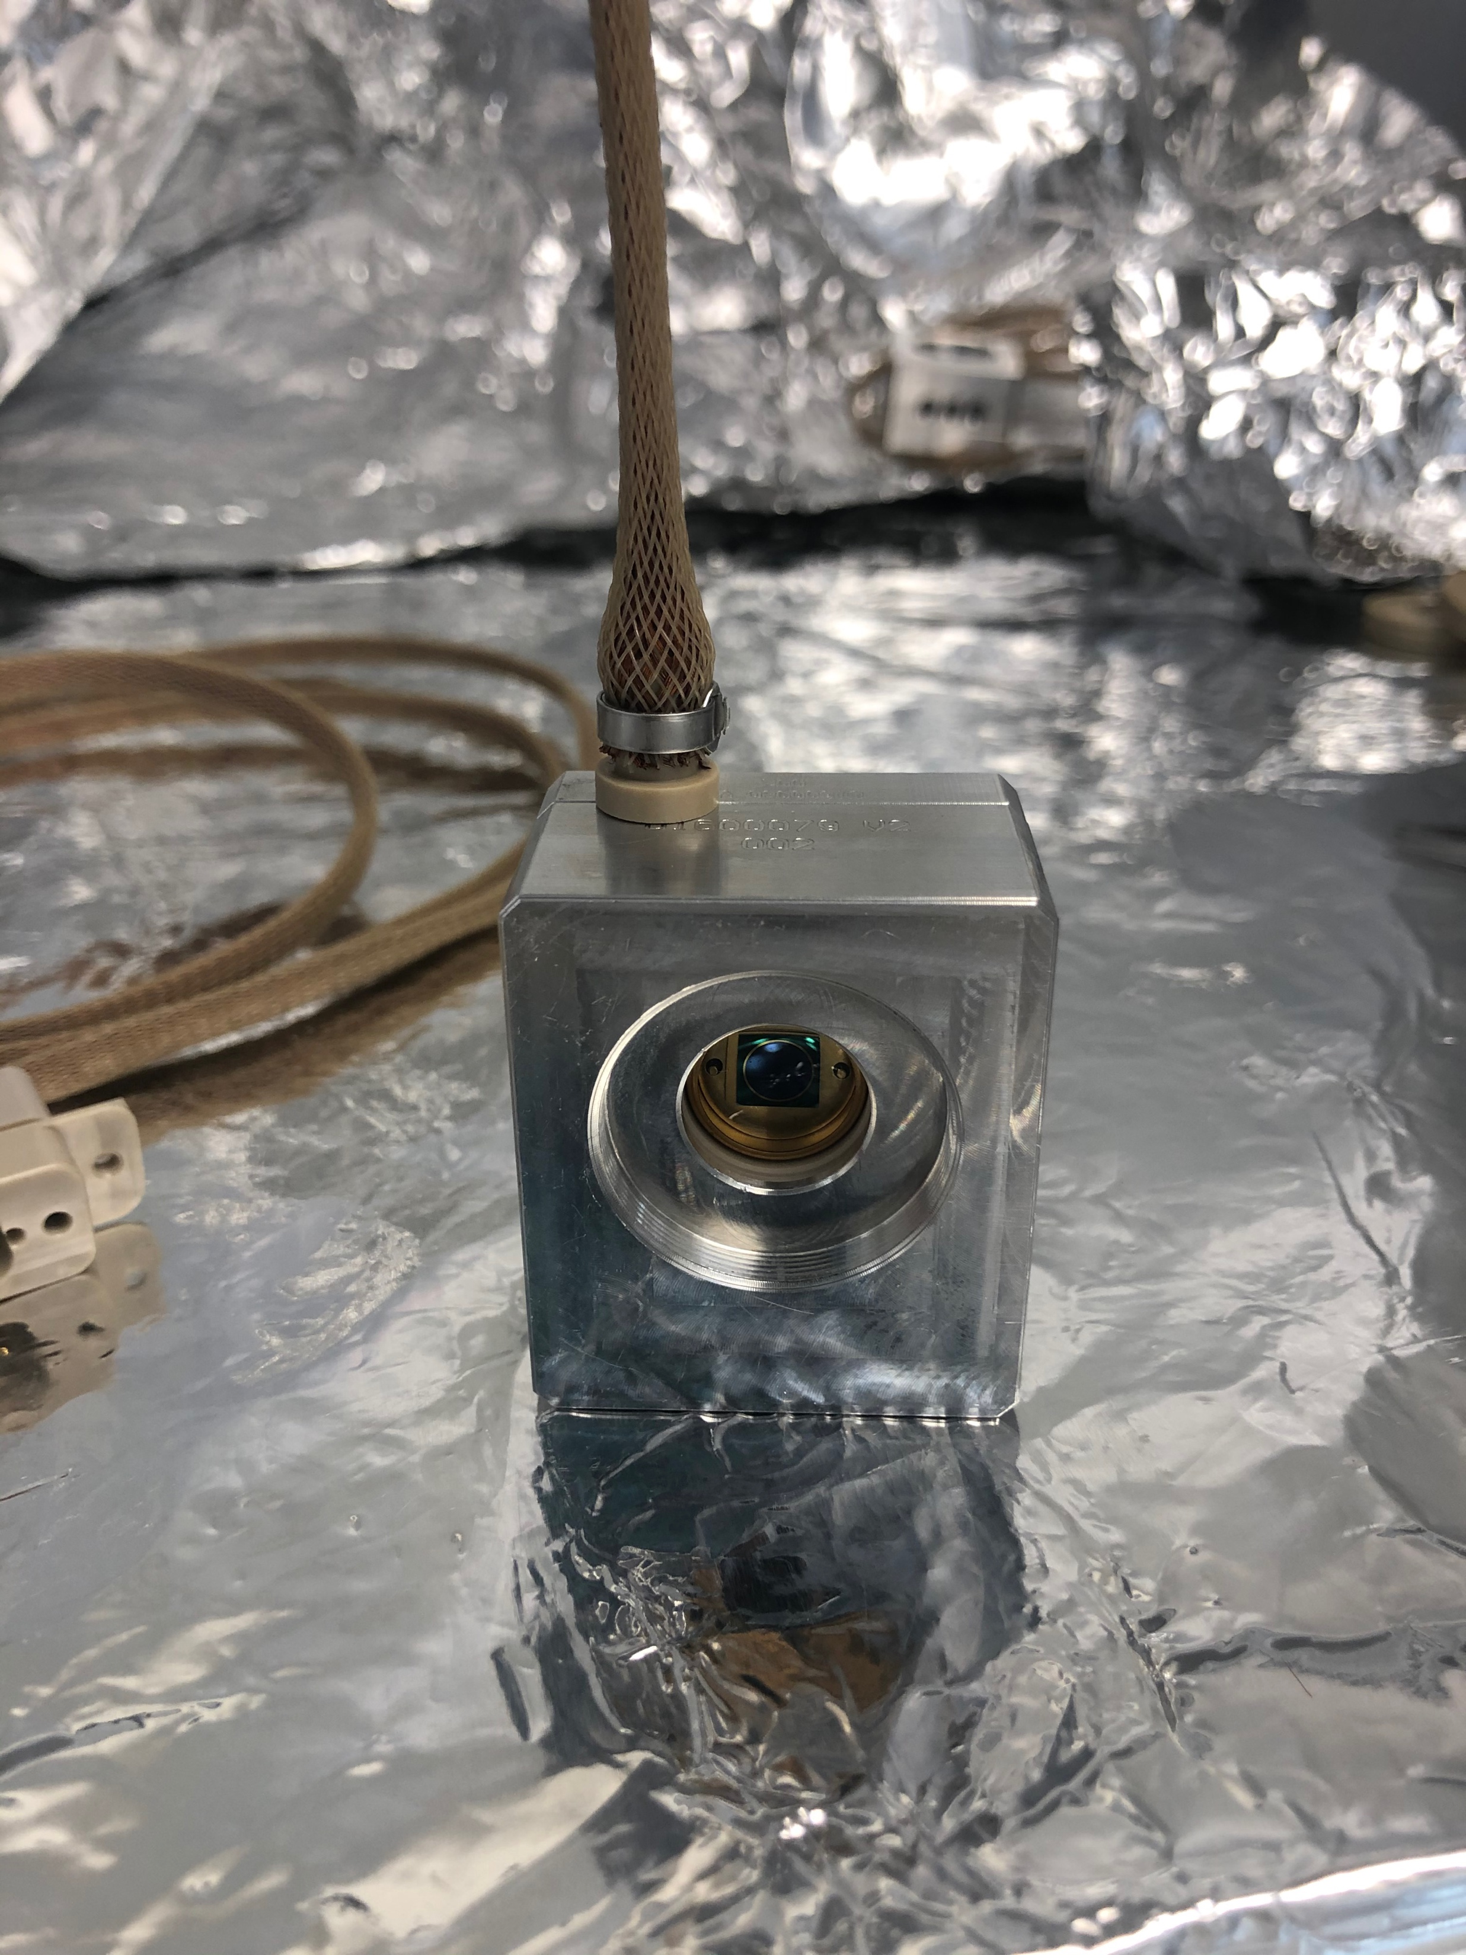
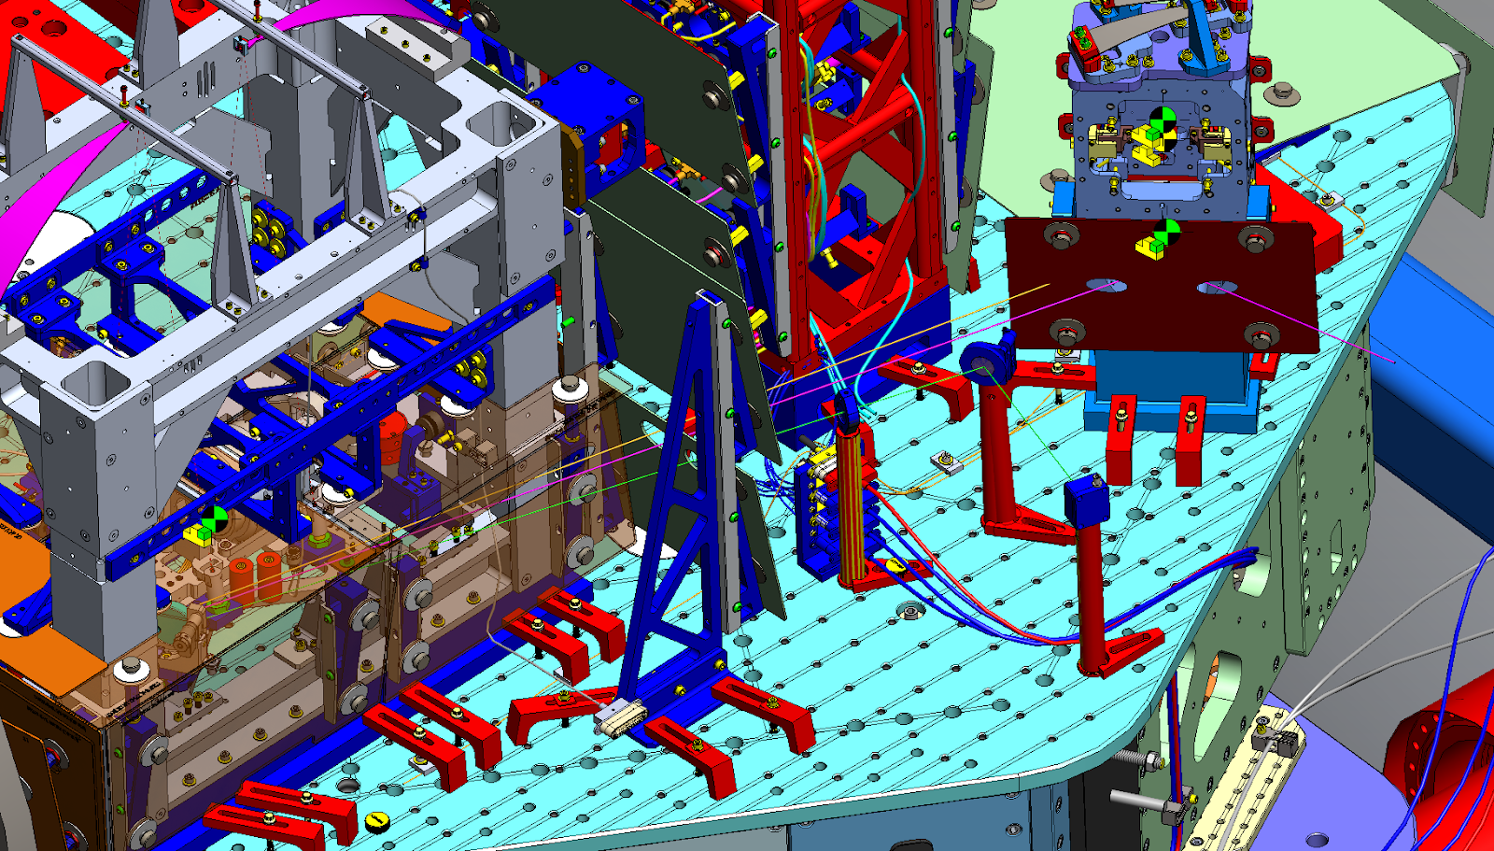
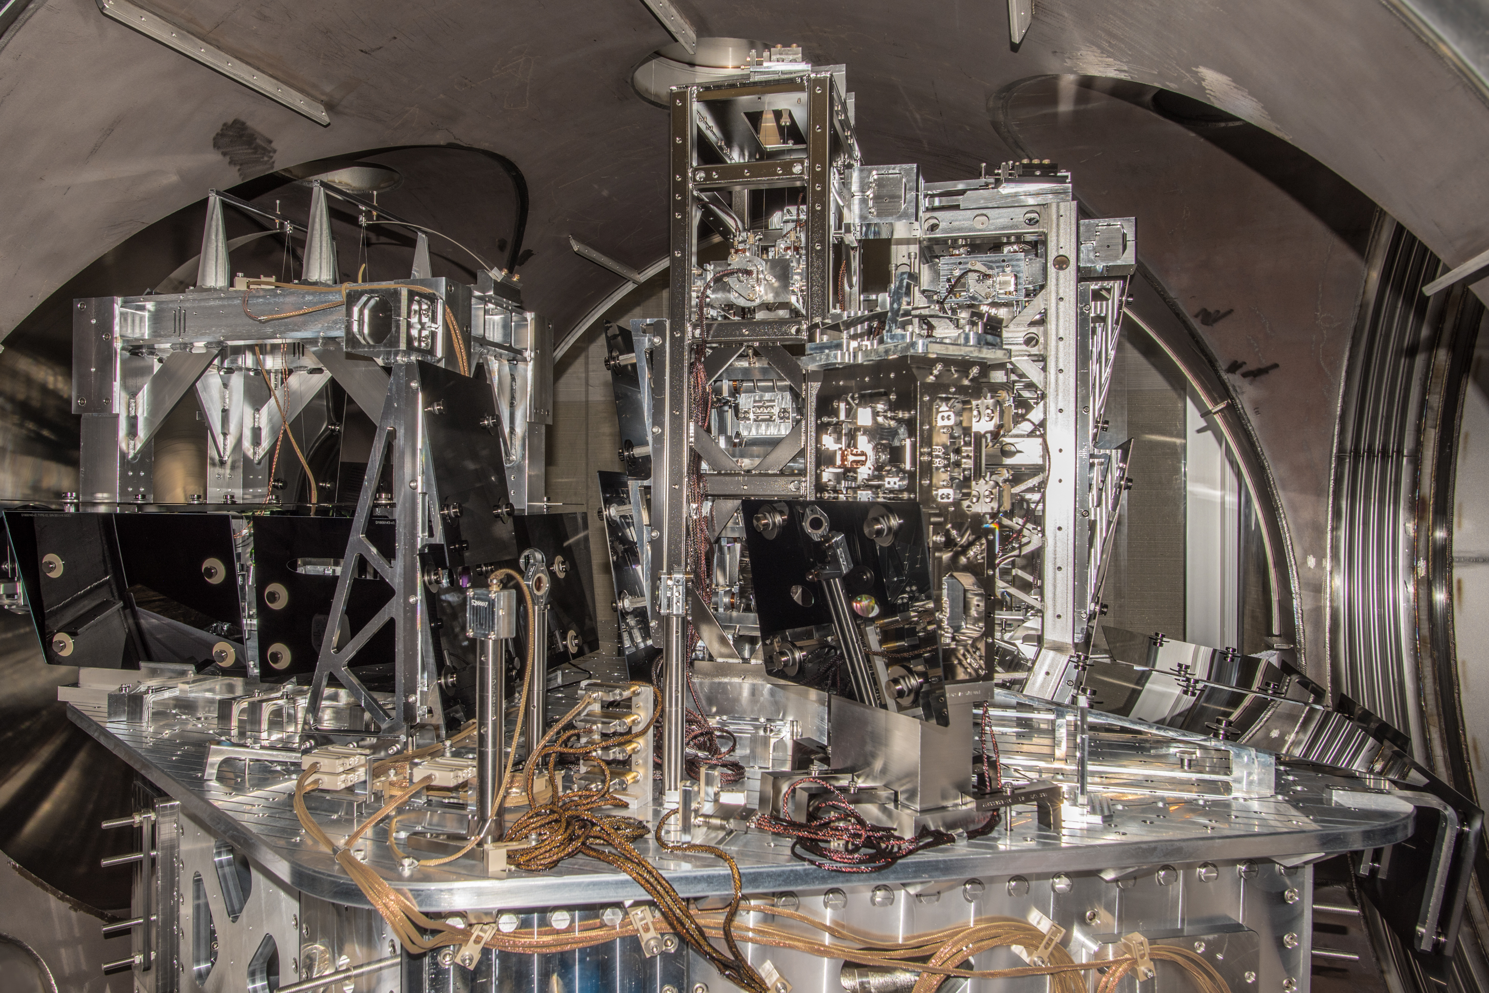
IFO s-pol rejected light monitor
Named OFI_B in HAM5
LIGO-
E2100030
LIGO-T2200018
LLO alog #59282

Slide 16
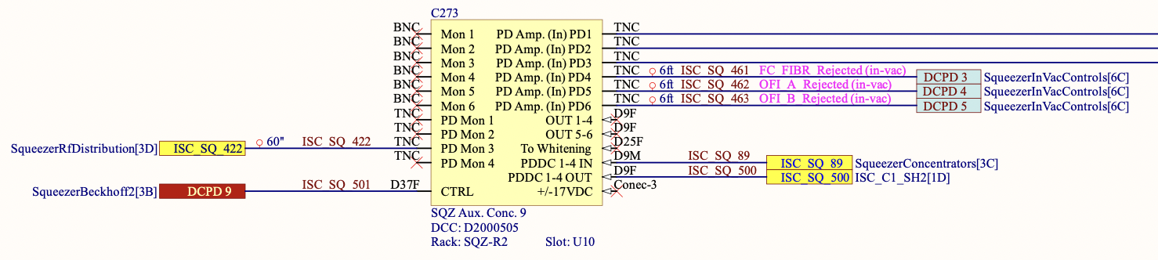
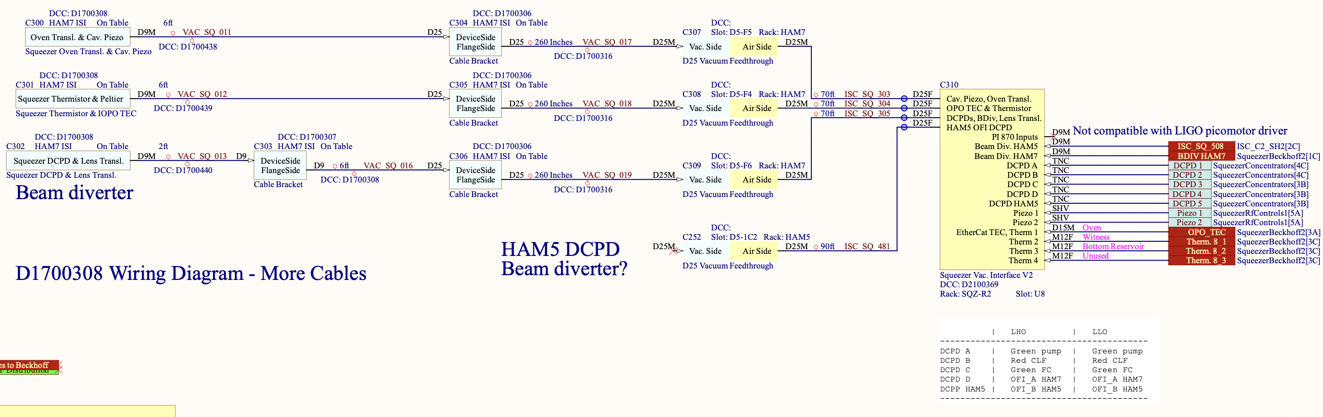
Current OFI_B Signal Chain
Excelitas FFD-200H (E2100030)
A+ Squeezer Interface Chassis (D2100369)
Auxiliary Signals Concentrator 9 (D2000505)
Dual DC Photodiode Amplifier (D1200543)
- Trans-impedance switchable from 1k, 3.16k, 10k 31.6k
- Has extra x(-2) gain
No whitening
ADC-ed with Beckhoff (16 Hz)
L1:IOO-OFI_PD_B in CDS (LLO alog #59076)
LIGO-D1900511

Slide 17
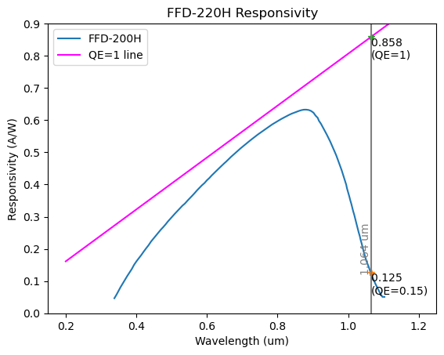
Noise Estimate
PD dark noise / transimpedance amp noise
- FFD-200H: 0.125 A/W at 1064 nm (Datasheet)
- FFD-200H: Dark current 56 fA/rtHz @ 1 kHz (Datasheet)
- OP97: 20fA/rtHz, 30nV/rtHz (Datasheet); assume 1 kOhm transimp
Shot noise
- Power at BS in O4: 2800 W? (400 kW at arm)
- s-pol power at OFI_B: ~11 mW with ~40W at PRM (LLO alog #60856); assumed 1 mW to be TEM00, and 10 mW to be junk)
- Assume no squeezing in s-pol
- FFD-200H has QE=15%
ADC noise
- 4 uV/rtHz ? (assuming 16bit ADC)
- Use 3-stage 10 Hz / 1 Hz whitening filter
(e.g. LIGO-D1001530)
- whitening filter noise: 3e-8 V/rtHz

Slide 18
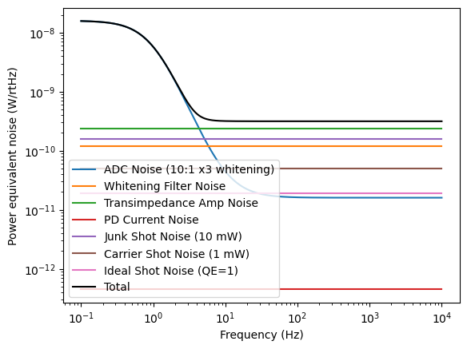
Estimated Power Equivalent Noise
Dominated by ADC noise at low frequencies
Transimpedance amp noise and shot noise from junk light (HOMs, RFSBs) at high frequencies
- Amp noise can be reduced further with modifications
Assumed 1 mW of carrier TEM00 and 10 mW of junk light for s-pol
ADC noise: if we use usual fast ADC with whitening filter (not current Beckhoff ADC)

Slide 19
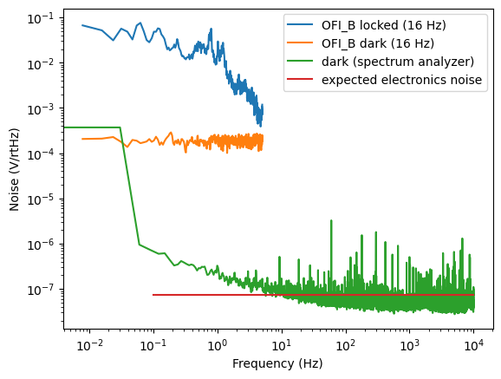
Measured Noise
From L1:IOO-OFI_PD_B_DC_VOLTS (16 Hz)
Dark noise also measured with spectrum analyzer by Masayuki
Currently Beckhoff ADC noise is limiting dark noise
Dark noise measured with a spectrum analyzer matches well with our electronics noise expectation

Slide 20
BS Phase
Number from LIGO-G1501374
HR
-54 mrad
AR
-28 mrad
-64 mrad
-28 mrad
-64 mrad
(transmission phase is the same
for both sides)
-2 mrad
(=(-28)*2-(-54) mrad; from energy conservation)

