Slide 1
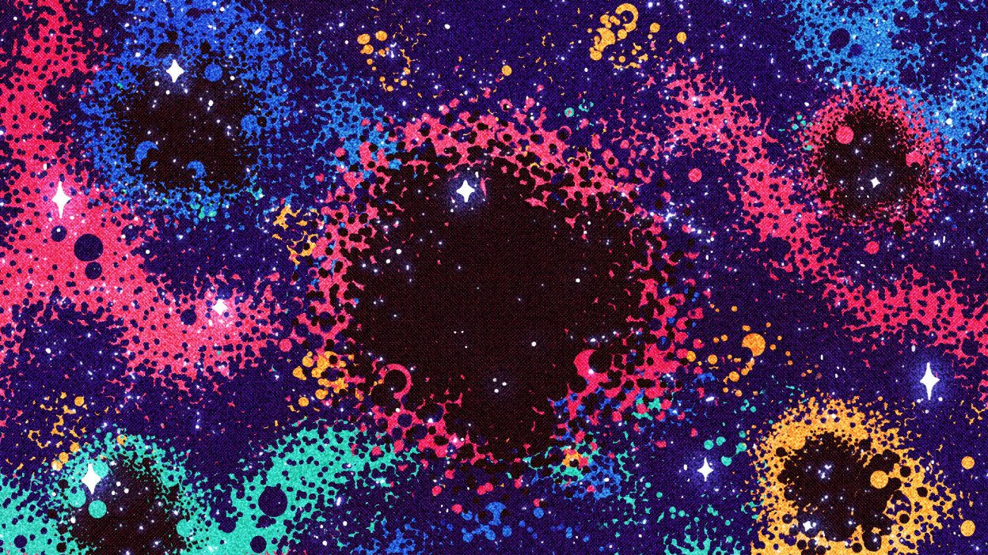
Recovering Higher Order Modes in the Ringdown of BBH Coalescences DCC #LIGO-T2200250
Rachel Mechum
University of Florida
Mentors: Richard Udall & Alan Weinstein
Caltech

Slide 2
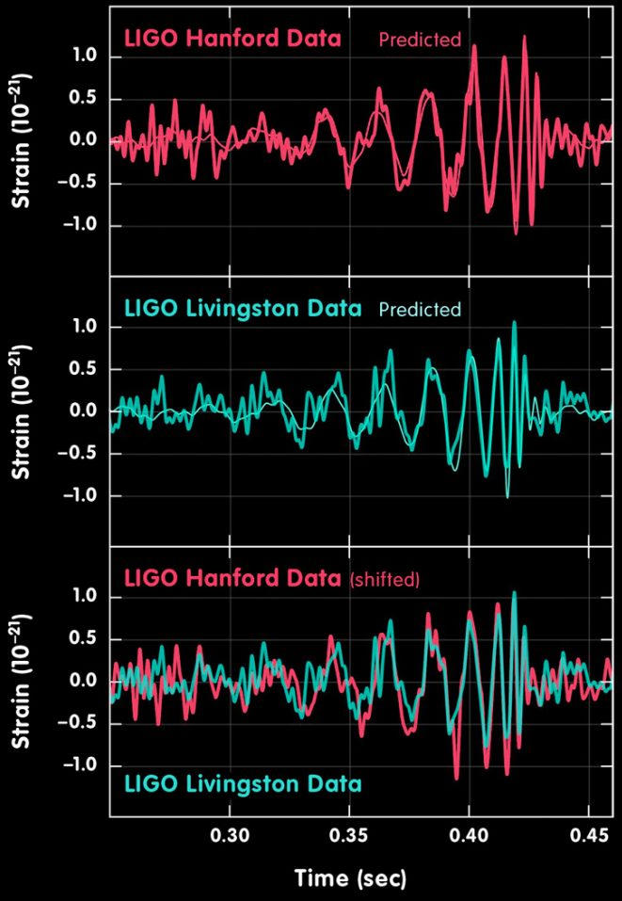
Overview
BBH mergers
Time domain ringdown analysis
Quasinormal Modes (QNMs)
Higher Order Modes (HOMs)
No Hair Theorem (NHT)
Notes:
Bbh mergers is the focus\
This plot shows gw150914 IMR waveform (inspiral then merger then ringdown where black hole rings down as a set of QNMs)
But this ringdown does not happen a hard set time…the merger to ringdown transition is soft and can change which is why we use time domain instead of frequency
Go over what a Quasinormal mode is and why we work with higher modes
Also discuss a little about Einstein and trying to prove him wrong with violations of NHT

Slide 3
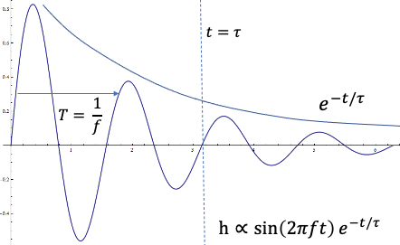
Quasinormal Modes (QNMs)
$$t_{M}=\frac{GM}{c^{3}}$$
$$Q=πfτ$$
$$Q=πfτ$$
Frequency & Damping ←→ Mass & Spin
Classified by l,m,n
l, m (angular multipoles)
n (radial overtones)
$$h∼\sum_{lmn}{A_{lmn}}sin⁡(2πf_{lmn}t)e^{−t/τ_{lmn}}$$
Notes:
Here is one QNM which is a single damped sinusoidal oscillation where t is the period and here is the exponential decay with a quality factor
The Q factor is essentially how damped the oscillation is so if we set t = tau we can ask how man cycles have happened thus far and it would be roughly 2
when we add multiple QNMs together we get this summation with complex amplitude, freq, and damping times, all dependent on mode configuration
QNMs tell us exactly what the frequency and damping times are from a certain remnant (merged) BH's mass and spin
this is directly derived from GR and the math states that only one combo of freq and tau can pair with one combo of mass and spin and vice versa
these QNMs are classified by their lmn or their angular multipoles and n their radial overtones
this plot I show you next is giving a little more insight on different modes and overtones along with their frequency, damping times, and q factor
all plots have x axis of spin against the y-axis, from left to right we have freq and then damping time, both accompanied by a time constant associated with BH mass there's the equation
and then quality factor
0th overtone has the greatest values with higher overtones following as we can see in every plot and when we get close to chi=1 the lines diverge due to our understanding of Kerr black holes

Slide 4
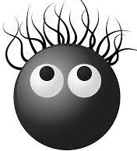
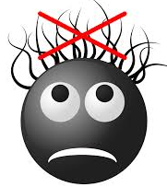
Higher Order Modes (HOMs)
$$Q=πfτ$$
$$t_{M}=\frac{GM}{c^{3}}$$
$$Q=πfτ$$
22 → 33, 44
NHT
To have hair, or not to have hair:
that is the question
Notes:
the same plots but showing you higher order modes like 33 and 44 (lm) where freq of modes are increasing with overtones 1 and up follow below values of n=0
but why HOMs? we have studied the dominant 22 mode but want to look deeper into these HOMs to test the no hair theorem
the no hair theorem states that mass and spin are the only two properties of black holes, referencing back to how mass and spin determine specific freq and damping times - if we see deviations in that we note that as a violation of the NHT and GR since these quantities are directly derived from GR

Slide 5
IMRPhenomXP(HM)
Approximant
Combines inspiral, merger, ringdown
Phenomenological model
Precessing BBHs
QNM configuration
21 (XPHM)
22 (XP)
32 (XPHM)
33 (XPHM)
44 (XPHM)
n = (0, 1, 2)
Notes:
Basically read this slide there isn’t much else to say

Slide 6
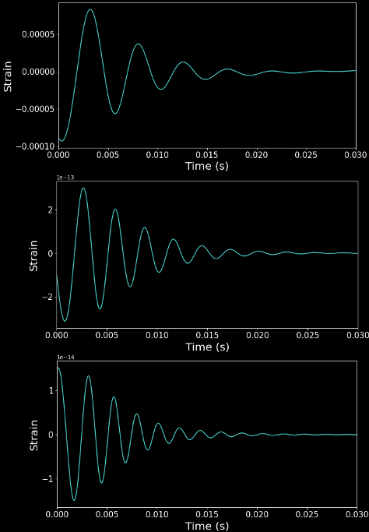
22
33
44
Notes:
Main point – these all have diff freq and damping times

Slide 7
Recovery Method
..…does it do a good job?
scipy.optimize.curve_fit
$$h∼\sum_{lmn}{A_{lmn}}sin⁡(2πf_{lmn}t)e^{−t/τ_{lmn}}$$
$$1−R^{2}=\frac{RSS}{TSS}$$
Notes:
Using curve fit to fit for this complex amplitude / freq / damping times given from input BBH masses and spins to final BH mass and spin
To see how well we are recovering the entirety of the waveform we use this residual value which was just a specific way to but there are other ways
Here we have the sum of squares of the residual which is what we want to be small (means we have a good fit) divided by the total which still returns a small #
Does it do a good job?

Slide 8
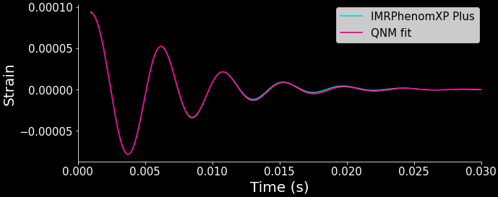
IMRPhenomXP [22]
Notes:
The answer here if you can see is yes!
There is in fact a blue line that is IMRPhenomXP waveform and over it is the QNM fit which fits for the remnant (final) mass and spin along with the amplitudes and phases of the modes
Woohoo this is good

Slide 9
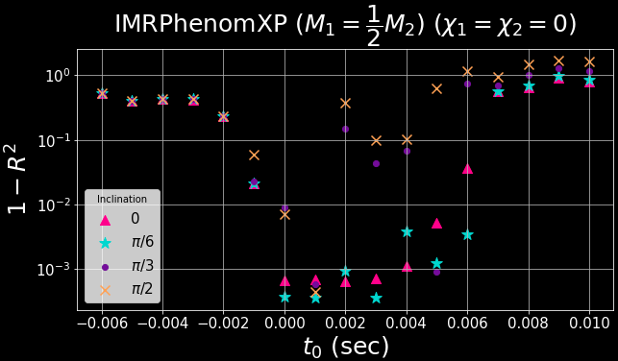
*IMRPhenomXP Modes: [22]*
Note: $t_{0}$ can be in units of $t_{M}$ using $t_{M}=\frac{GM}{c^{3}}$

Slide 10
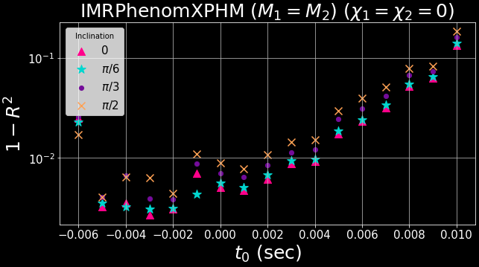
*IMRPhenomXPHM Modes: [21,22,32,33,44]

Slide 11
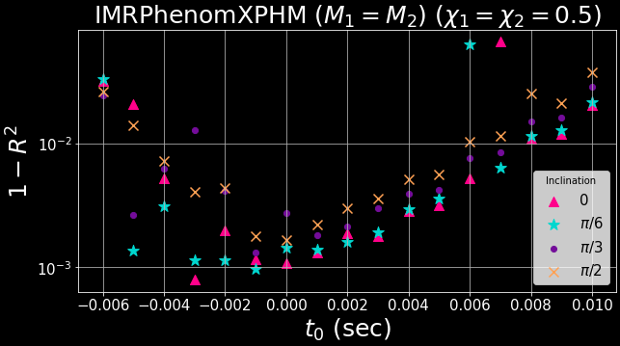
*IMRPhenomXPHM Modes: [21,22,32,33,44]

Slide 12
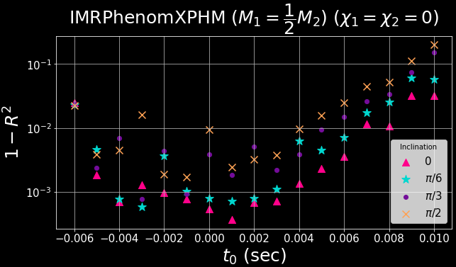
*IMRPhenomXPHM Modes: [21,22,32,33,44]

Slide 13
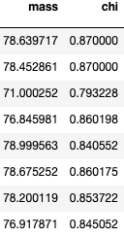
Remnant BH Parameter Recovery
XPHM [21,22,32,33,44]
SurfinBH package
returns remnant mass and spin
1-sigma error estimate

Slide 14
To Summarize:
IMRPhenomXP(HM)
Amplitude & phase
Remnant mass & spin
Recovery is highly dependent on $t_{0}$ and inclination
No violations of NHT

Slide 15
What’s Next?
Short-term
Compare ringdown analyses
Parameter estimation
Long-term
Better understand waveform models
Real data analyses
Test NHT

Slide 16
References
[1] N. Sago, S. Isoyama, and H. Nakano, Fundamental tone and overtones of quasinormal modes in ringdown gravitational waves: A detailed study in black hole perturbation, Universe 7, 357 (2021).
[2] R. Brito, A. Buonanno, and V. Raymond, Blackhole spectroscopy by making full use of gravitationalwave modeling, Physical Review D 98, 10.1103/physrevd.98.084038 (2018).
[3] M. Isi, M. Giesler, W. M. Farr, M. A. Scheel, and S. A. Teukolsky, Testing the no-hair theorem with GW150914, Physical Review Letters 123, 10.1103/physrevlett.123.111102 (2019).
[4] J. Veitch, V. Raymond, B. Farr, W. Farr, P. Graff, S. Vitale, B. Aylott, K. Blackburn, N. Christensen, M. Coughlin, W. D. Pozzo, F. Feroz, J. Gair, C.- J. Haster, V. Kalogera, T. Littenberg, I. Mandel, R. O’Shaughnessy, M. Pitkin, C. Rodriguez, C. R¨over, T. Sidery, R. Smith, M. V. D. Sluys, A. Vecchio, W. Vousden, and L. Wade, Parameter estimation for compact binaries with ground-based gravitational-wave observations using the LALInference software library, Physical Review D 91, 10.1103/physrevd.91.042003 (2015).
[5] G. Carullo, W. D. Pozzo, and J. Veitch, Observational black hole spectroscopy: A time-domain multimode analysis of GW150914, Physical Review D 99, 10.1103/physrevd.99.123029 (2019).
[6] C. D. Capano, M. Cabero, J. Westerweck, J. Abedi, S. Kastha, A. H. Nitz, A. B. Nielsen, and B. Krishnan, Observation of a multimode quasi-normal spectrum from a perturbed black hole (2021).
[7] M. Isi and W. M. Farr, Analyzing black-hole ringdowns (2021).
[8] E. Berti, J. Cardoso, V. Cardoso, and M. Cavagli`a, Matched filtering and parameter estimation of ringdown waveforms, Phys. Rev. D 76, 104044 (2007).
[9] G. Pratten, C. Garc´ı a-Quir´os, M. Colleoni, A. RamosBuades, H. Estell´es, M. Mateu-Lucena, R. Jaume, M. Haney, D. Keitel, J. E. Thompson, and S. Husa, Computationally efficient models for the dominant and subdominant harmonic modes of precessing binary black holes, Physical Review D 103, 10.1103/physrevd.103.104056 (2021).
[10] L. C. Stein, Qnm. [11] X. Forteza, S. Bhagwat, P. Pani, and V. Ferrari, Spectroscopy of binary black hole ringdown using overtones and angular modes, Physical Review D 102 (2020).
[11] X. Forteza, S. Bhagwat, P. Pani, and V. Ferrari, Spectroscopy of binary black hole ringdown using overtones and angular modes, Physical Review D 102 (2020).

Slide 17
Thank You!
I wish to acknowledge the tremendous support of my mentors, Richard Udall and Alan Weinstein, for offering suggestions and encouragement to help further my research. I also gratefully recognize the support from the National Science Foundation Research Experience for Undergraduates (NSF REU) program, the California Institute of Technology, and the LIGO Laboratory Summer Undergraduate Research Fellowship.

