Slide 1
GW strain calibration of LIGO detectors with high precision and low latencY
By: Naomi Shechter
Mentors: Ethan Payne and Dr. Alan Weinstein

Slide 2
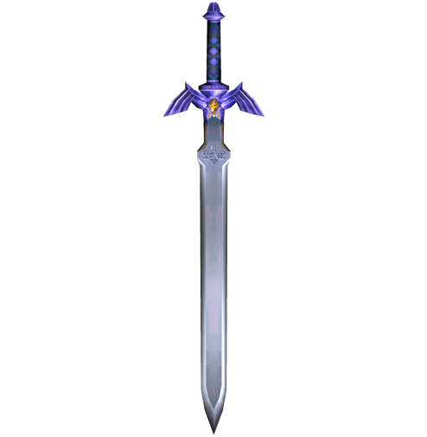
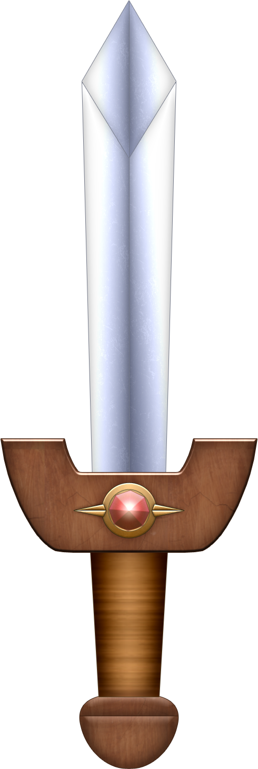
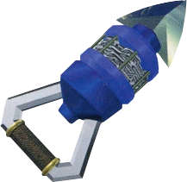
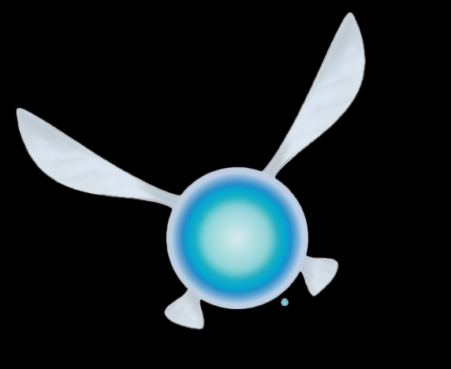
What is calibration?
A meterstick isn’t worth much if it isn’t actually a meter long. How well do we know our measuring tool? How reliable is it in providing self-consistent results?
How well can we know a measuring tool that’s changing all the time?

Slide 3
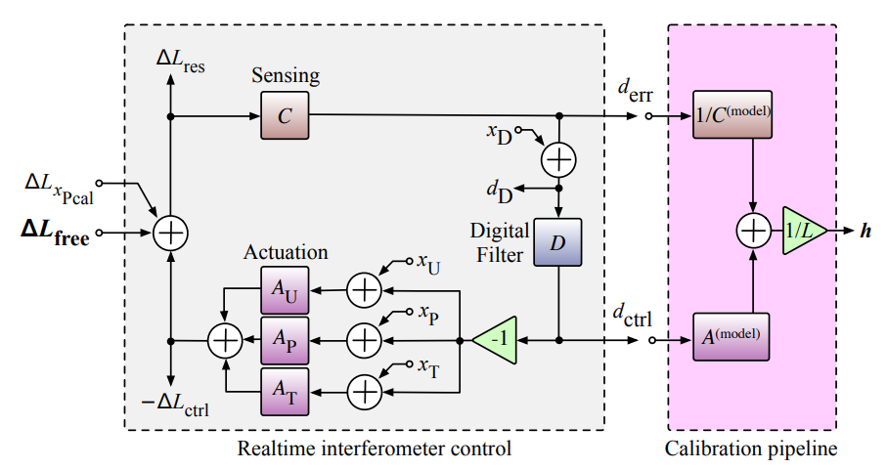
The Importance of Calibration
Calibration helps us characterize the detector response to strain.
We want meaningful, unbiased results!
GR tests
Multi-messenger / Parameter estimation
High SNR in O5
Uncertainty: we know it to 2% in magnitude, 2° in phase, but that’s not the full story. It took a few months to generate the final calibration.

Slide 4
The goal(S):
Background information.
Transfer old measurement files into compatible .ini files.
Piece together a code that runs MCMC, GPR and an uncertainty estimate. It should spit out a bunch of graphs and data files that help characterize calibration uncertainty.
Monitoring software – TDCFs: the gain coefficient of the sensing function and test mass actuation function, and the coupled cavity pole frequency).
It should be a low latency, precise calibration uncertainty estimate, and the monitoring software should be both reliably and robustly, producing the estimate, diagnostics and any flags in less than an hour.

Slide 5
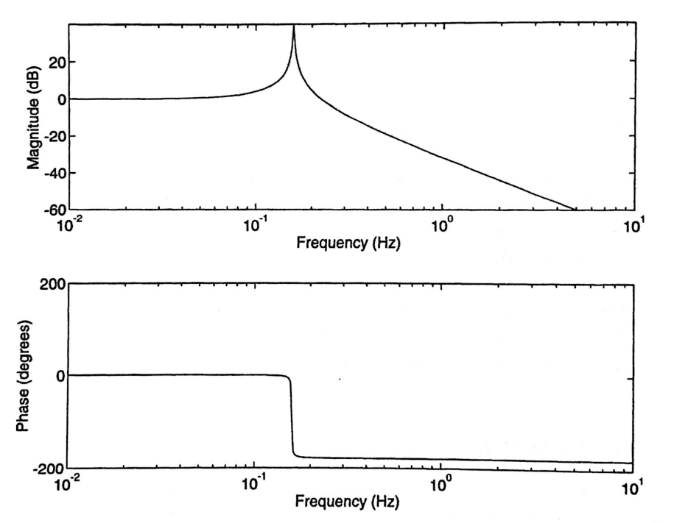
LTI / Control Systems, Null Instruments
LIGO uses a swept sign excitation signal.
Impulse → Decaying sine wave.
Convolution, or multiplication in frequency domain. Input * IR = Output.
That means the transfer function (the FFT of the response) is output divided by input.
Poles and zeroes are limiting cases of the transfer function.
By adjusting the DARM transfer function, we can place poles and zeroes in the necessary places. We can see this when we graph parts of the model.

Slide 6
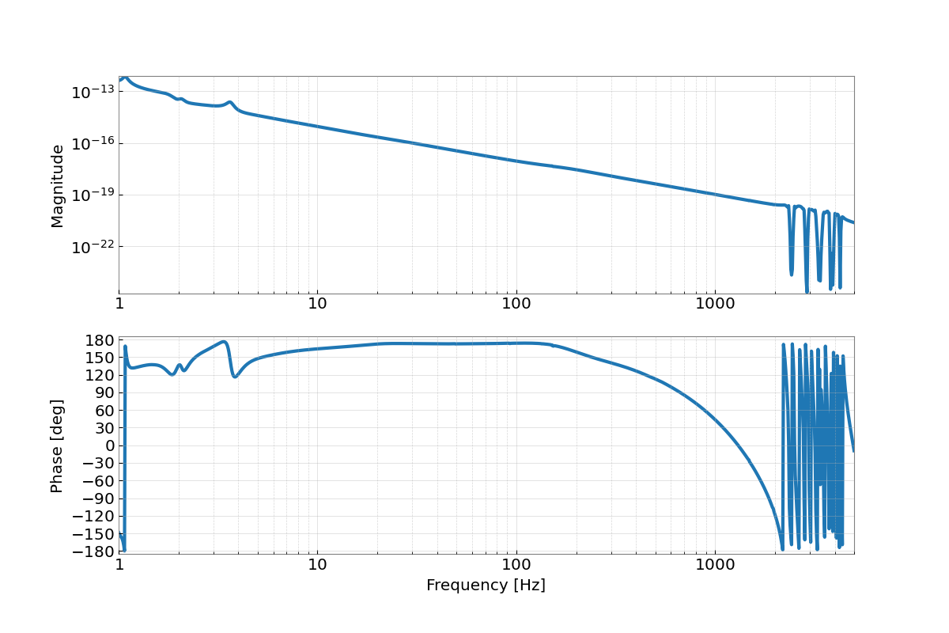
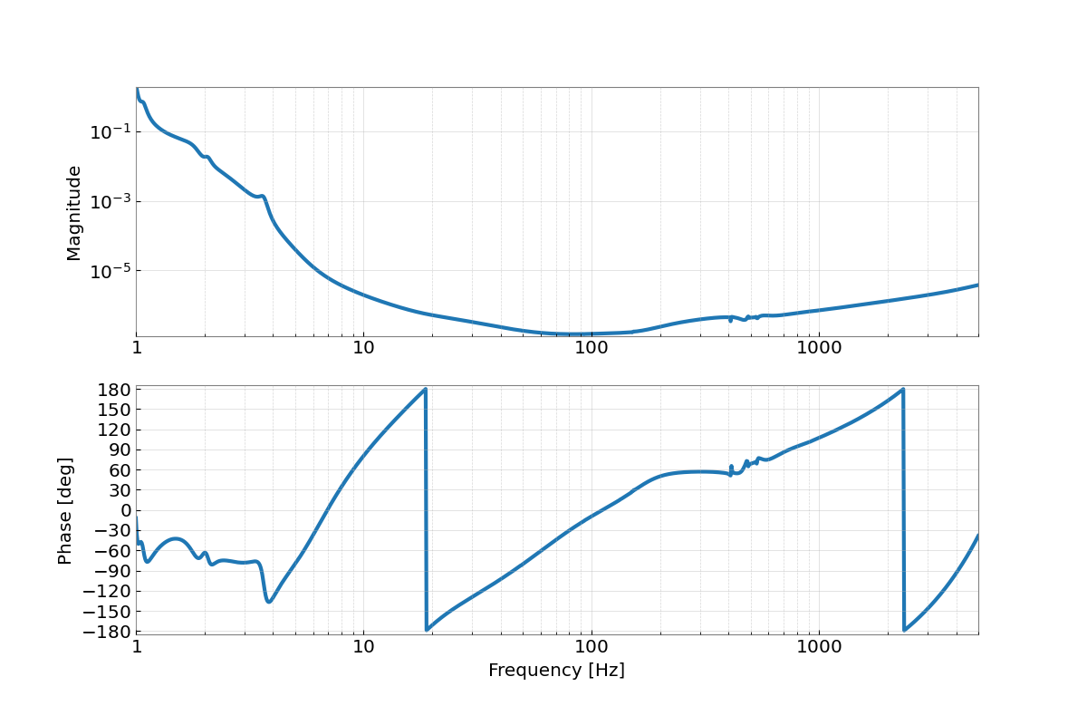
Sensing, Actuation, Response – 4/17/21
The sensing function is, as expected, most sensitive from 20-1000 Hz.
Our actuation function attenuates lower frequencies to reduce seismic noise.
The response function.

Slide 7
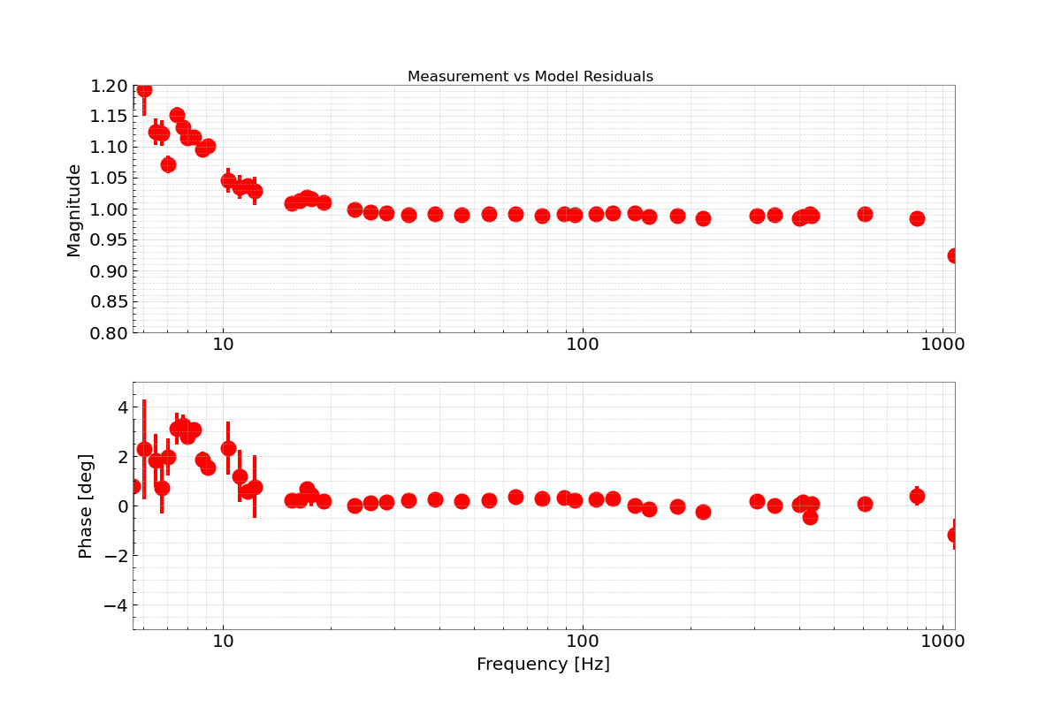
MCMC and GPR – 09/09/19
When significant changes are made to a LIGO detector, we begin a new epoch, with a new model of the response function.
MCMC – model fitting, maximizing likelihood function.
GPR – rebuilding our unknown uncertainty.
We perform the MCMC, create the best fit. We also take the residuals of the measurements versus the model, which only contain unknown systematic errors.
The GPR creates a distribution of possible functions fit to the data, which characterizes the uncertainty.

Slide 8
Goals for the Software
A reliable, robust software using pyDARM which examines the MCMC and GPR, sampling only as much data is needed. It should raise a flag when there is a significant issue in the estimate – with specificity. The diagnostic plots which it produces will be put into a Summary Page.
Side comment: issues with pyDARM.
The One Big Question:
What warrants a warning?
Uncertainty
Grocery List:
The sensing, actuation and digital filter parameters.
GPR systematic error for A and C.
TDCFs
Photon Calibrator Strength.

Slide 9
In conclusion: we’re GOING TO get this down to a science (literally)!

Slide 10
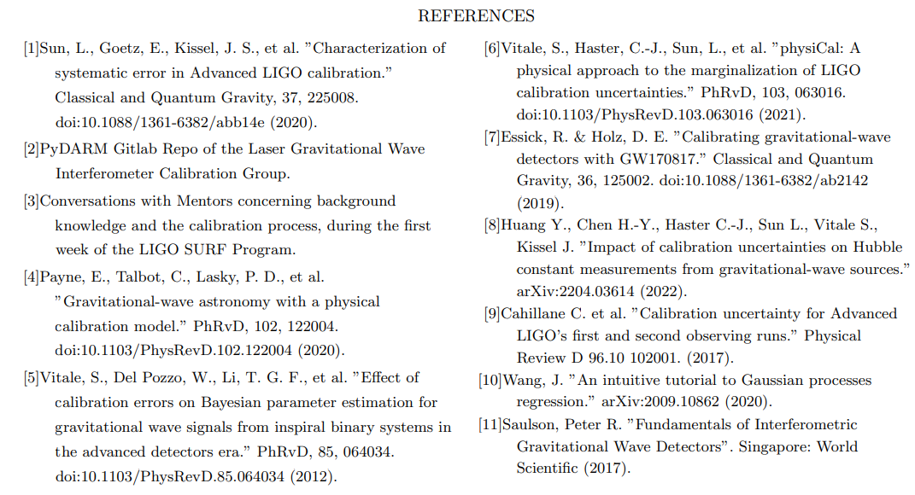
REFERENCES
I acknowledge and thank the NSF for funding the Caltech LIGO SURF program for the Summer of 2022, my mentors Dr. Alan Weinstein and Ethan Payne, and LHO for allowing us to visit today.

