Slide 1
Mariner Suspension for Cryogenic Interferometers
By Juan Gamez
Mentors: Koji Arai, Rana Adhikari

Slide 2
Overview
Background
-Motivation
-Advance Ligo
-Voyager Project
-Mariner Suspension
-OSEM
My Summer Work
-Experiments
Summary

Slide 3
Background

Slide 4
Motivation
Current Ligo Detectors will soon reach their Thermodynamic and quantum mechanical limits of their designs

Slide 5
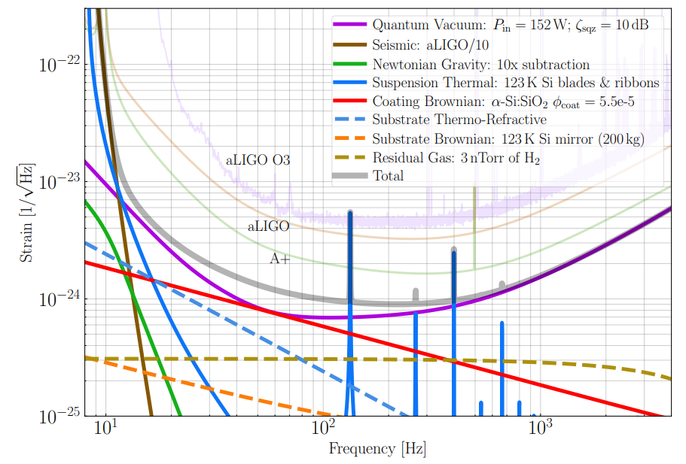
Voyager Upgrade
Increase range by factor 4-5 over aLIGO
Increase event rate by approximately 100 times

Slide 6
Mirror Suspension Comparison
aLIGO
Quad pendulum
40 kg Test Mass fused silica
Glass Fibers
Voyager Project
Quad pendulum with Lower half cooled
Cryogenic chamber
200 kg test mass (silicon)
Silicon Ribbon

Slide 7
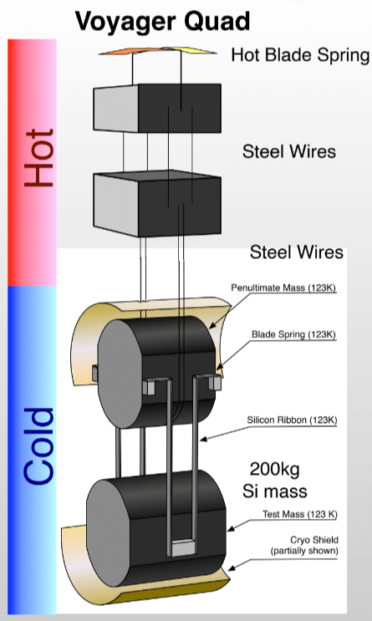
Voyager Project
~ 300 k
Quad Pendulum
Temperature Difference
Cryo Shield
Silicon Test Mass ~(200 kg)
Silicon Ribbon
~ 123k

Slide 8
Mariner Suspension

Slide 9
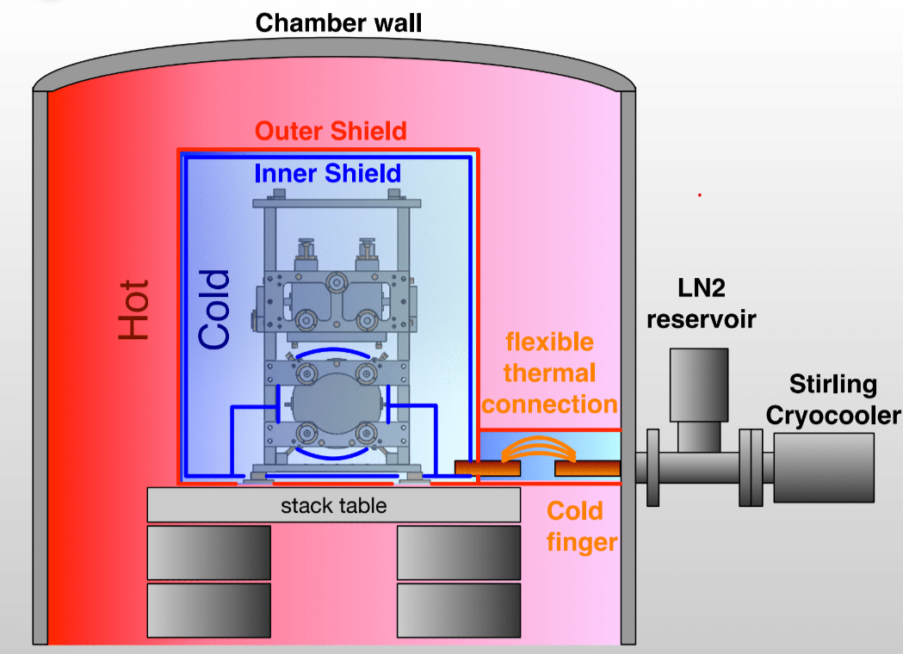
What is Mariner?
Bottom Stage of Voyager
Built at Caltech
Double Pendulum
Cryo-cooled(123 k)
Inner Shield
Outer Shield
Cold Finger

Slide 10
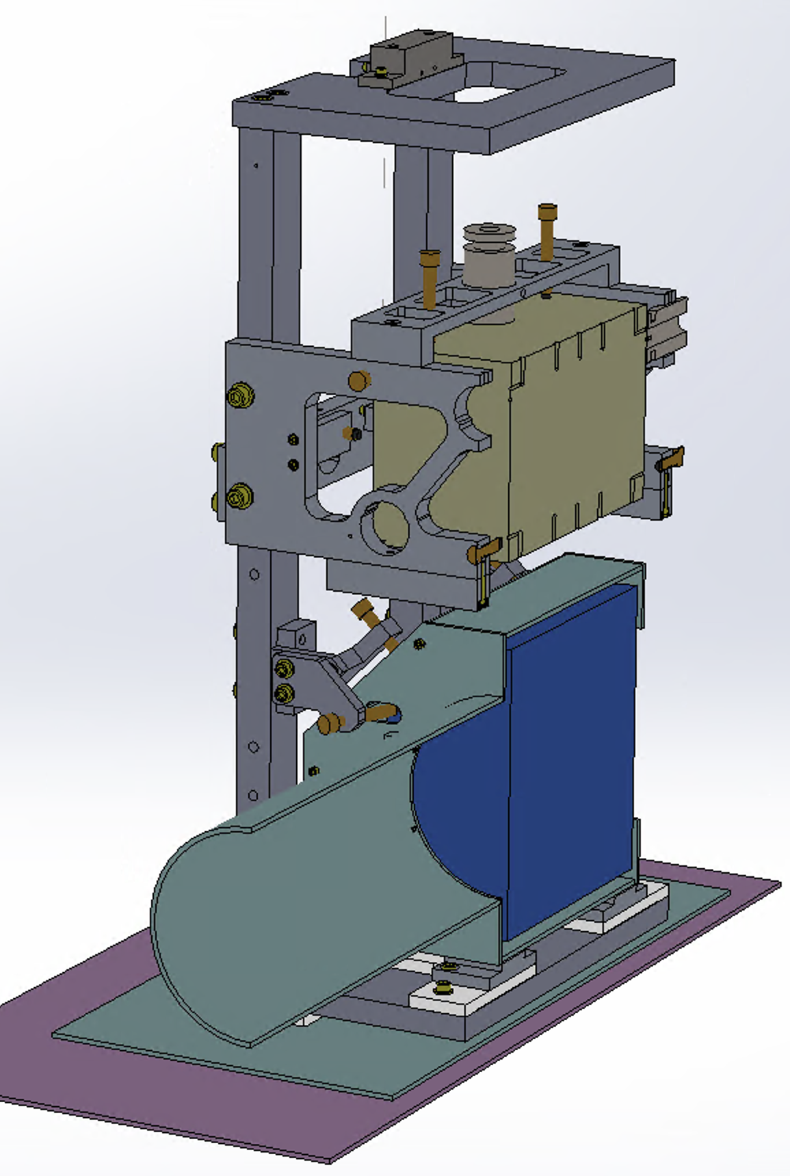
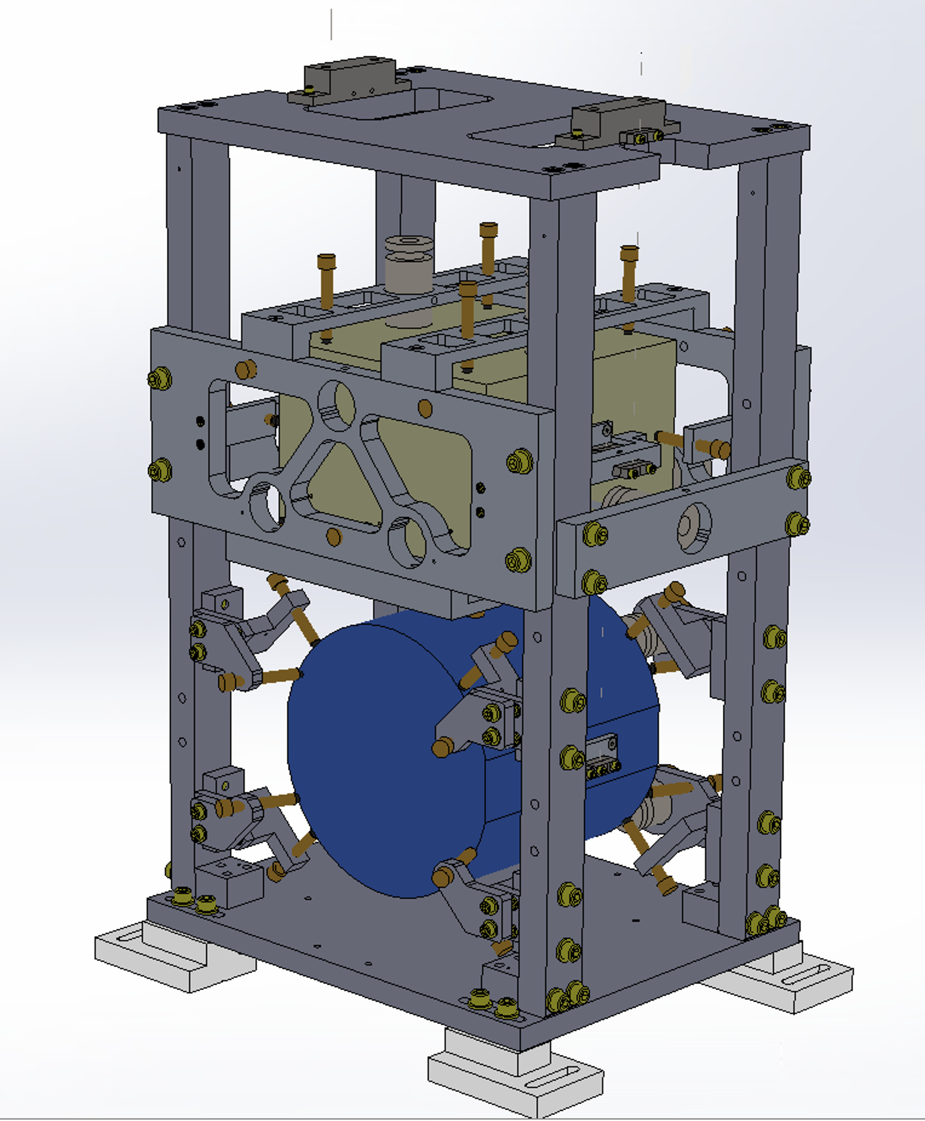
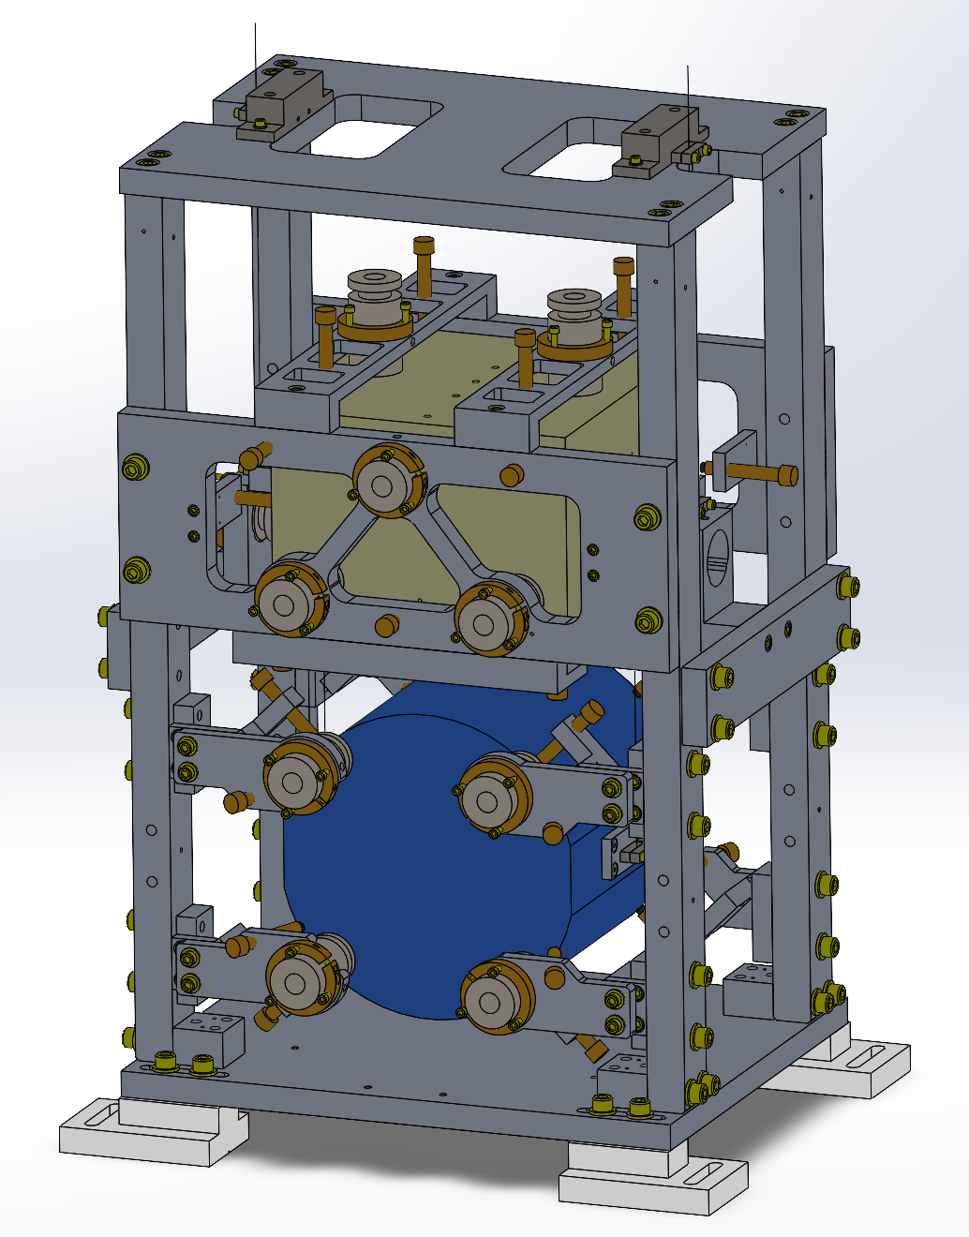
Mariner
Vibration Isolation
Active Control
Thermal Isolation

Slide 11
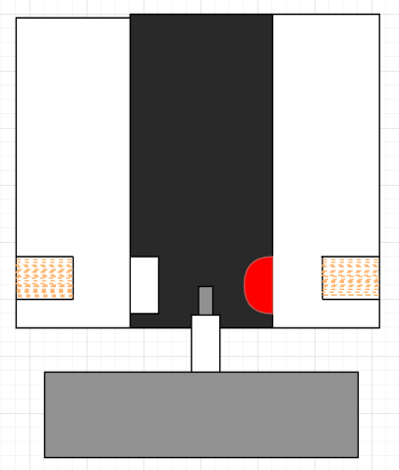
optical sensor - electromagnetic motor unit (OSEM)
PhotoDiode
LED
Coil
Magnet
Aluminum Block

Slide 12
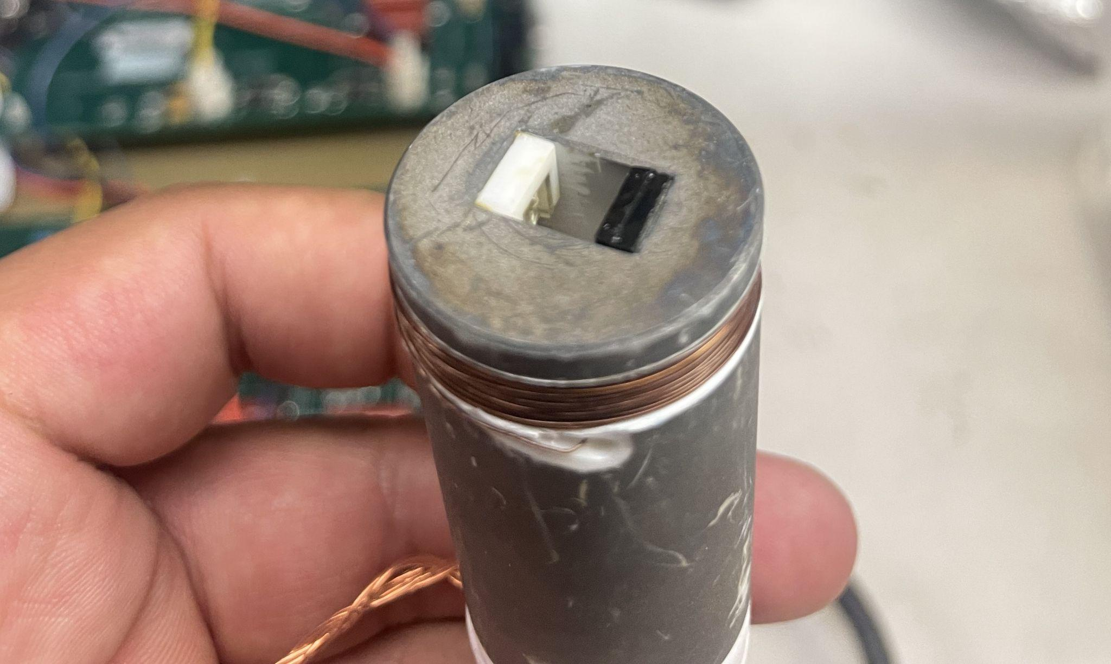
OSEM

Slide 13
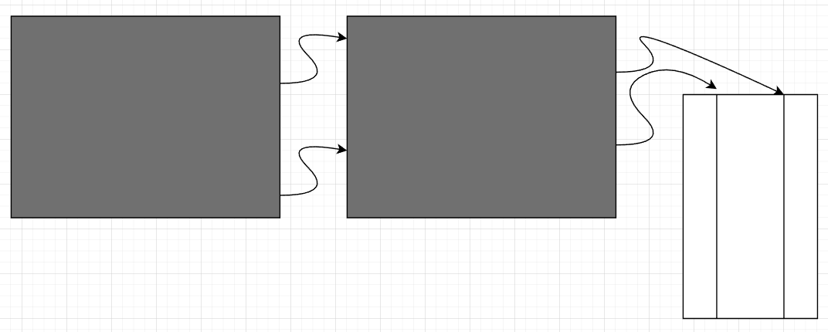
Coil Driver & Sat Amp
Coil Driver -
Drivers Current to the
OSEM coil
Sat Amp -
Give power to LED
Collect Data
Sat Amp
Coil Driver
OSEM

Slide 14
What have I done ?

Slide 15
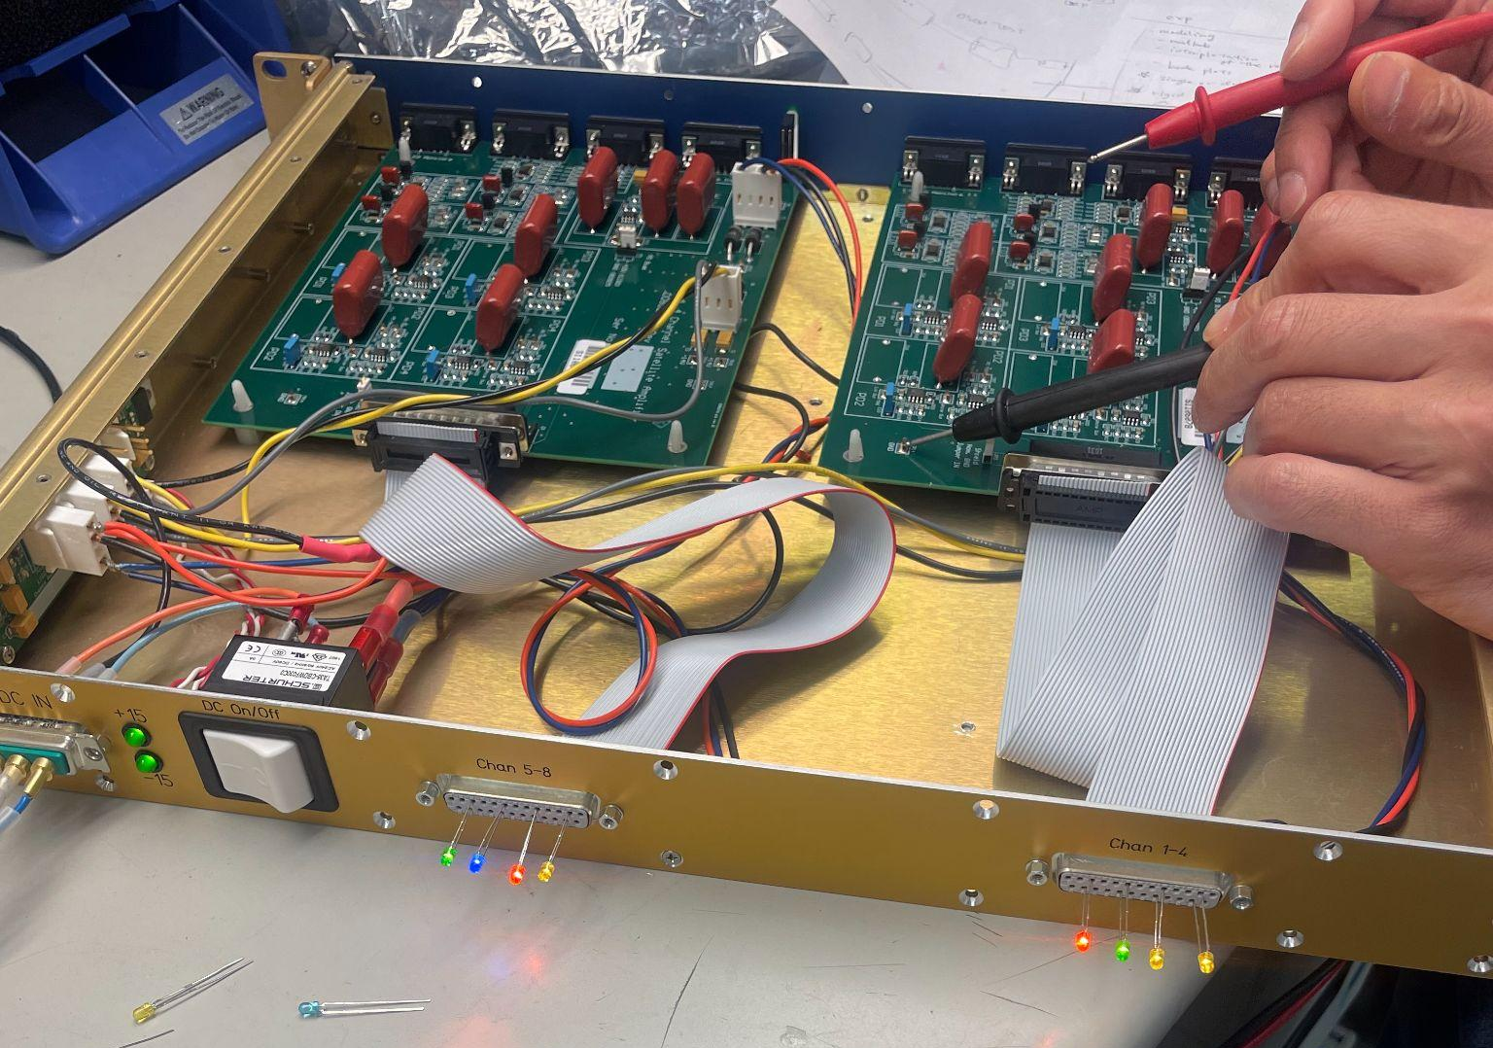
Build & Test
Coil Driver - 3
Sat Amp - 4

Slide 16
Experiments

Slide 17
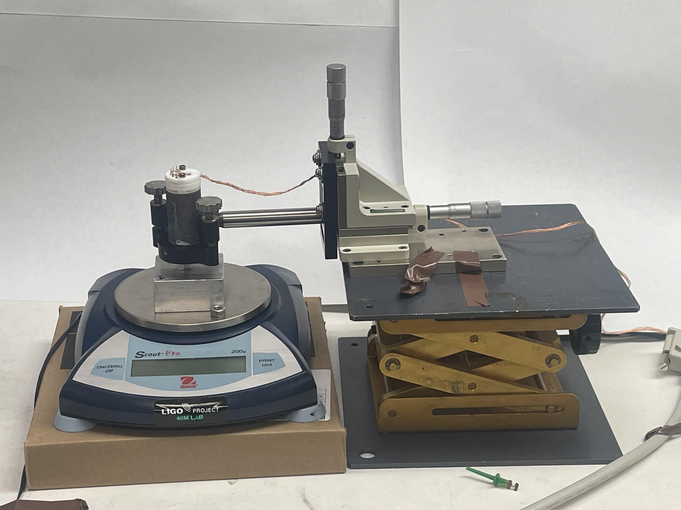
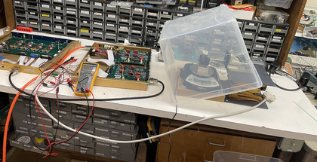
Force Actuation

Slide 18
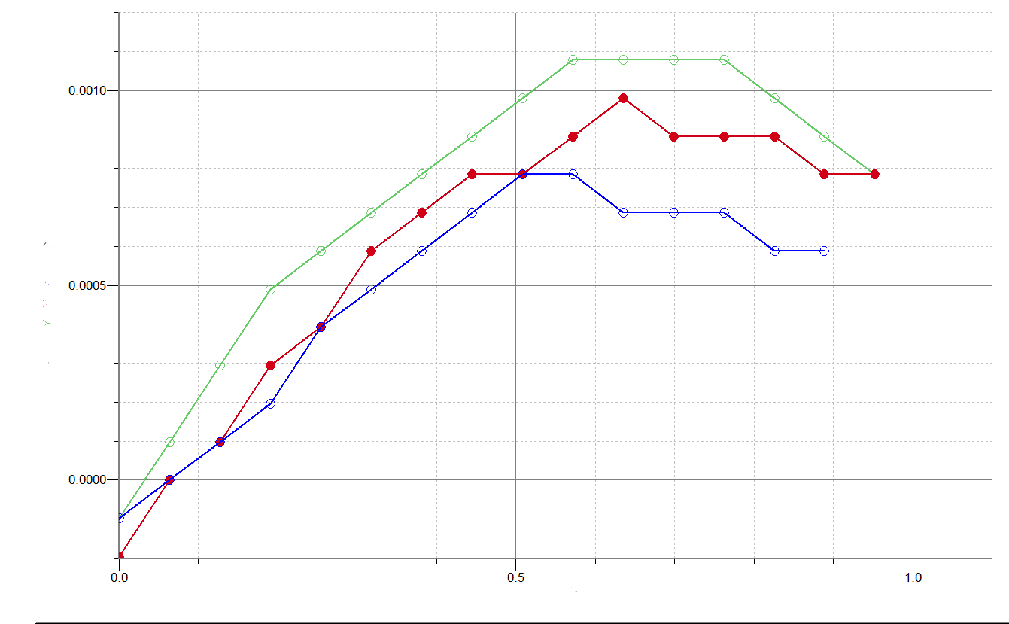
OSEM
OSEM - 108
OSEM - 008
OSEM - 106
Force [N]
X [mm]

Slide 19
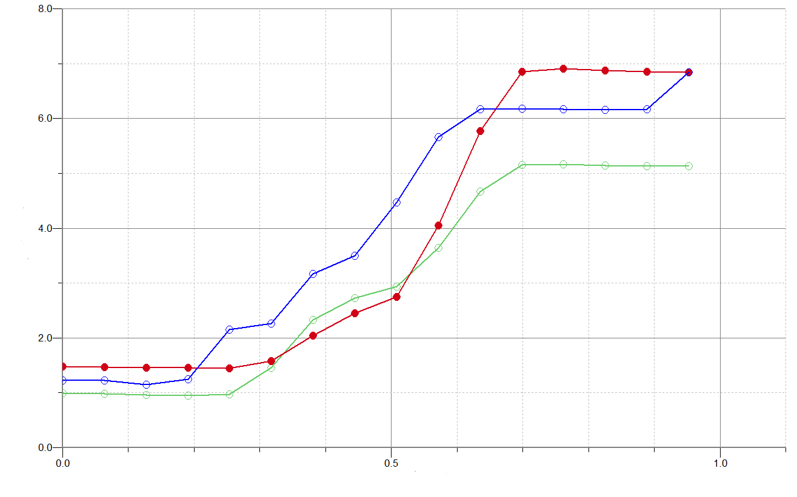
OSEM
OSEM - 108
OSEM - 008
OSEM - 106
Vpd [V]
X [mm]

Slide 20
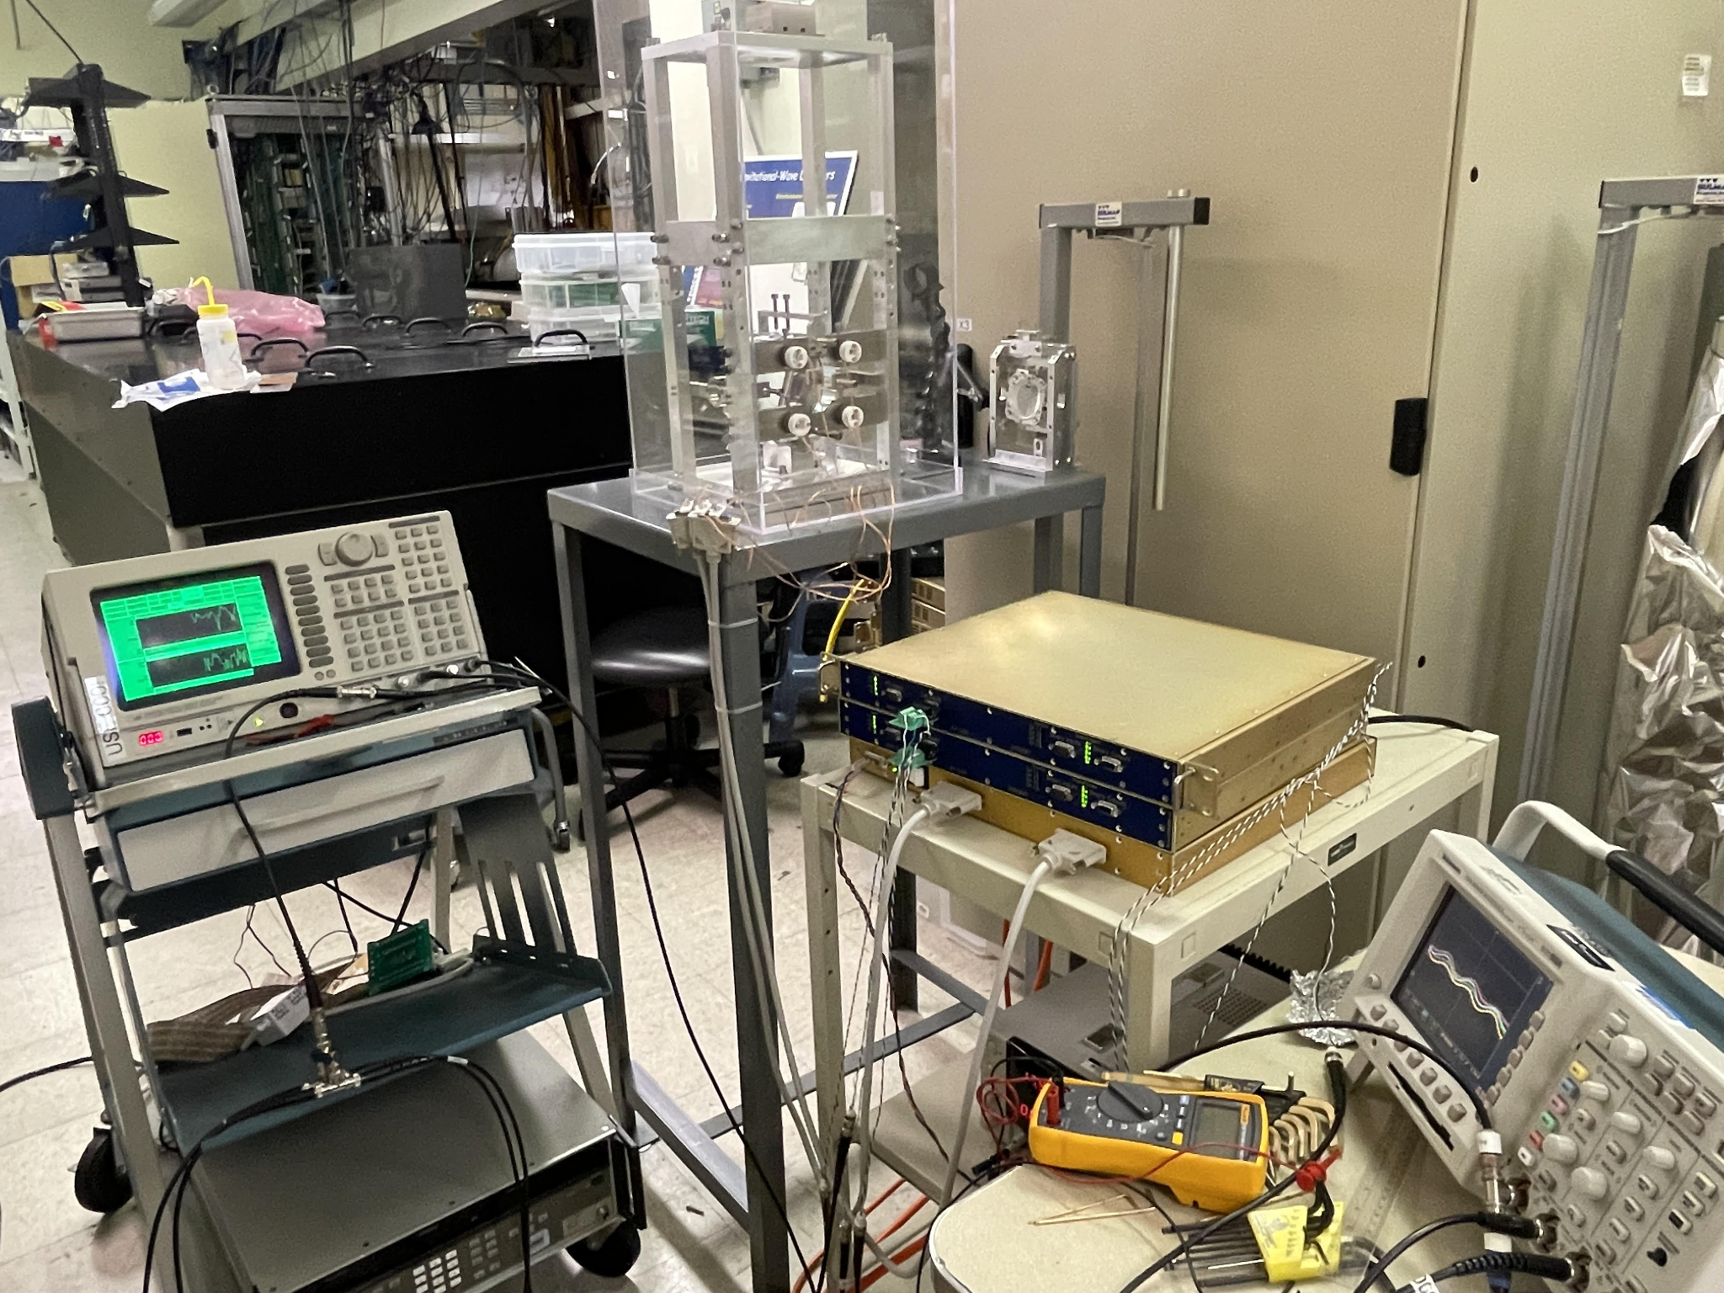
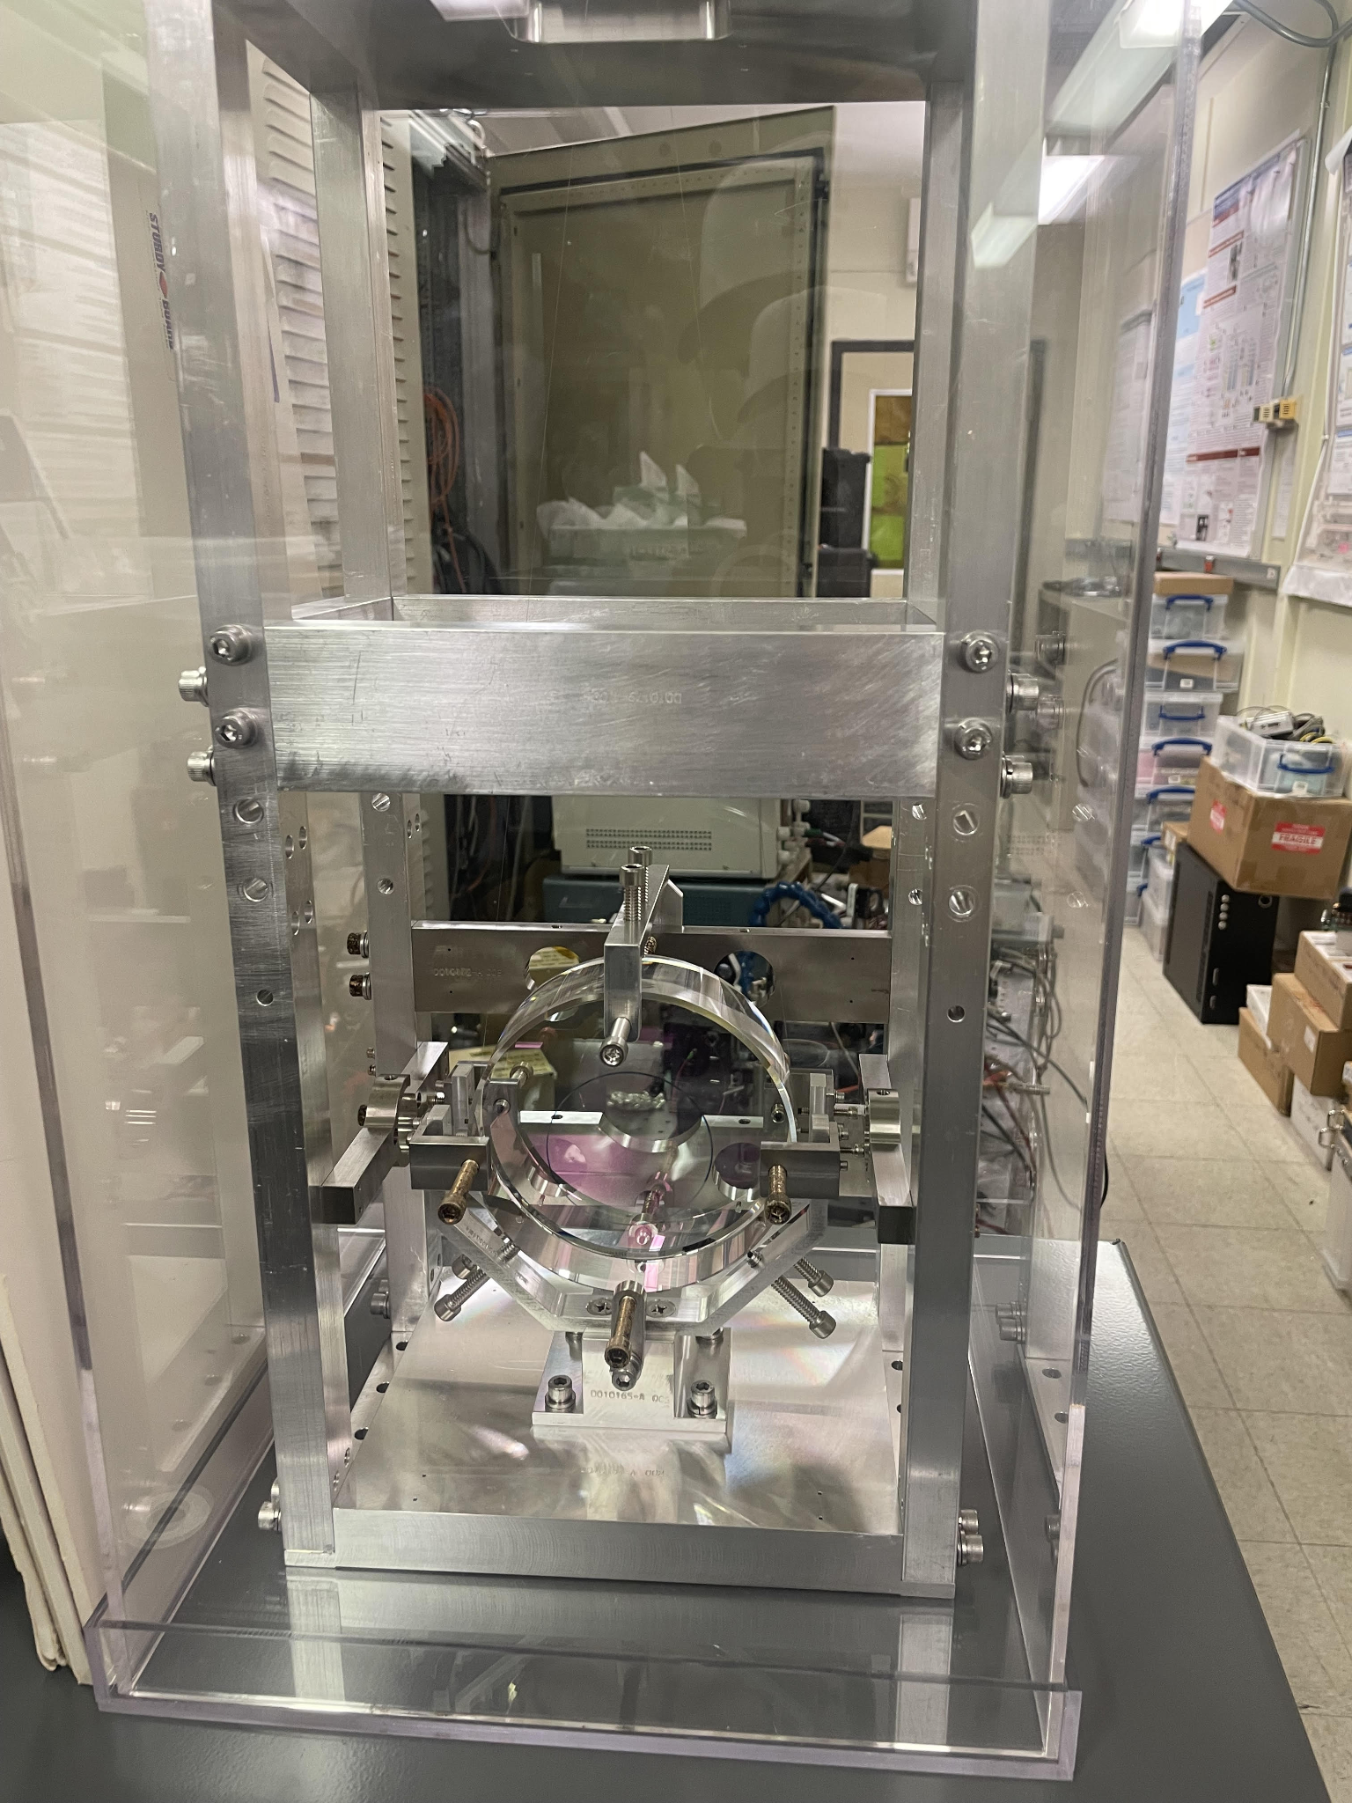
Transfer Function of Coil Input/Output

Slide 21
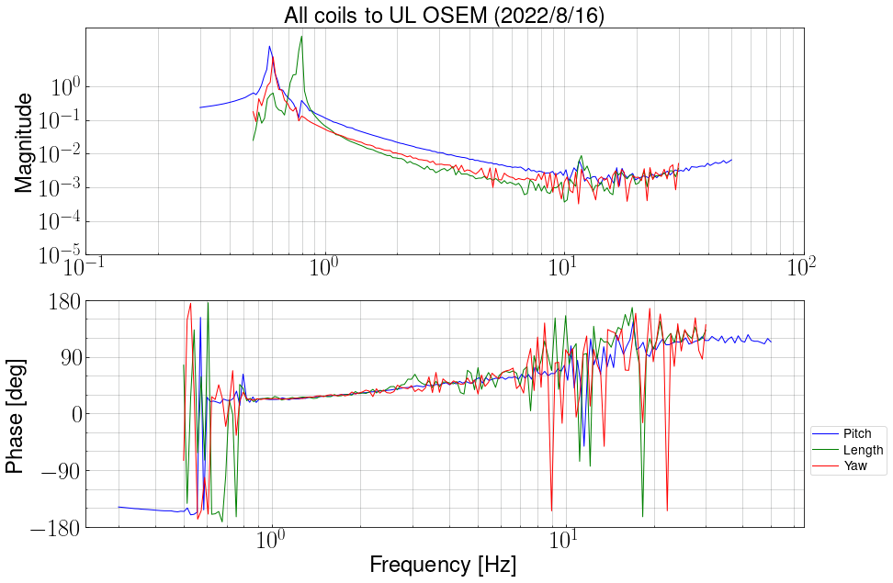
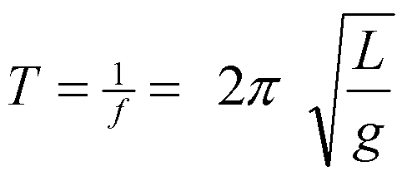
f= 0.788 Hz

Slide 22
Summary
-Voyager
- Need Prototype (Mariner)
Why my work Is import ?
Setup Electrical ground work for Mariner
Test and verified that OSEM are functioning properly

Slide 23
Thank you!
To Koji Arai,
Rana Adhikari,

Slide 24
Refrence
[1] Advanced ligo. Classical and quantum gravity, 32(7):074001, 2015.
[2] Benjamin P Abbott, Richard Abbott, TD Abbott, MR Abernathy, Fausto Acernese, Kendall Ackley, Carl Adams, Thomas Adams, Paolo Addesso, RX Adhikari, et al. Observation of gravitational waves from a binary black hole merger. Physical review letters, 116(6):061102, 2016.
[3] Rana X Adhikari, Koji Arai, AF Brooks, C Wipf, O Aguiar, Paul Altin, B Barr, L Barsotti, R Bassiri, A Bell, et al. A cryogenic silicon interferometer for gravitational-wave detection. Classical and Quantum Gravity, 37(16):165003, 2020.
[4] Stefan Hild, Simon Chelkowski, Andreas Freise, Janyce Franc, Nazario Morgado, Raffaele Flaminio, and Riccardo DeSalvo. A xylophone configuration for a third-generation gravitational wave detector. Classical and Quantum Gravity, 27(1):015003, 2009.
[5] Eiichi Hirose, Dan Bajuk, GariLynn Billingsley, Takaaki Kajita, Bob Kestner, Norikatsu Mio, Masatake Ohashi, Bill Reichman, Hiroaki Yamamoto, and Liyuan Zhang. Sapphire mirror for the kagra gravitational wave detector. Physical Review D, 89(6):062003, 2014.
[6] John Miller, Lisa Barsotti, Salvatore Vitale, Peter Fritschel, Matthew Evans, and Daniel Sigg. Prospects for doubling the range of advanced ligo. Physical Review D, 91(6):062005, 2015.

