Slide 1
SMBH Property Determination via Gravitational Radiation from Eccentrically Orbiting Stellar Mass BBHs
Andrew Laeuger, Northwestern University
Brian Seymour, Yanbei Chen
LIGO–T2200281

Slide 2
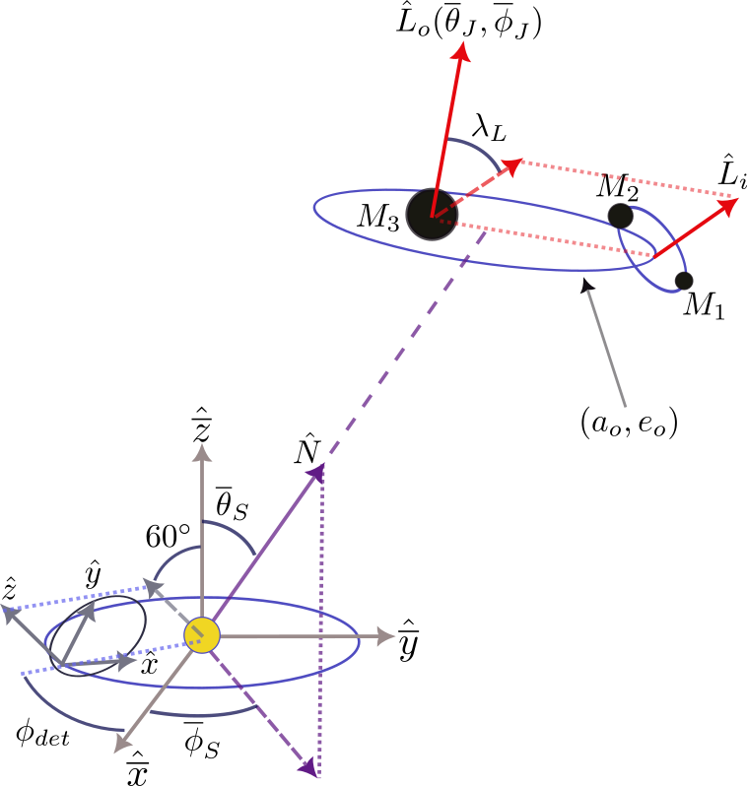
Background
Can we use GW from stellar mass binaries as a probe of properties of BBH+SMBH triple systems?
SMBH induces modifications to the BBH inspiral-regime waveform:
Doppler shift of waves from orbit around SMBH
de Sitter precession (O(months)): wobbling of ${\hat{L}}_{i}$ around ${\hat{L}}_{o}$
Does not occur if ${\hat{L}}_{i}$ $||$ ${\hat{L}}_{o}$
How does an increasingly-eccentric outer orbit (BBH around SMBH) affect measurability of system parameters?
Frequency band of present-day GW observatories aligns with only final seconds of compact binary merger event
Prevents measurement of phenomena occurring over longer time scales
Future space-based GW observatories (LISA, TianGO) will operate in lower frequency band
Detect new GW sources (i.e., binary WDs) but also observe familiar sources before they reach LIGO band
$${\hat{L}}_{o}$$
de Sitter Precession
Notes:
Can we use GW from stellar mass BBH to measure properties of nearby additional objects, like SMBH?
The diagram here shows a detector orbiting the Sun and a BBH+SMBH (inner+outer binary) triple system
A nearby SMBH will create some modulation in the BBH waveform which is dependent on parameters of the triple system
Doppler shift from orbital motion of BBH
de Sitter precession: angular momentum of BBH precesses about angular momentum of outer binary
Refer to the gif
How does increasing outer orbit eccentricity change measurability of parameters
Present-day GW detectors well-known for capturing short chirps at merger
Cannot capture waveform effects occurring over long time scales
There are plans for space-based detectors, like LISA (millihertz) and TianGO (decihertz)
BBH remains in these frequency bands for much

Slide 3
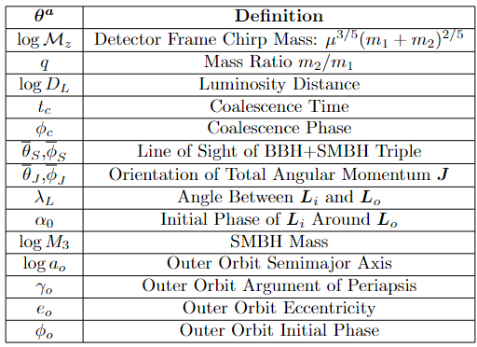
Quantifying Parameter Estimation Accuracy
A common method uses the Fisher information matrix to find the covariance:
Inverting the matrix can tough, especially with so many relevant parameters:
(in practice, integrate over 5-year observation window)
Notes:
How can we predict how well future detectors can measure properties of a triple system with GWs?
One frequently used method is the Fisher information matrix, which is calculated with a noise-weighted inner product of derivatives of the frequency domain waveform
Essentially: over the observed frequencies, how sensitive is the measured strain to a change in the source parameters?
The covariance matrix is roughly equal to the inverse of the Fisher matrix, and we use the diagonals of the covariance to calculate parameter estimation uncertainties
Applies when SNR ρ is high, though the Fisher matrix provides a lower bound for parameter estimation variances (essentially, a best case scenario)
One appeal of this method is more rapid computation than a full Bayesian approach
Using a large set of parameters leads to numerical inaccuracies and longer computation times, which we want to avoid

Slide 4
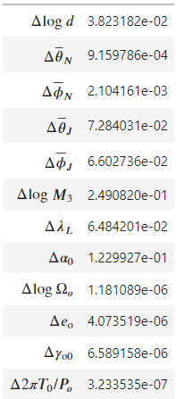
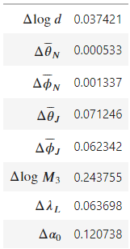
Simplifications
Precession effects of BH spins neglected (time scales of spin-induced effects are at least ~10 times longer)
Lidov-Kozai oscillations: time scales also too long (~10000 years $×f_{GW}^{2}$)
Inner orbit (BBH) assumed circular (inner eccentricity mostly affects the SNR)
Reduction of Fisher matrix dimensions:
can all be measured well by ground-based detectors
Exclude other parameters which are very well measured by the space-based system:
(Work to reduce the condition number of the Fisher matrix, improve numerical accuracy)
(One particular set of waveform parameters)
$${\left(Σ_{ii}\right)}^{0.5}=$$
(Exclude 4 boxed parameters)
Notes:
First, we can remove some physical effects which only contribute weakly to waveform modulation driven by the presence of the SMBH
For example, the time scales of precessional effects induced by various BH spins tend to be at least an order of magnitude slower than Doppler shift and de Sitter precession
So, we ignore them here
We also neglect Lidov-Kozai oscillations, which are the periodic exchange of outer orbit inclination and eccentricity, because they are quite slow
Finally, we assume the inner orbit is circular
The inner orbit eccentricity doesn’t make significant contributions to the measured strain outside the carrier waveform
So, it only impacts the SNR, so we can expect that increasing SNR (in this case specifically) leads to improved parameter estimation
We can also reduce the size of the Fisher matrix, which should improve computation time and accuracy, by excluding some parameters
The chirp mass, mass ratio, and time and phase of coalescence can all be measured quite well by detectors on the ground, which monitor the GWs much closer to BBH merger
Initial Fisher matrix calculations showed that four additional parameters: the secular orbital angular frequency, the outer eccentricity, the argument of periapsis, and the initial outer orbit can all be measured to high precision
Treat these parameters as perfectly well known (relative to the remaining 8) in Fisher analysis

Slide 5
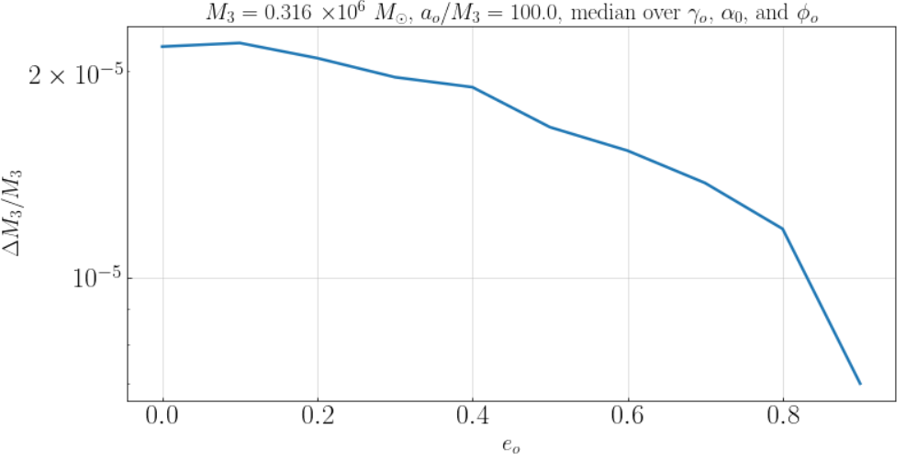
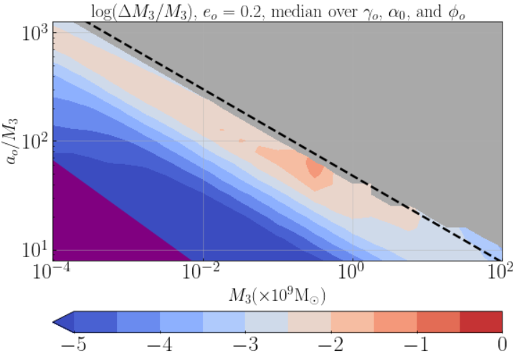
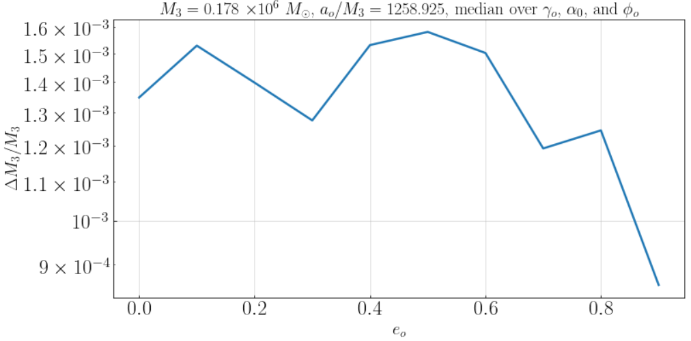
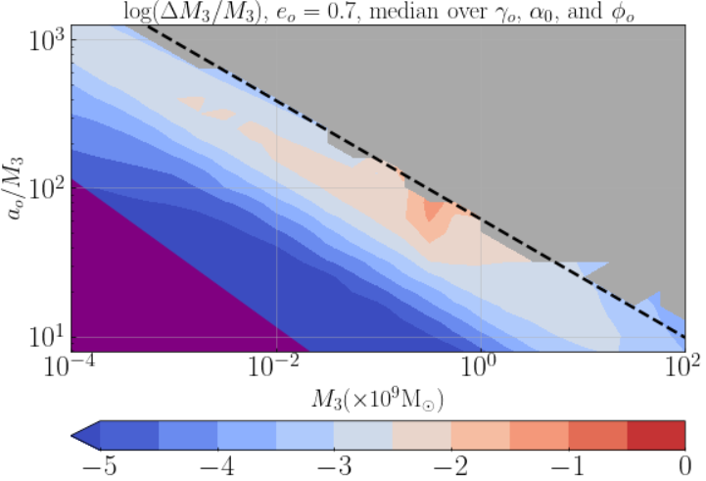
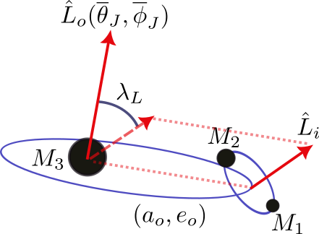
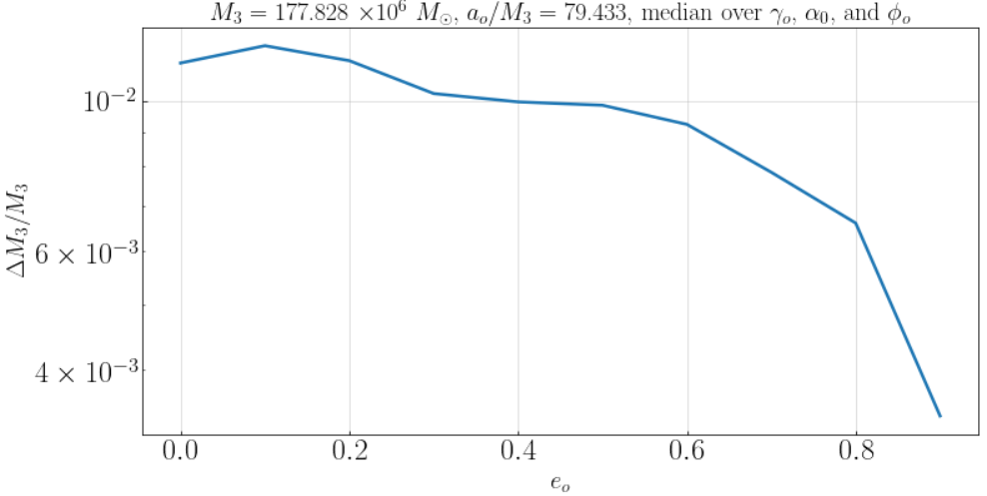
Measuring SMBH Mass: TianGO
$$P_{de Sitter}=10yr$$
Precession not discernible $$(∆λ_{L}>λ_{L})$$
Outer binary merges too quickly
Notes:
We first explore how well TianGO can constrain the SMBH mass as we vary the eccentricity
These contour plots give the fractional uncertainty in the mass as a function of mass and semimajor axis, where we have averaged over a few of the orbital angular parameters
Purple region shows where the outer binary merges in less than five years
We expect these to be quite rare – they only have a short window to form
Gray region is where we cannot distinguish the signal of de Sitter precession from absence of such a signal
Cannot exclude an opening angle of 0 from our estimation
Dashed line is a de Sitter precession of 10 years – roughly tracks the border of precession detectability regardless of eccentricity
Essentially suggests that the system needs to progress through a half of a de Sitter precession cycle, traveling the full range of variation, to become detectable
Fractional uncertainty varies significantly in the M_3, a_o parameter space, but broadly follows a trend of faster de Sitter precession improving estimation
As we increase eccentricity, we see that estimation of the mass further improves, in some cases by a factor of 3 or so
More rapid de Sitter precession and greater Doppler shift depth due to elliptic orbit

Slide 6
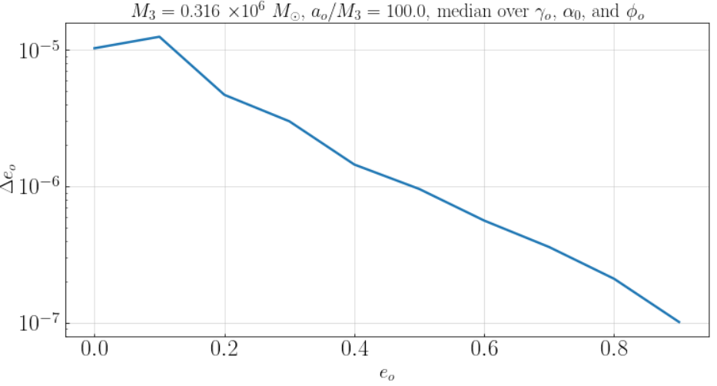
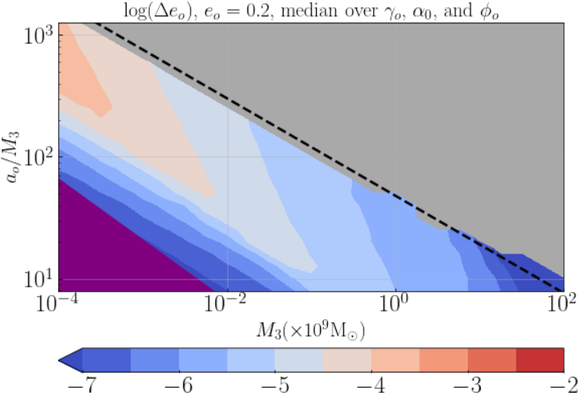
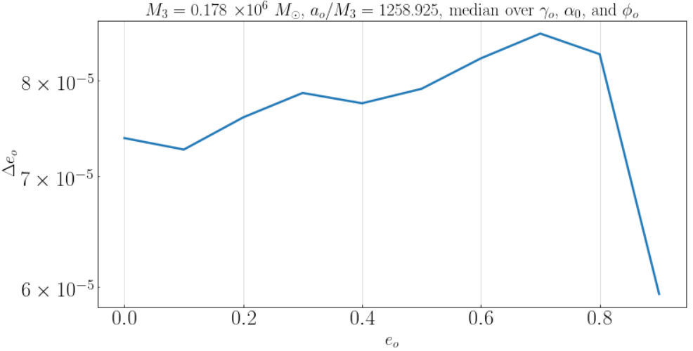
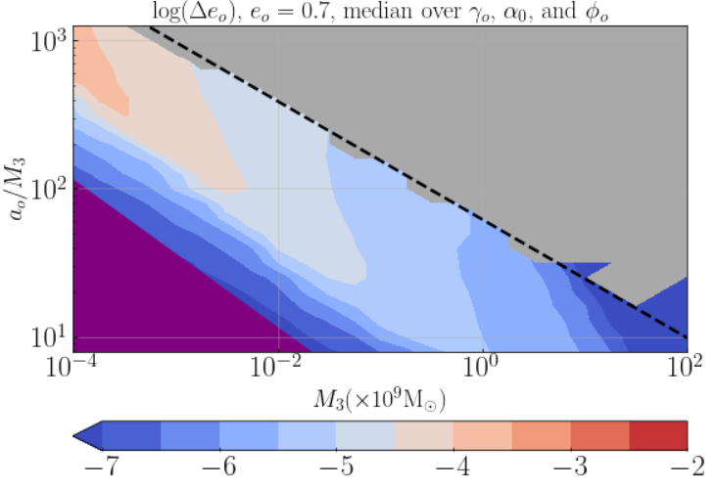
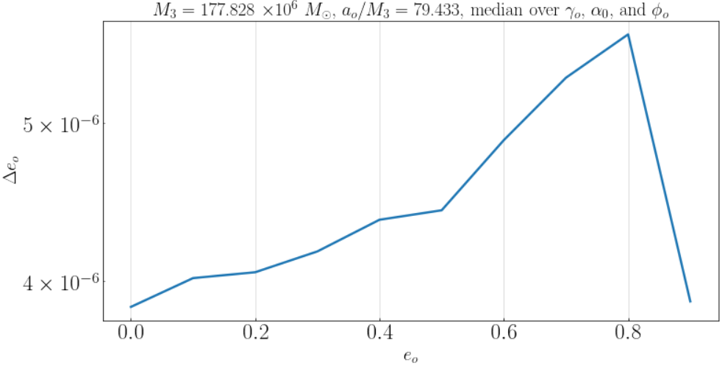
Measuring Eccentricity: TianGO
$$P_{de Sitter}=10yr$$
Precession not discernible $$(∆λ_{L}>λ_{L})$$
Outer binary merges too quickly
Notes:
We can also consider how well TianGO can measure the outer orbit eccentricity
We do have to add this parameter back into the Fisher matrix for this analysis
Eccentricity can consistently be measured quite well
Near the precession detectability boundary, uncertainty in eccentricity doesn’t change much with e, but for more rapid de Sitter precession, we can see an order of magnitude of improvement or more as eccentricity increases

Slide 7
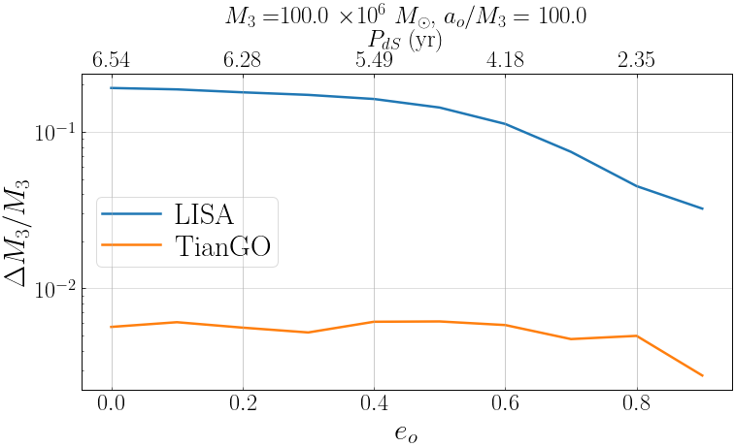
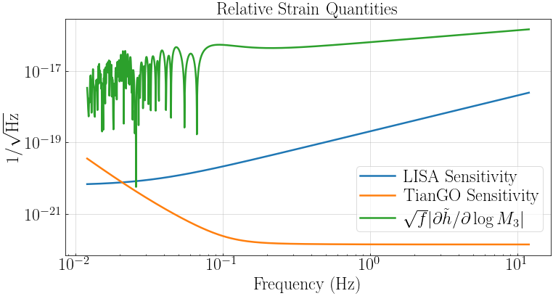
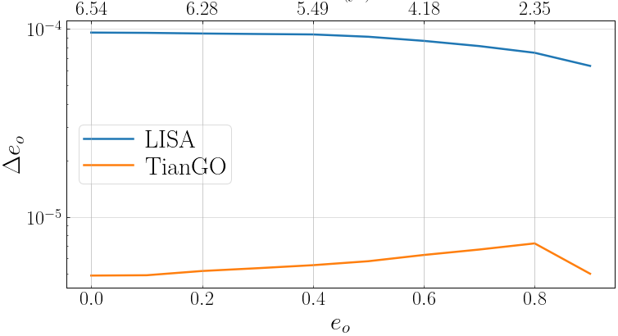
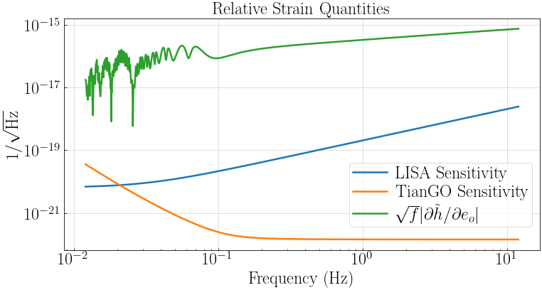
TianGO vs LISA
Notes:
It’s worth comparing the relative abilities of LISA and TianGO in measuring these quantities
TianGO is capable of achieving uncertainties which are an order of magnitude or more improved over LISA
Can attribute this to TianGO’s frequency band being better aligned with where these stellar mass BBHs experience the most modulation during our observation run length
These differences shrink as the de Sitter precession period drops
TianGO’s advantage emerges for systems where we have fewer de Sitter precession cycles over the observation time

Slide 8
Summary
We estimate measurability of triple system parameters using the Fisher matrix method
Relative contributions of certain parameters to $∂\tilde{h}$ allow simplification via exclusion from Fisher matrix
Increasing eccentricity can improve measurement uncertainties of SMBH properties
Greater Doppler shift modulation depth, faster precession
Proposed decihertz detectors are better equipped to measure effects than millihertz detectors
Future Additions:
Next order effects in waveform:
Precession of outer orbit perihelion, spin effects
Evolution of $a_{o}$ and $e_{o}$ over time due to outer orbit GW radiation reaction
Fisher analysis breaks down at low SNR – especially important for LISA
Implementation of full Bayesian analysis
Notes:
READ SUMMARY FIRST
As is customary in GR, we can always add higher order effects
Precession of outer orbit perihelion, radiation reaction, and spin effects
The Fisher analysis is known to become unreliable at low SNR, which is important for our analysis of LISA, where the sensitivity is poorly aligned to our chosen observation window
A more thorough calculation will implement the beloved Bayesian framework, though this is a meaningful first step

Slide 9
Acknowledgments
This work would not have been possible without the guidance of Brian Seymour and Prof. Yanbei Chen. I also am grateful for the generous support of the National Science Foundation’s Research Experience for Undergraduates program, Caltech, and the LIGO Summer Undergraduate Research Fellowship.

Slide 10
