Slide 1
Update on LIGO instruments OpenLVKEM town hall, 15 December 2022
P. Fritschel, LIGO Lab, MIT
LIGO-G2202195-v1

Slide 2
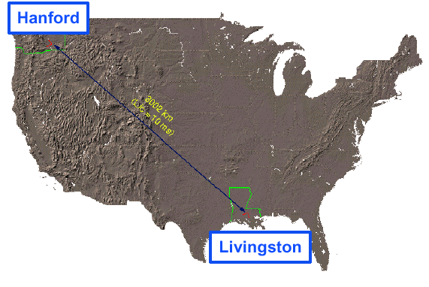
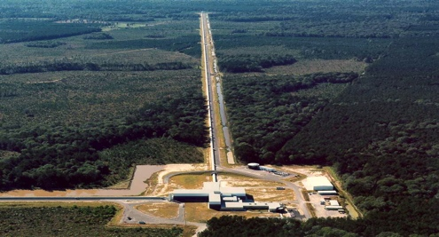
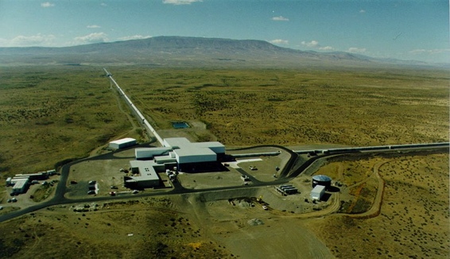
LIGO Interferometer Status
H1
In Commissioning mode since beginning November
Including new Filter Cavity since end November
3000 km (10 ms)
L1
In Installation mode since August for replacement of both End Test Masses
Commissioning will commence in January

Slide 3
Summary of LIGO Improvement Goals
 | Hanford, H1 |  | Livingston, L1
400 kW circulating arm power | ✓ |  | Starting in Jan.
Squeezed light efficacy 4.5 dB | ✓ | In progress | ✓ | Starting in Jan.
300 m filter cavity for frequency-dependent squeezing | Installation complete |  | Installation complete
Low frequency technical noise reduction (f < 100 Hz) | In progress |  | ✓
Binary Neutron Star inspiral detection range: 160-190 Mpc | 120 Mpc, w/out squeezing |  | 130 Mpc, w/out squeezing, low power

Slide 4
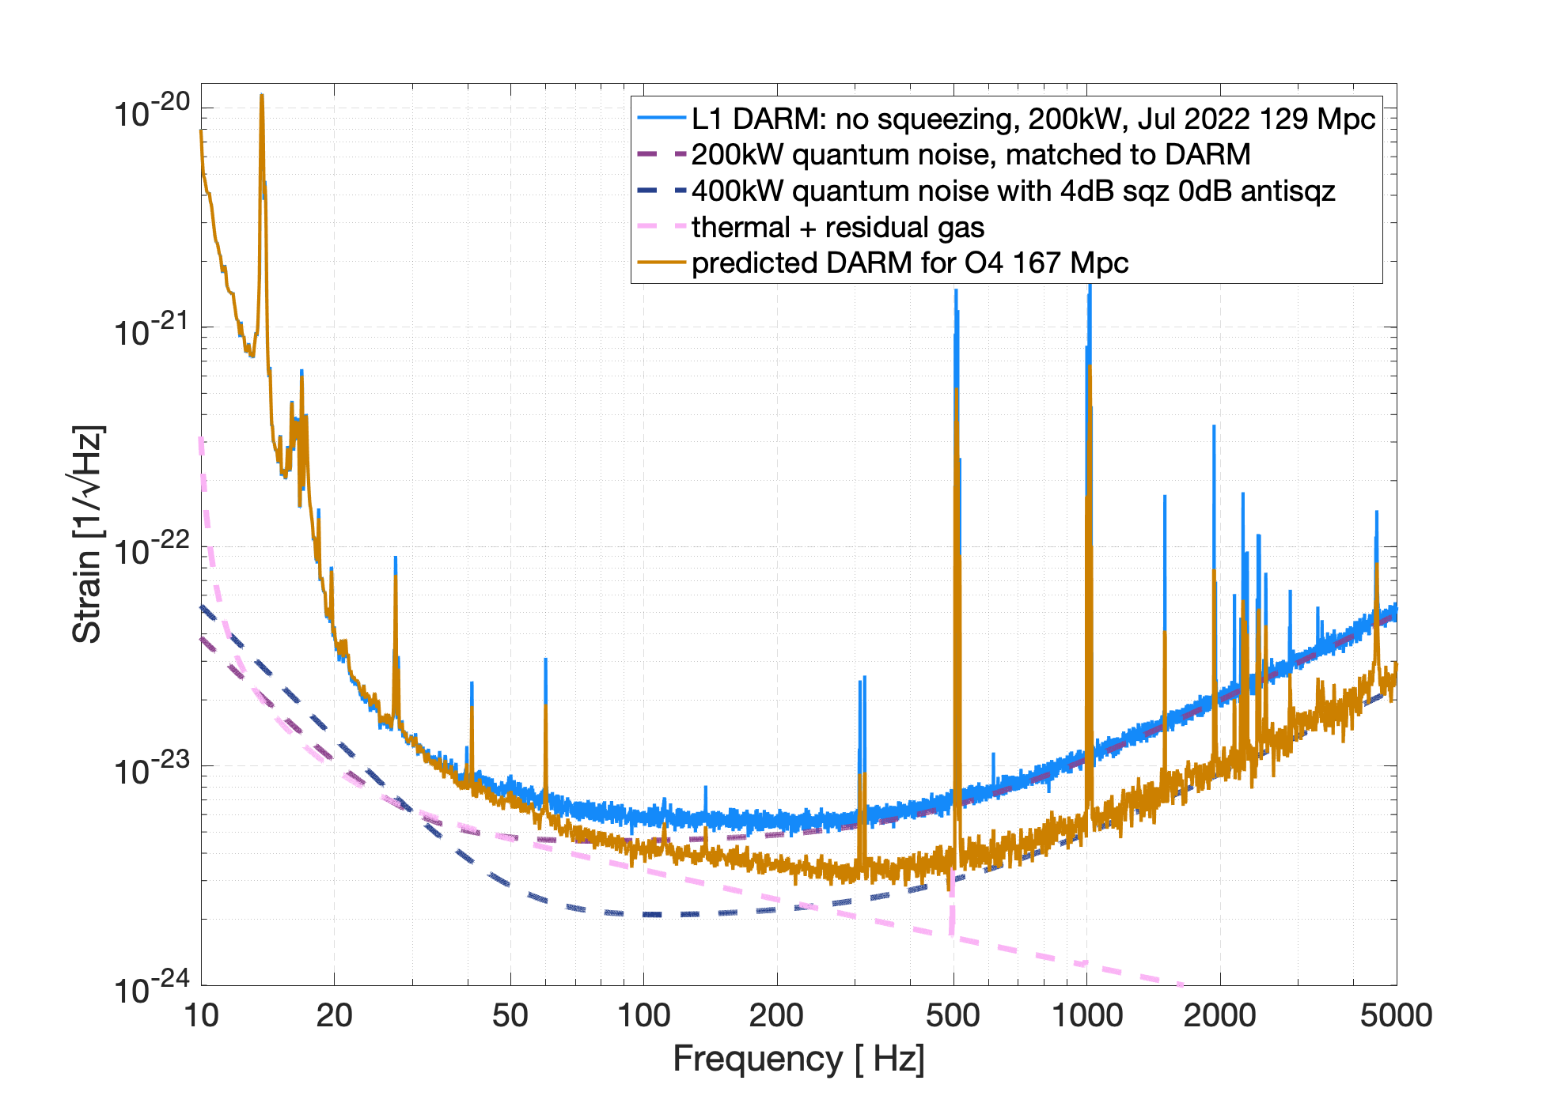
O4 Projection for L1
Start w/ July 2022 spectrum
Double the laser power
+ 4 dB of squeezing
0 dB of anti-squeezing thanks to the filter cavity (no radiation pressure increase)
167 Mpc BNS range, predicted
Plot from A. Effler

