Slide 1
Collaborations with Industry and Tech Transfer:
LIGO Laboratory’s Experience
David Shoemaker
LIGO Laboratory

Slide 2
LIGO Technology
The LIGO GW interferometers push the state-of-the-art in almost every type of technology that they use...
... and LIGO uses many different types of technologies.
  Stabilized lasers
  Squeezed light/quantum sensing
  Precision mirrors and optical components
  Sensors – seismometers, accelerometers, position sensors, tiltmeters
  Precision metrology
  Vibration isolation systems
  Servo control systems
  Vacuum systems and vacuum components
  Massively parallel computing, low latency searches for MMA
  Federated identity management for large collaborations
  …
Often, there are no ‘off the shelf’ solutions to meet our needs, so we partner with industry to develop components and systems that are needed to meet LIGO’s requirements.

Slide 3
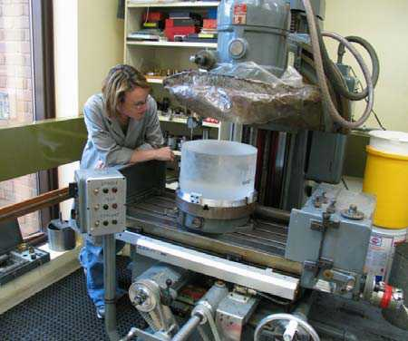
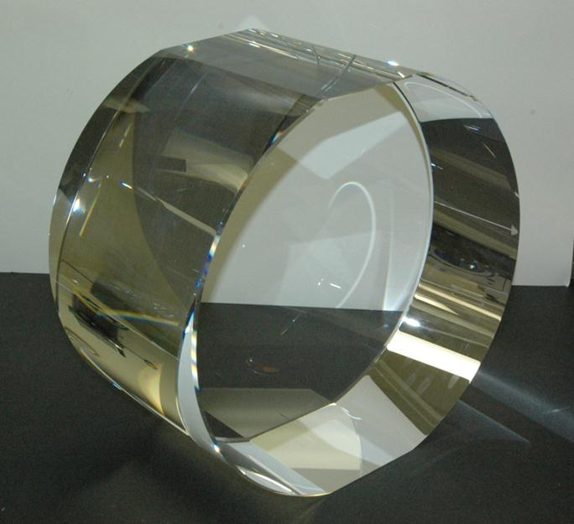
Example:
Advanced LIGO ‘Test Masses’
340 mm ⌀, 200 mm thick
40 Kg Fused Silica

Slide 4
Case Study: Advanced LIGO
Core Optics Coatings
Test masses coated by Laboratoire des Matériaux Avancés, Lyon, France
CNRS/INFN support, but also a commercial undertaking; LIGO awards competitive bids to LMA for optical dielectric coatings
Unique capability at LMA to coat optics for GW detectors
However: coatings initially did not meet requirements
Over a 20-year period, significant interaction with LIGO with transfer of intellectual insights from LIGO to LMA to aid in their industrial processes
Coating challenges mitigated:
Spirograph figure error
Anti-Reflection coating performance
Excess absorption
Large radius figure error
Transmission at secondary wavelength (532 nm)
Point defects

Slide 5
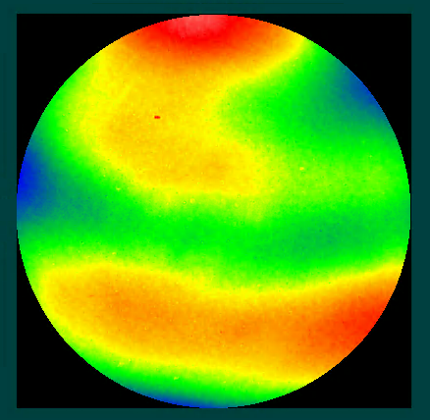
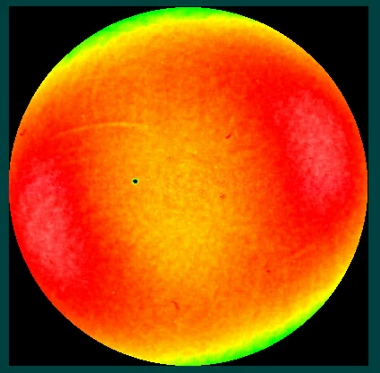
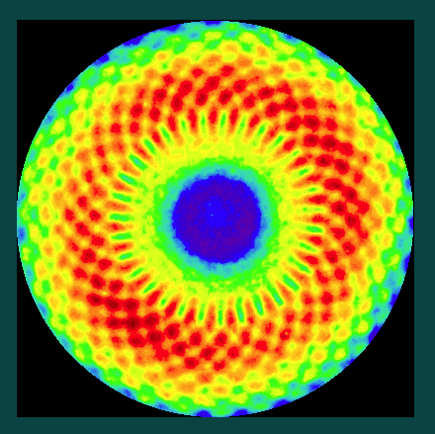
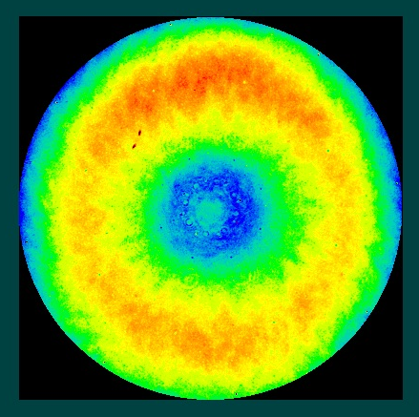
Case Study: Advanced LIGO
Core Optics Coatings
12 nm Peak-Valley 11 nm PV 4 nm PV 5 nm PV
Feb 2011 “Spirograph” Mar 2015
160 mm diameter
Iterative improvement in the uniformity of the coatings
LIGO provided characterization, interpretation, modeling, funding
LMA engaged to improve the coating process
LIGO’s and Virgo’s mirrors improved significantly

Slide 6
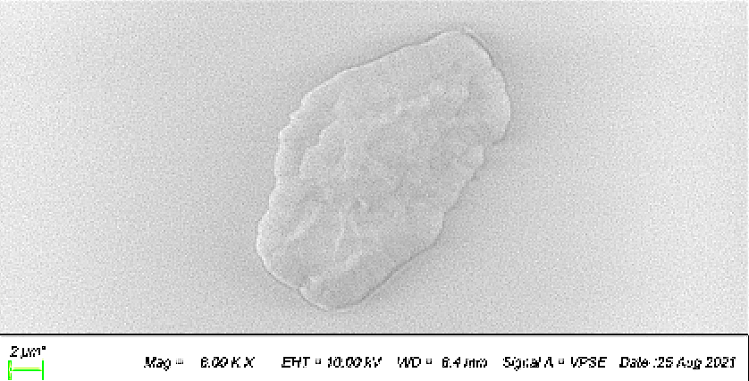
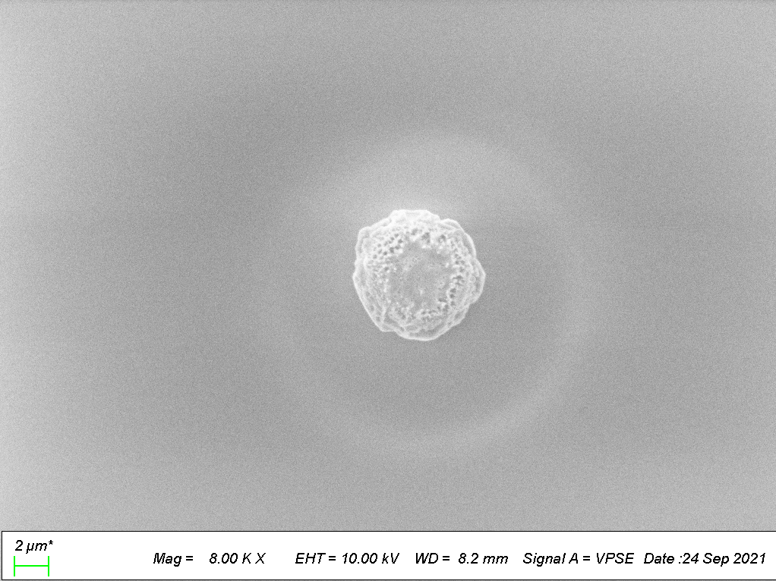
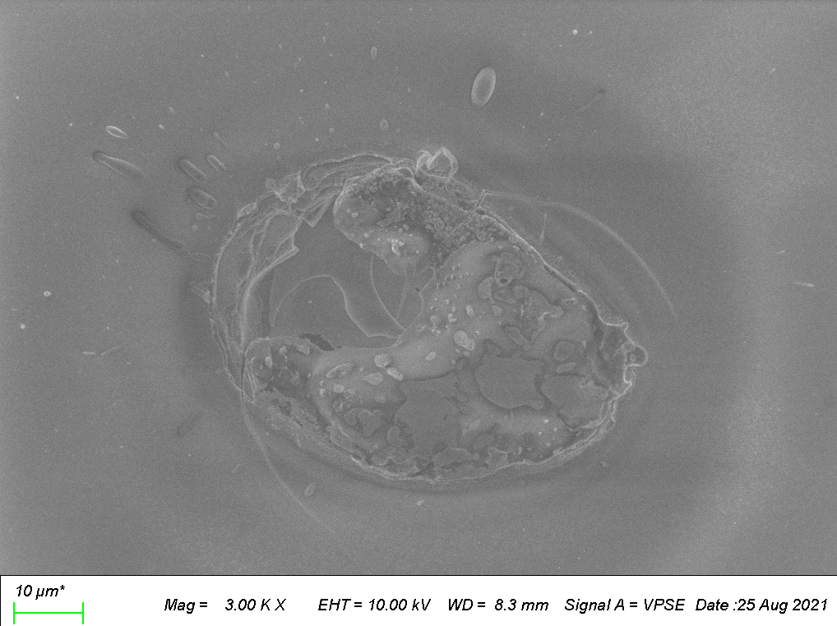
Case Study: Advanced LIGO
Core Optics Coatings
Point defects cause absorption of laser light, heat-induced distortion in the mirror surface
Collaborative effort between LMA and LIGO to identify the nature of the defects
Many absorbers are Aluminum, also seen Carbon, Titanium, Copper, Iron, Nickel
Iterative process of discussions, coating chamber modifications, coatings, and (LIGO) characterization and analysis
Result: most recent coatings have 0 or 1 defect
LIGO and Virgo coatings now have this improved performance

Slide 7
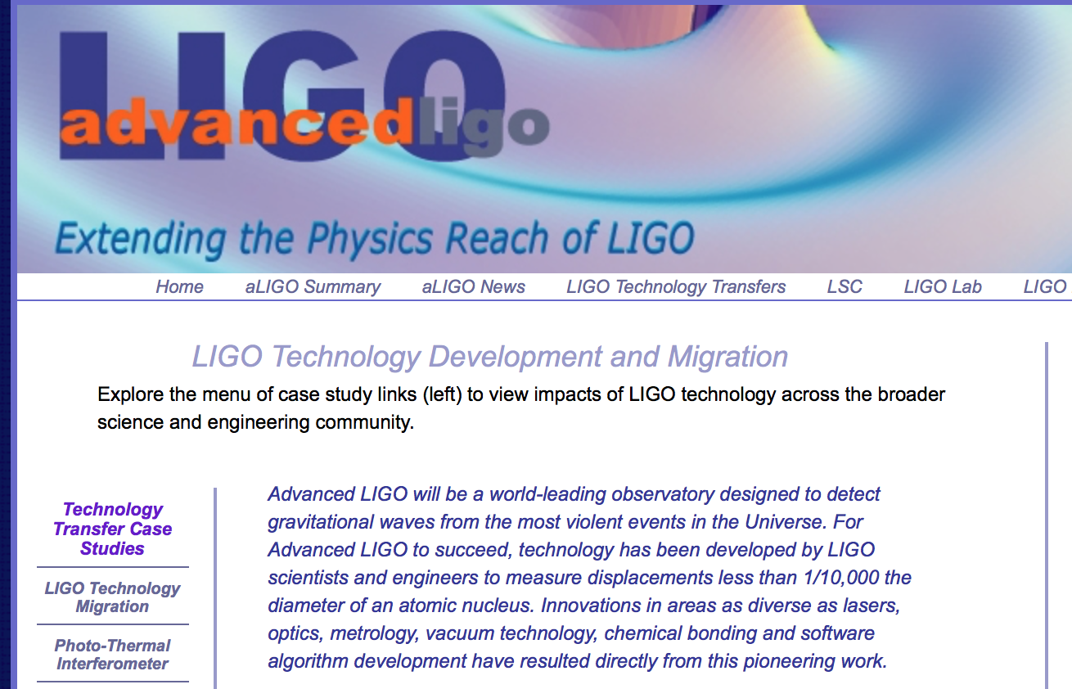
https://www.advancedligo.mit.edu/tech_overview.html
(or google ‘Advanced LIGO technology’)

Slide 8
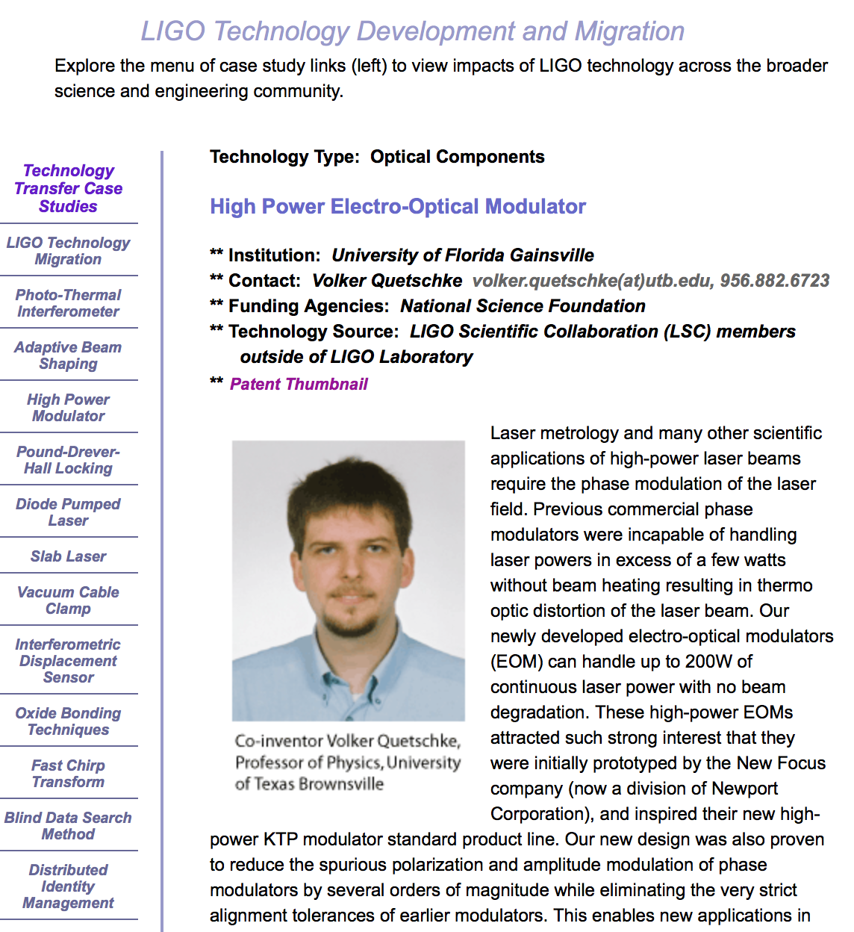
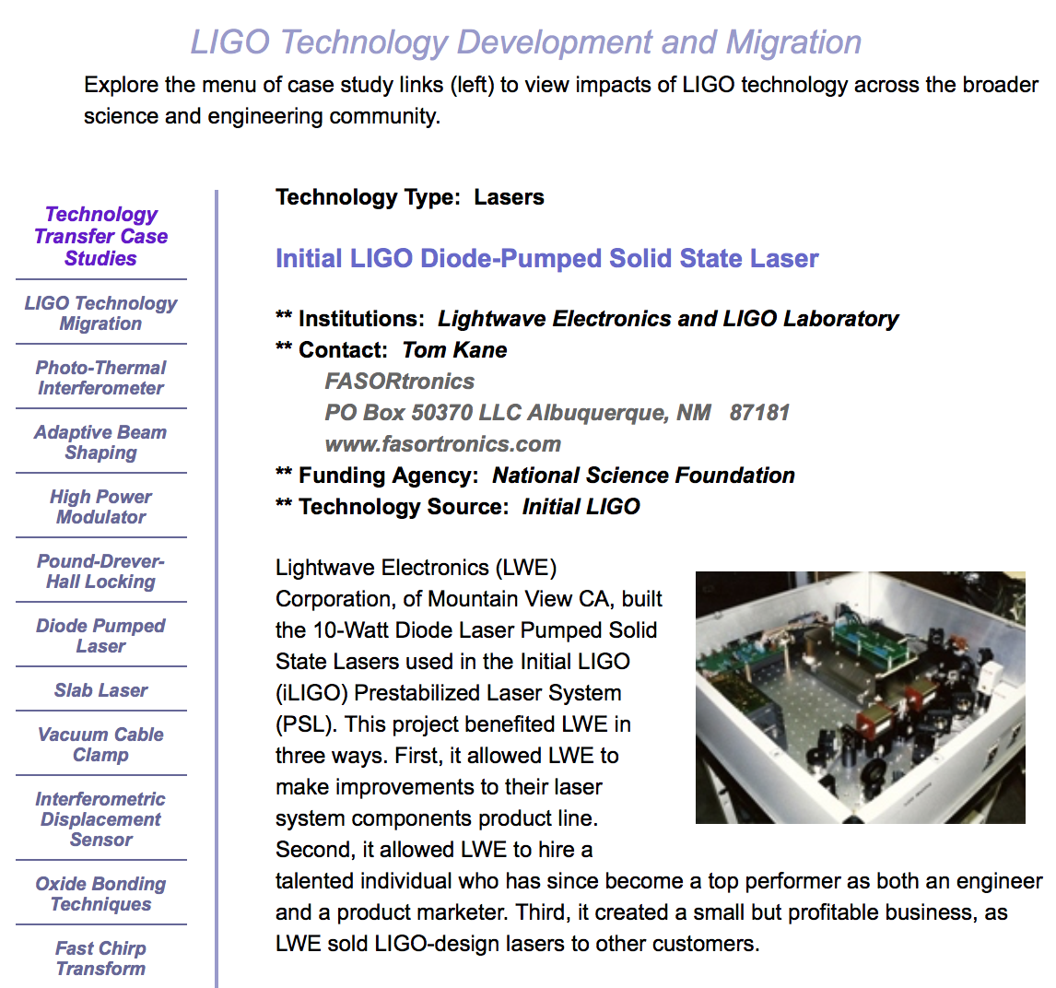
Tech Transfer: Lasers and Optics

Slide 9
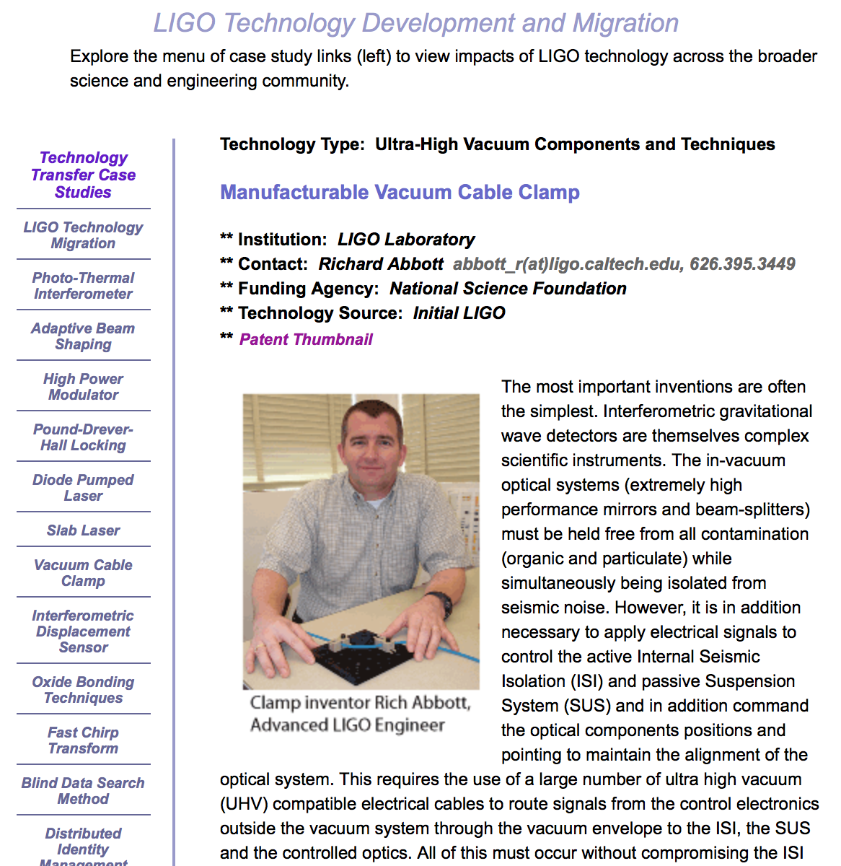
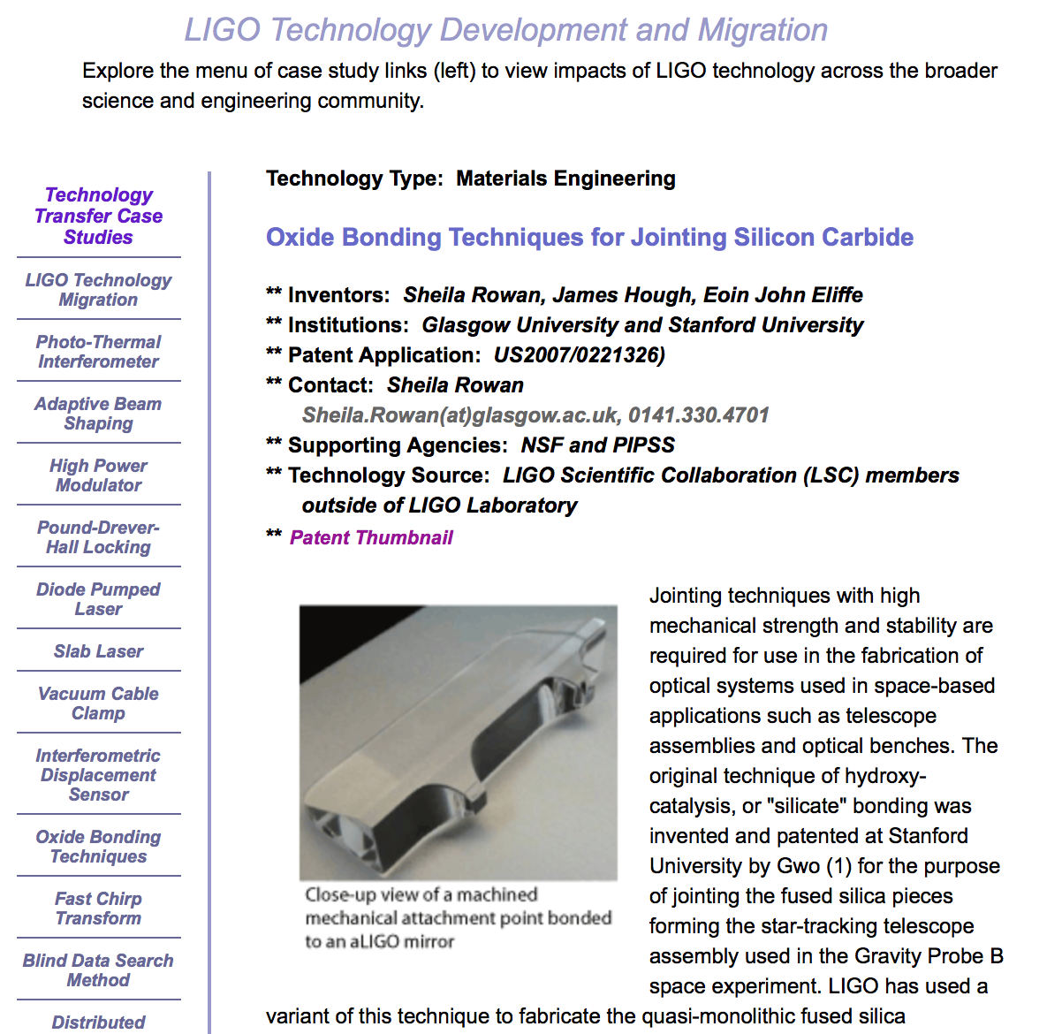
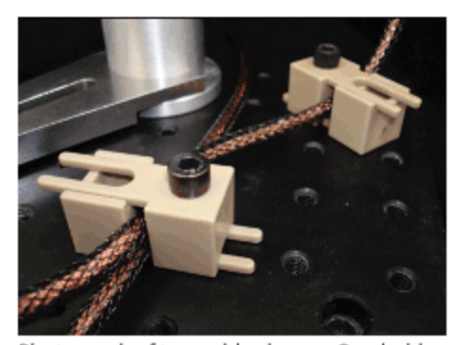
Tech Transfer: Materials and Processes

Slide 10
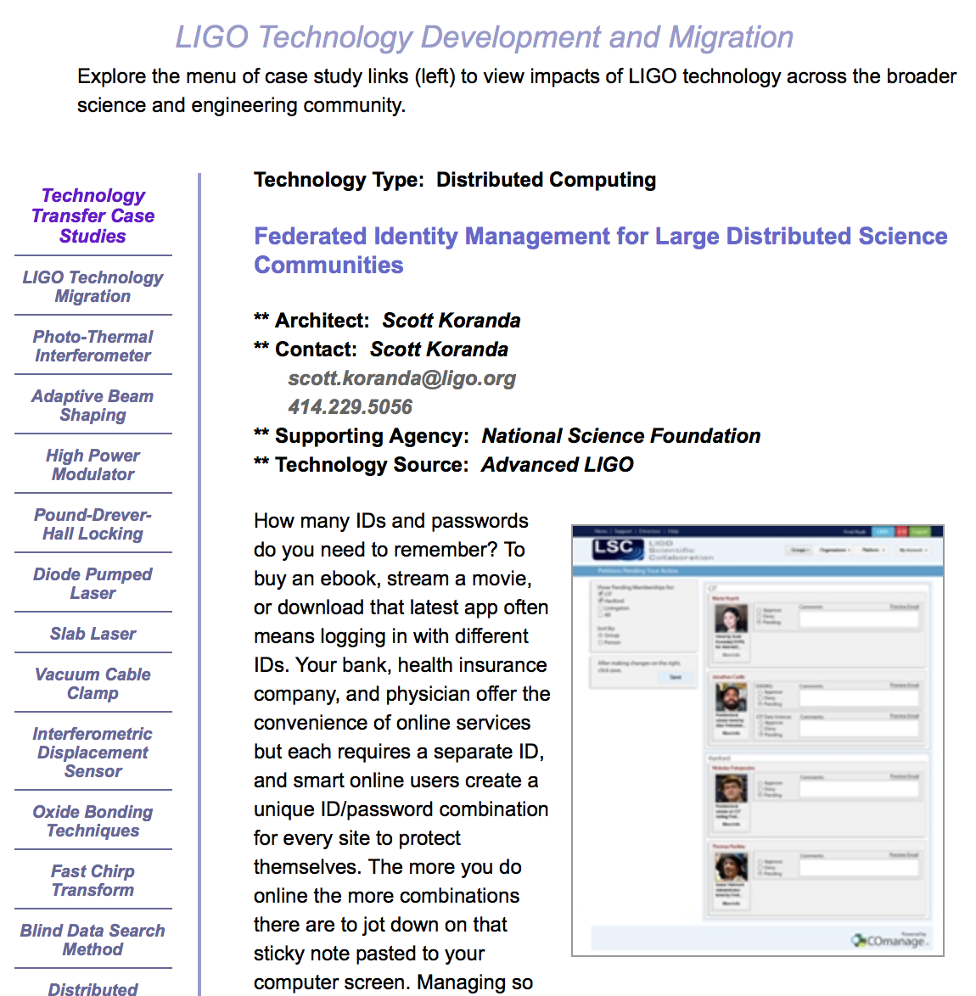
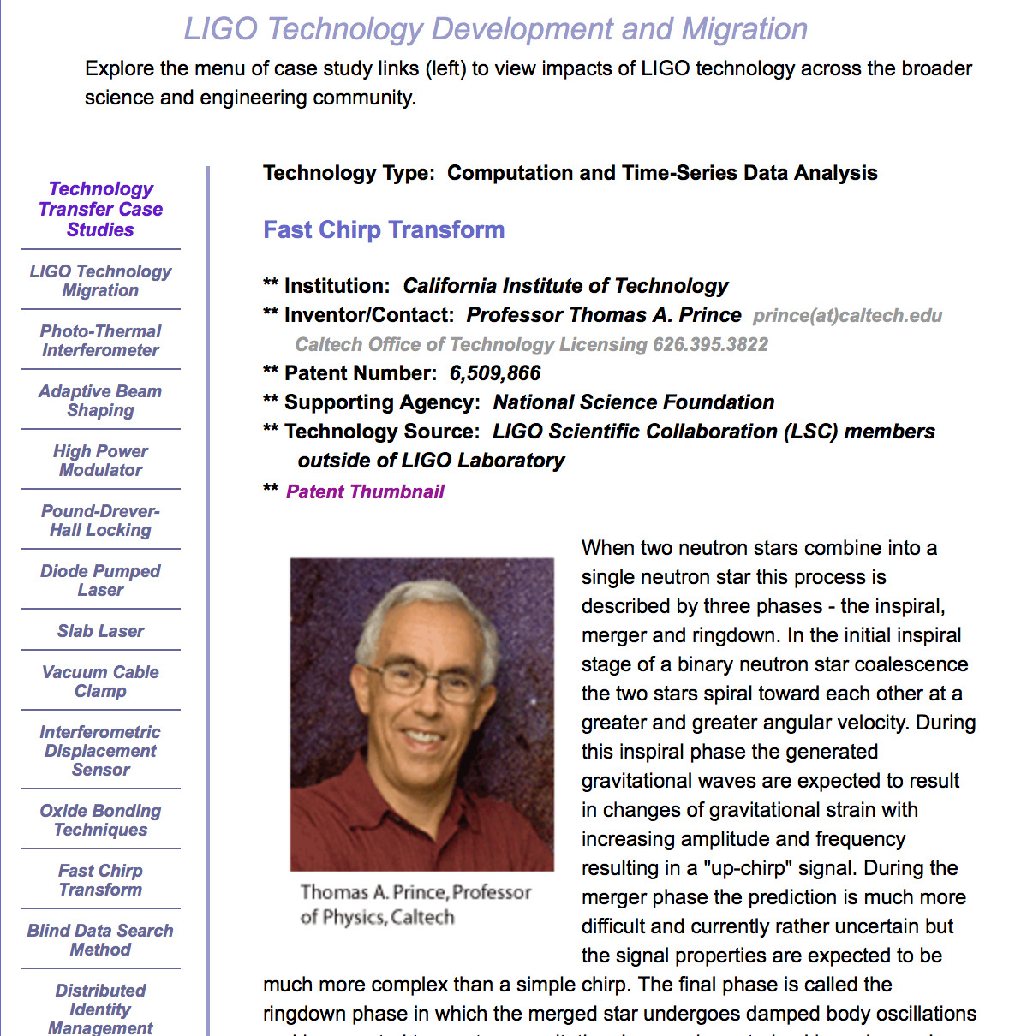
Tech Transfer:
Cyberinfrastructure and Computing

Slide 11
Examples of LIGO Commercial Optical Technology Partners (an abridged list)
Optics
  AMSL
  Research Electro-Optics
  Advanced Thin Films
  Laboratoire des Matériaux Avancés
  CSIRO
  Coastline Optics
  Hereaus (Virgo)
Lasers
  Lightwave Electronics
  Laser Zentrum Hannover
  NeoLASE
Electro-optic modulators and Faraday isolators
  New Focus/Newport Corp
  Moltech
  Raicol
Opto-mechanical components
  Siskiyou
  Lee’s Mounts → Spindler-Hoyer

Slide 12
Lessons from LIGO in industrial collaborations and tech transfer
LIGO’s needs are very unique and challenging → defining and specifying requirements is very important
  The challenge often motivates companies to want to work with LIGO
‘Throw over the fence’ doesn’t work → it’s critically important, as much as possible, to work in a partnership with industry
  Careful management of intellectual property and proprietary processes is important
  High bandwidth communications between LIGO cognizant scientists/engineers and companies
Contamination control and quality assurance/quality control comes into almost every aspect of the LIGO detector
  Initial LIGO had detector QA/QC, but needed much better QA/QC
Money matters → developing state-of-the-art technology is risky and therefore expensive.
  Value engineering is critical to maintain budgets

Slide 13
And…Tech Transfer:
Workforce
Many students and postdocs in the LIGO environment
  Some stay in the field
  Some go to academic positions
Many go to industry
  High-tech training and the work culture in the Lab is excellent preparation
Broad range of skills and destinations – Interferometry, mechanical engineering, programming; SpaceX, ASML, NASA, Google, etc.
This is perhaps the most important and enduring technology transfer value from LIGO to industry
We are looking forward to Tech Transfer with
Cosmic Explorer,
the US next-generation GW Observatory

