Slide 1
LIGO-Virgo-Kagra Status Report
GWANW 2023
Michael Ross – University of Washington

Slide 2
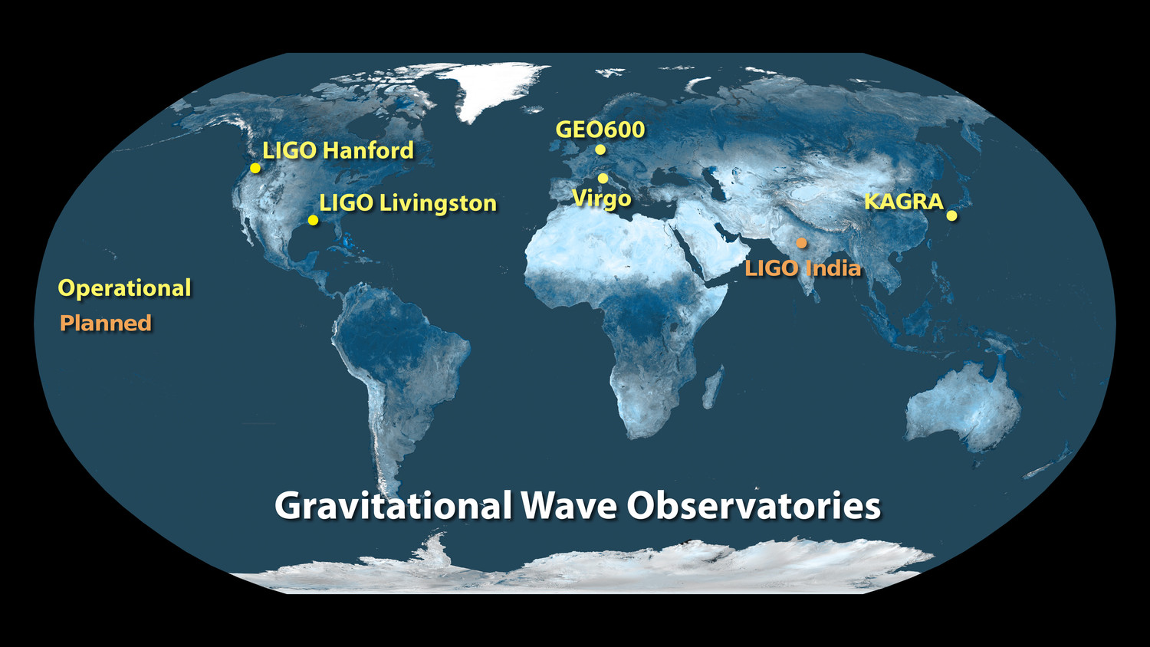
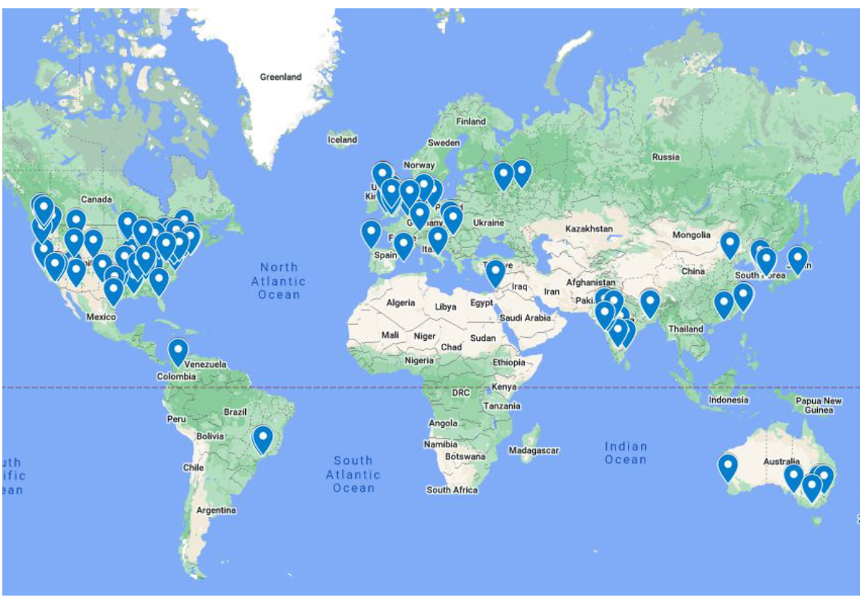
Network
Worldwide network of gravitational wave observatories
Multiple far-flung sites allows for better source localization and polarization studies
Collaboration spanning across five continents
Share knowledge and sync observing runs to maximize science
Collaborating Institutions

Slide 3
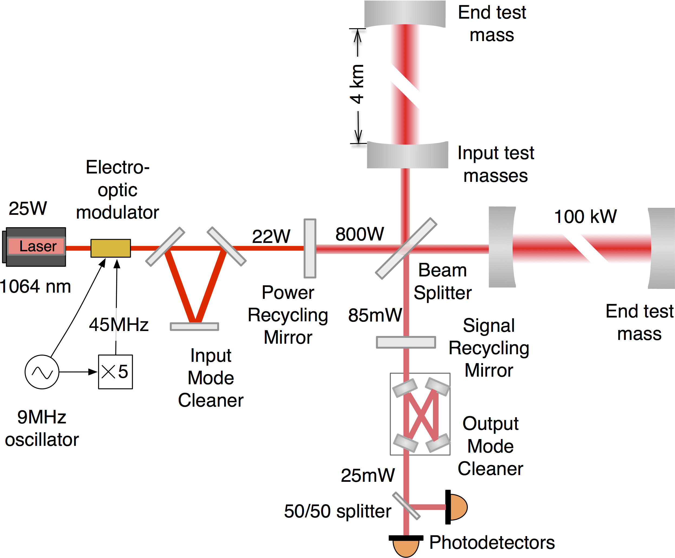
Interferometers
Each observatory is a Fabry-Perot Michelson interferometer
Measures differential strain across the two arms of the interferometer
Lots of optics to maximize sensitivity
Sensitive to GWs between 30 Hz – 8 kHz
Low frequency limited by being on the Earth’s surface
Primarily sensitive to stellar-mass binary black holes and binary neutron stars
Change in Length
Strain
$$h=\frac{ΔL}{L}$$
Arm Length

Slide 4
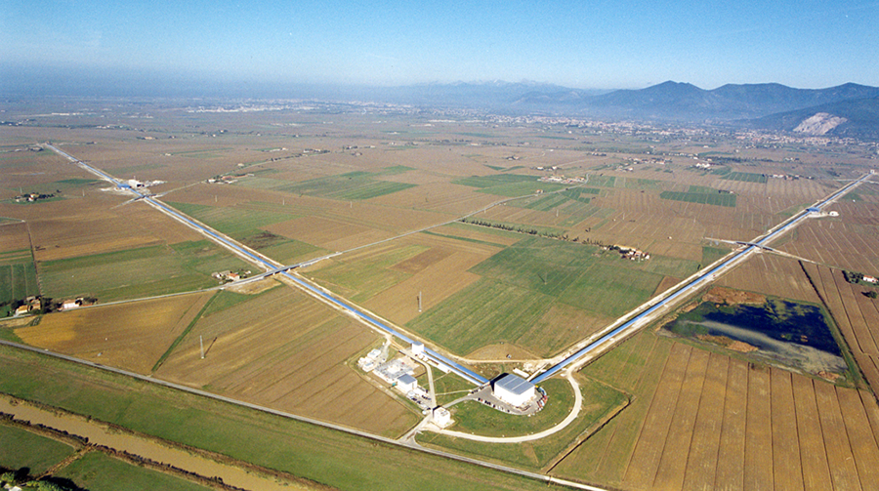
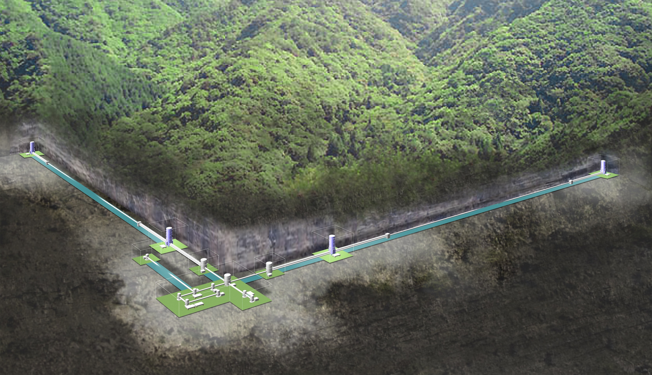
Observatories
LIGO (US):
Pair of 4-km long interferometers
Active seismic isolation + quadruple pendulum
Virgo (Italy):
3-km long
Passive isolation
KAGRA (Japan):
3-km long
Underground
Cryogenic
Passive isolation
LIGO
Virgo
KAGRA

Slide 5
Observing Schedule
Alternating periods of observing and upgrades
With each upgrade we have larger range, number of events goes like range cubed
Moving towards longer observing runs with each upgrade phase
Break between O3 and O4 was extended due to COVID
O4 started in May and will continue for a year and a half

Slide 6
Previous Results
Observations have been rapidly increasing in the last 8 years
First GW detection in 2015
First multimessenger (GW170817) in 2017
90 significant events in O1-O3
Novel Hubble constant measurement
Binary black hole population studies
Tests of general relativity
Neutron star equation of state

Slide 7
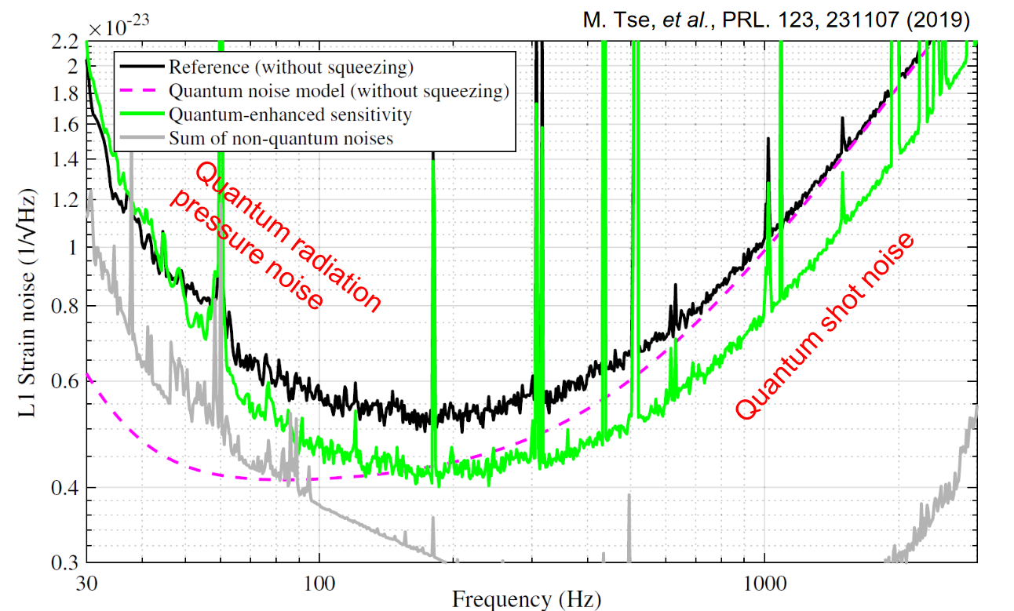
Recent Upgrades
Frequency Dependent Squeezing
LIGO:
New laser + clean test masses = 400 kW circulating power
More stray light baffles
Virgo:
Also new laser
Stray light mitigation
New output mode cleaner
KAGRA:
30 W laser
Implemented angular sensing and control
Mirrors at cryo temperature
More baffles!

Slide 8
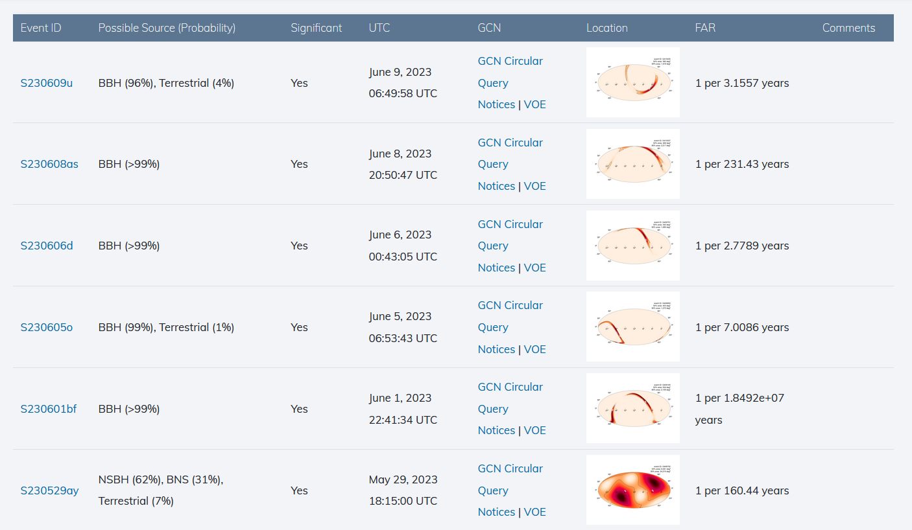
So Far in Observing Run 4
Six significant event seen in O4
Most are binary black hole mergers
One contained a ~6 M☉ object, heavy neutron star or light black hole?
Virgo has had technical issues and has yet to begin observing
48% double interferometer duty cycle, 40% single interferometer

Slide 9
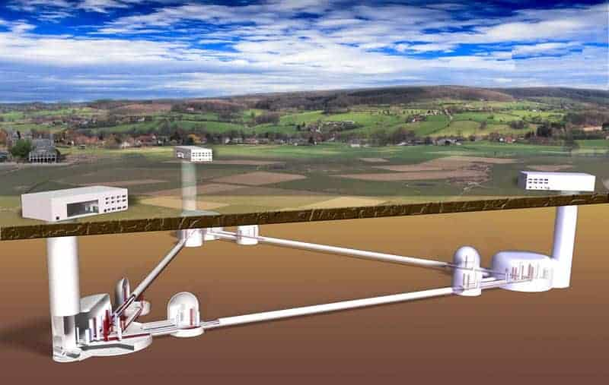
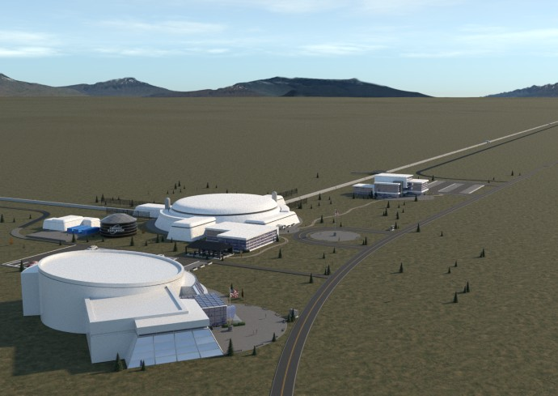
Future
After O4 is complete, we plan to undergo another set of upgrades before a longer O5 run
LIGO India is being built and will come online in the future
Further down the line, we look forward to third generation observatories
Einstein Telescope (Europe)
Cosmic Explorer (US)

Slide 10
Thanks

