Slide 1
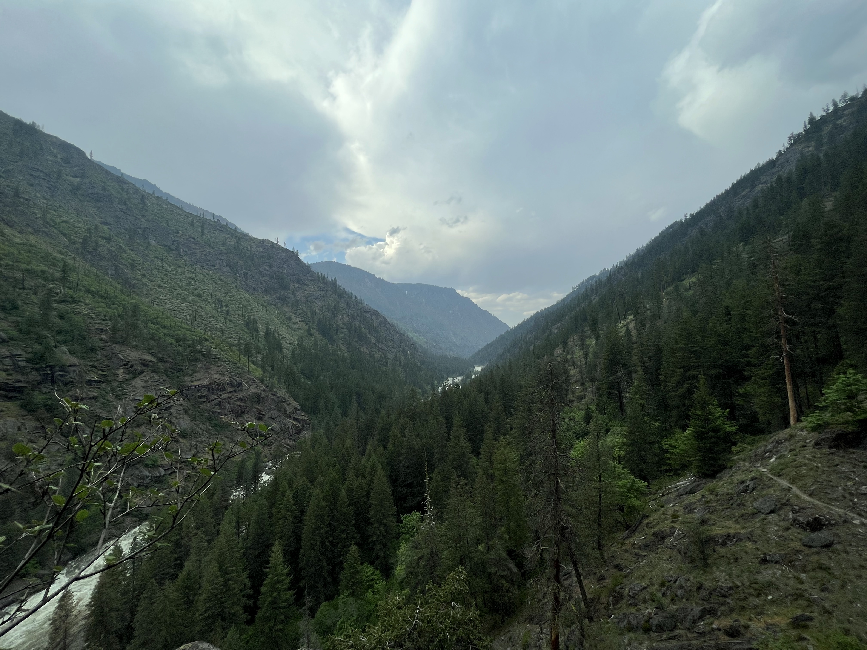
Gravitational Wave Astronomy
North-West
6th Annual GWANW
Jun 26-28 2023

Slide 2
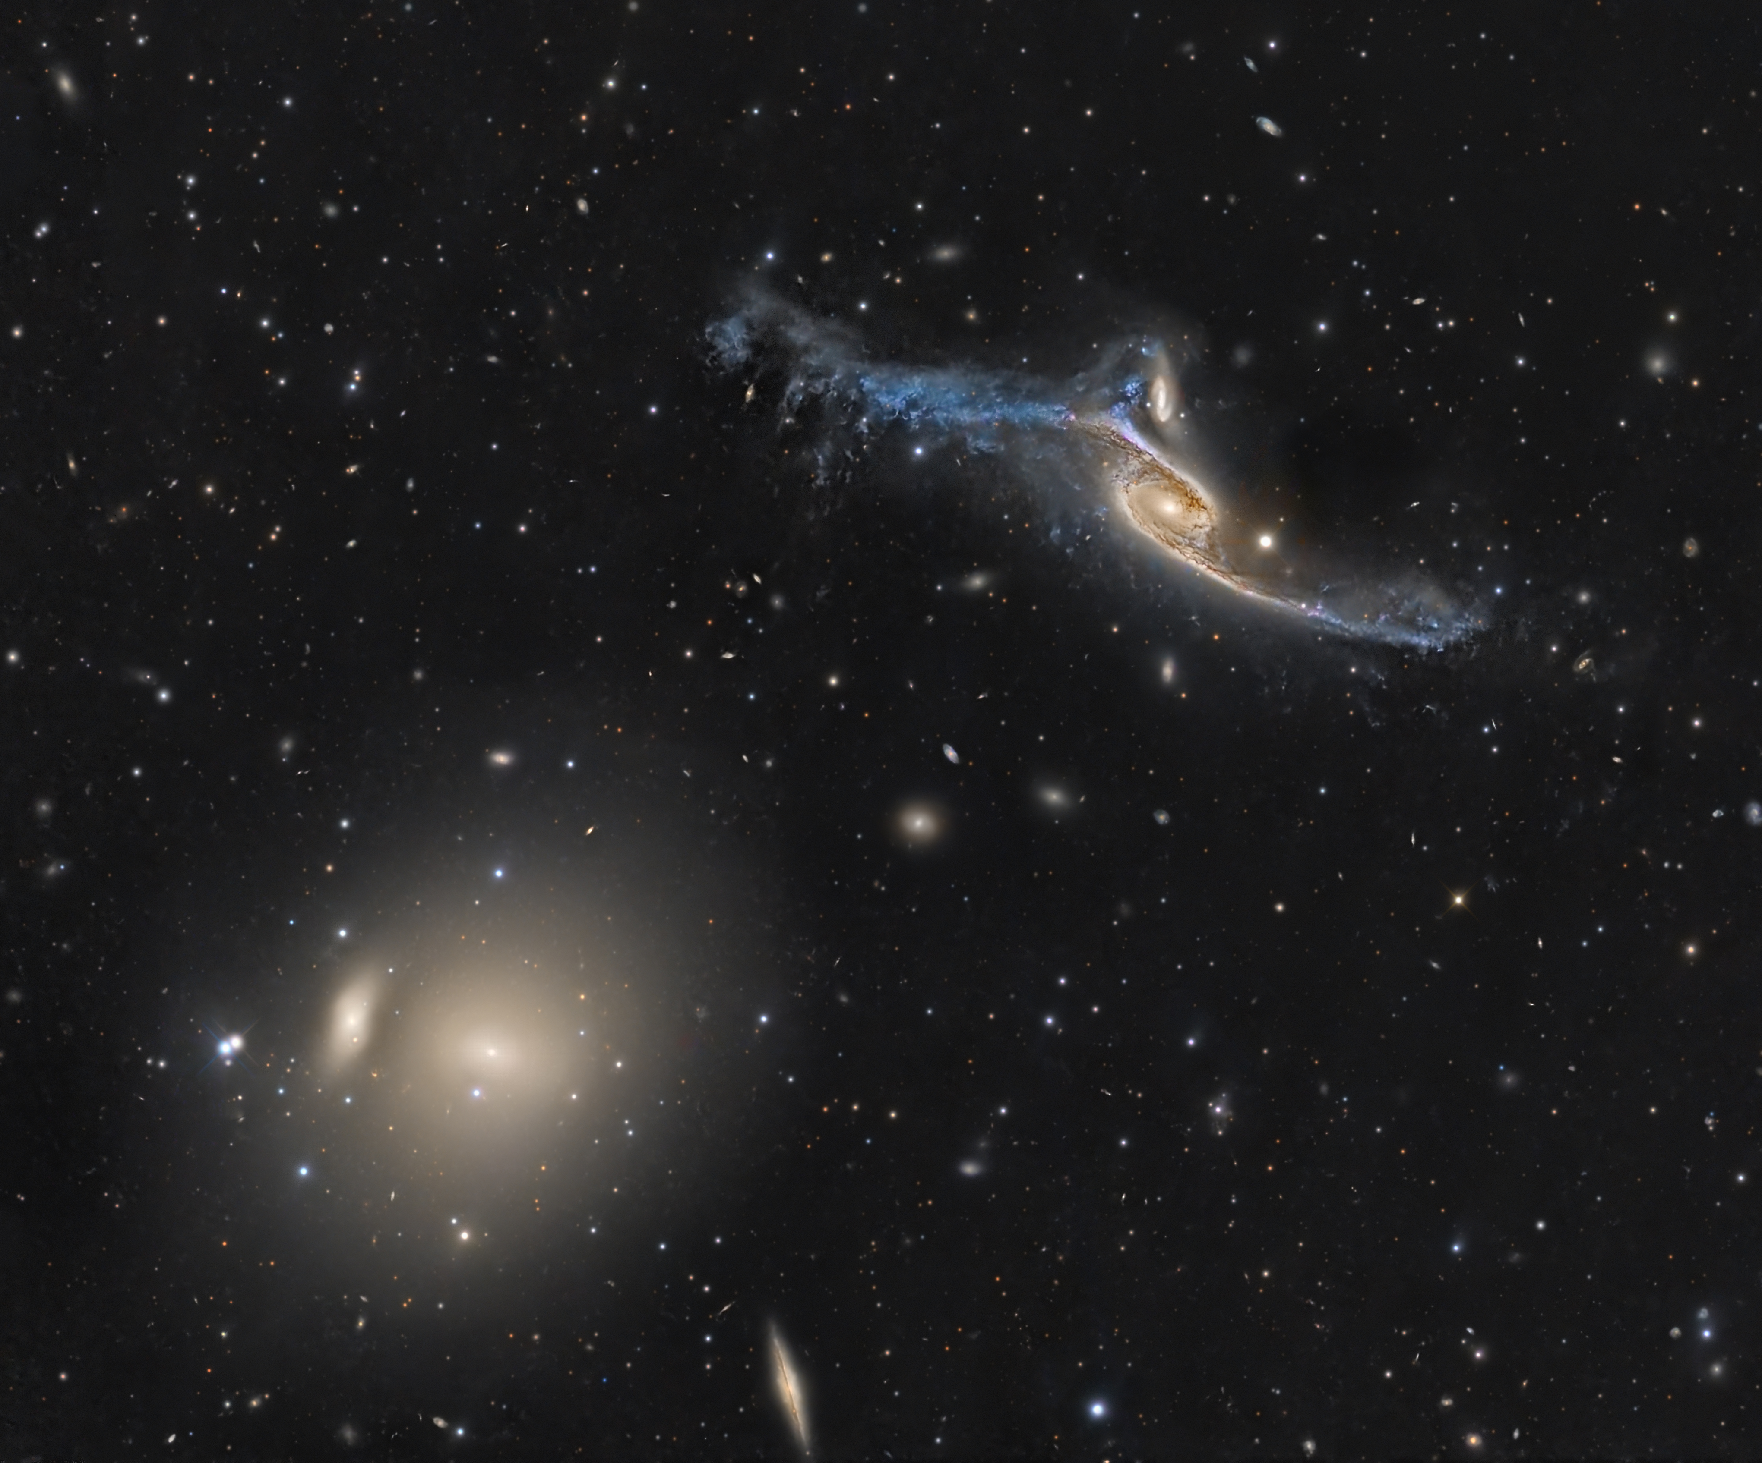
This is a safe space.
Take your time.
Be patient.
Listen.
Take a break.
Do whatever you need to do.
This week, we set aside the world for a moment to look (and “listen”) up.
Welcome.

Slide 3
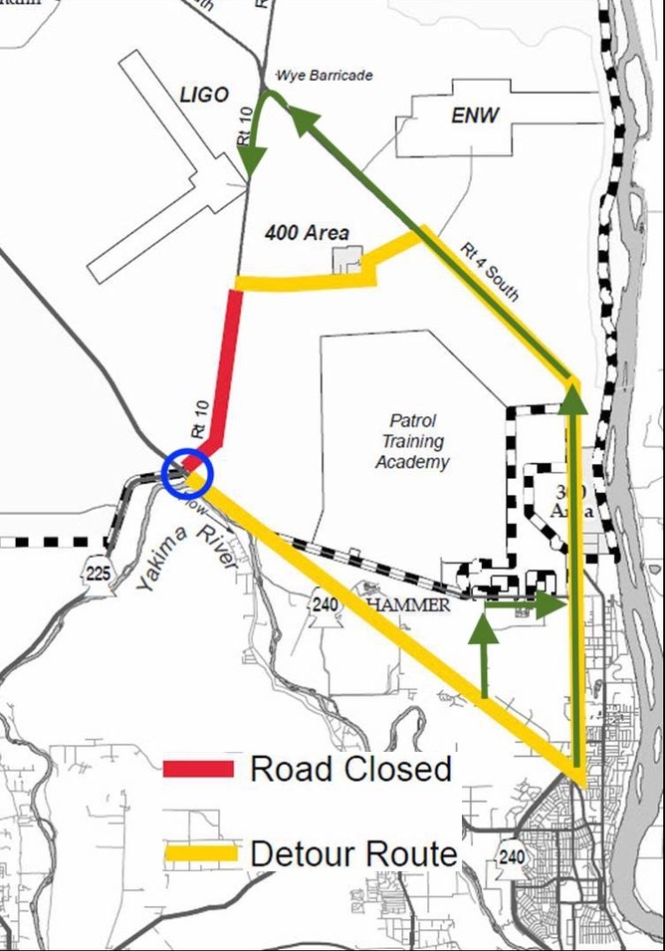
Getting Here All Week

Slide 4
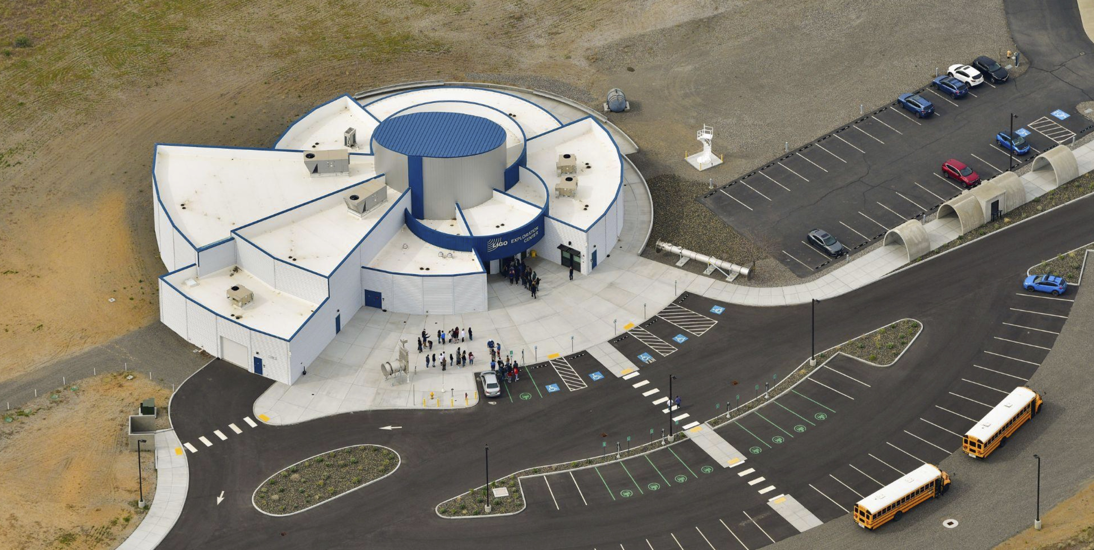
Human Things
Bathrooms and Water Stations are Behind You
Evacuation Areas for Fire and Active Shooter Emergencies
Coffee and Tea mugs are available for your sustainable use
Lunch, snacks, and dinner are provided for each day

Slide 5



GWANW 2023: Essential Links
  https://wp.wwu.edu/gravity/gwanw2023/
  https://dcc.ligo.org/cgi-bin/private/DocDB/DisplayMeeting?conferenceid=1163
  https://caltech.zoom.us/j/85830055170?pwd=RjlBeVhnclBrSXpTYXNWMW1Ya0hUZz09
Zoom Meeting ID: 858 3005 5170

Slide 6
GWANW 2023: Day 1
Today (DAY 1)
10:00 Gravitational Wave Astronomy Tutorial
11:00 LIGO Tutorial
12:00 Lunch Break
13:30 NANOGrav Tutorial
15:00 Coffee Break
15:30 LISA Tutorial
16:00 Outreach Topics
18:30 Board games and Pizza!

