Slide 1
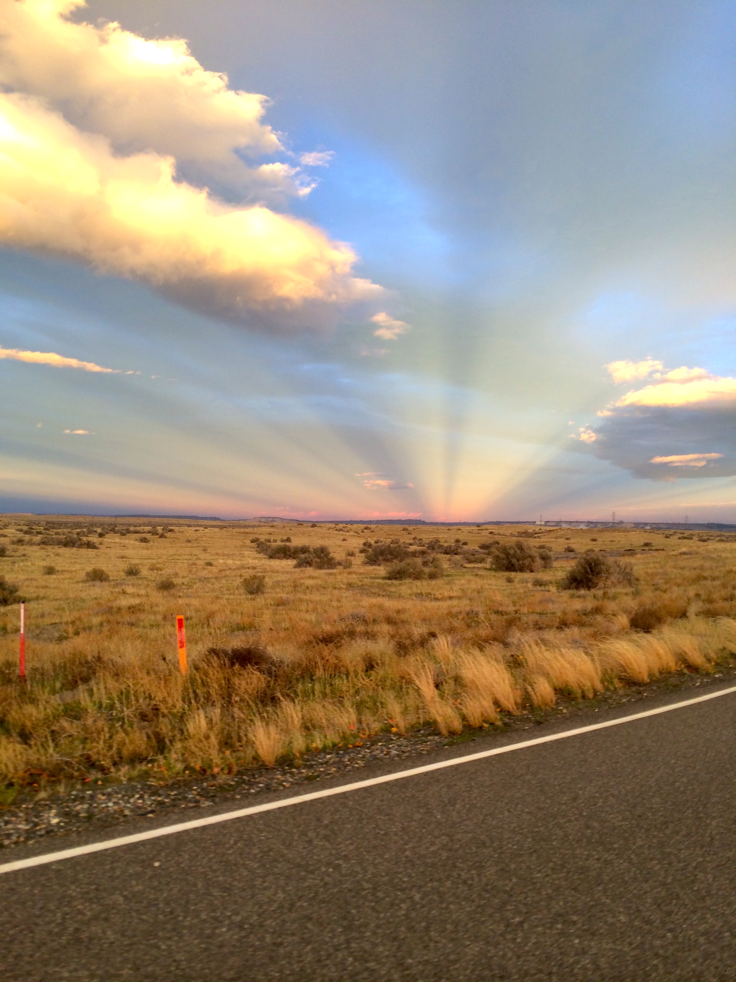
Gravitational Wave Astronomy
North-West
6th Annual GWANW
Jun 26-28 2023

Slide 2
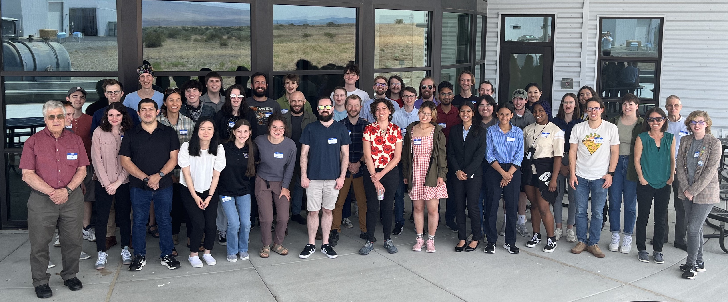
GWANW 2023!
That’s a wrap folks!
Thank you to Svenja @ WWU and Jeff @ LHO for hosting!
Thank you for participating!
All Talks Publically Available on LIGO DCC Here

Slide 3
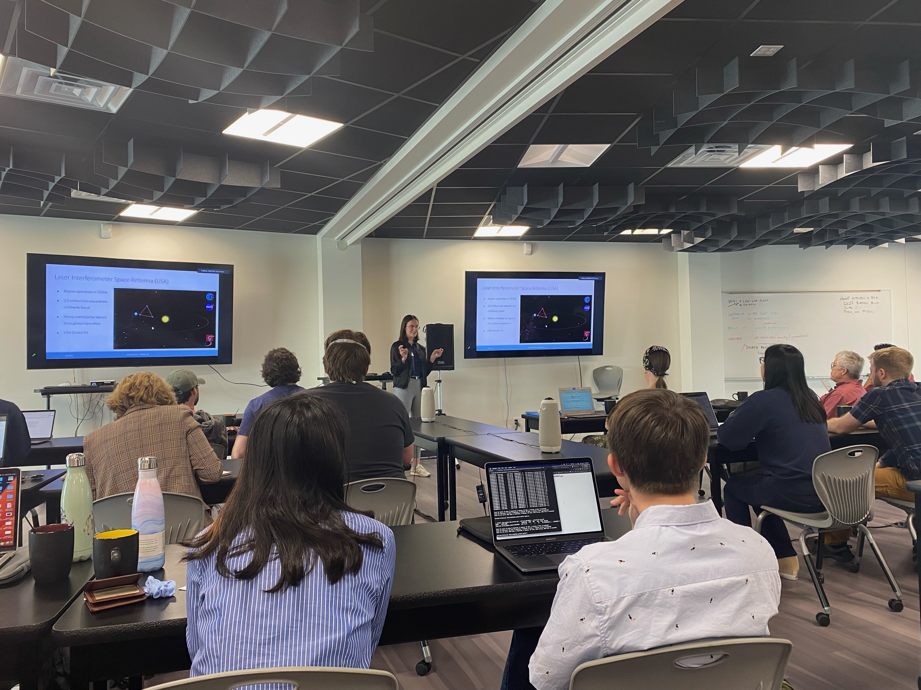
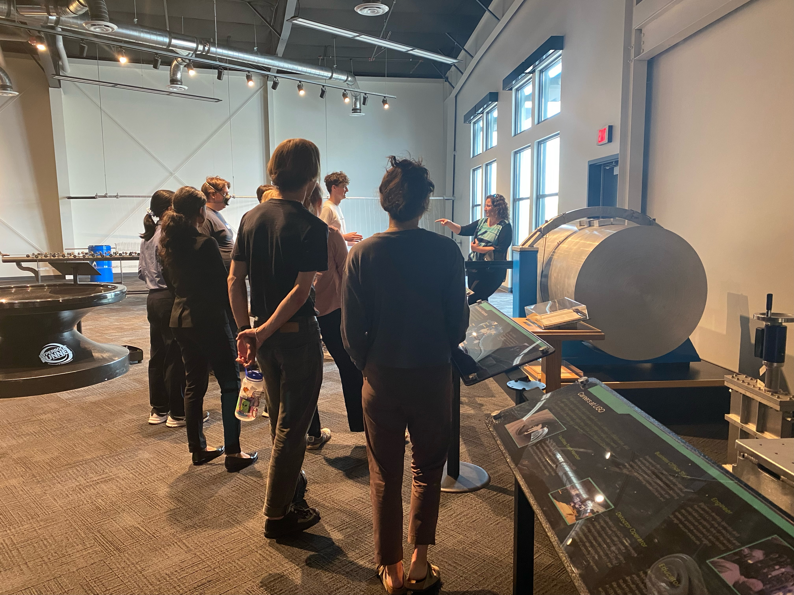
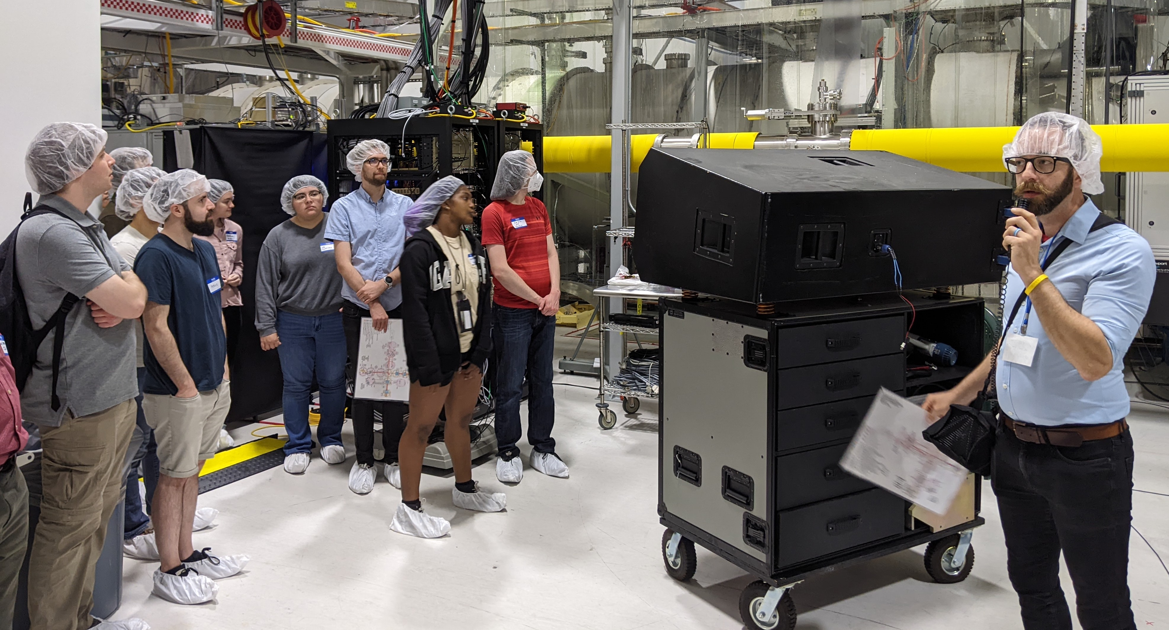
We Did The Science!

Slide 4
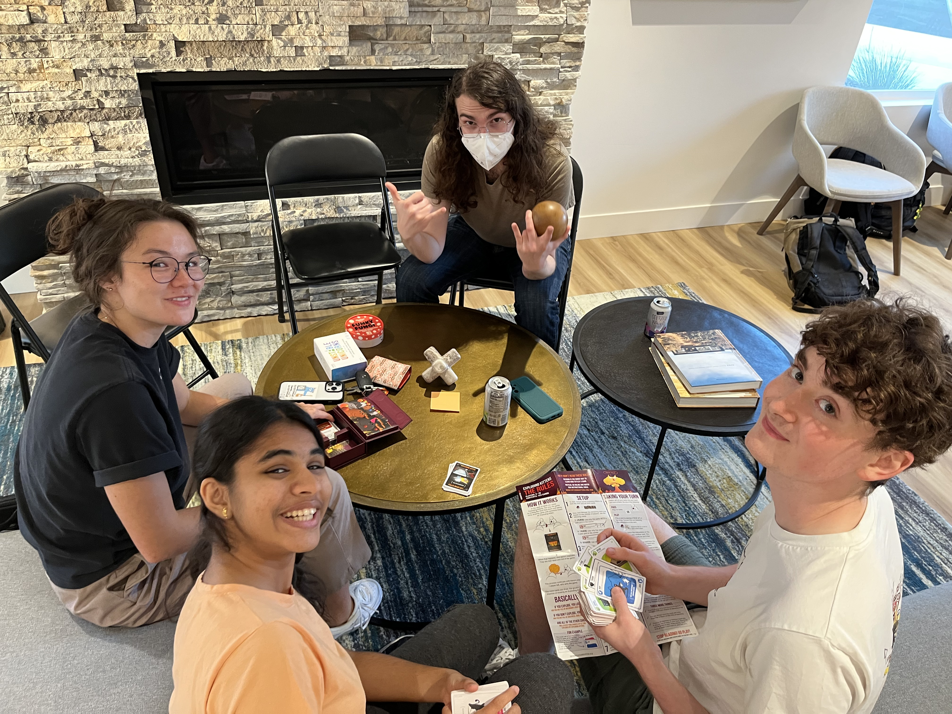
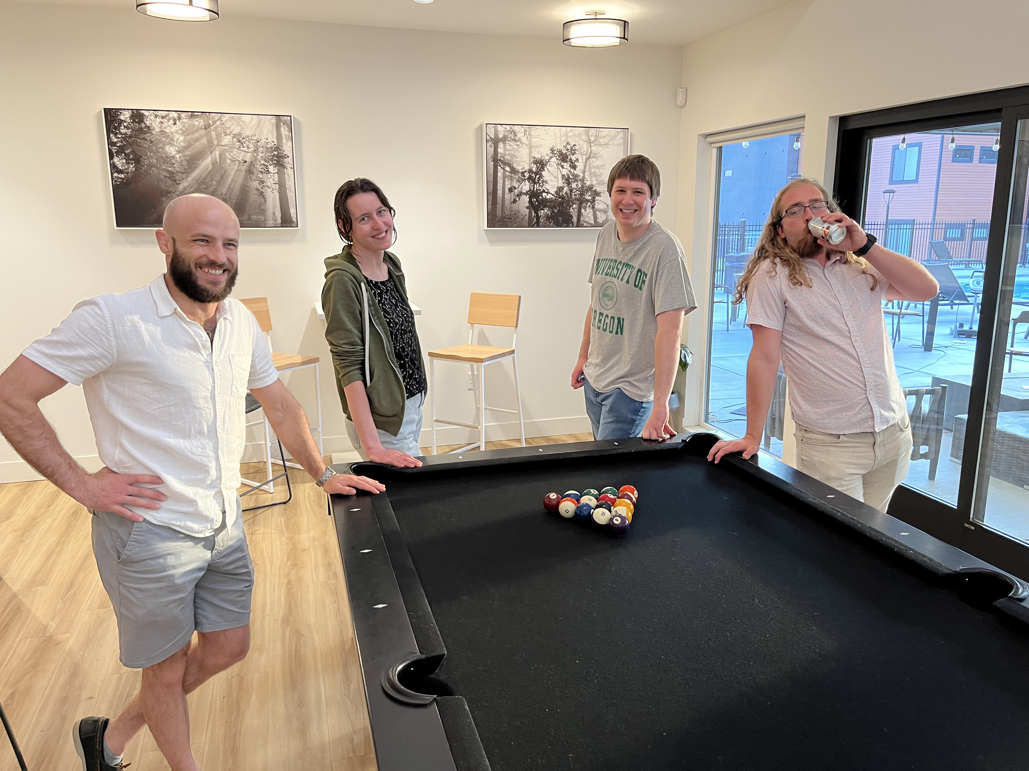
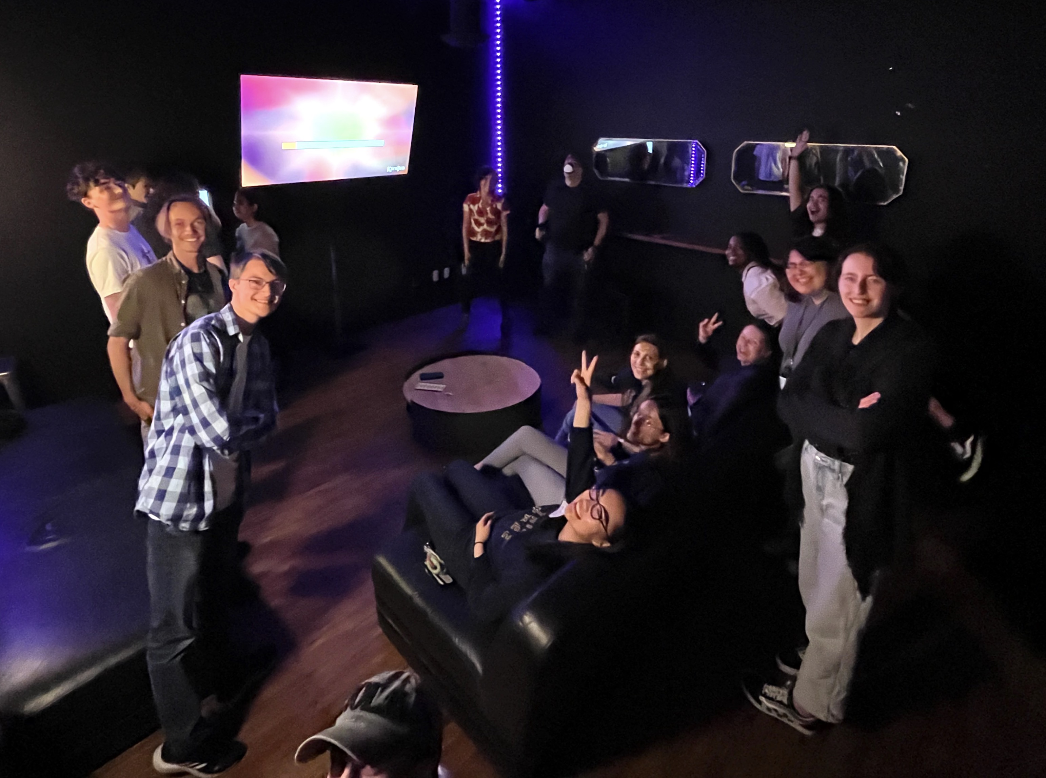
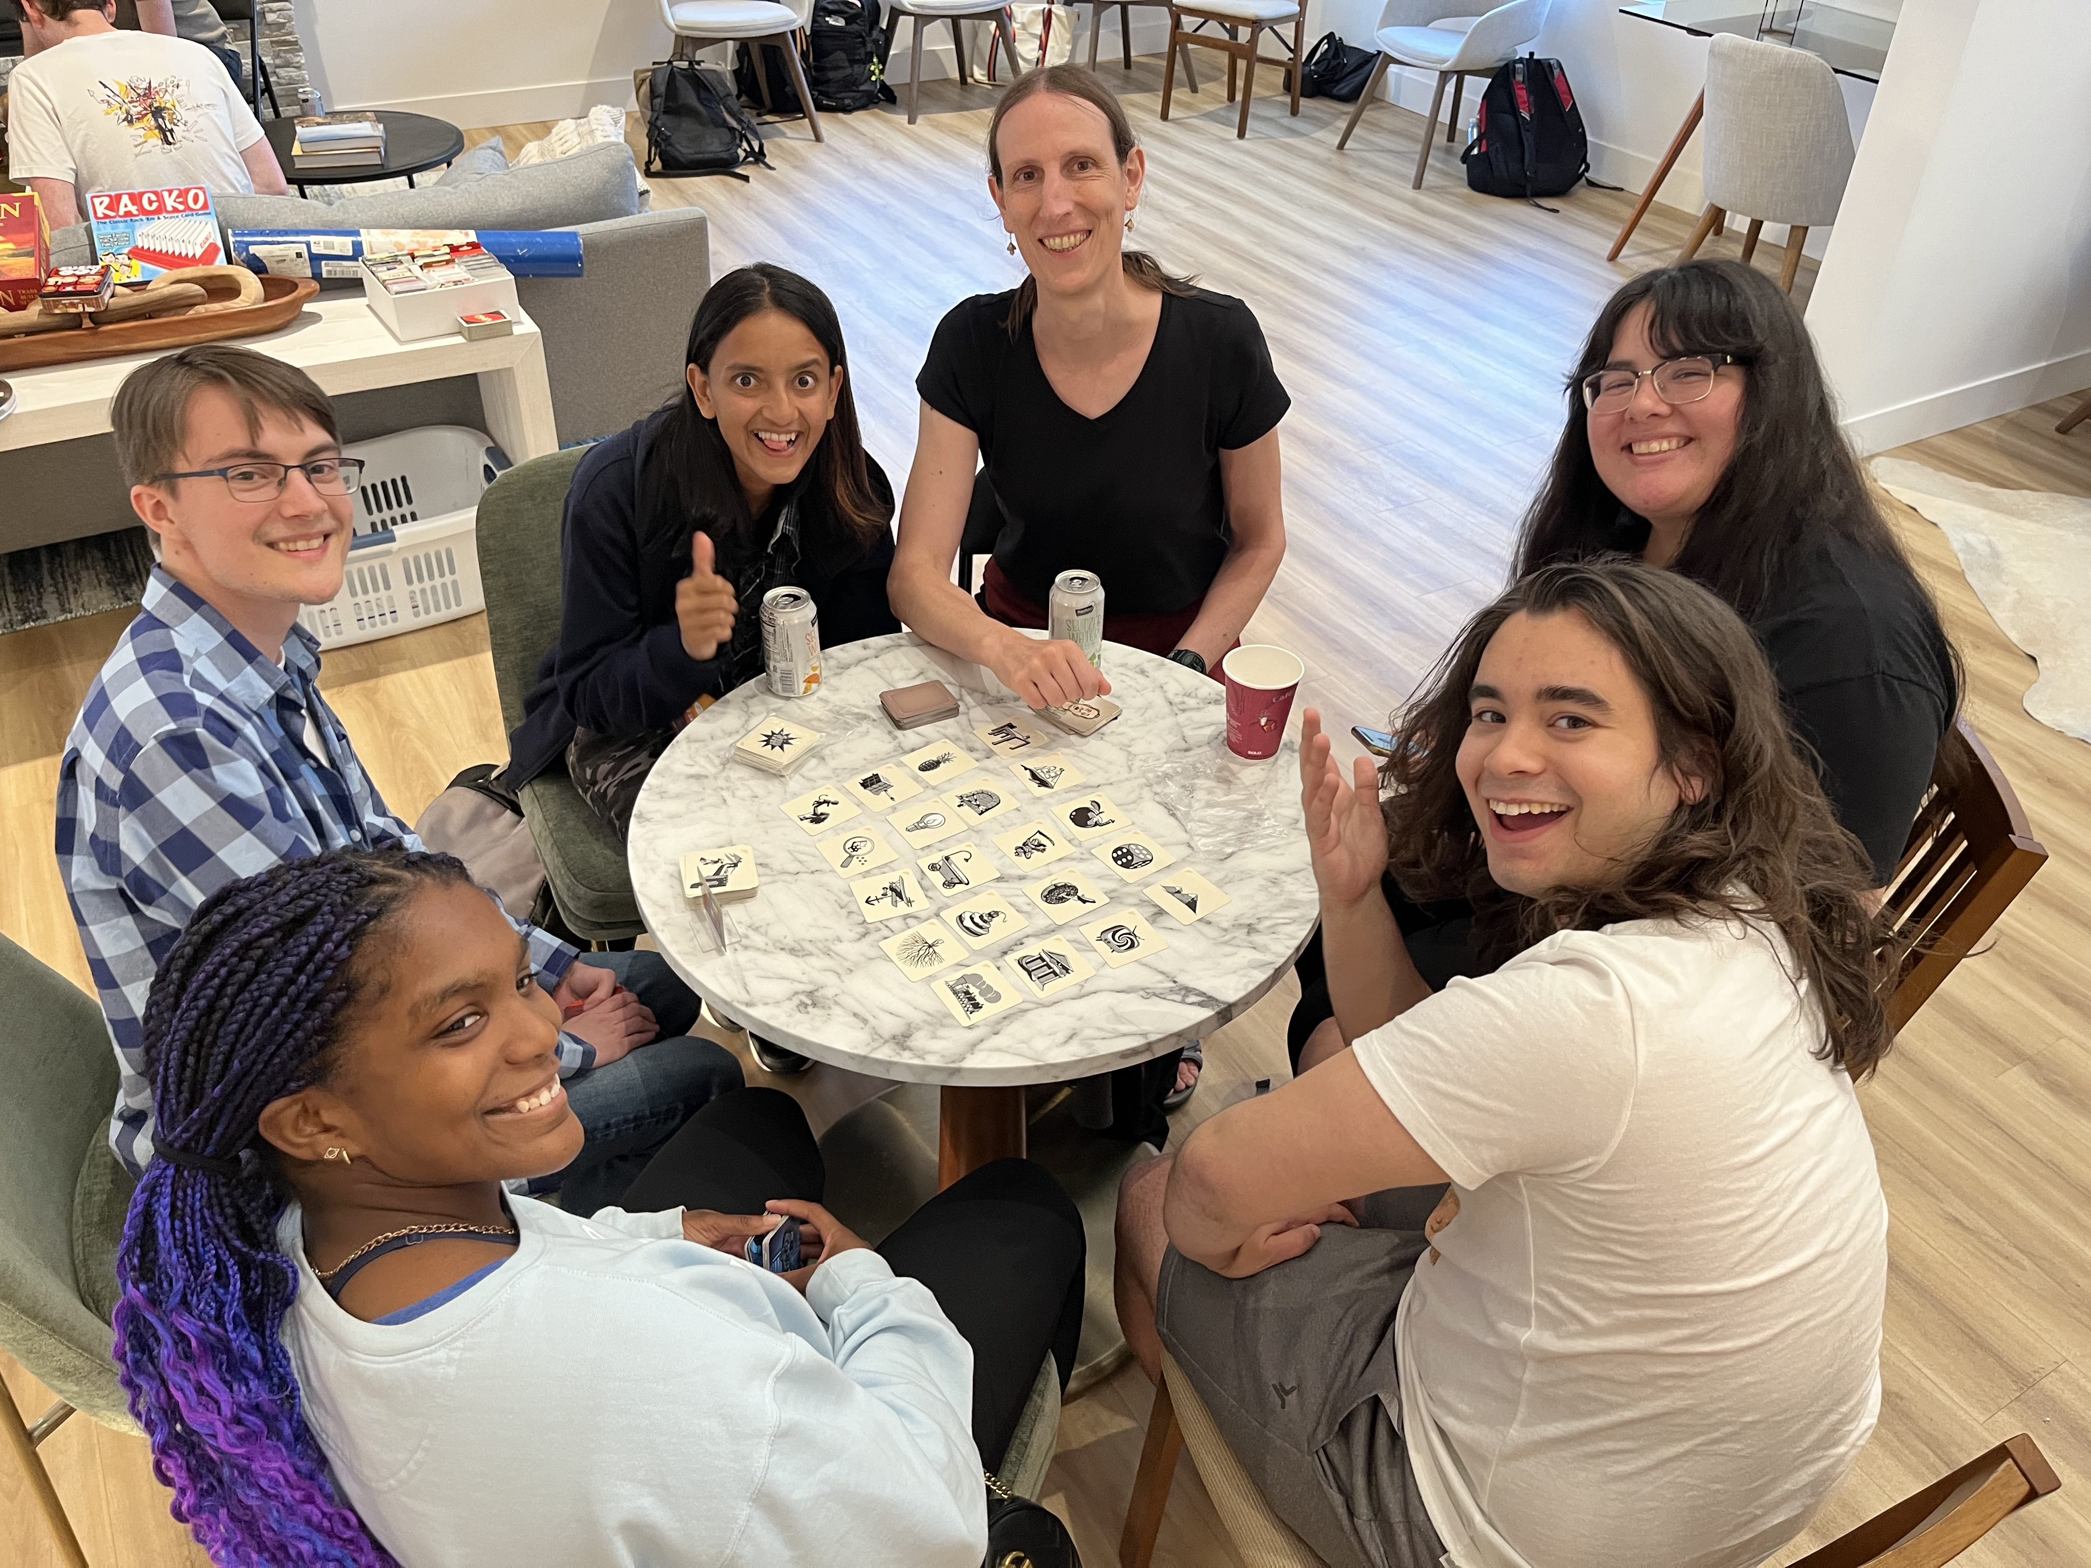
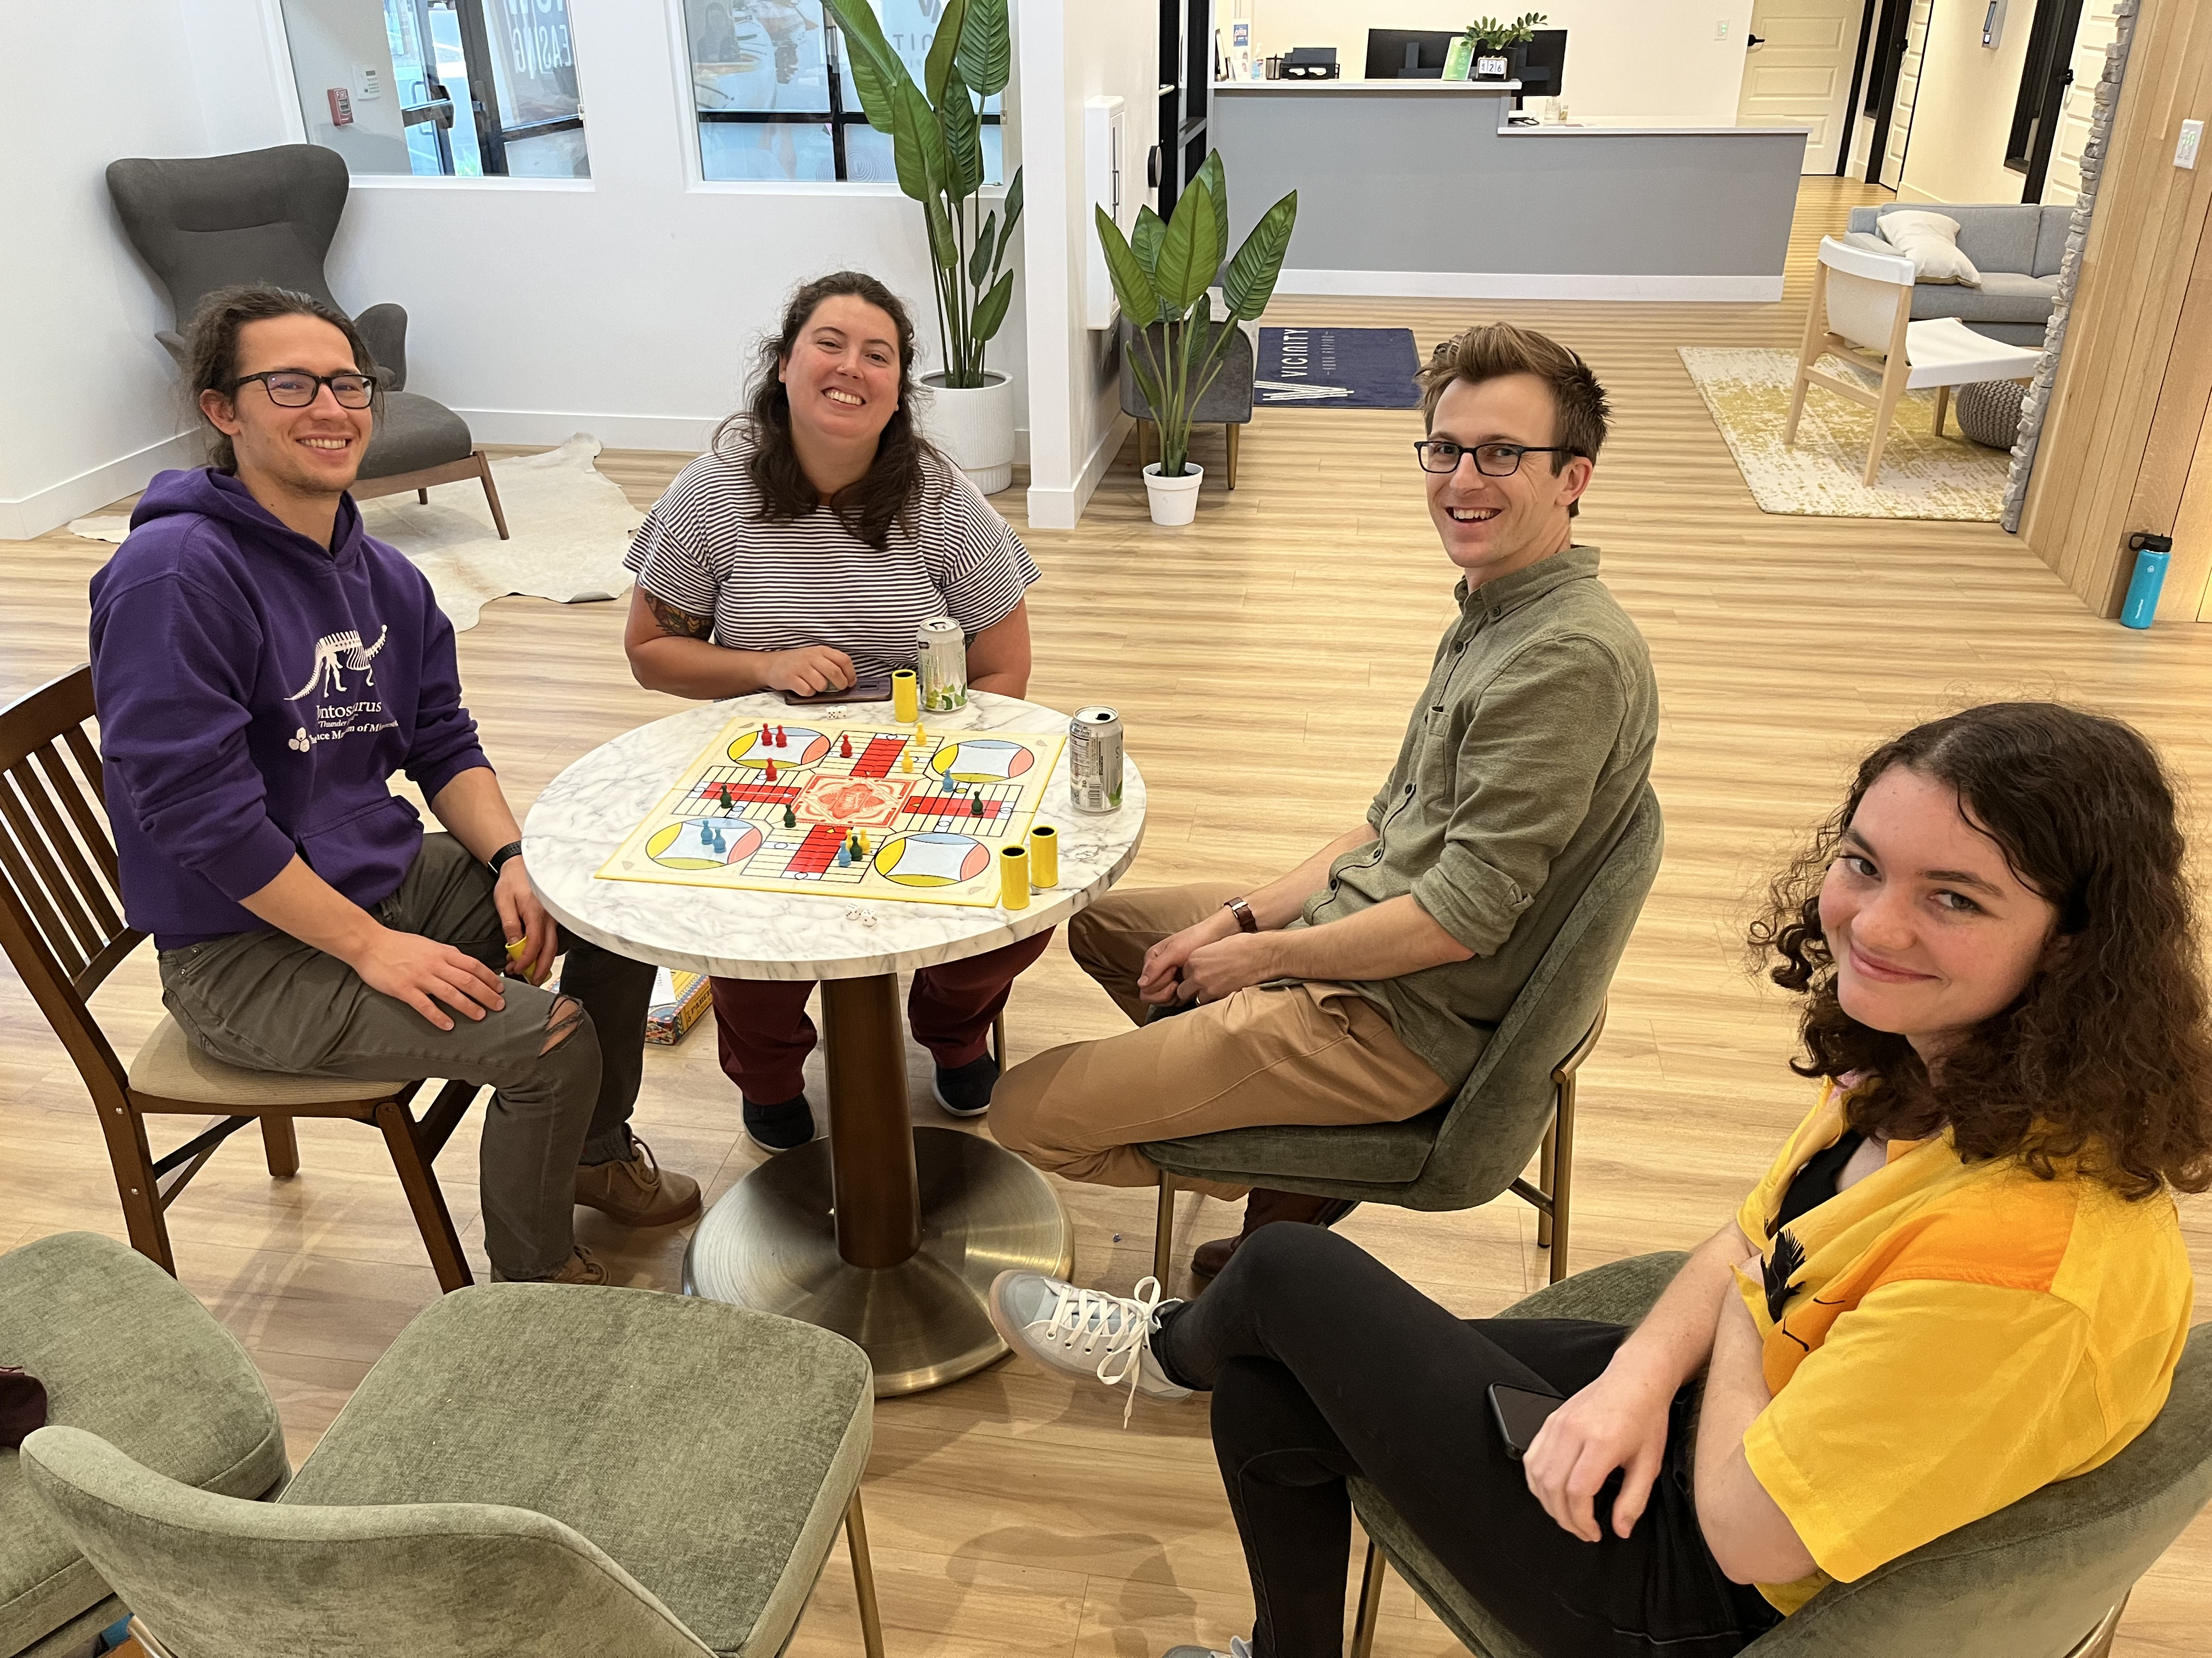
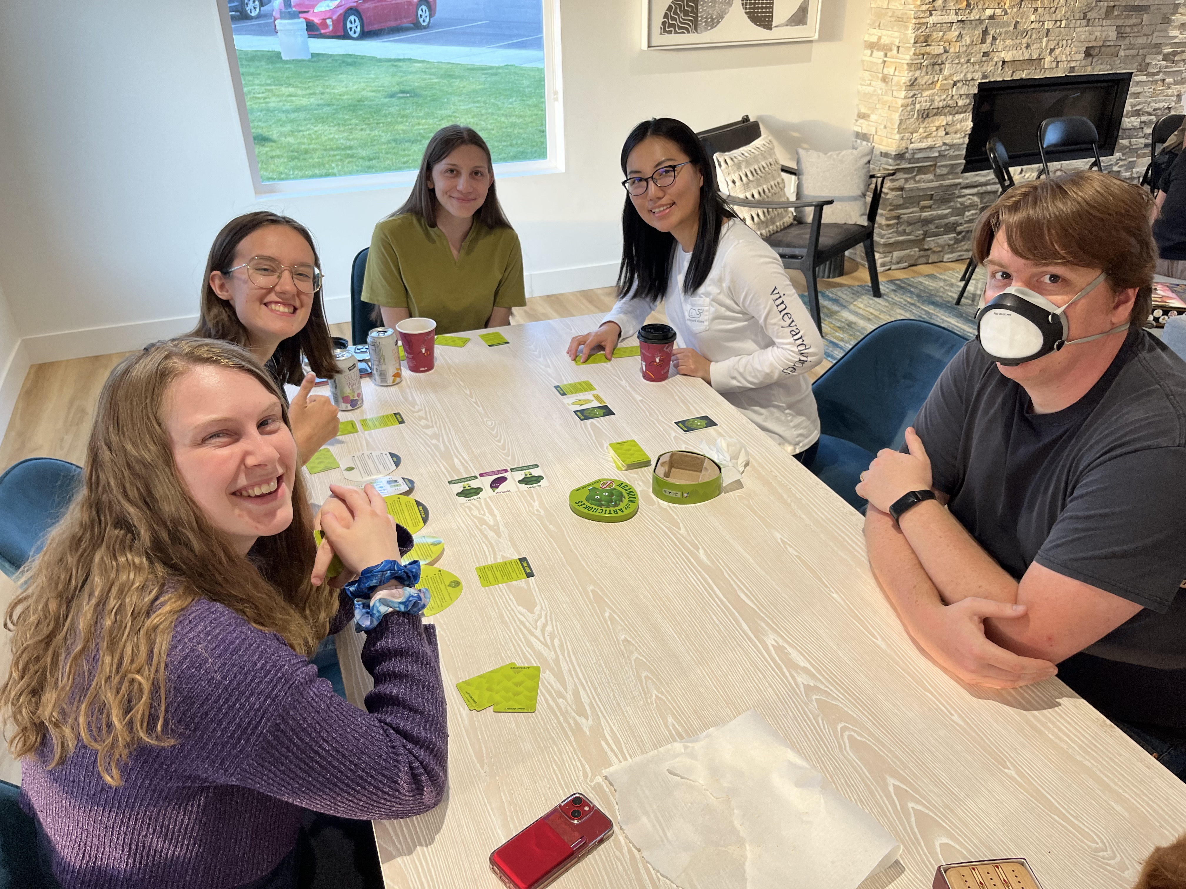
And we got to know each other!
Pics in
“Other Files”

Slide 5


Future GWANWs!!
(always *physically* at LHO)
June 24-26 2024
?
?
June 23-25 2025
Host Planning Checklist M2300131

Slide 6
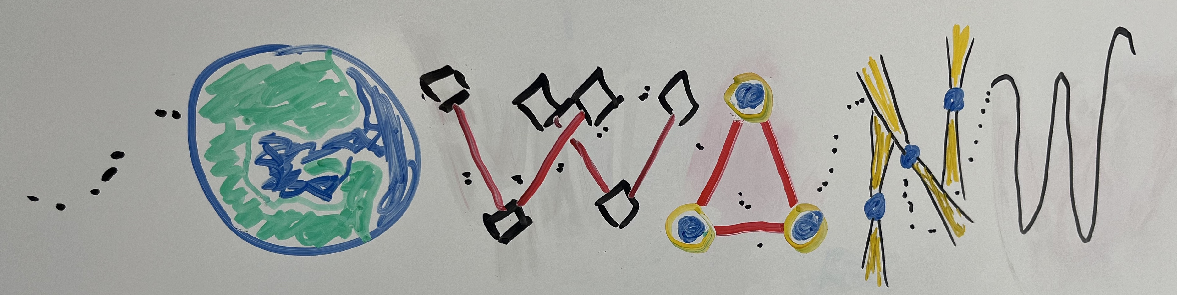
GWANW Future Logo??
First Draft of Idea by J. Kissel
Earth “upside down”
Central and South America
+Florida & Caribbean Islands
form the G
GW Detectors
Further away from earth, longer arms
Last W is formed by the last bit of an inspiral, but the wave goes through all other “letters,” the earth and detectors with transparency / in the background

Slide 7

Bonus!
https://nanograv.org/news/2023Announcement
Hooray for Pulsar Timing Arrays!!
NANOGrav
Papers Released Jun 28 2023 17:00 PDT!
Press Conference Jun 29 2023 10:00 PDT!
Press Conference YouTube Link

