Slide 1



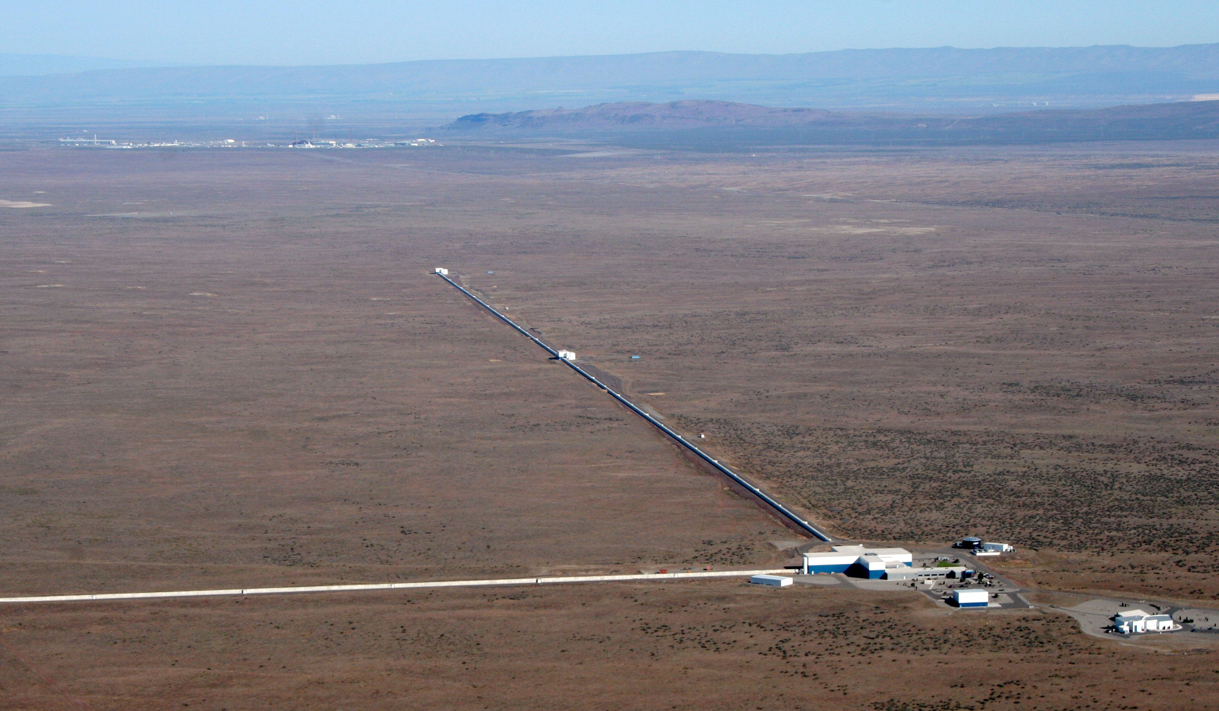
Present and Future Terrestrial GW Detectors
David Shoemaker
MIT Kavli Institute – LIGO Laboratory
Slides from many CE and LIGO Collaborators!
ICGAC
3 July 2023
G2301273

Slide 2
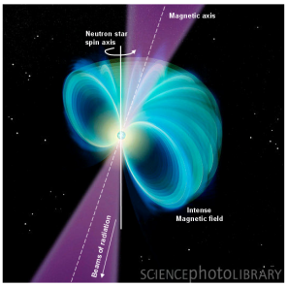
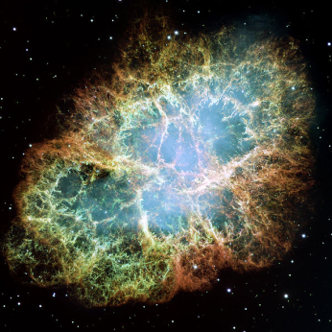
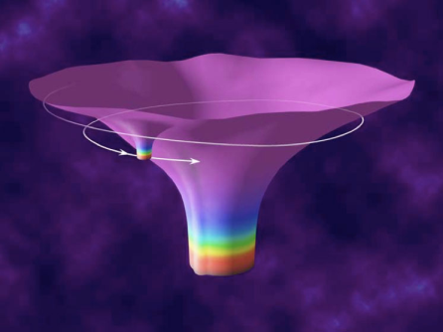
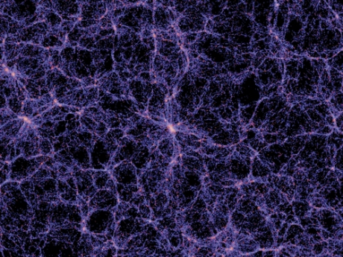
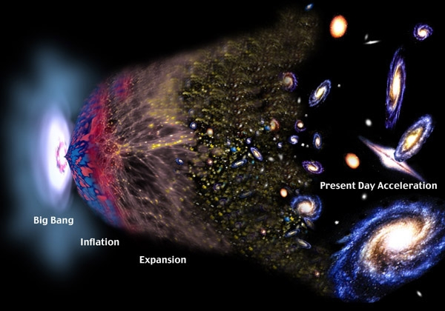
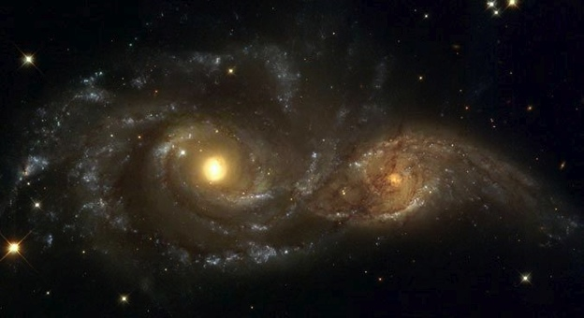
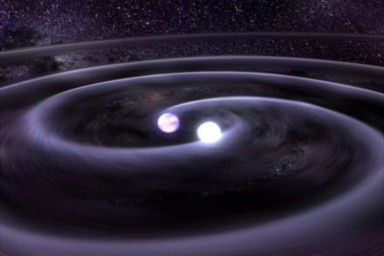
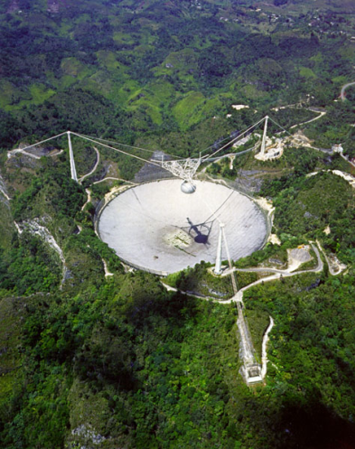
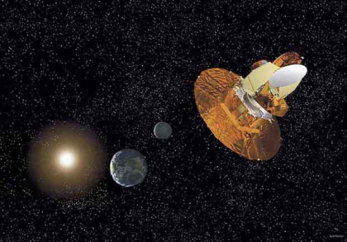
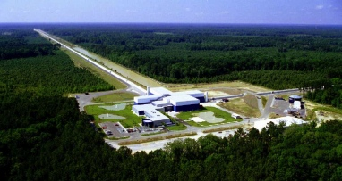
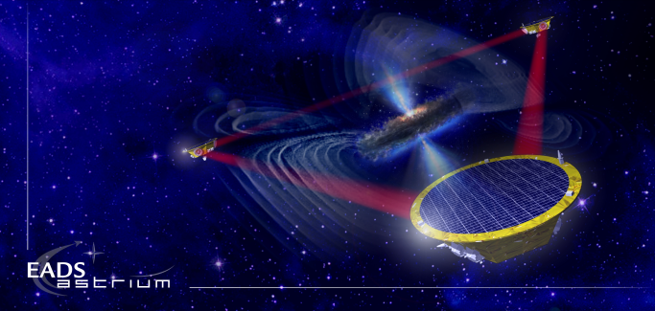
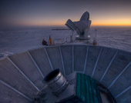
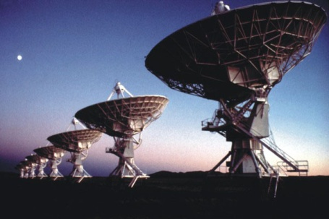
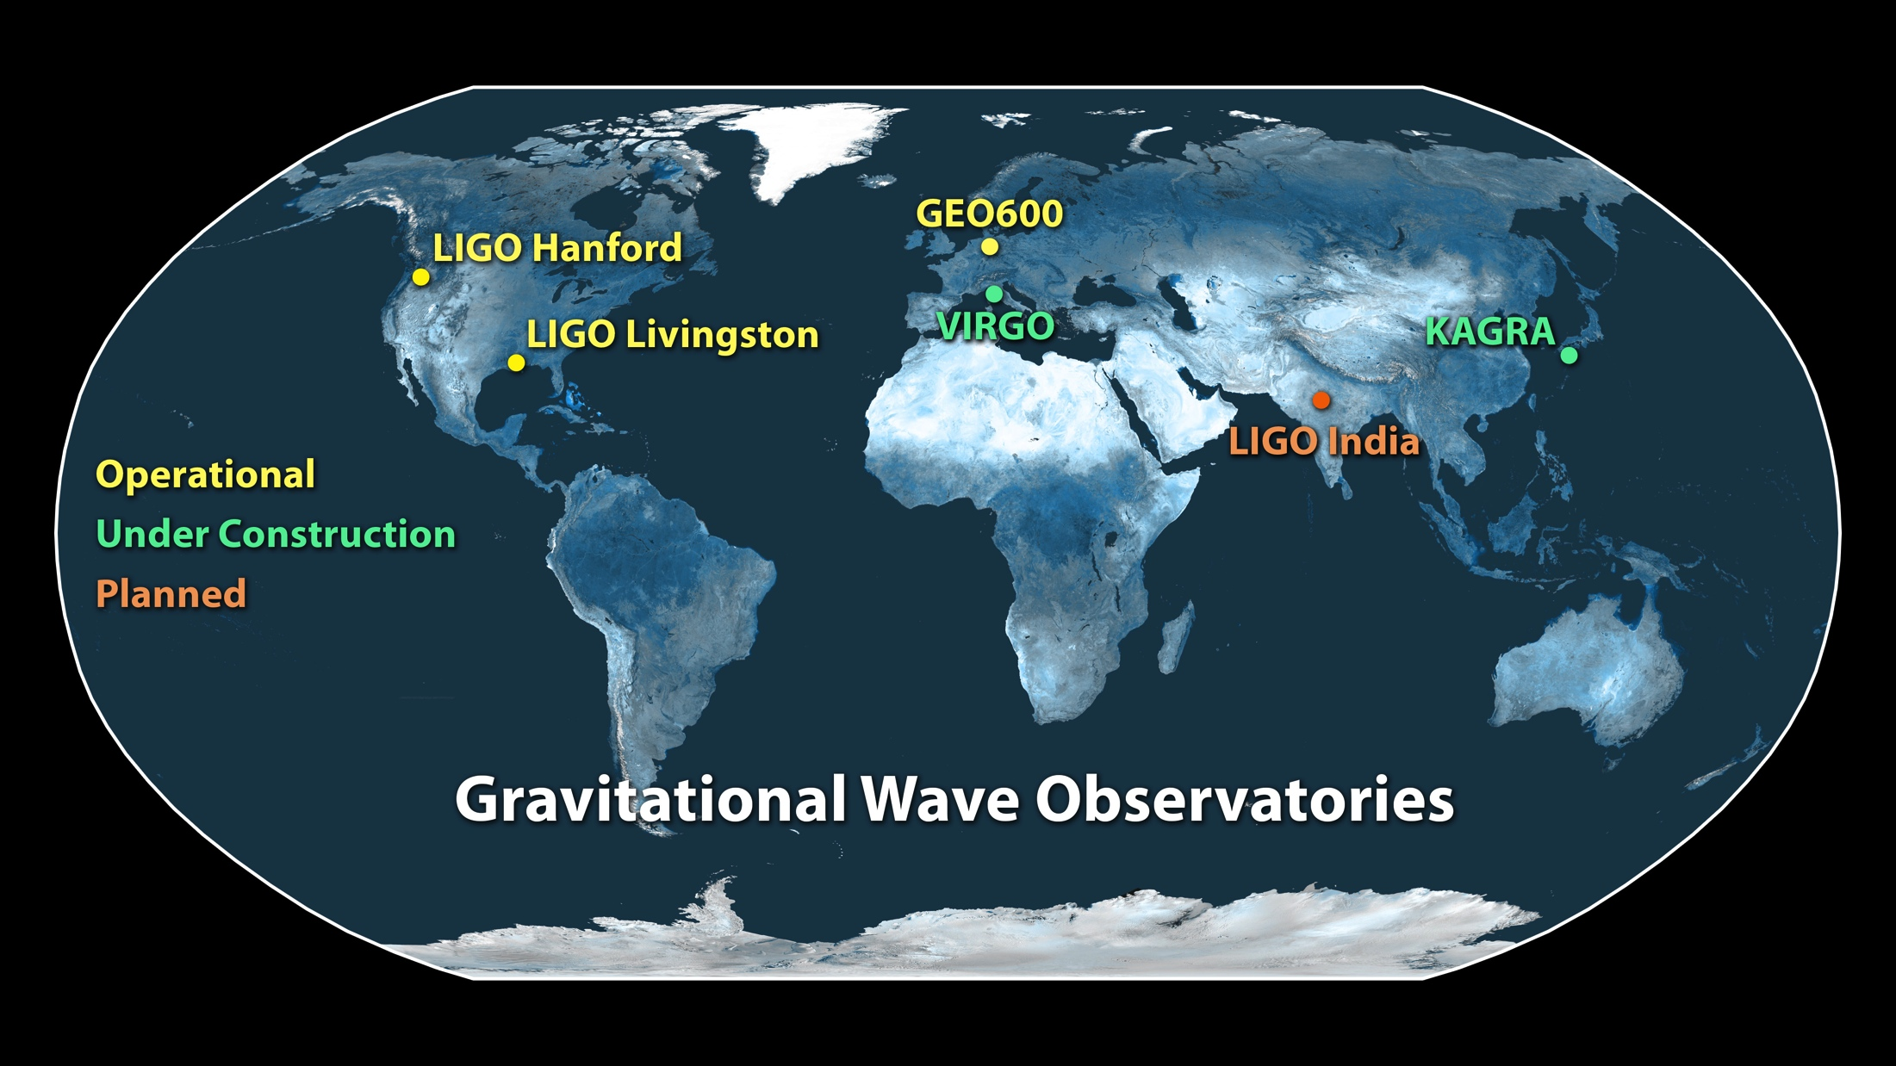
The Gravitational Wave Spectrum
Supernovae
Cosmic Strings
Relic radiation
Extreme Mass Ratio
Inspirals
Spinning NS
BH and NS Binaries
Supermassive BH Binaries
10⁻¹⁶ Hz
10⁻⁹ Hz
10⁻⁴ Hz
10⁰ Hz
10³ Hz
Pulsar timing
Space detectors
Terrestrial interferometers

Slide 3
The Gravitational Wave Spectrum
Supernovae
Cosmic Strings
Relic radiation
Extreme Mass Ratio
Inspirals
Spinning NS
BH and NS Binaries
Supermassive BH Binaries
10⁻¹⁶ Hz
10⁻⁹ Hz
10⁻⁴ Hz
10⁰ Hz
10³ Hz
Pulsar timing
Space detectors
Terrestrial interferometers

Slide 4
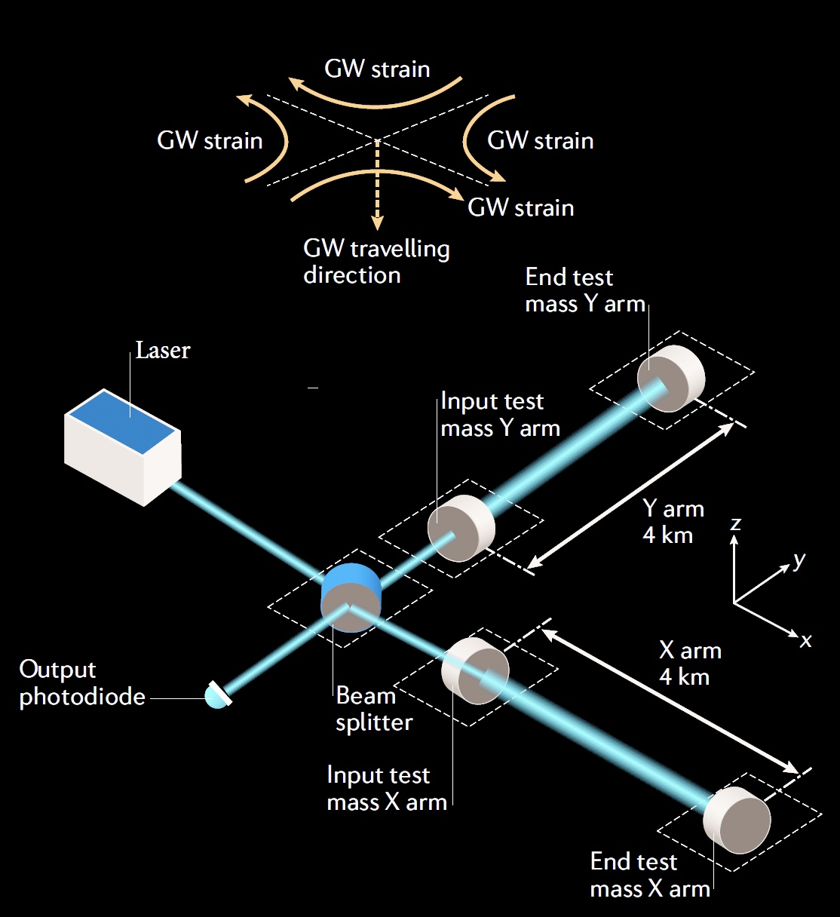
Why are terrestrial detectors limited to f > ~1 Hz?
Passing GW shortens the light path for one arm, lengthens for the other – and then vice-versa
ΔL = h_{GW} · L
Interference at the Beam splitter turns this into a light intensity variation, and a photodiode into an electrical signal
Resolution of the readout limited by quantum effects
Physical motion of the mirrors due to local forces masks the minuscule changes in light path due to GWs

Slide 5
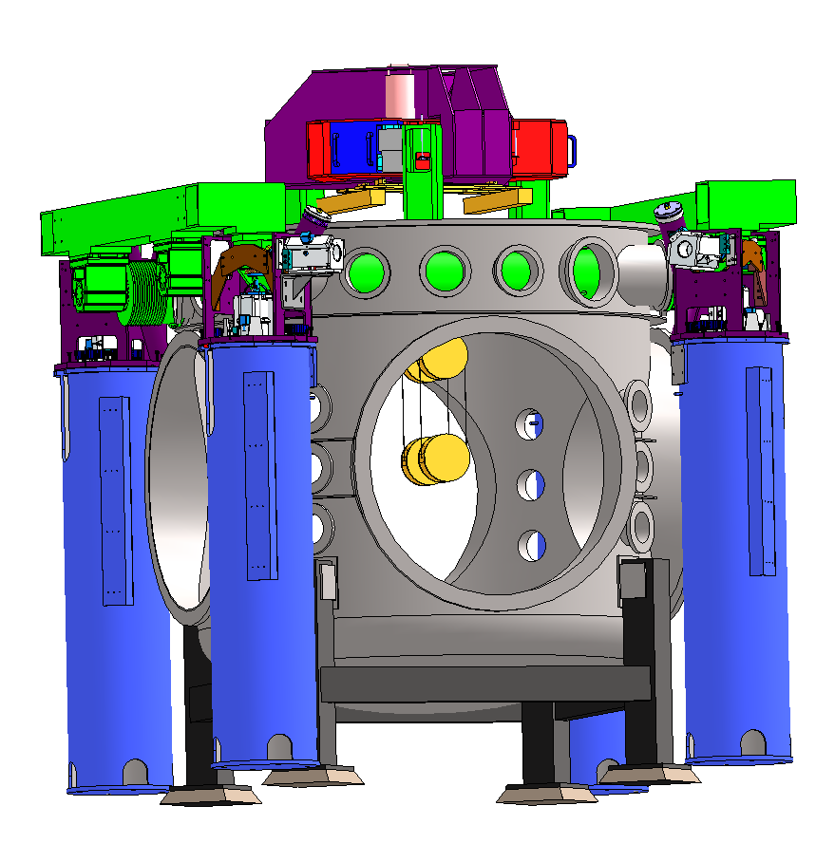
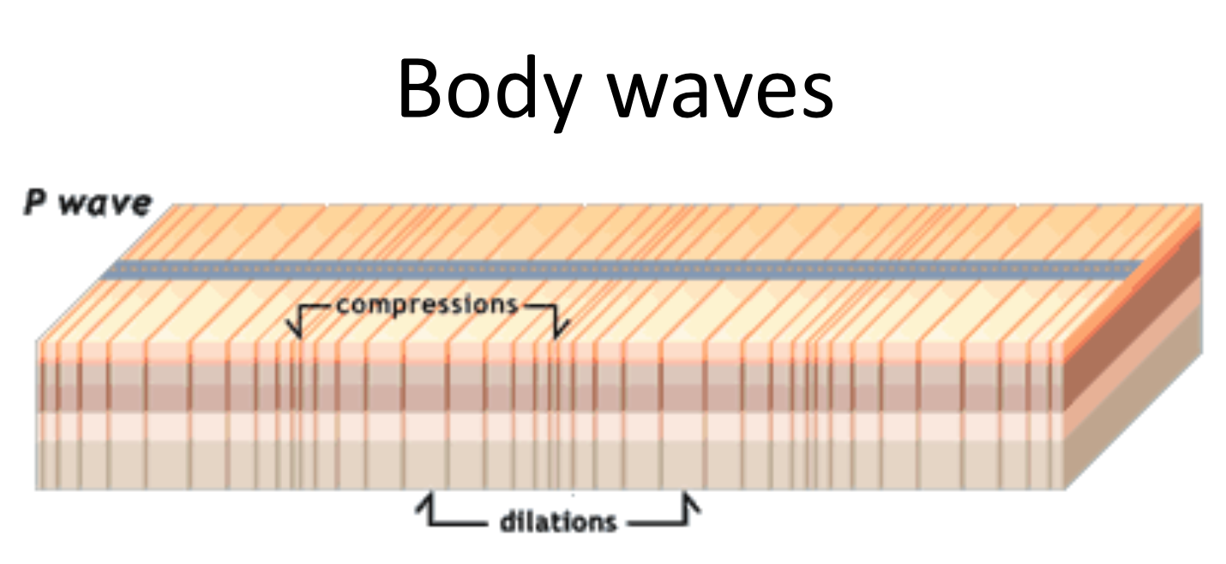
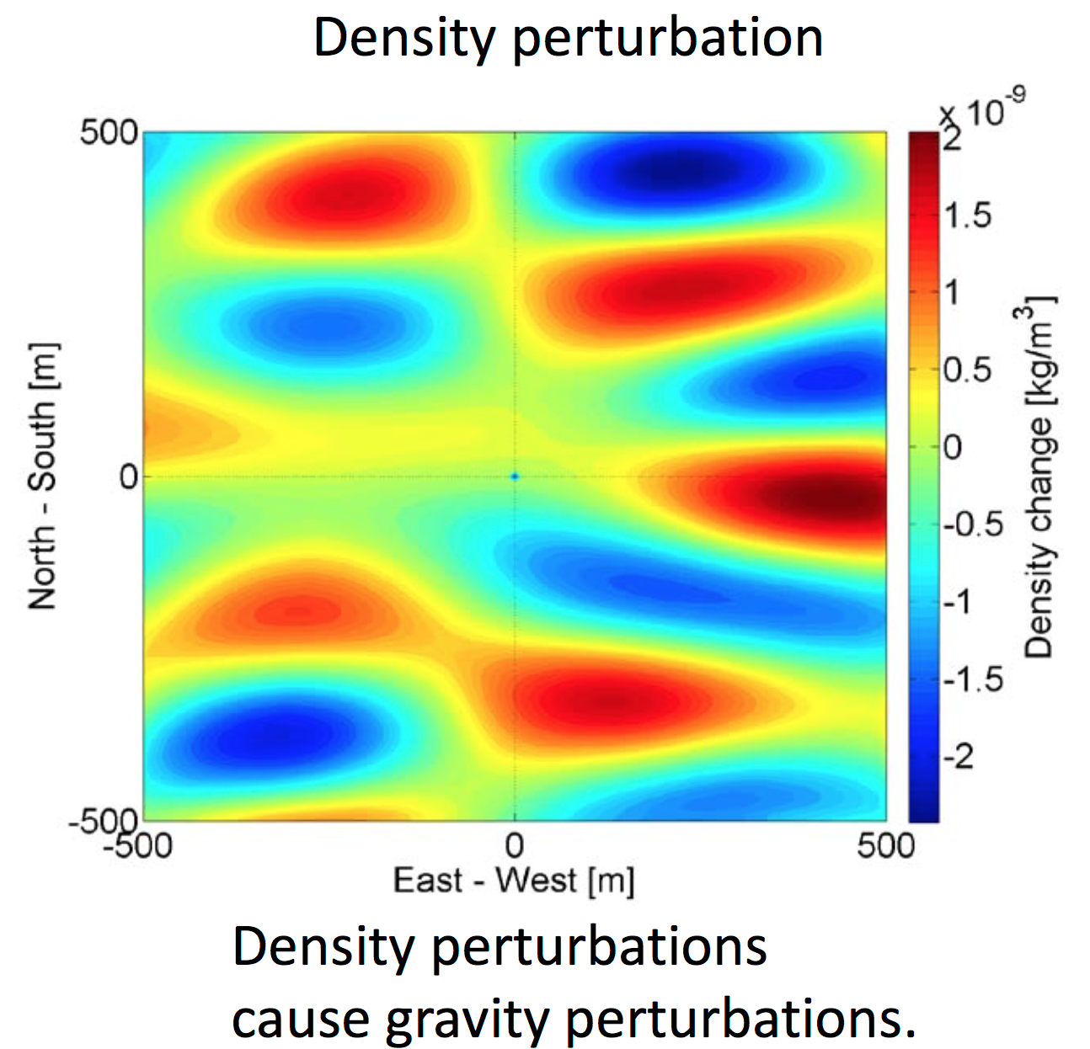
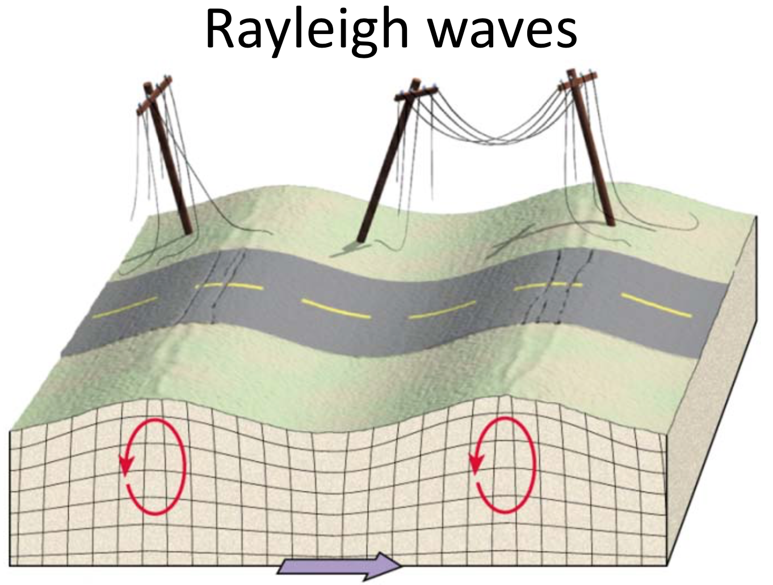
Newtonian background due to seismic environment
In principle, can eliminate all direct mechanical coupling
Can not shield against the wandering net gravity vector
Images: J. Harms
Images: J. Harms

Slide 6
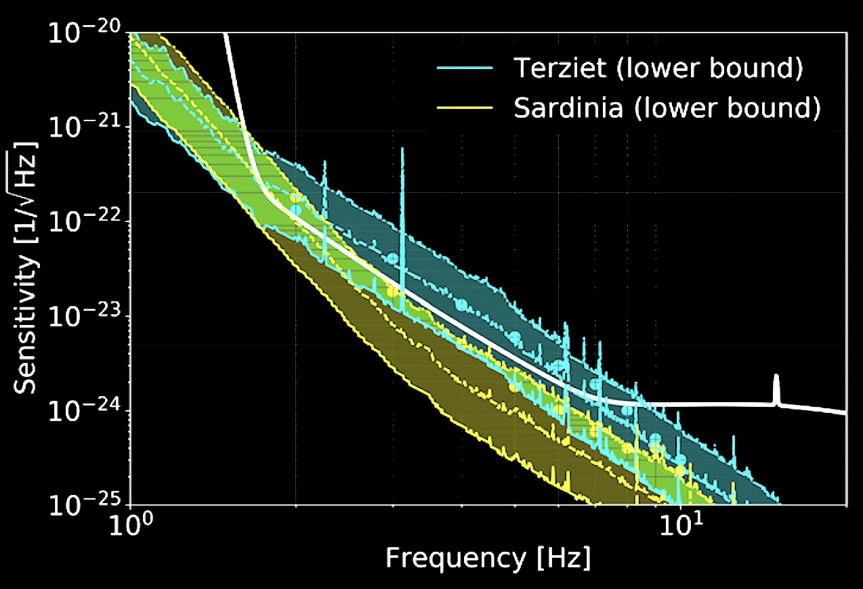
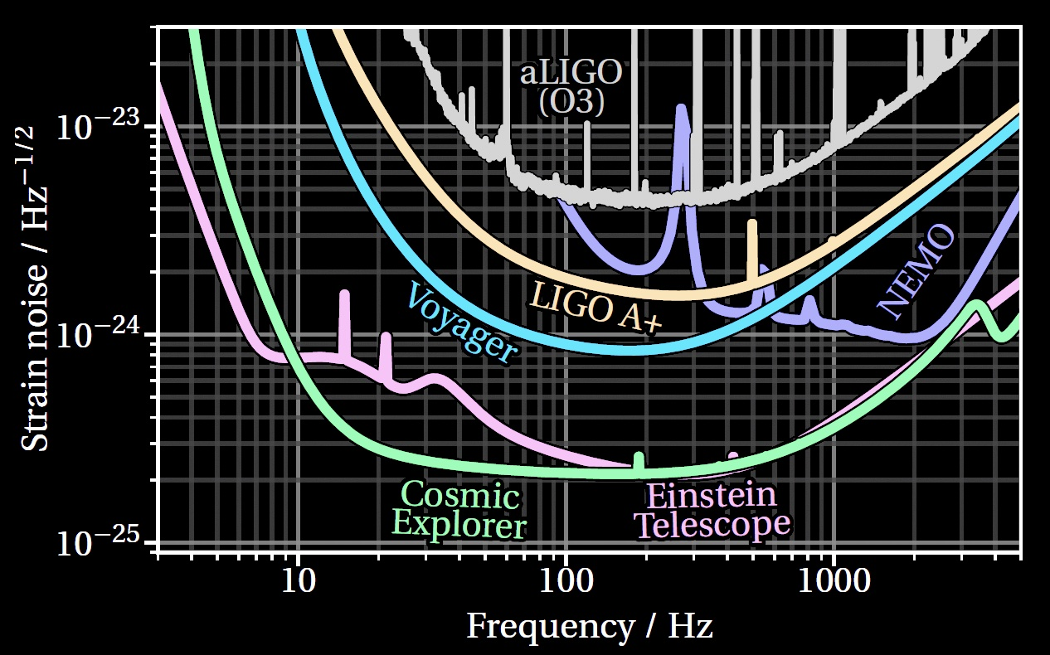
Newtonian background creates a wall at a few Hz
Harms et al. 2022
Newtonian Background falls as ~ 1/f ⁵
Can reduce somewhat by moving underground
  ET vs CE – more later on these two
Can reduce somewhat with arrays of seismometers and subtraction of effect
Forbiddingly large for ~3Hz and lower
Ultimate limit on the lowest frequency detectors on- or under-ground
And thus the largest BH masses detectable
Evans et al. 2023

Slide 7
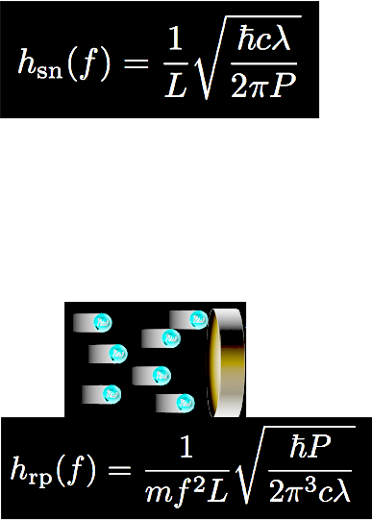
Practical limitations for Terrestrial Detectors
Arm length L – currently in short-antenna limit; path-length shift ΔL from a given strain grows with interferometer arm length. Maximize L !
  ΔL = h_{GW} · L
  LIGO 4km, Virgo and KAGRA 3km
Optical resolution – limited by photon
Poisson counting statistics; maximize laser power P
…but too much power, and the radiation pressure
causes mirror motion which masks the GW
Optimal power – naïve quantum limit
  Working with ~50-100 W

Slide 8
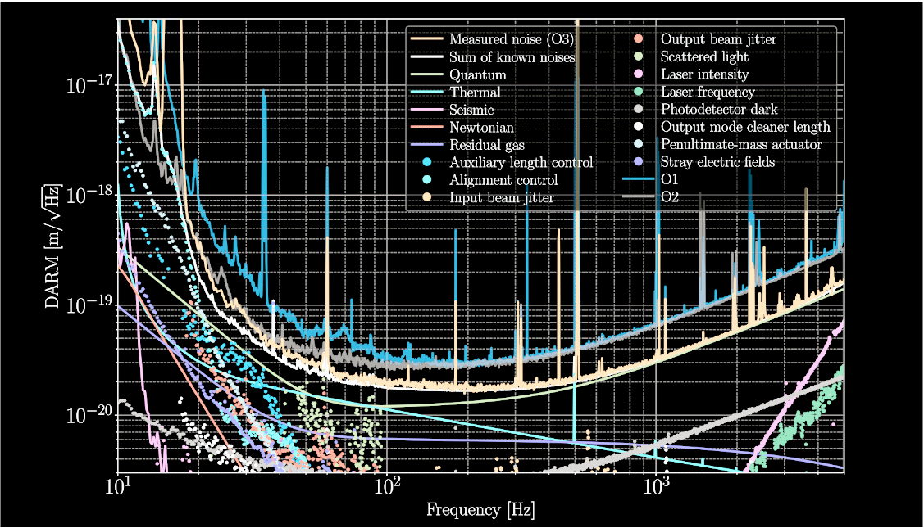
Many other technical noise sources…
Sensitivity and performance of the Advanced LIGO detectors in the third observing run
A. Buikema et al. Phys. Rev. D 102, 062003

Slide 9
Many other technical noise sources…
Newtonian,
Suspension thermal,
Seismic,
Scattered light,
Radiation pressure,
Servo controls
Sensitivity and performance of the Advanced LIGO detectors in the third observing run
A. Buikema et al. Phys. Rev. D 102, 062003

Slide 10
Many other technical noise sources…
Coating thermal,
Quantum
Sensitivity and performance of the Advanced LIGO detectors in the third observing run
A. Buikema et al. Phys. Rev. D 102, 062003

Slide 11
Many other technical noise sources…
Quantum,
Laser frequency,
Laser intensity
Sensitivity and performance of the Advanced LIGO detectors in the third observing run
A. Buikema et al. Phys. Rev. D 102, 062003

Slide 12
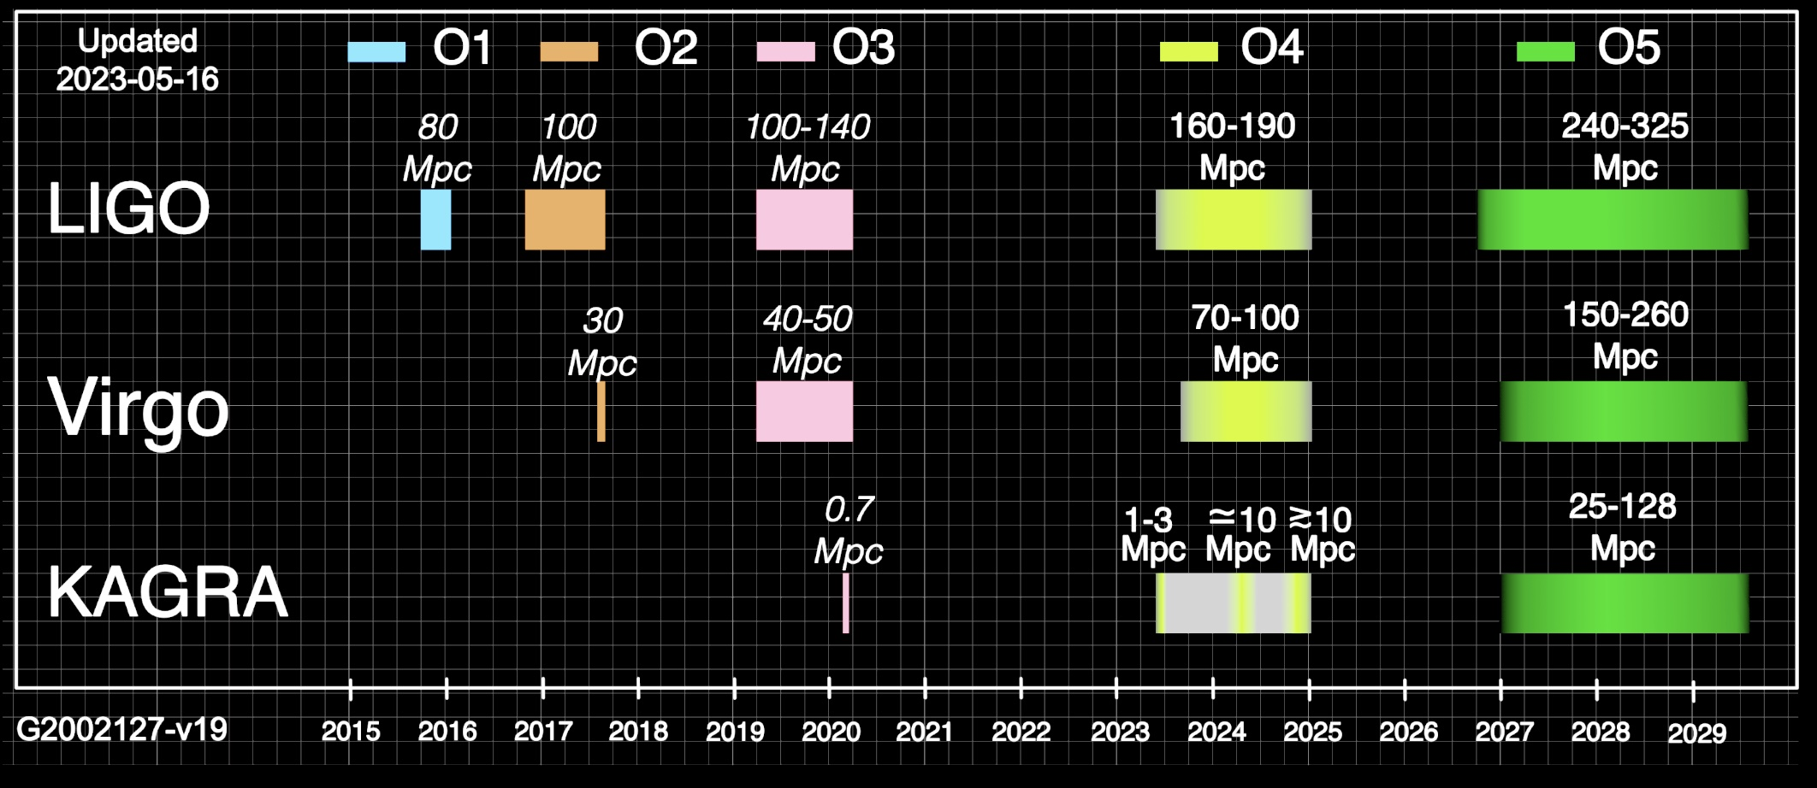
Good enough to start the new observational discipline of Gravitational Wave Astronomy
What have we seen so far?

Slide 13
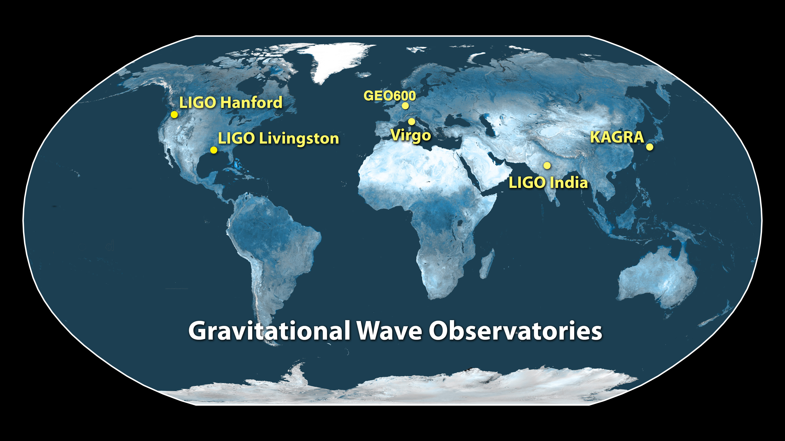
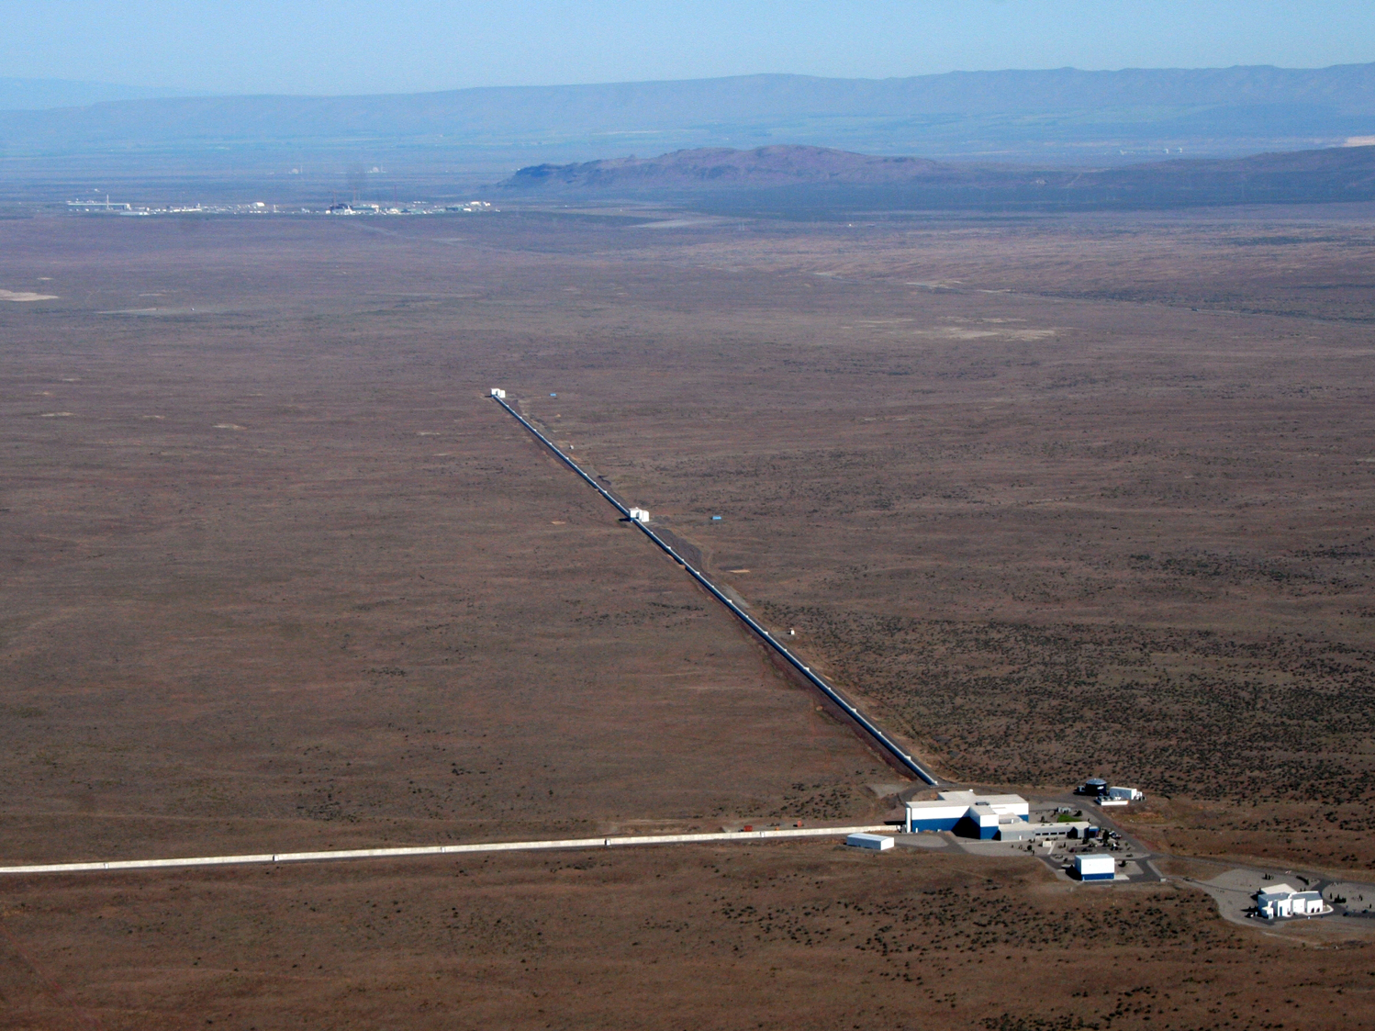
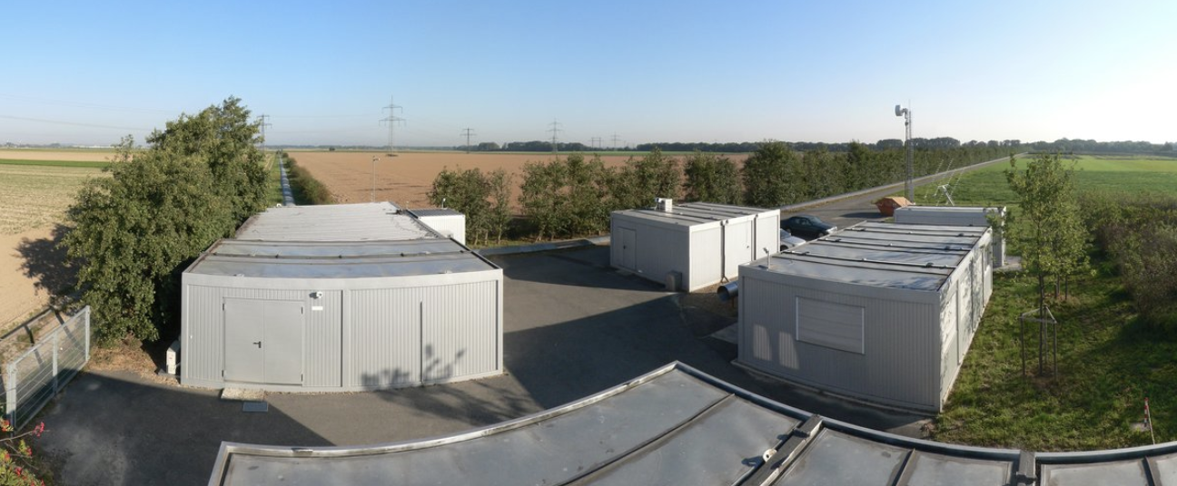
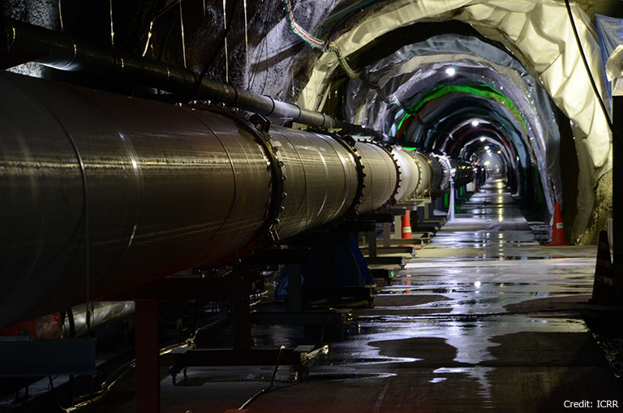
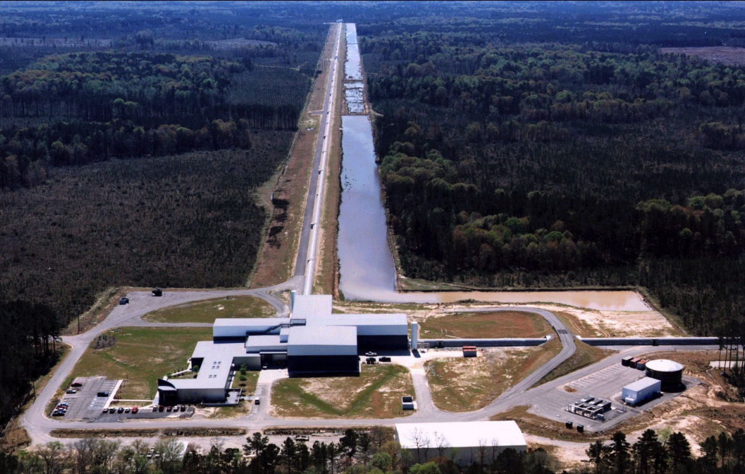
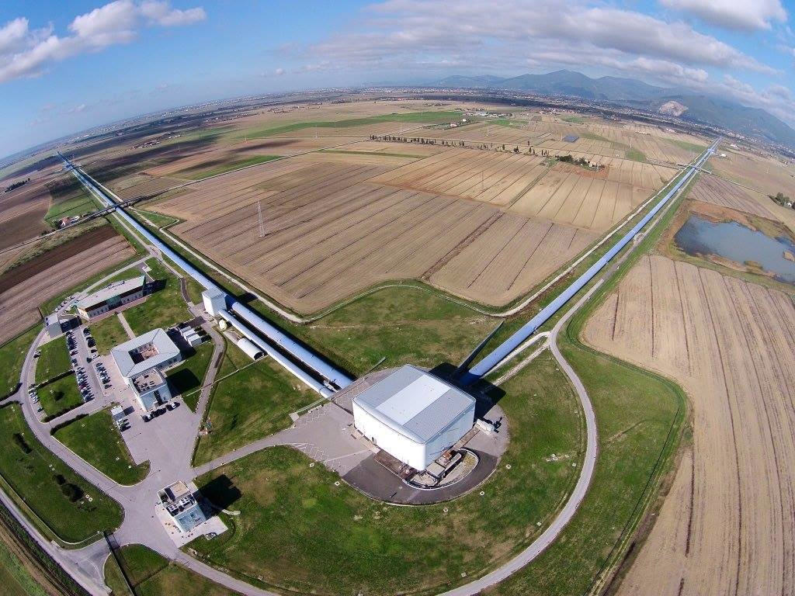
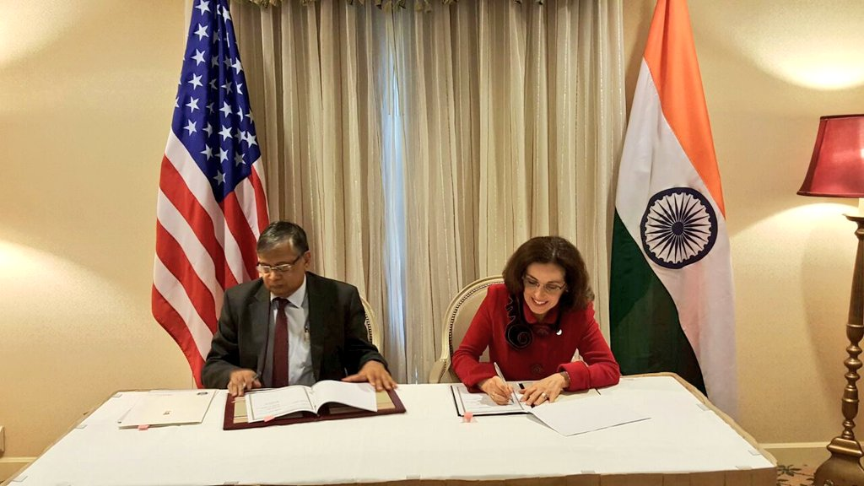
The ground-based gravitational-wave world-wide network in 2023
A third LIGO detector in India funded
(Operational late 2020s)

Slide 14
Gravitational Wave Physics & Astrophysics

Slide 15
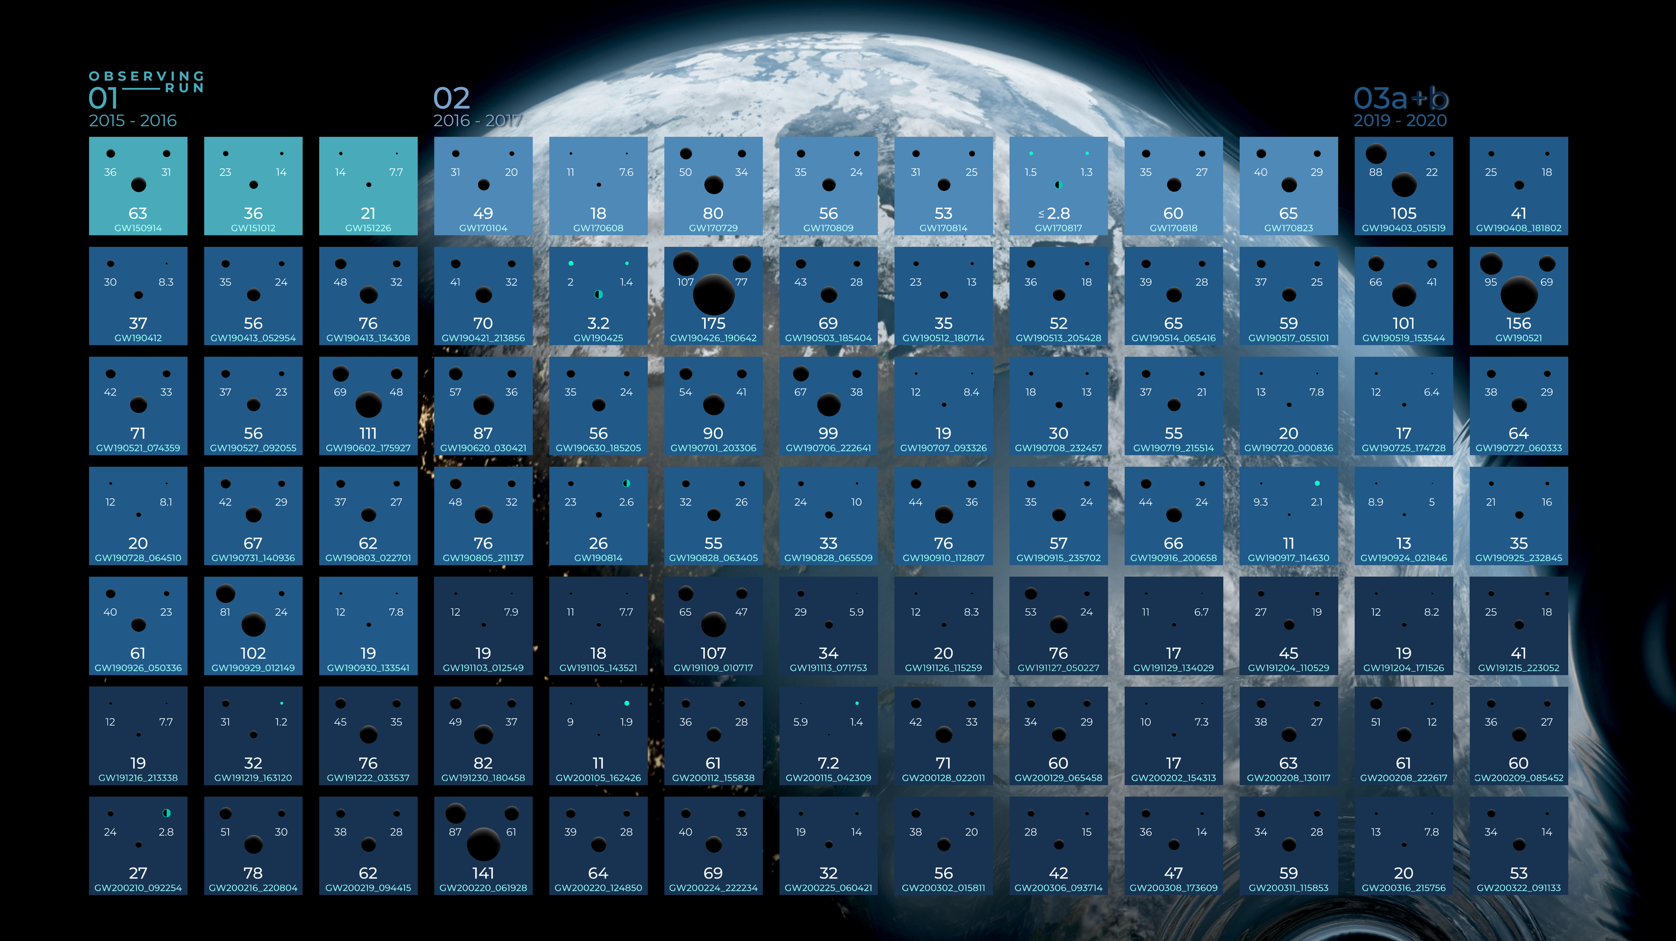
Observations
Image : Carl Knox (OzGrav, Swinburne University of Technology)
Slide: S. Fairhurst

Slide 16
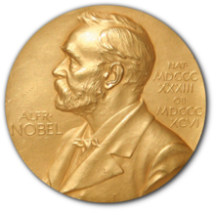
GW150914: First Detection
Abbott et al, “Observation of Gravitational Waves from
a Binary Black Hole Merger”, 2016
Image : Carl Knox (OzGrav, Swinburne University of Technology)
Slide: S. Fairhurst

Slide 17
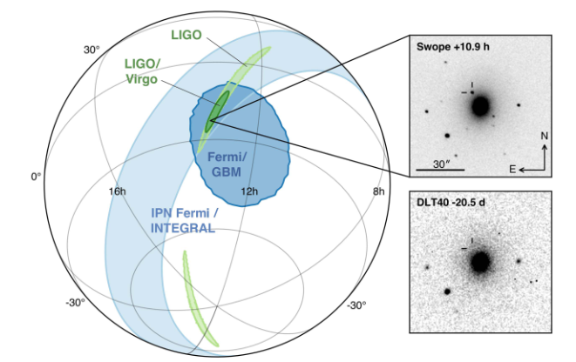
GW170817: Neutron Stars and Multi-messenger Observation
From Abbott et al, “Multi-Messenger Observations of
a Binary Neutron Star Merger ”, 2017
Image : Carl Knox (OzGrav, Swinburne University of Technology)
Slide: S. Fairhurst

Slide 18
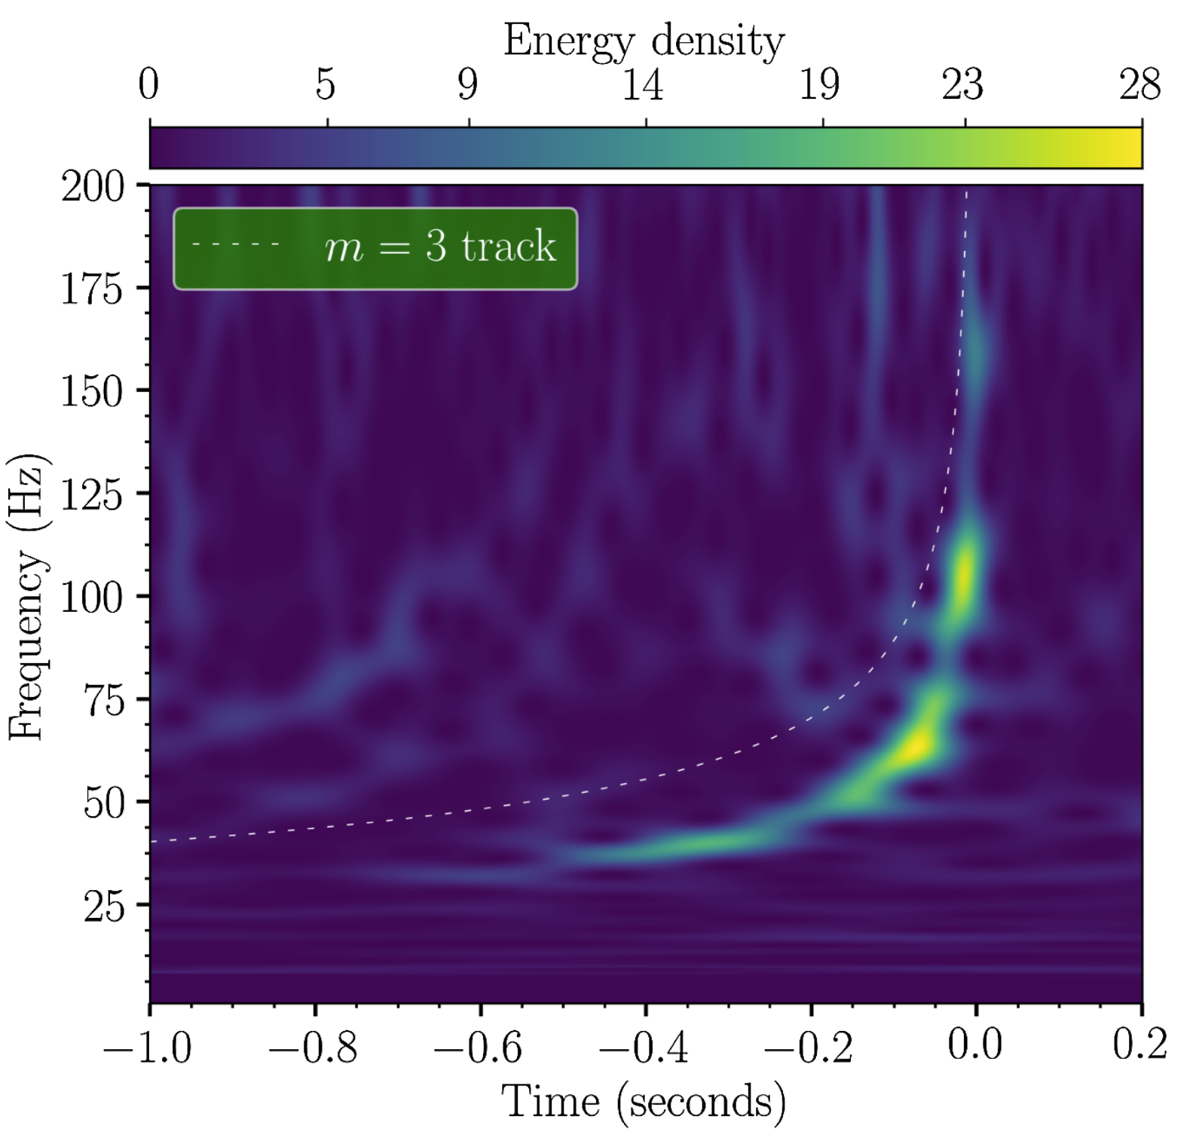
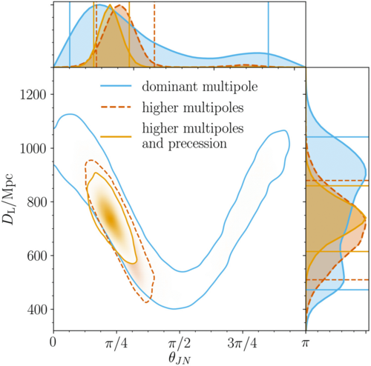
GW190412: Unequal mass binary
One of the black holes ~4 times heavier than the other
Slide: S. Fairhurst

Slide 19
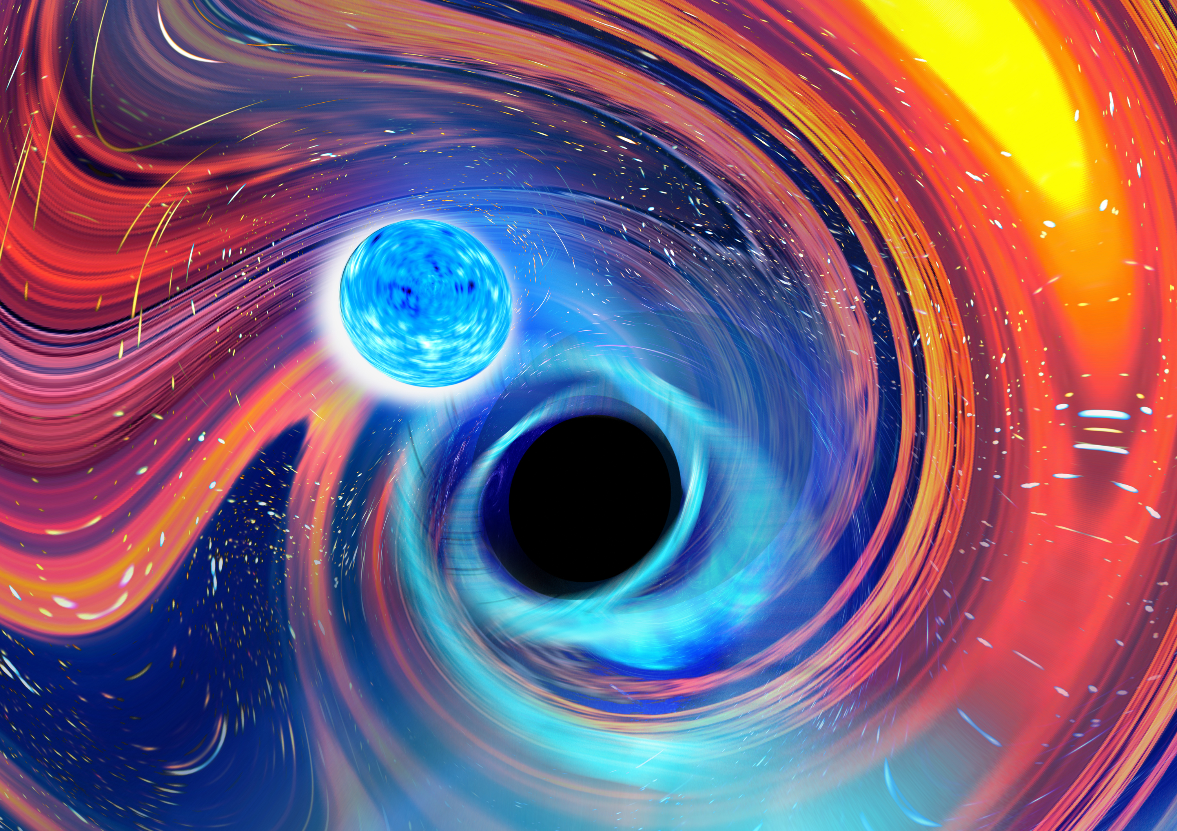
GW200105 and GW200115:
Observation of Neutron Star
Black Hole Mergers
First unambiguous observation
of NS-BH system
Slide: S. Fairhurst

Slide 20
Observations
GW190521: A Black Hole in the
Pair Instability Mass Gap
95 M_{sun}
156 M_{sun}
66 M_{sun}
Evidence for a hierarchical merger?
Or perhaps dynamical capture?
Image : Carl Knox (OzGrav, Swinburne University of Technology)
Slide: S. Fairhurst

Slide 21
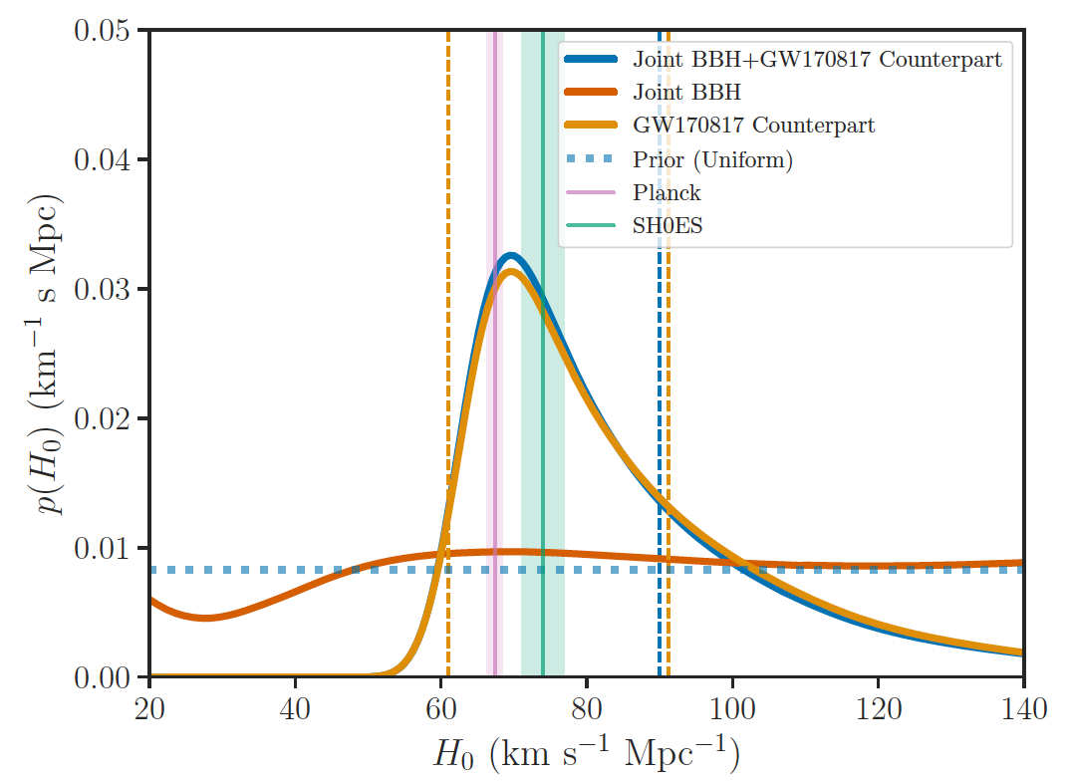
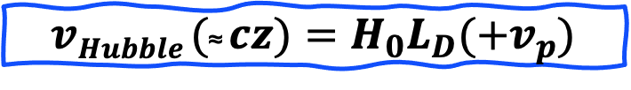
Measuring the Hubble Constant Using
Gravitational-wave ‘Standard Sirens’
$$vHubble (\text{≈} cz)=H_{0}L_{D}(+v_{p})$$
B. F. Schutz, “Determining the Hubble Constant from Gravitational Wave Observations”, Nature
323, 310–311 (1986).
B. P. Abbott, et al., “A gravitational-wave standard siren measurement of the Hubble constant”, Nature 551, 85-88 (2017).

Slide 22
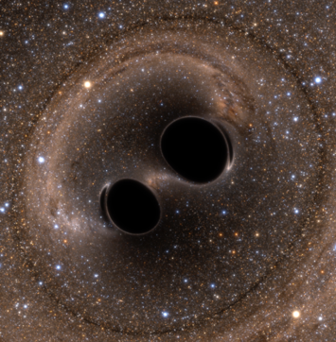
LIGO-Virgo Fundamental Results 2015-2021: What Ground-
Based Gravitational Wave Detections Have Taught Us
GW150914
O1: Gravitational waves from astrophysical sources can be measured.
O1: Binary black hole (BBH) systems exist.
O2: Binary neutron stars (BNS) are progenitors of short gamma ray bursts.
O2: BNS mergers produce kilonovae, which produce heavy elements.
O2: The speed of gravitational waves equals the speed of light.
O2: The Hubble-Lemaître constant can be measured using EM-bright GW ‘sirens’.
O2 – O3: The Hubble-Lemaître constant can be measured using dark GW ‘sirens’.
O3: Black holes with masses in the (pulsational) pair instability gap exist.
O3: Black hole – neutron star systems exist.
O3: Compact objects exist in the 2 – 3 M⦿ mass range.
O1-O3: Astrophysical black holes are Kerr black holes
O1 – O3: General relativity is valid in the high curvature, high field regime.
O1 – O3: Intermediate black holes and stellar mass black holes with mass > 20 M⦿ exist.
GW170817/
GRB170817A
SSS17A

Slide 23

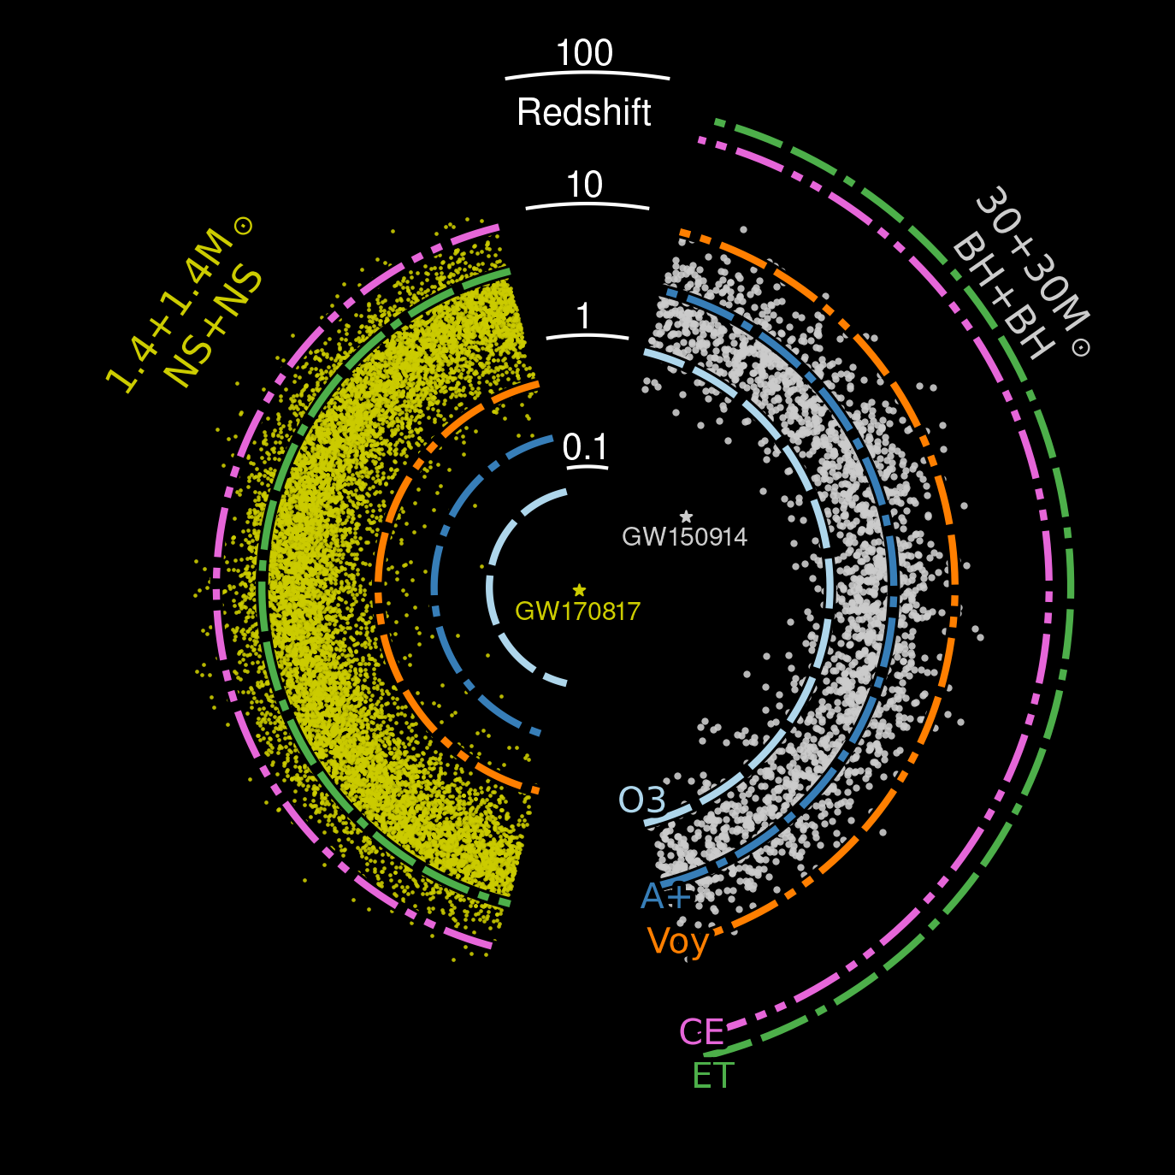
Current Ground-based GW Detector ‘Reach’
LIGO sources
LIGO sources
Credit: Nasa
Cosmic Explorer Horizon Study
Slide: S. Ballmer

Slide 24
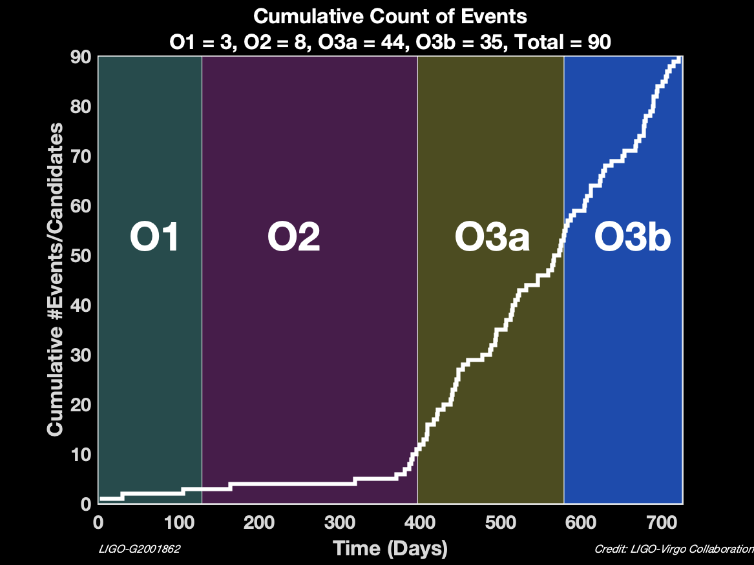

Sensitivity improvements boost signal rate
r_{reach} ∝ 1/h_{sensitivity}
Volume of space accessible –
and sources –grows as ~(sensitivity)³
There are gaps for the upgrades… but so far we make up for it

Slide 25
Sensitivity improvements boost signal rate
r_{reach} ∝ 1/h_{sensitivity}
Volume of space accessible –
and sources –grows as ~(sensitivity)³
There are gaps for the upgrades… but so far we make up for it

Slide 26
O4 started 24 May 2023
Significant delay from original planning – COVID primary cause
Starting without Virgo due to technical problems; hope to join in Fall ‘23
KAGRA still commissioning, with plans to join late in the run

Slide 27
O4 started 24 May 2023
Many event triggers sent out, range of likely binary systems represented
No EM/particle coincidences to date (and very poor localization…)
Eagerly awaiting Virgo!

Slide 28
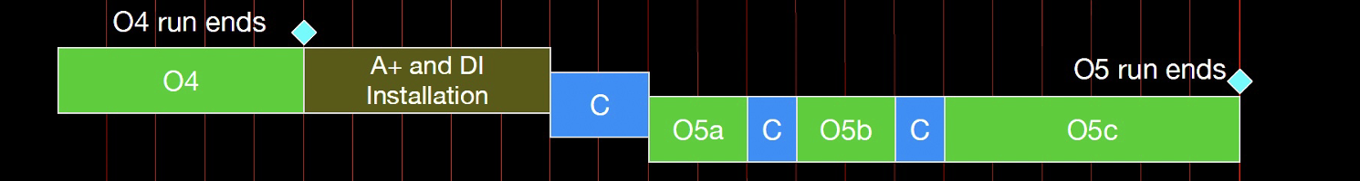
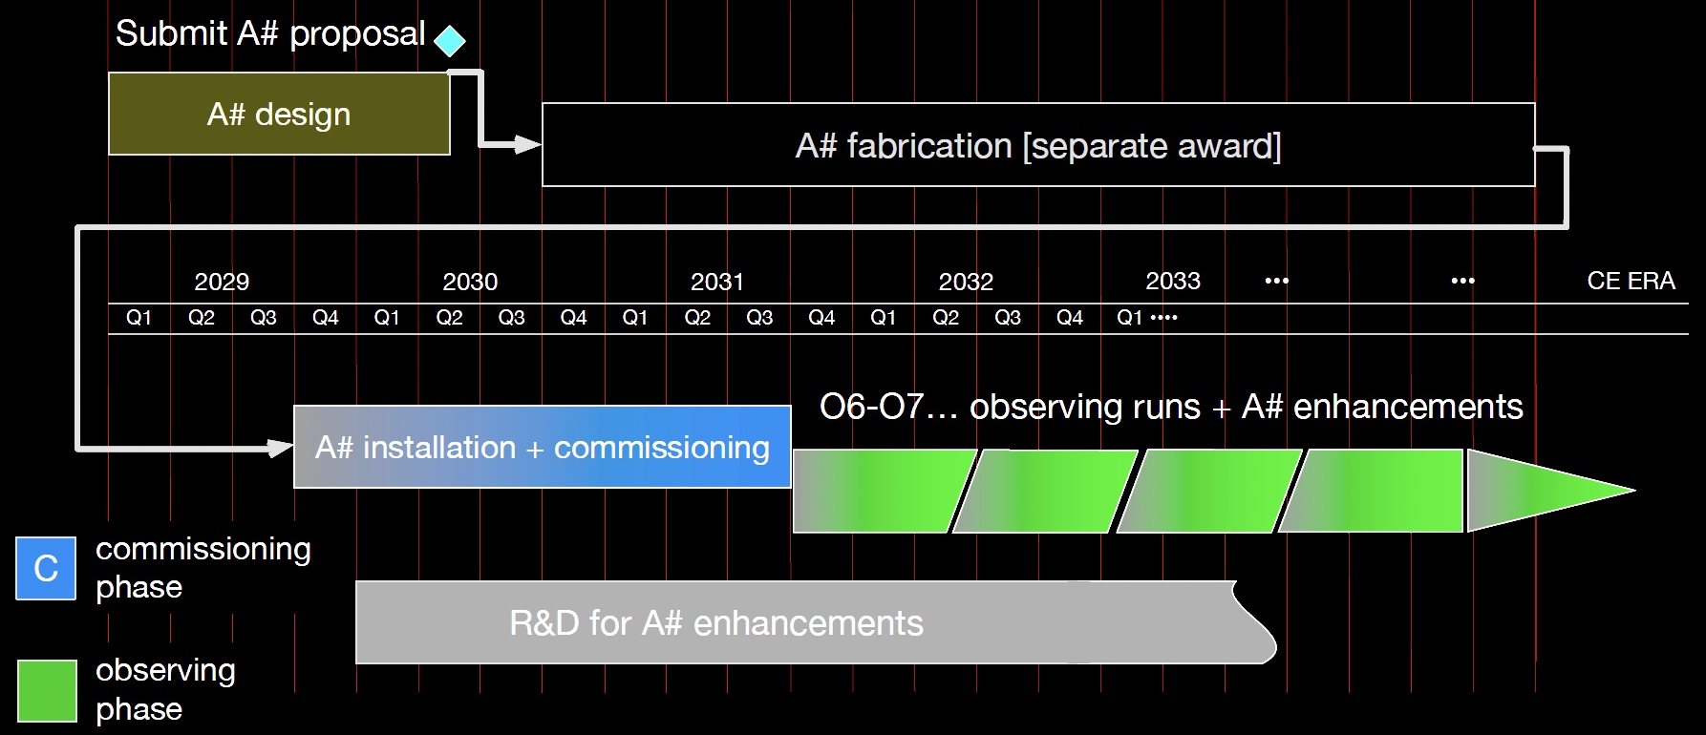
Notional Plans for the current 4km observatories –
2x improvements
~160 Mpc
~275 Mpc
Best guess for LIGO
Virgo similar
Gives improving performance and continuous operation to ~2040
~600 Mpc

Slide 29
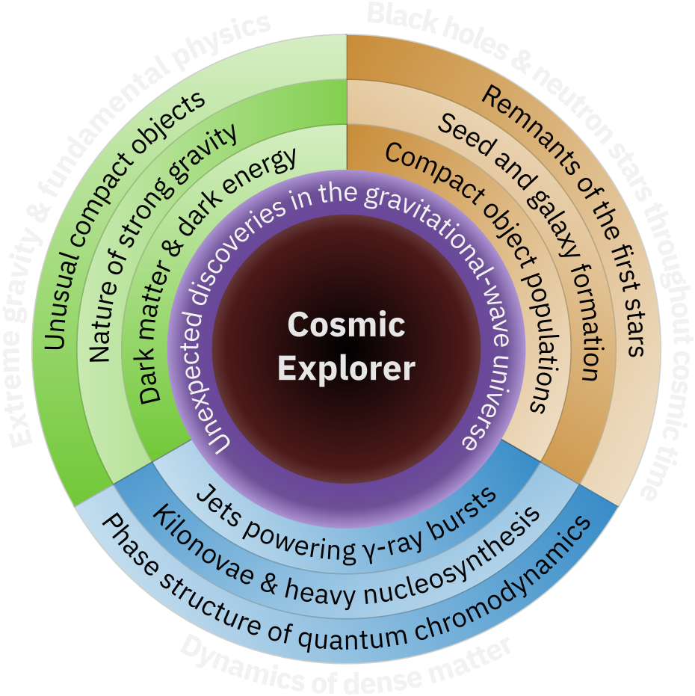
What could we do with 10x better GW detectors?
Greater sensitivity will enable a qualitative growth in the number of observed sources
(10x sensitivity →
few 10⁵ sources per year)
It also increases the resolution of waveforms, enabling more stringent tests of GR and more detailed models of the coalescences
Wider bandwidth can expose Neutron star coalescence and thus dynamics of dense matter

Slide 30

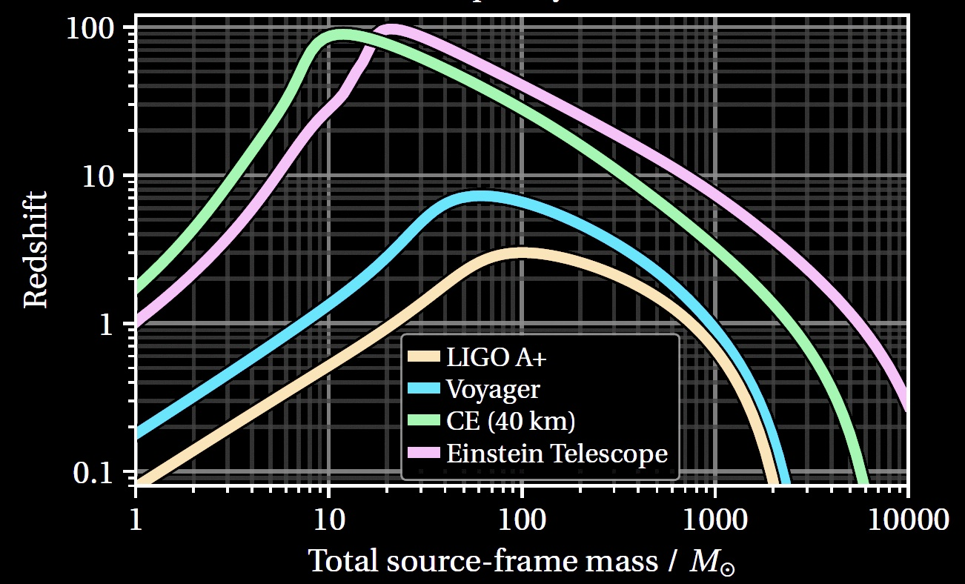
Black Holes and Neutron Stars throughout cosmic time
The best understood source of gravitational wave emissions are compact binary systems.
Can build a detector able see all binaries in a broad range of masses

Slide 31
Even better detectors would deliver more science.
How to build a such a 10x better detector?
Make it 10x longer → 10x larger signal
ΔL = h_{GW} · L

Slide 32
Noise due to stochastic forces is independent of armlength
ΔL = h L
The Newtonian Background is the same for 4 or 40km, but the signal is 10x larger
Also unchanged:
  Thermal noise motion (pendulum, substrate, coating)
  Magnetic and electrostatic dynamic forces
…Up to L = 1/2 λ_{GW} – giving an optimal length for a given signal

Slide 33
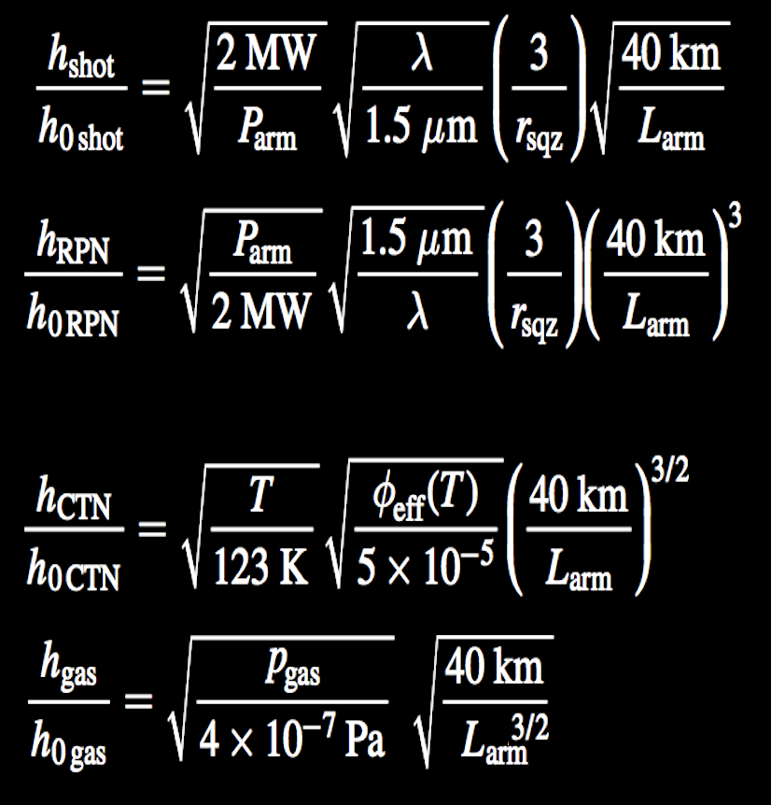
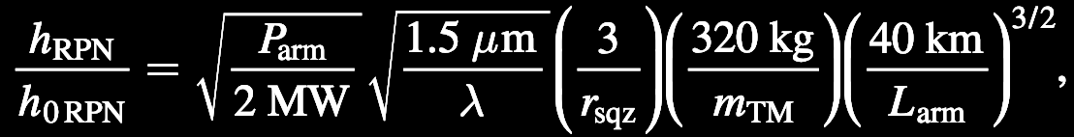
Sensing noises scale with arm length at various powers of 1/L – all get better
Shot Noise
while maintaining bandwidth
Radiation Pressure Noise
while maintaining bandwidth
Coating Thermal Noise
loss angle dependence
Residual Gas Noise
facility limit
33

Slide 34
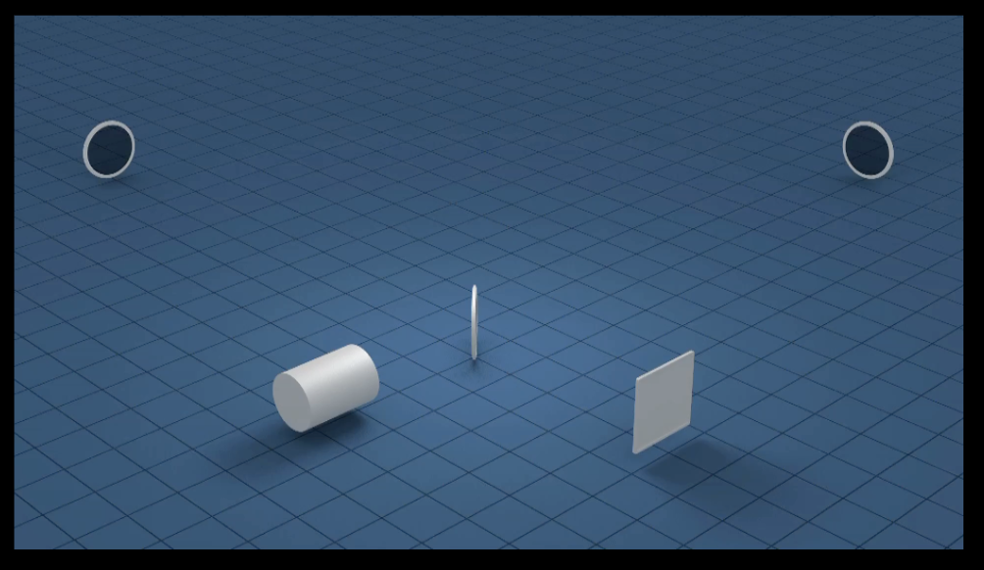
The Infrastructure for a realistic implementation
A sufficient length L of the arms is needed to bring the
GW-induced strain to a measurable level (4km → 40km)
Sensing laser light must travel in an excellent vacuum (10⁻⁹ Torr)
The vacuum system diameter must accommodate a diffraction limited beam over 4 or 40km (~1 m Diameter)
The vacuum system must be straight, level, and protected from the human and natural environment (earthmoving, concrete bed,
aligned to several mm over 4 or 40km, and protected by a concrete cover)
Corner and end buildings with particulate, temperature control;
staff buildings; outreach/public science building (~10,000 m²)

Slide 35

LIGO Hanford Observatory
LIGO Livingston Observatory
Present LIGO Observatory sites
L = 4km

Slide 36



Image: Eddie Anaya (Cal State Fullerton)
US contribution to the next-gen Network (with Einstein Telescope – European project)
LIGO-like concept for a single interferometer per site, on Earth’s surface
CE is a larger, and more technically advanced version of LIGO:
baseline of two widely separated observatories, 40km and 20km arms
cosmicexplorer.org
Image: Eddie Anaya (Cal State Fullerton)
Image: Eddie Anaya (Cal State Fullerton)
Image: Eddie Anaya (Cal State Fullerton)
cosmicexplorer.org
Image: Eddie Anaya (Cal State Fullerton)

Slide 37
CE Detector Design
LIGO is starting to plan upgrades to the LIGO 4km detectors for the ‘Post-O5’ epoch – ~2029 to the start of CE observing (optimistically 2035)
  Room temperature, 1 micron light, fused silica optics, sputtered optical coatings, frequency dependent squeezed light..
Initial CE detectors will usetechniques of this LIGO Post-O5 upgrade
Low risk – no significant advances in the detector are needed
  Some work on bigger masses, suspensions, lower-loss optics
(Later CE upgrades can include all insights from CE, ET, quantum sensing…)

Slide 38
CE Infrastructure
Baseline of 40km and 20km observatories
  20km = 1/2 λ_{GW} is ideal for observing ~2kHz endgame of
  neutron-star mergers
  40km is optimized for absolute ‘reach’ to enable all in-scope binaries to be observed
Sites separated by a continental baseline for position information
  Hope that ET in Europe will be built; expect that data will be shared
Working on less expensive vacuum systems (dominates the cost)
Single interferometric detector per site
Earth’s surface construction
  Bad: increased coupling to surface ‘seismic’ noise, and thus Newtonian background – limits low-frequency sensitivity (~7Hz compared to ~5 Hz for ET)
  Good: less expensive than tunneling; no complexity of underground work; future modifications of interferometer layout easier (no new caverns)
Geographically suitable sites can be found in the US (and Canada, Australia…)

Slide 39

The history of the land will play a pivotal role in this project.
We have the opportunity, and obligation, to work with Indigenous Peoples
We will build synergistic relationships and respect their land, their culture, and their sovereignty.
http://native-land.ca/
If you are not aware of issues surrounding TMT, please read arXiv:2001.00970 .

Slide 40
CE Status
Conceptual Design is now underway
CE Funding approved for this phase
  International contributions (in-kind) – UK, Canada, Australia, Germany
Goal: observatories by mid-2030’s

Slide 41

European Vision for the next generation:
Einstein Telescope
ET Design: underground, triangular, 3 detectors consisting of two interferometers each
(high frequency + low frequency ‘xylophone’)
  Cryogenic test masses, longer wavelengths for LF operation
  Underground infrastructure designed for future upgrades
Possible sites:
  Euregio Meuse-Rhine
  Sardinia, Italy
  (possibly) Saxony, Germany
Current envisioned timeframe:
  Construction to begin in 2026
  Science operations to begin in 2035
Status:
  ET is a fully recognized European Project on European Strategy Forum for Research Infrastructures (ESFRI) Roadmap → a key step in getting the project funding lined up.
  ET Project Organization and relevant Boards have been established
  ET Pathfinder facility in Maastricht, Netherlands under construction
  Site evaluation well underway

Slide 42

Reach of present and future instruments
Credit: ESO/NAOJ
Cosmic Explorer
and
Einstein Telescope
LIGO
~2033
LIGO
today
Slide: Kevin Kuns

Slide 43
The last page (at last!)
Ground-based GW observation works, and LIGO, Virgo, and KAGRA observing together
There are lots of sources yet to be observed
Scaling laws show the technical feasibility of better detectors
The US Concept, Cosmic Explorer
  Two sites, one 40km, one 20km
  Surface construction, LIGO Technology
The European Concept, Einstein Telescope
  Underground triangle multiple-interferometer approach
  Pushes detector technology with high power, low temperatures
Both eager to participate in Multi-Messenger Astrophysics
The future is bright for gravitational-wave astronomy!

Slide 44
Thank you!

Slide 45


Gravitational Wave Properties
Binary Coalescence of two compact objects
GW generation:
lowest order radiation is quadrupole
m
m
metric perturbation
quadrupole moment
f_{gw} = 2 x f_{orbital}
Two masses m in a circular orbit at a distance r create a periodic strain h in space
Distance r
Speed c
About once a week,
a wave passes with this characteristic strain:

Slide 46
Gravitational Wave Properties
Binary Coalescence of two compact objects
GW generation:
lowest order radiation is quadrupole
A change in distance from here to Alpha Centauri
(4 light-years distant)
of the thickness of a human hair
(10 microns)
m
m
metric perturbation
quadrupole moment
f_{gw} = 2 x f_{orbital}
Two masses m in a circular orbit at a distance r create a periodic strain h in space
Distance r
Speed c
About once a week,
a wave passes with this characteristic strain:

Slide 47


Stretching and squeezing of space-time
ΔL
Amplitude of the gravitational wave strain is h = ΔL/L
ΔL = h L
Big L makes ΔL easier to measure; current detectors have L = 4 km, so from our two-mass example
ΔL ~10⁻²¹ x ~10³ = ~ 10⁻¹⁸ m
L

Slide 48
Stretching and squeezing of space-time
ΔL
Amplitude of the gravitational wave strain is h = ΔL/L
ΔL = h L
Big L makes ΔL easier to measure; current detectors have L = 4 km, so from our two-mass example
~10⁻²¹ x ~10³ = ~ 10⁻¹⁸ m
L

Slide 49

The binary neutron star signal, with and without the interferometer noise

Slide 50


40km CE
Kuns

Slide 51

Why 40km?
Broadly speaking, the sensitivity of these instruments improves with length
The bandwidth is, however, limited to roughly
$\frac{c}{2L}=\frac{3×{10}^{5}\frac{km}{s}}{2 ×40 km}≃4 kHz$
so making a detector longer than 40km would compromise its access to interesting astrophysics (i.e., post-merger signals and supernovae).

Slide 52
What can CE do?
BBH
BNS
IMBH
arXiv 1902.09485

Slide 53


Noise improvements: reducing quantum noise
Increasing the laser power in the arms
  O1,O2 (100kW) → O3 (200kW) → goal is 400 kW for O4
Not easy!
  You need a high power laser first..
  Mirror radii must remain within a few meters of the ~2 kilometer nominal value
  Control issues: angular control and parametric instabilities
  ``Point absorbers”
Applied Optics Vol. 60, Issue 13 pp. 4047-4063 (2021)
  Complementary approach: squeezed states of vacuum
Applied Optics Vol. 60, Issue 13 pp. 4047-4063 (2021)
Applied Optics Vol. 60, Issue 13 pp. 4047-4063 (2021)
Applied Optics Vol. 60, Issue 13 pp. 4047-4063 (2021)
Applied Optics Vol. 60, Issue 13 pp. 4047-4063 (2021)
Applied Optics Vol. 60, Issue 13 pp. 4047-4063 (2021)
Applied Optics Vol. 60, Issue 13 pp. 4047-4063 (2021)

Slide 54

X1
Zero-point energy
(vacuum) fluctuations
X2
LASER
∆X₁ ∆X₂ ≥1
When average amplitude is zero, the variance remains
Heisenberg uncertainty principle, quadratures associated with amplitude and phase
They enter the interferometer from all the open ports of the interferometer, but the ones which matter are the one entering from the anti-symmetric port!
Phase
IFO Signal
Amplitude

Slide 55
Replace regular vacuum with squeezed vacuum
Reduce quantum noise by injecting squeezed vacuum: less uncertainty in one of the two quadratures
Heisenberg uncertainty principle: if the noise gets smaller in one quadrature, it gets bigger in the other one
One can choose the relative orientation between the squeezed vacuum and the interferometer signal (squeeze angle)
Squeezing is made by creating pairs of photons
using an optical parametric oscillator
The pairs are quantum-mechanically entangled
and have correlated arrival times at the detector
This reduces the randomness of the time distribution
LASER
Squeezed Field
Phase
IFO Signal
Amplitude

Slide 56

Squeezing performance in O3
PhysRevLett.123.231107
Nature 583, pages 43–47 (2020)
3 dB of squeezing observed at high frequency = 40% quantum noise reduction (in amplitude); observation of quantum radiation pressure noise in both detectors
6dB
GEO

Slide 57



Frequency Dependent Squeezing for O4
RADIATION PRESSURE
NOISE
GW Signal
~30Hz
~30Hz
Quantum Noise
SHOT NOISE
Credit: Antonio Pasqualetti
High finesse detuned “filter cavity” which rotates the squeezing angle as function of frequency
Highlight from Virgo:
300 m filter cavity already
built and locked and characterized, commissioning in progress
Kimble et al., Phys. Rev. D 65(2) 022002 2001

Slide 58

Initial results for Frequency Dependent Squeezing
LIGO Hanford

Slide 59

The Cosmic Explorer Project Organization today
Team members from
MIT
Cal State Fullerton
Syracuse
Penn State
Caltech
University of Washington Bothell
University of Oregon
University of Florida
Texas Tech University
University of Arizona
Bard College
Stanford
Harvard
UC Riverside
The Australian National University
Albert Einstein Institute
University Birmingham
University of Glasgow

Slide 60

The Cosmic Explorer Project Organization today
Team members from
MIT
Cal State Fullerton
Syracuse
Penn State
Caltech
University of Washington Bothell
University of Oregon
University of Florida
Texas Tech University
University of Arizona
Bard College
Stanford
Harvard
UC Riverside
The Australian National University
Albert Einstein Institute
University Birmingham
University of Glasgow

