Slide 1
Vacuum Challenges for the Next Generation Gravitational Wave Detectors
R. Weiss
Second Vacuum Workshop
CERN
March 27, 2023

Slide 2
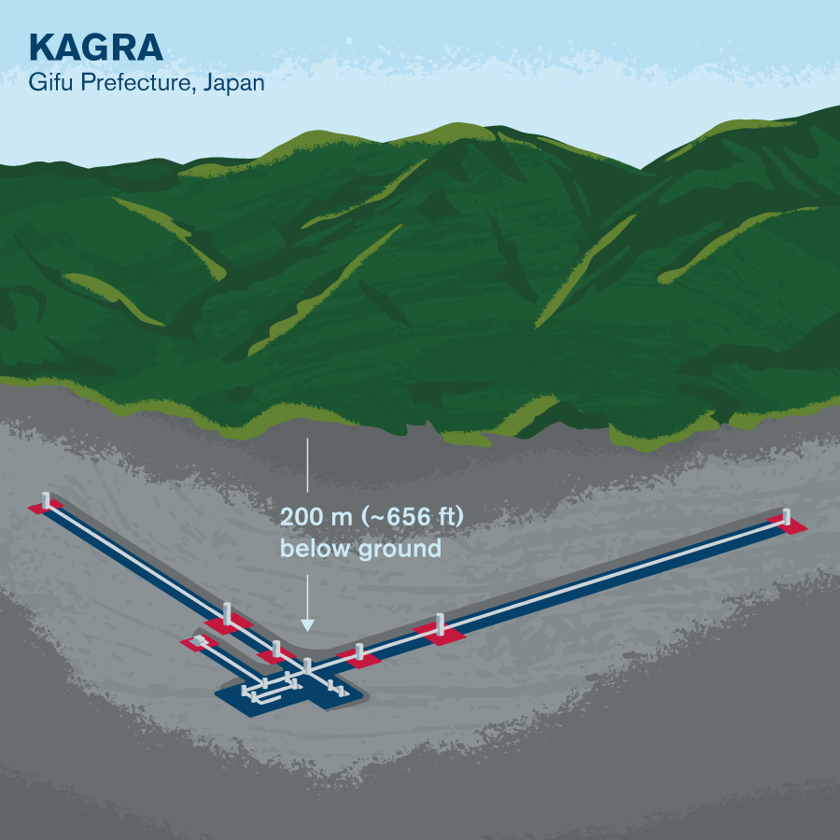
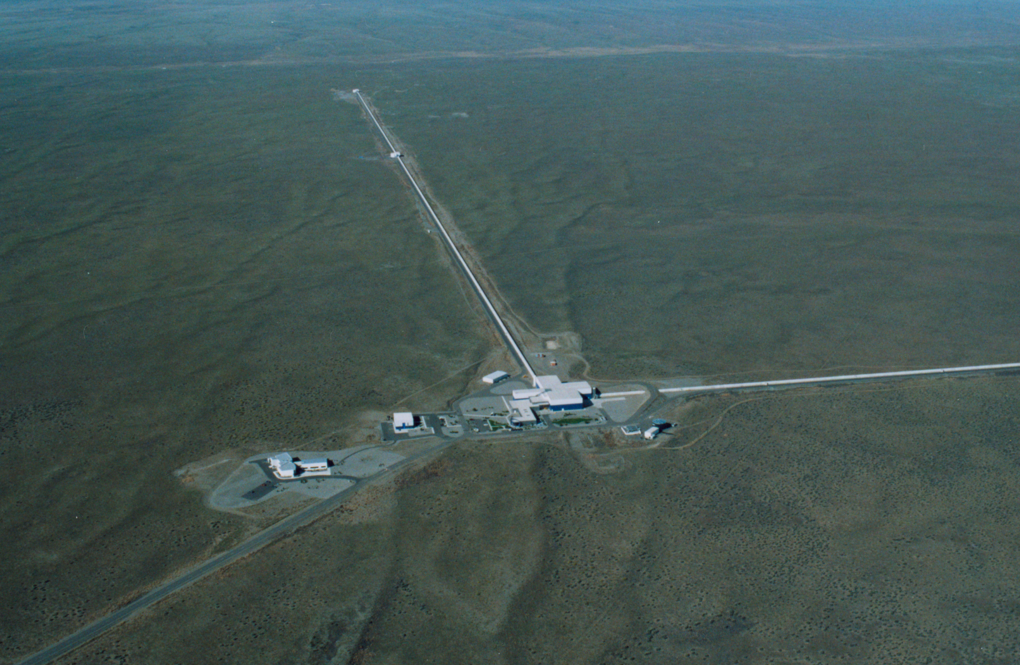
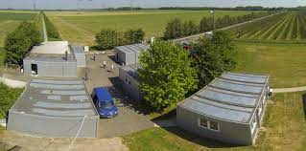
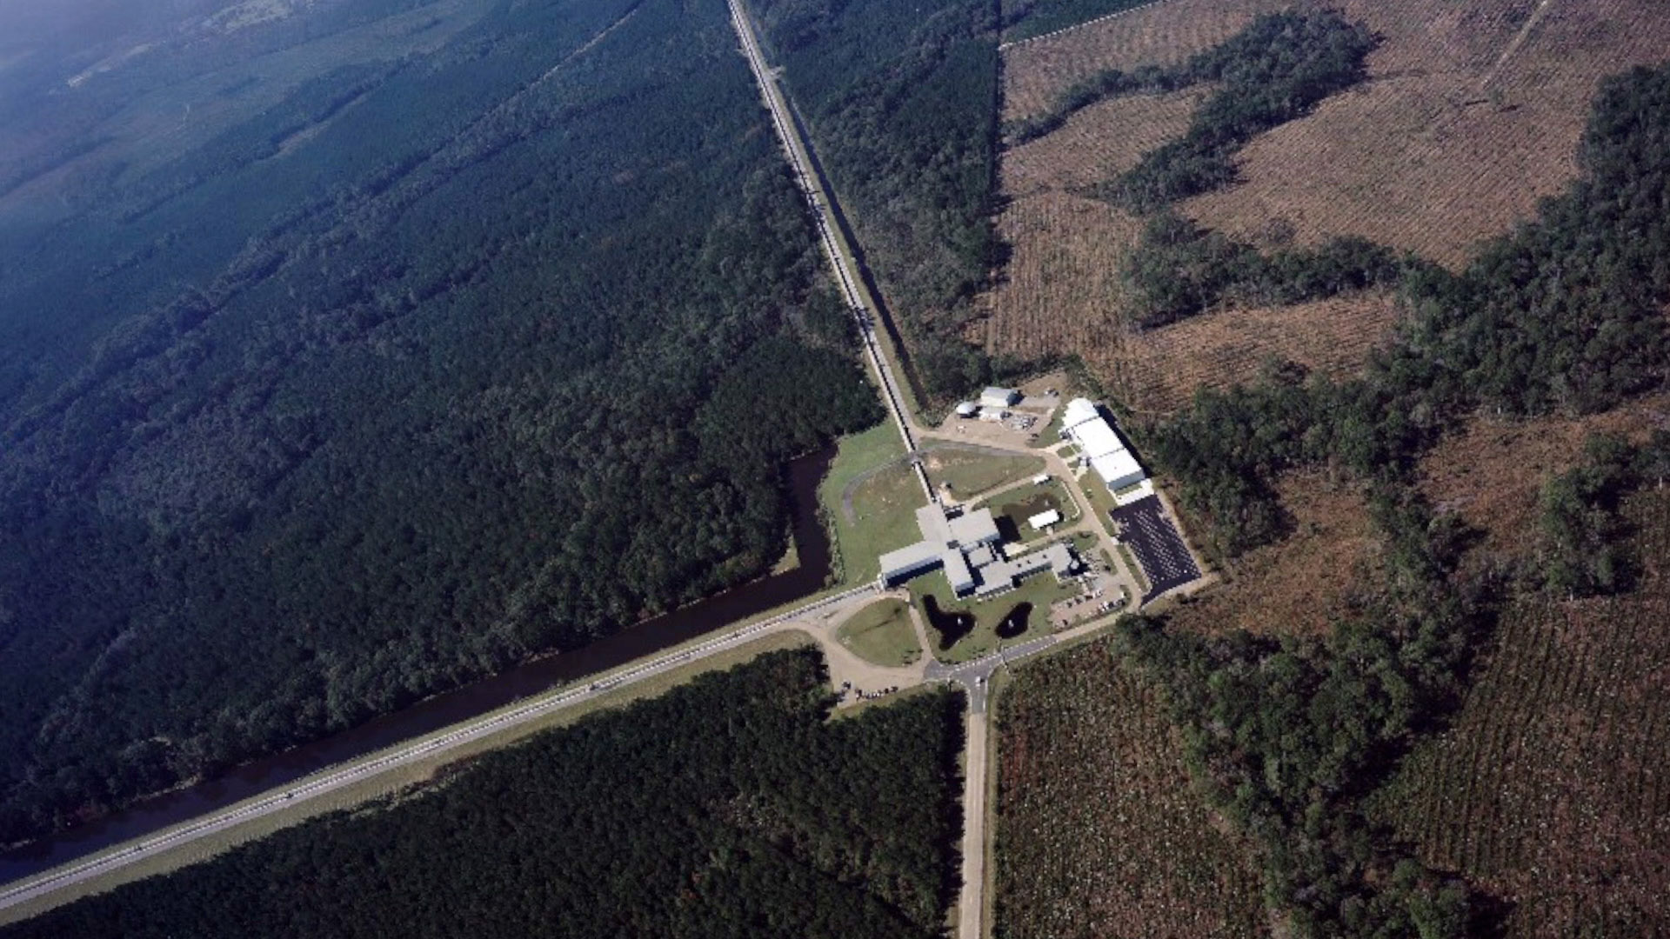
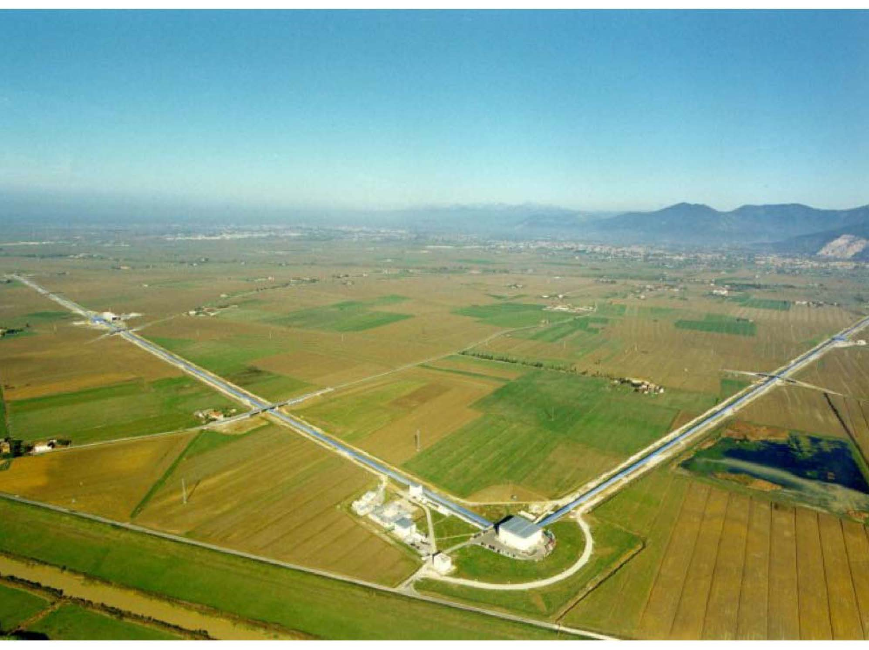
Operating Interferometric
Gravitational Wave Detectors
KAGRA
GEO Hannover
LIGO Hanford
LIGO Livingston
Virgo Cascina

Slide 3
Gravitational Wave Sensitivity
E.Hall and S. Vitale

Slide 4
Optical phase noise due fluctuations in molecular forward scattering
BASIS OF REQUIREMENTS
Optical phase noise due to scattering and diffraction by moving surfaces

Slide 5
Cosmic Explorer Pressure Requirements

Slide 6
Special Properties of Gravitational Wave Detector Beamtube Vacuum Systems
There is no large or variable gas load – laser or particle heating not an issue
When leak free, the outgassing of the wall material is the primary gas source
The diameter of the tube (0.5 to 1.2m depending on wavelength and tube length) is determined by the optics providing significant pumping capacity by the tube.
Distributed ion and getter pumping is effective and efficient in the system.
After initial construction and during operations, beamtubes are rarely (if ever) open to the atmosphere, allowing long pumpdown times (months) and moderate temperature bakeout for water and hydrocarbons.

Slide 7
Important aim of the workshop and near term future effort
Reaching the pressure requirements for the beamtubes of future more sensitive gravitational wave detectors has been obtained in the LIGO 4km arms for most gas species except hydrogen . Hydrogen requires more pumping capacity, now more easily provided by getters than in 1997. The issue is not can one make the requirement but rather can one make them at significantly reduced cost.
Extrapolating the costs for 16km of beam tube using the methods and materials in 1997 to 80km in 2030 including standard inflation is estimated at $700M . Using other materials than 304L SS and new techniques to reduce the water adsorption on the surface, it may be possible to reduce the beamtube part of the costs by around $300M.

