Slide 1
Enabling the Discovery of
Kilonovae Associated with Neutron Star Mergers
with Electromagnetic Follow-up
By: Marianna Pezzella
Mentors: Tomás Ahumada and Shreya Anand

Slide 2
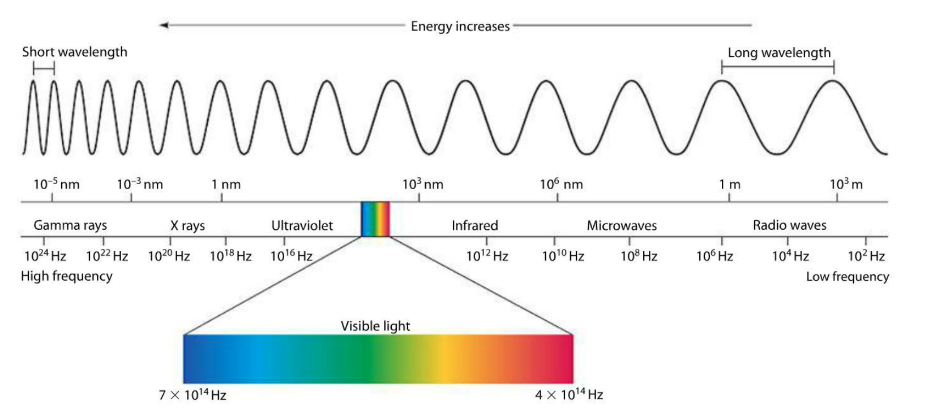
Focusing on the Electromagnetic Spectrum
1
Notes:
This project focused on the visible and infrared regions of the EM spectrum. But why is this? Well, we are expecting these types of light from the merger events we will be discussing in this talk. Studying this light can give us a complimentary study and provide more information about GW events. This is MMA.

Slide 3
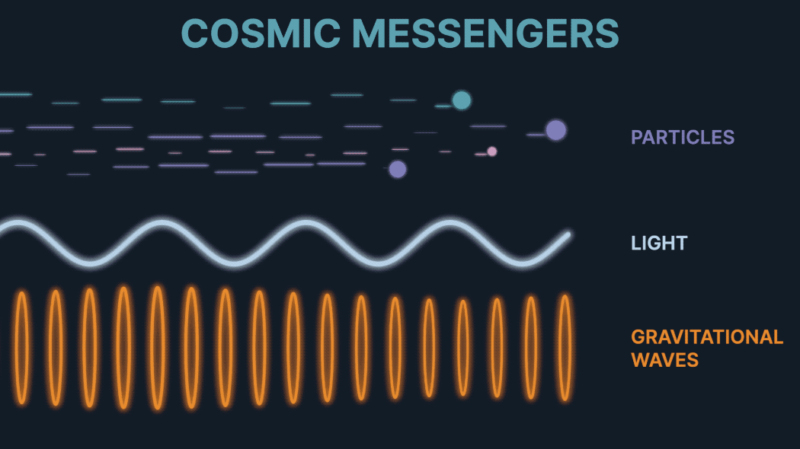
Multi-Messenger Astronomy (MMA)
2
MMA: The process of gathering information using multiple detection methods
Gravitational Waves (GWs): LIGO
Electromagnetic Radiation (Light): Telescopes

Slide 4
EM Counterpart
3
LIGO: GW170817
Jet
Afterglow
Kilonova
Problem: We need to find EM counterparts faster
BNS or
NSBH
Notes:
Once the two neutron stars merge, they produce this sort of picture in which you have a high energy jet, which collides with the surrounding environment to produce an afterglow, and the material in the neutron stars begin the process of nucleosynthesis, and that radiation then produces the kilonova. And this is what we are looking for. The KN is the signature of BNS and NSBH mergers. The problem we have is that KNe fade very quickly, so we need to find them as fast as possible.

Slide 5
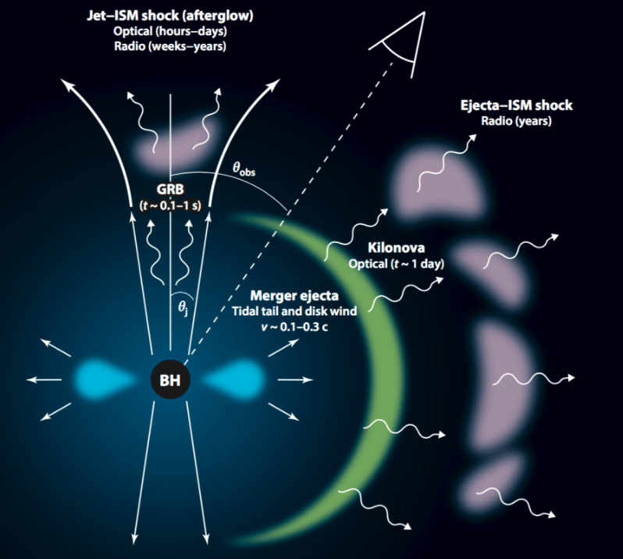
Kilonova
4
The EM counterpart powered by the radioactive decay of heavy elements produced during a BNS or NSBH merger
Tidal ejecta result from the tidal forces experienced by the neutron stars during the merger
Wind ejecta are produced by the high-speed winds that emanate from the merged object

Slide 6
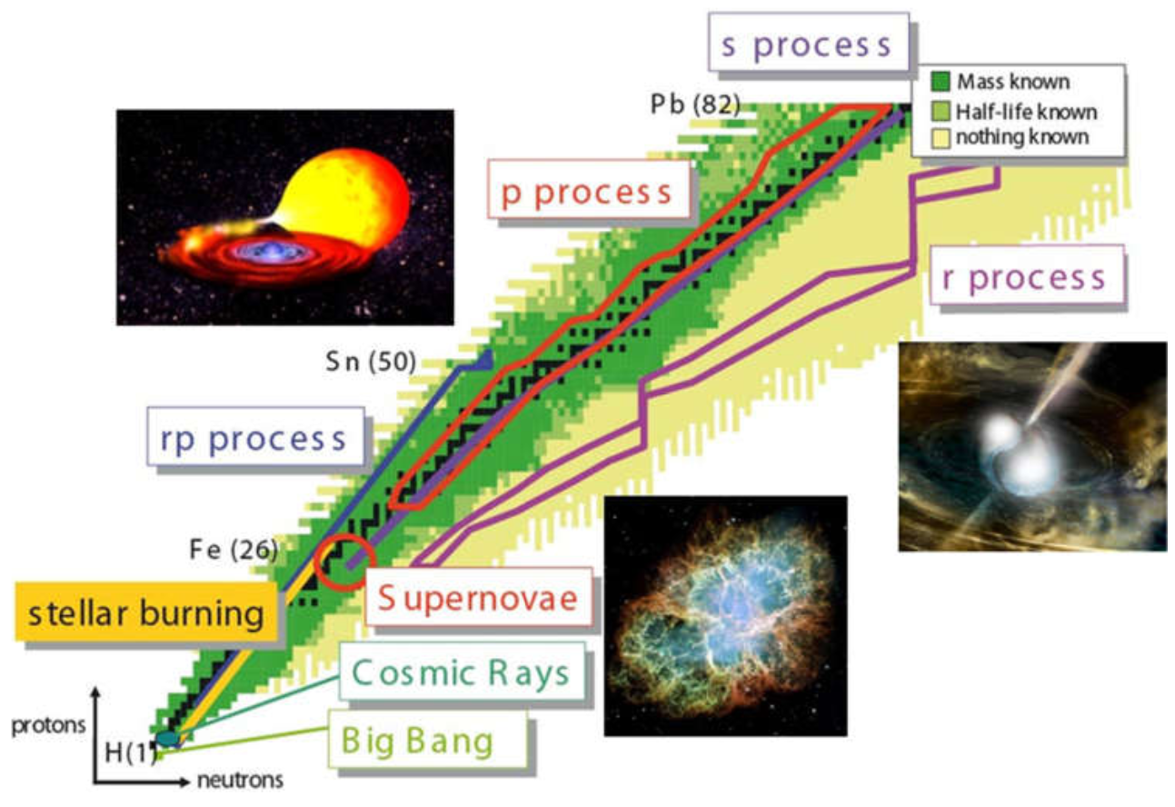
Why is this important?
5
Before GW170817, people theorized that heavy elements were created in BNS and NSBH mergers.
Rapid neutron-capture process (r-process nucleosynthesis)
Process by which heavy atomic nuclei in elements like gold, platinum, and uranium are synthesized
Now we can learn more about the elements on Earth.
Notes:
Why is this important? … We have only found one KN so far…Why have we only found one? Because it is very challenging to find KNe; that is why we use the ZTF.

Slide 7
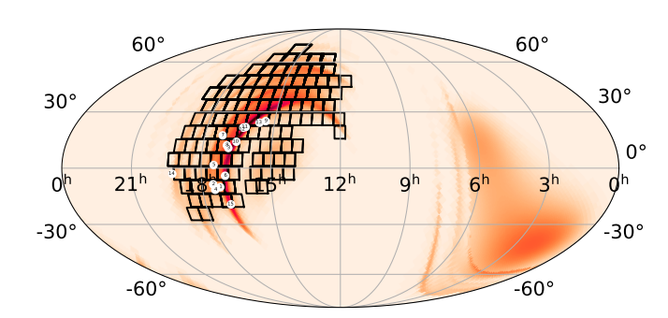
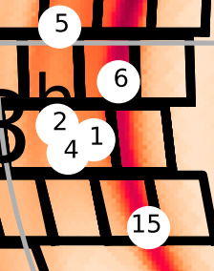
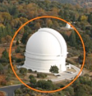
Zwicky Transient Facility (ZTF)
6
Each white circle is a candidate
Large field of view (FOV) of 47 sq deg
Surveys the entire northern sky every few nights
Searches for KN counterparts
“Triggered” after a compelling GW event
Each square is a ZTF field
Notes:
This image shows a ZTF sky map localization, meaning the KN could be anywhere in this region. We use ZTF because it can quickly scan large portions of the sky, allowing us to find the KN as fast as possible. Each square box represents one ZTF field, or one image of the telescope.

Slide 8
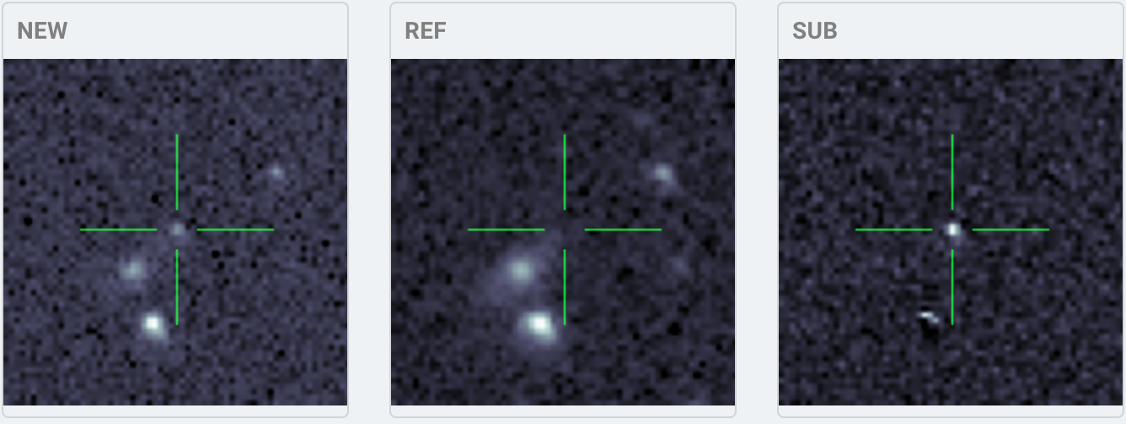
What Do We Get From ZTF?
7
Notes:
We get candidates based on image subtraction. We have our reference image that we compare to the new image taken after the GW event, and we look at the residuals after those images are subtracted. Specifically, we are trying to find residuals that are brighter than before. We can characterize this using a lightcurve.

Slide 9
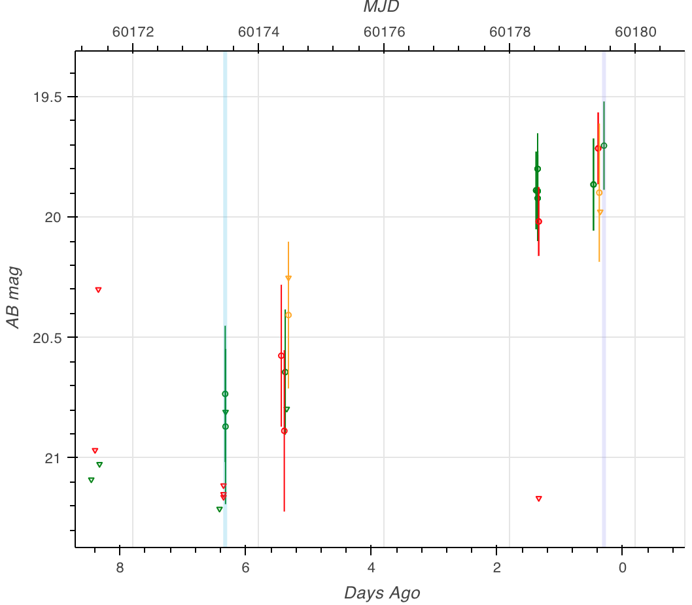
Lightcurve of a S230627c KN candidate
8
S230627c: detected by LIGO
ZTF was triggered and generated candidates
The lightcurve shown is for a good candidate
A good candidate has fast evolution (fast-fading)
For follow-up observations, telescopes like Keck, Gemini, GIT, LCO P60, P200 are used
No KN was found for S230627c
Notes:
A lightcurve is the evolution of the brightness of an object as a function of time. The lightcurve shown here is a KN candidate for S230627c. This candidate was found in the localization region, but was ruled out because as it evolved, it continued to get brighter. KNe are expected to fade quickly, showing a decay, instead of get brighter. If the candidate shows conditions consistent with those we know for a KN, we will follow-up the observations with telescopes (images) like Keck, Gemini…This was the context of my work this summer, as I developed a pipeline for the Gemini telescope.

Slide 10
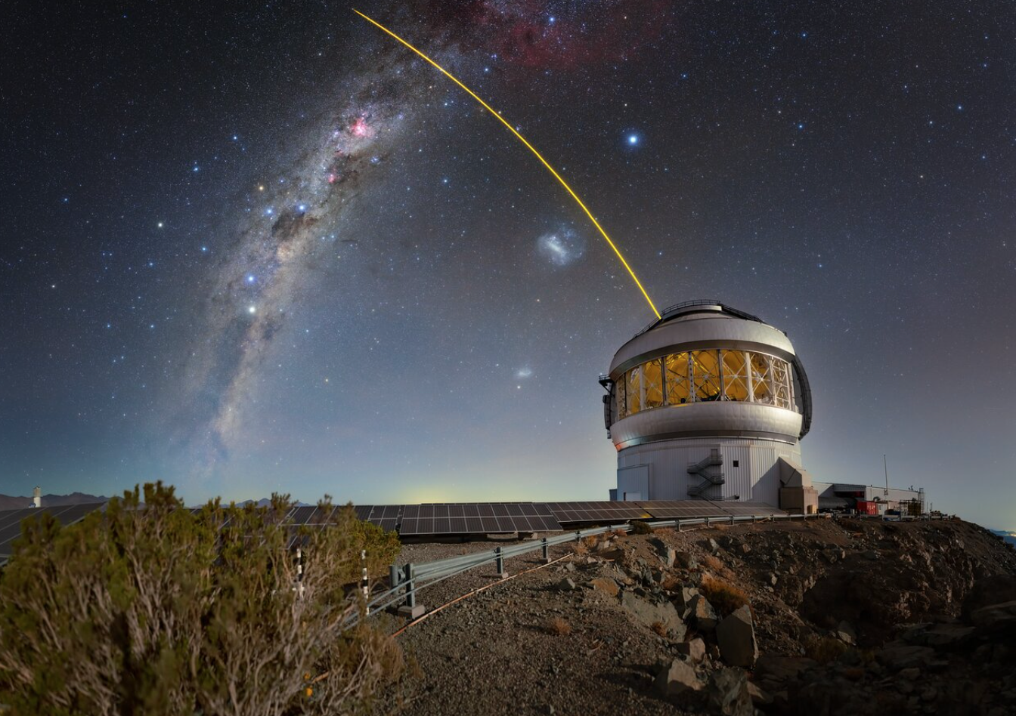
Gemini Multi-Object Spectrograph (GMOS)
9
Gemini North and Gemini South (8 meter - very large)
Gemini is a telescope that could be triggered once we have promising KN candidates
GMOS: instrument used to acquire spectroscopy
Spectroscopy is used to study heavy elements produced in the mergers
Notes:
I used GMOS… associated with the Gemini telescope... For GMOS, there is a already a pipeline called DRAGONS.

Slide 11
DRAGONS pipeline
10
DRAGONS: Data Reduction for Astronomy from Gemini Observatory North and South
Tasks:
Learn the DRAGONS pipeline
Use this pipeline to analyze Sample Data
Overlay spectral lines on the spectrum extracted from the Sample Data
Notes:
I modified this pipeline to create the DRAKE pipeline.

Slide 12
DRAKE pipeline
11
DRAKE: Data Reduction and Analysis for Kilonovae Exploration
*Modified from the DRAGONS pipeline
Tasks:
Download GW170817 data from the Gemini Archives
Modify DRAGONS pipeline to form a new, generalized pipeline (DRAKE)
Reduce the GW170817 data using the DRAKE pipeline, and reproduce the associated spectrum
Overlay spectral lines on the GW170817 spectrum
Notes:
But what does this pipeline do?

Slide 13
Bias Frames (Biases)
12
Calibrates the image of the target of interest
Images taken with no light hitting the imaging sensor
Shortest exposure time possible
Used to remove any dust or grime that is on the sensor itself
Biases were combined into one Master Bias
Notes:
The DRAKE pipeline provides more consistent calibration and is planned to be used for future characterization of KN candidates. Biases are used to … and we need them to calibrate the data.

Slide 14
Flat Frames (Flats)
13
Calibrates the image of the target of interest
Images taken of something known to be illuminated in the same way throughout the entire frame
Screen can be used as a filter to get symmetric illumination for a flat
Flats are used to remove vignetting and calibrate the light illumination
Flats were combined into one Master Flat
Notes:
The next step of the calibration is the flat frames. These are important because they force the illumination to be uniformly distributed, which calibrates the data further.

Slide 15
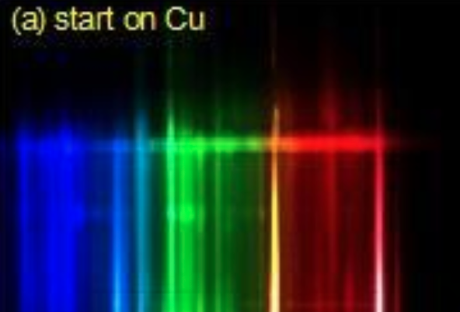
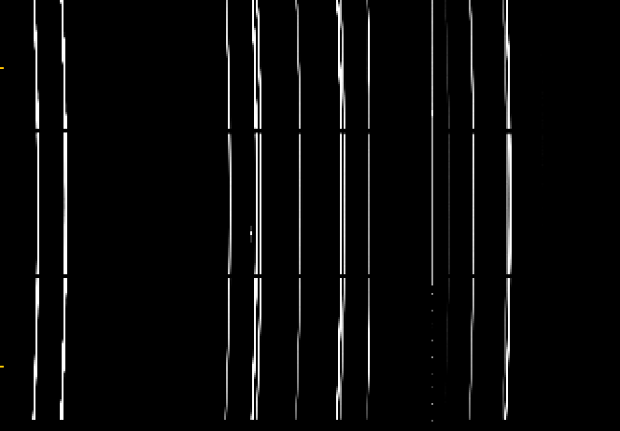
Arc Frames (Arcs)
14
Calibrates the target image of interest using the light from known elements
Arcs tell us where the wavelength lines are
Arcs convert from pixel to wavelength
Used CuAr lamp for this project (the CuAr lines calibrated for the wavelength
Arcs were combined into one Master Arc
Notes:
The second to last data calibration is to use arcs to convert the pixels to wavelengths. For this calibration, we use the known emission lines from a lamp. In this case, we used a copper/Argon lamp.
Arc calibration is not necessary for photometry, but since we will be working with spectrums, arcs are needed to calibrate and extract the wavelength data.

Slide 16
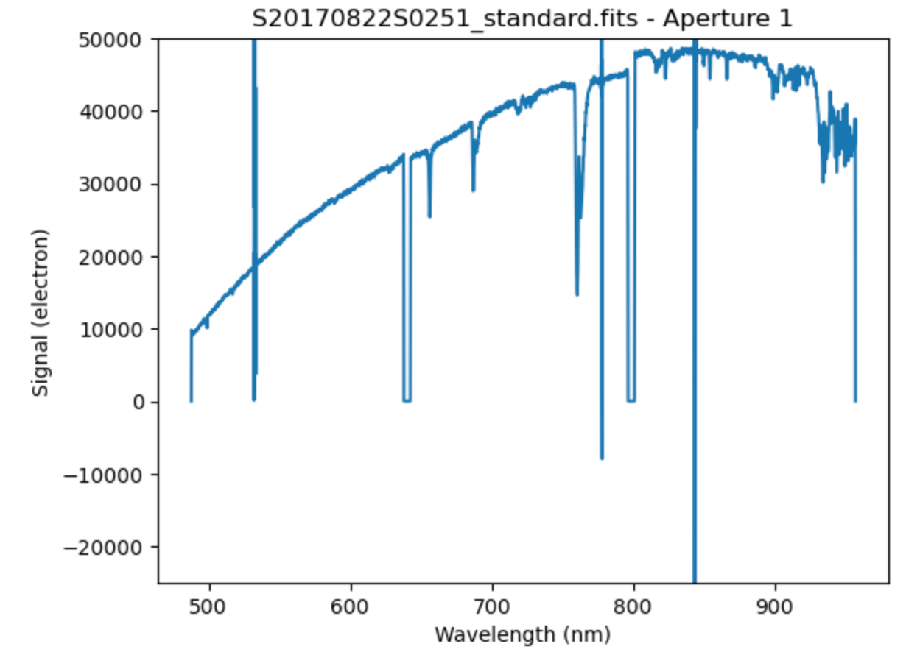
Spectrophotometric Standard Star (SSS)
15
Reference star to calibrate the new, unstudied object
The reference SSS with the same airmass as the target object will be used
SSSs were combined into two Processed Standards (one for each object)
Notes:
The last step in the calibration is to calibrate for flux. For this, we observe a nearby, standard star with the same airmass as the target object. You can think of the airmass as how much interstellar dust or material is in between the observer and the target object. This is what the standard looks like after being calibrated with biases, flats, and arcs, but now we need to extract the flux as a function of wavelength.

Slide 17
Science Observation (SO)
16
Normalize (divide) by the Master Flat
Pixel to wavelength calibration using Master Arc
Standard calibration using the Processed Standard
The SOs are the images of the target of interest
SOs were combined into one Science Observation
Subtract the Master Bias
Target object (star)
Horizontal white line is the trace (light coming from the star)
Notes:
This image shows the trace from the target of interest, which is in this case, a white dwarf star. The light from the star goes through a slit which decomposes light into its corresponding wavelengths and creates a trace.

Slide 18
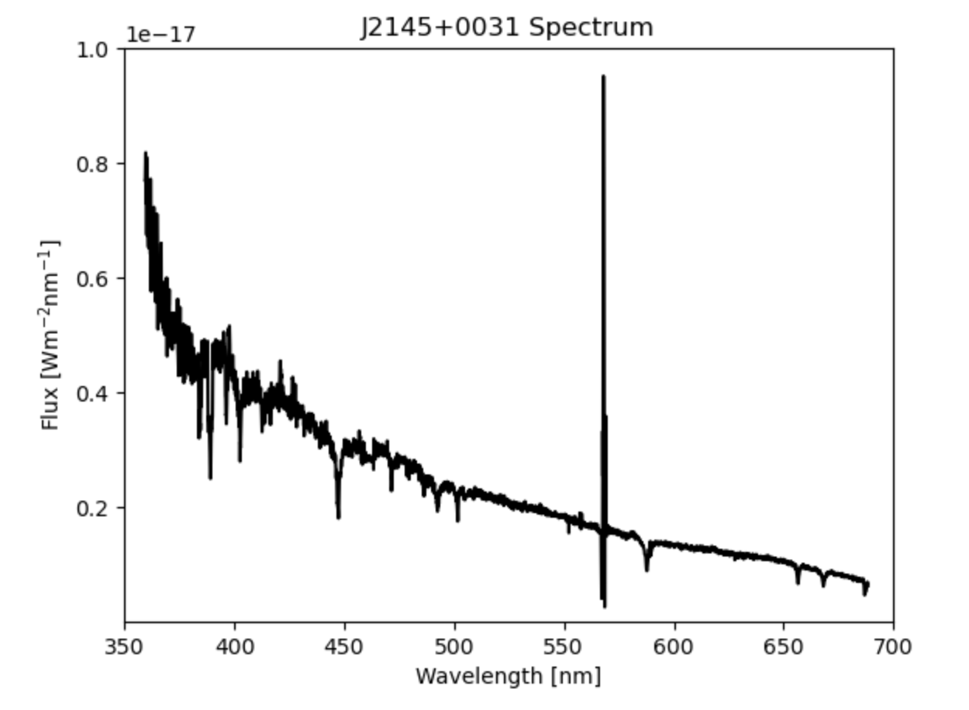
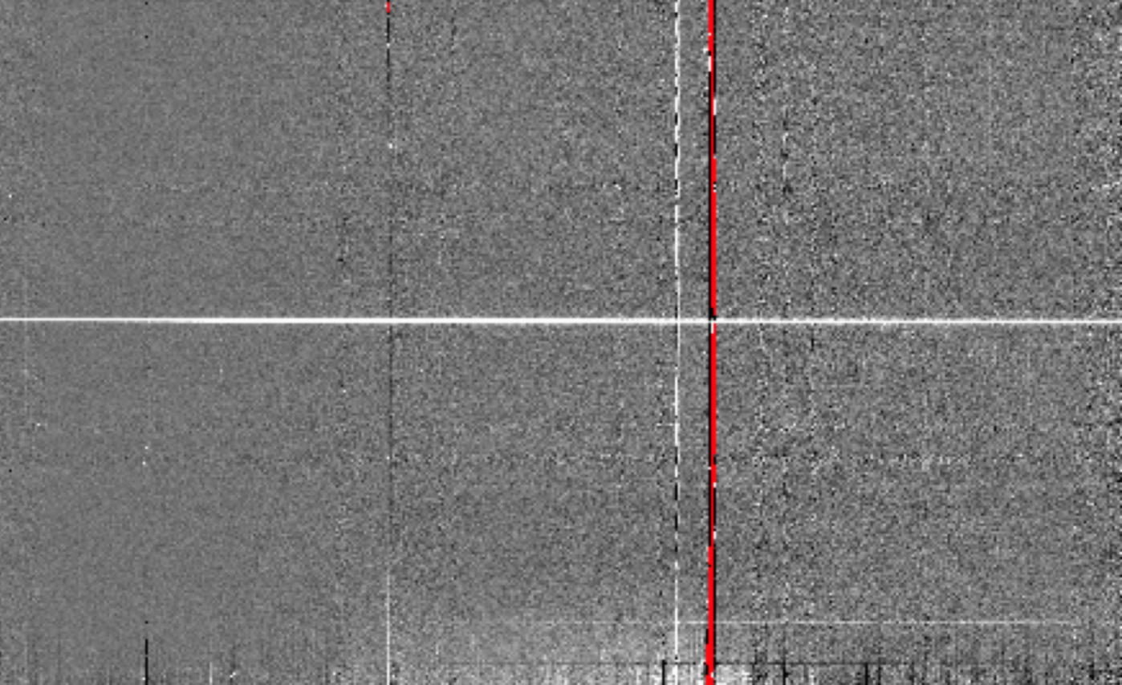
Sample Data with DRAGONS Pipeline
17
Target star with light being shone through a slit
Spectrum contamination
The trace (light from the star) is extracted into the spectrum shown on the right.
Starlight is decomposed into wavelengths
Notes:
For the sample data, we have a white dwarf that shines light through the slit and creates a trace. In this 2D image, you can see some spectrum contamination still lingering even after the reduction and calibration. From the leftmost 2D image, we then extract the flux and get the flux as a function of wavelength, as shown on the right.

Slide 19
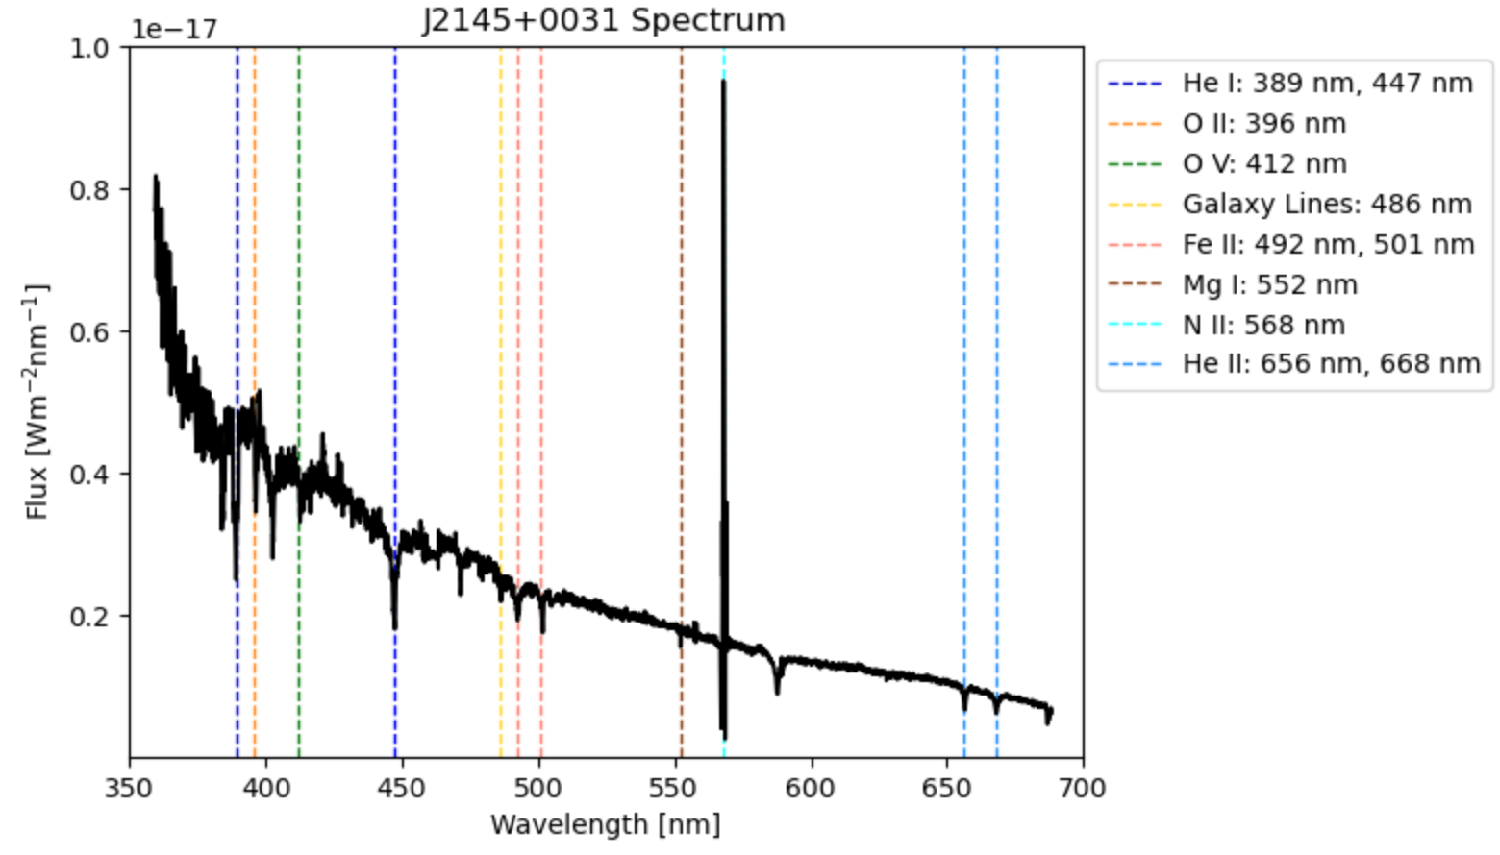
Spectrum Produced with DRAGONS Pipeline
18
Notes:
After the spectrum for the white dwarf star was produced, spectral lines were overlaid on the spectrum, showing the elements corresponding to the broadband absorption features, as listed in the legend to the right…

Slide 20
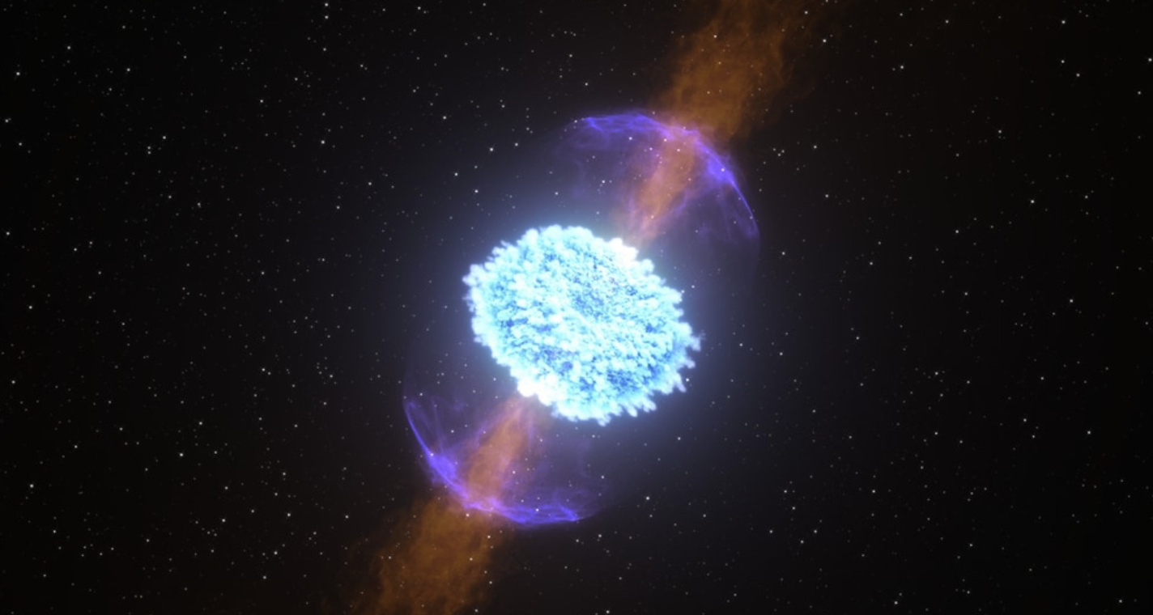
Spectrum Produced with DRAGONS Pipeline
19
Now for
GW170817…
Notes:
And same thing can be done for GW170817, which was the main task for my project.

Slide 21
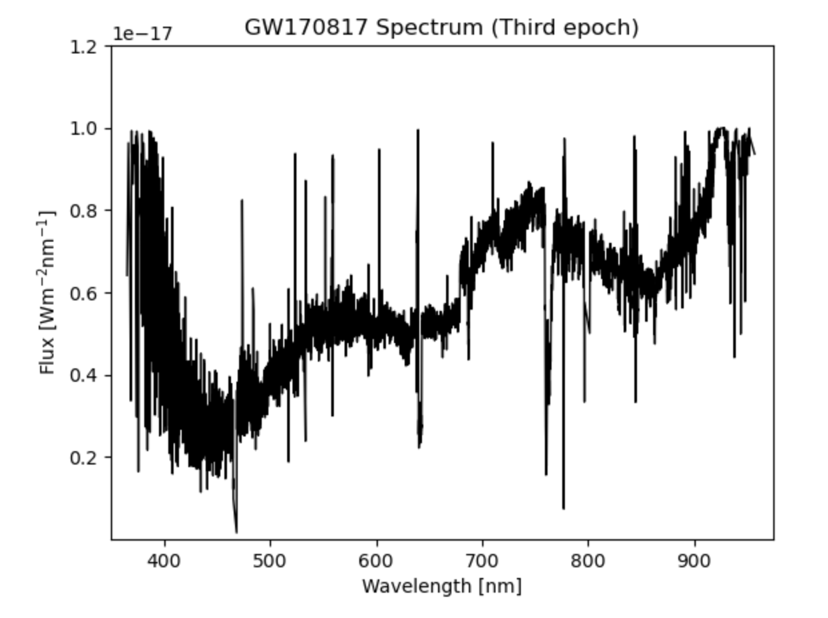
GW170817 Spectrum with DRAKE pipeline
20
Bias subtraction
Flat normalization
Wavelength calibration
Flux calibration
Notes:
After the bias subtraction…, the raw spectrum for GW170817 was produced.

Slide 22
Removing Contamination
21
Bias subtraction
Flat normalization
Wavelength calibration
Flux calibration
*We need to remove contamination!*
Contamination of the spectrum
Notes:
However, there seemed to be a bunch of contamination of the spectrum that is shown with the red arrows. We differentiate between spectrum absorption features and contamination by looking for spectral line broadening. With the target object’s velocity, there will be spectral line broadening.

Slide 23
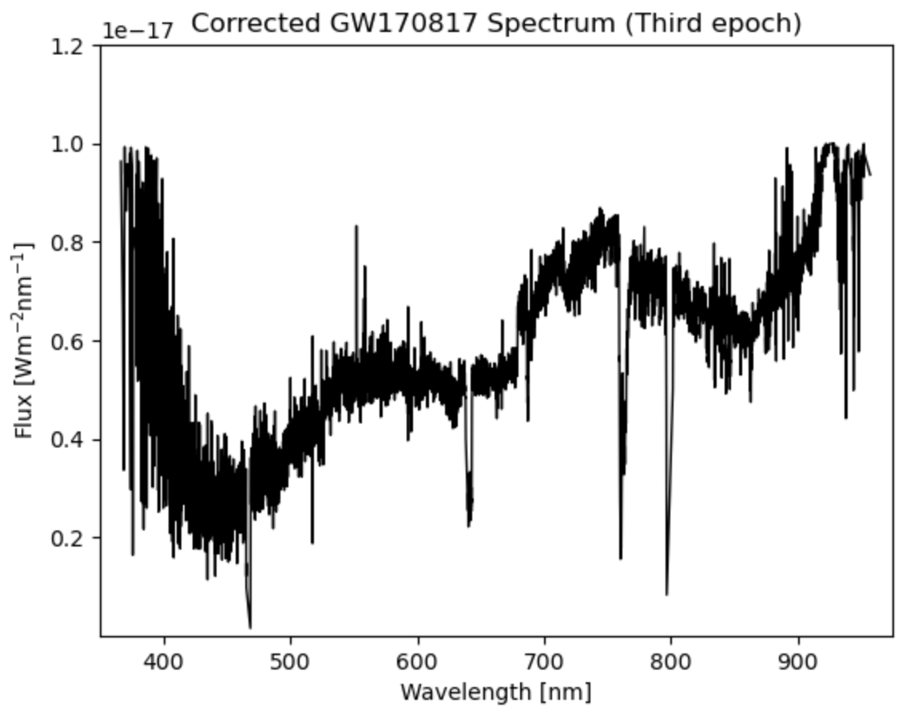
Final Spectrum for GW170817
22
Contamination of the spectrum
Bias subtraction
Flat normalization
Wavelength calibration
Flux calibration
Contamination removed
Notes:
So here we see how the spectrum looks after removing the contamination, which was done by going though and clipping the contamination lines.

Slide 24
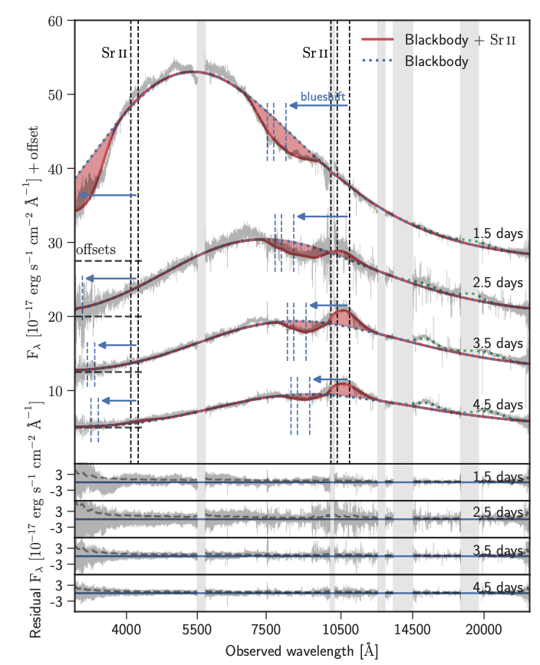
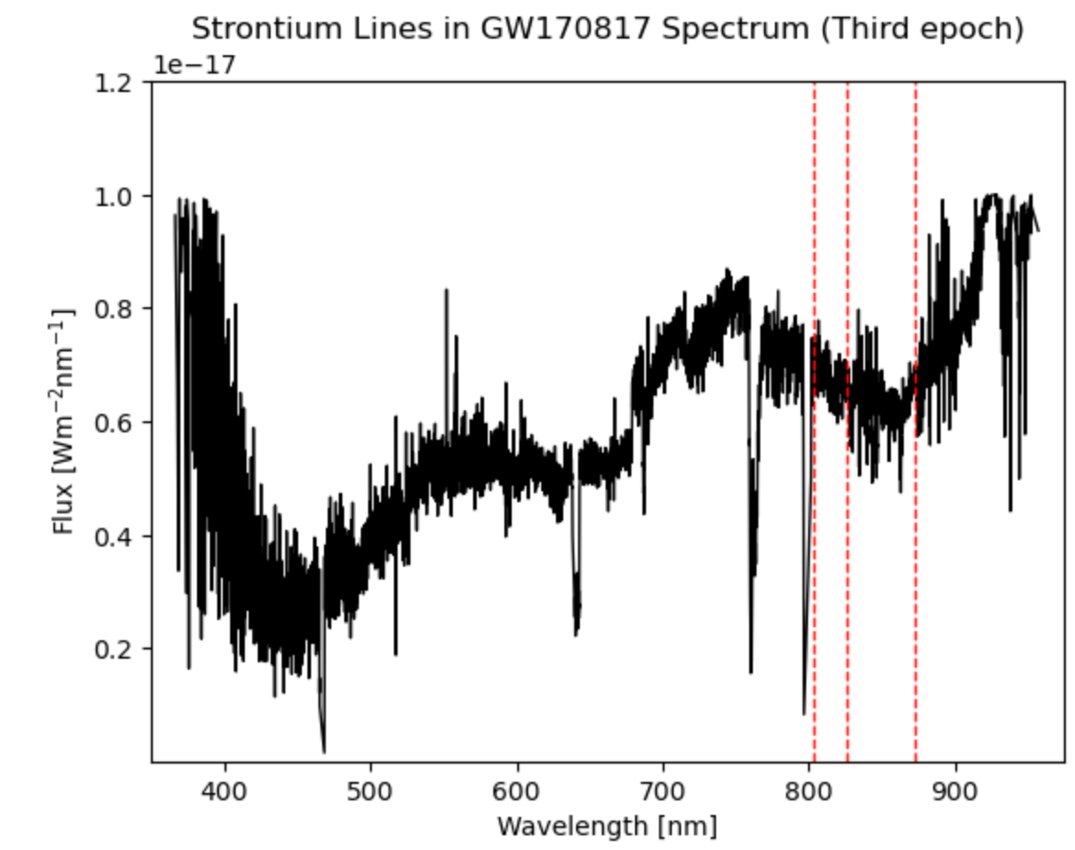
Comparing Results
23
Notes:
Talk about the three strontium lines and the dip that was shown in the Watson 2019 paper and we were able to reproduce those 3 lines and the dip in the spectrum.

Slide 25
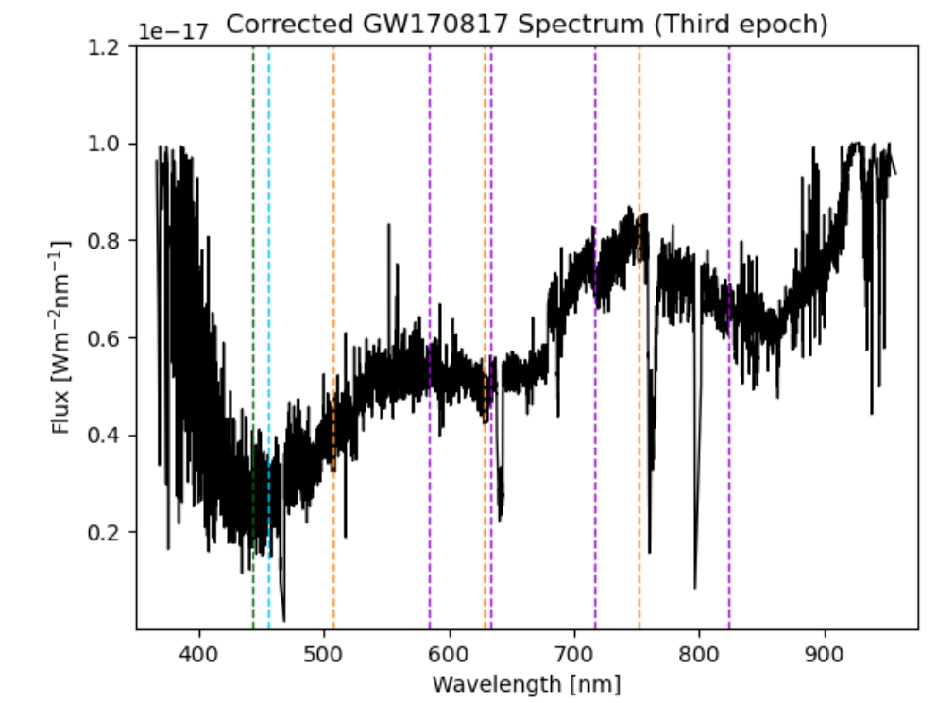
More Possible Elements Produced?
24
Notes:
This is an ongoing process, still need to run some test, but we have the equipment to test, and we would also like to find the temperature that comes from modeling the blackbody. This is actually one of our future endeavors.

Slide 26
Future Endeavors
25
Provide faster candidate elimination in the near future using heavy element spectroscopy
Produce more consistent blackbody temperature estimation
Classify more KN candidates
Provide a more in depth study of heavy element emission
Add current supernova classification algorithms to the DRAKE pipeline

Slide 27
Acknowledgements
26
A special thank you to…
Mentors: Tomás Ahumada and Shreya Anand
Supervisors: Alan Weinstein and Mansi Kasliwal
The National Science Foundation (NSF)
LIGO Lab
Caltech SFP

Slide 28
References
27
Senger, Peter. (2020). Astrophysics in the Laboratory—The CBM Experiment at FAIR. Particles. 3. 320-335. 10.3390/particles3020024.
HD wallpaper: Stars in the galaxy, milky way, starry sky, Night Sky, space. HD wallpaper: stars in the galaxy, milky way, starry sky, night sky, space | Wallpaper Flare. (n.d.).
https://www.wallpaperflare.com/stars-in-the-galaxy-milky-way-starry-sky-night-sky-space-wallpaper-wwweu
NASA. (2022, October 25). Sensing the universe. NASA. https://universe.nasa.gov/exploration/sensing-the-universe/
Admin. (n.d.). The Zwicky Transient Facility (ZTF). Media Platform for Bryan Penprase. http://bryanpenprase.org/the-zwicky-transient-facility-ztf/
Dixit, M. (2023, July 11). James Webb Space Telescope observes massive Kilonova explosion for first time. James Webb Space Telescope examines massive kilonova explosion for first time.
https://interestingengineering.com/science/james-webb-space-telescope-kilonova-explosion
Brockie, R. (n.d.). GMOs at UKATC, Edinburgh. https://www.roe.ac.uk/atc/projects/gmos/
Panchanathan, S. (2023, August 3). National Science Foundation. NSF. https://www.nsf.gov/
Daytona Beach - Embry-Riddle Aeronautical University. Daytona Beach | Embry-Riddle Aeronautical University. (n.d.). https://daytonabeach.erau.edu/
Home. California Institute of Technology. (n.d.). https://www.caltech.edu/
Dan. (2021, September 21). Astrophotography by Dan Gallo. Night Sky Dan. https://www.nightskydan.com/
Demystifying Flat-Frame Calibration. Sky &amp; Telescope. (2021, June 17).
https://skyandtelescope.org/astronomy-blogs/imaging-foundations-richard-wright/demystifying-flat-frame-calibration/
Mini Physics, Perspn, Chris, Anonymous, Remedy, Joe, Radford, M., &amp; Riemensperger, F. (2016, May 22). The electromagnetic spectrum. Mini Physics.
https://www.miniphysics.com/electromagnetic-spectrum_25.html
4. behavior of spectrum. Spectrum. (n.d.). http://wwwb.pikara.ne.jp/ogawa-giken/2016TWR/04.html
Info@noirlab.edu. (n.d.). Starry Night, laser light. www.noirlab.edu. https://noirlab.edu/public/images/iotw2223a/
Fritz. (n.d.). https://fritz.science/candidates
Coughlin, M. W., Ahumada, T., Anand, S., De, K., Hankins, M. J., Kasliwal, M. M., Singer, L. P., Bellm, E. C., Andreoni, I., Cenko, S. B., Cooke, J., Copperwheat, C. M., Dugas, A. M.,
Jencson, J. E., Perley, D. A., Yu, P.-C., Bhalerao, V., Kumar, H., Bloom, J. S., … Yatsu, Y. (2019, October 4). Growth on S190425Z: Searching thousands of square degrees to
identify an optical or infrared counterpart to a binary neutron star merger with the Zwicky Transient Facility and Palomar Gattini IR. arXiv.org. https://arxiv.org/abs/1907.12645
Watson, D., Hansen, C. J., Selsing, J., Koch, A., Malesani, D. B., Andersen, A. C., Fynbo, J. P. U., Arcones, A., Bauswein, A., Covino, S., Grado, A., Heintz, K. E., Hunt, L., Kouveliotou,
C., Leloudas, G., Levan, A., Mazzali, P., &amp; Pian, E. (2019, October 23). Identification of strontium in the merger of two neutron stars. arXiv.org. https://arxiv.org/abs/1910.10510
Metzger, B. D. (2019, August 29). Kilonovae. arXiv.org. https://arxiv.org/abs/1910.01617

