Slide 1
Bayesian Inference for Fast Scattering Glitches
Aislinn McCann
Mentors: Rhiannon Udall and Derek Davis
August 24, 2023

Slide 2
Roadmap
Motivation
What are glitches?
Parameter estimation
Objectives
A Sneak Peek…
Approach
Model derivation
Model testing (waveforms)
Model testing (itself)
Parameter estimation
P-P testing
Model testing (hardware-injected events)
Model testing (real events)
Conclusions

Slide 3
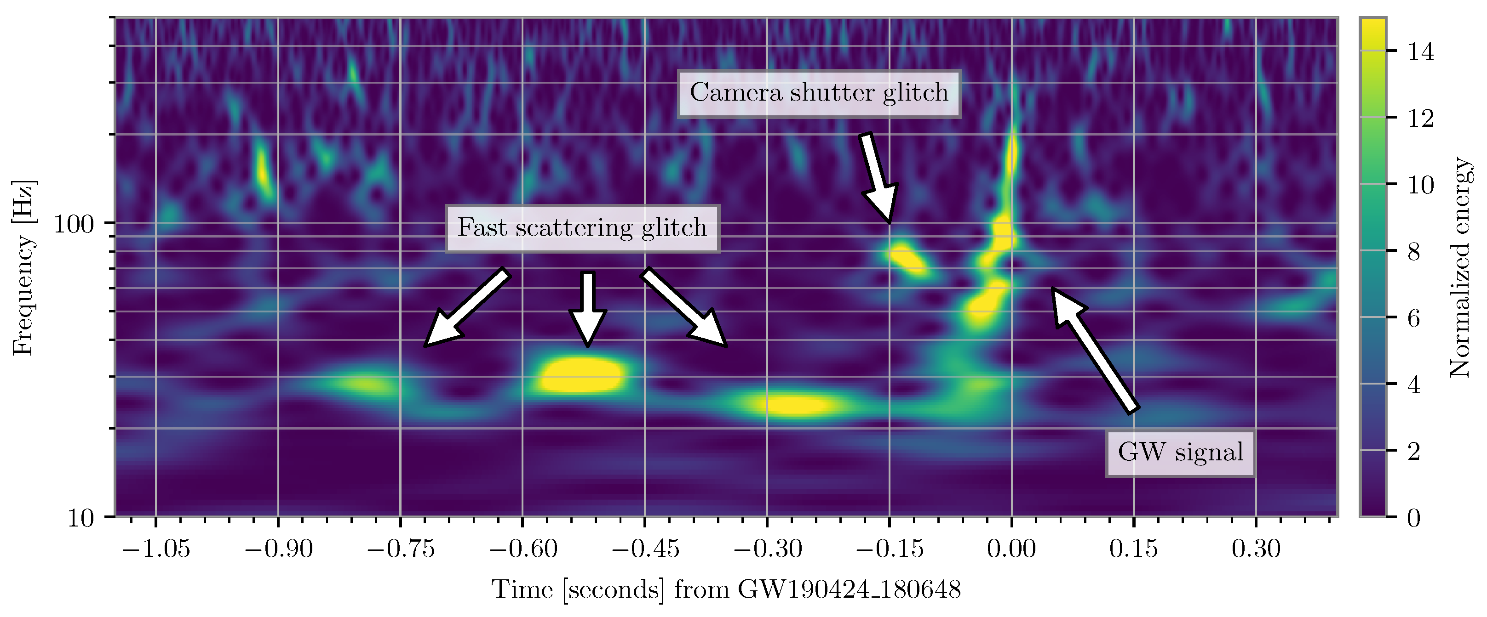
Motivation: What are Glitches?
Soni+ 2020
Persistent, short-duration noise transients in LIGO detector data
Environmental interference or electronic malfunction
Can overlap gravitational wave (GW) signals, prevent further analysis
Scattered light glitches: laser segments diverging from main beam path
Reflect off surrounding instrumentation w/ different relative motion
Rejoin main beam path and produce phase shift
Fast scattering (FS) produced by anthropogenic (1-5 Hz) and microseism (0.1-0.3 Hz) motion
Davis+ 2021
Notes:
So, what are glitches? Glitches are short duration noise transients seen in LIGO detector data and come from various sources of environmental interference or electronic malfunction. They’re a problem because they often overlap on top of gravitational wave signals and make them difficult to interpret, preventing further analysis. In particular, there’s one form of glitch we’re concerned about called scattered light glitches. These are the result of small laser segments within the detector’s interferometer arms scattering off of tiny imperfections on the surfaces of each test mass. These segments bounce off of surrounding surfaces of differing relative velocity and rejoin the main beam path, which produces an additional phase shift which is picked up by the detector. One of these scattered light glitches, known as fast scattering glitches, are the concern of this project. These glitches come from combined motion in the anthropogenic and microseismic bands, so pretty much human activity and oceanic activity.

Slide 4
Motivation: Parameter Estimation
Romero-Shaw+ 2020
Ashton+ 2019
Bayesian inference for compact binary coalescence (CBC) signals determine posterior probability distributions based on prior knowledge of conditions
Parameter estimation (PE) pipelines infer CBC posteriors using Bayes’ theorem:
Given parameters $θ$, data $d$, and model $ℳ$
PE pipelines assume GW noise data is Gaussian and stationary
Transient glitches non-Gaussian – removal necessary to improve functionality of PE pipelines
Likelihood
Prior
$$p\left(θ | d,ℳ\right)=\frac{ℒ\left(d | θ,ℳ\right)π\left(θ | ℳ\right)}{𝒵(d|ℳ)}$$
(1)
Evidence
Notes:
So, a lot of analysis of CBC instances is done with parameter estimation pipelines which use Bayesian inference, which uses Bayes’ theorem to infer the posterior probability densities of an event’s source parameters given the data and a model hypothesis. Bayes’ theorem states that the posterior of the parameters given the data d and model M is equal to the likelihood of measuring the data, assuming the source has some parameters with the model hypothesis, multiplied by the prior parameter distribution given the model, over the data evidence given the model. Parameter estimation pipelines assume noise data is Gaussian and stationary. However, transient glitches are non-Gaussian in nature which contradicts the assumption that PE pipelines make. So, to improve their functionality, it’s especially necessary to remove these instances from LIGO data so that CBC events can be better analysed.

Slide 5
Objectives
Derive mathematical model to emulate waveform of FS glitches
Test validity of model by:
Setting parameter values given constraints agreeing w/ model and generating waveform
Parameter estimations + injections w/ Bilby
P-P testing to see how well sampler produces parameters in credible intervals (CI)
Then, test model on:
Artificial (more simple structure) FS instances
Real (more complex structure) FS instances
Joint “CBC+glitch” instances
Focus: mitigate instances of FS in GW data to improve CBC analysis in future observing runs

Slide 6
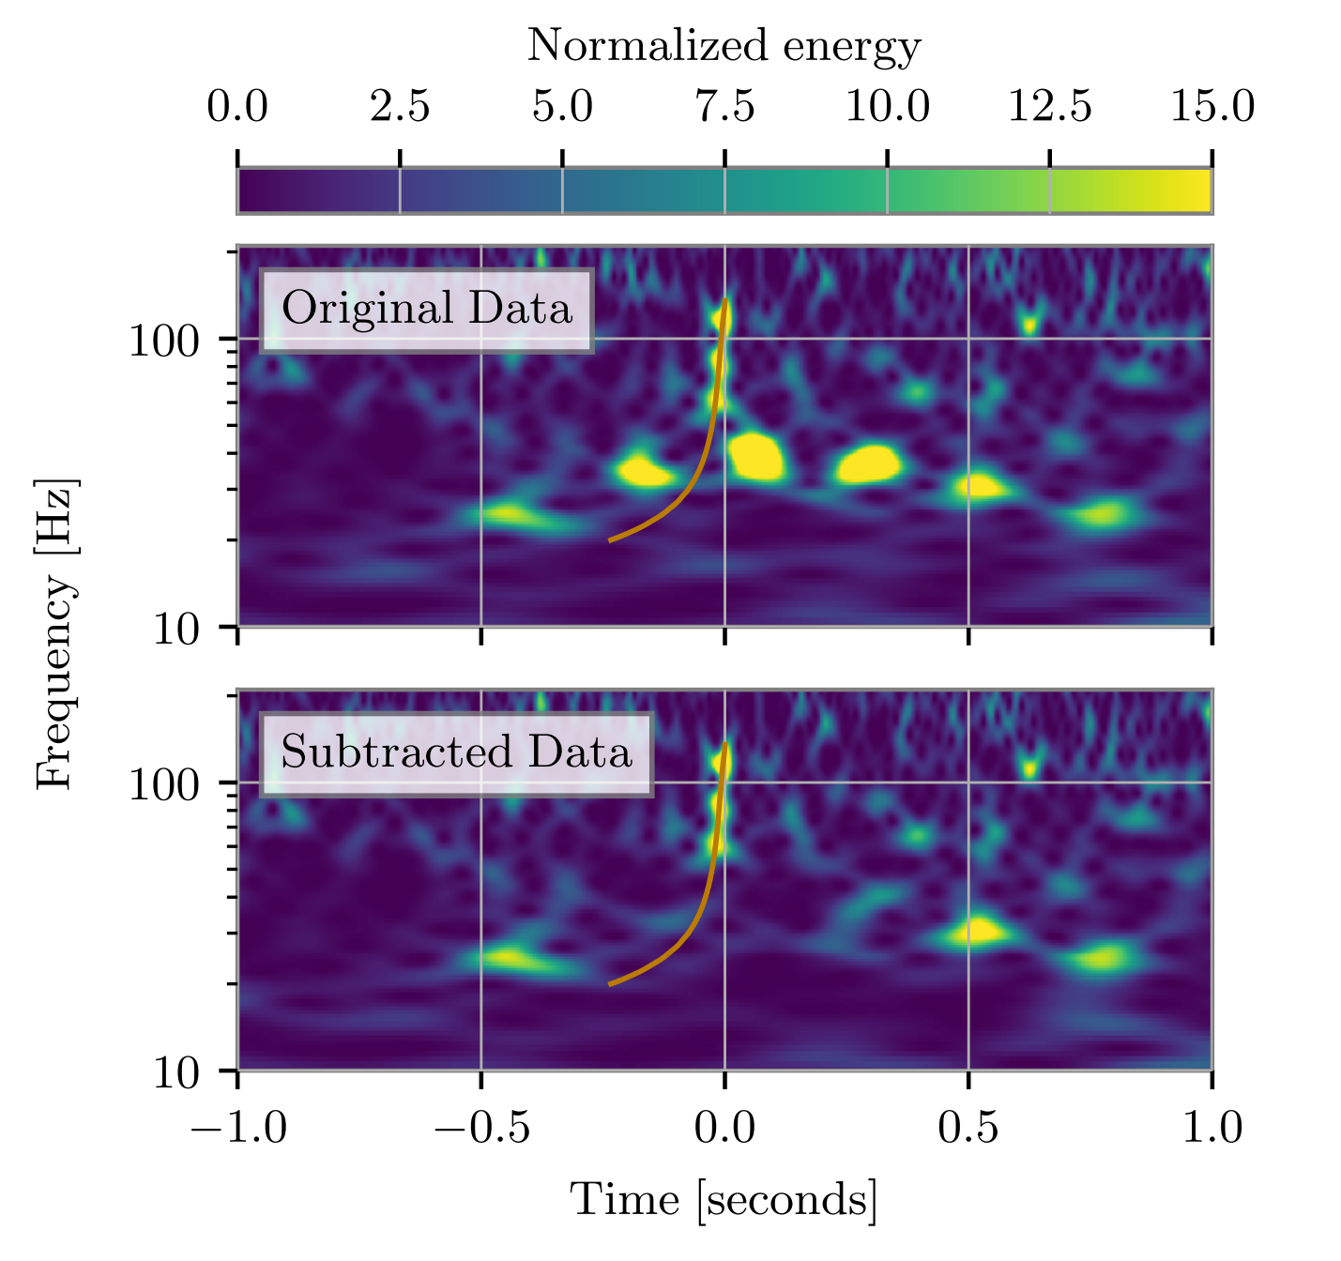
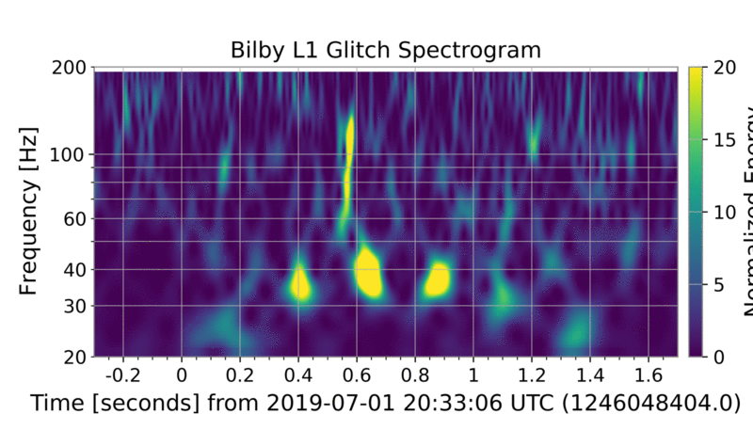
A Sneak Peek…
Successful FS mitigation on top of GW190701!
Abbott+ 2021
LVK result
Our result!
Notes:
So, here’s a preview of our big result that we achieved this summer! We were able to successfully subtract an instance of fast scattering from on top of a CBC merger, which was done previously in an LVK paper. As you can see, there are still some sub-arches present after LVK mitigation efforts in the spectrograms seen on the left. In the right spectrogram, you can see that our model performed beyond this and completely removed the fast scattering arch as a whole, leaving only the CBC merger. We just achieved this result yesterday so it was a really great way to end the summer!

Slide 7
Approach: Model Derivation
Tolley+ 2023
Udall+ 2022
$$h\left(t\right)=\overline{A}sin[\frac{4π}{λ}x\left(t\right)+φ]$$
Excess strain noise equation:
(2)
$\overline{A}$: amplitude of noise produced by glitch from surface motion $x\left(t\right)$ w/ phase shift $φ$
On assumption that reflecting surface is a simple harmonic oscillator:
$$x\left(t\right)=C_{1}\sin\left(f_{1}t\right)+C_{2}sin⁡(f_{2}t)$$
(3)
$C_{1}$ and $C_{2}$: amplitudes from driving frequencies $f_{1}$ and $f_{2}$
Therefore, we have our model:
$$h\left(t\right)=\overline{A}sin[C_{1}\sin\left(f_{1}t\right)+C_{2}\sin\left(f_{2}t\right)+φ]$$
(4)
Notes:
So, we started with the equation that describes the excess strain noise in GW data shown in Equation 2, where A bar is the amplitude of the noise produced by the glitch from the motion of the relevant surface x of t, with a phase shift phi. On the assumption that the reflecting surface is a simple harmonic oscillator, we use Equation 3 to describe the motion that comes from the two driving frequencies f1 and f2 with amplitudes C1 and C2. Combining both equation 2 and 3 gives us equation 4, which is the general form of our model to describe the waveform of a fast scattering glitch

Slide 8
Approach: Model Derivation
FS characterised by peak frequency at $\sim 50 Hz$ ($f_{max}$)
At $f_{max}$, Eqn (4) is described by:
$$C_{1}f_{1}+C_{2}f_{2}=f_{max}$$
(5)
Reparameterising model for efficiency ($d_{1}=C_{1}f_{1},d_{2}=C_{2}f_{2}$):
$$h\left(t\right)=\overline{A}sin[\frac{d_{1}}{f_{1}}\sin\left(f_{1}t\right)+\frac{d_{2}}{f_{2}}\sin\left(f_{2}t\right)+φ]$$
(6)
Notes:
So, we have constraints already mentioned for our two driving frequencies, so we then needed to constrain the two amplitudes with respect to these possible values. Various examples of fast scattering seen in gravitational wave data showed that fast scattering is very well characterised by a peak frequency at around 50 Hz, which we set as a guideline by introducing fmax into our model. Equation 4 yields then that the sum of C1 times f1 and C2 times f2 is equal to fmax, a relation we used to determine the values for C1 and C2. We then reparameterised our model to make it more efficient, calling C1 times f1 and C2 times f2 d1 and d2 respectively.

Slide 9
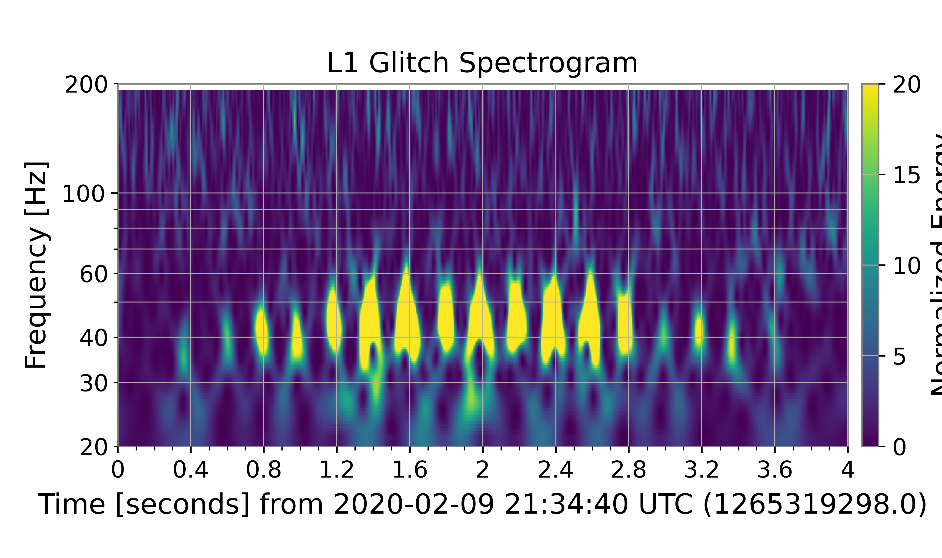
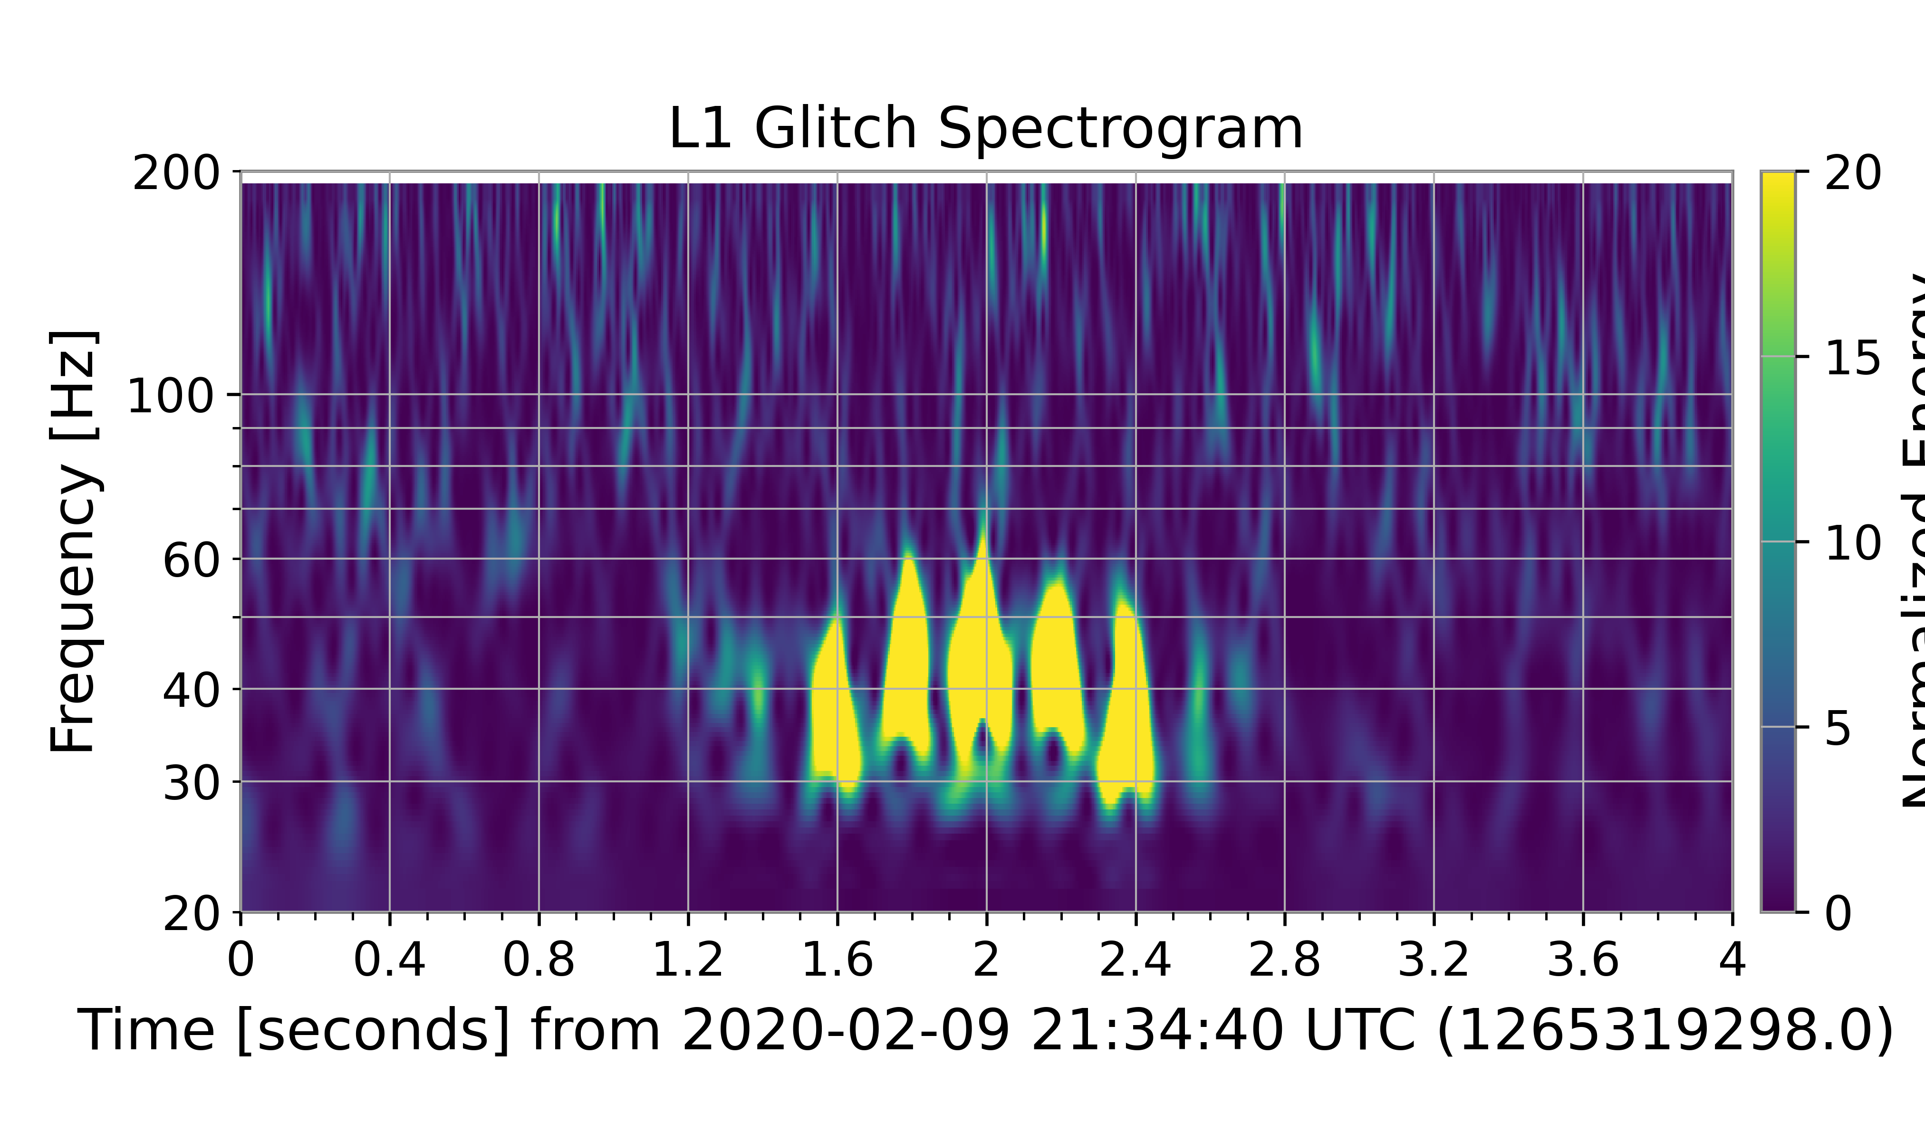
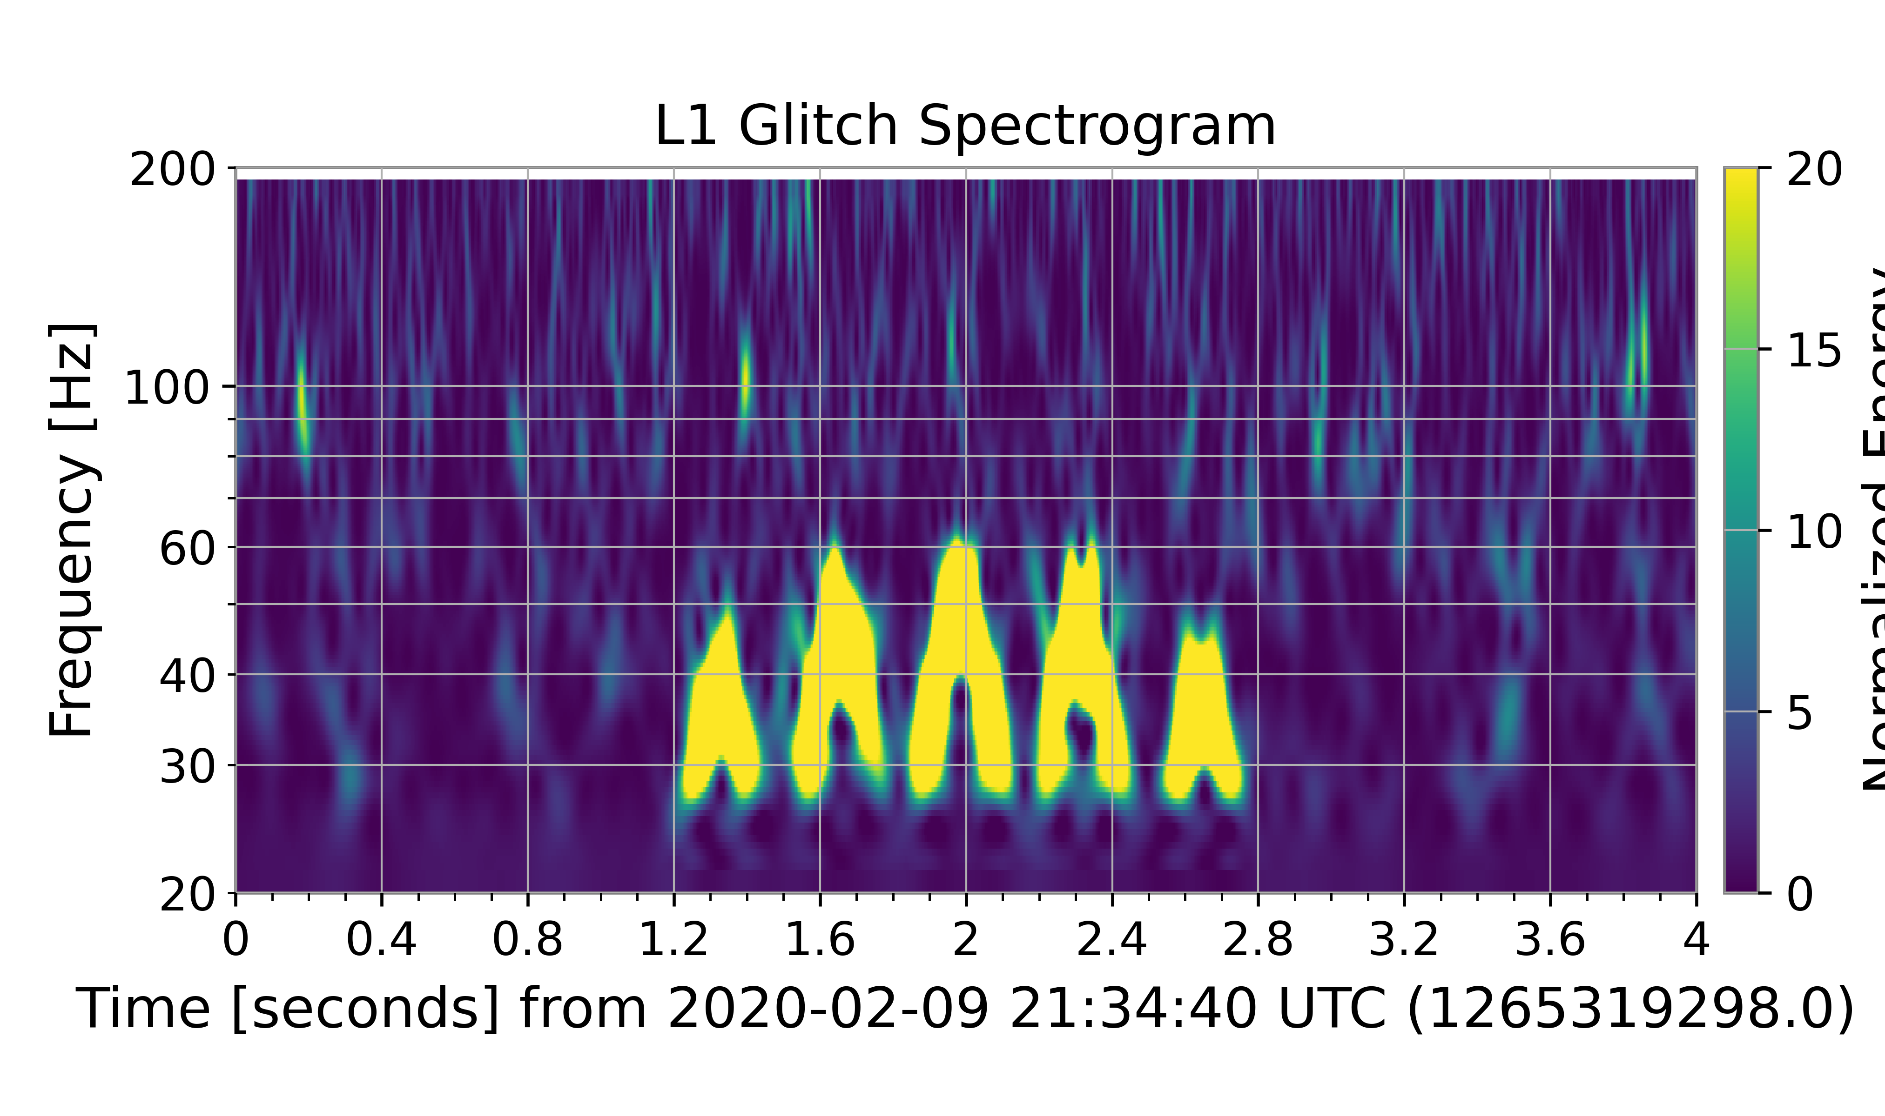
Model Testing: Waveforms
Created spectrograms of multiple possible combinations of $d_{1},{ f}_{1}$ and $d_{2}{,f}_{2}$
Verdict: model successfully recreates expected FS waveform
Notes:
So, our first order of business was to pick values for d1, f1, d2, and f2 that agreed with our constraints and pretty much play around with the values to see how well they emulate the general waveform of fast scattering seen in gravitational wave data. Each of these three spectrograms correspond to different possible combinations of each of these four parameters. We found that the model successfully recreates the expected waveform characteristic of fast scattering, so we moved onto our next tests which were done using Bilby.

Slide 10
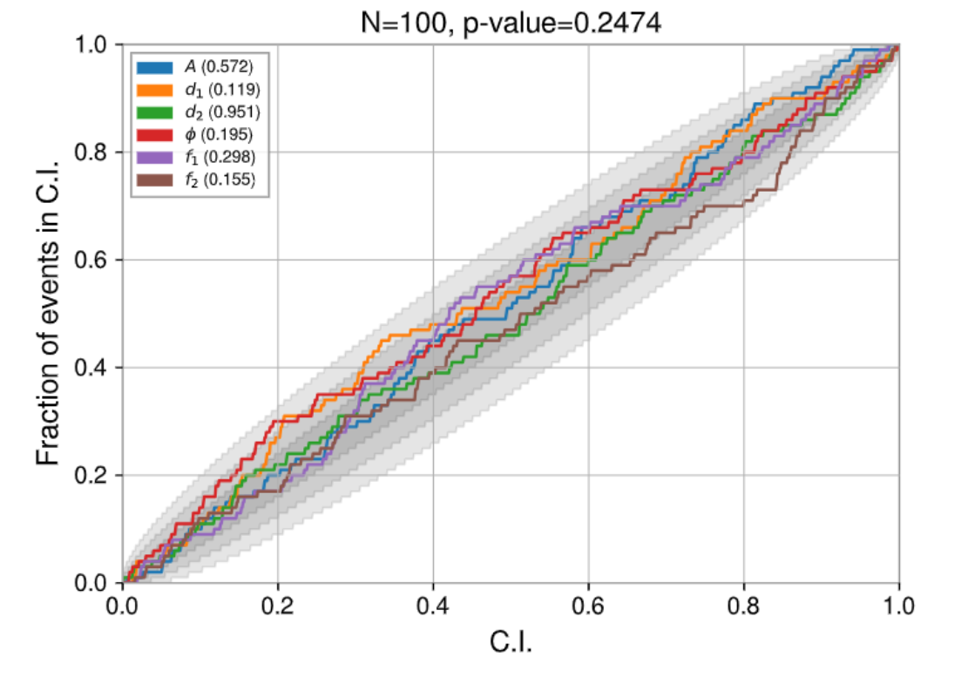
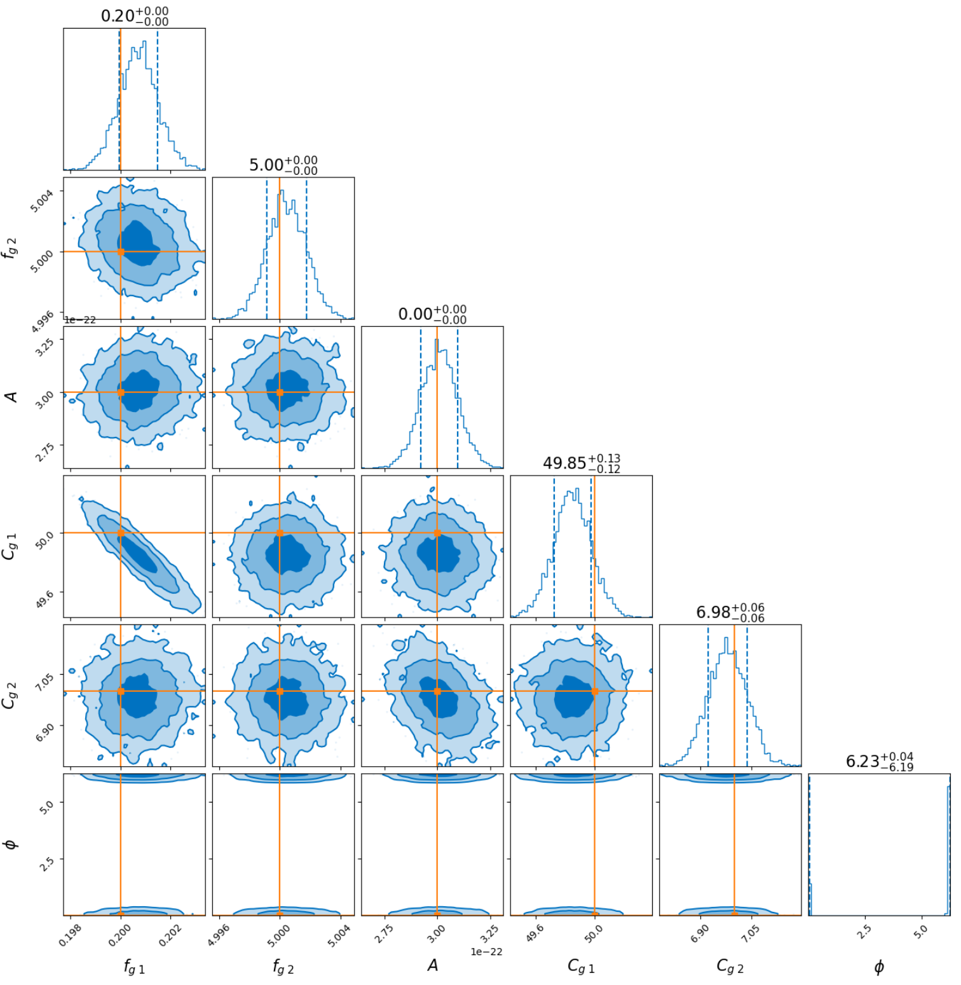
Model Testing: Itself
P-P test: correct value in 10% CI 10% of time, etc. (should follow linear trend if unbiased)
Corner plots show probability densities of parameter values
Injected parameters lie within greatest probability density regions
Verdict: model testing on itself successful!
Notes:
We performed PP testing on our model’s parameters over 100 samples to essentially see how well our model describes itself. For PP tests, the correct value for a parameter should lie in the 10% credible interval 10% of the time, the 20% credible interval 20% of the time, and so on. This would follow a linear trend given that the parameters are unbiased. A biased result would show a deviation from this diagonal, which is minimal for our PP test and indicates that our model passed.
On the right is a corner plot that describes the posterior probability densities of each parameter in our model, which generally shows where the value of each parameter lies with respect to another. Our injected values, shown by the orange dots and lines, lie pretty close to the greatest probability density regions, which tells us that our model is able to accurately perform parameter estimation, at least on itself. So, we move on from self-testing onto actual events!
CREDIBLE INTERVAL (Bayesian results), not confidence interval (Frequentist results)

Slide 11
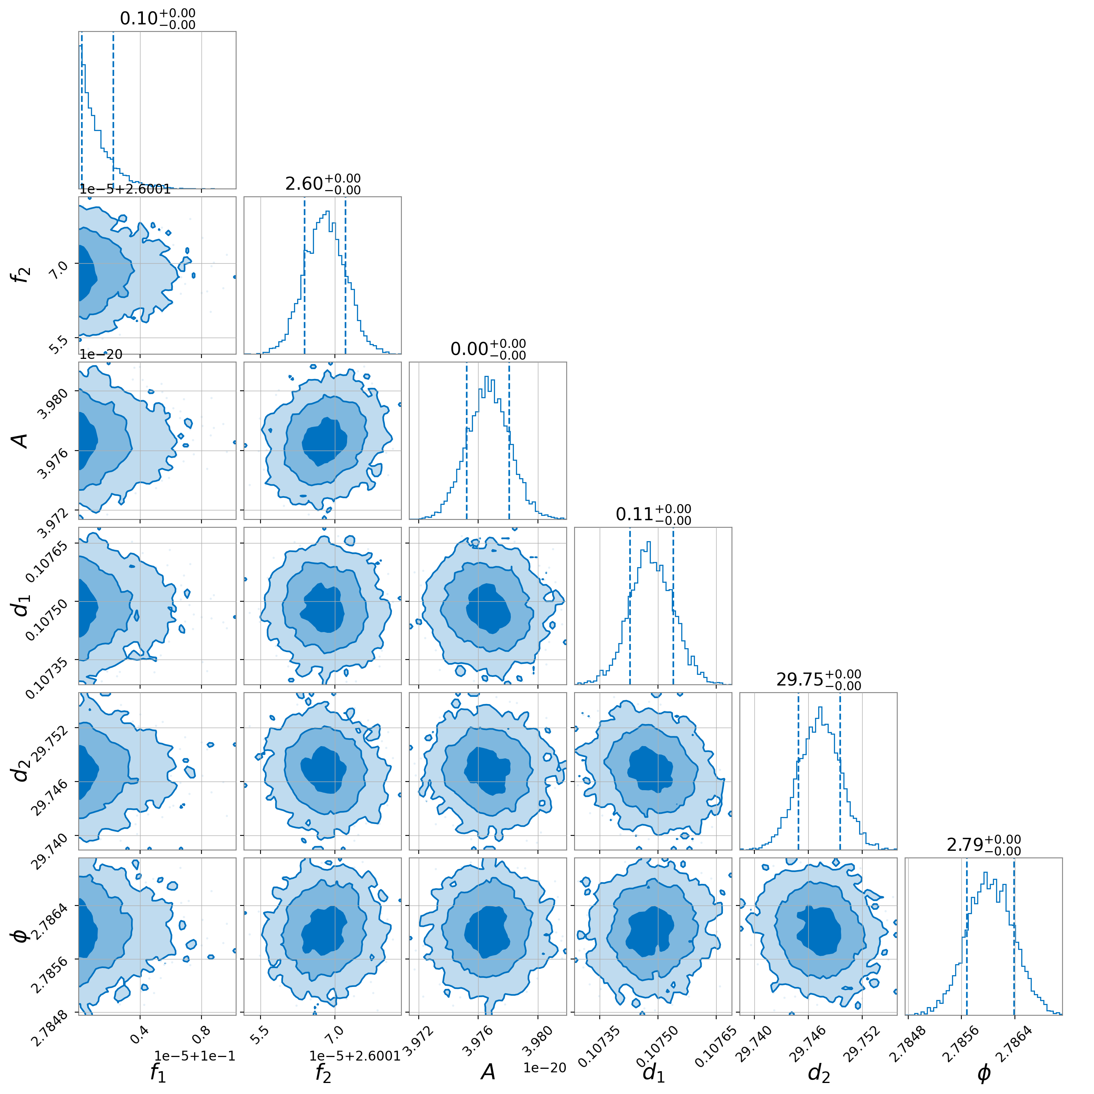
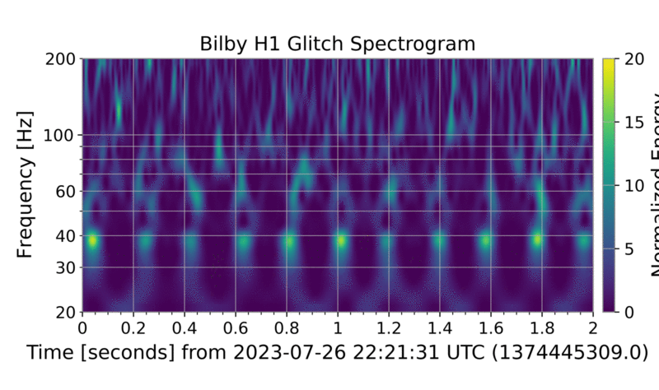
Model Testing: Hardware-Injected Events
Hardware-injected FS has simple structure
Residual: glitch subtraction but also amplification
Suspected due to amplitude changes
$f_{2}$ known at $2.6 Hz$ – accurately estimated
Verdict: some success in subtracting simple cases
Notes:
Our first actual event test was on a hardware injection of fast scattering glitches, which as you can see have a pretty simple and uniform structure. Subtracting the actual data from our model yielded a residual that showed glitch subtraction in some places, but amplification in others. We think this may be due to changes in the injection’s amplitude over time. On the left, I want to draw your attention to how well our model does in estimating f2. The hardware injected fast scattering is of a frequency of 2.6 Hz, which, as you can see for f2, was estimated pretty accurately in Bilby. So, all in all, our model did a decent job with this simple fast scattering case.
Hardware injected: take a large mass and shake it at 2.6 Hz which shakes the detector. Shaker injection

Slide 12
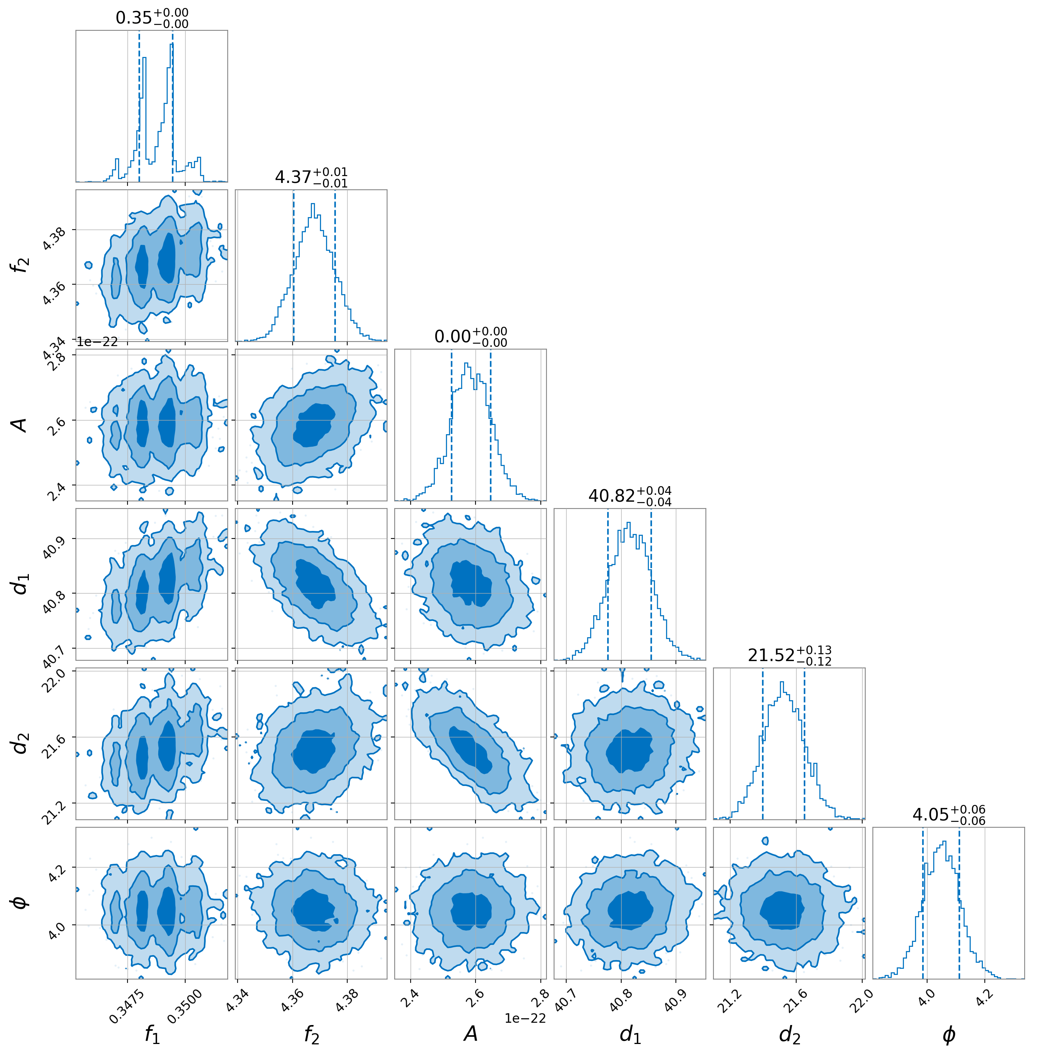
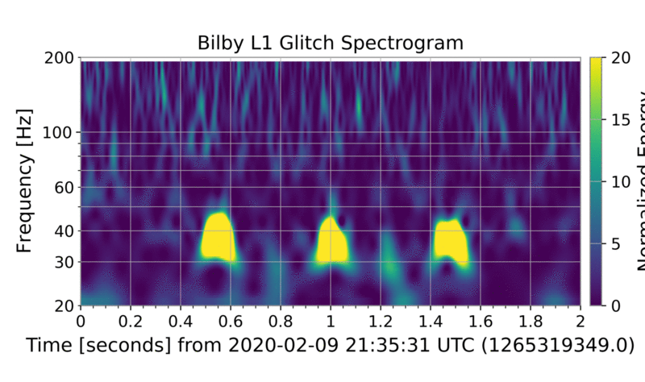
Model Testing: Real Events
Testing subtraction of more complex event
Little to no glitch mitigation seen in residual
Strange corner plot structure for $f_{1}$
Verdict: model facing difficulty – reparameterise and add additional phase shift
Notes:
We then moved onto an actual case of fast scattering in order to test how well our model can subtract a more complex event. In the residual, we see little to no glitch mitigation, instead we see that the residual has added arches. Additionally, our parameter estimations yielded a strange probability density result for f1. These results indicate that the model had some issues with this case, which we attempted to improve by reparameterising and adding another phase shift to give the model a little more freedom.

Slide 13
Approach: Reparameterising the Model
To guide model further and possibly improve results, we:
1.) Added $d_{2}$ dependence on $d_{1}$ and $f_{max}$ using (5) and (6)
$$d_{2}=f_{max}−d_{1}$$
(7)
2.) Replaced $φ$ with two phase shifts $φ_{1}$ and $φ_{2}$ to each frequency function for more model freedom:
$$h\left(t\right)=\overline{A}sin[\frac{d_{1}}{f_{1}}\sin\left(f_{1}t+φ_{1}\right)+\frac{d_{2}}{f_{2}}\sin\left(f_{2}t+φ_{2}\right)]$$
(8)

Slide 14
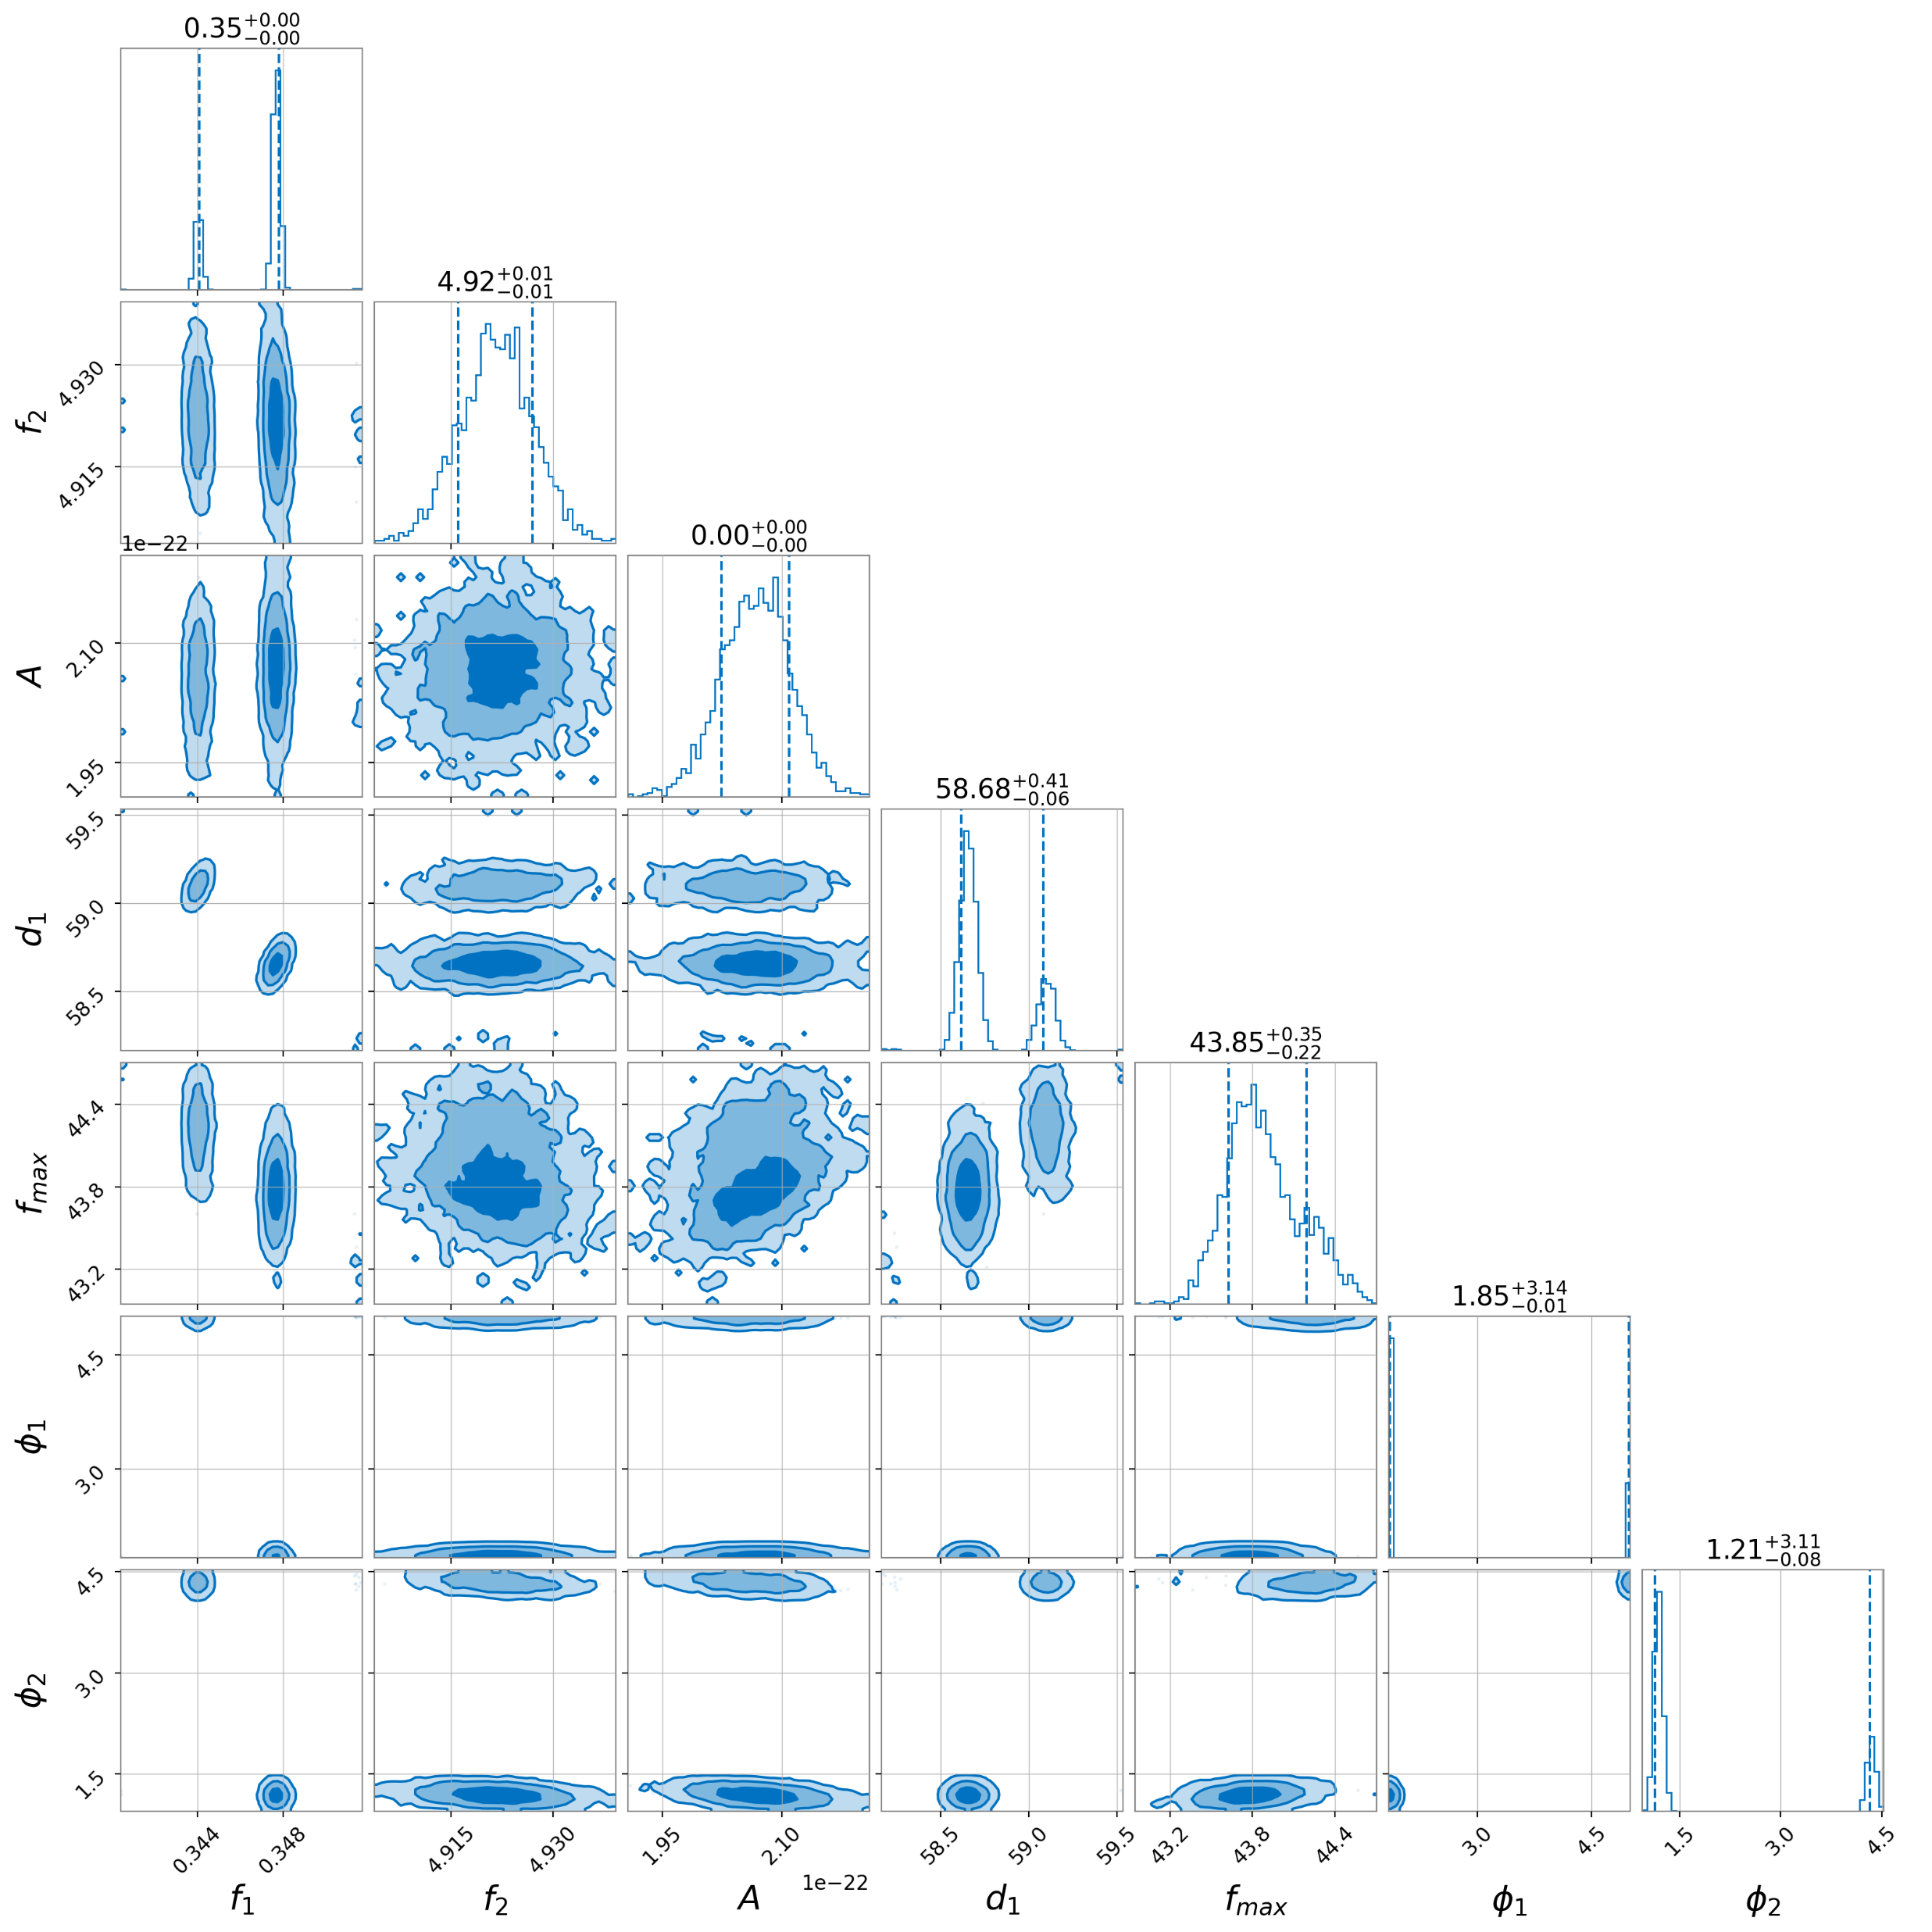
Model Testing: Real Events (reparameterised)
Still addition to residual
Railing seen in corner plot for various parameters
Verdict: model struggles with additional phase shift – removed for next attempt
Notes:
In this case, we see that there is still a new glitch being added without much subtraction going on. In addition, there’s a lot of railing happening for our parameters throughout in which the parameter estimation kind of branches off into two different nodes. We decided that the model had a really hard time with this additional phase shift, which we removed again in our next run.

Slide 15
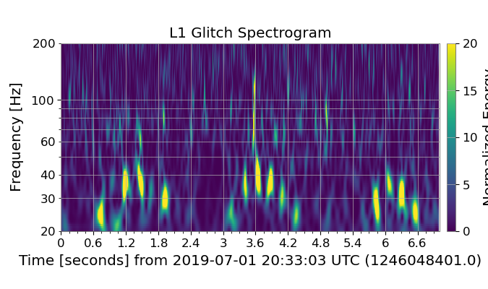
Model Testing: Real Events (GW190701)
Tested model capabilities for FS mitigation in GW event example
Less complex case than previous real event – gauge model effectiveness
Both on-GW and off-GW cases
GW190701
Off-GW
FS
On-GW
Notes:
We then moved onto an actual GW event with instances of fast scattering overlaid on top of the merger to test the model’s capabilities in this case. It’s a slightly less complex case of fast scattering than the previous real event, so this was used to gauge the model’s effectiveness in a slightly simpler case. We did this analysis on a fast scattering arch that happened both on and off the merger.

Slide 16
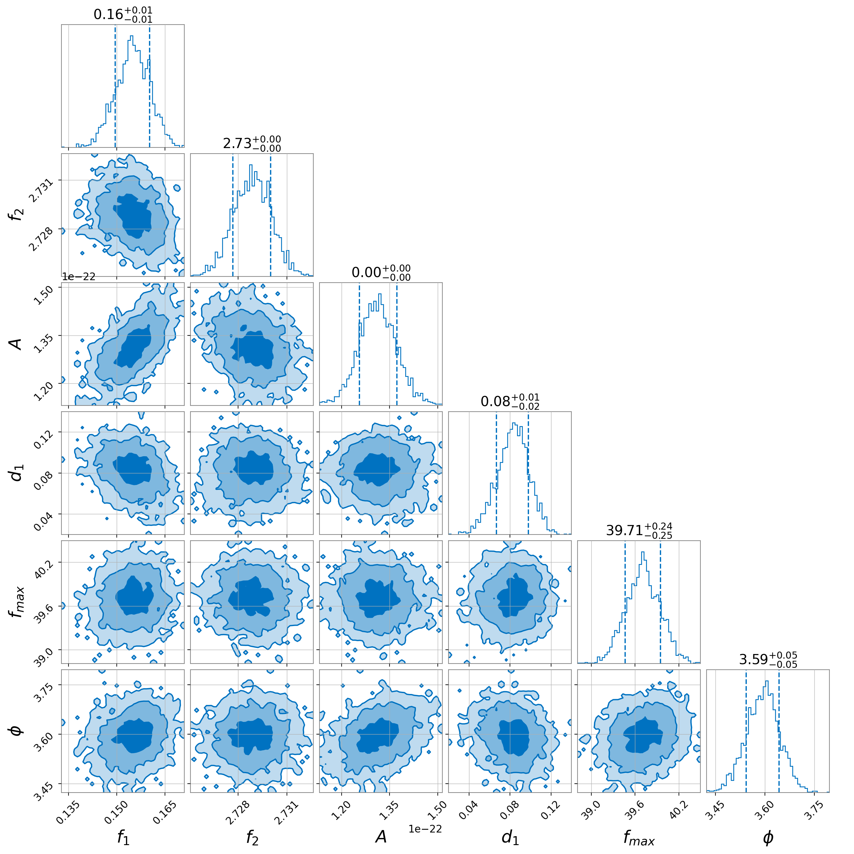
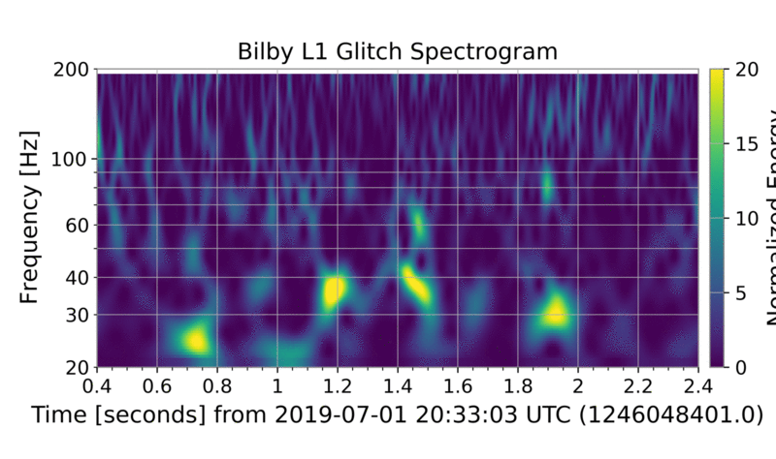
Model Testing: Real Events (GW190701 off-GW)
Slight subtraction
No more railing but unexpected $d_{1}$ value ($d_{1}→0)$
Note: FS not very “pretty” here
Verdict: not bad, needs improvement
Notes:
Starting with the off GW case, we see that there is some slight subtraction happening in our residual spectrogram, but only for the glitch within the 20-30 hz frequency range. Our corner plot shows some improvement now that there’s no more railing happening, but we still got an unexpected d1 value, implying that it lies close to zero. The fast scattering happening for the off-GW case is not very pretty in this segment, being that the blobs are pretty non-uniform and don’t occur at equal time intervals, so our model had a bit of a hard time with that. All in all, it’s not bad but it needs improvement

Slide 17
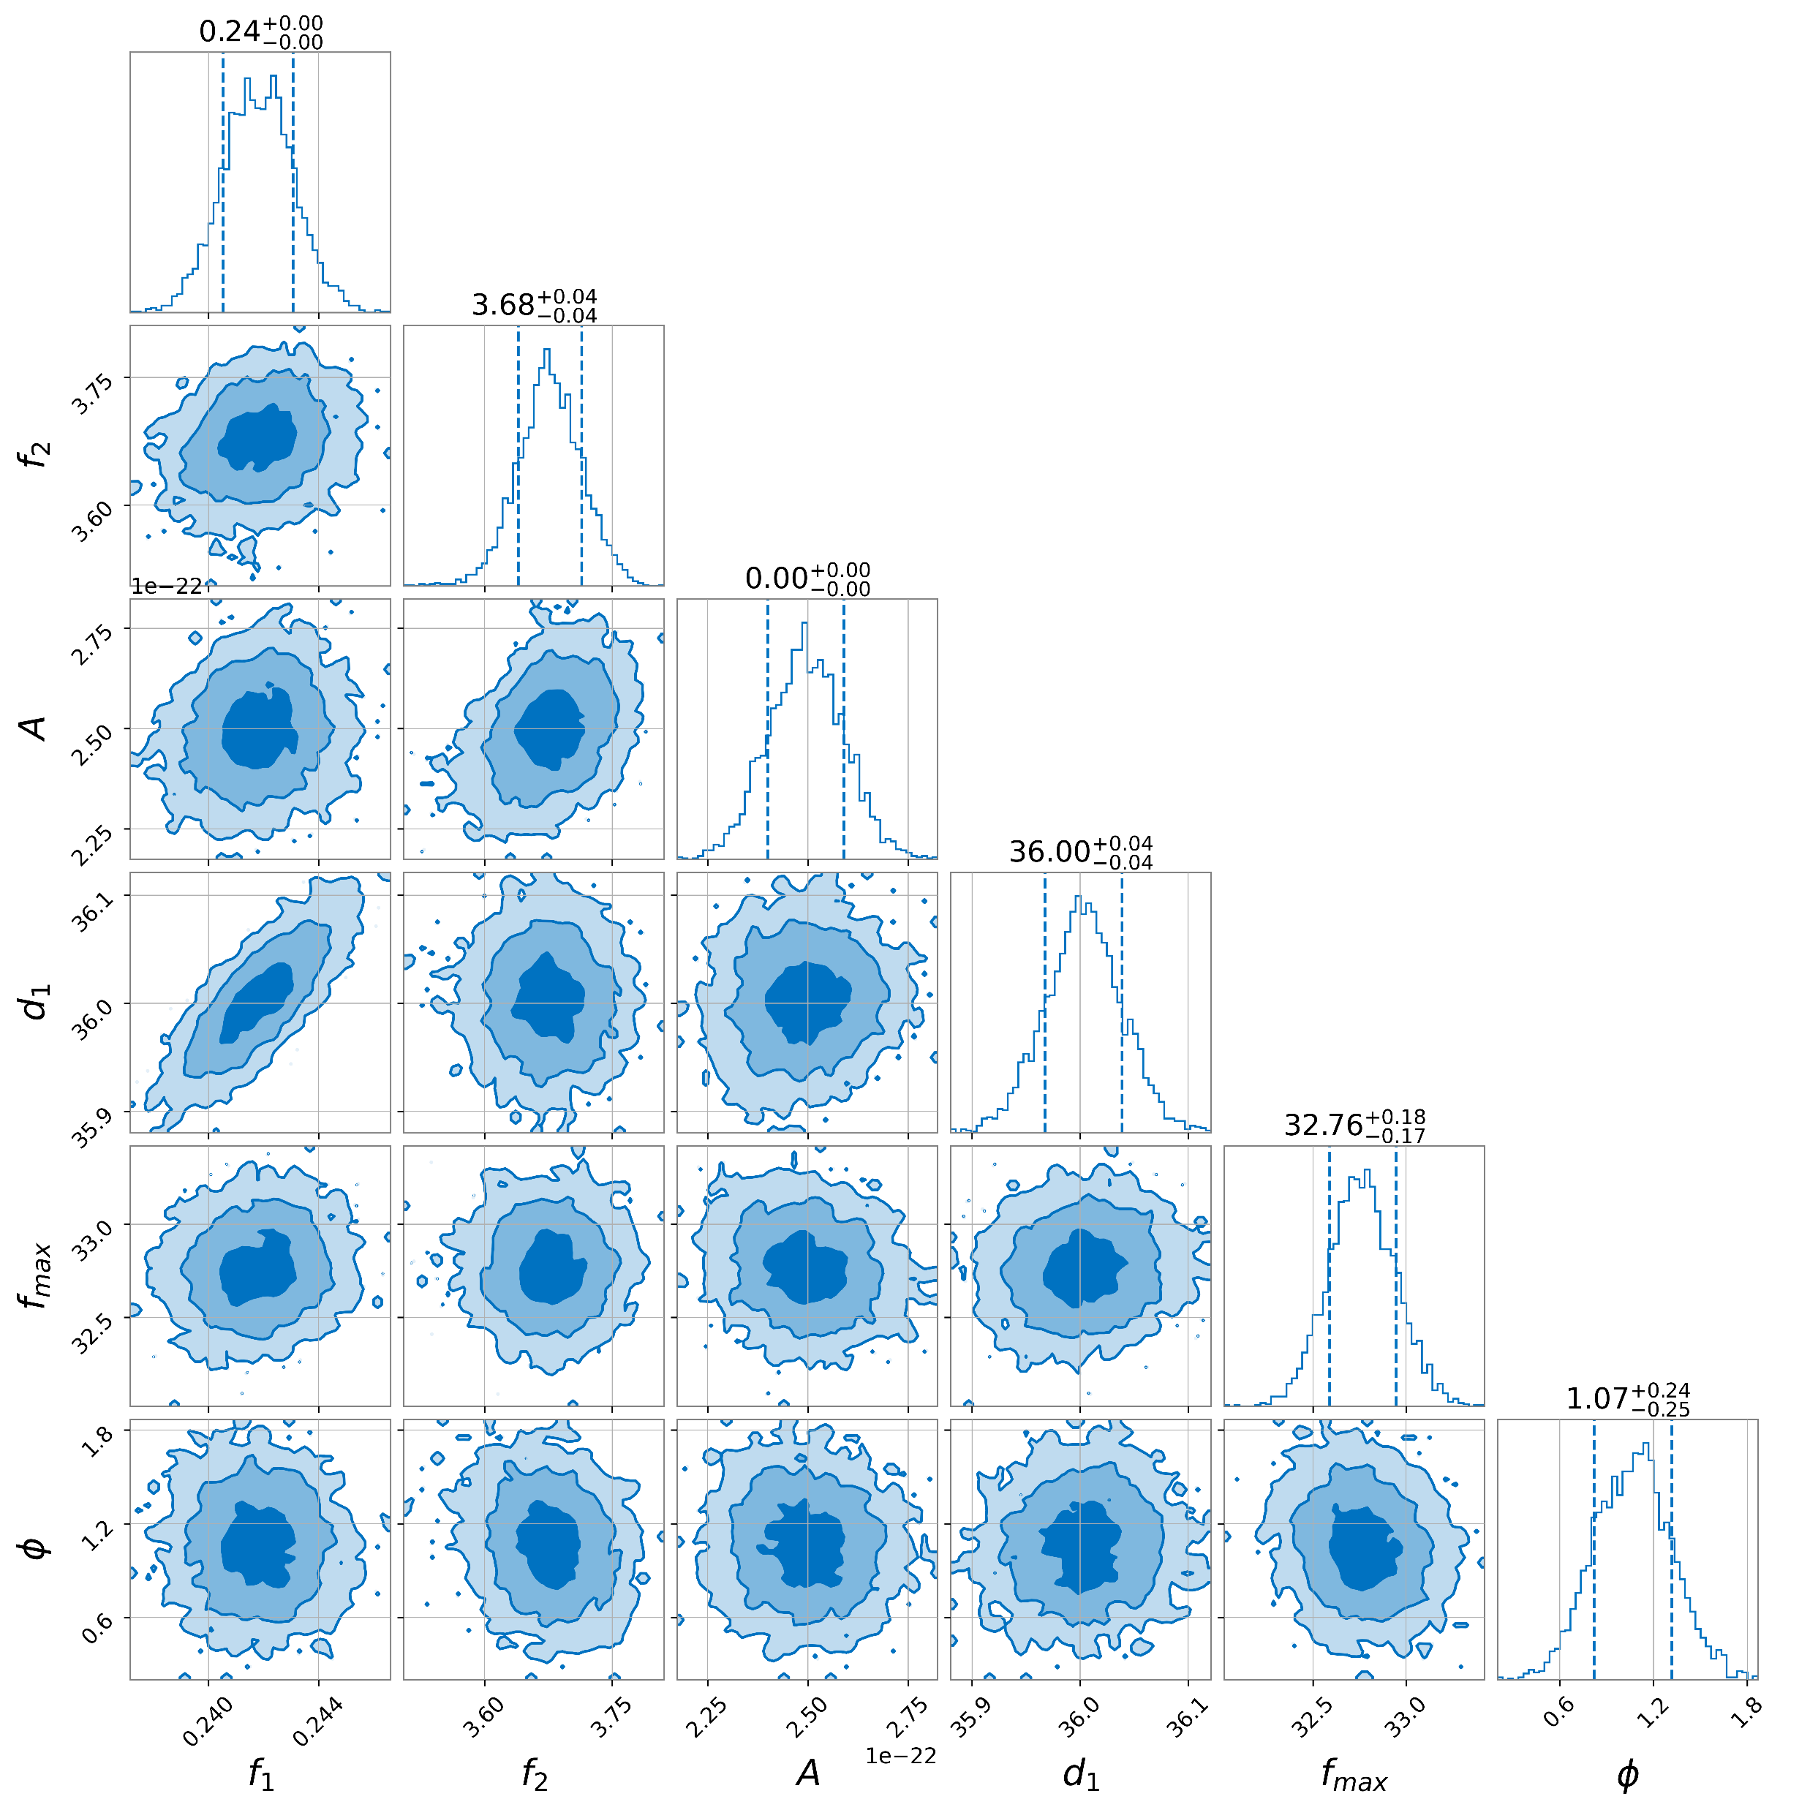
Model Testing: Real Events (GW190701 on-GW)
Complete glitch subtraction!
$d_{1}$ makes more sense now
FS structure more uniform than previous
Verdict: great!
Notes:
And here is the on GW case which I briefly showed a little sneak peek of earlier in my talk. In the residual the glitch is completely subtracted, leaving only the merger, which was pretty exciting to see! In the corner plot, we saw that the value for d1 makes a lot more sense than our previous result. Because the structure for the fast scattering glitch is a lot prettier and more uniform than the previous case, the model does a lot better in its subtraction. So, the model performed pretty flawlessly in this case.
Gaussian in corner plots implies that parameters are linearly correlated, even though they don’t really look like they would be in our model. Because we set our priors to zero in on a small space around the correct answer – basically a fisher matrix. How the parameters vary with each other

Slide 18
Conclusions
Currently
Model performs well with self-tests (P-P and injection tests)
Challenges
Model struggles with more complex and less predictable FS
Future Work
Revise parameters to try improving model performance
See how model fares with joint “CBC+glitch” instances
Test model on more FS cases
Success in mitigating simpler, uniform FS structures (including on mergers)

Slide 19
Acknowledgements
Rhiannon Udall and Derek Davis
Caltech Student-Faculty Programs (SFP)
LIGO Summer Undergraduate Research Fellowship (SURF) Program
National Science Foundation (NSF)
The friends I made along the way
Thank you!
Notes:
I’d like to thank

Slide 20
References
Soni, S., Austin, C., Effler, A., Schofield, R. M. S., González, G., Frolov, V. V., ... & Ryan, K. (2020). Reducing scattered light in LIGO’s third observing run. Classical and Quantum Gravity, 38(2), 025016.
Davis, D., & Walker, M. (2022). Detector characterization and mitigation of noise in ground-based gravitational-wave interferometers. Galaxies, 10(1), 12.
Udall, R. P., & Davis, D. (2023). Bayesian modeling of scattered light in the LIGO interferometers. Applied Physics Letters, 122(9).
Tolley, A. E., Davies, G. S. C., Harry, I. W., & Lundgren, A. P. (2023). ArchEnemy: Removing scattered-light glitches from gravitational wave data. arXiv preprint arXiv:2301.10491.
Ashton, G., Hübner, M., Lasky, P. D., Talbot, C., Ackley, K., Biscoveanu, S., ... & Thrane, E. (2019). BILBY: A user-friendly Bayesian inference library for gravitational-wave astronomy. The Astrophysical Journal Supplement Series, 241(2), 27.
Romero-Shaw, I. M., Talbot, C., Biscoveanu, S., D’emilio, V., Ashton, G., Berry, C. P. L., ... & Xiao, L. (2020). Bayesian inference for compact binary coalescences with bilby: validation and application to the first LIGO–Virgo gravitational-wave transient catalogue. Monthly Notices of the Royal Astronomical Society, 499(3), 3295-3319.

