Slide 1
Simulating Binary Neutron Star Mergers
Carter Anderson
Mentors: Isaac Legred & Katerina Chatziioannou

Slide 2
The Goal
Motivation
Longer more physically accurate simulations
Numerical Relativity Waveforms
Nuclear Physics
Super-nuclear density laboratories
Testing Observables

Slide 3
SpECTRE
Take a DG Step
FD Step
Wedged Domain
SubCell Numerical Method
Discontinuous Galerkin (DG)
  Spectral Method
  Fast, Accurate
  Struggles with Discontinuity
Finite Difference (FD)
  Normal approximation over a grid
  Less Accurate
  Doesn’t mind Discontinuity
Evaluate TCI
Reconstruct
DG Solution
Step Completed

Slide 4
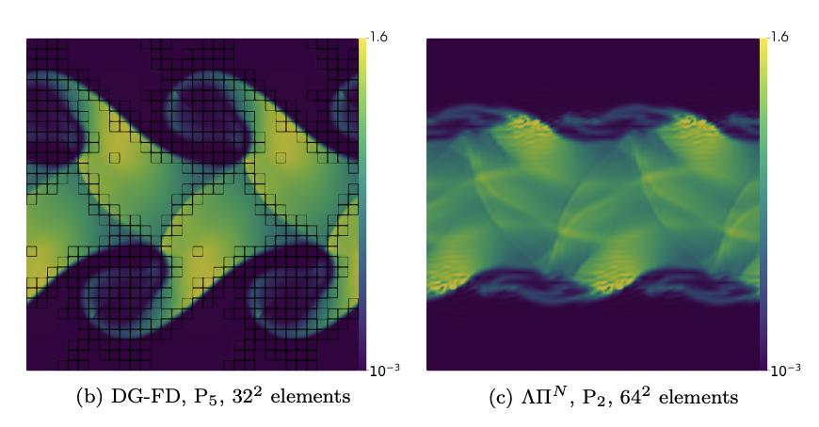
SpECTRE

Slide 5
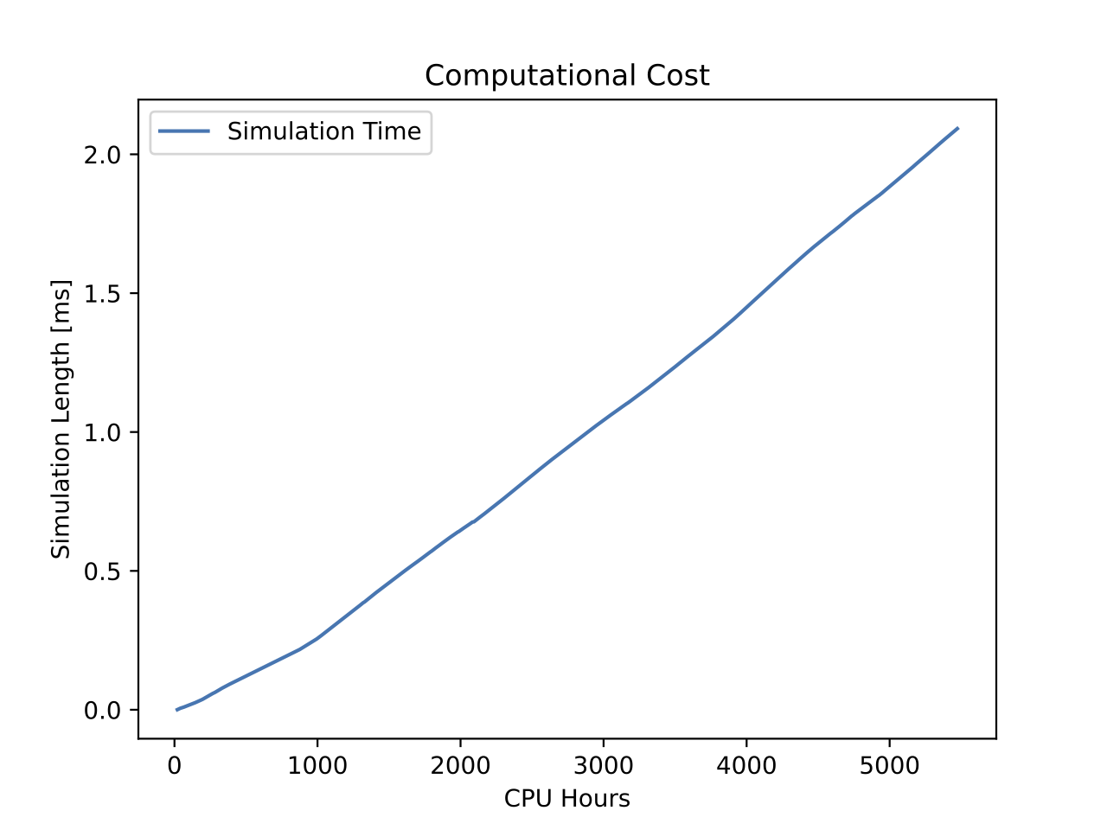
SpECTRE
Challenges
Current Implementation
Neutrons stars have matter
  More variables
  Fluid dynamics
Computationally expensive
Unknown physics
  generic implementations
Can’t evolve beyond a black-hole
Stars collide head on
Short some variables

Slide 6
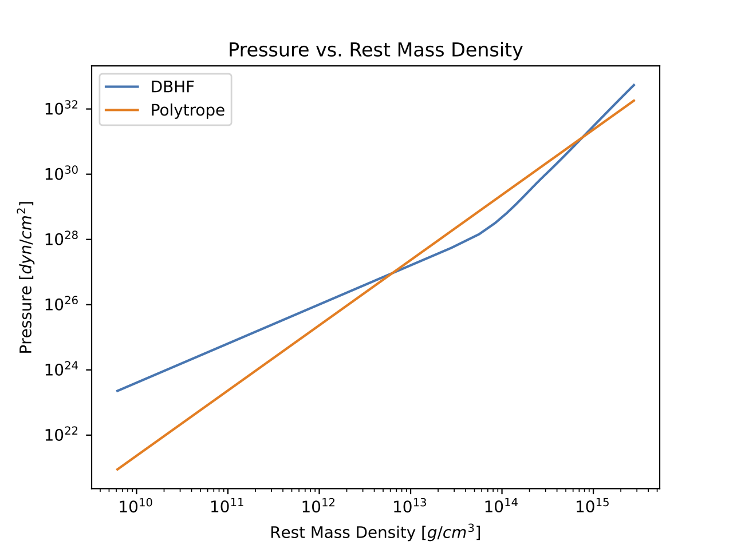
Equations of state
The relation between pressure, temperature, and density

Slide 7
Equations of state
Polytropic
  Thermodynamics, and ideal gas law
  P = K 𝞺
Spectral
  Smooth parametrization using basis
  Flexible with limitations
Enthalpy
  Parametrization of specific enthalpy
  Completely customizable
(n+1)/n

Slide 8
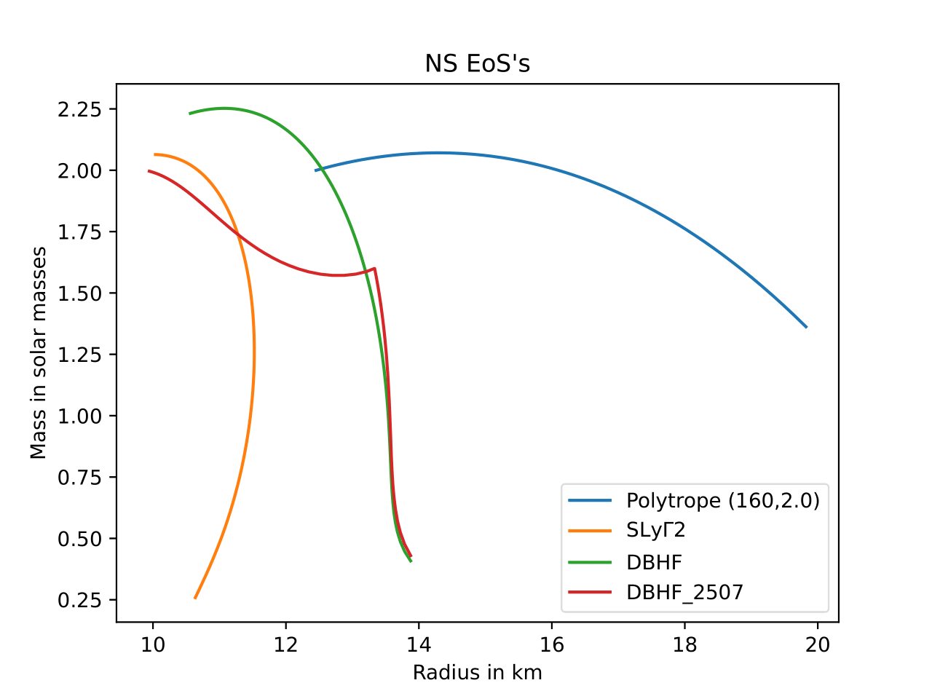
Equations of state

Slide 9
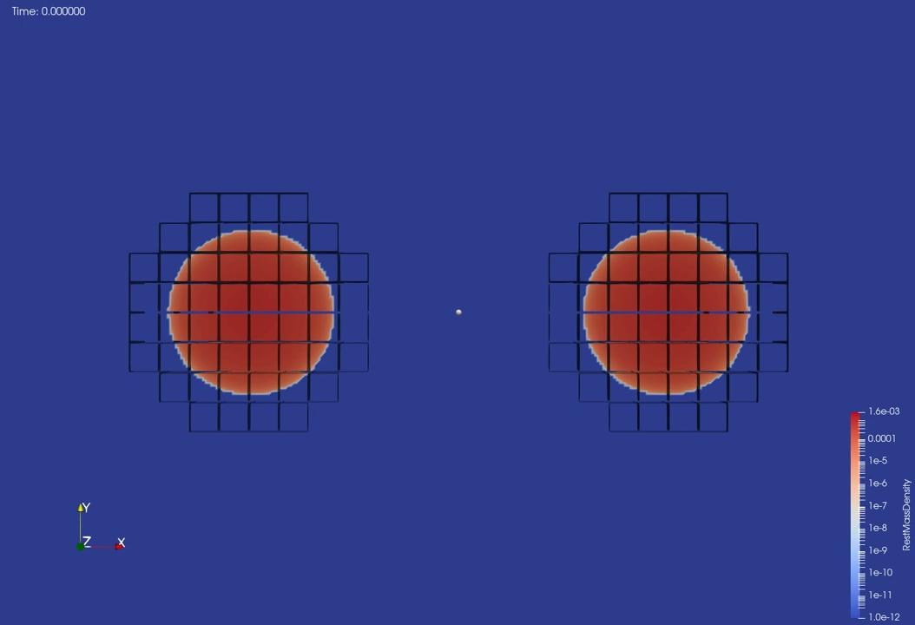

Simulations
Phase Transition
No Phase Transition

Slide 10
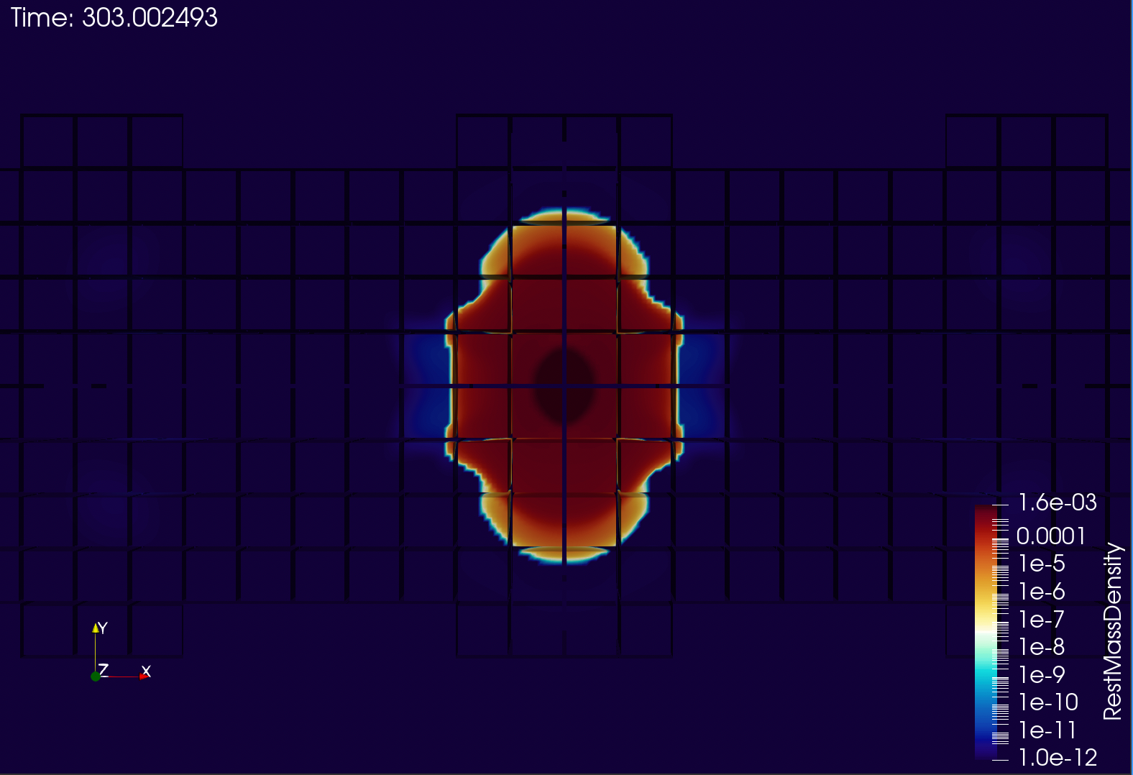
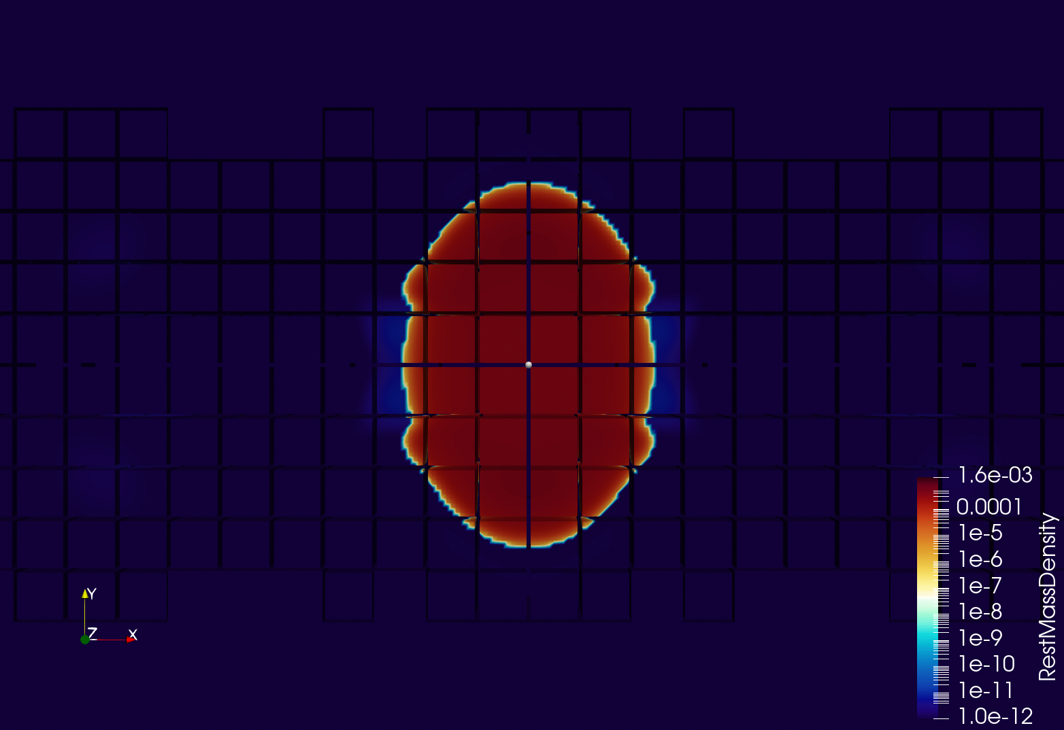
Simulations
Phase Transition
No Phase Transition

Slide 11
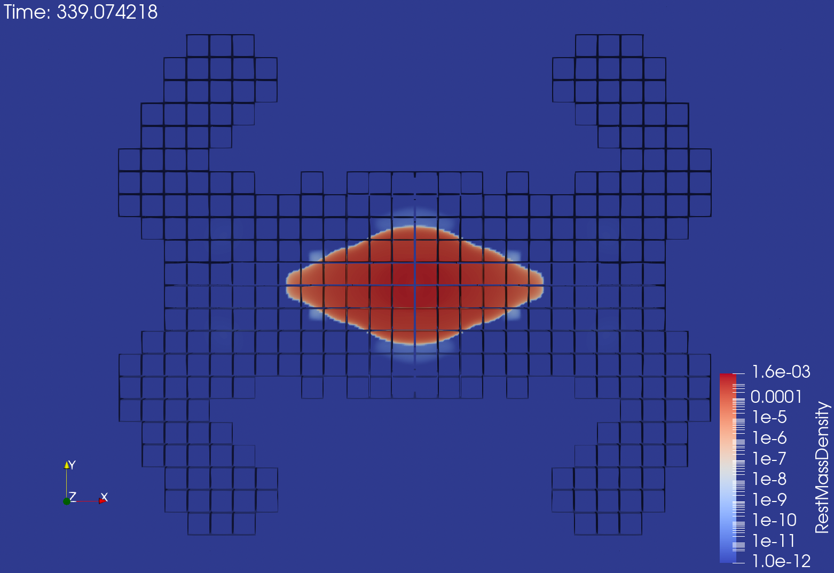
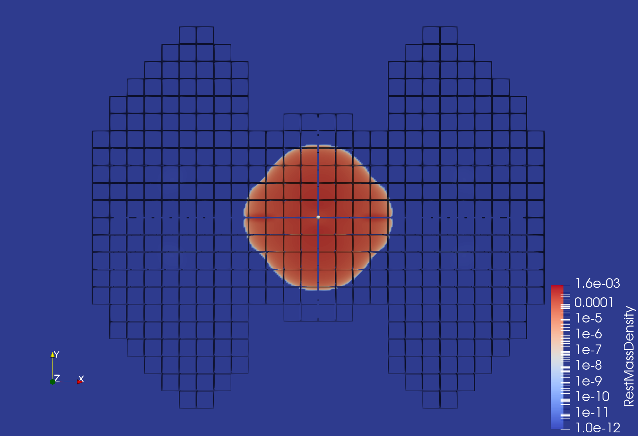
Simulations
Phase Transition
No Phase Transition

Slide 12
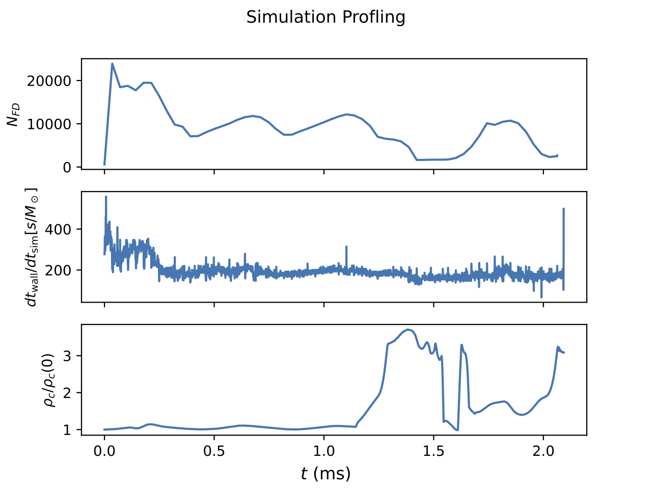
Effect of EoS on SubCell Methods
Smoother parametrizations work better
TCI flagging
  Cost of checking
  Atmosphere settings

Slide 13
Future Work
Convergence testing
Evaluate more EoS choices
Loss of accuracy by finite difference

Slide 14
Main points:
Subcell Numerical Methods offer an exciting new possibility for astrophysical simulation
EoS choice DOES effect simulation efficiency
  Smooth EoS seem faster

Slide 15
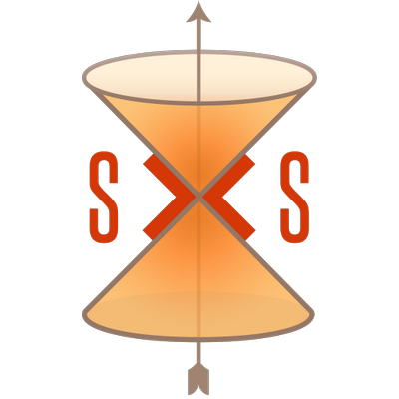


Acknowledgments
Thanks to my mentors and everyone else who answered my million questions!

Slide 16
