Slide 1
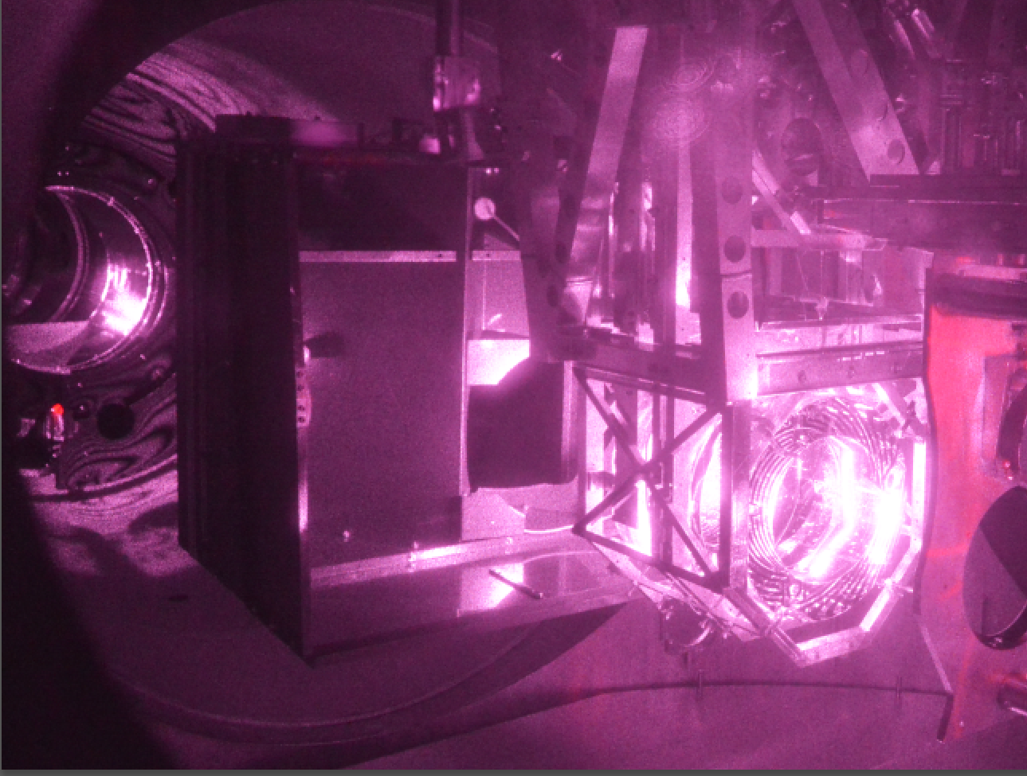
lit by scattered main beam (observation sensitivity)
September 2023 PEM update
Robert Schofield, Anamaria Effler, Sheila Dwyer, Jane Glanzer, Adrian Helmling-Cornell, Georgia Mansell, Filiberto Clara, Richard McCarthy, Benjamin Mannix
Photograph lit by scattered main beam light during high-sensitivity operation
LIGO-G2301888

Slide 2
1) O3-O4 vibration coupling reduction projects successful
2) Does vibration coupling tend to increase with main laser power?
3) PEM injections successfully completed before O4 run at LLO, and at LHO at 75W – redo’s after LHO power drop to 60W almost complete.
4) Low vibration coupling at LHO and LLO Filter Cavity End Stations.
5) New electronic grounding noise injection technique reveals grounding problems.
6) There is a non-zero TM bias that minimizes electronic ground noise coupling.
7) Arm Cavity Baffle identified as scattering source at LLO, hanging problems corrected.
8) HVAC shutdown, LHO, increases range by about 10Mpc, HVAC coupling likely due to: A) coupling at EX cryobaffle, B) PSL (jitter), and C) unknown source of vibration coupling in LVEA.

Slide 3
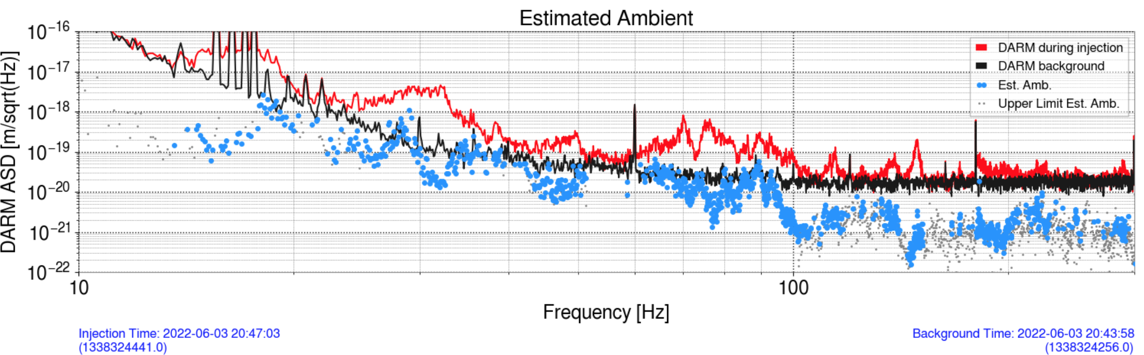
1) O3-O4 coupling reduction projects
A) HAM5-6 septum window removal greatly reduced coupling, LHO, LLO
June 2022
December 2022
The estimated noise from ambient vibration is now mainly upper limits. I pushed the injections until the accelerometers started to saturate.
ETMY test mass
annular reaction mass with reflective ESD traces

Slide 4
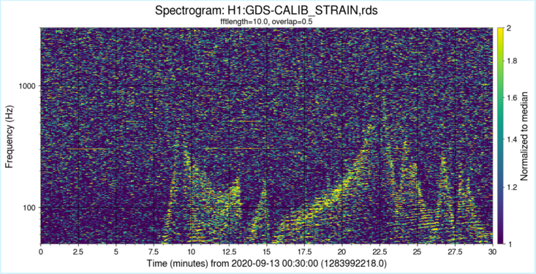
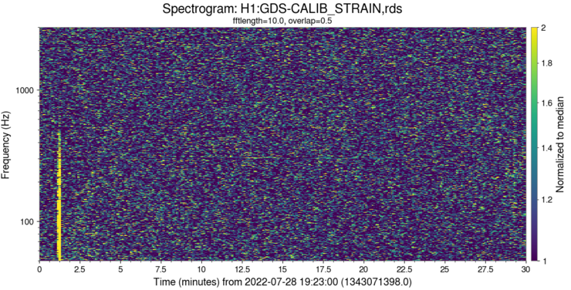
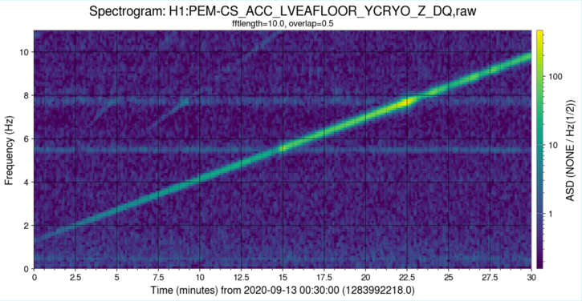
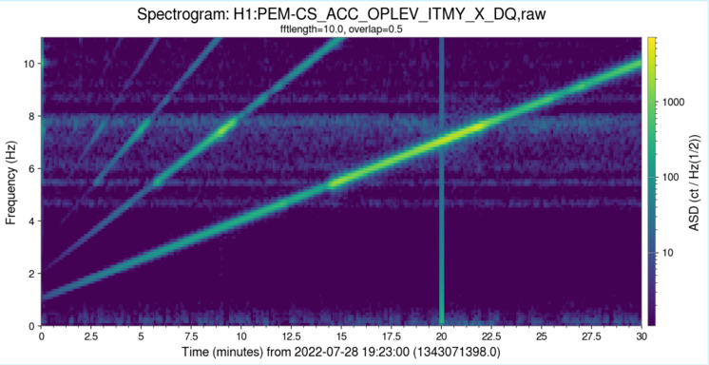
1) O3-O4 coupling reduction projects
B) ETMY, ITMY Cryobaffle scattering noise reduced by damping;
ETMX baffle not yet damped, LHO, LLO
Photographed while at full sensitivity, lit by scattered infrared beam.
Before ITMY Cryobaffle Damping
After ITMY Cryobaffle Damping
4.0
5.0
5.5
7.7
8.2
DARM
DARM
actually on last rib, Y direction
actually on last rib, Y direction
Accelerometer showing shaker frequency sweep
Accelerometer showing shaker frequency sweep
ETMY test mass
annular reaction mass with reflective ESD traces

Slide 5
1) O3-O4 coupling reduction projects
C) ITMY replacement reduced PSL jitter noise by almost 10, LHO
Right after ITMY replacement
Before, May 2019

Slide 6
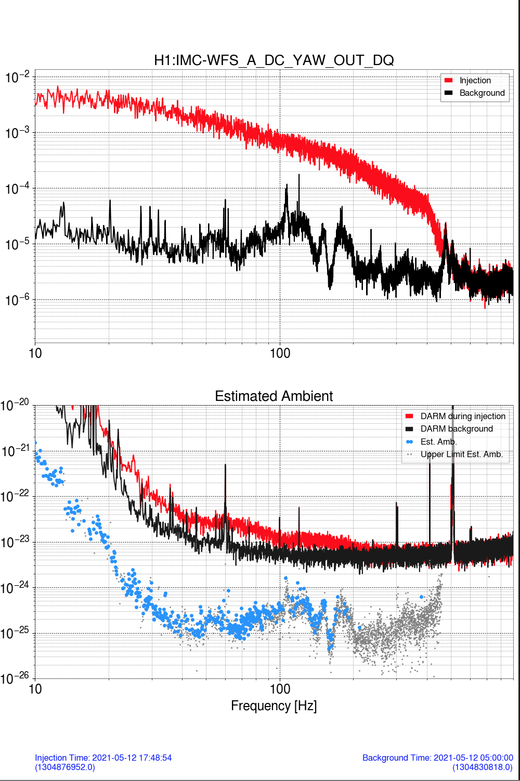
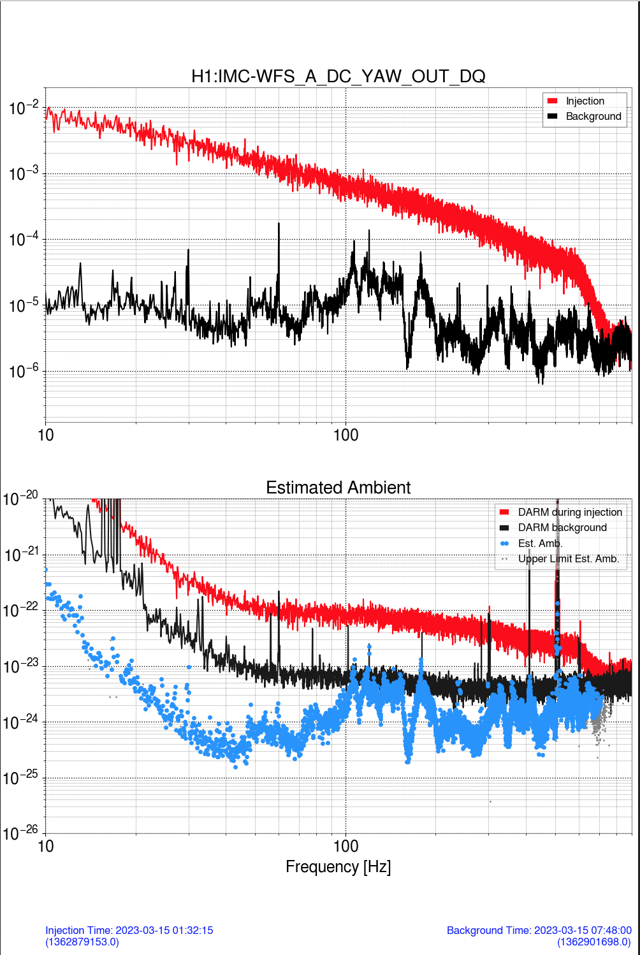
2) Does vibration coupling increase with laser power?
A) Input jitter coupling up by roughly 5 between 46W and 60W;
46W right after ITMY replacement May 12, 2021
60W March 15, 2023
Photographed while at full sensitivity, lit by scattered infrared beam.
Input jitter, Yaw,
Black: nominal Red: injection on H1:IMC-PZT_YAW_EXC
Strain
ETMY test mass
annular reaction mass with reflective ESD traces

Slide 7
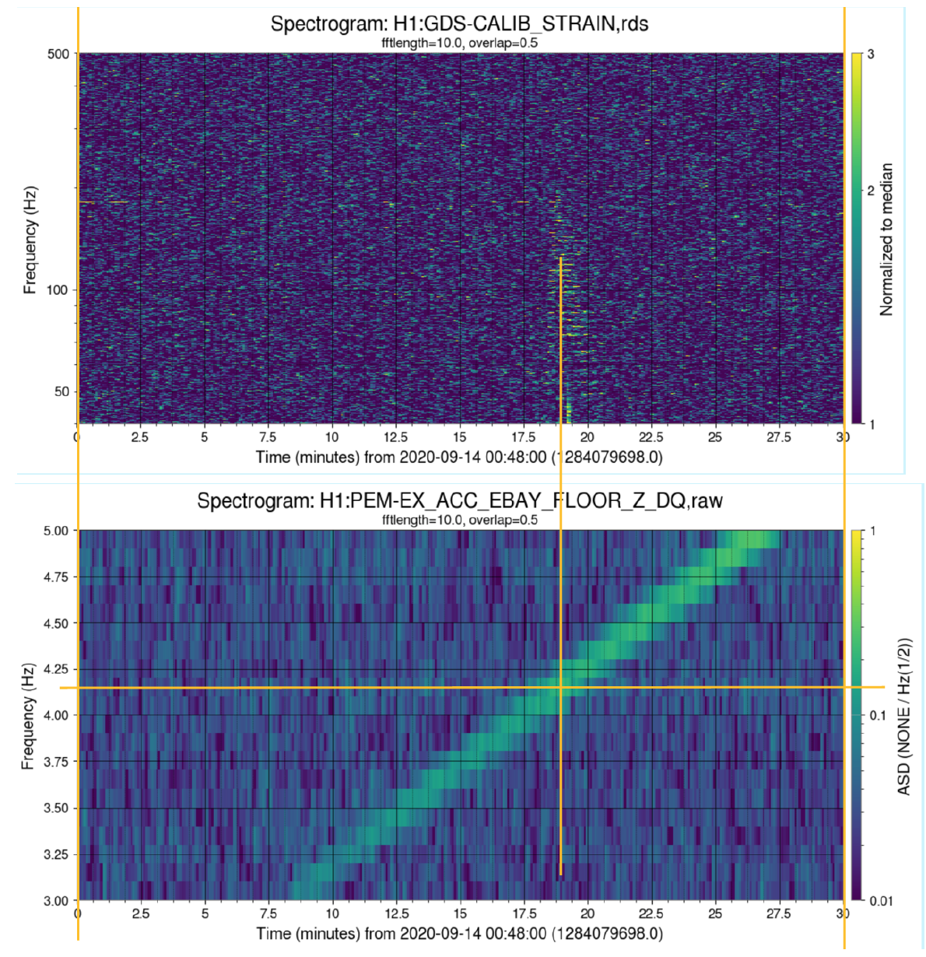
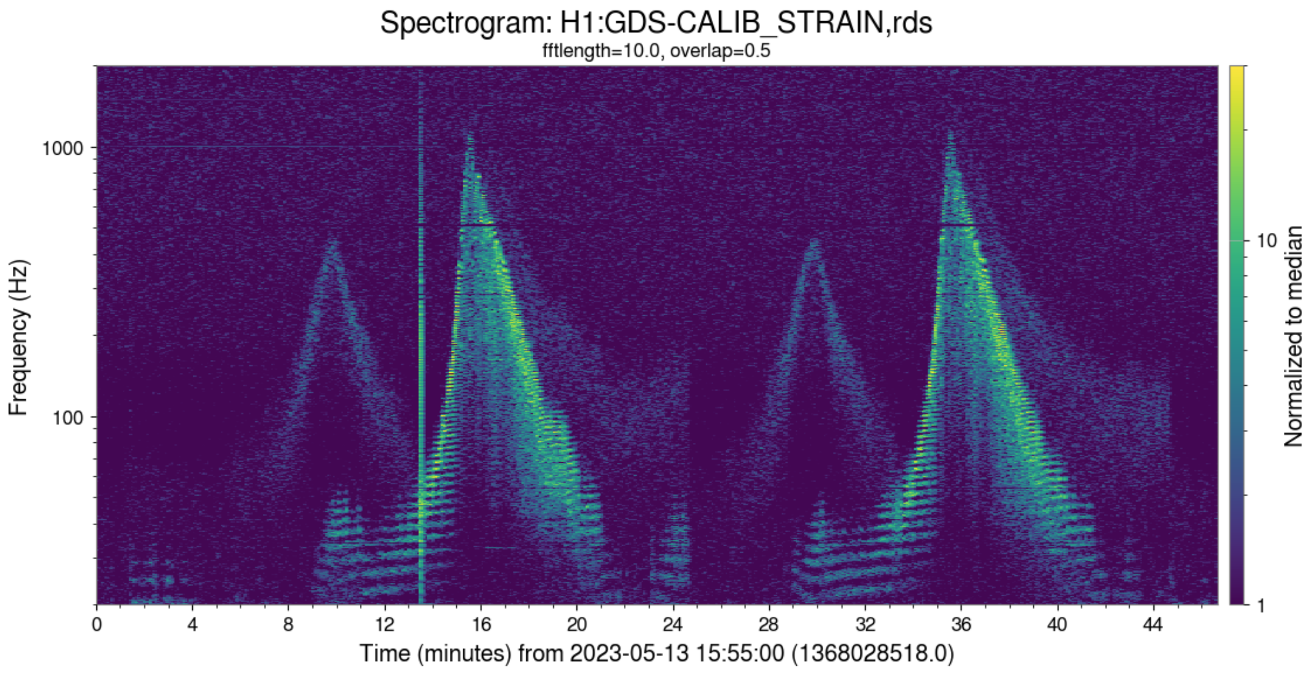
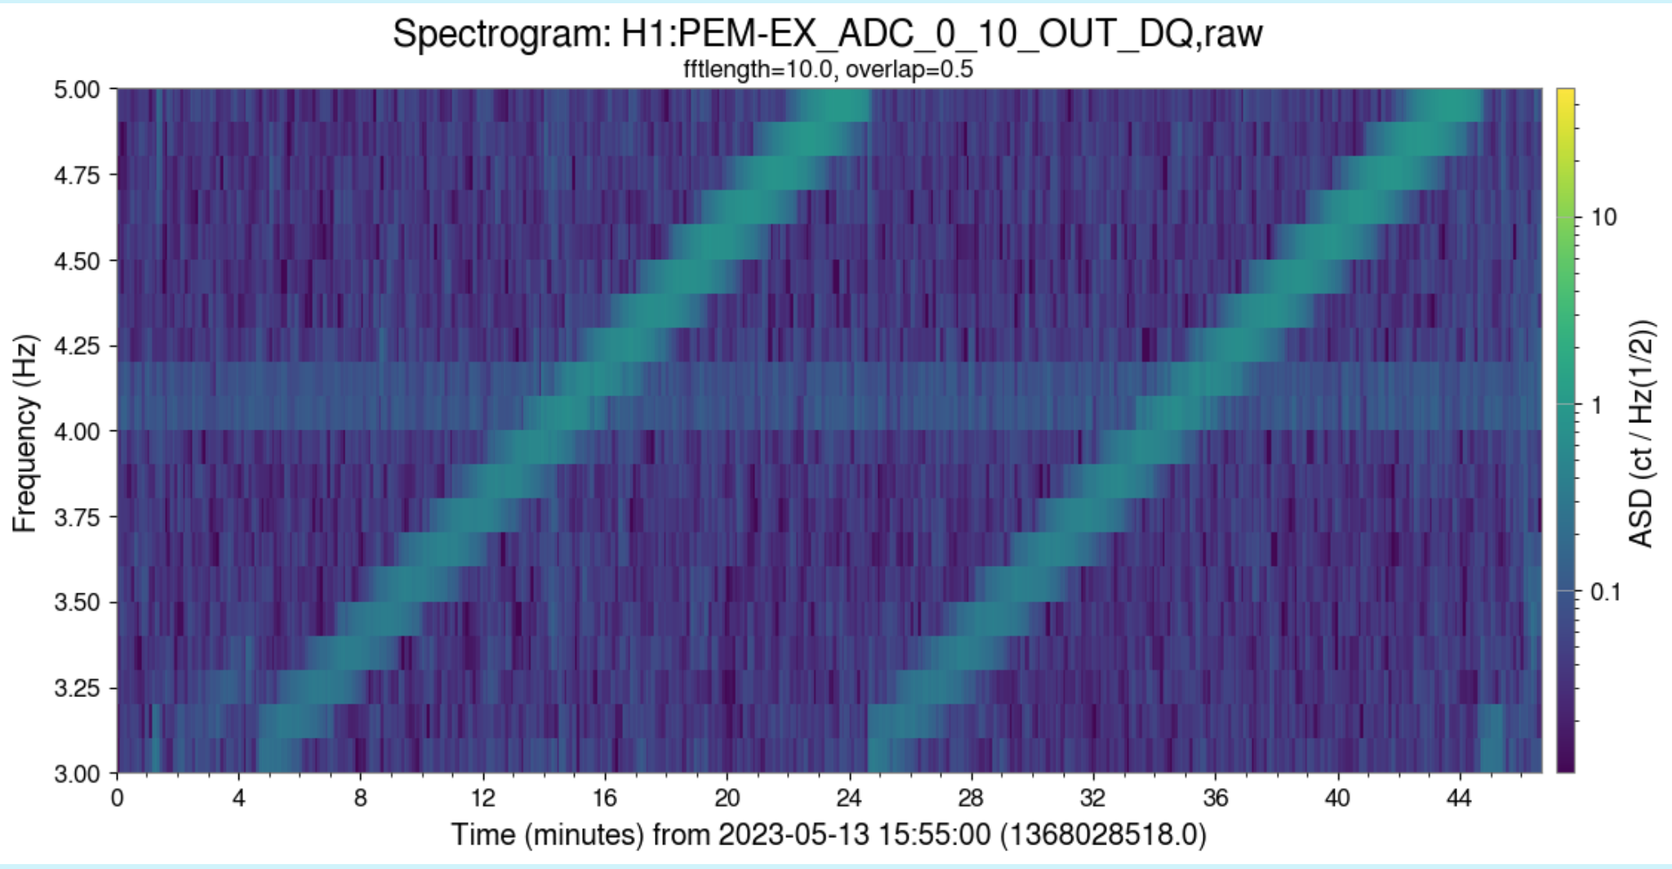
2) Does vibration coupling increase with laser power?
B) scattering noise increased by ~10 from the EX cryobaffles at LHO from 38W to 75W, also at LLO
Photographed while at full sensitivity, lit by scattered infrared beam.
38W, Sept. 2020 showing noise resonance of ETMX
cryo-baffle at 4.1 Hz (LHO alog 56857)
75W May 2023 repeat of shaking showing that noise is generated at about the same frequency and Q, but with much greater amplitude relative to the background.
ETMY test mass
annular reaction mass with reflective ESD traces

Slide 8
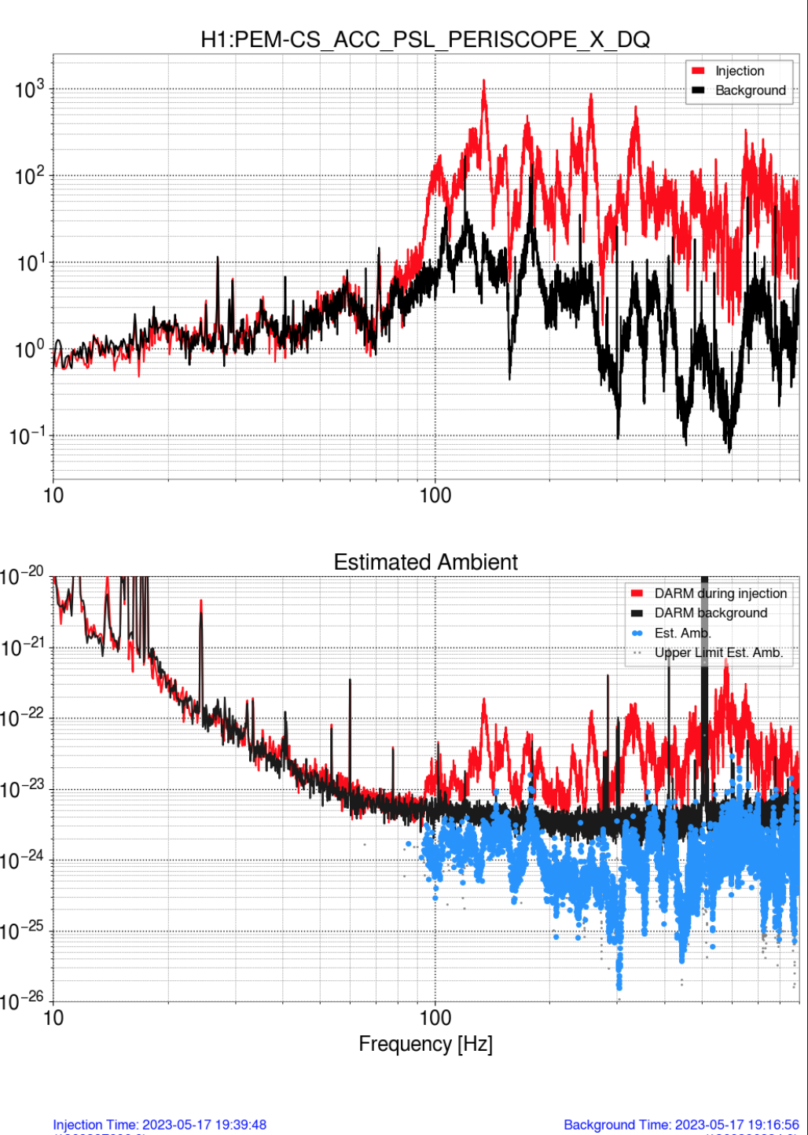
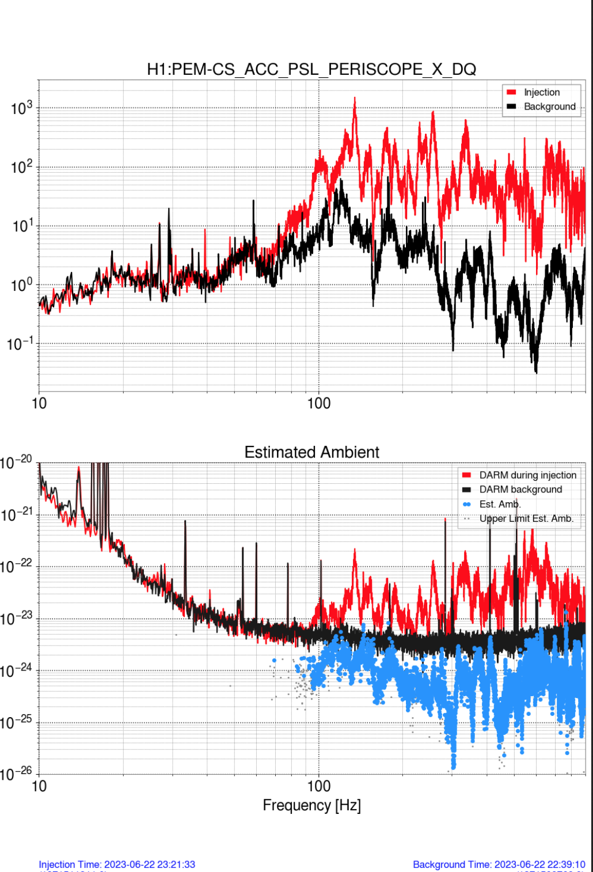
2) Does vibration coupling increase with laser power?
C) What happened when we decreased power from 75W to 60W? PSL jitter coupling dropped by roughly two.
100-1000 Hz speaker injection
75W
60W

Slide 9
2) Does vibration coupling increase with laser power?
C) What happened when we decreased power from 75W to 60W? Scattering noise at EX dropped by three.
Peak comparison for similar velocities suggests that the scattered light amplitude is, at 60W, about 1/3 of the level at 75W
DARM showing nominal spectra (thin lines) and during shaker injections (thick lines) at 75W (orange) and 60W (blue)

Slide 10
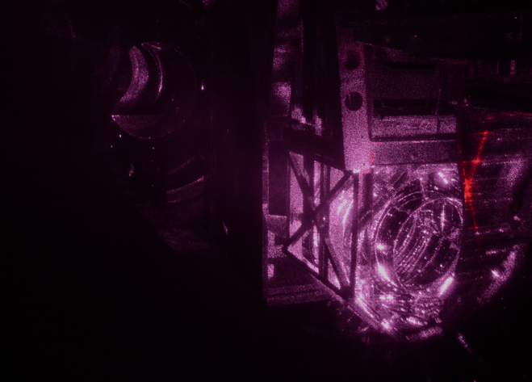
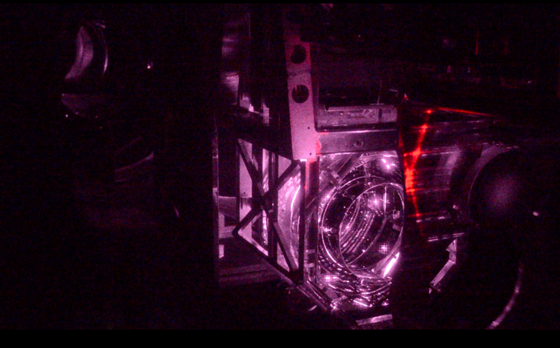
2) Does vibration coupling increase with laser power?
Any indication of extra light at ETMX?
75W 2023
38W 2019
I tried to normalize the photos because they were taken with a factor of two power difference. I noticed no difference except perhaps in this region; if not a photographic artifact, it suggests that there is relatively more light that is outside of the beam, consistent with greater scattering.

Slide 11
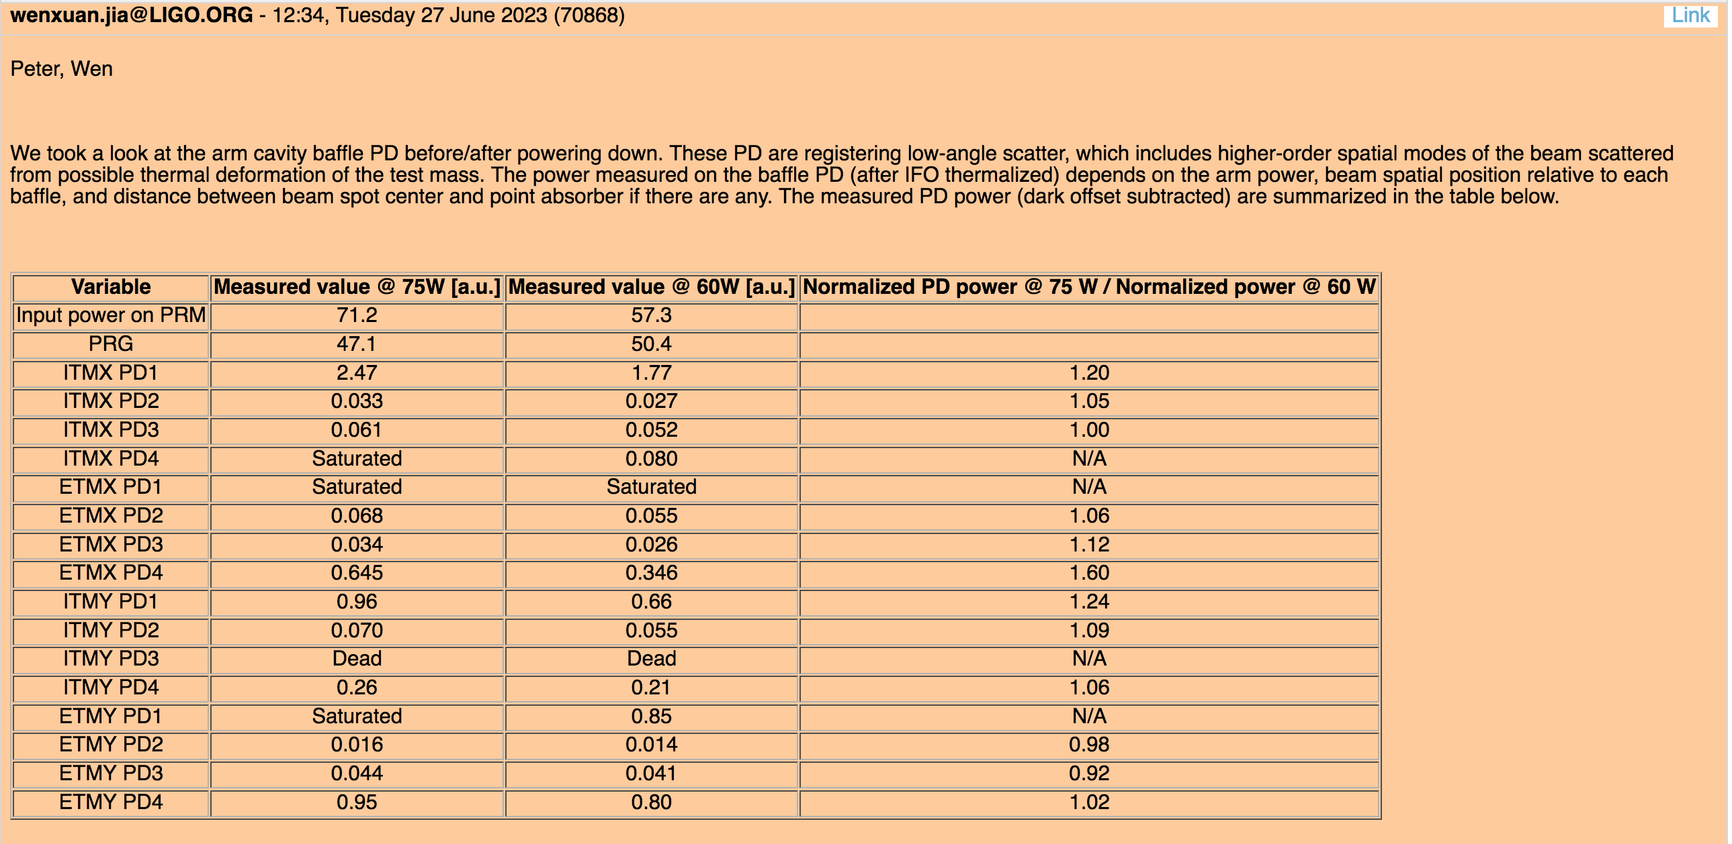
2) Does vibration coupling increase with laser power?
Comparison of ACB photodiodes suggests that there is a moderate fractional increase in the small angle scattering detected by these diodes between 60W and 75W
Photographed while at full sensitivity, lit by scattered infrared beam.
ETMY test mass
annular reaction mass with reflective ESD traces

Slide 12
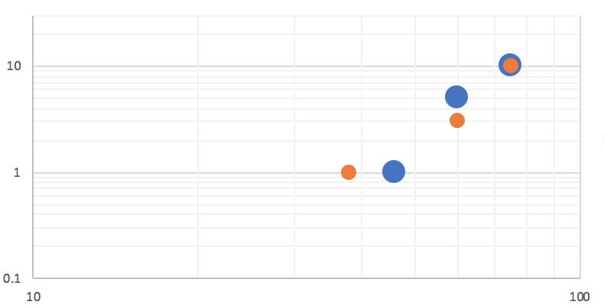
2) Do we have to worry about vibration coupling increasing with arm power?
D) Possible mechanism: greater surface distortion from greater heating of coating defects may increase scattering and arm asymetry
Photographed while at full sensitivity, lit by scattered infrared beam.
Blue: LHO PSL jitter noise
Red: LLO EX scattering noise
Normalized noise
Input power (W)
annular reaction mass with reflective ESD traces

Slide 13
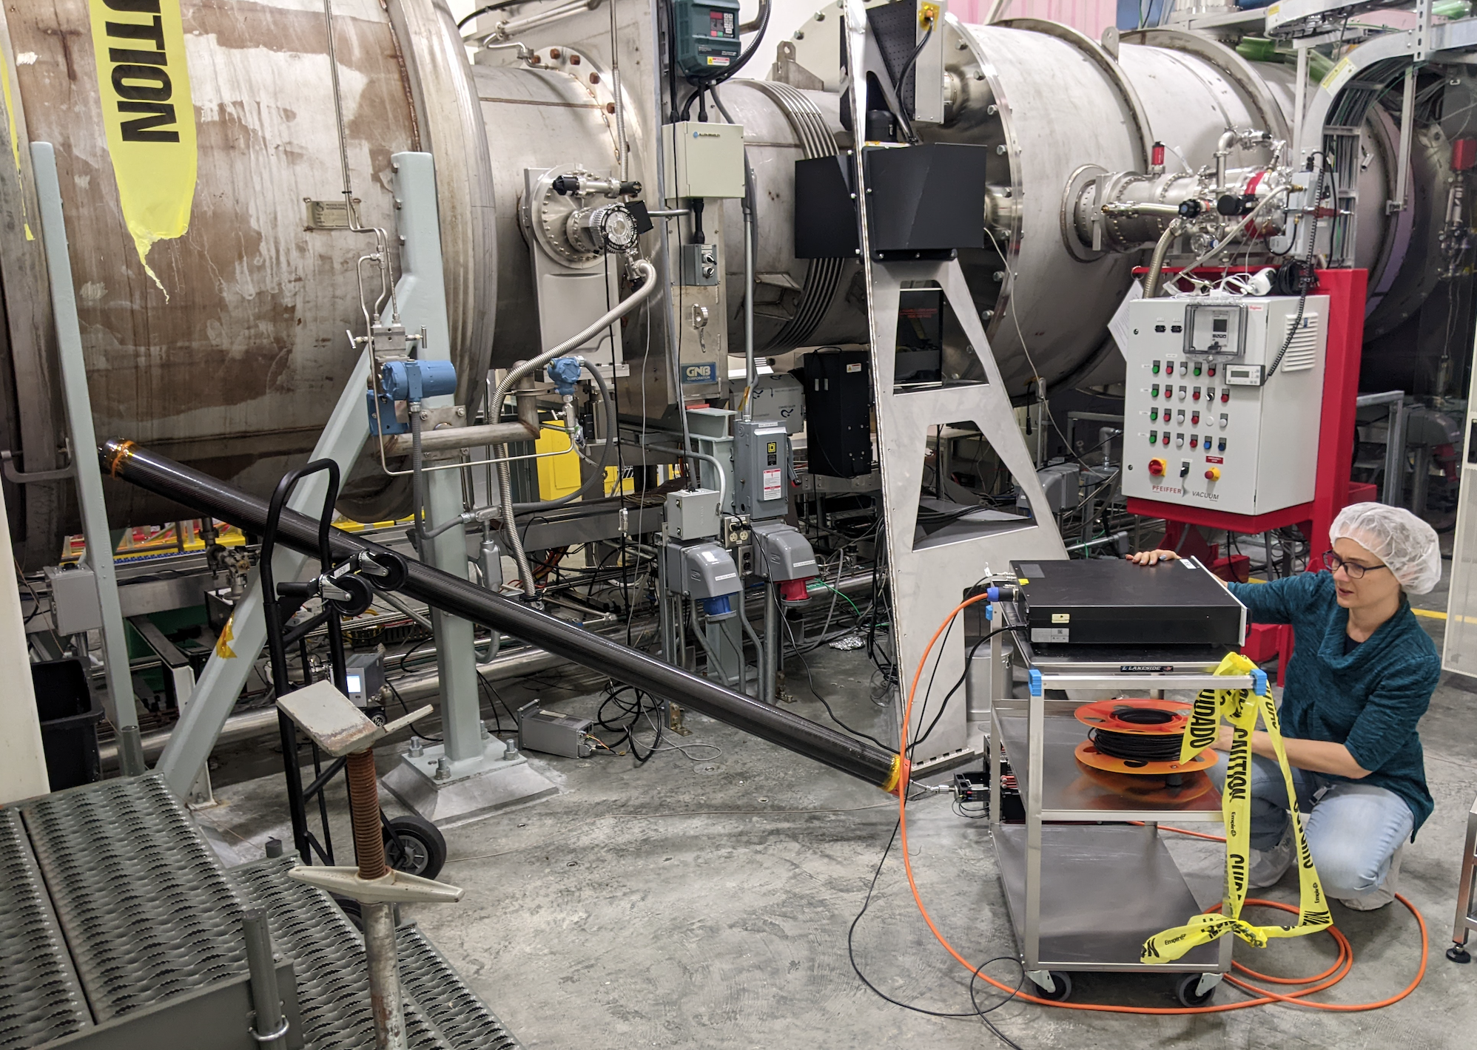
3) PEM injections completed before O4 run at LLO, and LHO at 75W – redo's after LHO dropped to 60W almost complete
Photographed while at full sensitivity, lit by scattered infrared beam.
ETMY test mass
annular reaction mass with reflective ESD traces

Slide 14
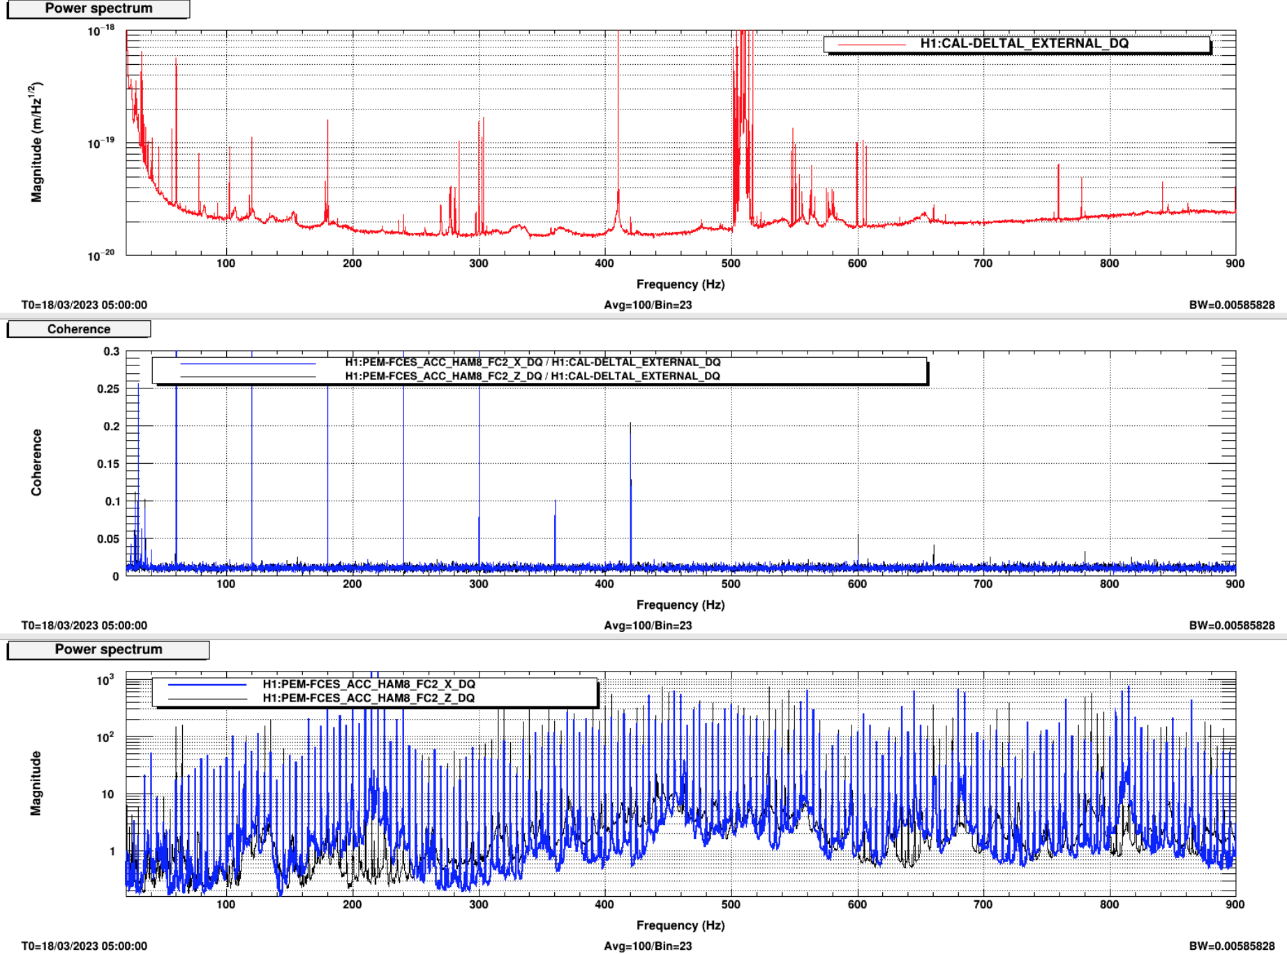
4) Low vibration coupling at LHO and LLO Filter Cavity End Stations
Photographed while at full sensitivity, lit by scattered infrared beam.
DARM
Coherence
FCES accelerometers during acoustic injection of 5 Hz comb
ETMY test mass
annular reaction mass with reflective ESD traces

Slide 15
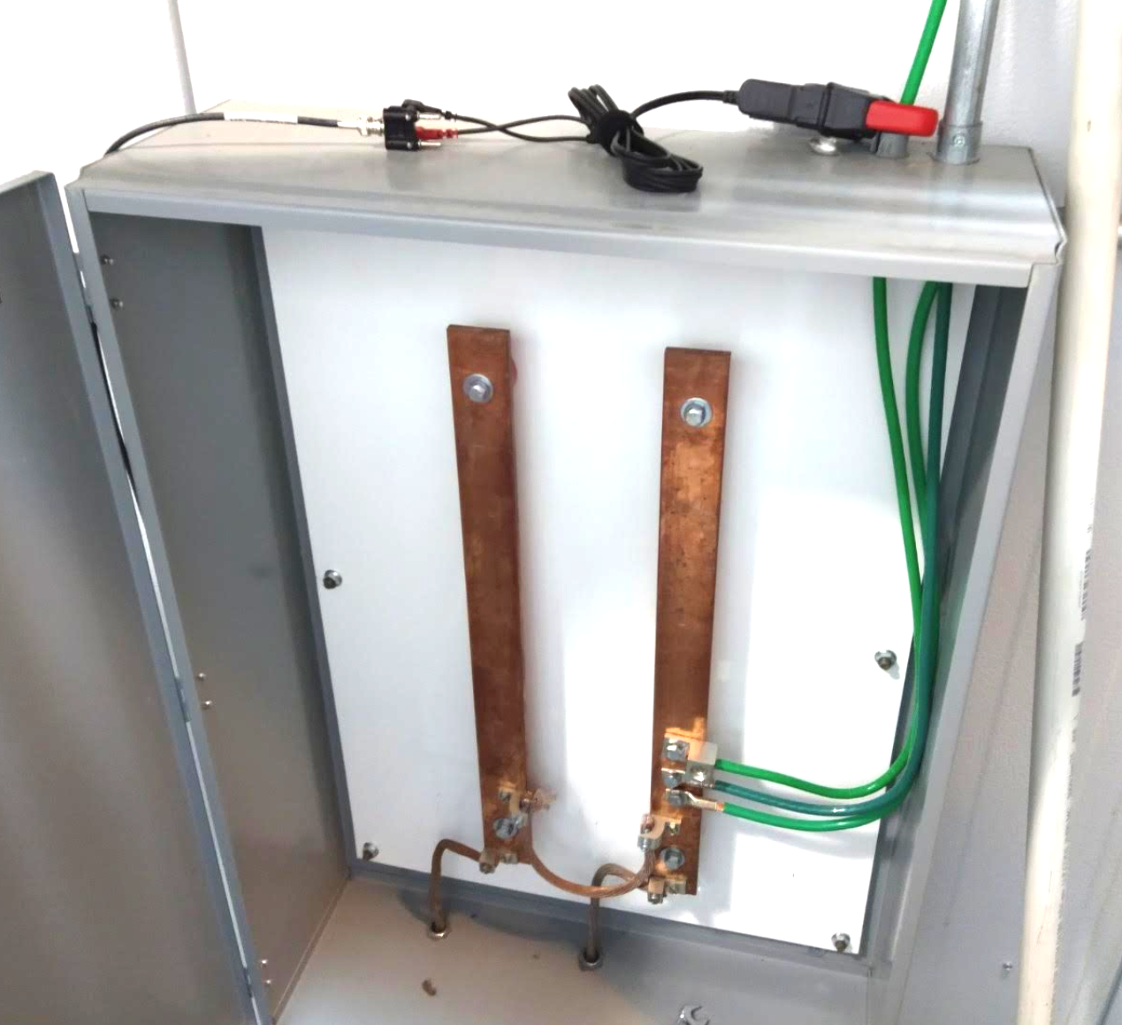
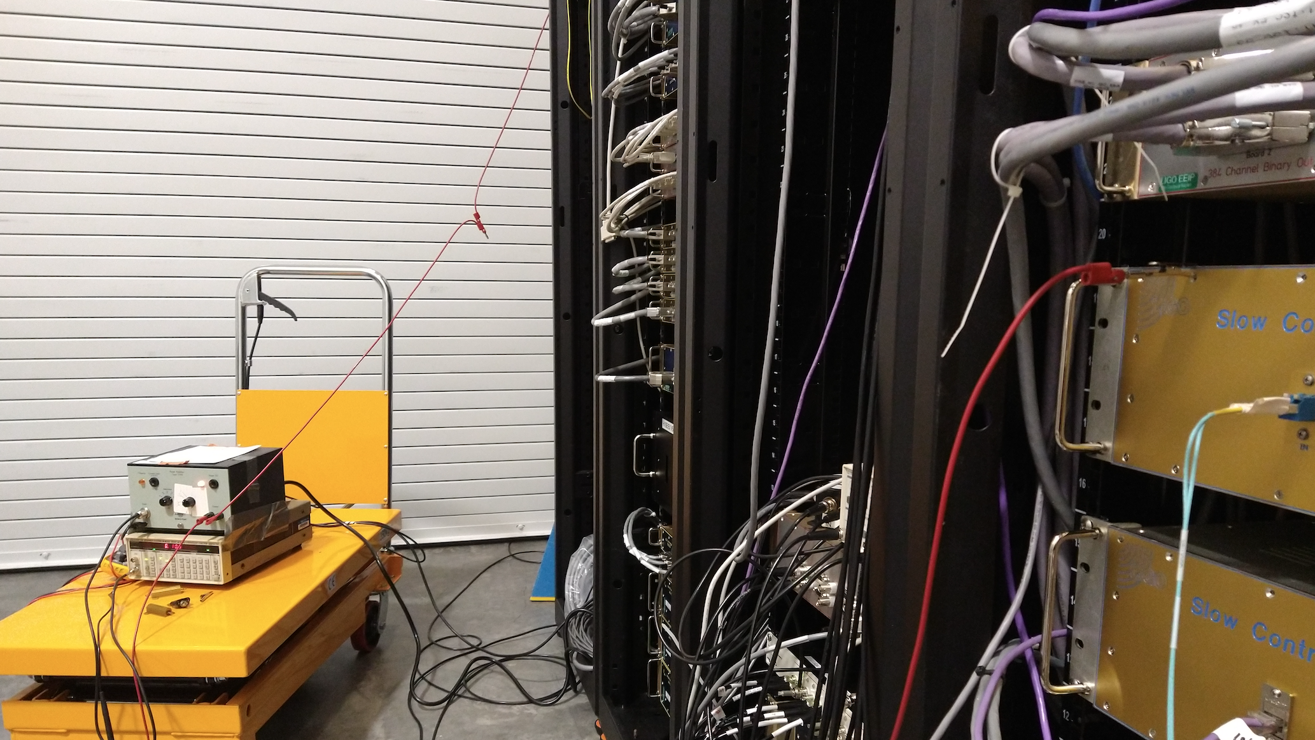
5) New electronic ground injection and monitoring techniques reveal grounding problems
Return from cable tray
Current monitor on grounding cable
Inject onto chassis
Ground current monitor channels
EX: H1:PEM-EX_ADC_0_09_OUT_DQ
EY: H1:PEM-EY_ADC_0_14_OUT_DQ
CS: H1:PEM-CS_ADC_5_26_2K_OUT_DQ
Injections of 11 Hz comb at EX onto ISC Common chassis with return from cable tray. The 1/f^3 slope in DARM is consistent with the 1/f slope in the current clamp monitor on the grounding cable.
To set the scale:
For my ground injection at 22 Hz, I get about 0.3mV/m sqrt(Hz) at the EFM,
and, about 12 mV/sqrt(Hz) of fluctuation of the building ground, determined from my measurement of 2 ohms between building “ground” and earth, and the current measured by the current clamp on a grounding cable,
and, about 1.53 mV/sqrt(Hz) of drive fluctuation, as indicated by H1:SUS-ETMX_L3_DRIVEALIGN_L_OUT_DQ

Slide 16
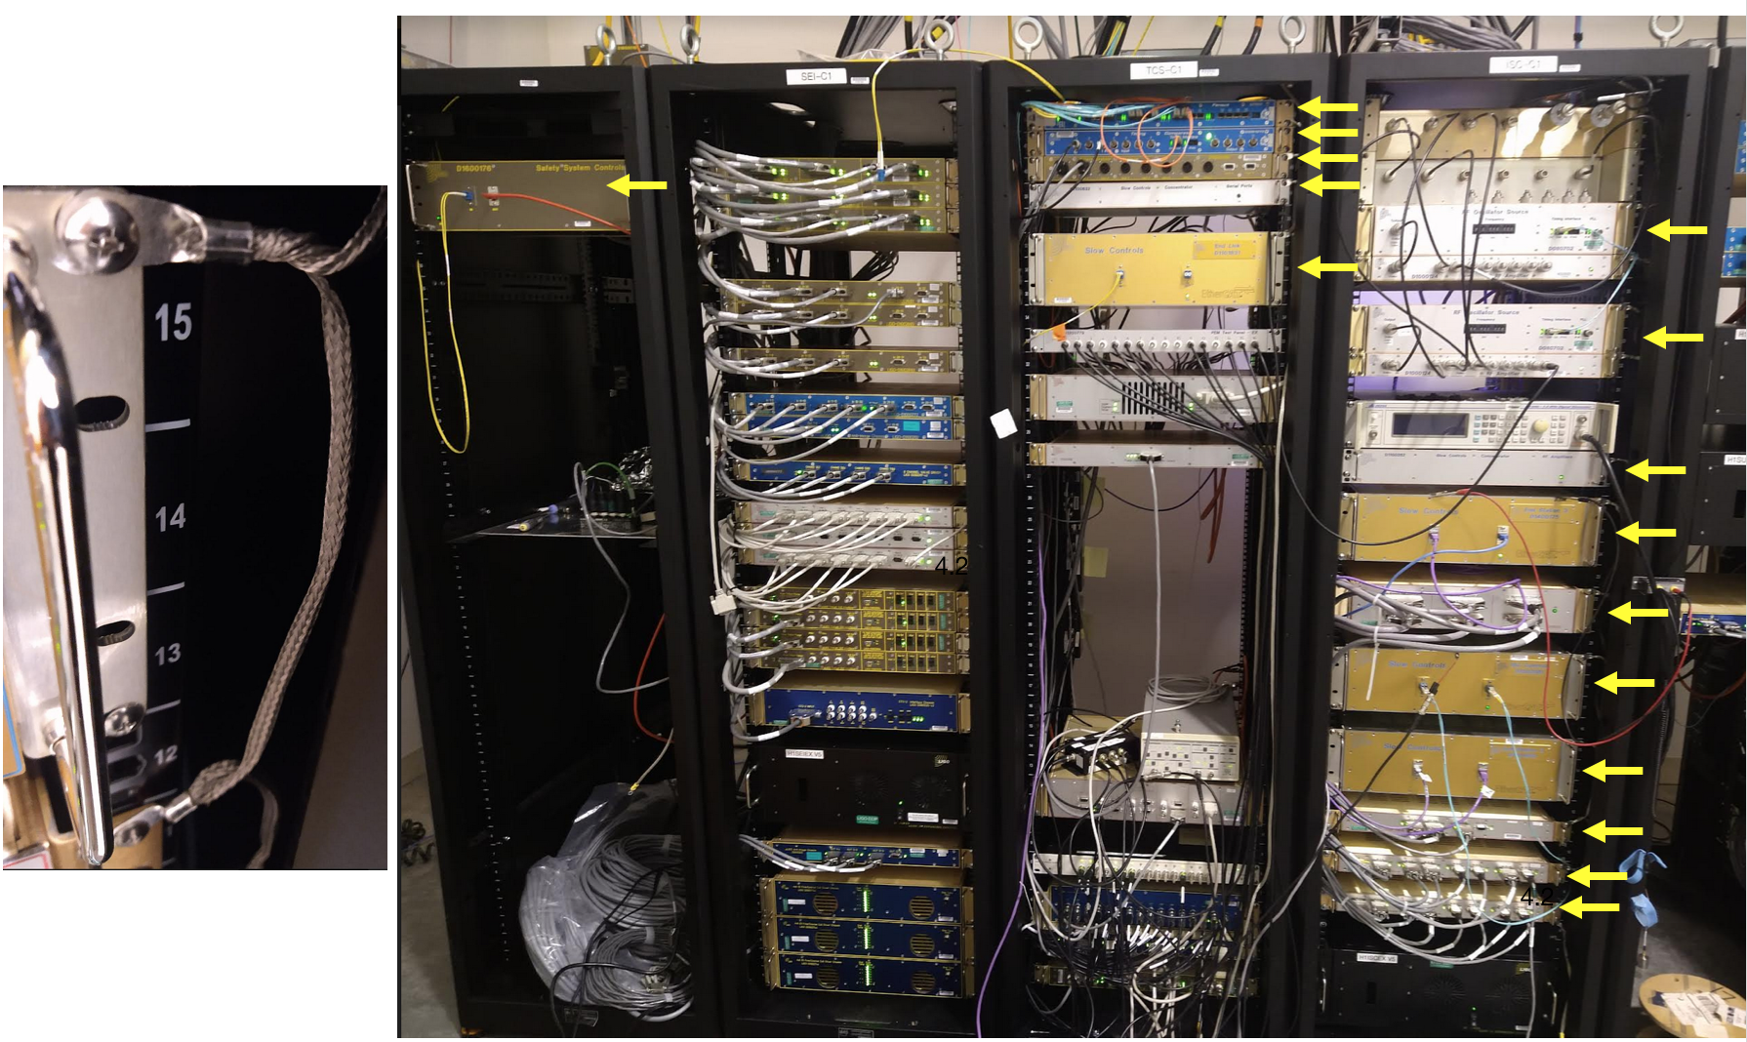
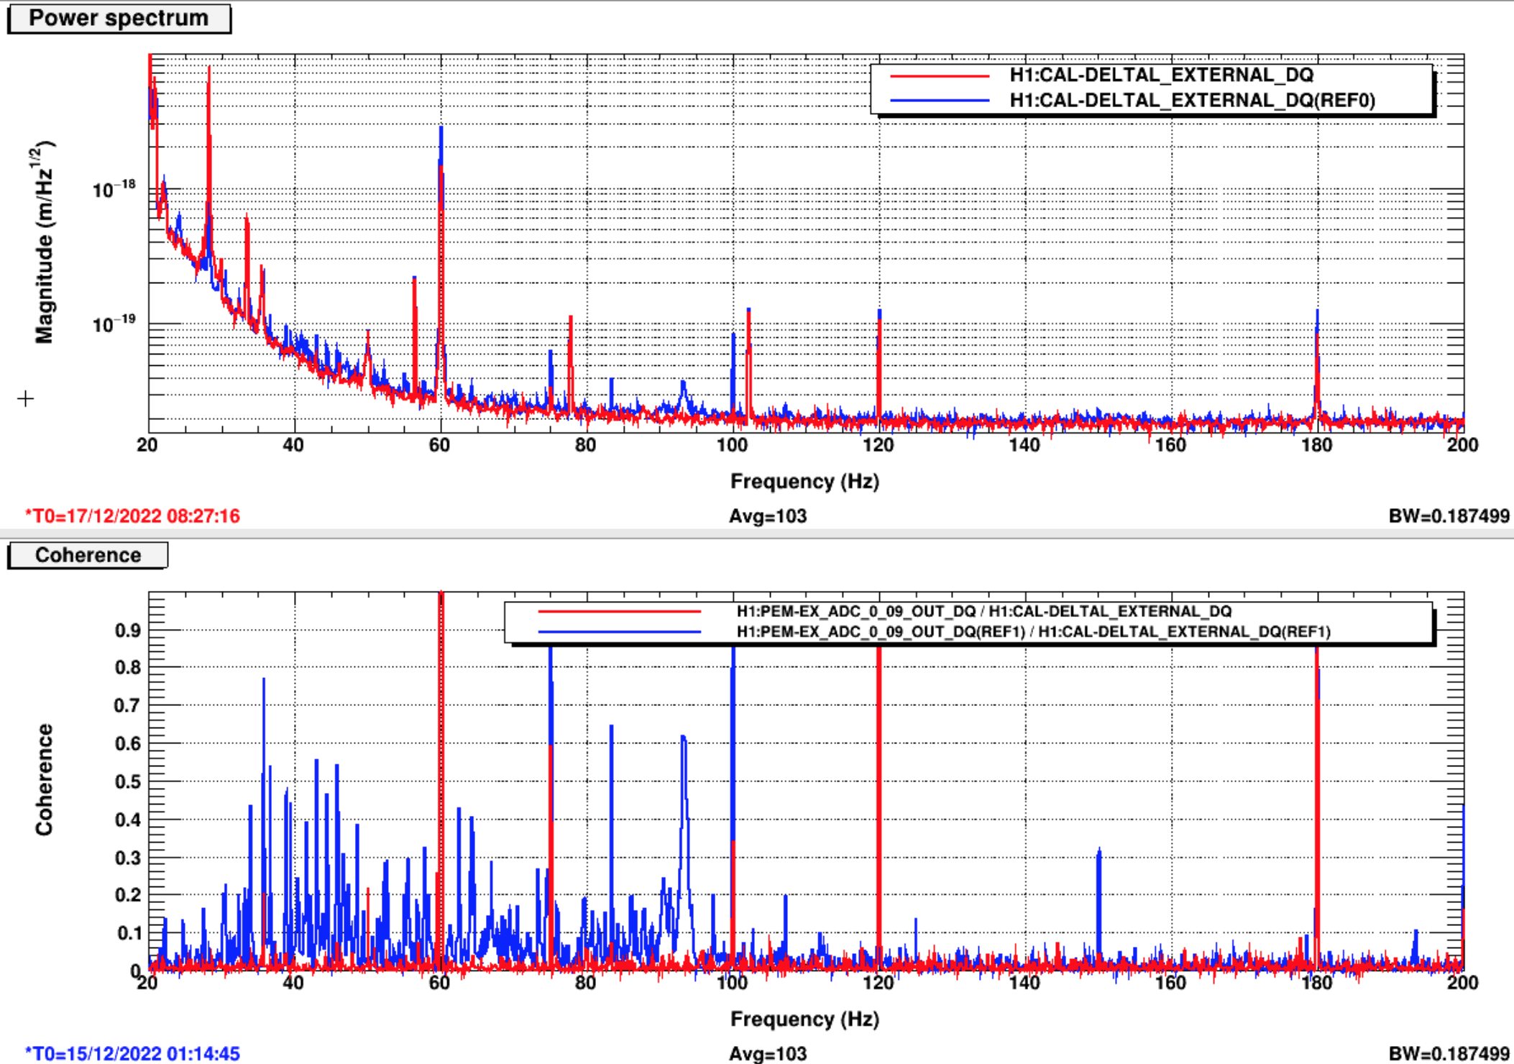
5) New electronic ground injection and monitoring techniques reveal grounding problems
Blue: before, Red: after chassis grounding improvements at EX
DARM
Coherence between DARM and current clamp on building grounding cable

Slide 17
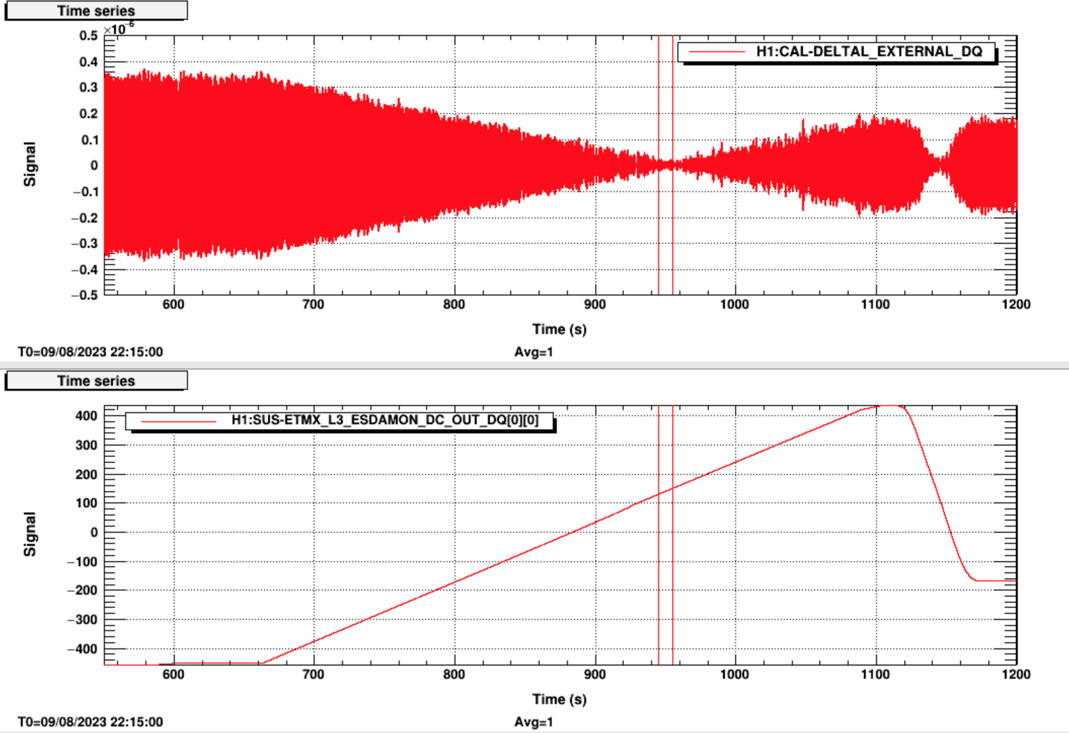
6) There is a non-zero test mass bias that minimizes grounding noise coupling.
Photographed while at full sensitivity, lit by scattered infrared beam.
Time series of amplitude of 66 Hz peak in DARM from ground injection at EX as ESD bias is swept
Minimum measured in January 2023 ~130 V
Minimum, Aug, 2023, ~150 V
128 V
DARM 66 Hz peak
EX
Bias sweep from -440V to +430V
Bias Voltage
ETMY test mass
annular reaction mass with reflective ESD traces

Slide 18
6) There is a non-zero TM bias that minimizes grounding noise coupling.

Slide 19
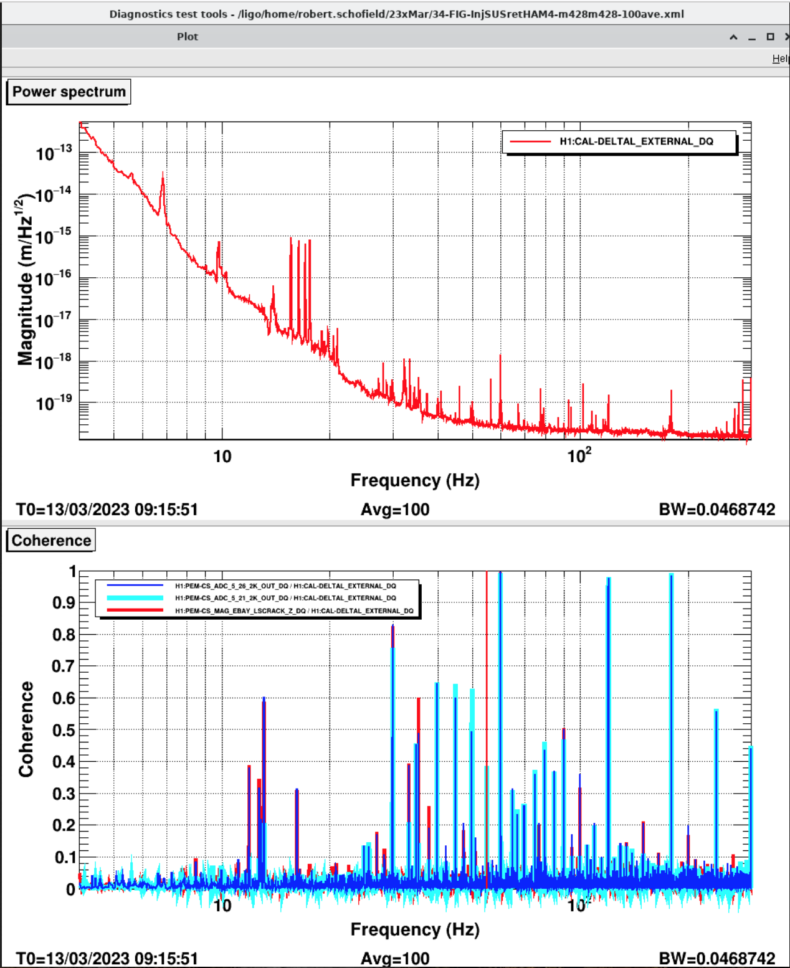
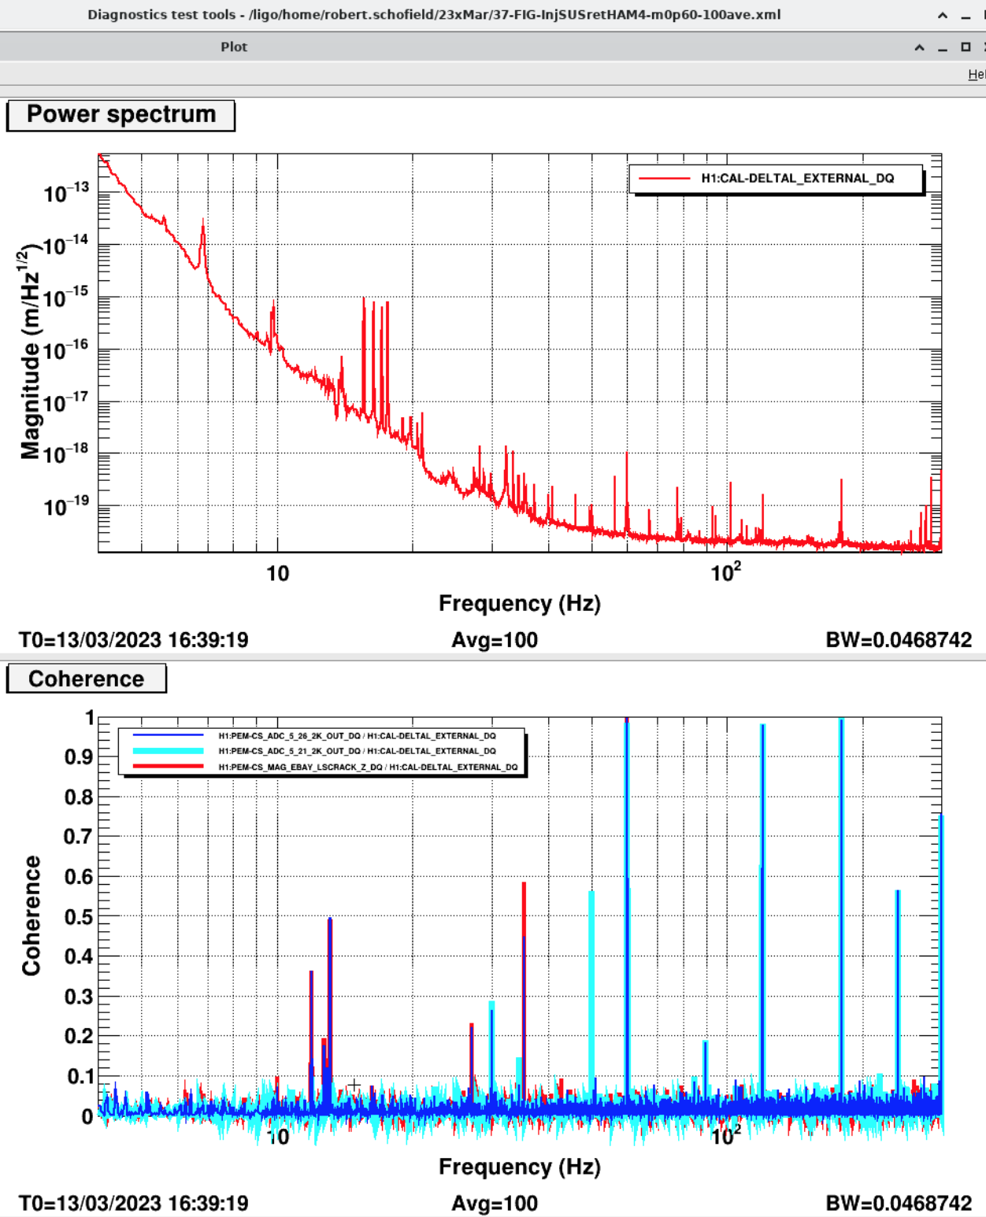
6) There is a non-zero TM bias that minimizes grounding noise coupling.
Minimizing lines from electronic ground injections also reduced other electronic lines
Current bias settings: ITMX -428V, ITMY -428V
Proposed bias settings: ITMX 0V, ITMY 60V
Dark Blue: clamp on grounding cable, Light Blue: magnetometer attached to BSC3, Red: rack magnetometer

Slide 20
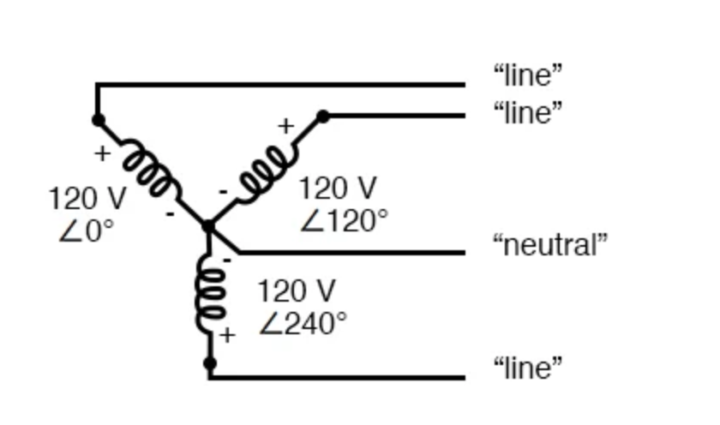
6) There is a non-zero TM bias that minimizes grounding noise coupling.
Possible mechanism: test mass is charged and bias is set so that force on charge cancels force on bias-polarized molecules
Anodized racks make high-resistance connections to chassis ground
Shield connected at both ends makes a local chassis ground among a group of chassis
ESD drive fluctuations as local ground fluctuates with respect to building ground
Viewport with fringing fields
Force on bias-polarized molecules ( -+ ) can be adjusted to cancel force on excess charge ( + )
+ +
+
++
Ethercat
AI Chassis
ESD drive signal
-+
-+
ESD
TCS Ethercat
Ring heater
Shields connected at ebay chasis
Ground potential fluctuations as current to ground varies
Mains transformer connected to building ground
Building ground potential varies by location depending on the low resistances in the grounding system
2 ohms; note that this is ~50 parallel ground spike resistors, and not a single grounding spike
Neutral Earth

Slide 21
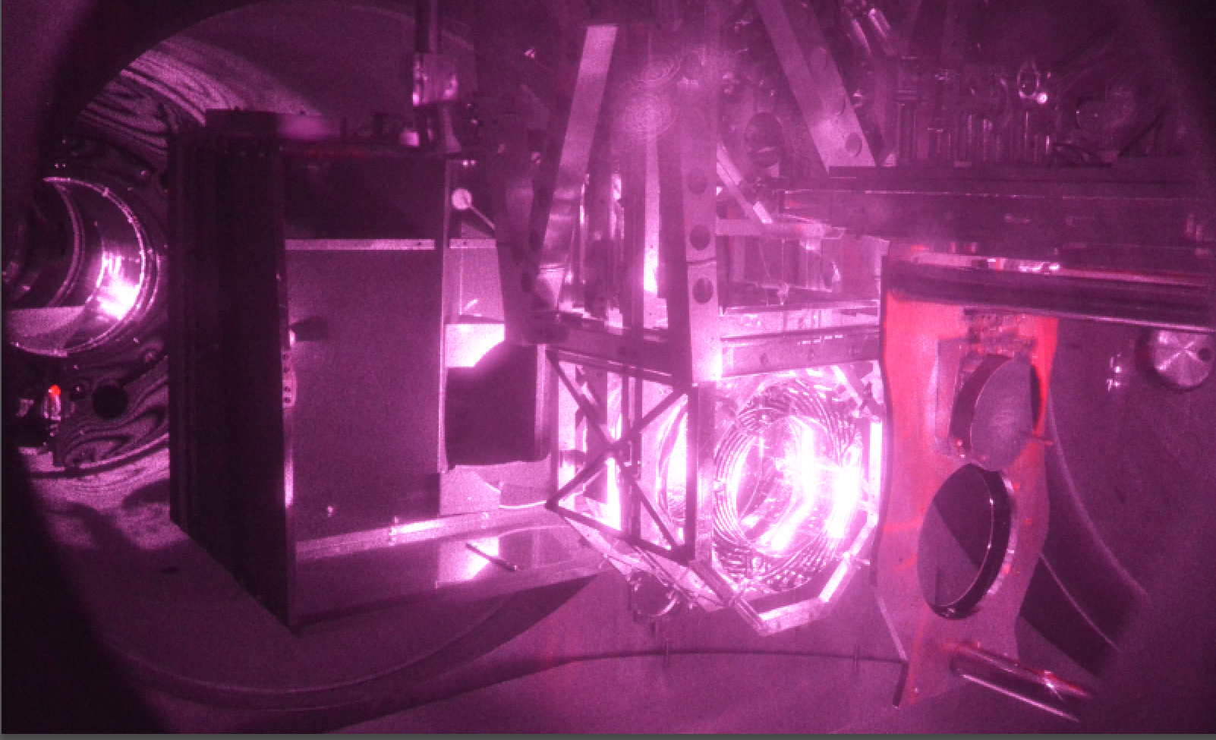
7) Arm Cavity Baffle identified as scattering source at LLO and hanging problems corrected
lit by scattered main beam (observation sensitivity)
Photographed while at full sensitivity, lit by scattered infrared beam.
cryo-baffle
Movies
transmission monitor (TMS)
ETMY test mass
ETMY test mass
arm cavity baffle (ACB)
annular reaction mass with reflective ESD traces

Slide 22
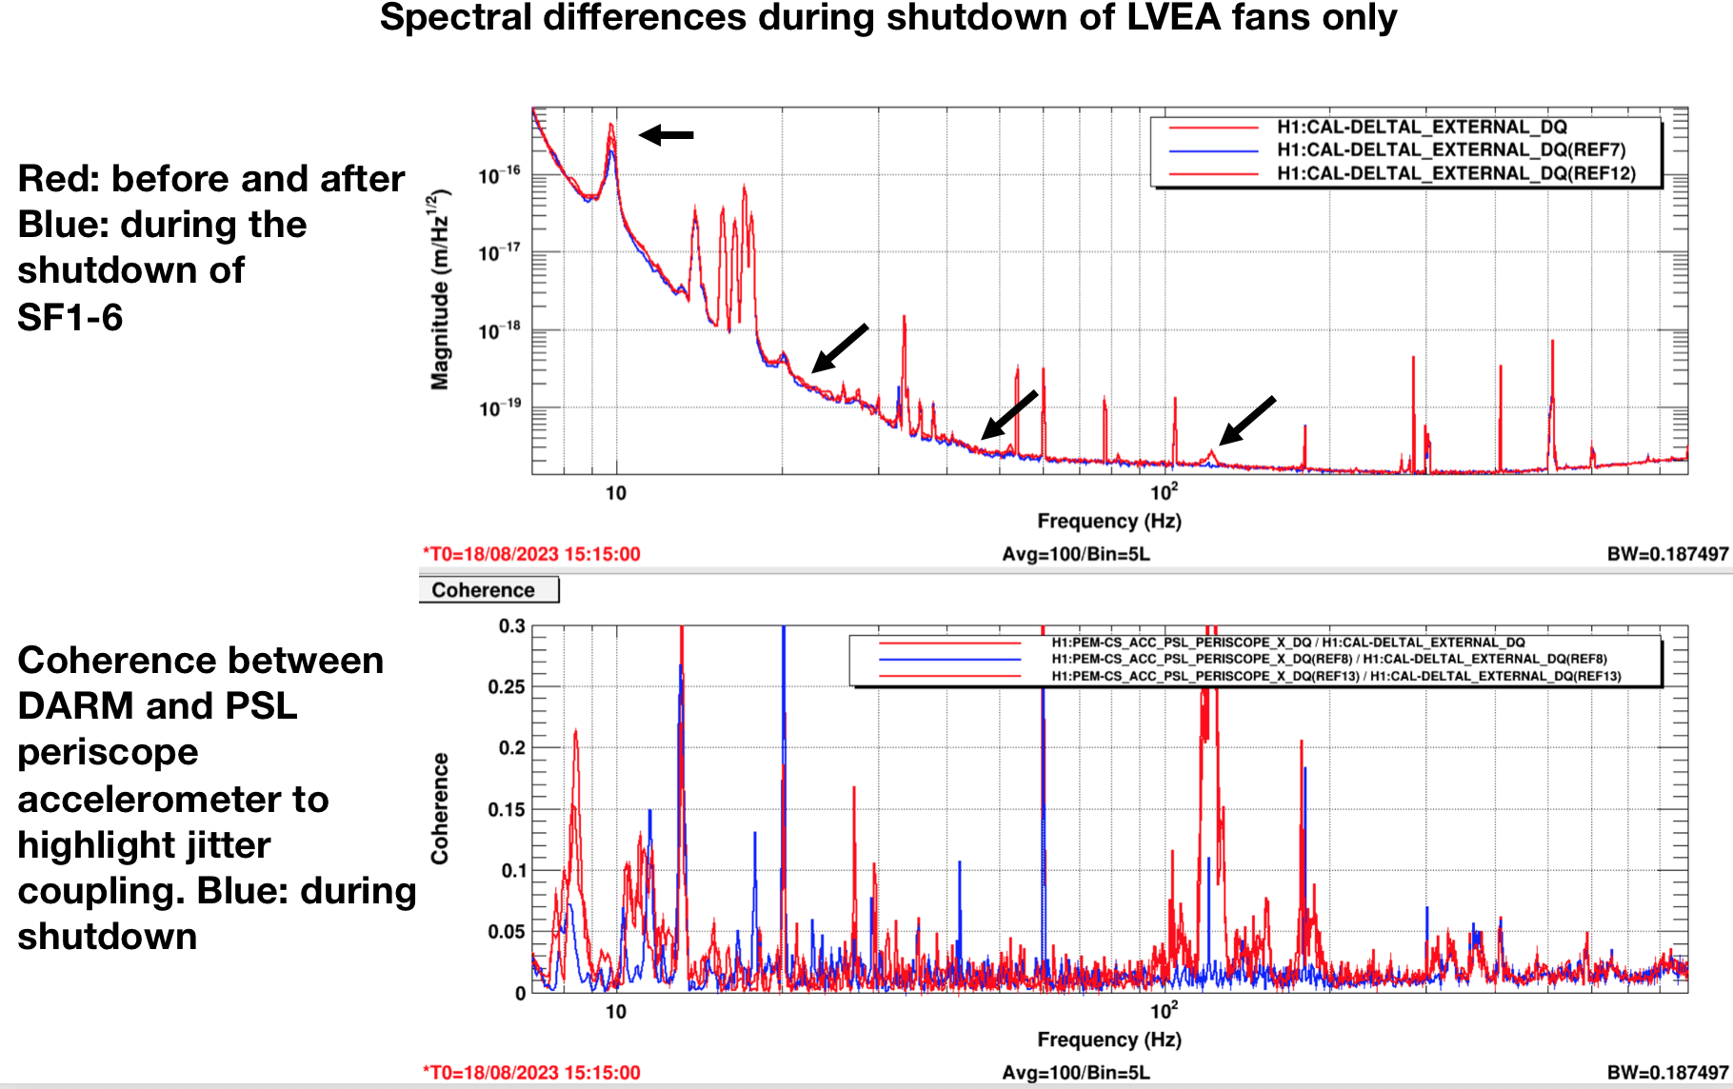
8) LHO HVAC shutdown increases range ~10Mpc
HVAC coupling likely due to:
A) coupling at EX cryobaffle,
B) PSL (jitter), and
C) unknown source of vibration coupling in LVEA
Photographed while at full sensitivity, lit by scattered infrared beam.
ETMY test mass
annular reaction mass with reflective ESD traces

Slide 23
1) O3-O4 vibration coupling reduction projects successful
2) Does vibration coupling tend to increase with main laser power?
3) PEM injections successfully completed before O4 run at LLO, and at LHO at 75W – redo’s after LHO power drop to 60W almost complete.
4) Low vibration coupling at LHO and LLO Filter Cavity End Stations.
5) New electronic grounding noise injection technique reveals grounding problems.
6) There is a non-zero TM bias that minimizes electronic ground noise coupling.
7) Arm Cavity Baffle identified as scattering source at LLO, hanging problems corrected.
8) HVAC shutdown, LHO, increases range by about 10Mpc, HVAC coupling likely due to: A) coupling at EX cryobaffle, B) PSL (jitter), and C) unknown source of vibration coupling in LVEA:

Slide 24
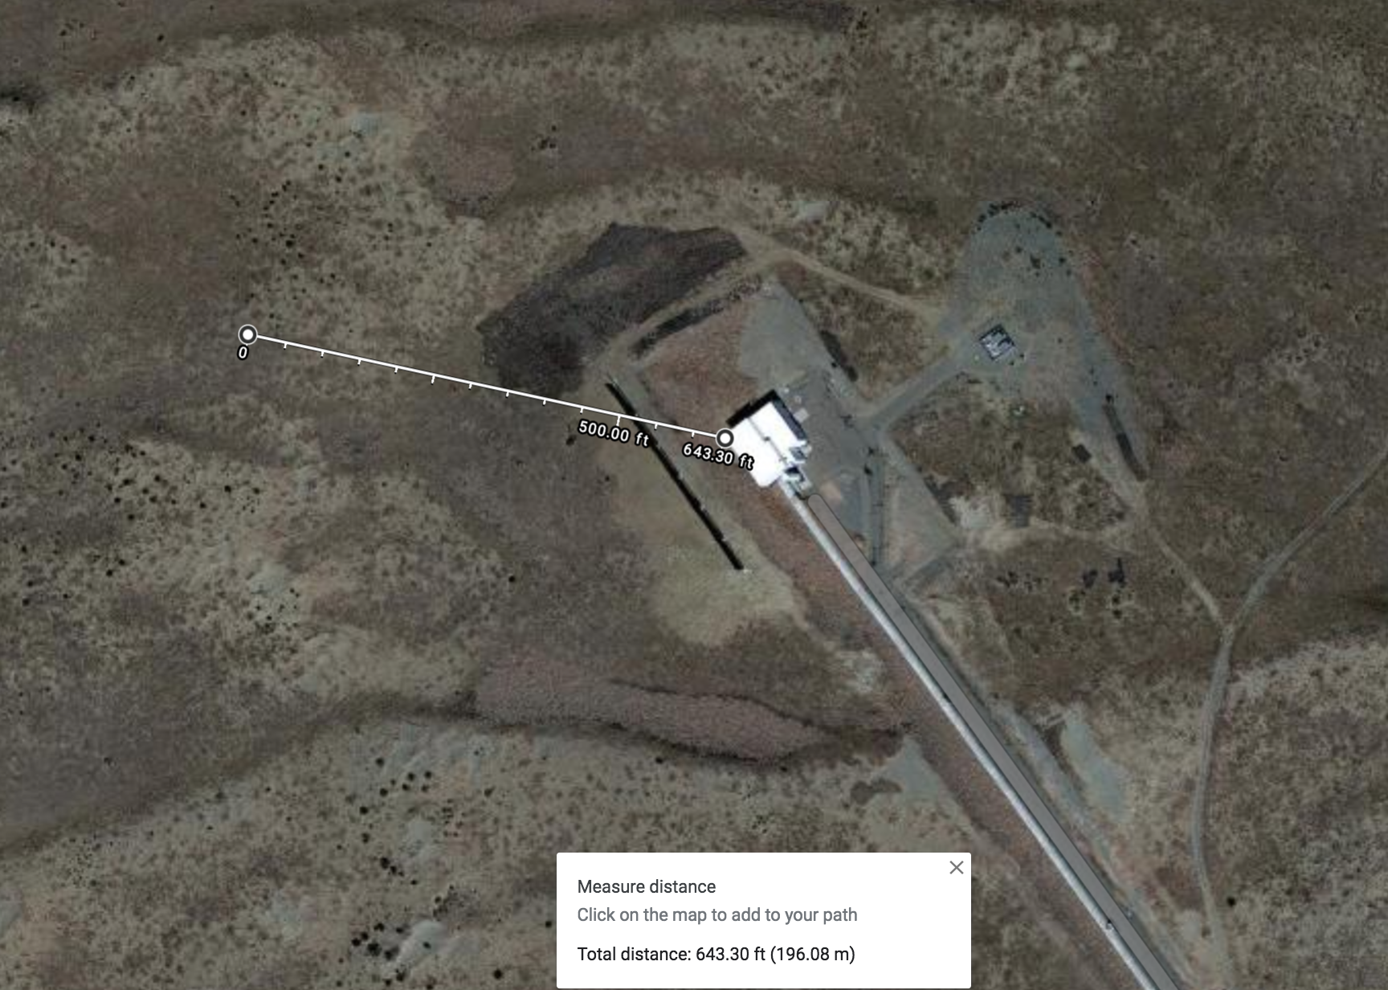
Line for data on next slide
160 m
105 m
160 m
78 m

Slide 25
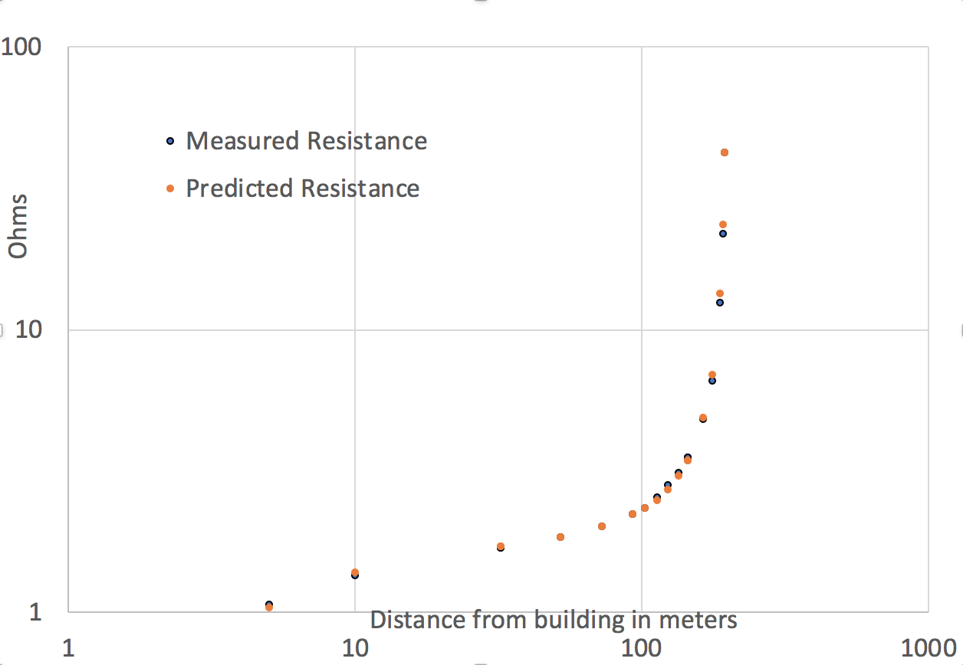

Slide 26
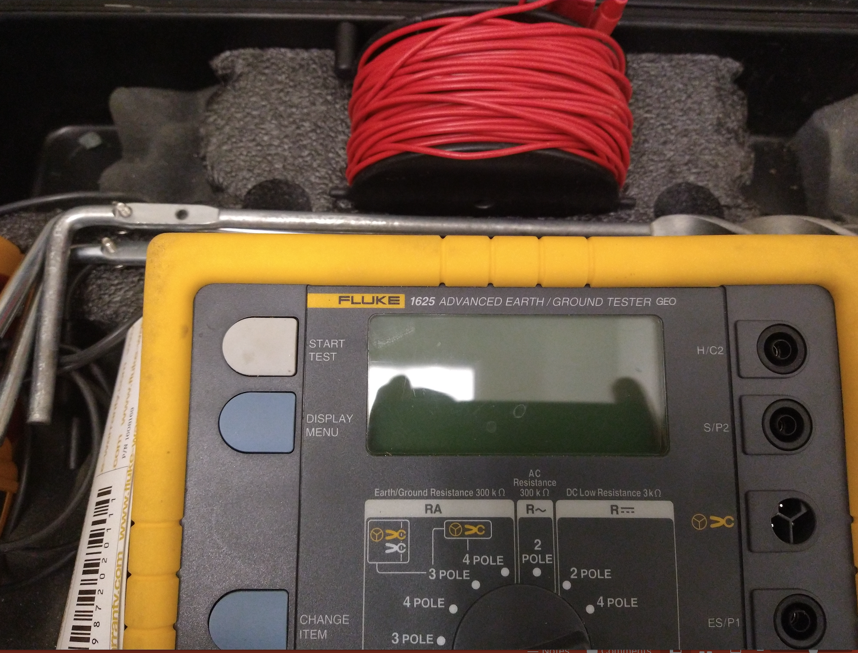
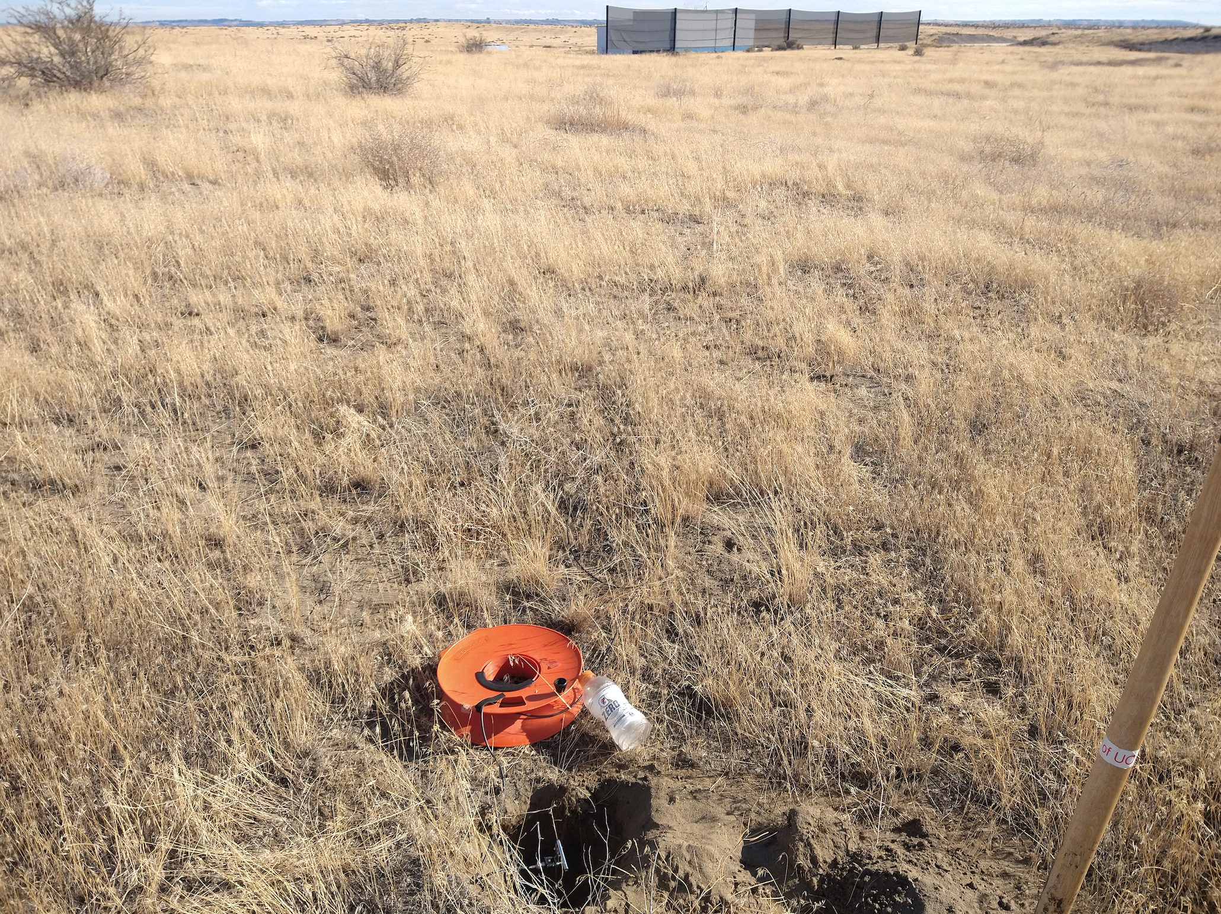

Slide 27
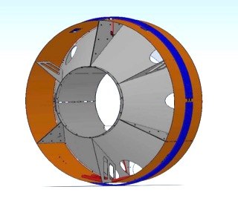
Manifold/Cryopump Baffle: “Cryo-baffle”
lit by scattered main beam (observation sensitivity)
Photographed while at full sensitivity, lit by scattered infrared beam.
cryo-baffle
transmission monitor (TMS)
p-cal periscope
ETMY test mass
arm cavity baffle (ACB)
annular reaction mass with electrostatic drive traces (concentric lines)

