Slide 1
Black-Hole Hunters: from Millwrights to Scientists, Jobs on the Frontier of Physics and Astronomy
Fred Raab
Senior Advisor to the Directorate
LIGO Laboratory
Caltech

Slide 2
Outline
What do we do? Who are we?
Basics of Gravitational Waves (GWs)
What does it take to operate a LIGO observatory?
Working at an Observatory
Perspective

Slide 3
What do we do at LIGO and how do we do it? (elevator version)
The LIGO team works to explore the most extreme regions of space and time and the most extreme forms of matter in the universe.
We do this by detecting the ripples in space-time, called gravitational waves, that are produced by black holes and neutron stars in some of the most violent events in our universe.

Slide 4
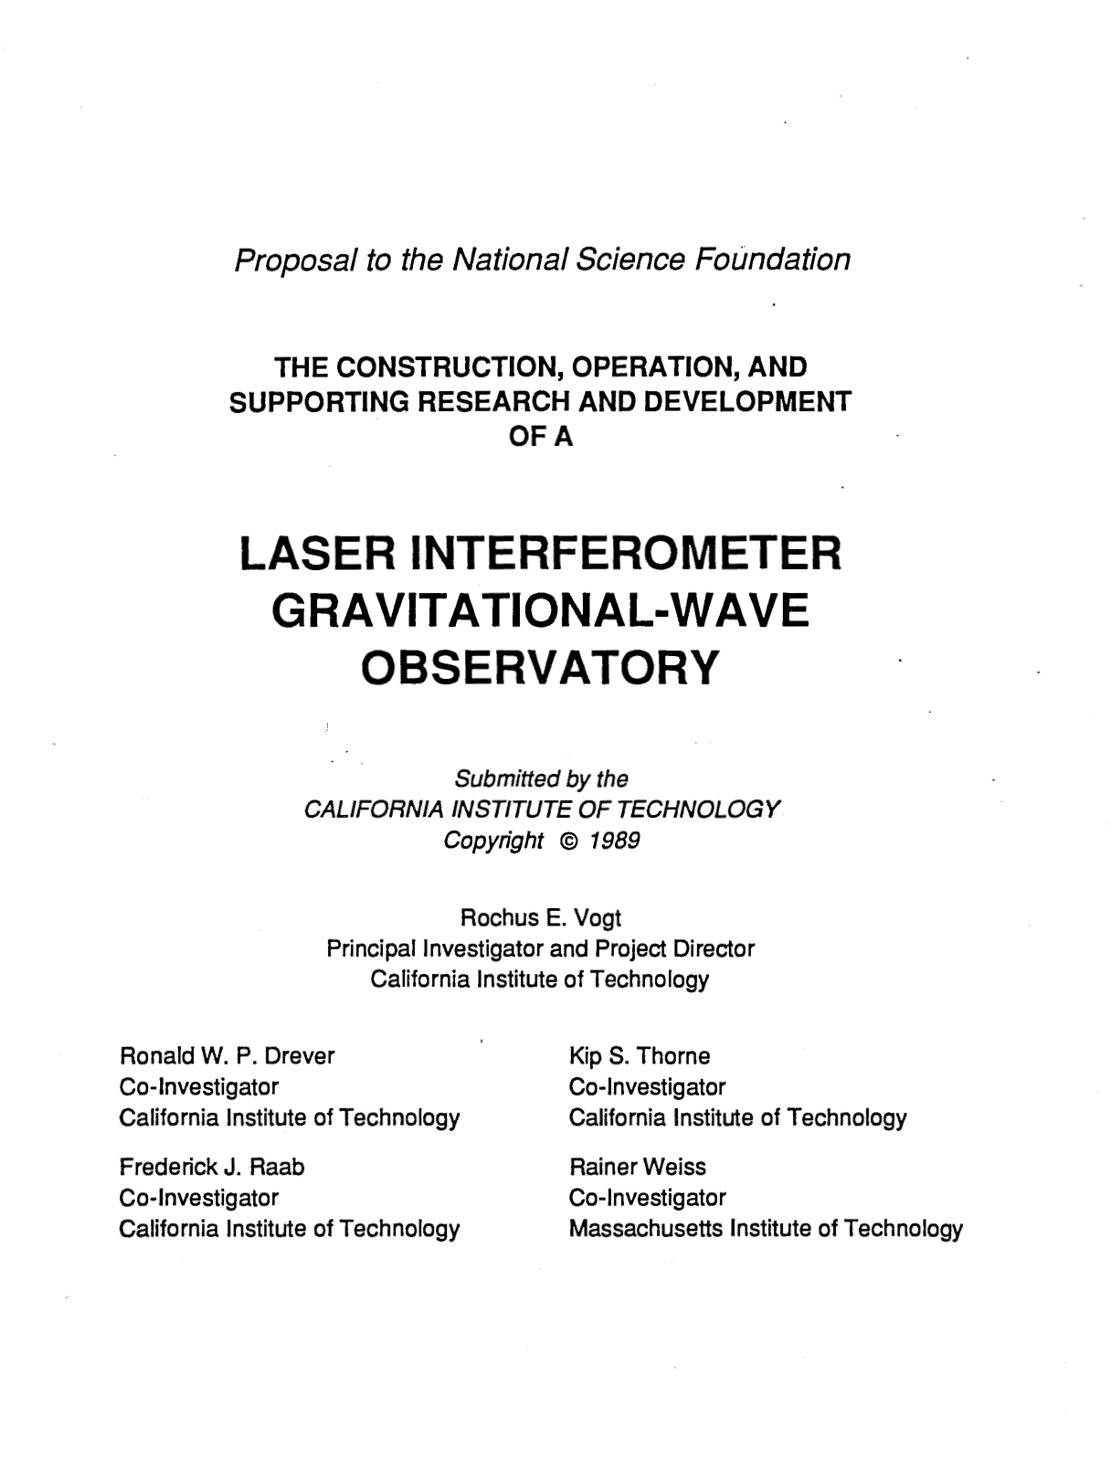
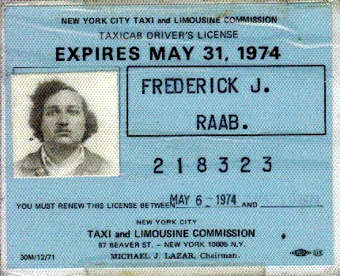
Who Am I?
Born to immigrants in NY City in 1951.
Had an “OK” but not “strong” high school science background.
Fan of space; fell in love with Physics.
Struggled in my first college physics course, but persevered.
BS-Manhattan College, PhD-SUNY Stony Brook (1980). U. Washington research scientist.
Kip Thorne recruited me to Caltech in 1988.
First LIGO Observatory Head (for 20+ years)

Slide 5
Who else is working on terrestrial GW detectors
LIGO Laboratory: 180 members.
LIGO Scientific Collaboration: 1600+ members in 19 countries on 5 continents.
Virgo Collaboration: 800+ members in 15 countries, mostly in Europe.
KAGRA Collaboration: 400+ members from 110+ institutions in 17 countries.
Science is a team sport!

Slide 6
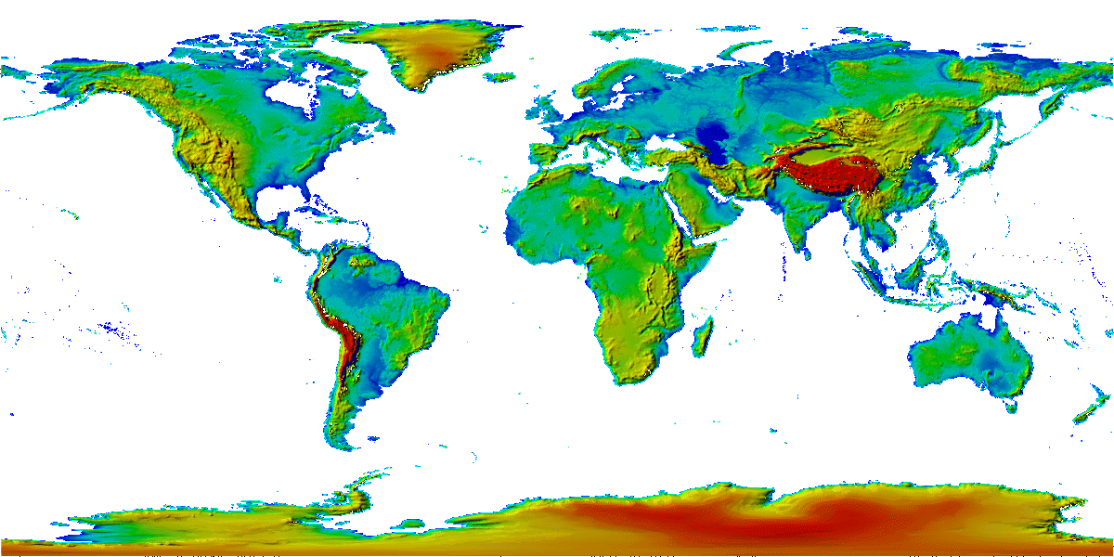
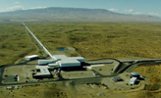
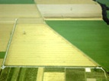

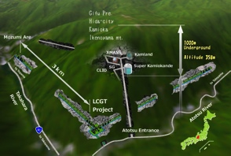
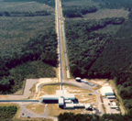


The advanced GW detector network:
2015-2030
Advanced LIGO
Hanford
2015
GEO600 (HF)
2011
KAGRA
2020
Advanced LIGO
Livingston
2015
Advanced
Virgo
2017
LIGO-India
2030
6
6

Slide 7
Basics of Gravitational-Waves

Slide 8
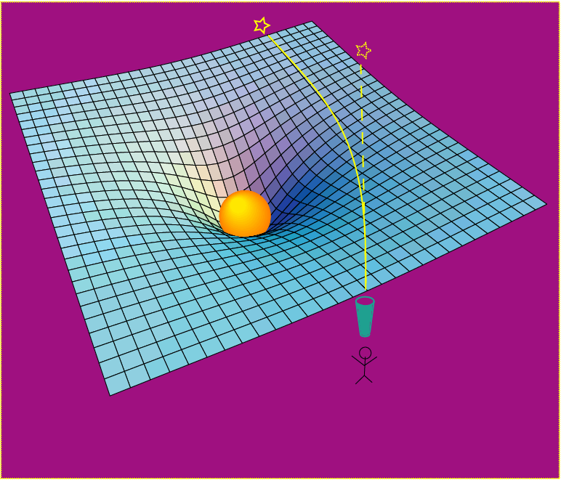
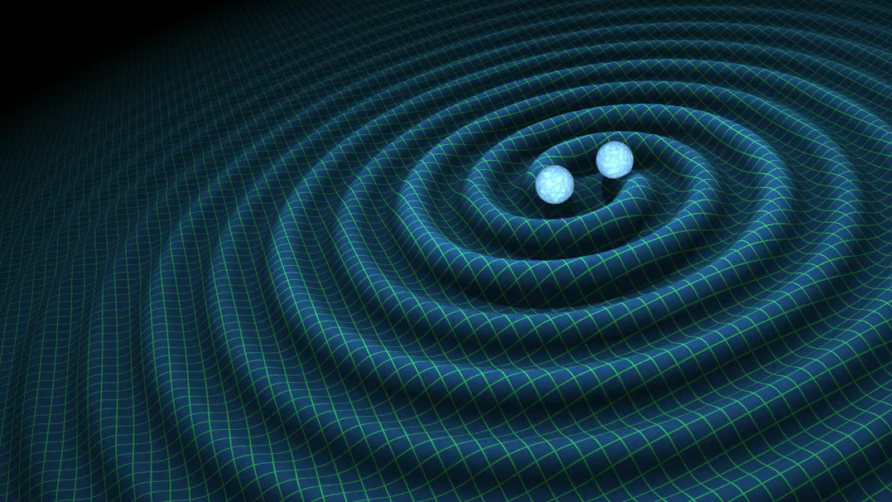
Einstein’s General Relativity:
gravity is a manifestation of space-time curvature
curved spacetime can bend light, too!
dynamic deformation of spacetime
Credit: R. Hurt - Caltech / JPL:
A massive object shifts apparent position of a star
Space has a shape, a stiffness and a maximum speed for information transfer.

Slide 9
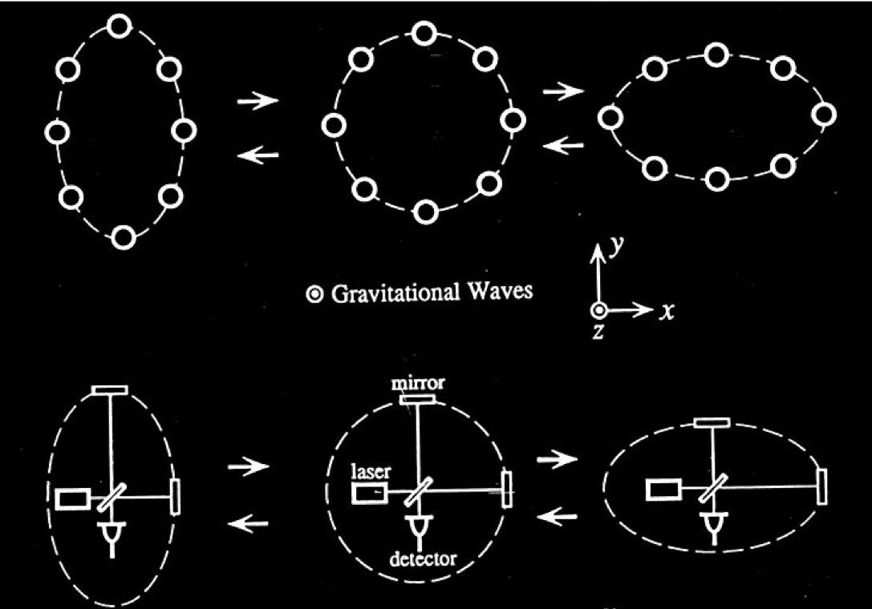
Basic idea for GW detection is simple
GW amplitude h = (R_{x}-R_{y})/R
When the arm lengths are equal, no light reaches the detector.
It takes longer for light to travel the longer arm path, which allows light to reach the detector.

Slide 10
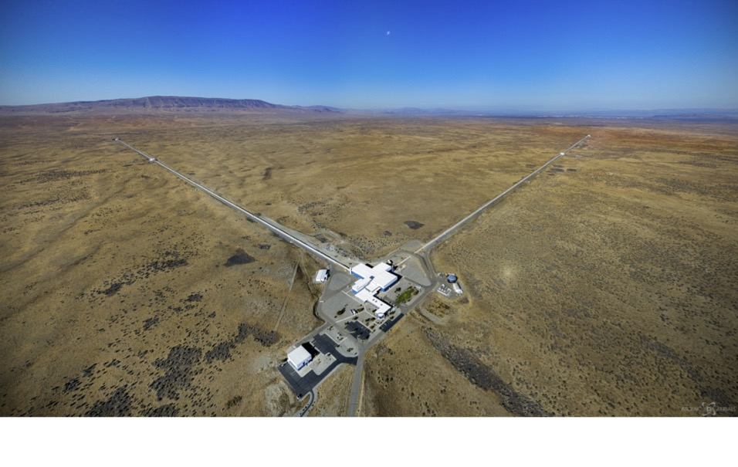
Monumental detectors for miniscule signals
The largest gravitational wave ever detected distorted the 4-km arms of LIGO by about 40 billionths of the size of an atom.
Credit: Atomic Aerials (5/12/22)

Slide 11
Reality is more complicated: schematic of LIGO chambers, seismic isolation and suspended optics.

Slide 12
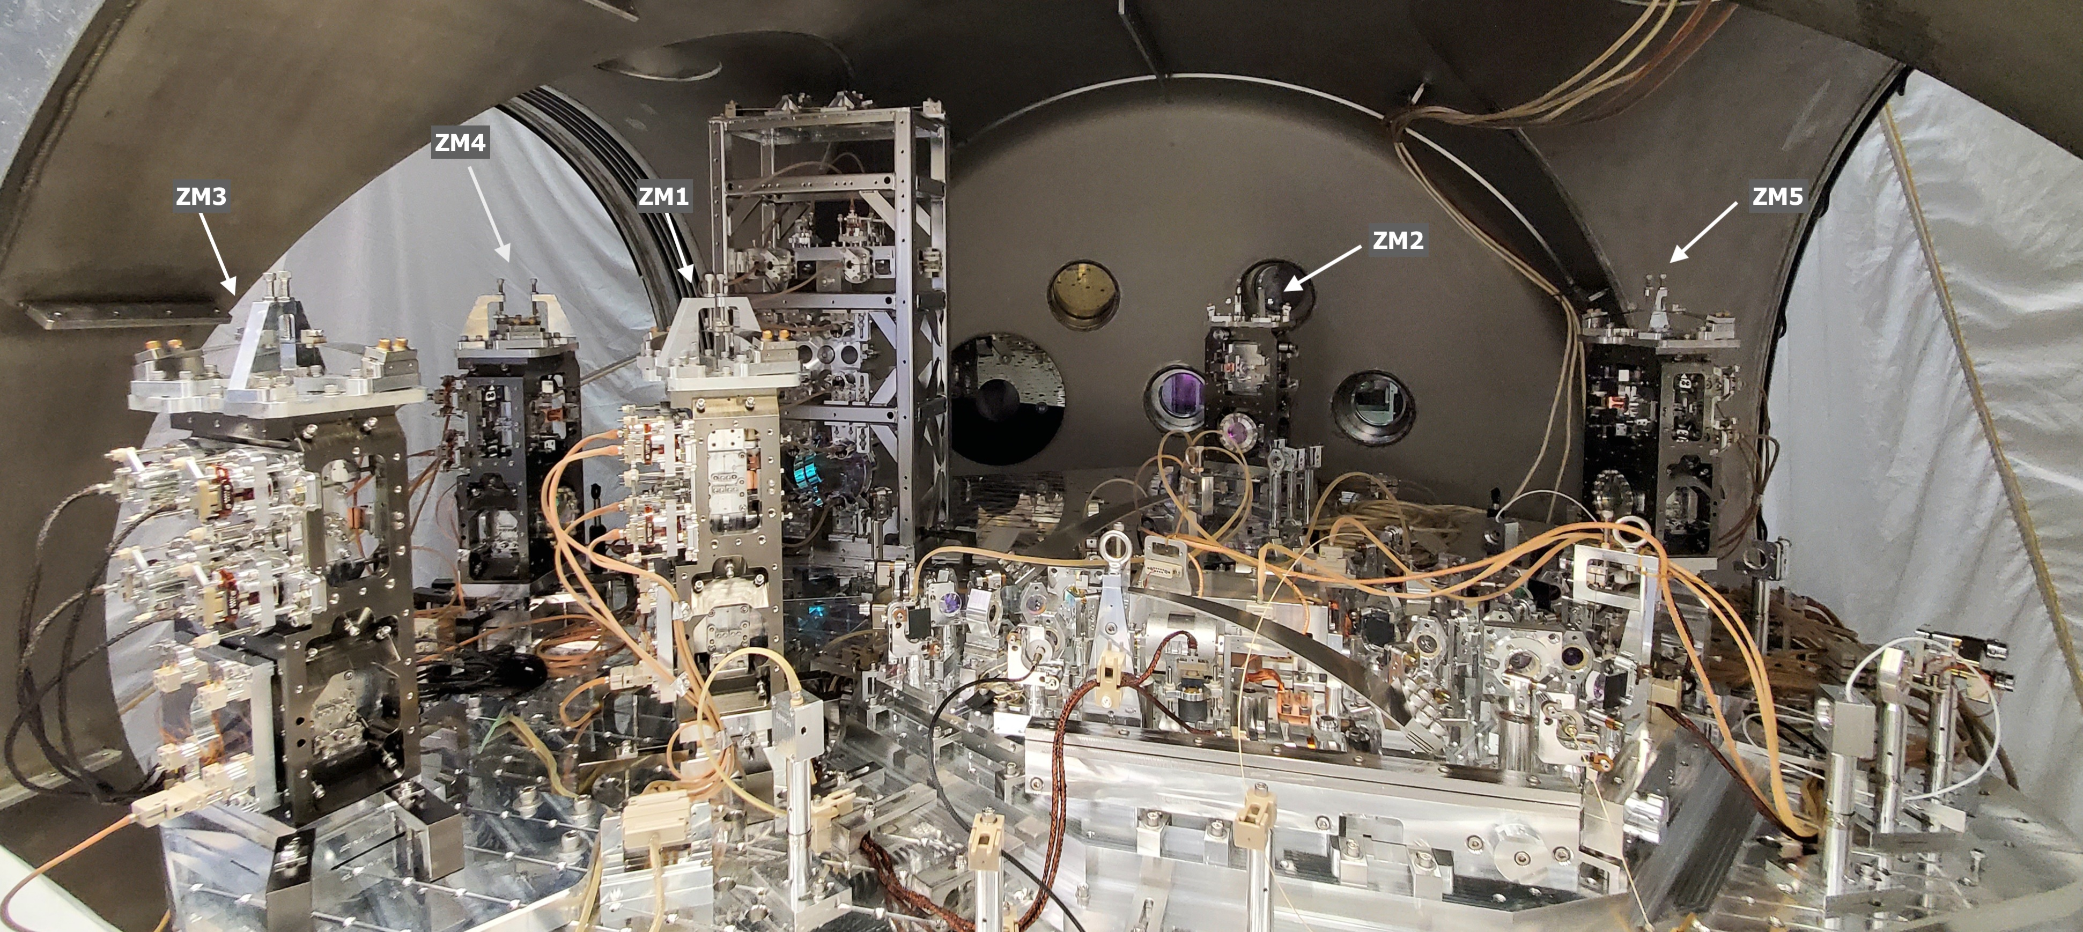
Reality is far more complicated: view inside a part of the vacuum squeezing system
LIGO Project, Caltech

Slide 13
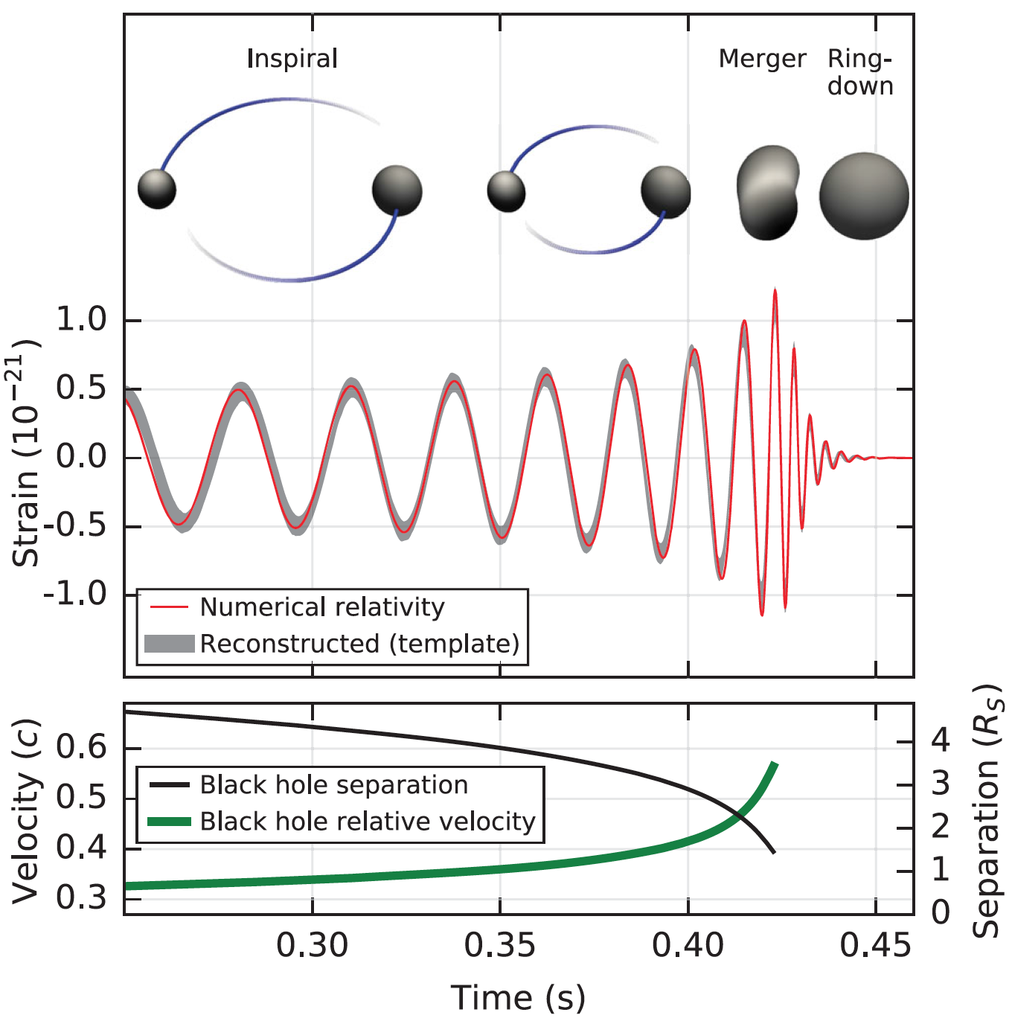
What can we learn from a gravitational wave?
Phase evolution gives chirp mass and aligned components of spin
Amplitude scale factor gives luminosity distance (standard siren)
B. P. Abbott et al. (LIGO Scientific Collaboration and Virgo Collaboration), Observation of Gravitational Waves from a Binary Black Hole Merger, Phys. Rev. Lett. 116, 061102 (2016)
Ringdown frequency and Q give mass and spin of final black hole
Modulation of amplitude gives nonaligned spin components
Highest frequency gives sizes of objects just before merger.

Slide 14
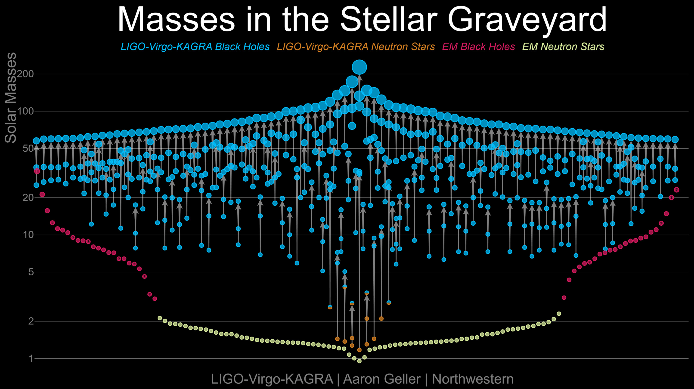
Black holes and neutron stars are the fossils of stars

Slide 15
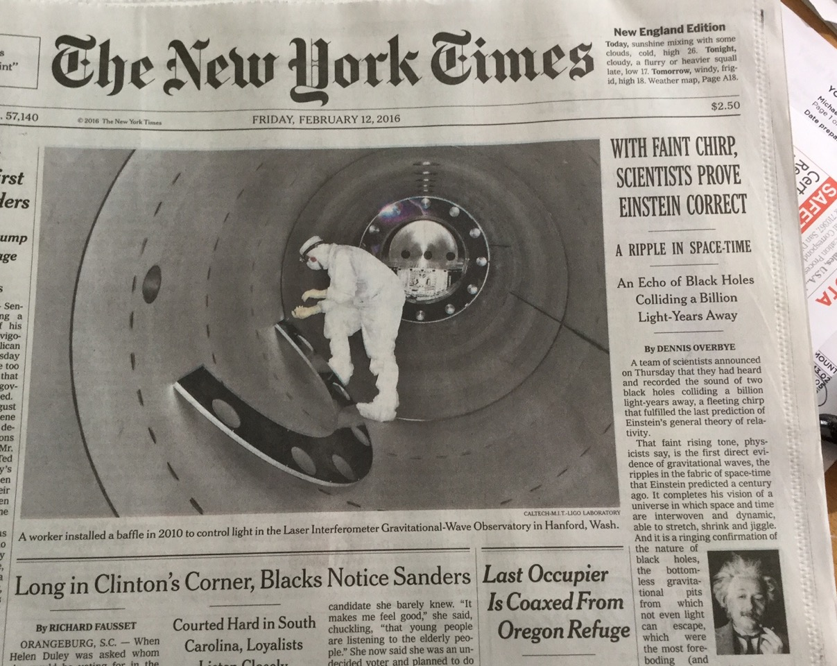

Slide 16
Disciplines that depend on gravitational-wave observations
Astronomy: black holes and neutron stars are the ”fossils” of stars, clues to the history of objects in the universe.
Fundamental physics: nature of the universe, gravitation, linkage to fundamental forces.
Nuclear physics: neutron star physics; nuclear fluids and solids above the densities in atomic nuclei.
Precision measurement science and engineering.
Quantum physics and quantum engineering: LIGO and it sister detectors are macroscopic quantum-limited detectors.
Observing coordination includes advance communication of observing run start/stop dates that are planned with increasing sensitivity to new EM capabilities coming online.

Slide 17
What does it take to operate a LIGO observatory?

Slide 18
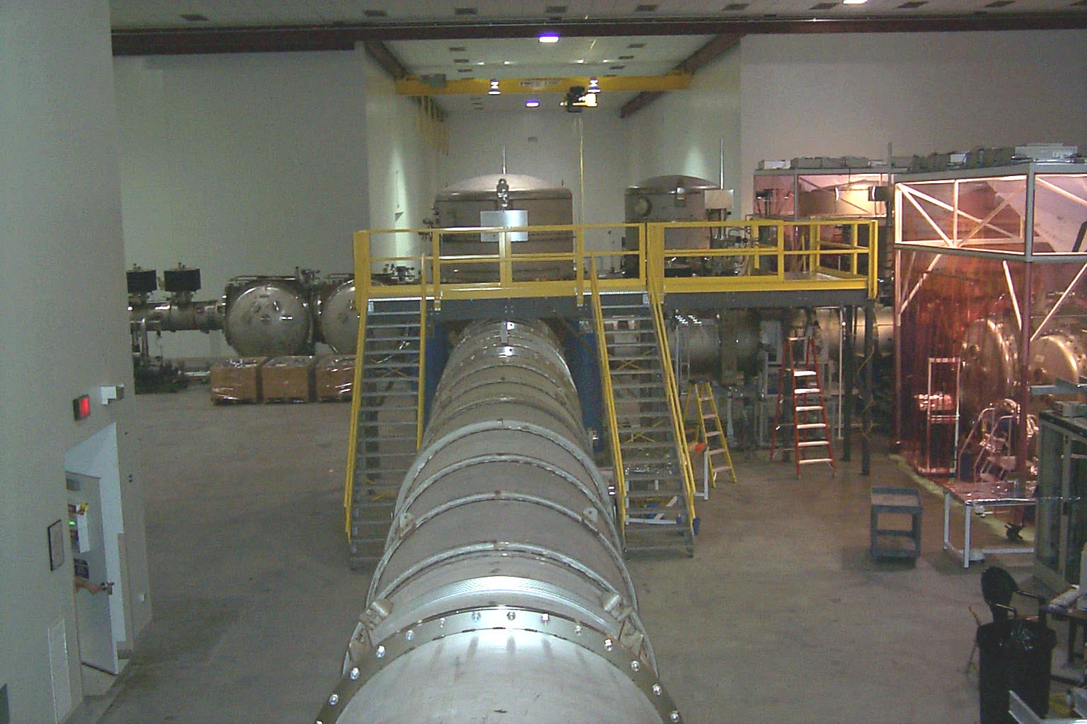
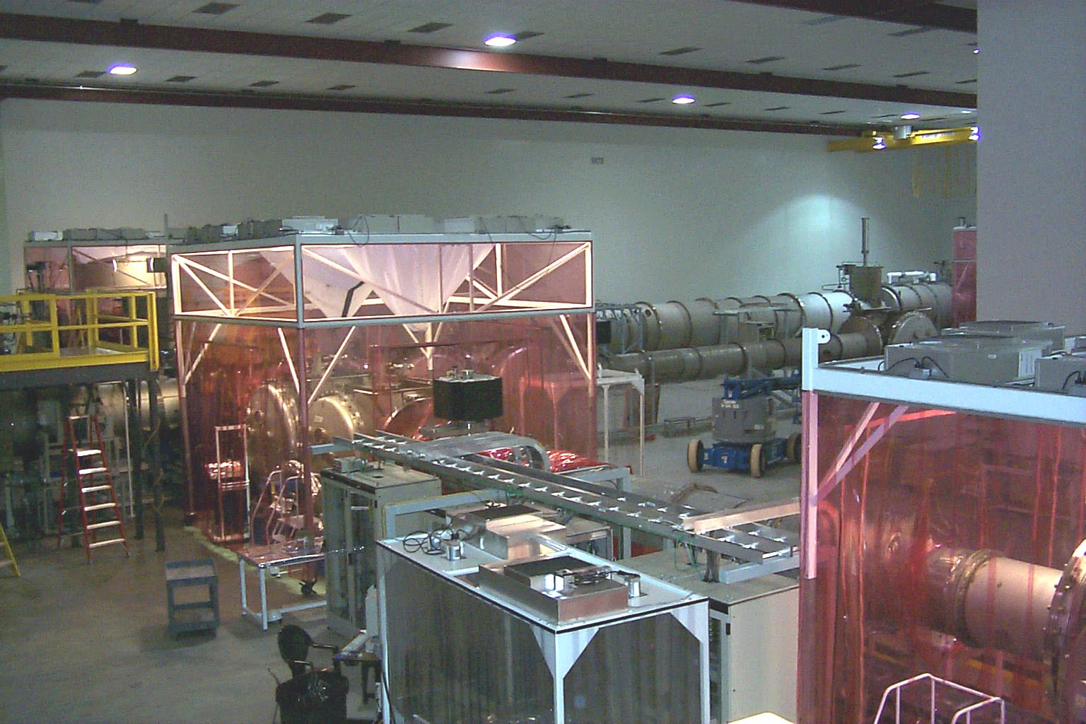
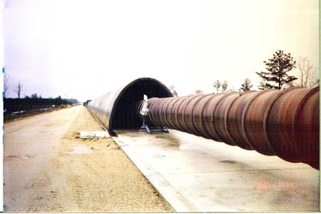
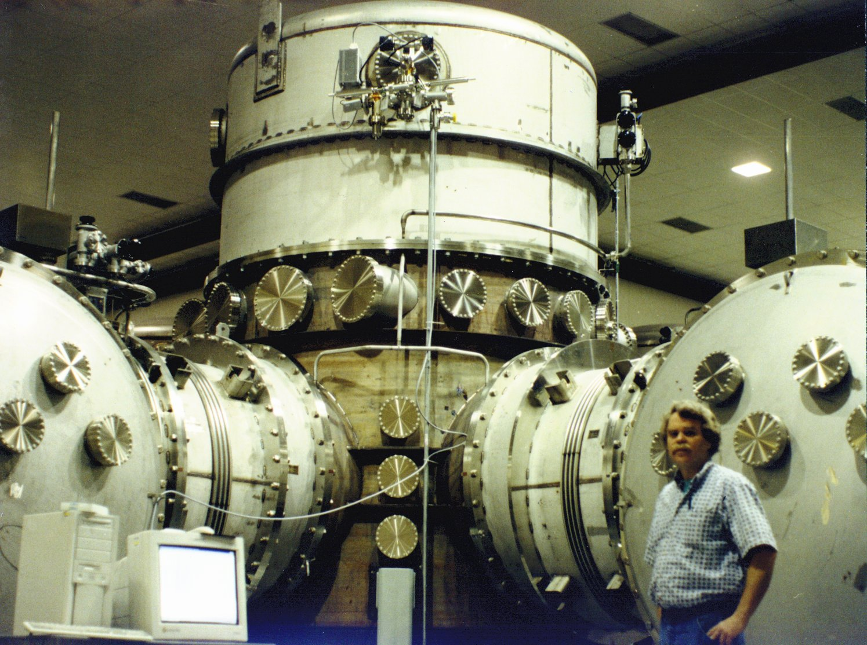
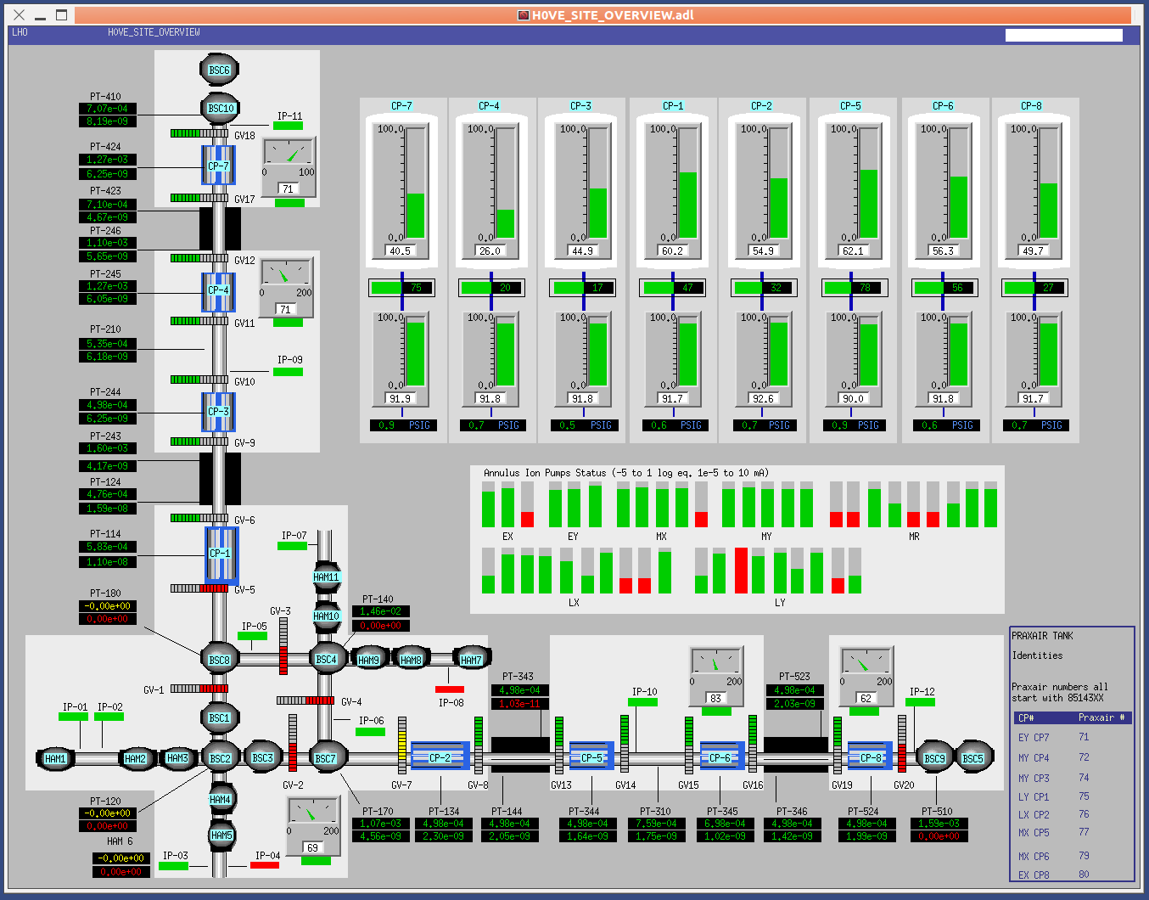
One of world’s largest vacuum systems: 10⁴ m³ vacuum system; ~500 sense/control points
View inside Corner Station
Beam Tube
Vertex beam splitter
Caltech/MIT/LIGO Lab

Slide 19
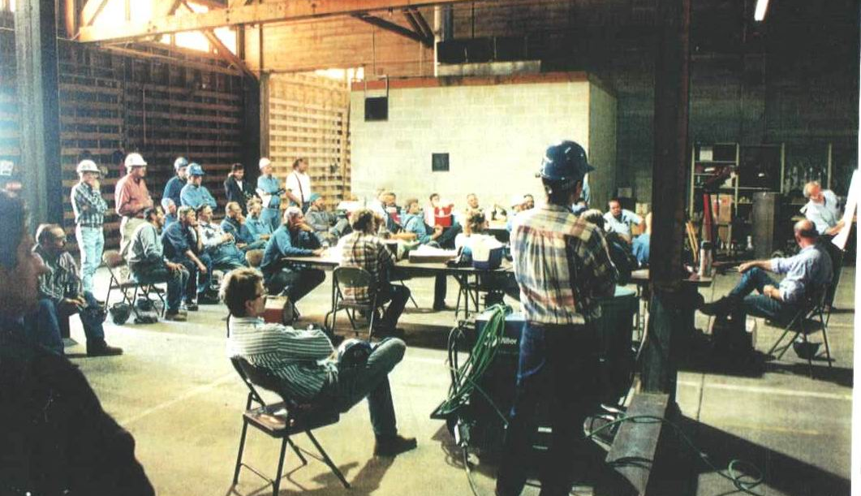
How to win the Nobel Prize.
Rai Weiss
Caltech/MIT/LIGO Lab
Boilermakers learning about critical role of their work.

Slide 20
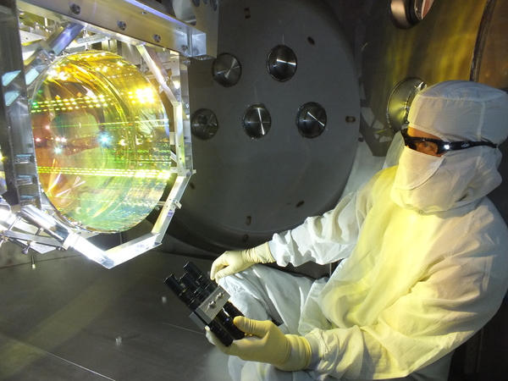
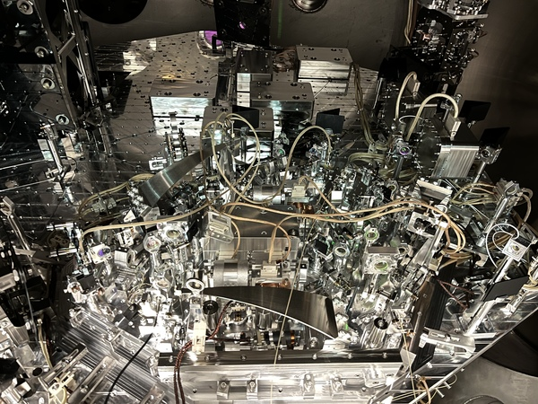
Laser Interferometer Gravitational-Wave Detector
Caltech/MIT/LIGO Lab/(Matt Heintze)
Powerful lasers
Mirrors hanging from glass fibers
Seismic isolation systems
View of the squeezed light source in LIGO's vacuum chamber.
(Image credit: Wenxuan Jia/MIT

Slide 21
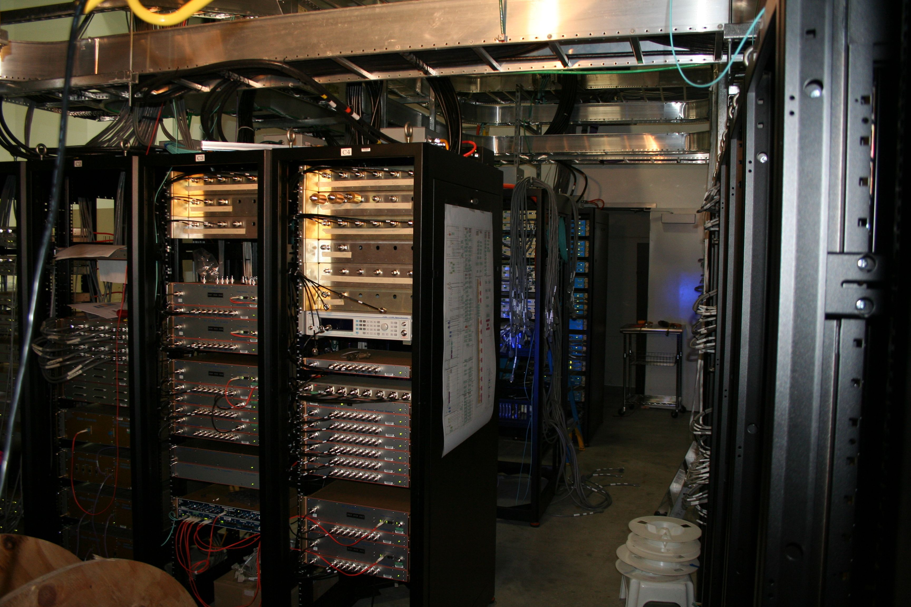
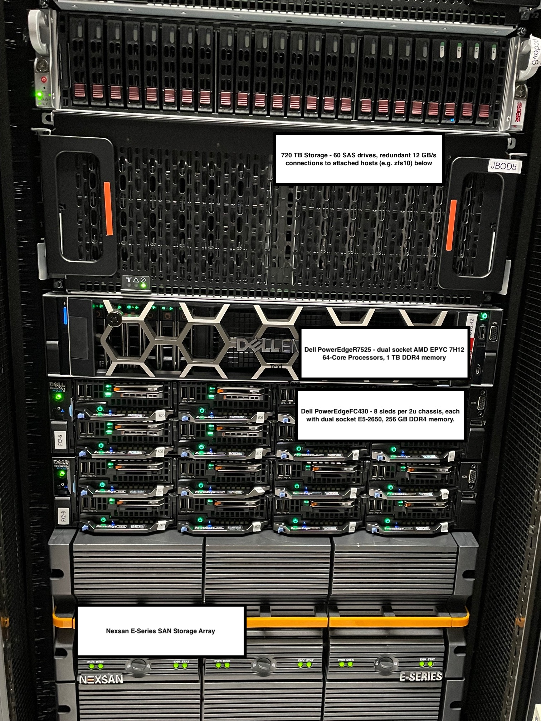
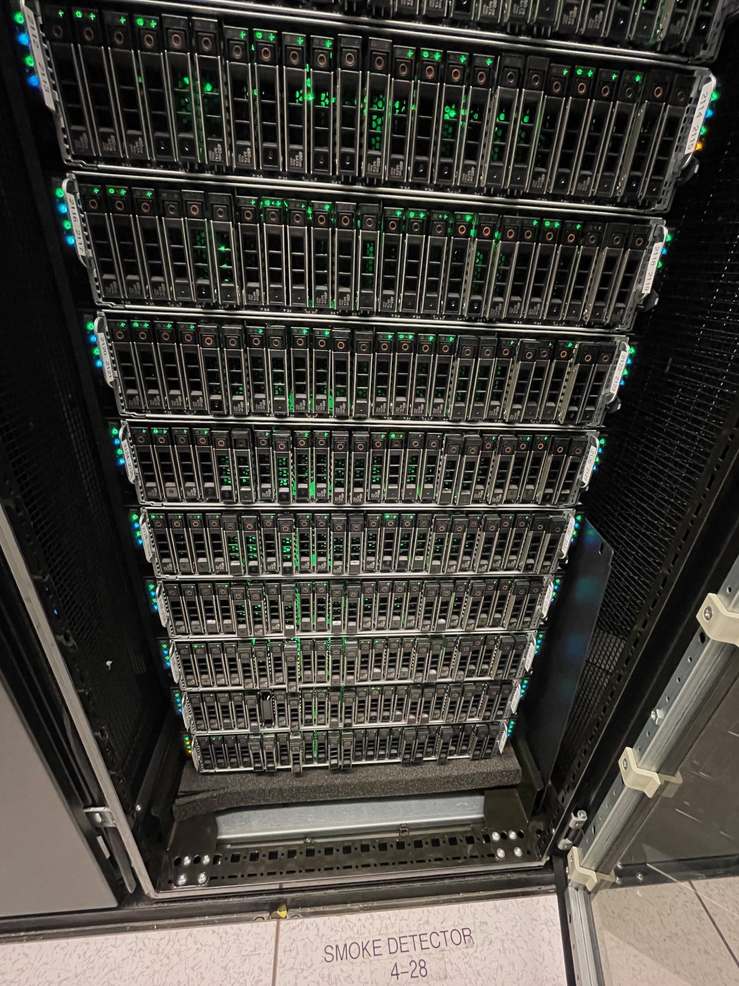
Information Technology
Caltech/MIT/LIGO Lab
Interferometer Control & Data Acquisition System
>350 high-performance servo-control loops
Physics Environmental Monitor (70 fast & 600 slow channels)
Caltech/MIT/LIGO Lab
Data Archive and Server System
Data ingestion & archiving
Data distribution
Online analysis and alert generation

Slide 22
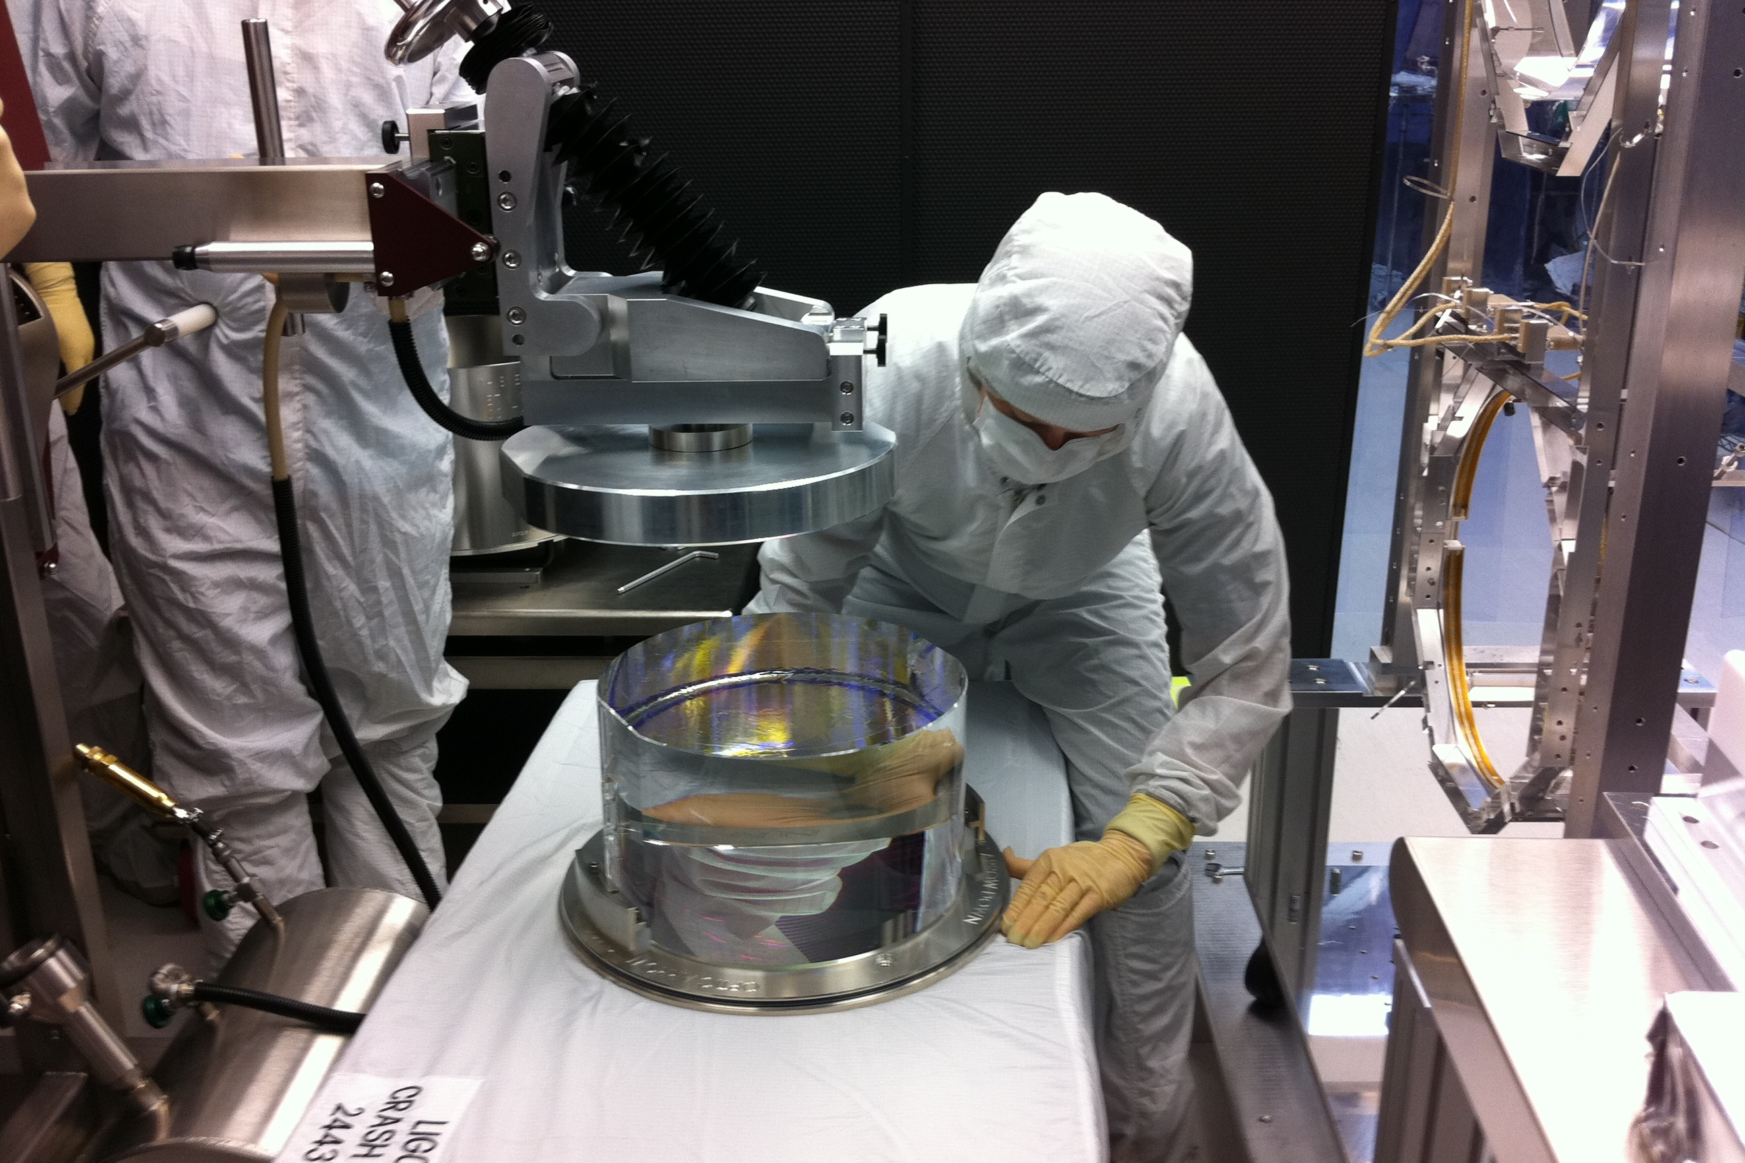
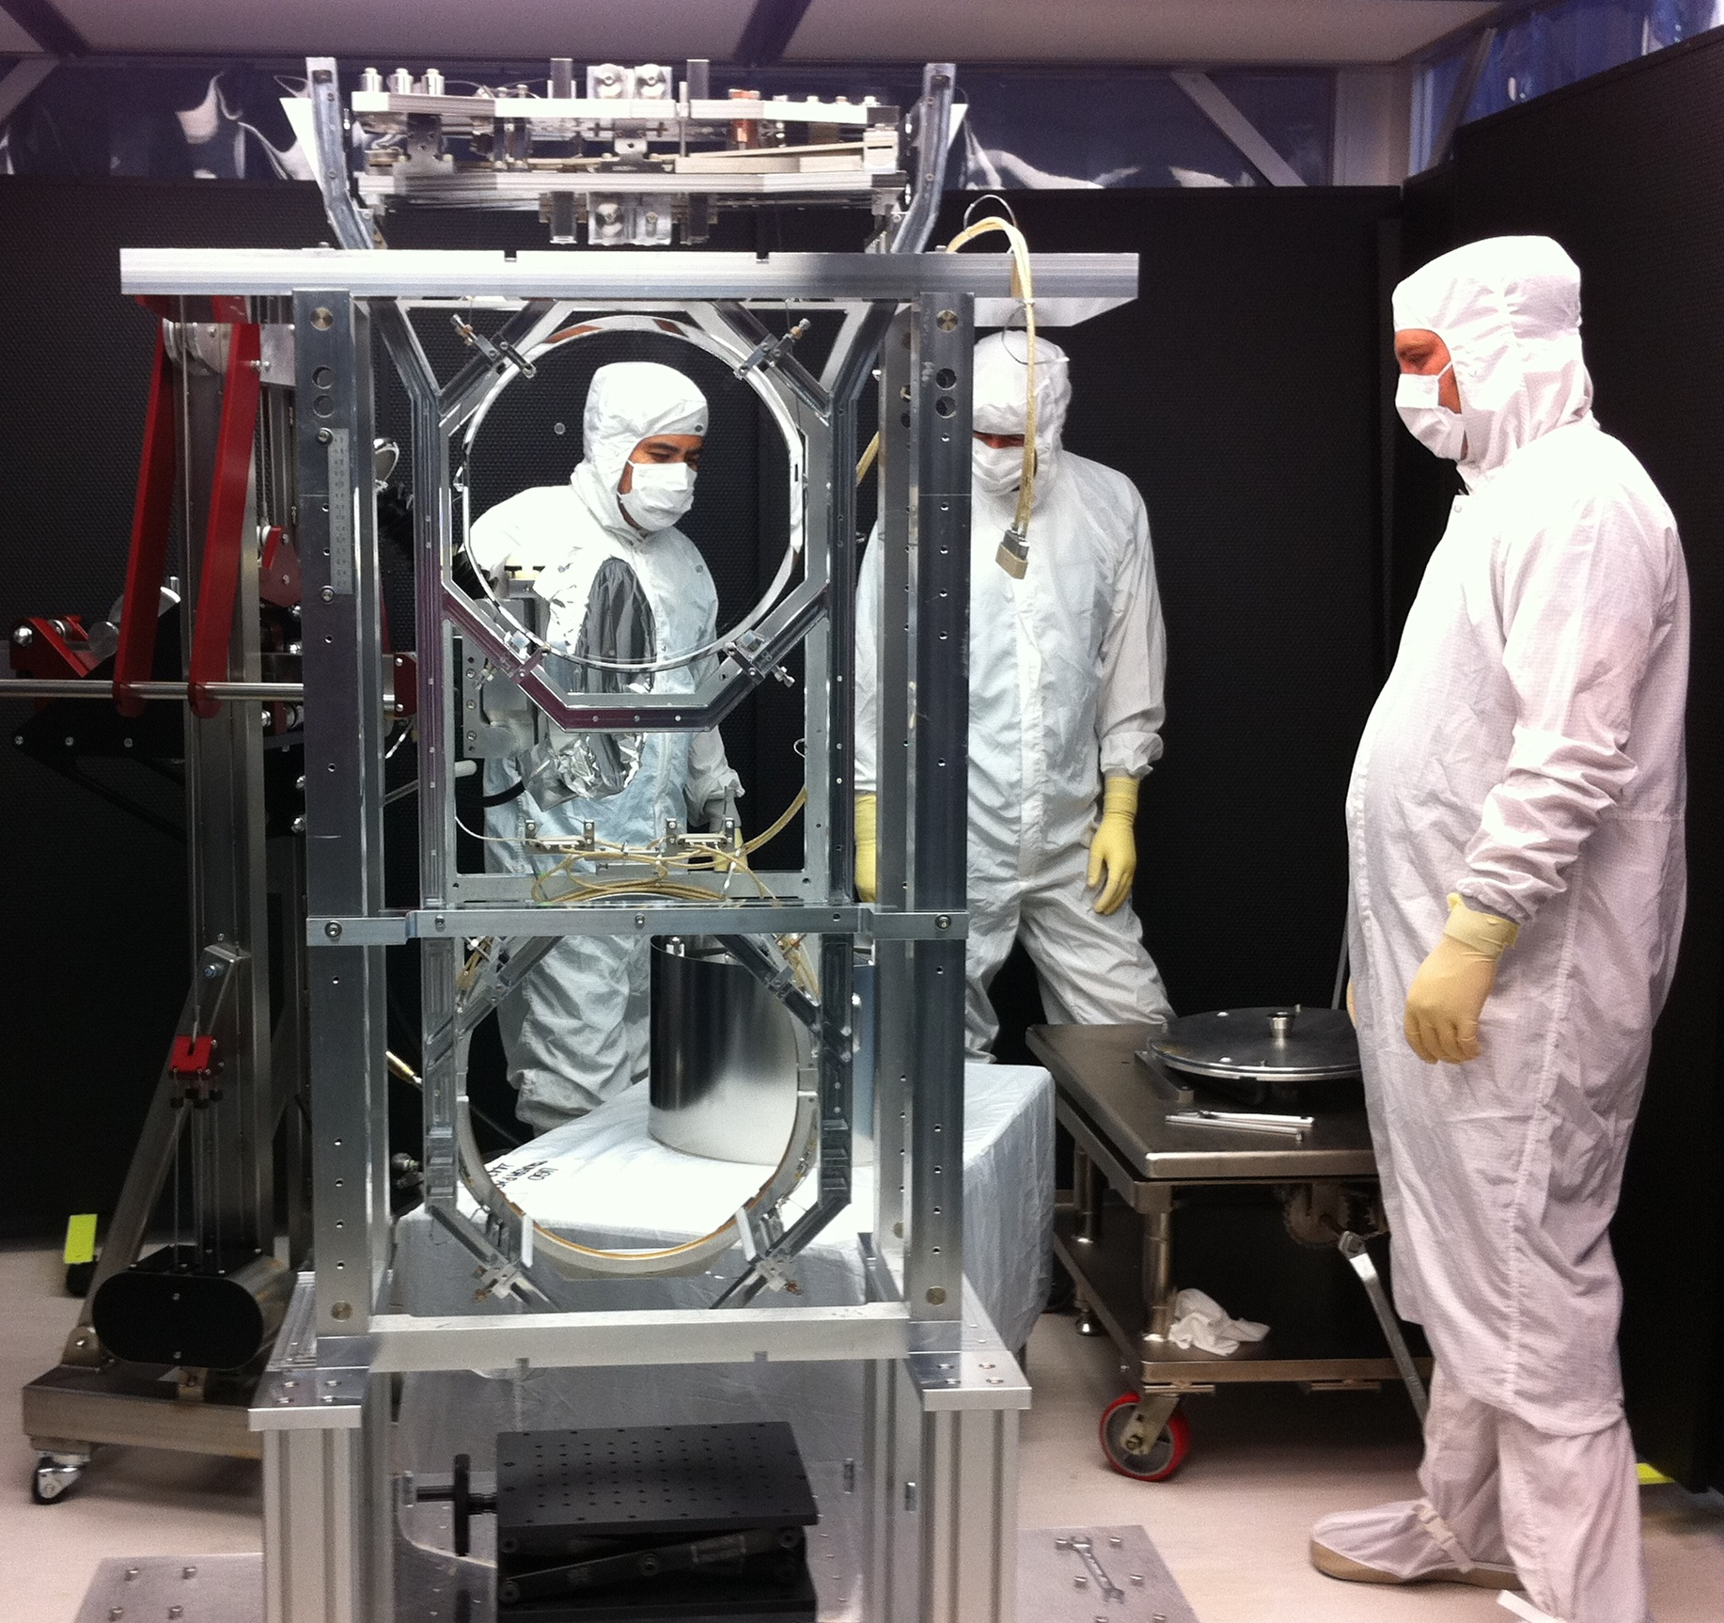
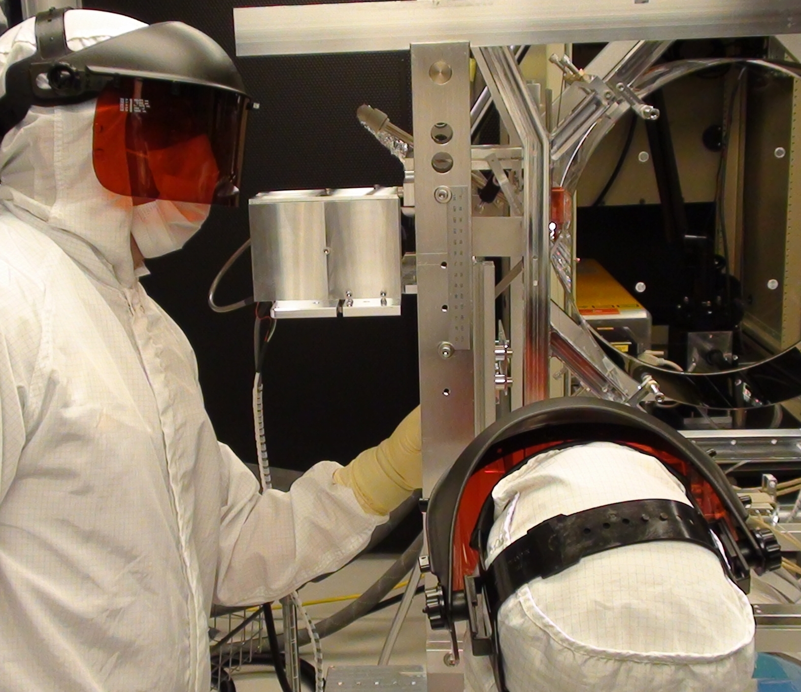
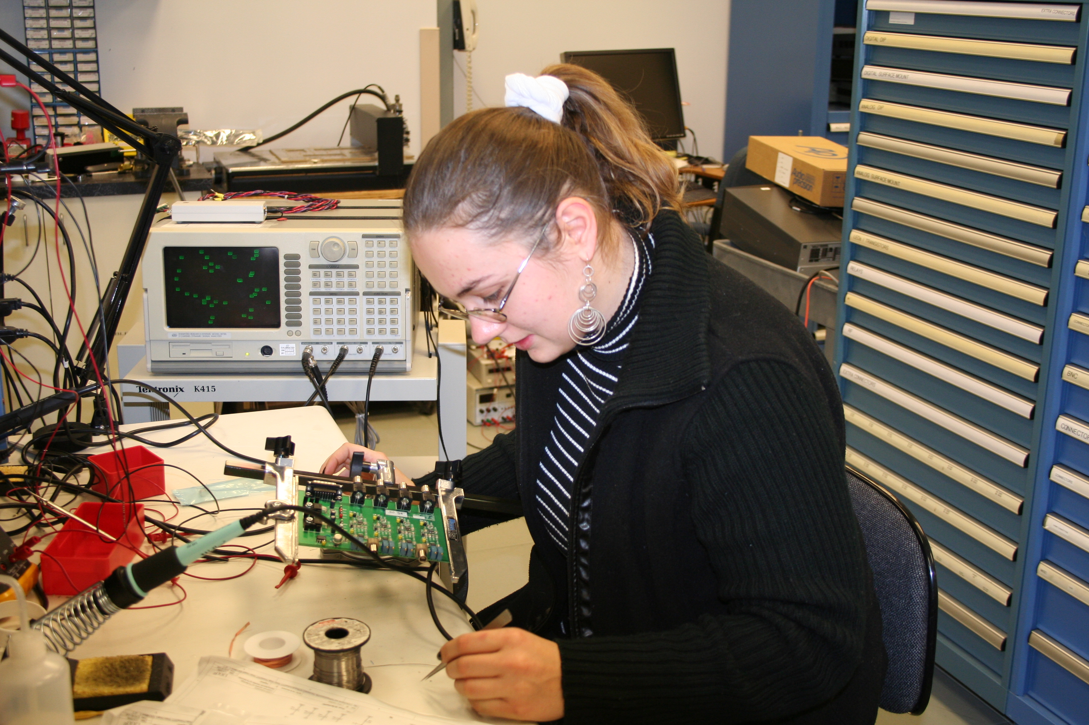
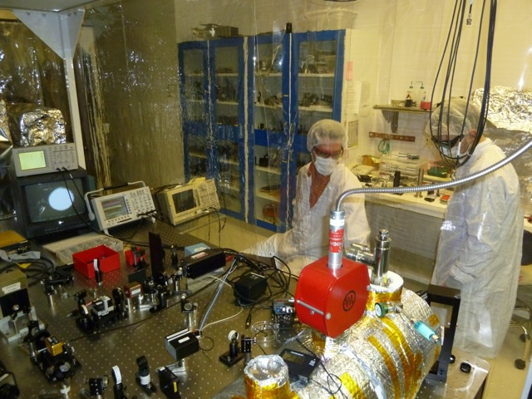
Support Labs for Optical, Mechanical, Electronics, Vacuum Prep Work
Caltech/MIT/LIGO Lab

Slide 23
Working at an Observatory

Slide 24
How to characterize working on LIGO
One team, many mail codes.
Belonging to a large international team of collaborators, we spend a lot of time communicating with colleagues.
Every job and every person matters!
LIGO needs strict standards all day, every day
Vacuum tube at an observatory has 50 km of weld seam, but a 1 micron defect can be ruinous (error rate < 1 in 50 billion).
An absorbing spot 10 microns in size on a core optic (error rate of 1 in 1 billion) can limit the range of detectors. Need to reduce this to error rates less 1 in 40 billion.

Slide 25
Observatory staffing is determined by required response times
On site – ability to respond to issues that compromise observing time or present hazards in minutes to hours.
On call – ability to respond within an hour.
Remote – carry on support tasks (e.g., lab-based research, engineering development, procurement, etc.) and can travel to support on-site activities. Labs at Caltech, MIT and other collaborating institutions are in this category.
Trades – varies by nature of the work. More craft labor, working in teams with scientists and engineers is needed during installation of detector upgrades.

Slide 26
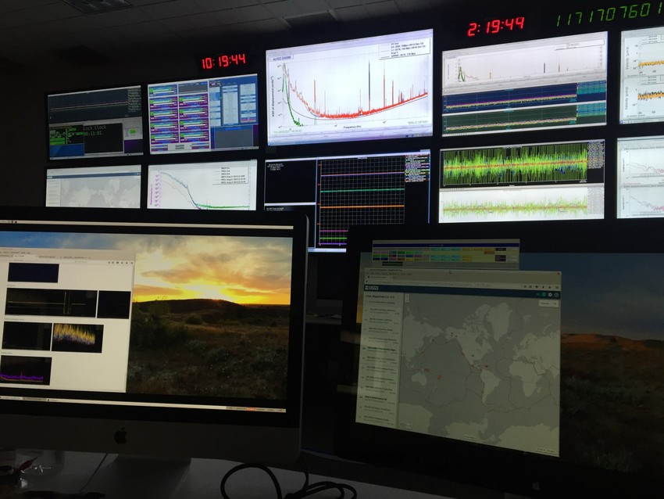
Control-Room Operations
Control-room coverage for 24x7 during runs and tech support outside runs
Detector maintenance
Technical support for construction and installation of detector upgrades
Caltech/MIT/LIGO Lab
Notes:
A Treat
Hearing light
Wire resonances
Look forward to being here in a few years with ALIGO
Quiet shift, ready & waiting for detection!
46 sec
Other stories: sense nuances—Gerardo is the best

Slide 27
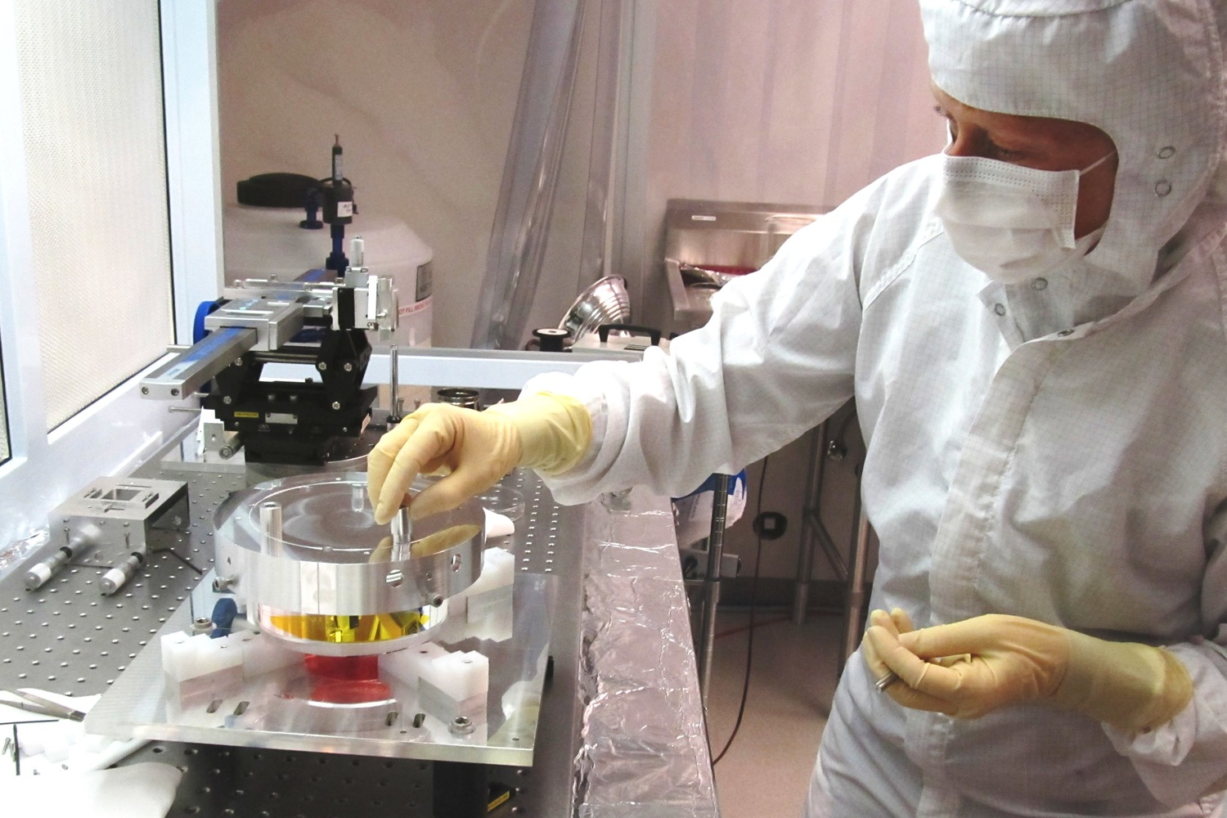
Observatory Engineering Groups
Vacuum Operations and Maintenance
Facilities Operations and Maintenance
Detector Operations and Maintenance
Electronics, Control & Data Systems Operations
Information Technologies
Caltech/MIT/LIGO Lab

Slide 28
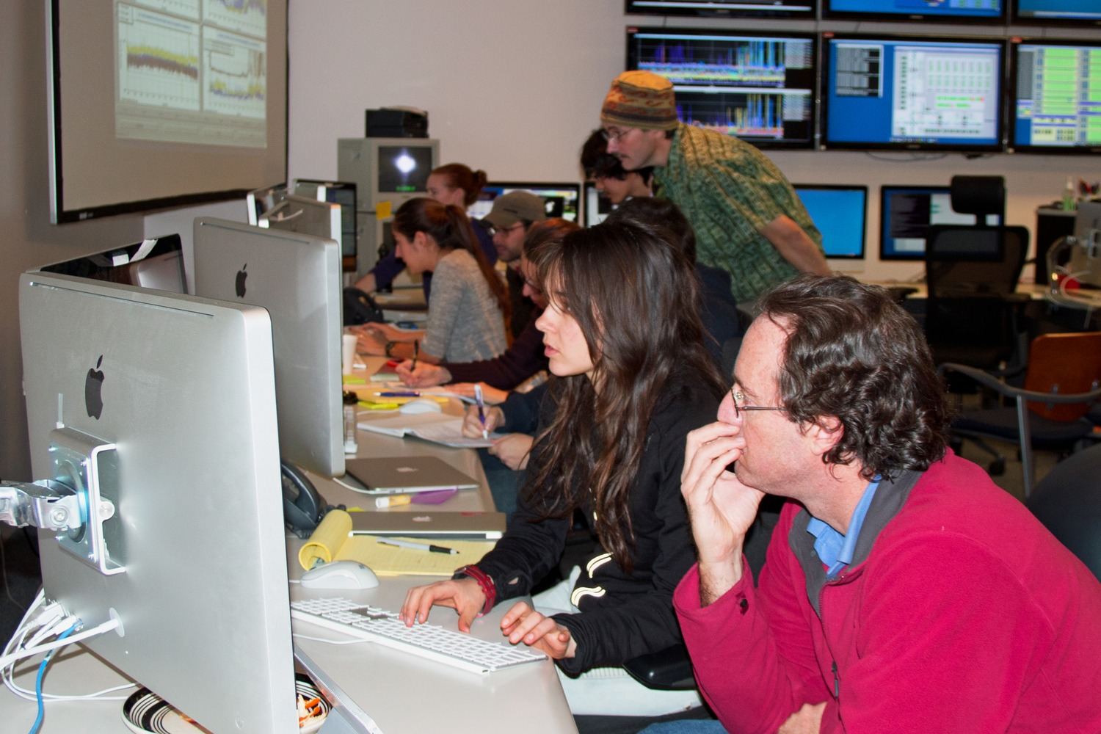
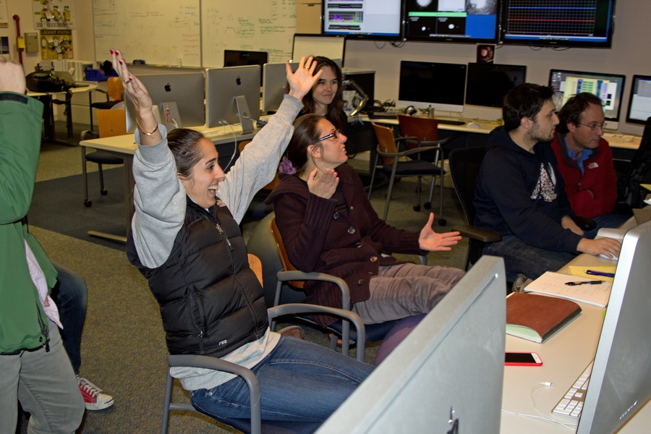
Observatory Science Group
Caltech/MIT/LIGO Lab
Commissioning
Detector Characterization
Detection Support

Slide 29
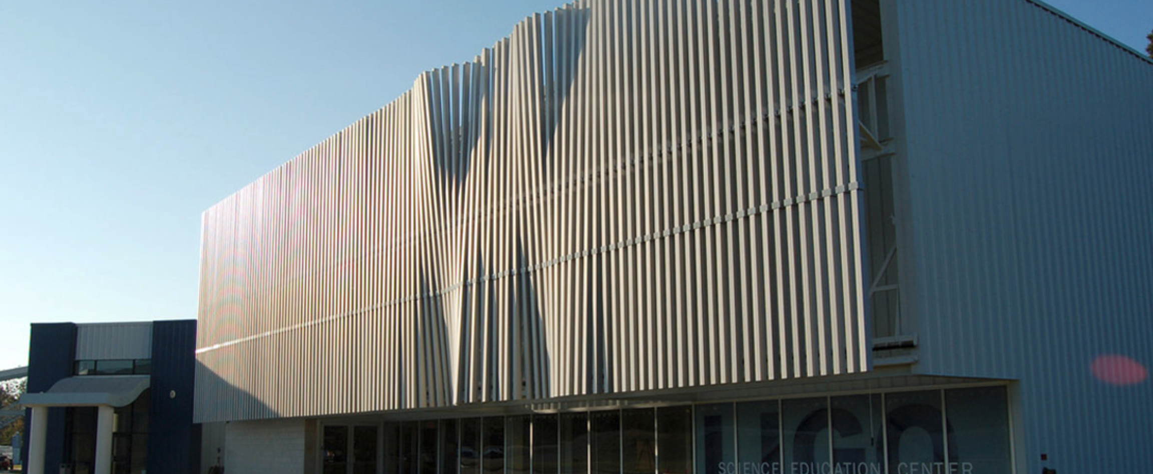
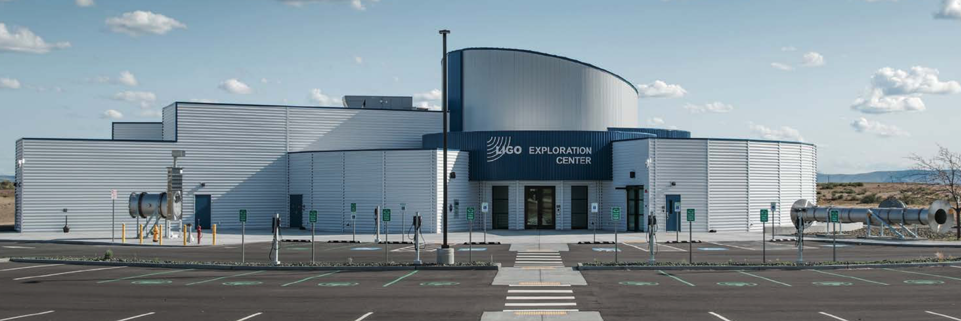
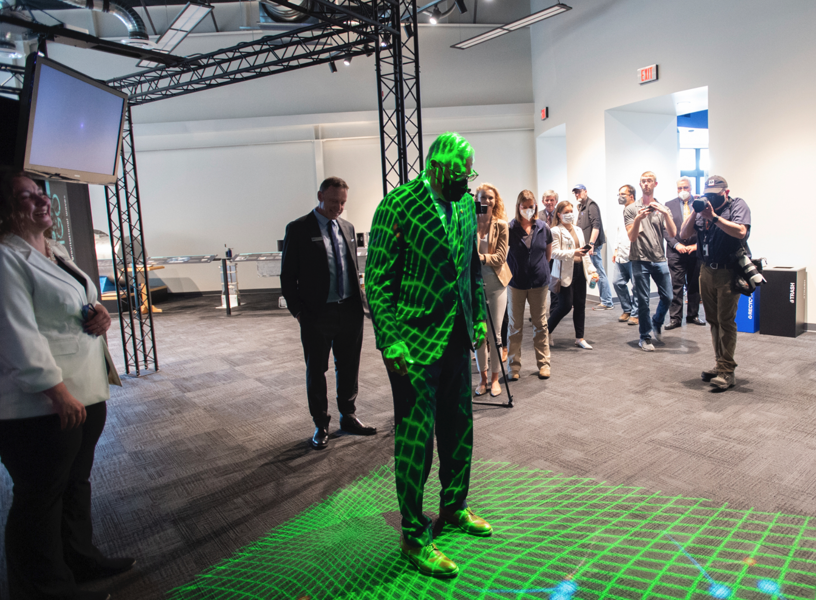
Observatory Educator Groups
Education functions
4-12 Grade Field Trips
Monthly Science Saturdays
Private Tours
Special Public Events
Teacher PD
Community Events
Classroom visits
Caltech/MIT/LIGO Lab
WA State Gov. Jay Inslee curving spacetime

Slide 30
Business Group
International science creates interesting challenges that need business solutions:
How to create fixed-price contracts for products that have never been delivered?
How to design and build state-of-the-art equipment across international institutions and multiple national funding agencies?
How to manage working to schedules and budgets across national boundaries and time zones.

Slide 31
Perspective
Gravitational-Wave Astronomy will achieve in a few decades what it has taken Optical Astronomy 400 years to do: reach out to the first era of stars.
It is rare in human history for the rate of discovery to undergo sustained acceleration by orders of magnitude.
This will be achieved by international collaborations of experimental scientists, engineers, technicians and craft specialists across many disciplines at many different astronomical and physics facilities.
Want to ride this new wave?
https://hr.caltech.edu/careers
summer internships, google “LIGO SURF”

