Slide 1




How LIGO and Virgo Changed the Way
We Think About Physics
David Reitze
LIGO Laboratory
California Institute of Technology
(for the LIGO Scientific Collaboration)
LIGO-G2400009-v3
Image Credit: Aurore Simmonet/LIGO-Virgo/Sonoma State Univ.
Notes:
Thanks for the opportunity to speak about the recent GW discoveries and how they’ve enriched our knowledge of physics and astrophysics. This talk represents the work of the LIGO-Virgo (and most recently KAGRA) collaborations, some of whom are in this room!

Slide 2
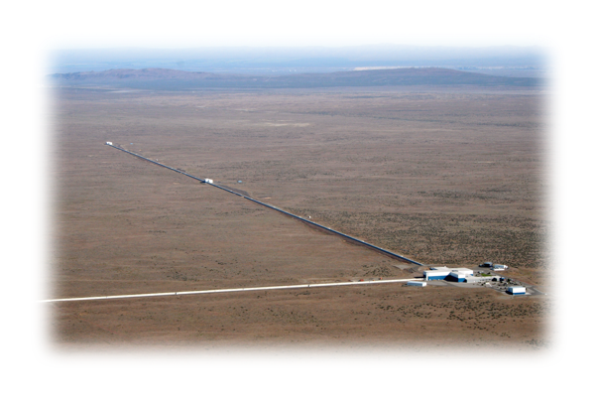
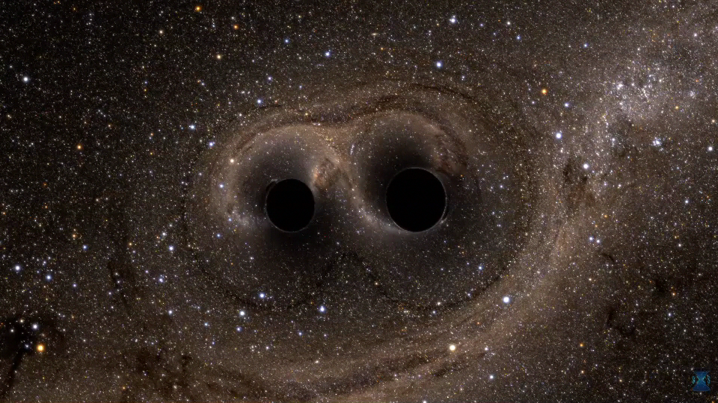
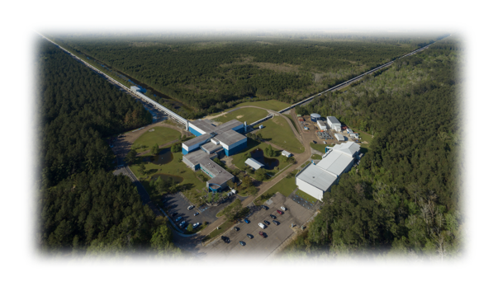
Observation of Gravitational Waves from a Binary Black Hole Merger
(September 2015)
Abbott, et al., LIGO Scientific Collaboration and Virgo Collaboration, “Observation of Gravitational Waves from a Binary Black Hole Merger” Phys. Rev. Lett. 116, 061102 (2016)
Strain = ΔL/L
GW150914
Notes:
The detection that began GW astronomy. It changed our thinking in many ways! First, that GWs from astrophysical sources could actually be detected! Second, that black holes exist in binary systems. Third, that stellar mass black holes can have masses > 20 M_sun (limit inferred from LMXB observations)

Slide 3
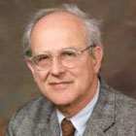

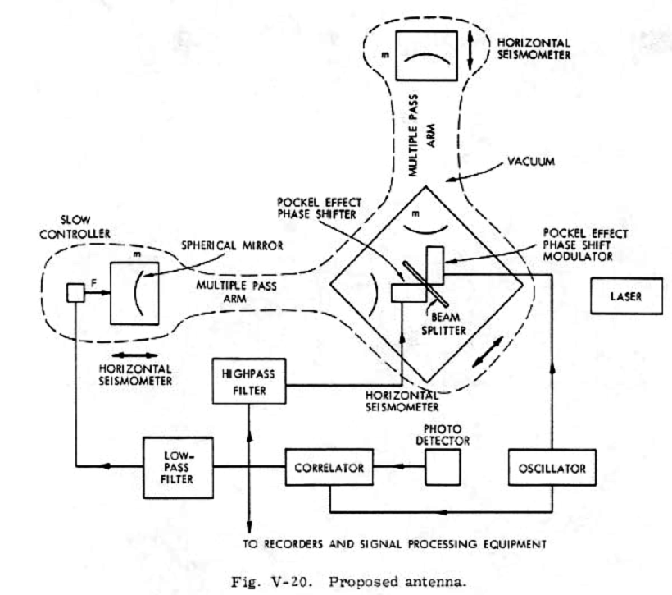

Early LIGO History
It’s about:
Arm length
Understanding
and minimizing
noises
Rai Weiss, MIT
(The Seminal Paper in GW Interferometry. Yet wasn’t published in an archival journal until 2022!)
R. Weiss, “Electromagnetically Coupled Broadband Gravitational Antenna”, General Relativity and Gravitation (2022) 54:153
Notes:
This paper taught us to think that it was possible to build gravitational-wave detectors that could detect gravitational waves!

Slide 4
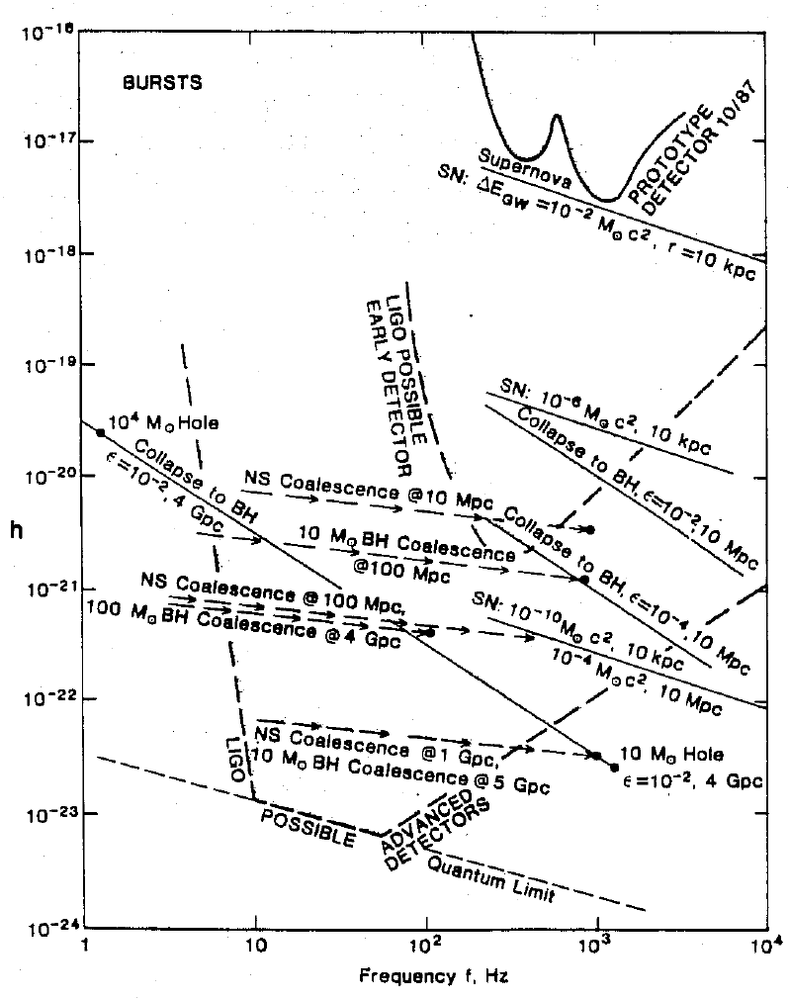
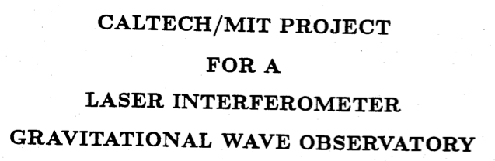

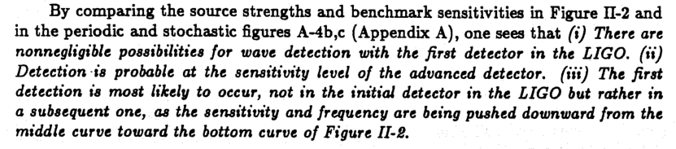
Early LIGO History (Cont’d)
LIGO Arm Lengths: 4 km
https://dcc.ligo.org/LIGO-M870001/public
Notes:
The original proposal had the foresight to propose an upgrade (Advanced LIGO) because the GW detection rates were very uncertain (many orders of magnitude)

Slide 5
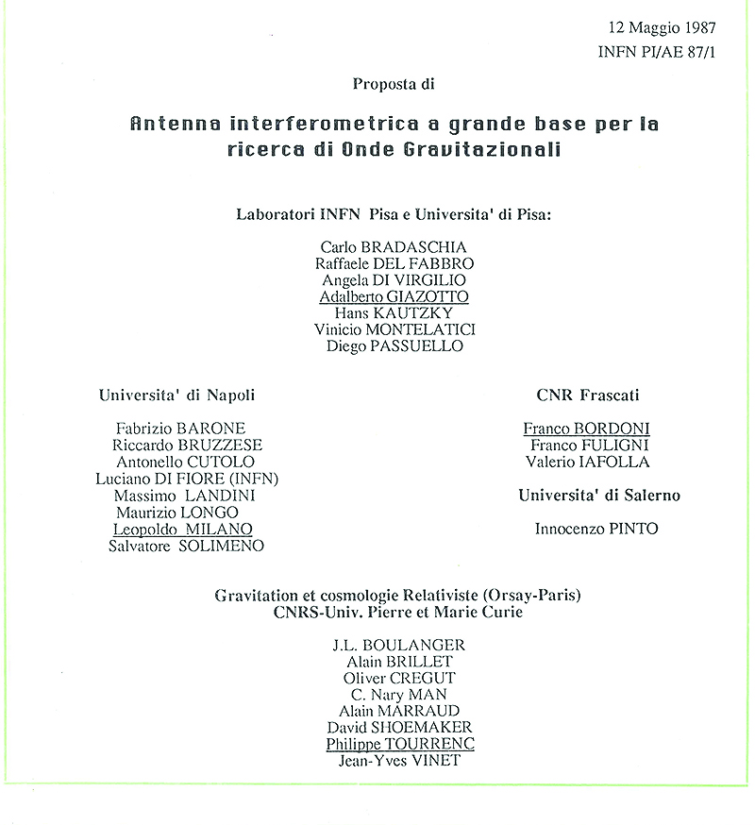
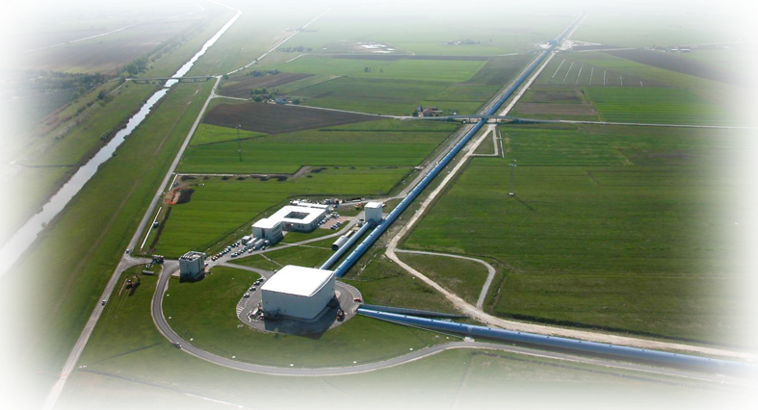
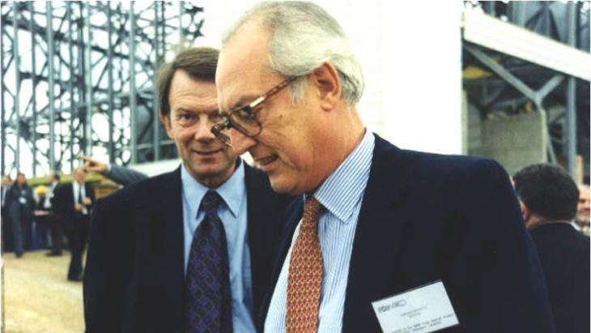
Early Virgo History
qwe
Virgo Arm Lengths: 3 km
Alain Brillet (Orsay); Adalberto Giazotto (Pisa)
Notes:
Virgo followed a similar path

Slide 6
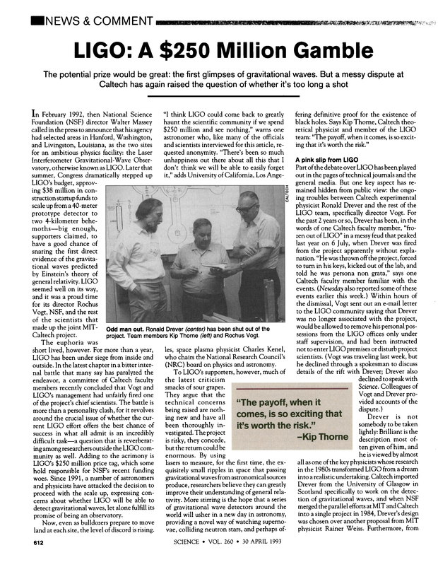
Science Magazine 30 April 1993
LIGO – Not without Controversy!
Congressional Testimony to the House Committee on Science, March 1991
"the sources we think we know are out there are too weak to be detected in gravity waves by LIGO."
"LIGO is at best, a physics experiment, not an astronomical observatory."
" ... astronomers can think of cheaper experiments that are much more likely to yield fundamental advances.”
“…even if all the estimated improvements over the LIGO prototype are achieved in LIGO, the resulting sensitivity of LIGO falls at least ten times short of being useful astronomically”
At the time, these criticisms were all very valid!
Notes:
For picture on right, point out that LIGO was a completely new kind of detector for a new kind of science. There was tremendous physics complexity, and tremendous management complexity. Messy dispute refers to a conflict between Ron Drever who initially led the Caltech GW detector group and Robbie Vogt who took over after the initial management team (Drever, Weiss, Thorne) were fired. Vogt was later replaced by Barish

Slide 7

The Critical Role of the National Science Foundation in Providing Long Term Support to LIGO
LIGO’s success is also a testament to the vision and determination of the National Science Foundation.
Virgo’s success is a testament to the vision and determination of the Italian INFN and French CNRS/IN2P3.
These projects were funded and sustained over decades despite very serious concerns about their chances for success!
Rich Isaacson
“Future Nobel Prizes are won in congressional-committee hearing rooms and on august panels at the National Academy of Sciences, by budget-wielding bureaucrats. Without their efforts, there would be no labs or research grants.”
“The LIGO team owes its Nobel Prize partly to skeptical physicists and astronomers (who didn’t like that a physics experiment was being called an “observatory”) who fought the project tooth and nail, holding its proponents’ feet to the fire in studies and workshops over and over, making them prove that it would work."
Notes:
Praise the NSF, … Note important role of Rich Isaacson. Befittingly, there is now the Richard Isaacson Award in GW science!

Slide 8
How LIGO and Virgo Have Changed The Way We Think About High Energy Astrophysics

Slide 9

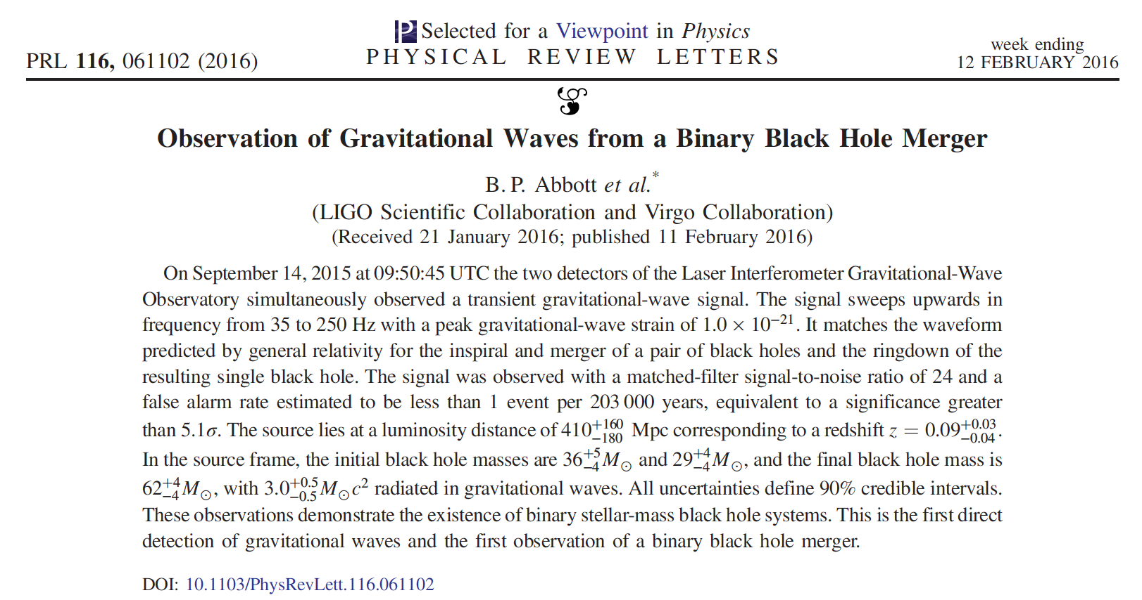
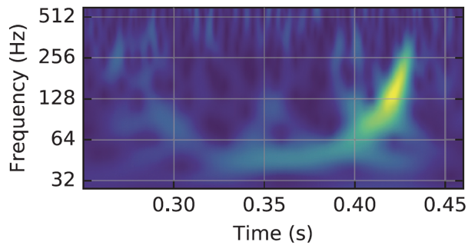


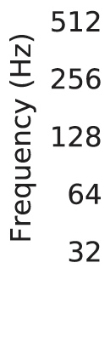
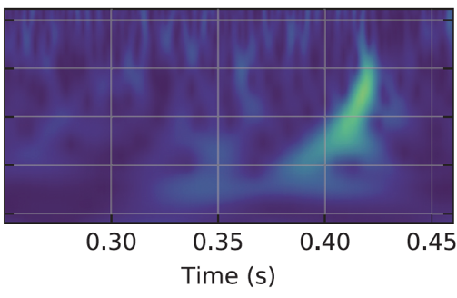
How LIGO and Virgo Have Changed Our Thinking About Black Holes
Short answer: A lot!
Notes:
Emphasize A LOT

Slide 10
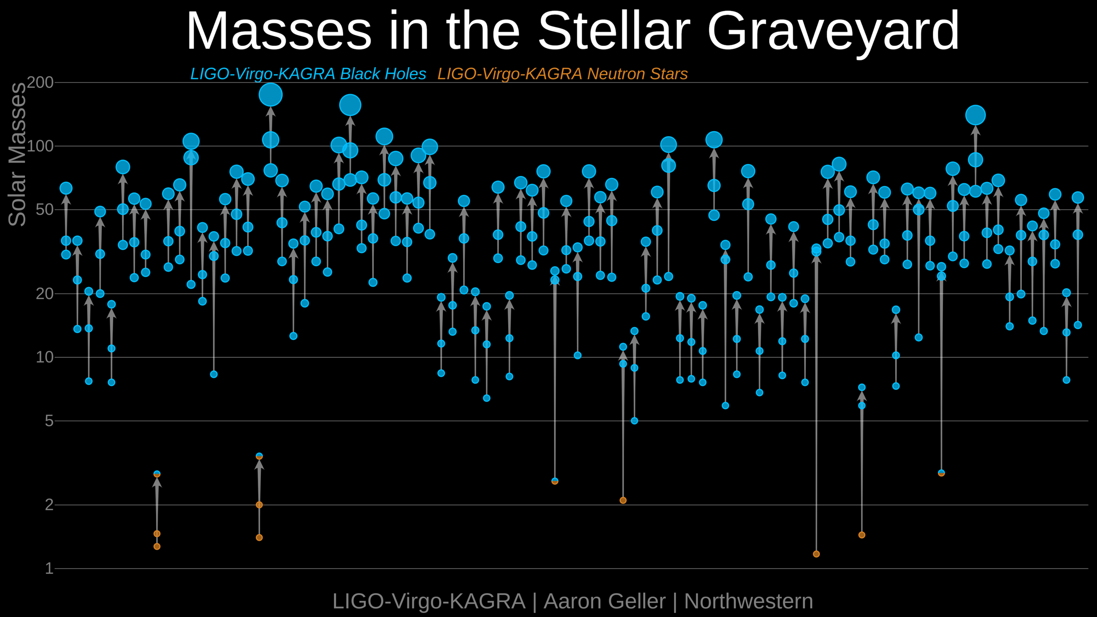
Binary Black Hole (BBH) Properties: Events
<Detector Strain Sensitivity> ~ Range # of detections ~ Range^3

Slide 11
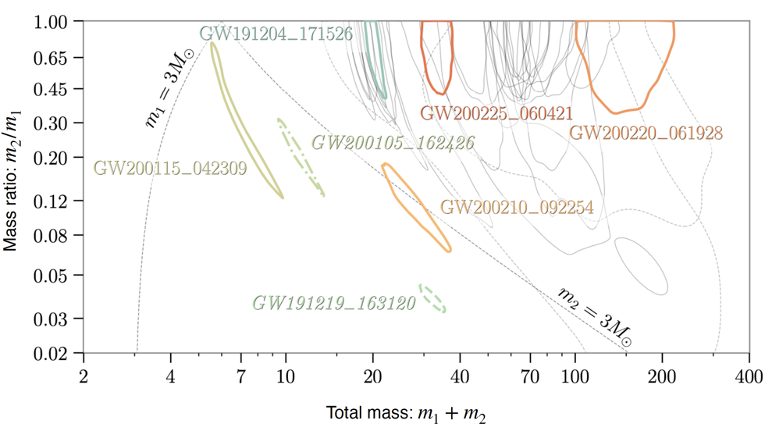
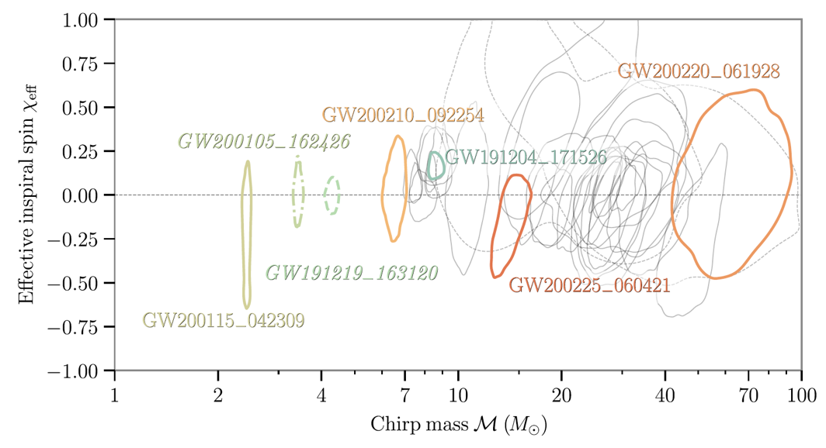
Binary Black Hole (BBH) Properties: Mass Ratio and Spin Distribution
Formation channel? Isolated Binary vs Dynamical Capture
How Do Black Holes Pair Up? (O3b events)
Most (but not all) BHs are born without spin.
Do Black Holes Spin?
Can We Learn How BBHs Were Formed?
Intermediate mass
black holes!
O3b
NS-NS
NS-BH
BH-BH
Most binary systems are equal mass.
Abbott, et al., (LIGO Scientific Collaboration, Virgo Collaboration, KAGRA Collaboration) “GWTC-3: Compact Binary Coalescences Observed by LIGO and Virgo During the Second Part of the Third Observing Run” Phys. Rev. X 13, 041039 (2023)
Notes:
Note that spins give clues to formation mechanisms (isolated binary vs dense stellar environment…)
Preference for equal mass
BBH progenitors are mostly spinless

Slide 12
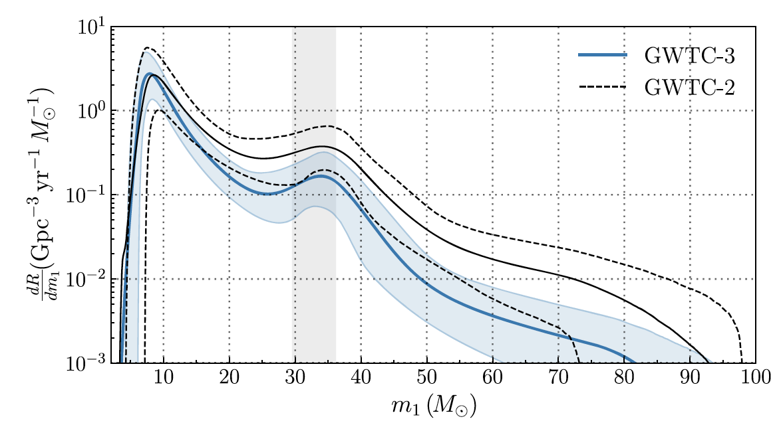
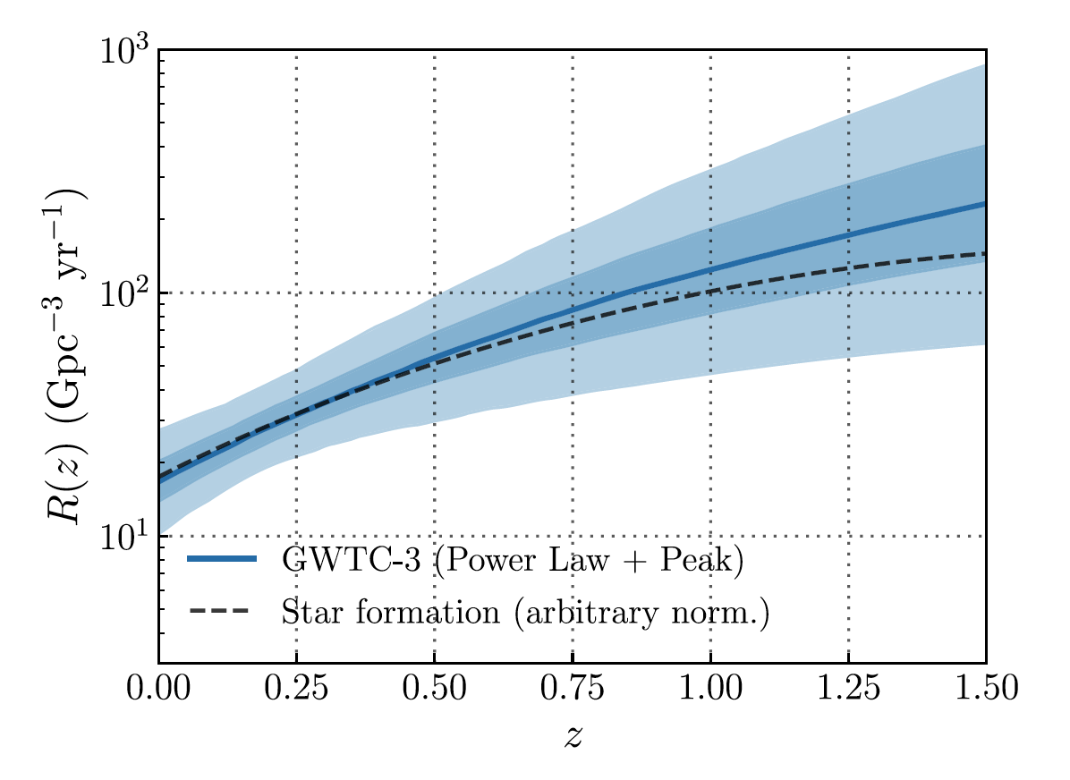
Binary Black Hole Properties: Mass Distributions and Rates
GWTC-3 Binary Black Hole Mass Distribution
GWTC-3 Redshift-Dependent BBH Merger Rate
Mass Gap?
Structure!
Abbott, et al., (LIGO Scientific Collaboration, Virgo Collaboration, KAGRA Collaboration) “Population of Merging Compact Binaries Inferred Using Gravitational
Waves through GWTC-3” Phys. Rev. X 13, 011048 (2023)
Abbott, et al., (LIGO Scientific Collaboration, Virgo Collaboration, KAGRA Collaboration) “GWTC-3: Compact Binary Coalescences Observed by LIGO and Virgo During the Second Part of the Third Observing Run” Phys. Rev. X 13, 041039 (2023)
Notes:
Right plot 1: differential merger rate vs primary mass for GWTC-3 (assuming PP, but features are generic)
Structure in the plot; overdensities at 10 and 35 M_sun. The upper mass peak could be due to, eg, pileup at the PP limit.
No hard mass cut off above 50 M_sun
Right Plot 2: Rates: between 10 – 100 / Gpc^3 / Mass,
increasing with z in line with standard star formation rates.

Slide 13

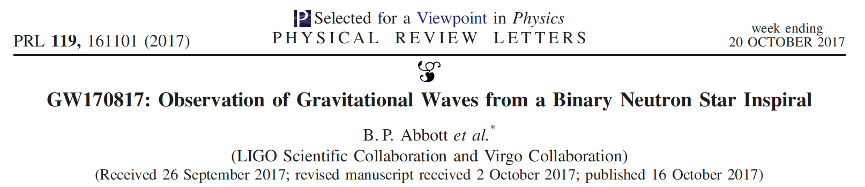
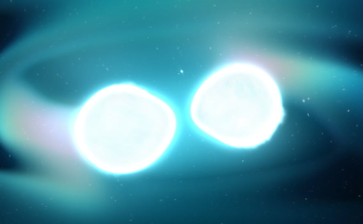
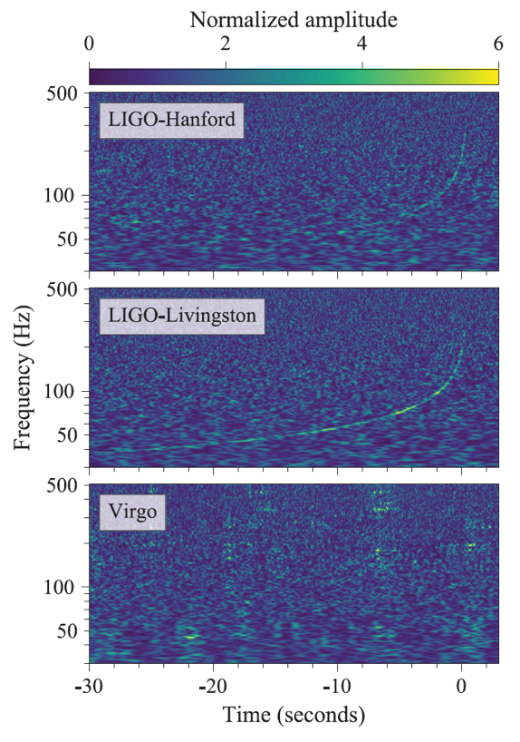
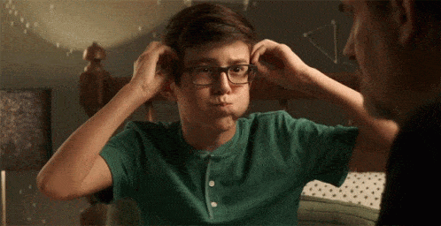

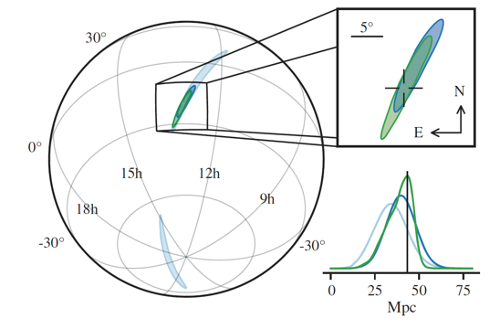
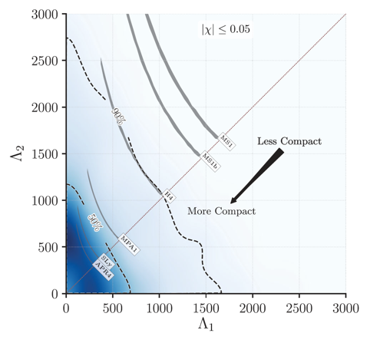
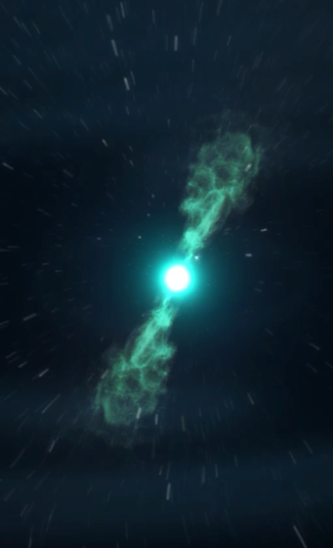
How LIGO and Virgo Have Changed Our Thinking About Neutron Stars (and …)
Short answer: Even More!
GW170817!
Tidal Deformation
Source Localization
Images: NASA Goddard
Abbott, et al. ,LIGO Scientific Collaboration and Virgo Collaboration, “GW170817: Observation of Gravitational Waves from a Binary Neutron Star Inspiral” Phys. Rev. Lett. 161101 (2017)
Notes:
The multi-messenger event of the 21st century! And a really fortuitous event.
Spectrograms show the BNS chirp. Localized to ~ 28 sq degrees on the sky. The low SNR in Virgo results from the location of GW170817 on the sky; ie is HELPFUL in producing the sky map.
Plot on left show posterior upper limits on the tidal deformation of the BNS progenitors obtained from the waveform (under the assumption of low spin). Places hard constrains NS EOS → more dense and compact objects. Also (not shown) provides insights into interior densities of NSs

Slide 14
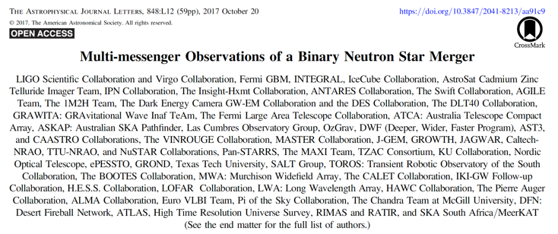
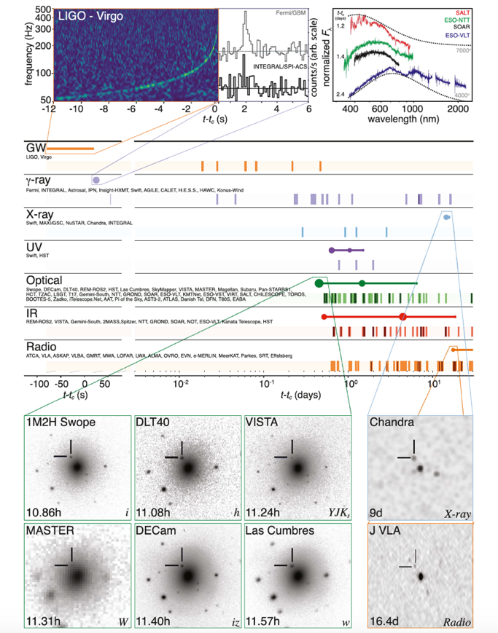
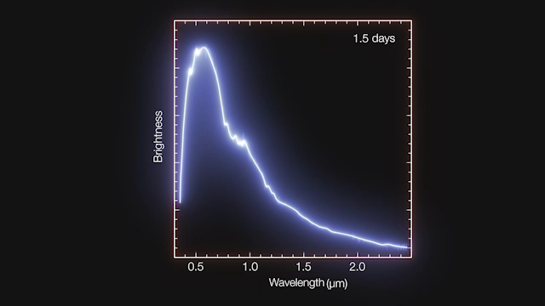
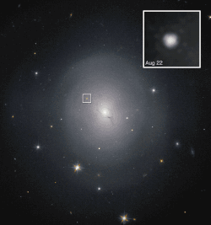
How LIGO and Virgo Have Changed Our Thinking About Neutron Stars
Multi-messenger Astronomy with Gravitational Waves
NGC4993, ~40 Mpc
distant
~ 3500 authors
Optical Afterglow
Credit: Hubble/NASA
Credit: ESO-VLT/X-Shooter
Abbott, et al., “Multi-messenger Observations of a Binary Neutron Star Merger” Astrophys. J. Lett., 848:L12, (2017)
Notes:
The birth of GW MMA. Emission across most of the EM bandwidth, revealing a wealth of information. Paper summarizing the observations had almost 1000 institutions and 3500 authors.

Slide 15
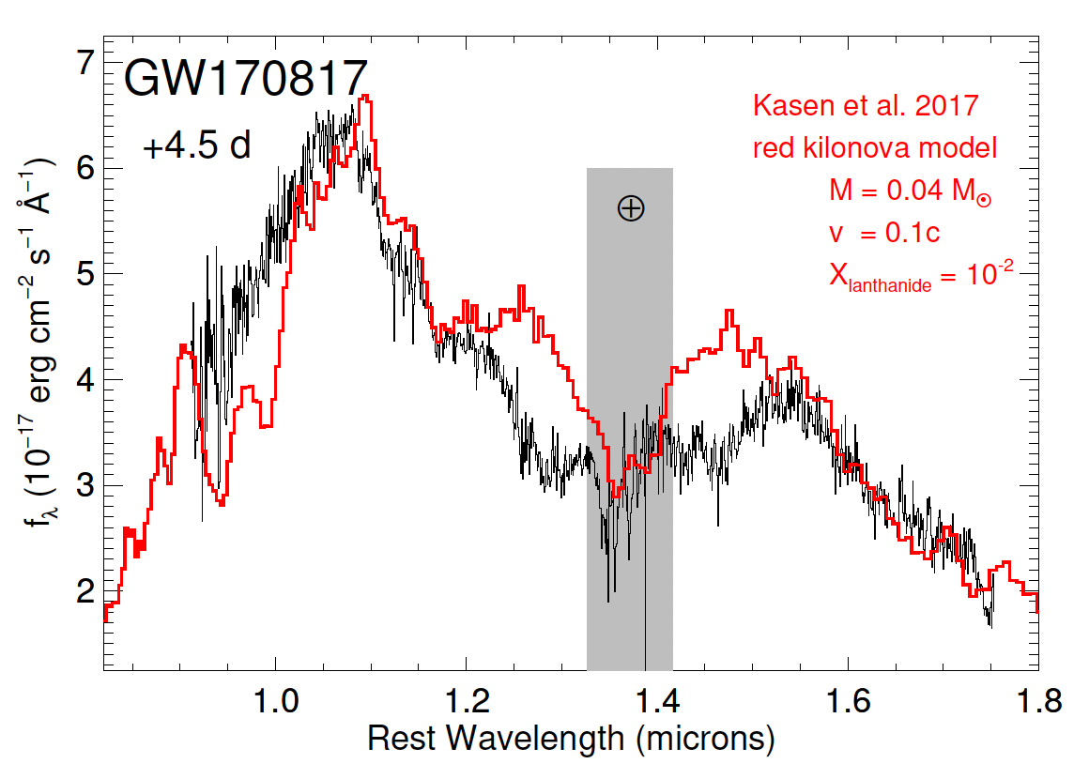
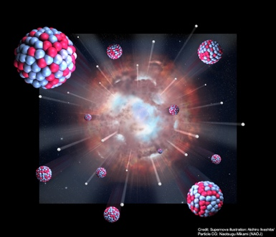
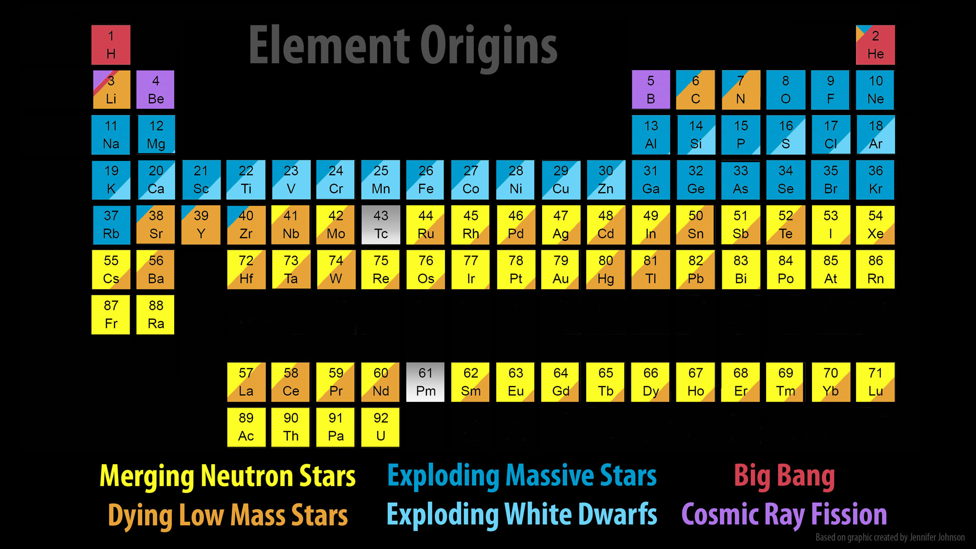
Binary Neutron Star Collisions Are Foundries of Heavy Elements!
R-Process Nucleosynthesis
Periodic Table: Jennifer Johnson
Notes:
Explain r-process nucleosythesis: dense neutron rich environments (~ 10^24 / cm^3) permits formation of heavy nuclei via rapid neutron capture faster than beta (minus) decay converts neutrons to p, e- and anti-neutrino up to the stability imposed by nuclear physics.

Slide 16
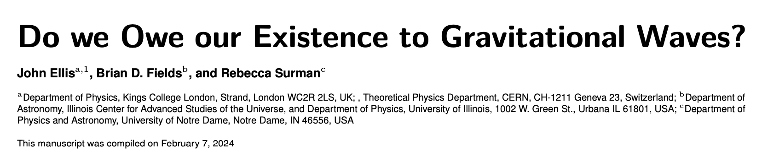
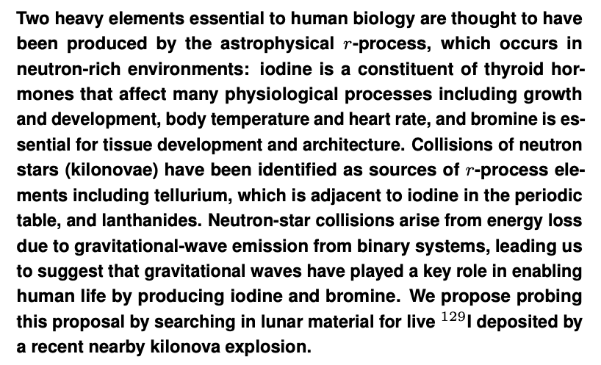
And Perhaps…?
https://arxiv.org/abs/2402.03593
Notes:
And just for fun!

Slide 17
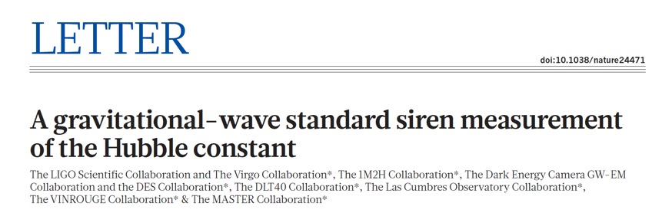
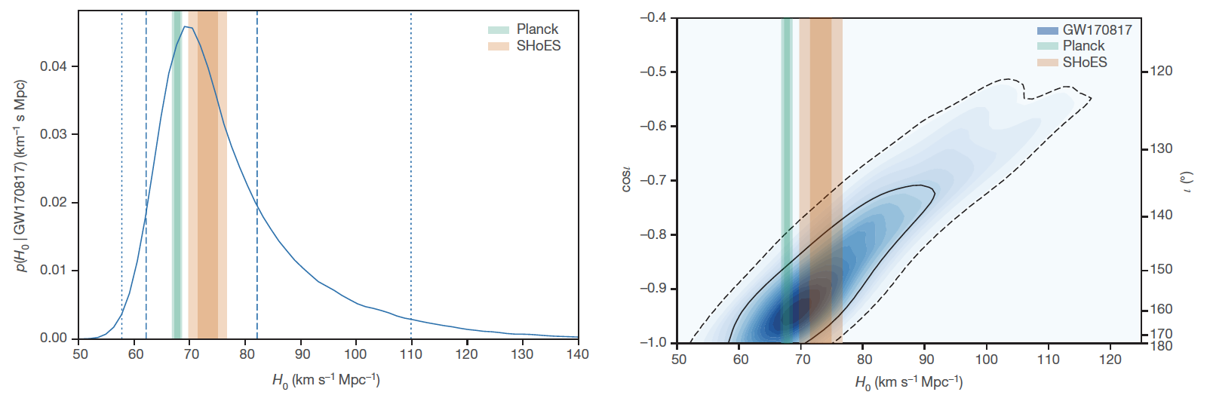
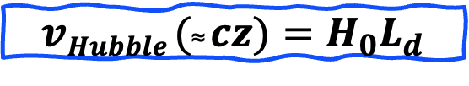
Measuring the Hubble Constant: Gravitational Wave Standard Sirens
Hubble expansion velocity
Hubble constant
$$vHubble (\text{≈} cz)=H_{0}L_{d}$$
+ v_{p}
Redshift
Luminosity distance
Notes:
Another way the fist BNS merger detection as changed our thinking – we can get an independent measurement of the Hubble constant. For nearby objects (small z), equation holds.
Explain standard sirens. Luminosity distance (absolute distance to the GW source) is obtained directly because of absolute calibration of radiated GWs. Errors in the lh plot come from uncertainty in L_d due to calibration and degeneracy of L_d with orbital inclination.
RH plot – LVK network is able to measure polarization, so provide information about orbital inclination. Can in turn infer the posterior of orbital inclination from the date.

Slide 18


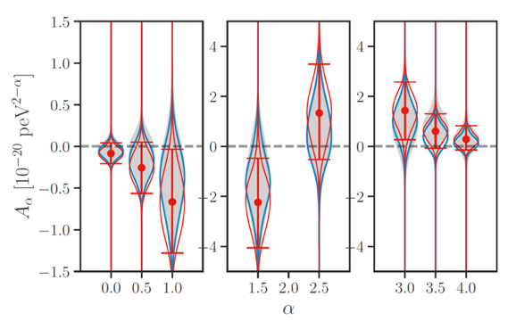
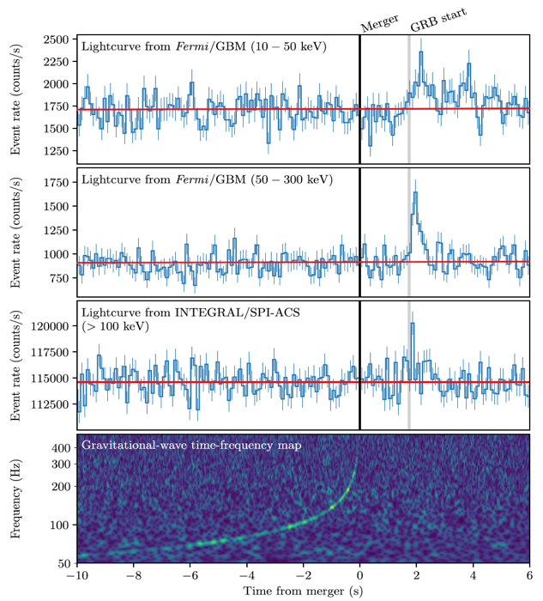

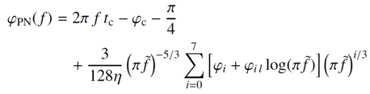
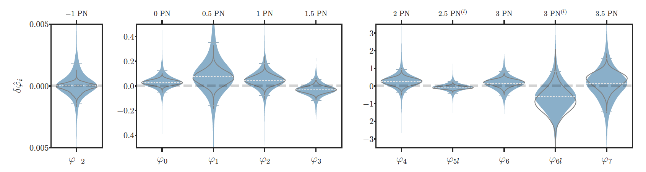
How LIGO and Virgo Have Changed Our Thinking About General Relativity
Speed of Gravity = Speed of Light!
Short Answer: Not Much At All…
Dispersive Gravity?
Δt = 1.7 s
And:
Tests of GW Polarization, Lorentz invariance, black hole merger ringdowns
→ entirely consistent with General Relativity!
Deviations from Post-Newtonian Approximation
B. P. Abbott, et al. (LIGO Scientific Collaboration and Virgo Collaboration, Fermi Gamma-ray Burst Monitor, and INTEGRAL), “Gravitational Waves and Gamma-Rays from a Binary Neutron Star Merger: GW170817 and GRB 170817A” Astrophys. J. Lett., 848:L13, (2017)
B. P. Abbott, et al. (LIGO Scientific Collaboration, Virgo Collaboration, KAGRA Collaboration), “Tests of General Relativity with GWTC-3”, https://arxiv.org/pdf/2112.06861.pdf
Notes:
Go quickly through the three tests. Don’t get hung up on PN phase approximation. For speed of gravity, explain that upper bound on Delta_v gotten by assuming GWs and photons were emitted at the same time (GWs trave faster than light). For lower bound, assume that photons were emitted later (10 sec) due to astrophysics.
Click and say that other tests hold, also.

Slide 19
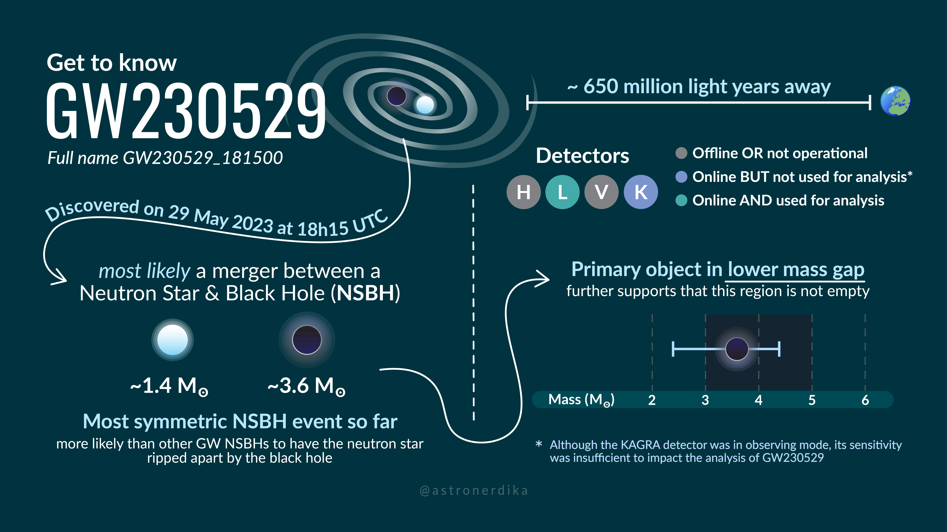
First Results from O4 Observing Run: GW230529
LVK Events and Event Candidates to Date
Credit: Shandika Galaudage
Presented by M. Zevin “New Results from the LIGO-Virgo-KAGRA Gravitational-wave Observatory Network”, Session M09, Friday, Apr 5.
Paper available at:
https://dcc.ligo.org/LIGO-P2300352/public

Slide 20
How LIGO and Virgo Have Changed The Way We Think About Precision Measurement

Slide 21
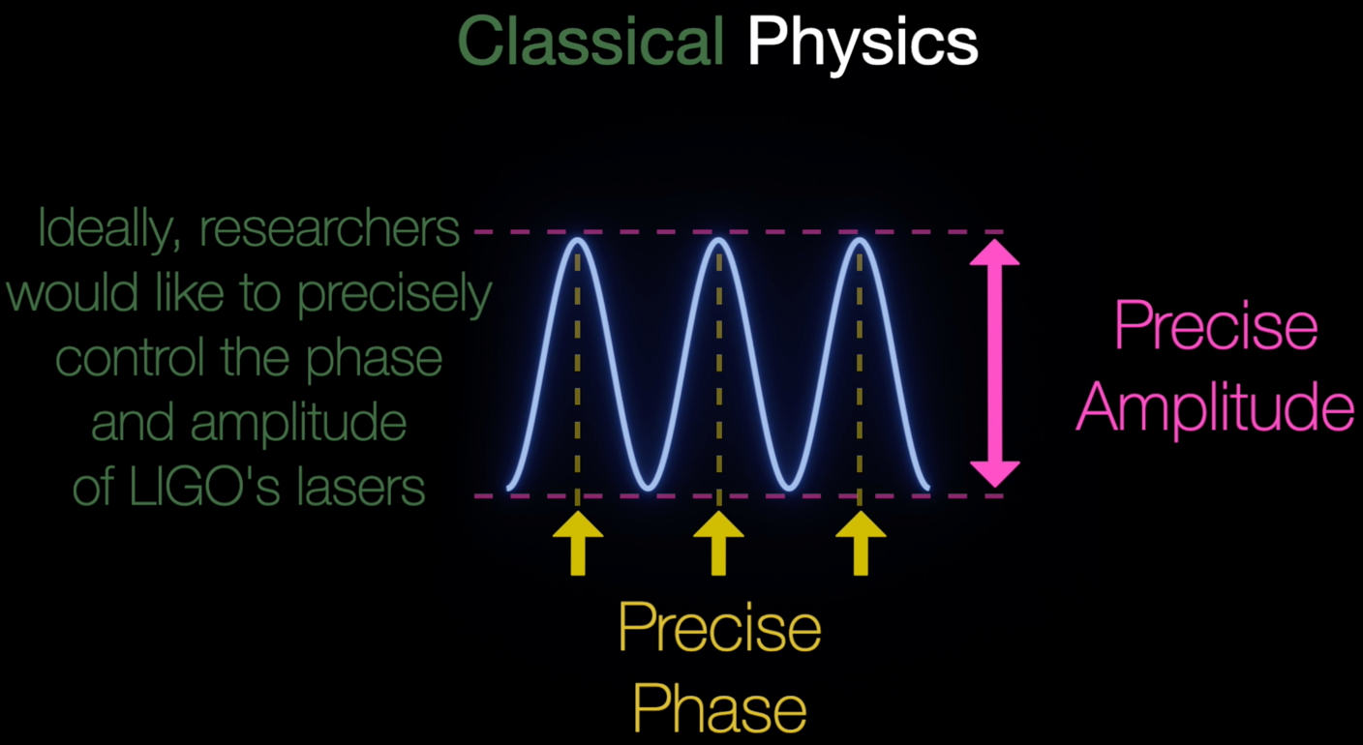
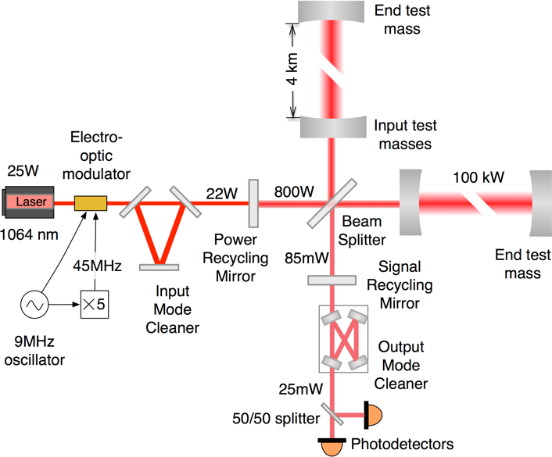
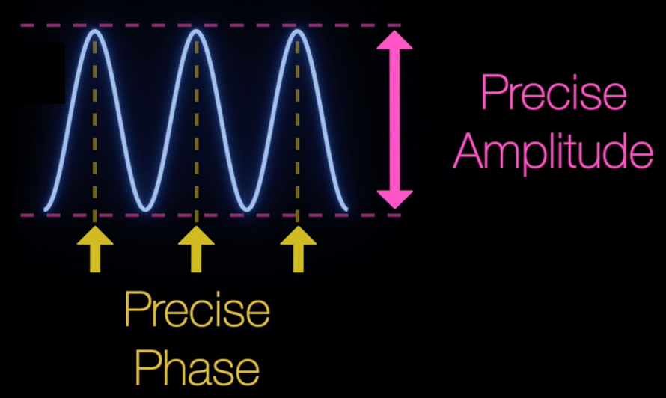
L_{y}
L_{x}
GW Interferometer requirements: to measure physical displacements approaching 10⁻¹⁹ m
Credit: Peter Hoderness/Caltech
Notes:
A schematic cartoon of GW detectors. In a classical world (perfect amplitude and phase), the detector could sense arbitrarily small displacements (ignoring all kinds of noises). Phase is a measure of the arrival time of the photons. For coherent light, the phase is precisely defined. Amplitude imparts a force to the suspended mirrors, in a classical world the force is static and therefore won’t introduce measurement uncertainty. All good!

Slide 22
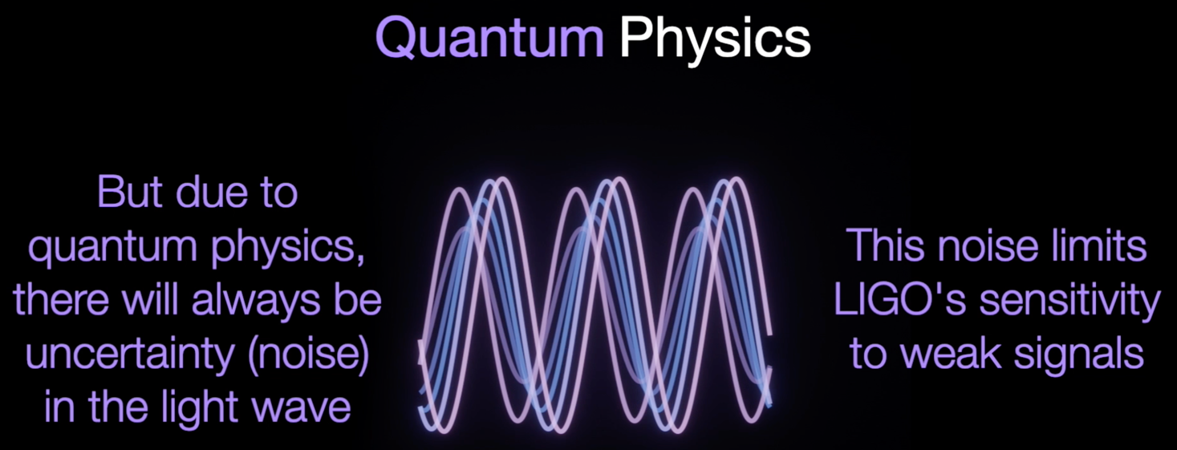
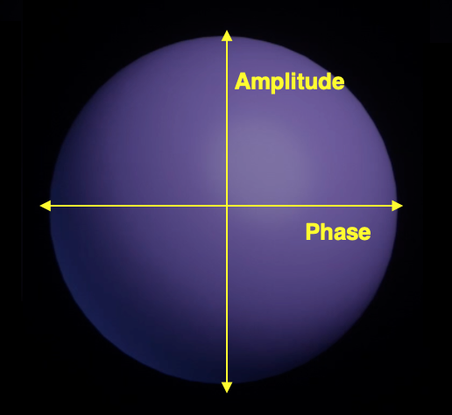



Inspiration: Peter Hoderness/Caltech
Notes:
Except light is not classical… Explain quantization and uncertainty. Even for coherent laser light! Explain that even a vacuum (no light) has uncertainty. → Measurement error in both phase (time of arrival called shot noise) and amplitude (photon momentum imparted to the mirrors, called quantum radiation pressure noise). Frequency dependence (dictated by the detector) is such that phase noise introduced at high freq; QRPM at low freq. Noise depends on laser power in opposite ways.

Slide 23

Noises in Gravitational Wave Interferometers
Quantum
Radiation
Pressure
Noise
→ √P_{Laser}
Shot Noise
→ 1/√P_{Laser}
Notes:
Noises in GW interferometers

Slide 24

Squeezing Light Takes Advantage
of the Uncertainty Principle
Credit: Peter Hoderness/Caltech
Notes:
Phase squeezing – lower noise at high f (TOAs line up) → reduced shot noise

Slide 25

Squeezing Light Takes Advantage
of the Uncertainty Principle
Squeezing Light Takes Advantage
of the Uncertainty Principle
23
Credit: Peter Hoderness/Caltech
Notes:
Amplitude squeezing – lower noise at low f (TOAs line up) → reduced shot noise

Slide 26

Quantum Physics Meets Astrophysics! Frequency-dependent Squeezing
Kimble, et al., “Conversion of Conventional Gravitational-Wave Interferometers Into Quantum Nondemolition Interferometers by Modifying Their Input and/or Output Optics, Phys. Rev. D 65, 022002 (2001).
Ganapathy, et al., “Broadband Quantum Enhancement of the LIGO Detectors with Frequency-Dependent Squeezing” Phys. Rev. X 13, 041021 (2023)
Notes:
How we do it. Quickly explain back action

Slide 27



Improving LIGO Strain Sensitivity with Frequency-dependent Squeezing
we
LIGO Hanford
LIGO Livingston
Ganapathy, et al., “Broadband Quantum Enhancement of the LIGO Detectors with Frequency-Dependent Squeezing” Phys. Rev. X 13, 041021 (2023)
It works!
Notes:
Explain one of the plots.

Slide 28



How LIGO and Virgo (+KAGRA+LIGO-India+Cosmic Explorer+Einstein Telescope) Will Change Our Thinking in the Future
LIGO-India: 2030+
Cosmic Explorer (USA): 2035+
40 km arm lengths!
Check out Session S10: Next Generation Gravitational Wave Detector Concept This Afternoon at 1:30 pm
Einstein Telescope (Europe): 2035+
10 km arm lengths!
Notes:
New detects on the horizon. Bigger better ones in the 2030s.

Slide 29

ET+CE: No Binary Black Hole Merger Left Behind!
Credit: Evan Hall, MIT
Notes:
Quickly: Redshifts of up to 100 for BH masses (before the beginning of star formation).

Slide 30



And Perhaps?
L. Sellers, et al., “Searching for Intelligent Life in Gravitational Wave Signals Part I: Present Capabilities and Future Horizons”, arXiv:2212.02065

Slide 31





LIGO-Virgo KAGRA Meeting, Louisiana State University, March 14, 2024

Slide 32


Thank you!

Slide 33
Extra Material

Slide 34

Intermediate Mass Black Holes; Black Holes in the Pair Instability Gap
GW190521 (observed in O3a)
At the time, the most massive BBH merger observed
  Distance of ~ 4 Gpc (z ~ 0.64)
First ever observation of an intermediate mass black hole (MBH > 150 M☉)
More massive progenitor falls in the (pulsational) pair instability gap 60 M☉ < M₁ < 80 M☉
Strong evidence for spin precession; both progenitor black holes were spinning
→ Implications for how these black holes formed
GW190521 Has Intrinsic Spin
Is this a 2nd Generation Black Hole Merger?
95 M ☉
B. Abbott et al., (LIGO Scientific Collaboration, Virgo Collaboration), “GW190521: A binary black hole merger with a total mass of 150 M☉”, Phys. Rev. Lett. 125, 101102 (2020).
69 M ☉
B. Abbott et al., (LIGO Scientific Collaboration, Virgo Collaboration), “Properties and astrophysical implications of the 150 M☉ binary black hole merger GW190521”, Astrophys. J. Lett. 900, L13 (2020).
Notes:
Right plot:
Left side: posteriors of the spins distributions (direction and magnitude) of the individual progenitor BH components. Note that they are misaligned with the orbital angular momentum and are non-zero.
Right side: Chi_eff is the mass weighted average of the BBH spin (= sum of mass*mag of spin parameter a*cos(theta_L dot S). Chi_p is a measure of in plane spin → precession
Because one and possibly both of these BBHs lie in the pair instability mass range prohibiting ‘conventional’ BH formation via SNe, and because each of the progenitor has intrinsic spin misaligned with the orbital angular momemtum vector, they could be 2nd generation BBH (BBH seeds)

Slide 35


Neutron Star Mass Distributions and Rates
Inferred Neutron Star Mass Distribution
From LIGO/Virgo Detections
GW190425: Not Your Typical Galactic Neutron Star
qwe
Abbott, et al., (LIGO Scientific Collaboration, Virgo Collaboration) “GW190425: Observation of a Compact Binary Coalescence with Total Mass ∼ 3.4 M⊙”, Astrophys. J. Lett. 892 L3 (2020).
Abbott, et al., (LIGO Scientific Collaboration, Virgo Collaboration, KAGRA Collaboration) “Population of Merging Compact Binaries Inferred Using Gravitational Waves through GWTC-3” Phys. Rev. X 13, 011048 (2023)
Notes:
Left plot – the second BNS merger GW190425 teaches us that the universe contains heavier NSs than the previously inferred galactic NS population from. Posteriors show individual NS masses well above 2 M_sun. Right plot displays

Slide 36

Inferring Neutron Star Radii Through Binary Neutron Star Mergers
Limits Using EOS-insensitive relations
Limits Using parametrized EOS (M< 1.97 M☉)
Compare with mass/radius measurement of PSR
J0740+6620 from NICER/XMM-Newton
B. Abbott et al., (LIGO Scientific Collaboration, Virgo Collaboration), “GW170817: Measurements of Neutron Star Radii and Equation of State”, Phys. Rev. Lett. 121, 161101 (2018).
Notes:
Note the NICER has better precision

Slide 37

The Payoff: The Worldwide Ground-based Gravitational Wave Network

Slide 38



Impact of Gravitational Wave Detections On Our Understanding Of…
The Nature of Black Holes
The Origin of Heavy Elements
How Matter Behaves Under the
Most Extreme Conditions in Nature
EINSTEINIAN?
Image Credit: Robert Hurt, IPAC, Caltech
Image Credit: Robin Dienel/Carnegie Institution for Science
Image Credit: Akihiro Ikeshita/Naotsugu Mikami NAOJ
Credit: LIGO Scientific Collaboration
Notes:
Walk through slide

Slide 39



LIGO and Virgo (and KAGRA!) Haven’t Yet Changed Our Thinking About …
Continuously Emitting Neutron Stars
How Supernovae Explode
SN1987a
Astrophysical Stochastic Background
Image Credit: ScienceBlog
Credit: Planck Collaboration
Image Credit: JWST NIRcam/NASA,ESA,CSA

Slide 40

LIGO-Virgo Greatest Hits 2015-2021: What Ground-
Based Gravitational Wave Detections Have Taught Us
GW150914
O1: Gravitational waves from astrophysical sources can be measured.
O1: Binary black hole (BBH) systems exist.
O2: Binary neutron stars (BNS) are progenitors of short gamma ray bursts.
O2: BNS mergers produce kilonovae, which produce heavy elements.
O2: The speed of gravitational waves equals the speed of light.
O2: The Hubble-Lemaître constant can be measured using EM-bright GW ‘sirens’.
O2 – O3: The Hubble-Lemaître constant can be measured using dark GW ‘sirens’.
O3: Black holes with masses in the (pulsational) pair instability gap exist.
O3: Black hole – neutron star systems exist.
O3: Compact objects exist in the 2 – 3 M⦿ mass range.
O1-O3: Astrophysical black holes are Kerr black holes
O1 – O3: General relativity is valid in the high curvature, high field regime.
O1 – O3: Intermediate black holes and stellar mass black holes with mass > 20 M⦿ exist.
GW170817/
GRB170817A
SSS17A

Slide 41


Collaborative Agreements Between Gravitational-wave Laboratories
2007: Agreement for joint data analysis ratified between LIGO and the Virgo Collaboration which operates the Virgo interferometer in Cascina, Italy.
August 14, 2017: Advanced LIGO and Advanced Virgo detect gravitational waves from the collision of a pair of neutron stars
2019: Agreement for joint data analysis ratified between LIGO, Virgo, and the KAGRA
Virgo, Cascina, Italy
2007
2019
Total Virgo, LIGO,
KAGRA Membership:
~ 2100 people

Slide 42




Advanced LIGO: How Does It Really Work?
An Interferometer is a Gravitational-
Wave Transducer
Quadruple Mirror Suspension
200W , 1064 nm
stabilized laser
LIGO Test Mass Mirror
Δφ
Actively Controlled
Seismic Isolation
Squeezer
Notes:
Emphsize extreme precision nature of the measurement and the need to isolate from the environment.
ADD SQUEEZER TO IFO DIAGRAM, AND IF POSSIBLE ADD A PHOTO OF THE SQUEEZER AT THE END OF THE ANIMATION.

Slide 43






LIGO Hanford
Observatory
Washington, USA
Virgo
Observatory
Italy
KAGRA
Observatory (2019)
Japan
LIGO Livingston
Observatory
Louisiana, USA
LIGO-India (2025)
Notes:
In addition to LIGO, there are other GW detectors planned or in operation. Point out the Virgo observatory

