Slide 1
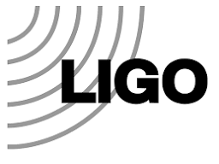
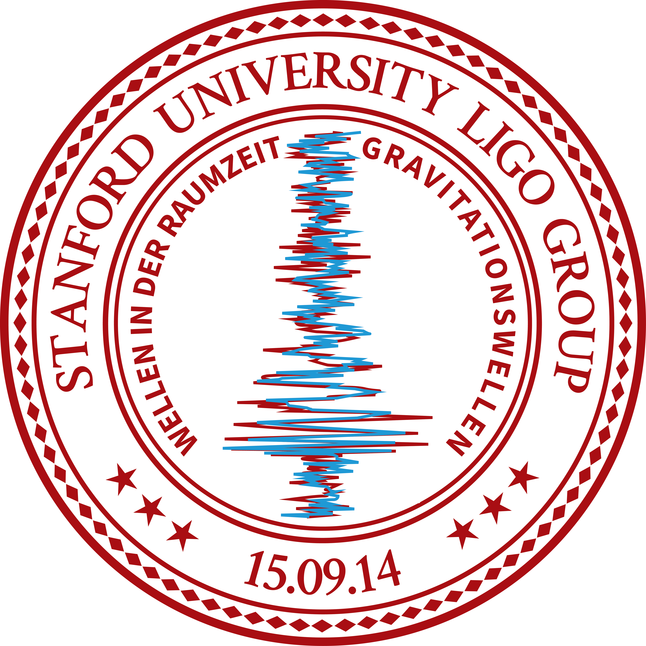
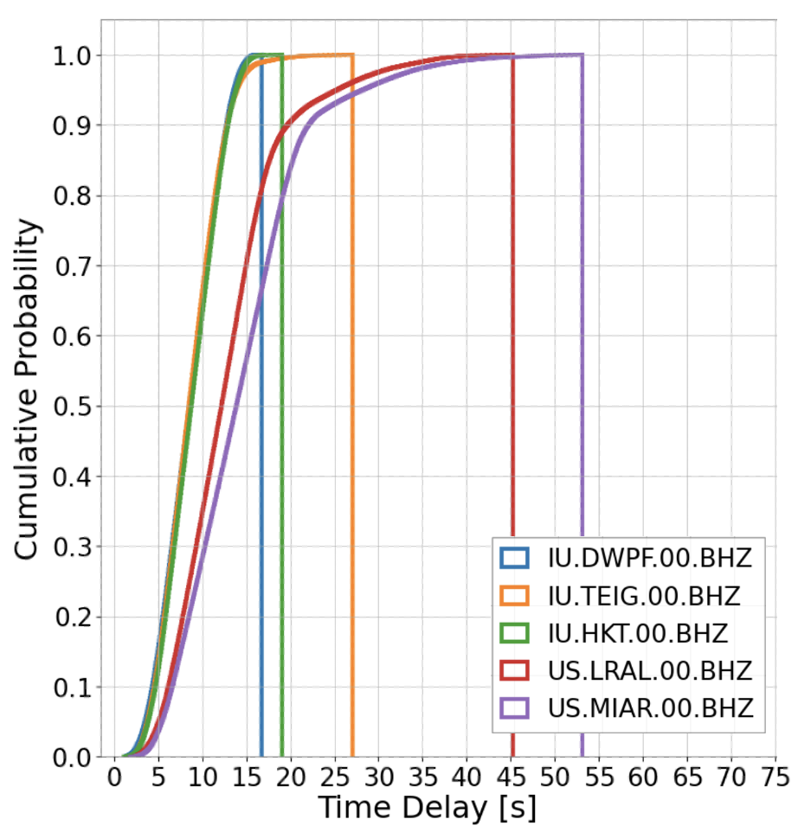
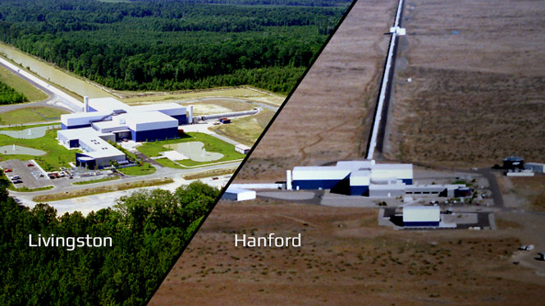
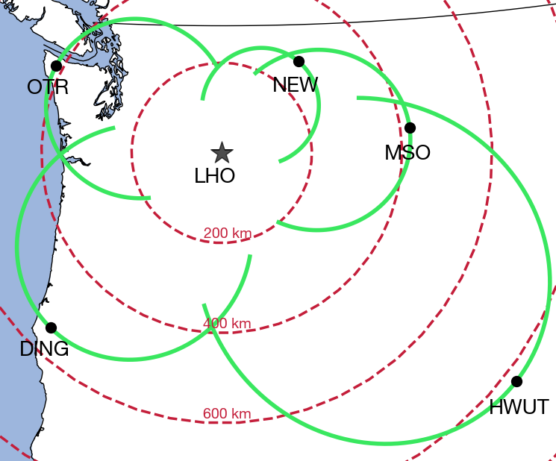
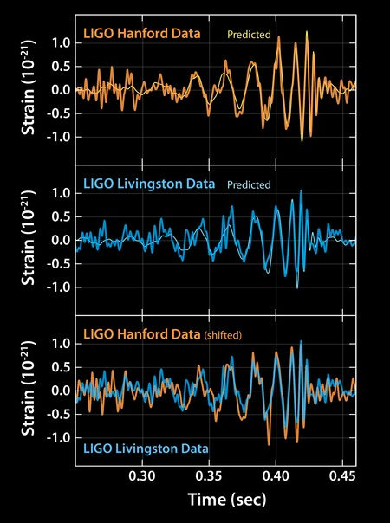
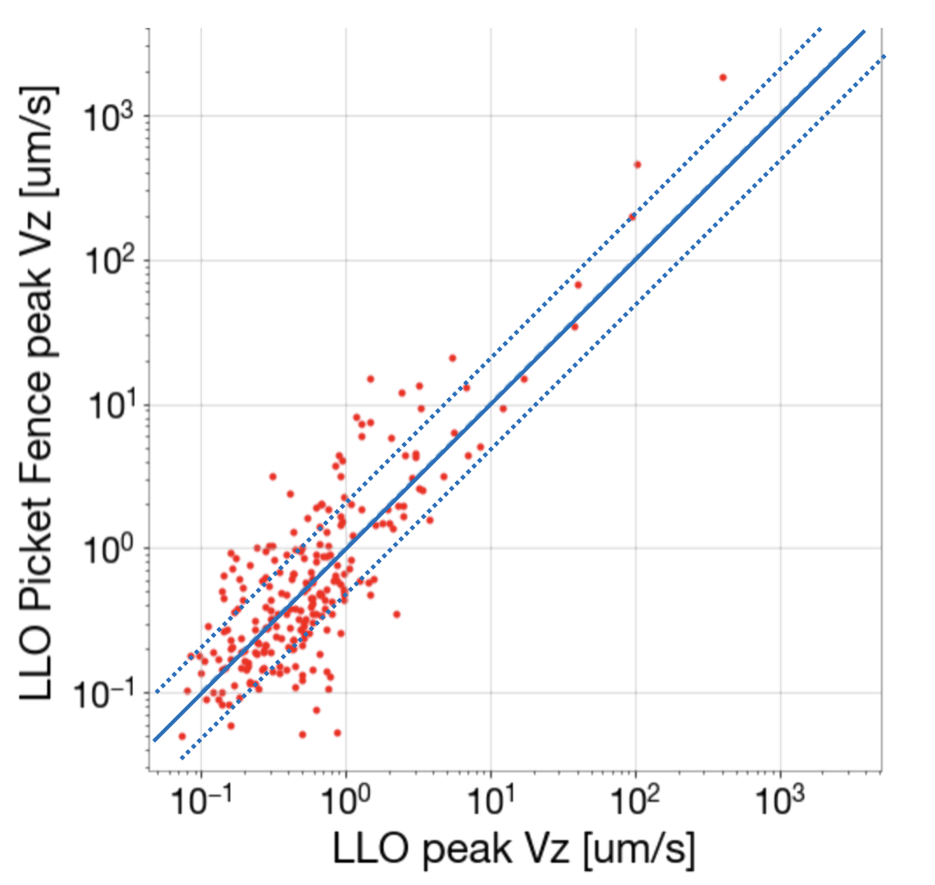
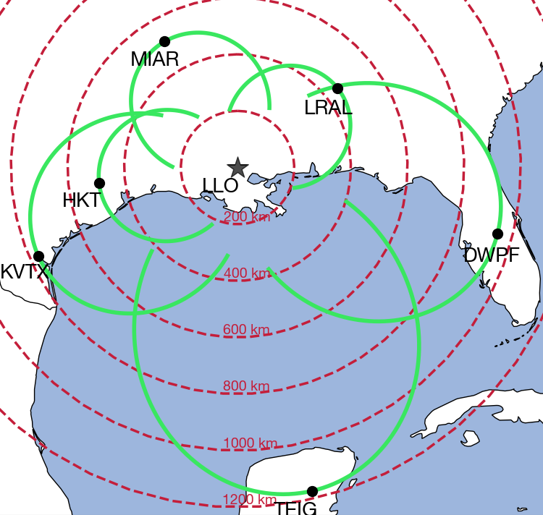
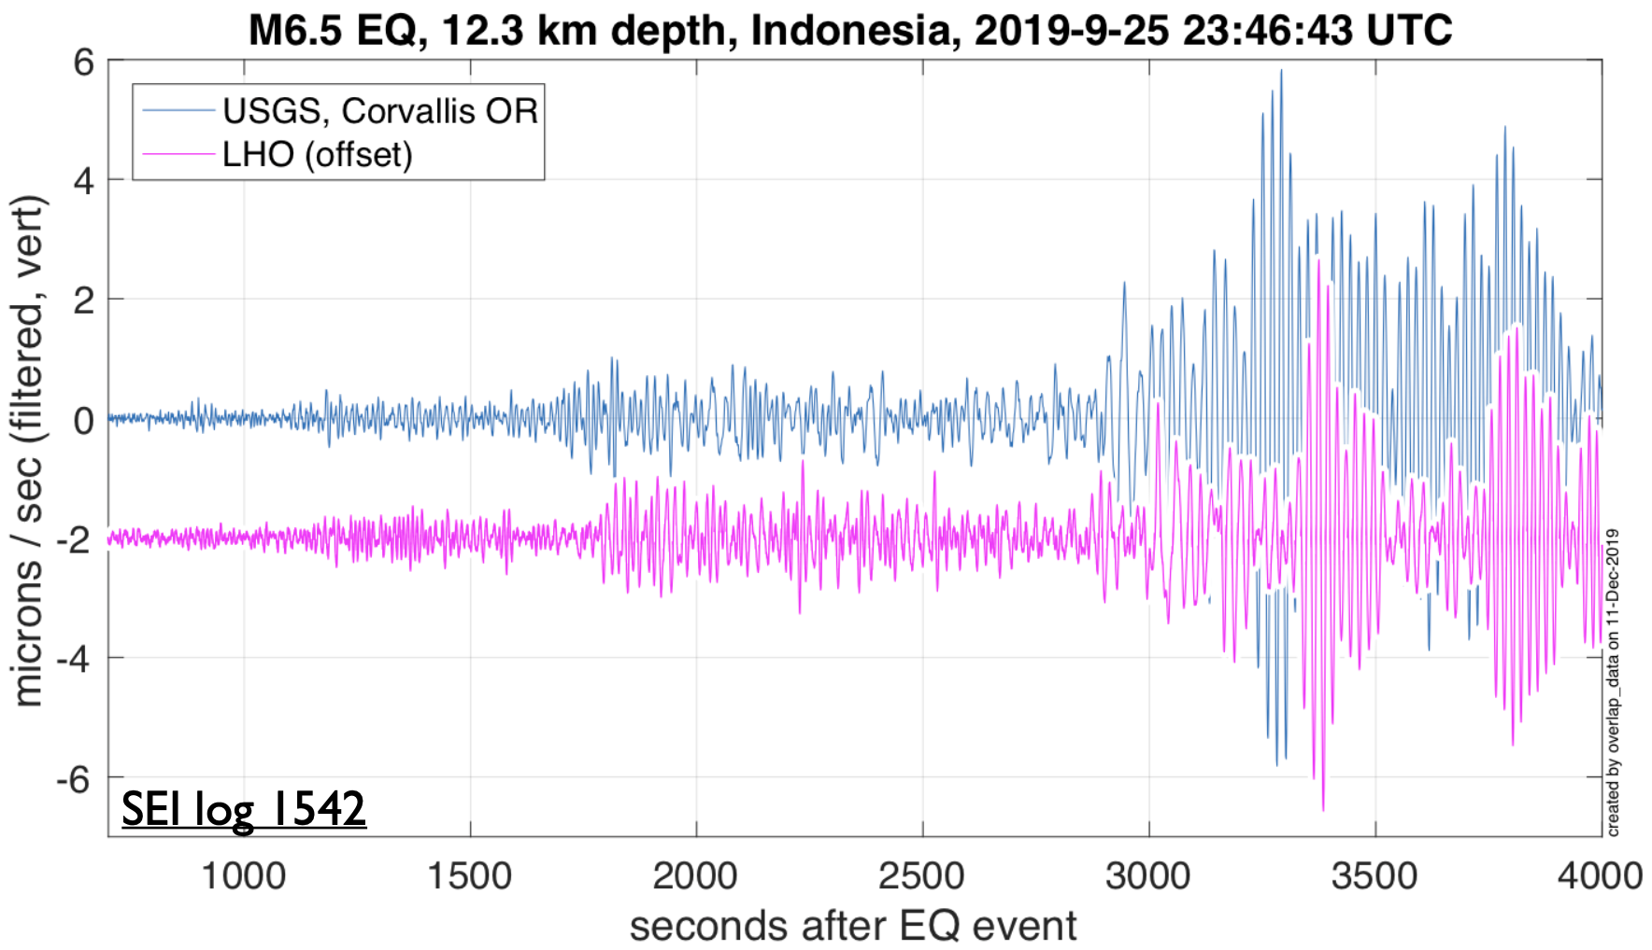
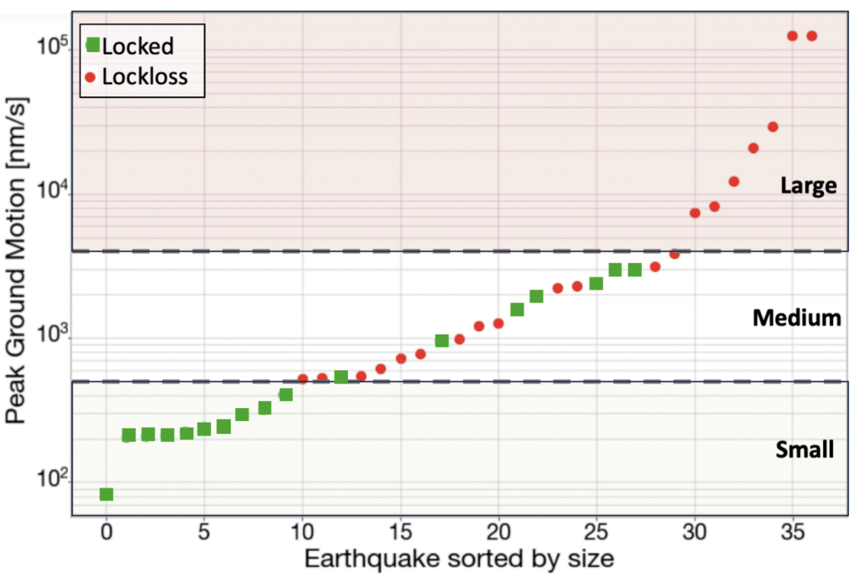
Picket Fence:
an Earthquake Alert system for the LIGO detectors
Edgard Bonilla, Isaac Aguilar, and Brian Lantz, Stanford University, Stanford, CA.
What is LIGO?
What is the picket fence?
Picket Fence Performance
LIGO stands for Laser interferometer Gravitational-wave Observatory. wo separated interferometers with 4-km arms and attometer length change sensitivity [1]
It is a stream of real-time data from broadband seismometers around the LIGO observatories to warn of incoming earthquakes. The data is streamed using ObsPy [4] and a seedlink connection.
Thanks to the low-latency streams from NEIC and PNSN we gather data with less than 35 s delay from a remote station 95% of the time [6].
This translates into at least 30 seconds of warning for remote Rayleigh waves.
Two LIGO detectors:
Livingston, Louisiana
Hanford, Washington
Equidistant azimuthal projection maps of the Picket Fence.
Top: LIGO Hanford Observatory (LHO).
Bottom: LIGO Livingston Observatory (LLO).
Image Credit: Caltech/MIT/LIGO Lab
LIGO detects gravitational waves produced by cataclysmic events, like black hole or neutron star mergers [2].
The predicted peak vertical amplitude of the Rayleigh waves at the LIGO sites and the actual measured ground motion agree to within a factor of two around 63% of the time [6].
The solid lines represent virtual locations of the stations for events incoming from different azimuths. They form a protective ‘fence’ around the detectors.
Image Credit: Caltech/MIT/LIGO Lab
LIGO and Earthquakes
Future Prospects
Earthquakes take LIGO out of ‘Lock’ or the resonance condition that grants it the sensitivity needed for gravitational-wave detection. Earthquakes caused 24% of locklosses during LIGO’s third observing run [3].
Add redundancies for improved robustness.
Use the picket fence to automate controls decisions
Find low-latency Canadian stations.
Use synthetic seismograms to assist the picket fence predictions.
IU.COR - Corvallis, OR
LHO (offset vertically)
An early warning strategy, together with control changes can be used to mitigate the impact of earthquakes with a peak local ground velocity of 500-2000 nm/s in the sub 0.1 Hz band.
Acknowledgements
Special thanks to Renate Hartog, Paul Earle, David Mason, and Brian Mielke for enabling access to lower latency data. This project is based upon work supported by NSF’s LIGO Laboratory which is a major facility fully funded by the National Science Foundation. This project was supported by NSF grants PHY-2309161, PHY-2011786.
By looking at the waveforms before they arrive, we can make semi-automated control decisions (Earthquake Mode [5]) to increase the robustness of the observatories.
References and Links
[1] “What is LIGO?.” Caltech, www.ligo.caltech.edu/page/what-is-ligo. Accessed 01 May. 2024.
[2] “GW150914 - the First Direct Detection of Gravitational Waves.” GW150914 - The First Direct Detection of Gravitational Waves, www.ligo.org/detections/GW150914.php. Accessed 30 Apr 2024.
[3] A. Pele, “Lockloss status at the beginning of O3 (LLO)”. https://dcc.ligo.org/LIGO-G1901122/public. Accessed 30 Apr 2024.
[4] M. Beyreuther, M., Barsch, R., Krischer, et al. “ObsPy: A Python Toolbox for Seismology”. Seismological Research Letters, 81 (3), 530-533.
[5] E. Schwartz, et al. “Improving the Robustness of the Advanced LIGO detectors to Earthquakes”. Classical and Quantum Gravity 37.23 (2020): 235007.
[6] E. Bonilla “Picket fence white paper”. https://dcc.ligo.org/LIGO-T2300281/public. Accessed 01 May. 2024.

